Slide 1
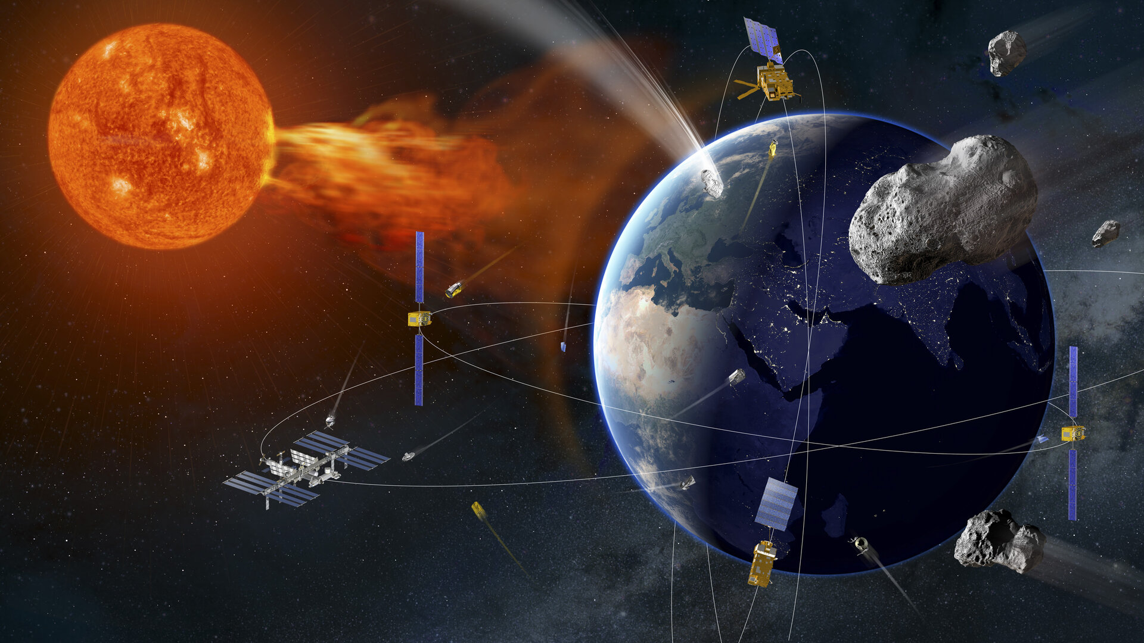
ESA Space Weather services
Alessandra Di Cecco, PhD
Italian Space Agency

Slide 2
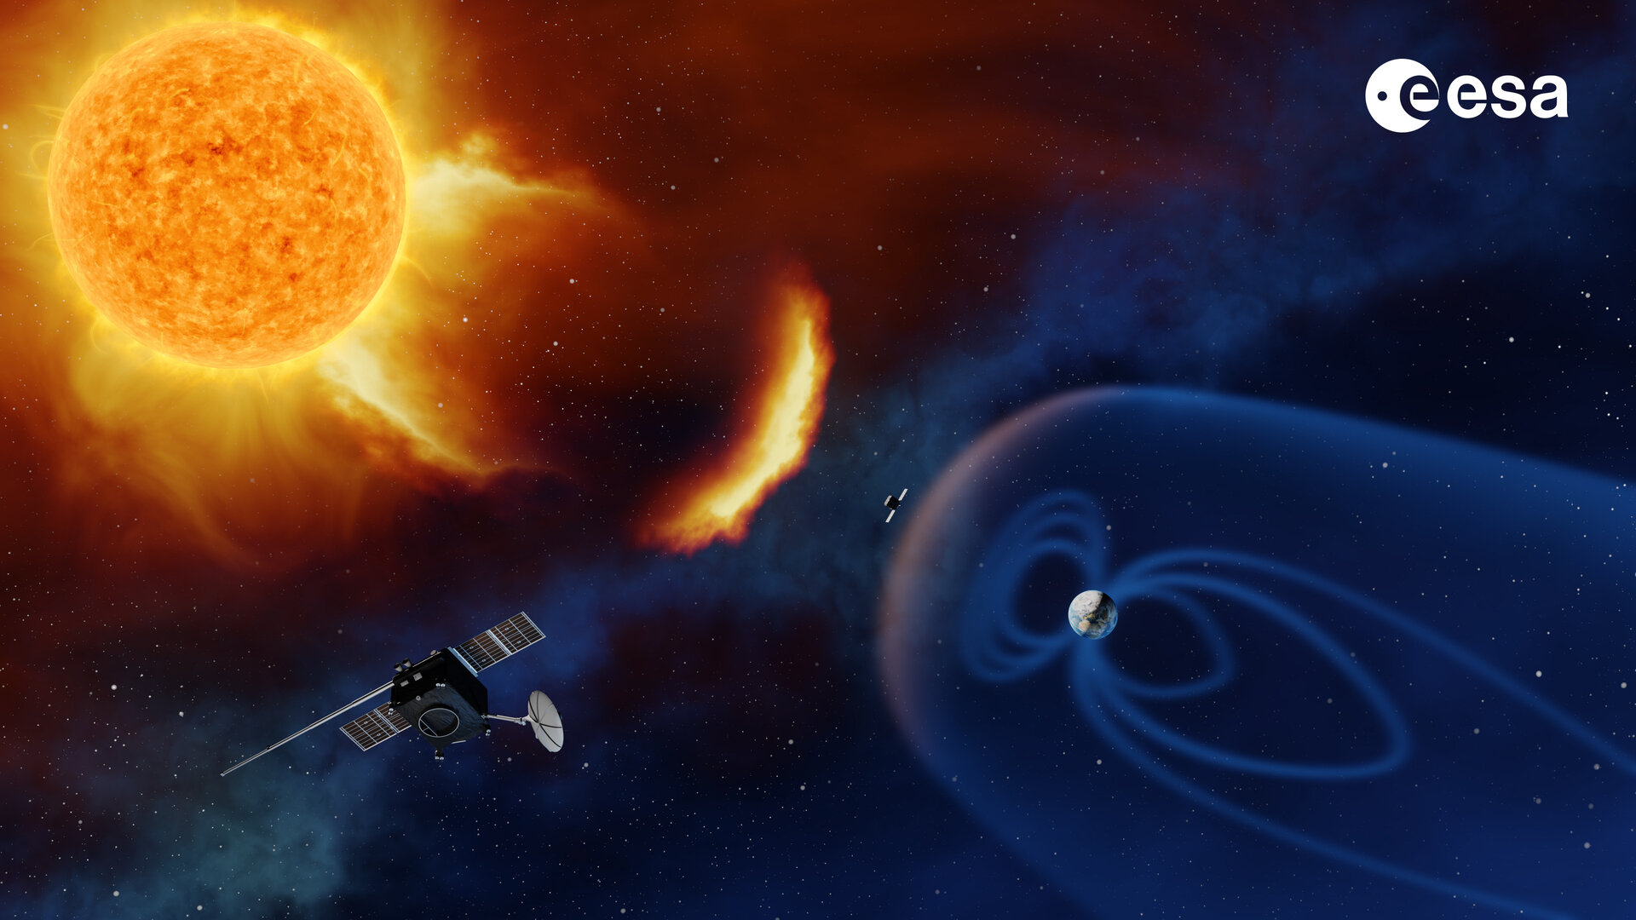
ESA Space Safety Programme (S2P)
Objectives:
Protect space assets
Protect daily services
Protect public and private investments
Protect astronauts in space
Protect life on our planet
ESA S2P address three main topics:
Space Debris
Near-Earth Objects (NEO)
Space Weather
Credit: ESA

Slide 3
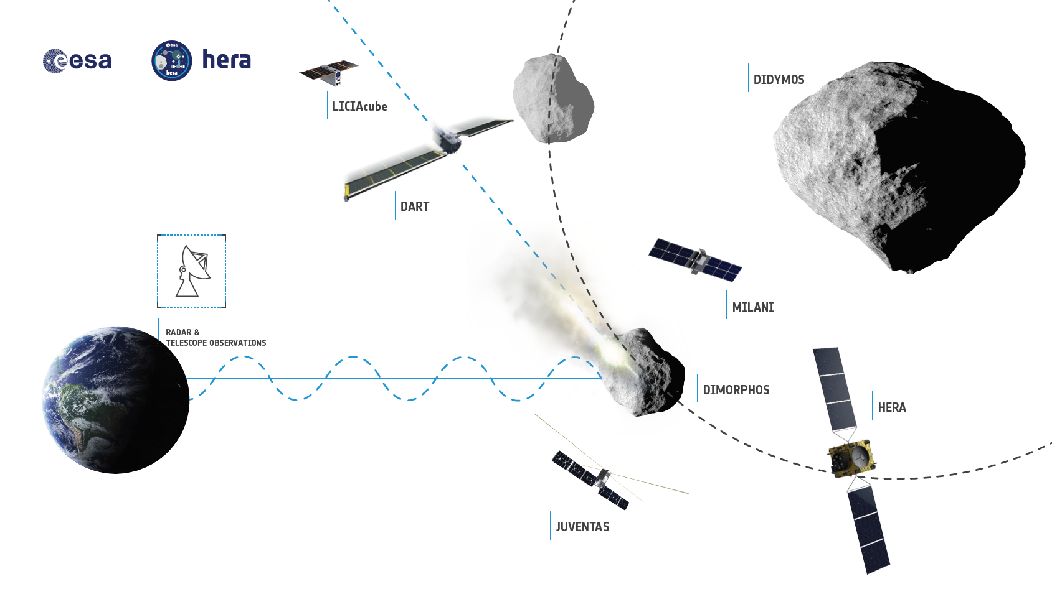
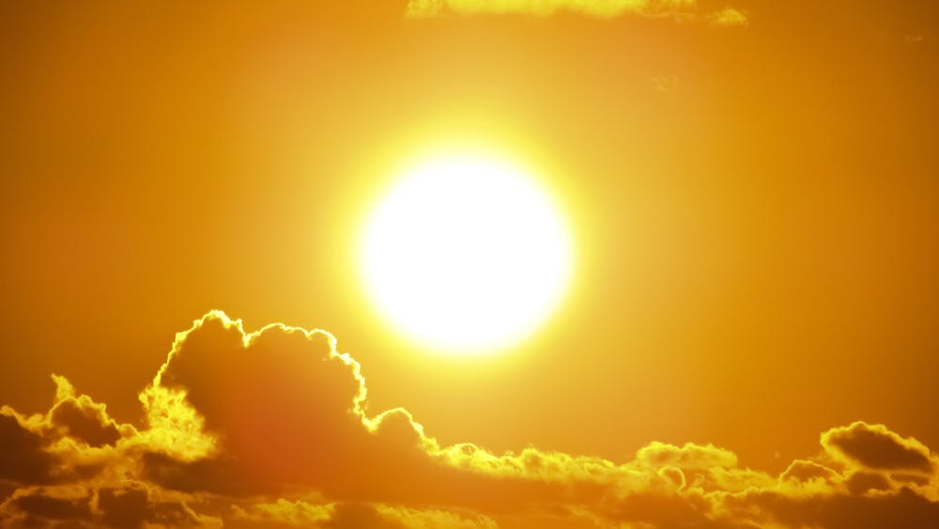
ESA Space Safety Programme
Space Debris orbits
Space Debris orbits
Space Weather

Slide 4
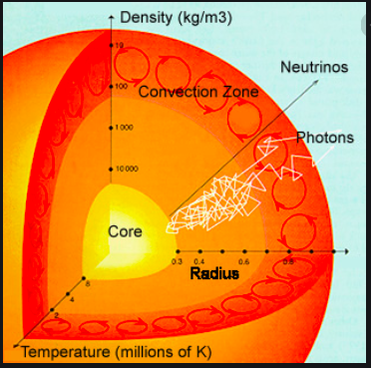
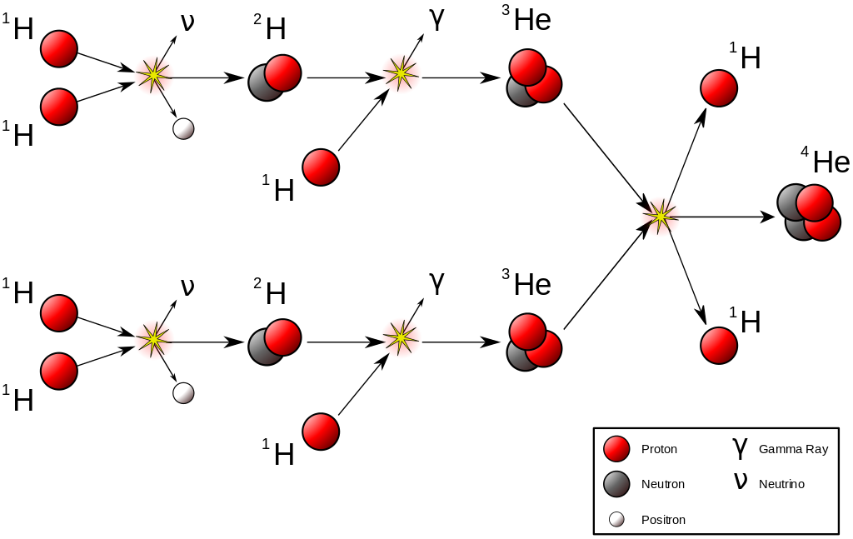
Sun’s internal structure
Hydrostatic Equilibrium between Radiation Pressure and Gravity
Nuclear fusion of H in He (differently by nuclear reactors)
Energy transport:
Radiative zone
Convective zone
Photon scattering path from core to surface: 100.000-1.000.000 yr
Neutrinos travel straight: no matter interaction
Credit: NASA / H. Smithsonian

Slide 5
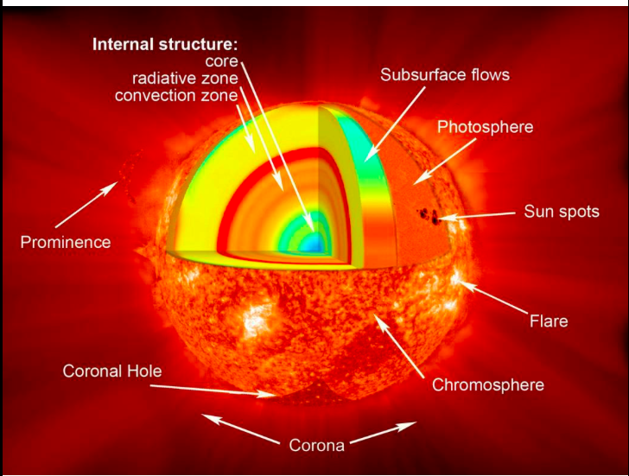
Sun’s surface phenomena
Solar atmosphere:
Chromosphere
Corona
Core Temperature | 15 10⁶ K
Photosphere Temperature | 6 10³ K
Corona Temperature | 1-3 million K
Solar wind
Credit: NASA/Goddard

Slide 6
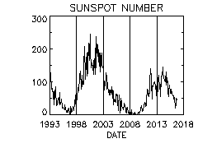
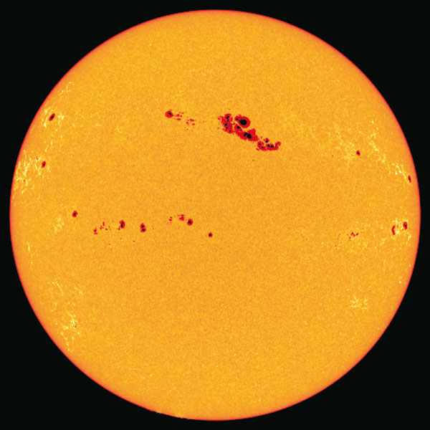
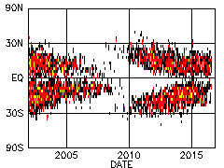
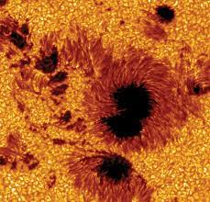
Sunspots
Sunspots approx. 4000 K
11-years cycle
Magnetic activities
and field lines
Credit: NASA

Slide 7
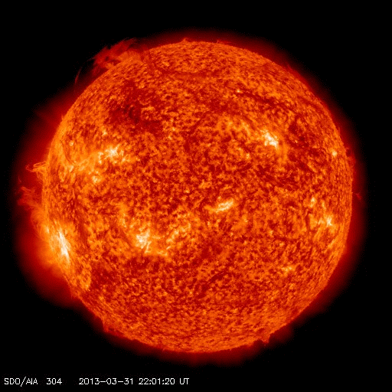
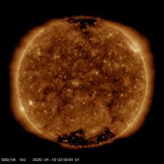
Solar eruptions and coronal holes
Flares: Brightness flash near Sunspot
CME: Coronal Mass Ejection Shock waves
Magnetic field lines reconnection
Strong X-ray emission
Solar wind emission (H, alpha, e⁻ ) High kinetic energy particles (10KeV) supersonic wind plasma emission magnetosonic waves
Credit: NASA Solar Dynamic Observatory (SDO)

Slide 8
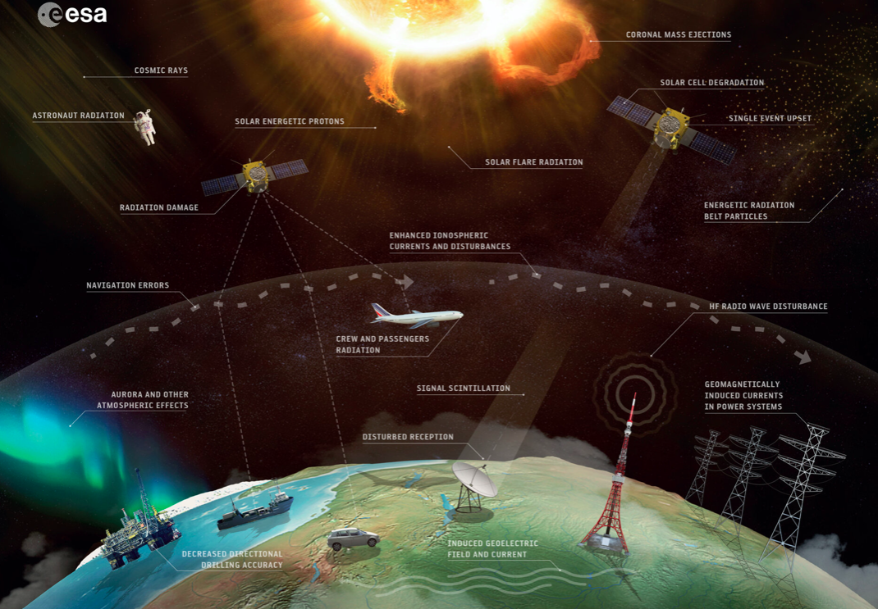
Space Weather (SWE)
Solar Activity affects the space environment:
Satellite interference in radio signal or sub-system damage
Geomagnetic storms and substorms
Aircraft passenger exposed to radiation
Problem to transmission lines
Magnetosphere effects

Slide 9
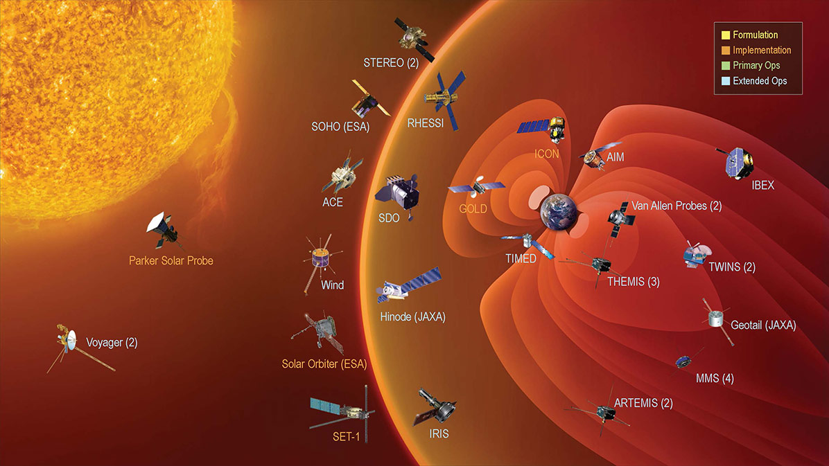
ESA SWE Service Network
Expert Service Centers (ESC):
Solar Weather (BE)
Heliospheric Weather (UK)
Space Particle Radiation (BE)
Ionospheric Weather (DE)
Geomagnetic activity (NO)
SWE monitoring system:
SWE space missions
Ground-based sensors
Portal and users
Products grouped by services
https://swe.ssa.esa.int/current-space-weather
SSA Space Weather Coordination Centre (SSCC) located in Belgium
two line of supports: first SSCC support and Expert Service Center support

Slide 11
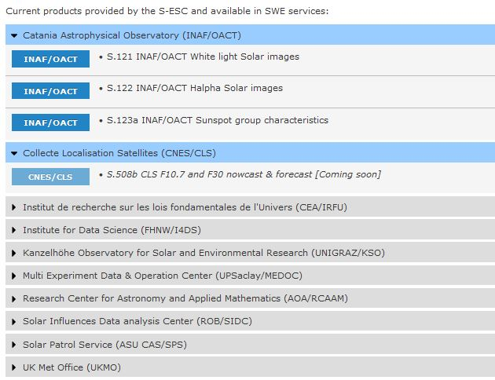
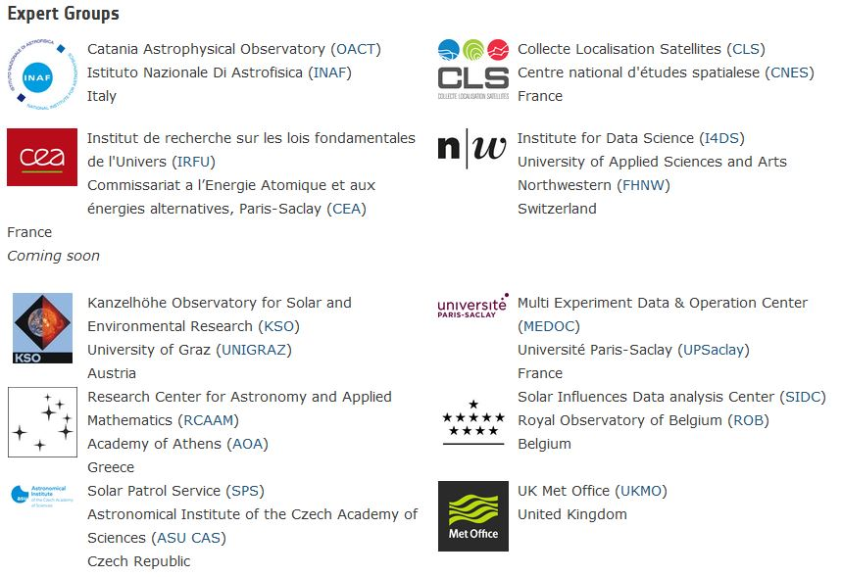
Solar Weather ESC
To provide, implement and support the Solar Weather products
For observation, monitoring, interpretation, modelling and forecasting of Solar Weather conditions with an emphasis on solar (sub-)surface and solar coronal
Solar phenomena analyzed by high-quality data

Slide 12
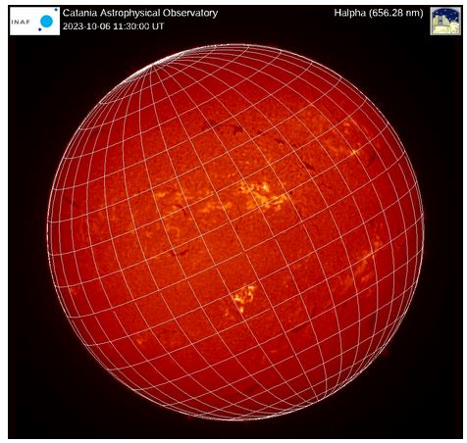
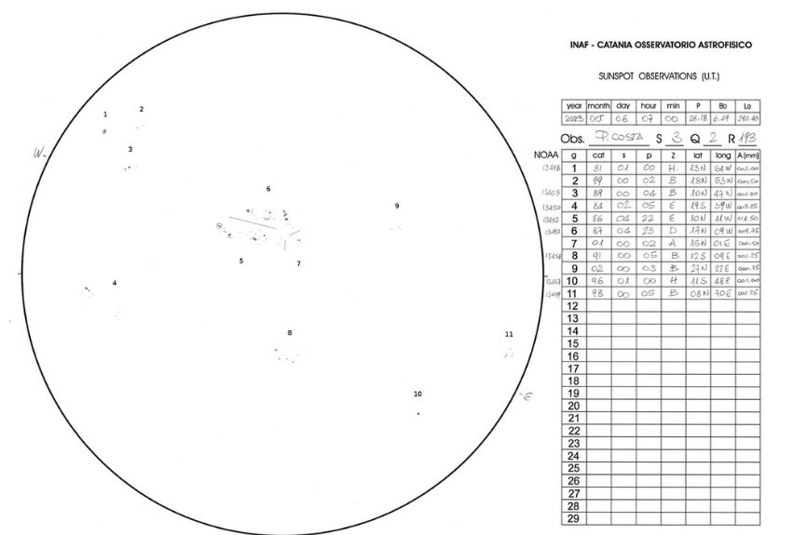

Slide 13
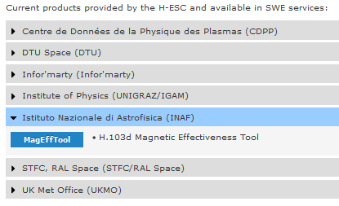
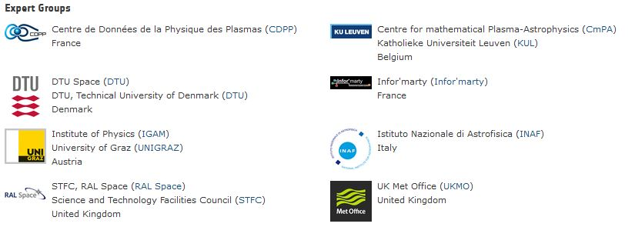
Heliospheric Weather ECS
Heliosphere → solar wind and magnetic field
to provide, improve and support the provision of alerts, forecasts and post event analysis of space weather conditions near to the Earth and within the heliosphere (interplanetary mission)
Euhforia forecast
Prototype level and products in federated websites
Solar wind density
Speed STFC, RAL Space (STFC)

Slide 14
Heliospheric Weather
EUropean Heliospheric FORecasting Information Asset
Data-driven model for Solar Wind and heliospheric weather

Slide 15
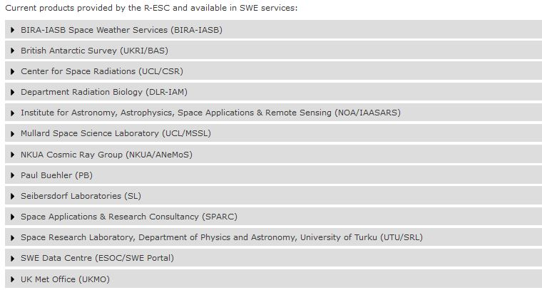
Space Radiation ESC
high-energy ionized particles with different origin (i.e. Galactic cosmic ray, Solar Energetic Particle, Earth’s trapped radiation belt)
Galactic cosmic rays (p, α, heavy nuclei) flux is constant and modulated by solar activity, problem for high altitude aircraft crew, we are protect on Earth by geomagnetic field
SEP (mainly p, e-) accelerated by shock waves associated to CME, they are problem as GCR and for EVA of astronauts
Radiation belts cause problems for spacecraft
Some services are proposed for future

Slide 16
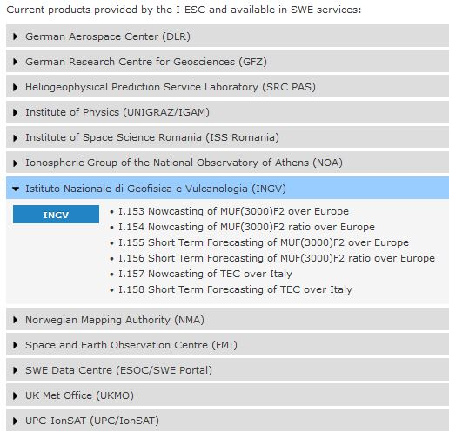
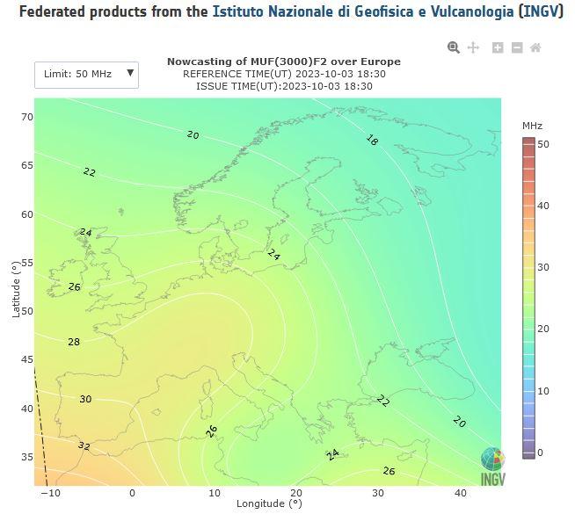
Ionospheric Weather ESC
IW affects radio systems in communication, space based navigation and remote sensing
Global Navigation Satellite Systems (GNSS, such GPS) could be delayed, refracted and diffracted by the highly variable ionospheric plasma
GNSS is essential tool for safety of life

Slide 17
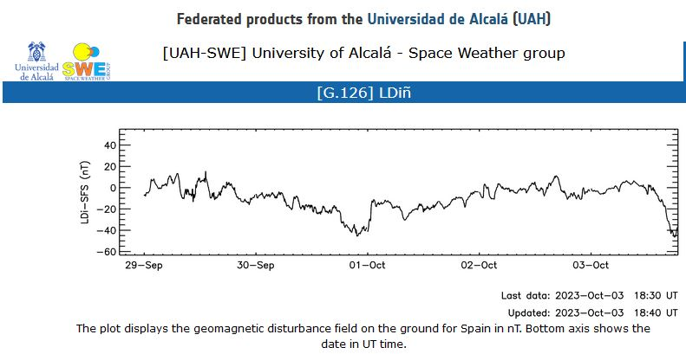
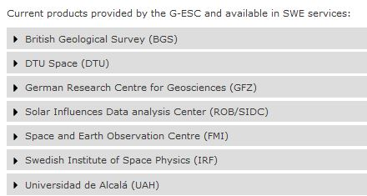
Geomagnetic Conditions ESC
Geomagnetic field shows variations on different scales (slow for years and centuries, daily, irregular variations, during magnetic storms)
Geo-magnetometers

Slide 18
ESA SWE Services
More than 30 services (data, predictions and tools)
Users: Spacecraft design and spacecraft operations
Human spaceflight
Launch operations
Communications and navigation
Airlines and aviation
Pipeline operations
Auroral tourism

Slide 19
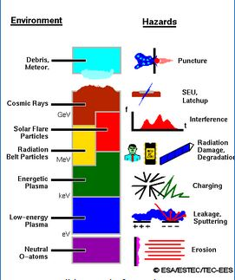
Spacecraft Design
Spacecraft are affected by Space environment and Space Weather:
degradation, contaminations, radiation damage, thermal changes, interference
Spacecraft’ systems and sub-systems design need to be studied:
Shielding requirements
Thermal control
Realistic representation in laboratories

Slide 20
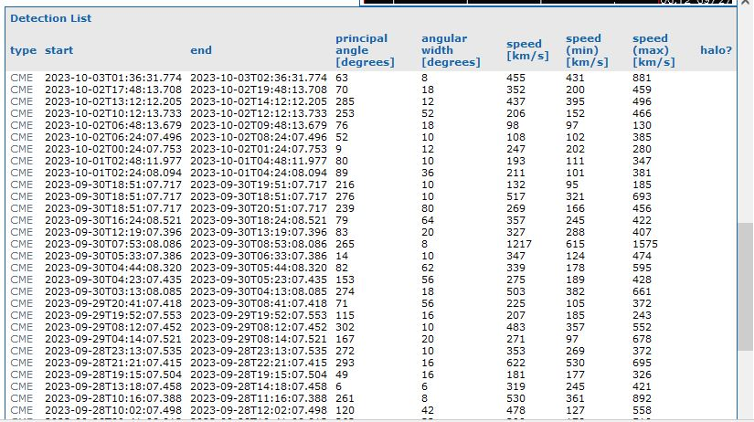
Spacecraft Design
Solar Wind Forecast & CME arrival prediction (UKMO)
Environment specification: data archive (statistical information*)
In-orbit verification (local information by Proba 2, Herschel/Planck)
Post event analysis for correlating in-situ anomalies of a spacecraft with space weather phenomena at a given time and/or location
Space Weather in the Solar System (The daily space weather bulletin )
*ionising radiation, plasma, microparticles, atmosphere, and UV
CME prediction and counting
Federated products from Solar Influences Data analysis Center (ROB)

Slide 21
Spacecraft Operation
In-orbit Environment and Effects Monitoring
Post-Event Analysis
In-Orbit Environment and Effects Forecast
Mission Risk Analysis
Space Weather in the Solar System

Slide 22
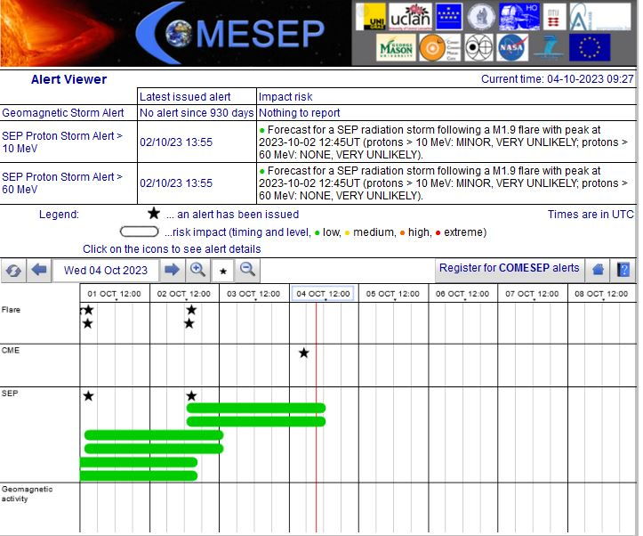
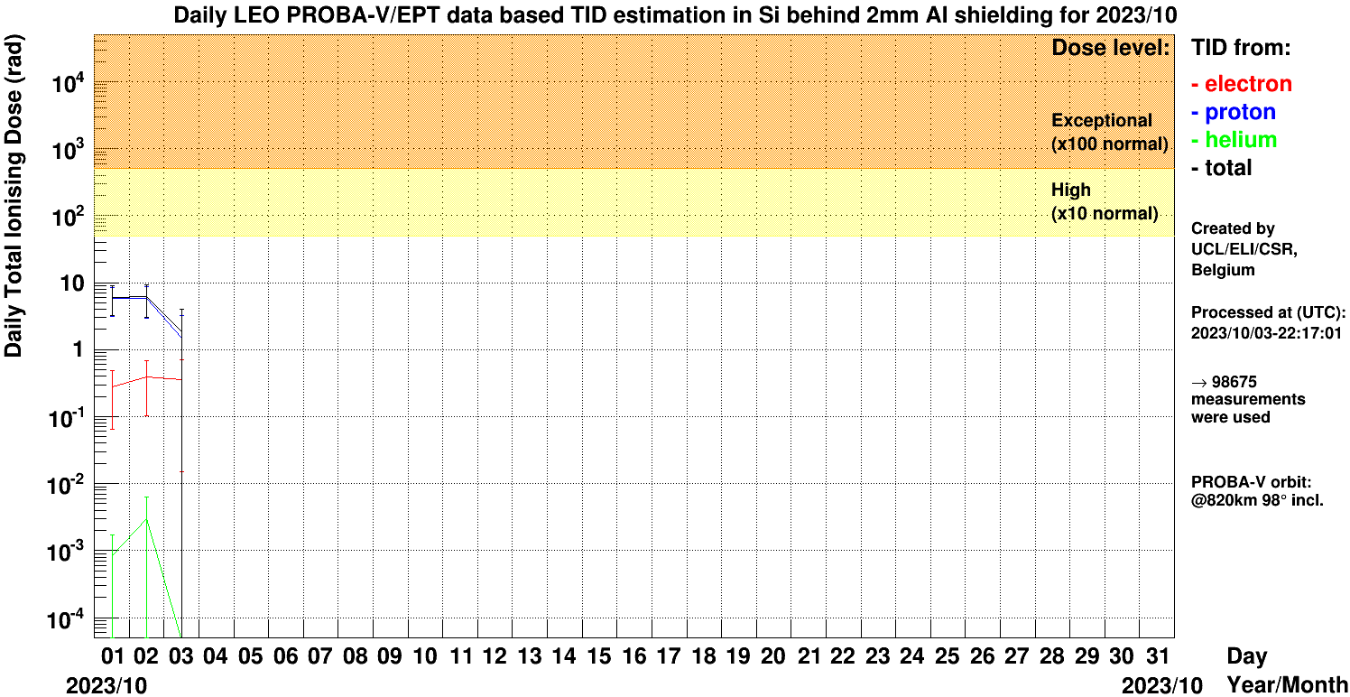
Human Spaceflight
In-flight Crew Radiation Exposure
Cumulative Crew Radiation Exposure Risk
Increased Crew Radiation Exposure Risk
Federated products from the Center for Space Radiations (UCL)

Slide 23
Launch Operation

Slide 24
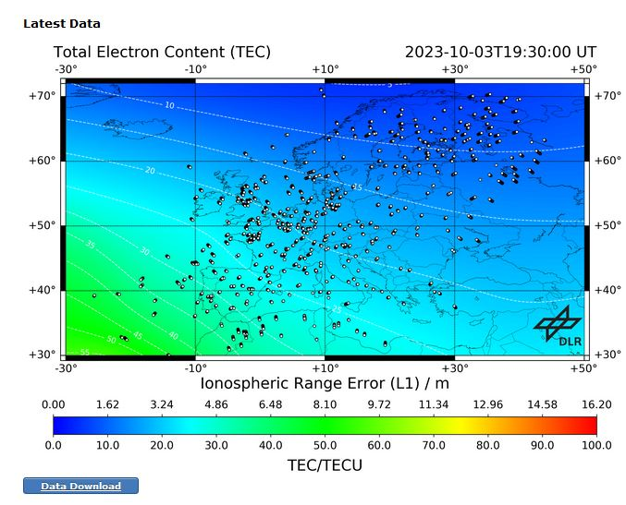
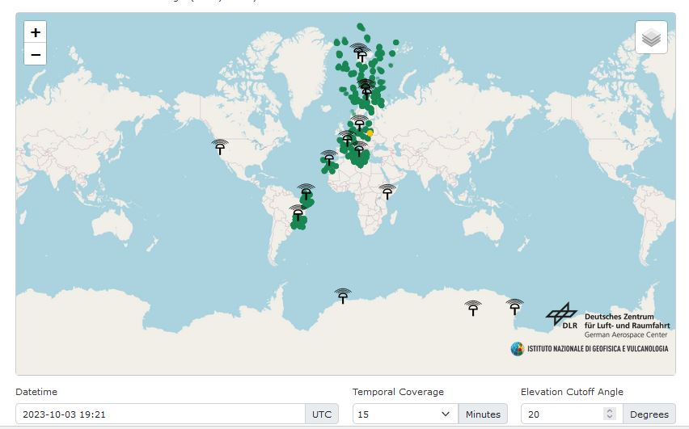
Transionospheric Radio Link
Near-Real Time TEC Maps
Forecast TEC Maps
Quality Assessment of Ionospheric Correction
Near Real-Time Ionospheric Scintillation Maps
Monitoring and Forecast of ionospheric Disturbances
to present an overview of the current and forecasted ionospheric conditions with the different types of available data (measurement, nowcast, and forecast) at a global or local level
DLR federated
scintillation indices observed at distributed high-rate GNSS receivers

Slide 25
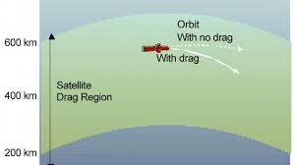
Space Surveillance and Tracking
SWE affects LEO objects
Atmospheric Estimates for Drag Calculation
Archive of Geomagnetic and Solar Indices for Drag Calculation
Forecast of Geomagnetic and Solar Indices for Drag Calculation
Products such Kp planetary index of geomagnetic activity
current atmospheric, geomagnetic and solar conditions for drag calculation
Credit: NOAA

Slide 26
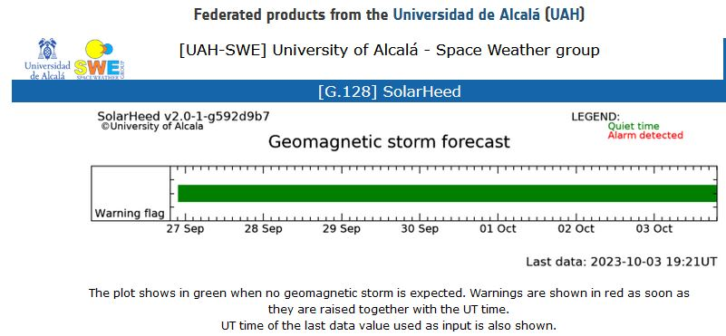
Power System Operation
Service to Power Systems Operations (induced currents)
to present an overview of the current and forecasted geomagnetic conditions and heliospheric weather with the different types of available data (measurement, nowcast, and forecast)

Slide 27
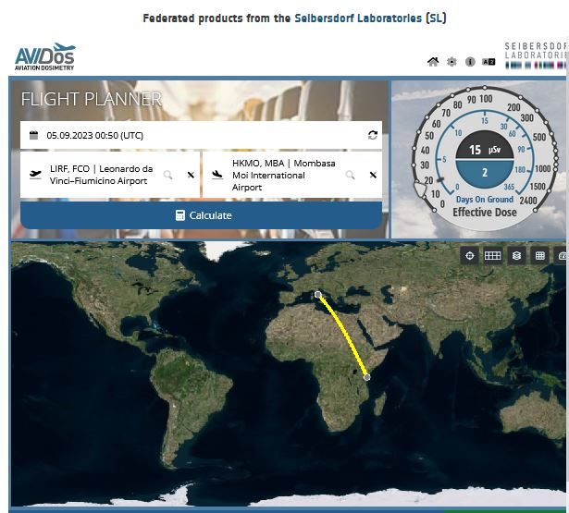
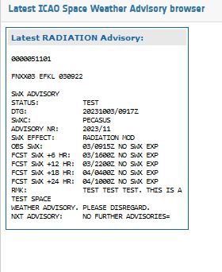
Aviation
Health of aircrews is affected by SWE phenomena
Access to data, model and tools
Alert service

Slide 28
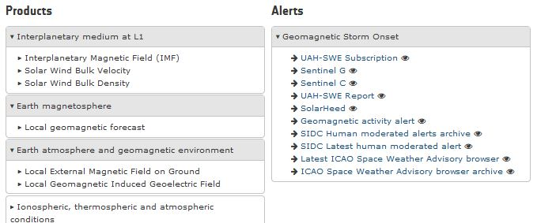
Resource Exploitation System Operation
Service to RESO

Slide 29
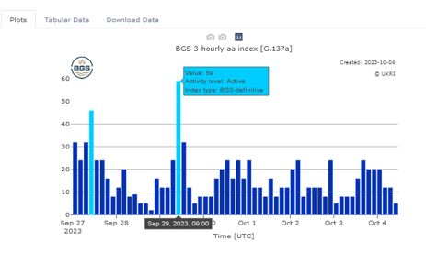
Pipeline Operation
Pipeline operation service

Slide 30
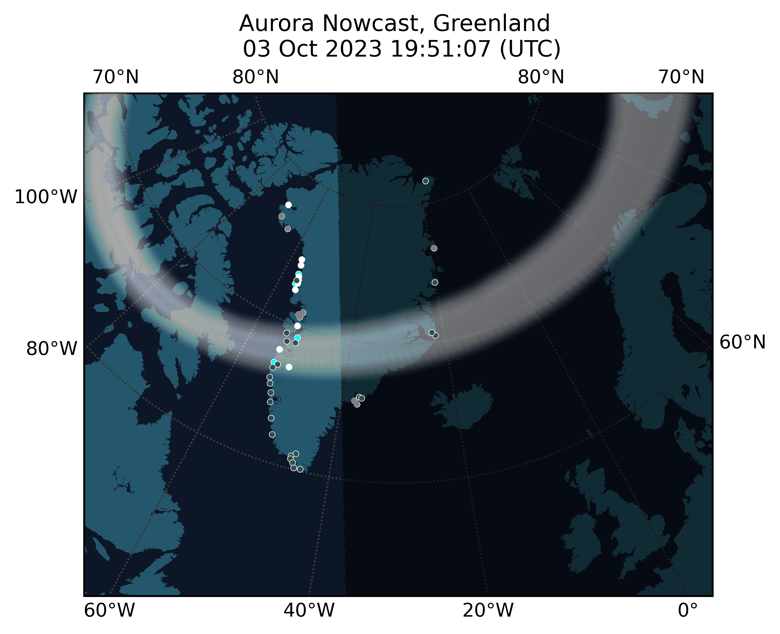
Auroral Tourism
Access to Kiruna (Sweden) sky images, archived and in real-time with 1-minute resolution.
Greenland Aurora Nowcast (DTU Center)

Slide 31
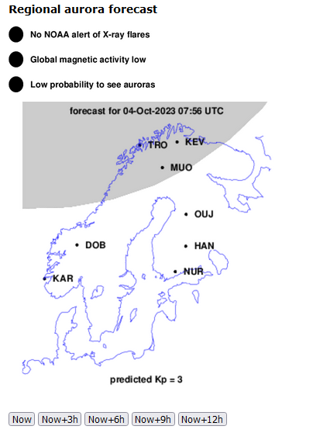
Credit:

Slide 32
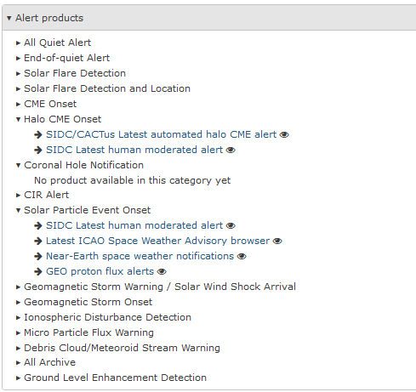
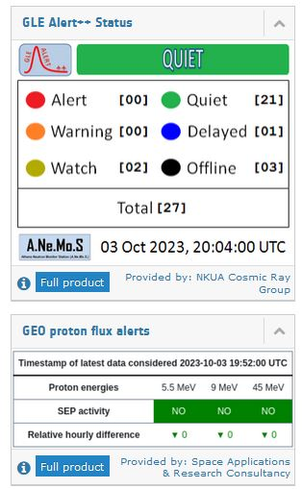
General Data Service
SWE data archive
Latest Data Service
SWE nowcast and forecast products (daily and weekly)
Alert Service

Slide 33
SWE
https://swe.ssa.esa.int/
From space+ground-based data and data-processing
Supporting
European industry
Space mission design
Planned launches, trajectory
Suggesting ECSS standards
Tool available under registration

Slide 34
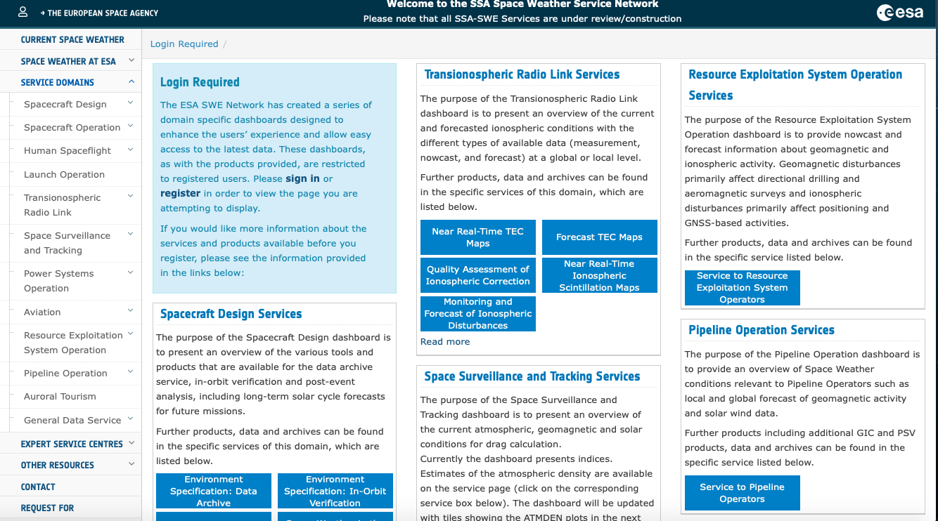
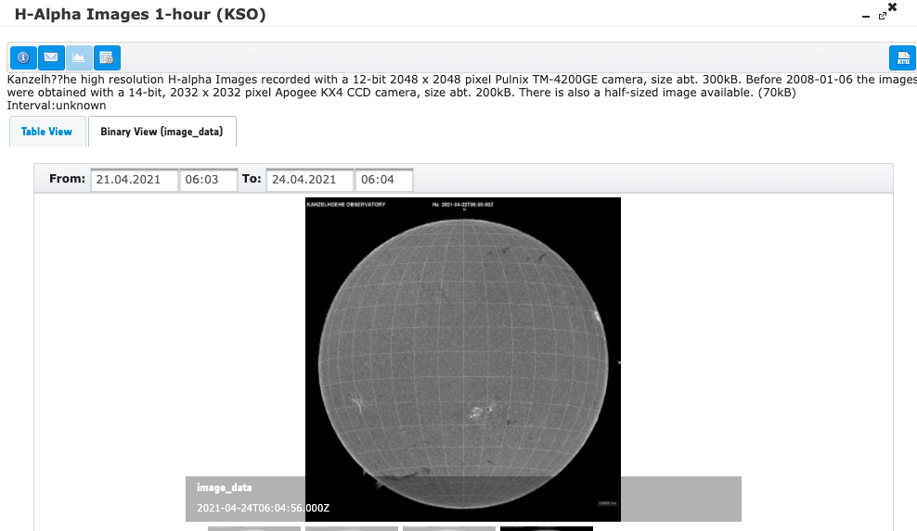
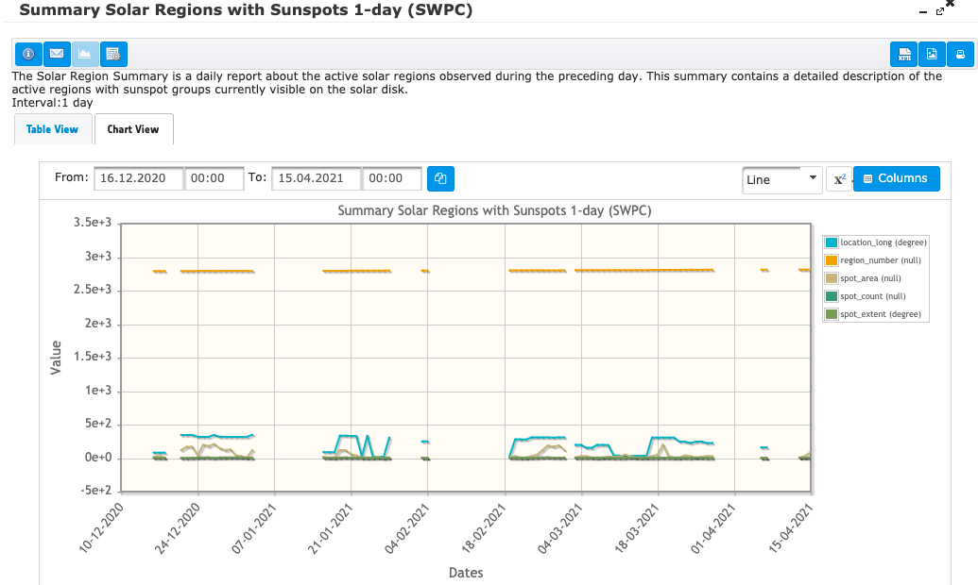
Service domain
https://swe.ssa.esa.int/

Slide 35
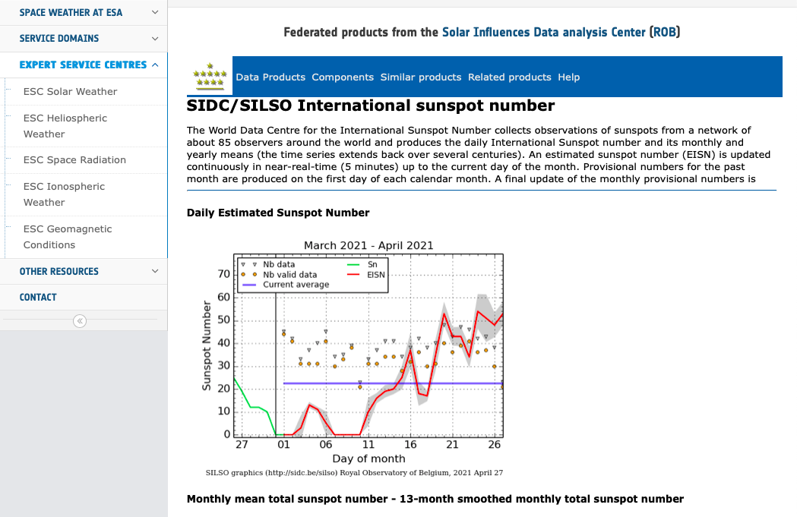
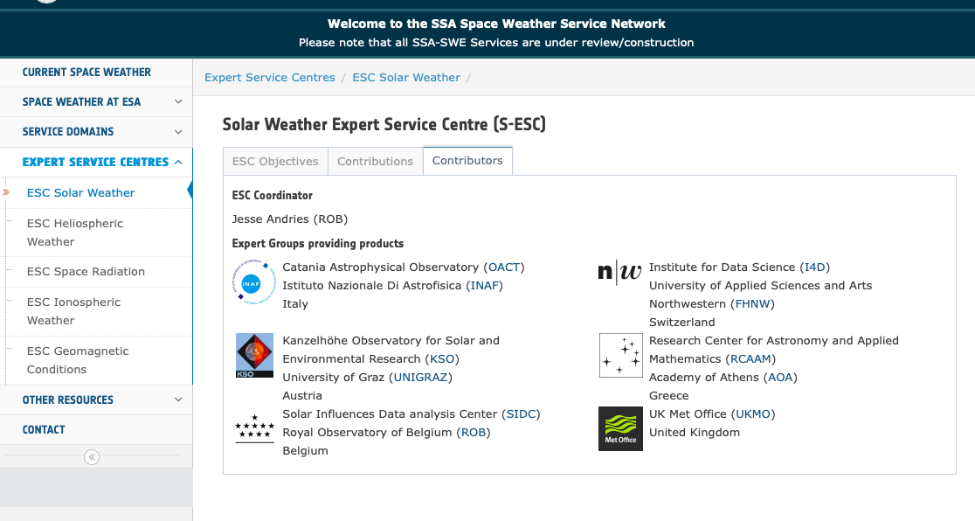
Expert Centers Data and Tools

Slide 36
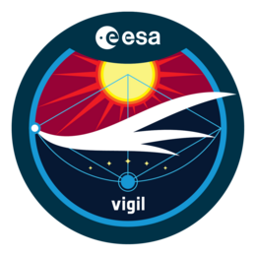
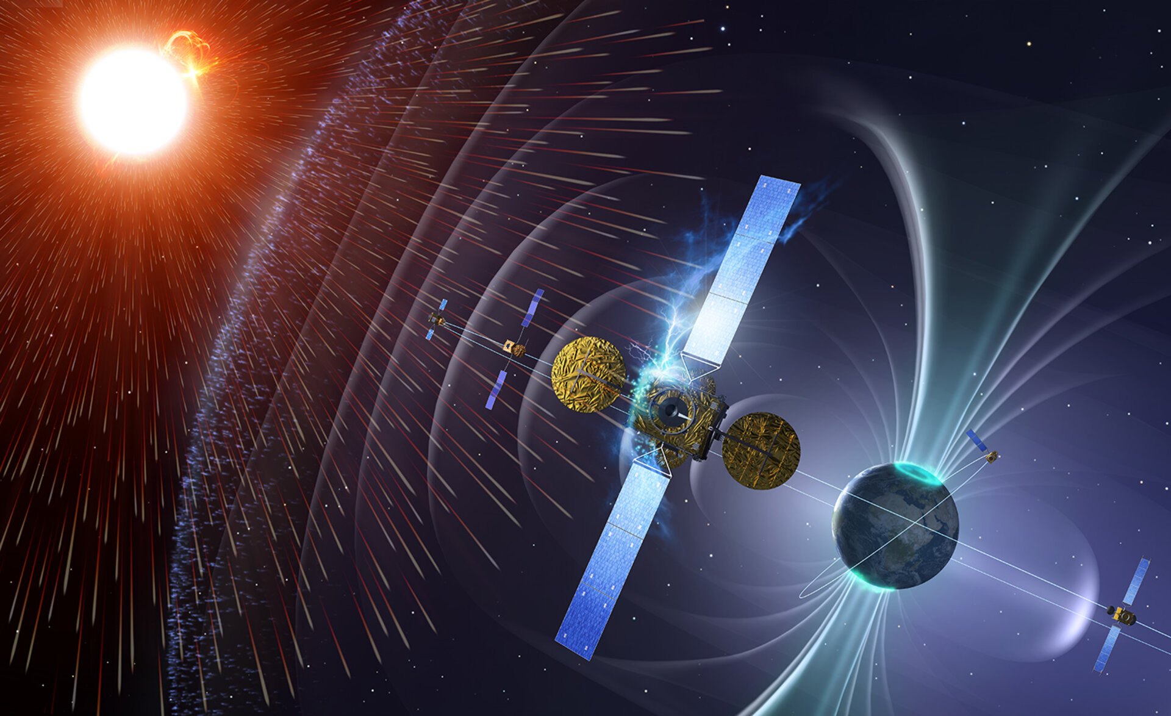
ESA S2P Satellites
VIGIL Mission (M. Castronuovo Lecture)
Smallsats missions
As part of the Distributed Space Weather Sensor System (D3S)
The first is Aurora (optical, far-UV and X-ray) observations
Based on Cubesat in LEO with high TRL
A demonstrator mission (Aurora-C) followed by a full constellation of 4-5 SmallSats
Core instrument: Wide Field of View Auroral Imager (WFAI) consisting of two modular assemblies, the Auroral Optical Spectral Imager (AOSI) and the Auroral UV Imager (AUI)

Slide 37
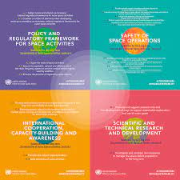
Long-Term Sustainability (LTS) guideline
Two guidelines address Space Weather
Guideline B.6 - Share operational space weather data and forecasts
Guideline B.7 - Develop space weather models and tools and collect established practices on the mitigation of space weather effects

Slide 38
Thank you!
Website and manuals
https://swe.ssa.esa.int
https://swe.ssa.esa.int/manuals-and-tutorials

Slide 39
NASA SWE
https://www.swpc.noaa.gov

Slide 40
Geomagnetic field and magnetosphere
Credit: SOHO (ESA & NASA)

