Slide 1


Multi-instrument approach to ionospheric studies
Lucilla Alfonsi
lucilla.alfonsi@ingv.it
Eastern Africa Capacity Building Workshop on Space Weather and Low-latitude Ionosphere

Slide 2
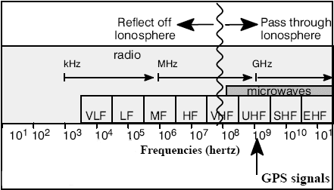
The ionospheric electron density and the height can be derived from radio probing (ground and space-based) exploiting the ionosphere property of influencing the radio wave propagation (by working frequencies spanning from kHz to GHz range).
VHF, HF radars and receivers provide several information on plasma structuring and variability but the devices are sparse and offer poor coverage (in time and space)
L-band (eg. GNSS) is a very powerful diagnostic tool but often does not provide a complete picture in time and space

Slide 3
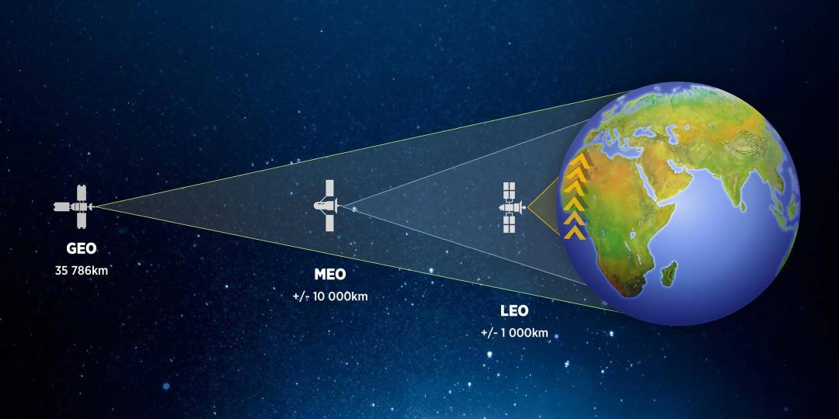
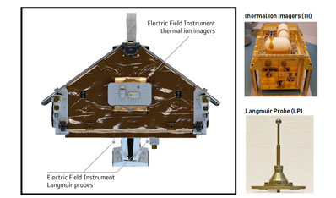
In-situ satellite measurements from LEO satellites allow deriving the electron density, electron temperature, ion drift and velocity along the satellite line of sight inside the ionosphere but the satellite moves too fast to provide a good coverage in space and time.
EngineerIT
Credits: ESA Swarm
Notes:
The Langmuir probe technique involves applying a voltage to a metallic conductor immersed in plasma and observing the collected current. The observed total current, I, is a summation of various currents such as electron and ion thermal currents, photoelectron current, secondary electron currents, …

Slide 4
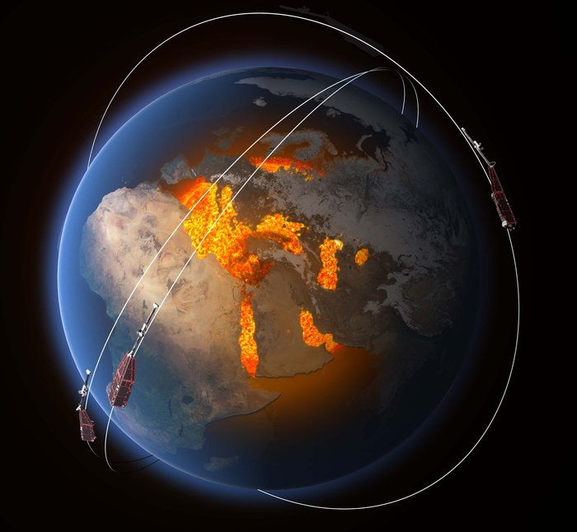
IONOSPHERIC ELECTRON DENSITY FROM LANGMUIR PROBE ON BOARD LEO SATELLITES:
The Swarm measurements
Mission
Launched: 22 November 2013
Duration: 4 years (following 3-month commissioning phase) but still in orbit!
Type: Low Earth; near-polar
Configuration: constellation of three identical satellites: two orbit side-by-side, decaying naturally from an initial altitude of 460 km to 300 km over 4 years; the third maintains an altitude of about 530 km.
The final constellation of the mission was achieved on 17 April. Swarm A and C form the lower pair of satellites flying side-by-side (1.4° separation in longitude) at an altitude of about 470 km (inclination angle is equal to 87.35°), whereas Swarm B is cruising at higher orbit of about 520 km (inclination angle is equal to 87.75°).
https://earth.esa.int/web/guest/missions/esa-eo-missions/swarm/mission-overview#Swarm_Mission

Slide 5
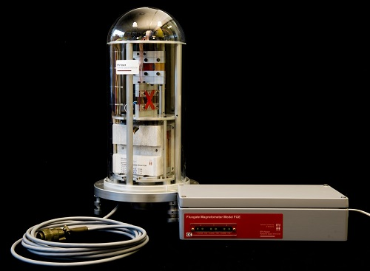
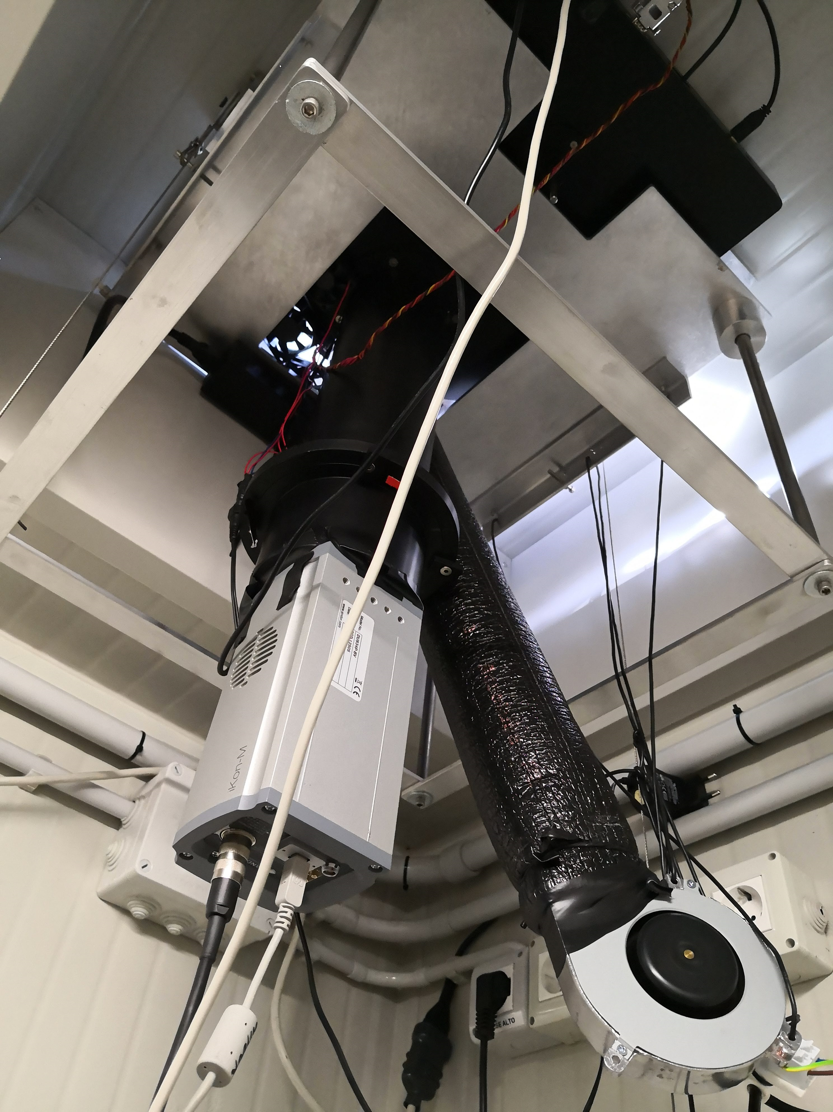
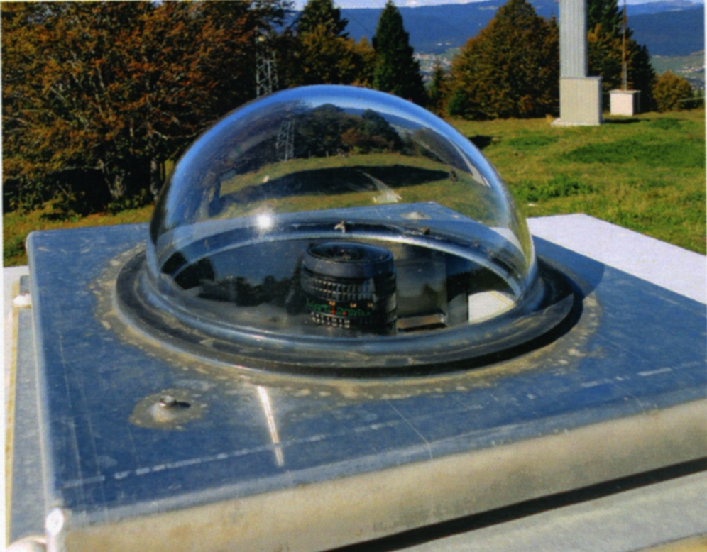
Other useful instruments
Magnetometers
Optical instruments: All Sky Cameras, All Sky Imagers
UV sensors
…
www.space.dtu.dk
sirius.bu.edu

Slide 6
WHY RELYING ON DIFFERENT MEASUREMENTS?
Detection of perturbation effects on ionosphere
Investigation of the cause-effect mechanisms through post-processing analysis
Gap analysis on what is still missing for a better understanding
ADVANCEMENT OF KNOWLEDGE
IMPROVEMENT IN MODELING
IMPROVEMENT IN ALERTING
IMPROVEMENT IN MITIGATING

Slide 7
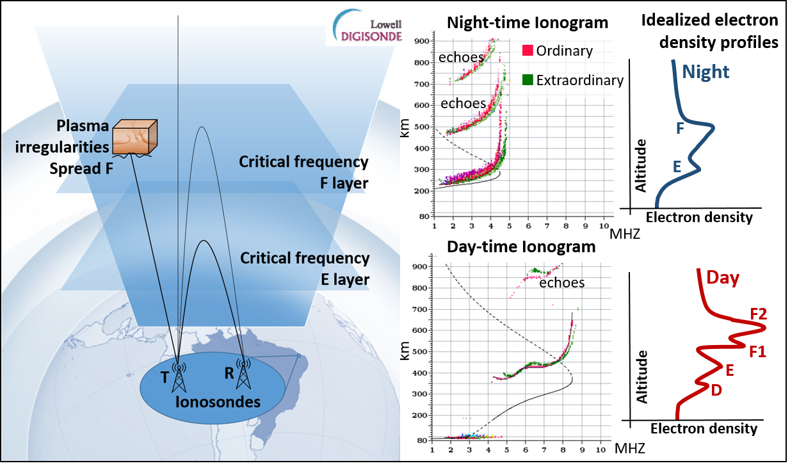
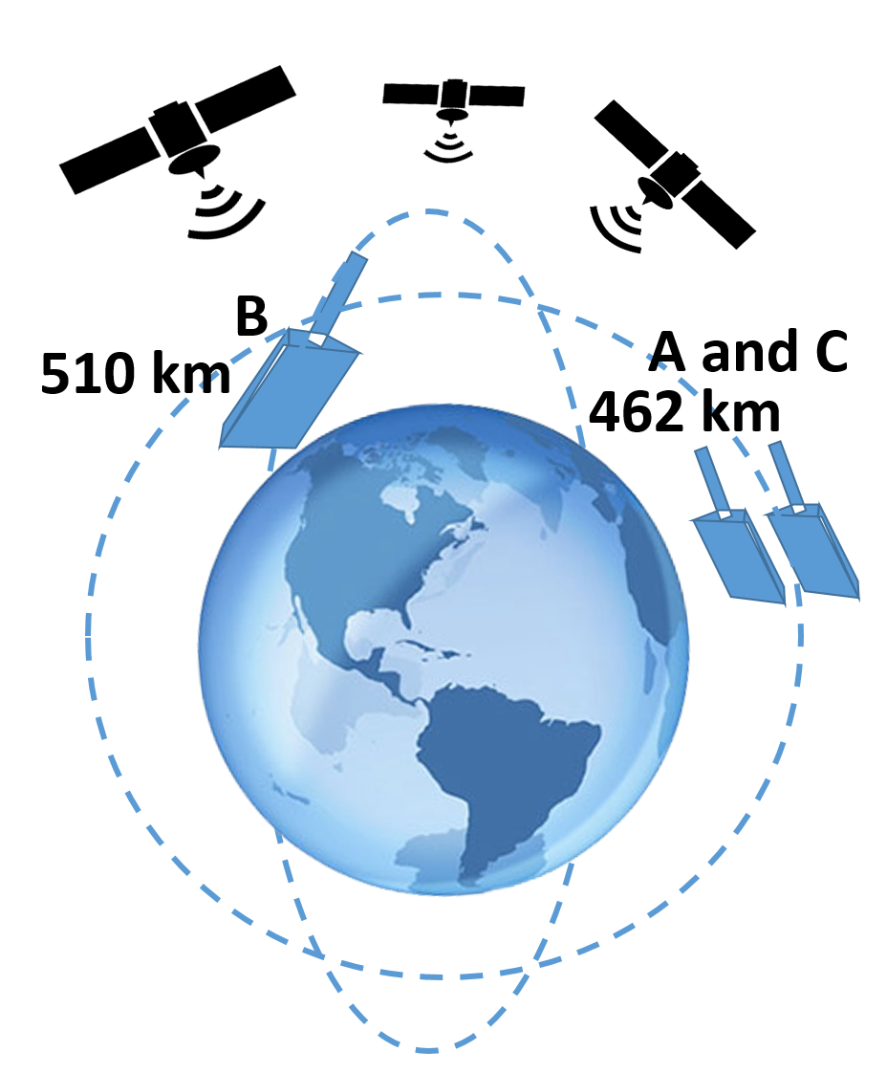
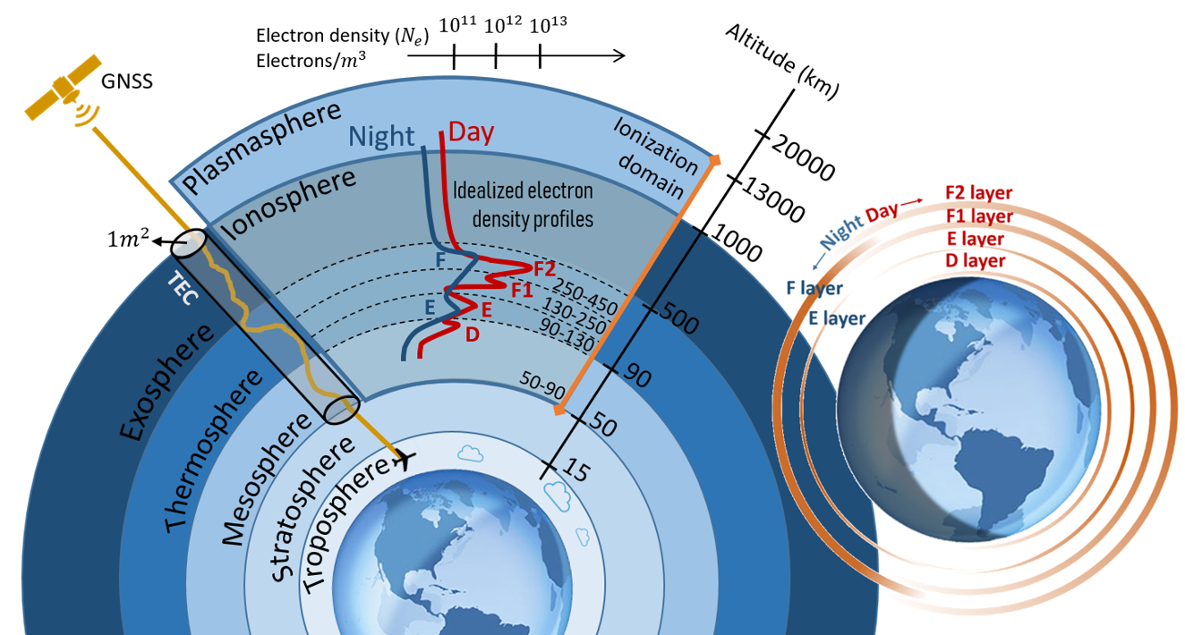
The combination of different kind of measurements is very informative, but…
Courtesy J. Damaceno

Slide 8
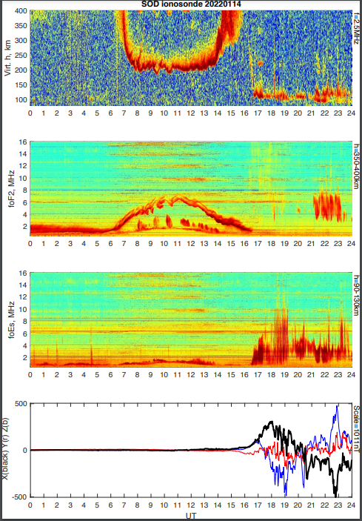
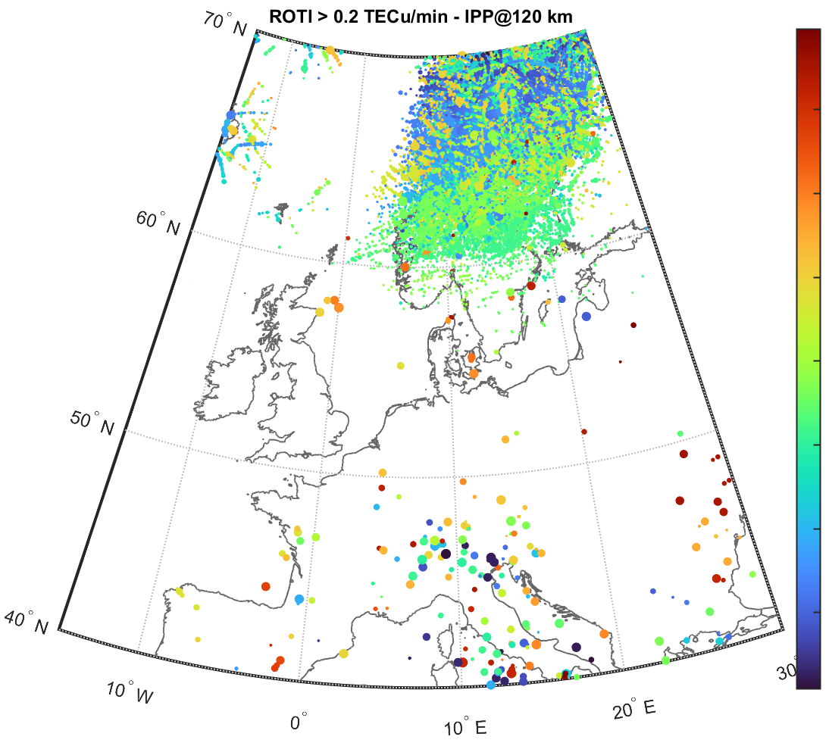
…BUT
Different observation geometry
Different sampling
Different working frequency
Different spatial coverage
Different temporal coverage
Different metrics and standard
…

Slide 9
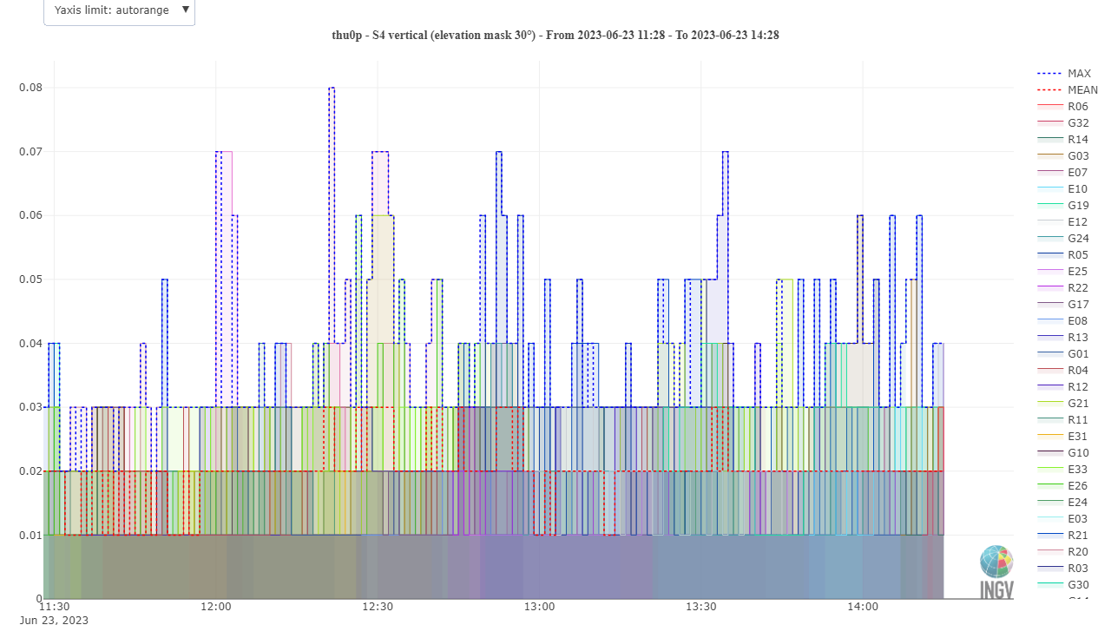
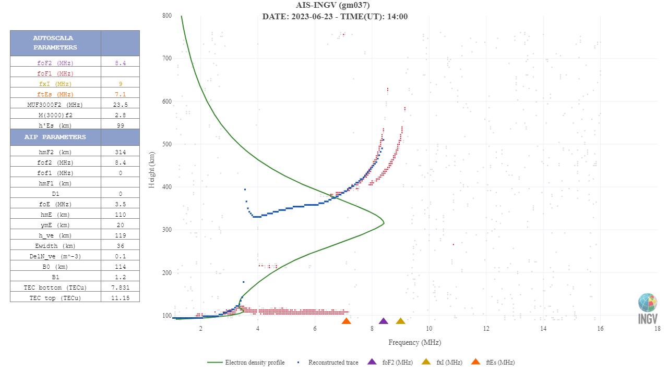
Once the case event is decided we know where and when the event is
First step: fill in a checklist
Instrument | Geographic/ Geomagnetic sector (known) | Temporal coverage (known) | Considered (C)/ Not considered (NC)
Ionosondes
Inchoerent Scatter radars
HF-backscattering radars
Ground-based GNSS receivers
Space-based GNSS receivers
In situ LP/TI
SAR
Others?...
An example of checklist
www.eswua.ingv.it

Slide 10
Once the case event is decided we know where and when the event is
First step: fill in a checklist
Instrument | Geographic/ Geomagnetic sector (known) | Temporal coverage (known) | Considered (C)/ Not considered (NC)
Ionosondes |  | X | NC
Inchoerent Scatter radars |  |  | C
HF-backscattering radars | X |  | NC
Ground-based GNSS receivers |  |  | C
Space-based GNSS receivers | X | X | NC
In situ LP/TI |  |  | C
SAR |  | X | NC
Others?...
An example of checklist
www.eswua.ingv.it

Slide 11
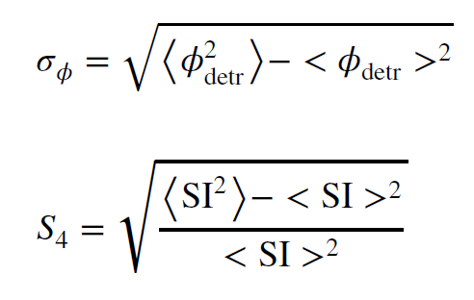
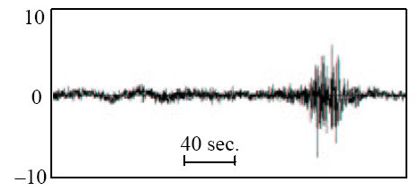
An example: the study of the ionospheric irregularities from the GNSS perspective
Some recall:
Ionospheric scintillations: sudden and rapid fluctuations of phase and amplitude of the GNSS signals triggered by ionospheric plasma irregularities due to the diffraction of the signal.
If the signal meets the “irregularities of the ionosphere" the signal may “Scintillate"
How to monitor
Phase (a.u.)
L. Alfonsi - An attempt of adaptive phase detrending for GNSS scintillation detection

Slide 12
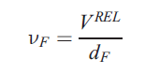
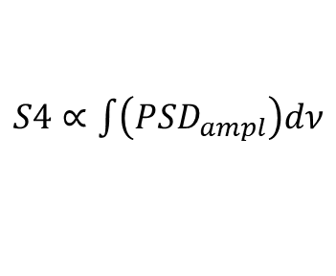
What about the irregularities scale-size triggering scintillations on GNSS signals?
Amplitude scintillation:
Diffraction triggered by small-scale irregularities
What does “small” means?
Small for GNSS signals:
scale-sizes up to hundreds of meters
ν_{F}: Fresnel’s Frequency
V^{REL}: relative velocity ray-path-ionosphere
d_{F}=sqrt(2*λ*h_{IPP})
λ∼19 cm for L1, assuming h_{IPP} = 350 km
d_{F} is about 250 m
Log(PSD)
$S4∝\int{\left({PSD}_{ampl}\right)dν}$
ν_{Fresnel}
ν_{Nyquist}
Log(ν)

Slide 13
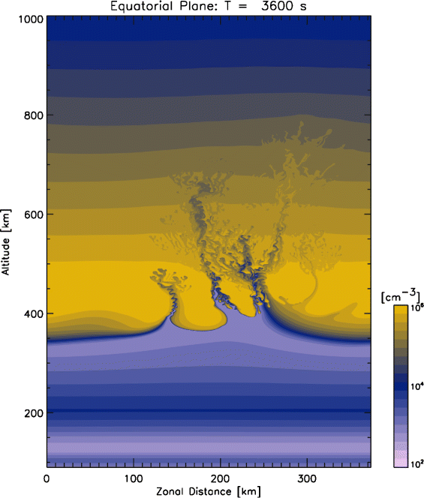
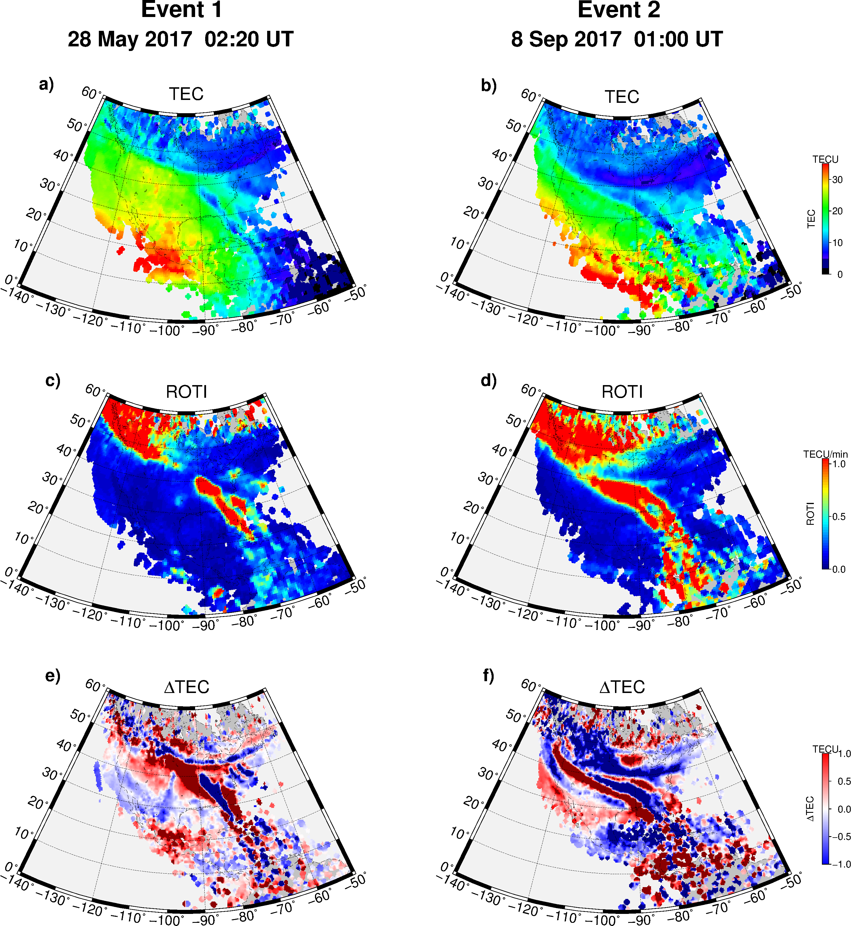
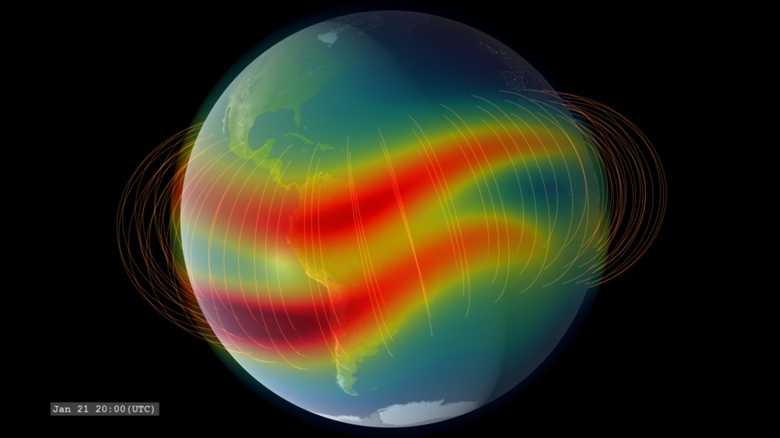
The study of the ionospheric irregularities
Credits: Cherniak
Credits: NASA
Credits: Yokoyama
100 m
1 km
10 km
100 km
1000 km
*Small scale
(Fresnel’s scale)
*Medium scale
*Large scale
Courtesy Luca Spogli
*from a GNSS perspective

Slide 14
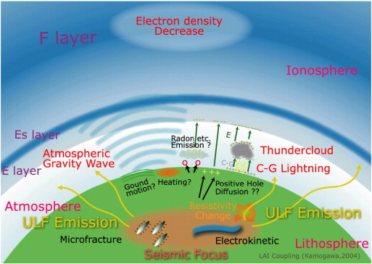
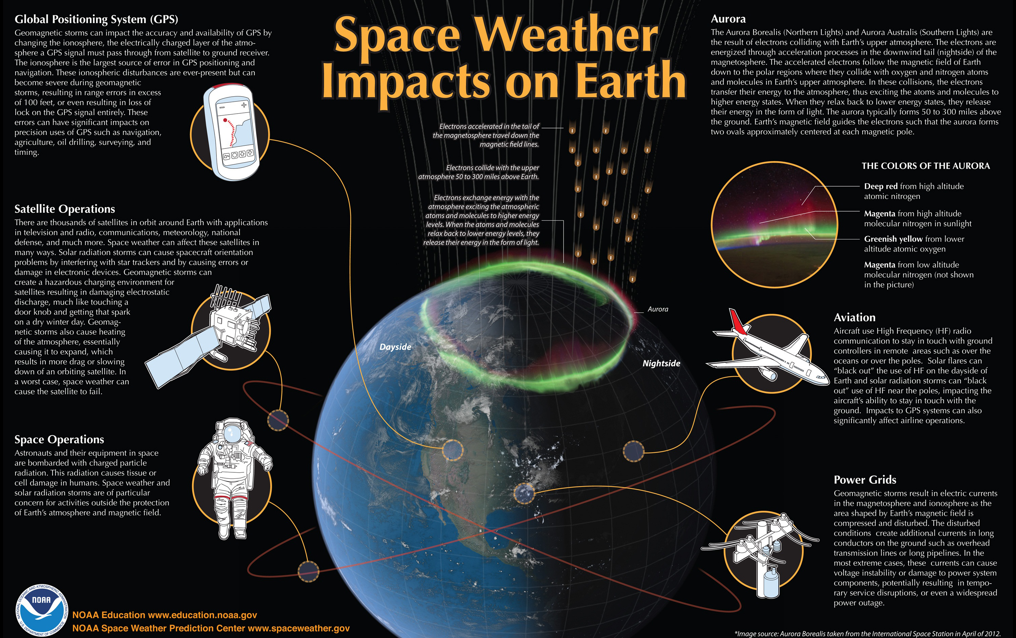
Ionospheric irregularities can form due to:
Neutral atmosphere variability
Earthquake, volcanic and tsunami events
Eclipses
Anthropogenic sources
Space weather events
From Jin et al., 2015 (adapted from Kamogawa, 2004)

Slide 15

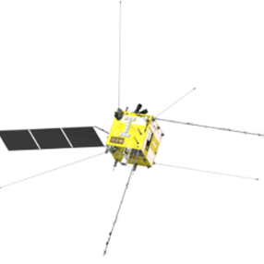
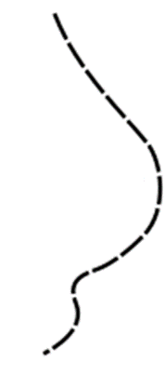
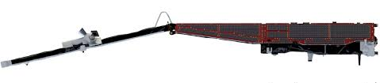
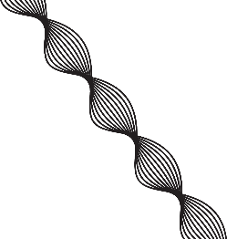
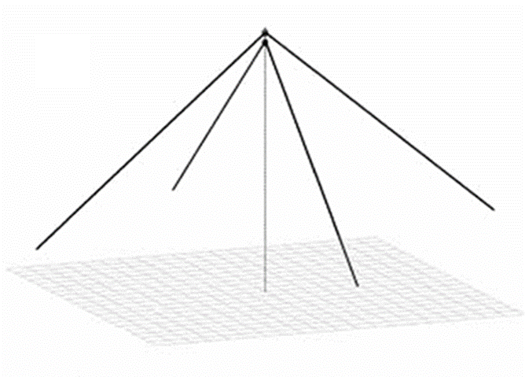
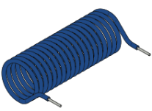
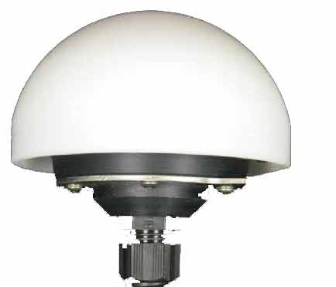

Multi-sensor observation
Bottom-side ionosphere
information
In-situ information of
the topside ionosphere
Equatorial Electrojet
1000 km
⁓ 510 km
CSES / Swarm B
⁓ 440 km
Swarm A/C
Ne
Ionosphere
Integrated information
foF2
hmF2
TEC
$${\vec{J}}_{E}^{}$$
50 km
GNSS receivers
Ionosonde
Magnetometer
Courtesy Luca Spogli

Slide 16
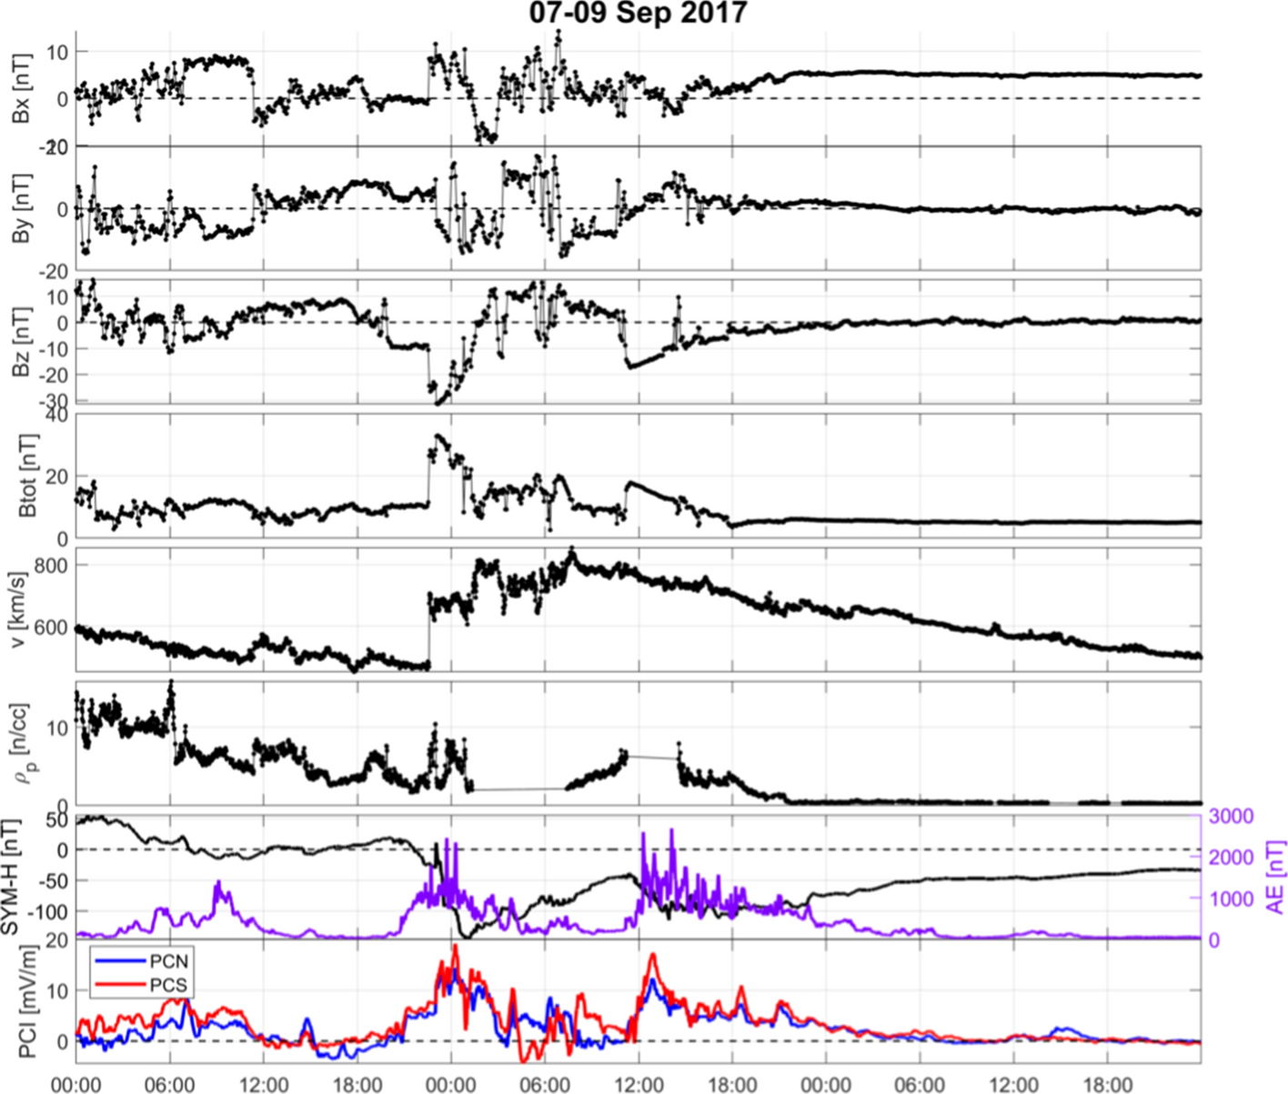
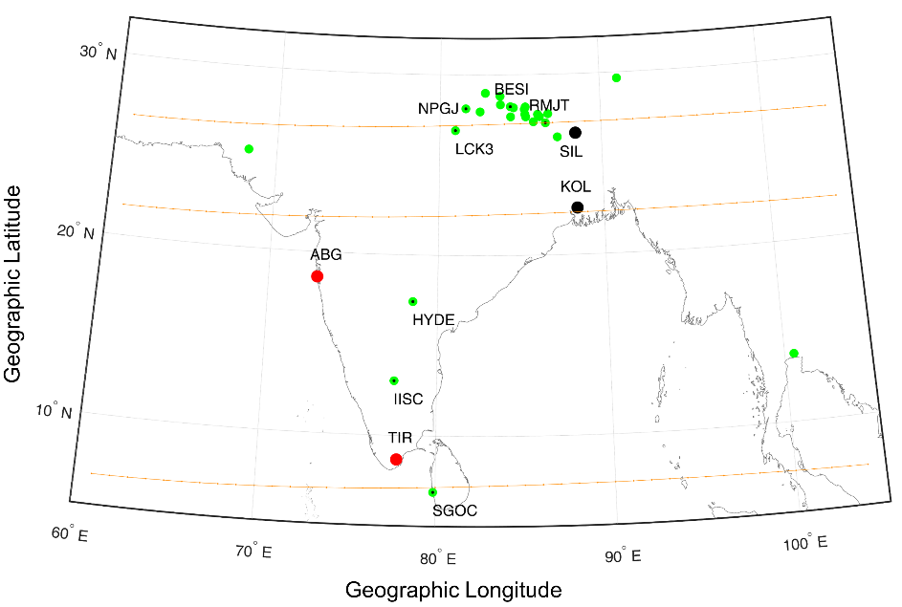
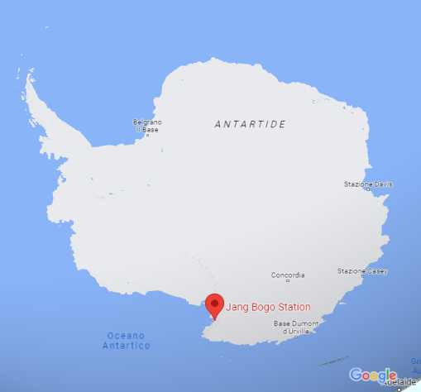

Space weather event of September 2017
ionospheric response from low latitudes (India) and high latitudes (Antarctica)
GEOSPACE
EARTH

Slide 17
Space weather event of September 2017 - ionospheric response over India
Observing system | System output or derived product | Expected Information
GNSS ground-based receivers | DTEC, TEC, scintillation indices | Ionospheric irregularities
Swarm satellites | Ion density | In-situ electron density variations
Ground-based magnetometers | Geomagnetic field components | Geomagnetic field variations

Slide 18
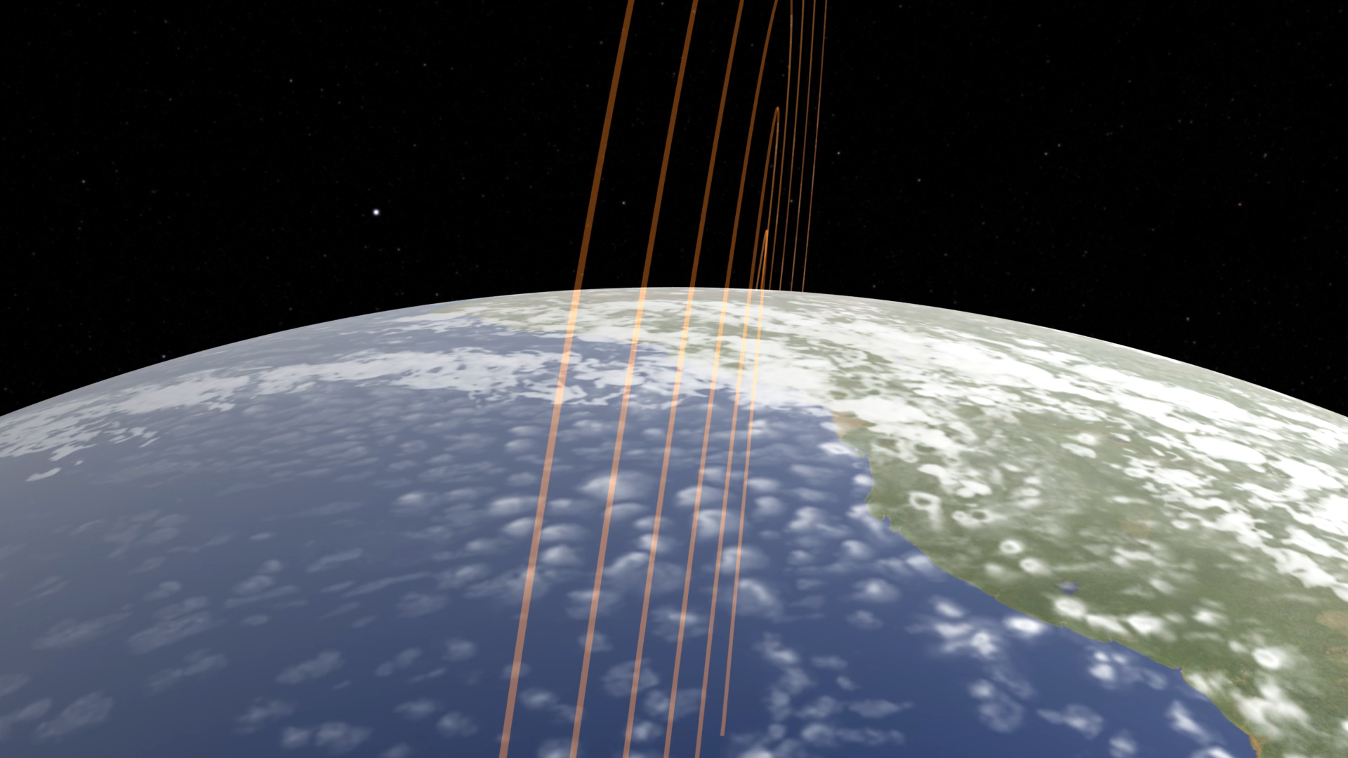

Slide 19
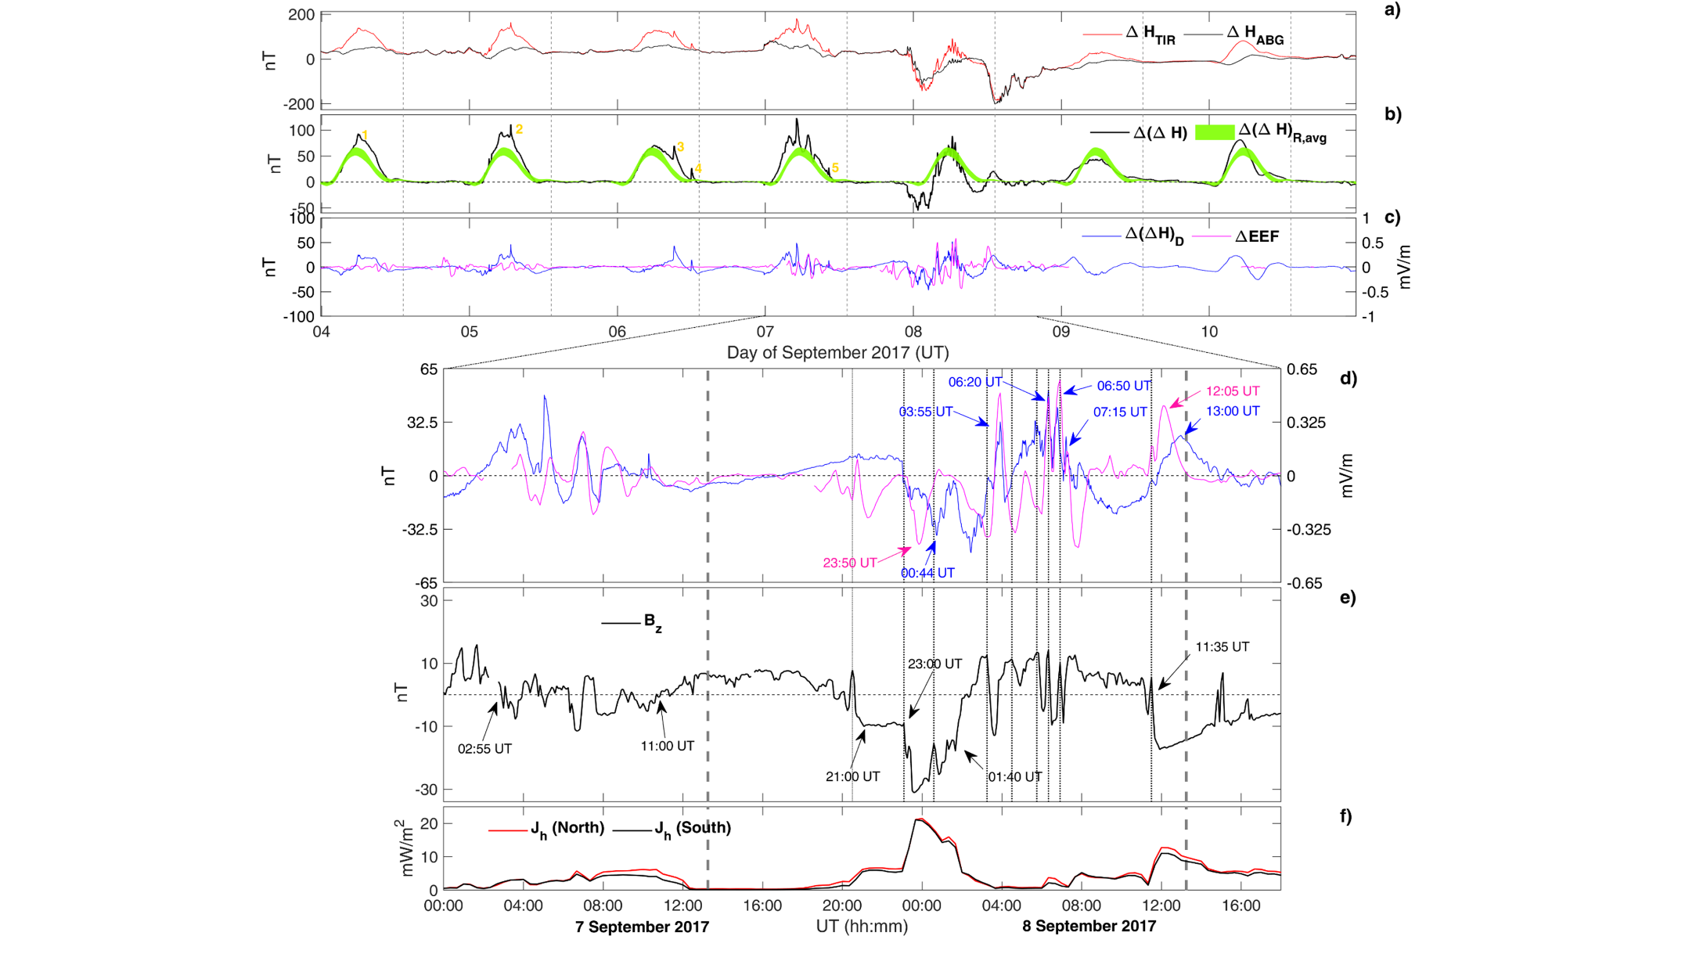
Highlights of the results from the ground-based magnetometer
Geomagnetic horizontal field variations ΔH at ABG and TIR
Difference between horizontal field variations at ABG and TIR (black curve) and its average regular variation (green strip)
equatorial electric field variation (magenta curve) and disturbed part of the difference between horizontal field variations at ABG and TIR (blue curve).
From 7 September 00:00 UT to 8 September 18:00 UT
  the southward Interplanetary Magnetic Field component Bz
  the Joule heating.
In the early UT hours of 7 September, ΔEEF fluctuations are in phase with those observed in the Δ(ΔH)D, indicating that probably the main disturbance came from PPEF.
From 18:00 (corresponding to ~ 23 LT) onwards fluctuations of both ΔEEF and Δ(ΔH)D are not always in agreement: interplay between PPEF and DDEF effects on EEJ intensity variations. In this time range, main PPEF events peak during local daytime, specifically at 03:55 UT, 06:20 UT, 06:50 UT and 07:15 UT on 8 September.

Slide 20
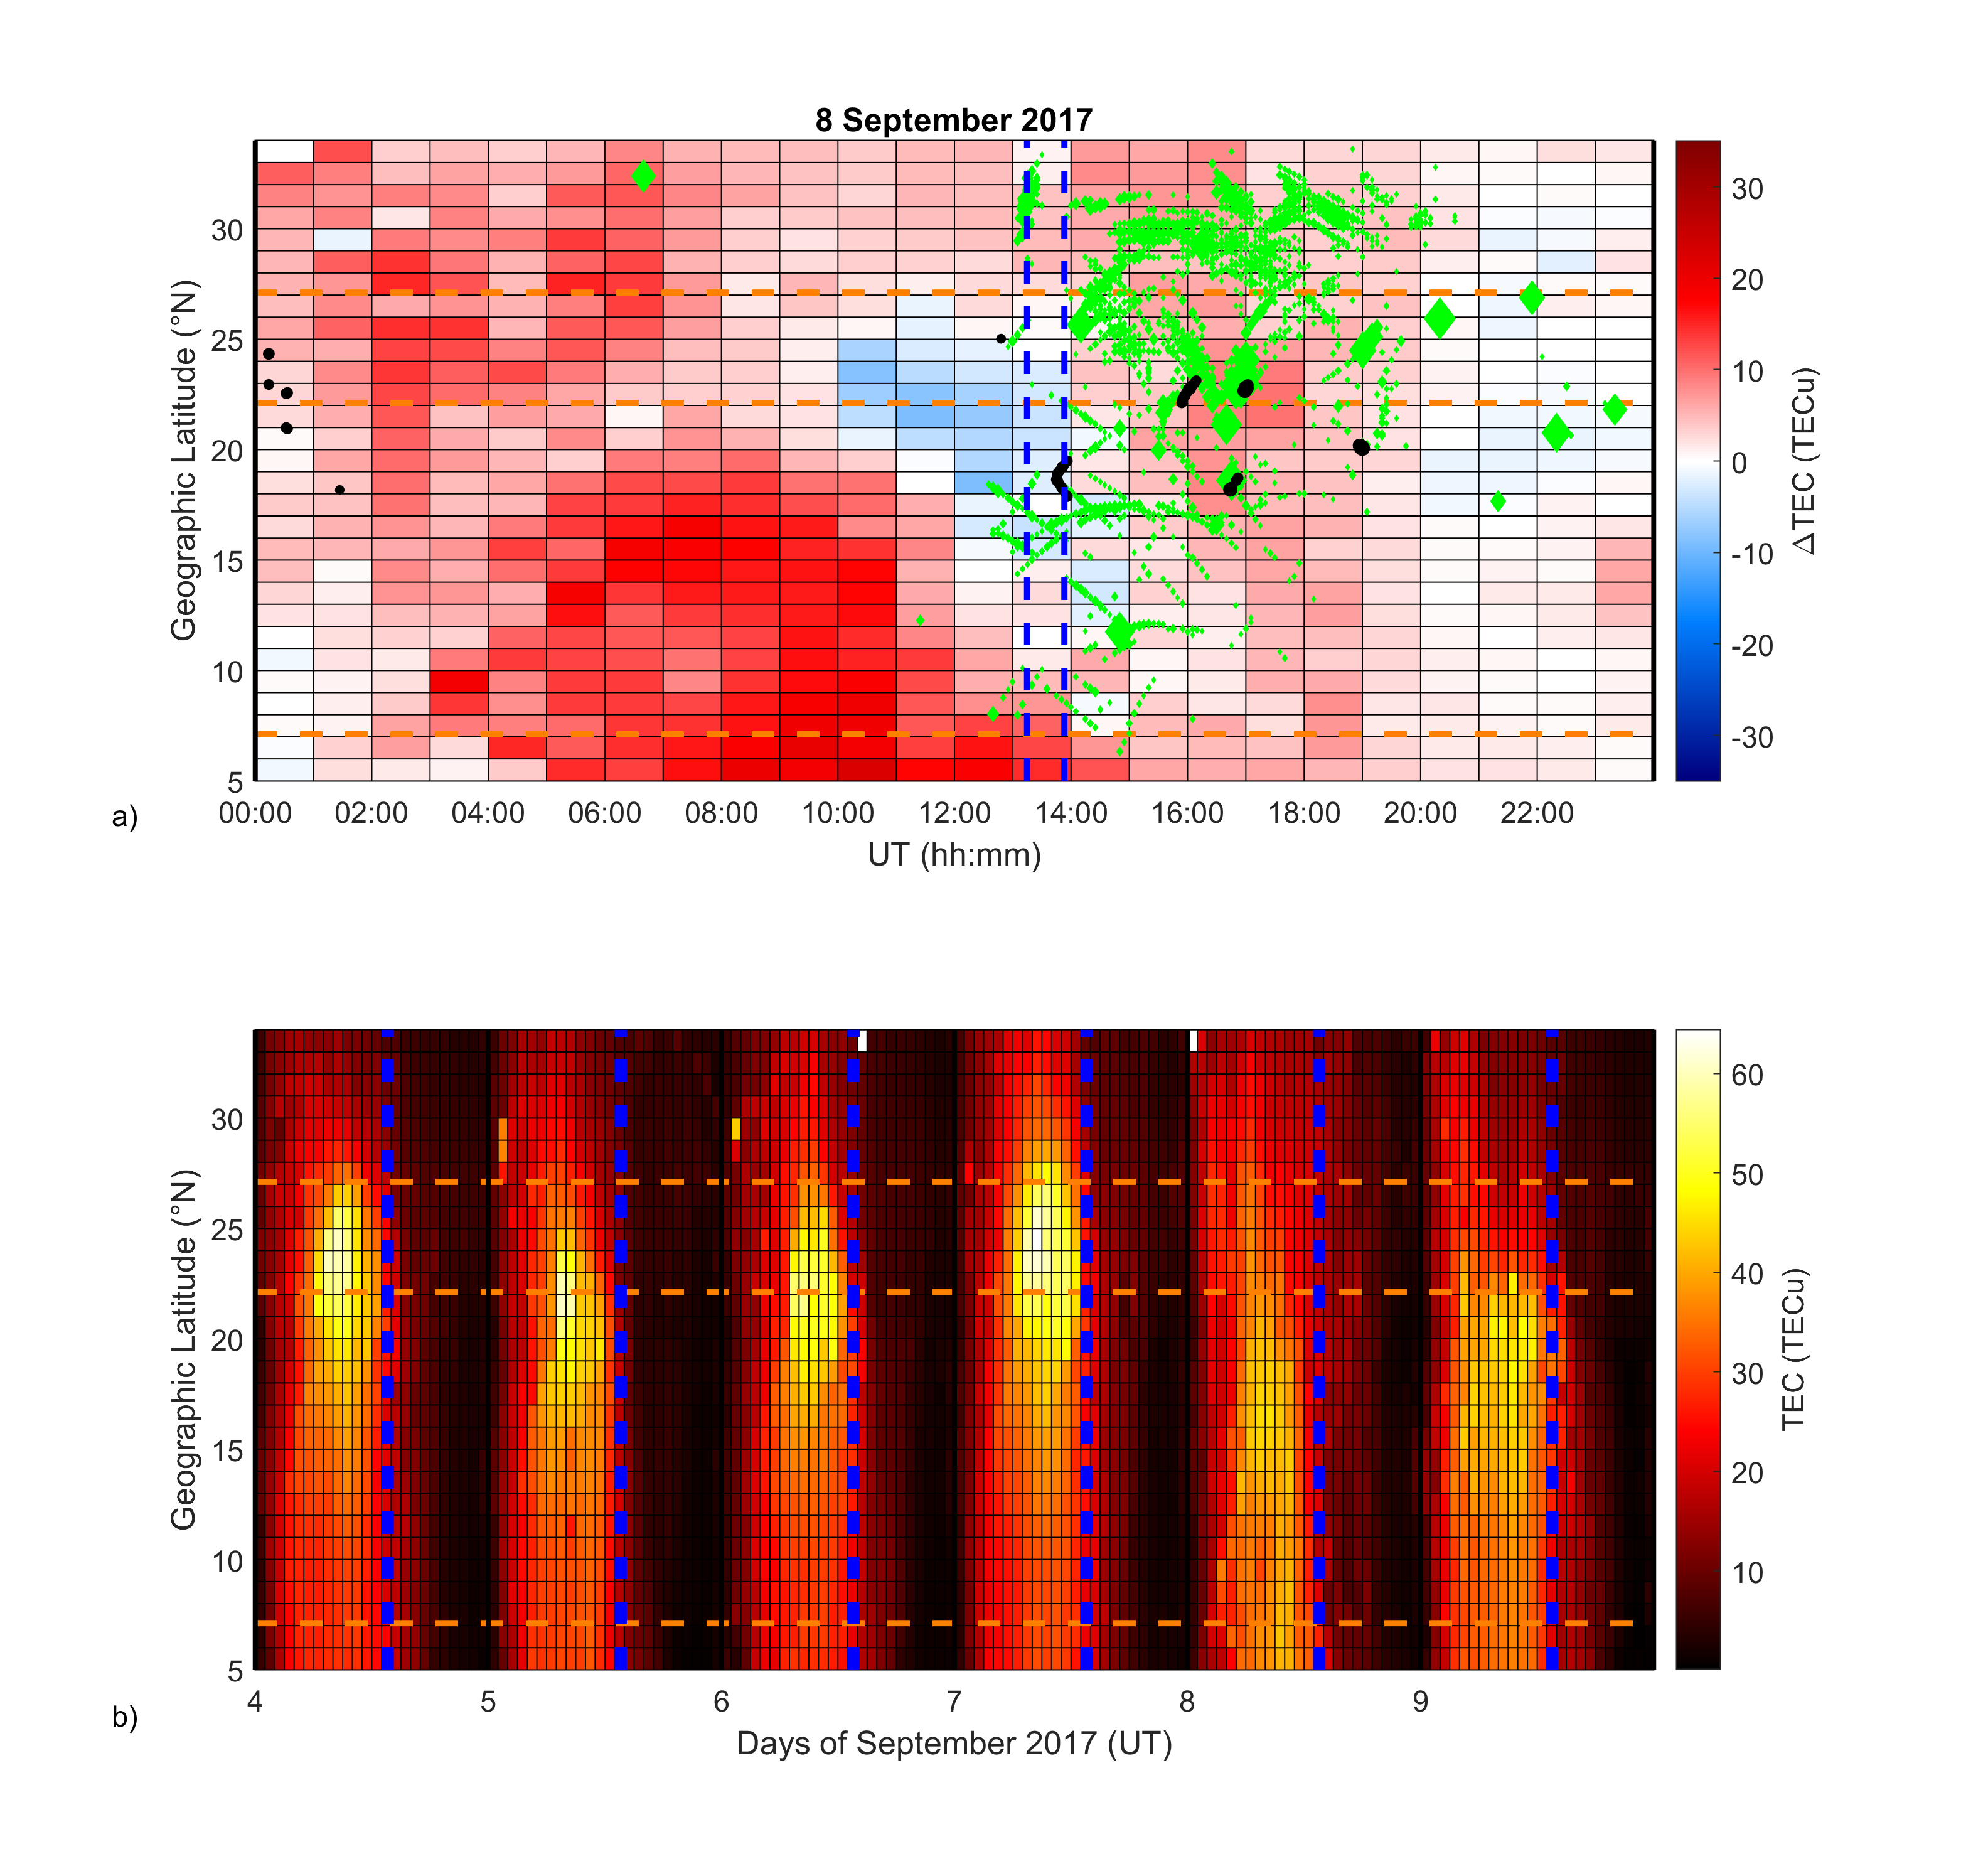
Absolute TEC from 4 to 9 September 2017
The orange dashed lines indicate the position of the magnetic equator and of the isoclinic lines at +15° and +20°. The blue dashed lines indicate the time of the solar terminator at (24°N; 88°E).
TEC difference between 8 September and quiet reference
Green diamonds represent the time and latitude of IPP having ROTI>0.5 TECu/min, while black dots are for IPP having S4>0.3.
From Alfonsi et al., 2021

Slide 21






From GNSS receivers we can derived ROTI
A simplified picture…
$$\vec{V_{IPP}}$$
$$\vec{V_{irr}}$$
… so large scales with respect to what revealed by S4
Scale-sizes up to hundreds of meters
$$r_{irr}^{ROTI}= {V_{irr}}/{f_{irr}^{ROTI}}$$
$$f_{irr}^{ROTI}$$
Is the Nyquist frequency of the ROTI observation (2 x 30 s)⁻¹
?
$$V_{irr}≈600\frac{m}{s}$$
$$r_{irr}^{ROTI}=600 \frac{m}{s}×60 s=36 km$$
Adapted from Luca Spogli

Slide 22
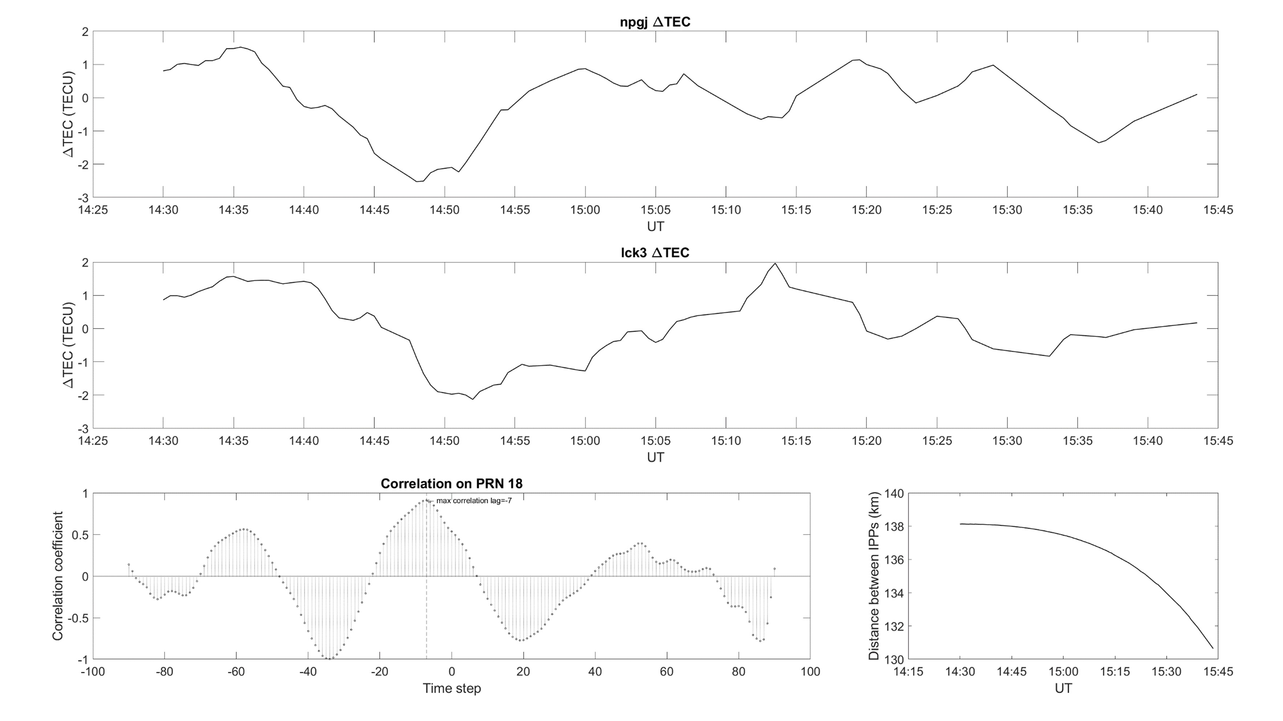
Detrended TEC (∆TEC) of the two stations pair NPGJ and LCK3 and of the pair LCK3 and HYDE (quasi-meridionally distributed) between 14:30 UT and 15:45 UT on 8 September for PRN18. In the bottom panels the corresponding cross-correlation coefficient between −45 and + 45 min is reported, while the distance between the IPPs of PRN18, related to the different stations at the same time.
From both the station pairs the mean propagation velocity can be derived from the ratio between the time lag corresponding to the maximum correlation coefficient and the mean distance of the IPPs.
From Alfonsi et al., 2021

Slide 23
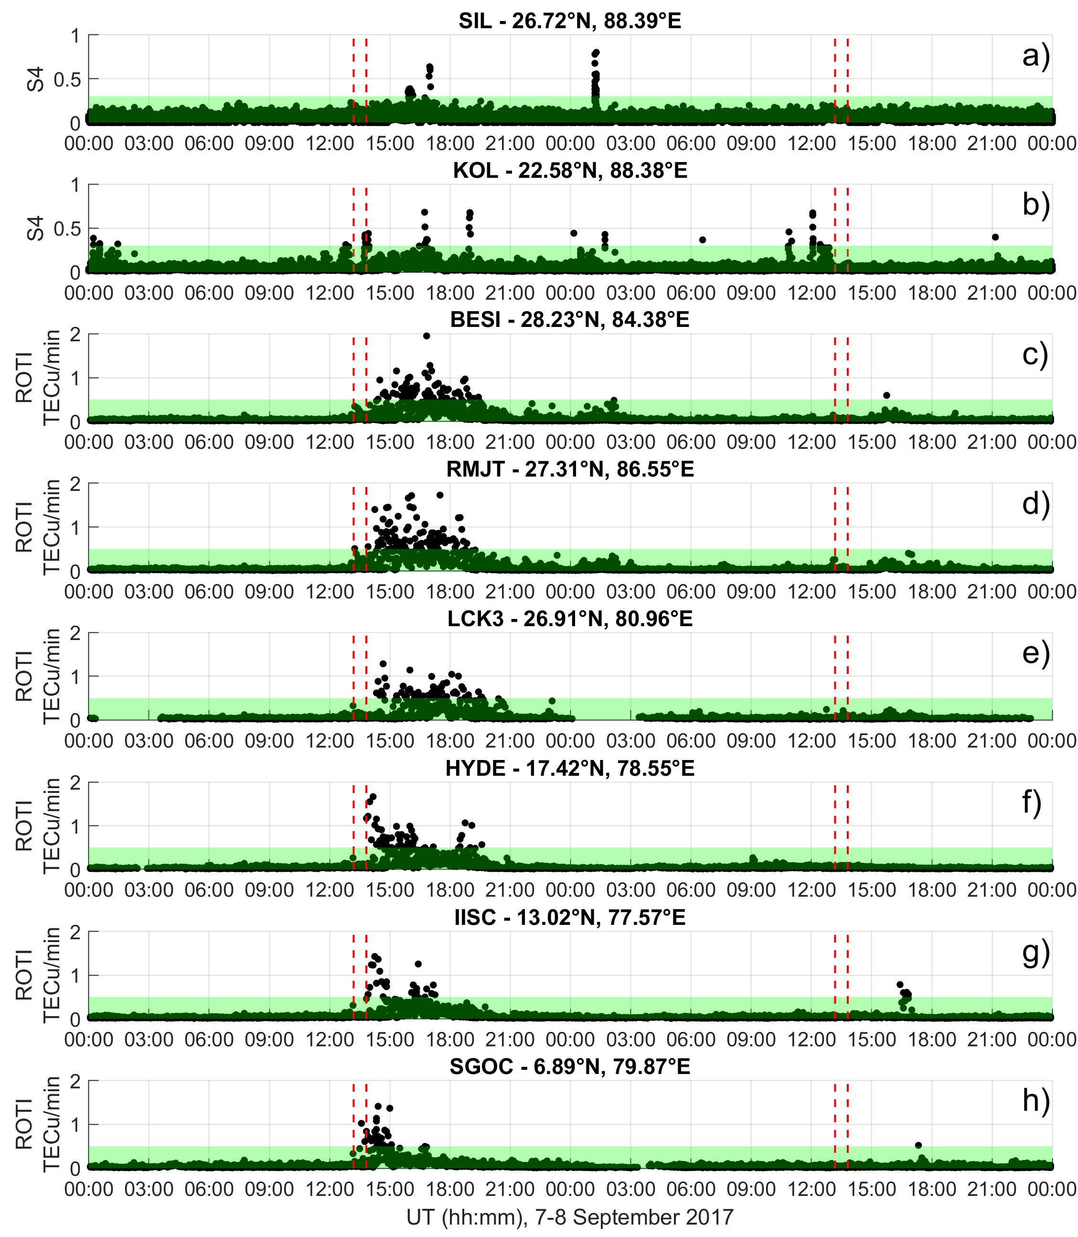
Space weather event of September 2017 - India
Time profiles of S4 and of ROTI obtained by considering all GNSS satellites in view from the station indicated in each panel during 7 and 8 September. The red-dashed lines indicate the time of the passage of the Sun terminators at the station location and at an altitude of 120 km and of 350 km. The green shaded area indicates the ranges S4<0.3 and ROTI<0.5 TECu/min.
From Alfonsi et al., 2021

Slide 24
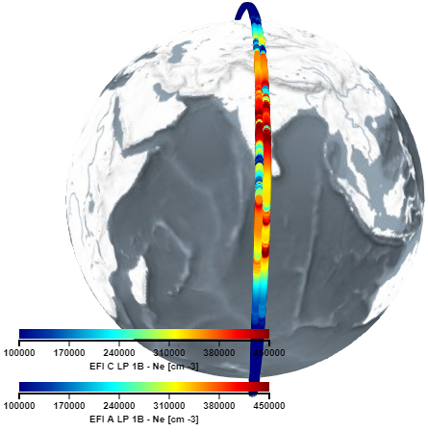
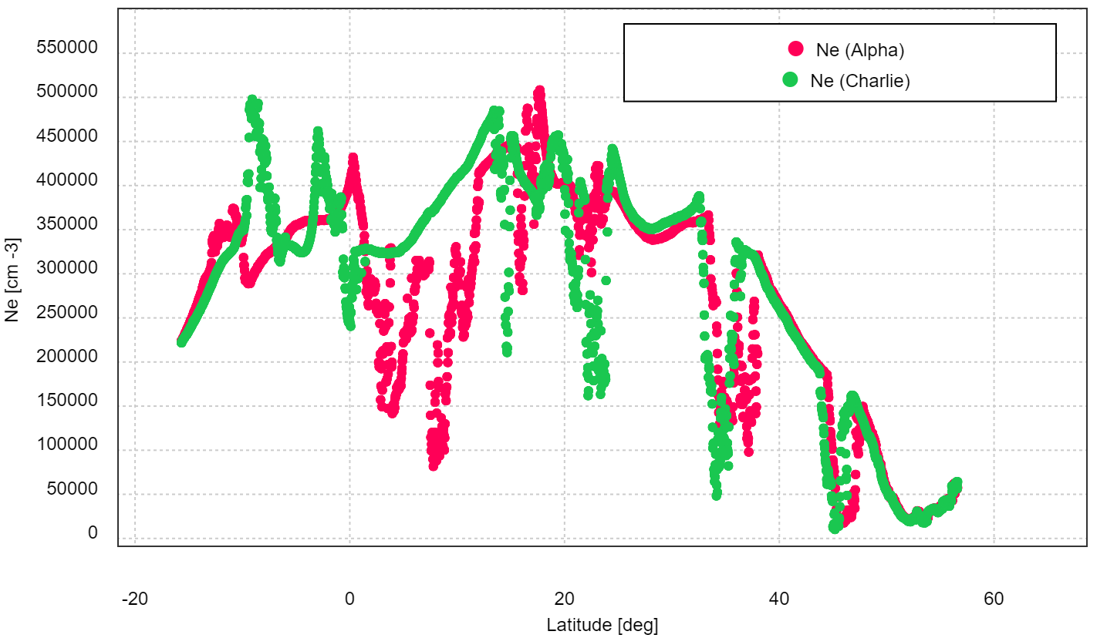
From Swarm satellites other scale sizes can be identified
Velocity of Swarm satellites: 7.5 km/s
Sampling frequency of the electron density by onboard Langmuir probes: 2Hz
Maximum resolution of the ionospheric irregularities scale-size:
7.5·10³ (m/s) x 0.5 (s) ≈ 4·10³ m
By Swarm data analysis we can identified irregularities of few kilometers-scale size or bigger
With faceplate electron density measurements sampled at 16 Hz, the maximum resolution of the ionospheric irregularities scale-size ≈500 m

Slide 25
Space weather event of September 2017 - ionospheric response over Antarctica
INGREDIENTS TO STUDY THE IONOSPHERIC RESPONSE
Observing system | System output or derived product | Expected Information
GNSS ground-based receivers | ΔTEC, TEC, scintillation indices | Ionospheric irregularities
Defense Meteorological Satellite Program | Auroral radiance | Auroral oval position
Ground-based ionosondes | ionograms | Ionospheric irregularities/extra-ionization:absorption
Ground-based magnetometers | Geomagnetic field components | Geomagnetic field variations
Swarm satellites | Ion density | In-situ electron density variations

Slide 26
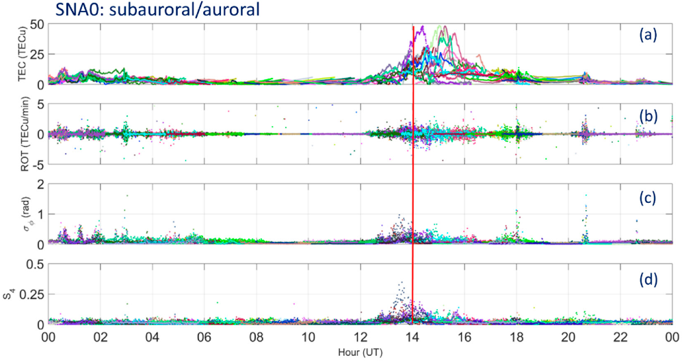
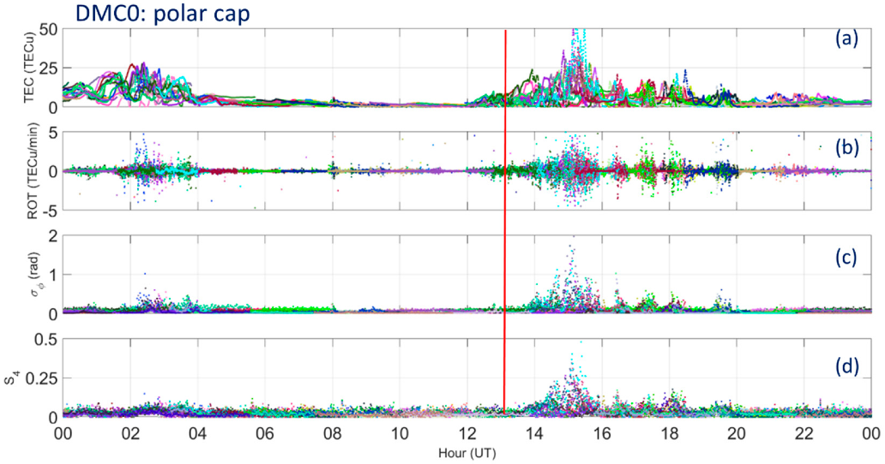
$V_{irr}≈1000\frac{m}{s}$ $r_{irr}^{ROT}=1000 \frac{m}{s}×60 s=60 km$
S4 sensitive to scale-sizes up to hundreds of meters
$V_{irr}≈1000\frac{m}{s}$ $r_{irr}^{ROT}=1000 \frac{m}{s}×60 s=60 km$
S4 sensitive to scale-sizes up to hundreds of meters
From D’Angelo et al., 2021

Slide 27
Comparison of scintillations from 3 stations
The time-shift in the S4 enhanchement appearance suggest the small scale ionospheric irregularities are moving anti-sunward
D’Angelo PhD thesis, 2018

Slide 28
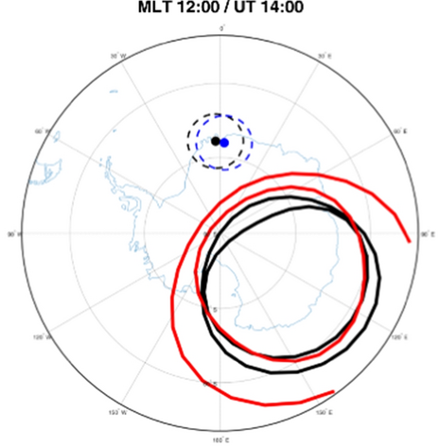
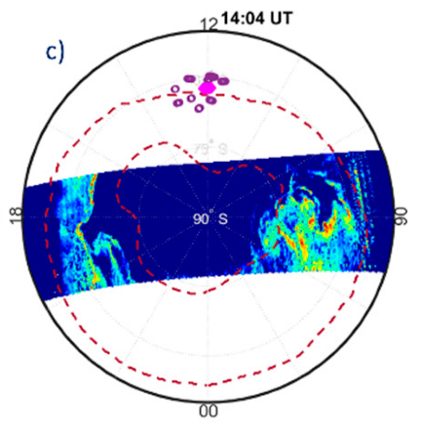
Climatological representation of the SANAE GNSS receiver field of view wrt auroral oval position
(black IQ=0; red IQ=6) from the Feldstein model
Polar-view maps in AACGM latitude and MLT of the austral auroral radiance measured by SSUSI instrument at 14:04 UT. The map also reports the auroral oval boundary location retrieved from the auroral radiance data, and S4 greater than 0.1 recorded at SANAE
D’Angelo PhD thesis, 2018
From Alfonsi et al., 2022
From D’Angelo et al., 2021

Slide 29
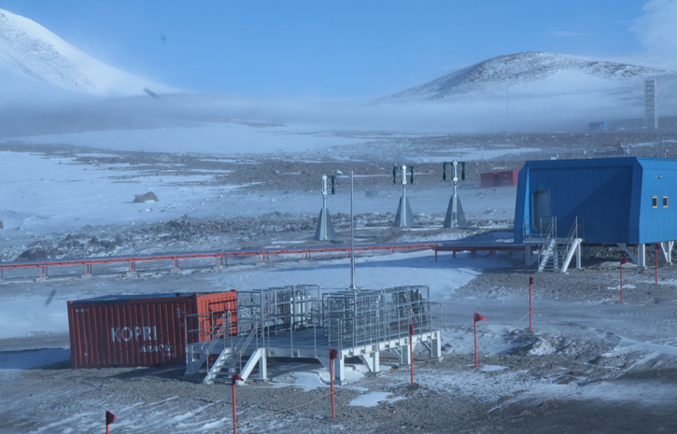
What scale sizes of the ionospheric irregularities from vertical sounding?
ν_{F}: Fresnel’s Frequency
V^{REL}: relative velocity ray-path-ionosphere
d_{F}=sqrt(2*λ*h_{IPP})
Computing from working frequencies of few MHz
d_{F} is of the order of 1-10 Kilometers
University of Colorado/KOPRI

Slide 30
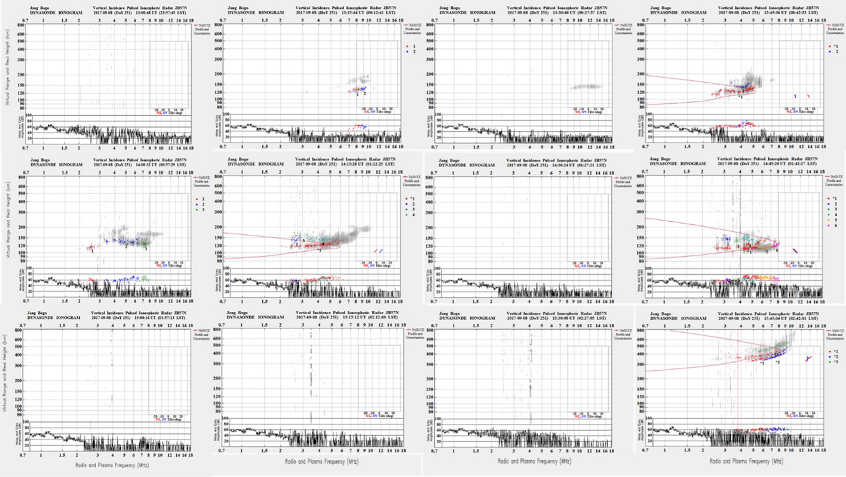
Ionogram series recorded by Jang Bogo VIPIR between 13:00 and 16:00 UT on September 8, 2017
From Alfonsi et al., 2022
From D’Angelo PhD thesis, 2018

Slide 31
Useful References
Alfonsi, L., Cesaroni, C., Spogli, L., Regi, M., Paul, A., Ray, S., ... & Sinha, A. K. (2021). Ionospheric disturbances over the Indian sector during 8 September 2017 geomagnetic storm: Plasma structuring and propagation. Space Weather, 19(3), e2020SW002607.
Alfonsi, L., Bergeot, N., Cilliers, P. J., De Franceschi, G., Baddeley, L., Correia, E., ... & Zou, S. (2022). Review of Environmental Monitoring by Means of Radio Waves in the Polar Regions: From Atmosphere to Geospace. Surveys in Geophysics, 43(6), 1609-1698.
D’Angelo, Investigation of GNSS scintillations under different configurations of the magnetosphere-ionosphere coupling
Thesis for the degree of Doctor of Philosophy, 2018 http://hdl.handle.net/2307/40642
D’Angelo G, Piersanti M, Pignalberi A, Coco I, De Michelis P, Tozzi R, Pezzopane M, Alfonsi L, Cilliers P, Ubertini P. Investigation of the Physical Processes Involved in GNSS Amplitude Scintillations at High Latitude: A Case Study. Remote Sensing. 2021; 13(13):2493. https://doi.org/10.3390/rs13132493

Slide 32
Multi-instrument approach to ionospheric studies
Lucilla Alfonsi
lucilla.alfonsi@ingv.it
Thanks!
Eastern Africa Capacity Building Workshop on Space Weather and Low-latitude Ionosphere

Slide 33
Backup slides

Slide 34
















































mV
RIOMETER 38.2MHz 26 February 2004
UT

Slide 35
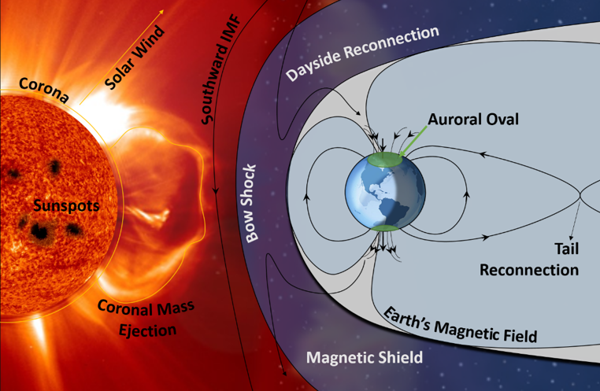
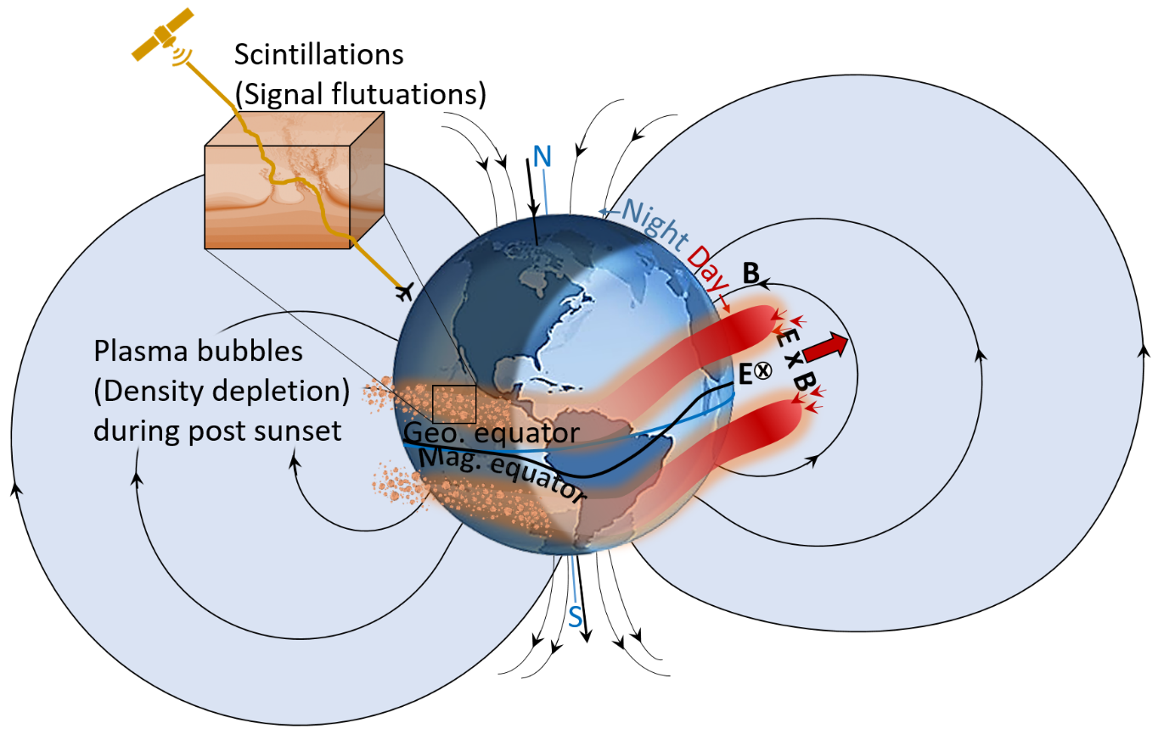
ADOPTING A GNSS PERSPECTIVE TO APPROACH A MULTI-INSTRUMENT STUDY OF THE IONOSPHERIC IRREGULARITIES
Small scale: scale sizes up to hundreds of meters
What about larger scales?
What about the spatial and temporal evolution of the irregularities (any scale size)?
What about the formation mechanisms?

Slide 36
METRICS and STANDARD
a common language still missing in the ionospheric community but crucial for space weather
Instrument | Data metrics | Data standard
Ionosondes and Digisondes
Inchoerent Scatter radars
HF-backscattering radars
Ground-based GNSS receivers | X
Space-based GNSS receivers | X
In situ LP/TI | X
www.eswua.ingv.it

Slide 37
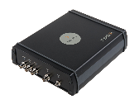
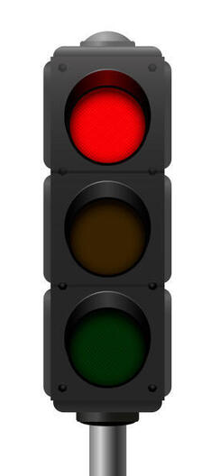


A simplified picture
1000 km
Ionosphere
50 km
Reduced accuracy of positioning
Scintillation indices
Loss of lock
Ampl.
Phase

Slide 38



September 2017 storm
Concordia Station - Antarctica

Slide 39


What causes phase and amplitude fluctuations in the GNSS signals?
Ionospheric irregularities
Diffraction
Refraction
Scale size range: full ionospheric spectrum
Affects: phase
Physical mechanism: phase mixing
Effect: deterministic fluctuations
Mitigation: IFLC (1st ionospheric order)
Positioning issues: Cycle Slips, Losses and Lock, Phase Noise, 2nd order ionospheric effect (fraction of cm), etc.
Scale size range: up to Fresnel’s scale
Affects: amplitude, phase
Physical mechanism: decorrelation, interference
Effect: stochastic fluctuations
Mitigation: e.g., Conker et al., Aquino et al., etc., de-weighting methods.
Positioning issues: stochastic nature is challenging, TEC cannot be calculated

Slide 40

What is scintillation?
A deeper look
Phase “fluctuations”:
2 mechanisms:
-diffraction (small-scale irregularities)
-refraction (all scale range and scaling with 1/f)
Stochastic and deterministic effects
Log(PSD)
Phase Amplitude
If cutoff frequency is “wrong” (ususally fixed at 0.1 Hz), detrending is wrong, σ_{Φ} value includes mainly phase fluctuations due to refraction, i.e., mostly deterministic effects.
Overestimated σ_{Φ}
Not suitable at high-latitudes
0.1 Hz
ν_{cutoff}=ν_{Fresnel}
ν_{Nyquist}
Log(ν)
Notes:
By adopting c = F = 0.1 Hz and by considering
hirr = 350 km, the relative velocity is vrel = 36.5 m/s.

Slide 41


What is scintillation?
Scintillation on L1?
Scintillation on L2?
NO! Ionosphere-Free Linear Combination says NO!
*adapted from a slide by Jayachandran (UNB)

Slide 42
What is scintillation?
Scintillation on L1?
Scintillation on L2?
YES! Ionosphere-Free Linear Combination doesn’t account for all fluctuations
*adapted from a slide by Jayachandran (UNB)

Slide 43
What is scintillation?
If properly detrended, SigmaPhi has almost the same information content of S4
Ghobadi et al. (2020).
GPS Solutions
Spogli et al. (2021).
IEEE Geoscience and Remote Sensing Letters.
Courtesy of Jayachandran (UNB)

Slide 44


This is an issue for high-latitude only, where plasma convection is way larger
Spogli et al. (2021).
IEEE Geoscience and Remote Sensing Letters.
Cesaroni et al. (2021).
Earth and Planetary Physics
0.1 Hz cutoff is not that bad at low latitudes…

