Slide 1



Low-Cost SDR-Based Ionosonde / HF bistatic ionospheric sounder data ingestion into NeQuick 2
A. Kashcheyev¹, A. Koloskov¹, B.Nava², P.T. Jayachandran¹ and V. Paznukhov³
(1) University of New Brunswick, Fredericton, NB, Canada
(2) The Abdus Salam International Centre for Theoretical Physics, Trieste, Italy
(3) Institute for Scientific Research, Boston College, Boston, MA, USA
ICTP Workshop, Malindi, Kenya, October 03-12, 2023

Slide 2
Motivation
Reduce the cost of ionospheric sounding keeping scientific grade data quality
Replace aging instrument(s)
Reduce level of interference reducing transmitted power
Make instrument portable
Allow developing countries use the technology
ICTP Workshop, Malindi, Kenya, October 03-12, 2023

Slide 3
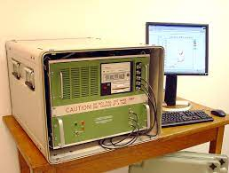
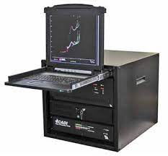
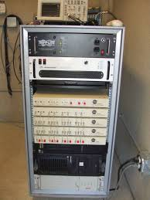
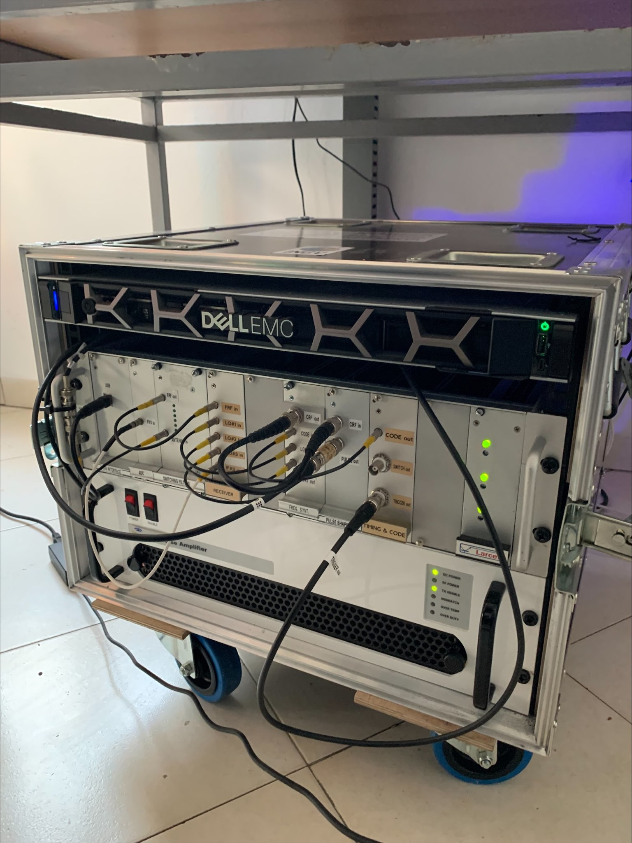
Ionosonde market
Digisond DPS-4D
CADI
VIPIR (Dynosonde)
INGV?
ICTP Workshop, Malindi, Kenya, October 03-12, 2023

Slide 4
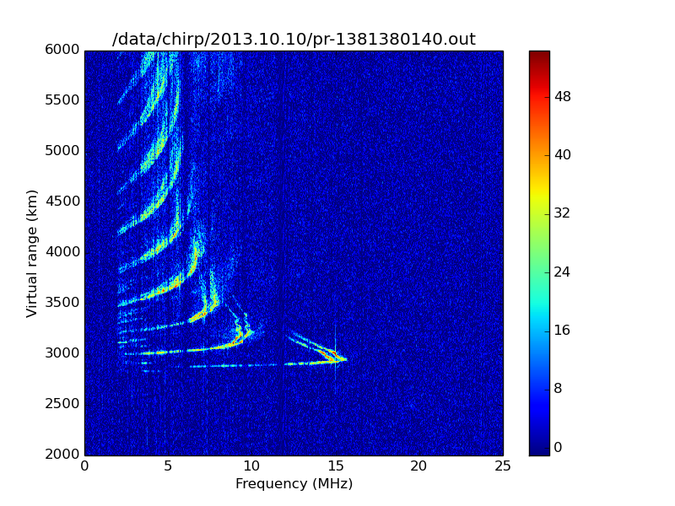
Low-cost ionospheric sounders
GNU Chirp sounder, Yuha Vierinen (https://www.sgo.fi/~j/gnu_chirp_sounder )
  Software defined radio-based receiver for monitoring ionospheric sounders (ionosondes) and over-the-horizon radars that use linear frequency sweep FM-CW transmissions
  Based on gnuradio and relies on Ettus research USRP2 and USRP N210 based digital receivers
  The receiver can be used to receive the whole HF band (typically at 25 MHz bandwidth) simultaneously, and to receive multiple sounders simultaneously
Design of a flexible and low-power ionospheric sounder, Alex Morris, M.S. Thesis (https://scholarworks.alaska.edu/handle/11122/4535)
  USRP-N200 based ionospheric sounder
  Active magnetic loop antenna
  Peak transmit power 10W
  Barker code
ICTP Workshop, Malindi, Kenya, October 03-12, 2023

Slide 5
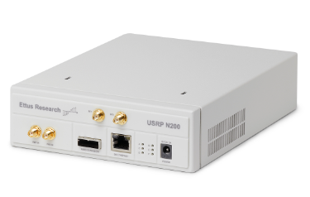
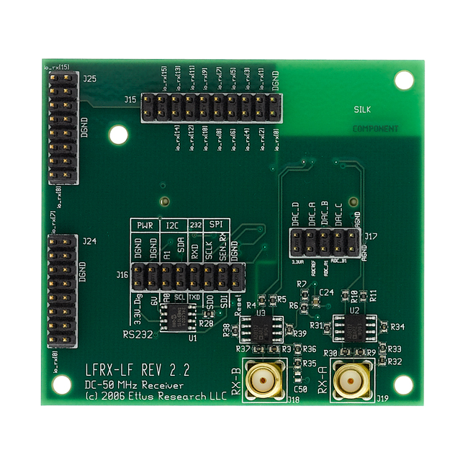
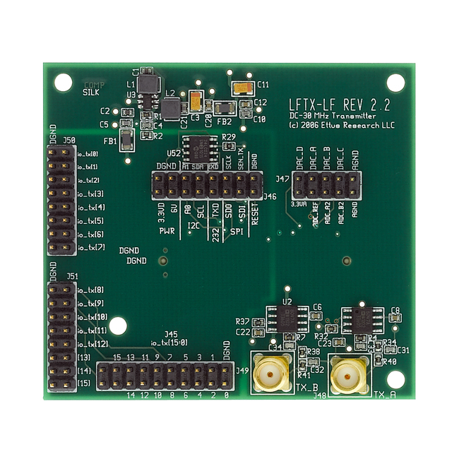
SDR-based ionosonde (ISDR): core SDR
Ettus research (NI) USRP N200
Software-defined radio (Spartan FPGA-based)
Direct conversion receiver/transmitter
Dual 100 MS/s, 14-bit ADC
Dual 400 MS/s, 16-bit DAC
Up to 50 MS/s Gigabit Ethernet Streaming
UHD interface (open source available via Github)
Supports different daughterboards (in our case they are LFRX and LFTX, 0-30 MHz)
Supports external reference oscillator and PPS signal input (coherent work capabilities)
ICTP Workshop, Malindi, Kenya, October 03-12, 2023

Slide 6
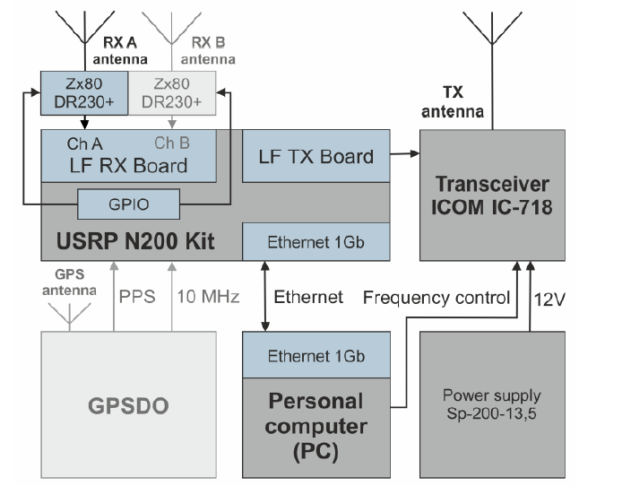
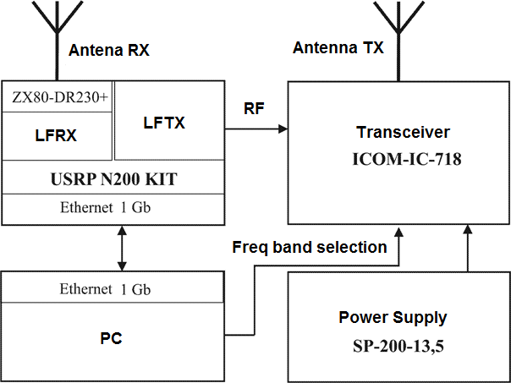
ISDR: functional diagram
Basic configuration, single channel
Extended configuration, dual-channel
ICTP Workshop, Malindi, Kenya, October 03-12, 2023

Slide 7
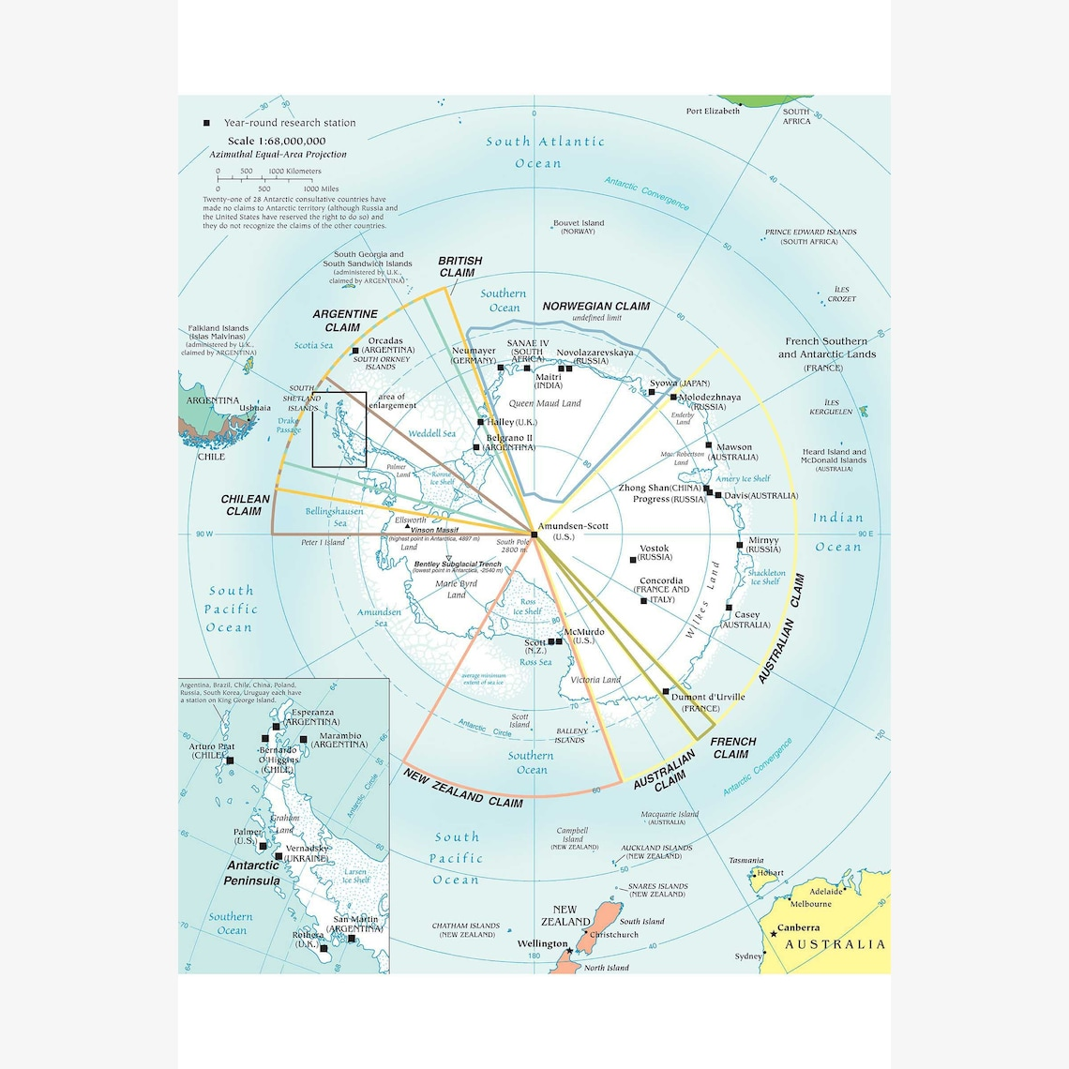
ISDR: setup
Vernadsky Research Base,
Galindez Island
Geographic
-65.25°N 64.26°W
Geomagnetic (IGRF-13)
-51.06°N 9.27°E
ICTP Workshop, Malindi, Kenya, October 03-12, 2023

Slide 8
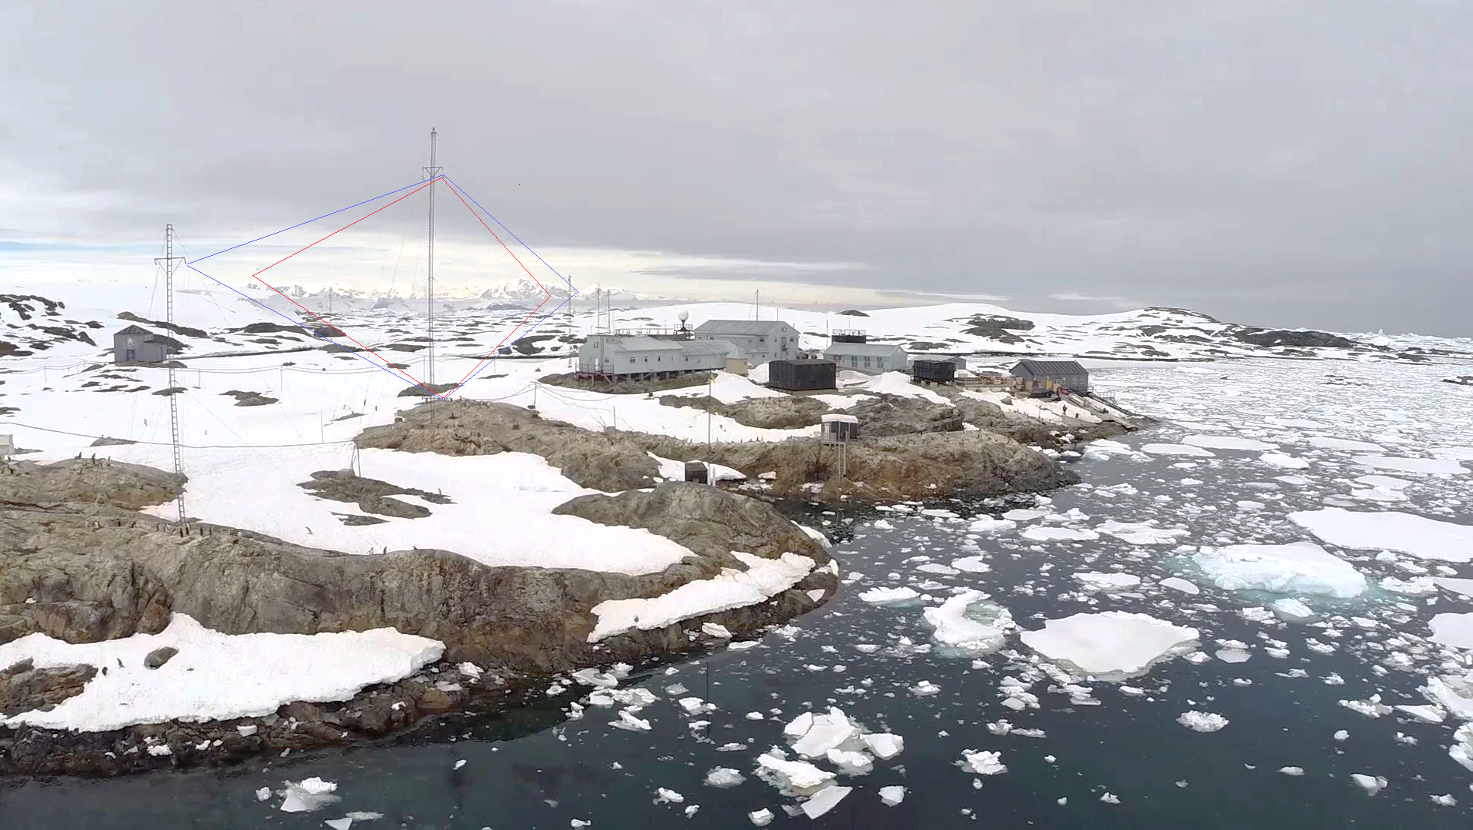
ISDR: setup
LF RX
HF RX
ICTP Workshop, Malindi, Kenya, October 03-12, 2023

Slide 9
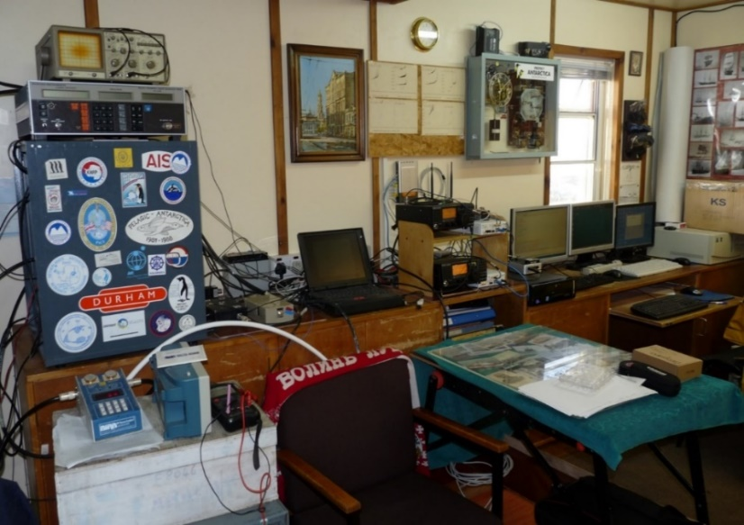
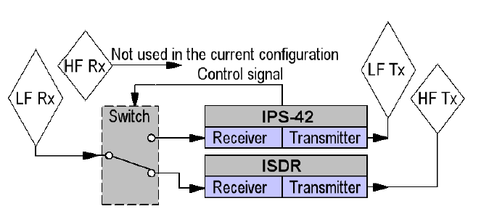
ISDR: setup
IPS-42
SDR-based
ICTP Workshop, Malindi, Kenya, October 03-12, 2023

Slide 10
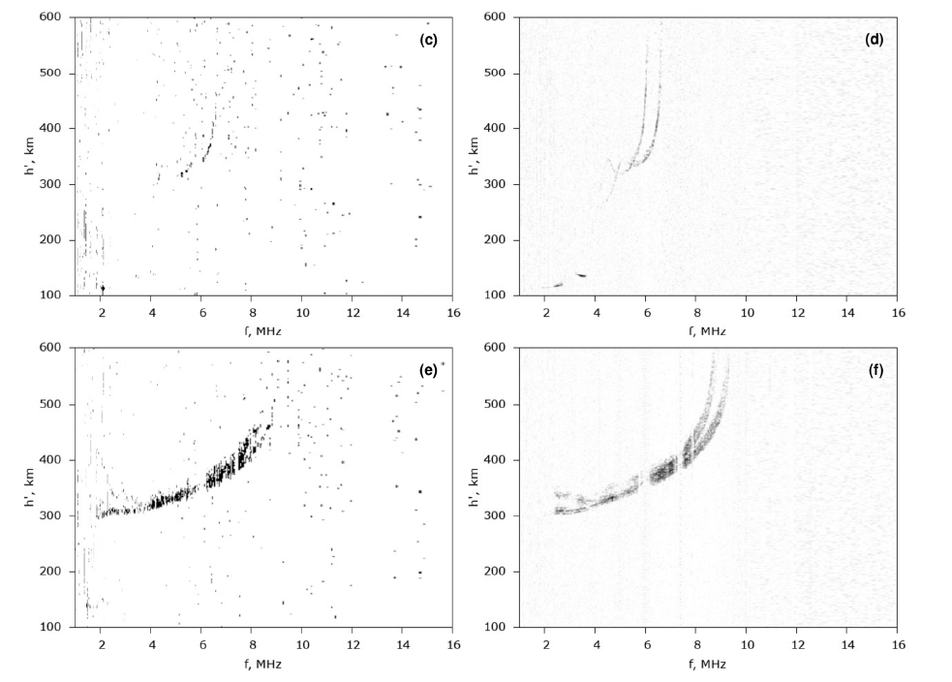
Comparison Results: examples
Dec 2021
IPS-42
ISDR
3.5 kW
100 W
ICTP Workshop, Malindi, Kenya, October 03-12, 2023

Slide 11
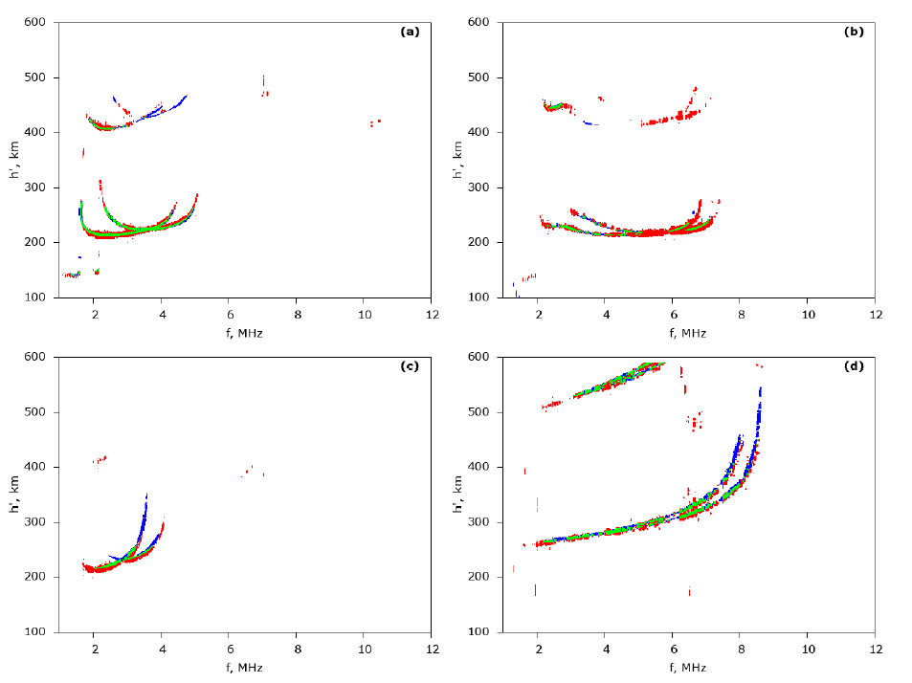
Comparison Results: examples
Only ISDR
Only IPS-42
Both
ISDR - 4.5km (16-bit code)
IPS-42 - 6km
Scaling soft - 5km
ICTP Workshop, Malindi, Kenya, October 03-12, 2023

Slide 12
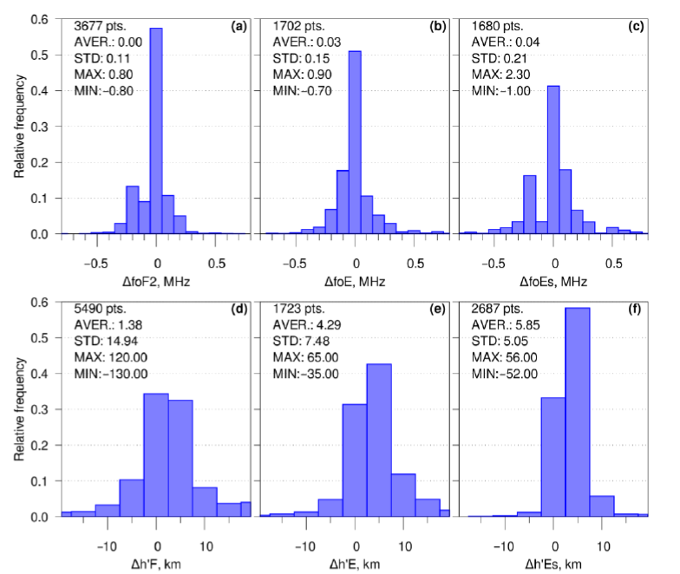
Comparison Results: statistics
Year 2021
ISDR - 4.5km (16-bit code)
IPS-42 - 6km
Scaling soft - 5km
ISDR - 3 min
IPS-42 - 20 sec
ICTP Workshop, Malindi, Kenya, October 03-12, 2023

Slide 13
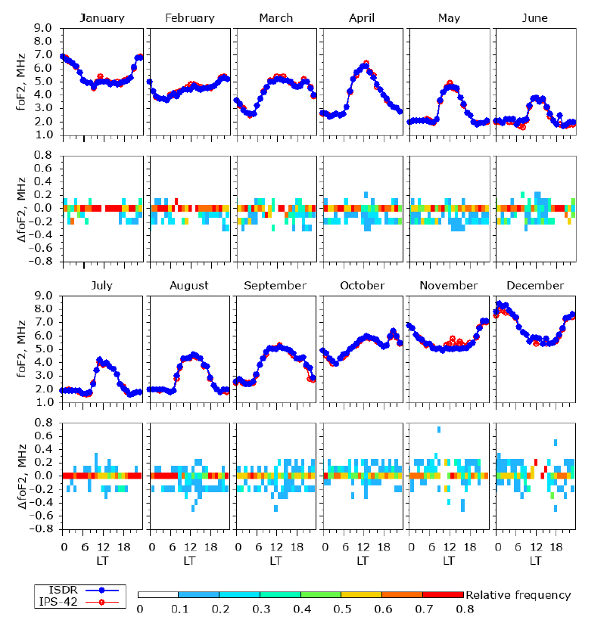
Comparison Results: statistics
Year 2021
ICTP Workshop, Malindi, Kenya, October 03-12, 2023

Slide 14
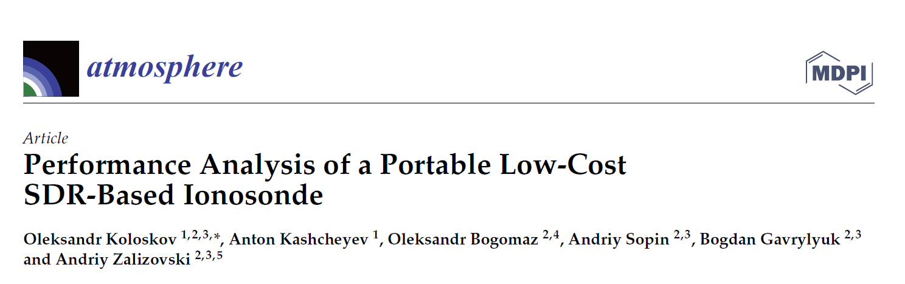
Results: publication
ICTP Workshop, Malindi, Kenya, October 03-12, 2023

Slide 15
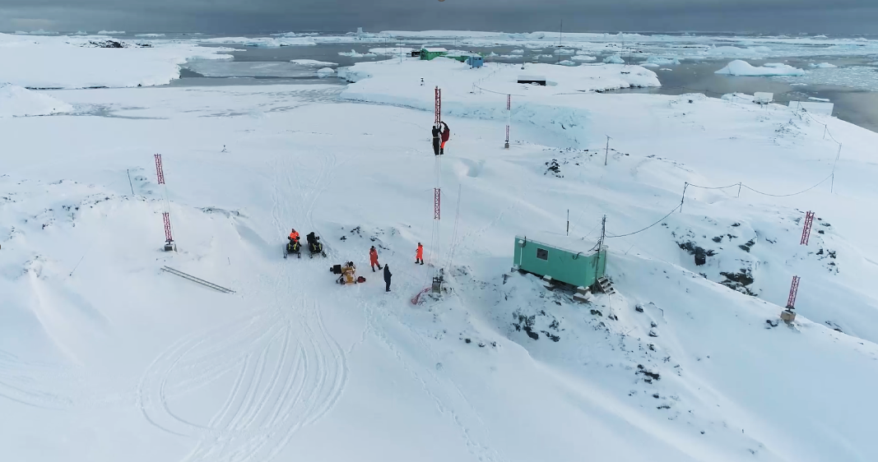
New setup: extended version
2022
~400m
ICTP Workshop, Malindi, Kenya, October 03-12, 2023

Slide 16
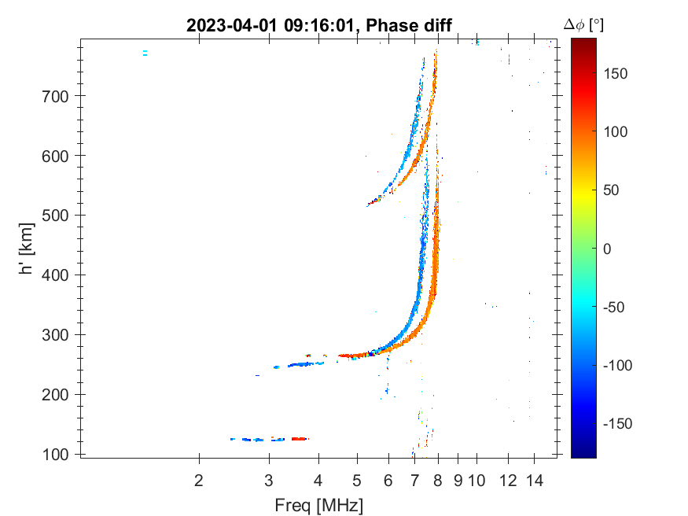
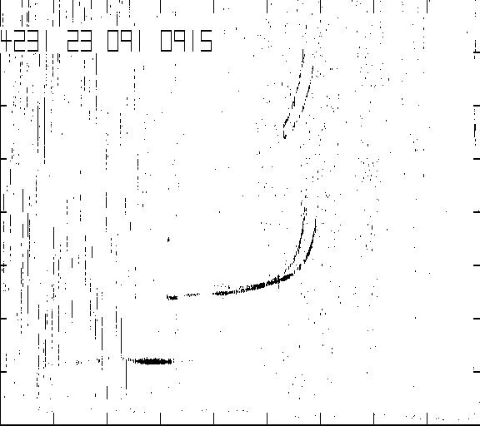
New setup: first results
ICTP Workshop, Malindi, Kenya, October 03-12, 2023

Slide 17
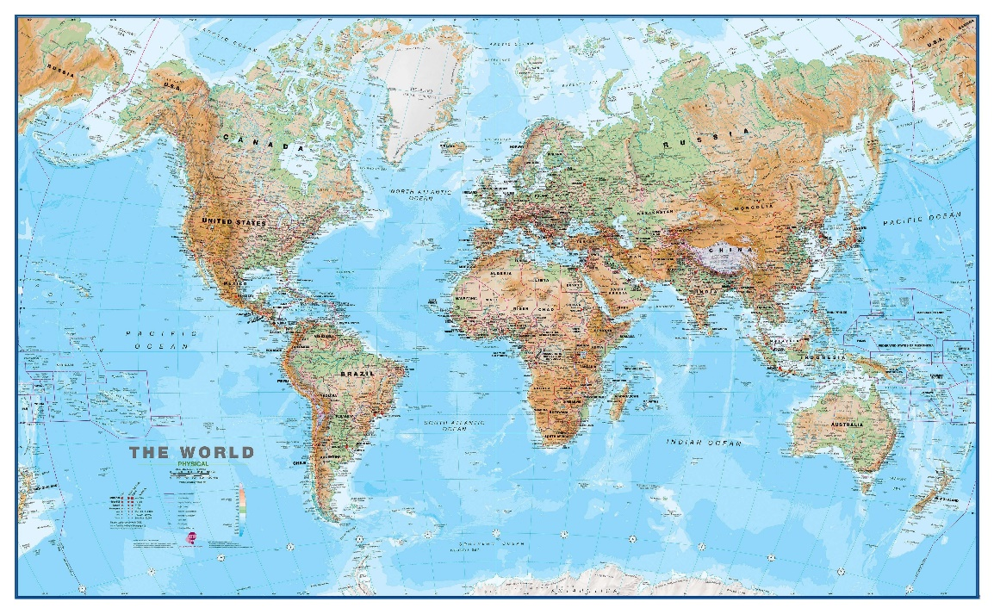
ISDR network
Research Base “Ak Vernadksy”,
Antarctica (Apr 2017)
Kharkiv, Ukraine (Dec 2017)
Blissville, Canada (Dec 2019)
Abuja, Nigeria (2024?)
ICTP Workshop, Malindi, Kenya, October 03-12, 2023

Slide 18
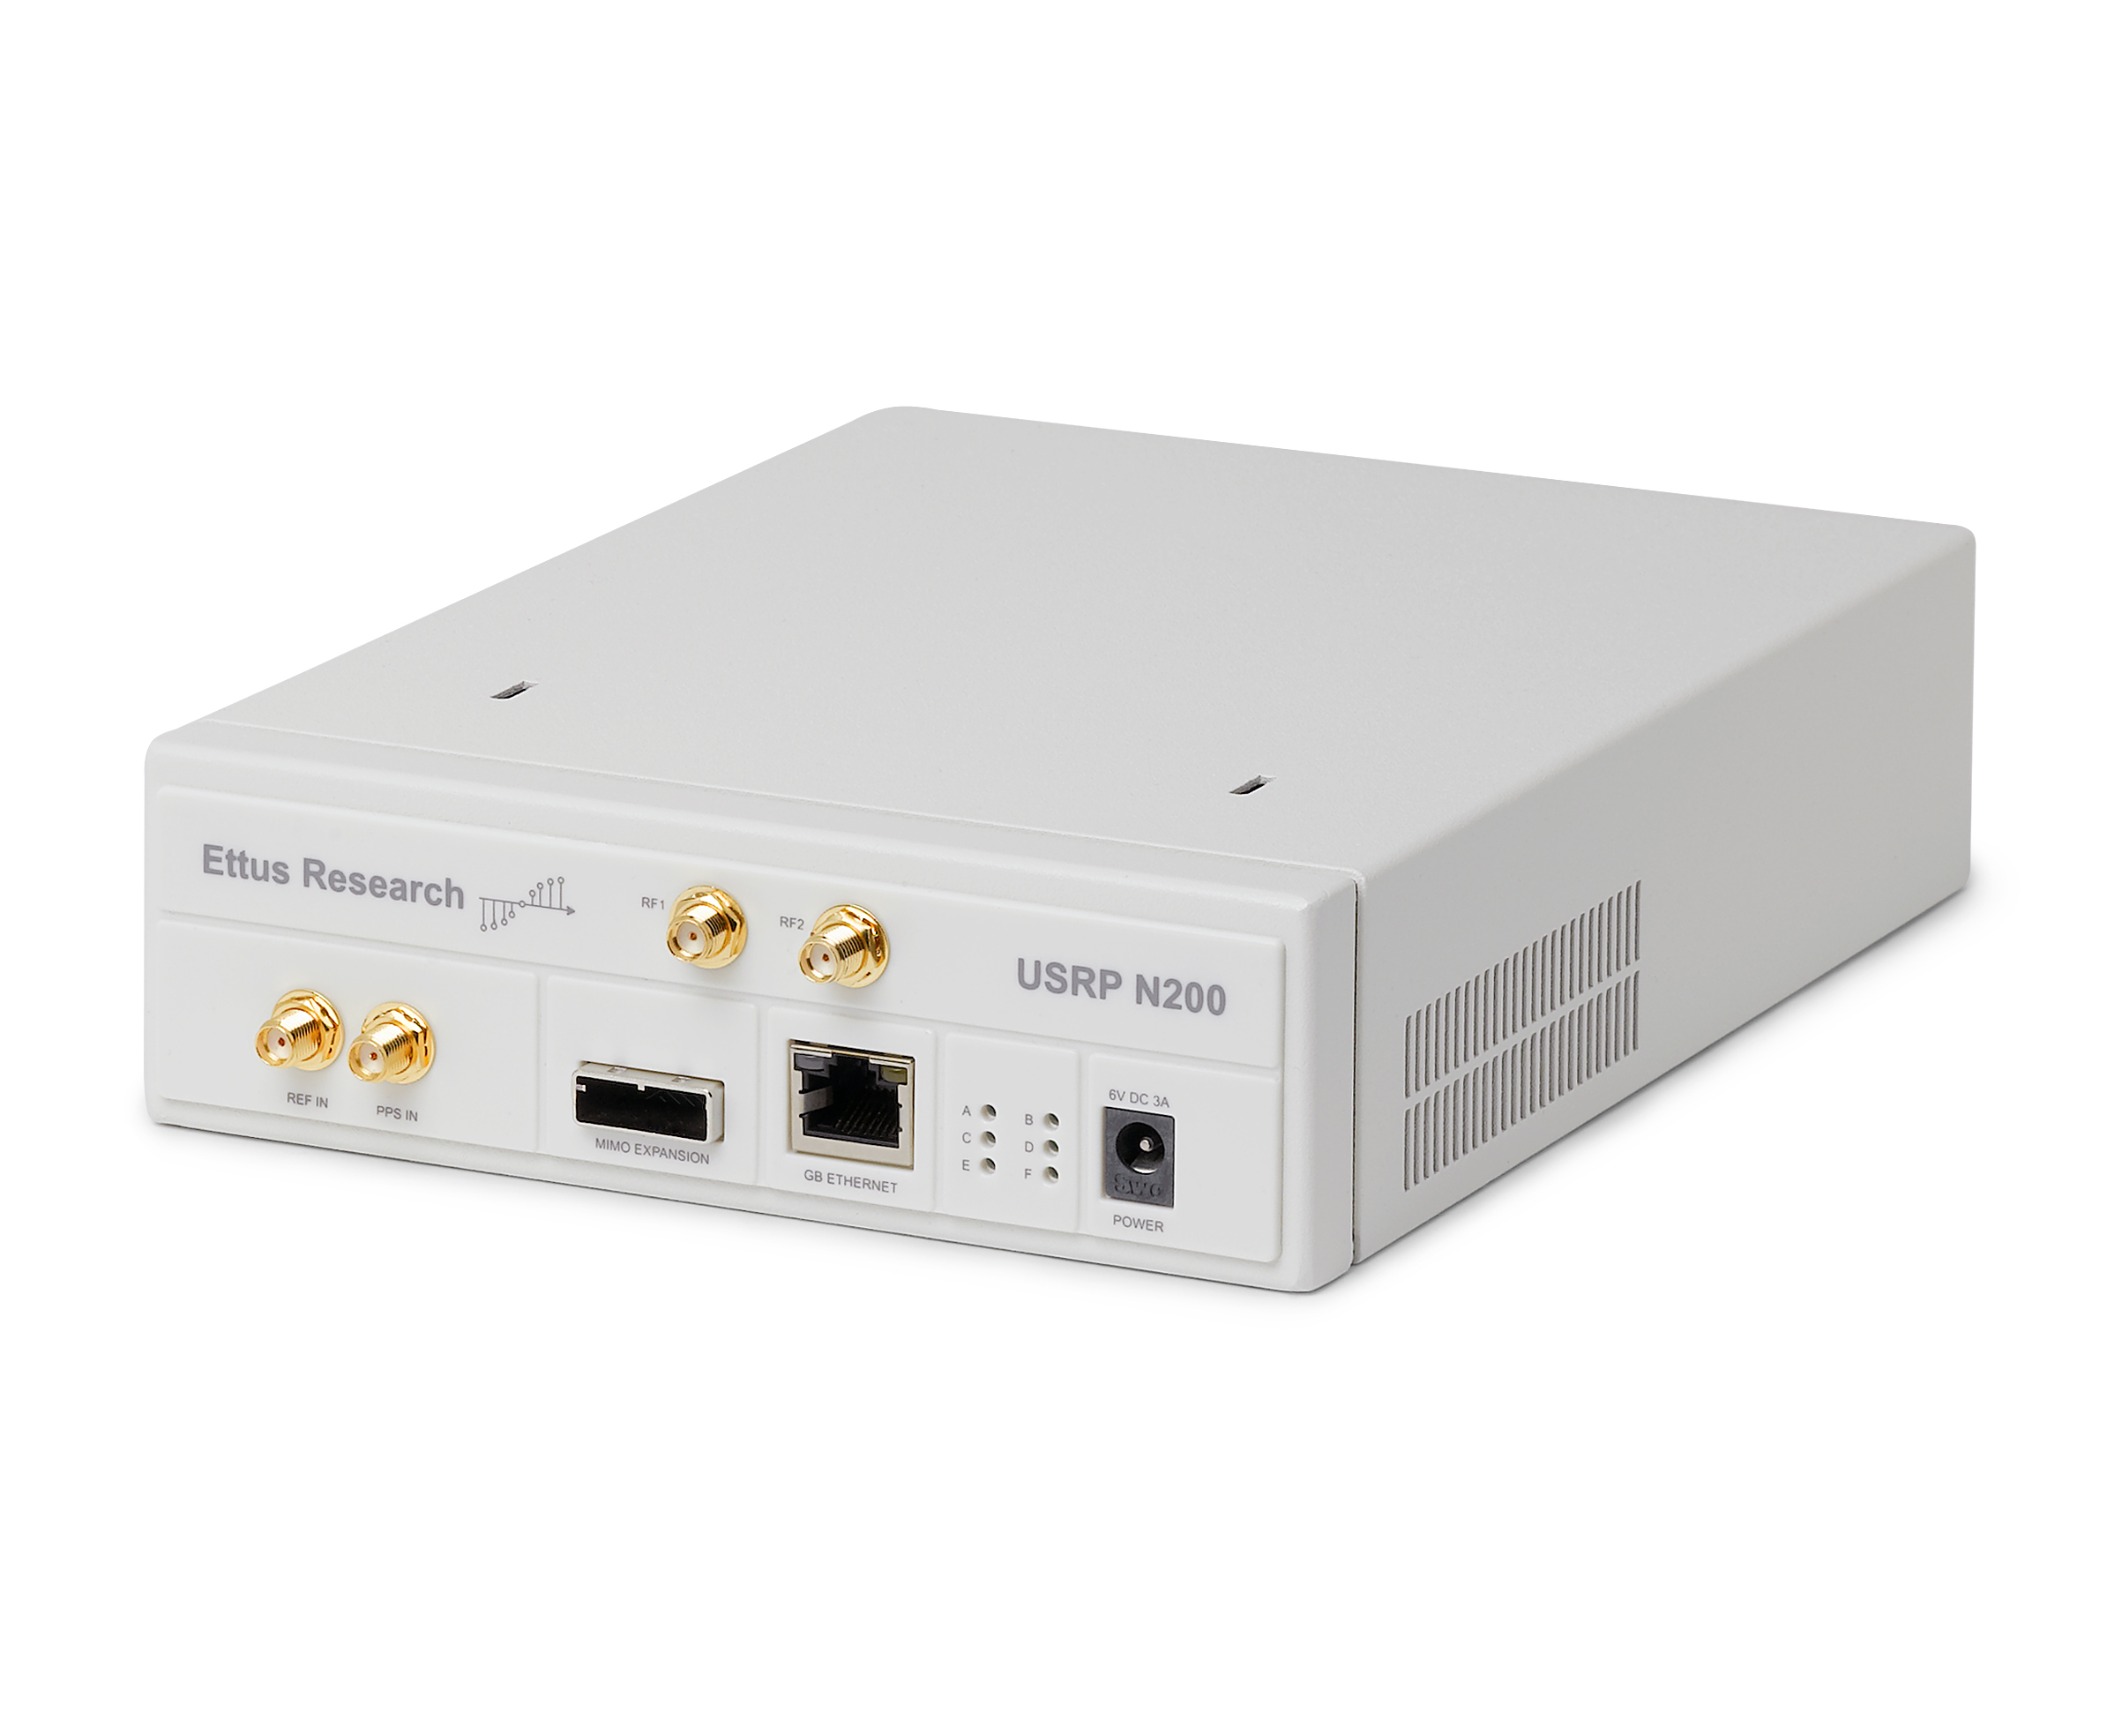
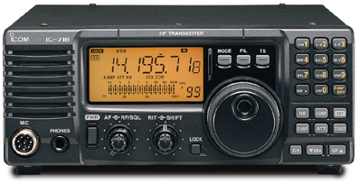
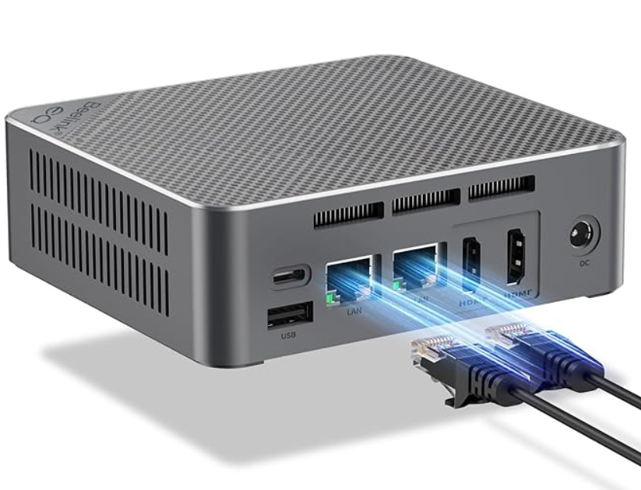
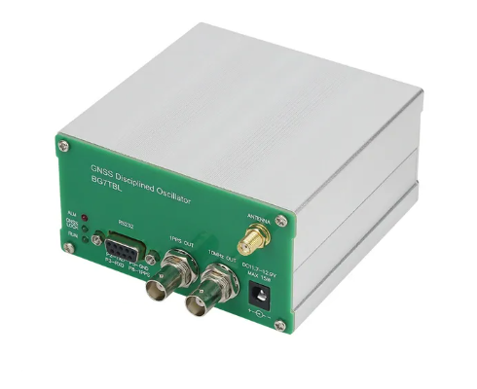
Bill of material
USRP N200, LFTX & RFTX - $3,260 USD
https://www.ettus.com/all-products/un200-kit/
ICOM IC-718 - $780 USD
https://www.universal-radio.com/catalog/hamhf/0718.html
Data logger PC - $290 USD
https://www.amazon.com/Beelink-Lake-N100-Mini-Computer-Supports-Home-Server/dp/B0C339KVH9
GPSDO - $140 USD
https://www.aliexpress.com/item/4001022596521.html
Cabling - ~$200 USD
https://www.aliexpress.com/item/4001022596521.html
Total: < $5,000 USD
18
ICTP Workshop, Malindi, Kenya, October 03-12, 2023

Slide 19
HF bistatic ionospheric sounder data ingestion into NeQuick 2
A. Kashcheyev¹, A. Koloskov¹, B.Nava², P.T. Jayachandran¹ and V. Paznukhov³
(1) University of New Brunswick, Fredericton, NB, Canada
(2) The Abdus Salam International Centre for Theoretical Physics, Trieste, Italy
(3) Institute for Scientific Research, Boston College, Boston, MA, USA
ICTP Workshop, Malindi, Kenya, October 03-12, 2023

Slide 20
Motivation
Can signals of opportunities (e.g. from existing ionosondes) be used for scientific research?
Can a simple and a relatively low-cost technique help improving the description of the ionosphere?
Can this data be used in real-time, without a need of manually/automatically scaling?
Are there any practical application of the technique/data?
20
ICTP Workshop, Malindi, Kenya, October 03-12, 2023

Slide 21
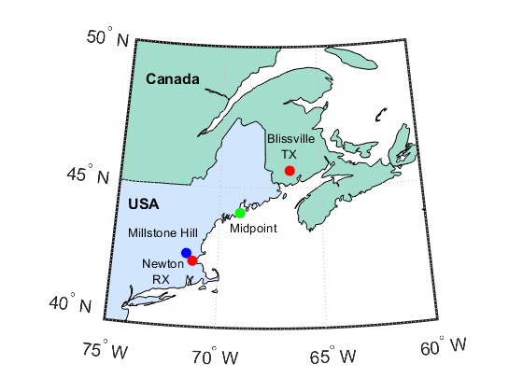
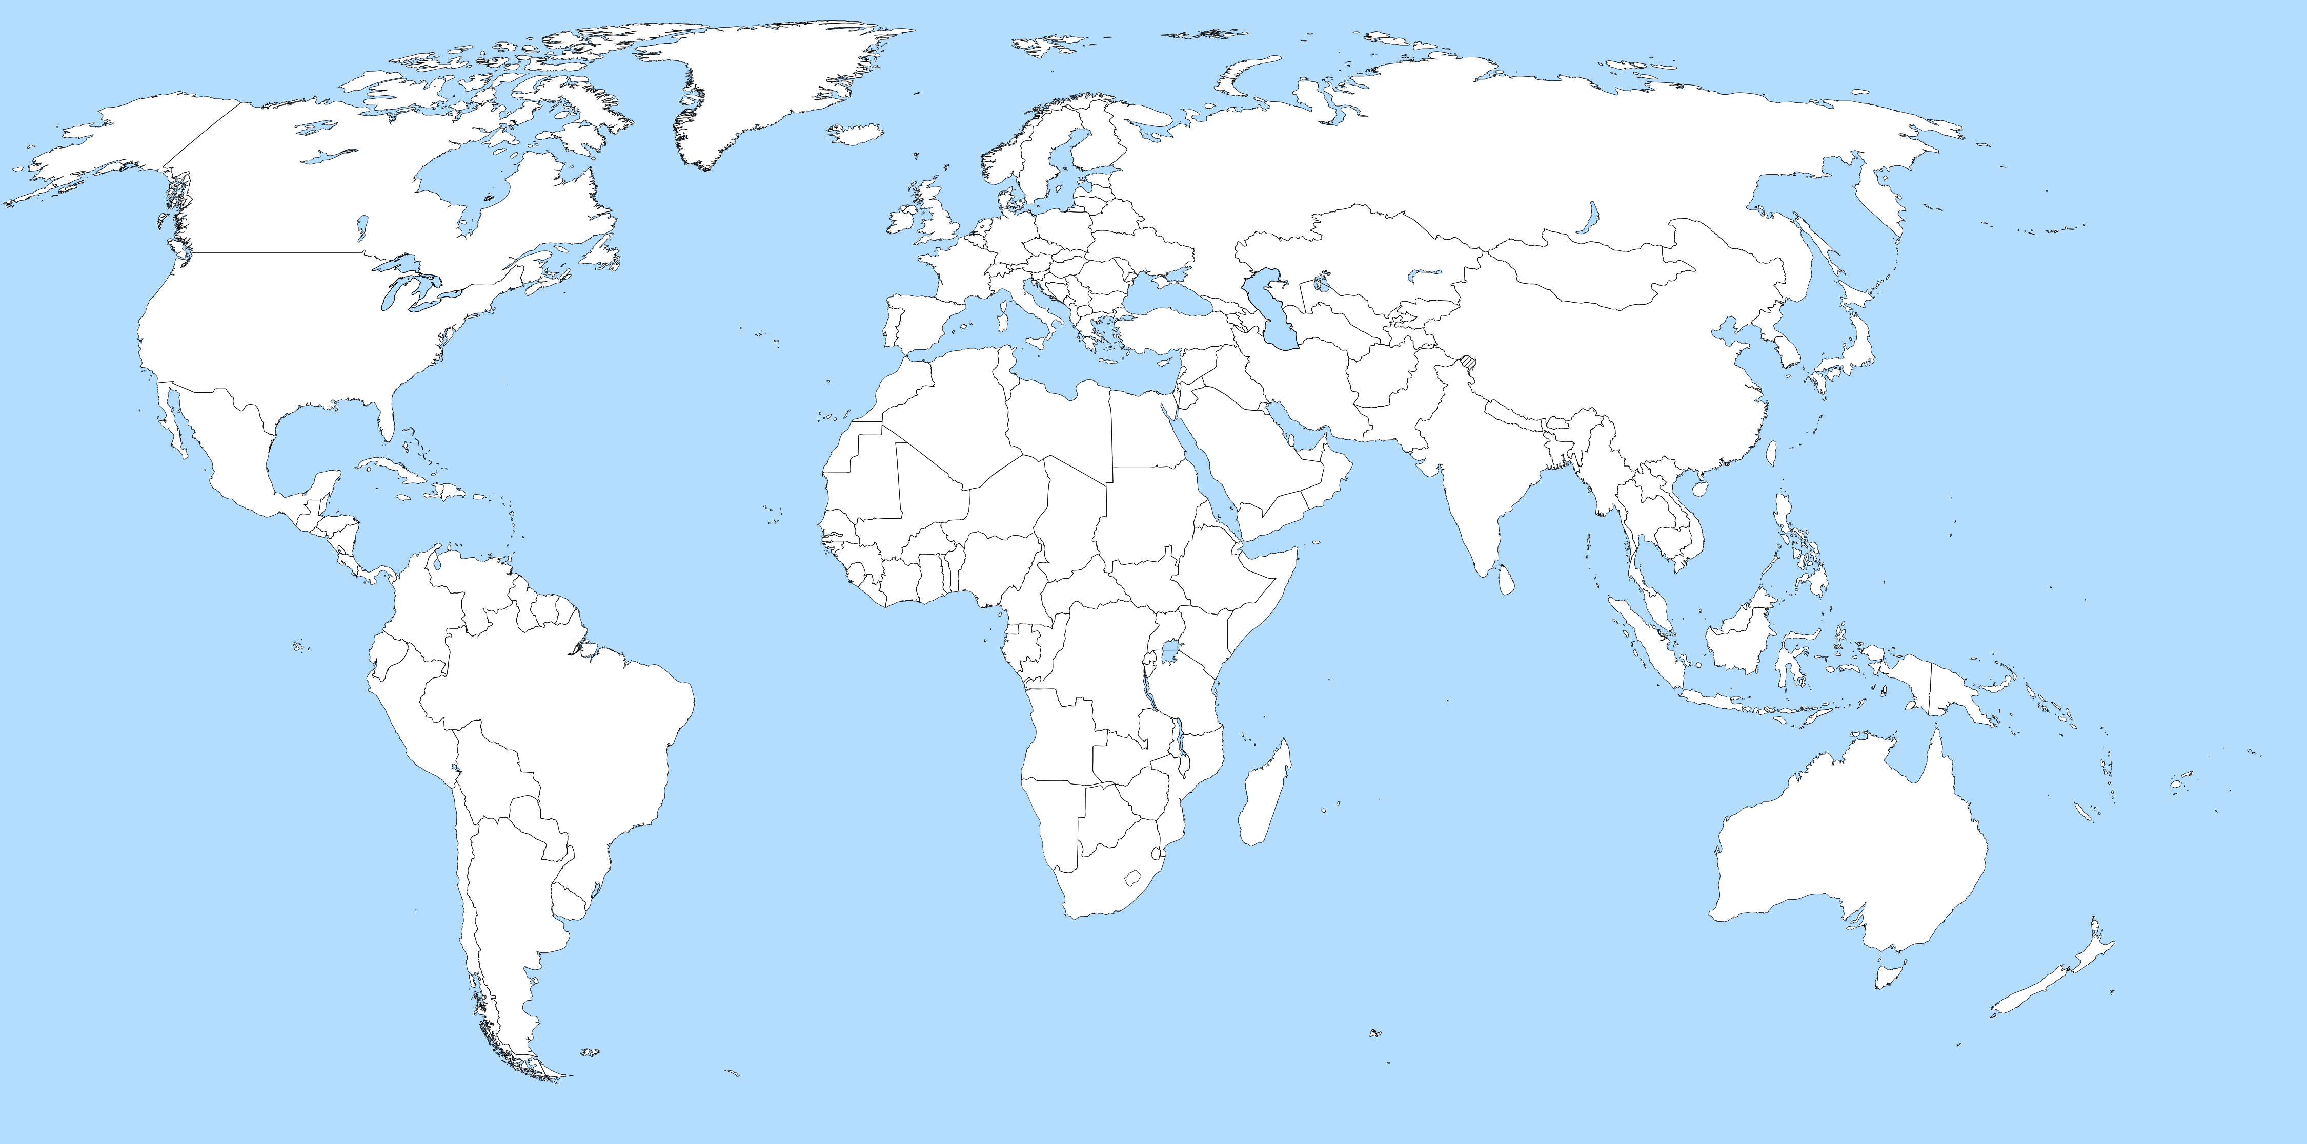
Experiment layout
 | Site | Location
 | Blissville, NB, Canada (TX & RX) | 45.6 N, 66.6 W
 | Newton, MA, USA (RX) | 42.3 N, 71.2 W
 | Millstone Hill, MA, USA (Digisonde) | 42.6 N, 71.5 W
 | Midpoint | 44.0 N, 69.0 W
Site 1 | Site 2 | Distance, km
Blissville, NB | Newton, MA | 520
Blissville, NB | Midpoint | 260
Blissville, NB | Millstone Hill, MA | 515
Newton, MA | Millstone Hill, MA | 40
21
ICTP Workshop, Malindi, Kenya, October 03-12, 2023

Slide 22
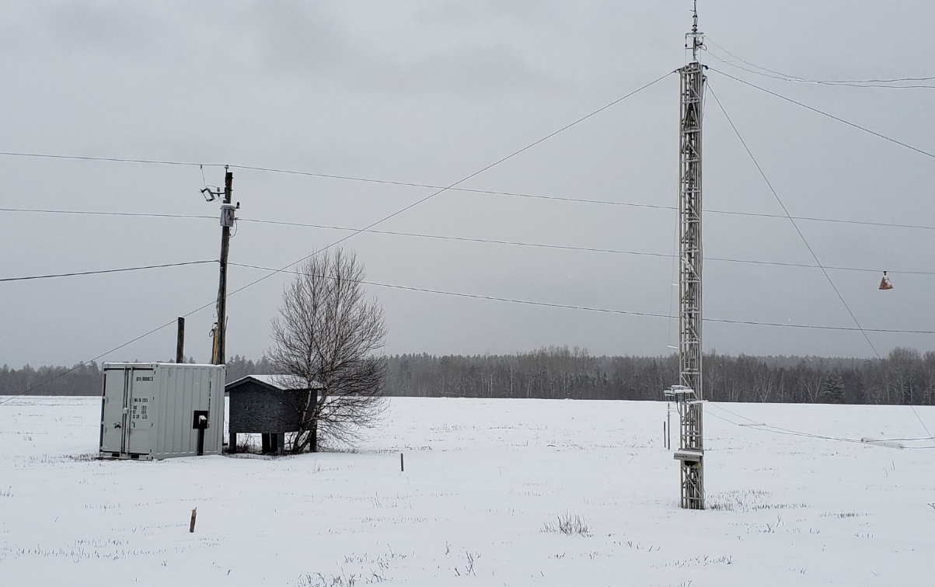
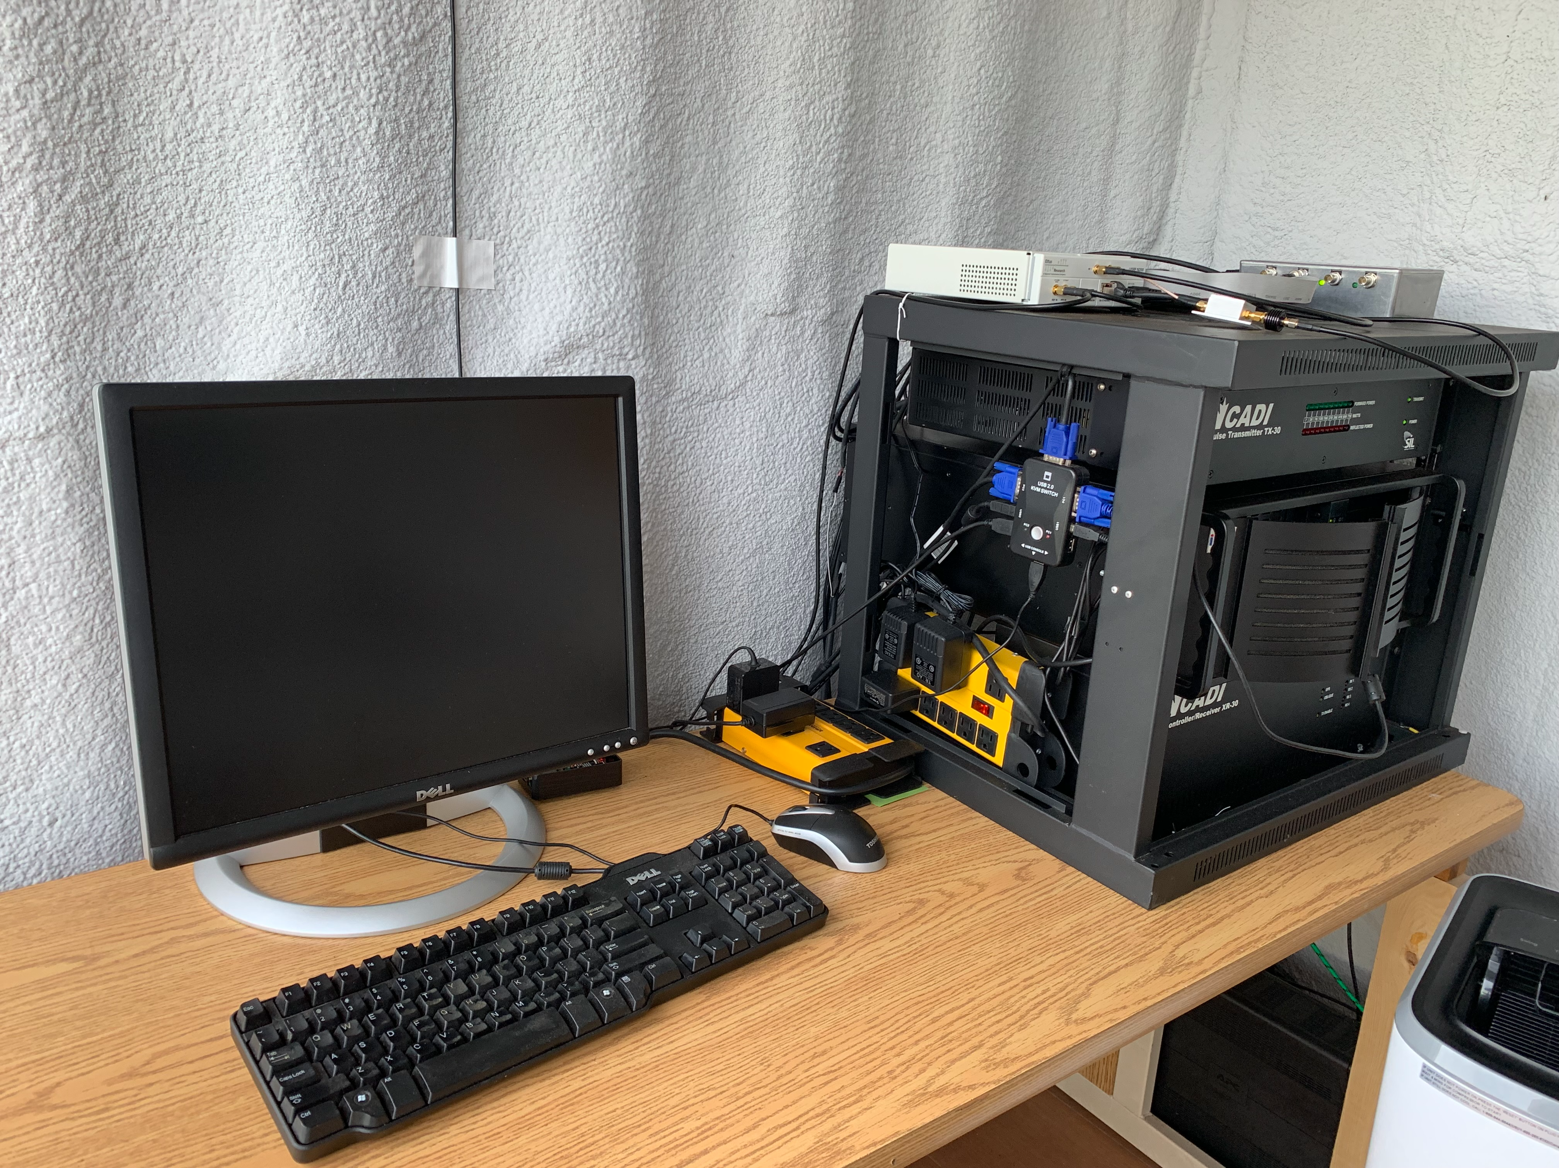
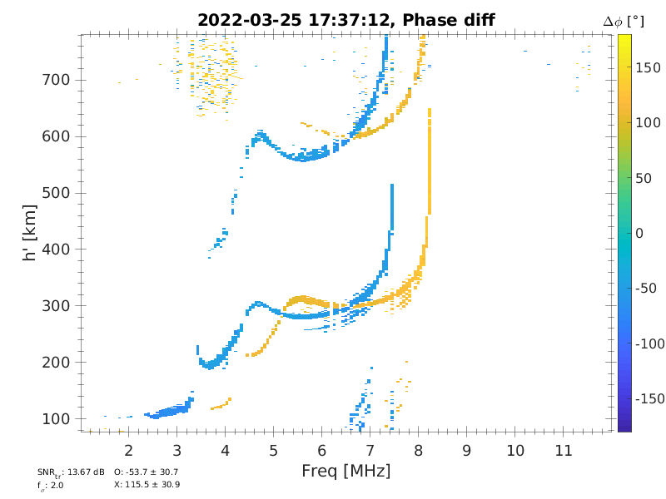
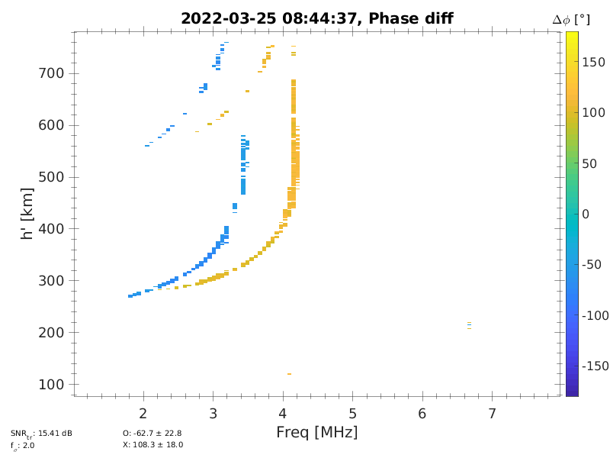
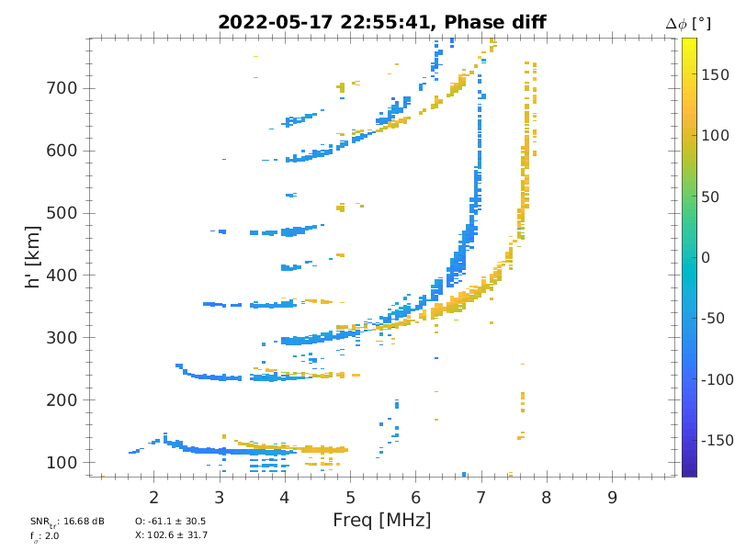
ISDR (TX & RX)
Delta antenna (TX)
Horz dipole antenna(s) (RX)
SDR (USRP N-200 + LFTX, LFRX)
GPS disciplined OCXO
Power amplifier (600W max)
30 sec/ionogram
22
ICTP Workshop, Malindi, Kenya, October 03-12, 2023

Slide 23
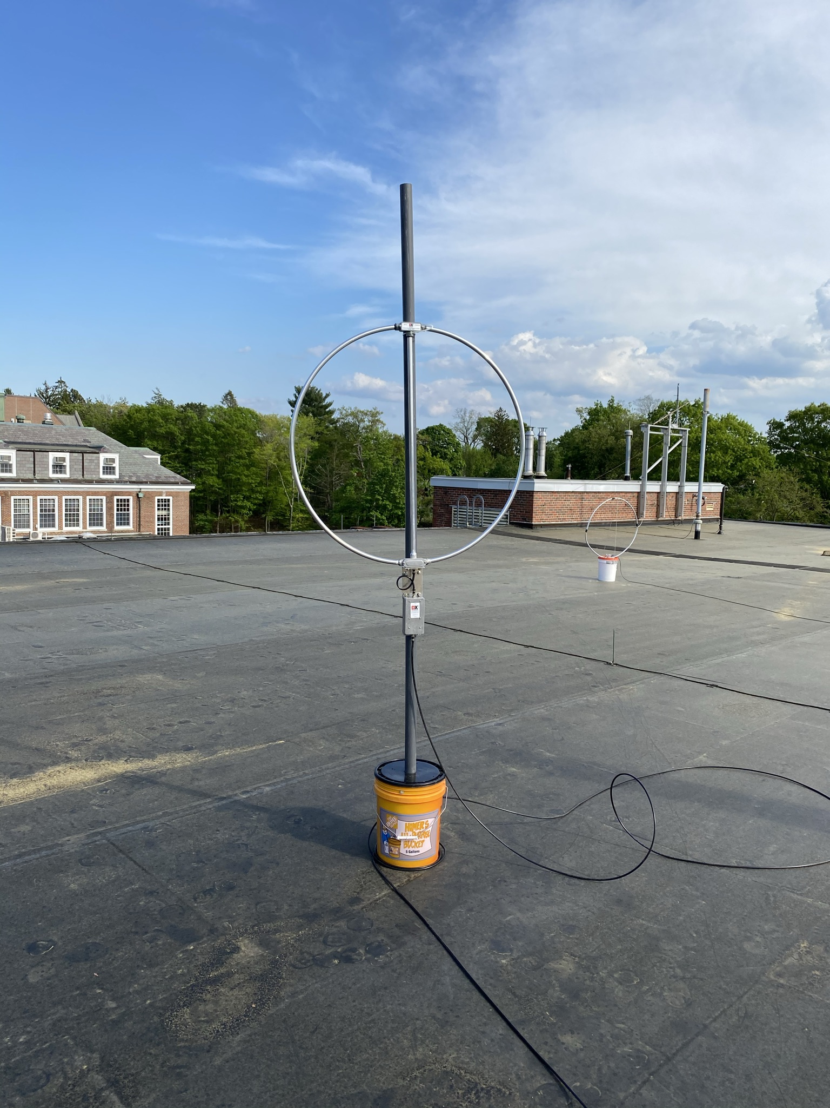
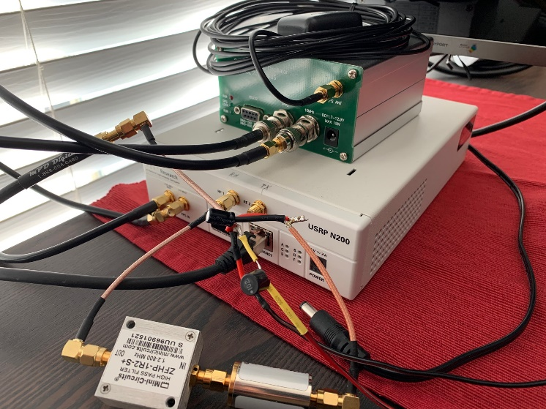
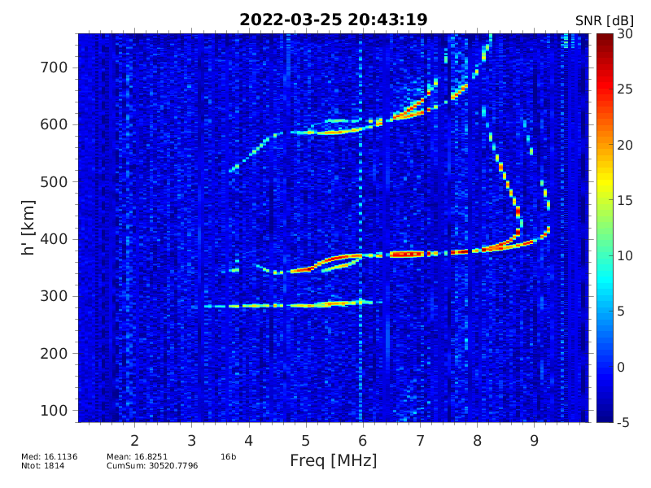
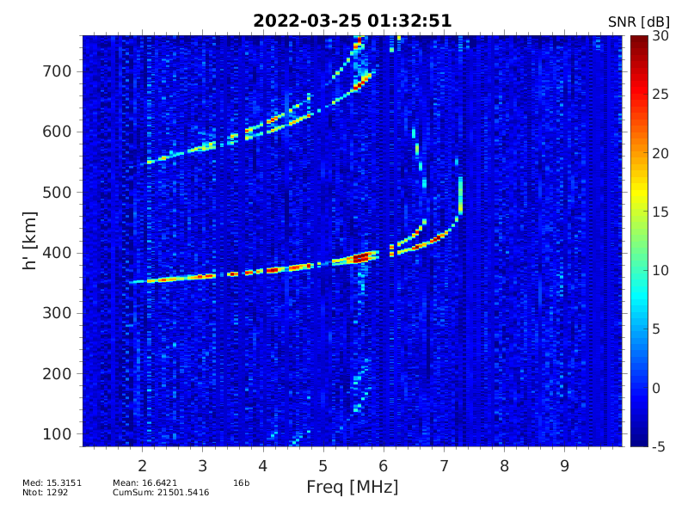
ISDR oblique (RX)
HF RX antenna
GNSS antenna
Active loop antenna
SDR (USRP N-200, LFRX)
GPS disciplined OCXO
Data logger (PC)
USRP N200 kit
GPSDO
10 MHz + PPS
Ethernet 1 Gb
PC (Linux or Windows)
Ethernet 1 Gb
23
ICTP Workshop, Malindi, Kenya, October 03-12, 2023

Slide 24
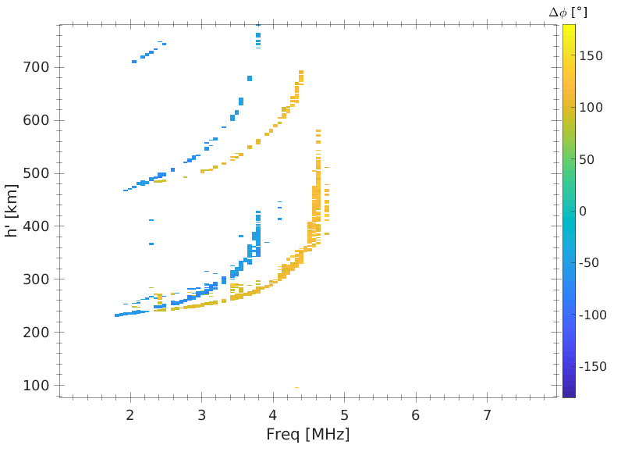
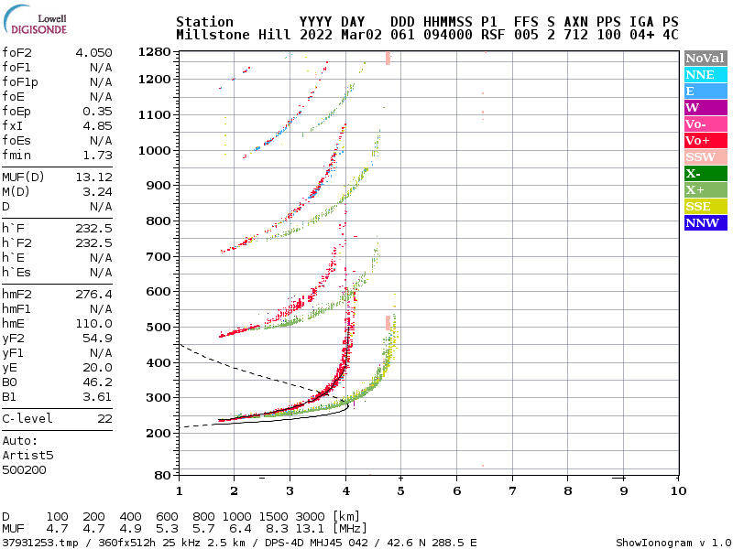
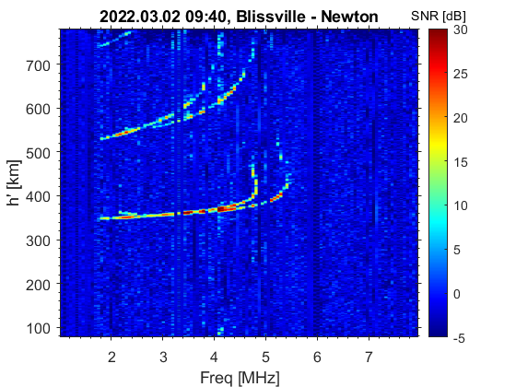
Experimental data
Blissville Millstone Hill Newton
24
ICTP Workshop, Malindi, Kenya, October 03-12, 2023

Slide 25
NeQuick 2 model
The model profile formulation includes 6 semi-Epstein layers with modeled thickness parameters and is based on anchor points defined by foE, foF1, foF2 and M(3000)F2
These values can be modeled (e.g. ITU-R coefficients for foF2, M(3000)F2) or experimentally derived
Model inputs are: position, time and solar flux; the output is the electron concentration at the given location and time
B. Nava, P. Coïsson, S. M. Radicella, "A new version of the NeQuick ionosphere electron density model", Journal of Atmospheric and Solar-Terrestrial Physics (2008), doi:10.1016/j.jastp.2008.01.015
25
ICTP Workshop, Malindi, Kenya, October 03-12, 2023

Slide 26
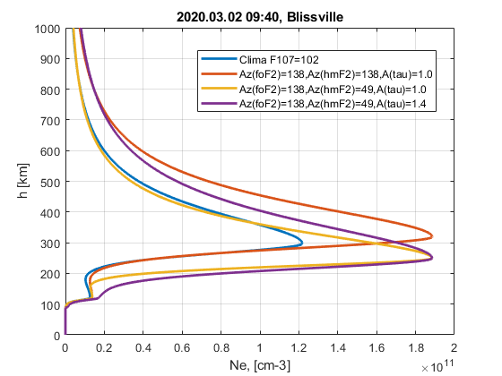
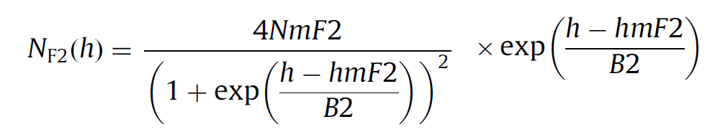
NeQuick 2 modification
Az parameters concept is implemented in NeQuick 2
Az(foF2) controls foF2
Az(hmF2) controls hmF2
Alpha(τ) is a factor of the thickness parameters (B2)
B. Nava, S. M. Radicella and F. Azpilicueta, "Data ingestion into NeQuick 2," in Radio Science, vol. 46, no. 06, pp. 1-8, Dec. 2011, doi: 10.1029/2010RS004635
26
ICTP Workshop, Malindi, Kenya, October 03-12, 2023

Slide 27
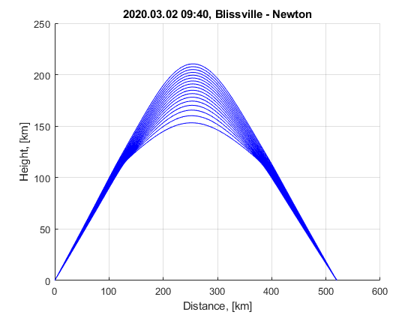
Ray tracing
Numerical 3-D ray-tracing algorithm
Supports different ionospheric models (e.g. IRI, NeQuick 2, parabolic, quasi-parabolic, exponential etc.)
Supports 2 magnetic field models (IGRF, WMM)
Solves for the homing-in problem
NeQuick 2 modified is used
W/O magnetic field
Kashcheyev, A., B. Nava, and S. M. Radicella (2012), Estimation of higher‐order ionospheric errors in GNSS positioning using a realistic 3‐D electron density model, Radio Sci., 47, RS4008, doi:10.1029/2011RS004976
27
ICTP Workshop, Malindi, Kenya, October 03-12, 2023

Slide 28
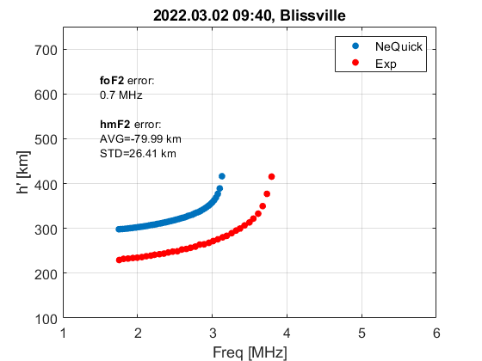
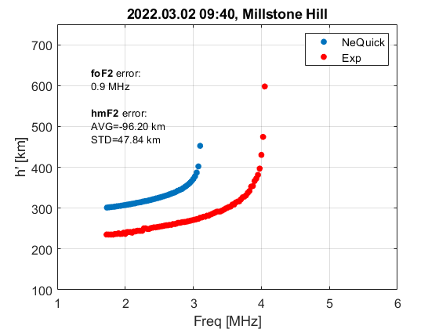
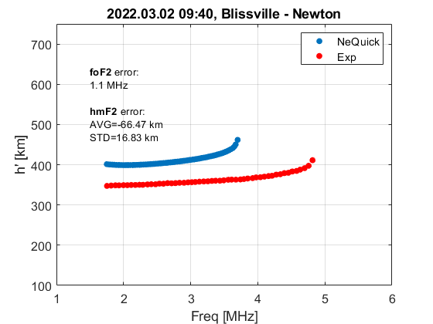
Climatology
Az(foF2) = 102 sfu, Az(hmF2) = 102 sfu, Alpha(τ) = 1.0
28
ICTP Workshop, Malindi, Kenya, October 03-12, 2023

Slide 29
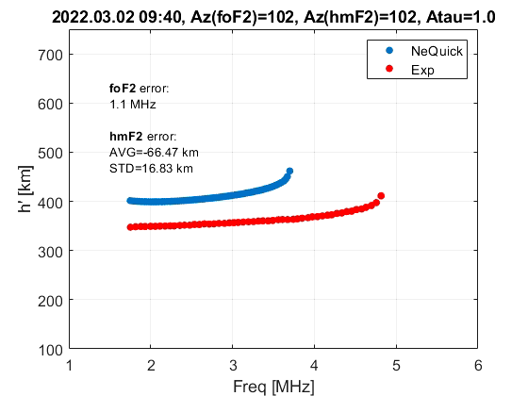
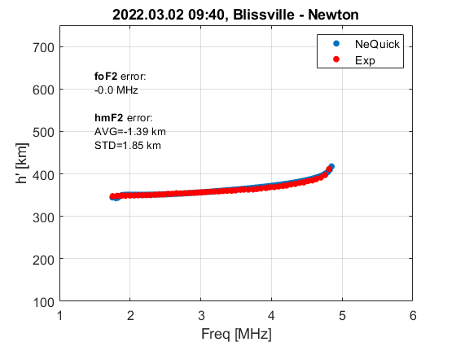
Data ingestion
29
ICTP Workshop, Malindi, Kenya, October 03-12, 2023

Slide 30
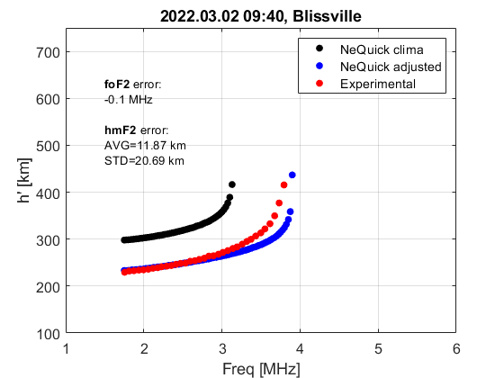

Results
Az(foF2) = 138 sfu, Az(hmF2) = 49 sfu, Alpha(τ) = 1.4
foF2 error: 0.7 MHz -> 0.1 MHz
hmF2 error: AVG: -80 km -> 12 km; STD: 26 km -> 20 km
foF2 error: 1.1 MHz -> 0.1 MHz
hmF2 error: AVG: -96 km -> 0 km; STD: 48 km -> 22 km
30
ICTP Workshop, Malindi, Kenya, October 03-12, 2023

Slide 31
Conclusions
Long-term comparison showed ISDR has the same or higher level of performance
Advantages: low-cost, low-power, reliability, flexibility
Disadvantages: longer sounding time
ISDR is recommended to replace IPS-42
A possibility to use higher power amplifier to reduce sounding time is under discussion
31
ICTP Workshop, Malindi, Kenya, October 03-12, 2023

Slide 32
Conclusions
Bistatic HF ionospheric sounder provides useful data
Data ingestion technique into NeQuick 2 model is implemented
The results of the data ingestion are promising
Extension of the existing sounding network can be achieved at low-cost/low-efforts
Good candidate for improving regional and possibly global description of the ionosphere in 3D
32
ICTP Workshop, Malindi, Kenya, October 03-12, 2023

