Slide 1





What do we mean by quality and what is the Role of the Medical Physicist ?
Assoc Prof Paddy Gilligan, Dublin Ireland ( with assistance from Harry Delis and Annalisa Trianni )

Slide 2
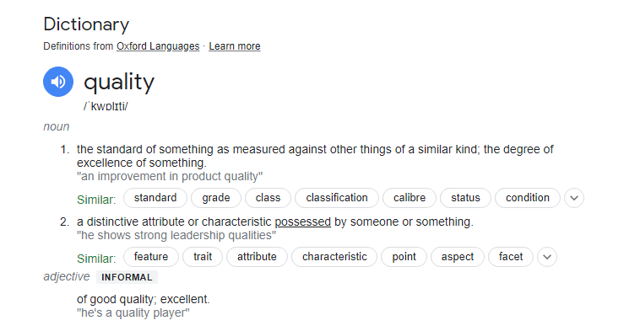
Quality
Conformance to requirements

Slide 3

What is Quality ?
A degree of excellence
Conformance to requirements
Totality of characteristics which act to satisfy a need
Fitness for use
Fitness for purpose
Freedom from defects
Delighting customers
“… the degree to which a set of inherent characteristics
fulfils a need or expectation that is stated, generally
implied or obligatory” [ISO 9000]

Slide 4
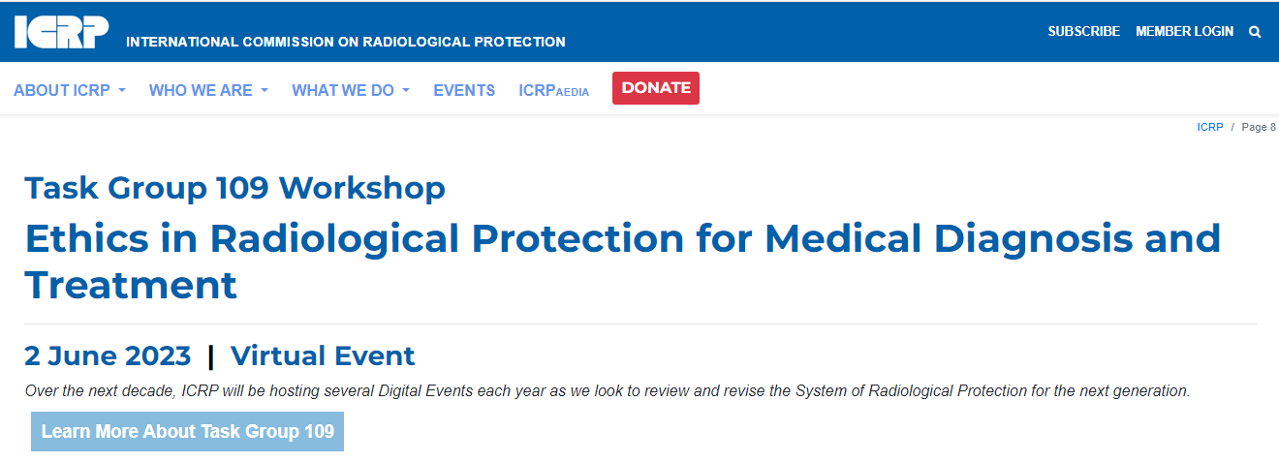

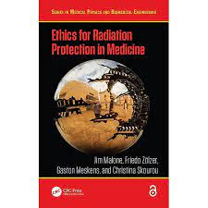
“Primum non nocere”
First, do no harm - The most important rule of healthcare !!
Especially in radiation medicine, either for diagnosis or for treatment, this is even more evident as the “harm” associated with radiation is well-known.
Some tools that modern medicine has in order to monitor that radiation medicine is performed safely and effectively are:
  Quality Processes and Dosimetry

Slide 5
Quality health care can be defined in many ways but there is growing acknowledgement that quality health services should be:
Effective – providing evidence-based healthcare services to those who need them;
Safe – avoiding harm to people for whom the care is intended; and
People-centred – providing care that responds to individual preferences, needs and values.
To realize the benefits of quality health care, health services must be:
Timely – reducing waiting times and sometimes harmful delays;
Equitable – providing care that does not vary in quality on account of gender, ethnicity, geographic location, and socio-economic status;
Integrated – providing care that makes available the full range of health services throughout the life course;
Efficient – maximizing the benefit of available resources and avoiding waste.

Slide 6

Sustainable health care
Sustainability is defined by the World Wildlife Fund for Nature (WWF) as “an economic activity that meets the needs of the present generation without compromising the ability of future generations to meet their needs”.
A sustainable health care system is based on delivering high quality care and improved public health and wellbeing without exhausting natural resources or causing adverse ecological damage.

Slide 7

Medical physicists apply physics to benefit patients and staff :
Relevant to the patients, demographics we serve
Accessible and affordable treatment and diagnostics which minimise
high standard of training availability
Able to sustain shocks in the modern world
  climate,
  war , cyber and physical
  unsteady electrical supply
  Financial shocks
Minimum harm to the environment and public health e.g radioactive waste , use of highly toxic agents in production,
Optimisation and audit

Slide 8
We are all part of eco system
Society
Healthcare system
Hospital
Medical Physicist
World

Slide 9
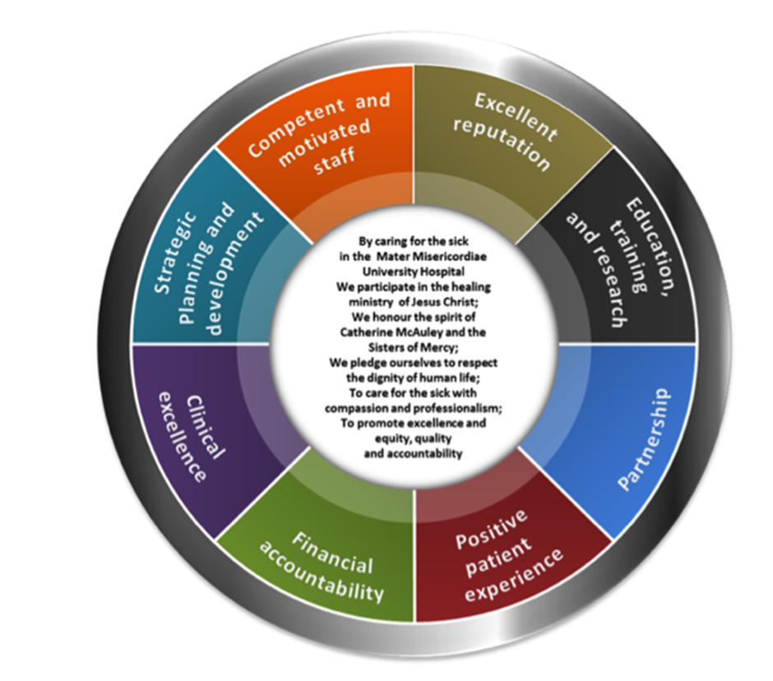
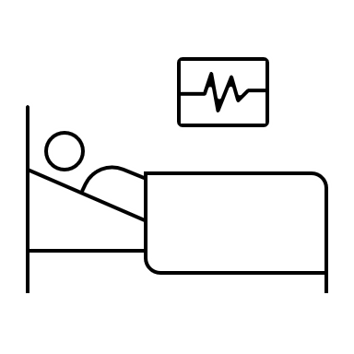
What is the mission statement of your hospital ?

Slide 10
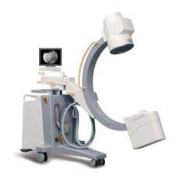
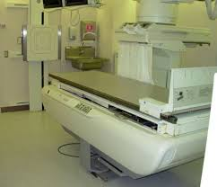
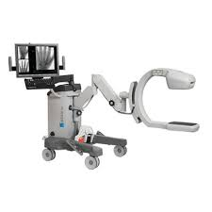
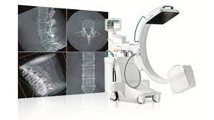
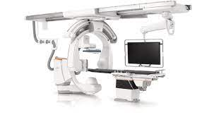
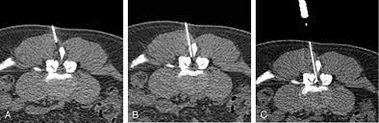
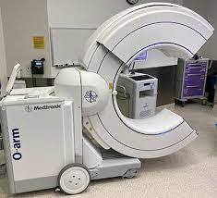
Types of fluoroscopic equipment:
Mini c-arms
C-arms with image intensifiers
3d flat panel detector
R/F fluoro rooms
C-arm angio, cardiovascular, radiology
CT fluoroscopy
O-arm fluoroscopy
Hybrid systems e.g. CT and C-arm
Imaging systems on linear accelerator

Slide 11

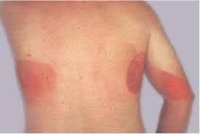
why these devices are important
critical life saving equipment involved in complex procedures often outside radiology
Potential for highest patient and staff doses with tissue effects
  Keep your clinicians working and your patients from erythema
Expensive piece of equipment in constant state of evolution
Complex human machine interaction

Slide 12
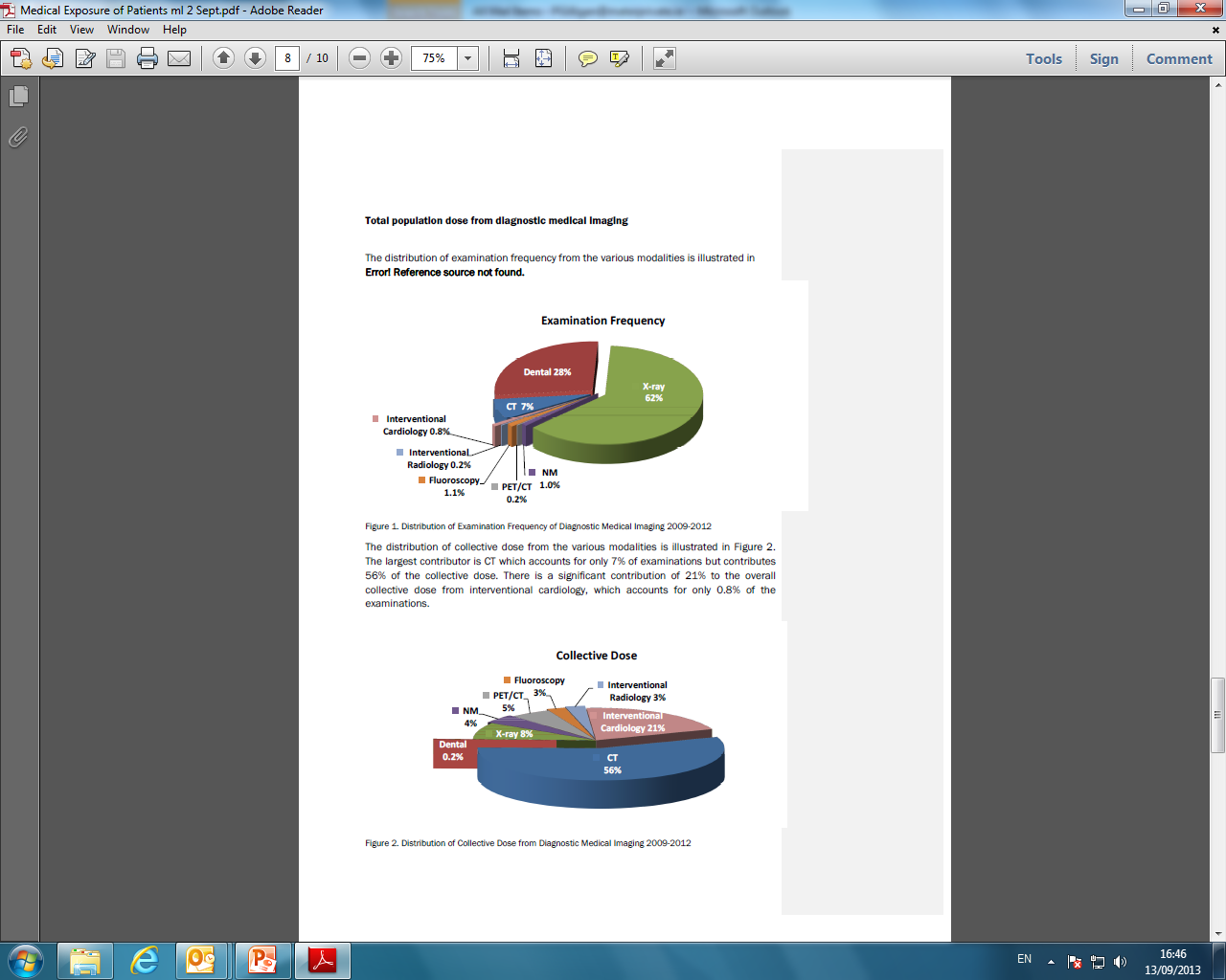
Exams using ionising radiation, Ireland 2009-2012

Slide 13
Exams using ionising radiation, Ireland 2009-2012

Slide 14
Occupational doses from interventional systems can be the highest Occupational doses in any hospital
Limit
Classification

Slide 15


Slide 16
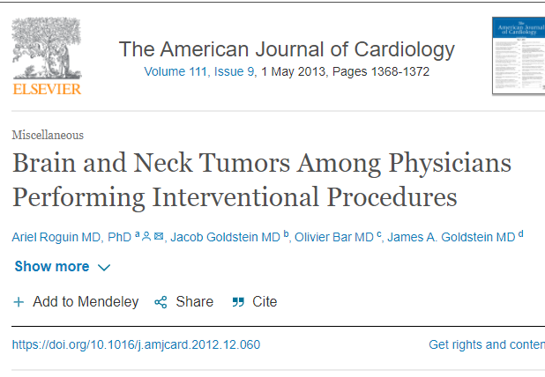
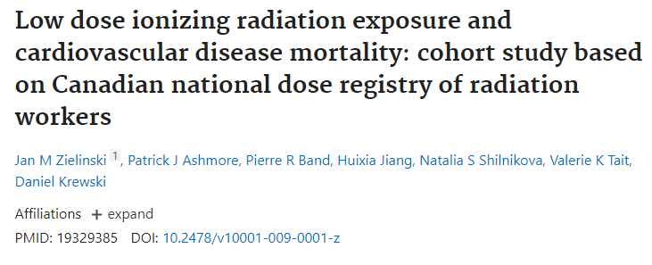
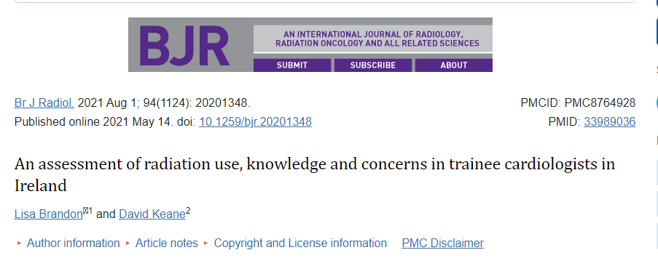
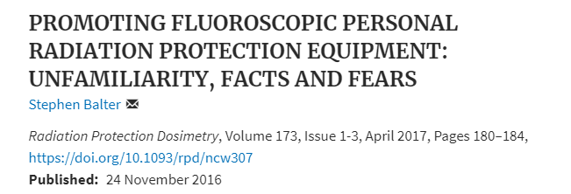
Associated radiation effects :absence of evidence versus evidence of absence

Slide 17
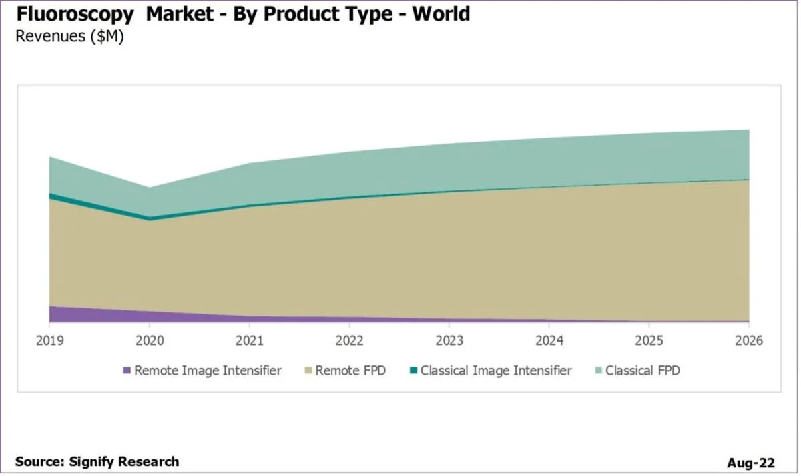
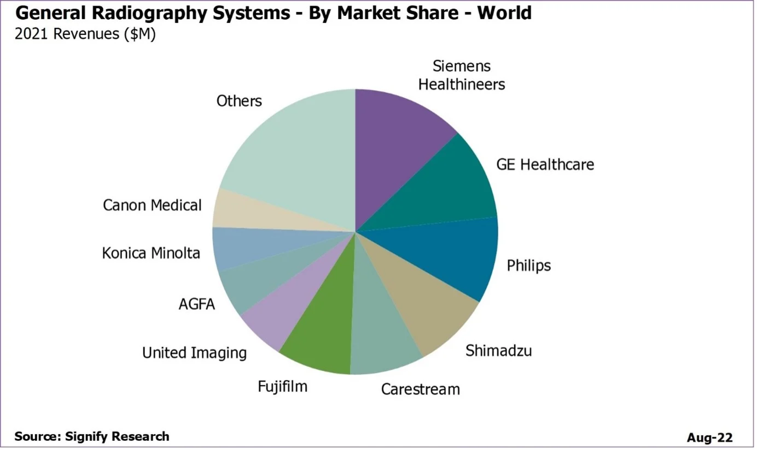
18% growth in fluoro systems
https://www.itnonline.com/article/fixed-digital-radiography-and-fluoroscopy-see-market-growth

Slide 18

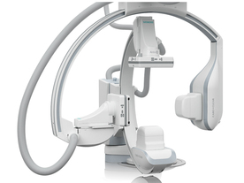
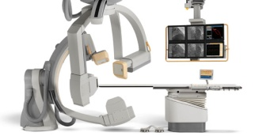
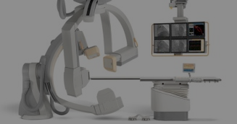
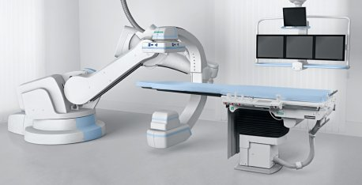
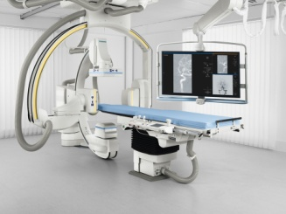
Challenges in the near future – XA ( courtesy Johan Sjoberg)
?
?
?
?
?
?
KS+KH pre 2016
Today: 17 labs
NKS + CHOPIN (KH)
>2016: ~ 35 labs

Slide 19
How will we resource the medical physics needs ?
Workforce planning
Surveys EU rest
Training syllabus
Regulatory compliance
Provide a meaningful and impactive physics service aligned with hospital care system goals
Review this service
Value

Slide 20
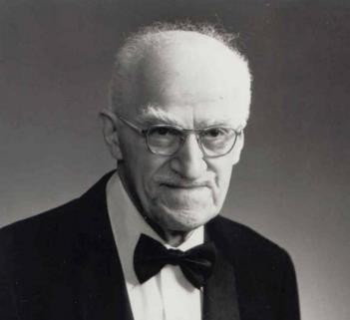
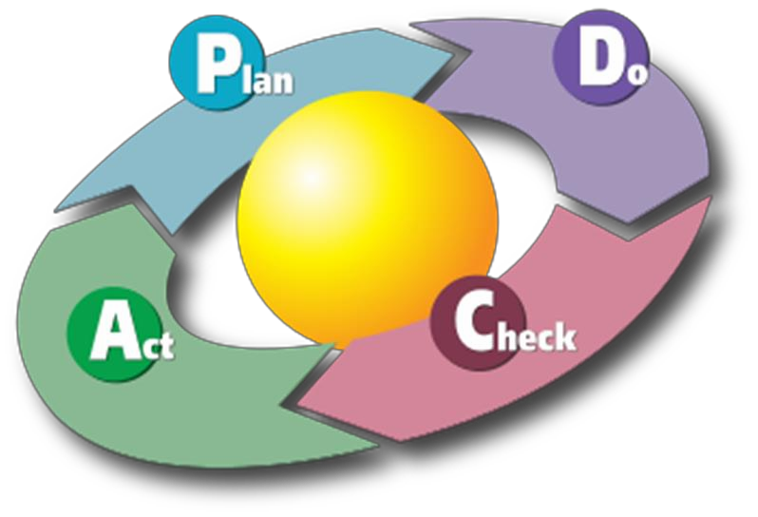
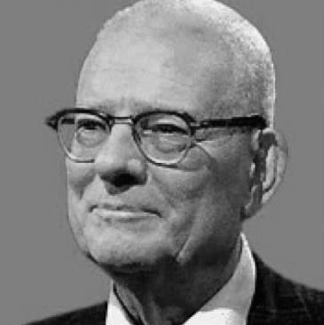

How to achieve Quality
“Quality does not happen by accident, it must be planned”
Joseph Moses Juran
(1904 – 2008)
“Quality is everyone's responsibility”
W. Edwards Deming
(1900 - 1993)

Slide 21
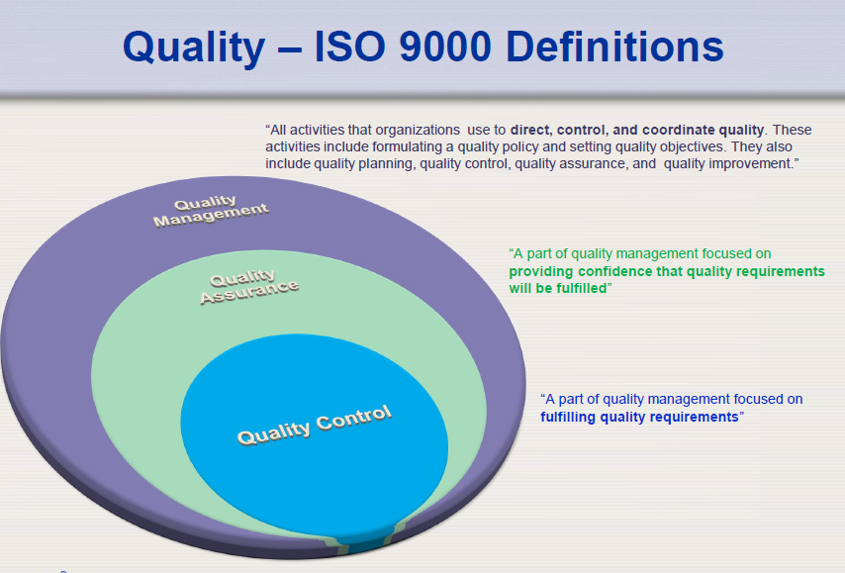

Slide 22
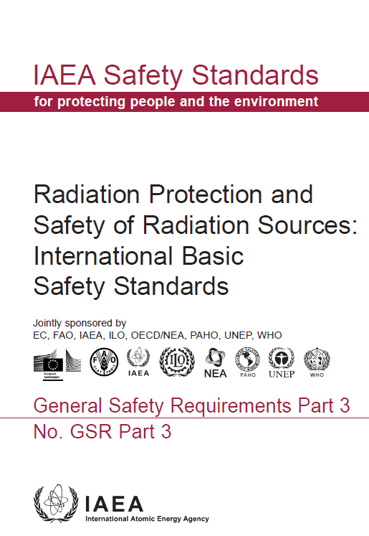
Management System
Quality has to be achieved and maintained by means of an effective management system
“The term management system reflects and includes the concept of ‘quality control’ (controlling the quality of products) and its evolution through ‘quality assurance’ (the system for ensuring the quality of products) and ‘quality management system’ (the system for managing quality)”
2014

Slide 23
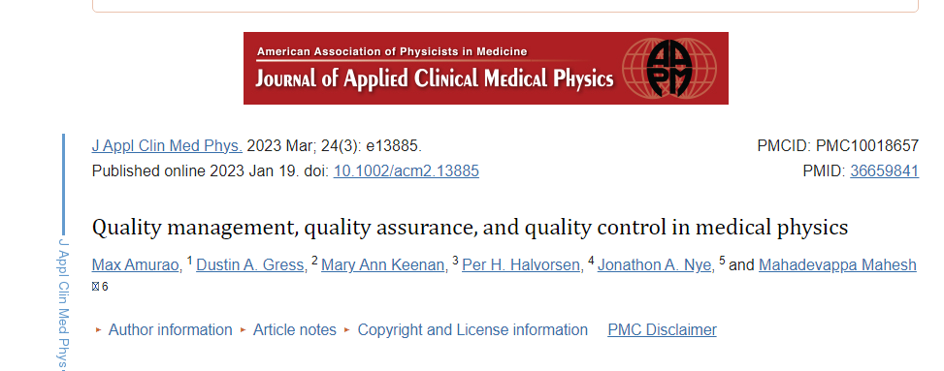
Common terms
Summary of terms and definitions:
QM: An overall management system that includes establishing quality policies and quality objectives, and processes to achieve quality objectives through quality planning, QA, QC, and quality improvement.
QA: A component of QM focused on providing confidence that quality requirements will be fulfilled; it includes all activities (planned, systematic, and practice‐based activities) that demonstrate the level of quality achieved by the output of a process.
QC: A component of QM focused on the fulfilment of quality requirements; it includes activities that impose specific quality on a process; and entails the evaluation of actual operating performance characteristics of a device or system, comparing it to desired goals, and acting on the difference; QC works on the input to a process to ensure that important elements or parameters specific to the process are correct.

Slide 24
EU BSS 59/2013
Proactive process to prevent defects
Reactive process to detect defects
"quality assurance" means all those planned and systematic actions necessary to provide adequate assurance that a structure, system, component or procedure will perform satisfactorily in compliance with agreed standards. Quality control is a part of quality assurance;
"quality control" means the set of operations (programming, coordinating, implementing) intended to maintain or to improve quality. It includes monitoring, evaluation and maintenance at required levels of all characteristics of performance of equipment that can be defined, measured, and controlled;

Slide 25

Optimisation & clinical audit
Member States shall ensure that the optimisation includes the selection of equipment, the consistent production of adequate diagnostic information or therapeutic outcomes, the practical aspects of medical radiological procedures, quality assurance, and the assessment and evaluation of patient doses or the verification of administered

Slide 26
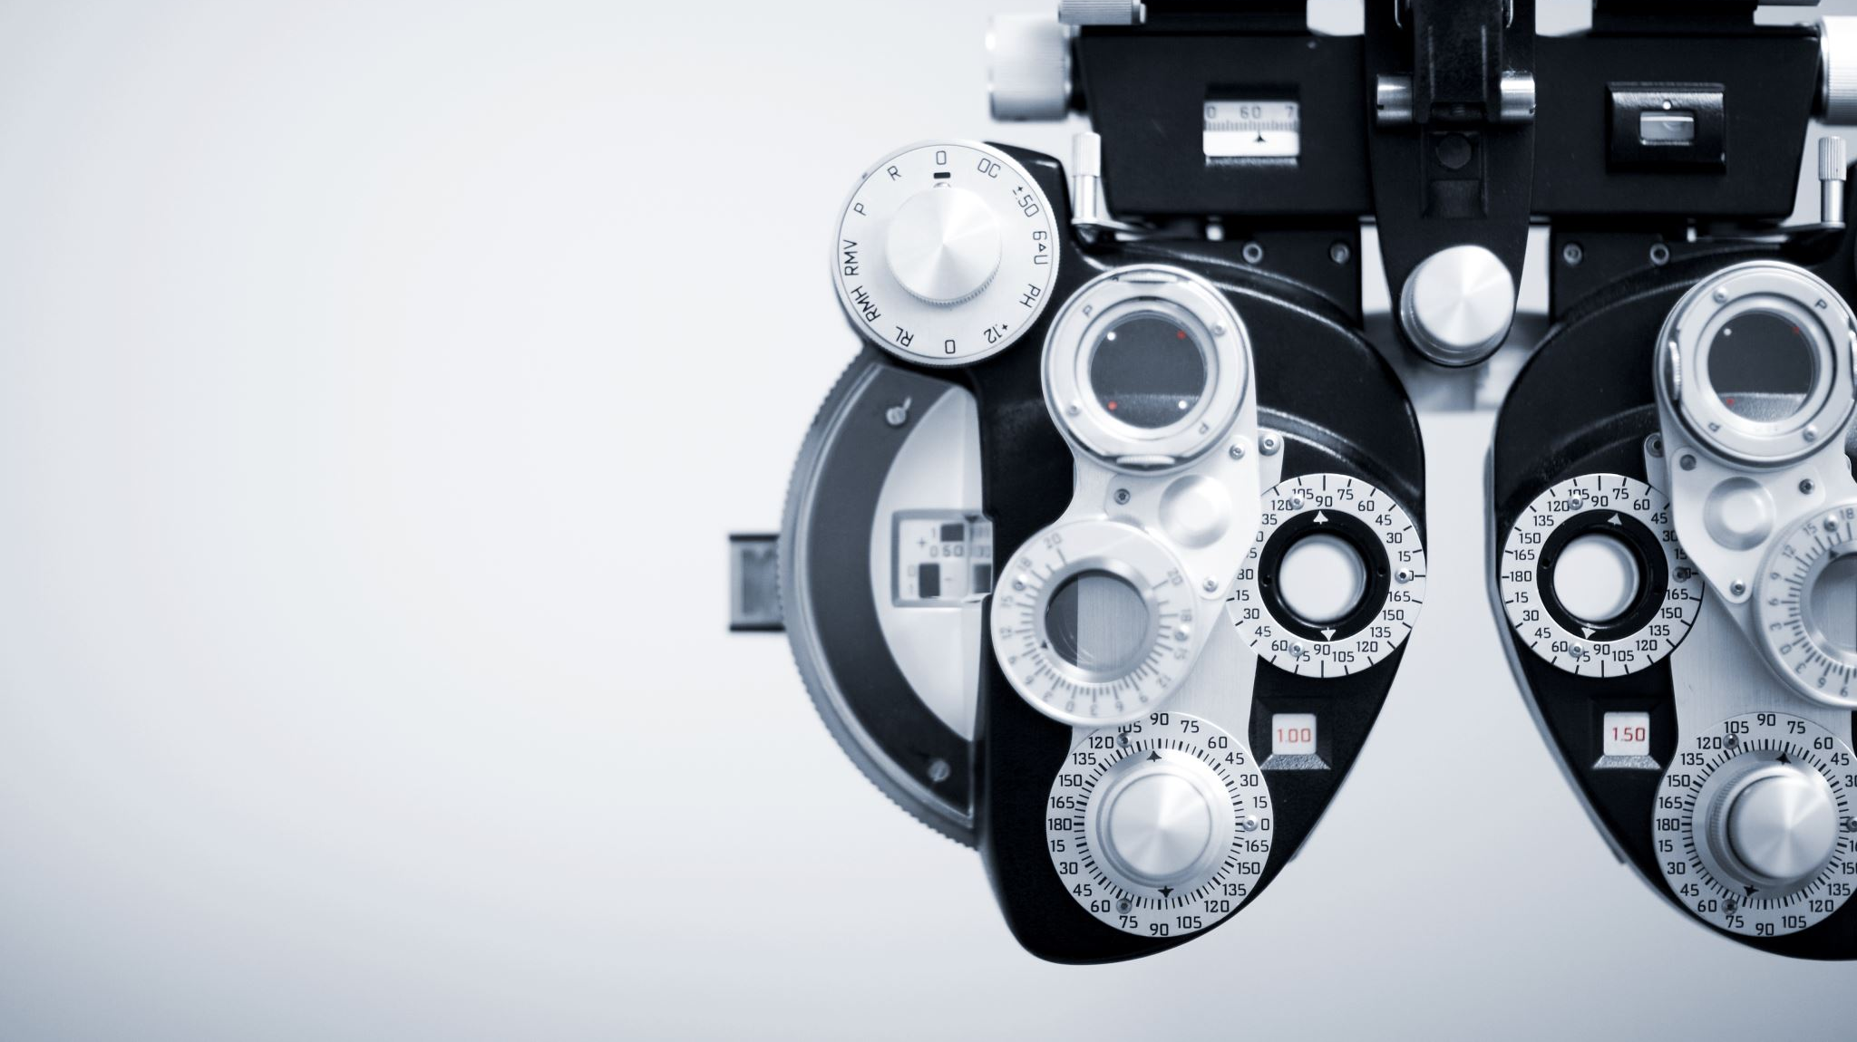
medical physics expert /BSS EU 13/59
(a) optimisation of the radiation protection of patients and other individuals subject to medical exposure, including the application and use of diagnostic reference levels;
(b) the definition and performance of quality assurance of the medical radiological equipment;
(c) acceptance testing of medical radiological equipment;
(d) the preparation of technical specifications for medical radiological equipment and installation design;
(e) the surveillance of the medical radiological installations;
(f) the analysis of events involving, or potentially involving, accidental or unintended medical exposures;
(g) the selection of equipment required to perform radiation protection measurements;
(h) the training of practitioners and other staff in relevant aspects of radiation protection;
3. The medical physics expert shall, where appropriate, liaise with the radiation protection expert.

Slide 27
Quality management system
Procedures
Documentation and document control
Equipment performance
Procurement
Environment
Responsibilities
Training & Personnel
Dose reference levels
Fault logs
Procedures
clinical audits
Incidents
Risk register
Knowledge sharing and training

Slide 28
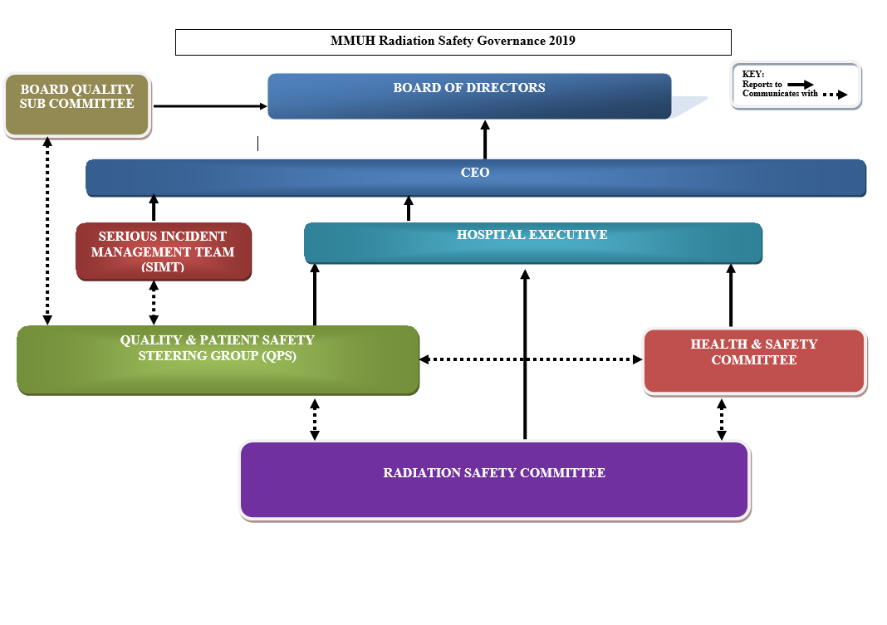

Slide 29
Standards
Clinical audit
Accreditation
Regulatory compliance and inspection

Slide 30


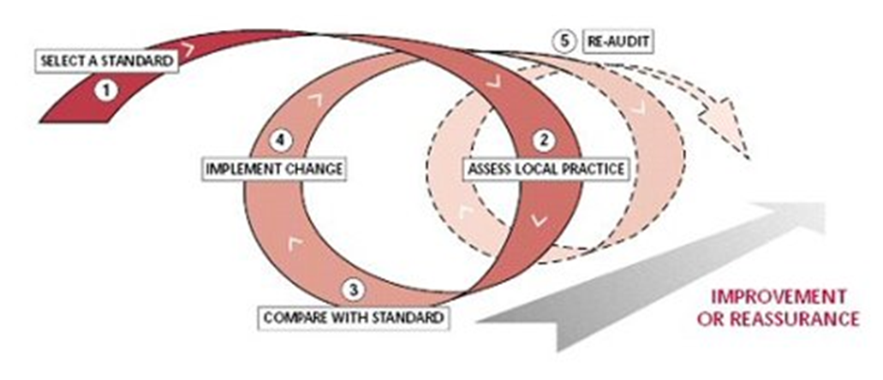
What is a clinical audit ?
One of the key elements within the framework of quality is the comprehensive and critical review of the practice in a medical radiation facility

Slide 31

What is a clinical audit ?
One of the key elements within the framework of quality is the comprehensive and critical review of the practice in a medical radiation facility
  Independent external evaluation → independent assessment of how actual clinical practice compares with good practice

Slide 32

What is a clinical audit ?
One of the key elements within the framework of quality is the comprehensive and critical review of the practice in a medical radiation facility
  Independent external evaluation → independent assessment of how actual clinical practice compares with good practice
  Peer review evaluation of the quality of practice → any areas for improvement will be identified with a view to bring the services to the internationally accepted level

Slide 33
What is a clinical audit ?
One of the key elements within the framework of quality is the comprehensive and critical review of the practice in a medical radiation facility
  Independent external evaluation → independent assessment of how actual clinical practice compares with good practice
  Peer review evaluation of the quality of practice → any areas for improvement will be identified with a view to bring the services to the internationally accepted level
Quality Improvement

Slide 34

What is a clinical audit ?
Council Directive 2013/59/EURATOM
Clinical Audit is “a systematic examination or review of medical radiological procedures which seeks to improve the quality and outcome of patient care through structured review, whereby medical radiological practices, procedures and results are examined against agreed standards for good medical radiological procedures, with modification of practices, where appropriate, and the application of new standards, if necessary”

Slide 35

What a clinical audit IS NOT
Clinical audits are NOT designed for:
  Regulatory purposes
    Not enforcing tool but of advice on quality improvement
  Investigation of accidents or reportable medical events
    A more focused audit is required
  Assessment for entry into cooperative clinical research studies

Slide 36

What does a clinical audit cover?
A comprehensive clinical audit of diagnostic radiology practices consists of a review and evaluation of the quality of all elements involved in the practices:
  Staff
  Equipment
  Procedures, patient protection and safety
  Overall performance of the facility
  Interaction with external service providers

Slide 37
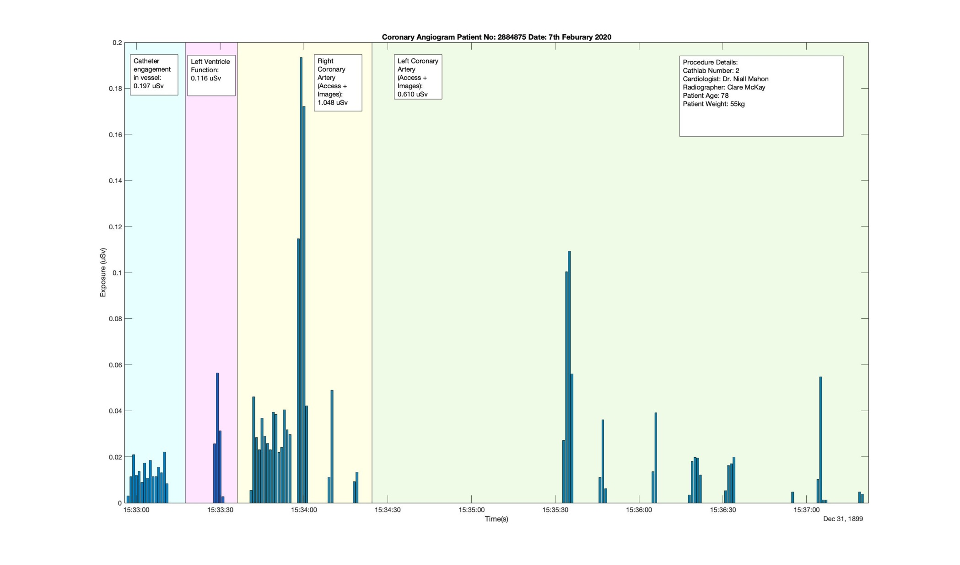
Time staff dose and motion study Cardiology

Slide 38




Accreditation
Accreditation is a formal, independent verification that a program or institution meets established quality standards and is competent to carry out specific conformity assessment tasks. Conformity assessment tasks may include, but are not limited to, testing, inspection, or certification

Slide 39

Role of the physicist in life cycle of equipment

Slide 40
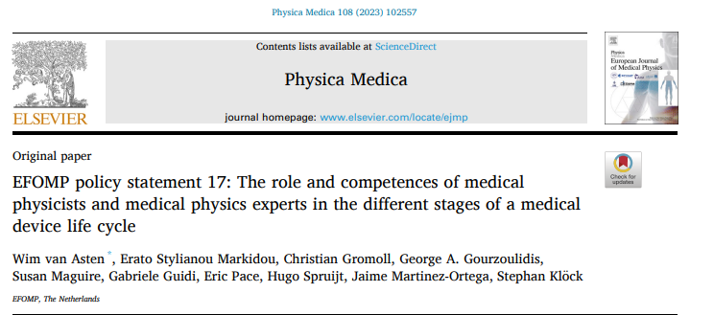
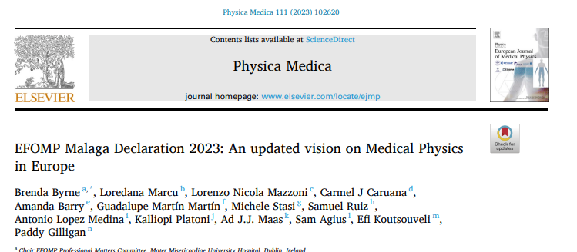
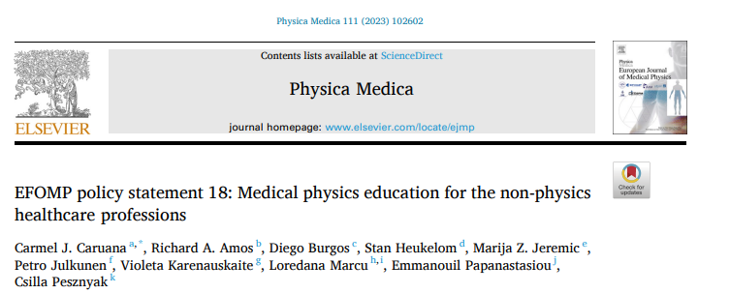
Role of the medical physicist

Slide 41
MPP’s potential roles and degrees of involvements in the stages / procedures within a medical device life cycle Responsible (r), accountable (a), consulted (c), or informed (i) Involvement: High (H), Medium (M) or Low (L)
Procurement: | Definition of requirements | r/a | M
 | b. Market analysis of potential technical solutions / vendors | r/a | H
 | c. Requirements / specifications, standardization | r/a | H
 | d. Decision criteria / quote evaluation | r/a | M
 | e. Business case / Budget | c/i | M
 | f. Price; TCO; cost effectiveness | c/i | M
 | g. Availability of upgrades / improvements | r/a | H
 | h. Maintenance options / contracts | a/c | M
 | i. Risk management | r | H
 | j. Training possibilities | a/c | H
 | k. Investment decision / placing order | c/i | L
Quality control / assurance | a. Working procedures | r | H
 | b. Assessments | r | H
 | c. Audits | r/a | H
Implementation / Commissioning | a. Acceptance | r/a | H
 | b. Application | a | M
Training | a. (Technical) application training | a | H
 | b. Maintenance training | a/c/i | M
Operation | a. Maintenance | c/i | L
 | b. Administration / management | a | L
 | c. Optimization and training | r | H
 | d. Updates and upgrades | r/a | H
Decommissioning | a. Discharge / disassemblance | a | M
Think sustainable at all stages of the life cycle , from design , use to disposal

Slide 42
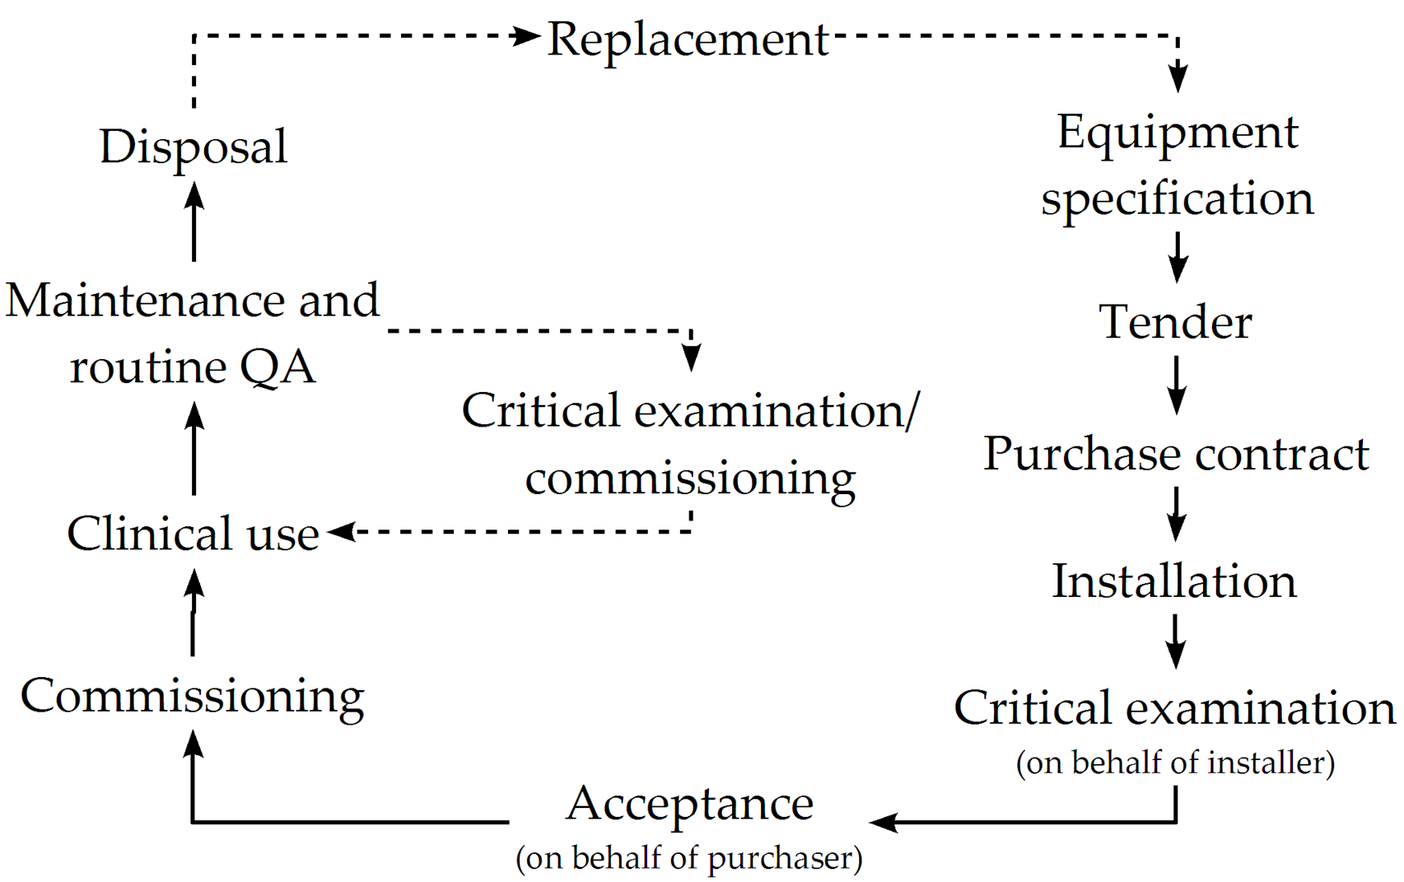
Types of testing

Slide 43
Physics Role in quality assurance
On site as part of team
Visit out of hours
Remote monitoring

Slide 44
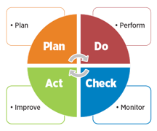
Testing equipment does not become quality control unless results are acted upon ;

Slide 45

Standards we use for equipment monitoring
RP 162,
IEC
NEMA
RP 91
XR 27
Published DRLS
EFOMP angio QC protocol ( in press)
EFOMP CBCT protocol

Slide 46



Look around
...and update

Slide 47
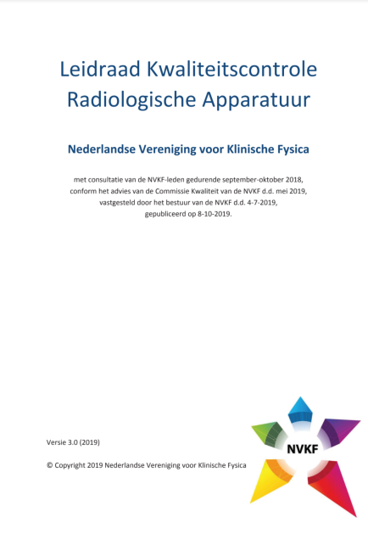



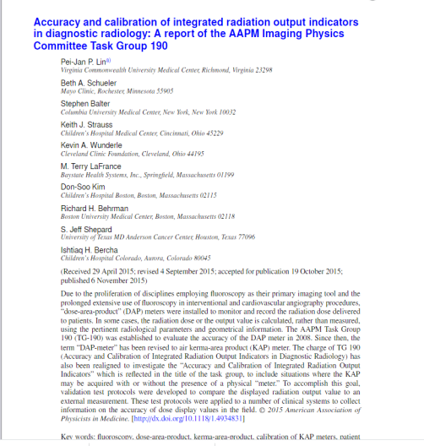
Look around

Slide 48

Look around
Need for harmonization

Slide 49
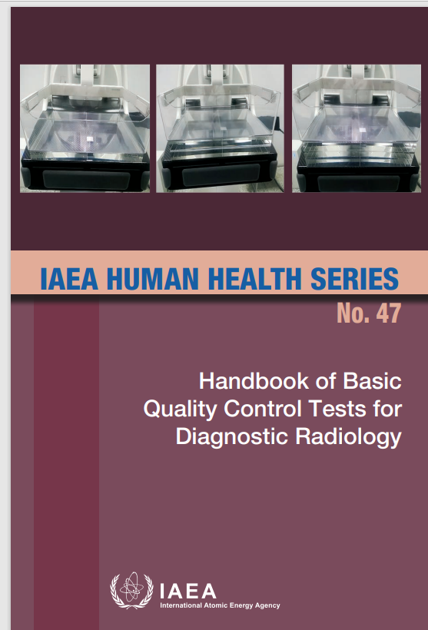


Slide 50
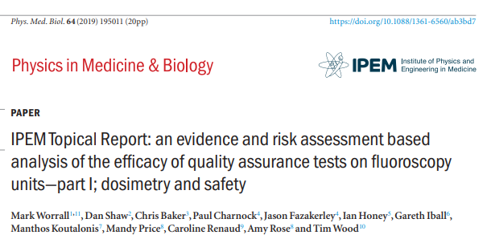
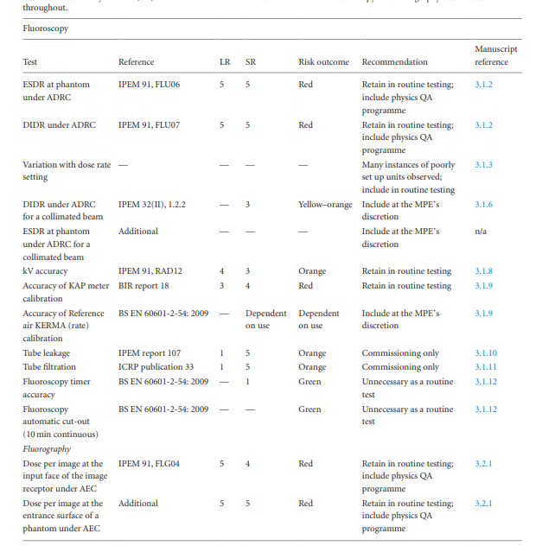
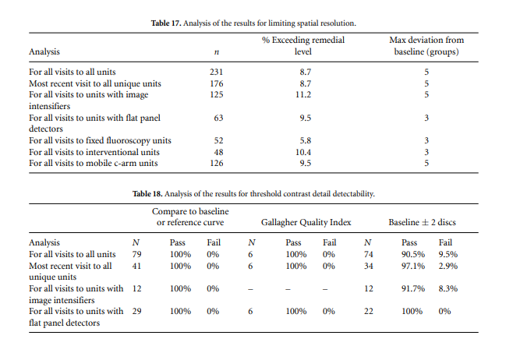
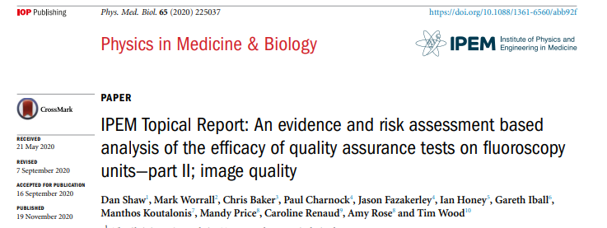
I do a lot of tests but they always pass, why should I bother ?
1-2 %

Slide 51

EU 59/13
Accidental and unintended medical exposures are a source of continuing concern …
It is the role of the competent authority in radiation protection to address the prevention of accidental and unintended medical exposure and the follow-up in case of their occurrence…
In this respect, the role of quality assurance programmes, including a study of risks in radiotherapy, to avoid such incidents should be emphasised, and recording, reporting, analysis and corrective action should be required in such cases.

Slide 52

Incident analysis teams :
The person in charge of the facility/department/staff where the incident took place;
The person who was exposed;
The person(s) acting as operator during the exposure;
The Radiation Protection Officer; and
The Radiation Protection Expert / Medical Physics expert.
In the case of an incident which occurred as a result of defective equipment the following people should also be involved in the investigation:
  The service engineer who examined the equipment following the incident; and
  The person who was responsible for quality assurance on the equipment.

Slide 53

The incident reporting toolkit
What has happened the patient and their care
The guidelines ( read them)
Good safety culture, Active RSO & trained staff
Incident recording software
Dose tracking software
Quality structures for investigation/reporting
Medical physics expert with appropriate dose software
Resource to report and follow up on findings
Patient disclosure training
Records

Slide 54
Every system is not always perfect but we can use a priori knowledge to mitigate future risks
Incidents, Near Misses, root cause analysis
Fault logs , heat maps, uptime
Service report
Service portals
Proactive monitoring alerts
Hazard alerts field safety notices
Recalls
FDA Maude Data base
Root cause analysis
Trends Parieto analysis
Newsgroups
Publications

Slide 55



Estimation of effective and organ doses in patient undergoing interventional neuroradiology procedures:
Preliminary results of a multicenter study
Andrea D’Alessio¹, Barbara Cannillo¹, Giulia Azzalin², Roberta Matheoud¹, Giuseppe Guzzardi³, Andrea Giorgianni⁴, Marco Brambilla¹, Sabina Strocchi⁵
(1) Medical Physics Unit - AOU Maggiore della Carità - Novara - Italy
(2) School of Medicine - Università del Piemonte Orientale A. Avogadro - Novara - Italy
(3) Radiology Unit - AOU Maggiore della Carità - Novara - Italy
(4) Neuroradiology Unit - ASST Sette Laghi - Varese - Italy
(5) Medical Physics Unit - ASST Sette Laghi - Varese - Italy

Slide 56
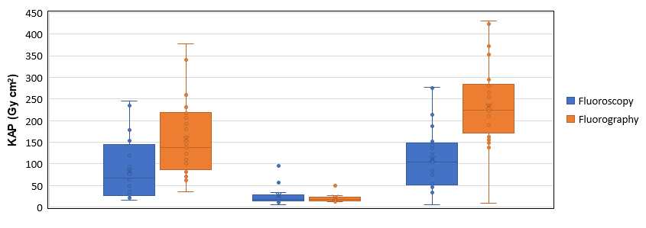
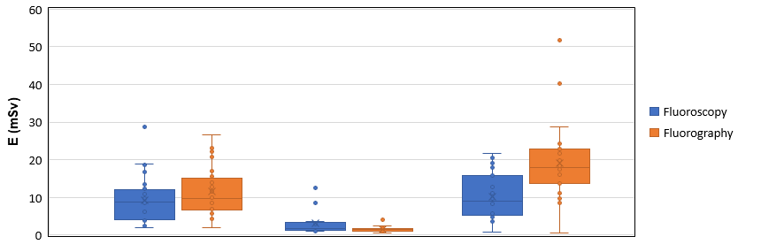
Results: KAP and Effective dose (E)
158 Gycm²
233 Gycm²
111 Gycm²
84 Gycm²
Air Kerma-Area Product
26 Gycm²
21 Gycm²
Clarity reduces patient exposure by about 5 times, even more on fluorography.
Hospital 1
w/o Clarity
Hospital 1 with Clarity
Hospital 2 Biplane
11.5 mSv
19.1 mSv
Effective dose
10.2 mSv
9.2 mSv
3.1 mSv
1.6 mSv
Hospital 1
w/o Clarity
Hospital 1 with Clarity
Hospital 2 Biplane

Slide 57
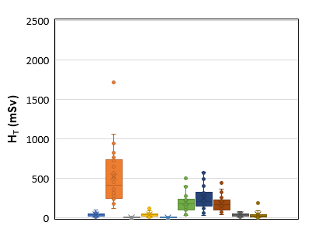



Results: Organ doses (H_{T})
Hospital 1 w/o Clarity
Hospital 1 with Clarity
525
254
150
61
194
74
177
48
42
40
11
11
43
39
10
5
5
1
0.8
6
Hospital 2 Biplane
888
338
221
259
64
9
50
8
55
24

Slide 58

Inter vendor comparison of open service call length in days

Slide 59
Early life cycle interventions
Risk assessments
Business case
Failure mode and effects
analysis ( particularly useful in new uses and projects)

Slide 60


Slide 61


Failure mode and effects analysis
FMEA
RPN = Risk priority number
Assess top risks
Apply control
Eliminate top risks

Slide 62

Documentation: write a good report

Slide 63




Artificial intelligence

Slide 64



AI Generated fluoro images
Courtesy Laura Gambini, trinity college Dublin, Subject of workshop

Slide 65

“Measure what is measurable, and make measurable what is not so”
― Galileo Galilei

Slide 66

Conclusions
Fluoroscopy and angio has the highest criticality and some of the highest occupaiti0onal and patients dose with risk of tissue effects
A good patient focused quality management system aligned with health care objectives can make real patient impact
Quality control and quality assurance are part of that
Equipment testing is only one important part of quality control
It is essential that medical physics add value to results to create patient impact
It is essential that we adaptable to new environments such as AI and we continue to assess our existing and develop new techniques
Optimizations, Audits and incidents control need physics involvement to turn the quality cycle
We need more medical physicists involved in diagnostic and fluoroscopy in many countries

Slide 67


