Slide 1

Acceptance Testing
Monday 16:45
Beth Schueler, AAPM
Mayo Clinic Rochester
RSNA Annual Meeting 2015

Slide 2
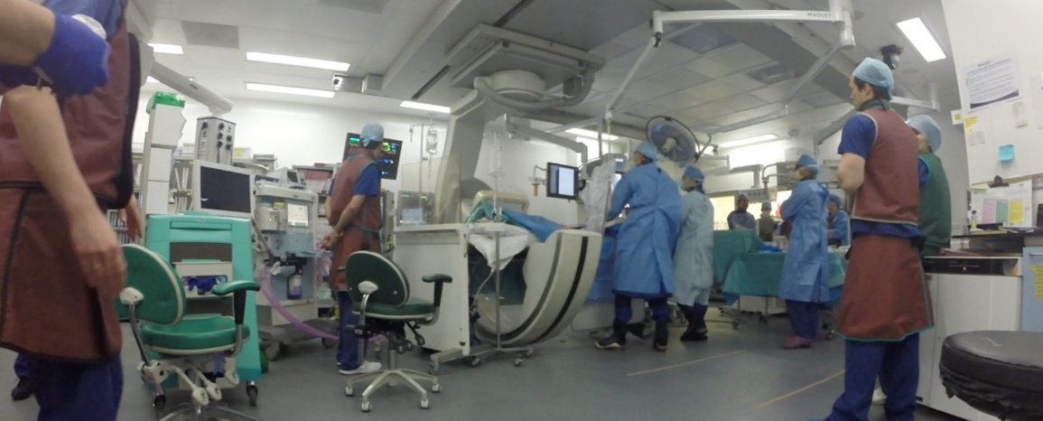
Outline
Framework for quality assurance
  Where does acceptance testing fit it?
Performance evaluation tests for FGI systems

Slide 3
Quality Assurance Program
Organized effort to assure quality in medical imaging
Over-arching program which includes the following elements:
  Quality control testing of imaging equipment
  Corrective action for below standard parameters
  Verification of clinical protocol technique factors
  Maintenance of records and data
  Calibration of test equipment
Reference: IAEA Safety Series No. GSR Part 3, IAEA, Vienna (2014)
Notes:
Check reference and design into blocks

Slide 4
Types of Quality Control Testing
Acceptance Testing
Commissioning
Routine QA
Notes:
Make into boxes

Slide 5
Acceptance Testing
Ensures compliance with regulations
Verifies equipment meets all specifications
Confirms all purchased options are installed and functional
Occurs prior to clinical use
Eliminates substandard components
  Image receptors, grids, filters, …

Slide 6
Commissioning
Includes fine-tuning of system to optimize for clinical use
  Verification of clinical exam protocols
  Requires knowledge of clinical procedures to be conducted
Establish baseline values
Completed in conjunction with applications specialists and physicians

Slide 7
Routine QC
Ensures continued equipment performance
Includes a selected subset of performance evaluation tests conducted at acceptance testing
  Limit testing to the most commonly used imaging modes
Repeat of applicable tests after major service (tube change, image receptor change, …)

Slide 8
Standards and Protocols
AAPM Report No. 272 Comprehensive acceptance testing and evaluation of fluoroscopy imaging systems (2022)
IPEM Report 91 Recommended standards for the routine performance testing of diagnostic X ray imaging systems (2005)
Notes:
IPEM 91: A recommended list of tests is provided with specified test frequencies and both remedial and suspension performance levels. Image quality tests are based on the Leeds test objects.
EC 162 – tests and control limits

Slide 9
Performance Evaluation Tests
Mechanical
X-ray tube/generator/collimation
Automatic dose rate control (ADRC) function
Dose measurements
Table/pad attenuation measurement
Display monitors
Image Quality Evaluation
Connectivity

Slide 10
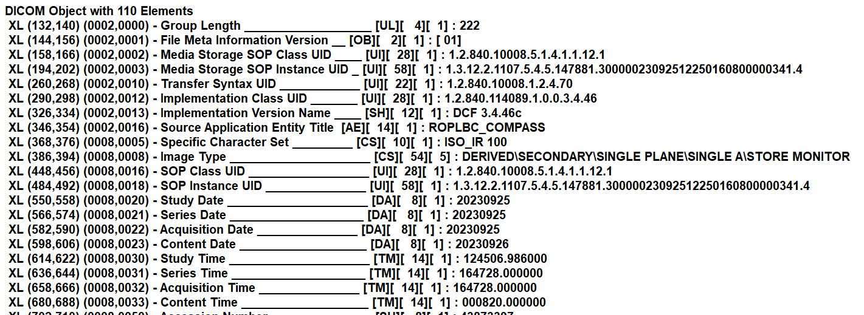
Mechanical
Mechanical system check
Table to C-arm Alignment
DICOM position parameter verification
  Image DICOM header
  Radiation Dose Structured Report (RDSR)

Slide 11
Mechanical System Check
Verify operation of
  Movements of table, display monitor, radiation shields
  Collision guards
  Beam indicators
  X-ray disable
  switches
  Alarms
  Emergency off
  switches

Slide 12
Table to C-arm Alignment
Verify accurate positioning of the table relative to the C-arm gantry
Method:
  Place a metal bar along centerline of table

Slide 13
Table to C-arm Alignment
Adjust position of metal bar until it remains in the image center as C-arm is angled
Ensure table position corresponds to isocenter

Slide 14
DICOM Position Verification
Verify patient orientation, primary/ secondary angulation, table position, reference point

Slide 15
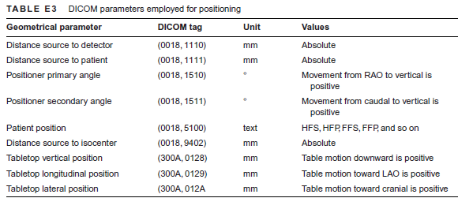
DICOM Position Verification
Method:
  Acquire images at different positions and check corresponding DICOM tags in images and radiation dose structured report (RDSR)

Slide 16
X-ray tube/Generator/Collimation
kVp accuracy, mAs output linearity, HVL
X-ray tube leakage
Collimation
  Congruence of radiation field to image receptor
  Centering of central beam to image receptor center

Slide 17
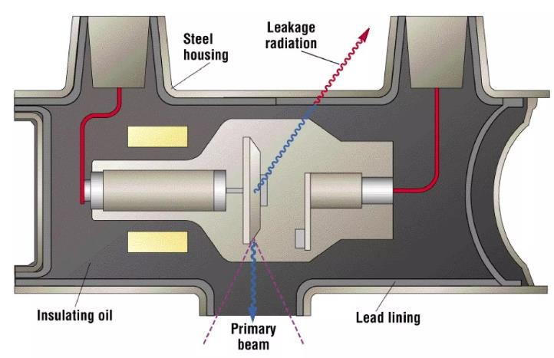
X-Ray Tube Leakage
Ensure radiation leaking from x-ray tube is below regulatory limit
Method:
  Block beam and place a survey meter 1 m from focal spot at multiple locations
Control limit:
  1 mGy/hr maximum

Slide 18
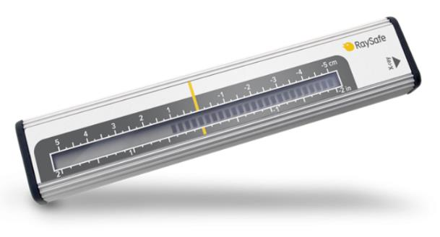
Congruence of Radiation to IR
Method:
  Fluorescent screen or radiochromic film with grid markings or digital rulers
  Use lead sheet on IR to drive up technique factors
  Compare radiation field to displayed image on the display monitor

Slide 19
Congruence of Radiation to IR
Control limit:
  Radiation field should be < 2% of SID larger than IR

Slide 20
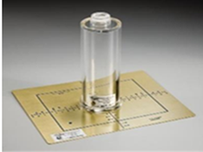
Centering of Beam to IR
Method:
  Collimation/alignment tool or
  2 washers
    Place on center of
    IR and other on table
    Move table to align
    Washers should be
    circular

Slide 21
Centering of Beam to IR
Control limit:
  Distance between central ray and center of image receptor should be < 2% of SID

Slide 22
ADRC Function
Characterize and ensure function of ADRC by varying phantom thickness over a wide range
Notes:
New CNR optimized systems will have complex logic
Further discussion of this topic in another lecture

Slide 23
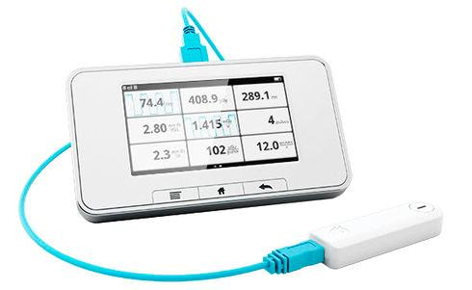
Dose Measurements
Image receptor input air kerma
Displayed reference point air kerma accuracy
Maximum air kerma rate
Typical patient
entrance air kerma
rate

Slide 24
Image Receptor Input Air Kerma
Method:
  Remove grid
  Minimize effect of scatter
    Attenuator (Al or PMMA) at x-ray tube
    Dosimeter > 15 cm from IR (if not lead-backed)
  Adjust attenuator thickness until ADRC drives to ∼80 kVp
Dosimeter
Al or
PMMA
Notes:
Test equipment required include a ionization chamber and some attenuator, either copper, aluminum or lucite or some combination of these. The chamber is placed near the entrance to the image receptor input and the attenuator is placed near the x-ray tube to minimize scatter. It is best if the grid can be removed for this measurement, but for some systems, this is not practical to do. If the grid remains, the exposure rate measured should be corrected for the grid attenuation factor to obtain the actual entrance exposure rate at the image receptor. This grid attenuation factor can be measured once or obtained from the grid manufacturer based on the specifications of the grid. The thickness of the attenuator should be adjusted to drive the kVp to a standard value, generally 80 kVp. Results will vary depending on which attenuator type used, due to the exit x-ray energy spectrum from that material. For consistency, make sure to use the same type of attenuator for QC measurements or vendor comparisons.

Slide 25
Image Receptor Input Air Kerma
Result will vary depending on attenuator
  PMMA gives value 30% higher than Al
Repeat for all FOVs, all fluoroscopy and acquisition modes
Recommended values (20-25 cm FOV):
Operational Mode | IR Input Air Kerma (nGy/fr)
Fluoroscopy | 6-30
Digital acquisition | 450-900
DSA | 4500-9000
Cardiac digital | 90-130

Slide 26
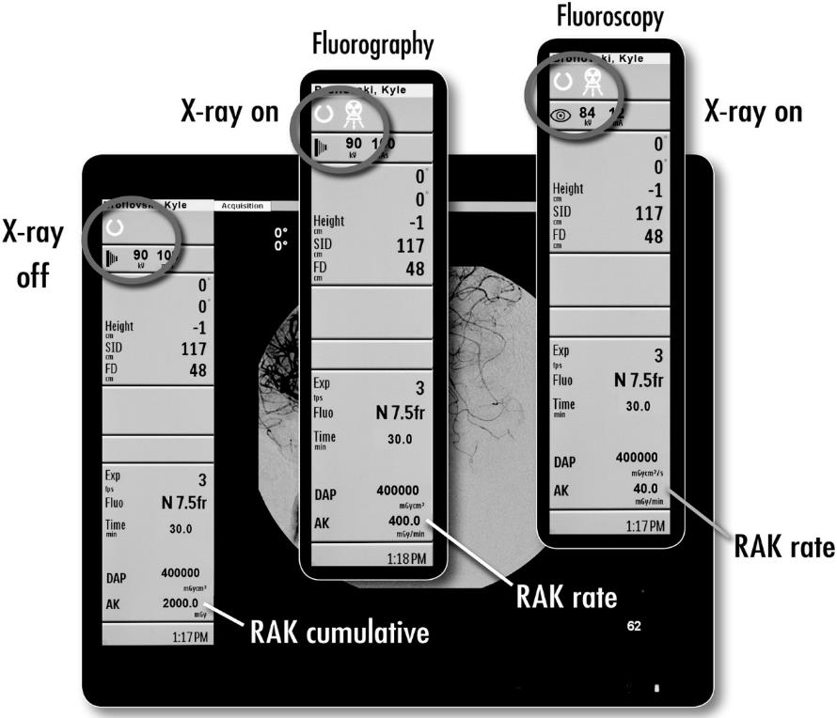
Displayed Air Kerma Accuracy

Slide 27
Displayed Air Kerma Accuracy
Method:
  Dosimeter at Reference Point
    Approximate location of patient entrance point
    Typically 15 cm from isocenter toward focal spot for C-arms
    Source to isocenter distance and reference point is specified in user manual
Isocenter
Reference Point
15 cm

Slide 28
Displayed Air Kerma Accuracy
Method:
  Cu or Al attenuator on IR
  No table or pad
  Measure air kerma rate and compare to display
  Repeat for fluoro and acquisition modes
Control limit:
  Displayed value within ±35% of measured value
Cu or Al
Dosimeter

Slide 29
Maximum Air Kerma Rate
Method:
  Dosimeter 30 cm from IR
  Drive ADRC to maximum technique
  Normal and high-level control modes
Control limit:
  Normal mode < 88 mGy/min
  High-level control mode < 176 mGy/min
Pb or Cu
30 cm
Dosimeter
Notes:
Place Pb or Cu at the IR entrance

Slide 30
Typical Entrance Air Kerma Rates
Can be done with ADRC function evaluation
Method:
  Use clinical configuration
  Phantom
    10, 20, 30 cm PMMA or
    2.5, 5, 7.5 cm Al
Measure for all FOVs,
dose rates, fluoro and
acquisition modes

Slide 31
Table/pad Attenuation Measurement
Required for skin dose estimation
Incorporated into radiation dose monitoring system software
Measure air kerma or rate with and without table and pad in place

Slide 32
Table/pad Attenuation Measurement
Use service mode to maintain technique parameters
If service mode is not accessible,
  Lock ADRC or
  Measure air kerma on either side of table/pad and correct to same source to dosimeter distance
Transmission factor
  air kerma with table/pad ÷ air kerma without table/pad
  Typical values: 0.6 - 0.7

Slide 33
Table/pad Transmission Factors
mm Cu | 60 kVp | 90 kVp | 120 kVp
0 | 0.59 | 0.64 | 0.67
0.3 | 0.66 | 0.71 | 0.72
0.6 | 0.68 | 0.72 | 0.73
0.9 | 0.69 | 0.72 | 0.74
Notes:
Will be higher for a higher energy beam

Slide 34
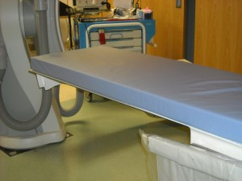
Table/pad Attenuation Measurement
Transmission factors too low may drive kV/mAs to high levels
  Reduces image quality
  Reduce x-ray tube life
Values < 0.6 should be
investigated to ensure
table and pad are
designed for
radiographic use

Slide 35
Display Monitors
Notes:
Display monitors critical for guidance
Typically used in rooms with high ambient light
Large displays are expensive component ($65K)

Slide 36
Display Monitors
Method
  Calibrated photometer
  Test patterns
Luminance levels
  Ambient, L_{amb} = light reflected from display surface
  L_{min} should be set so L_{amb}/L_{min} < ¼
  L_{max} should be set so (L_{max} + L_{amb}) / (L_{min} + L_{amb})= 250-450
Notes:
Display monitors critical for guidance
Typically used in rooms with high ambient light

Slide 37
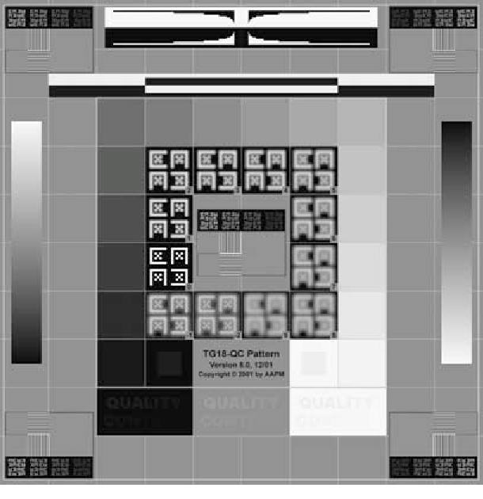
Test Patterns
TG270-sQC
TG18-OQC
Notes:
Test patterns include uniform images of varying luminance and more complex QC pattern with low contrast and detail components
For IR equipment, generally limited to what patterns the manufacturer provides

Slide 38
Display Monitors
Luminance response
  Measure luminance of 18 gray scale levels and compare to DICOM grayscale standard display function (GSDF)
  See AAPM Report No. 270 Display Quality Assurance for detailed methods
  If deviation > 20%, recalibrate
  Qualitative evaluation can also be done with the TG18-OQC test pattern
Notes:
Display monitors critical for guidance
Typically used in rooms with high ambient light

Slide 39
Display Monitors
Luminance uniformity
  Measure luminance in centers of 3x3 grid locations in a uniform image
  Calculate LUDM = maximum % deviation from average luminance
  LUDM should be < 30%
Notes:
Display monitors critical for guidance
Typically used in rooms with high ambient light

Slide 40
Display Monitors
Practical considerations
  Duplicate clinical lighting conditions – high ambient light is common
  Large displays can have multiple configurations – select the most commonly used
  Protective covers can alter performance – make sure to measure with cover in place if in clinical use
  All displays should be evaluated at acceptance, including control room monitors
Notes:
Display monitors critical for guidance
Typically used in rooms with high ambient light

Slide 41
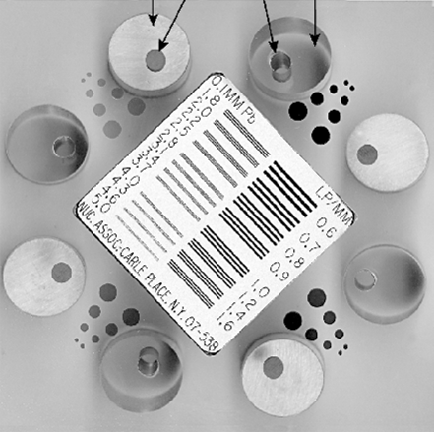
Image Quality Evaluation
Many phantoms and methods are available
Establish baselines for regular QC
Subjective evaluation requires reproducible conditions (technique, room lighting, observer, …)
Quantitative assessment
generally requires access
to unprocessed images
Notes:
Previously discussed

Slide 42
Image Artifacts and Uniformity
Method:
  Uniform PMMA or Cu phantom
  For II systems, image a grid phantom
  Review at minimum and maximum SID to look for non-uniformity due to grid cutoff
Calculate % deviation in pixel value from ROIs at corners compared to center
Assess visually for defects and artifacts using a narrow window

Slide 43
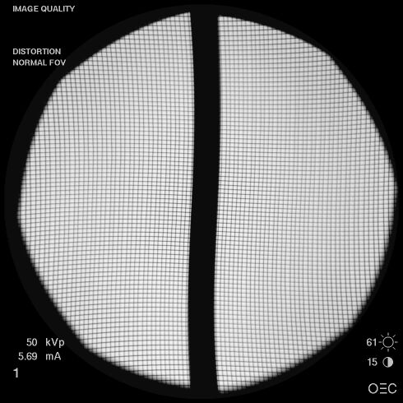
Image Artifacts and Uniformity
II potential artifacts:
  Brightness falloff
  Pincushion distortion
  S-distortion
    Varys with C-arm angulation
    More severe if magnetic fields present

Slide 44
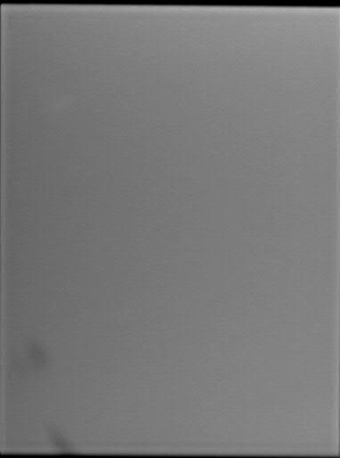
Image Artifacts and Uniformity
FPD potential artifacts:
  Damage to the grid (if not present during gain calibration)
  Dead pixels
  Debris in beam included in gain calibration

Slide 45
Connectivity
Verify image transfer to PACS and connected workstations
  Image quality
  Annotations
Reference:
  AAPM Report No. 248: Interoperability Assessment for the Commissioning of Medical Imaging Acquisition Systems

Slide 46
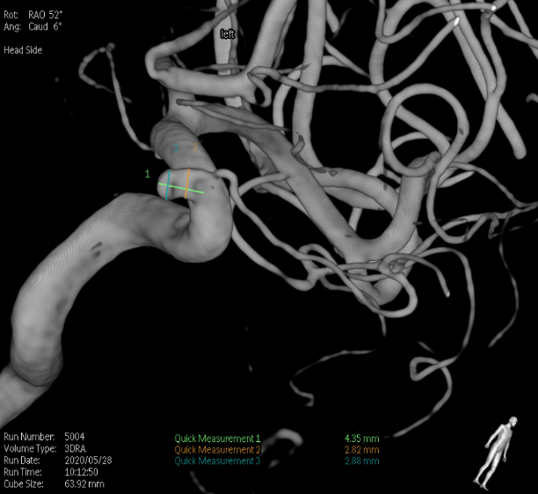
Cone Beam CT Evaluation
Includes “DynaCT”, “Innova3D”, “XperCT”
Used for interventional guidance, embolizations, pedicle screw placement
QC Tests:
  Dosimetry
  Image Quality
  Reference: AAPM
  Report 238 3D C-Arms
  with Volumetric
  Imaging Capability

Slide 47
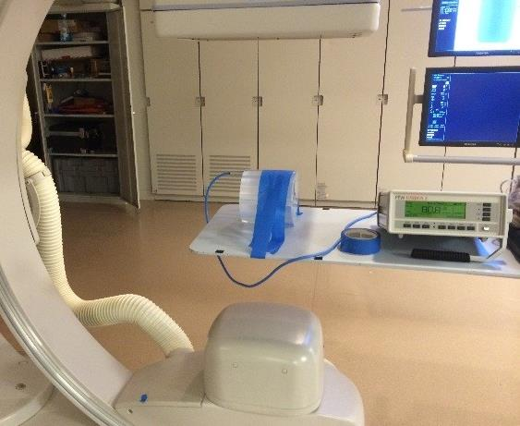

Cone Beam CT Evaluation
Dose measurement:
  16-cm CTDI phantom at isocenter
  Measure dose at center of z axis (z=0) in center and 4 peripheral locations
  Calculate planar average dose:
  $$\overline{f }\left(0\right)=\frac{f_{center}(0)}{3}+\frac{2}{3N}\sum_{i=1}^{N}{f_{position}(0)}$$
Expected result:
  10-80 mGy depending on protocol

Slide 48
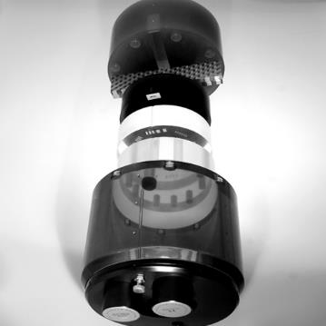
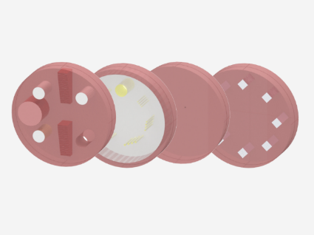
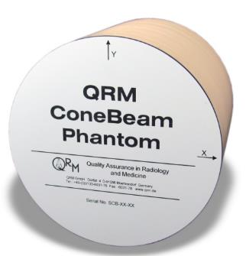
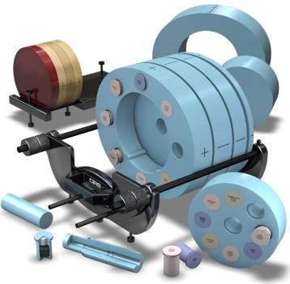
Cone Beam CT Evaluation
Image quality evaluation:
Catphan (The Phantom Lab, Greenwich NY)
CT ACR 464 Phantom
(Sun Nuclear, Madison WI)
ConeBeam Phantom
(QRM, Möhrendorf Germany)
CBCT Image Quality Phantom
(Model 062MQA, CIRS, Norfolk VA)

Slide 49
Additional Guidance for AT
Review the manufacturer’s user manual
  Obtain a pdf version if possible
Review the purchase quotation
  Ensure all components, software and other options are installed
Compare performance test results to other like systems
Meet applications specialist and review clinical parameter recommendations
  Knowledge of clinical procedures is helpful

Slide 50

Questions?

