Slide 1

Optimization of Image Quality
and Radiation Dose
Thursday 12:00
Beth Schueler
Mayo Clinic Rochester
RSNA Annual Meeting 2015

Slide 2
Outline
Radiation protection principles
Framework for optimization
Examples

Slide 3
Radiation Protection Principles
Justification
  Benefit should exceed harm
Optimization
  Radiation should be as low as reasonably achievable
Dose limitation
  Occupational dose does not exceed regulatory limits
Reference: ICRP Report 103 (2007)

Slide 4
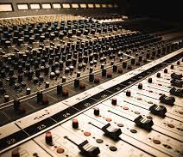
Optimization for FGI is Complex
Radiation dose levels should be matched to the imaging requirements of the task
Multiple parameters
available to adjust dose
and image quality
Understanding the
clinical procedure is
important

Slide 5
Optimization Process
1
2
3
4
5
Establish a quality assurance program
Put together an optimization team
Define baselines
Implement modifica-tions
Evaluate
Reference: Tsapaki V, Radiation dose optimization in diagnostic and interventional radiology, Physica Medica 79 (2020) 16
Notes:
Make into boxes

Slide 6
1. Quality Assurance Program
Quality control testing of equipment parameters
  Acceptance testing, commissioning, routine QC
Corrective action for failing parameters
Verification of clinical protocol technique factors
Record keeping
QAP
1
Team
2
Define base-lines
3
Implement mods
4
Eval
5

Slide 7
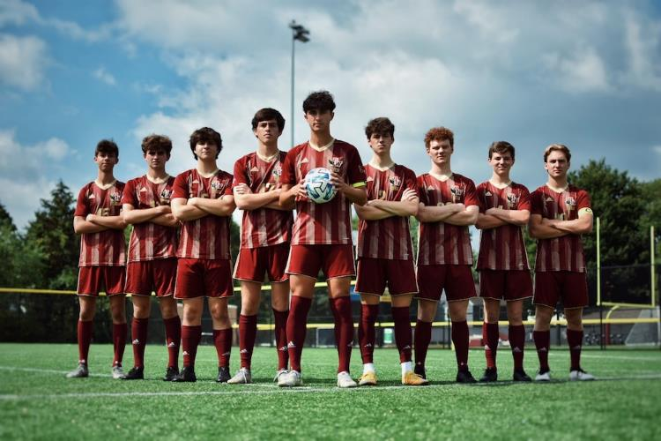
2. Optimization Team
Physicians, technologists, medical physicist, service engineer, vendor IQ specialist
QAP
1
Team
2
Define base-lines
3
Implement mods
4
Eval
5

Slide 8
2. Optimization Team
Physicians
  Provides assessment of image quality required
  Identifies specific
  procedures or problem
  areas to address
  At least one should be
  on the team
  Should be able to speak
  for the physician group or
  bring back feedback

Slide 9
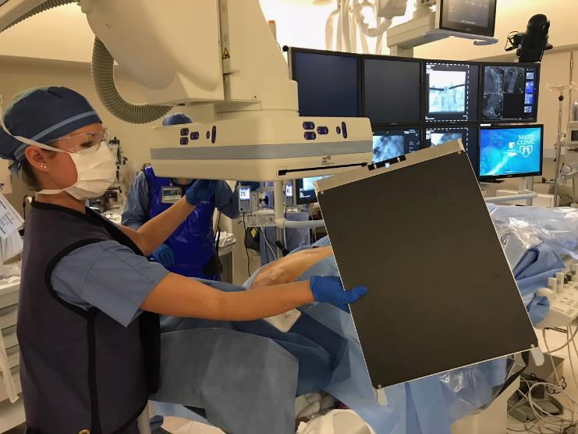
2. Optimization Team
Technologists
  Provides assessment of clinical workflow
  Ensures actions are implemented
  At least one should be
  on the team
  Should be able to
  speak for the RT
  group or bring back
  feedback

Slide 10
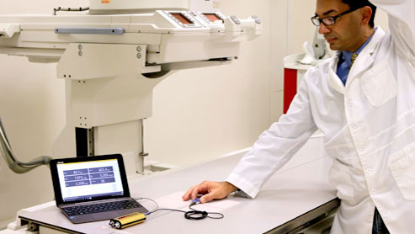
2. Optimization Team
Medical physicist
  Evaluates quantitative assessment of radiation dose and image quality
  Tests with QC and anatomic phantoms as needed
  Guides protocol adjustments

Slide 11
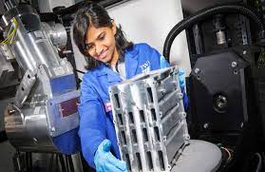
2. Optimization Team
Service engineer
  Knowledgeable about equipment specifications
  Ensure protocol adjustments are achievable and appropriate so as not to damage equipment

Slide 12
2. Optimization Team
Vendor IQ specialist
  Knowledgeable about specific equipment features and adjustments
  Able to adjust image processing parameters to achieve desired results
  Best to include them as needed
  May be limited to remote consultation

Slide 13
3. Define Baselines
Identify procedures and/or tasks to be optimized
Record current state for later comparisons after improvements implemented
May include:
  Compiled patient dose or occupational dose data
  IQ/ dose measurements
  Recorded clinical
  images
QAP
1
Team
2
Define base-lines
3
Implement mods
4
Eval
5

Slide 14
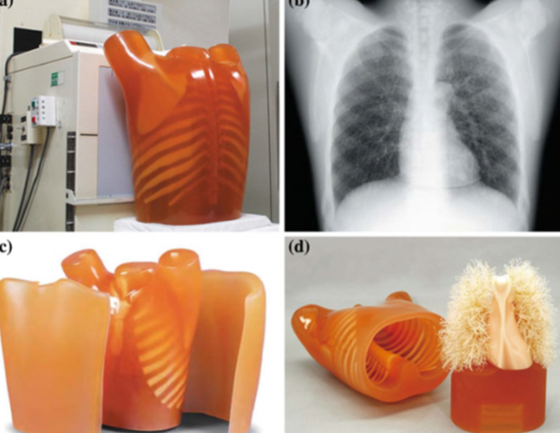
Image Quality Evaluation with Phantoms
Technical image quality evaluation is limited
Anthropomorphic phantoms helpful

Slide 15
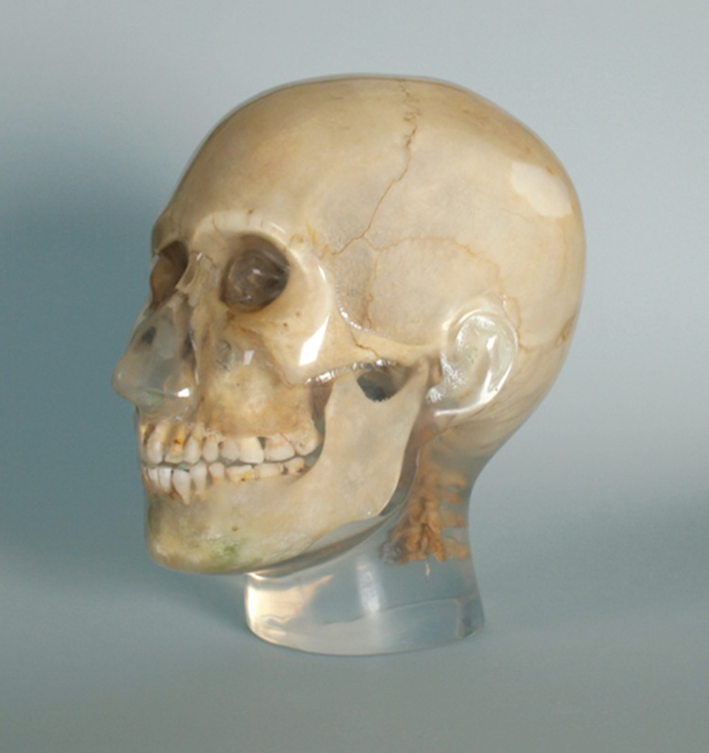
Anthropomorphic Phantoms
Duplicates attenuation and anatomy of clinical image
Allows imaging with defined parameters without human exposure
Limitations
  Static
  Bone density typically is
  lower than patients

Slide 16
4. Implement Modifications
Modifications may include:
  Edits to exam protocol parameters
  Equipment changes
  Adjustments in workflow
  Operator behavior modification
  Training of personnel
QAP
1
Team
2
Define base-lines
3
Implement mods
4
Eval
5

Slide 17
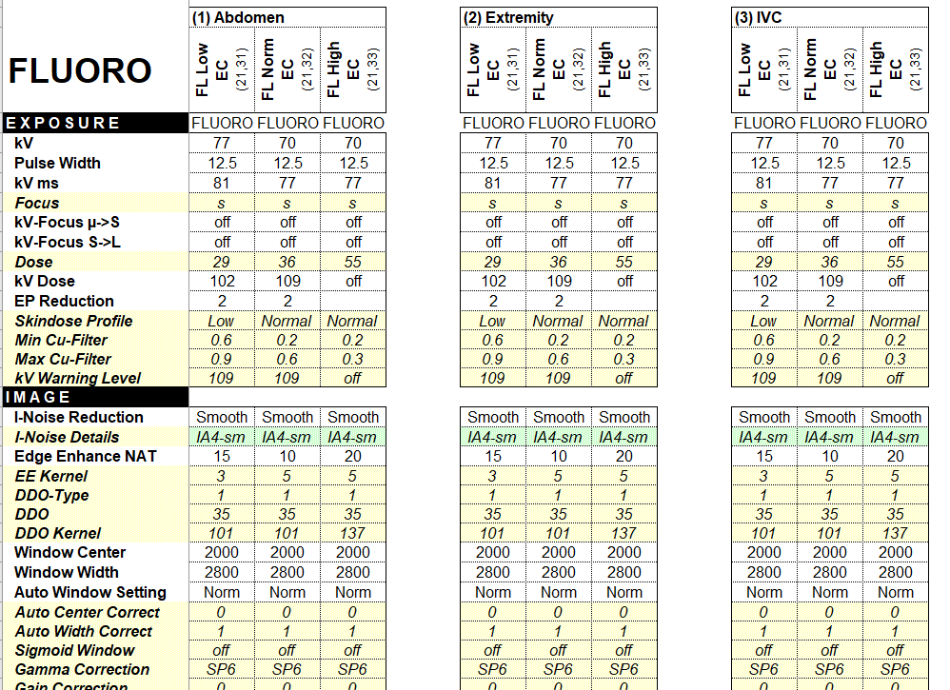
Exam Protocols

Slide 18
Factors Affecting IQ and Dose
kVp target
  System will try to maintain kVp at this value, ADRC will increase kVp with attenuation
  Effect:
    Low kVp will increase low contrast visibility and increase patient dose rate
Pulsewidth target
  System will try to maintain pulsewidth at this value
  Effect:
    Short pulsewidth reduces motion blur
    Lower pulsewidth will maintain kVp at target level

Slide 19
Factors Affecting IQ and Dose
Focal spot size
  Can be selected for full range or set to increase when specified kVp is reached
  Effect:
    Use of small focal spot will improve spatial resolution but may increase tube heating or limit maximum dose rate if set too low

Slide 20
Factors Affecting IQ and Dose
IR target dose
  Typically set as nGy/pulse
    Fluoro: 5-100 nGy/pulse
    Acquisition: 100-5000 nGy/pulse
  Effect:
    Low IR target dose increases image noise and reduces patient dose rate
  Dose level should be matched to the imaging requirements of the task

Slide 21
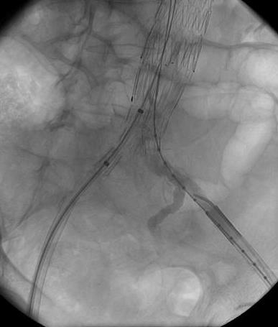
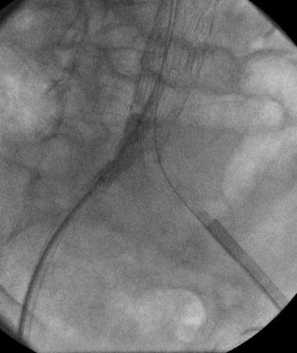
Dose Level Comparison
DA:
7 sec @ 2 F/s
3000 nGy/pulse
122 mGy
Store Fluoro:
7 sec @ Low – 15 pps
29 nGy/pulse
1.1 mGy

Slide 22
Factors Affecting IQ and Dose
Fluoroscopy frame rate
  Rates range from 3 -30 fps
  Effect:
    Low frame rate reduces patient dose rate and reduces temporal resolution
    Since eye integrates frames, low frame also increases appearance of image noise if IR target dose is kept constant
    Some vendors increase IR target dose for lower frame rates to maintain image noise appearance
Notes:
Spoke phantom with different rates?

Slide 23
Factors Affecting IQ and Dose
Temporal filtration
  Applies a recursive weighting factor to previous frames to decrease their contribution
  M_{inew} = M_{i} x (1-1/K) + V_{i}/K
  K = selectable averaging factor (1,2,3,4,8)
Incoming
Video
V_{i}
M_{inew}
1/K
Display
M_{i}
1-1/K

Slide 24
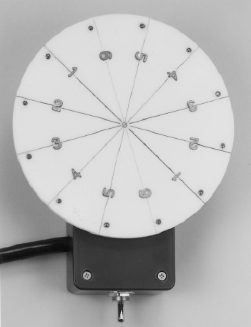
Rotating Spoke Phantom
5.5” diameter acrylic disk with steel 12 wires arranged in 30° intervals
Wire diameters range from 0.02” to 0.005”
Disk is mounted on a synchronous motor with a speed of 30 RPM

Slide 25
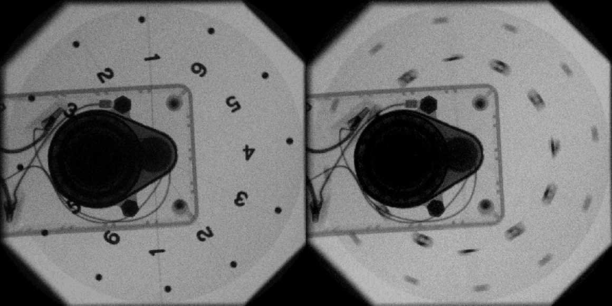
Rotating Spoke Phantom
Provides method of evaluating dynamic images, e.g. pulsed vs continuous fluoro

Slide 26
Temporal Filtration, K=2
M_{inew} = V_{i}/K + M_{i} x (1-1/K), for K = 2
  Frame 1: 0.5V₁
  Frame 2: 0.5V₂ + (0.5V₁)x(0.5)
    = 0.5V₂ + 0.25V₁
  Frame 3: 0.5V₃ + (0.5V₂ + 0.25V₁)x(0.5)
  = 0.5V₃ + 0.25V₂ + 0.125V₁
  Frame 4: 0.5V₄ + (0.5V₃ + 0.25V₂ + 0.125V₁)x(0.5)
  = 0.5V₄ + 0.25V₃ + 0.125V₂ + 0.063V₁

Slide 27
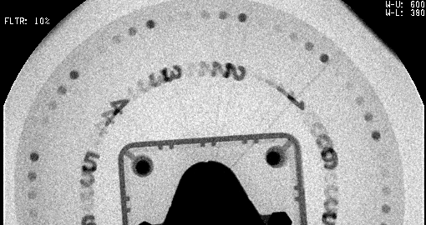
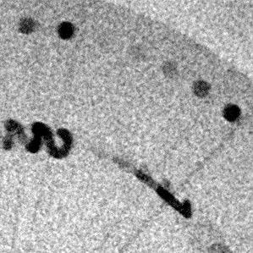
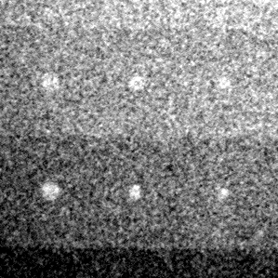
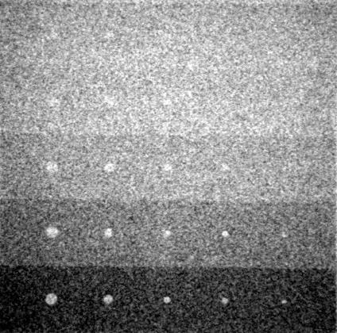
K = 2
(10 Frames)

Slide 28
Temporal Filtration, K=1
M_{inew} = V_{i}/K + M_{i} x (1-1/K), for K = 1
  Frame 1: V₁
  Frame 2: V₂ + (V₁)x(0)
    = V₂
  Frame 3: V₃ + (V₂)x(0)
  = V₃
  Frame 4: V₄ + (V₃)x(0)
  = V₄

Slide 29
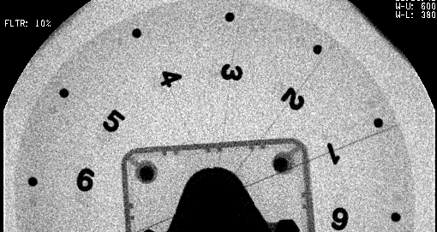
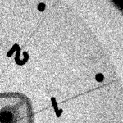
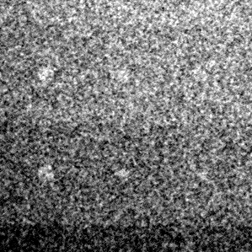
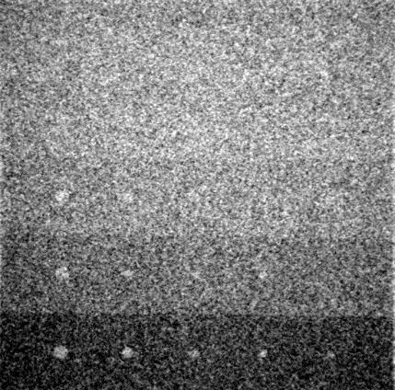
K = 1
(1 Frames)
Notes:
Figure 25. Recursive Filtering
These images were acquired by capturing the fluoroscopy scene as a reference image. The upper left image of each set is of a moving spoke pattern rotating at 30 revolutions per minute. The second test pattern of each set was a stationary Rose type contrast-detail phantom. Fluoroscopy was set to 30 pulses per second with a 16 cm (measured) field of view. The measured image intensifier input exposure rate was 113 µR/s. Note that as the value of K increases the noise is reduced and low contrast detail become more visible. However, moving objects become progressively more blurred.

Slide 30
Temporal Filtration, K=4
M_{inew} = V_{i}/K + M_{i} x (1-1/K), for K = 4
  Frame 1: 0.25V₁
  Frame 2: 0.25V₂ + (0.25V₁)x(0.75)
    = 0.25V₂ + 0.19V₁
  Frame 3: 0.25V₃ + (0.25V₂ + 0.19V₁)x(0.75)
  = 0.25V₃ + 0.19V₂ + 0.14V₁
  Frame 4: 0.25V₄ + (0.25V₃ + 0.19V₂ + 0.14V₁)x(0.75)
  = 0.25V₄ + 0.19V₃ + 0.14V₂ + 0.11V₁

Slide 31
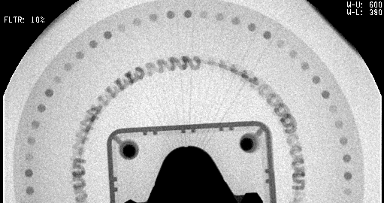
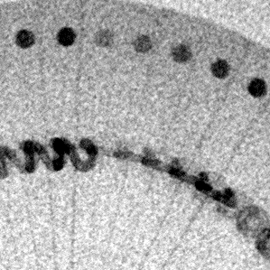
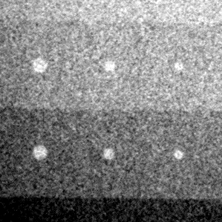
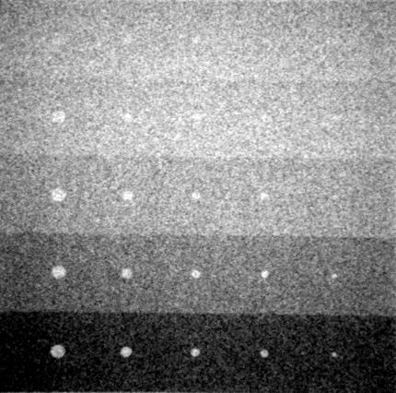
K = 4
(24 Frames)

Slide 32
Factors Affecting IQ and Dose
Temporal filtration
  Higher K factor reduces image noise or reduces patient dose rate with noise level maintained
  Higher K factor increase blur or lag in moving objects
  Optimal setting should be matched to clinical task
    Use higher settings for relatively stationary anatomy

Slide 33
Factors Affecting IQ and Dose
Image processing settings
  Generally includes the following parameters:
    edge enhancement
    dynamic range compensation
    window width/level
    noise reduction
    gamma (contrast) curve selection
  Effect:
    Will have substantial effect on image quality
  Adjusting one factor likely to affect others
  Expert vendor guidance is required if adjusting
Notes:
Examples?

Slide 34
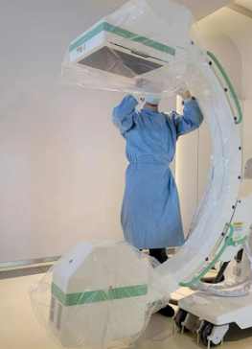
Factors Affecting IQ and Dose
Grid use
  Effect:
    Reduces patient dose rate but also reduces image contrast
  May disrupt workflow
    Grid must be removed prior to sterile cover installation
Notes:
Examples?

Slide 35
5. Evaluate
Repeat #3 Define Baselines to determine if modifications resulted in a positive change
Implement further modifications as needed
QAP
1
Team
2
Define base-lines
3
Implement mods
4
Eval
5

Slide 36
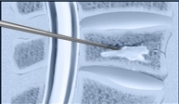
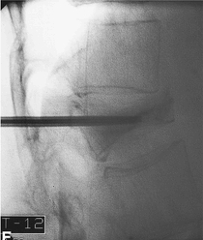
Optimization Example
Vertebroplasty:
  Cement is injected into a vertebral body for the stabilization of a compression fracture
  for radiographic opacification, cement is mixed with barium sulfate powder
Notes:
The particular procedure is vertebroplasty.

Slide 37
Vertebroplasty: Imaging Problems
Constant fluoroscopic observation required during cement injection
Cement in vertebral body is difficult to see
  barium sulfate volume is limited to preserve hardening properties
  large attenuation in lateral projection
Require visualization of barium sulfate flakes moving through the needle during injection
High patient radiation dose possible

Slide 38
Vertebroplasty: Baselines
Compile patient dose data
Phantom image quality assessment is difficult in this case
  Duplicating cement with barium sulfate flakes mixture is helpful

Slide 39
Vertebroplasty: Modifications
Use low frame rate pulsed fluoroscopy
  acceptable for this procedure due to low motion
Increase temporal filtration K factor setting
  reduces image noise, but too much may cause objectionable blur of moving barium sulfate flakes
Increase edge enhancement setting
  improves visualization of barium sulfate flakes, but too much will increase noise appearance

Slide 40
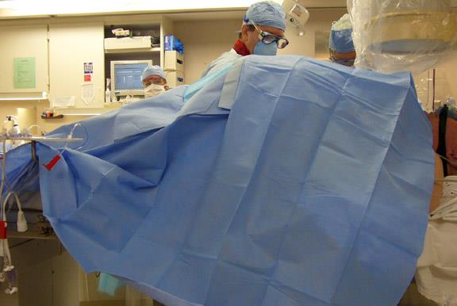
Obese Patient Imaging
Photo credit: Malcom Bell, M.D.
Notes:
Once the system has arrived, considerations for acceptance testing
Regulations:
Max rates, HVL, collimation, kVp, dose display
Substandard components and errors less likely due to software controls and automatic calibration routines
Will address specfic performance evaluation tests coming up

Slide 41
Obese Patient Imaging
Problem
  Over 33% of US adults are classified as obese
  Complications of obesity requires interventional fluoroscopy treatment
Imaging limitations
  High patient dose
  Poor image quality due to high kVp and scatter
  High occupational exposures
  Equipment limitations
Notes:
Once the system has arrived, considerations for acceptance testing
Regulations:
Max rates, HVL, collimation, kVp, dose display
Substandard components and errors less likely due to software controls and automatic calibration routines
Will address specfic performance evaluation tests coming up

Slide 42
Effect of Patient Size
8
4
2
1
0.5
0.25 mGy/hr
24 cm
29 cm
34 cm
Collar: 0.4 mGy/hr
Patient: 11 mGy/min
0.6 mGy/hr
33 mGy/min
0.8 mGy/hr
87 mGy/min
Notes:
One last situation is 3 different patient thicknesses, corresponding to a typical small, medium and large-sized patient. Note how the operator exposure increases dramatically with increasing patient thicknesses and how the distribution is relatively isotropic for the small patient, but quite strongly concentrated in the backscatter direction for the large patient

Slide 43
Obese Patients: Baselines
Compile patient dose data vs BMI
  KAP most useful
Compile personnel badge data vs patient BMI
Phantom image quality evaluation with large PMMA thicknesses
Notes:
Once the system has arrived, considerations for acceptance testing
Regulations:
Max rates, HVL, collimation, kVp, dose display
Substandard components and errors less likely due to software controls and automatic calibration routines
Will address specfic performance evaluation tests coming up

Slide 44
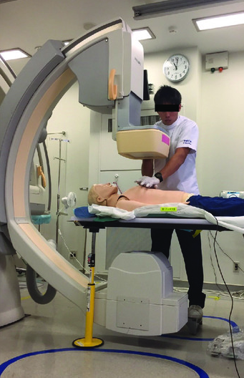
Obese Patients: Modifications
Ensure weight limit of table is not exceeded
  Higher weight limits allowed with no table movement
  Use of CPR stand increases weight limit
Notes:
Once the system has arrived, considerations for acceptance testing
Regulations:
Max rates, HVL, collimation, kVp, dose display
Substandard components and errors less likely due to software controls and automatic calibration routines
Will address specfic performance evaluation tests coming up

Slide 45
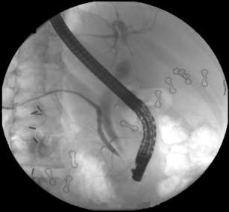

Obese Patients: Modifications
Encourage collimation
  Reduces scatter radiation
  Improves image quality by increasing contrast
  Decreases personnel exposure
Notes:
Once the system has arrived, considerations for acceptance testing
Regulations:
Max rates, HVL, collimation, kVp, dose display
Substandard components and errors less likely due to software controls and automatic calibration routines
Will address specfic performance evaluation tests coming up

Slide 46
Obese Patients: Modifications
Reduce fluoroscopy frame rate
Ensure low dose fluoroscopy modes are able to achieve maximum allowable air kerma rates
  Many vendors low dose mode default has a limited maximum rate
  Adjustment requires assistance of vendor image quality specialist
  Operators will use high dose mode or even acquisition mode if image quality is insufficient
Notes:
Once the system has arrived, considerations for acceptance testing
Regulations:
Max rates, HVL, collimation, kVp, dose display
Substandard components and errors less likely due to software controls and automatic calibration routines
Will address specfic performance evaluation tests coming up

Slide 47
Conclusions
Medical physicists are an important member of the optimization team
Participation in this function extends the influence of the physicist beyond standard equipment QC and regulatory compliance verification
QAP
1
Team
2
Define base-lines
3
Implement mods
4
Eval
5

Slide 48
Questions?

