Slide 1


Patient Skin Dose Estimation
Joint ICTP-IAEA Training Course on
Quality Assurance, Quality Control and Optimization of Equipment and Procedures Used in Fluoroscopically-Guided Procedures
Chai Hong Yeong, PhD
Chair, Medical Physics World Board, IOMP
Taylor’s University, Malaysia
Chaihong.Yeong@taylors.edu.my

Slide 2
Contents
Why are we concern about skin dose?
Related Dosimetry Quantities in Fluoroscopy
“Dose Alarm”
Calculation of Patient Skin Dose (Example)
Homework ☺

Slide 3
Disclaimer
Majority part of this lecture are extracted from the IAEA Training Material on Radiation Protection in Diagnostic and Interventional Radiology
I would like to acknowledge Dr Zoe Brady for lending some of her training materials used in the IAEA TN-RAS9089-2102464 "Virtual” Regional training Course on Advanced Radiation Protection in Interventional Radiology, 2021

Slide 4
Quiz
What is the annual equivalent dose limit in skin for a radiation worker?
500 mSv
What is the annual equivalent dose limit in skin for a member of the public?
50 mSv
What is the dose limit for skin for a patient?
No dose limit for patient, but threshold dose for skin erythema is known as 2 Gy

Slide 5
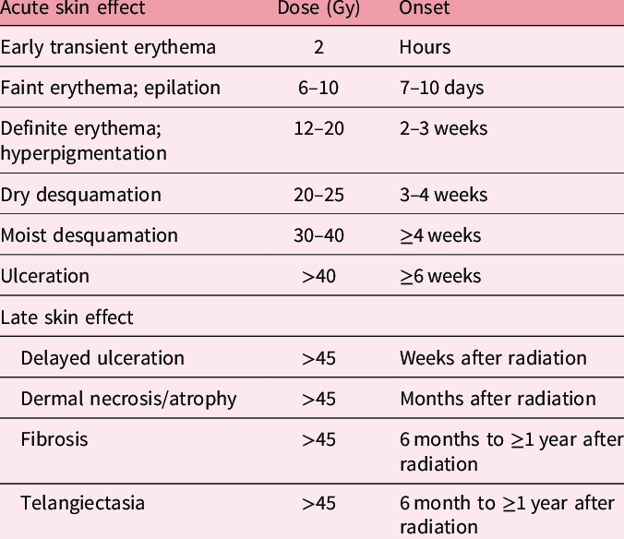
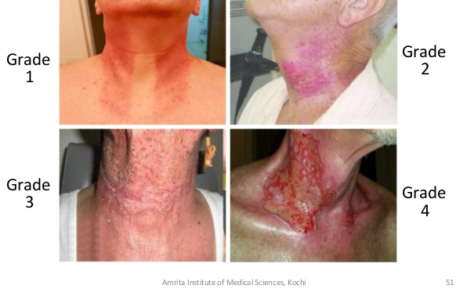
Why are we concern about skin dose?
Skin is the first entry point of a fluoroscopy-guided procedure, the dose metrics can help to estimate the organ(s) doses and predict radiation effects.
Source: Ryan JL. J Investig Dermatol 2012; 132: 985–993

Slide 6
1. Related Dosimetry Quantities in Fluoroscopy

Slide 7
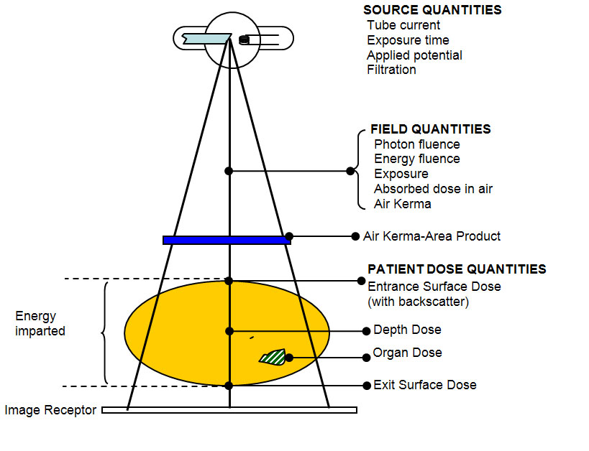
Radiation Dosimetry in General X-ray
Air Kerma: in the air
Dose: involve tissue
Independent of distance along SSD
(mGy.cm²)
Incidence AK (mGy)
(mGy)
Source: Ministry of Health, Malaysia

Slide 8
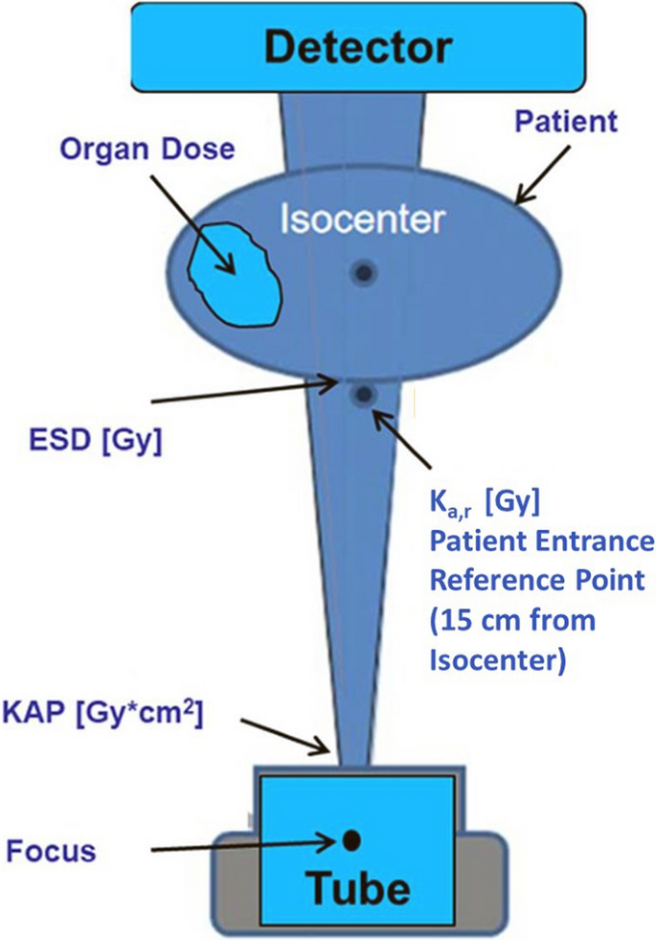
Radiation Dosimetry in Fluoroscopy
Radiation Dosimetry in Fluoroscopy
1.1 Entrance Skin Dose (ESD)
1.2 Backscatter Factors (BSF)
1.3 Kerma-Area Product (KAP)
1.4 Patient Entrance Reference Point (IRP)
1.5 Reference Air Kerma (K_{a,r})
1.6 Table Transmission Factors
1.7 Peak Skin Dose (PSD)
“Dose Alarm”
15 cm
Source: Loose & Wucherer. Cardiovasc Intervent Radiol, 2011: 835–841

Slide 9
1.1 Entrance Surface Dose (ESD)
Radiation Dosimetry in Fluoroscopy
1.1 Entrance Skin Dose (ESD)
1.2 Backscatter Factors (BSF)
1.3 Kerma-Area Product (KAP)
1.4 Patient Entrance Reference Point (IRP)
1.5 Reference Air Kerma (K_{a,r})
1.6 Table Transmission Factors
1.7 Peak Skin Dose (PSD)
“Dose Alarm”
Absorbed dose is a property of the absorbing medium as well as the radiation field, and the exact composition of the medium should be clearly stated.
Usually ESD refers to soft tissue (muscle) or water.
Absorbed dose in muscle is related to absorbed dose in air by the ratio of the mass energy coefficients.

Slide 10
1.1 Entrance Surface Dose (ESD)
Radiation Dosimetry in Fluoroscopy
1.1 Entrance Skin Dose (ESD)
1.2 Backscatter Factors (BSF)
1.3 Kerma-Area Product (KAP)
1.4 Patient Entrance Reference Point (IRP)
1.5 Reference Air Kerma (K_{a,r})
1.6 Table Transmission Factors
1.7 Peak Skin Dose (PSD)
“Dose Alarm”
The obtained value for all typical diagnostic X-ray qualities can be assumed to be 1.06 (± 1%)
F =
where (µ_{en}/ρ) are the mass energy coefficients of water and air, respectively.
⎛
⎛
µ
⎞
⎛
µ
⎞
⎞
⎜
⎜
en
⎟
⎜
en
⎟
⎟
≈
1.06
⎜
⎟
⎜
⎟
⎝
⎝
ρ
⎠
⎝
ρ
⎠
⎠
water
air

Slide 11
1.1 Entrance Surface Dose (ESD)
Radiation Dosimetry in Fluoroscopy
1.1 Entrance Skin Dose (ESD)
1.2 Backscatter Factors (BSF)
1.3 Kerma-Area Product (KAP)
1.4 Patient Entrance Reference Point (IRP)
1.5 Reference Air Kerma (K_{a,r})
1.6 Table Transmission Factors
1.7 Peak Skin Dose (PSD)
“Dose Alarm”
On the other hand, the ESD measured on the surface of the patient or phantom includes a contribution from photons scattered back from deeper tissues, which is not present for free air measurements.
For this reason, correction factor (backscatter factor) must be introduced.
If measurements are made at other distances than the true focus-to-skin distance, doses must be corrected by the inverse square law.

Slide 12
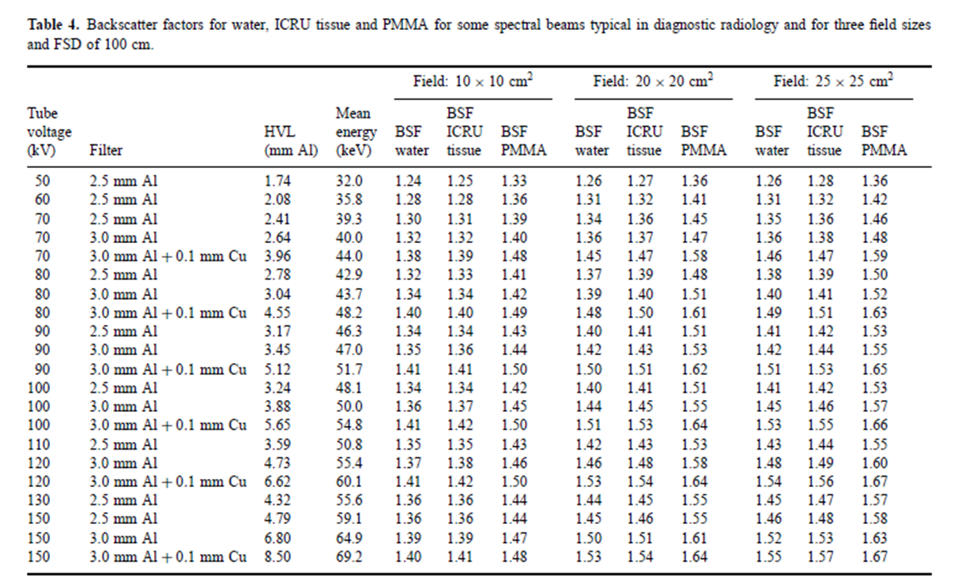
1.2 Backscatter factors (Water/soft tissue)
Radiation Dosimetry in Fluoroscopy
1.1 Entrance Skin Dose (ESD)
1.2 Backscatter Factors (BSF)
1.3 Kerma-Area Product (KAP)
1.4 Patient Entrance Reference Point (IRP)
1.5 Reference Air Kerma (K_{a,r})
1.6 Table Transmission Factors
1.7 Peak Skin Dose (PSD)
“Dose Alarm”
BSF depends on:
kVp
Filtration
FOV
https://www-pub.iaea.org/MTCD/Publications/PDF/TRS457_web.pdf

Slide 13
1.2 Backscatter factors (Water/soft tissue)
X-ray tube
& housing
Radiation Dosimetry in Fluoroscopy
1.1 Entrance Skin Dose (ESD)
1.2 Backscatter Factors (BSF)
1.3 Kerma-Area Product (KAP)
1.4 Patient Entrance Reference Point (IRP)
1.5 Reference Air Kerma (K_{a,r})
1.6 Table Transmission Factors
1.7 Peak Skin Dose (PSD)
“Dose Alarm”
ESAK = entrance skin air kerma (mGy)
ESD = entrance skin dose (mGy)
BSF = back scatter factor
kVp = X-ray tube peak kilovoltage
FOV = field of view
ESD = ESAK * BSF
BSF depends on:
- kVp
- Filtration
- FOV
BSF for conventional radiography is in the range 1.2 to 1.5, generally use 1.3
This means the ESD is 30% higher due to backscatter from the patient themselves

Slide 14
1.3 Kerma Area Product (KAP or P_{KA})
Radiation Dosimetry in Fluoroscopy
1.1 Entrance Skin Dose (ESD)
1.2 Backscatter Factors (BSF)
1.3 Kerma-Area Product (KAP)
1.4 Patient Entrance Reference Point (IRP)
1.5 Reference Air Kerma (K_{a,r})
1.6 Table Transmission Factors
1.7 Peak Skin Dose (PSD)
“Dose Alarm”
KAP is the product of the intensity of the radiation beam (air kerma) multiplied by the area.
KAP (Gy·cm²) is constant with distance since the cross section of the beam is a quadratic function which cancels the inverse quadratic dependence on dose.
Previously known as dose-area product (DAP)

Slide 15
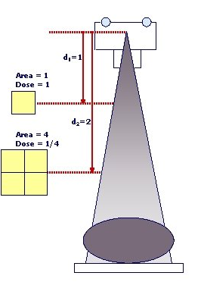
1.3 Kerma Area Product (KAP or P_{KA})
Radiation Dosimetry in Fluoroscopy
1.1 Entrance Skin Dose (ESD)
1.2 Backscatter Factors (BSF)
1.3 Kerma-Area Product (KAP)
1.4 Patient Entrance Reference Point (IRP)
1.5 Reference Air Kerma (K_{a,r})
1.6 Table Transmission Factors
1.7 Peak Skin Dose (PSD)
“Dose Alarm”
KAP is independent of source distance:
  D decrease with the inverse square law
  Area increase with the square distance
  The effects cancel each other out
KAP 1 = KAP 2

Slide 16
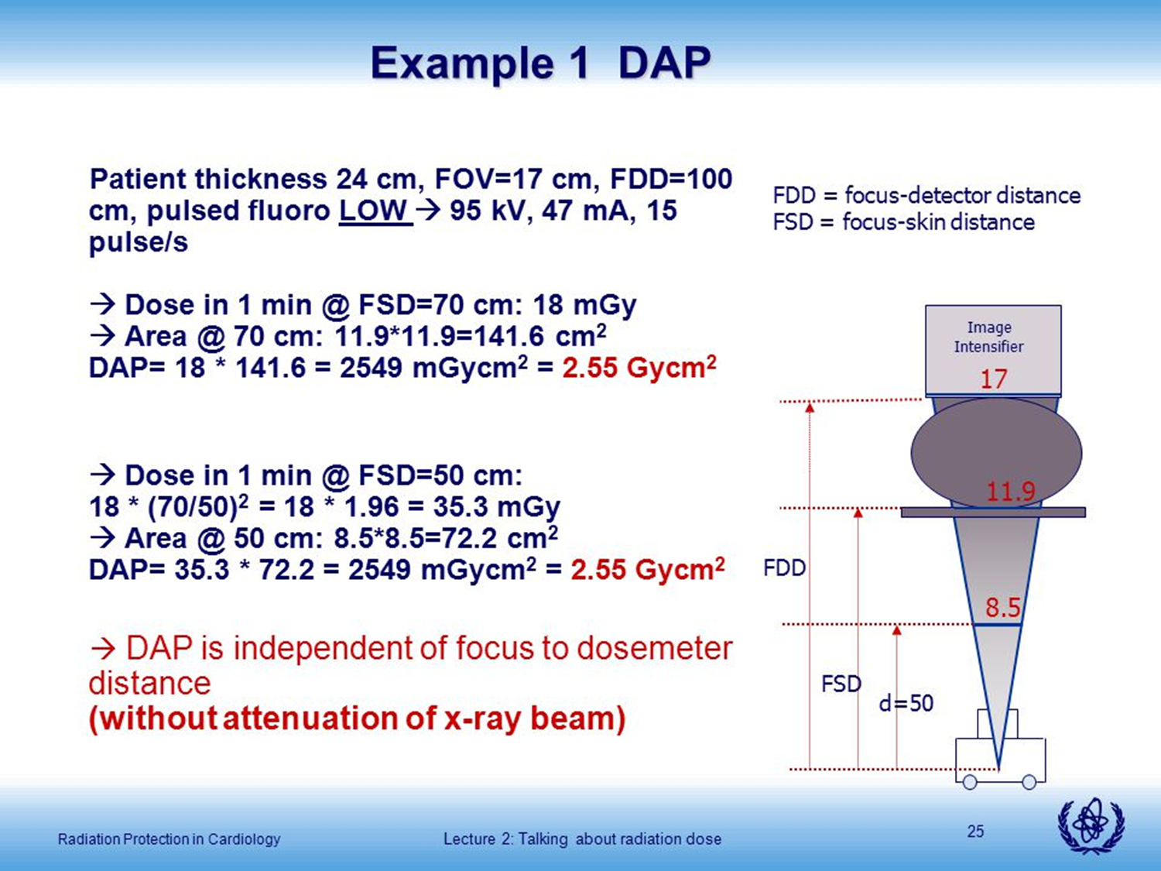
1.3 Kerma Area Product (KAP or P_{KA})
Radiation Dosimetry in Fluoroscopy
1.1 Entrance Skin Dose (ESD)
1.2 Backscatter Factors (BSF)
1.3 Kerma-Area Product (KAP)
1.4 Patient Entrance Reference Point (IRP)
1.5 Reference Air Kerma (K_{a,r})
1.6 Table Transmission Factors
1.7 Peak Skin Dose (PSD)
“Dose Alarm”
Example:
cm
Inverse square law
D = 100 cm
cm
DAP2 = 100 mGy x (50/70)² x (11.9 cm)²
= 7225 mGycm²
D = 70 cm
cm
DAP1 = 100 mGy x (8.5 cm)²
= 7225 mGycm²
cm

Slide 17
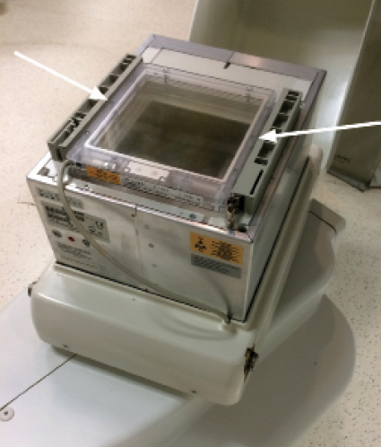
1.3 KAP Meter
Radiation Dosimetry in Fluoroscopy
1.1 Entrance Skin Dose (ESD)
1.2 Backscatter Factors (BSF)
1.3 Kerma-Area Product (KAP)
1.4 Patient Entrance Reference Point (IRP)
1.5 Reference Air Kerma (K_{a,r})
1.6 Table Transmission Factors
1.7 Peak Skin Dose (PSD)
“Dose Alarm”
KAP meter with flat transparent ionization chamber
In some systems, KAP is calculated from kV, filtration, mAs, diaphragm’s position
KAP Meter
X-ray Tube
KAP meter is slightly larger than the beam to capture the entire beam.

Slide 18
1.3 KAP Display
Radiation Dosimetry in Fluoroscopy
1.1 Entrance Skin Dose (ESD)
1.2 Backscatter Factors (BSF)
1.3 Kerma-Area Product (KAP)
1.4 Patient Entrance Reference Point (IRP)
1.5 Reference Air Kerma (K_{a,r})
1.6 Table Transmission Factors
1.7 Peak Skin Dose (PSD)
“Dose Alarm”
Source: Vijayan et al, Proc. Of SPIE Vol 9783, 97836G

Slide 19
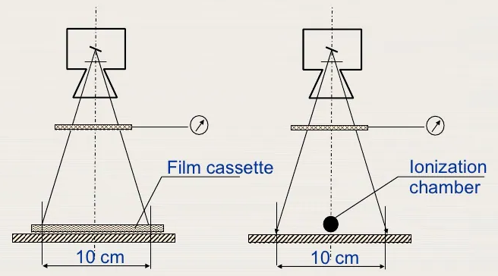
1.3 Calibration of KAP meter
It is always necessary to calibrate and check the KAP meter
In some countries, it is compulsory that new equipment is equipped with an integrated KAP meter.
It is convenient, however, some systems overestimate the real KAP value
Calibration of KAP Meter
Radiation Dosimetry in Fluoroscopy
1.1 Entrance Skin Dose (ESD)
1.2 Backscatter Factors (BSF)
1.3 Kerma-Area Product (KAP)
1.4 Patient Entrance Reference Point (IRP)
1.5 Reference Air Kerma (K_{a,r})
1.6 Table Transmission Factors
1.7 Peak Skin Dose (PSD)
“Dose Alarm”

Slide 20
1.3 KAP to Effective Dose Conversion Factors
Groups/Subgroups | Examinations | Dose Conversion Coefficient (DCC) (mSv/Gy∙cm²⁾
Urinary studies | Cystometrography, Cystography, Excretory urography, micturating cysto-urethrography, Urethrography | 0.18
Endoscopic retrograde cholangio-pancreatography (ERCP) |  | 0.26
Arthrograms |  | 0.1
Orthopaedic procedures |  | 0.01
Vertebroplasty |  | 0.2
Obstetrics and gynaecology procedure | Pelvimetry | 0.29
 | Hysterosalpingogram | 0.29
Noncardiac diagnostic procedures
Peripheral vascular | Arteriography (all types) | 0.26
 | Peripheral phlebography/venography | 0.1
 | Carotid and cerebral angiography | 0.087
Renal | Antegrade pyelography, Retrograde pyelography | 0.18
 | Renal angiogram, Abdominal aortography | 0.26
 | Thoracic aortography, arch angiogram | 0.12
Radiation Dosimetry in Fluoroscopy
1.1 Entrance Skin Dose (ESD)
1.2 Backscatter Factors (BSF)
1.3 Kerma-Area Product (KAP)
1.4 Patient Entrance Reference Point (IRP)
1.5 Reference Air Kerma (K_{a,r})
1.6 Table Transmission Factors
1.7 Peak Skin Dose (PSD)
“Dose Alarm”
Ref: Report No. 160 - Ionizing Radiation Exposure of the Population of the United States (2009)

Slide 21
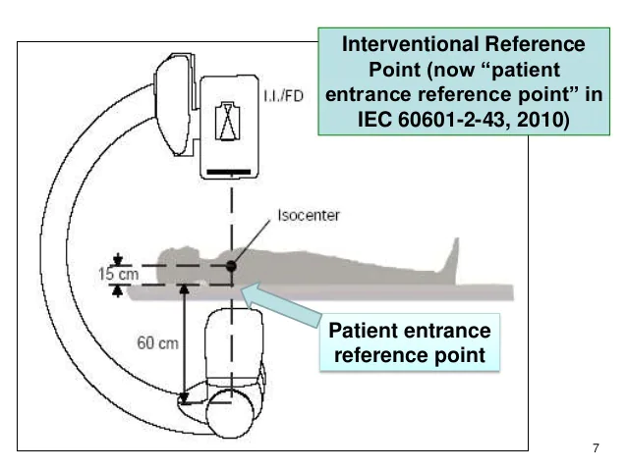
1.4 Patient Entrance Reference Point (formerly IRP)
For isocentric fluoro systems, IRP is a point in space along the central X-ray beam, 15 cm back from the isocenter toward the X-ray tube.
It is now known as Patient Entrance Reference Point (IED60601-2-43)
This is the point where the K_{a,r} is reported.
Radiation Dosimetry in Fluoroscopy
1.1 Entrance Skin Dose (ESD)
1.2 Backscatter Factors (BSF)
1.3 Kerma-Area Product (KAP)
1.4 Patient Entrance Reference Point (IRP)
1.5 Reference Air Kerma (K_{a,r})
1.6 Table Transmission Factors
1.7 Peak Skin Dose (PSD)
“Dose Alarm”
K_{a,r}

Slide 22
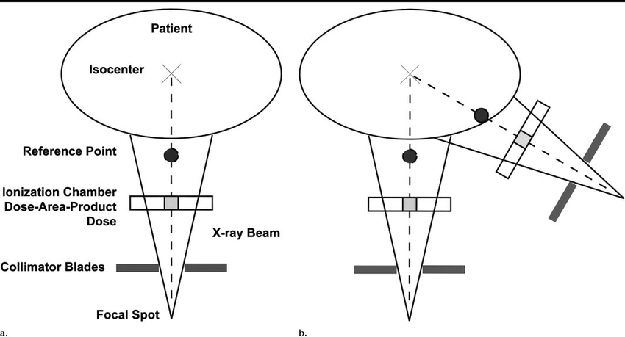
1.5 Reference Air Kerma (K_{a,r})
K_{a,r} is only a rough approximation of skin dose; it is not equivalent to the skin dose.
The IRP may correspond to the skin level, a point within the patient, or a point outside of the patient.
In addition, Ka,r does not include beam repositioning, backscatter, or the attenuation of the table.
Ka,r has also been referred to as “cumulative dose” and “air kerma at the reference point”.
Radiation Dosimetry in Fluoroscopy
1.1 Entrance Skin Dose (ESD)
1.2 Backscatter Factors (BSF)
1.3 Kerma-Area Product (KAP)
1.4 Patient Entrance Reference Point (IRP)
1.5 Reference Air Kerma (K_{a,r})
1.6 Table Transmission Factors
1.7 Peak Skin Dose (PSD)
“Dose Alarm”
15 cm
15 cm
K_{a,r}
K_{a,r}
Note: No meter is positioned at the IRP. Rather, air kerma is measured close to the source in the center of the beam. Then, using the inverse square law, the value is calculated for the IRP and displayed.

Slide 23
1.6 Table Transmission Factors
Table transmission depends on X ray energy, filtration (beam quality)
Radiation Dosimetry in Fluoroscopy
1.1 Entrance Skin Dose (ESD)
1.2 Backscatter Factors (BSF)
1.3 Kerma-Area Product (KAP)
1.4 Patient Entrance Reference Point (IRP)
1.5 Reference Air Kerma (K_{a,r})
1.6 Table Transmission Factors
1.7 Peak Skin Dose (PSD)
“Dose Alarm”
Filtration: 2.5 mm Al

Slide 24
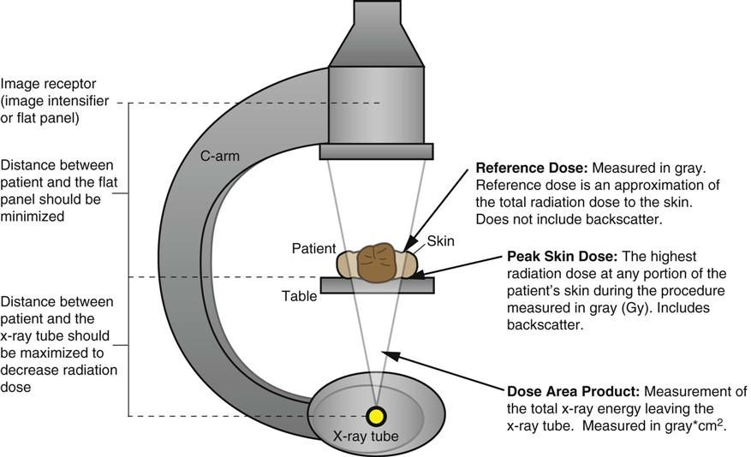
1.6 Peak Skin Dose (PSD)
Radiation Dosimetry in Fluoroscopy
1.1 Entrance Skin Dose (ESD)
1.2 Backscatter Factors (BSF)
1.3 Kerma-Area Product (KAP)
1.4 Patient Entrance Reference Point (IRP)
1.5 Reference Air Kerma (K_{a,r})
1.6 Table Transmission Factors
1.7 Peak Skin Dose (PSD)
“Dose Alarm”

Slide 25
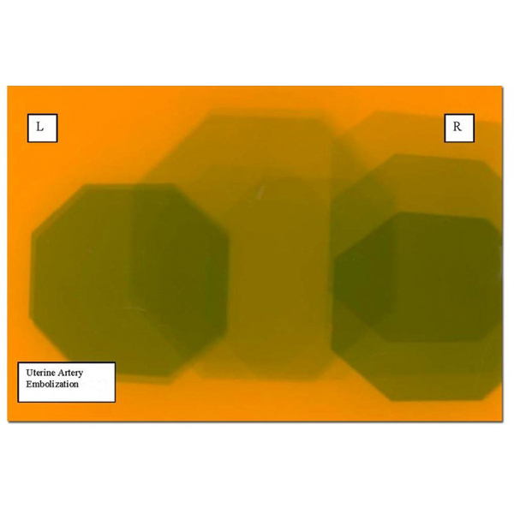
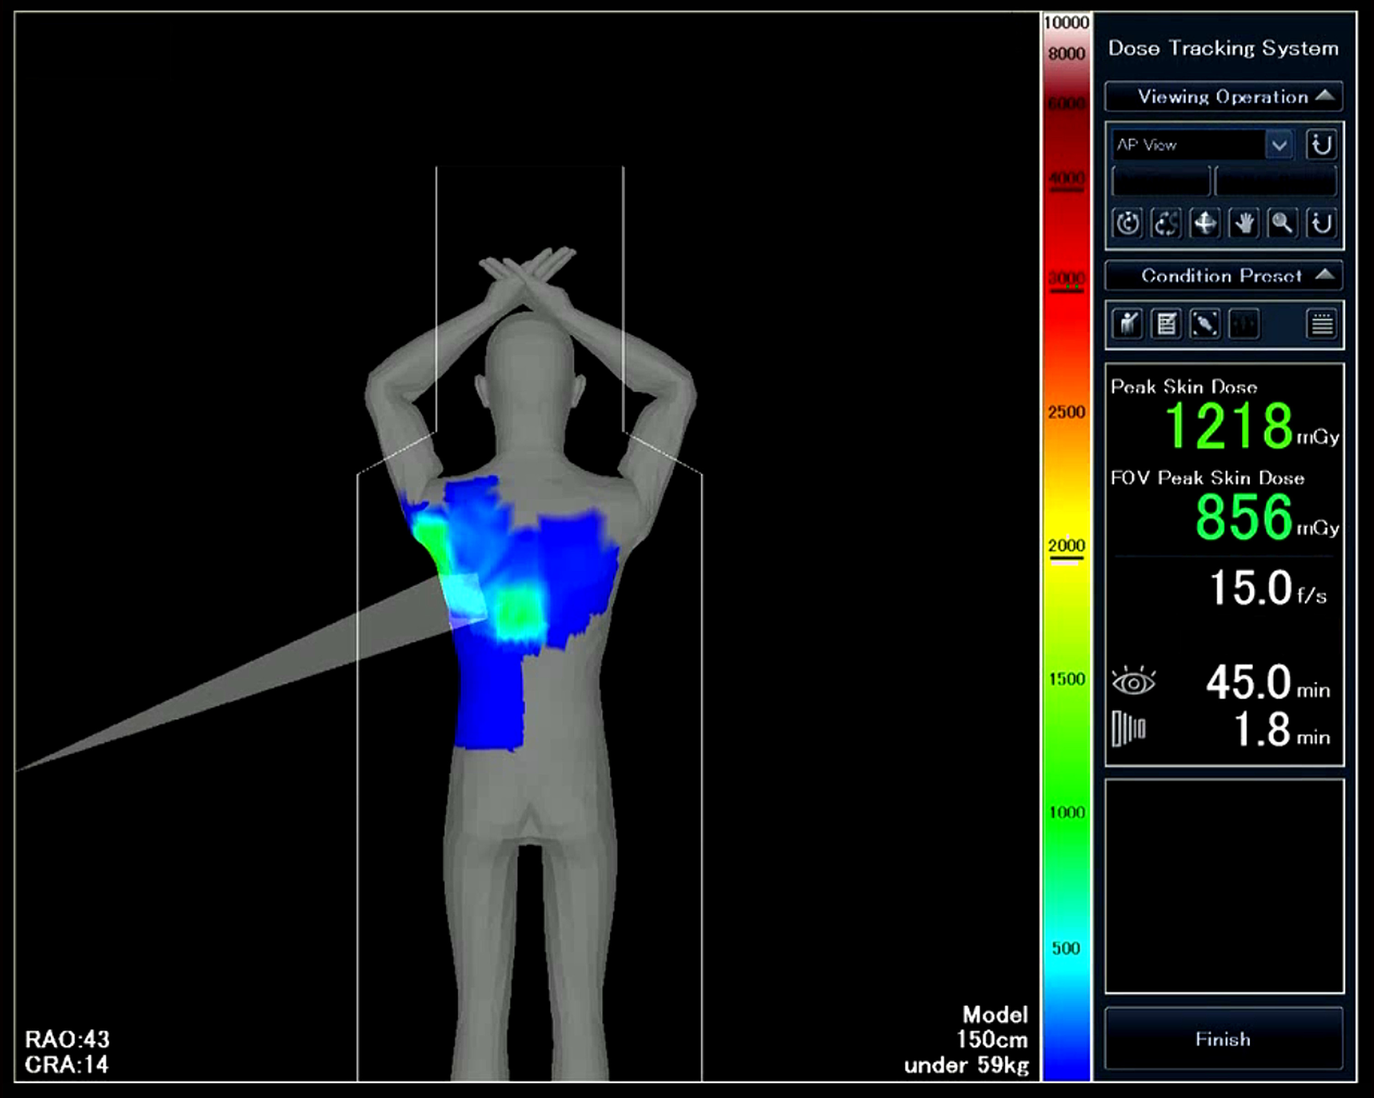
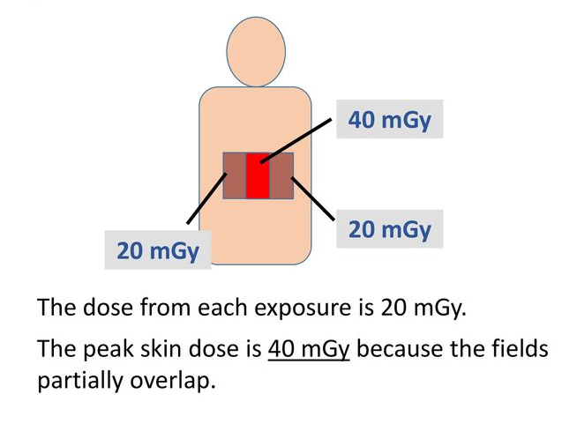
1.7 Peak Skin Dose (PSD)
Radiation Dosimetry in Fluoroscopy
1.1 Entrance Skin Dose (ESD)
1.2 Backscatter Factors (BSF)
1.3 Kerma-Area Product (KAP)
1.4 Patient Entrance Reference Point (IRP)
1.5 Reference Air Kerma (K_{a,r})
1.6 Table Transmission Factors
1.7 Peak Skin Dose (PSD)
“Dose Alarm”
Some advanced systems provide real-time dose tracking system

Slide 26
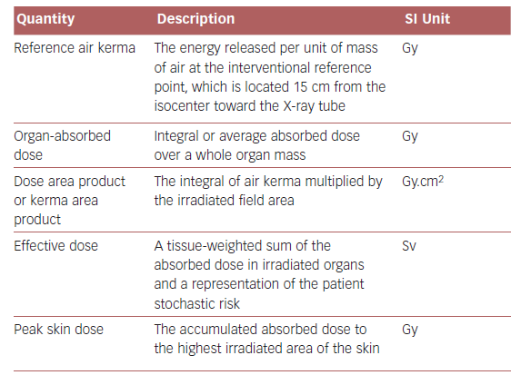
Summary

Slide 27
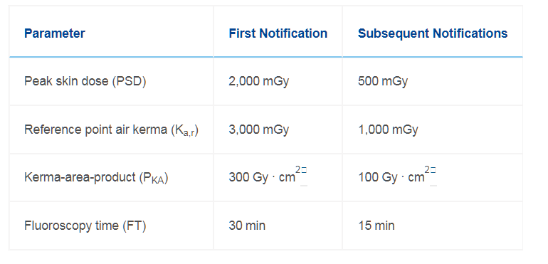
“Dose Alarms”
Radiation Dosimetry in Fluoroscopy
1.1 Entrance Skin Dose (ESD)
1.2 Backscatter Factors (BSF)
1.3 Kerma-Area Product (KAP)
1.4 Patient Entrance Reference Point (IRP)
1.5 Reference Air Kerma (K_{a,r})
1.6 Table Transmission Factors
1.7 Peak Skin Dose (PSD)
“Dose Alarm”
If dosimetry interface available
Threshold dose for erythema
If dose calibration available
If KAP meter available
*Assuming 100 cm² FOV at the patient's skin. The value should be adjusted to the actual procedural field size.
Ref: Society of Interventional Radiology, USA

Slide 28
2. Estimating (Calculation) Patient Skin Dose

Slide 29
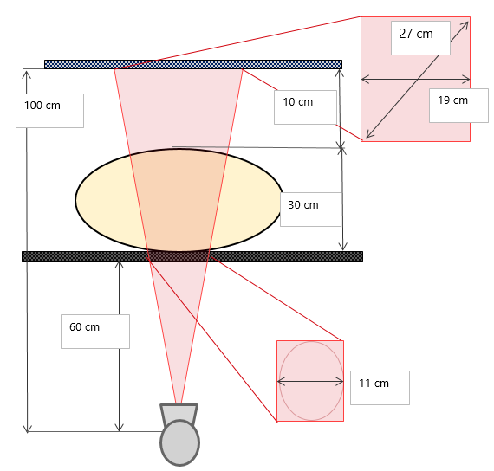
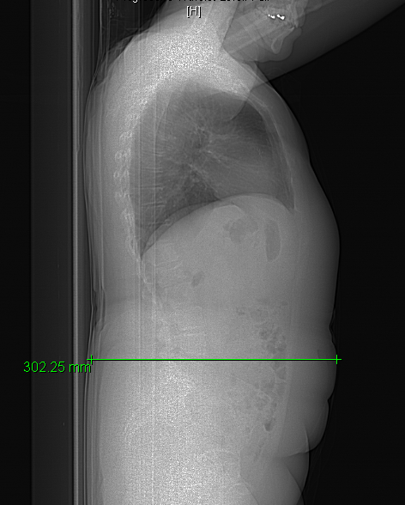
Exercise: Calculate Patient Skin Dose
Step 1: Fill in the labels on the diagram
Abdominal angio, 70 kVp, 2.5 mmAl + 0.6 mmCu filtration
SID = 100 cm
IRP = 55 cm
Air gap = 10 cm
Square FOV = 27 cm (diagonal)
Assume tube does not move – PA angle
K_{a,r} = 3 Gy

Slide 30
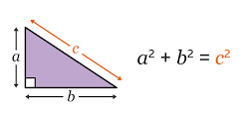
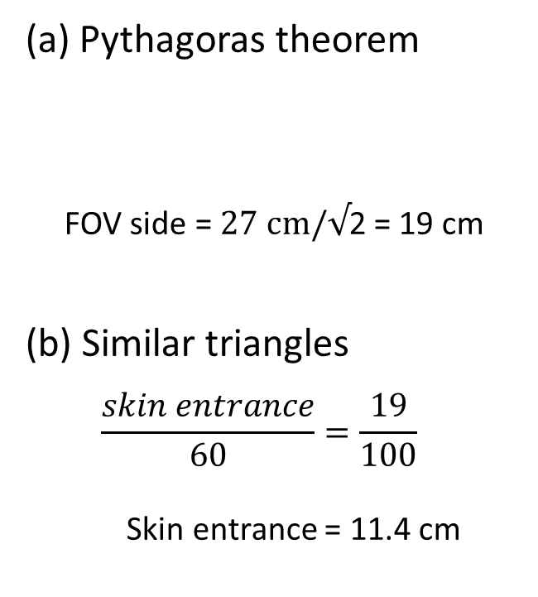
Exercise: Calculate Patient Skin Dose
Step 2: What is the peak skin dose?
(a) Pythagoras theorem
  FOV side = $27 cm/√$2 = 19 cm
(b) Similar triangles
  $$\frac{skin entrance}{60}=\frac{19}{100}$$
  Skin entrance = 11.4 cm
(a)
(b)

Slide 31
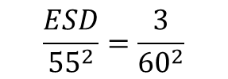
Exercise: Calculate Patient Skin Dose
ESD = K_{a,r} x ISL x BSF x f-factor x table transmission
ESD = 3 Gy x (55 cm)²/(60 cm)² x BSF x f-factor x table transmission
= 2.5 Gy x 1.31 x 1.06 x
0.75
= 2.6 Gy
*
K_{a,r} = 3 Gy
IRP
55 cm
ISL:
$$\frac{ESD}{{55}^{2}}=\frac{3}{{60}^{2}}$$

Slide 32
Exercise: Calculate Patient Skin Dose
Step 3: Can you work out the KAP?
Without BSF, f-factor, table correction
KAP = 2.5 Gy x 11 cm x 11 cm = 303 Gy·cm²
KAP 2
ESD = 2.6 Gy
*
K_{a,r} = 3 Gy
IRP
55 cm
KAP 1
KAP 1 = KAP 2

Slide 33
Exercise: Calculate Patient Skin Dose
Step 4: What is the effective dose estimate?
Report No. 160 - Ionizing Radiation Exposure of the Population of the United States (2009)
https://www.iaea.org/resources/rpop/health-professionals/interventional-procedures/radiation-doses-in-interventional-fluoroscopy#3
Effective dose = 303 Gy·cm² x 0.26 mSv/Gy·cm²
= 78 mSv
ESD = 2.6 Gy
*
K_{a,r} = 3 Gy
IRP
55 cm
KAP = 303 Gy·cm²

Slide 34
Homework
If the IRP = 65 cm and the patient is 35 cm from the tube, will the skin dose be higher or lower than the cumulative air kerma? By how much?
What factors need to be taken into account when calculating peak skin dose from the cumulative air kerma?
How do you currently record patient dose quantities at your hospital?
Notes:
1. ESD = Ka,r x (65^2 / 35^2)
= 3.45 Ka,r
2. ISL, BSF (~1.3), f-factor (1.06), Table transmission factor (~75%)
3. My experience is that it is a combination of:
Fluoroscopy time
Cumulative air kerma
Kerma area product
PSD, MSD (if available)

Slide 35
References
IAEA Training Material on Radiation Protection in Diagnostic and Interventional Radiology
ICRP Publication 85: Avoidance of Radiation Injuries from Medical Interventional Procedures, 2000.
ICRP Publication 113: Education and Training in Radiological Protection for Diagnostic and Interventional Procedures, 2009.
ICRP Publication 117:Radiological Protection in Fluoroscopically Guided Procedures outside the Imaging Department, 2010.
National Council on Radiation Protection and Measurements (NCRP) Report 168: Radiation Dose Management for Fluoroscopically Guided Interventional Medical Procedures, 2010.
ICRP (2007). The 2007 Recommendations of the International Commission on Radiological Protection

Slide 36
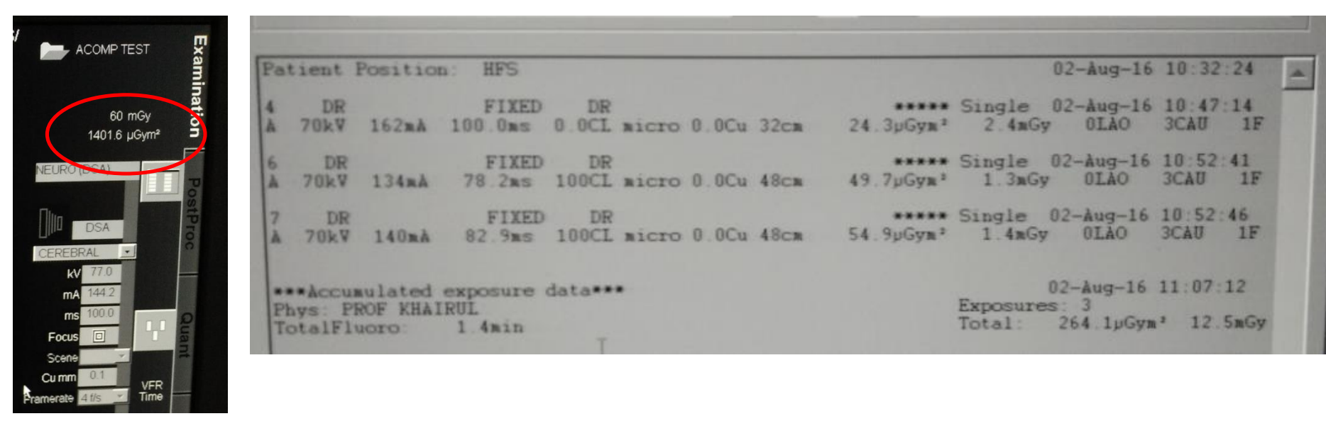
Radiation Dose Structured Report

