Slide 1





The Physicist’s Role in Minimizing Downtime in Radiology
David Caldwell
Senior Medical Physicist
Mater Misericordiae University Hospital, Dublin, Ireland.
✉: davidcaldwell@mater.ie

Slide 2
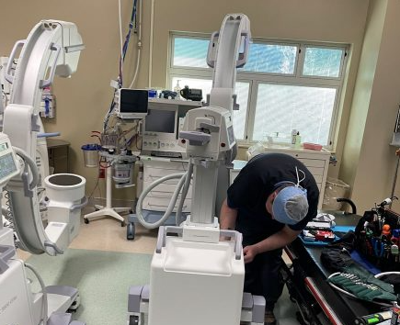
“Downtime” definition
  Downtime refers to “a period of time when something, such as a machine or system, is not operational or not performing its intended function”.
  Downtime can occur due to various reasons, such as scheduled maintenance, unscheduled repairs, equipment failure, or software updates.
  Downtime in Radiology is inevitable. We cannot eliminate it, but we should aim to minimize it.
https://1904htm.com/services/imaging-service/c-arm-repair/
Notes:
Downtime in the context of equipment in a hospital refers to the period during which the equipment is not operational or available for use. It is the time when the equipment is offline or undergoing maintenance, repair, or calibration. Downtime can occur due to various reasons, such as scheduled maintenance, unscheduled repairs, equipment failure, or software updates.
During downtime, the equipment is not able to perform its intended functions, which can have significant implications for patient care and workflow efficiency in a hospital setting. Therefore, minimizing downtime and ensuring quick resolution of equipment issues are crucial to maintain the smooth operation of healthcare facilities.

Slide 3
Impact of Downtime on the Hospital
  Issues concerning radiology equipment are important to hospital managers because they account for a significant share of the hospital budget.
  According to the American College of Radiology (ACR), Radiology typically accounts for around 10-15% of a hospital's total budget^{[1]}.
  The complexities of modern Radiology equipment can give rise to additional durability and/or reliability issues.
Notes:
https://pubs.rsna.org/doi/full/10.1148/radiol.2020209027

Slide 4
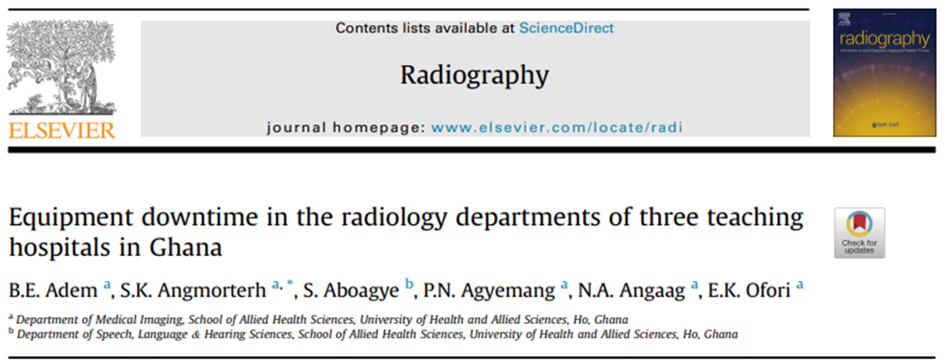
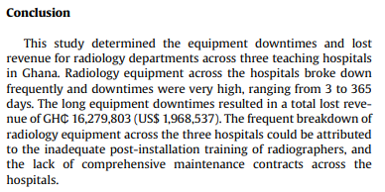
Case Study: Ghana^{[2]}
  Key Messages:
  Much of the Radiology equipment has been donated, but 70% of the equipment is unserviceable.
  Lost revenue of up to $2m/year.
  Rapidly increasing population puts even more strain on Radiology services.
  Expatriating maintenance services are very expensive.
  Comprehensive post-installation training for staff decreases downtime and should be included in contract where possible.
Notes:
https://doi.org/10.1016/j.radi.2023.06.002

Slide 5
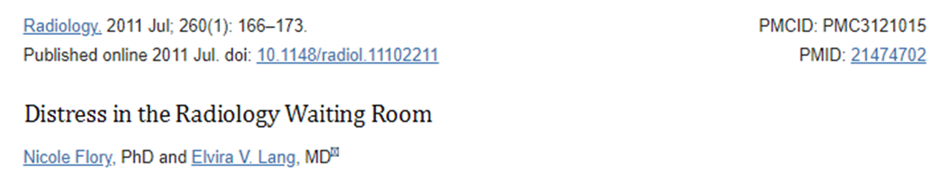

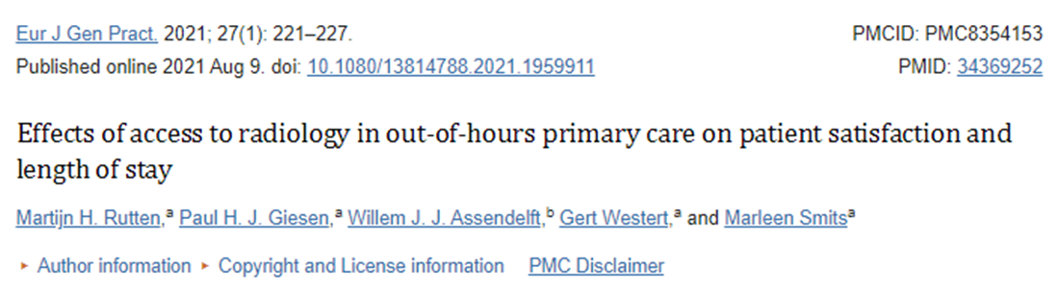
Impact of Downtime on the Patient
  Increased distress and anxiety^{[3]}:
  Delayed diagnosis and treatment^{[4]}:
  Patient dissatisfaction^{[5]}:
Notes:
The effect of downtime in radiology on patients can be significant. Here are some key points to consider:
Increased distress and anxiety: When patients have to wait for radiologic procedures due to downtime, the uncertainty of their diagnosis can lead to greater stress and anxiety[6]. This can be especially true for procedures like breast biopsies, where patients reported significantly higher levels of anxiety compared to other procedures.
Delayed diagnosis and treatment: Downtime in radiology can result in delayed diagnosis and treatment, especially for trauma patients. Timely access to radiological systems is crucial in managing polytraumatized patients and enabling prompt diagnosis and treatment to reduce patient mortality.
Patient satisfaction: Patients appreciate direct access to radiology facilities, as it reduces their length of stay (LOS) and provides more efficient care. Access to radiology by general practitioner (GP) cooperatives has been shown to decrease the number of emergency department referrals and contribute to patient-centered care.
Communication and transparency: During downtime, it is important to keep patients informed about the situation and provide updates on when the system is expected to be back online. This helps manage patient expectations and reduces unnecessary inquiries to the IT department.

Slide 6
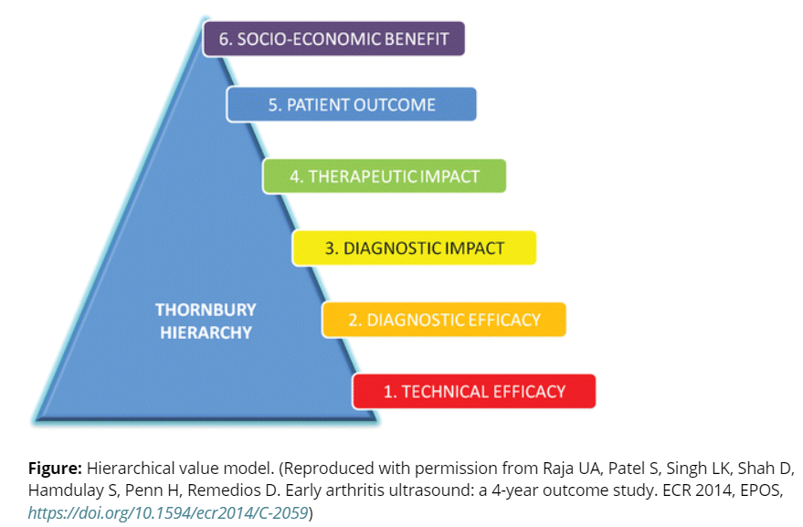
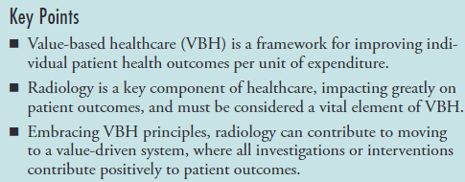
Value-Based Healthcare
Medical Physicists role!
Optimization
Quality (Assurance/ Control & Management)

Slide 7
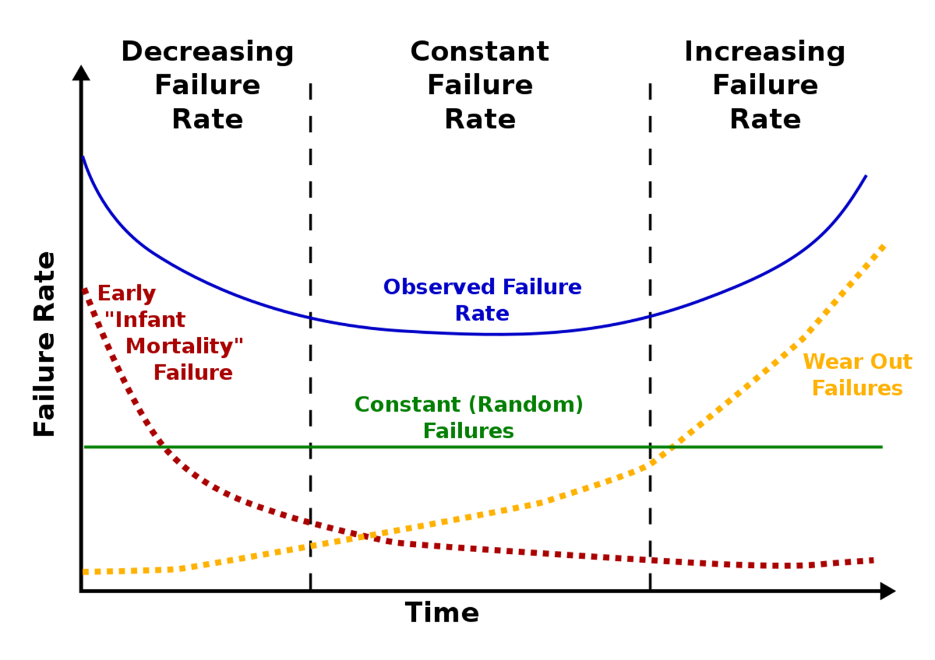
“Bathtub” Curve of Equipment Failure
  The bathtub curve is a graphical representation of the failure rate of equipment over time.
  The curve has three distinct regions:
    Infant Mortality period
    Normal Life period
    Wear Out period
https://en.wikipedia.org/wiki/Bathtub_curve
Notes:
Infant mortality period: This is the beginning of the equipment's lifecycle, where there is a high rate of failures. These failures are often a result of manufacturer defects, incorrect installation, or improper usage. During this period, it is common to discover failures that can be replaced under warranty or correct human errors to prevent future failures.
Normal life period: This is the middle region of the curve, where the failure rate remains relatively constant. Failures during this period are random and cannot be eliminated by burn-in periods or preventive maintenance practices. The length of this period is typically much greater than the other two regions.
Wear-out period: This is the end-of-life period of the equipment, where failures occur due to wear and tear. The failure rate increases sharply during this period as the equipment and its parts reach the end of their designed useful life. Depending on the asset, some parts may be replaceable to reset the curve and extend the overall lifecycle of the equipment.

Slide 8
“Ideal” (Achievable) Bathtub Curve
  A perfect bathtub curve would show no faults – but this is completely unrealistic.
  What is achievable is:
    Decreasing early faults.
    Remain as long in the constant failure rate period as possible.
    Recognise when we have reached the increasing failure rate to plan for equipment replacement.
https://en.wikipedia.org/wiki/Bathtub_curve

Slide 9
“Bathtub” Curve of Equipment Failure
https://en.wikipedia.org/wiki/Bathtub_curve

Slide 10
“Infant Mortality” Failures
  Manufacturer defects: Flaws that are inherent in the product due to issues during the manufacturing process.
  Incorrect installation: If an asset is not installed correctly, it may fail early in its lifecycle. This includes hardware, software and interconnectivity with PACS systems.
  Improper usage: If operators use an asset incorrectly due to poor training or unfamiliarity with the asset, it could lead to early failures.
  Material defects: These are failures caused by the use of sub-standard or inappropriate materials during manufacturing.
Notes:
Manufacturer defects: Flaws that are inherent in the product due to issues during the manufacturing process. For instance, a faulty detector element. Such failures typically occur very early in the product's life, and discovering them can be beneficial as they can often be replaced under the manufacturer's warranty.
Incorrect installation: If an asset is not installed correctly, it may fail early in its lifecycle. This includes hardware, software and interconnectivity with PACS systems. For example, an incorrect detector gain calibration.
Improper usage: If operators use an asset incorrectly due to poor training or unfamiliarity with the asset, it could lead to early failures. For instance, wrong controls used to move the C-arm causes a crash with surrounding equipment.
Material defects: These are failures caused by the use of substandard or inappropriate materials during manufacturing. This could occur anywhere in the installation and not become apparent until after installation.

Slide 11
Reducing “Infant Mortality” Failures
  Manufacturer defects / Incorrect installation: Comprehensive acceptance testing. End of warranty testing if there any doubts.
  Improper usage: Appropriate training with applications specialists. Physicists should be present for this! Applications specialist should be invited back after a short period of clinical usage.
  Material defects: Can be minimized in the tender specification by selecting good products from reliable vendors.
  Strong communication between technical experts (Vendor, YOU) and project management team will ensure the room is an appropriate environment for the new installation.
Notes:
Manufacturer defects: Flaws that are inherent in the product due to issues during the manufacturing process. For instance, a faulty detector element. Such failures typically occur very early in the product's life, and discovering them can be beneficial as they can often be replaced under the manufacturer's warranty.
Incorrect installation: If an asset is not installed correctly, it may fail early in its lifecycle. This includes hardware, software and interconnectivity with PACS systems. For example, an incorrect detector gain calibration.
Improper usage: If operators use an asset incorrectly due to poor training or unfamiliarity with the asset, it could lead to early failures. For instance, wrong controls used to move the C-arm causes a crash with surrounding equipment.
Material defects: These are failures caused by the use of substandard or inappropriate materials during manufacturing. This could occur anywhere in the installation and not become apparent until after installation.

Slide 12
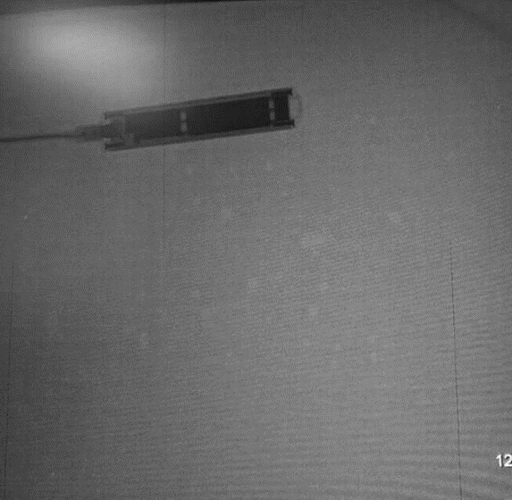
Case Study: Effect of Humidity
  All digital radiology devices are based on electronics and are computer controlled.
  Most computer equipment is specified for ambient operating temperatures between 18 and 30°C, and between 20% and 75% condensing humidity for long term reliable operation.
Detector Failure and Artefacts
  Detector on a newly installed system kept showing artefacts and failing (3 replacements within one year).

Slide 13
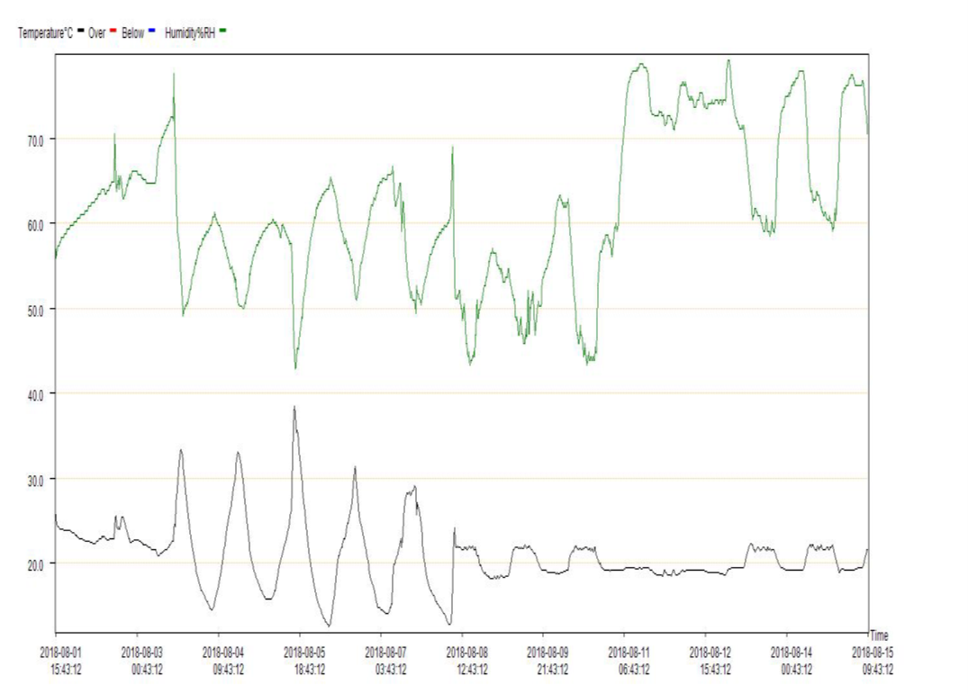
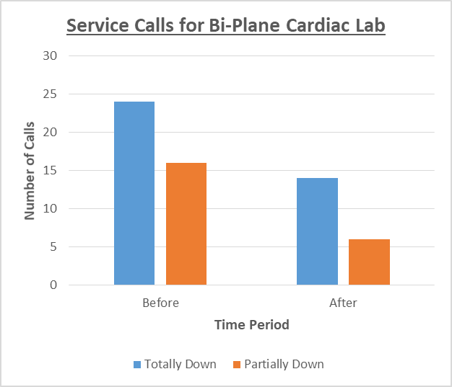
Case Study: Effect of Humidity
Increased humidity above detector tolerance
Notes:
Physicist identified cause of detector failure as humidity
Monitoring initiated
Team effort radiology, hospital admin, and vendor
New air conditioning unit fitted 11/2018
Reduction in service calls

Slide 14
“Bathtub” Curve of Equipment Failure
https://en.wikipedia.org/wiki/Bathtub_curve

Slide 15
Constant Rate Failures
  X-Ray Tube Failures: Overheating, filament failure, high voltage arcing, loss of vacuum, etc.
  Image Intensifier Degradation: Photocathode loses sensitivity, microchannel plate (amplifier) degrades, phosphor screen burn in etc.
  Wear and Tear of C-arm Mechanism: The mechanical components of C-arm fluoroscopy machines have several degrees of freedom and experience constant wear and tear.
  Software Updates and Compatibility: As software evolves and requires updates or becomes less compatible with older hardware components, it can lead to compatibility problems and system instability over time.
Notes:
Tube Failure: X Ray tubes generally last 3-7 years depending on usage. Tube overheating: X-ray tubes can fail due to overheating. This can occur when the heat load exceeds the tube's heat dissipation capacity. Overheating can lead to melting of the anode or the tube envelope, leading to tube failure.
Filament failure: The filament in an X-ray tube can fail due to prolonged use, which leads to thinning of the filament wire and eventual breakage. This is a common cause of x-ray tube failure pubmed.ncbi.nlm.nih.gov.
High voltage arcing: This can occur when there's a short circuit within the x-ray tube. It can cause damage to the tube and lead to its failure.
Loss of vacuum: X-ray tubes operate in a vacuum, and any loss of vacuum can lead to tube failure. This can occur due to a crack in the tube or faulty
Image Intensifier Degradation: The image intensifier in fluoroscopy systems can suffer from gradual deterioration of its components, leading to reduced image brightness and clarity over time. Regular recalibration or replacement may be necessary to maintain optimal image quality.
Wear and Tear of C-arm Mechanism: The mechanical components of C-arm fluoroscopy machines, such as the C-arm itself and its movement mechanisms, can experience constant rate wear and tear. This may result in decreased smoothness of movement, potentially affecting the precision required in interventional procedures.
Fan and Cooling System Reliability: Constant rate failures can occur in the cooling systems of radiology equipment. Over time, fans and cooling components may degrade, leading to increased operating temperatures and a higher risk of overheating, which can affect equipment performance.
Wiring and Connector Deterioration: The wiring and connectors in fluoroscopy equipment may degrade gradually, leading to issues like intermittent electrical connections. Constant rate failures in these components can result in equipment malfunctions or intermittent faults.
Software Updates and Compatibility: Constant rate failures can also arise from software-related issues. As software evolves and requires updates or becomes less compatible with older hardware components, it can lead to compatibility problems and system instability over time.

Slide 16
Reducing Constant Rate Failures
  A strong line of communication is required between Radiographers, Radiology Managers, Physicists, Maintenance Crew and Service Engineers.
  You are often the link between the vendor and staff on the ground!
  Encourage processes to facilitate regular maintenance, e.g., online service portals, automatic e-mails, handover forms etc.
  Get to know the service engineers. Help them troubleshoot where appropriate.
  Make your quality assurance reports readable to non-physicists.
  Keep track of hazard alerts.
  Be aware of “normal” standards of image quality/ doses.

Slide 17
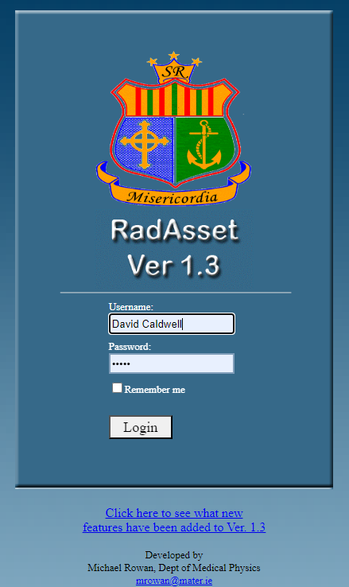
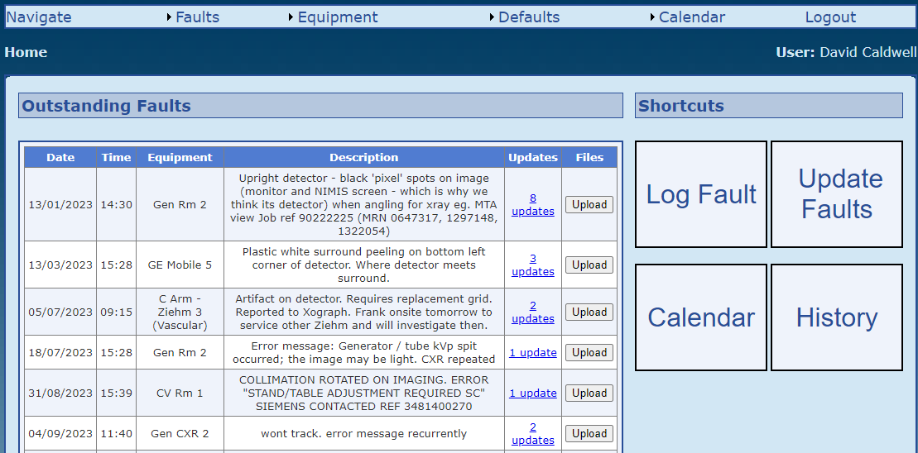
Case Study: Asset Management
Notes:
In house software developed by the medical physics department.
Off the shelf solutions also available

Slide 18
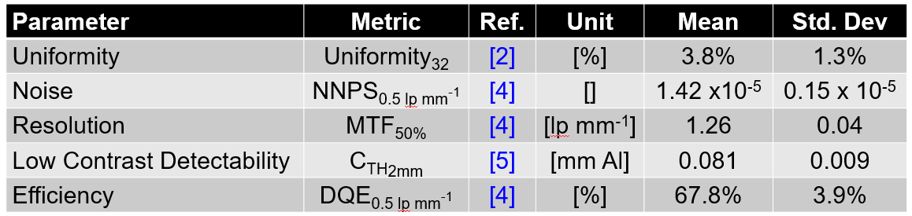
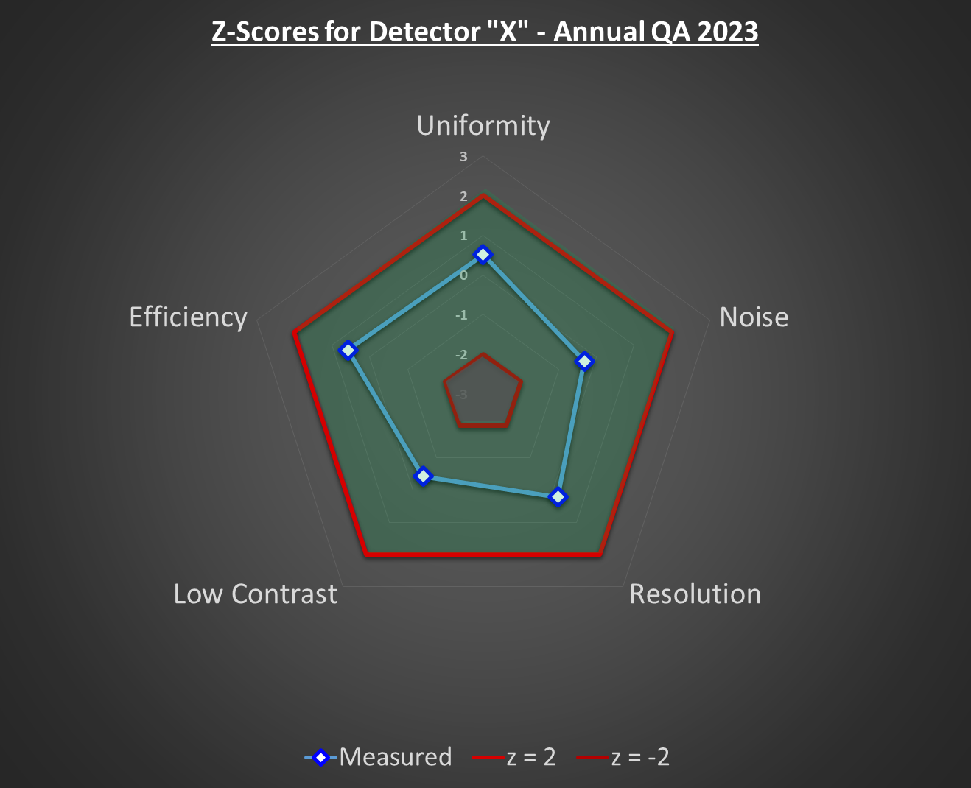
Case Study: Improper Detector Calibration
How do we know that a quality assurance test result is abnormal if there are no tolerances?
With a large bank of quality assurance data gathered over the past five years, the abnormality of a given metric can be assessed
using z-scores, i.e., the number of standard deviations a measured metric is away from the mean.
Z-scores can then be plotted on a radar diagram giving an easy-to-understand visual representation of a detector’s performance. The mean value has a z-score of 0.
Using the Empirical Rule, 95% of data lies within two standard deviations of the mean. Any measured metrics outside this range can easily be identified for further investigation.

Slide 19
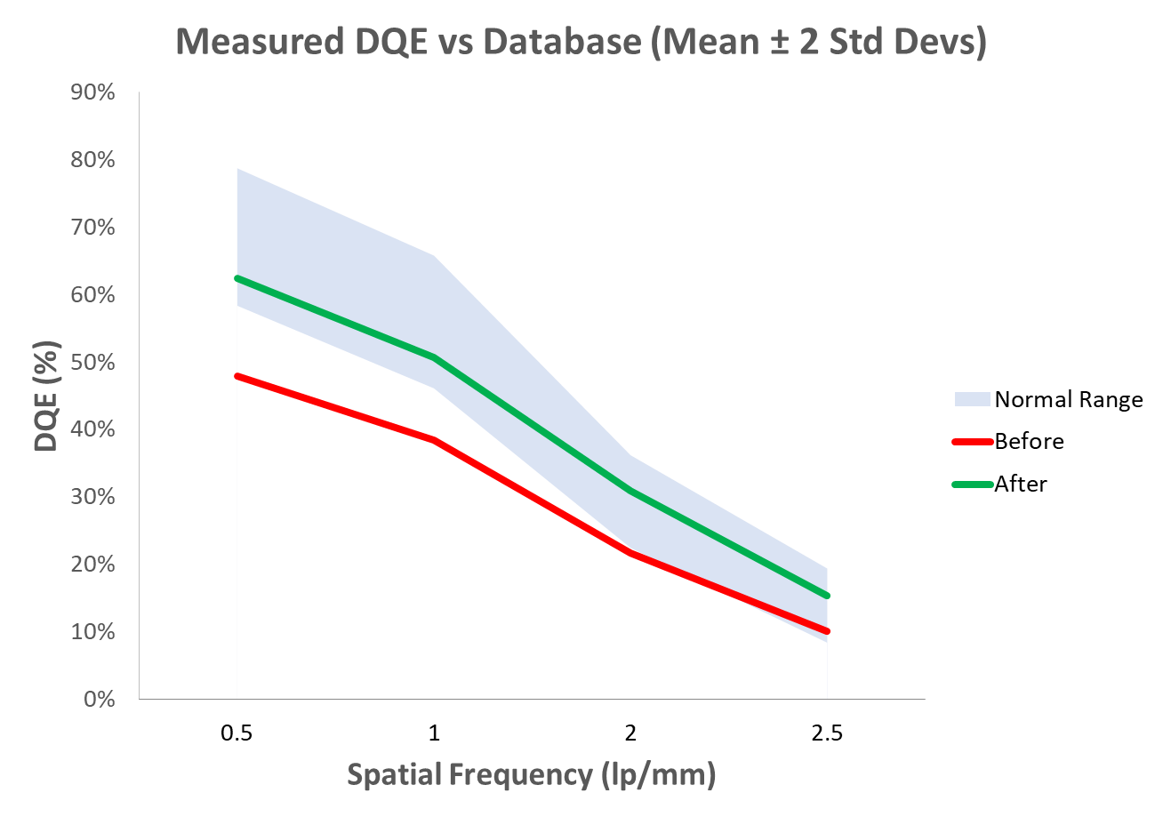
Case Study: Improper Detector Calibration
After a detector replacement, a member of the medical physics team carried out post-service quality assurance.
It was noted that the DQE z-score was well outside the |z| < 2 local tolerance.
Further investigation found that although the detector passed the engineer’s tests, not all of the calibrations had been successfully applied.
Recalibration of the detector brought DQE values back within the “normal” range.

Slide 20
“Bathtub” Curve of Equipment Failure
https://en.wikipedia.org/wiki/Bathtub_curve

Slide 21
Wear Out Failures
  Similar to the constant rate failures, but more frequently as the equipment approaches end of life.
  Watch out for evidence of structural fatigue in the frame and housing as well as exposed/ loose cables.
  Image quality complaints may arise from display screen aging.
  May not be parts available and/or the manufacturer may be unwilling to service the equipment.
  Risk of cyber attacks if security updates are no longer available.

Slide 22
Reducing Wear Out Failures
  A regularly serviced system should last longer- facilitate this as much as possible.
  Older equipment may require more frequent quality assurance tests.
  Have back-up plans for equipment near end of life.
  Carry out risk assessments of the impact of aging equipment.
  A “State of the Modality” report can be useful so that stakeholders in Radiology understand the differences in performance between systems.
  Keep up to date with the latest technologies so that you can advise on the procurement of the replacement.

Slide 23
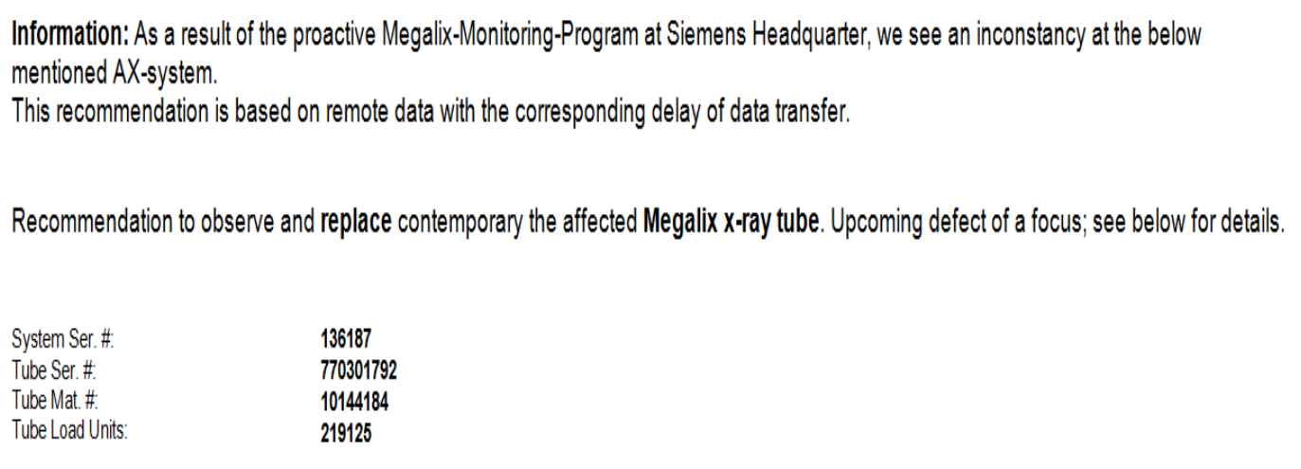
Case Study: Focal Spot Issue
“It has been brought to our attention from <Manufacturer> Headquarters who remotely monitor the condition of your x-ray tube that the tube in <Hospital> Cath Lab <X> is about to become defective, i.e., Small Focal Spot defect.”
Cardiologist asks you if they can use the system?

Slide 24
Case Study: Time of Resolution
  The majority of fluoroscopy systems in our hospital come from two vendors (let’s call them A and B).
  Vendor B tended to be very slow in resolving issues in comparison to Vendor A. Also, failed to close off issues which impacted our KPIs.
  We took our complaints to Vendor B – but they did not take the complaints seriously.
  Physics team compiled data from both of the main vendors to present to Vendor B.

Slide 25
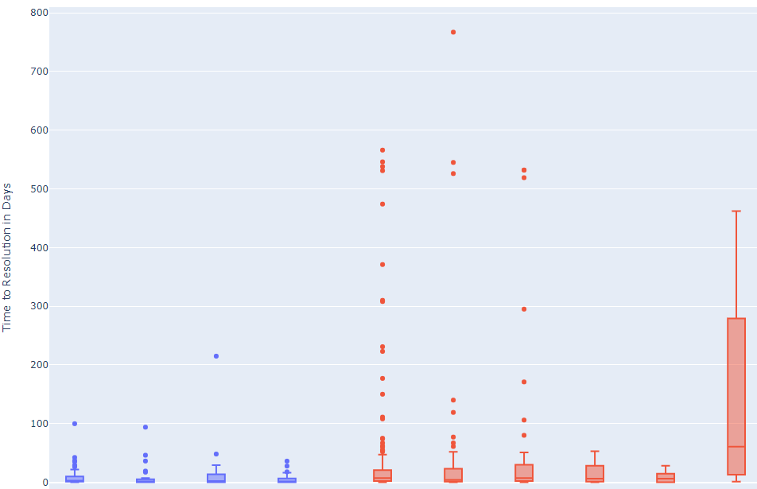
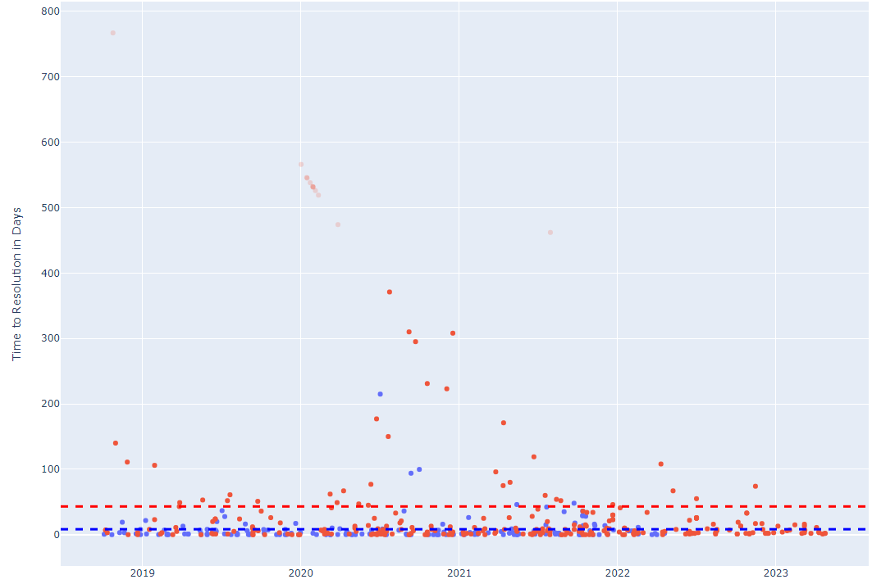

Case Study: Time of Resolution
Time of Resolution of Fault by System
Time of Resolution of Fault by Individual Faults

Slide 26
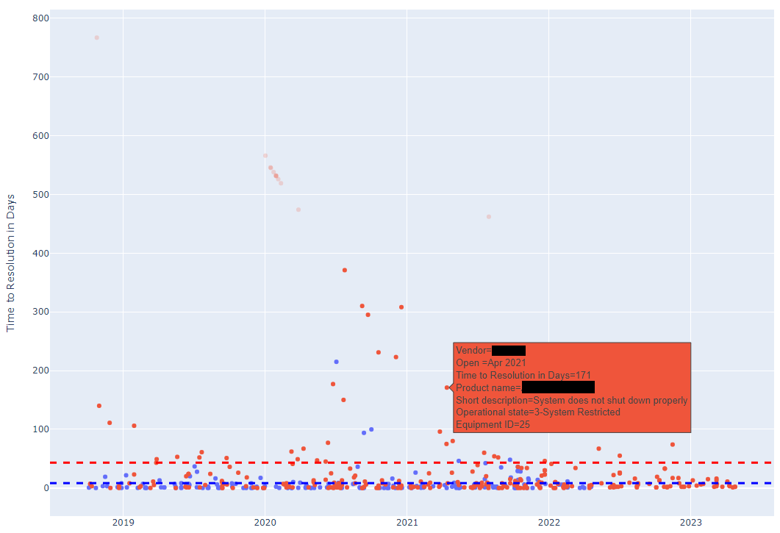
Case Study: Time of Resolution
Interactive Plot made with Plotly Python library.
The user can hover over each plot point for more information related to the Vendor, Fault Date, Fault Description, System ID and Time to Resolution.

Slide 27
Case Study: Time of Resolution
  Vendor B was presented with data showing long resolution times in comparison to Vendor A.
  Data was clear – unacceptable resolution times in comparison to their competitors.
  Vendor B has committed to improving their time of resolution. Wouldn’t have admitted fault only for comprehensive data analysis.
Average Number of Days to Resolve Issue
Vendor A | Vendor B
7 | 43

Slide 28
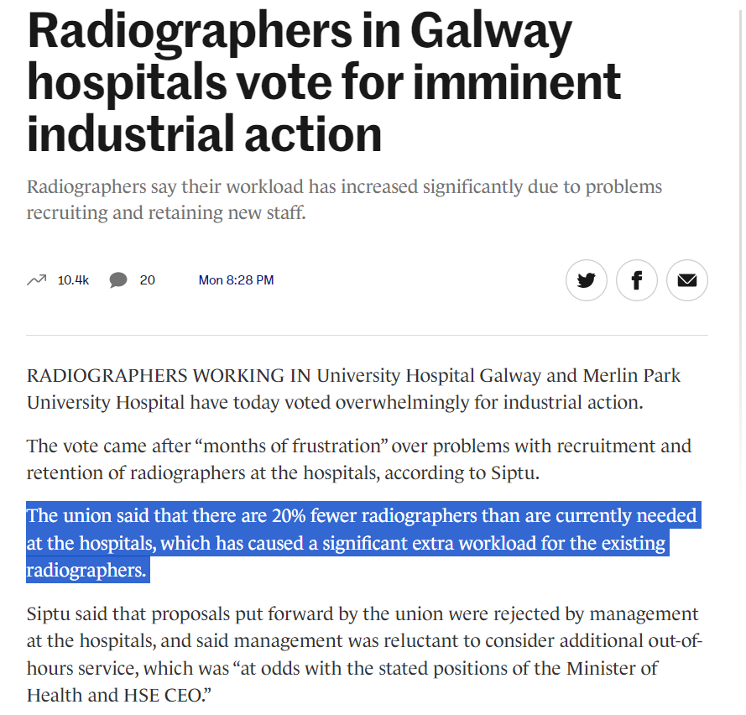
Staffing Issues: Radiographers
  Sometimes there is nothing wrong with the equipment- there just aren’t enough staff to manage it!
  Example from Dublin, Ireland.
    Cost of living is in top 3% in the world [source].
    Radiographers tend to emigrate after basic training (2 years).
    MRI only operates Mon-Friday 8am-4pm despite 8,000+ waiting list due to staffing issues.
  Opposite problem is likely to be true in other countries!
  https://www.thejournal.ie/galway-radiographers-industrial-action-strike-6190935-Oct2023/

Slide 29
Staffing Issues: Radiologists
  Are newly-qualified doctors less likely to specialize in Radiology because of the perceived threat of AI?
  In survey of more than 1000 radiologists from Huisman et al (2021), 38% said they feared replacement by AI.^{[6]}
  In another survey of American medical students from Reedman et al (2022): “One-sixth of students who would have chosen radiology as the first choice did not do so because of AI, and approximately half of those considering radiology within their top 3 choices remained concerned about AI.” ^{[7]}

Slide 30
Efficient Quality Assurance
  As physicists, we contribute to down time by taking a system out of service to carry out quality assurance.
  Make as much use of the commissioning time as possible to gather baseline data.
    This will be useful for troubleshooting potential problems that arise in the future.
    Repeat tests to get a measure of the natural variation (uncertainty) in the measurement, especially for subjective tests.
  Liaise with clinical staff to find a suitable time for QC (flexibility).
    Early mornings/ late evenings will build up goodwill with clinical staff.

Slide 32
Efficient Quality Assurance
  Routine QA: Aim to extract the maximum amount of information from the minimum number of acquisitions.
  Have a list of all equipment required for the tests.
  Be able turn on, login to and operate the system.
  Leave no trace! Remember to take out any beam filtration/ put the grid back, leave the C-arm in the position it was found etc.
  Record your results in a spreadsheet that automatically calculates the deviation from baseline.
    Checks if there is an unusual result in real time.
  Graph the results over time to see if there any trends.

Slide 33
Summary
  Downtime is inevitable in a Radiology department. We cannot avoid it, but we can aim to reduce it.
  Downtime can have a big impact on both the patient and the hospital.
  Physicists can help minimize downtime in each stage of the system’s life-cycle by:
    “Infant Mortality”: Comprehensive acceptance testing, appropriate training for users and a robust procurement system.
    “Constant Failure”: Regular maintenance, good communication between stakeholders and knowledge of normal dose and image quality metrics for the system.
    “Wear Out”: More frequent QA, back-up plans in case of failure, risk assessments, analysis of faults.
  Physics testing also increases downtime- so be as flexible and efficient with your time as possible!

Slide 34
References
  Peer-reviewed papers
  Brady, A.P. et al. (2021) ‘Radiology in the era of value-based healthcare: A multi-society expert statement from the ACR, CAR, ESR, IS3R, RANZCR, and RSNA’, Radiology, 298(3), pp. 486–491. doi:10.1148/radiol.2020209027.
  Adem, B.E. et al. (2023) ‘Equipment downtime in the radiology departments of three teaching hospitals in Ghana’, Radiography, 29(5), pp. 833–837. doi:10.1016/j.radi.2023.06.002.
  Flory N, Lang EV. Distress in the radiology waiting room. Radiology. 2011 Jul;260(1):166-73. doi: 10.1148/radiol.11102211. Epub 2011 Apr 7. PMID: 21474702; PMCID: PMC3121015.
  Iacobellis F, Abu-Omar A, Crivelli P, Galluzzo M, Danzi R, Trinci M, Dell'Aversano Orabona G, Conti M, Romano L, Scaglione M. Current Standards for and Clinical Impact of Emergency Radiology in Major Trauma. Int J Environ Res Public Health. 2022 Jan 4;19(1):539. doi: 10.3390/ijerph19010539. PMID: 35010799; PMCID: PMC8744756.
  Rutten MH, Giesen PHJ, Assendelft WJJ, Westert G, Smits M. Effects of access to radiology in out-of-hours primary care on patient satisfaction and length of stay. Eur J Gen Pract. 2021 Dec;27(1):221-227. doi: 10.1080/13814788.2021.1959911. PMID: 34369252; PMCID: PMC8354153.
  Huisman M, Ranschaert E, Parker W, Mastrodicasa D, Koci M, Pinto de Santos D, Coppola F, Morozov S, Zins M, Bohyn C, Koç U, Wu J, Veean S, Fleischmann D, Leiner T, Willemink MJ. An international survey on AI in radiology in 1,041 radiologists and radiology residents part 1: fear of replacement, knowledge, and attitude. Eur Radiol. 2021 Sep;31(9):7058-7066. doi: 10.1007/s00330-021-07781-5. Epub 2021 Mar 20. PMID: 33744991; PMCID: PMC8379099.
  Reeder, K. and Lee, H. (2022) ‘Impact of artificial intelligence on US Medical Students’ choice of Radiology’, Clinical Imaging, 81, pp. 67–71. doi:10.1016/j.clinimag.2021.09.018.

