Slide 1
Cross Section Measurements of Protactinium Isotopes Production Using Thorium-232
Naser Burahmah
ICTP-IAEA Workshop on Simulation of Nuclear Reaction Data with the TALYS Code

Slide 2
Outline
Introduction
Objectives
Methodology
Results
Conclusion

Slide 3
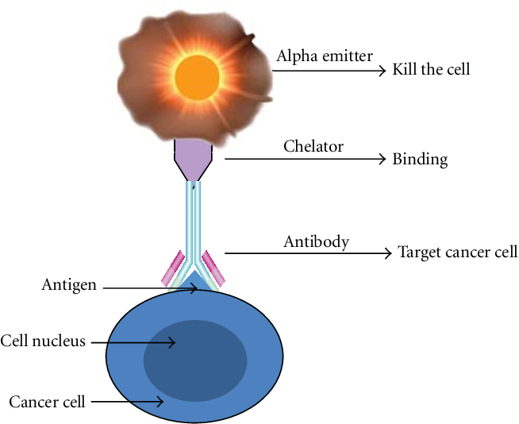
Targeted alpha therapy and ²²⁵Ac
²²⁵Ac
9.92 d
α
Limited range in tissue
  On the order of a few cell diameters
  Energy most likely to deposit in tumor
  cells, not in surrounding healthy cells
High LET of ~ 100 keV/μm
  Intense tissue destruction over small area
Delivers a series of 4 α-particles
  E_{avg}= 7 MeV
²²¹Fr
4.79 m
α
²¹⁷At
32 ms
α
²¹³Bi
45.6 m
²¹³Po
β⁻
45.6 m
α
4.2 ms
α
²⁰⁹Tl
2.2 m
²⁰⁹Pb
β⁻
3.23 h
β⁻
²⁰⁹Bi
 | Alpha (MeV) | Max Range (μm)
²²⁵Ac | 5.935 | 45.61
²²¹Fr | 6.457 | 52.19
²¹⁷At | 7.067 | 60.39
²¹³Po | 8.376 | 79.79
²¹³Bi | 0.492 | 1.53
Credit: [1-6]

Slide 4
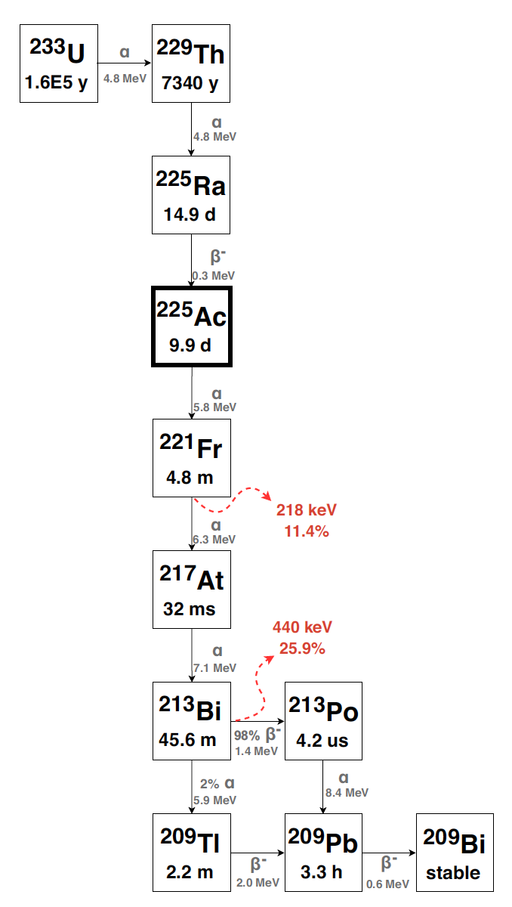
²²⁵Ac current production
Chemical separation from ²²⁹Th
Yearly supply of 1.7 Ci and demand estimated to be at least 5-6 Ci
  Oak Ridge National Lab (USA)
  Institute for Transuranium Element (Germany)
  International for Physics and Power Engineering (Russia)
Initiatives to enhance ²²⁵Ac production
  Deuteron irradiation of ²³²Th (This work)
  High energy proton accelerator using ²³²Th (Tri-lab project)
  Reactor Production of ²²⁹Th at ORNL High Flux Isotope Reactor
  Low energy proton accelerator using ²²⁶Ra target
  Production of ²²⁵Ra through photonuclear reaction of ²²⁶Ra
U-233 Decay chain
Credit: [7-12]

Slide 5
²³²Th(d,x)²²⁹Th
²³²Th[d,5n]²²⁹Pa
²³²Th[d,x]²²⁵Ac
²³²Th[d,x]²²⁹Ac

Slide 6
Objectives
Measure the cross section of ²³²Th(d,5n)²²⁹Pa for the first time
Compare measured cross sections from this work with data available in the literature
Validate the experimental data with predictions from simulation codes

Slide 7
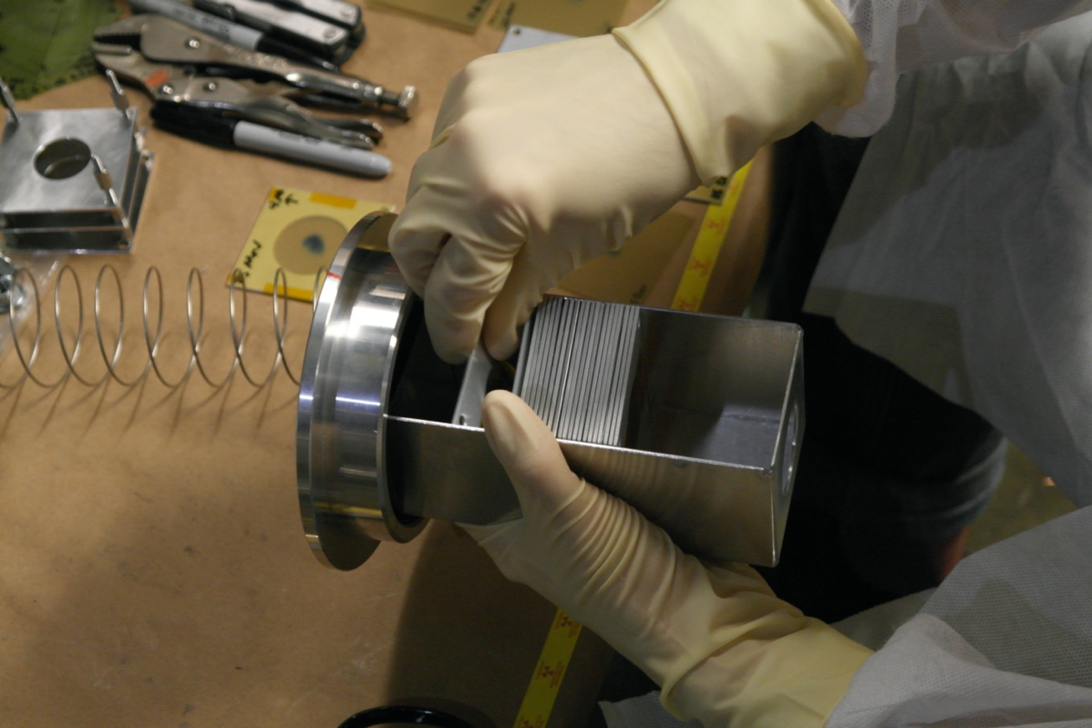
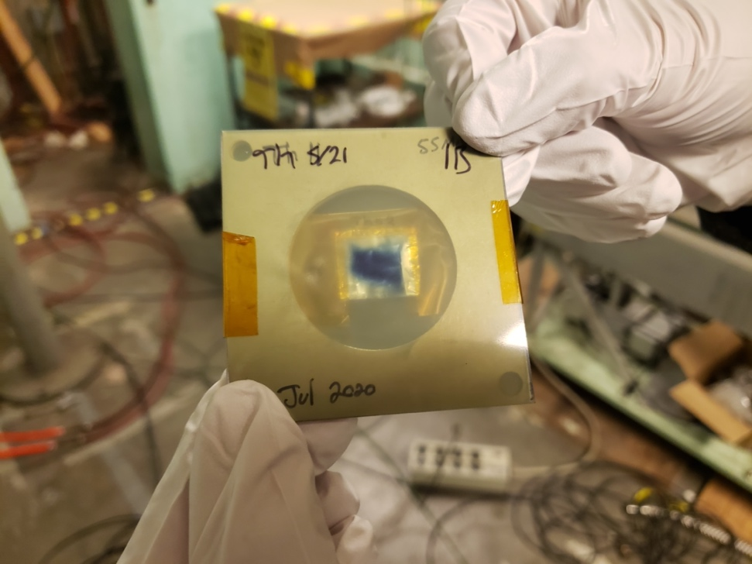
Target irradiation
Irradiation was conducted at the 88-Inch cyclotron at LBNL at cave 0
4 Foils (~17 mg cm⁻²) using stack foil technique with Al degraders
The irradiation parameters
  Beam intensity of 1 μA
  Deuteron energies 49.6, 41.3, 35.0, and 30.7 MeV
  Beam time of 10.9 hours
Notes:
17um

Slide 8
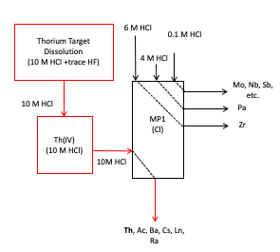
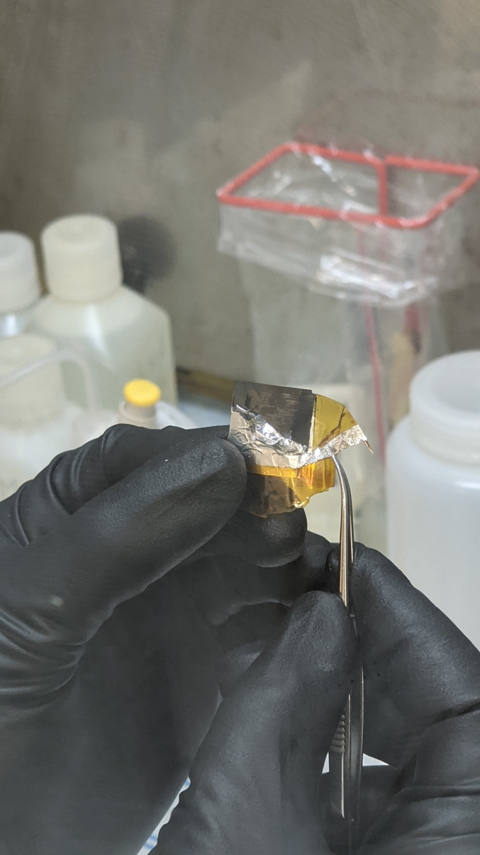
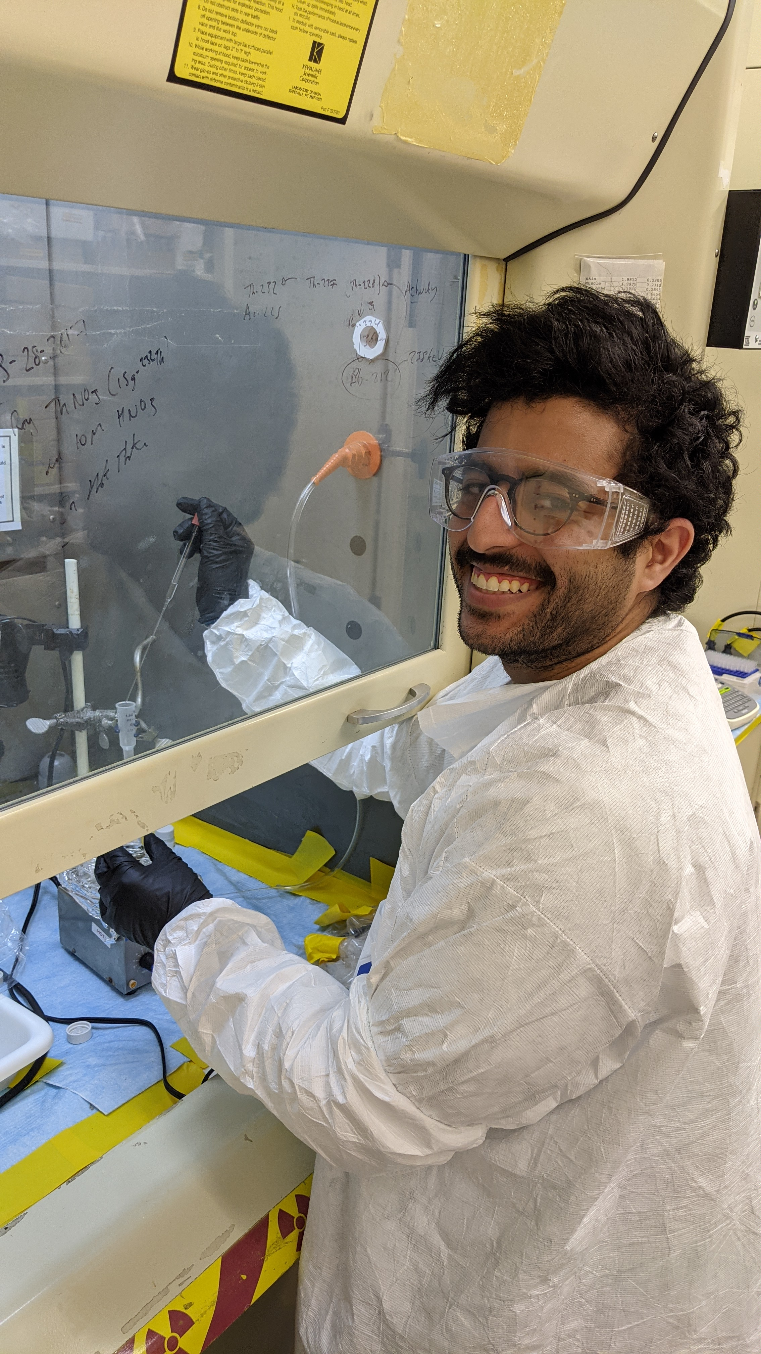
Chemical separation
The separation performed after the irradiation
Difficulty to assay ²²⁹Pa because of short half-life (t_{1/2}= 1.5 d), low gamma ray intensity (119.0 keV, 0.13 %) and the high background
²²⁹Pa is major contributor to ²²⁹Th production
²³²Pa (t_{1/2}= 1.32 d) was utilized as a tracer for the chemical yield (894.4 keV, 19.6 %)
Notes:
Ion exchange chromotagrophy

Slide 9
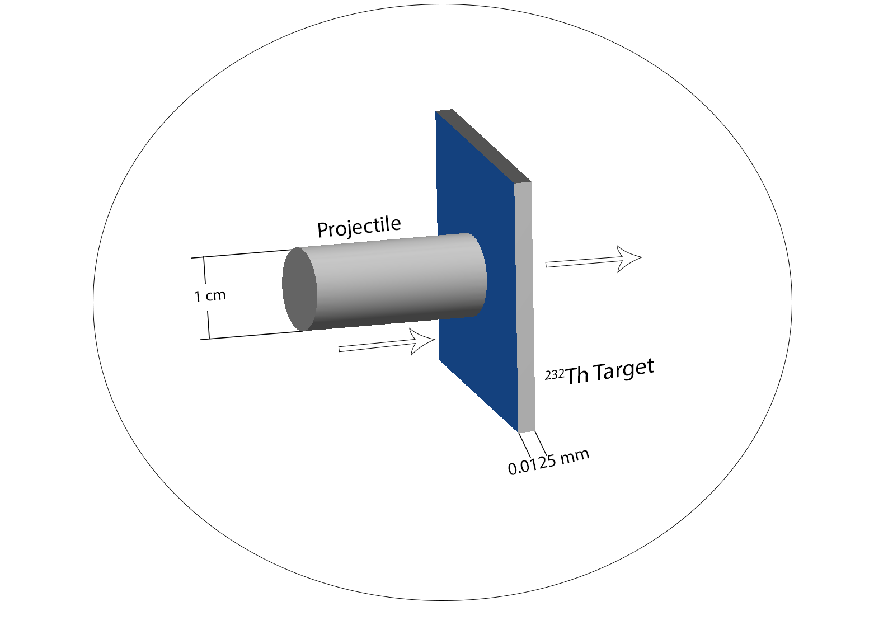
PHITS Simulation
PHITS is a Monte Carlo based particle transport simulation code managed by the Japan Atomic Energy Agency
Simulation geometry
  Natural ²³²Th foil target with a thickness of 0.0125 mm
  The energy of the projectiles ranged from 5 to 60 MeV per nucleon
The geometry of target and projectiles (not to scale)
Credit: [13-18]
Notes:
It is important to note that the calculated cross sections are time independent and do not include contributions from the decay of any precursors, nor do they include the decay of the product nuclei itself
43 energy points from 5 to 75 MeV/n for each model
In summary, 43 simulations were performed by varying the incident energy from 5 to 75 MeV/n, and the same number of simulations were used for the three models mentioned before. A total of 129 simulations were performed to get the simulated cross section in this work.
Gaussian beam higher flux in the middle and lower in the side
It can deal with the transport of all particles across a wide range of energies using several nuclear reaction models and nuclear data libraries.
PHITS, the first stage involves the intranuclear cascade model where the primary particle (i.e., incident proton) scatters multiple times within the nucleus and produces secondary particles several times before being absorbed by the nucleus or escaping it entirely. The second stage employs the coalescence model to generate high-energy particles up to A 4. Simultaneously, these high-energy particles escape and leave the residual nucleus in the preequilibrium stage that is simulated by the modified exciton model. Equilibrium evaporation or fission comprises the final stage of the CEM3.03 model.

Slide 10
Results
Cross sections for ²³²Th(d,xn)^{228,229,230,232,233}Pa reactions at 30.8, 35.0, 41.3, and 49.6 MeV are presented
The measured cross sections were compared with PHITS simulated cross sections, TENDLE-2019, TENDLE-2021, and TALYS
The measured cross sections from deuteron bombardment were compared to cross sections from literature when available

Slide 11
  ²³²Th(d,5n)²²⁹Pa reaction channel

Slide 12
  ²³²Th(d,4n)²³⁰Pa reaction channel

Slide 13
Discussion
Measurements from this work agree with reported cross sections in the literature
Across the data, there were some agreement with the simulated cross sections
Proton and deuteron-induced reactions exhibit the same order of magnitude for the experimentally measured cross sections
  (Burahmah, Naser, "Production of Protactinium-229 via Deuteron Irradiation of Thorium-232. " PhD diss., University of Tennessee, 2021.)

Slide 14
Conclusions
Experimentally measured cross sections are reported for all protactinium isotopes produced from deuteron-induced reactions on thorium targets
The ²³²Th(d,5n)²²⁹Pa reaction cross sections are reported for the first time
The data from this work on other Pa isotopes agree with published results from previous measurements
The importance of transport codes and reaction models like PHITS, TALYS and TENDL in new experiment designs
For more information
  Burahmah, N., et al. "Pa 229 cross section measurements via deuteron irradiation of Th 232." Physical Review C 108.2 (2023): 024609

Slide 15
Our Project Team
ORNL
Justin Griswold (PI)
Roy Copping
Mike Zach
Saed Mirzadeh
Naser Burahmah
LBNL/UCB- Nuclear Engineering Dept.
Lee Bernstein (PI)
Andrew Voyles
Jonathan Morrell
UTK – Nuclear Engineering Dept.
Naser Burahmah
Lawrence Heilbronn (PI)

Slide 16
Acknowledgments
I want to thank KFAS to give me the opportunity to participate in this workshop
This research is supported by the U.S. Department of Energy Isotope Program, managed by the Office of Science for isotope R&D and production. Under contract DE-SC0020140.

Slide 17
References
[1] https://d3i71xaburhd42.cloudfront.net/68b25c08de37e242a625b2bbebb1a7990e879c97/4-Figure1-1.png
[2] IAEA, Alpha Emitting Radionuclides and Radiopharmaceuticals for Therapy,, in Technical Meeting Report. 2013: Vienna, Austria.
[2] Weidner, J.W., et al., 225Ac and 223Ra production via 800MeV proton irradiation of natural thorium targets. Applied Radiation and Isotopes, 2012. 70(11): p. 2590-2595.
[3] Weidner, J.W., et al., Proton-induced cross sections relevant to production of 225Ac and 223Ra in natural thorium targets below 200MeV. Applied Radiation and Isotopes, 2012. 70(11): p. 2602-2607.
[4] Ermolaev, S.V., et al., Production of actinium, thorium and radium isotopes from natural thorium irradiated with protons up to 141 MeV, in Radiochimica Acta International journal for chemical aspects of nuclear science and technology. 2012. p. 223.
[5] Duchemin, C., et al., Production of medical isotopes from a thorium target irradiated by light charged particles up to 70 MeV. Phys Med Biol, 2015. 60(3): p. 931-46.
[6] Griswold, J.R., et al., Large scale accelerator production of (225)Ac: Effective cross sections for 78-192MeV protons incident on (232)Th targets. Appl Radiat Isot, 2016. 118: p. 366-374.
[7] Griswold, J.R., et al., Production of Th229 for medical applications: Excitation functions of low-energy protons on Th232 targets. Physical Review C, 2018. 98(4).
[8.] Robertson, A.K.H., et al., Design of a Thorium Metal Target for 225Ac Production at TRIUMF. Instruments, 2019. 3(1): p. 18.
[9.] McDevitt, M., et al., Tumor therapy with targeted atomic nanogenerators. Science, 2001. 294(5546): p. 1537-40.
[10] Ballangrud, A.M., et al., Alpha-particle emitting atomic generator (Actinium-225)-labeled trastuzumab (herceptin) targeting of breast cancer spheroids: efficacy versus HER2/neu expression. Clin Cancer Res, 2004. 10(13): p. 4489-97.
[11] Morgenstern, A., et al., An Overview of Targeted Alpha Therapy with (225)Actinium and (213)Bismuth. Curr Radiopharm, 2018. 11(3): p. 200-208.
[12] Rao, J.R., J. Ernst, and H. Machner, Comparative study of d- and 6Li-induced reactions on 232Th in terms of breakup and preequilibrium processes. Nuclear Physics, Section A, 1986. 448(2): p. 365-380.
[13] Sato, T., et al., Features of Particle and Heavy Ion Transport code System (PHITS) version 3.02. Journal of Nuclear Science and Technology, 2018. 55(6): p. 684-690.
[14] Scheidenberger, C. and H. Geissel, Penetration of relativistic heavy ions through matter. Nuclear Instruments and Methods in Physics Research Section B: Beam Interactions with Materials and Atoms, 1998. 135(1): p. 25-34.
[15] Boudard, A., et al., New potentialities of the Li\`ege intranuclear cascade model for reactions induced by nucleons and light charged particles. Physical Review C, 2013. 87(1): p. 014606.
[16] Iida, K., A. Kohama, and K. Oyamatsu, Formula for Proton–Nucleus Reaction Cross Section at Intermediate Energies and Its Application. Journal of the Physical Society of Japan, 2007. 76(4): p. 044201.
[17] Sihver, L., et al., Current status of the “Hybrid Kurotama model” for total reaction cross sections. Nuclear Instruments and Methods in Physics Research Section B: Beam Interactions with Materials and Atoms, 2014. 334: p. 34-39.
[18] Tripathi, R.K., F.A. Cucinotta, and J.W. Wilson, Accurate universal parameterization of absorption cross sections. Nuclear Instruments and Methods in Physics Research Section B: Beam Interactions with Materials and Atoms, 1996. 117(4): p. 347-349.
[19] Tripathi, R.K., J.W. Wilson, and F.A. Cucinotta, Accurate universal parameterization of absorption cross sections II — neutron absorption cross sections. Nuclear Instruments and Methods in Physics Research Section B: Beam Interactions with Materials and Atoms, 1997. 129(1): p. 11-15.
[20] Tripathi, R.K., F.A. Cucinotta, and J.W. Wilson, Accurate universal parameterization of absorption cross sections III – light systems. Nuclear Instruments and Methods in Physics Research Section B: Beam Interactions with Materials and Atoms, 1999. 155(4): p. 349-356.
[21] Minomo, K., K. Washiyama, and K. Ogata, Deuteron–nucleus total reaction cross sections up to 1 GeV. Journal of Nuclear Science and Technology, 2017. 54(1): p. 127-130.

Slide 18
Questions ?

Slide 19
  ²³²Th(d,5n)²²⁹Pa reaction channel

Slide 20
  ²³²Th(d,4n)²³⁰Pa reaction channel

