Slide 1
A theoretical study for the production of ³²P radioisotope using neutrons from the ⁶⁸Zn(p,n)⁶⁸Ga reaction in a medical cyclotron
16-20 October 2023
Trieste, Italy
M. Tatari¹, Z. Dehghan¹, H. Naik²
¹Department of Physics, Yazd University, Yazd, Iran
²Radiochemistry Division, Bhabha Atomic Research Centre, Mumbai, India

Slide 2
Abstract
⁶⁸Ga radioisotope with a half-life of 68 minutes and 89% positron decay is employed in the positron emission tomography (PET) imaging for diagnosing tumors. The radioisotope ³²P with a half-life of 14.3 days and pure negative beta decay (maximum energy 1.71 MeV) can be used as a patch brachytherapy source and as a tracer in agriculture.
The theoretical estimation of a combined production of ⁶⁸Ga and ³²P radioisotopes were investigated using a medical cyclotron.
Protons are used in the ⁶⁸Zn(p,n) reaction to produce the medical isotope ⁶⁸Ga, and the neutrons from the ⁶⁸Zn(p,n)⁶⁸Ga reaction are used to launch the ³²S(n,p) reaction to produce ³²P radioisotope.
The cross section of these reactions was calculated using TALYS 1.9 code and compared with the available experimental results.
SRIM-2013 code was used to calculate the stopping power and range of protons in the ⁶⁸Zn target and GEANT4 toolkit was used to evaluate the proton and neutron flux within the ⁶⁸Zn and ³²S targets, respectively.

Slide 3
$$Y=\frac{N_{A}a_{is}a_{ch}I}{M}\left(1−e^{−λt}\right)\int_{E_{out}}^{E_{in}}{\frac{σ\left(E\right)}{S_{p}\left(E\right)}}dE (1)$$
Calculation of the production yield
N_{A} is the Avogadro number,
a_{is} is the isotope abundance of target nuclei (%),
a_{ch} is the chemical abundance of the target (%),
I is the proton beam current (μA),
M is the molar mass of the target material (g),
λ is the decay constant of the product (h⁻¹),
t is the irradiation time of the target (h),
σ(E) is the production cross section of the product at energy E (mb),
S_{p}(E) is the stopping power of the projectile in the target (MeV/mg/cm²),
E_{in} and E_{out} are the initial and outgoing energies of protons in the target (MeV).
$$Y=\frac{N_{A}a_{is}a_{ch}Iρd}{M}\left(1−e^{−λt}\right)\int_{E_{out}}^{E_{in}}{φ\left(E\right)σ\left(E\right)dE \left(2\right)}$$
ρ is the density of the target (g/cm³),
d is the thickness of the target (cm),
Φ is the normalized flux distribution of the projectile in the target at energy E

Slide 4
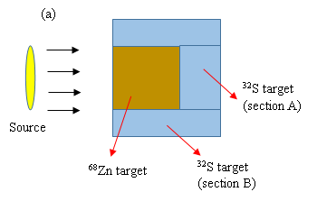
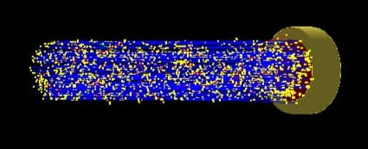
Different isotopes of natural zinc and natural sulfur and the contributing nuclear reactions that lead to the production of ⁶⁸Ga and ³²P radio-isotopes.
Isotope | Abundance (%) | Nuclear reaction | Threshold energy (MeV)
⁶⁴Zn | 49.17 | --- | ---
⁶⁶Zn | 27.73 | --- | ---
⁶⁷Zn | 4.04 | ⁶⁷Zn(p,γ)⁶⁸Ga | 0
⁶⁸Zn | 18.45 | ⁶⁸Zn(p,n)⁶⁸Ga | 3.76
⁷⁰Zn | 0.61 | ⁷⁰Zn(p,3n)⁶⁸Ga | 19.69
³²S | 94.99 | ³²S(n,p)³²P | 0.96
³³S | 0.75 | ³³S(n,np)³²P | 9.86
³⁴S | 4.25 | ³⁴S(n,2np)³²P | 21.62
³⁶S | 0.01 | ³⁶S(n,4np)³²P | 38.95
(b)
Simulated geometry to calculate the production yield of ⁶⁸Ga and ³²P in the ⁶⁸Zn(p,n)⁶⁸Ga and ³²S(n,p)³²P reactions, (b) Targets geometry as designed for the input of the GEANT4 toolkit.

Slide 5
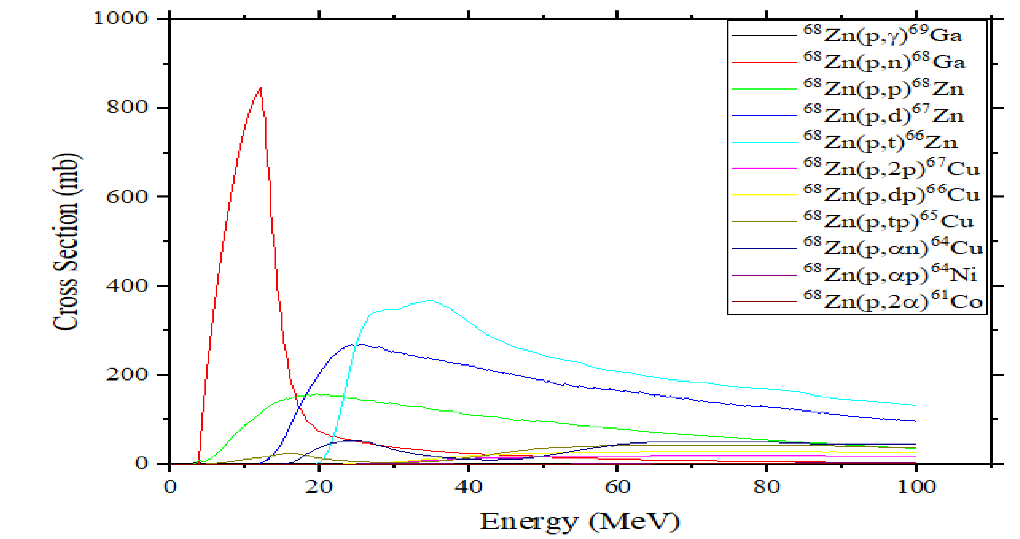

Slide 6
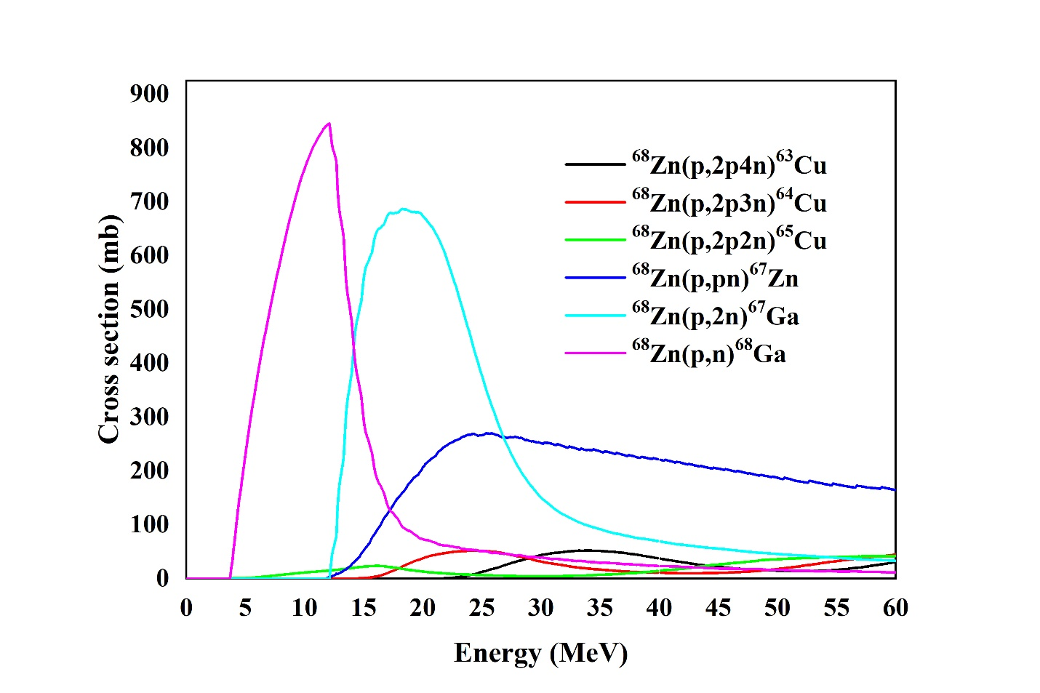
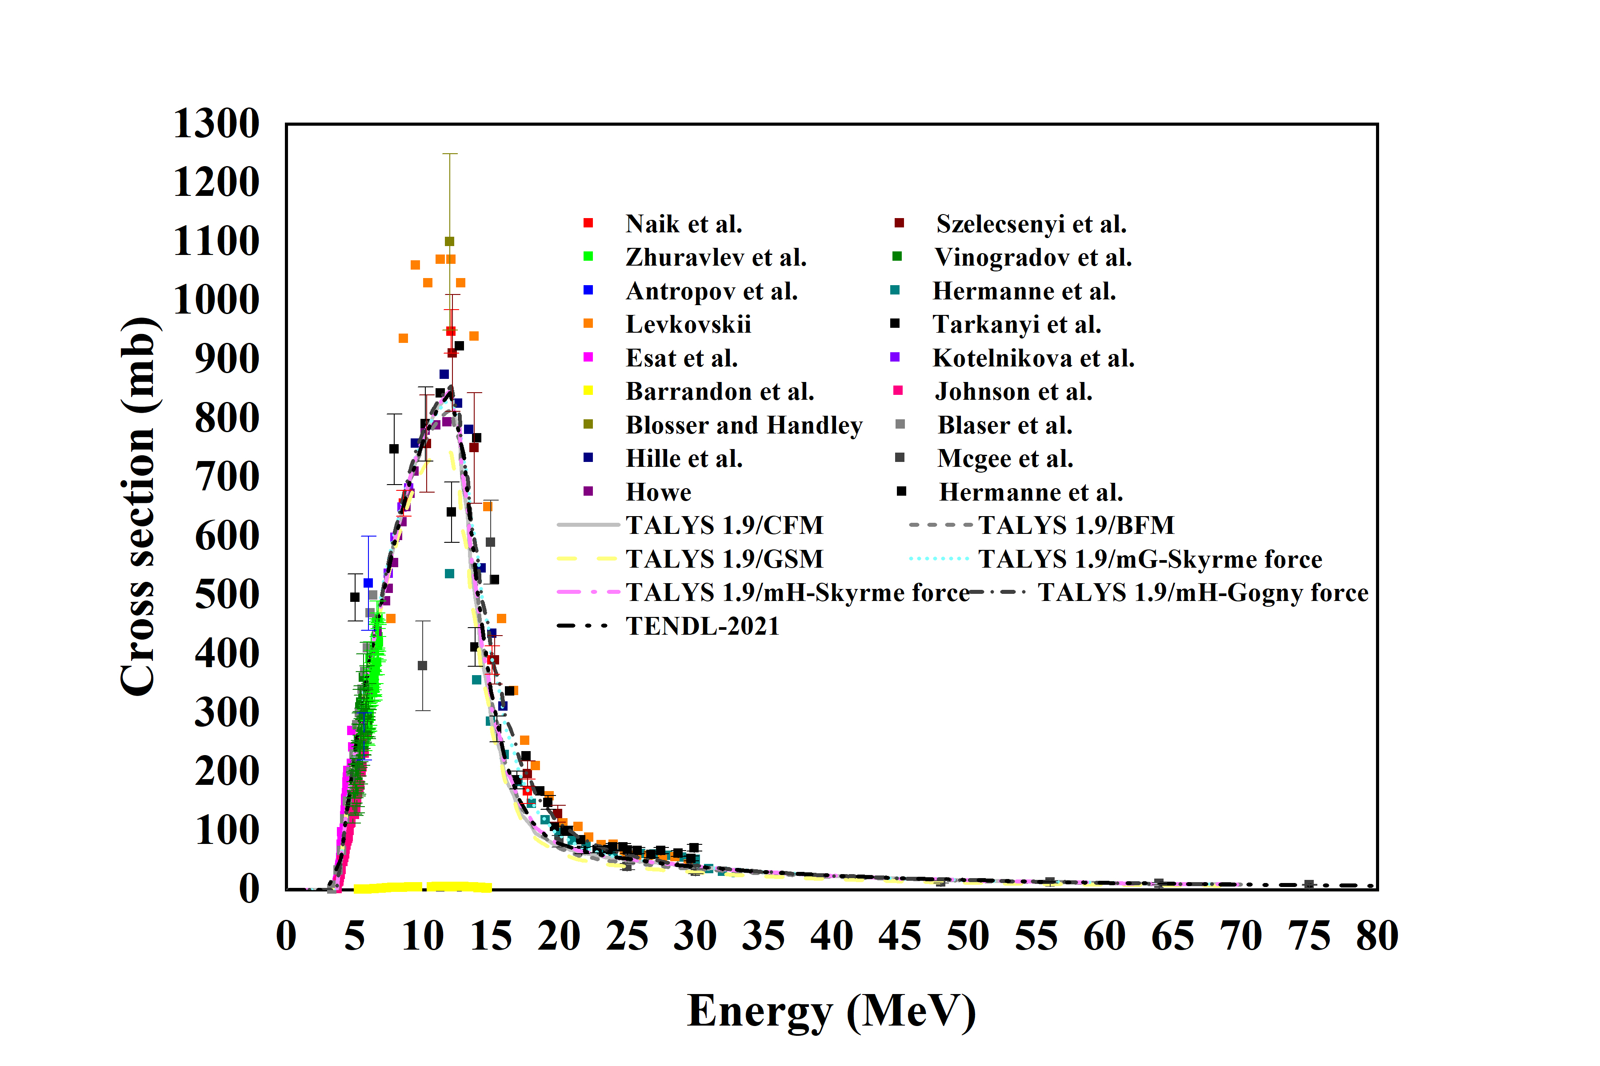
Excitation function of ⁶⁸Zn(p,xpyn) reactions
calculated using TALYS 1.9 code.
The excitation function of ⁶⁸Zn(p,n)⁶⁸Ga reaction was calculated using different models of TALYS 1.9 code and their comparison with TENDL results and experimental data.

Slide 7
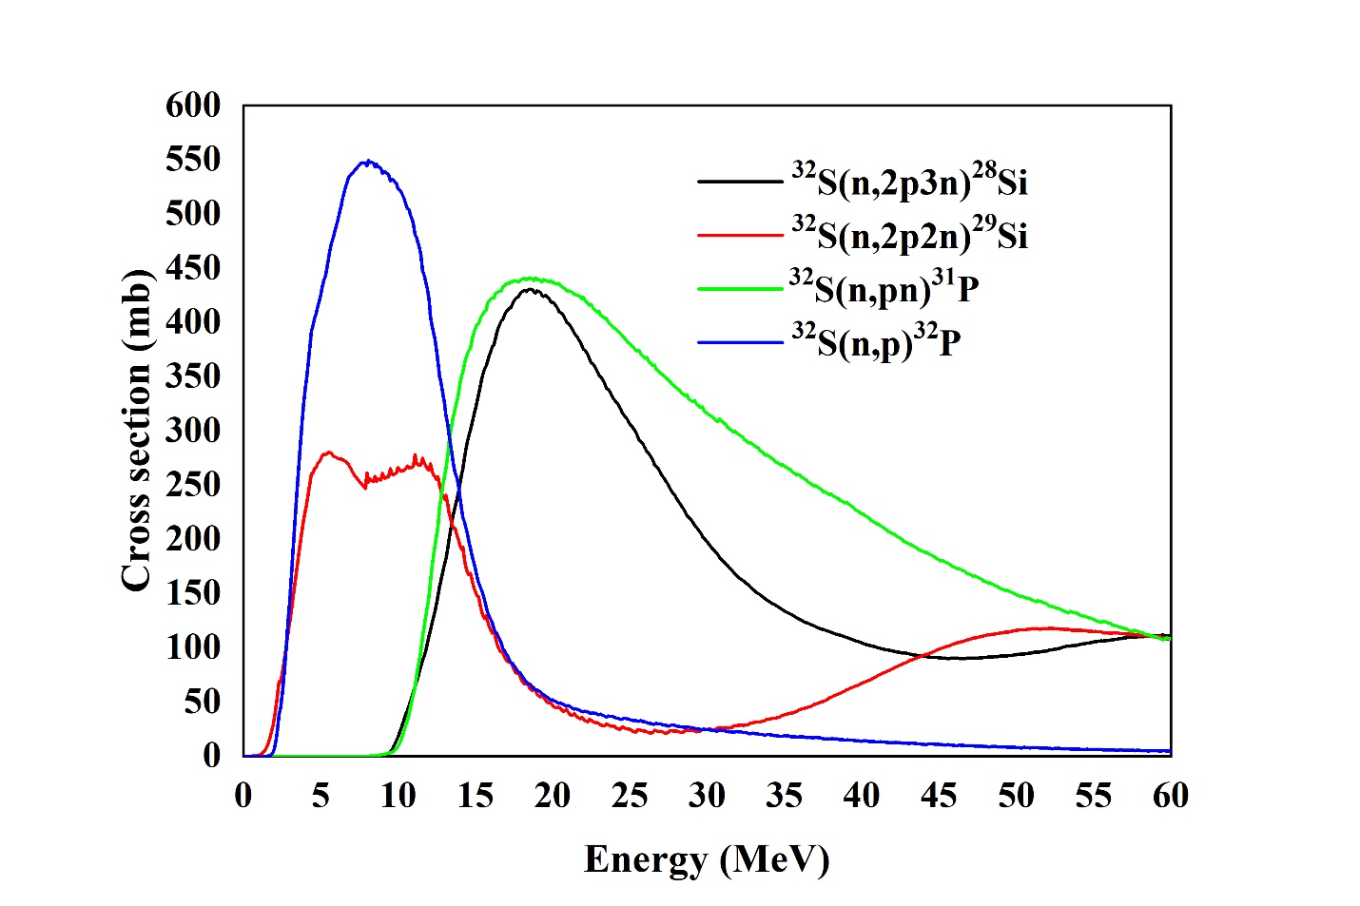
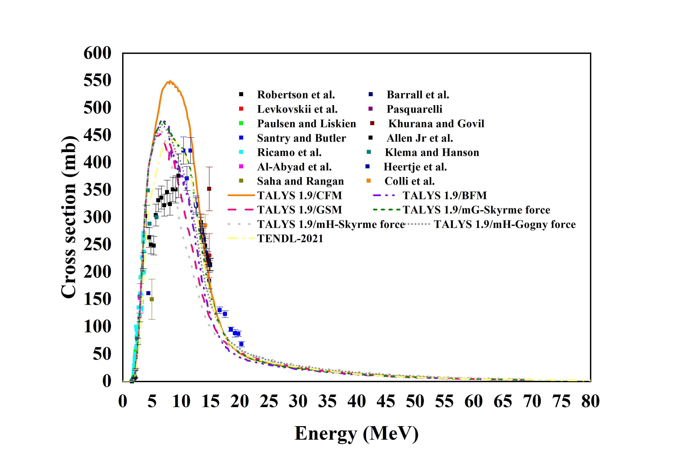
Excitation function of ³²S(n,xpyn) reactions
calculated using TALYS 1.9 code.
The excitation function of ³²S(n,p)³²P reaction was calculated using different models of TALYS 1.9 code and their comparison with TENDL results and experimental data.

Slide 8
Theoretical and simulation production yield of ⁶⁸Ga and ³²P radio-isotopes.
Nuclear reaction | Theoretical reaction yield (MBq/µA.h) | Simulation reaction yield (MBq/µA.h) | Experimental yield (MBq/μA.h)
⁶⁸Zn(p,n)⁶⁸Ga | 4213.4 | 4490.2 | 4-11 MeV: 4033 (Nickles, 1991) 14 MeV: 2200-4800 (Alnahwi et al., 2020) 15 MeV: 5032 (Sadeghi et al., 2009) 15 MeV: 7900 (Mokhtari-Oranj et al., 2012) 20 MeV: 5809 (Szelecsenyi et al., 2012) 16.5 MeV: 2720 (Lin et al., 2018)
³²S(n,p)³²P | --- | 0.04 | 2-20 MeV: 0.8 (Saied et al., 2015)

Slide 9
Thank you for your attention

