Slide 1
Analysis of 209Bi(γ,xn) reactions
Rade smolović, faculty of sciences, university of novi sad

Slide 2
Contents
Experimentally determined saturation activities ratio.
Calculation of saturation activities using TALYS cross-section and independent theoretical cross-section calculations, with GEANT4 photon flux simulation.
Comparison of saturation activities ratios obtained experimentally, using TALYS, and using independent cross-section calculations.

Slide 3
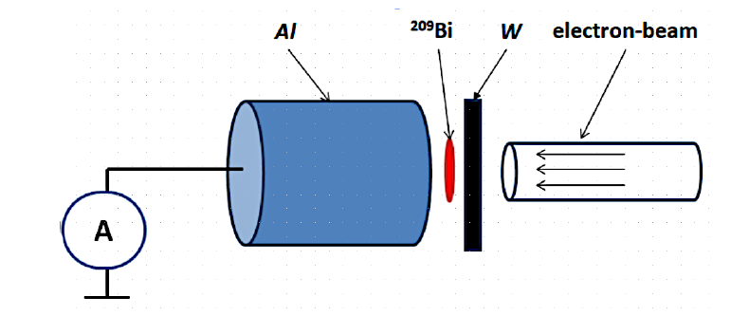
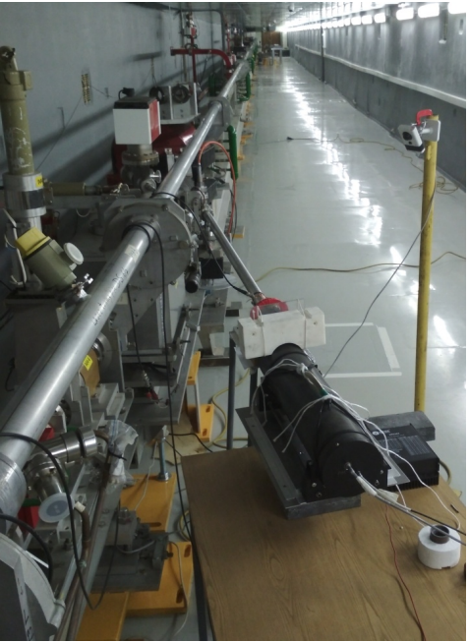
Experiment
- LINAC 200 Electron Accelerator, JINR, Dubna.
- Bremsstrahlung beams of 60, 80, and 100 MeV irradiating 209Bi.
- Activated 209Bi transported to HPGe detector for spectroscopic measurements.
For more details: M.Demichev et al., Phys. At. Nucl. 85, 805–812 (2022)

Slide 4
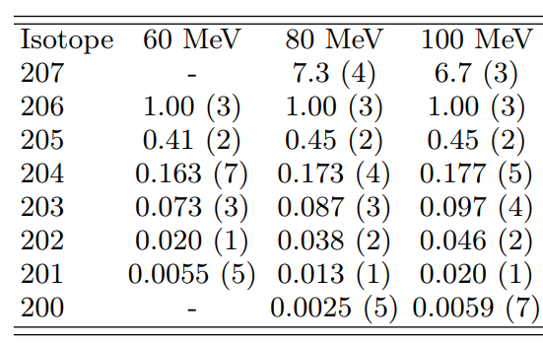
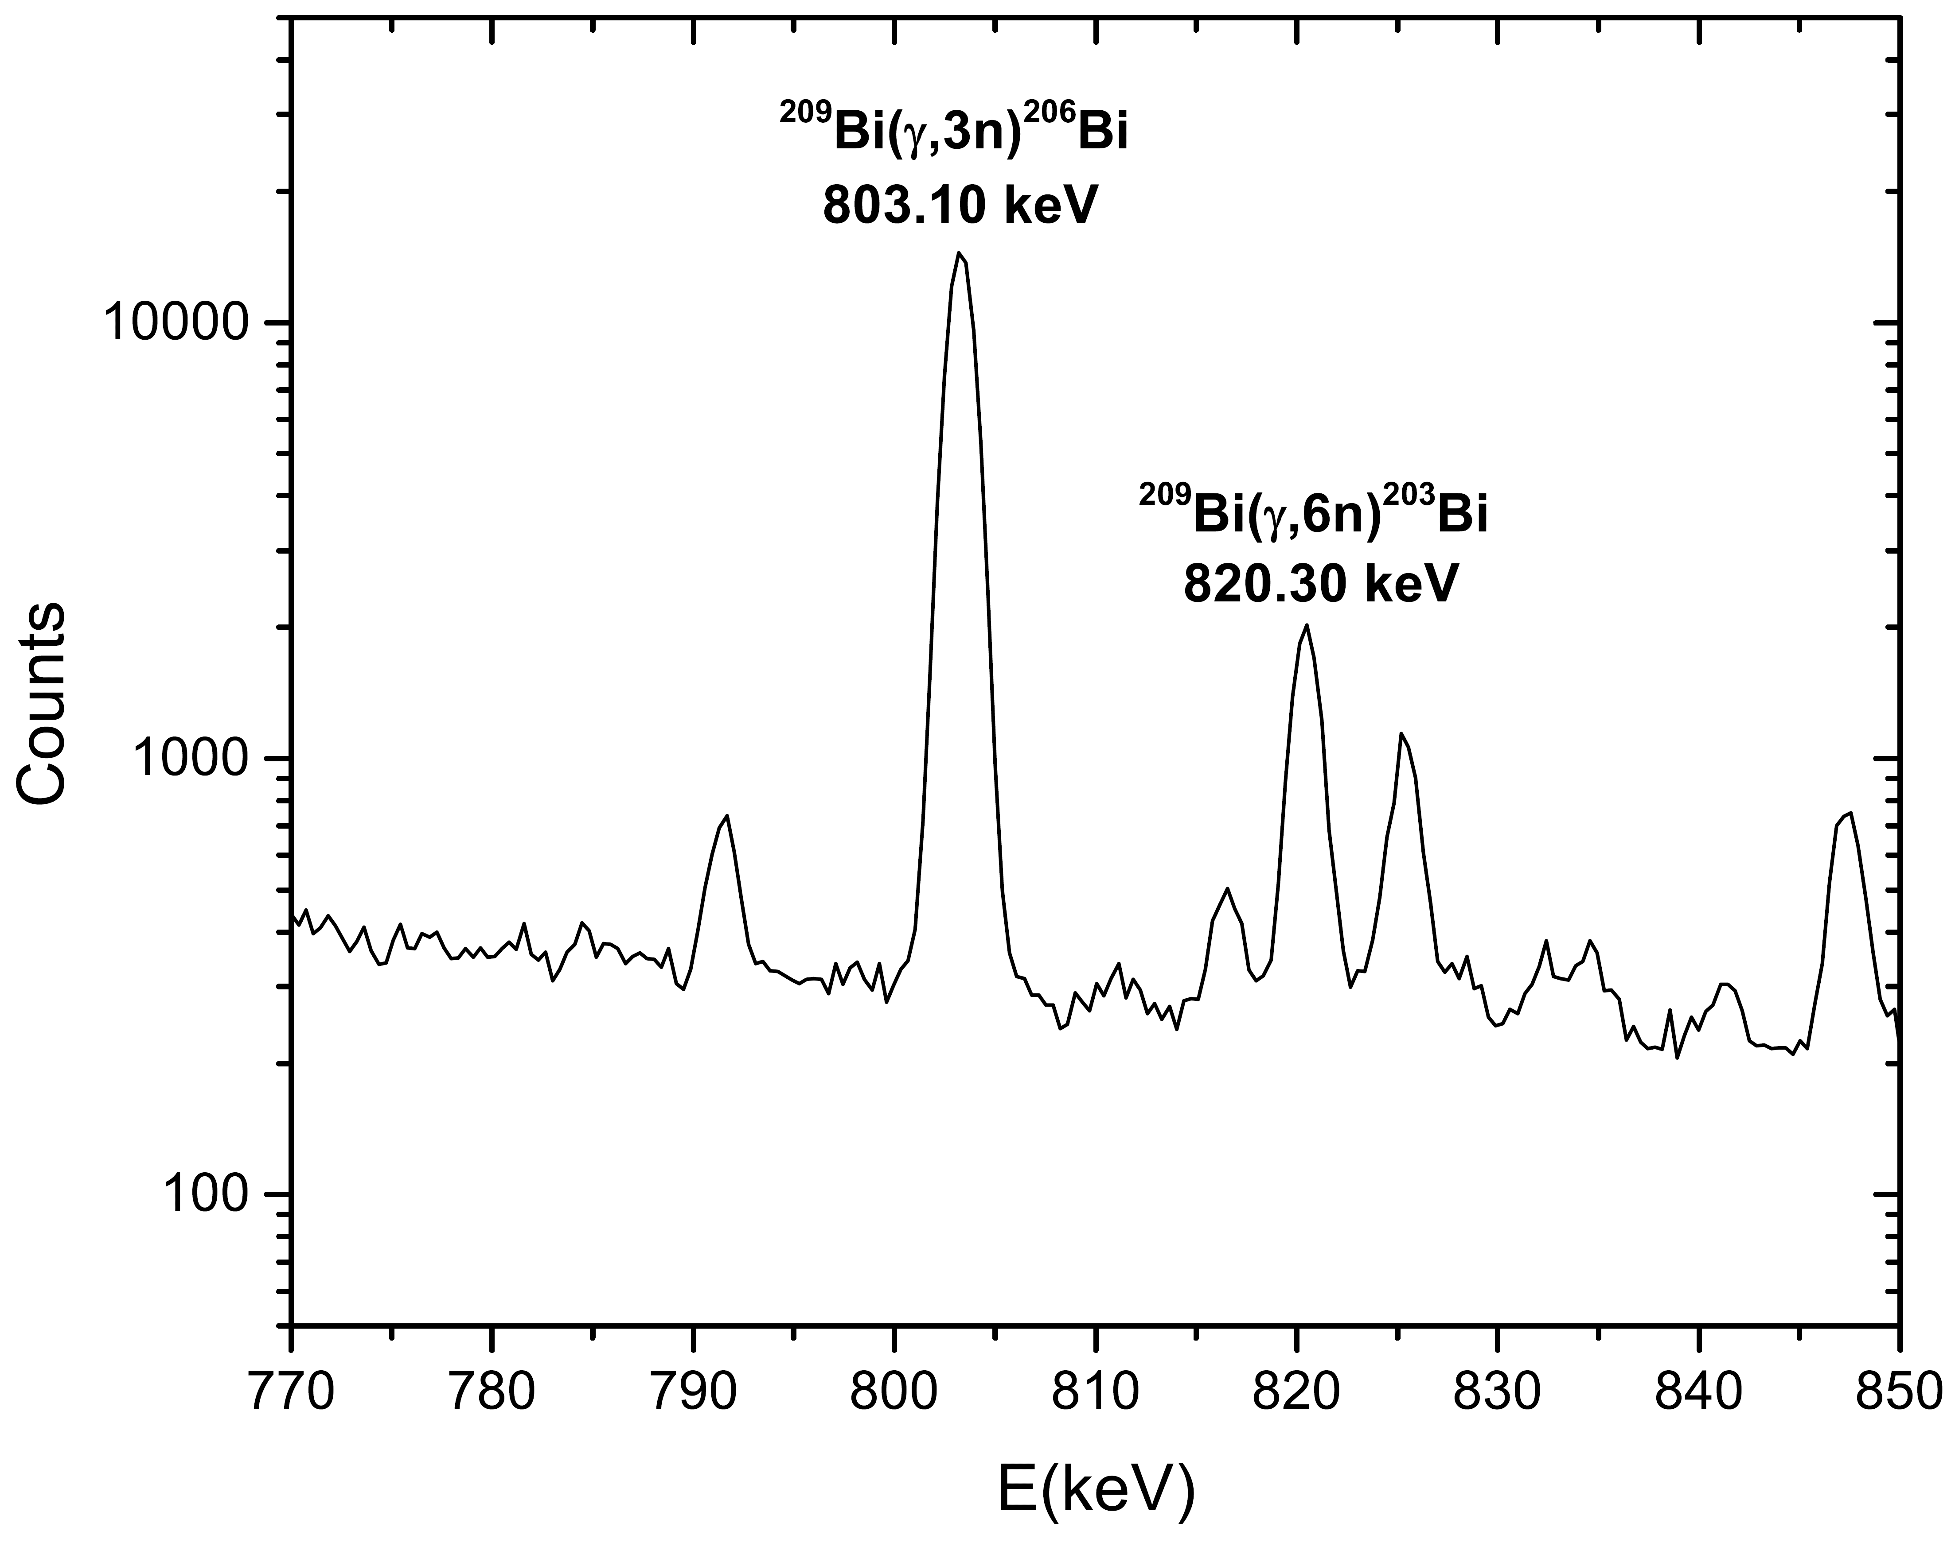
Experimental saturation activities ratio

Slide 5
Calculation of saturation activities
1. TALYS cross-section + GEANT4 simulated photon flux.
2. Independent theoretically calculated cross-section + GEANT 4 simulated photon flux.

Slide 6
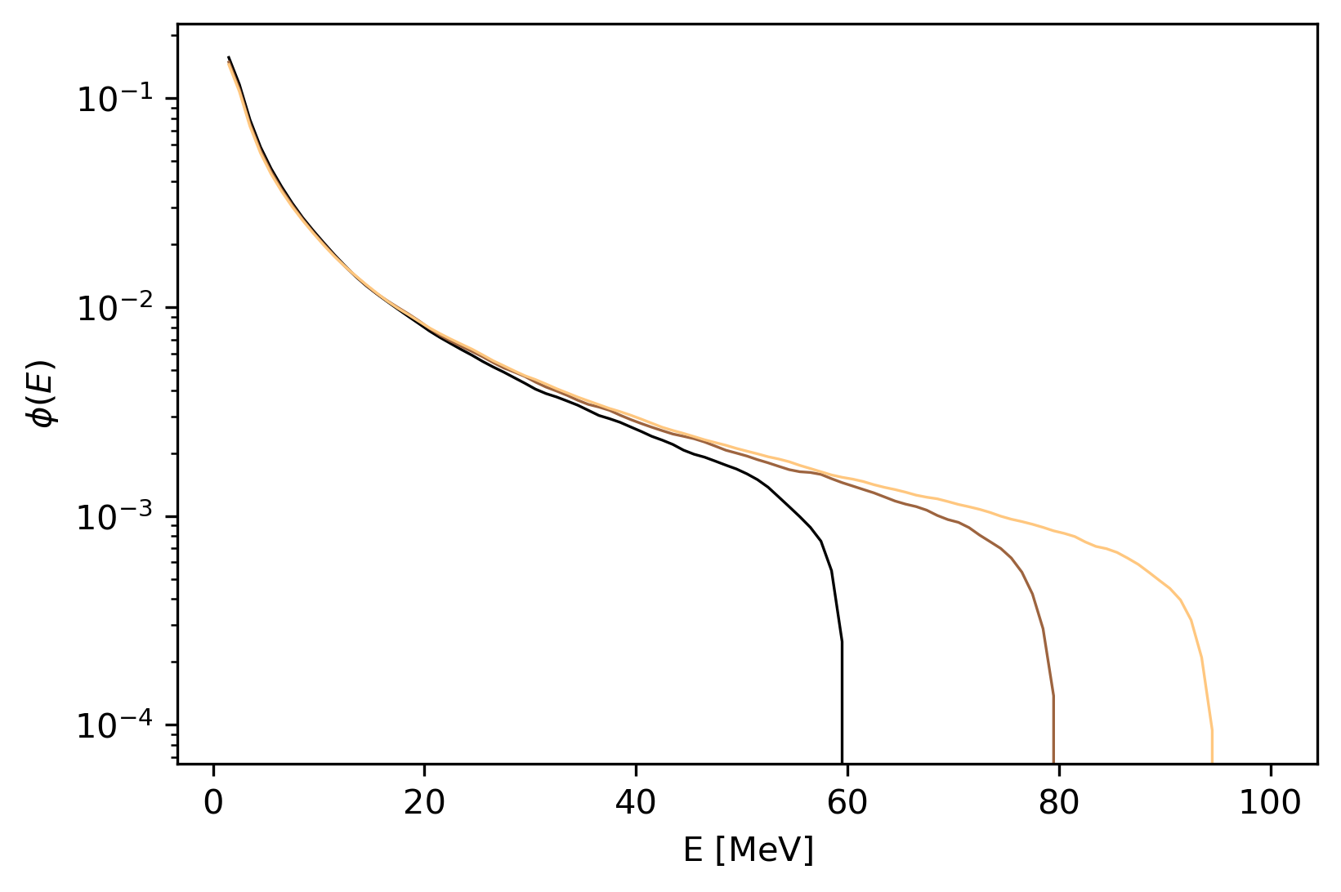
Photon flux simulation
- GEANT4 simulation of bremsstrahlung for 60, 80, and 100 MeV.
- Wolfram thickness 5.65mm.
- 10mm radius Bi target, 17cm away from the converter.

Slide 7
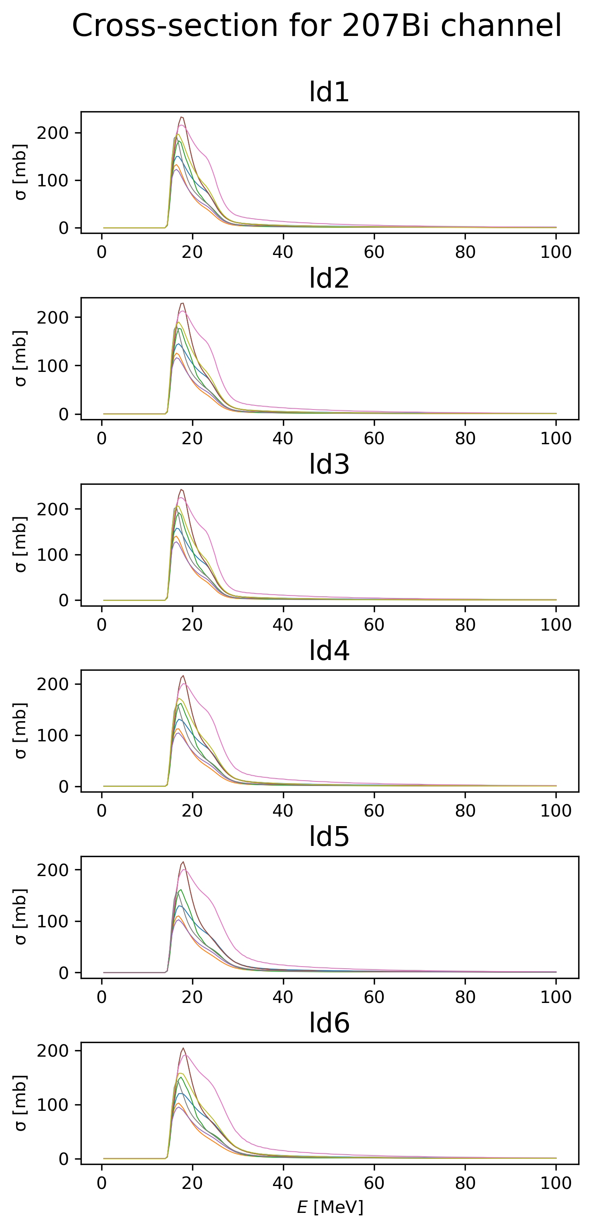
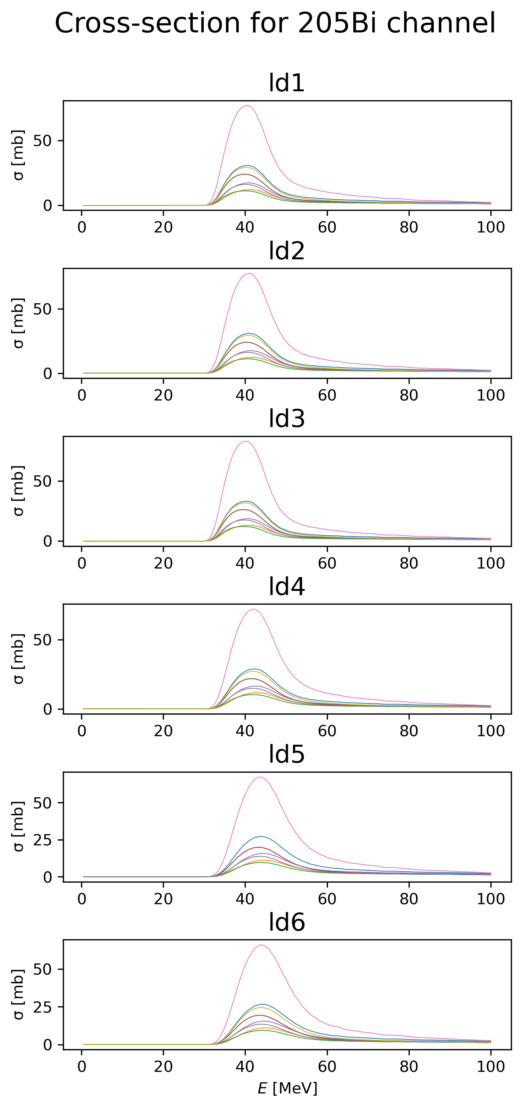
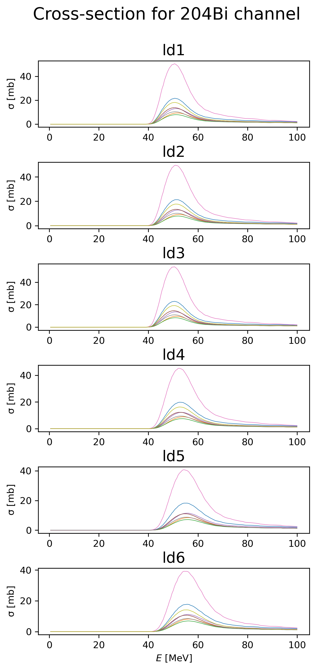
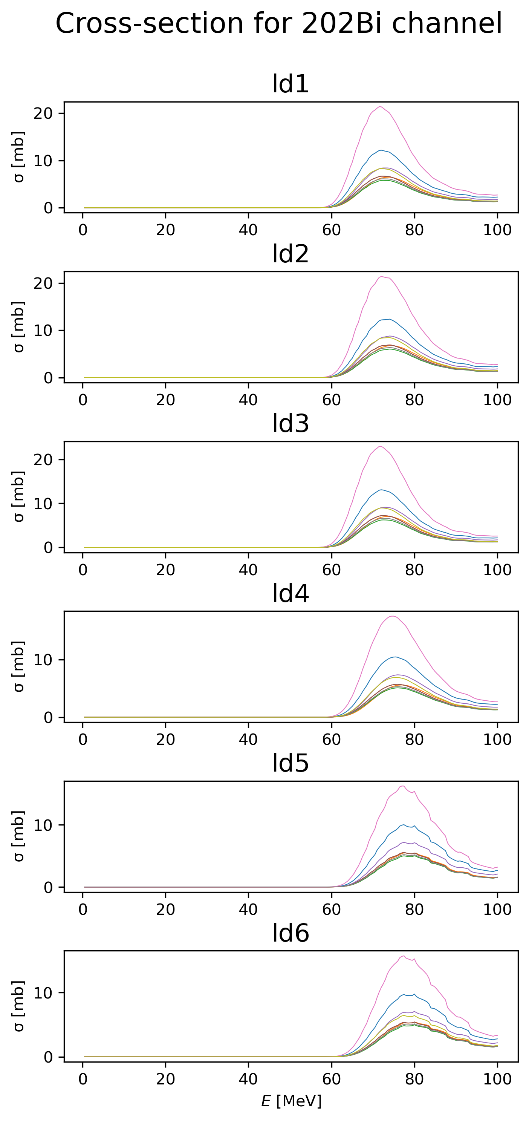
TALYS cross-sections for different level density and photon strength function models, total of 54 model combinations.

Slide 8
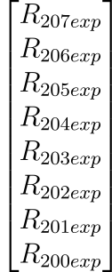
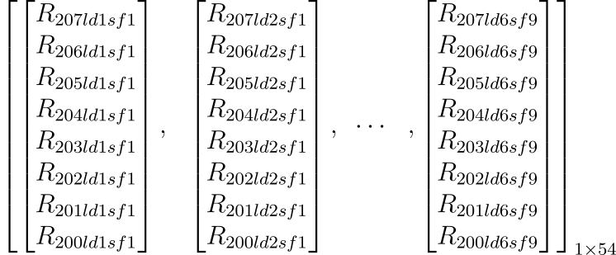
Comparing saturation activities ratios
- For the 54 cross-sections, saturation activities ratios were calculated with GEANT4 photon flux.
- Find which model fits the experimental saturation activities best for all neutron emissions considered.

Slide 9
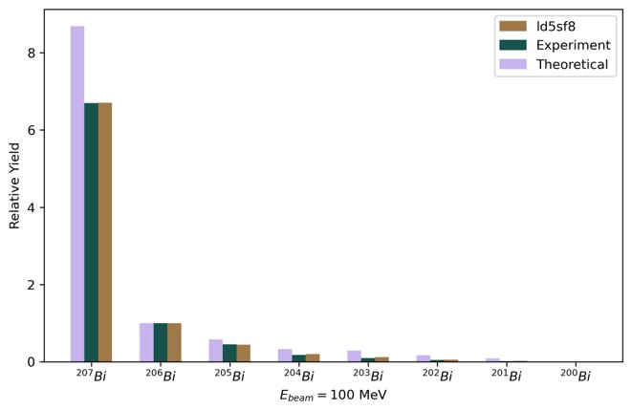
Comparison results 100MeV flux

Slide 10
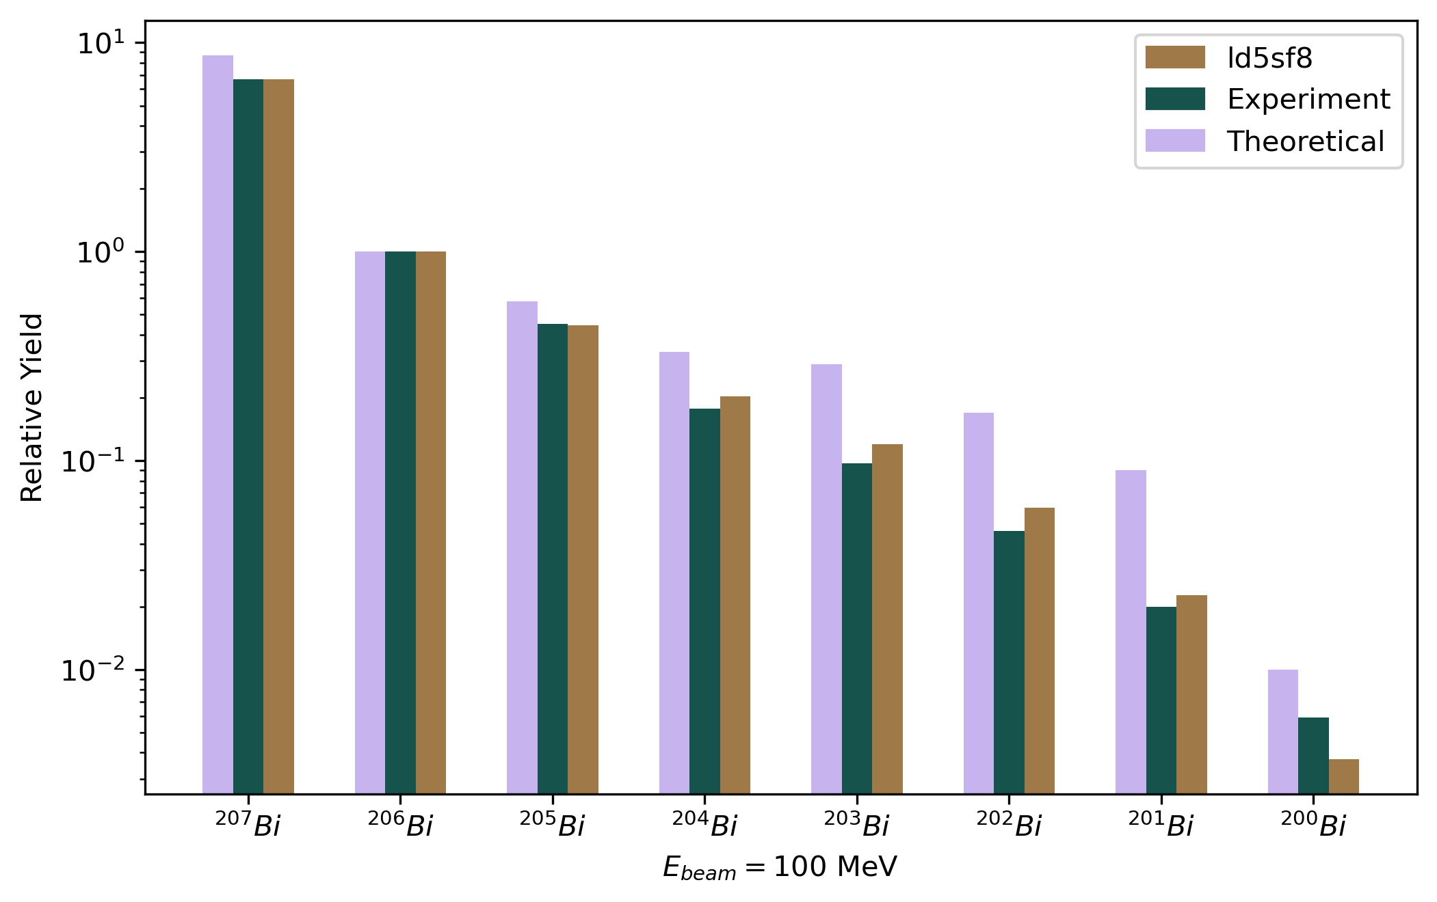
Comparison results 100MeV flux

Slide 11
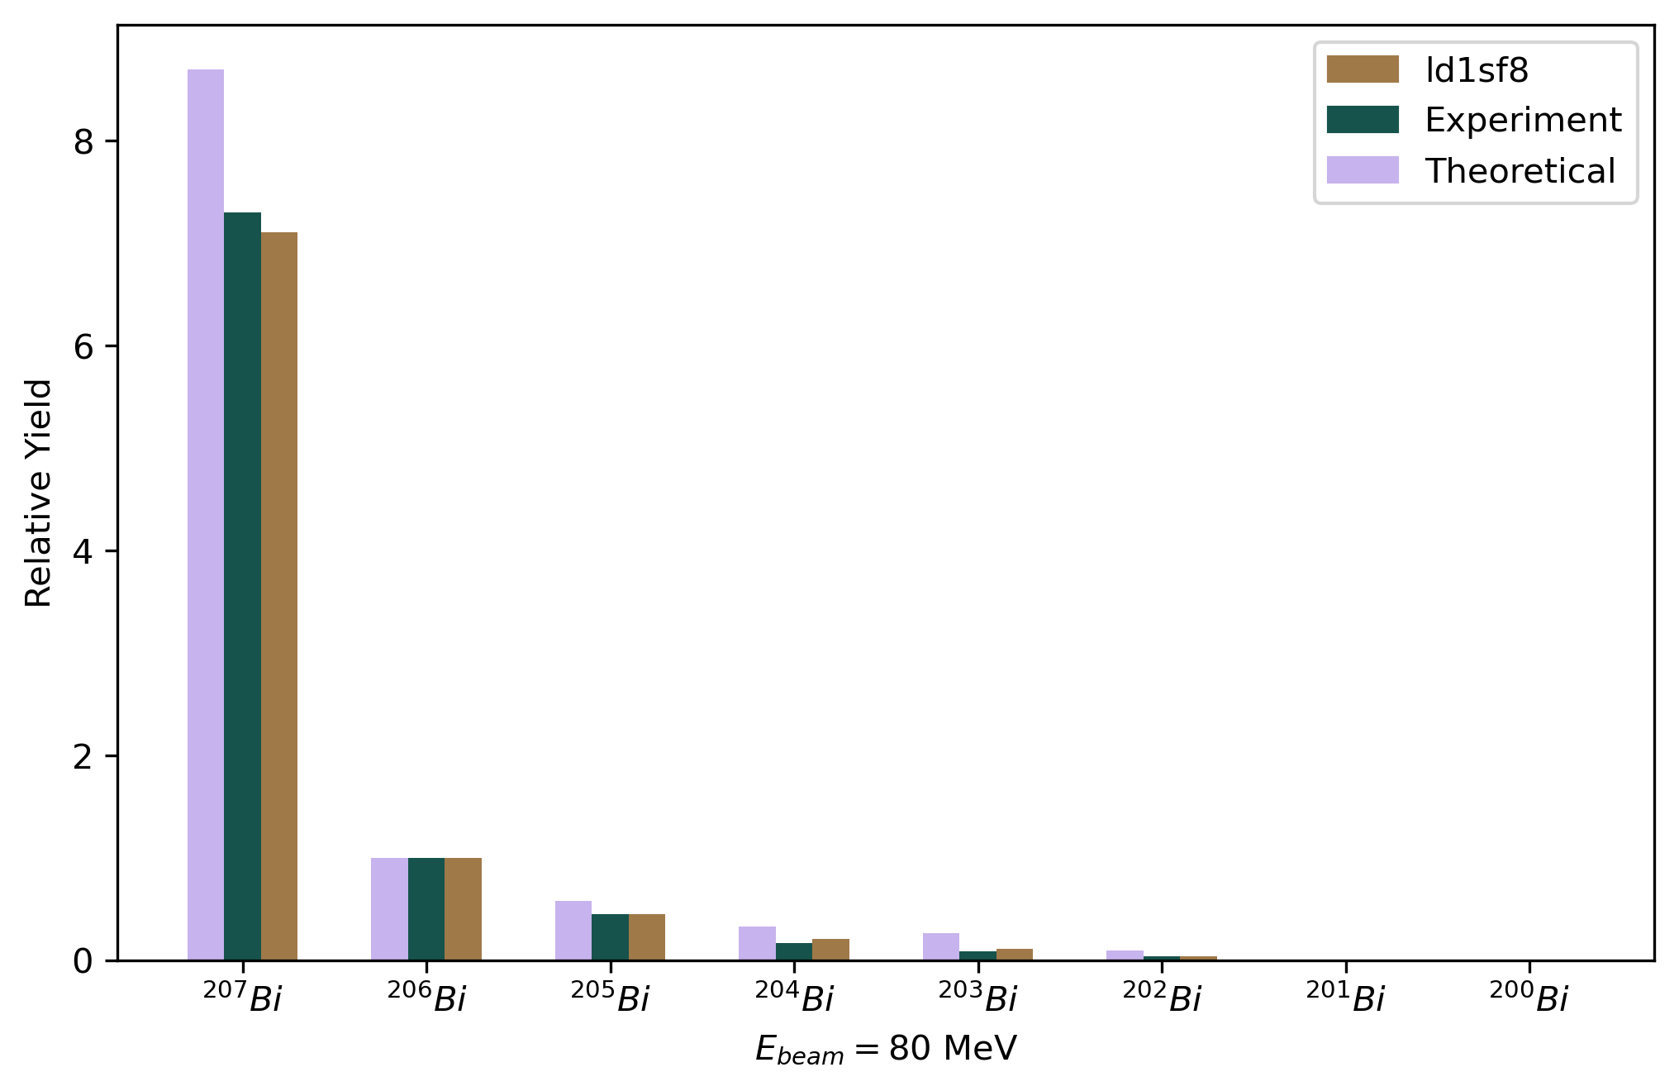
Comparison results 80MeV flux

Slide 12
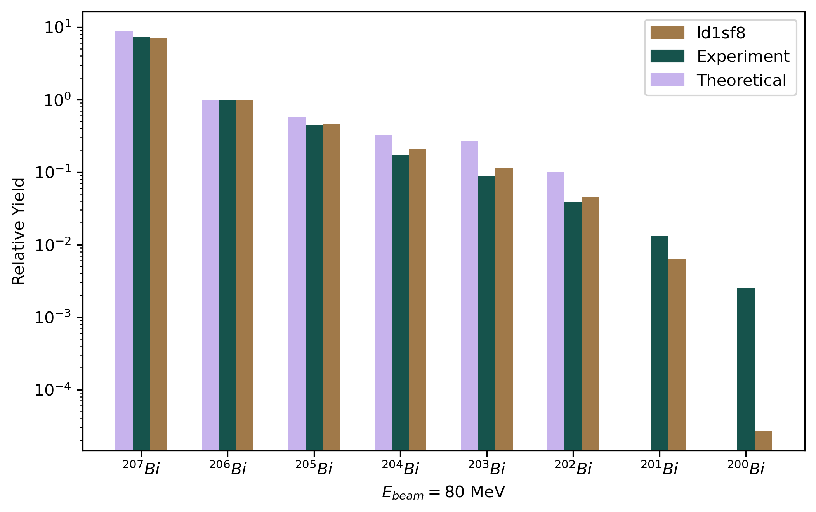
Comparison results 80MeV flux

Slide 13
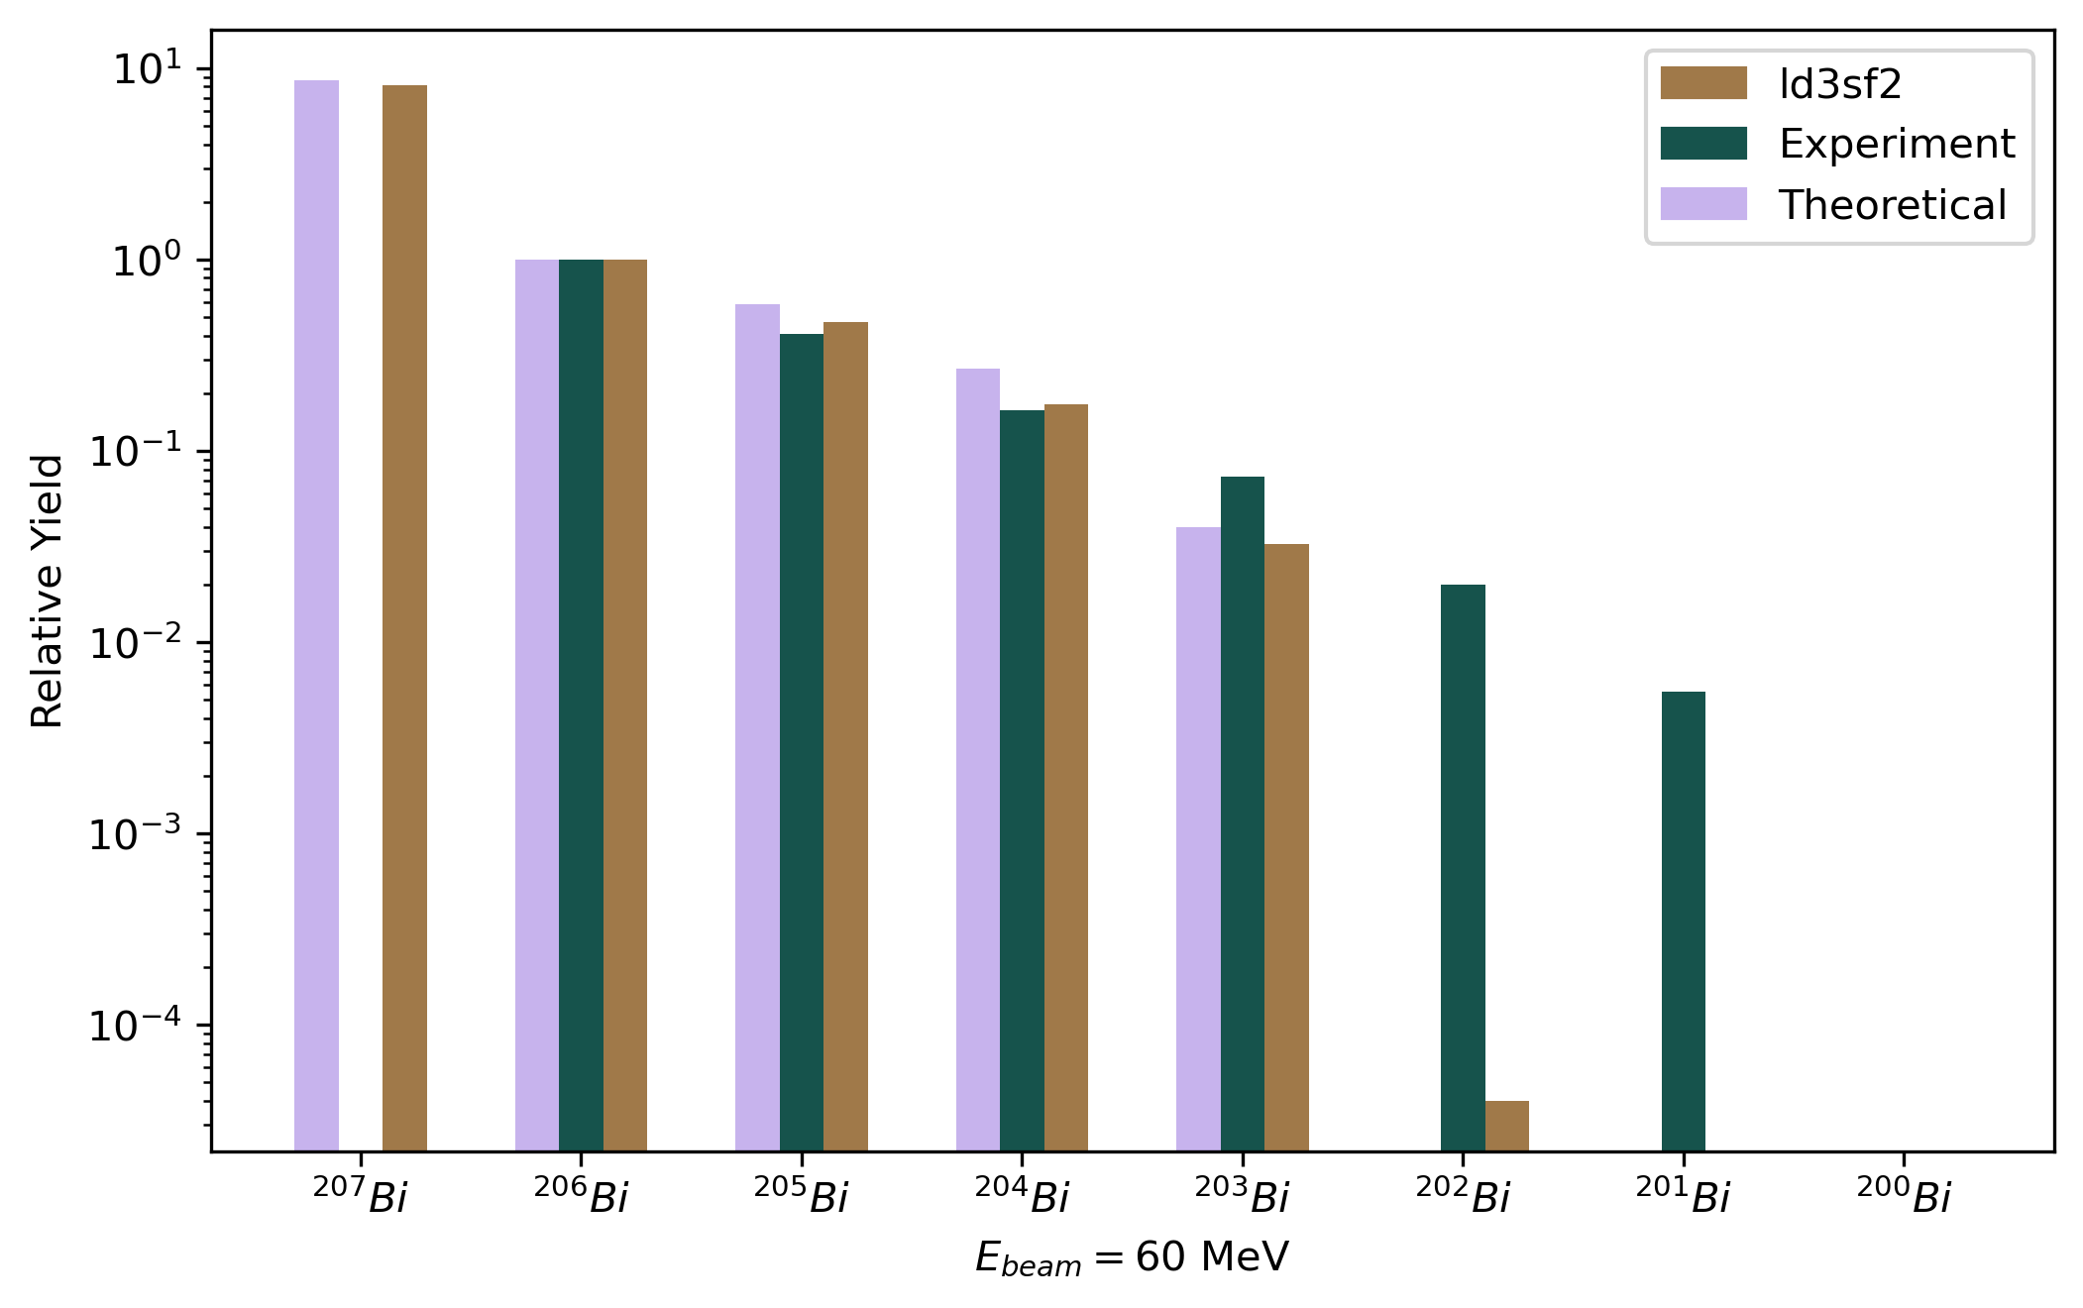
Comparison results 60MeV flux

Slide 14
Thank you for your attention!

Slide 15
Theoretical calculations
For more details: M.Demichev et al., Phys. At. Nucl. 85, 805–812 (2022)

