Slide 1

Global comparison between experimentally measured isomeric yield ratios and nuclear model calculations
S. Cannarozzo¹, S. Pomp¹, A. Koning², A. Al-Adili¹, A. Solders¹, A. Göök¹
¹ Uppsala University, ² International Atomic Energy Agency
Joint ICTP-IAEA Workshop on Simulation of Nuclear Reaction Data with the TALYS Code - Trieste 2023

Slide 2
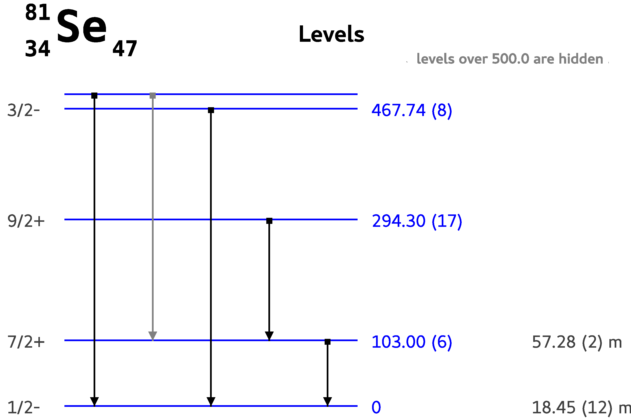
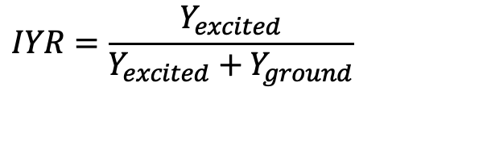
Intro - Isomers and isomeric yield ratio (IYR)
Isomers are excited meta-stable states of a nucleus
IYR is a reaction observable that can give info about angular momentum of reaction products
TALYS can calculate the IYR
Many factors influence performance, e.g. optical model, level scheme, level density model (LDM)
We studied the performances of TALYS to calculate IYR in reactions involving light particles and 𝛄
excited state
ground state
$$IYR=\frac{Y_{excited}}{Y_{excited}+Y_{ground}}$$

Slide 3
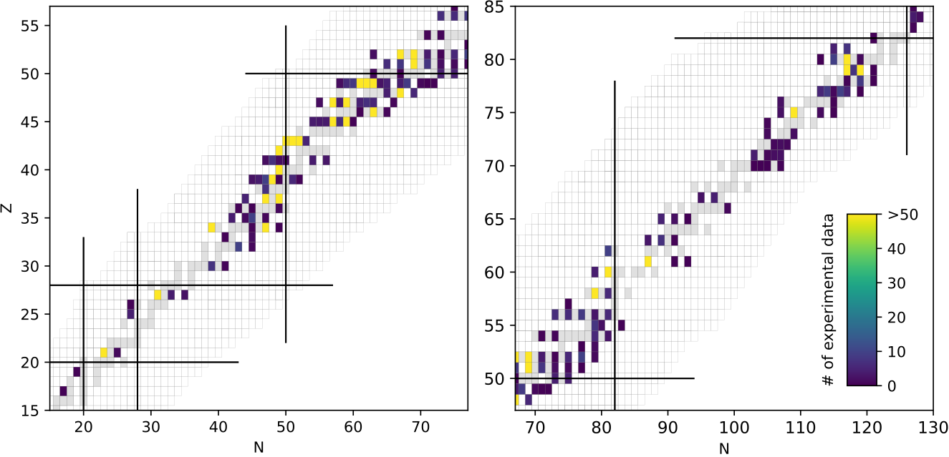
Method - outline
IYR measured in reactions retrieved from EXFOR library
Experimental data reproduced with TALYS
Values compared
Calculations can be repeated with different TALYS settings to study their impact (LDM and spin cut-off parameter)
Distribution of the nuclei included in the IYR database used in this work on the nuclear chart.

Slide 4
Experimental data
Data retrieved from EXFOR, nuclear data library maintained by IAEA
Reactions used based on TALYS constraints:
  Light particles (n, p, d, ³He, 𝜶) and 𝛄
  Energies < 200 MeV
Database divided into entries (single experiments)
1131 entries retrieved containing one or more measured IYR
Total of 5404 measured IYR
Projectile | Entries | Experimental IYR
n | 499 | 1396
γ | 290 | 1247
⍺ | 151 | 1248
p | 138 | 1010
d | 40 | 342
h | 13 | 161
Total | 1131 | 5404

Slide 5
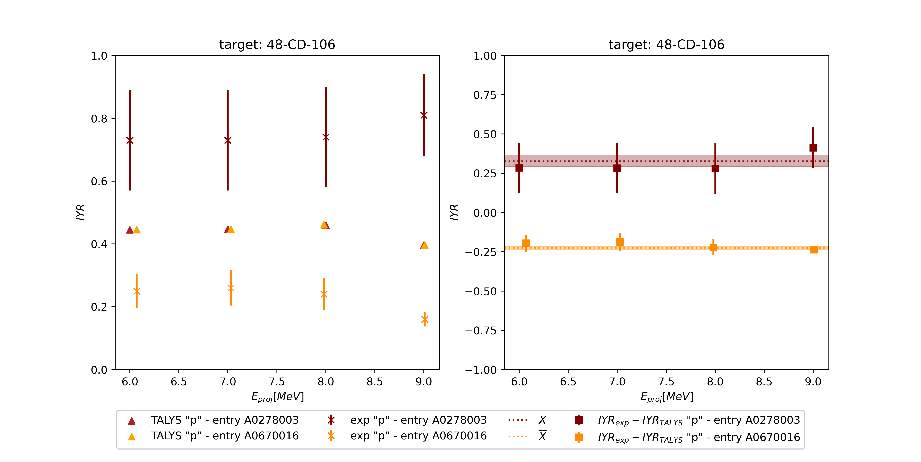
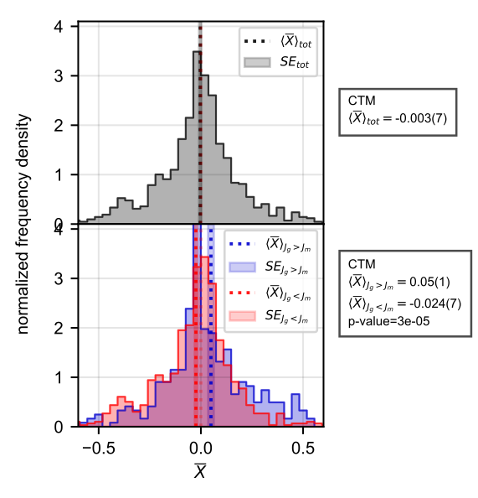
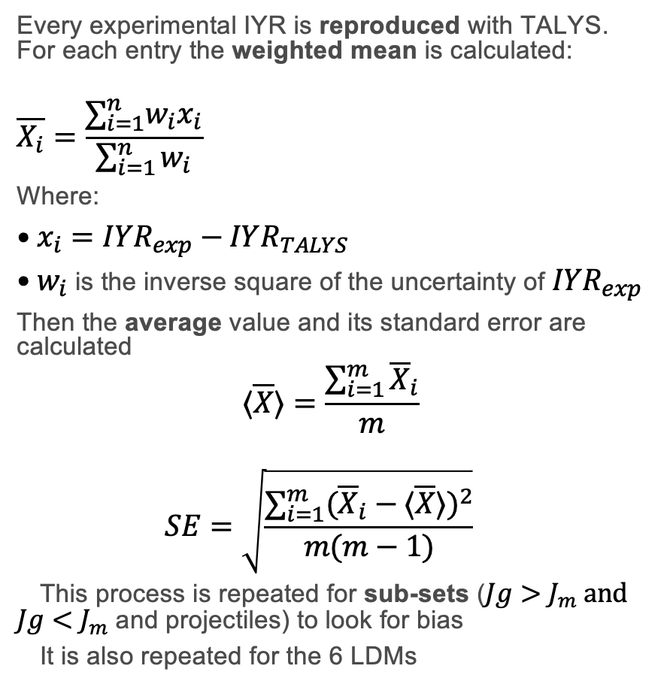
Analysis
Every experimental IYR is reproduced with TALYS. For each entry the weighted mean is calculated:
                $$\overline{X_{i}}=\frac{∑_{i=1}^{n}w_{i}x_{i}}{\sum_{i=1}^{n}{w_{i}}}$$
Where:
$x_{i}=IYR_{exp}−IYR_{TALYS}$
$w_{i}$ is the inverse square of the uncertainty of $IYR_{exp}$
Then the average value and its standard error are calculated
  $$⟨\overline{X}⟩=\frac{\sum_{i=1}^{m}{{\overline{X}}_{i}}}{m}$$
  $$SE=\sqrt{\frac{∑_{i=1}^{m}({\overline{X}}_{i}−⟨\overline{X}⟩)^{2}}{m(m−1)}}$$
  This process is repeated for sub-sets ($Jg>J_{m} and$ $Jg<J_{m}$ and projectiles) to look for bias
  It is also repeated for the 6 LDMs
$$Δ(IYR)$$

Slide 6
Analysis – level density models
On average, TALYS underestimates the low-spin state
Mild dependency on the LDM showed

Slide 7
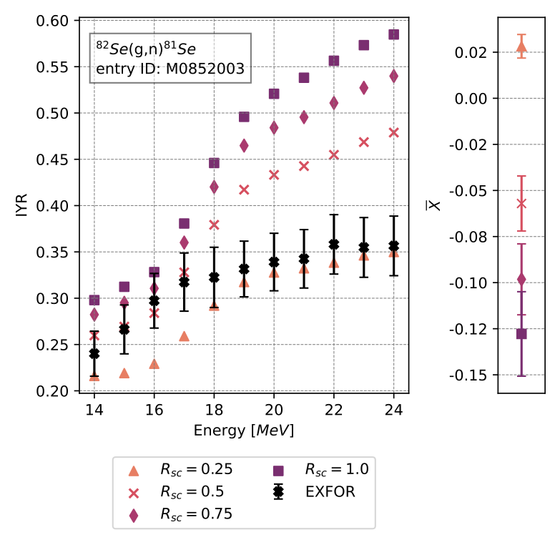
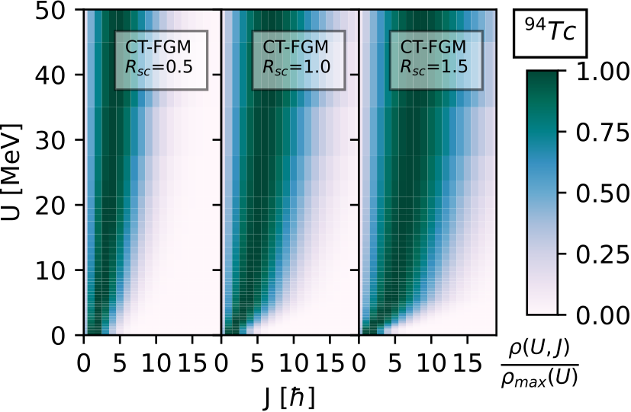

Analysis - spin cut-off parameter
  Investigated the effect of spin cut-off parameter ($R_{sc}$), used by TALYS to calculate the width of the spin distributions for different level density models

Slide 8
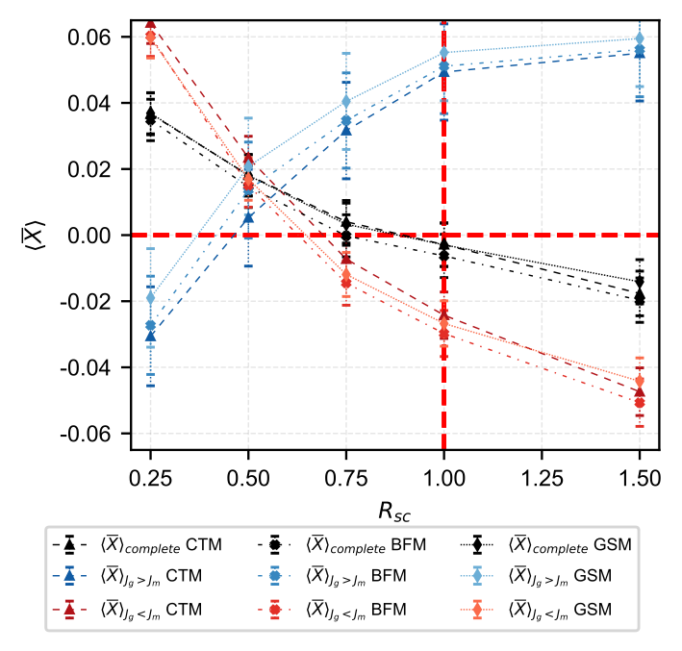
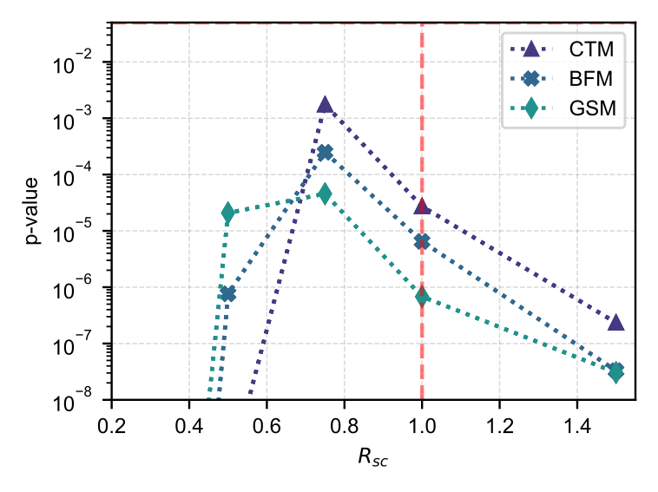

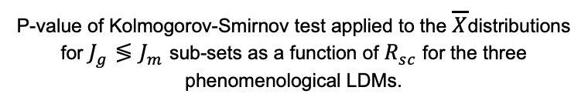
Results and conclusions
  To lower values of $R_{sc}$, on average, correspond closer biases and more similar distributions
Trend of $⟨\overline{X}⟩$ as a function of $R_{sc}$ for empirical LDMs.
P-value of Kolmogorov-Smirnov test applied to the $\overline{X}$distributions for $J_{g}≶J_{m}$ sub-sets as a function of $R_{sc}$ for the three phenomenological LDMs.

Slide 9
Thank you for the attention!

Slide 10
