Slide 1
Neutron inelastic scattering cross section measurements at Lawrence Berkeley National Laboratory
Thibault A. Laplace
Department of Nuclear Engineering
University of California, Berkeley
Nuclear Science Division Lawrence Berkeley National Laboratory

Slide 2
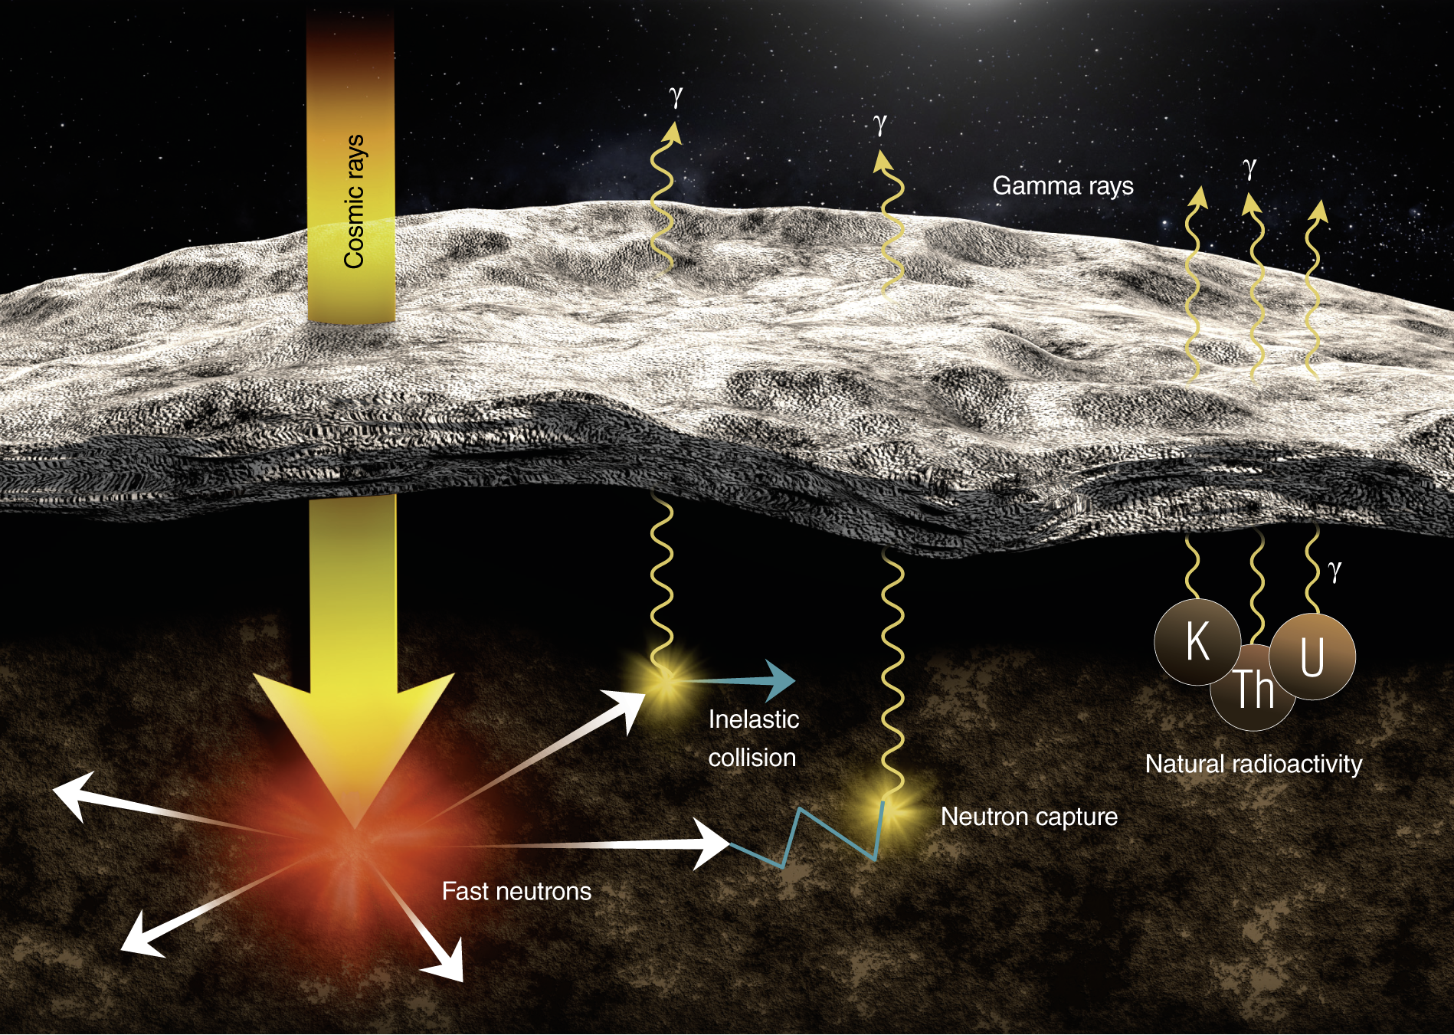
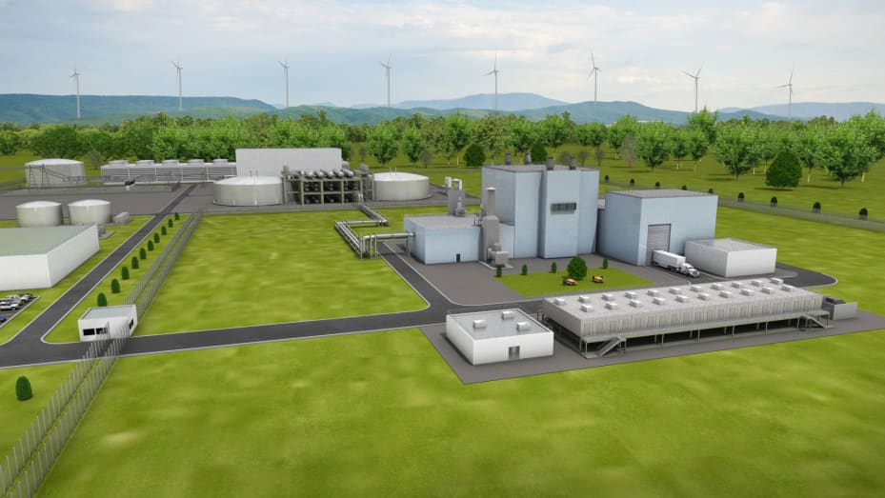
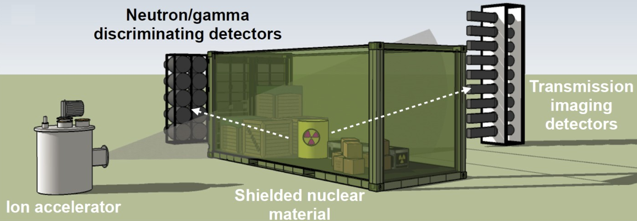
Neutron inelastic scattering cross sections
Advanced Nuclear Energy Systems
Space Exploration
Deficiencies in inelastic scattering cross section required for a broad range of applications
Nuclear
Logging
Active interrogation
Notes:
https://www.nature.com/articles/srep24388

Slide 3
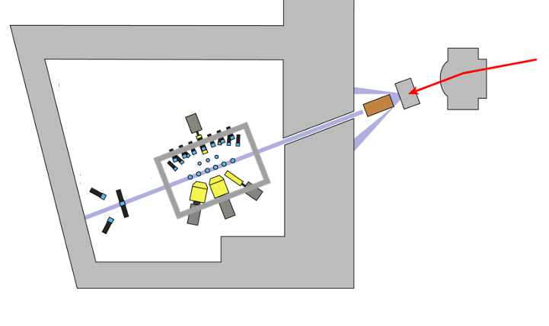
GENESIS at the 88-Inch Cyclotron
Switching magnet
Breakup target
GENESIS
Collimator
Kinematic neutron spectrometer

Slide 4
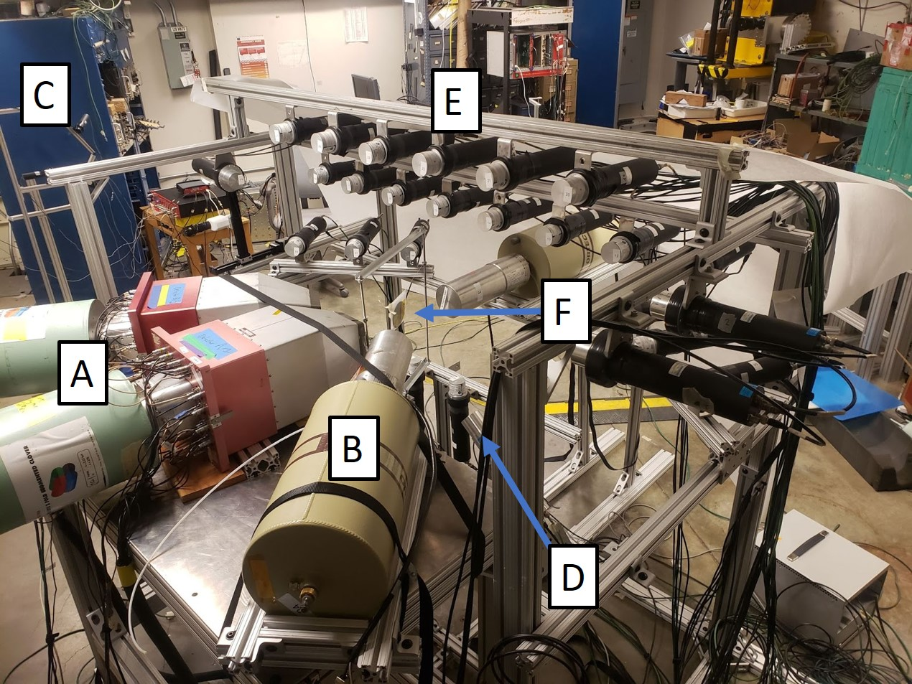
GENESIS array
2-fold segmented HPGe with BGO anti-Compton shields
Single-crystal HPGe
Kinematic neutron spectrometer
LaBr₃(Ce) fast gamma-ray detector
26 EJ-309 organic liquid scintillators
GENESIS scattering target (⁵⁶Fe, ²³⁸U, ¹²C, NaCl, Al₂O₃)
GENESIS

Slide 5
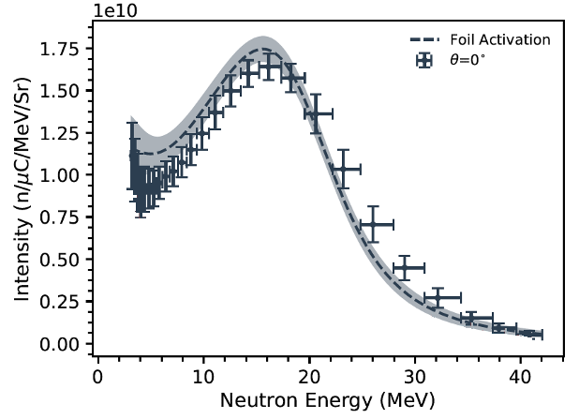
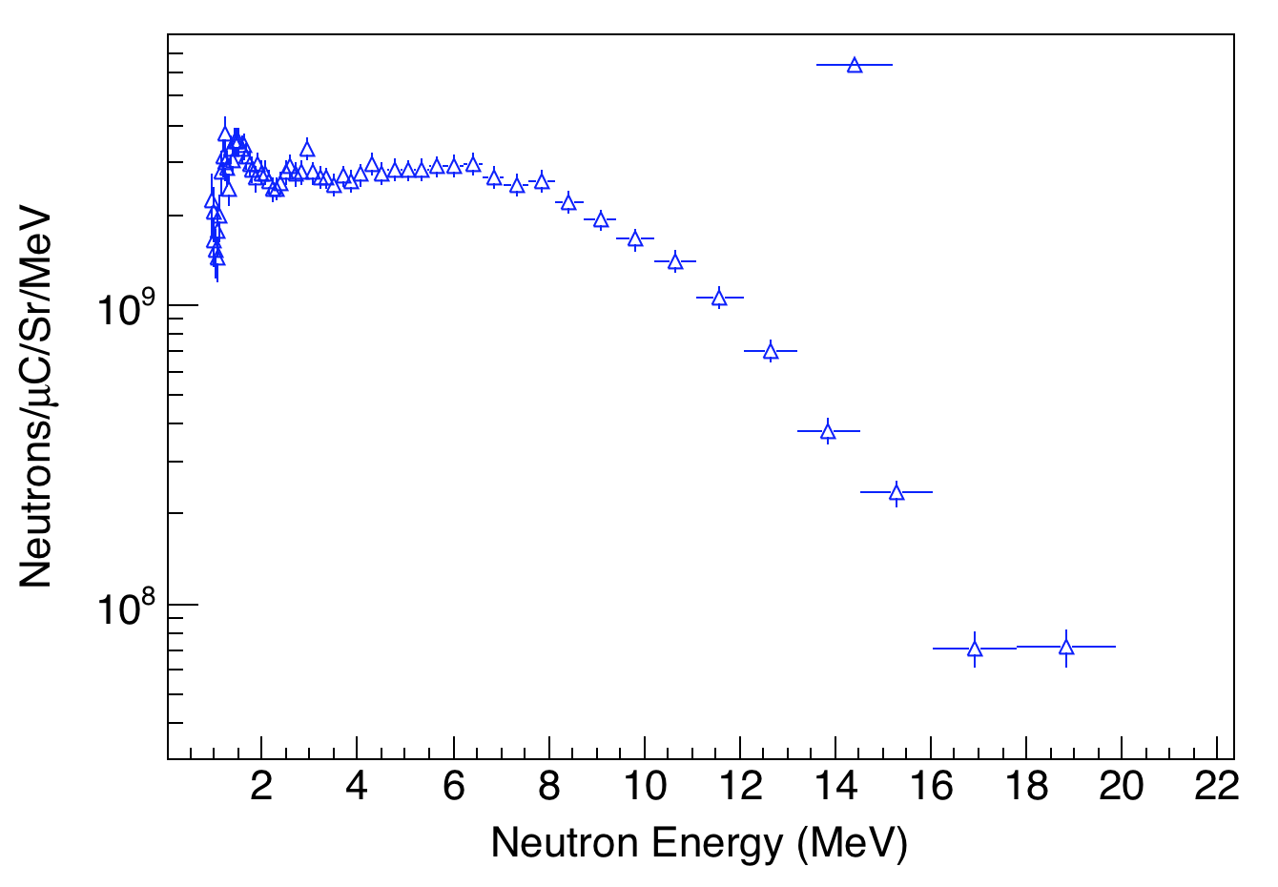
Tunable neutron source
E_{d} = 16 MeV
E_{d} = 40 MeV
K.P. Harrig, B.L. Goldblum, et al., Nucl. Instrum. Meth. (2018).
J. Morrell, Ph.D. thesis, University of California, Berkeley, 2021.

Slide 6
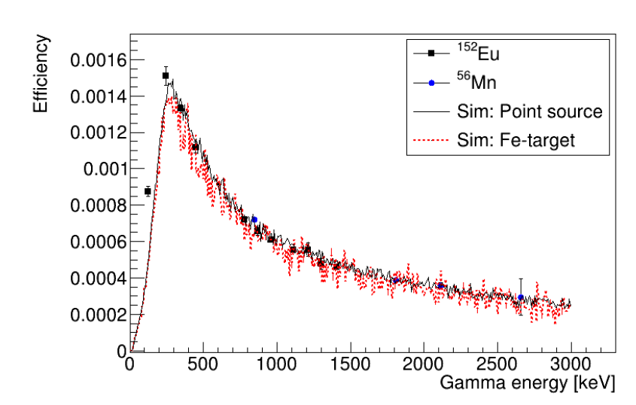
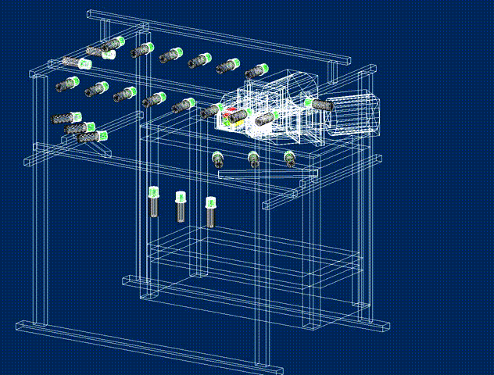
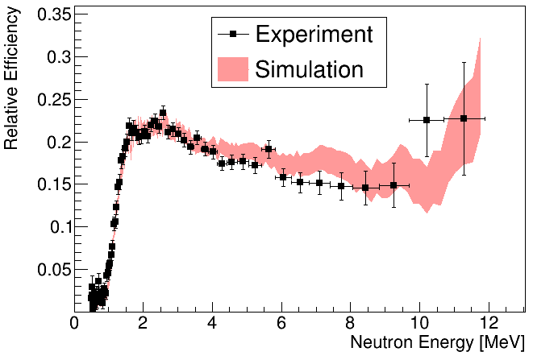
Geant4 model for detector response
Percent level agreement in measured and simulated gamma response with isotropic and extended sources
Geant4 model of GENESIS array developed for detector response simulations
²⁵²Cf source used to benchmark integral and differential neutron detection efficiency
J. Gordon, to be published.

Slide 7
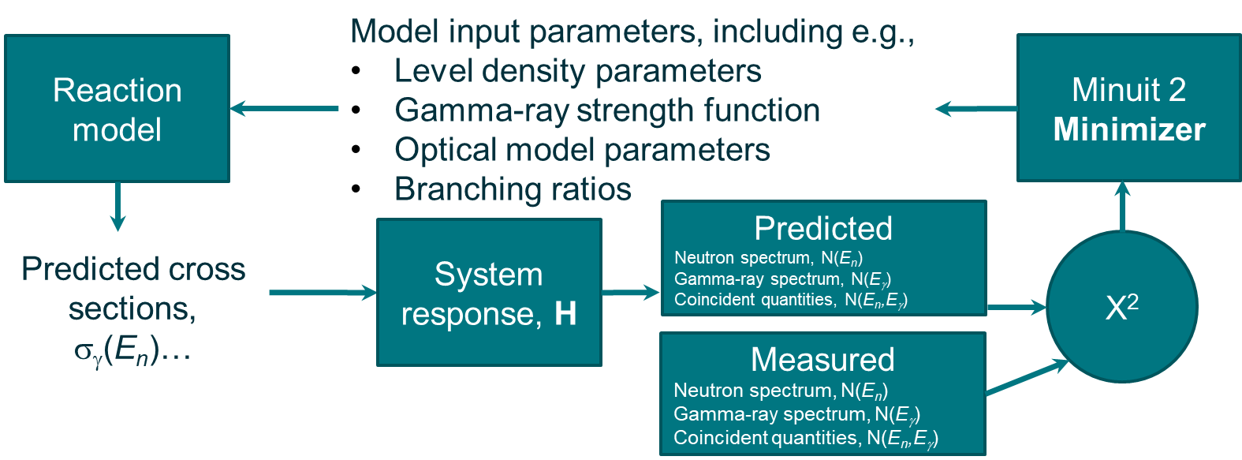
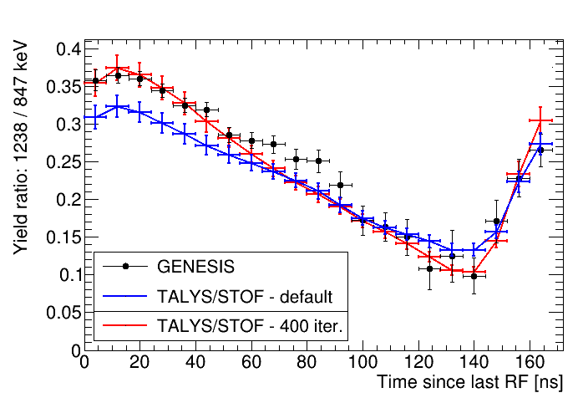
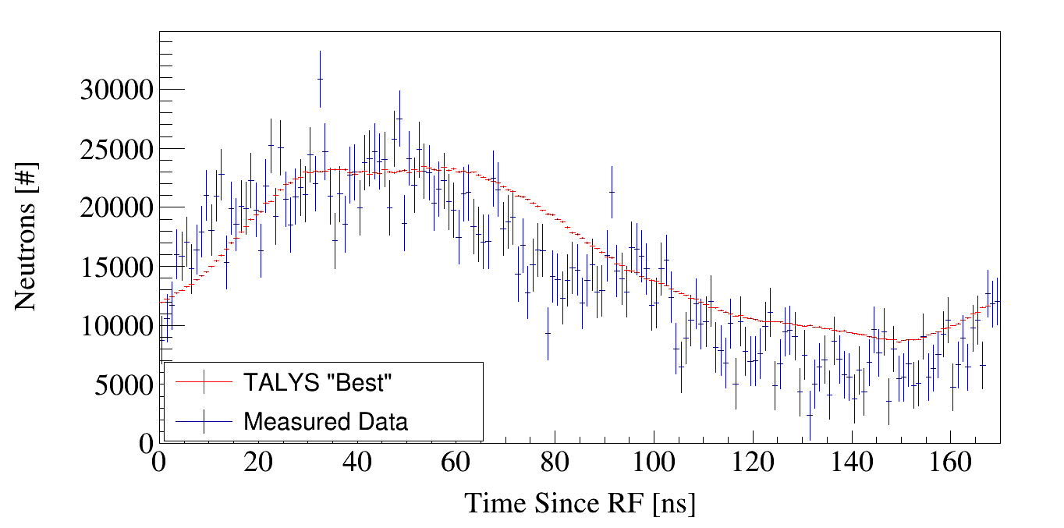
Forward modeling
TALYS

Slide 8
Acknowledgements
J.C. Batchelder¹, L.A. Bernstein^{1,2}, D.L. Bleuel³, B. Buckley⁴, C. Brand^{1,3}, J.A. Brown¹, B.G. Frandsen⁴, A. Georgiadou¹, B.L. Goldblum^{1,2}, J.M. Gordon¹, J.J. Manfredi⁴, K. Myers¹, T. Nagel¹, M. Wakeling⁴
¹Department of Nuclear Engineering, University of California, Berkeley
²Nuclear Science Division, Lawrence Berkeley National Laboratory
³Lawrence Livermore National Laboratory,
⁴Air Force Institute of Technology, Wright Patterson AFB
This material is based upon work supported by the Department of Energy National Nuclear Security Administration through the Nuclear Science and Security Consortium under Award Number DE-NA0003996. This work was performed under the auspices of the U.S. Department of Energy by Lawrence Berkeley National Laboratory under Contract DE-AC02-05CH11231. The project is funded by the U.S. Department of Energy, National Nuclear Security Administration, Office of Defense Nuclear Nonproliferation Research and Development (DNN R&D).
This report was prepared as an account of work sponsored by an agency of the United States Government. Neither the United States Government nor any agency thereof, nor any of their employees, makes any warranty, express or limited, or assumes any legal liability or responsibility for the accuracy, completeness, or usefulness of any information, apparatus, product, or process disclosed, or represents that its use would not infringe privately owned rights. Reference herein to any specific commercial product, process, or service by trade name, trademark, manufacturer, or otherwise does not necessarily constitute or imply its endorsement, recommendation, or favoring by the United States Government or any agency thereof. The views and opinions of authors expressed herein do not necessarily state or reflect those of the United States Government or any agency thereof.

