Slide 1

Development of a detection technique of nuclear fuel materials using photonuclear reactions
R. Kunitomo ¹, T. Katabuchi ¹, C. Ishizuka¹,
and H. Sagara¹
¹Tokyo Institute of Technology

Slide 2
Contents
Introduction
Non-Destructive Analysis (NDA)
The merit of using photonuclear reaction
Pelletron Accerelator

Slide 3
1. Introduction
Nuclear security at nuclear reactor facilities is a significant concern.
theft and smuggling of nuclear material
sabotage of the facilities
To prevent these security incidents, the development of Non-Destructive Analysis (NDA) techniques for identifying nuclear material is important.
Notes:
Nuclear security at nuclear reactor facilities is a significant concern, particularly with regards to the theft and smuggling of nuclear material, as well as sabotage of the facilities. Nowadays, import managements which include illegal nuclear materials and radioactive materials. One crucial task to prevent these security incidents is the development of non-destructive detection techniques for identifying nuclear material. For example, United States develops NDA technique to analyse nuclear materials. It is because the US focus on homeland security since September 11th attacks. Not only in the US, but also many countries research the NDA techniques. Although numerous techniques have been proposed, further study is still required to meet the necessary requirements.

Slide 4
2. Non-Destructive Analysis (NDA)
Passive
measuring gamma ray or neutron which are emitted by fissile materials
- detection of Pu is good but U is not good
Active
At first, we irradiate the nuclear material by gamma ray or neutron. Then, we measure gamma ray or neutron that is emitted at the reaction.
- detection of U is developed
Notes:
There are 2 NDA techniques, one is Passive and the other is Active. Passive way is measuring gamma ray or neutron which are emitted by fissile materials. Active way also measures gamma ray or neutron but the process is different from previous one. At first, we irradiate the nuclear material by gamma ray or neutron. Then, we measure gamma ray or neutron that is emitted at the reaction. It is possible to detect Plutonium in Passive way. But it is difficult to detect high concentrate Uranium because we have difficulty to measure its low radiation. So now, the researches are progressed to detect high concentrate Uranium in Active way.

Slide 5
3. The merit of using photonuclear reaction
Neutrons are not affected by Coulomb forces in matter → High penetrating power
Nucleus
Electron
Charged particle
α, β, p etc.
Neutron
Interaction of neutron with Matter
Notes:
Sagara has suggested to use photonuclear fission caused by high-energy gamma-rays. In the suggested method, neutrons emitted from the photofission are used to detect nuclear material like uranium-235. High-energy gamma ray and emitted neutrons have enough energies to penetrate samples. So uranium can be detected even if the material is shielded. In addition, multiple coincidence counting of fission neutrons enables separation from background neutrons. If we detect neutrons from a fission reaction, we can understand what the nuclear material is. Furthermore, photofission neutron ratio of uranium-235 to uranium-238 changes with the photon energy. Uranium enrichment can be derived by comparing the rate of fission neutrons between different photon energies. They performed a theoretical work and show that the method is feasible but neutron background in a photon-irradiation field is a big issue.

Slide 6
3. The merit of using photonuclear reaction
When a high-energy photon interacts with nuclear material, such as uranium or plutonium, it induces nuclear fission and emits fast neutrons.
These neutrons can be detected using neutron detectors such as liquid scintillator.
High-energy photon
Fast neutrons
Pu, U
Liquid scintillator
Notes:
In this research, a new non-destructive technique using a low-background gamma-ray source is being developed to detect nuclear material. High-energy gamma-rays are employed as probes for this purpose. When a high-energy photon interacts with nuclear material, such as uranium or plutonium, it induces nuclear fission and emits fast neutrons. These neutrons can be detected using neutron detectors such as liquid scintillator. Neutrons possess a high power of penetrability, enabling the detection of nuclear material even if it is concealed within a container made of high-Z materials. The feasibility of this technique will be evaluated through simulations and experiments using an accelerator.

Slide 7
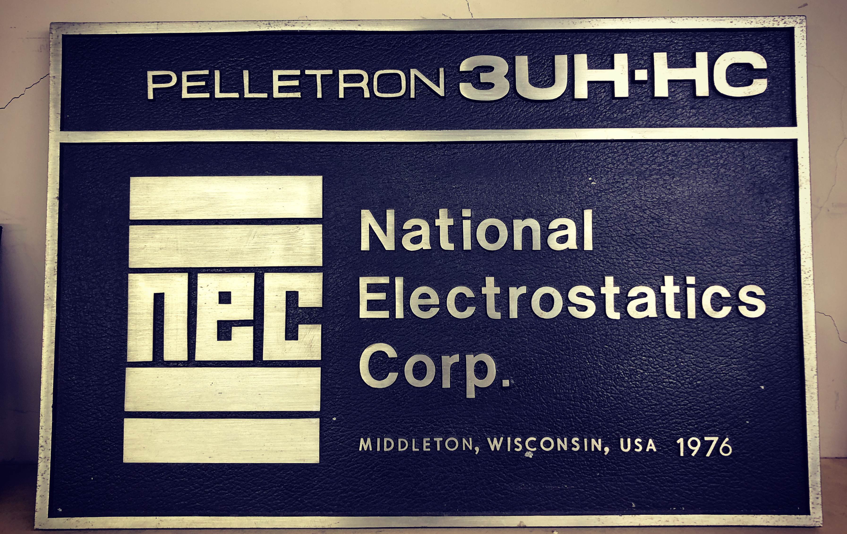
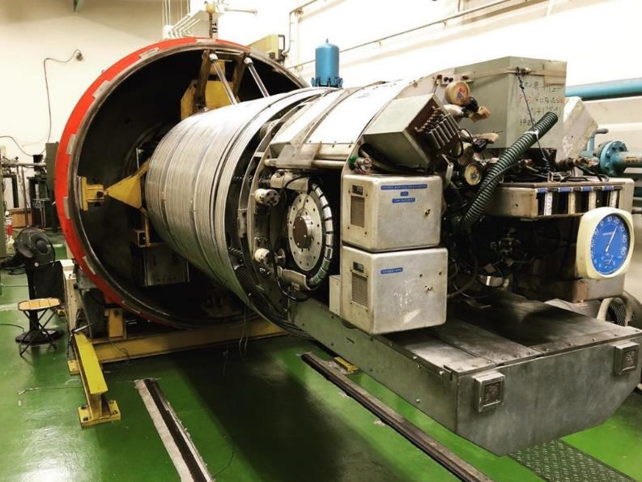
4. Pelletron Accelerator
Machine performance：
          Pelletron 3UH-HC（nec, USA）
          Accelerating voltage：Max 3 MV
          Ions：p, d, α
          Beam current：10 μA（Pulse）
          Maximum beam energy：3 MeV for proton
          Pulsed beam（width 1.5ns, repetitive cycle 4MHz）

Slide 8
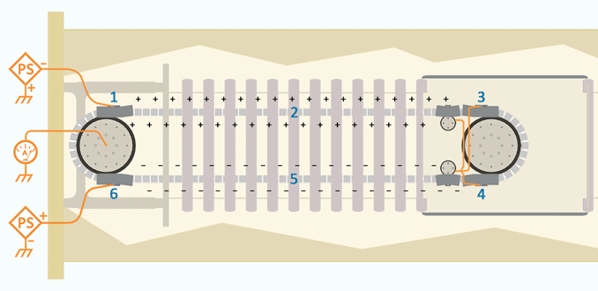
4. Pelletron Accelerator
Electrostatic accelerator
Van de Graaf type
Single-ended
Pellet chains
https://www.pelletron.com/products/pelletron-tutorial/

Slide 9
Thank you for your attention.

Slide 11
5. Nuclear reactions used as neutron sources
d + d → n + ³He + 3.26 MeV
d + t → n +⁴He + 17.6 MeV
p + t → n + ³He – 0.764 MeV
p + ⁷Li → n + ⁷Be – 1.64 MeV
p + ⁹Be → n + ⁹B – 1.85 MeV
p + ⁴⁵Sc → n + ⁴⁵Ti – 2.84 MeV
Photonuclear reactions
– electron beam → bremsstrahlung → photonuclear reactions
Spallation reaction
– Large accelerator required
Exothermic
reaction
Endothermic
reaction

Slide 12
Types of neutron sources
Radiation source, Spontaneous fission
²⁵²Cf
Radiation source, (α,n) reaction
²³⁹Pu-Be, ²⁴¹Am-Be
α + ⁹Be → n + ¹²C
Nuclear reactor
Research reactors are used.
Accelerator-based neutron source
Neutron generating nuclear reactions are used.

Slide 13
Produced Neutron Energy
Available neutron energies are different depending on the nuclear reaction
10⁻³
10⁻²
10⁻¹
10⁰
10¹
10²
MeV
⁴⁵Sc(p,n)⁴⁵Tl
D(d,n)³He
⁷Li(p,n)⁷Be
T(d,n)⁴He
T(p,n)³He
⁹Be(p,n)⁹B
Tokyo Tech Pelletron

Slide 14
Principle of neutron detection
Neutrons do not directly cause electrical signals in the detector because they are electrically neutral.
To detect neutrons, neutrons must be converted into charged particles by nuclear reaction, and then the charged particles induce an electrical signal in the detector.
detector
ionization or
Electron excitation
Charged particle
-
-
-
-
Neutron
-
+
+
+
+
+
Nuclear reactions

Slide 15
Commonly-Used Neutron Detectors
³He Proportional counters
³He + n → p + t + 0.764 MeV
BF₃ Proportional counters
¹⁰B + n → α + ⁷Li + 2.79 MeV
Lithium Glass Detector
⁶Li + n → t + α + 4.78 MeV
Organic liquid scintillation detector
Elastic scattering with protons. Detect recoil protons
n + p → n + p
More sensitive to low-energy neutrons
Sensitive only to fast neutrons
Recoil proton
n
p
n
p

Slide 16
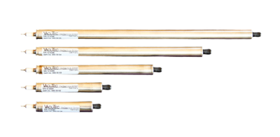
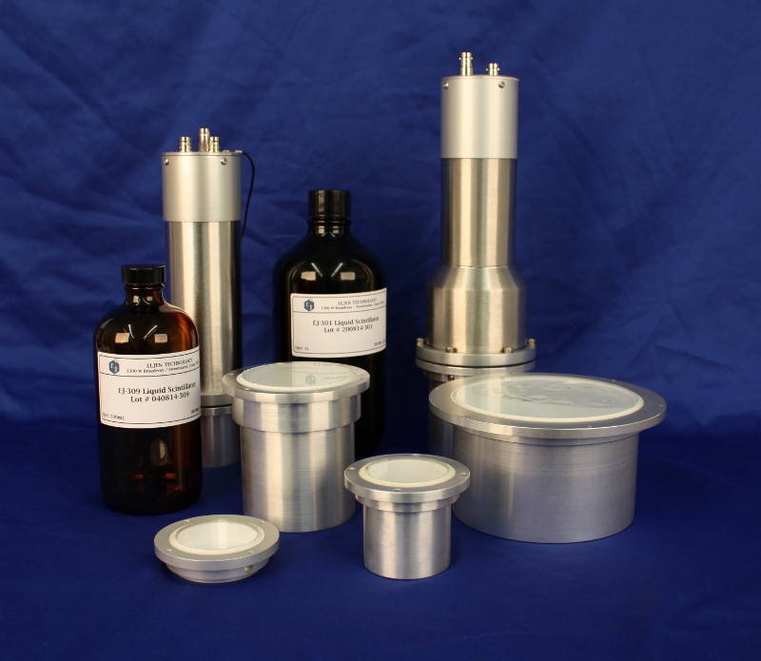
Neutron detector
³He Proportional counters
³He Proportional counters + Polyethylene moderator
Liquid scintillation detector

Slide 17
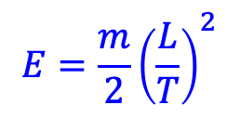
Neutron Time-of-Flight Method
Neutron detectors give only counts. Information on neutron energy cannot be obtained.
The time-of-flight (TOF) method is used to measure neutron energy.
The TOF method requires a pulsed neutron beam.
The Tokyo Tech Pelletron Accelerator can provide a pulsed neutron beam. 4MHz, 1.5ns wide
$$E=\frac{m}{2}{\left(\frac{L}{T}\right)}^{2}$$
Neutron
Neutron source
Detector
L
Neutron Intensity
1.5 ns
250 ns
Time

Slide 18
Neutron Capture Reaction and Prompt γ-rays
A neutron is captured and become part of the nucleus. Prompt gamma-rays are emitted.
e.g. Neutron capture reaction by gold
¹⁹⁷Au + n → ¹⁹⁸Au + γ
Neutron capture
¹⁹⁷Au + n
capture state
Excited state
Transit to ground state with several prompt gamma rays
¹⁹⁸Au decays with a half-life of 2.7 days in β decay, emitting 0.412 MeV of decay γ-rays.
Prompt γ-rays
Prompt γ-rays are emitted in a very short time and reach a ground state of ¹⁹⁸Au.
β⁻ decay
T_{1/2} = 2.7 d
¹⁹⁸Au
Decay γ-ray
Ground state
0.412 MeV
¹⁹⁸Hg

Slide 19
Measurement of Prompt γ-rays
The neutron capture reaction can be studied by measuring prompt gamma rays.
Gamma rays are measured during neutron beam irradiation.
Because of the high background, it is difficult to identify the prompt γ-rays from the sample unless the γ-ray detector is shielded.
detector
background
γ-rays
background
Neutron
Neutral source
Prompt γ-rays
Neutron beam
試料

Slide 20
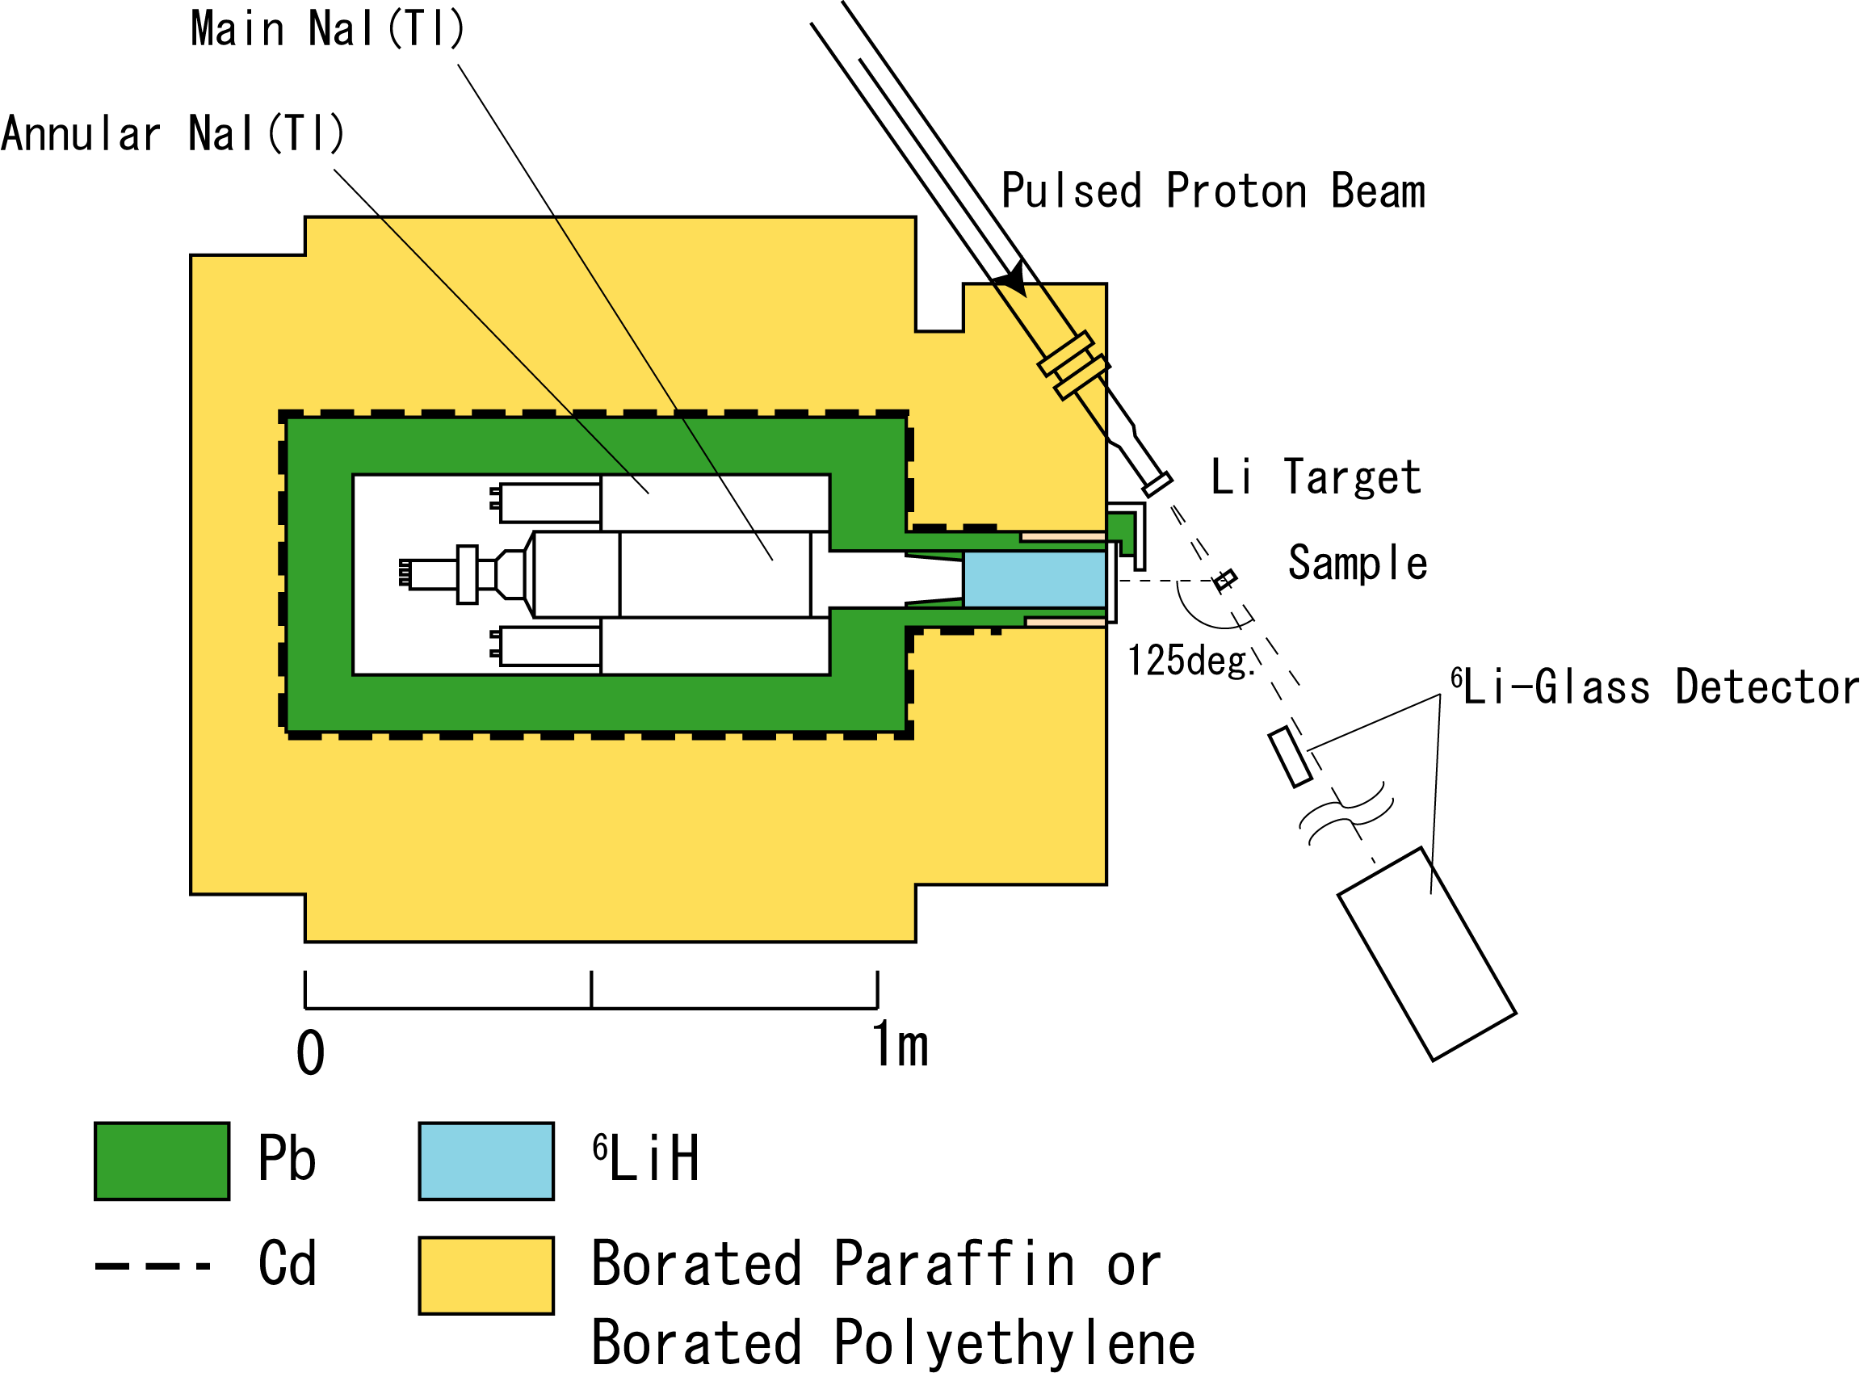
Detection of Prompt γ-ray and Detector Shielding
Proton beam
Neutron shielding
borated polyethylene
Gamma ray detector NaI(Tl)
Absorption by boron
Pb
Detector
Neutron
γ
γ-rays
Cadmium
Absorption of
thermal neutrons
Lead
γ-ray shielding

