Slide 1
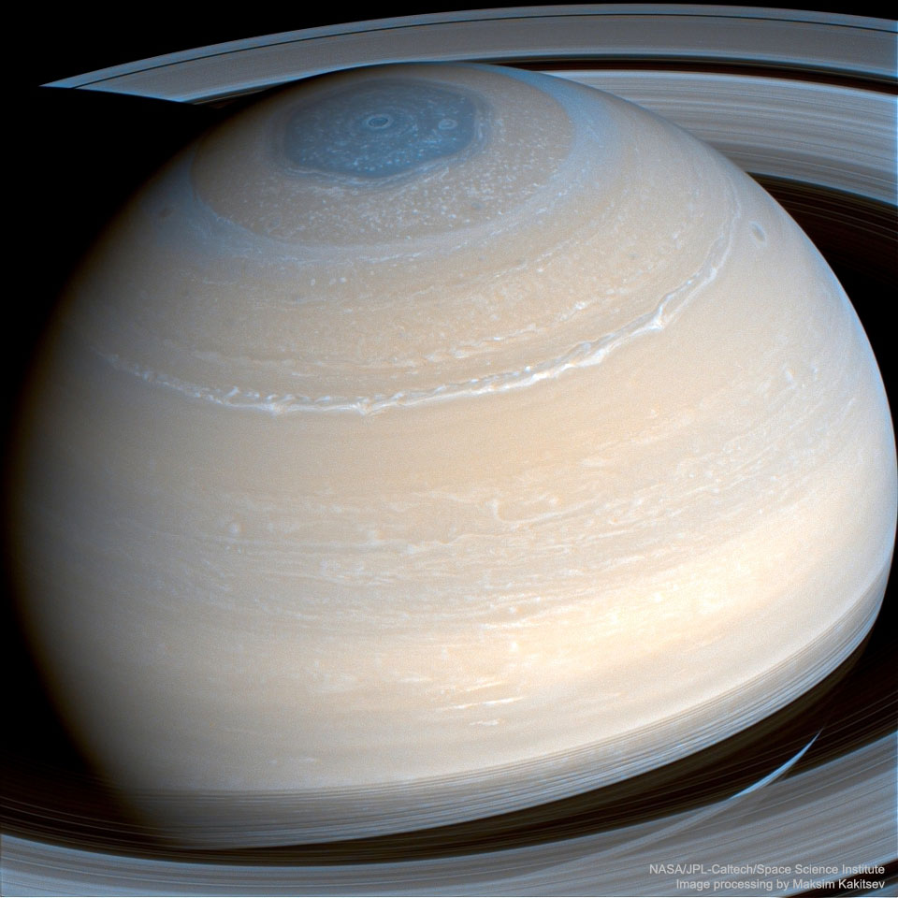
Precision measurements of nuclear data for planetary nuclear spectroscopy
Joint ICTP-IAEA Meeting
10/17/2023
Mauricio Ayllon Unzueta

Slide 2
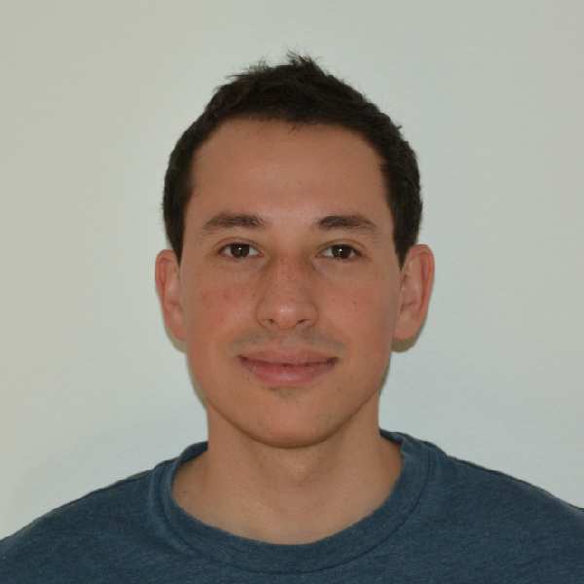
Our team
Richard Starr
Arun Persaud
Patrick Peplowski
Jack Wilson
Mauricio Ayllon
Ann Parsons
Bernhard Ludewigt
Caroline Egan

Slide 3
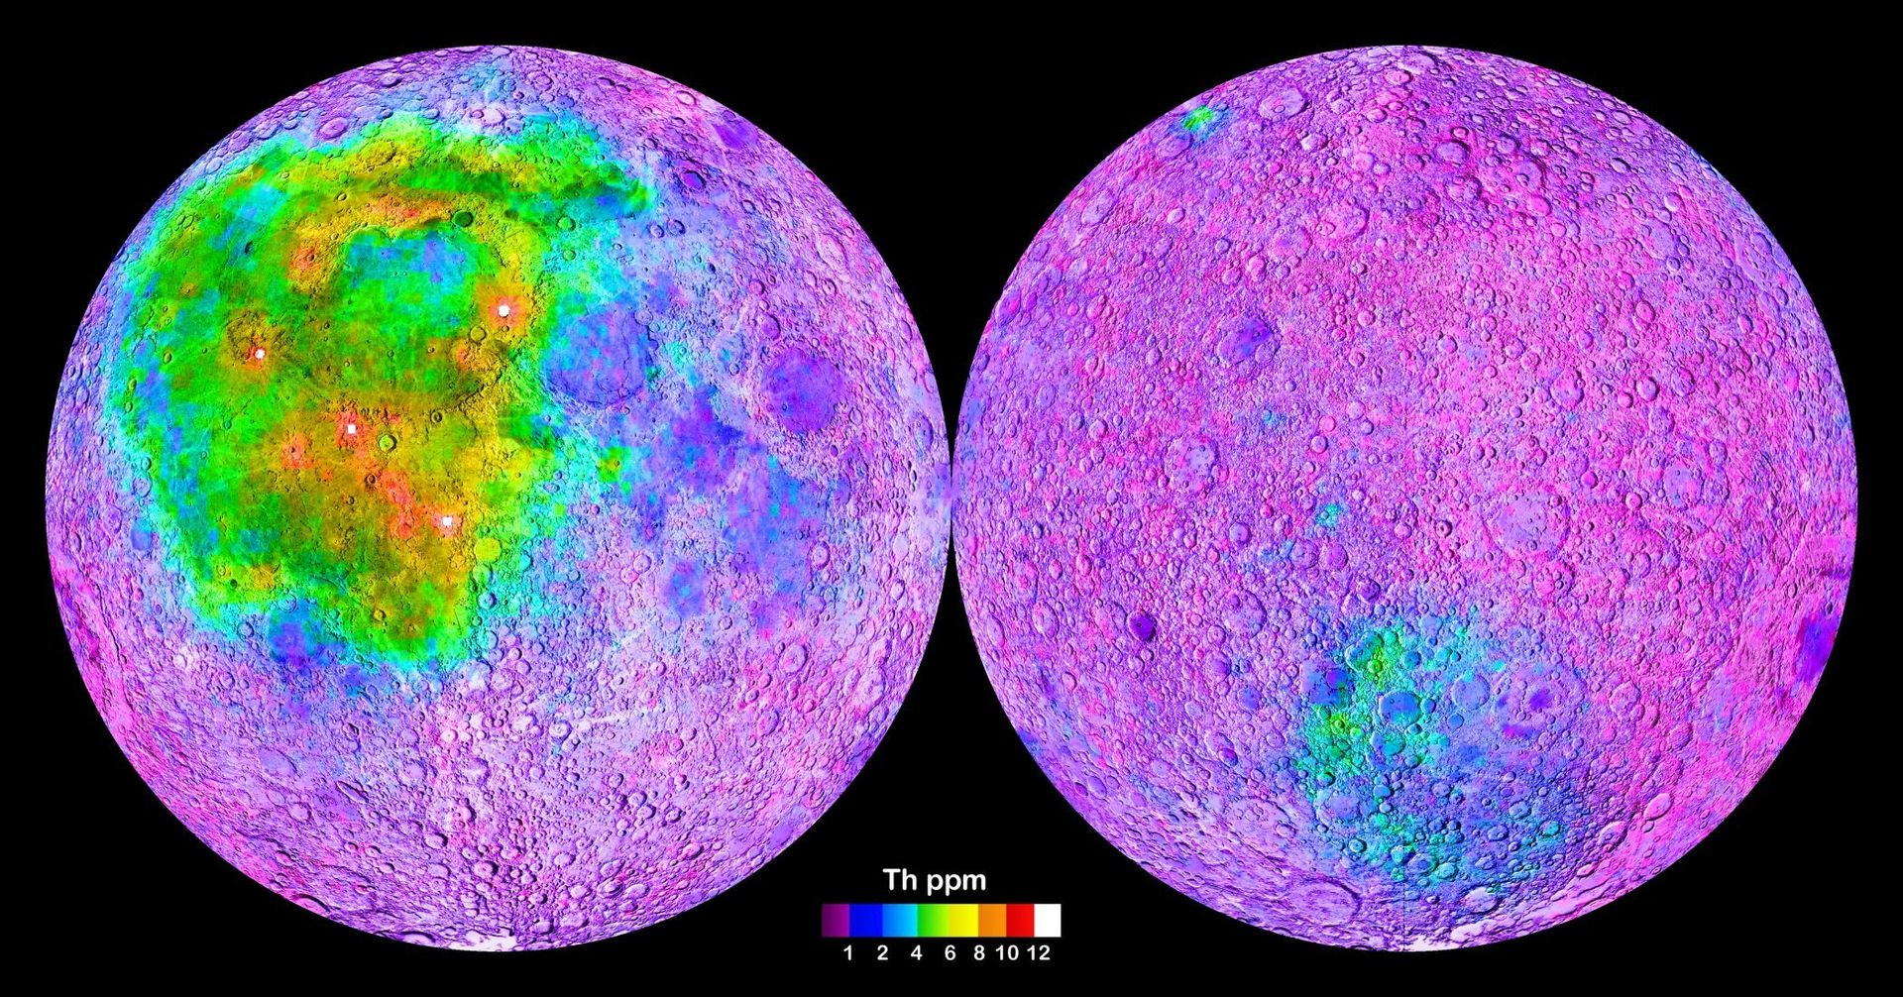
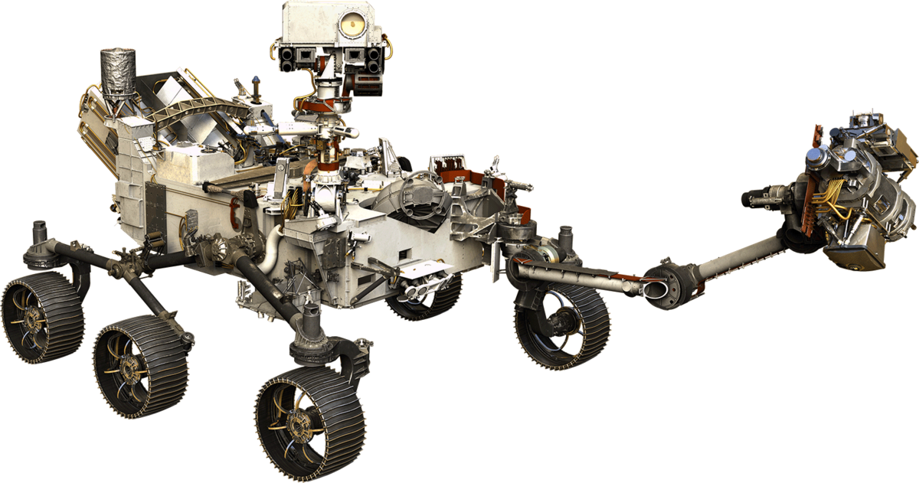
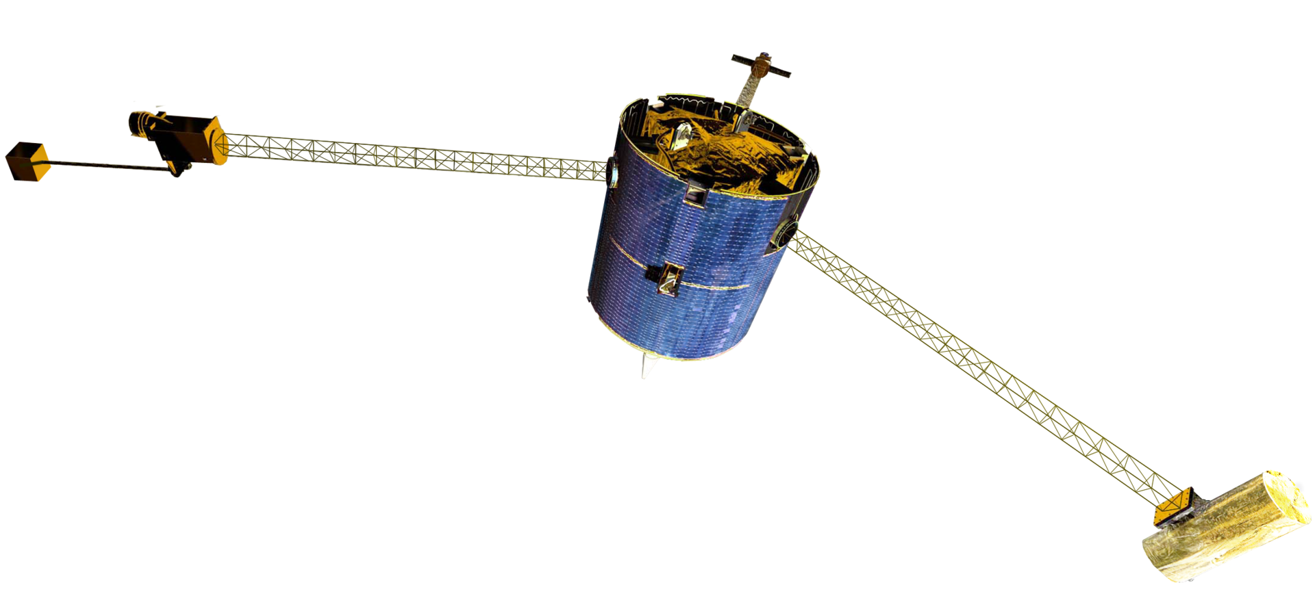
Planetary nuclear spectroscopy allows us to measure the bulk elemental composition of a planetary object
Passive orbital measurements
Passive/active in situ measurements
GRS
NS
Inspected volume ~ 50 x 50 x 50 cm3
Constrain theories on formation and evolutionary processes.
Identify resources, anomalies, biosignatures.
Provide geochemical context for other instruments.
Plan future missions.
Lunar prospector gamma ray spectrometer: first direct measurements of the lunar chemical composition of the entire surface. Image credit NASA
GRS = Gamma ray spectrometer
NS = Neutron sensor

Slide 4
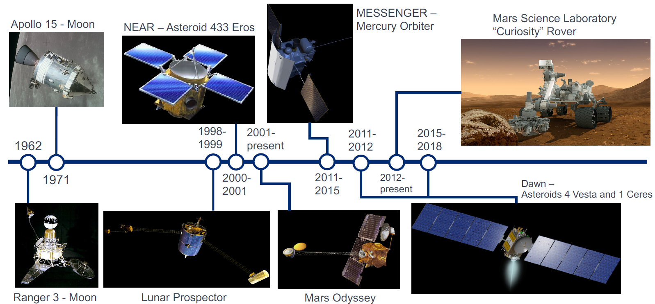
Notable past missions with nuclear spectrometers
Image credit: Patrick Peplowski (JHU-APL)

Slide 5
Successfully launched last Friday!
Image credit: Patrick Peplowski (JHU-APL)

Slide 6
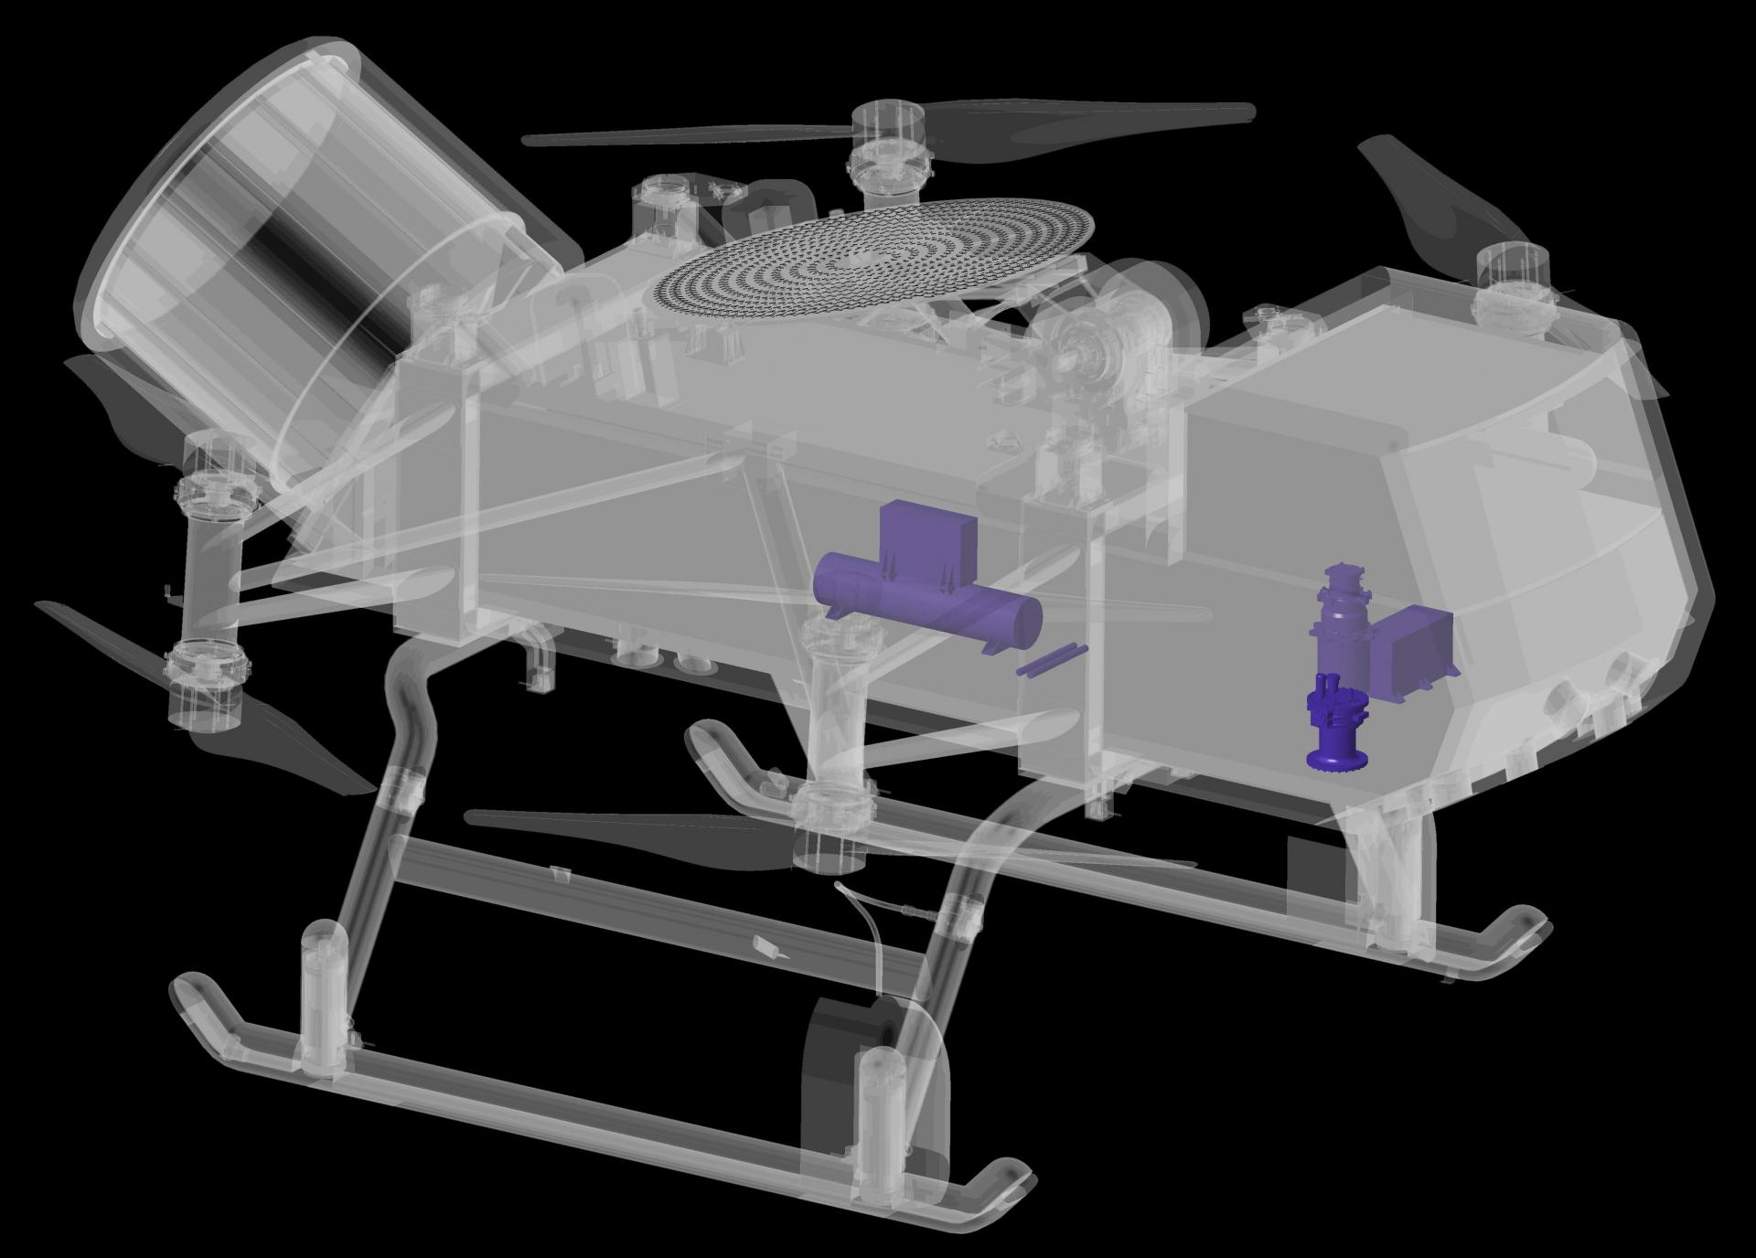
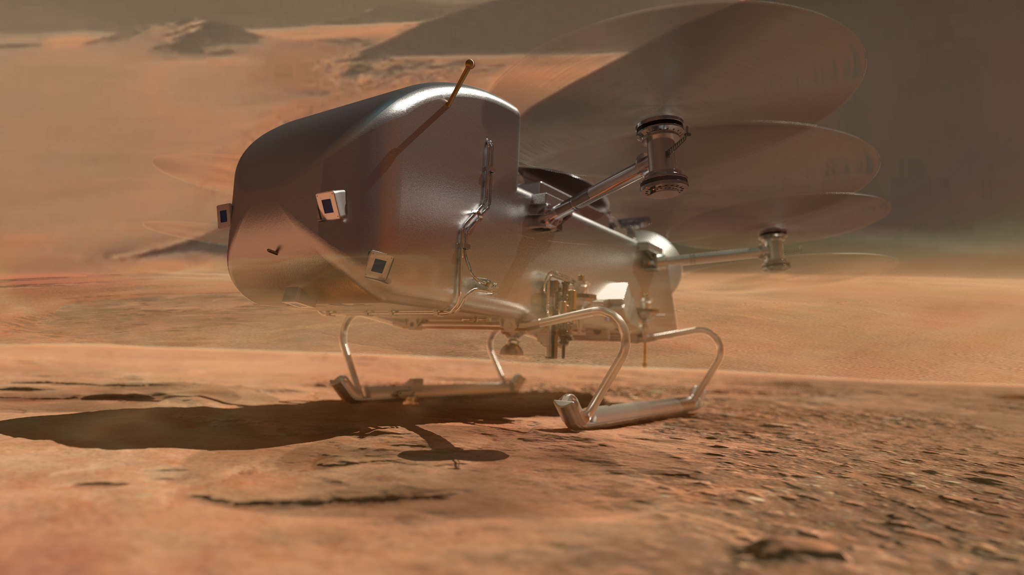
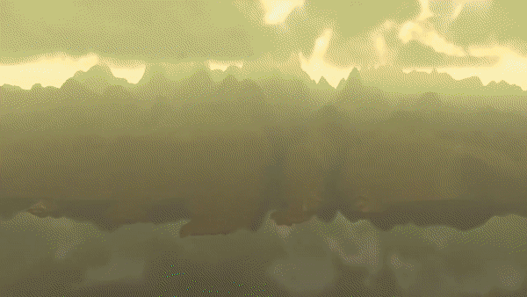
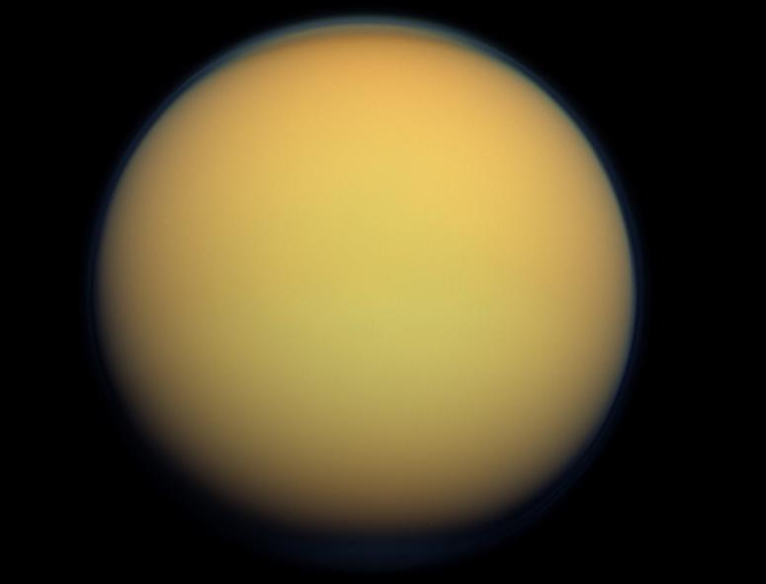
Dragonfly: Mission to Titan
In-situ active GRS:
Pulsed neutron generator (PNG) onboard.
Monoenergetic 14.1 MeV neutrons from DT reaction.
Allows for higher elemental sensitivity with shorter integration times.
Dragonfly mission (2027) will have a PNG, GRS, and a NS onboard.
PNG
HPGe + 3He
DraGNS:
Dragonfly Gamma-Ray and Neutron Spectrometer.
Measure bulk composition of Titan surface and provide context for other instruments.
Titan, Saturn’s largest moon

Slide 7
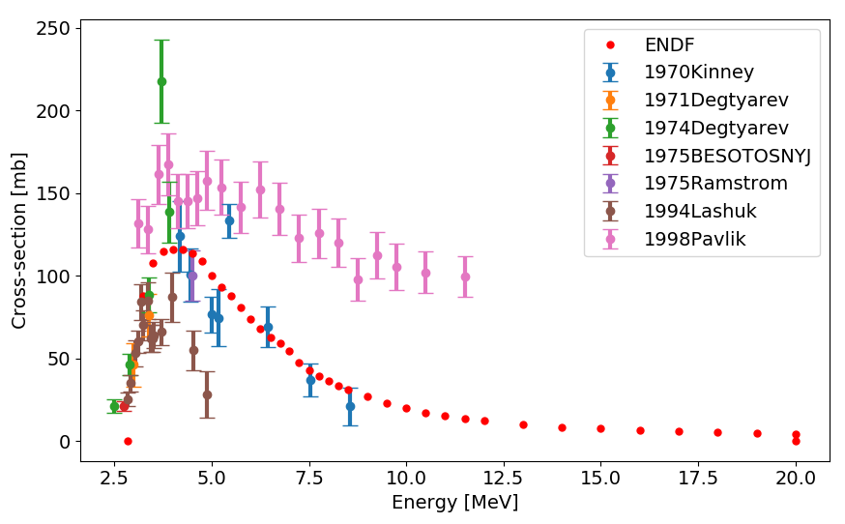
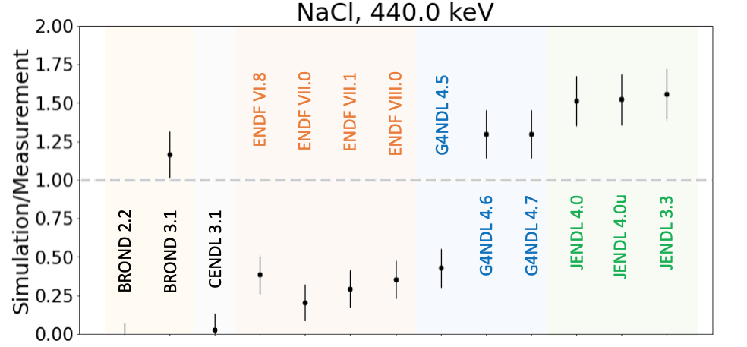
Challenge to gamma ray spectroscopy: cross sections
The limiting factors to higher elemental precision are the gaps and inconsistencies in gamma production cross section libraries.
56Fe(n,n’g) @ 847 keV cross section.
27Al(n,n’g) @ 1720 keV cross section.
GEANT4 benchmarking metrics produced by Peplowski [2022] highlighting deficiencies in simulation of neutron-induced gamma-ray production.
None of the libraries yield a 1-𝝈 match to the measurements.

Slide 8
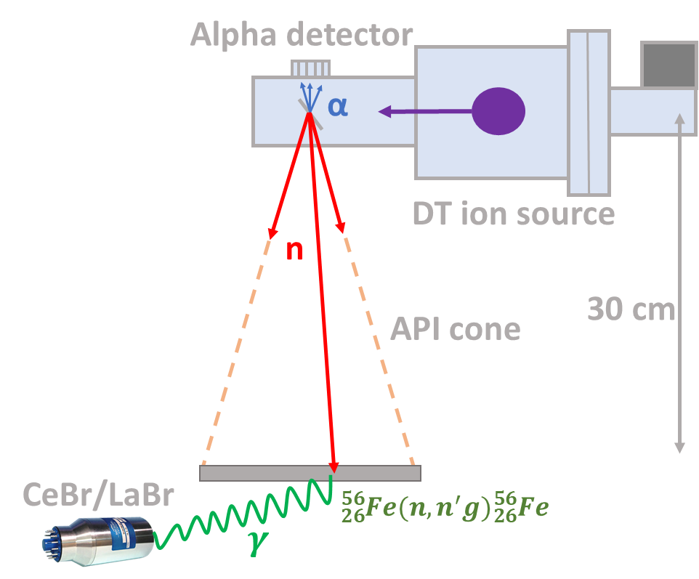
How are we trying to improve (n,n’g) cross sections? Enter Associated Particle Imaging (API)
NASA funded work allowed for the first precision measurements of inelastic scattering cross sections with a novel instrument system at LBL: Associated Particle Imaging (API).
API vs. other techniques:
API: Direct flux measurements
Other: Activation foils “gold standard”
API: Only prompt reactions
Other: Difficult to filter out parasitic reactions
API: Monoenergetic neutron flux
Other: Requires additional neutron energy measurements (nTOF, etc.)
API: Gamma-ray background suppression
Other: May be difficult to account for background
API: Compact, portable, low-cost
Other: Usually large facilities e.g. accelerator, reactor
LBNL: Arun Persaud, PI

Slide 9
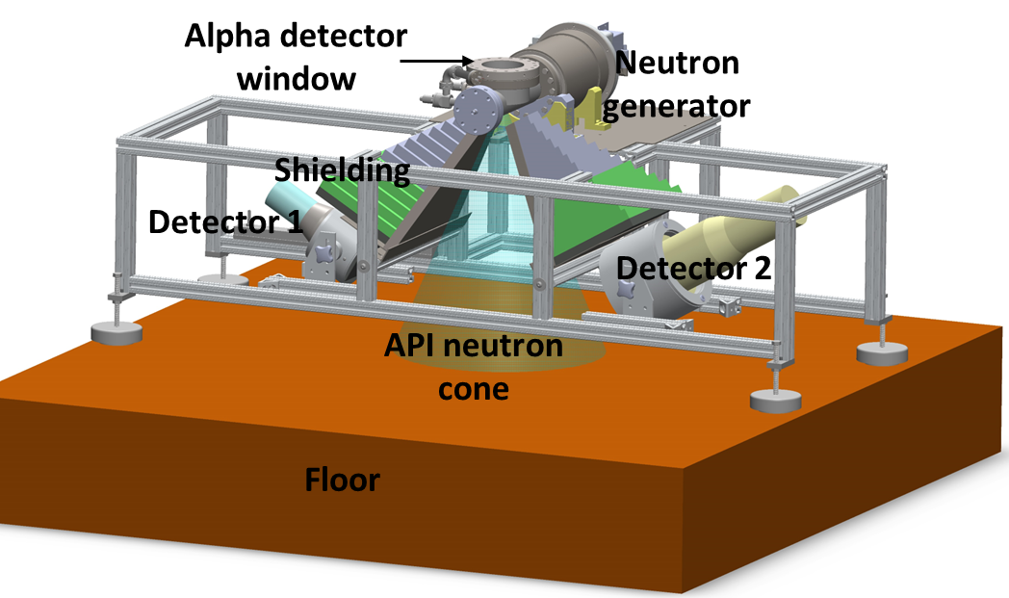
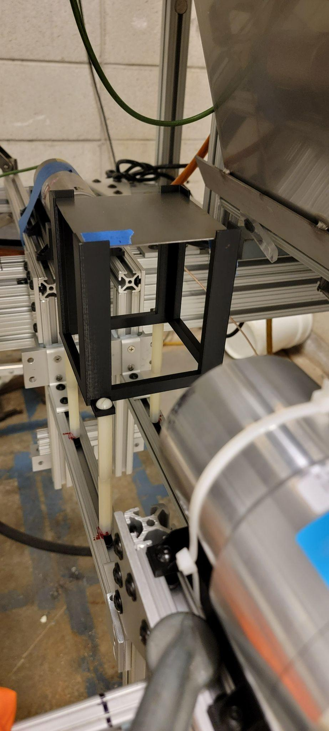
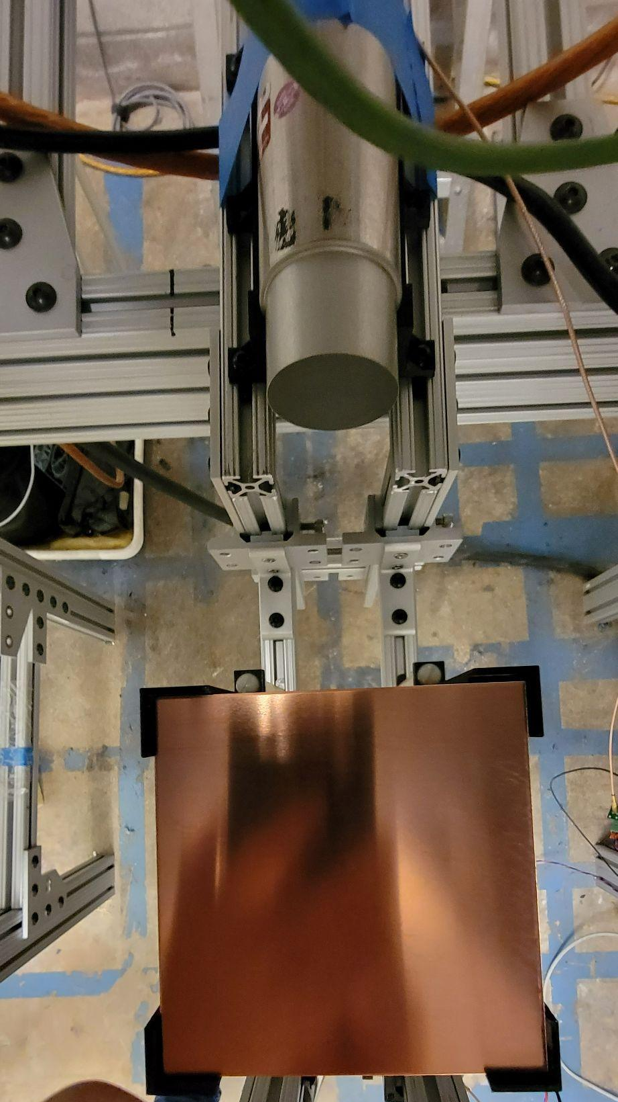
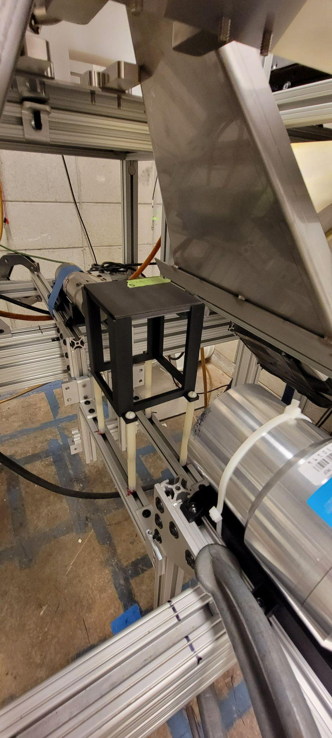
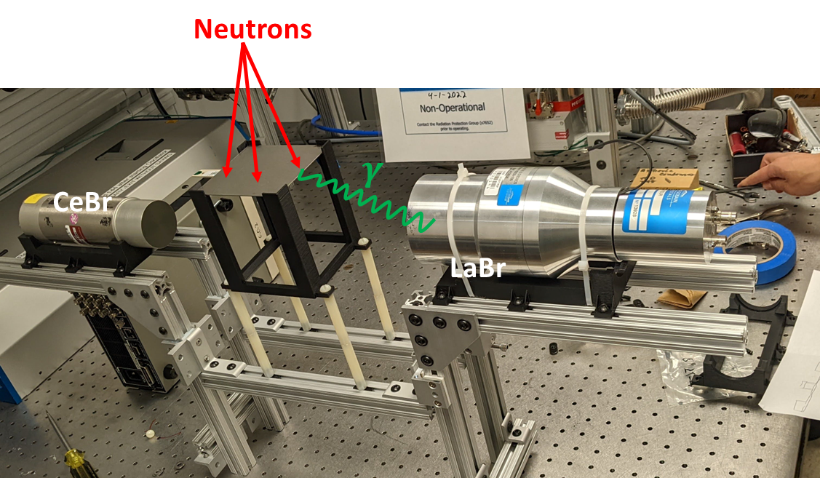
First measurement campaign (Aug 2022)
Fe
C
Cu

Slide 10
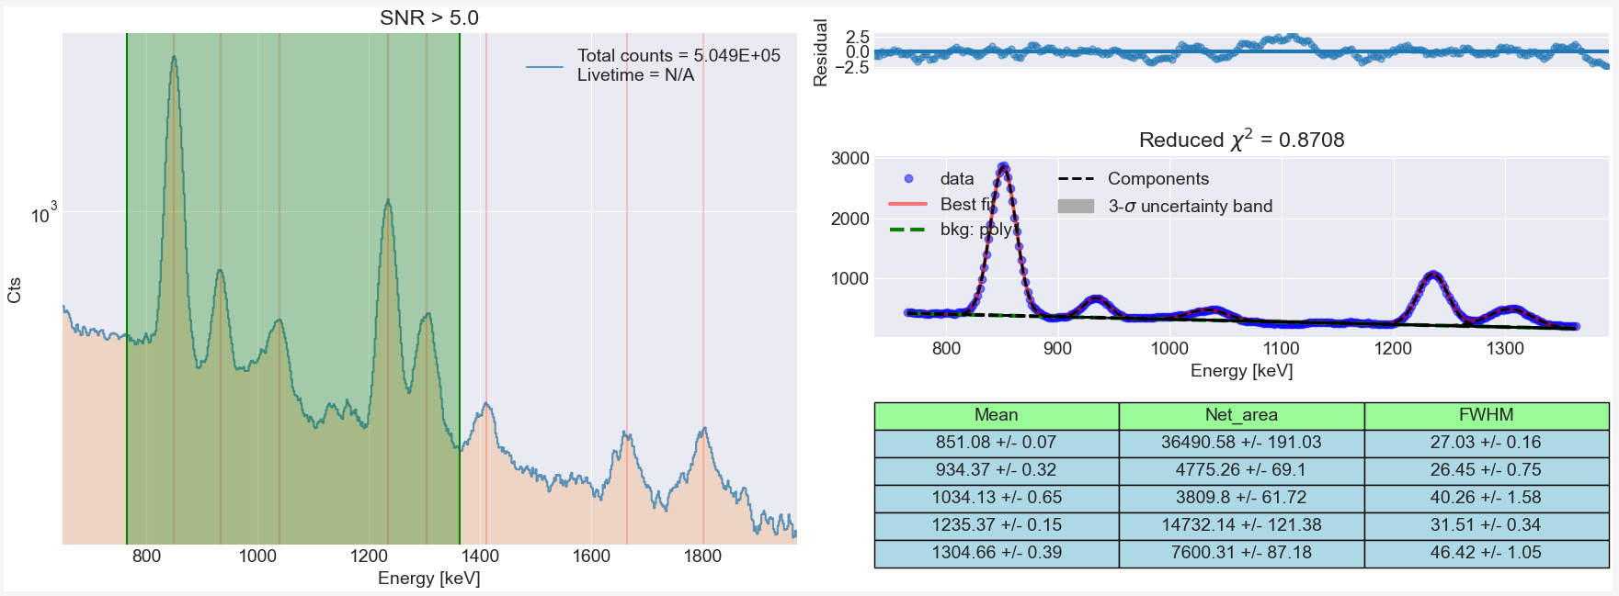
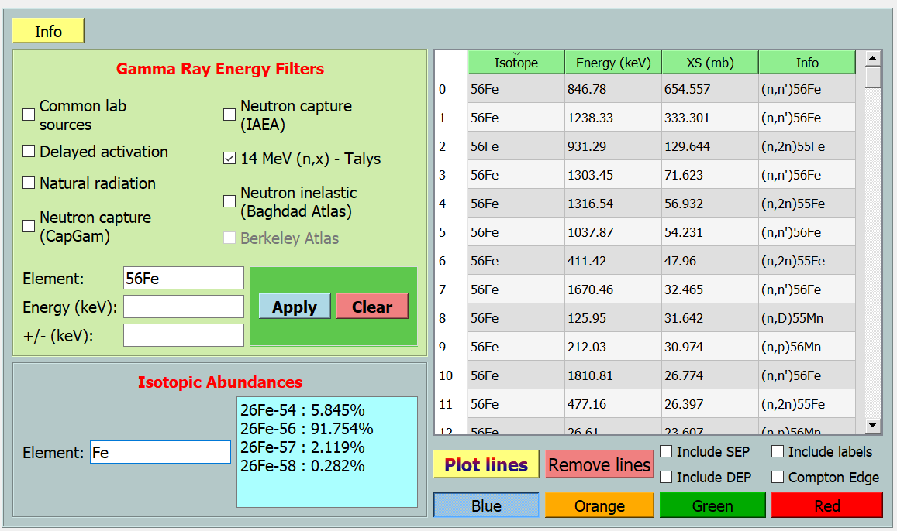
56Fe(n,n’g) cross sections
Organization | Year | En (MeV) | σ - 847 keV (mb) | σ - 1238 keV (mb)
This work | 2022 | 14.05 ± 0.09 | 695 ± 5.1% | 339 ± 5.1%
GELINA | 2014 | 14.14 ± 0.14 | 699 ± 4.1% | 356 ± 5.0%
LANL | 2004 | 14.05 ± 0.10 | 705 ± 3% | N/A
ORNL | 1990 | 14.53 ± 0.56 | 621± 4.7% | 290 ± 5.5%
Talys | - | 14.1 | 655 | 333
847 keV
1238 keV
Python based gamma spectroscopy GUI (https://github.com/mauricioAyllon/NASA-gamma).
TALYS:
Used to design experiments.
Predict measurement times, expected energies
Optimize geometry, target mass, etc.
Predict angle dependencies

Slide 11
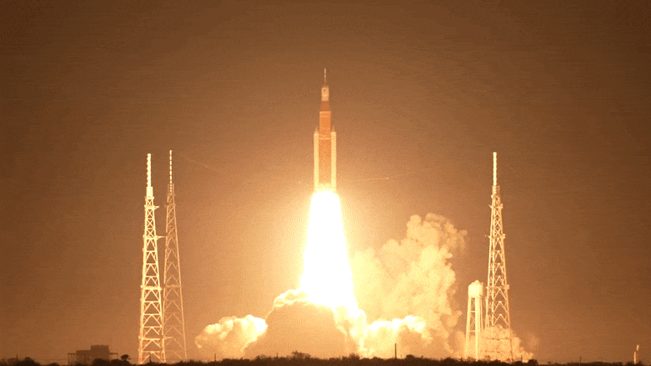
Thank you for your attention!
Image credit: NASA (SLS)
Contact: mauricio.ayllonunzueta@nasa.gov

Slide 12
Extra slides

Slide 13
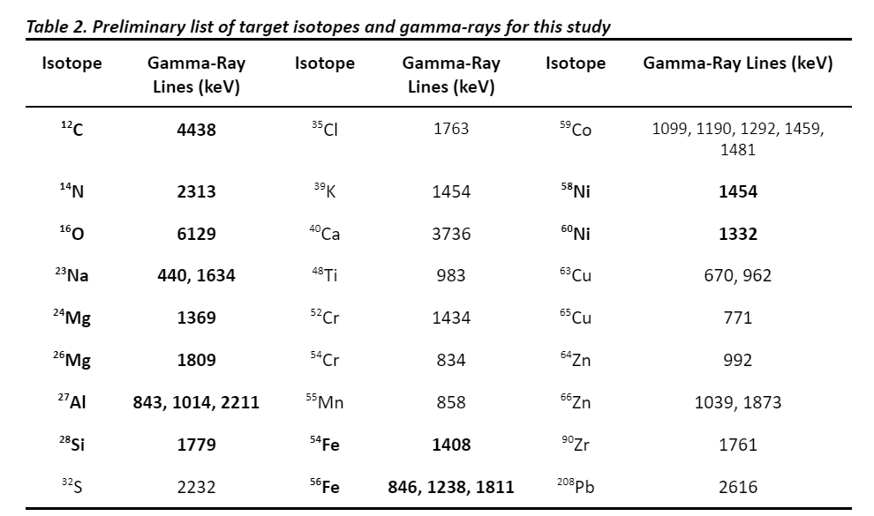
Proposed list of isotopes needed for successful space missions

Slide 14
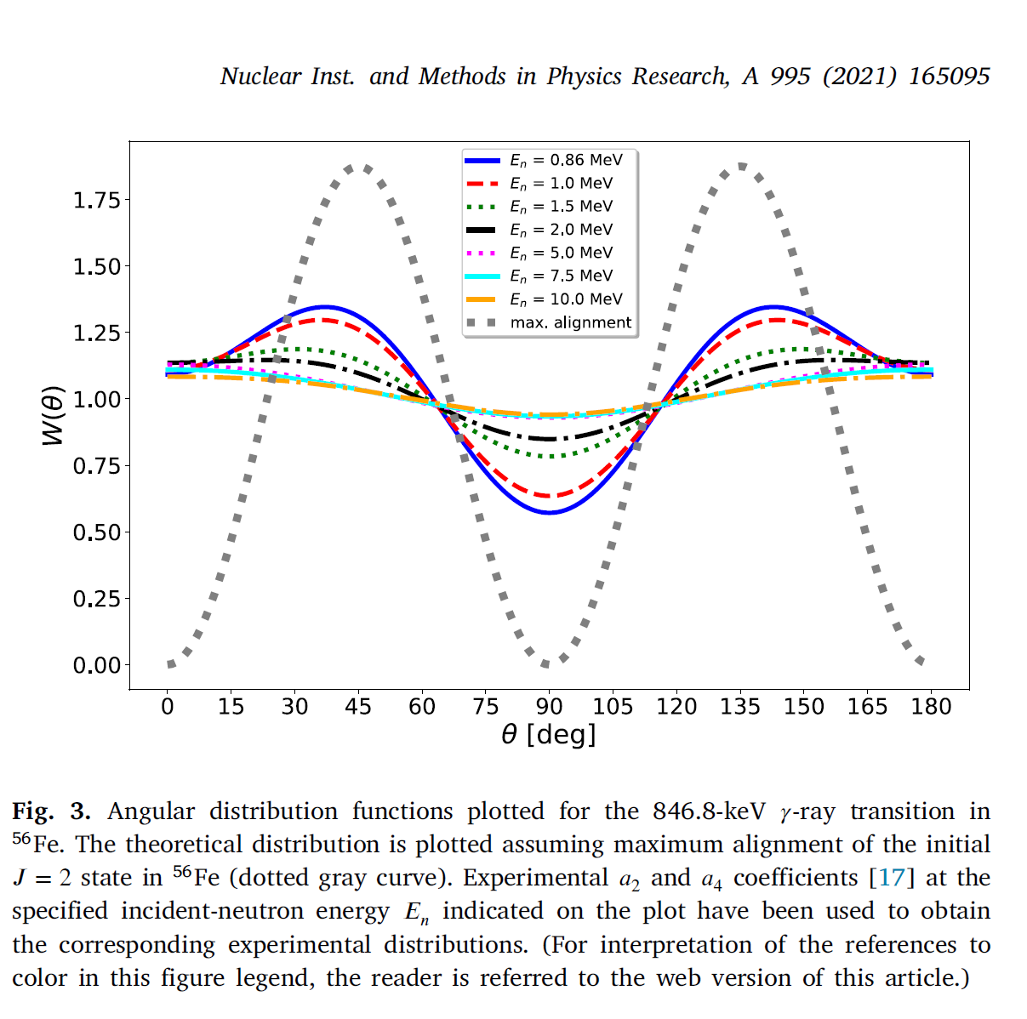
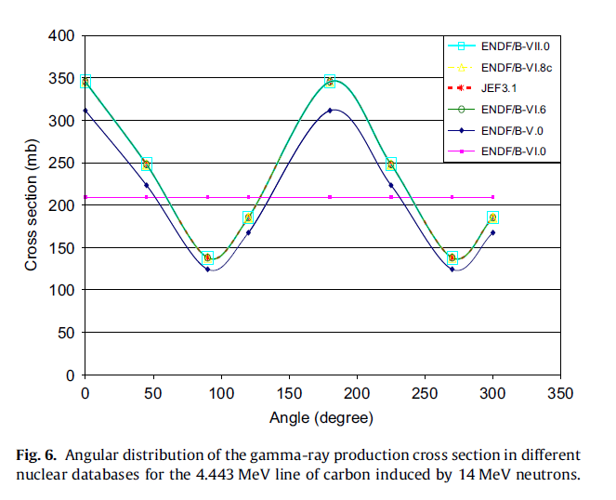
Angular distributions

Slide 15
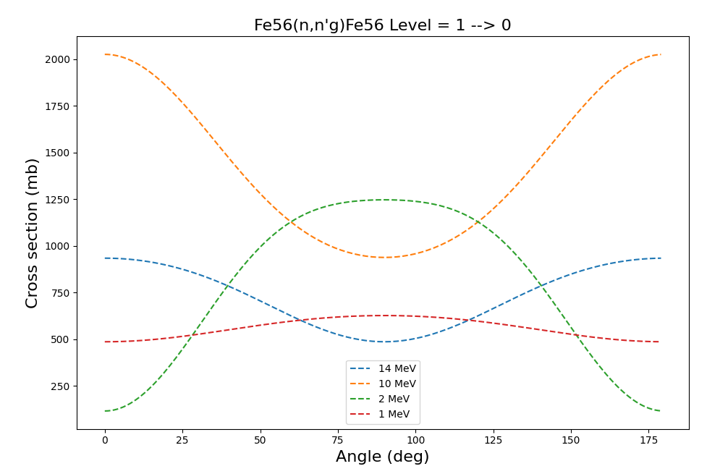
Angular distributions with TALYS
Based on Legendre coefficients and following Baghdad Atlas paper

Slide 16
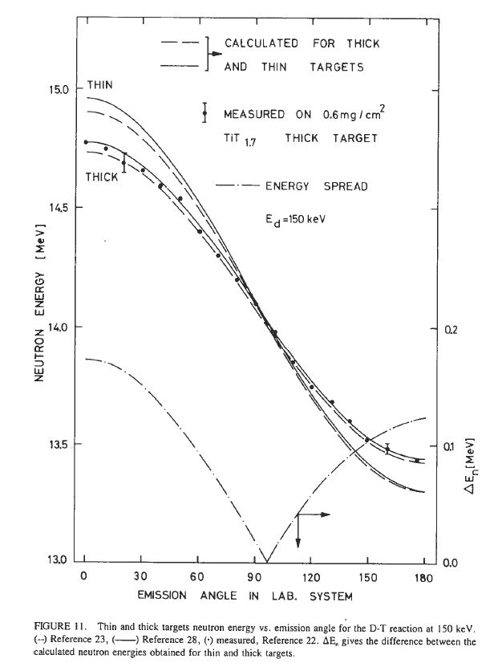
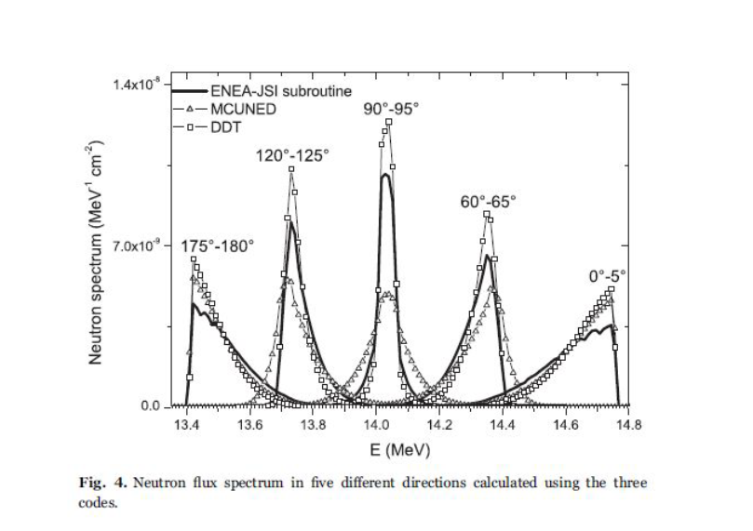
Neutron energy distribution

Slide 17
Neutron energy distribution

Slide 18
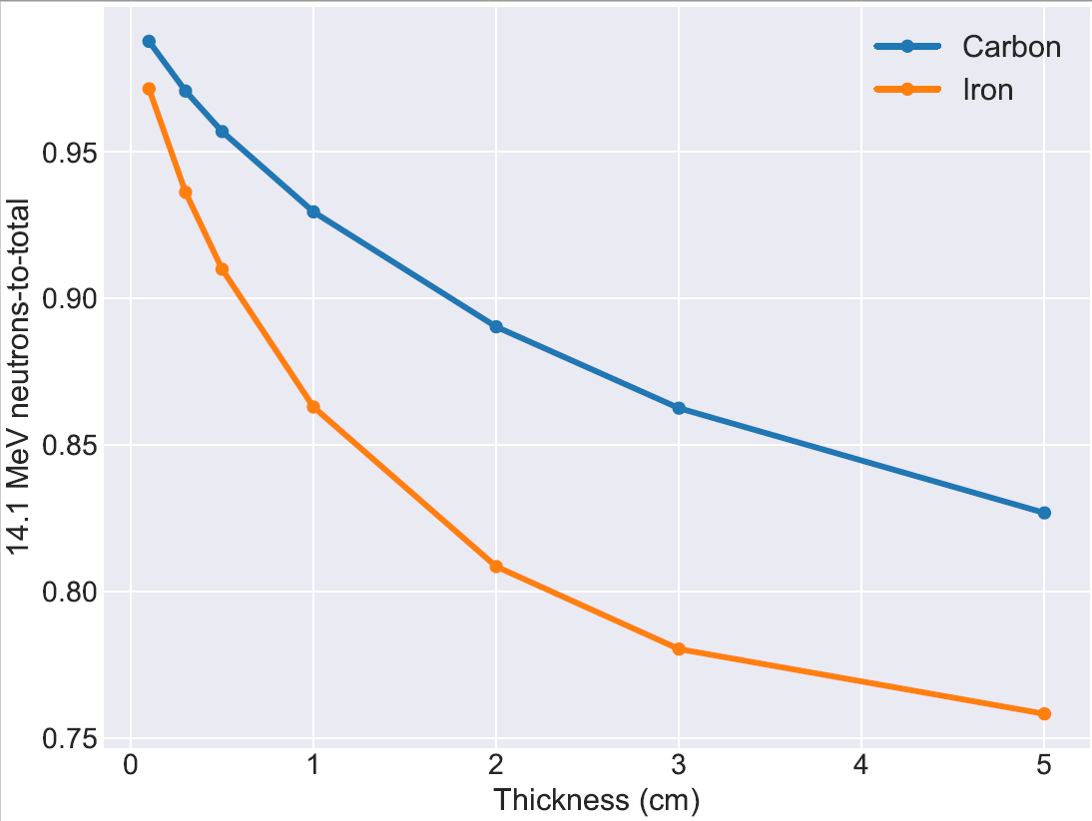
Target thickness selection criteria

