Slide 1
Measurement of neutron capture cross-section of ⁶⁸Zn and the uncertainty analysis with correlation assessment.
Presented by; Supervisor;
Monika Dahiya Dr. Rebecca Lalnuntluangi
(Junior Research Fellow) (Assistant professor)
Department of Physics Department of Physics
Institute of science Institute of science
Banaras Hindu University, Banaras Hindu University,
Varanasi – 221005, India Varanasi – 221005, India
Enroll No : 449957

Slide 2
Content
Measurement of neutron capture cross-section of ⁶⁸Zn and the uncertainty analysis with correlation assessment.
Experimental details
Decay data table
Sample cross-section
Correlation formula
Fractional uncertainties and correlation coefficients table
Results
References

Slide 3
Measurement of neutron capture cross-section of ⁶⁸Zn and the uncertainty analysis with correlation assessment
The purpose of this work is to measure the cross section of ⁶⁸Zn(n, γ) ⁶⁹Znᵐ reaction at neutron energies 0.8, 1.12 and 1.63 MeV and to report the data with detailed uncertainty propagation and covariance analysis by taking into consideration the uncertainties of all parameters involved in the activation equation.
Figure 1. $Neutron capture reactions$

Slide 4
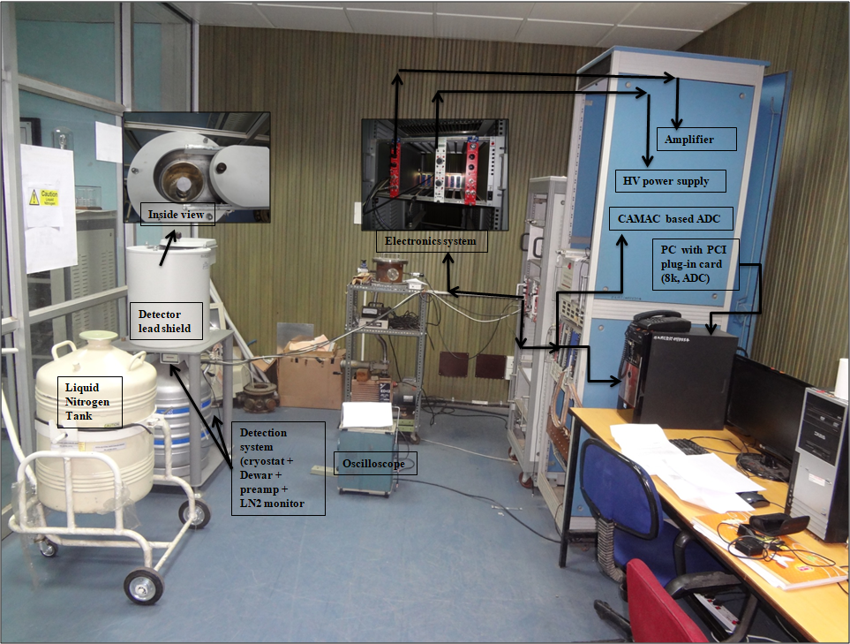
Experimental Details
THE EXPERIMENT HAD BEEN PERFORMED USING THE FOTIA FACILITY, BARC, [1] Mumbai
⁷Li(p, n)⁷Be reaction had been used as neutron source[2].
¹¹⁵In (n, n’ )¹¹⁵In^{m} reaction had been used as monitor and its cross section retrieved from IRDFF.
The irradiation had been followed by offline γ-ray counting of activated samples using HPGe detector having 50% relative efficiency.
The CAMAC-based LAMPS software had been used for the data acquisition and data analysis of γ spectra [3].
Figure 2. γ-ray counting room with complete HPGe Offline detection system

Slide 5
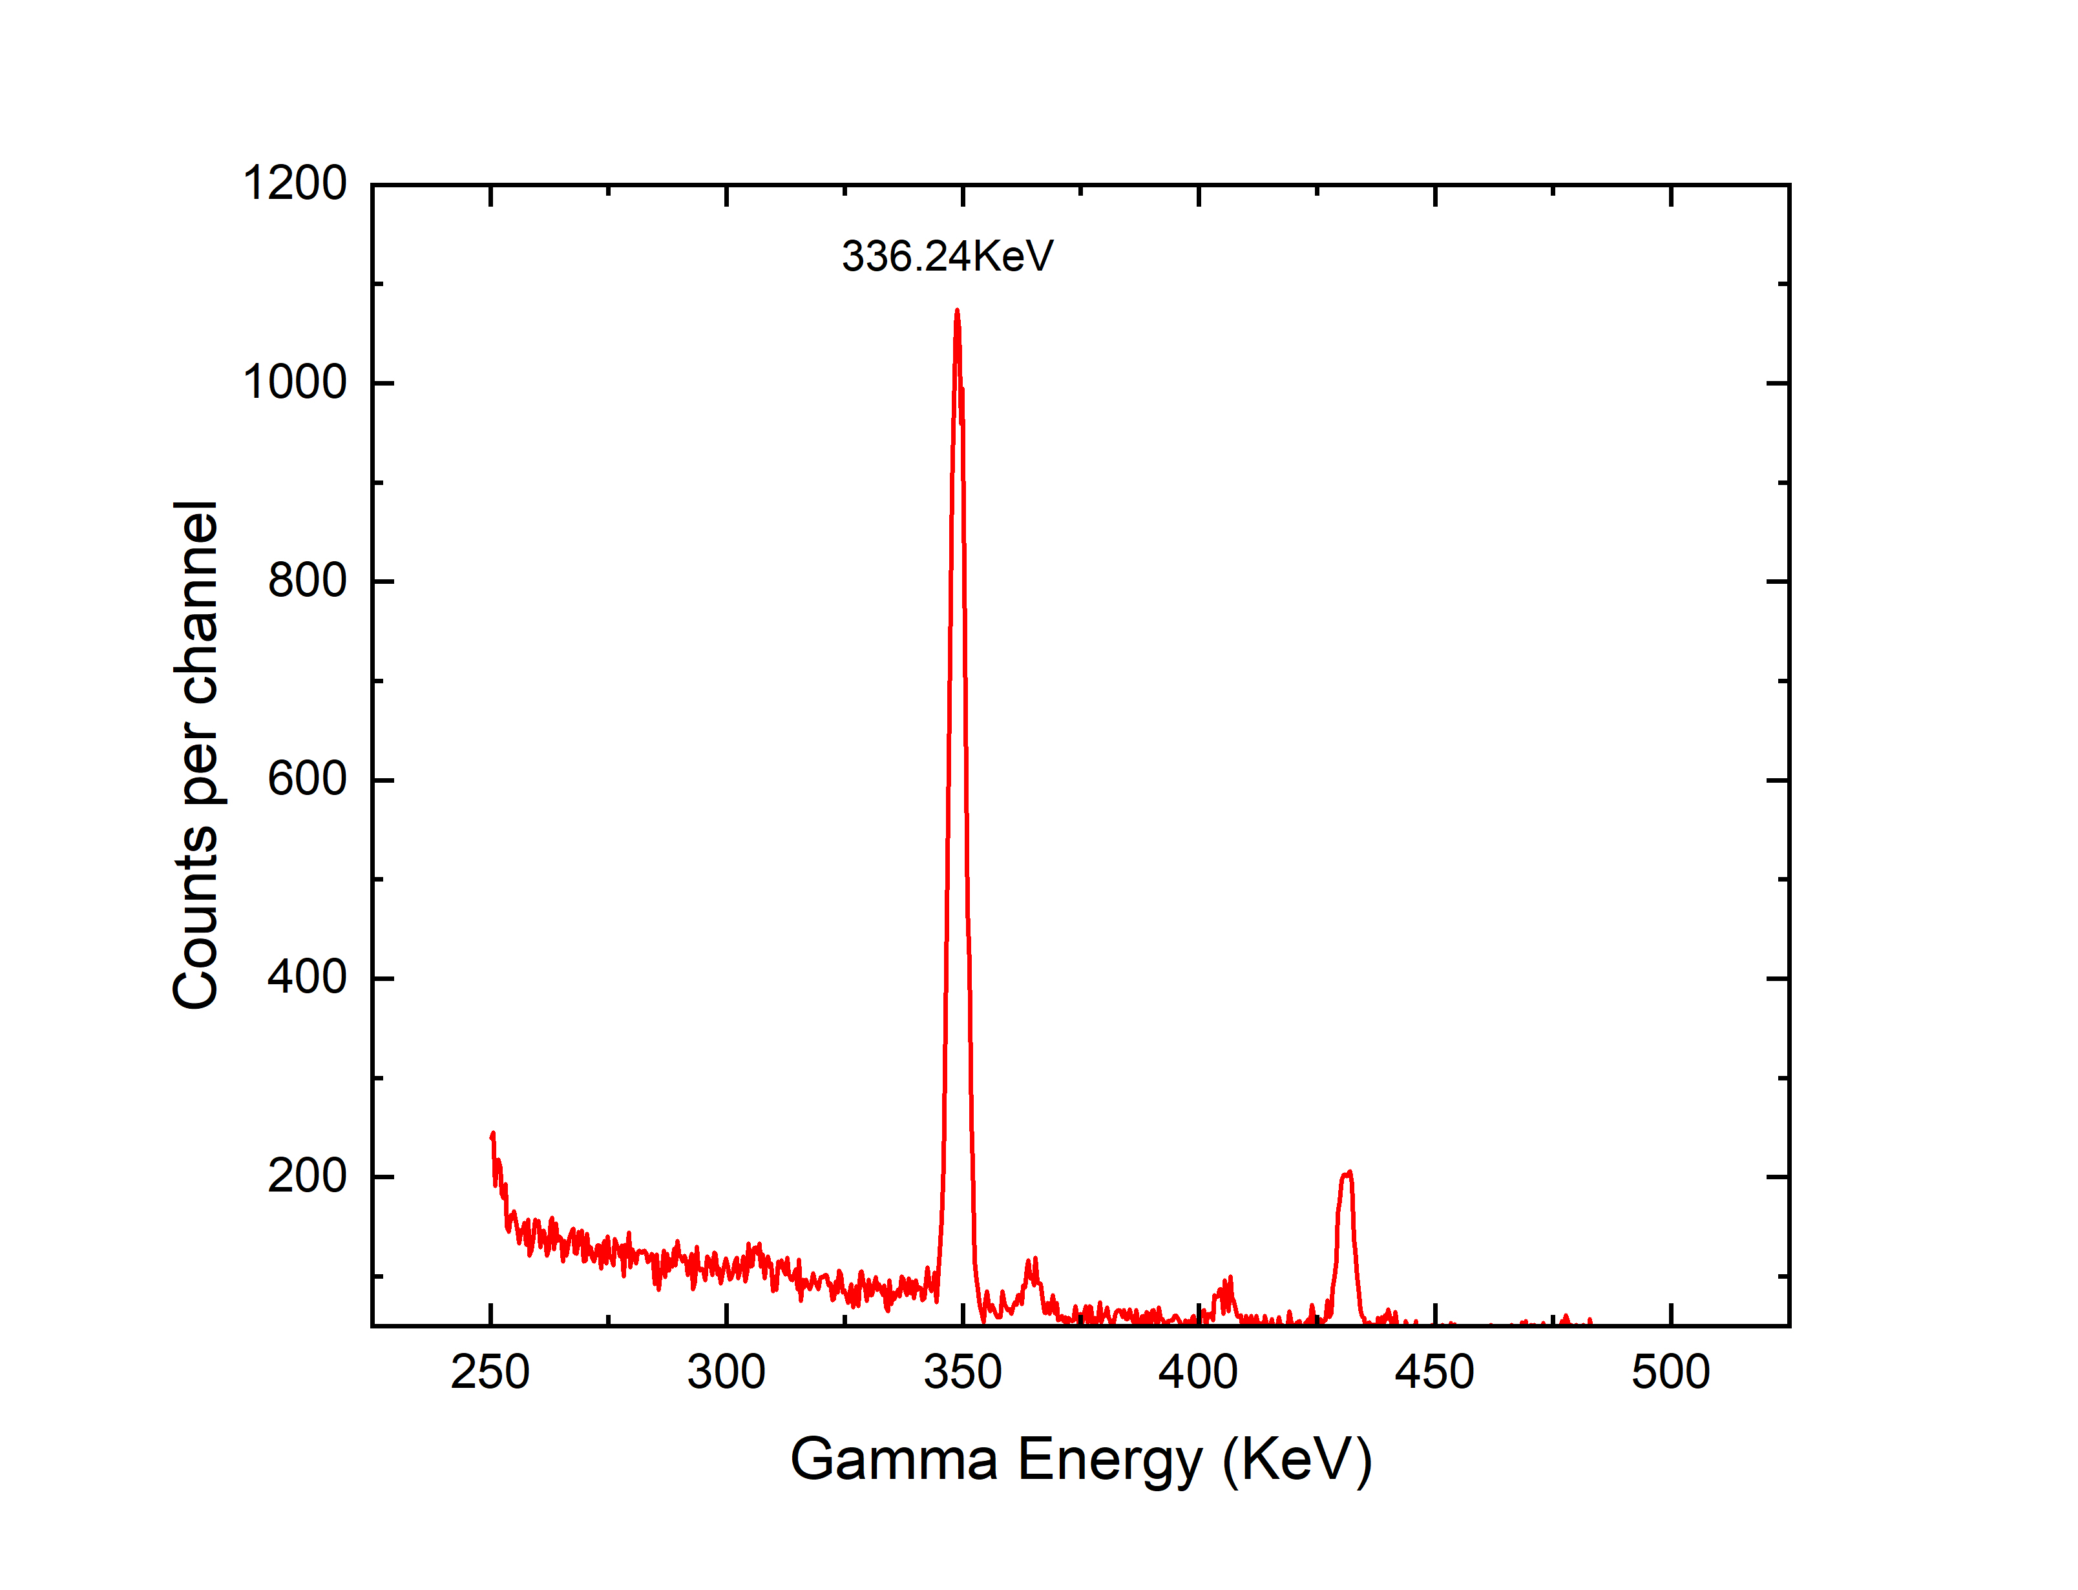
MEASUREMENT OF NEUTRON CAPTURE CROSS-SECTION OF ⁶⁸Zn AND THE UNCERTAINTY ANALYSIS WITH CORRELATION ASSESSMENT
Gamma ray spectra of the irradiated Indium sample at 3500 ± 20 keV is shown in figure 3.
Proton beam of all energies ranges from [2700 - 3500] ± 20 keV had been accelerated and bombarded on freshly prepared Li foils of thickness 2.5mg/cm² for the generation of neutrons.
Figure 3. Gamma ray spectra of the irradiated In for proton energy Eₚ= 3500 ± 20 keV .

Slide 6
Measurement of neutron capture cross-section Of ⁶⁸Zn and the uncertainty analysis with correlation assessment
Experimentally measured efficiencies with their uncertainties for gamma ray peaks of ¹⁵²Eu is presented in figure 4.
Average neutron flux during the entire irradiation period was calculated ranges from 2 × 10⁶ to 7 × 10⁶ n/cm²/s through EPEN code [2] for the spectrum averaged neutron energies 0.8 to 1.63 MeV.
Figure 4. HPGe detector efficiency data points and its fitted curve.

Slide 7
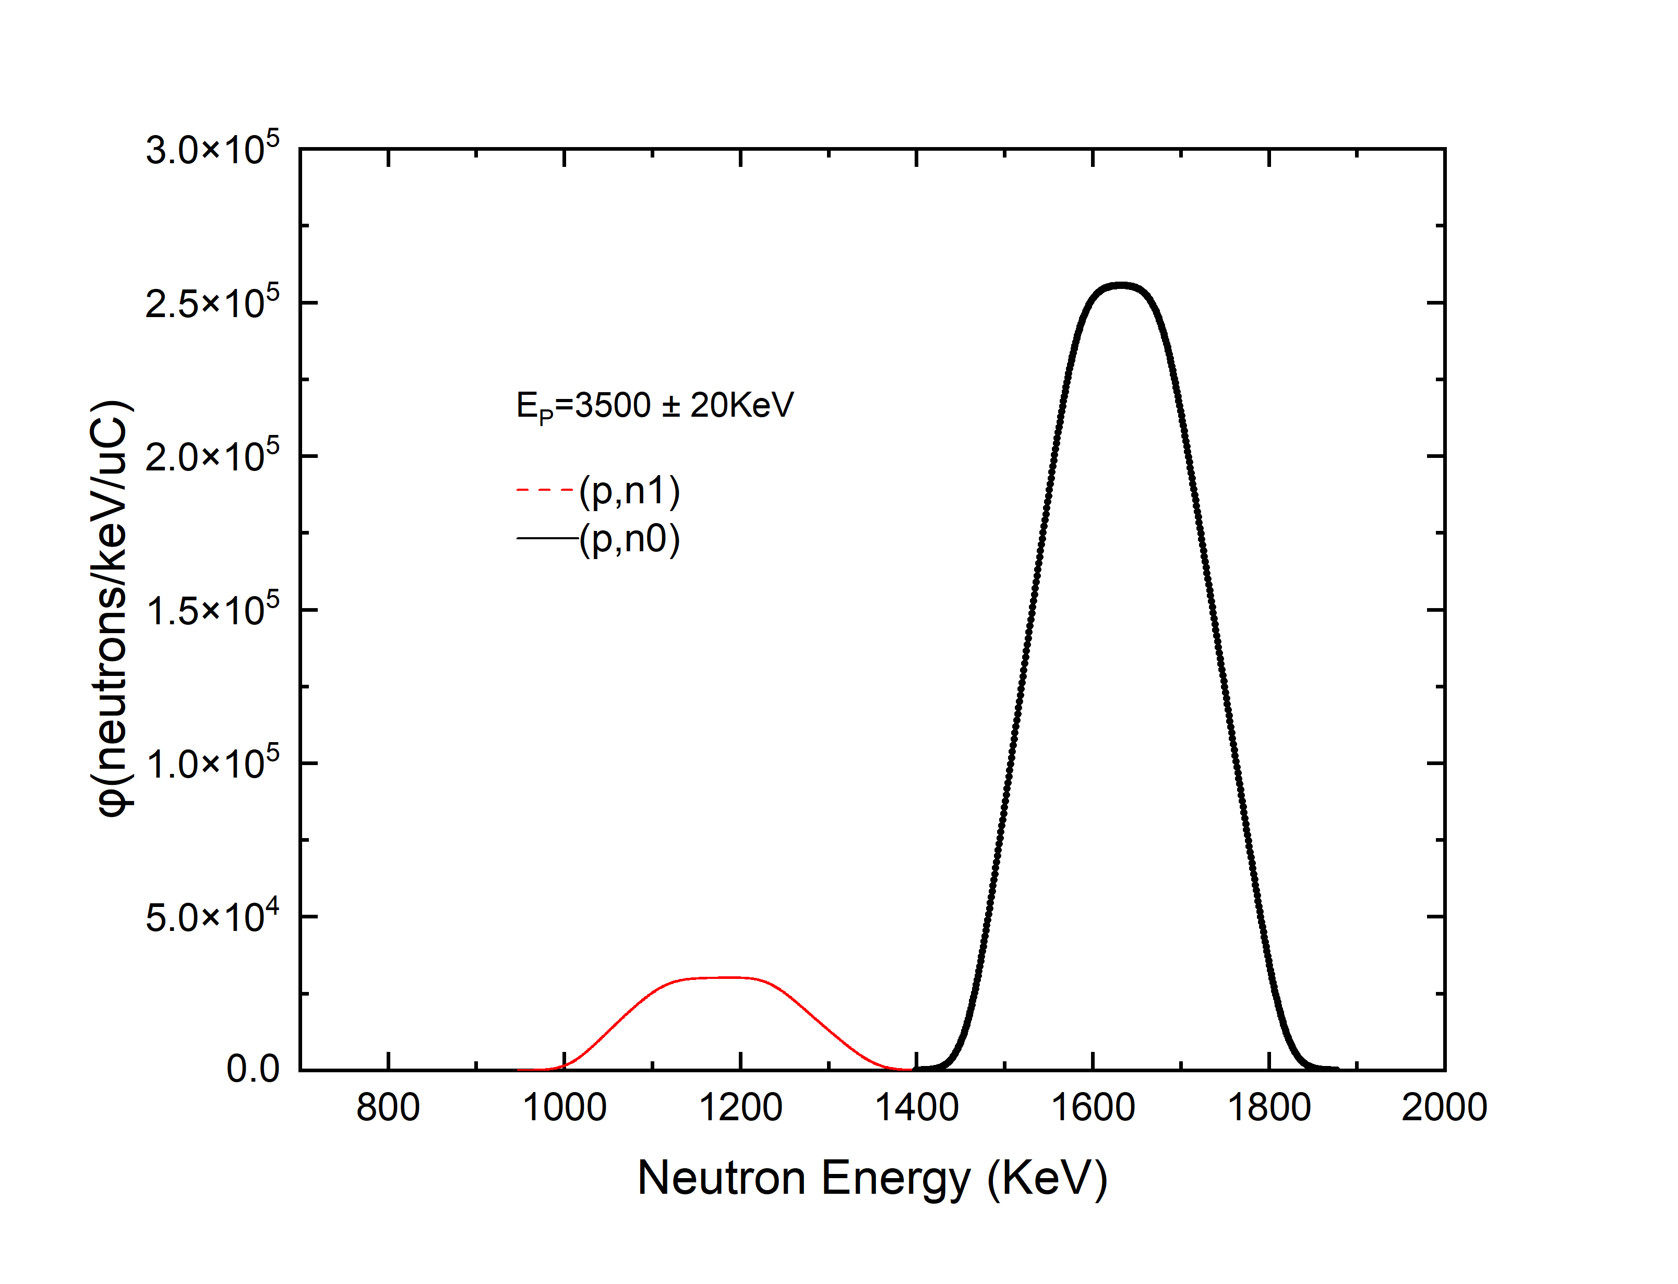
Table 1: Decay data table for present work
Reaction | Nuclide | Half-life(h) | E_{γ}(keV) | I_{γ}(%)
⁶⁸Zn(n, γ) | ⁶⁹Znᵐ | 13.756 ± 0.002 | 438.634 | 94.85 ± 0.07
¹¹⁵In(n, n’) | ¹¹⁵Inᵐ | 4.486 ± 0.004 | 336.24 | 45.9 ± 0.1
Proton energies Eₚ = 3500 ± 0.02, 3000 ± 0.02 and 2700 ± 0.02 keV and their equivalent spectrum averaged neutron energies had been calculated 1.63, 1.12 and 0.8 MeV respectively through EPEN Code.
Proton beam current during entire irradiation ranges from 80-100 nA.
Figure 5. Neutron flux energy spectra obtained at proton energy 3500 ± 20 KeV using EPEN.

Slide 8
Measurement of neutron capture cross-section for ⁶⁸Zn and the uncertainty analysis with correlation assessment
$$σ= \frac{Aλ}{NφaεI_{γ}\left(1−e^{−λt_{irr}}\right)e^{−λt_{cool}}(1−e^{−λt_{count}})}$$
Cross-section
Table 2: Fractional uncertainties (%) and correlation coefficients
A = Counts (activity)
N = No. of atoms in sample
$φ$ = Flux
a = Isotopic abundance
ɛ = Detector efficiency
$I_{γ}$ = Gamma branching ratio
$λ$ = Decay constant
$t_{irr}$ = Irradiation time
$t_{cool}$ = Cooling time
$t_{count}$= Counting time
Parameters (x) | 1.63 ${(∆x}_{i})$ | 1$.12 {(∆x}_{j})$ | 0.8 ${(∆x}_{k})$ | Correlation coefficient $Cor\left(∆x_{i},∆x_{j}\right)$
$$f_{s}$$ | 0.16 | 0.16 | 0.11 | 1
$$f_{m}$$ | 0.08 | 0.06 | 0.03 | 1
$$η$$ | 0.021 | 0.021 | 0.021 | 1
$$I_{s}$$ | 0.07 | 0.07 | 0.07 | 1
$$I_{m}$$ | 0.22 | 0.22 | 0.22 | 1
$$σ_{m}$$ | 2.86 | 3.04 | 3.14 | 0.36
$$a_{m}$$ | 0.05 | 0.05 | 0.05 | 1
$$a_{s}$$ | 3.41 | 3.41 | 3.41 | 1
$$N_{s}$$ | 0.03 | 0.03 | 0.03 | 0
$$N_{m}$$ | 0.06 | 0.02 | 0.01 | 0
$$A_{s}$$ | 2.69 | 3.20 | 3.62 | 0
$$A_{m}$$ | 0.95 | 1.15 | 2.41 | 0
Total error | 5.3 | 5.7 | 6.3 | 0.75

Slide 9
Measurement of neutron capture cross-section for ⁶⁸Zn and the uncertainty analysis with correlation assessment
Fractional Uncertainty in efficiency
$${(∆η/η)}^{2}= {(∆ε_{s}/ε_{s})}^{2}+ {(∆ε_{m}/ε_{m})}^{2}−Cov(ε_{m}, ε_{s})/(ε_{s} × ε_{m})$$
$$Cov\left(σ_{s_{i}},σ_{s_{j}}\right)= \sum_{i}{\sum_{j}{∆x_{i}}}×Cor\left(∆x_{i},∆x_{j}\right)× ∆x_{j}$$
Covariance formula
$$Cor\left(σ_{s_{i}},σ_{s_{j}}\right)=\frac{Cov(σ_{s_{i}},σ_{s_{j}})}{\left(∆σ_{s_{i}}\right)×\left(∆σ_{s_{j}}\right)}$$
Correlation formula

Slide 10
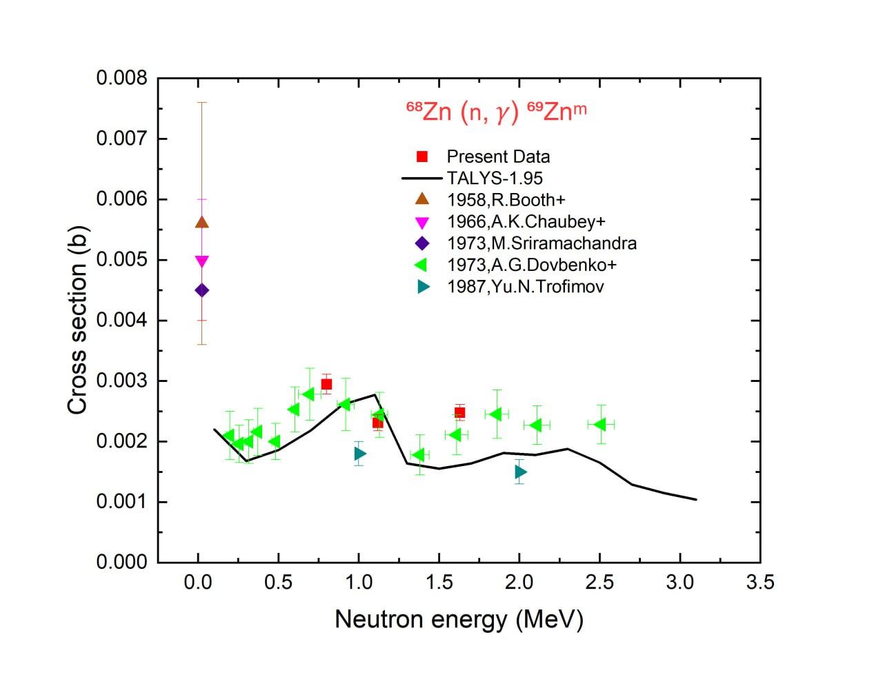
Measurement of neutron capture cross-section Of ⁶⁸Zn and the uncertainty analysis with correlation assessment
Results
The cross section values are measured for neutron energies 0.8, 1.12 and 1.63 MeV are 2.94 ± 0.18 mb, 2.31 ± 0.13 mb , 2.47 ± 0.13 mb, and total uncertainties measured are less than 7%.
Figure (6) . Newly measured ⁶⁸Zn(n,γ) ⁶⁹Znᵐ reaction cross section and its comparison with previously measured data and theoretical calculations.

Slide 11
Measurement of neutron capture cross-section Of ⁶⁸Zn and the uncertainty analysis with correlation assessment
References
[1] P. Singh et al., Pramana 59, 739 (2002)
[2] R. Pachuau et al.. Nuclear Science and ported data from Engineering. 187:70, (2017).
[3] LAMPS, https://www.tifr.res.in/pell/lamps.html.
[4] EXFOR database. https://www-nds.iaea.org/exfor/exfor.html.

Slide 12
Thank You……….

