Slide 1
Device and method for low-uncertainty and high-efficiency neutron TOF spectrometry
¹ Jorge Martín Yi *
¹ Daniel López Aldama
¹ Guido Martín Hernández
² Pierfrancesco Mastinu
² Elizabeth Mussachio González
* Contact: +53 54754717 - jorgeyi99@gmail.com
¹ Centro de Aplicaciones Tecnológicas y Desarrollo Nuclear, Miramar, La Habana, Cuba
² INFN- Laboratori Nazionali di Legnaro, Legnaro, Italia

Slide 2
Scope
Motivation & Detector’s proposal
Methods & Experiment features
Results
Estimation of uncertainties
Conclusions

Slide 3
Li-glass Scintillator
Low abundance of the reactive element for neutron detection and high cross section uncertainties of remaining elements.
O, Si, Mg, Ce, Al, Li
10% - ⁶Li
⁶Li (n, ³H) ⁴He
Boron-capture based detector
> 99% - ¹⁰B
94%
⁷Li (p,n) ⁷Be
¹⁰B (n,α)⁷Li*
478 keV γ
T_{n} - 1 keV - 250 keV
A boron-capture based detection system should guarantee higher efficiency and lower uncertainty than Li-glass scintillators.
BGO scintillator

Slide 4
Detected Neutron energy spectrum
Li target
photomultiplier tube
neutrons cone
pulsed proton beam
Boron capsule
BGO scintillator
$$S_{j}= \sum_{i=1}^{n}{N_{i} {RM}_{ij}}$$
$$\sum_{i=1}^{n}{ {RM}_{ij}}=1$$
j = 1 … n, where
MCNP6
ENDF/B-VIII.0 ≡ TENDL-2021

Slide 5
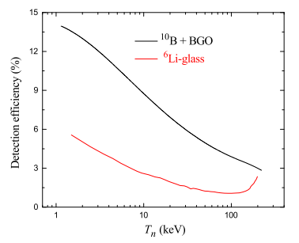
$$\frac{dN\left(T_{n}\right)}{dT_{n}}=\frac{{N\left(T_{n}\right)}^{det}}{dT_{n }ε\left(T_{n}\right)}$$
*
$$ε\left(T_{n}\right)=\sum_{j=1}^{n}{ {RM}_{ij}}$$
* G.Feinberg et al., Quasi-stellar neutrons from the ⁷Li (p,n) ⁷Be reaction with an energy-broadened proton beam, Phys. Rev. C 85 (2012) 055810

Slide 6
Detection efficiency
Boron detector
T_{p} = 1886 keV
Li-glass scintillator
2.79 ± 0.01

Slide 7
Estimation of uncertainties
SANDY
the expected value + 300 altered cross sections
NJOY
ACE format
MCNP6
34 neutron energy bins
10234 runs
std(T_{n}) ~ 0.8% - 2.3%

Slide 8
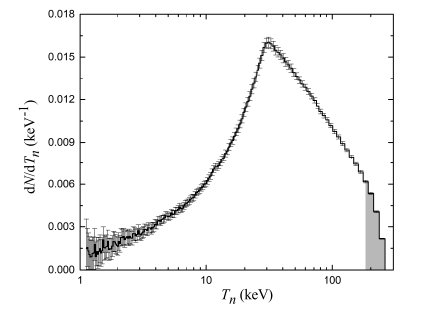
Emitted neutron energy spectrum
$$\frac{dN\left(T_{n}\right)}{dT_{n}}=\frac{{N\left(T_{n}\right)}^{det}}{dT_{n }ε\left(T_{n}\right)}$$
T_{p} = 2018 keV

Slide 9
Detection efficiency’s uncertainties
$$p\left(\overline{T_{n}}\right)=\frac{N_{{}_{}^{6}{Li}} σ_{{}_{}^{6}{Li}}\left(\overline{T_{n}}\right) }{N_{{}_{}^{6}{Li}} σ_{{}_{}^{6}{Li}}\left(\overline{T_{n}}\right)+\sum_{χ=1}^{12}{N_{χ} σ_{χ}\left(\overline{T_{n}}\right)}}$$
$N_{{}_{}^{6}{Li}}$ - ⁶Li atomic fraction in the glass
$σ_{{}_{}^{6}{Li}}\left(\overline{T_{n}}\right)$- ⁶Li energy averaged microscopic capture cross section for T_{n} energy
$N_{χ}$ - atomic fraction of isotope χ in the glass
$σ_{χ}\left(\overline{T_{n}}\right)$ - energy averaged microscopic elastic scattering cross section of isotope χ
$$\frac{δp\left(\overline{T_{n}}\right)}{p\left(\overline{T_{n}}\right)}$$

Slide 10
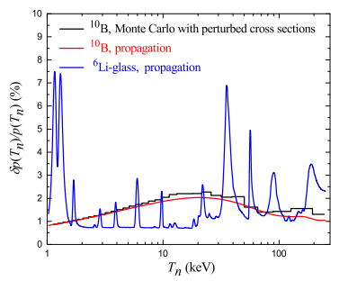
Detection efficiency’s uncertainties

Slide 11
conclusions
⁷Li(p,n)⁷Be was used as a neutron source.
The standard nuclear reaction cross section ¹⁰B(n,α)⁷Li* is used to measure neutron spectra from 1 keV to 250 keV with systematic uncertainties below 2.3%.
A count ratio of 2.79 between our detector and a comercial Li-glass scintillator was achieved.
Outline
Boron-based neutron detection system showed superior performance in both detection efficiency and systematic uncertainty when compared to the Li-glass scintillator.

Slide 12
Device and method for low-uncertainty and high-efficiency neutron TOF spectrometry
Article link:
https://authors.Elsevier.com/c/1hq-KcPqbota-

