Slide 1
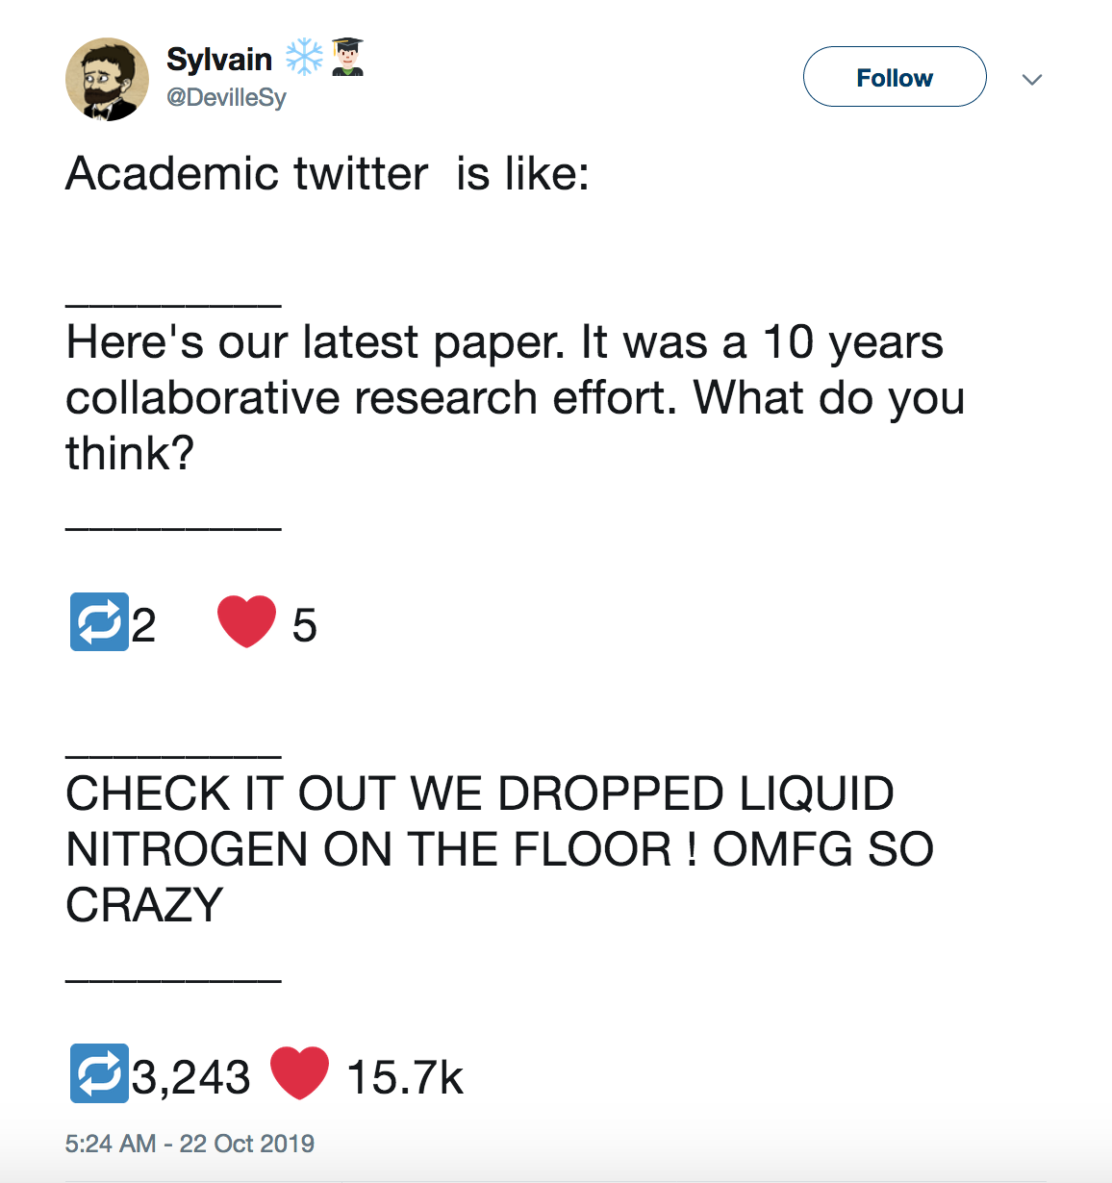

Slide 2
Why are you on social media?
(if you are)

Slide 3
Why I am on social media
Feel part of a community
Share my thoughts about cross-cutting issues
(academic life, gender balance, etc)
Enhance my teaching activities
Make social media a better place
Share the results of my research

Slide 4
My hints:
Choose your social media
(Facebook: more content, X(Twitter): “vertical”,
Instagram: visual, LinkedIn: professional)
Keep a coherent profile / Be your professional self
Your social bubble: nourish it / break it
Share with care (you’re a scientist: verify!)
Make social media a better place

Slide 5
https://paroleostili.it/the-manifesto-of-non-hostile-communication-for-science/

Slide 6
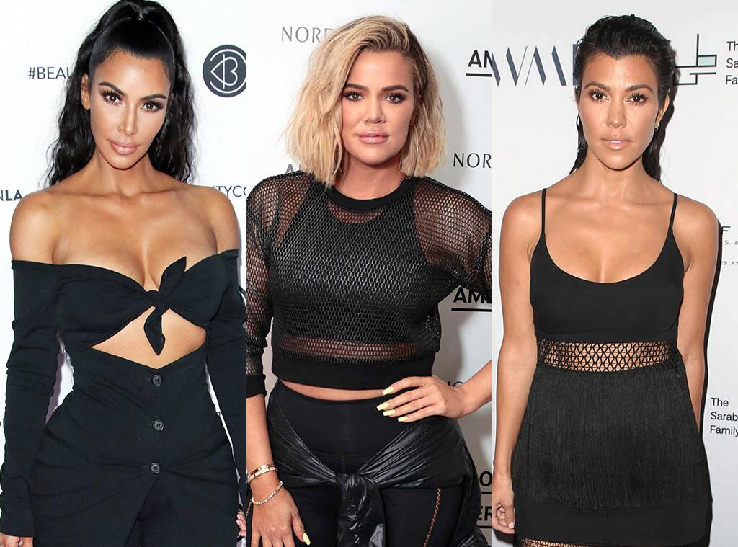
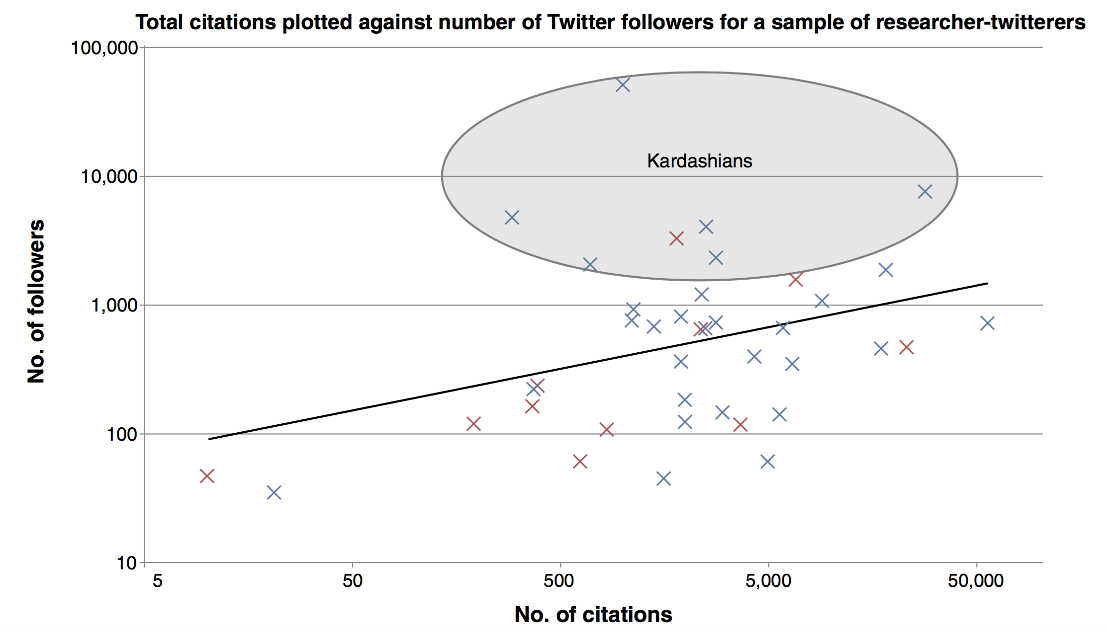
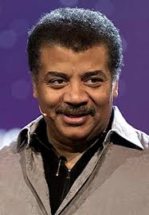
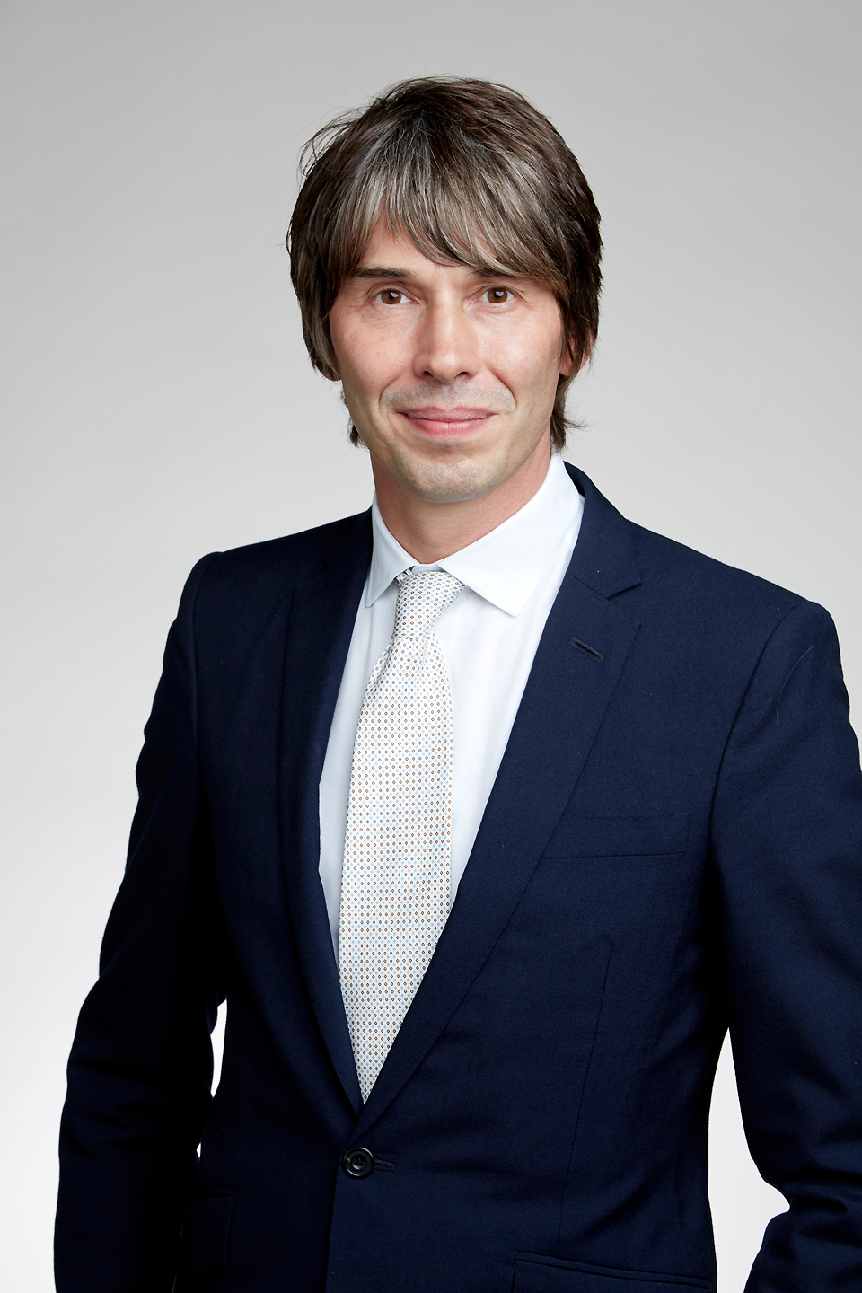
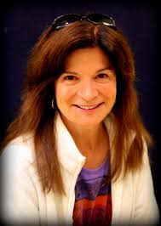
The Science Kardashians
K_{I}=1
@Sandro.Scandolo
https://en.wikipedia.org/wiki/Kardashian_Index

