Slide 1
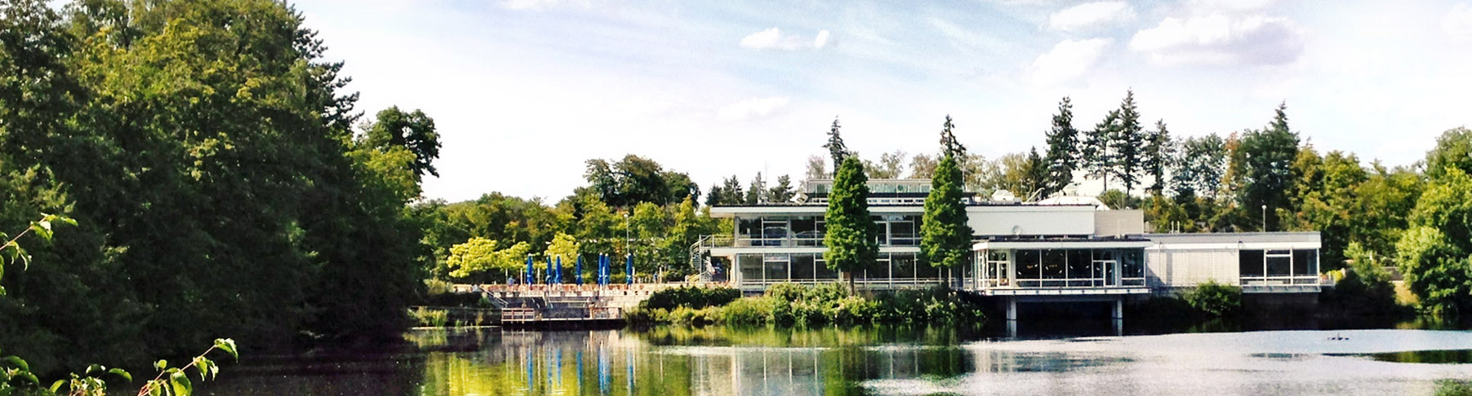
Introduction to land surface processes and land surface modelling
27.05.2024 I Harrie-Jan hendricks-franssen, bamidele oloruntoba and stefan kollet

Slide 2
Land surface modellIng – water and energy
Land surface is a necessary component of global and regional atmospheric circulation models, both for NWP and climate simulations.
The land surface model component calculates the coupled water and energy fluxes from the land into the atmosphere (total evapotranspiration, sensible heat flux, outgoing shortwave and longwave radiation) given incoming precipitation and radiation (incoming shortwave and longwave).
These fluxes are needed by the atmospheric circulation model as lower boundary condition, and affect the atmospheric conditions.
Atmospheric processes are influenced by energy partitioning, surface roughness and albedo.

Slide 3
Land surface modellIng – biogeochemistry
Newer generations of land surface models (since ~25 years) also calculate carbon fluxes between land and atmosphere.
This is important for climate models as the biogeochemical feedback from the land to increased warming could enhance the release of carbon and further accelerate global warming (e.g., methane emissions from thawing permafrost areas or increased respiration from soils).
In addition, biophysical responses from the vegetation to climate change also can have a feedback on the climate (e.g., greening or increased droughts).
Even newer generations of land surface models (since 10-15 years) also calculate nitrogen fluxes between land and atmosphere (role of N as nutrient, emissions of N₂O).

Slide 4
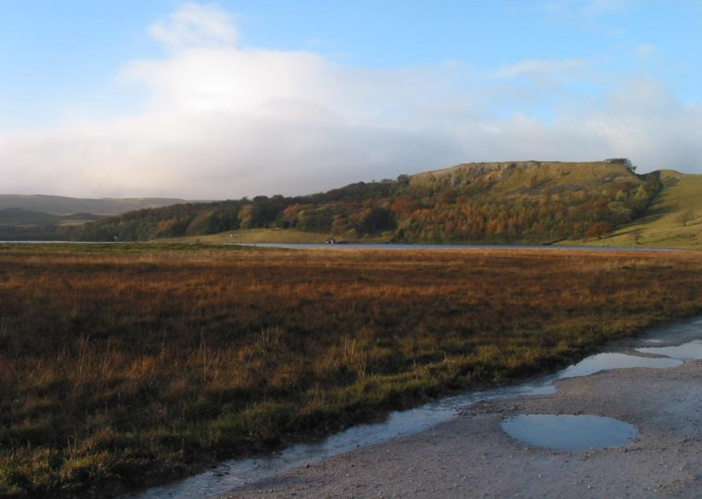
why is land surface modelling important?
Not only to serve atmospheric modelling (NWP and climate).
Impact on the land itself (i.e. droughts, crop yields, water resources, fire, development of carbon storage function).

Slide 5
The interdisciplinary evolution of land models
Land as a lower boundary to the atmosphere
Land as an integral component of the Earth System
Figure: Fisher and Kove, 2020, JAMES
Notes:
1) In the beginning: land model a conceptual bucket. Simple partitioning of net radiation into sensible and latent heat.
2) NCAR scientist Deardorff (1978) provided a blueprint for mechanistic modeling of land processes.
- The emergence of models with an explicit canopy.
- These models focus on short-term fluxes, where land properties (vegetation, soils) prescribed
3) Land models evolved to focus on the dynamics of the Earth System, and the interactions and feedbacks among processes across time scales (e.g., root adaptation to climate).
- An important focus is to represent heterogeneity and emergent behavior.

Slide 6
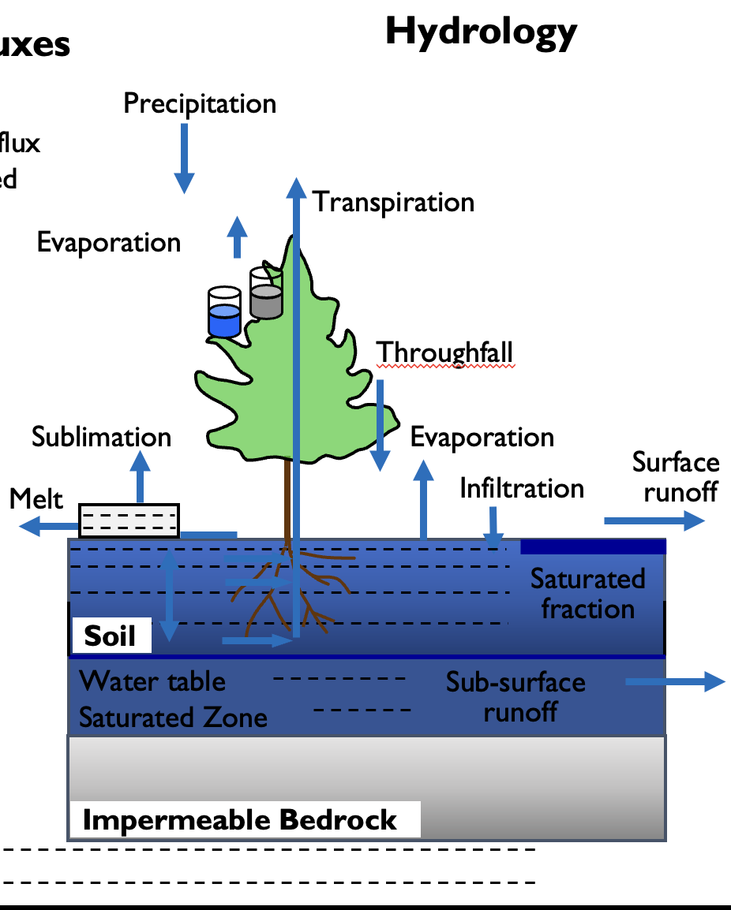
Water cycle in LSM´s
P + I = ET + Q_{surface} + Q_{subsurface} + ΔS.
P = precipitation, I = irrigation, ET = total evapotranspiration, Q_{surface} = surface runoff, Q_{subsurface} is subsurface runoff (from groundwater) and ΔS is change in storage (in soil, aquifer and snow pack). All in L³/T.
ET includes evaporation, transpiration, evaporation from interception and sublimation
Lawrence et al., 2011, 2019

Slide 7
Water cycle in LSM´s
Started with bucket approaches (Manabe,1969).
Later: 1D Richards equation to solve water flow in soils (1990´s).
Recently: also 3D fully hydrodynamics, considering groundwater and surface water in a coupled fashion (e.g., CLM-ParFlow, Kollet and Maxwell, 2008).
Lawrence et al., 2011, 2019

Slide 8

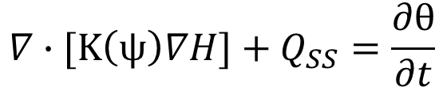
Richards equation
K hydraulic conductivity [LT⁻¹]
ψ suction [L]
H total potential head [L]
Q_{SS} sinks and sources [T⁻¹]
θ soil moisture [-]
t time [T]
H_{g} gravitational potential head [L]
H_{p} pressure potential head [L]
$$∇∙[K\left(ψ\right)∇H]+Q_{SS}=\frac{∂θ}{∂t}$$
$$H=H_{g}+H_{p}$$
Source:
Environmental Soil Physics- Daniel Hillel

Slide 9
RICHARDS EQUATION
In LSM´s solved numerically, using f.e. finite difference formulations.
The result is a vertical profile of soil moisture content, in general with thinner layers close to the land surface and thicker layers at greater depths (why?).
The vertical soil moisture profile exerts an important control on the soil evaporation and plant transpiration and therefore the water vapour flux from the land to the atmosphere.
Lawrence et al., 2011, 2019

Slide 10
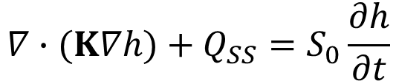
GROUNDWATER
Groundwater is usually present at greater depths, but often not (well) represented in LSM´s. Important is that in aquifers flow is mostly lateral, and that is affects soil moisture above groundwater.
Groundwater flow equation (numerically solved in LSM´s like TSMP):
$$∇∙(K∇h)+Q_{SS}=S_{0}\frac{∂h}{∂t}$$
h hydraulic head [L]
S₀ specific storativity: volume of water removed if head decreases 1m [L⁻¹]

Slide 11
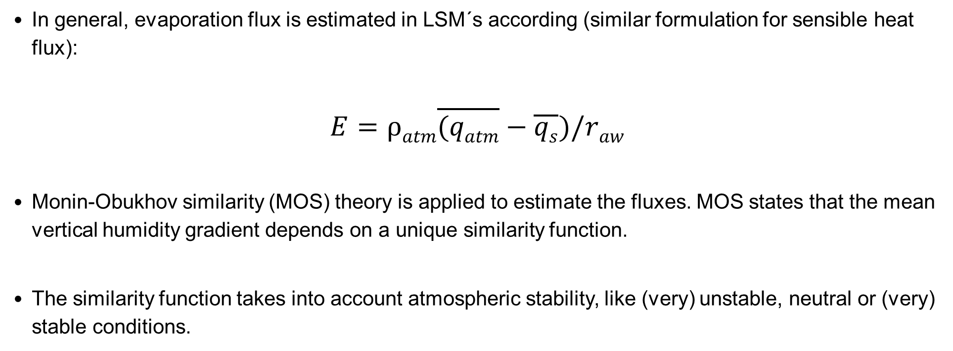
Evaporation
In general, evaporation flux is estimated in LSM´s according (similar formulation for sensible heat flux):
$$E=ρatm\overline{(qatm}−\overline{qs})/raw$$
Monin-Obukhov similarity (MOS) theory is applied to estimate the fluxes. MOS states that the mean vertical humidity gradient depends on a unique similarity function.
The similarity function takes into account atmospheric stability, like (very) unstable, neutral or (very) stable conditions.
q_{s} specific humidity at land surface [-]
q_{atm} specific humidity in atmosphere (near surface) [-]
r_{aw} aerodynamic resistance to water vapour [TL⁻¹]

Slide 12
Evaporation
SOIL, SNOW, OPEN WATER
VEGETATED AREAS

Slide 13
TRANSPIRATION
Transpiration is also controlled by root water uptake.
Transport of water from soil via roots to atmosphere is calculated in eCLM with plant hydraulics.
Conceptualization: series of resistances.
Medlyn stomatal conductance model. Calculates stomatal conductance as function of net leaf photosynthesis, vapor pressure deficit, CO₂ concentration and plant specific parameters.

Slide 14
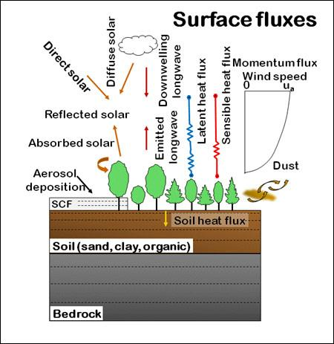
ENERGY cycle in LSM´s
R_{n} ≈ SW↓ + SW↑ + LW↓ + LW↑
R_{n} – G ≈ H + LE
R_{n} = net radiation, SW↓ = incoming shortwave radiation, SW↑ = outgoing shortwave radiation, LW↓ = incoming longwave radiation, LW↑ = outgoing longwave radiation. H = sensible heat flux, LE = latent heat flux, G = ground heat flux. All in M/T³.
Water and energy cycles coupled via ET.
Lawrence et al., 2011, 2019

Slide 15
Net radiation
Reflected short-wave
radiation
Long wave radiation
Long wave
radiation from
atmosphere
Incoming short
wave radiation
LE
H
G
SOIL

Slide 16
Energy cycle
R_{n} ≈ SW↓ – SW↑ + LW↓ – LW↑
R_{n} – G ≈ H + LE
Equations approximation: photosynthesis in general minor contribution, maximum 5% during daytime under sunny conditions.
Advection contribution in general small. Examples are rainfall, or river flow in a shallow lake.
Storage changes are not important for a thin layer, but can be larger for tall canopy. Over longer time scales not important.
Example of energy balance for irrigated alfalfa-brome hay in Wisconsin, USA.
Source: Tanner, 1960.

Slide 17
shortwave RADIATION
Shortwave radiation is 1366 Wm⁻² at top of Earth atmosphere. It is affected by scattering, adsorption and reflection (e.g., clouds, colloidal particles) and reaches Earth surface as direct solar radiation and diffuse sky radiation.
Incoming short wave radiation shows daily and yearly cycles with maxima around noon. For Northern hemisphere north of 22.5°N maximum is in June.
Reflected short wave radiation depends on albedo α_{S}
Albedo depends also on sun angle and is lower for higher sun angles (i.e., at midday).

Slide 18
shortwave radiatIon
LSM´s calculate reflected shortwave radiation based on incoming shortwave radiation (from atmospheric model, reanalysis or direct measurements) and surface properties.
Important is information on land use, state of the land (e.g., soil colour) and sun angle.
Typical albedo values for some surfaces:
  Moist dark soils: α_{S} ≈ 0.05-0.15
  Dry soils, desert: α_{S} ≈ 0.25-0.35
  Green gras and short vegetation: α_{S} ≈ 0.15-0.20
  Coniferous forest: α_{S} ≈ 0.10-0.15
  Clean, stable snow: α_{S} ≈ 0.60-0.75
  Fresh dry snow: α_{S} ≈ 0.80-0.90

Slide 19

longwave radiation
Assuming that land surface is an infinitely deep grey body of uniform temperature and emissivity. Then according Stefan-Boltzmann law:
Emissivity for natural surface between 0.95 and 0.99, in general close to unity.
Outgoing longwave radiation measured at eddy covariance stations, and often simply approximated by replacing land surface temperature simply with air temperature.
In LSM´s: outgoing longwave radiation calculated from land surface temperature, which is iteratively solved by coupled water and energy cycles (including numerical solution of water and energy transport equations in soils).
T_{S} land surface temperature [K]
σ Stefan-Boltzmann constant = 5.6697 x 10⁻⁸ Wm⁻²K⁻⁴
$$Rlu=ε_{s}σT_{s}^{4}$$

Slide 20


longwave radiation
Incoming long wave radiation from atmosphere is also given by Stefan-Boltzmann law:
The atmospheric emissivity is estimated by various different approaches, often empirical. For example:
ε_{ac} emissivity of atmosphere
T_{a} air temperature [K]
e_{a} actual air vapour pressure [ML⁻¹T⁻²]
a=1.24, b=1/7
$$Rld=ε_{ac}{σT}_{a}^{4}$$
$$ε_{ac}=a{\left(\frac{e_{a}}{T_{a}}\right)}^{b}$$

Slide 21

longwave RADIATION
Incoming longwave radiation measured at eddy covariance stations.
But commonly it is estimated on the basis of cloudiness, using also field data. A general expression is:
In LSM´s: from atmospheric model, reanalysis or measurement, or also internally approximated with help of some variables.
R_{ldc} incoming longwave radiation without clouds [MT⁻³]
m_{c} cloudiness fraction [-]
a and b constants (e.g., a=0.05-0.22; b=2-2.5)
$$Rld=Rldc(1+am_{c}^{b})$$

Slide 22
Groundheat flux
Flux G into soil (or vegetation canopy or water body) is especially for vegetated areas one order of magnitude smaller than R_{n}, H, LE.
Positive daytime values of G often compensated by negative nighttime values and therefore net sum close to zero.
Groundheat flux is measured by one or, better, multiple heat flux plates (heterogeneity) installed in the soil 5-10cm below the surface. The heat storage in the layer above the heat flux plate can be estimated.
In LSM´s calculated by solving numerically the heat equation based on Fourier law´s for thermal conduction.

Slide 23
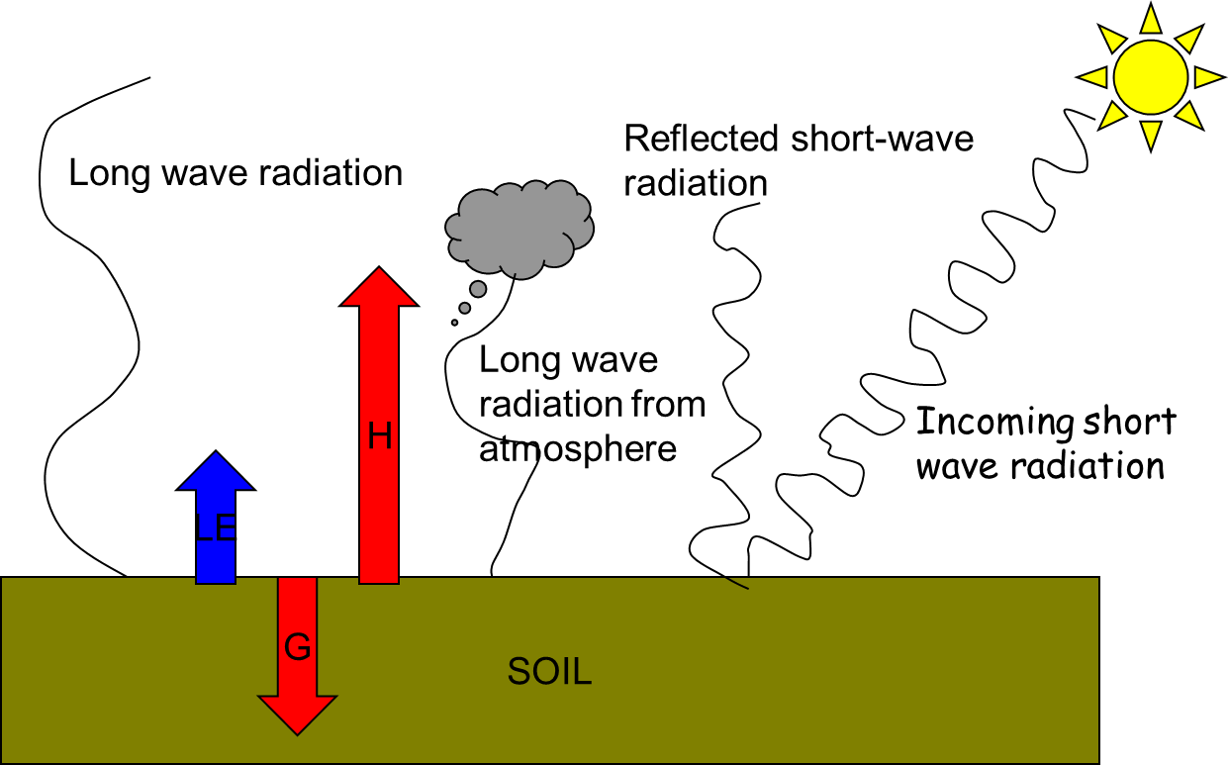
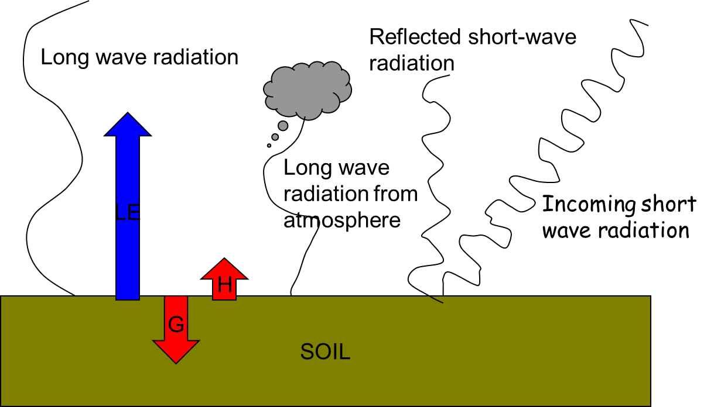
ENERGY PARTITIONING
DRY SOIL CONDITIONS
WET SOIL CONDITIONS

Slide 24
Climatology of energy balance
Ohmura (2005) found from extensive observation data the following values for the energy balance components at the land surface, as global average:
  Incoming shortwave 169 W/m²
  Outgoing shortwave 25 W/m²
  Incoming longwave 345 W/m²
  Outgoing longwave 385 W/m²
  Net radiation 104 W/m²
  Latent heat flux 85 W/m² = 1090mm evapotranspiration
  Sensible heat flux 19 W/m²

Slide 25
human water USE IN LSM´s
Atmosphere
Radiation
Precipitation
???
???
Advection
Pumping/Irrigation
Evapo-
transpiration
Infiltration
Runoff
Surface
water
Plant/soil system
Discharge
Return flow
Ground
water
Base flow

Slide 26
human water USE IN LSM´s /ESM´s.
Atmosphere
S
P
A
q_{s}
ET
R
I
Surface
water
Plant/soil system
D
Q_{r}
Ground
water
Q_{d}

Slide 27
Thank you

