Slide 1

land surface modelling and eclm
27.05.2024 I Harrie-Jan hendricks-franssen, theresa boas, bamidele oloruntoba and paul rigor

Slide 2
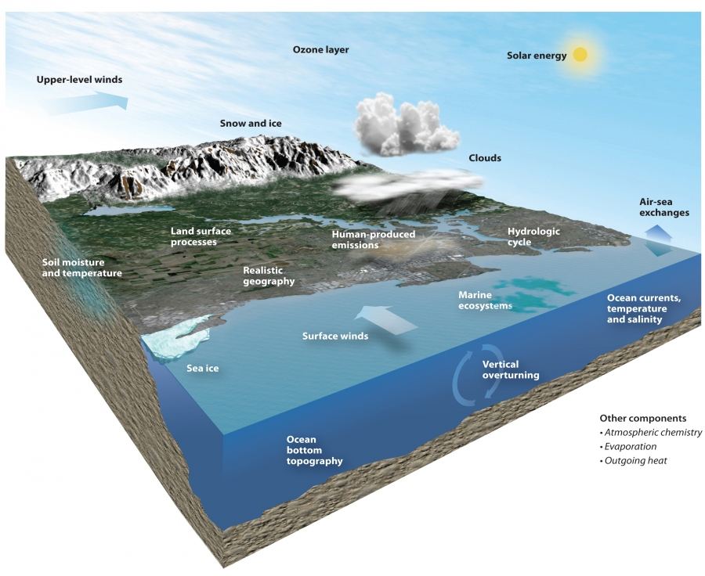
Overview of CLM5.0
What is CLM5.0?
Community Land Model (CLM5.0) is the land surface model component of the Community Earth System Model (CESM)
Simulates biogeophysical, biogeochemical, and ecological processes.
CLM5.0 builds on the improvements of CLM4.5, CLM4.0 and CLM3.5
The Community Earth System Model version 2 (CESM2)

Slide 3

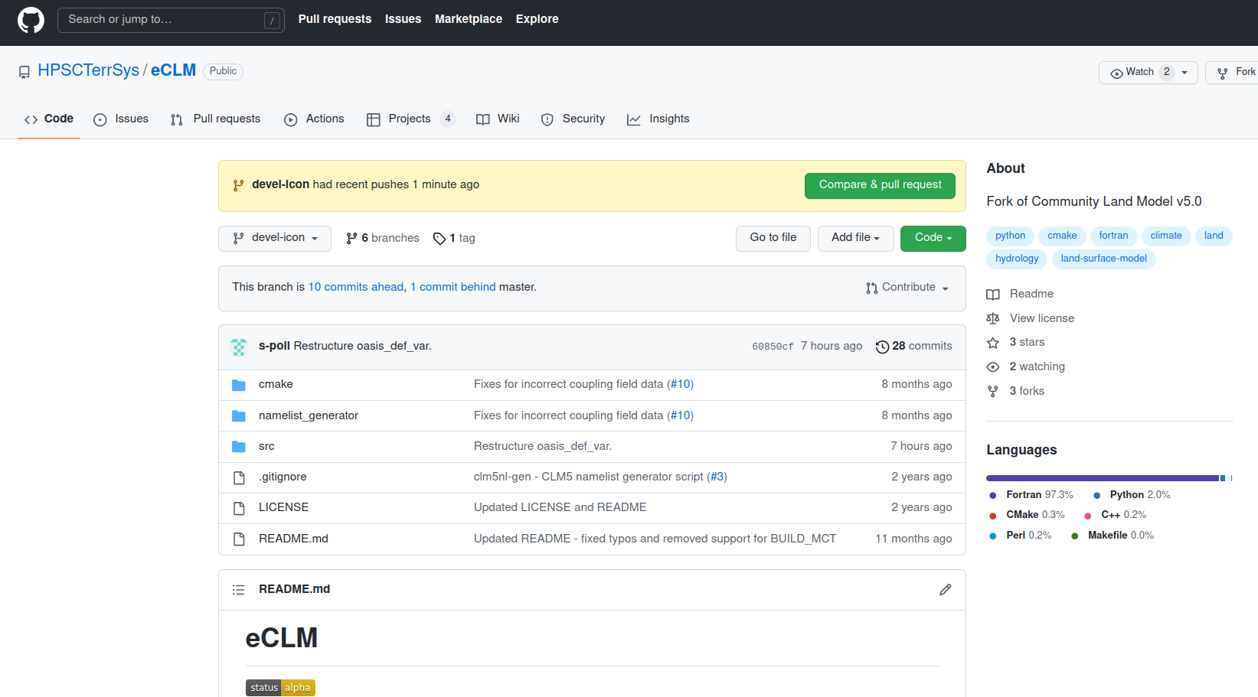
eCLM – Fork of CLM5.0
Land-surface model eCLM
eCLM – Fork of CLM5.0
Developed within FZJ (IBG-3)
Same modeling capabilities as CLM5.0
Simplified infrastructure for
build and namelist generation
Build system is handled entirely
by CMake
Namelist generation through small set of Python scripts
Additional features are being included
eCLM github
https://github.com/HPSCTerrSys/eCLM

Slide 4
ECLM model
Simulates exchange of water, energy, C and N between land and atmosphere.
Simulates soil and vegetation states (soil moisture, soil temperature, LAI).
Recent features include for example:
  land use land cover change
  enhanced representation of human management (e.g., irrigation, fertilization)
  better representation of urban areas with specific sub-module (CLMU)
  better representation of fire with specific sub-module (SPITFIRE)
  better representation of crops with specific crop module
  Possibility to consider ecosystem dynamics (submodule FATES)

Slide 5
ECLM model
Input variables:
  atmospheric forcings (precipitation, air temperature, specific humidity, wind speed, air pressure, incoming shortwave radiation, incoming longwave radiation)
  Surface characteristics (land units, percentage of PFT´s and CFT´s per grid cell, specific parameters directly linked to PFT´s and CFT´s, soil texture information, soil organic matter content, slope etc.).
Output variables:
  Up to 95 pre-defined output variables.
File format:
  NetCDF4

Slide 6
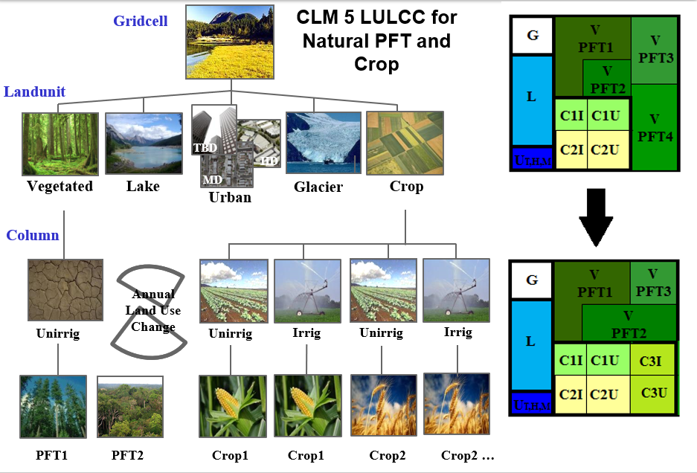
How is the land surface represented in eclm?
CLM5 uses a multi-level sub grid hierarchy.
Each grid cell contains land units.
Each land unit contains columns.
Each column contains a plant functional type (PFT).
There are up to 78 PFT´s and CFF´s in eCLM.
Image source: http://www.cesm.ucar.edu/models/clm/

Slide 7
ECLM land units, columns, PFT´s and CFS´s
Plant functional types:
  eCLM uses 78 PFTs
    8 Tree PFTs
    3 Shrub PFTs
    3 Grass PFTs
    64 Crop PFTs (32 irrigated / not irrigated)
Parameter file contains 133 parameter values for each PFT
  e.g., rooting depth, tree height, photosynthetic parameters
Surface data set / land use change data set contains PFT distribution for each grid cell.

Slide 8
Clm5 input data
Atmosphere | Land Surface | Social & others
Precipitation | Land cover | Population density
Incoming Solar radiation | Soil texture | Gross Domestic Product
Air Temperature | Soil depth | Urban areas
Specific Humidity | Land mask | Urban density
Wind Speed | Soil carbon
Surface pressure | LAI
Long wave radiation | Soil colour
Aerosol deposition* | Glacier regions*
 | Albedo
 | Irrigation data
 | Organic matter

Slide 9
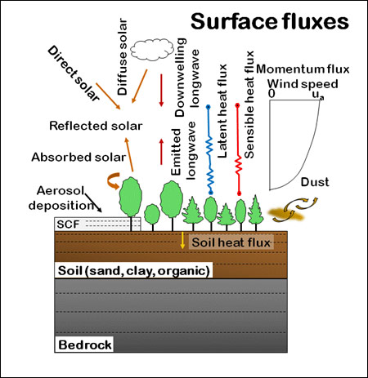
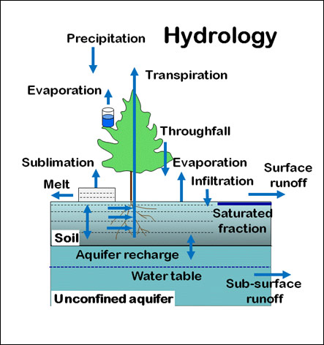
ECLM Model – water and energy cycles
Image source: http://www.cesm.ucar.edu/models/clm/

Slide 10
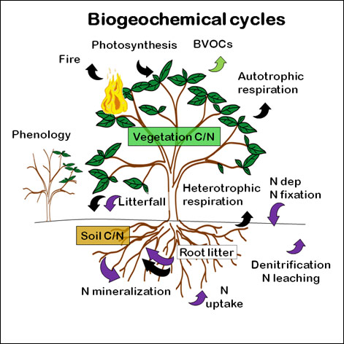
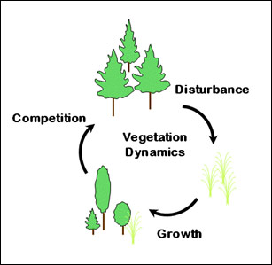
ECLM Model – nutrient cycles and dynamic vegetation
Image source: http://www.cesm.ucar.edu/models/clm/

Slide 11
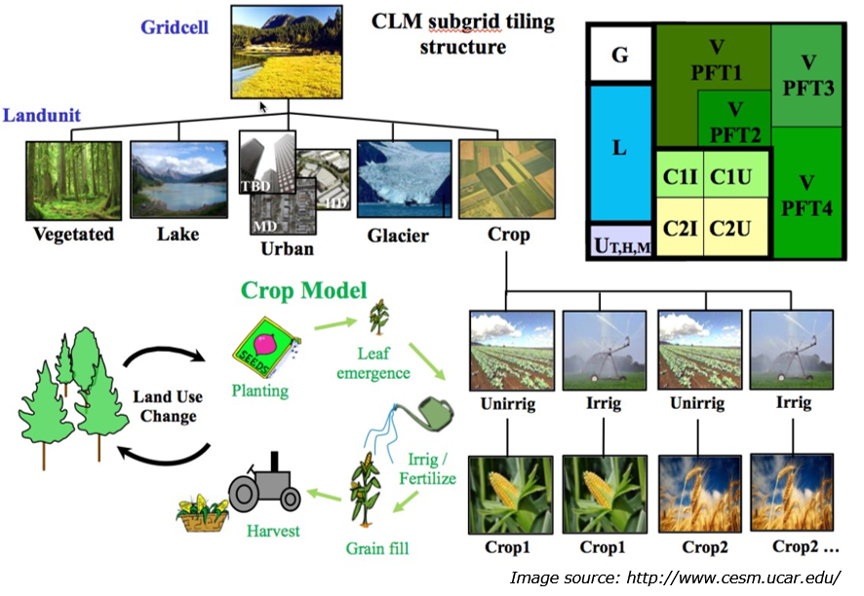
eCLM CROP modULE
New
Prognostic crop growth
New CFT
Transient crop management and dynamic adjustment of land units​
C and N cycling including human management, grain and planting C
Updated soil and plant hydrology
|

Slide 12
Regional scale crop modeling – WHY LSM?
Land atmosphere interactions and energy fluxes
Regional crop yields
  Food supply
Influence of human management and land use changes
Carbon and nitrogen cycles
Image source: http://www.cesm.ucar.edu/

Slide 13
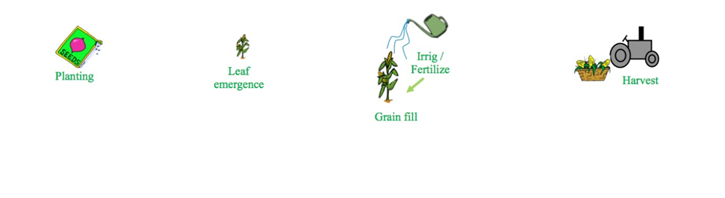
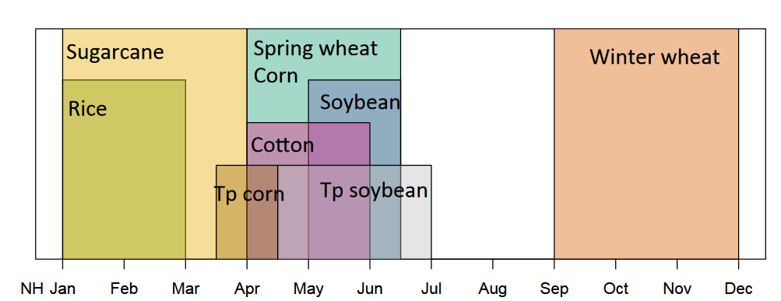
Eclm phenology
Phase 1: Planting
Temperature thresholds - 10 consecutive days to be met within planting window
e.g. spring wheat: Tmin,p = 0°C , Tp = 7°C
T_{10d} > T_{p}
T_{min,10d} > T_{min,p}
Planting windows
|
Notes:
CLM 5.0 Crop adopts the crop phenology algorithm of 4 phases
These phases are governed by the percentage of Growing Degree Days (GDD) required for maturity of the crop
1st phase - planting
The crop is planted when the 10-day running means of the daily 2-m air temperature T_{10d} and the daily minimum 2-m air temperature T_{min,10d} surpass the crop specific coldest planting temperatures T_{p} and T_{min,p} respectively
Besides planting windows also GDD window with pre defined min and max GD

Slide 14
Eclm phenoloGY
Phase 2: Leaf emergence
Based on heat accumulated in the top soil layers
Leaf, stem, root C increasing
Phase 3: Grain fill
Based on heat accumulated since leaf emergence
Max. LAI is reached
Grain C increasing, leaf C decreasing
Phase 4: Harvest
GDD for maturity is reached
Max. days for crop growth exceeded
GDD_{Tsoi} = 1 - 5 % GDD_{mat}
GDD_{T2m} = 40 – 65 % GDD_{mat}
_{or}
TLAI = L_{max}
GDD_{mat}
_{or}
max GDD_{plant}
|
Notes:
2nd phase Begins when GDD_{Tsoi} (the growing degree-days of soil temperature at 0-05 m depth) reaches 1 - 5 % of GDD_{mat} with crop specific base T for GDD.
Upon leaf emergence, the seed C and an equivalent amount of seed N according to the crop specific C to N ratio (CN_{leaf}) is then transferred to the leaves.
3rd phase Begins either when GDD_{T2m} (the simulated 2 m air temperature) reaches a heat unit threshold (h) of 40 – 65 % of GDD_{mat} or when is reached
4th phase Happens when GDD_{mat} or plant growth window is reached

Slide 15
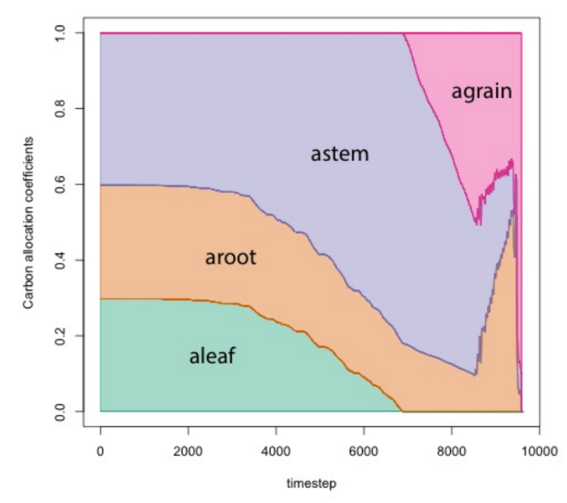

C and n allocation in crops
Carbon allocation
Allocation coefficients based on phenology phases
C allocation begins during leaf emergence
Nitrogen allocation
C:N ratios calculated dynamically to meet target C:N values
N retranslocation to reproductive pool during grain fill phase
Additional N for plant N demand from soil N
C allocation coefficients [-]
timestep
tissue carbon [gC/m2]
timestep
Image source: http://www.cesm.ucar.edu/
|
Notes:
C
is linked to the crop phenology phases and ends with harvest of the crop.
crop seed pool is assigned 3 gC/m² from its grain product pool at planting.
N
The nitrogen allocation scheme in CLM uses two different C:N ratios for each crop based on the phenology stages to account for the generally lower C:N ratios generally early in the growth cycle, higher ratios in later growth stages and the N retranslocation during grain fill.
The plant nitrogen demands are met with nitrogen from the mineral soil nitrogen pool once the reproductive pool is depleted.

Slide 16
Calculations in clm5
Timesteps: CLM5 has a default time step of 30 minutes. Calculations are performed every 30 minutes.
Time Interpolation: If all input data are available at 30 minutes interval, calculations are performed with available data or available data is interpolated.
Time interpolation methods: Rainfall interpolation is often nearest.
Solar radiation is by COSZEN (Cosine Zenith Angle).
Temperature and Specific Humidity, linear.
Wind, similar value is assumed across timesteps.
Land use/ land cover is assumed to change annually while LAI(Leaf Area Index) changes monthly.

Slide 17
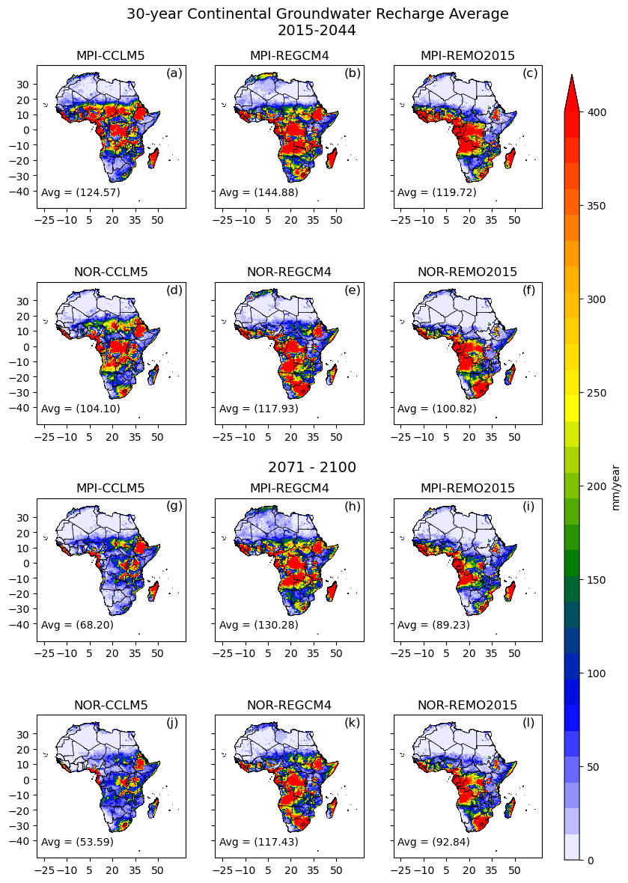
Post-processing
CLM5 outputs are called history files.
CLM5 outputs are in NetCDF format.
Data visualization tools like GrADS, R, Python, Ferret and NCL can post process and display.
GIS tools like QGIS and ArcGIS can display but may have limited post processing ability especially with large sets of data.
For water balance components, outputs are provided in mm/s.
Post processing and analysis depend on the research question.

Slide 18
Climate change impacts
In the last century, our planet’s average temperature has increased by approximately 1,3˚K.
Groundwater (GW) will be affected:
  GW recharge patterns will change (rainfall and ET change)
  GW sustainable yield will change (higher temperature ==> more water usage!)
  GW storage and accessibility will change (over-exploitation ==> decline/depletion of GW level)
If groundwater is affected, the reduced water supplies would place additional stress on water users (e.g., agriculture, municipal, and industry sectors).
CLM5 model was used to predict climate change impacts on groundwater recharge in Africa.

Slide 19
Selected RCM´s
Experiment | Global Model | Regional Model | Scenario
EXP 1 | MPI | CCLM5 | RCP2.6
EXP 2 | MPI | CCLM5 | RCP8.5
EXP 3 | MPI | REGCM4 | RCP2.6
EXP 4 | MPI | REGCM4 | RCP8.5
EXP 5 | MPI | REMO2015 | RCP2.6
EXP 6 | MPI | REMO2015 | RCP8.5
Why MPI?
Cai et al 2009, assessed 17GCMs globally
UK’s HadGEM Model performed well in Central Africa for both temperature and Precipitation.
MPI performed well in West Africa, Central Africa and some parts of Southern Africa for both temperature and precipitation.

Slide 20
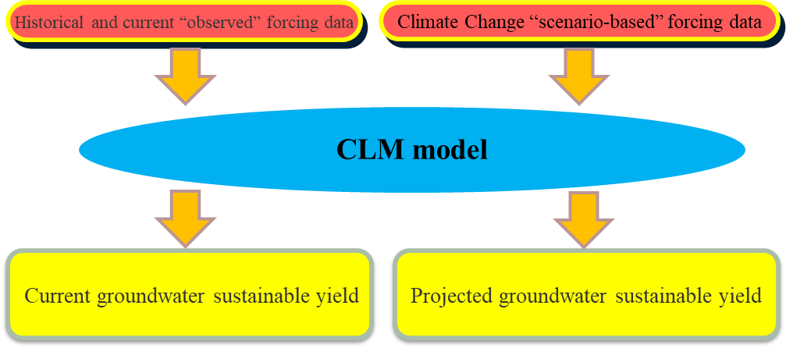
CLM5 Modeling approach

Slide 21
CLM5 Future simulations
Precipitation change (2020 – 2100) across Africa
Evaporation and transpiration change (2020 – 2100)
Surface runoff change (2020 – 2100)
Groundwater recharge projections (2020 – 2100)
Groundwater sustainable yield projections (2020 – 2100)

Slide 22
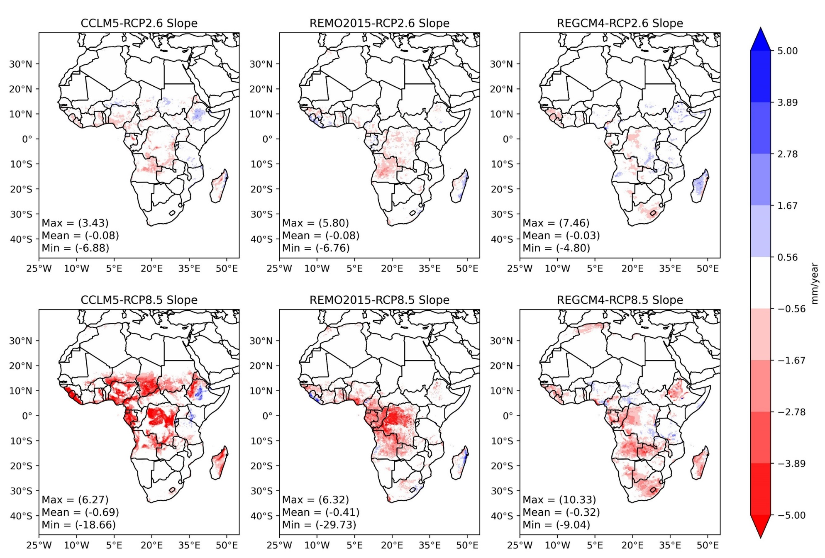
Recharge trends
2006-2100
GWR shows mostly negative trend for both RCP´s.
Steeper negative gradients are observed in RCP8.5 than RCP2.6 especially over parts of West and Central Africa.
Locally positive GWR trends are observed in Madagascar and Ethiopia in RCP2.6

Slide 23
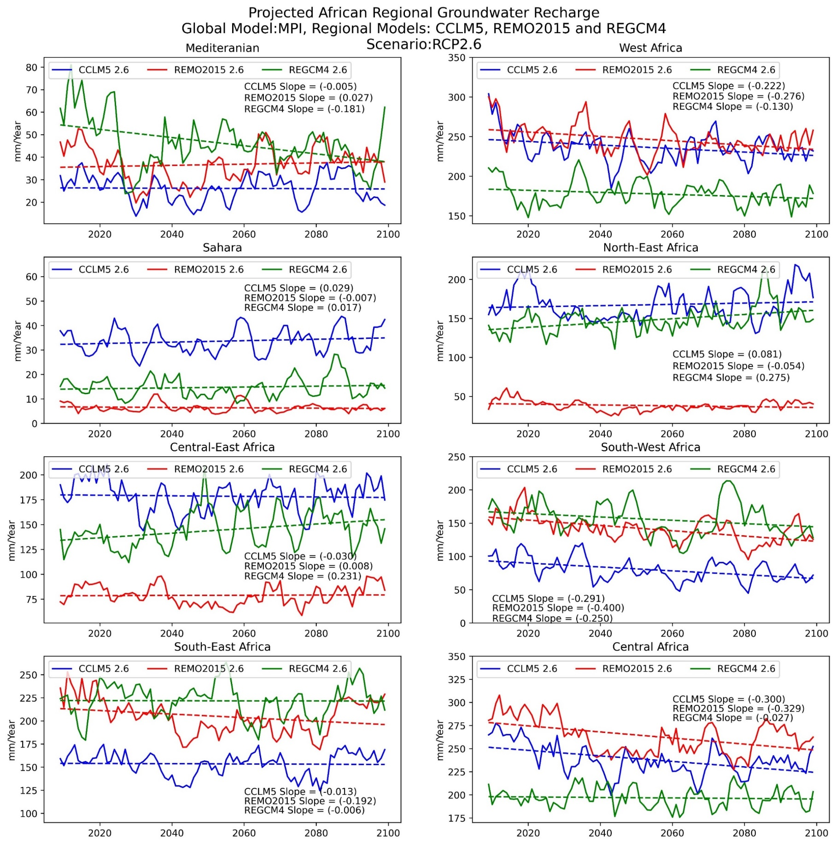
Recharge trends RCP2.6 – time series
2006-2100
The three models agree on negative GWR trends in West Africa, South-West Africa and Central Africa.
REMO2015 shows negative GWR trends in all regions except Central-East Africa.
CCLM5 and REGCM4 show both positive and negative trends in multiple regions.

Slide 24
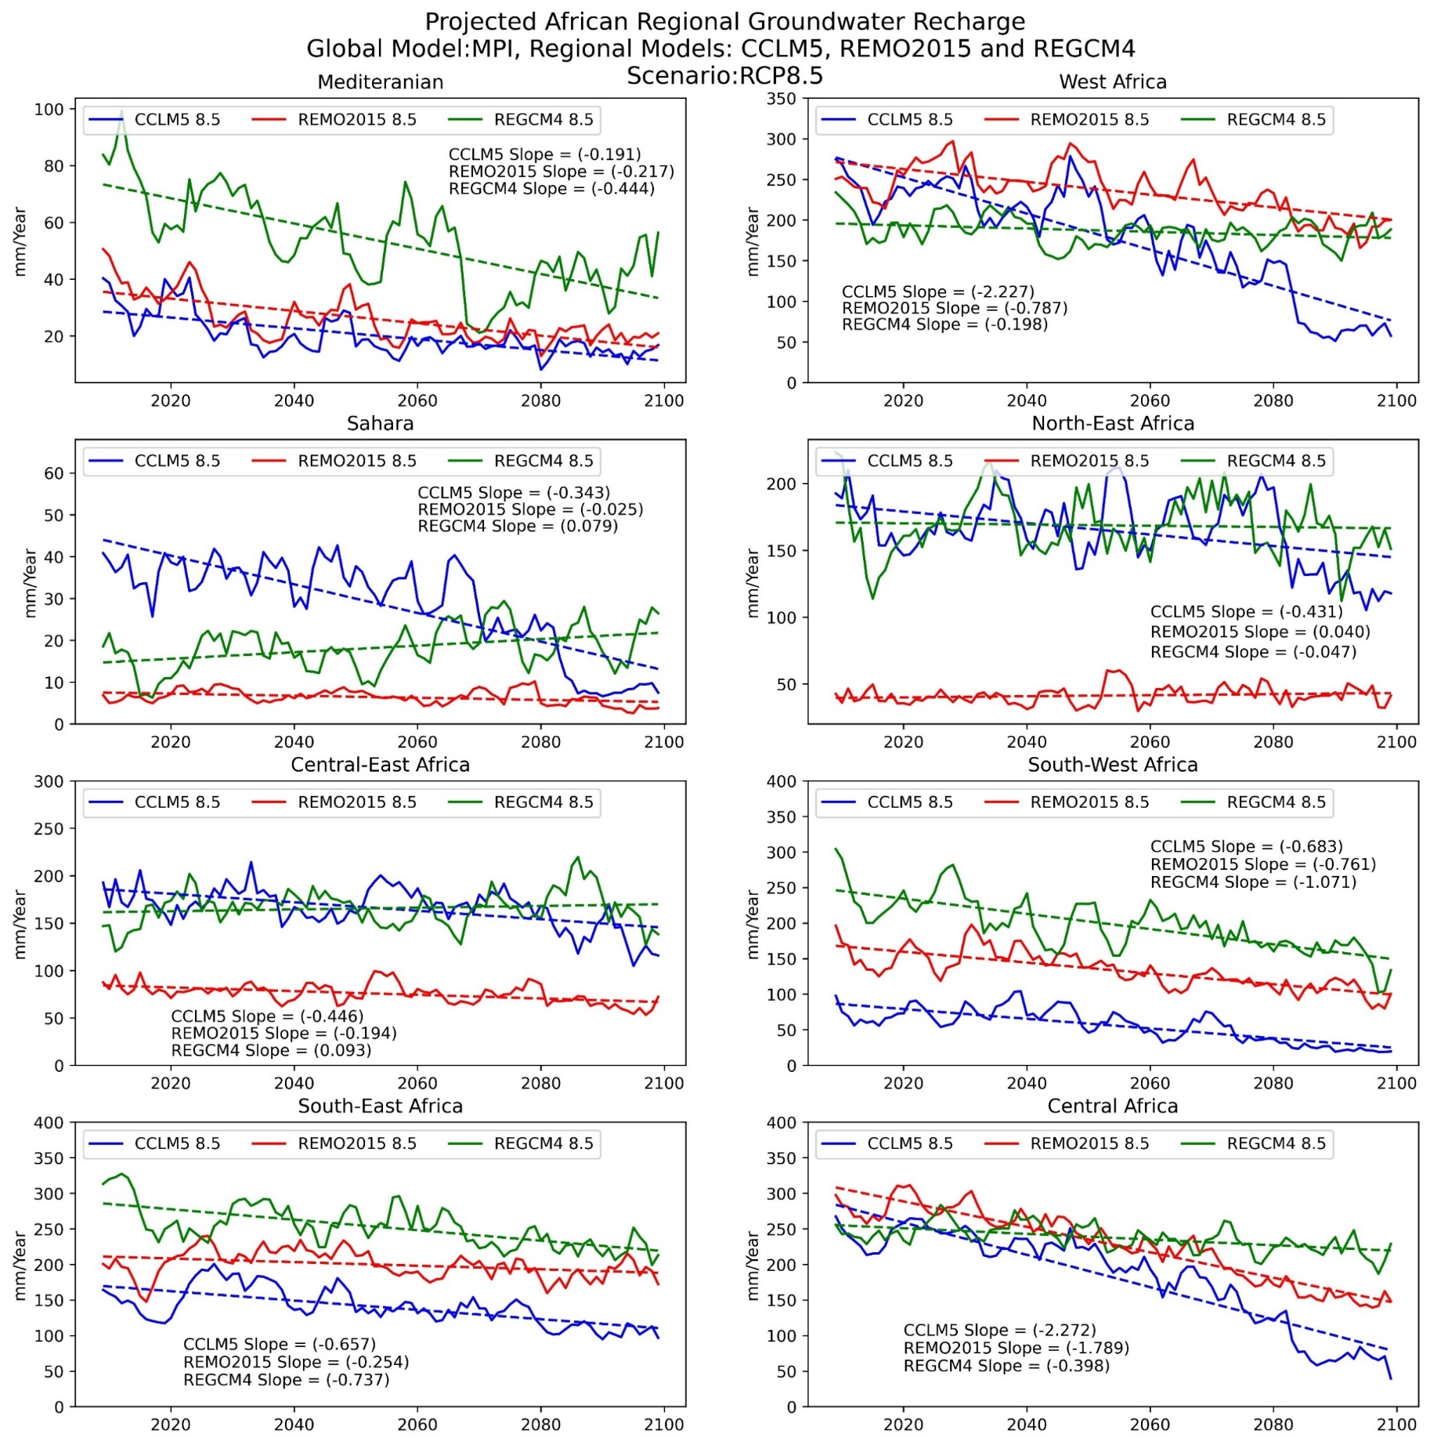
Recharge trends RCP8.5 – time series
2006-2100
All three models agree on negative GWR trends in Mediterranean, W Africa, SW Africa, SE Africa and Central Africa.
For the other three regions (CEAF & SAH), 2 out of 3 models project a negative GWR trend.
Trends vary between +0.1mm/year (REGCM4 Central East Africa) and -2.2mm/year (CCLM5 Central Africa).

Slide 25
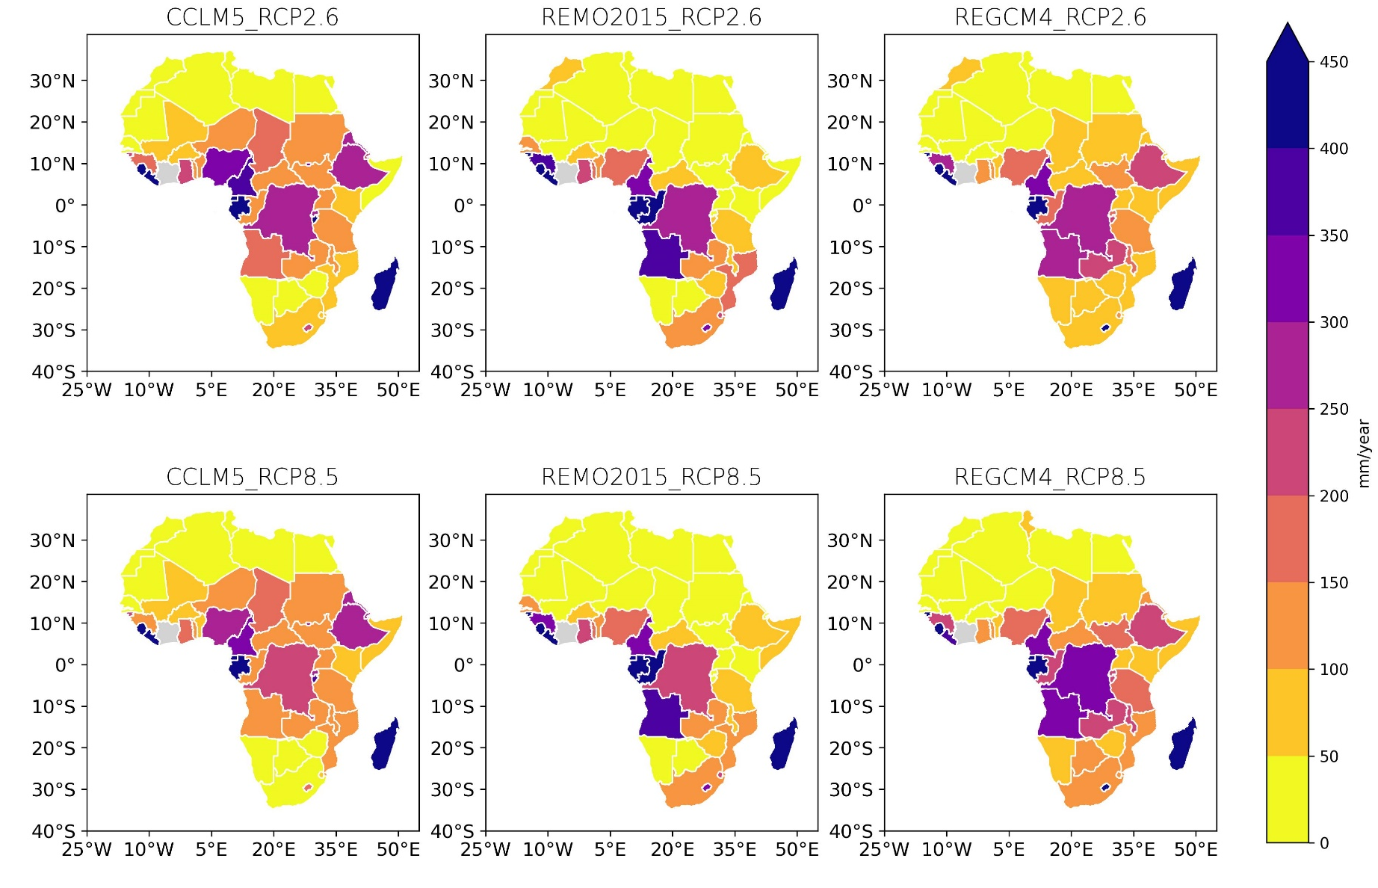
Average national gWR
Highest GWR estimates are found in the tropics around the Equator.
Comparing three models, REMO 2015 has clearly lower GWR estimates in Cameroun and Chad than other models, while CCLM5 and REGCM4 have higher GWR values especially in Sudan and Ethiopia.

Slide 26
TRENDS HWU/GWR RATIOS
Projected changes of HWU/GWR according RCP2.6 and RCP8.5 scenarios.
Everywhere increasing pressure on GW resources.
For RCP2.6 related to increasing HWU, for RCP8.5 also related to reduced GWR.

Slide 27
conclusionS
Long-term average groundwater recharge Africa estimated by CLM5. Especially for RCP8.5 clear decrease of GWR.
Groundwater sustainable yield from assumptions on environmental flow and human water use (HWU) data → amount of water available for further activities like green hydrogen production.
Groundwater sustainable yield projected to decrease more than GWR, related to increased HWU.
Limitation of the approach is related to uncertainty on climate, vegetation, soil and human water use data, as well as modelling assumptions. The assessment could be improved with help of detailed aquifer data.

Slide 28
Thank you

Slide 29
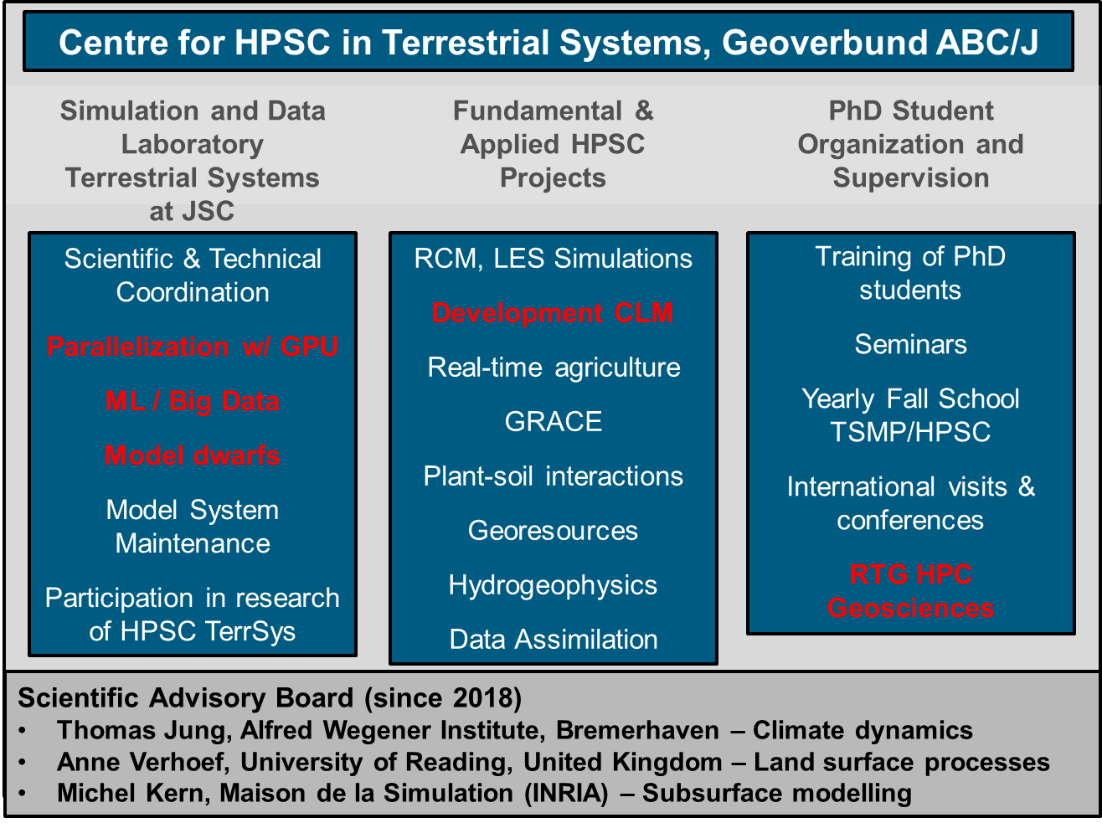
High performance computing terrestrial systems
With Simulation and Data Lab Terrestrial Systems (SDLTS)
Competence centre of ABC/J (Aachen, Cologne, Bonn, Julich)
Strengthening of HPC in all aspects of terrestrial systems research
Research and eduction
Simulation and Data Laboratory Terrestrial Systems (SDLTS) bridge between terrestrial systems research and HPC expertise
Coordinator: Daniel Caviedes-Voullieme

