Slide 1
The General Circulation and its link to Convection
Simona Bordoni
Department of Civil, Environmental and Mechanical Engineering
University of Trento, Italy
5th Summer School on Theory, Mechanisms and Hierarchical Modeling of Climate Dynamics,
ICTP, Trieste, July 2th 2024

Slide 2
Tropical precipitation
Data source: GPCP

Slide 3
Tropical precipitation
Data source: GPCP

Slide 4
Tropical precipitation
Data source: GPCP
Why is the maximum precipitation (ITCZ) north of the equator?

Slide 5
Precipitation is tied to the atmospheric circulation
Hadley cell
Ferrel cells
Easterlies
Westerlies
Westerlies
Data source: ERA-I
Maximum precipitation is co-located with ascending branch of the Hadley cell

Slide 6
Large-scale circulations and clouds
Courtesy: Bjorn Stevens

Slide 7
What drives the general circulation of the atmosphere (and ocean)?
Kiehl and Trenberth (2009)

Slide 8
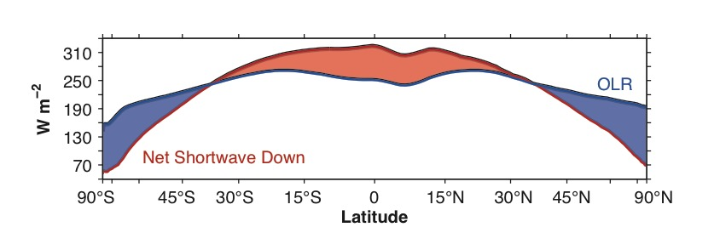
What drives the general circulation of the atmosphere (and ocean)?

Slide 9
What drives the general circulation of the atmosphere (and ocean)?
Net energy surplus
Net energy deficit

Slide 10
Implied energy transport
Hartmann (2015)

Slide 11
MMC vs eddies
Hartmann (1994)

Slide 12
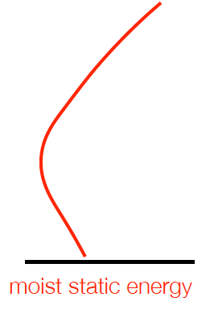
The Hadley cell is an energetically direct cell
Moist static energy
Height
S
Eq
N
The Hadley cell transports sensible and latent heat equatorward, but moist static energy poleward. In general, moist static energy is transported in the direction of the upper-level flow.

Slide 13
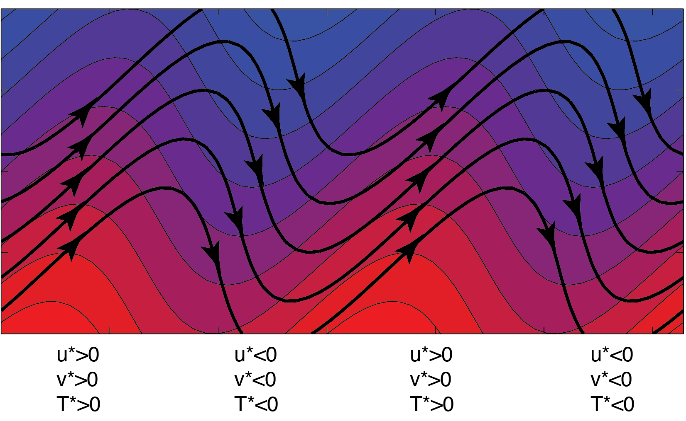
Extratropical eddies
Hartmann (2015)

Slide 14
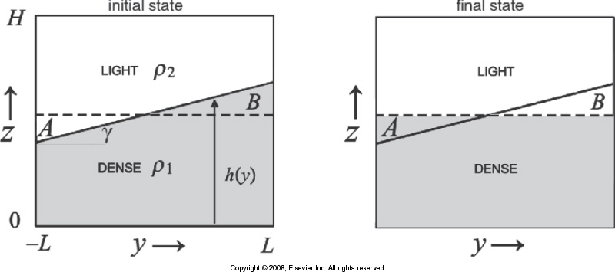
Tropical vs extratropical atmospheres
Marshall & Plumb (2008)

Slide 15
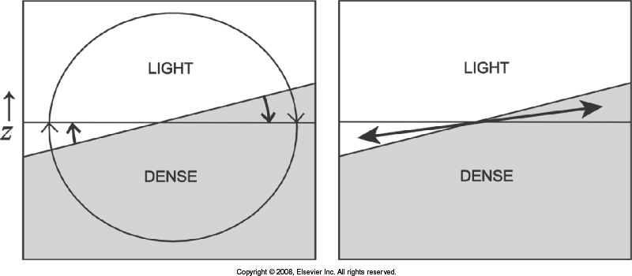
Tropical vs extratropical atmospheres
Tropical
Extratropical
Marshall & Plumb (2008)

Slide 16
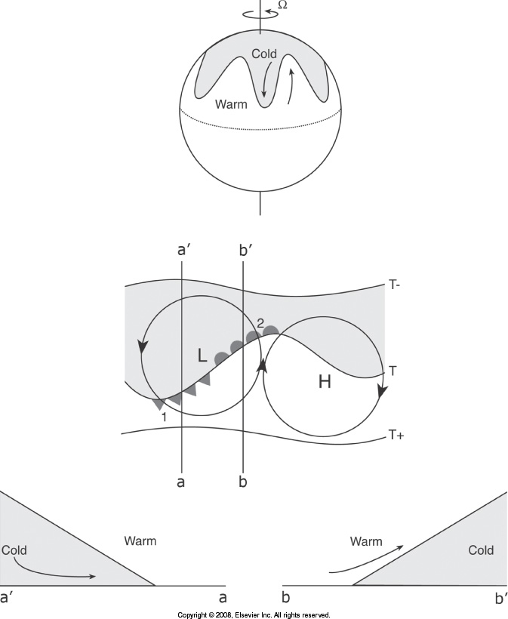
Tropical vs extratropical atmospheres
Marshall & Plumb (2008)

Slide 17
Tropical precipitation
Data source: GPCP
Why is the maximum precipitation (ITCZ) north of the equator?

Slide 18
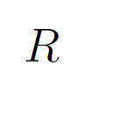
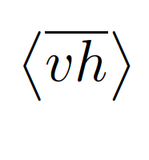

Why is the ITCZ north of the equator?

Slide 19
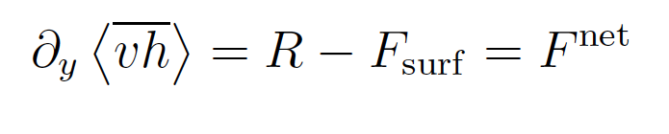
Why is the ITCZ north of the equator?
Relates the circulation to energy sources and sinks, without explicit consideration of latent heating
e.g., Neelin and Held (1987), Held (2001), Merlis, Eisenman, Bordoni and Schneider (2013 a,b,c)

Slide 20
Why is the ITCZ north of the equator?
Moist static energy
Height
S
Eq
N
The Hadley cell diverges energy away from its ascending branch, usually coinciding with maximum net energy input. Energy is transported in the direction of the upper-level flow.

Slide 21
Why is the ITCZ north of the equator?
Moist static energy
Height
S
Eq
N
Weaker energy stratification in moist circulations require a stronger circulation to accomplish same energy transport as dry circulations. Moist circulations are less efficient than dry circulations.

Slide 22
Why is the ITCZ north of the equator?
Net energy deficit
Net energy input
Moist static energy
Height
S
Eq
N
The fact that the ITCZ is north of the equator implies that the NH receives more energy than the SH hemisphere.

Slide 23
Why is the ITCZ north of the equator?
Net energy deficit
Net energy input
Moist static energy
Height
S
Eq
N
The Hadley cell transports energy southward across the equator to re-establish energy balance.

Slide 24
Why is the ITCZ north of the equator?
Net energy deficit
Net energy input
Moist static energy
Height
S
Eq
N
This is primarily due to ocean heat transport from the SH into the NH.

Slide 25
Implied energy transport
Hartmann (2015)

Slide 26
Implied energy transport
Frierson et al. (2013), Marshall et al. (2014)

Slide 27
Energetic constraints on the ITCZ
Net energy deficit
Net energy input
Moist static energy
Height
S
Eq
N
This framework emphasizes the anti-correlation between the ITCZ position and cross-equatorial energy transport.
e.g., Kang et al. 2008, Hwang and Frierson 2012, Donohoe et al. 2013, Bischoff and Schneider 2014

Slide 28
Energetic constraints on the ITCZ
Net energy deficit
Net energy input
Moist static energy
Height
S
Eq
N
Energy Flux Equator

Slide 29
The solstice seasons
Data source: GPCP

Slide 30
The solstice seasons
Data source: GPCP

Slide 31
Monsoons are part of the atmospheric overturning
July zonal mean
Cross-equatorial
Hadley cell

Slide 32
The solstice seasons
Data source: GPCP

Slide 33
Monsoons are part of the atmospheric overturning
July zonal mean
July mean over Indian monsoon sector
Cross-equatorial
Hadley cell
Cross-equatorial monsoon cell

Slide 34
Monsoons are part of the atmospheric overturning
July zonal mean
July mean over Indian monsoon sector
Cross-equatorial
Hadley cell
Cross-equatorial monsoon cell
Monsoon circulations are cross-equatorial Hadley circulations that project strongly on the solstice zonal mean
e.g, Walker, Bordoni & Schneider (2015), Walker & Bordoni (2016)

Slide 35
The global monsoon
Monsoons are dominant circulation features of the tropics and subtropics, characterized by rainy summers and dry winters, and accompanied by a reversal of the prevailing winds.
Data source: GPCP, JRA-55

Slide 36
The global monsoon
EOF analyses of the annual cycle of the precipitation and lower-level winds reveal a dominant, global-scale solstitial mode, driven by the annual cycle of insolation: the Global Monsoon.
e.g., Wang and Ding 2008

Slide 37
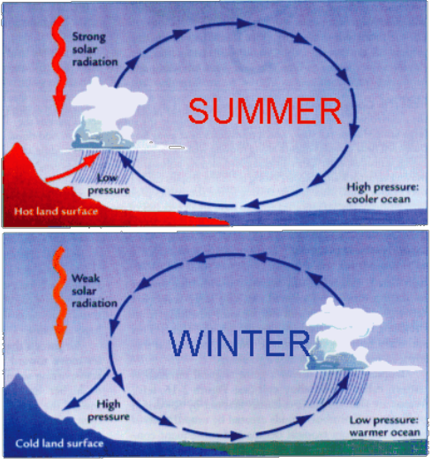
Rethinking monsoons
Ruddiman (2007)

Slide 38
Rethinking monsoons
Monsoons are NOT land-sea breeze circulations driven by near-surface meridional temperature gradients!
Ruddiman (2007)

Slide 39
Role of the near-surface temperature gradient
“It has generally been held that the south-west monsoon owes its origin to the great difference of temperature which exists during the summer months between the heated land surface of India and the surrounding oceans…. This theory has to face the difficulties that the temperature over India is much higher in May, before the
monsoon sets in, than it is during the monsoon itself; that the temperature is higher in years of bad monsoon than in years of good monsoon; and that the part of India which has the highest temperature and the lowest pressure, is a region of practically no rainfall throughout the monsoon.”
Simpson (1921)

Slide 40
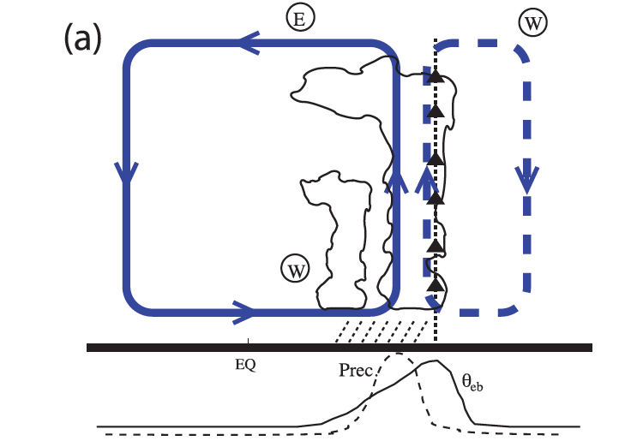
Monsoons as cross-equatorial Hadley circulations
h_{b}
As part of the large-scale tropical overturning, monsoons participate to large-scale transports of energy and angular momentum. In particular, monsoons NEED to transport energy from the summer into the winter hemisphere.

Slide 41
Monsoons as cross-equatorial Hadley circulations
Maxima of T_{u} and h_{b} coincide at poleward edge of cell
h_{b}
Constraints from conservation of angular momentum and modern views of convection establish link between the circulation and the distribution of low-level moist static energy
e.g., Lindzen and Hou (1988), Emanuel et al. (1994), Emanuel (1995), Prive and Plumb (2007), Nie et al. (2010)

Slide 42
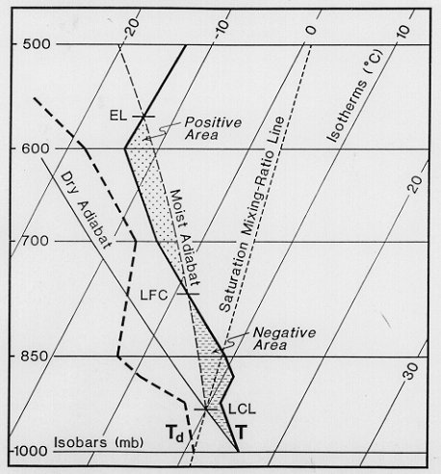
Is convection a heat source for large-scale circulations?
  The concept of conditional instability has been central to the thinking about moist convection and its interaction with large-scale circulations;
  Conditional implies that the instability is finite amplitude in nature:
  The existence of CIN acts as a barrier to convection;
  Only large perturbations can trigger convection;
  But unambiguosly conditionally unstable profiles have only been demonstrated over continental areas.
CAPE
CIN

Slide 43
Is convection a heat source for large-scale circulations?
  In this external view, energy released by convection drives the flow:
    Latent heat released typically exceeds energy required to maintain the KE of large-scale motions against dissipation;
    Latent heating leads to KE production.
  But this energy conversion requires positive correlation between heating and temperature fluctuations:
    No a priori reason for this to be the case;
    In fact, latent heat release is largely balanced by radiative and adiabatic cooling – any residual is a small percentage of large compensating terms.

Slide 44
Is convection a heat source for large-scale circulations?
  In this external view, energy released by convection drives the flow:
    Latent heat released typically exceeds energy required to maintain the KE of large-scale motions against dissipation;
    Latent heating leads to KE production.
  But this energy conversion requires positive correlation between heating and temperature fluctuations:
    No a priori reason for this to be the case;
    In fact, latent heat release is largely balanced by radiative and adiabatic cooling – any residual is a small percentage of large compensating terms.

Slide 45
Convective Quasi-Equilibrium
  Convective scale processes act on timescales that are much smaller than those of large-scale processes;
  Convection consumes CAPE as soon as it is generated by radiation or large-scale flow;
  CAPE can be non-zero, but it’s rate of change is approximately zero. For typical tropical conditions, net surface flux and column radiative cooling generate ~4000 J kg-1day-1, while CAPE values are below 1000 J kg-1day-1.
  The fact that CAPE is largely invariant has important implications for the temperature of convective atmospheres:
  Moist convection does not act as a heat source for large-scale flow, but maintains free troposphere close to a moist adiabat;
  Changes in free tropospheric temperatures are in equilibrium with changes in boundary-layer moist static energy
e.g., Emanuel et al. (1994)

Slide 46
Convective Quasi-Equilibrium
Subcloud MSE
δT_{u} ~ δh_{b}
Free-tropospheric temperature
Courtesy Bill Boos

Slide 47
Observational evidence
Nie et al. (2010)

Slide 48
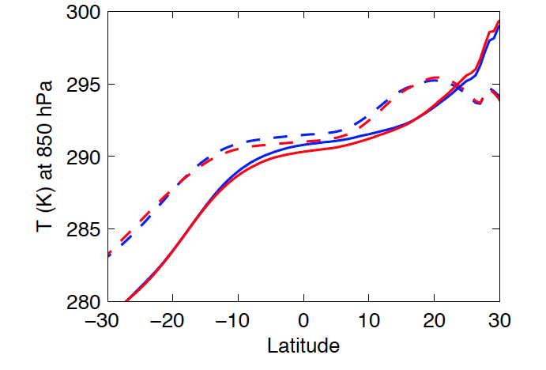
Also on interannual timescales
Walker et al. (2015)

Slide 49
Also on interannual timescales
Strong monsoon years are characterized by a weaker near-surface meridional temperature gradient
Walker et al. (2015)

Slide 50
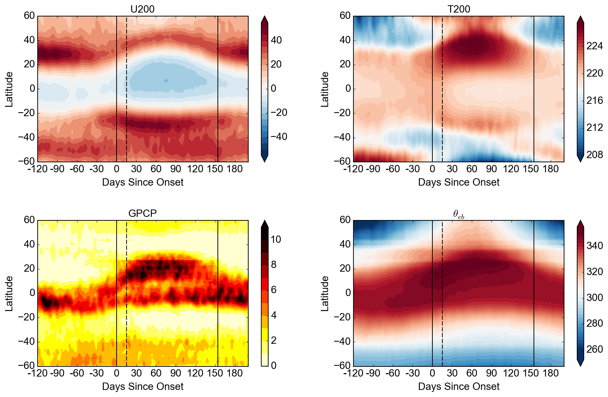
And on intreaseasonal timescales
Walker and Bordoni (2016)

Slide 51
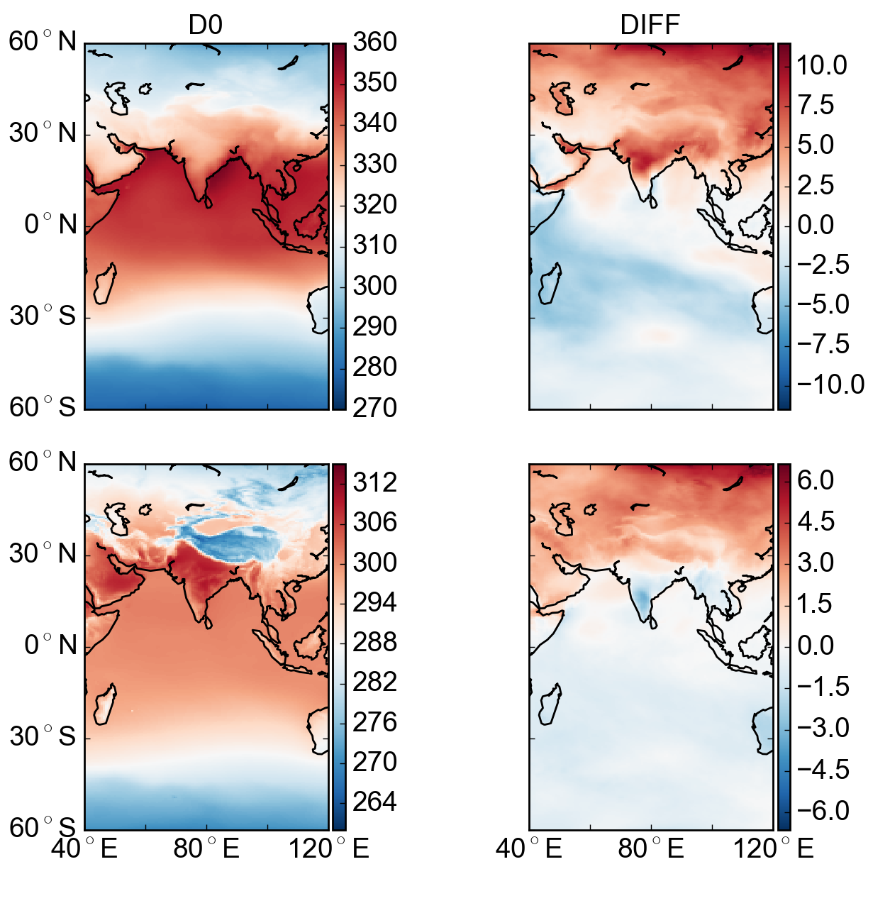
And on intreaseasonal timescales
Day 0
Day 15 – 0 anomaly
θ_{eb}
T_{b}
Walker and Bordoni (2016)

Slide 52
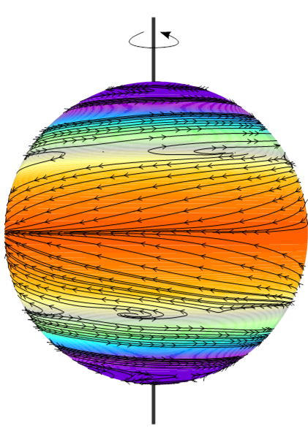
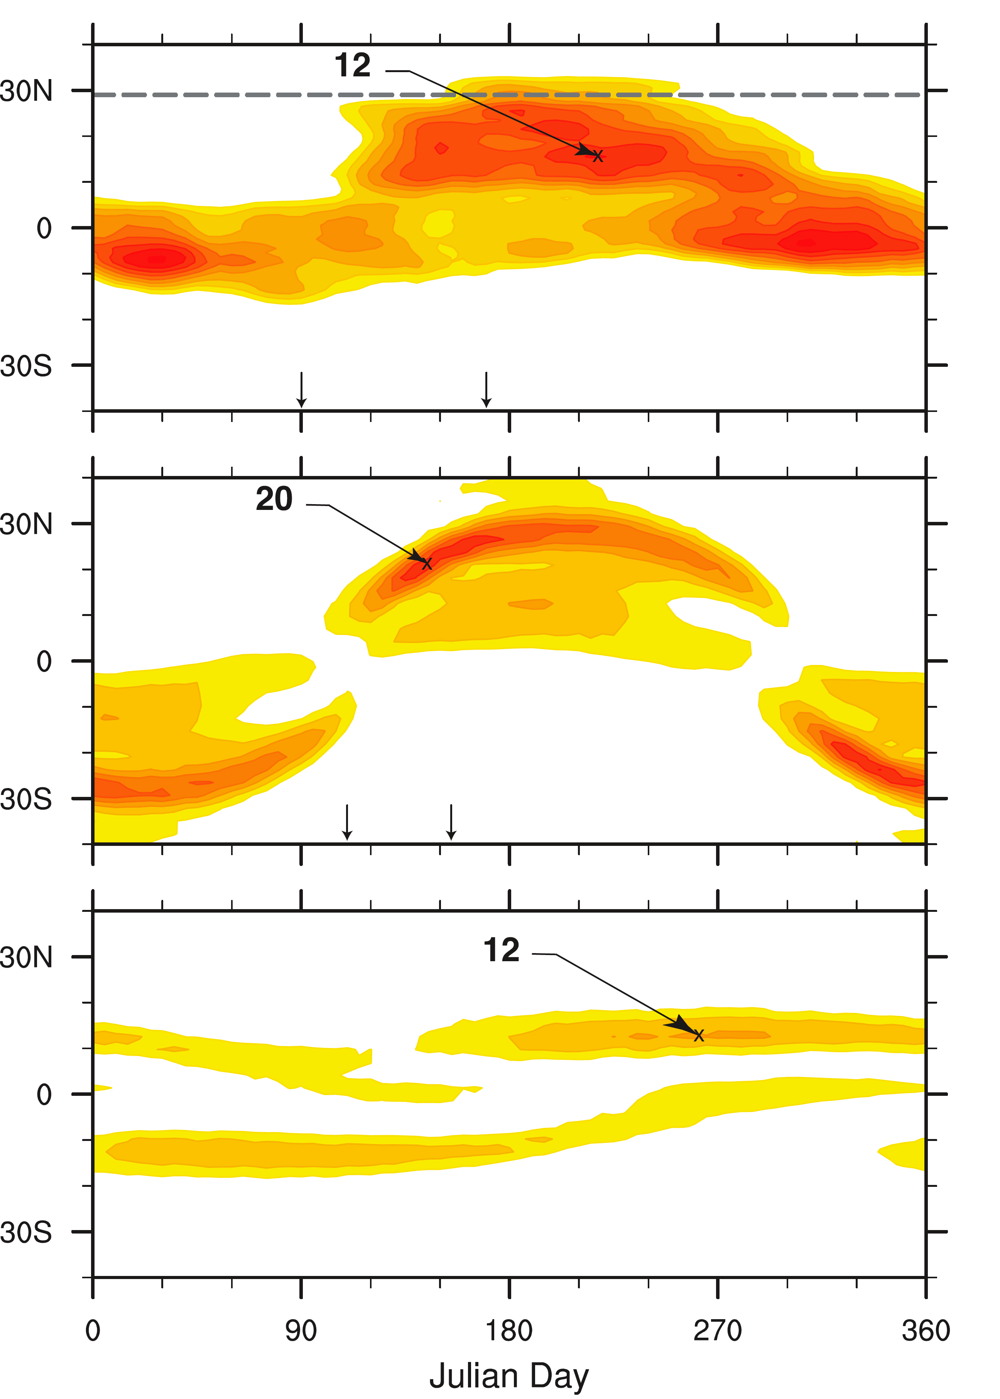
Monsoons can exist over an aquaplanet
Indian monsoon
Shallow mixed layer
(0.5 m)
Deep mixed layer
(50 m)
Bordoni and Schneider (2008)

Slide 53
Aquaplanet monsoons
Aquaplanet
Observations
Adapted from Bordoni and Schneider (2008)

Slide 54
Aquaplanet monsoons
The reversed meridional temperature gradient can develop even without a subtropical landmass (let alone topography!)
Adapted from Bordoni and Schneider (2008)

Slide 55
Aquaplanet monsoons
Aquaplanet
Observations
Monsoons over aquaplanets can only be simulated over shallow oceans. This suggests that land is a driver of monsoons in that it provides a surface with low enough thermal inertia, rather than driving near-surface temperature gradients.
Adapted from Bordoni and Schneider (2008)

Slide 56
Aquaplanet monsoons
In aquaplanet simulations, the convergence zone migrates poleward fastest at a latitude of ~ 7º, suggesting this to be the poleward limit of a near-equatorial ITCZ. Beyond this latitude, there is a rapid transition into a monsoon regime with convergence zone at subtropical latitudes.
Geen et al. (2019)

Slide 57
Monsoons over idealized continents
Hui and Bordoni (2021)

Slide 58
Implications for “real” monsoons
Monsoons cannot be thought of as large-scale sea breeze circulations driven by thermal contrast between the land and the ocean;
Monsoons are intimately connected to the tropical overturning; as regional Hadley cells, they need to satisfy large-scale constraints implicated by the energy and angular momentum budgets;
Monsoons and oceanic ITCZs are manifestation of the ascending branches of regional Hadley cells. The presence of land over monsoon regions allows for more pronounced responses to the insolation forcing, which leads to more non-linear cross-equatorial monsoonal circulations;
Importantly, the ITCZ and the monsoon regimes differ in their dominant angular momentum budget.

Slide 59





The angumal momentum budget
The large-scale circulation needs to satisfy the angular momentum budget, which in steady state in the upper branch of the circulation is
with local Rossby number
When the angular momentum budget reduces to and the circulation strength is directly constrained by the large-scale eddies.
When the angular momentum budget reduces to a trivial balance, with no constraint on the circulation strength, which responds directly to the energy balance and which conserves angular momentum.

Slide 60
Transition in dynamical regimes
Near-equatorial regime
Monsoon regime
Angular momentum
Streamfunction
Adapted from Bordoni and Schneider (2008)

Slide 61
Monsoons vs ITCZ
Small Rossby number
Linear regime
Circulation responds directly to changes in large-scale eddies
Large Rossby number
Non-linear regime
Circulation responds directly to the energetics
Circulations approaches AM conservation
Geen et al. (2020)

Slide 62
Monsoons vs ITCZ
Geen et al. (2020)

Slide 63
Implications for “real” monsoons
Monsoons cannot be thought as large-scale sea breeze circulations driven by thermal contrast between the land and the ocean;
Monsoons are intimately connected to the tropical overturning; as regional Hadley cells, they need to satisfy large-scale constraints implicated by the energy and angular momentum budgets;
Monsoons and oceanic ITCZs are manifestation of the ascending branches of regional Hadley cells. The presence of land over monsoon regions allows for more pronounced responses to the insolation forcing, which leads to more non-linear cross-equatorial monsoonal circulations;
Importantly, the ITCZ and the monsoon regimes differ in their dominant angular momentum budget;
Consequences of these emerging theoretical views on observed monsoons and how they respond to perturbations on different timescales are currently being investigated.

Slide 64
But there is some observational evidence
The overturning circulation in the South Asian and South African monsoon approaches conservation of angular momentum. Stronger deviations in other monsoon regions, especially Australia and the Americas.
Geen et al. (2020)

Slide 65
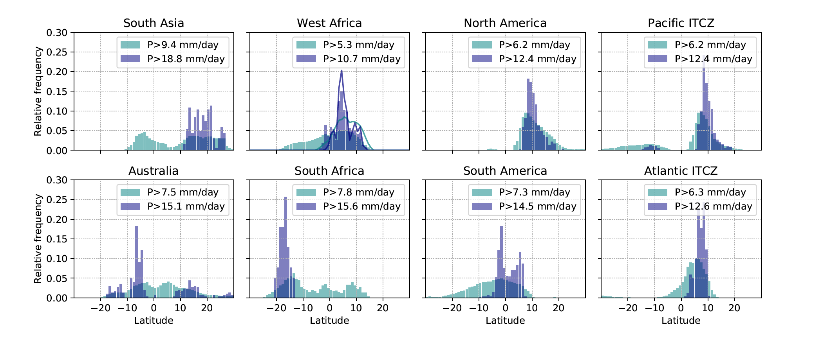
But there is some observational evidence
The presence of multiple precipitation peaks suggest changes in the precipitation (and circulation) regime over the year in South Asia, Australia, Southern Africa and West African.
Geen et al. (2020)

Slide 66
Summary
Theory suggests monsoons and ITCZs can be interpreted as different regimes of the tropical overturning circulation and associated convergence zone, with the monsoon regime being characterized by an angular momentum conserving circulation extending into the subtropics and coupled to the lower-level moist static energy distribution, and the ITCZ regime being characterized by an eddy-driven cell with ascending branch remaining close to the equator.
The differing leading order momentum budget suggests different responses of these two regimes to different forcings;
Observed regional systems can be differentiated and characterized in terms of these two theoretical regimes (at least to some extent);
Implications for their behavior on different timescales are only now beginning to be explored, but this seems to be a very promising avenue of future investigations.

Slide 67
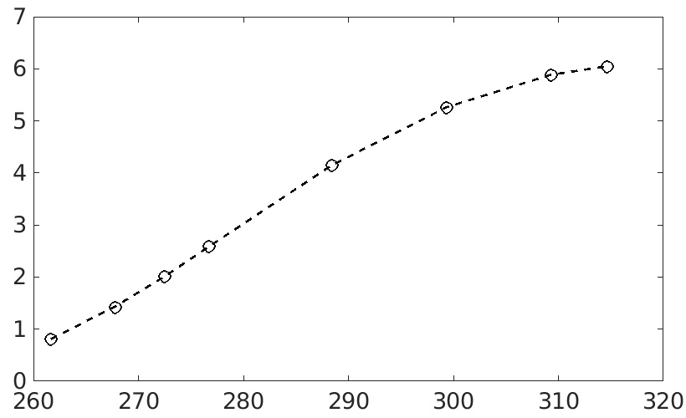
Climate change experiments
Climate (α) | Global Mean T_{s} (K) | Global Mean Precip. (mm d⁻¹)
0.2 | 261.7 | 0.81
0.3 | 267.8 | 1.43
0.4 | 272.7 | 2.01
0.5 | 276.9 | 2.59
1.0 | 288.6 | 4.15
2.0 | 299.7 | 5.26
4.0 | 309.6 | 5.88
6.0 | 314.9 | 6.05
Global Mean Precipitation (mm d⁻¹)
Global Mean Surface Temperature (K)
Bordoni and Hui, in prep

Slide 68
Simulated climates
Climate (α) | Global Mean T_{s} (K) | Global Mean Precip. (mm d⁻¹)
0.2 | 261.7 | 0.81
0.3 | 267.8 | 1.43
0.4 | 272.7 | 2.01
0.5 | 276.9 | 2.59
1.0 | 288.6 | 4.15
2.0 | 299.7 | 5.26
4.0 | 309.6 | 5.88
6.0 | 314.9 | 6.05
Global Mean Precipitation (mm d⁻¹)
Global Mean Surface Temperature (K)
Bordoni and Hui, in prep

Slide 69
Simulated monsoons
ITCZ
+ Onset
𝚘 retreat
+
𝚘
+
𝚘
+
𝚘
+
𝚘
mm/day
+
𝚘
+
𝚘
+
𝚘
+
𝚘
e.g., Bordoni and Schneider (2008), Merlis et al. (2013), Geen et al. (2020)

Slide 70
Monsoonal precipitation changes with warming
With warming, monsoonal precipitation:
Increases in intensity;
Moves further poleward;
Gets progressively delayed.

Slide 71
Monsoonal precipitation changes with warming
With warming, monsoonal precipitation:
Increases in intensity;
Moves further poleward;
Gets progressively delayed.
Monsoon onset and retread based on method of Walker and Bordoni (2016).

Slide 72
Monsoon onset delay in CMIP models
CMIP5 RCP8.5 multi-model mean change (2080-99) minus (1980-99) for the amplitude change and phase delay of the annual cycle precipitation
Dwyer et al. (2014)
Spread remains large in the amplitude of precipitation and circulation changes to warming within CMIP models, but one robust response is a delay in monsoon onset timing in almost all monsoon regions.
Is land-sea contrast behind this delay?
Yes (Seth et al. 2013, 2014), No (Song et al. 2018, Byrne and Zanna 2020)

Slide 73
The energetic framework
Monsoonal circulations export moist static energy away from their ascending branches in regions of maximum net energy input
ITCZ
e.g., Neelin and Held (1987), Held (2001), Merlis, Eisenman, Bordoni and Schneider (2013 a,b,c)

Slide 74
The energetic framework
Monsoonal circulations export moist static energy away from their ascending branches in regions of maximum net energy input.
But this neglects any contribution from atmospheric energy storage
ITCZ
e.g., Neelin and Held (1987), Held (2001), Merlis, Eisenman, Bordoni and Schneider (2013 a,b,c)

Slide 75
Is storage becoming increasingly important with warming?
Energy budget terms averaged between 10N and 30N (NH tropics)
Net energy input
Atmos energy divergence
Atmos energy storage

Slide 76
Implied energy transport

Slide 77
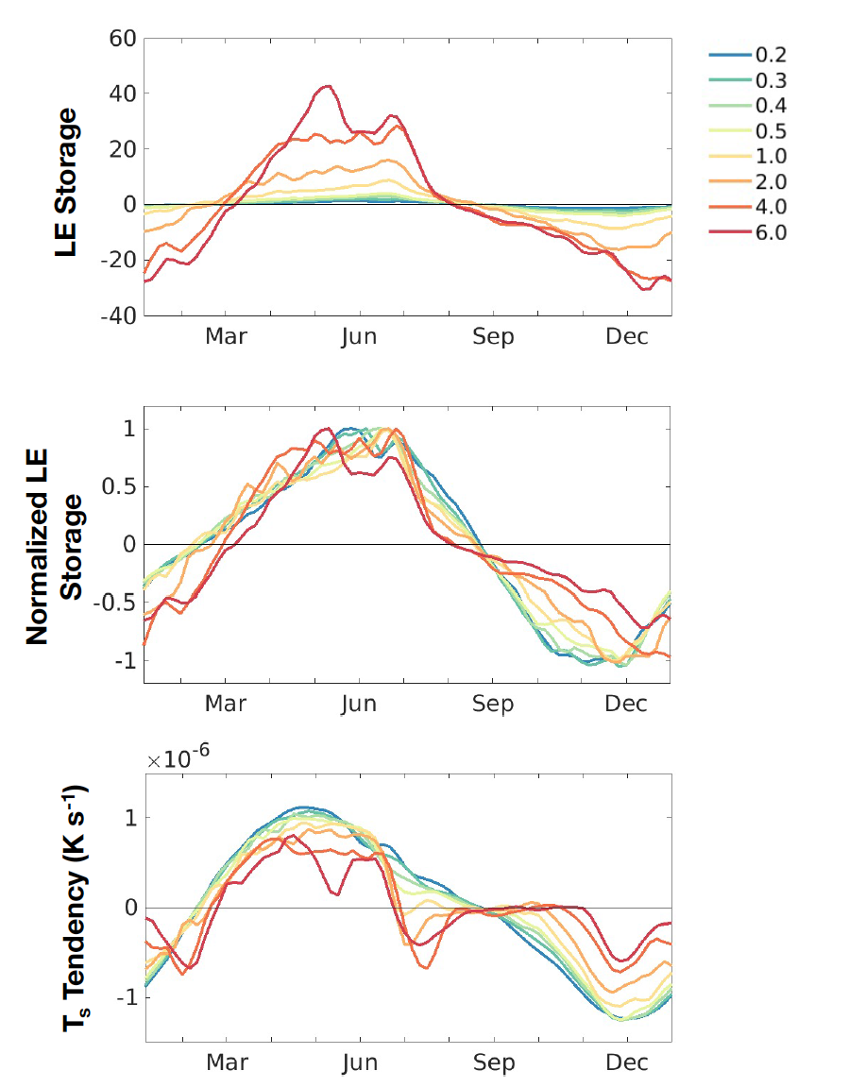
What causes these changes in the storage term?
Latent energy storage term and T_{sfc} averaged between 10N and 30N (NH tropics)

Slide 78
But why does the onset delay stop increasing in the warmest climates?

Slide 79
But why does the onset delay stop increasing in the warmest climates?
Given that precipitation evolves together with the lower-level mse (and hence temperature), we are going to use the simple two-variable energy balance model of atmosphere-surface interaction in RCE of Cronin and Emanuel (2013)
The mode of variability with same-signed and nearly equal perturbations in TA and TS has an adjustment timescale
Barsugli and Battisti (1998), Cronin and Emanuel (2013)

Slide 80
But why does the onset delay stop increasing in the warmest climates?
With a seasonally varying insolation forcing with period ω_{orb,} we can define a parameter α that measures the ratio of the seasonal timescale to the thermal inertial timescale
which controls the time lag between the seasonally varying forcing and the lower-level temperature response:
Mitchell and Vallis (2014), Hill et al. (2022)

Slide 81
But why does the onset delay stop increasing in the warmest climates?

Slide 82
Summary I
Idealized aquaplanet simulations show a robust delay in monsoon onset with warming consistent with projections based on CMIP models;
This delay is due to an increase in the energy stored in an atmospheric column through an increase in its latent energy component, which compensates for any change in net energy input, requiring little change in the circulation;
A simple EBM well captures this behavior, and highlights the role that the increased effective heat capacity of the atmospheric column plays in the response of lower-level temperature (and precipitation) to the imposed insolation forcing;
Importantly, this mechanism acts irrespective of land-sea contrast.

Slide 83
Summary II
Studying monsoons over aquaplanet is fun! And reveals fundamental constraints dictated by large-scale budgets.
These constraints provide insight into the response of aquaplanet monsoons with warming that might also be relevant to observed monsoons.
More work is needed to fill the gap between the idealized and more complex simulations and the real world.

Slide 84
What drives rapid monsoon transitions in aquaplanet simulations
  So far we have only talked about thermodynamics and energetics, but to understand the rapidity of monsoon transitions in aquaplanet simulations, we have to think about dynamics too.
  Let’s look at the zonal momentum budget (which one can show is equivalent to the angular momentum budget).

Slide 85
The zonal momentum budget
  Making the following assumptions:
  Each variable can be decomposed in a mean an eddy term
  Assuming continuity in both the mean and eddy velocities
  the zonal and time mean zonal momentum budget becomes

Slide 86
The zonal momentum budget
  Introducing the vertical component of the relative vorticity
  the zonal momentum budget can be rewritten as
  Notice how convergence (divergence) of eddy momentum flux results in a westerly (easterly) tendency of the mean zonal momentum.

Slide 87
Zonal momentum and large-scale eddies
  Large-scale extratropical eddies converge zonal momentum in regions in which they are generated (extratropics) and they divergence momentum from regions in which they break (subtropics). They propagate in regions of upper-level westerly flow and they tend to break as they approach their critical latitude.
Courtesy of Marty Singh

Slide 88
Zonal momentum and large-scale eddies
Convergence (divergence) of eddy momentum flux

Slide 89
The zonal momentum budget in steady state
  In steady state and neglecting the vertical advection and vertical eddy momentum flux terms, the zonal momentum budget becomes
  with eddy momentum flux divergence
  We can define a local Rossby number as
  and the momentum budget becomes

Slide 90
The zonal momentum budget in steady state
  Let’s look at the two opposing limits of small and large local Rossy number.
  Small Rossby number (extratropical regime)
  In this regime, the overturning cell is entirely driven by the eddies, as its strength is directly linked to the eddy momentum flux convergence. Any change in eddies will have to be met by a change in the strength of the meridional circulation.

Slide 91
The zonal momentum budget in steady state
  This is the relevant regime for the Ferrel cell. The Ferrel cell can be indirect because it is driven by dynamical constraints.
Hadley cell
Ferrel cell

Slide 92


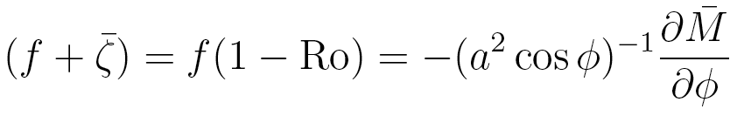
The zonal momentum budget in steady state
  2. Large Rossby number (tropical regime)
  Remembering that
  this limit is the limit of a cell that conserves angular momentum. AM is is homogenized by the overturning circulation in its upper branch. Streamlines and AM contours coincide.

Slide 93
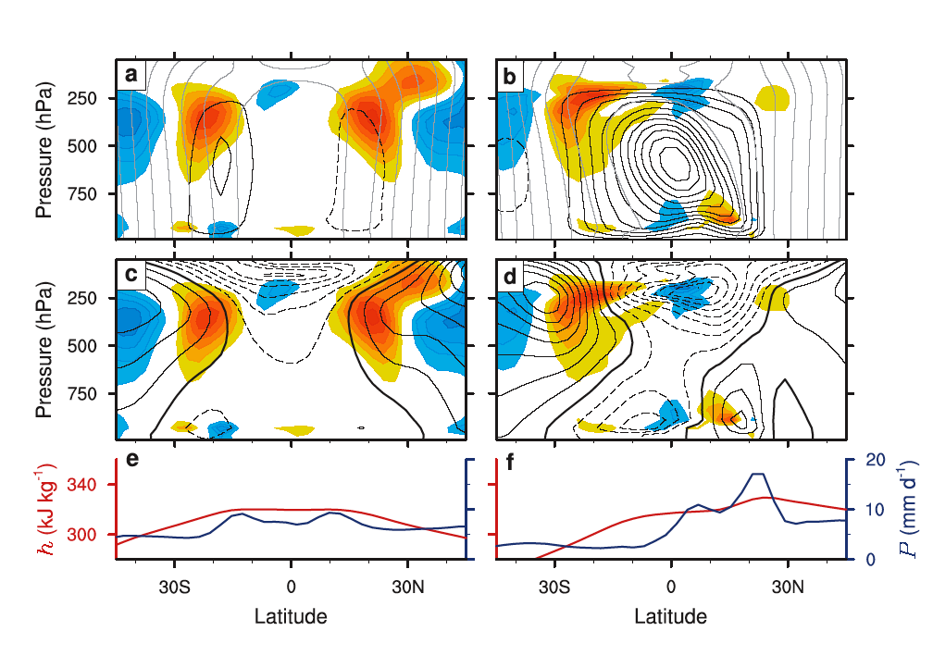
Monsoons can exist over an aquaplanet
Before onset
After onset
Bordoni and Schneider (2008)

