Slide 1


Convective Parameterization: Trigger and Closure
Partha Mukhopadhyay
(Collaborator: Siddharth Kumar, R. Phani, Malay Ganai, Snehlata Tirkey, Bidyut Goswami, Kumar Roy, Boualem Khouider, Sourav Taraphdar, Himabindu and colleagues and students in my lab)
Indian Institute of Tropical Meteorology, Pune
(email:mpartha@tropmet.res.in)
ICTP SMR 3952

Slide 2
Outline of the talk
Introduction
Basics of NWP
Convective Closures
Convection in current Climate Models
Deterministic vs Stochastic

Slide 3
Numerical modeling of the atmosphere: In retrospect
ENIAC (Electronic Numerical Integrator and Computer, 1945)

Slide 4
initial state: Jan. 5, 1949, 0300GMT observed(t=24hours)
forecasted(t=24hours)

Slide 5
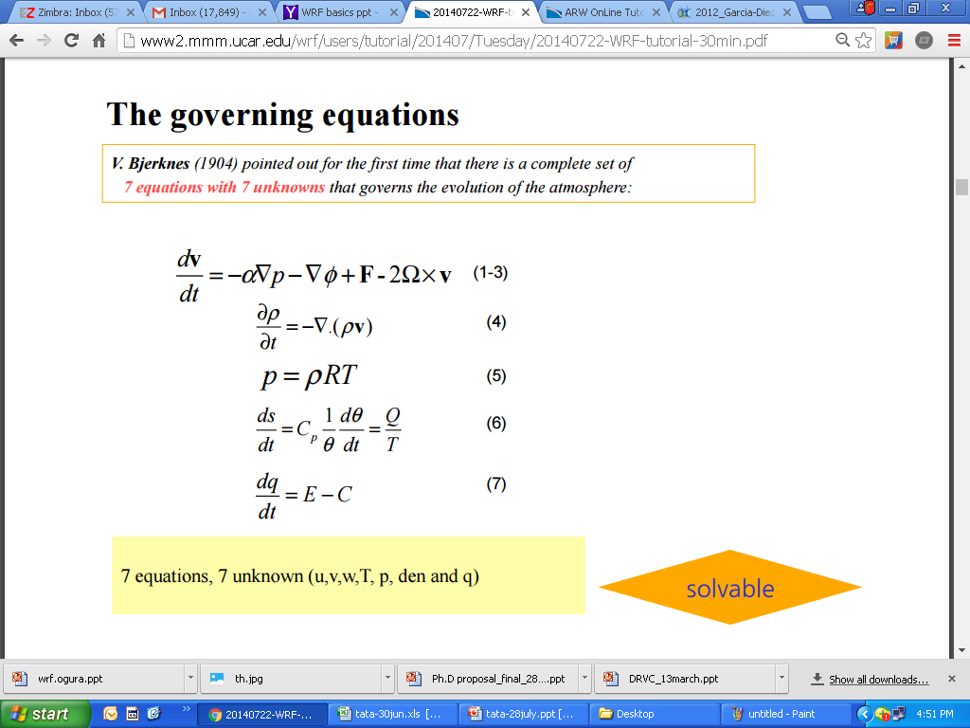
Numerical Model : Introduction
Numerical modeling is simply taking the equations that govern a system and using them to simulate the changes in a system using math.
Momentum
Mass
Ideal gas
Energy
Moisture

Slide 6
Why do we need physical parameterization?
ICs
Dynamics Physics
Models
Forecast
BCs
Dynamic core of models
Model physics:
Processes such as phase change of the water are in too small scale and too complex.
Processes such as cloud microphysics are poorly understood.

Slide 7
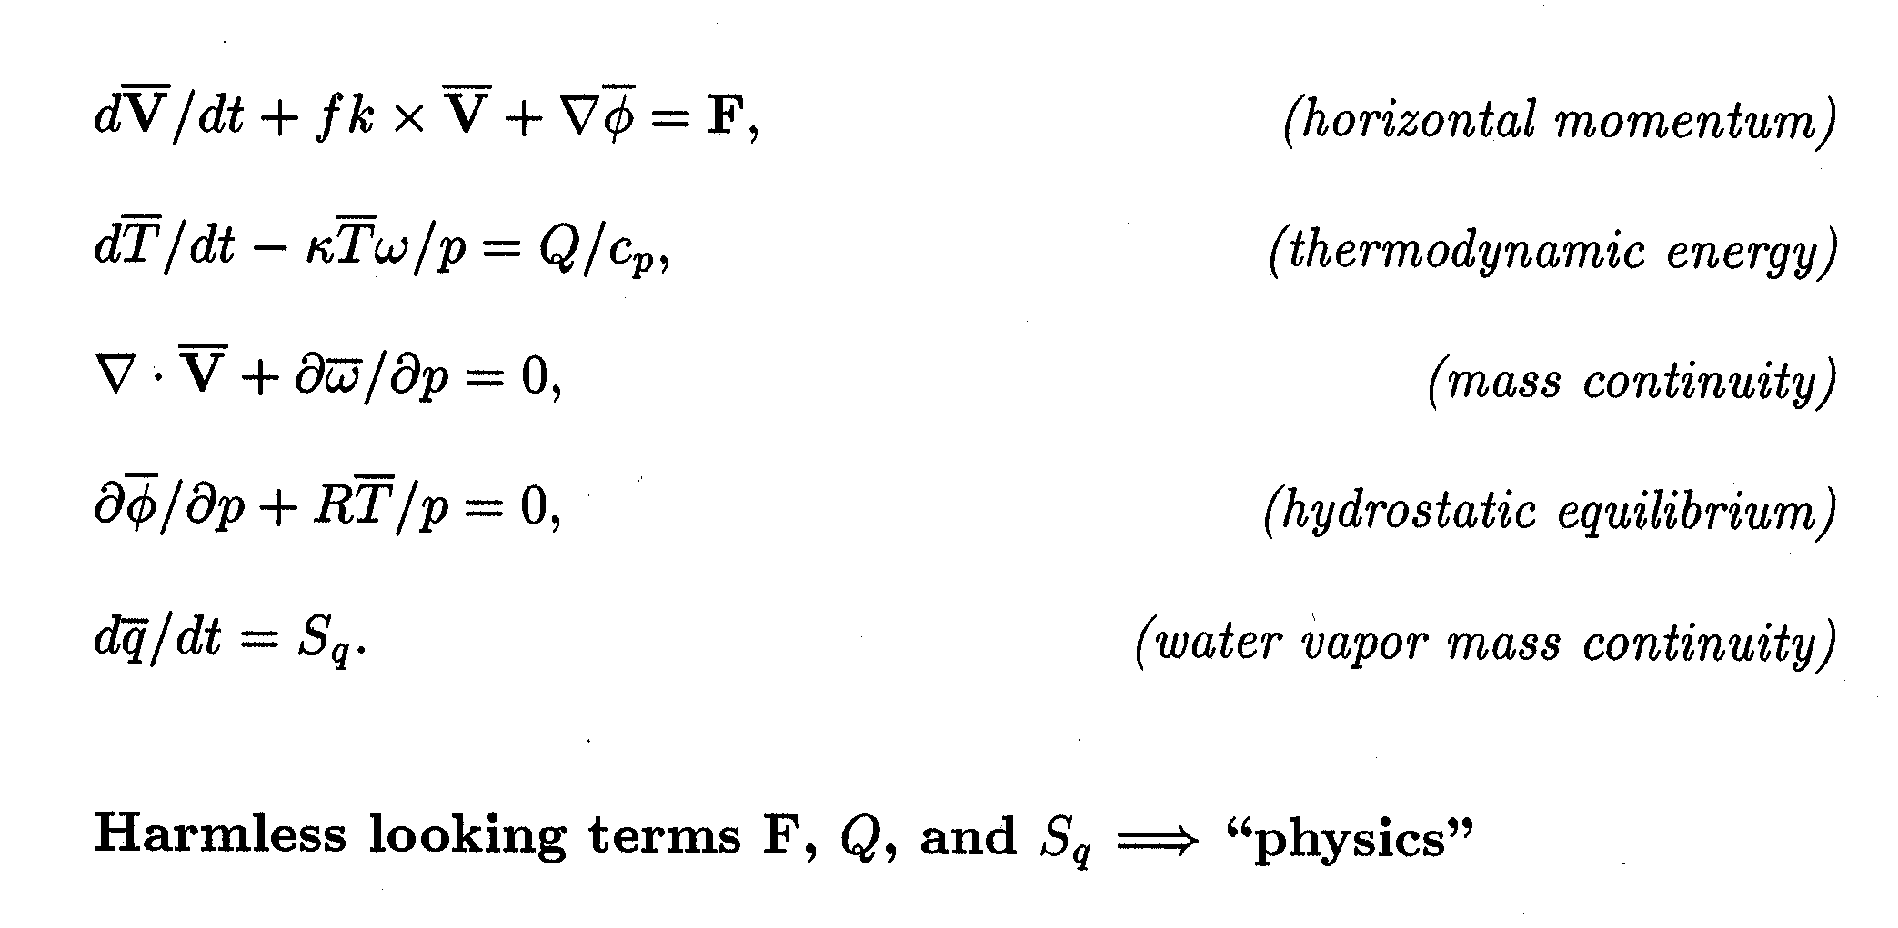
Meteorological Primitive Equations

Slide 8
Global Climate Model Physics
Terms F, Q, and S_{q} represent physical processes
Equations of motion, F
  turbulent transport, generation, and dissipation of momentum
Thermodynamic energy equation, Q
  convective-scale transport of heat
  convective-scale sources/sinks of heat (phase change)
  radiative sources/sinks of heat
Water vapor mass continuity equation
  convective-scale transport of water substance
  convective-scale water sources/sinks (phase change)

Slide 9
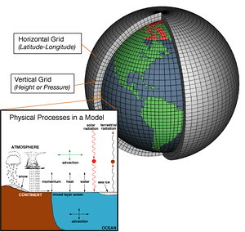
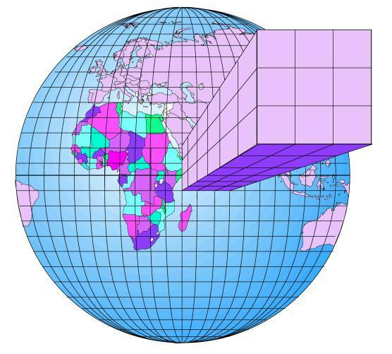
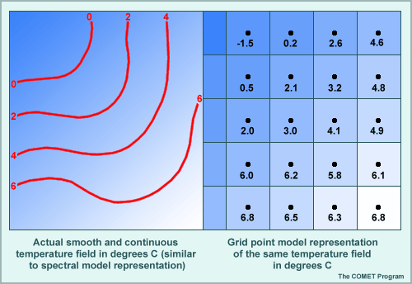

Slide 10


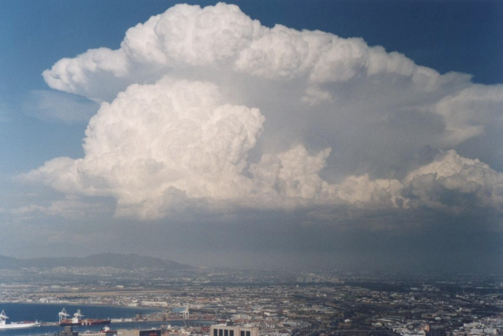
Can a single model encompass all relevant processes?
mm
10 m
100 m
1 km
10 km
100 km
1000 km
10000 km
Cloud microphysics
Cumulus
clouds
Cumulonimbus
clouds
Mesoscale
Convective systems
Extratropical
Cyclones
⬅
Planetary
waves
turbulence
DNS
Subgrid
Large Eddy Simulation (LES) Model
Cloud System Resolving Model (CSRM)
Numerical Weather Prediction (NWP) Model
Global Climate Model
10
Notes:
10

Slide 11
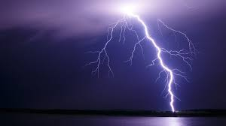
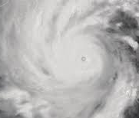
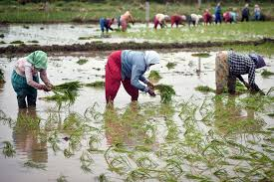
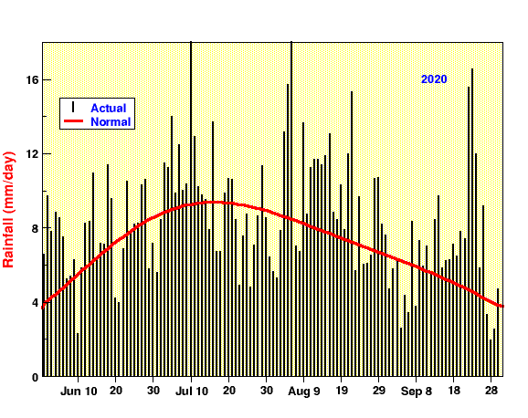
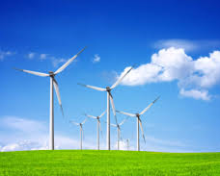
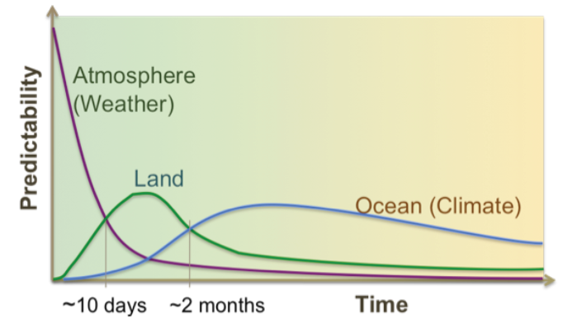
Models for earth system relevant processes
Short range
Medium range
Extended range
Seasonal range
Decade
& Climate
1 km, 48 h
TS
12 km, 240 h
100, 38 km. 4 wk
38 km, 10 mons
200 km, multi yr
Cumulus
clouds
Renewable
⬅
TCs, MDs
LES Model, DNS
Cloud System Resolving Model (CSRM)
WRF
GFS/GEFS GFS/CFS CFS
T1534. 21EM T126/T382 T382
Subgrid
Numerical Weather Prediction (NWP) Model
Global Climate Model
11
Dirmeyer et al. 2015
Notes:
11

Slide 12
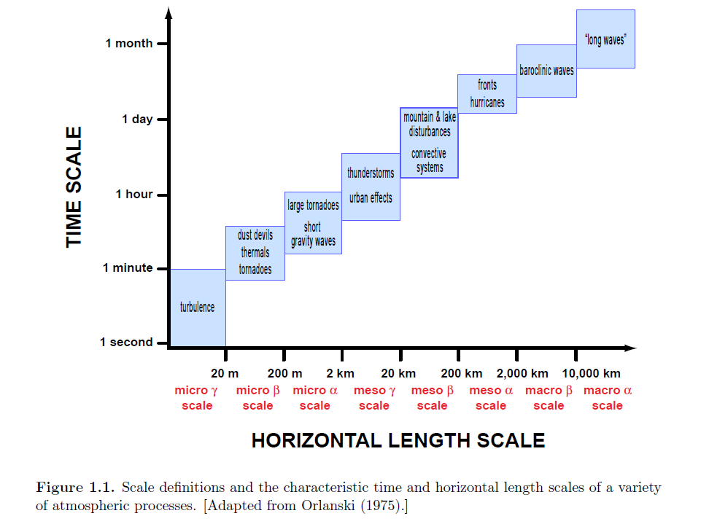
Scales of Motions
Atmospheric motions have different scales.
Climate model resolutions: Regional: 50 km Global: 100~200 km
Sub-grid scale processes: Atmospheric processes with scales can not be explicitly resolved by models.
Physical parameterization: To represent the effect of sub-grid processes by using resolvable scale fields.
Characteristic scales of atmospheric processes

Slide 13
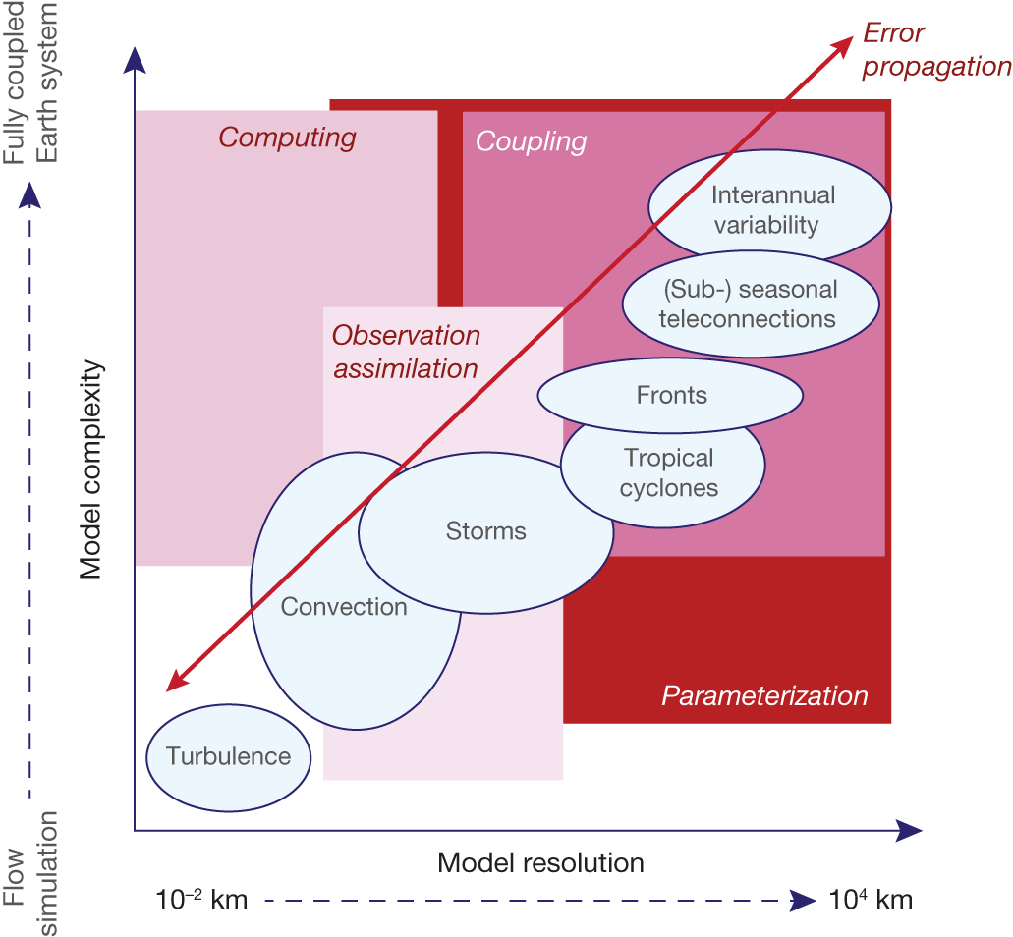

Key challenge areas for NWP in the future.
Advances in forecast skill will come from scientific and technological innovation in computing
The representation of physical processes in parameterizations,
Coupling of Earth-system components,
The use of observations with advanced data assimilation algorithms, and the consistent description of uncertainties through ensemble methods and how they interact across scales.
The ellipses show key phenomena relevant for NWP as a function of scales between 10⁻² and 10⁴ km resolved in numerical models and the modelled complexity of processes characterizing the small-scale flow up to the fully coupled Earth system.
The boxes represent scale-complexity regions where the most significant challenges for future predictive skill improvement exist.
The arrow highlights the importance of error propagation across resolution range and Earth-system components.
The quiet revolution of numerical weather prediction
P Bauer et al. Nature 525, 47-55 (2015) doi:10.1038/nature14956

Slide 14
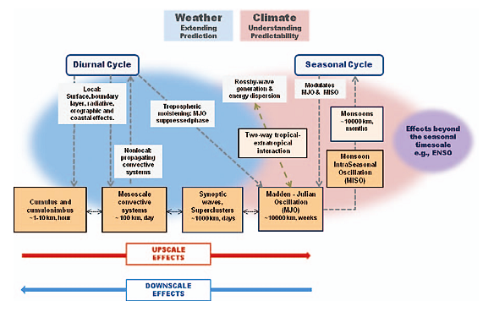
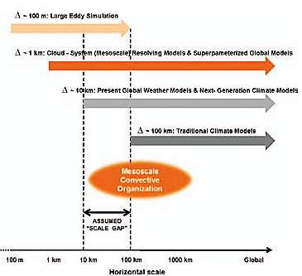
Moncrieff et al, 2012, BAMS
Scientific Basis of the study
The organized systems exhibit hierarchical coherence: (i) mesoscale systems consist of families of cumulonimbus; (ii) cumulonimbus and MCS are embedded in synoptic waves; and (iii) the MJO/MISO
is an envelope of cumulonimbus, MCS, and superclusters.
The upscale effects of convective organization are not represented in traditional climate models.
The mean atmospheric state exerts a strong downscale control on convective
structure, frequency, and variability. Mesoscale convective organization bridges the scale gap assumed in traditional convective parameterization.
SCM/CRM resolves cumulus, cumulonimbus, mesoscale circulations, but the computational domain is small (~100 km) and simulations short (~1 day).
Two-dimensional CSRMs in superparameterized global models permit MCS-type organization and mesoscale dynamics.
High-resolution global numerical prediction models may crudely represent
large MCS (superclusters). (iv) MCS, and other mesoscale dynamical systems,
are absent from traditional climate models—organized convection is not parameterized.

Slide 15
Issues identified as Grand challenge by WCRP: on Cloud and convection processes are as follows
WCRP Grand Challenge on Clouds, Circulation and Climate Sensitivity
White Paper on WCRP Grand Challenge #4 Sandrine Bony and Bjorn Stevens, Nov, 2012
Limited understanding of clouds is the major source of uncertainty in climate sensitivity, but it also contributes substantially to persistent biases in modelled circulation systems.
As one of the main modulators of heating in the atmosphere, clouds control many other aspects of the climate system
Initiative on coupling clouds to circulation (Dr. Siebesma and Frierson)
Tackle the parameterization problem through a better understanding of the interaction between cloud / convective processes and circulation system
Lessons from observations and cloud-resolving modelling over large domains; Interaction between diabatic heating and large-scale dynamics.

Slide 16
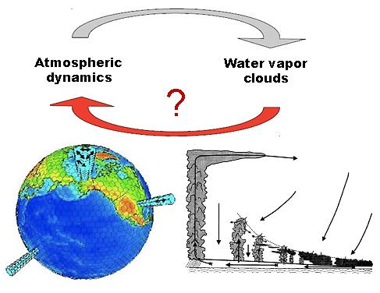
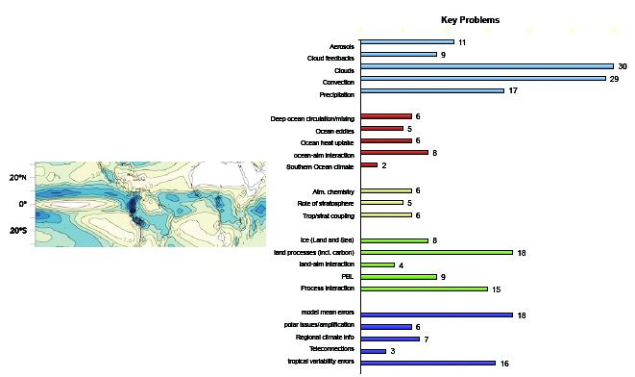
Source: https://www.wcrp-climate.org/gc-clouds-circulation-activities/gc4-clouds-initiatives/114-gc-clouds-inititative2
Initiative - towards more reliable models
Led by Dr. Christian Jakob (Monash Univ., Australia) & Masahiro Watanabe (Tokyo Univ., Japan)
Aim: Interpret and reduce model errors to gain confidence in projections and predictions.
Focus: Long-standing model biases (at least a few of them); Understand how model errors or shortcomings impact projections and predictions; Gain physical understanding of the climate system through model development.

Slide 17
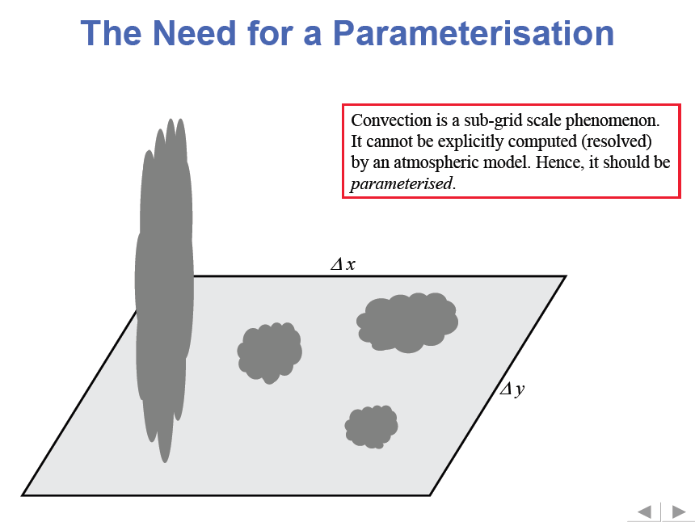
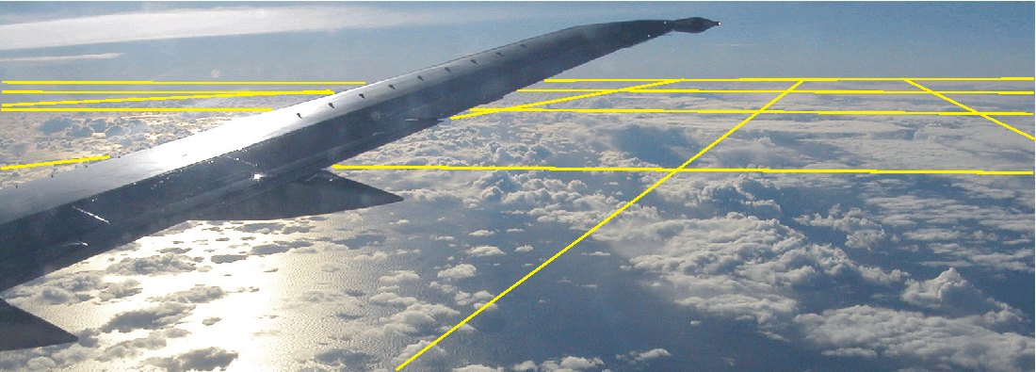

Slide 18
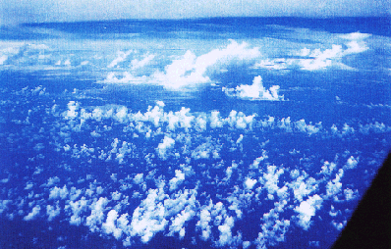
Clouds in GCMs - What are the problems ?
Many of the observed clouds and especially the processes within them are of subgrid-scale size (both horizontally and vertically)
GCM Grid cell 10-100km

Slide 19
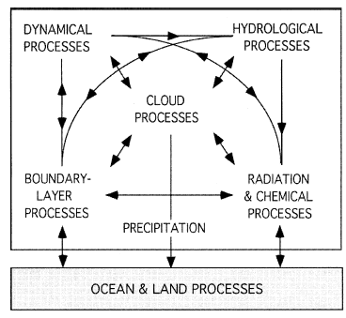
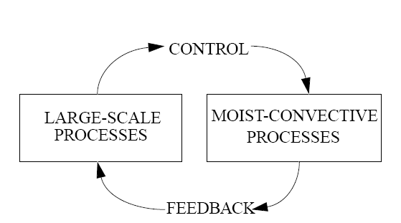
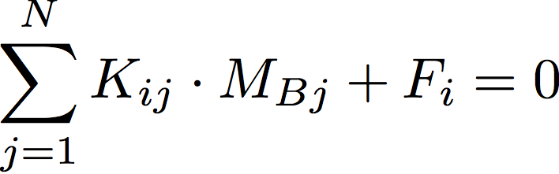
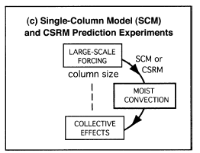
Issues of cumulus Parameterization
The Cumulus Parameterization Problem: Past, Present, and Future
By Akio Arakawa, JOC, 2004, Arakawa et al. 2011, Arakawa and Wu 2013, Wu and Arakawa 2014
“Major practical and conceptual problems in the conventional approach of cumulus parameterization, includes inappropriate separations of processes and scales”.
K_{ij} = effect of cloud j on cloud i,
F_{i} = environmental forcing for
cloud i
M_{Bj} = mass flux at base of cloud j
Task of Conv. Param
To calculate the collective effects of an ensemble of convective clouds in a model column

Slide 20
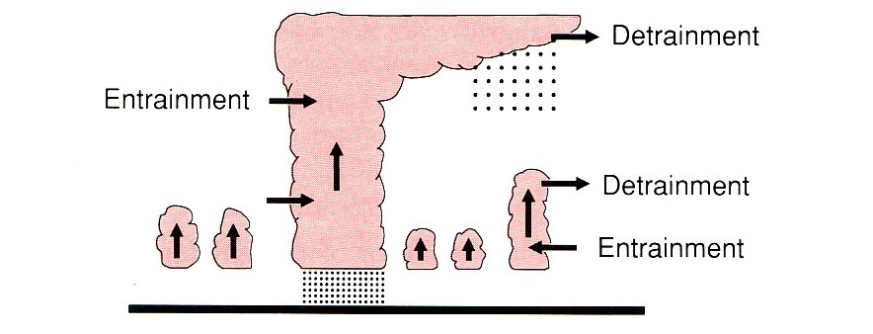
4 Arakawa – Schubert scheme
Complex scheme from Arakawa and Schubert 1974.
Basic idea: (Convective Quasi-equilibrium)
Assume convection can be represented as an ensemble of entraining plumes with different height and entrainment rates. Convection keeps the atmosphere nearly neutral.
Cloud work function : measure of moist convective instability of each type of cloud.
Quasi-equilibrium assumption:
Convective tendencies are very fast.
So large scale tendencies approximately
balances the convective tendencies.
Limitations:
Complexity, take longer time
Requires detailed cloud ensemble model
  Schematic of an ensemble of cumulus clouds.
  (from Trenberth, 1992)

Slide 21
Arakawa, Met. Mono. No.46, 1993

Slide 23
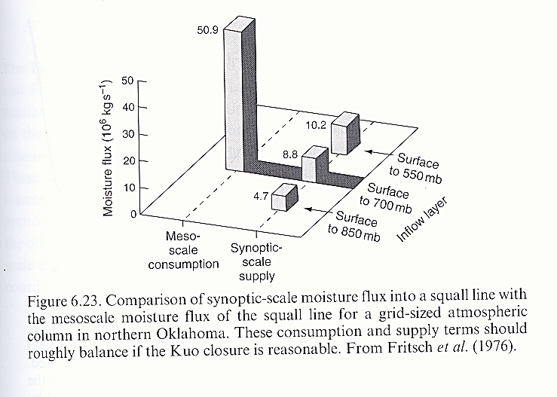

Slide 24
Models | Convective precipitation | Large-scale precipitation | Convective Trigger | Convective Closure
Cloud Model Type: Spectral Cloud Ensemble
GFDL-CM3 | Relaxed Arakawa–Schubert scheme of Moorthiand Suarez [1992] with few modifications in physics from Donner et al. [2011] | Cloud microphysics of Rotstayn [2000] and macrophysics from Tiedtke [1993], stratiform clouds from Golaz et al. [2011] | Cloud work function (CWF) similar to dilute cape (DCAPE) | CAPE closure towards a threshold over a relaxation time scale
GFDL-ESM2G | Relaxed Arakawa–Schubert scheme of Moorthiand Suarez [1992] and Dunne et al. [2012 and 2013] | Same as GFDL-CM3 | Cloud work function (CWF) similar to DCAPE | CAPE closure towards a threshold over a relaxation time scale
GFDL-ESM2M | Same as GFDL-ESM2G | Same as GFDL-CM3 | Cloud work function (CWF) similar to DCAPE | CAPE closure towards a threshold over a relaxation time scale
MIROC5 | Entraining plume model scheme of Chikira et al. [2010] similar to Gregory [2001] with some modification according Pan and Randall [1998] | Prognostic large-scale cloud scheme of Watanabe et al. [2009] and bulk microphysical scheme from Wilson and Ballard [1999] | CAPE | Prognostic convective kinetic energy closure similar to CAPE closure
MIROC4h | Prognostic closure Arakawa Schubert scheme from Pan and Randall [1998] and addition of relativehumidity-based suppression condition by Emori et al. [2001] | Prognostic cloud water scheme of Treutand Li [1991] | Relative humidity | Prognostic convective kinetic energy closure similar to CAPE closure
MIROC-ESM | Same as MIROC4h | Large-scale condensation is diagnosed based on Treut& Li (1991) and simple cloud microphysics scheme | Relative humidity | Prognostic convective kinetic energy closure similar to CAPE closure
MIROC-ESM-CHEM | Same as MIROC4h | Same as MIROC-ESM | Relative humidity | Prognostic convective kinetic energy closure similar to CAPE closure
Table 2 Description of Convective and Large-scale parameterization, Convective triggers and Convective closures.
From: Pathak et al. 2019 Precipitation Biases in CMIP5 Models over the South Asian Region

Slide 25
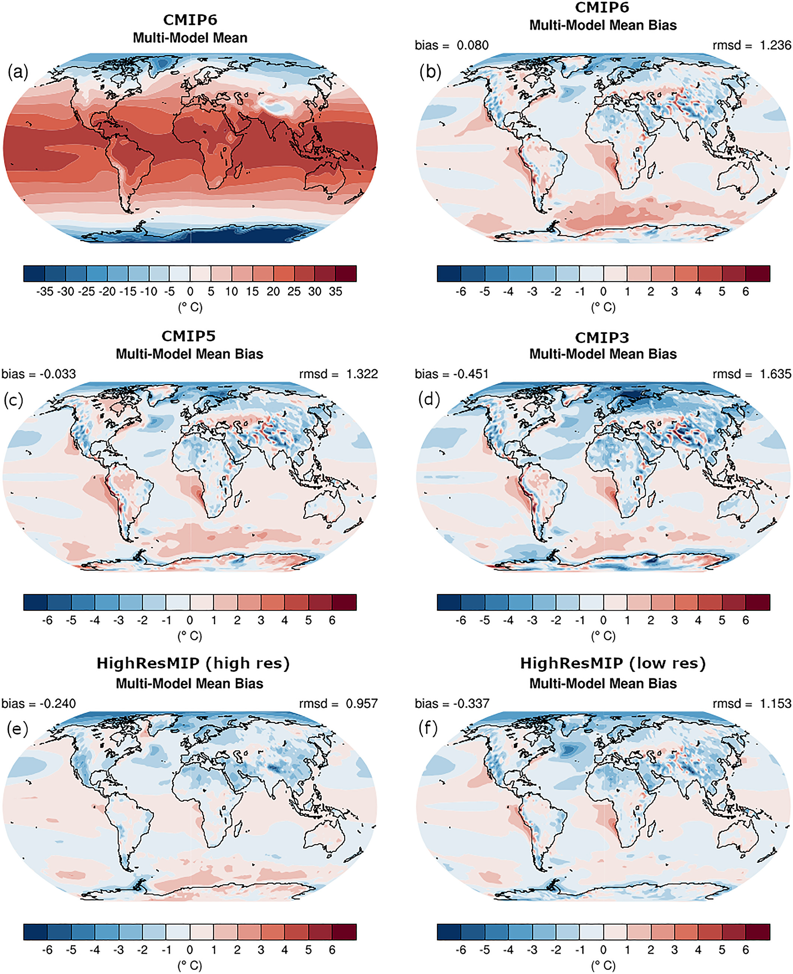
Annual mean near‐surface (2 m) air temperature (°C). (a) Multimodel (ensemble) mean constructed with one realization of CMIP6 historical experiments for the period 1995–2014. Multimodel‐mean bias of (b) CMIP6 (1995–2014), (c) CMIP5 (1985–2004), (d) CMIP3 (1980–1999), (e) high‐resolution, and (f) low‐resolution simulations of the HighResMIP ensemble (1995–2014) compared to the corresponding time period of the climatology from ERA5 (Copernicus Climate Change Service (C3S), 2017).
Bock, L., Lauer, A., Schlund, M., Barreiro, M., Bellouin, N., Jones, C., et al. (2020). Quantifying progress across different CMIP phases with the ESMValTool. Journal of Geophysical Research: Atmospheres, 125, e2019JD032321. https://doi.org/10.1029/2019JD032321

Slide 26
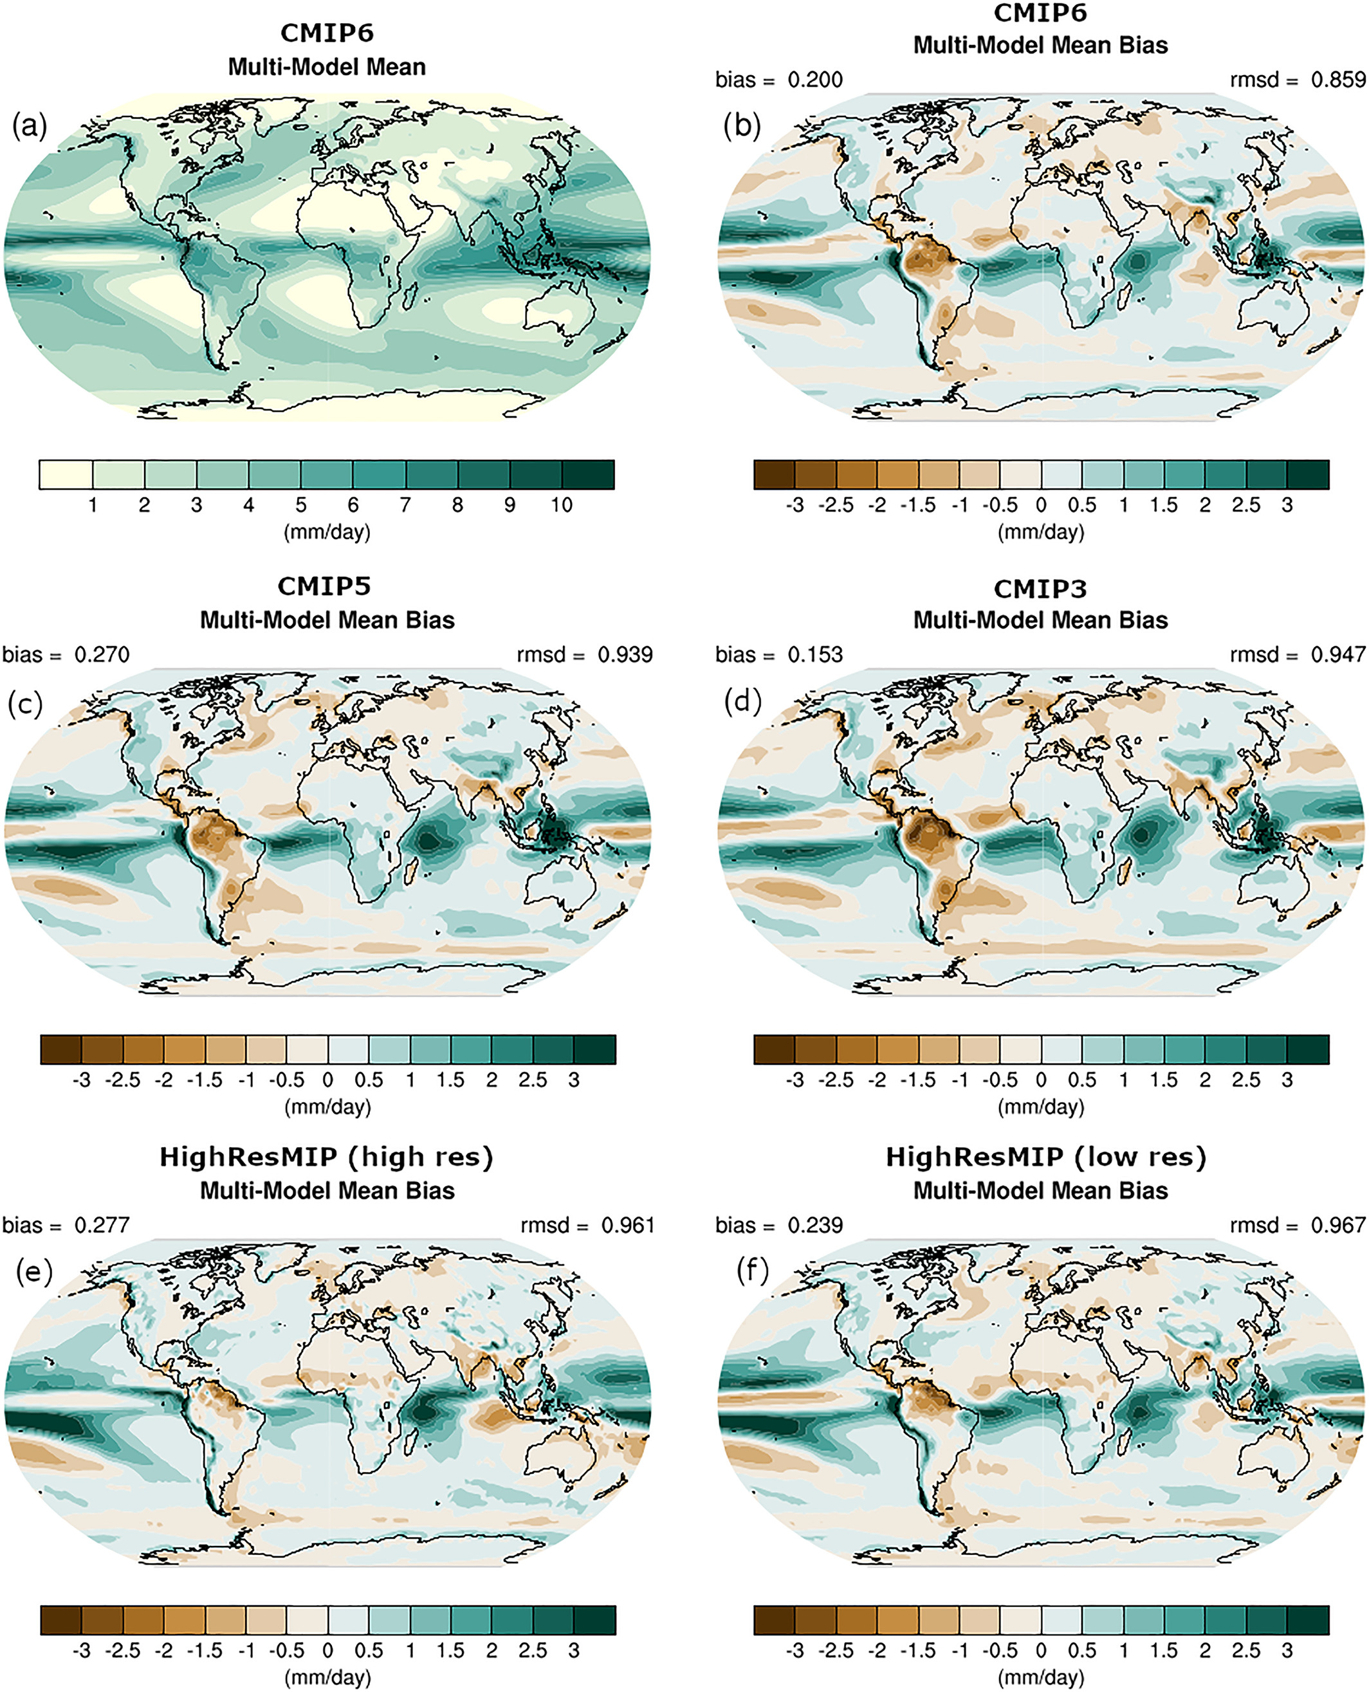
Annual mean precipitation rate (mm day−1). Data from the Global Precipitation
Climatology Project (GPCP) Version 2.3 (Adler et al., 2003) are used as a reference.

Slide 27
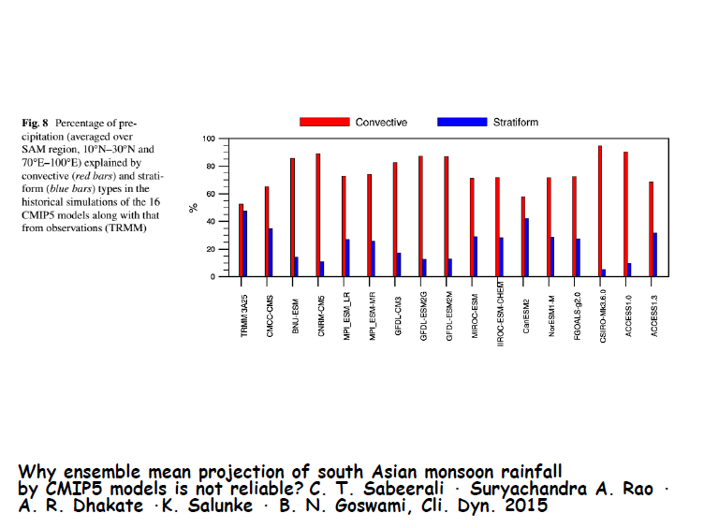

Slide 28
Time Latitude Hovmöller diagram of rainfall in JJAS 2001–2007 over Indian Region from Observation, BMJ, KF and GRELL averaged between 70⁰E–90⁰E, hor. Res. 15km with WRF
Mukhopadhyay et al. 2010, WAF
System used: NIMBUS Cluster

Slide 29
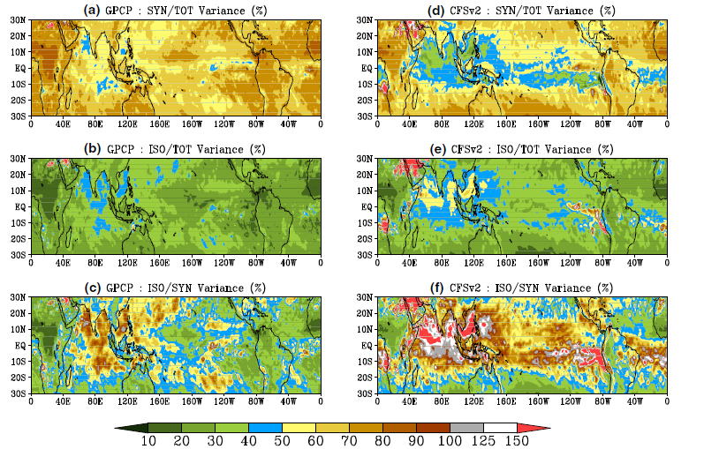
Goswami et al. 2014
CFSV2: Less synoptic variance and more ISO variance
a) Ratio of synoptic scale (2–10 day bandpassed) variance to total variance in GPCP; b) ratio of ISO scale (10–90 day bandpassed) variance to total variance in GPCP; c) ratio of ISO scale variance to synoptic scale variance in GPCP; d) ratio of synoptic scale variance to total variance inCFSv2. e) Ratio of ISO scale variance to total variance in CFSv2; f) ratio of ISO scale variance to synoptic scale variance in CFSv2 (the values are given in percentage)

Slide 30
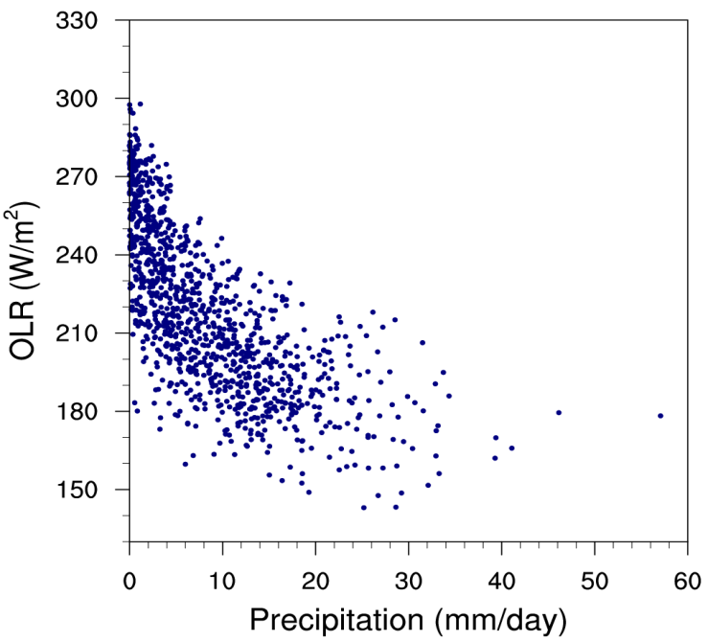
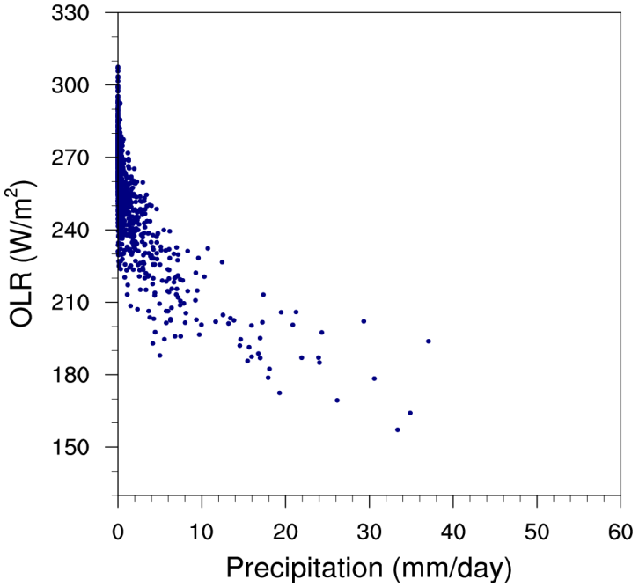
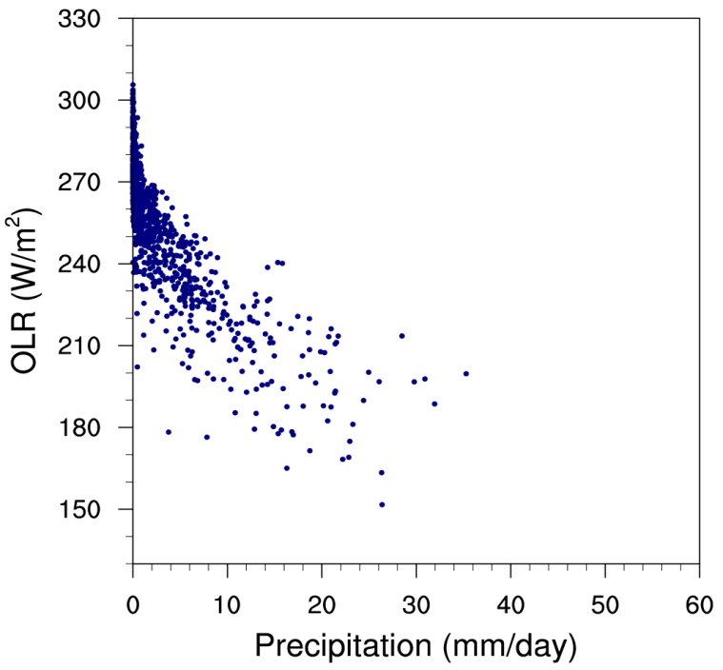
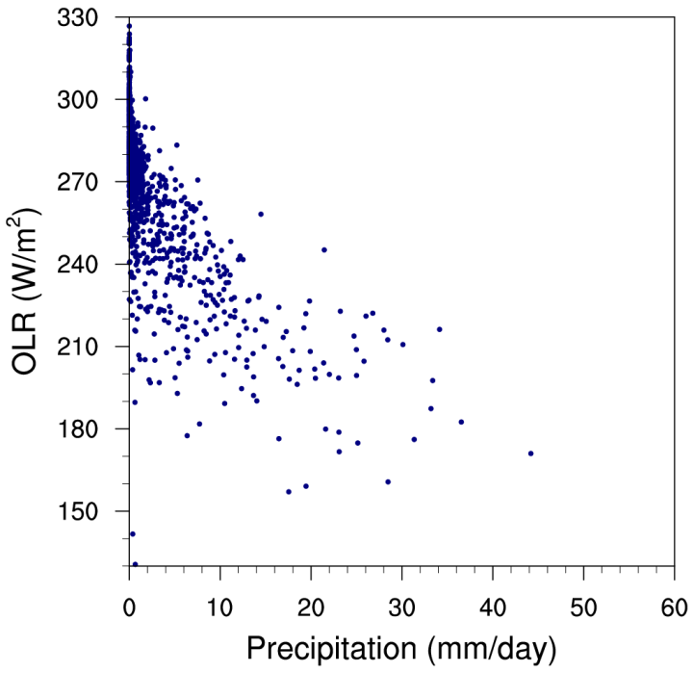
(a) Observation
(b) T62
(b) T382
(c) T126
Scatter plot of OLR vs Precipitation for JJAS monsoon zone India. OLR is taken from NOAA and precipitation from TRMM

Slide 31
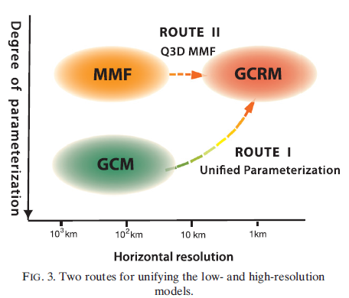
Arakawa and Wu, 2013
Route II with 2D MMF: accomplished in IITM through development of SP-CFS

Slide 32
Multi-scale cloud
convective and stratiform clouds
0830
1130
1730

Slide 33
State of the art:
Separation into stratiform and convective clouds, detraining water from convective clouds is source for stratiform clouds => radiative effects
If convective clouds change so do stratiform.
Latent heat
water

Slide 34
Revised Cloud-Convective-Radiation in CFSv2 T126
radiation
convection
(REV SAS)
(SAM)
microphysics
(WSM6)
turbulence
dynamics
Clouds are the result of complex interactions between a large number of processes
SAM: System of Atmospheric Model

Slide 35
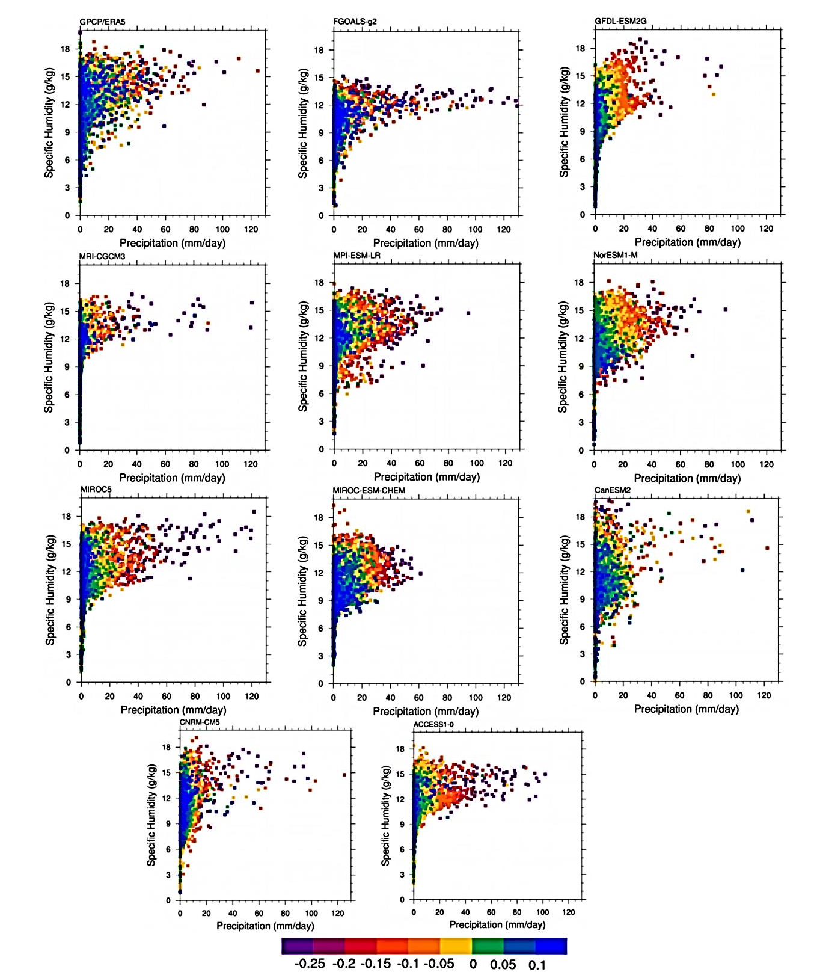
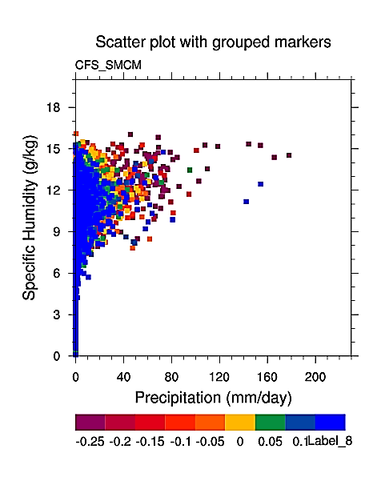
Scatter plot of total rainfall (X-axis) with respect to specific humidity ((×10³, Y-axis) and vertical velocity (Pa/s, coloured) over the ISM domain (15S-30N, 60-95E) for MISO events
CFS T126

Slide 36
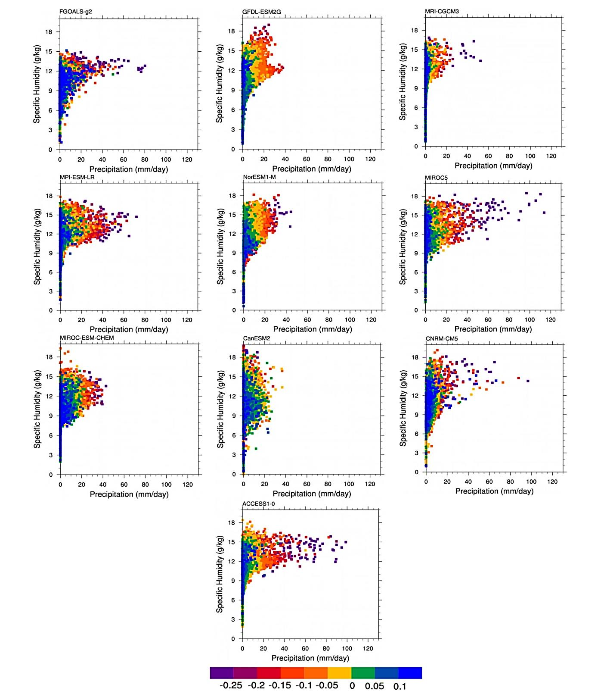
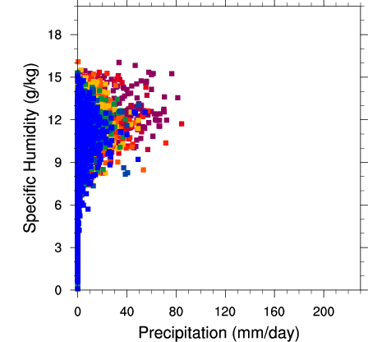
CFS T126
Scatter plot of convective rainfall (X-axis) with respect to specific humidity (×10³, Y-axis) and vertical velocity (Pa/s, coloured) over the ISM domain for MISO events

Slide 37
Probability Distribution Function (PDF)_GFS-Hindcast simulations and observations (JJAS_2000-2018)

Slide 38
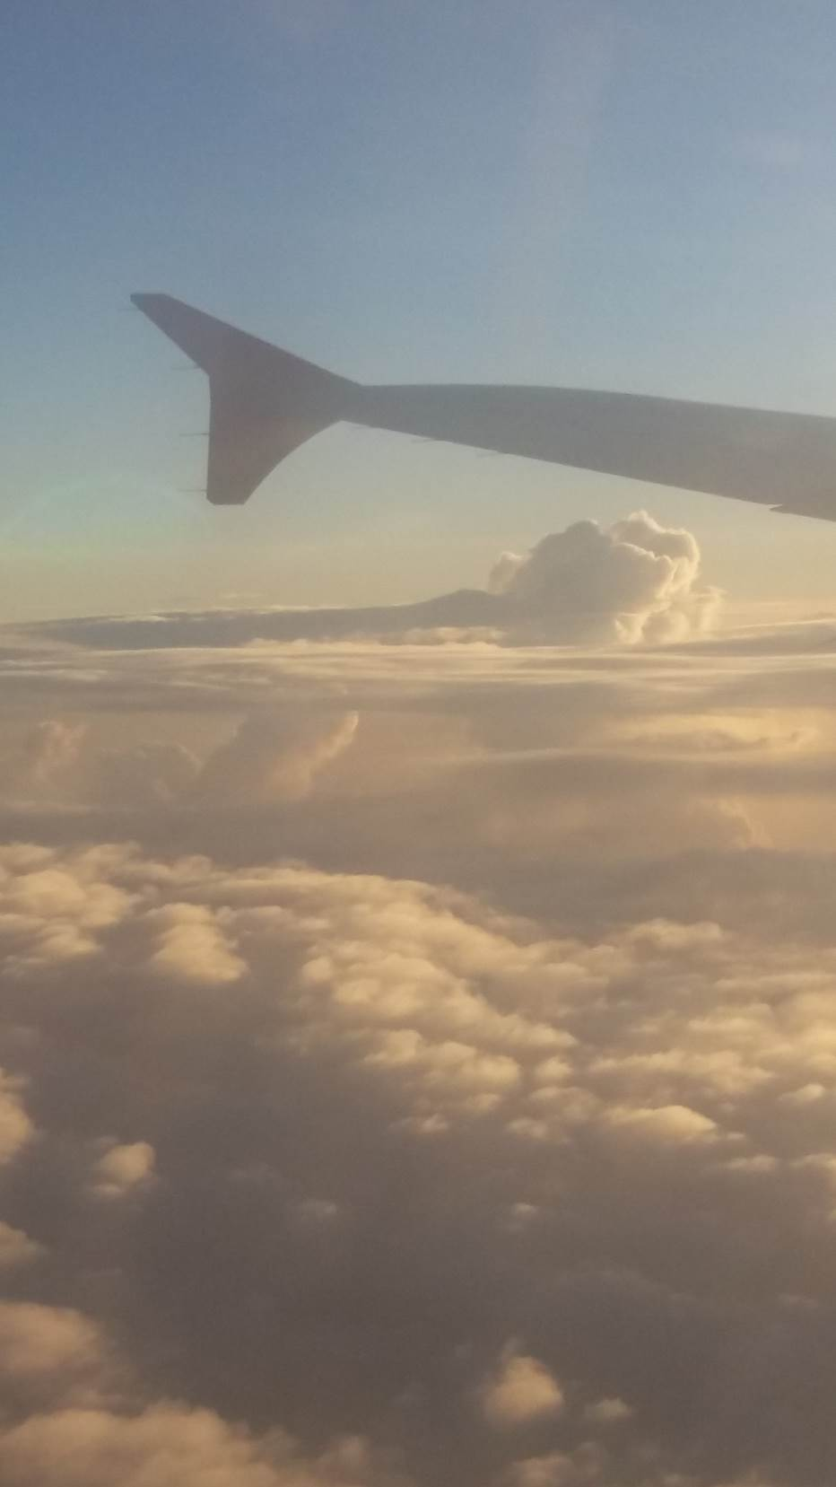
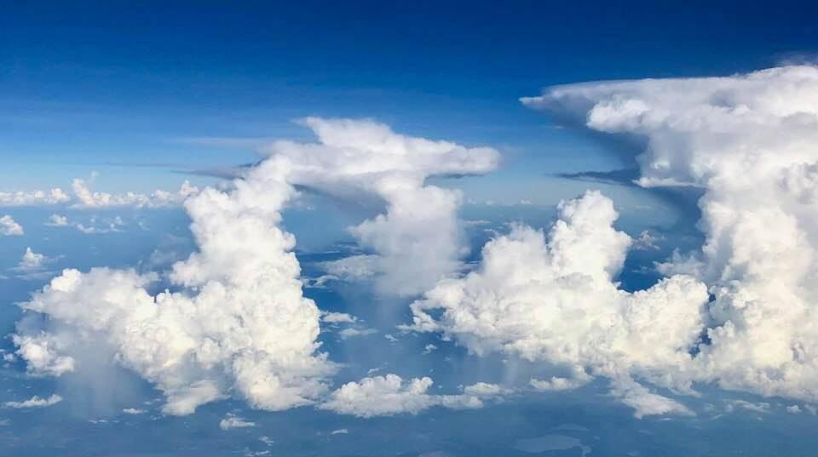

Multi-scale clouds
Courtesy: Brian Mapes
Marine stratocumulus

Slide 39
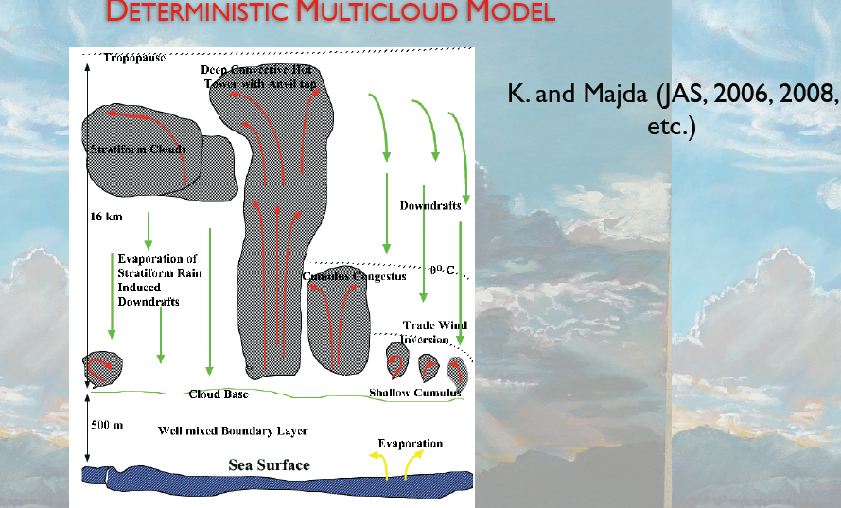

Slide 40
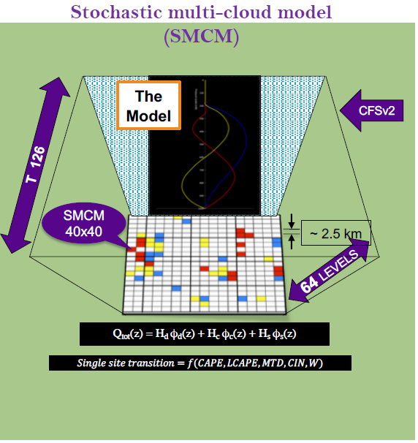
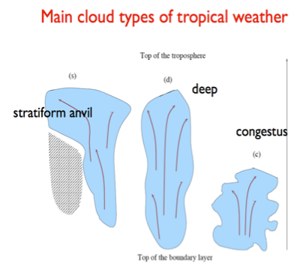
B. B. Goswami et al. 2017, JAS
B. B. Goswami et al., 2017 JAMES
B. B. Goswami, 2017, GRL

Slide 41
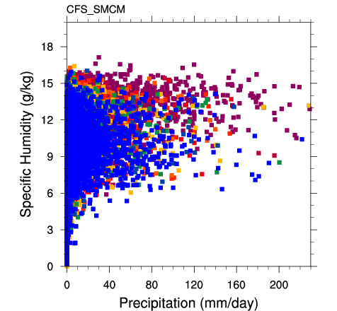
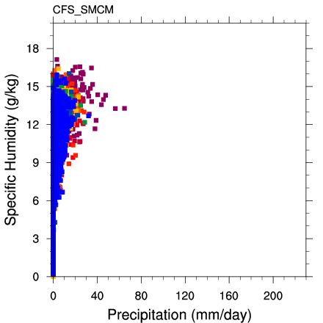

With total precipitation
With convective precipitation

Slide 42
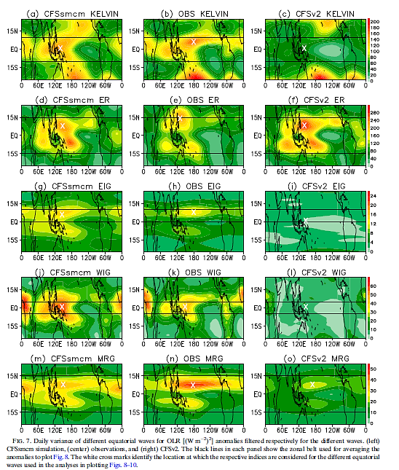
B. B. Goswami et al. JAS, 2017

Slide 43
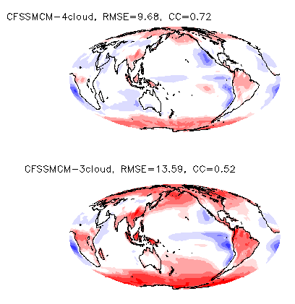
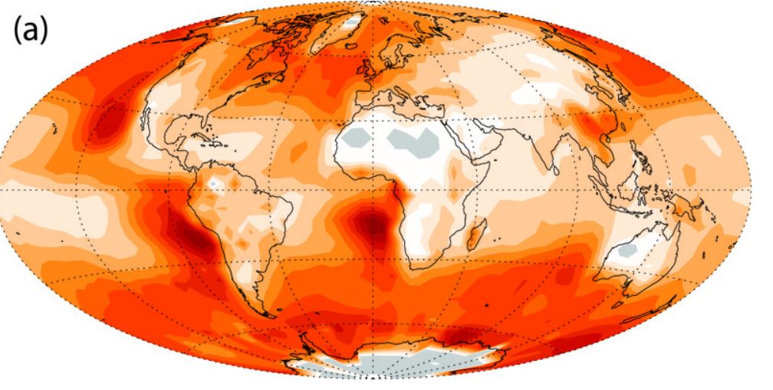

B. B. Goswami et al. 2017, JAS
B. B. Goswami et al., 2017 JAMES
B. B. Goswami, 2017, GRL
Annual mean Low-cloud cover[Adopted from Wood 2012]
Bias of Annual mean Low-cloud cover
Please see poster

Slide 44
Thank You !

Slide 45

Wedi et al. 2020, JAMES

