Slide 1


Convective Parameterization: challenges and breaking the deadlock
Partha Mukhopadhyay
(Collaborator: Siddharth Kumar, R. Phani, Malay Ganai, Snehlata Tirkey, Bidyut Goswami, Kumar Roy, Boualem Khouider, Sourav Taraphdar, Himabindu and colleagues and students in my lab)
Indian Institute of Tropical Meteorology, Pune
(email:mpartha@tropmet.res.in)
ICTP PIMS SMR 3952 (5th Summer School on Theory, Mechanisms and Hierarchical Modelling of Climate Dynamics: Convection and Clouds )

Slide 2
Outline of the talk
Introduction
Basics of NWP contd
Estimating convective closure in GCM
Deadlock and Possible pathways
Summary/take home message

Slide 3
Equations of motion in a rotating co-ordinate frame
Rate of change of absolute velocity following the motion as viewed in an inertial frame = Sum of real forces acting per unit mass
Coriolis force
Pressure gradient force
Gravity force per unit mass = Sum of the
gravitational and centrifugal force terms
Frictional force in the fluid
Note: The Coriolis and Centrifugal force terms are apparent / fictitious forces

Slide 4
Continuity equation: Conservation of mass
Local increase of density with time must be balanced by divergence of mass flux
Equivalently
Or
Thermodynamic energy equation
Conservation of thermodynamic energy as applied to a moving fluid element
According to the first law of thermodynamics, the change in the internal energy of a system is equal to the difference between the heat added to the system and the work done by the system

Slide 5
Dry atmosphere: Thermodynamic energy equation
Specific heat of dry air at constant
Pressure = 1004 J kg⁻¹ K ⁻¹
Specific volume (inverse of density)
Rate of heating per unit mass
(eg. conduction, radiation, convection)
Divide above equation by T and use Equation of State
The first law of thermodynamics takes the Entropy form
R= Gas constant for dry air
= 287 J kg⁻¹ K⁻¹
The above equation gives the rate of change of entropy per unit mass following the motion for a thermodynamically reversible process
The entropy “S” is a field variable which depends only on the state of the fluid (ie., “ds” is a perfect differential and ds/dt is regarded as a total derivative)
However heat (Q) is not a field variable, so that the heating rate is not a total derivative

Slide 6
Complete set of model equations when moisture (q = specific humdity) is included
There are seven unknowns: U (u, v, w); T, p, (ρ or α) and q; and seven equations
3 Momentum equations for
the 3 components (u, v, w)
Continuity equation
Thermodynamic energy equation
Equation of state
α = Inverse of density
= Specific volume
Moisture equation
E = Evaporation (moisture source)
C = Condensation (moisture sink)

Slide 7






For unit mass, HORIZONTAL equation of motion:
Scale analysis: estimate the order of magnitude for each term, using the observed values.
Observed scales: Velocity V: 10-30 m/s; Time t (1 day):
Acceleration term:
Coriolis term:
The Coriolis term is one order of magnitude larger than the acceleration term.
In free atmosphere, friction is negligible. Therefore, to the lowest order:
0
0
Geostrophic balance: PGF is balanced by CF:

Slide 8



Illustration
Northern Hemisphere (NH):
H
L
CF
PGF
y
P1 P2 P3 P4 P5
x

Slide 9
Why do we need physical parameterization?
ICs
Dynamics Physics
Models
Forecast
BCs
Dynamic core of models
Model physics:
Processes such as phase change of the water are in too small scale and too complex.
Processes such as cloud microphysics are poorly understood.

Slide 10
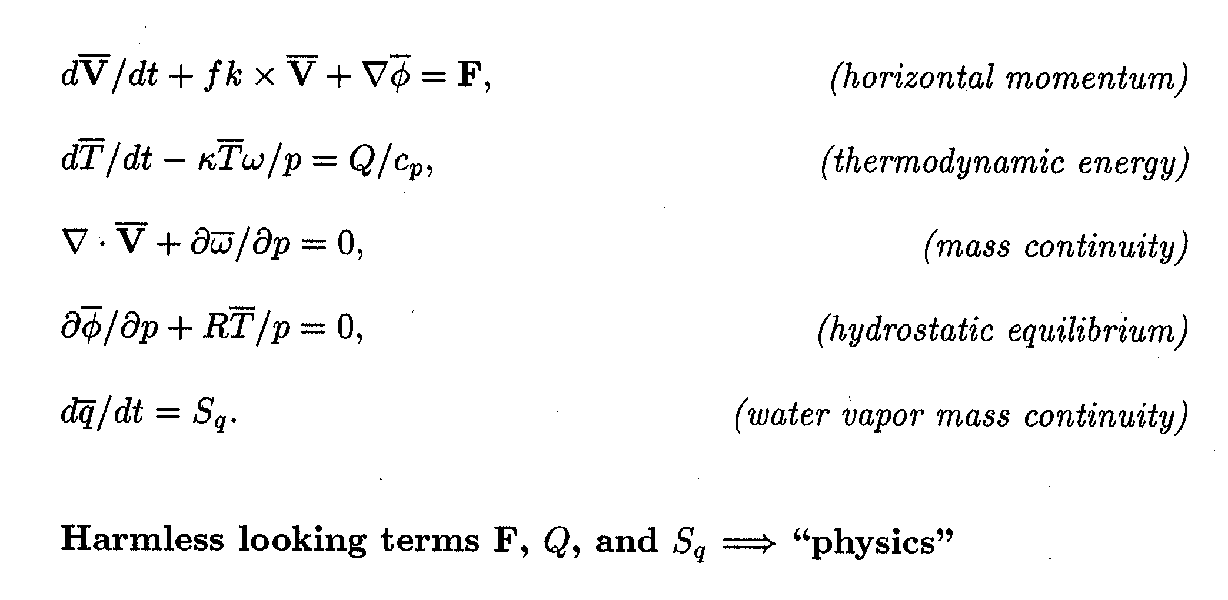
Meteorological Primitive Equations

Slide 11
Basic Logic in a GCM (Time-step Loop)
For a grid of atmospheric columns:
‘Dynamics’: Iterate Basic Equations
  Horizontal momentum, Thermodynamic energy,
  Mass conservation, Hydrostatic equilibrium,
  Water vapor mass conservation
Transport ‘constituents’ (water vapor, aerosol, etc)
Calculate forcing terms (“Physics”) for each column
  Clouds & Precipitation, Radiation, etc
Update dynamics fields with physics forcings
Gravity Waves, Diffusion (fastest last)
Next time step (repeat)

Slide 12
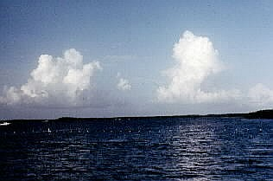
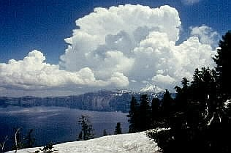
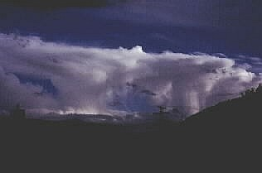
Cumulus convective Parameterization schemes
Arakawa – Schubert scheme.
Betts – Miller scheme.
Kuo scheme.
Early stage of cumulus development.
Mature stage of cumulus development.
This storm has reached an upper-level inversion, forming an anvil-shape to the cloud.

Slide 13
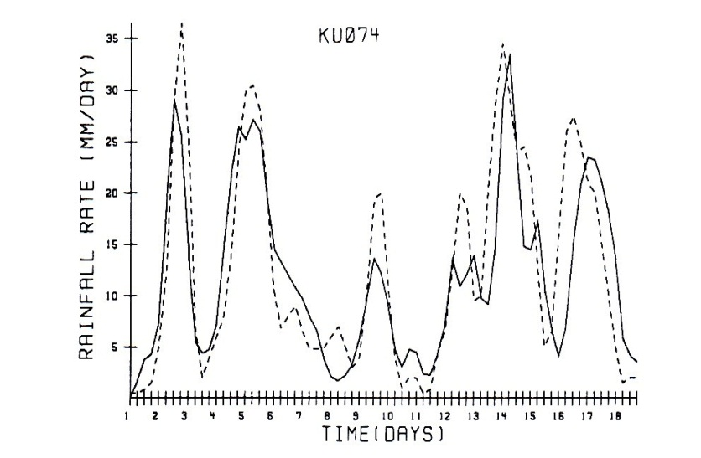
2. Kuo scheme
Simple scheme from Kuo(1965, 1974)
Widely used in GCMs for deep convection.
Basic idea:
The rate of precipitation is balanced by the rate of horizontal convergence of moisture and surface evaporation.
Limitations:
Too simple, can not represent the realistic physical behavior of convection.
Can not represent shallow convection
b is a constant.
  Radar observed rainfall(dashed line) and rainfall diagnosed from Kuo scheme(solid line) for a period of 18 days during GATE. (From Krishnamurti et al. (1980))

Slide 14
3. Betts – Miller scheme
Betts 1986, Betts and Miller 1986
Basic idea:
To relax temperature and mixing ratio profile back to reference profiles in the unstable layer.
R represent reference profile, τ is relaxation
time scale.
Deep convection and shallow convection are considered separately:
Deep convection: if the depth of the convective layer exceeds a specified value. The reference profile are empirically determined from observations.
Shallow convection: when the depth of the convective layer is less than the value, it will not produce precipitation.
Limitations:
A fixed reference profile of RH may cause problems in climate models.
Changes below cloud base have no influence.

Slide 15
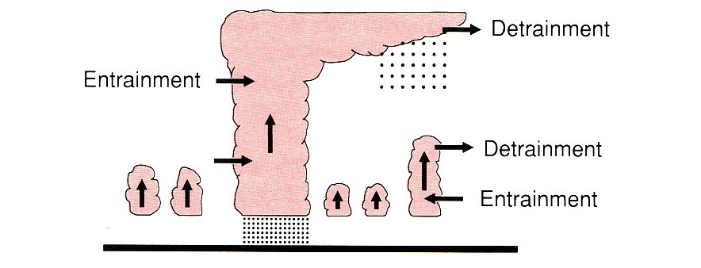
4 Arakawa – Schubert scheme
Complex scheme from Arakawa and Schubert 1974.
Basic idea: (Convective Quasi-equilibrium)
Assume convection can be represented as an ensemble of entraining plumes with different height and entrainment rates. Convection keeps the atmosphere nearly neutral.
Cloud work function : measure of moist convective instability of each type of cloud.
Quasi-equilibrium assumption:
Convective tendencies are very fast.
So large scale tendencies approximately
balances the convective tendencies.
Limitations:
Complexity, take longer time
Requires detailed cloud ensemble model
  Schematic of an ensemble of cumulus clouds.
  (from Trenberth, 1992)

Slide 17
Time Latitude Hovmöller diagram of rainfall in JJAS 2001–2007 over Indian Region from Observation, BMJ, KF and GRELL averaged between 70⁰E–90⁰E, hor. Res. 15km with WRF
Mukhopadhyay et al. 2010, WAF
System used: NIMBUS Cluster

Slide 18
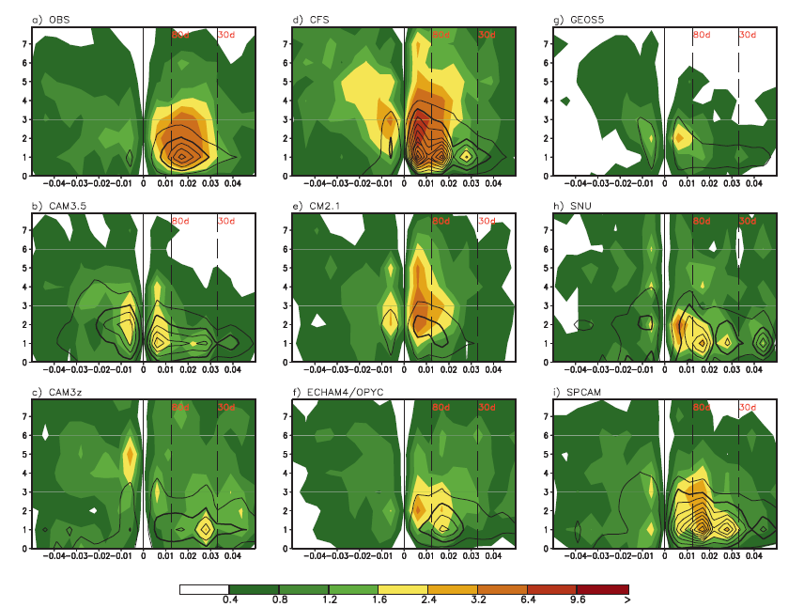
Kim et al, 2009, JCLI
November–April wavenumber–frequency spectra of 10⁰N–10⁰S averaged precipitation (mm² day⁻²) (shaded) and 850-hPa zonalwind (m² s⁻²) (contoured) for the (a) CMAP/NCEP/NCAR, (b) CAM3.5, (c) CAM3z, (d) CFS, (e) CM2.1, (f) ECHAM4/OPYC,(g) GEOS5, (h) SNU, and (i) SPCAM. Individual November–April spectra were calculated for each year and then averaged over all years of data. Only the climatological seasonal cycle and time mean for each November–April segment were removed before calculation of the spectra.

Slide 19
Scatter plot of OLR vs rainrate
Both the model produces shallow convection throughout the day consistent with too much of lighter precipitation
Ganai et al. 2015

Slide 20
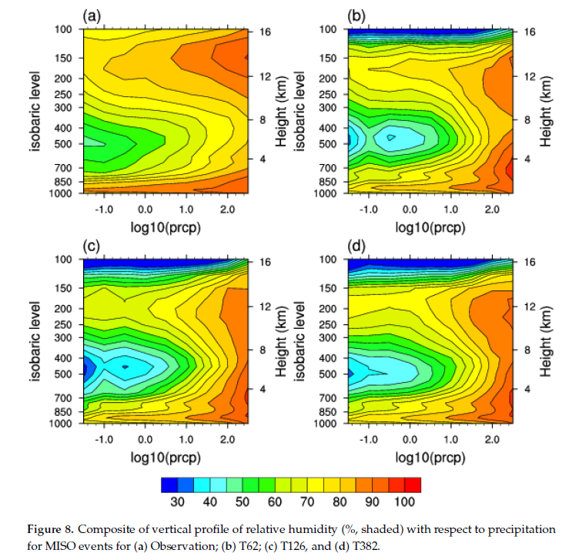
Tirkey et al. 2019

Slide 21
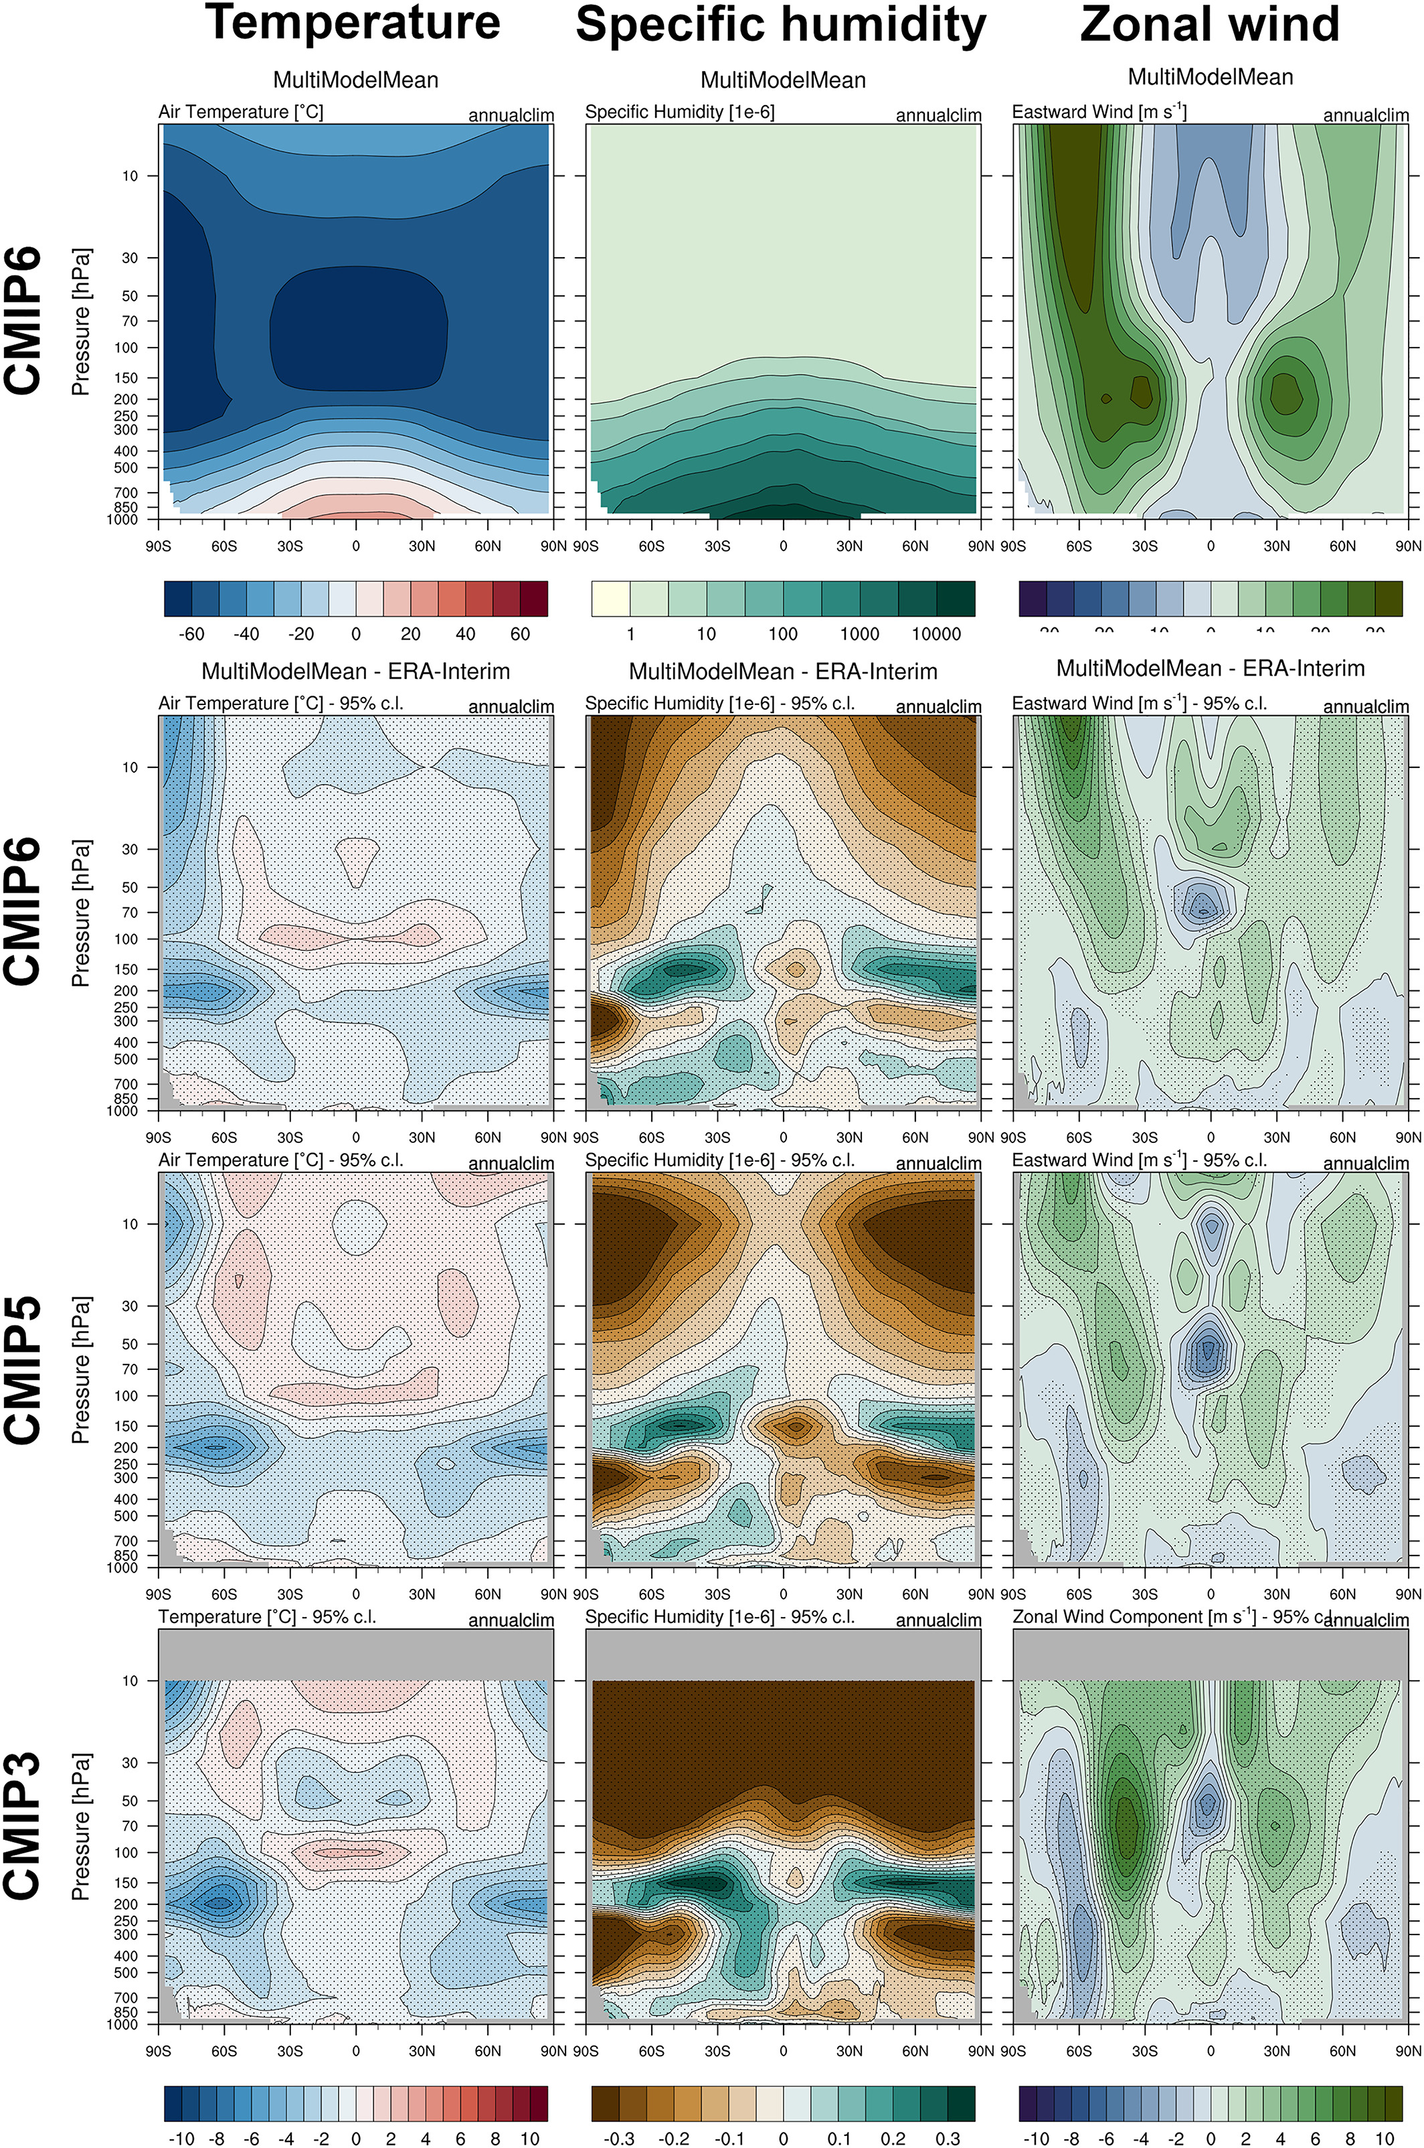
Quantifying Progress Across Different CMIP
Phases With the ESMValTool
JGR Atmospheres, Volume: 125, Issue: 21, First published: 18 October 2020, DOI: (10.1029/2019JD032321)
Notes:
Multimodel mean of zonal averages for temperature (C°, left), specific humidity (10−6, middle) and zonal wind (m s−1, right) from CMIP6 (1995–2004) (upper row). Also shown are the absolute (temperature and zonal wind) and the relative (specific humidity) deviations from ERA‐Interim for (from top to bottom) CMIP6 (1995–2004), CMIP5 (1995–2004) and CMIP3 (1980–1999) multimodel means. Stippled areas show differences that are statistically significant at a 95% confidence level.
IF THIS IMAGE HAS BEEN PROVIDED BY OR IS OWNED BY A THIRD PARTY, AS INDICATED IN THE CAPTION LINE, THEN FURTHER PERMISSION MAY BE NEEDED BEFORE ANY FURTHER USE. PLEASE CONTACT WILEY'S PERMISSIONS DEPARTMENT ON PERMISSIONS@WILEY.COM OR USE THE RIGHTSLINK SERVICE BY CLICKING ON THE 'REQUEST PERMISSIONS' LINK ACCOMPANYING THIS ARTICLE. WILEY OR AUTHOR OWNED IMAGES MAY BE USED FOR NON-COMMERCIAL PURPOSES, SUBJECT TO PROPER CITATION OF THE ARTICLE, AUTHOR, AND PUBLISHER.

Slide 22
Does Increasing Horizontal Resolution Improve Seasonal Prediction of Indian Summer Monsoon?: A Climate Forecast System Model Perspective
Siddharth Kumar1,2 , R. Phani1, P. Mukhopadhyay1 , and C. Balaji2
GRL, 2022, 10.1029/2021GL097466

Slide 23
(a) Probability density function (in percentage) of rainfall over land (central India 74−86°E, 16°N−28°N) and equatorial Indian ocean (60−100°E; 15°S−5°N) and Total variation distance between rainfall probability distributions of (b) CFST126 and Global Precipitation Climatology Project (GPCP) (c) CFST382 and GPCP (d) CFST126 and CFST382.

Slide 24
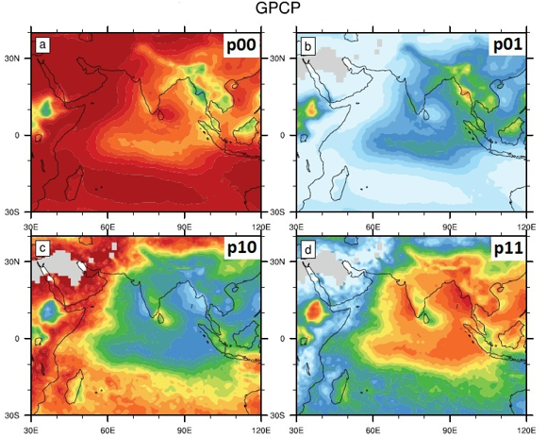

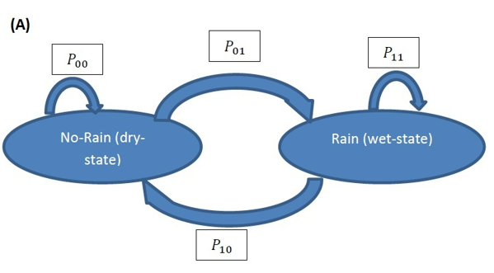
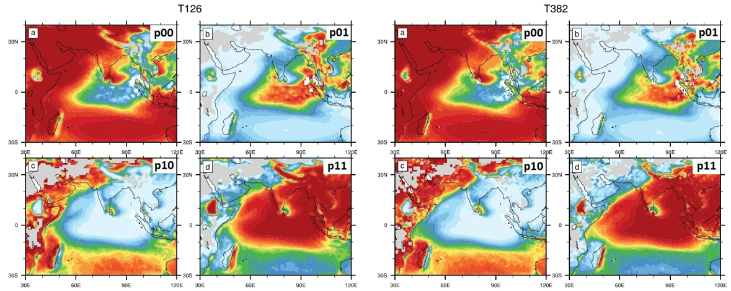

Model has the tendency to remain in wet state
Transition probability
Rainfall is modelled as discrete time Markov chain
Rainy: if rain >2.5 mm/day
$$\begin{aligned}&p_{ij}=P\left(X_{t+1}=j∣X_{t}=i\right) \\ &\{i,j\}∈\{0,1\}\end{aligned}$$
Transition probabilities
Courtesy: Siddharth et al.

Slide 25
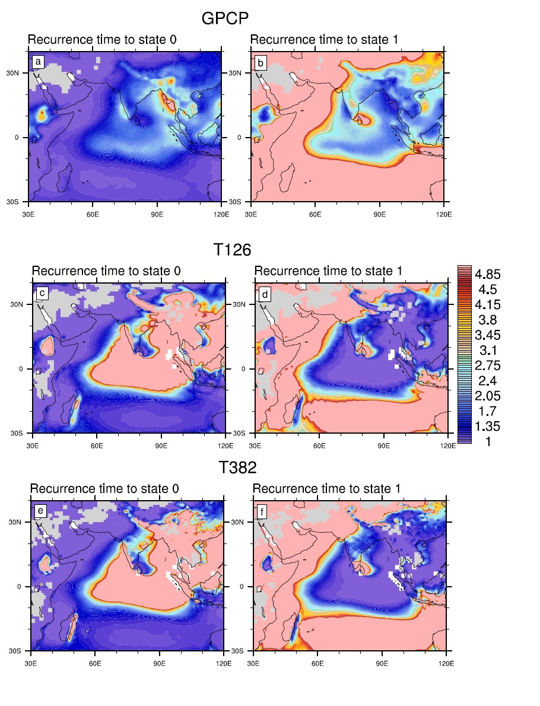
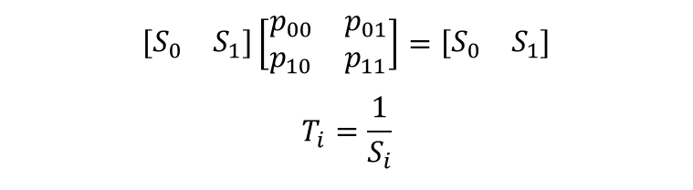
What else Markov Model convey?
Steady state probabilities calculation
$$\left[\begin{matrix}S_{0} & S_{1}\end{matrix}\right]\left[\begin{matrix}p_{00} & p_{01} \\ p_{10} & p_{11}\end{matrix}\right]=\left[\begin{matrix}S_{0} & S_{1}\end{matrix}\right]$$
$$T_{i}=\frac{1}{S_{i}}$$
Mean recurrence time

Slide 26
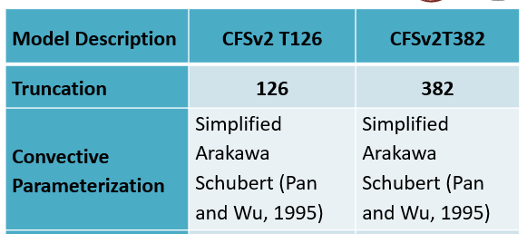
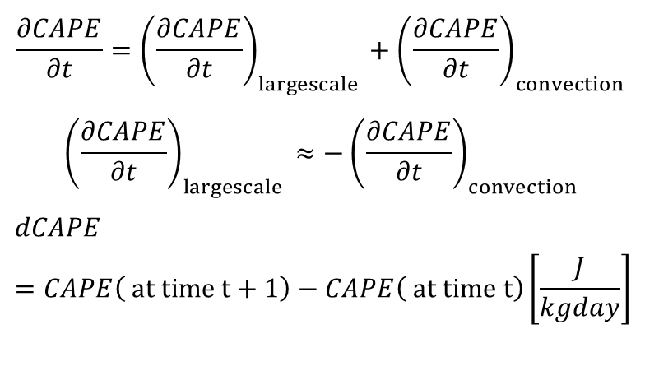
Common issue in most CMIP model
Convective quasi-equilibrium (CQE)
$$\frac{∂CAPE}{∂t}={\left(\frac{∂CAPE}{∂t}\right)}_{largescale }+{\left(\frac{∂CAPE}{∂t}\right)}_{convection }$$
$${\left(\frac{∂CAPE}{∂t}\right)}_{largescale }≈−{\left(\frac{∂CAPE}{∂t}\right)}_{convection }$$
$$dCAPE=CAPE\left( at time t+1\right)−CAPE\left( at time t\right)\left[\frac{J}{kgday}\right]$$
The tropical atmosphere does not obey CQE on temporal scales of day and shorter ( Zhang, 2003)
Arakawa and Schubert, 1974

Slide 27
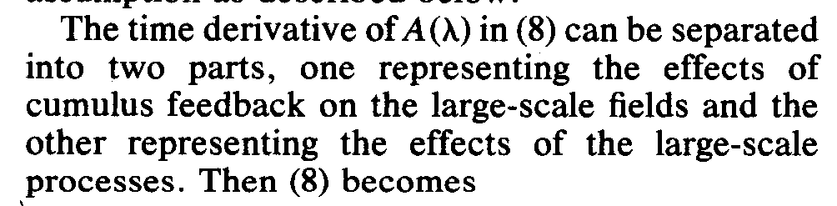
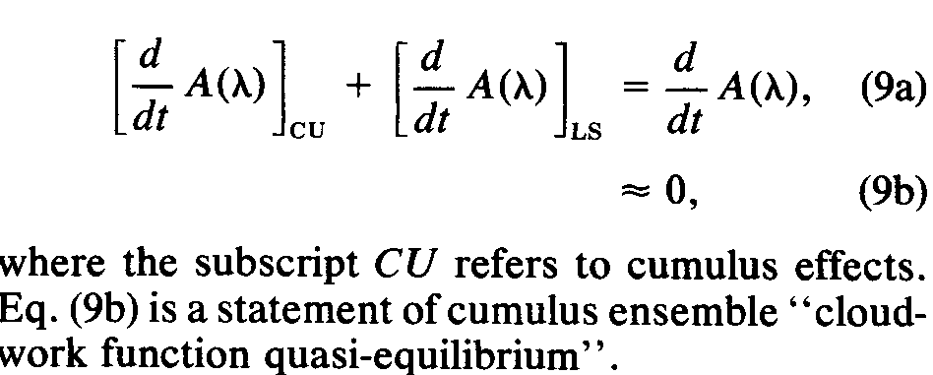

Slide 28
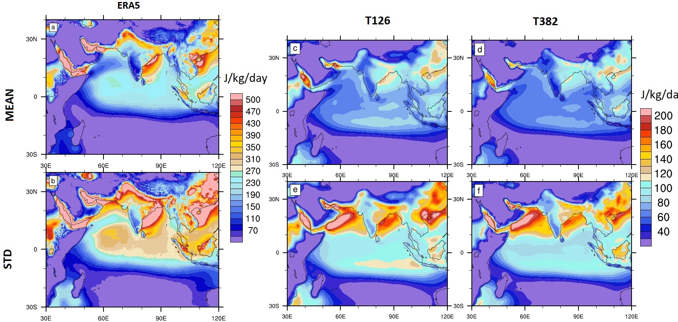
Convective quasi-equilibrium in CFSv2 models
Siddharth et al. GRL, 2022

Slide 30

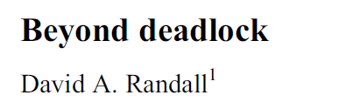
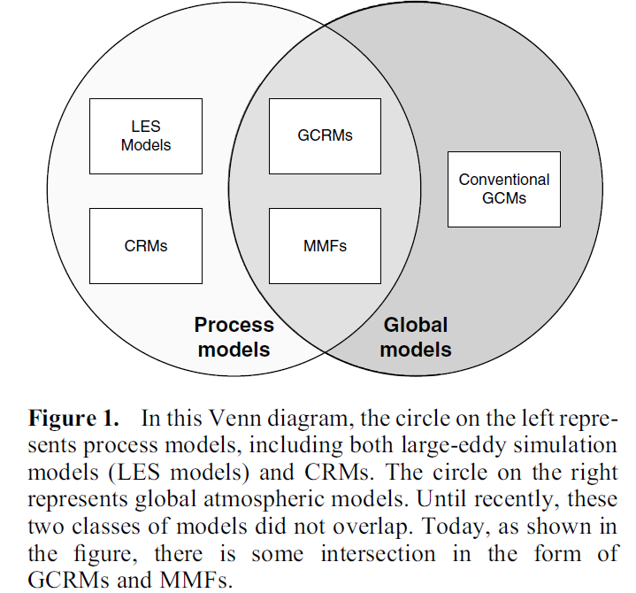
BAMS, 2003
GRL 2013
GCRMs and superparameterized GCMs are simultaneously global models and process models (Figure 1). They explicitly simulate much of the input that is needed for pa-rameterizations of microphysics, turbulence, and radiation. This makes it possible to use what we actually know about these important but necessarily parameterized processes. Future work with GCRMs and MMFs will accelerate our efforts to understand the roles of microphysical and turbulent processes in the global circulation of the atmosphere.

Slide 31
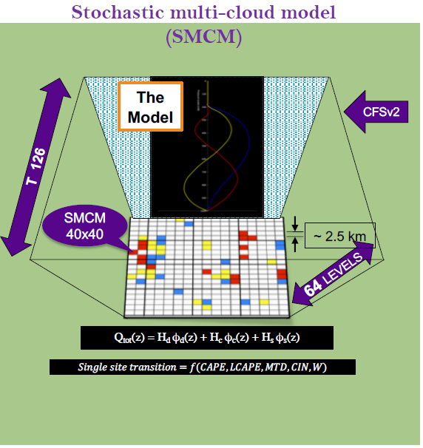
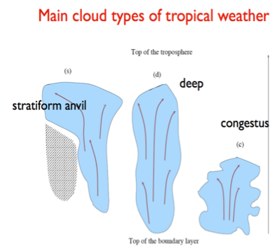
B. B. Goswami et al. 2017, JAS
B. B. Goswami et al., 2017 JAMES
B. B. Goswami, 2017, GRL

Slide 32
A possible pathway for deep convection trigger
A machine learning based trigger for deep convection
Stochastic Cloud Parameterization
Scale aware cloud representation
A machine learning and SP based cloud representation

Slide 33
Deep convection trigger in observations
BT < threshold
Convective
No
Non-convective
Yes
Rain rate >threshold
Convective
No
Non-convective
Yes
Hernandez-Deckers, 2022; Song and Zhang, 2018, 2017; Pfister et al., 2022; Chung et al., 2006; Liess and Geller, 2012; Yano et al., 2013; Song and Zhang, 2017, 2018; Zhang et al., 2021
Siddharth et al. 2024 Clim. Dyn

Slide 34
Neural Network
Hidden layers
Input layer
Output layer (0. 1)
Temp profile
Humidity profile
Sensible heat flux
Latent heat flux
Solar insolation

Slide 35
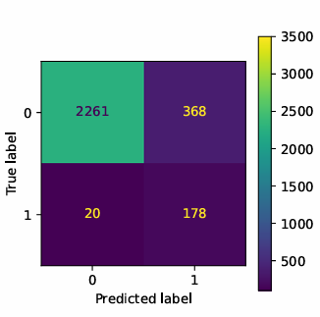
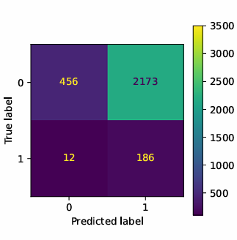
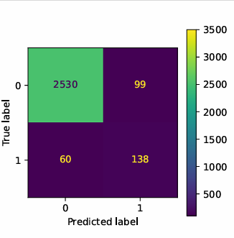
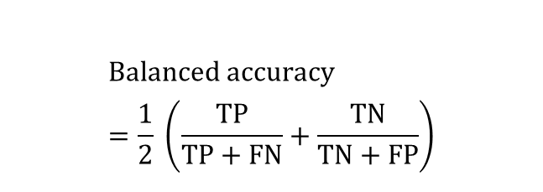
Performance of ML-based classifier
SVM
CAPE-based
Balanced accuracy score
CAPE-base : 0.56
SVM : 0.85
Neural Network : 0.79
$$Balanced accuracy=\frac{1}{2} \left(\frac{TP}{TP+FN}+\frac{TN}{TN+FP}\right)$$
Neural Network
CAPE-based classification:
1- if CAPE>70 J/kg
0- Otherwise
TP-True positive (1, 1)
FP-False Positive (0, 1)
FN- False negative (1, 0)
TN-True negative (0, 0)
Confusion matrix of classifiers

Slide 36
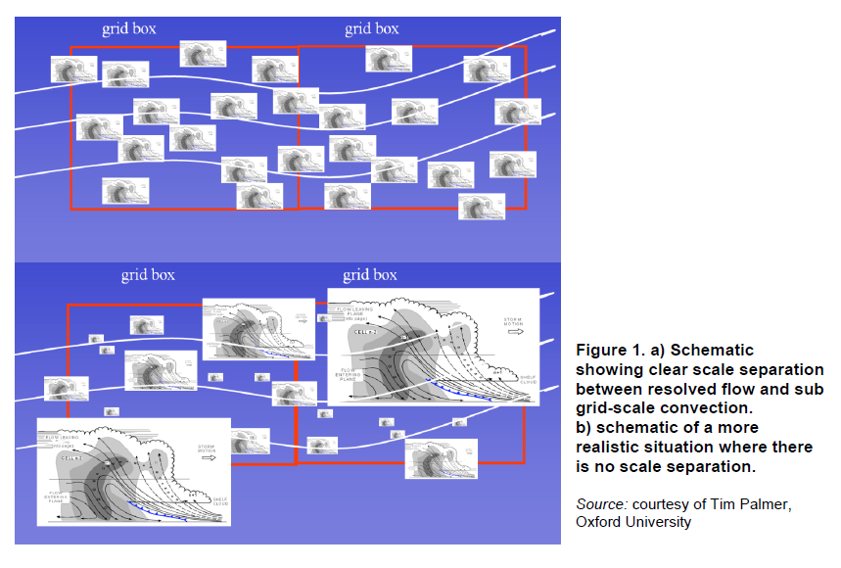
Need for Stochastic approaches

Slide 37
Scale Aware convection

Slide 38
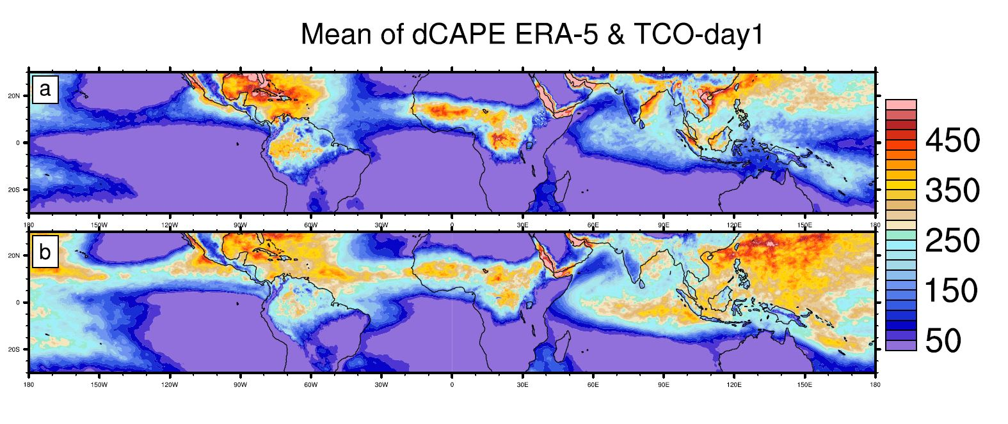
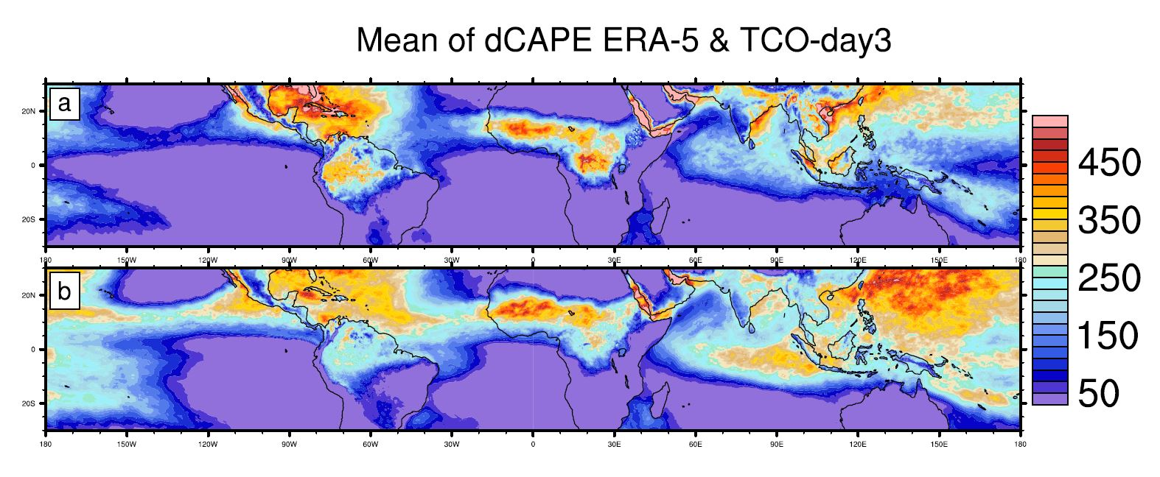
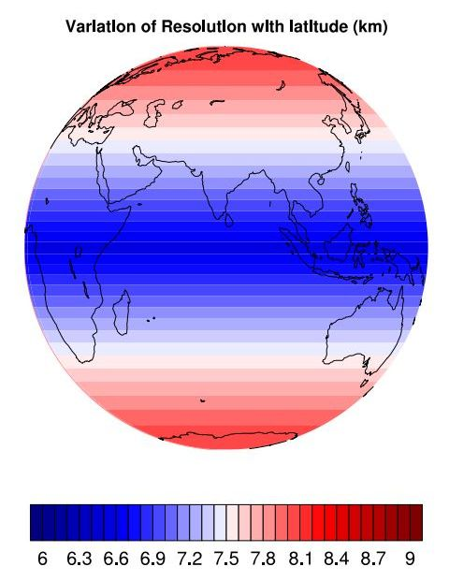
ERA-5
TCO_1534

Slide 39
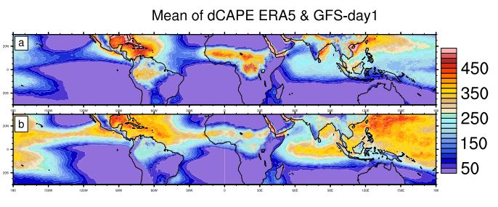
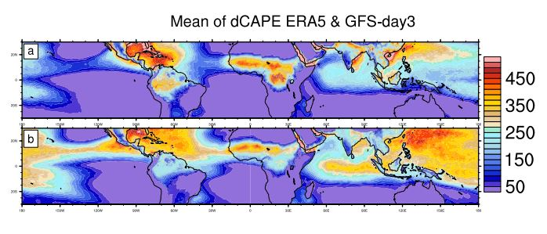
JJAS mean for five years (2016-2020)
ERA-5
GFS_T1534

Slide 40
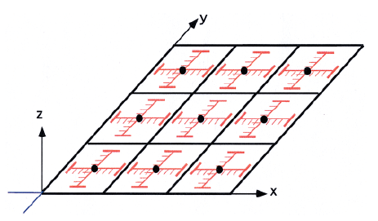
About Superparameterization
The concept first put forward by Grabowski (2001, JAS) and Khaidrotdinov and Randal (2001, GRL). KR01 has coined the word ‘Super parameterization’
Randal et al (2003, BAMS)
A typical grid in super parameterizattion
3D CRM
Randal et al. 2003, BAMS

Slide 41
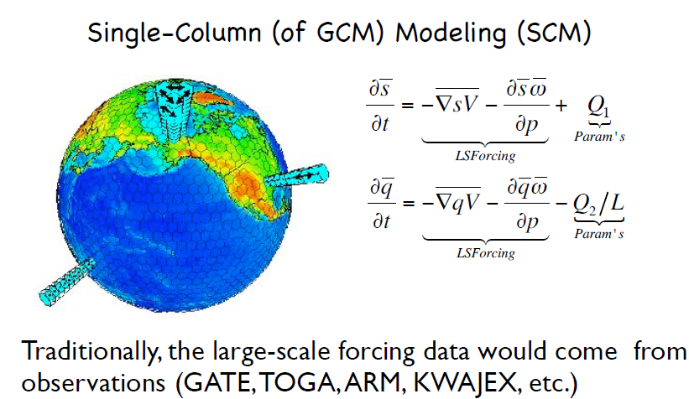
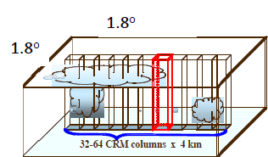
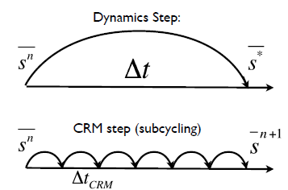
Super-parameterization-New Approach of treating cloud in GCM

Slide 42
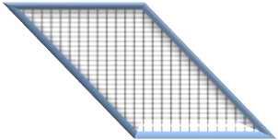
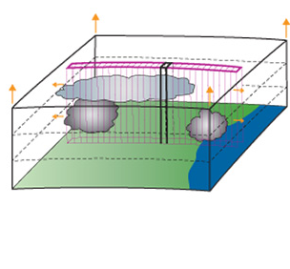
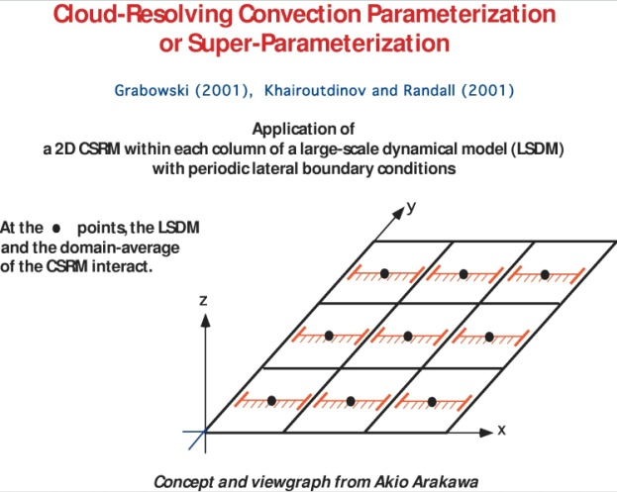
Superparameterized CFSv2-T62 (SPCFS) Analyses of 6.5 year free run
Convective tendencies are explicitly simulated with a Cloud Resolving Model running in each GCM grid column which replaces the traditional cumulus parameterization of the GCM.
Model integrated for 6.5 years and five years are analyzed
T62
64 levels CFS
4km

Slide 43
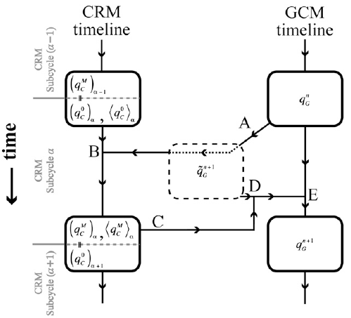
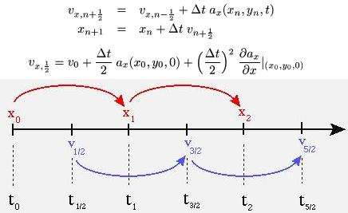
The Concept of Superparameterization
Requirement for CFS for Leap-Frog
BENEDICT AND RANDALL, JAS 2009

Slide 44
Ratio of Synoptic to ISO variance.
SP-CFS has improved the bias in synoptic and ISO variance

Slide 45
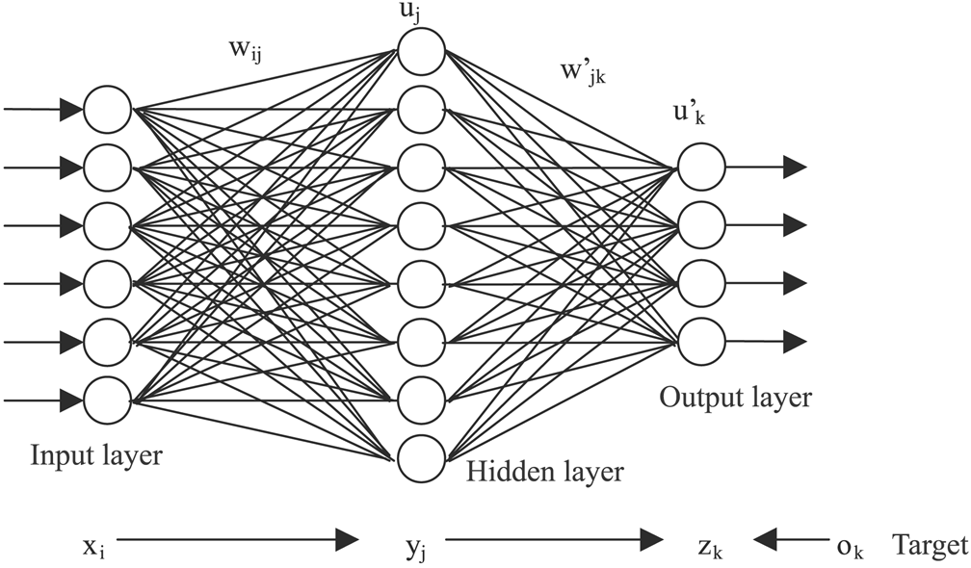
Presentation of a feed forward neural network architecture and the inputs used as well as the predicted tendencies
The deep layers will be trained from the cloud resolving model tendencies embedded in CFS (i. e. from Sp-CFS)
The trained tendencies will be given to CFS grid and the conventional cumulus parameterization will be switched off.

Slide 46
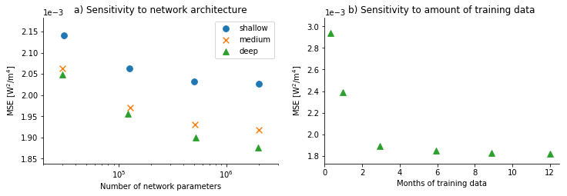
Sensitivity tests to (a) network architecture and (b) amount of training data. The score is the mean squared error averaged over time, space and variables in energy units computed from the validation set.
Gentine et al. 2018

Slide 47
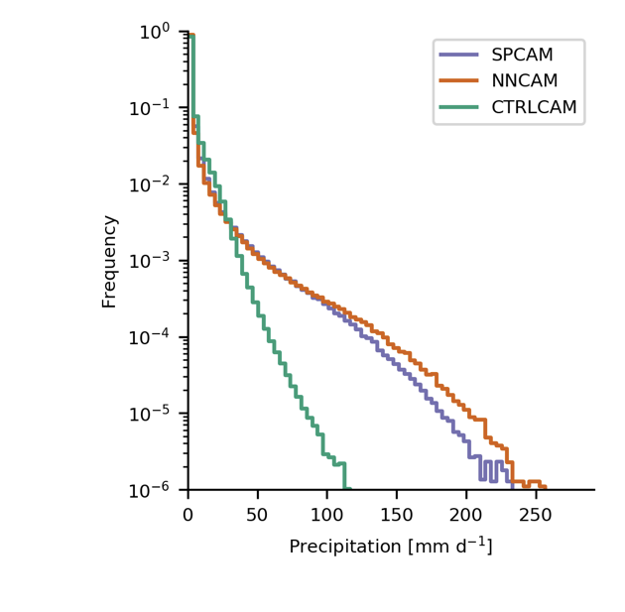
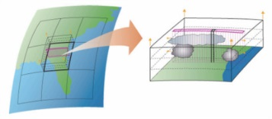
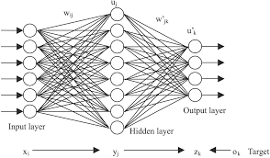
High-resolution constraints
Regular CAM
parameterization
Rasp et al. 2018

Slide 48
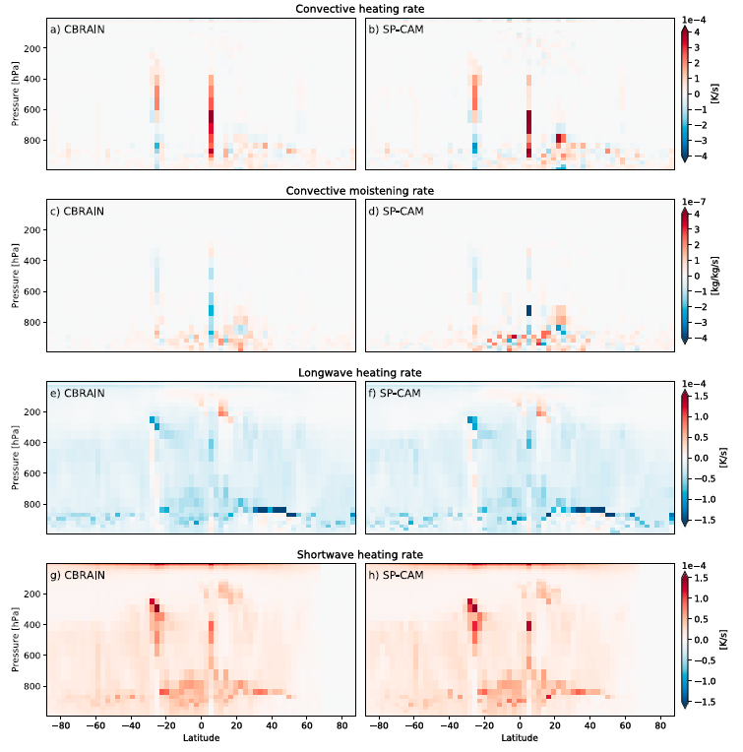
Gentine et al. 2018

Slide 49
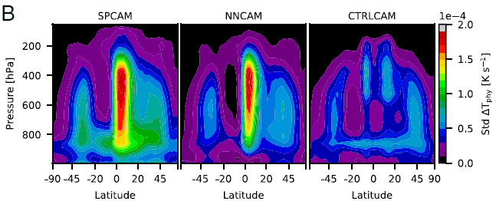
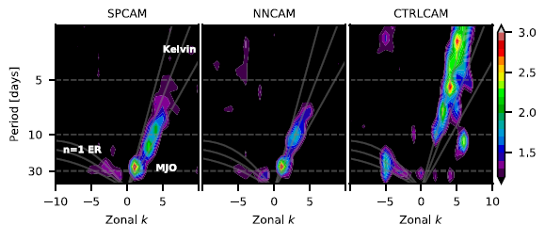
B. Zonally averaged temporal SD of convective and radiative subgrid heating rates Tphy.
Space–time spectrum of the equatorially symmetric component of
15S–15N daily precipitation anomalies
Rasp et al. 2018

Slide 50

High-resolution constraints
machine learning from high-resolution cloud-resolving models
HiRes
model
Machine
learning
model
Precipitation
Radiation
Gentine P., Pritchard M., Rasp S., Reinaudi G., GRL, 2018
Rasp, Pritchard and Gentine, PNAS 2018

Slide 51


Our approach to improve the convection in operational GFS forecast using DL
Using SP-CFS CRM tendencies for 1 year to train and build the deep layers.
Use the output of trained tendencies in the GFS similar to what has been done for SP-CFS.
Test the NNGFS in forecast mode

Slide 52
Concluding remarks
A realistic representation of clouds, however, remains a challenge in current climate modeling.
Here, further model improvements, stemming from higher resolution (Palmer & Stevens, 2019)
or
completely novel approaches to parameterize clouds and convection in climate models such as, for instance, machine learning based cloud parametrizations (Gentine et al., 2018; Rasp et al., 2018)
are required to make further progress toward more realistic simulations of clouds with climate models. (Bock et al. 2020)
First studies suggest that the causes might be improvements in the representation of mixed‐phased clouds, which leads to changes in cloud feedbacks and in the shortwave component of the cloud feedback in particular. It is noteworthy that cloud‐radiation interactions and in particular the shortwave cloud radiative effect in CMIP6 models are closer to observations than in previous generations of climate models.

Slide 53
Thank You !

Slide 54

Wedi et al. 2020, JAMES

