Slide 1
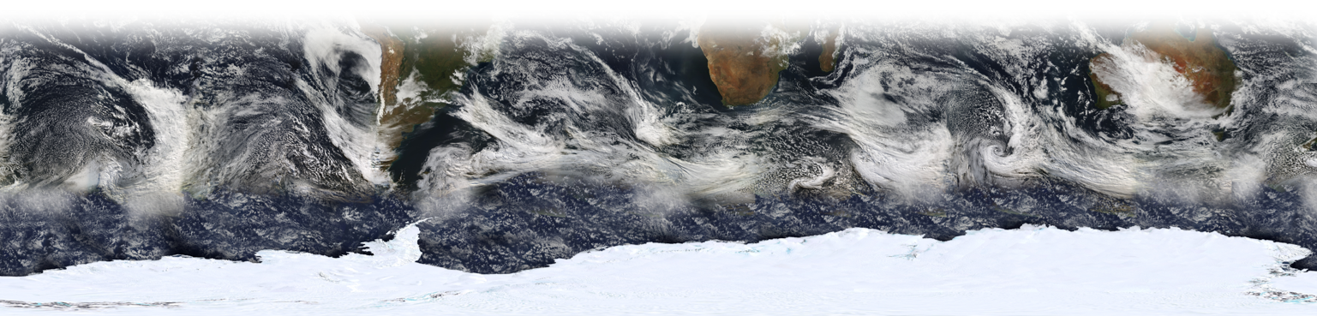
Changing polar atmosphere-ocean-sea-ice interactions with the general circulation
Lecture 2
Tom Bracegirdle
British Antarctic Survey
Summer school on Polar Climates
ICTP, Trieste, Italy - July 22-28, 2024
NASA MODIS Image 11 July 2005

Slide 2

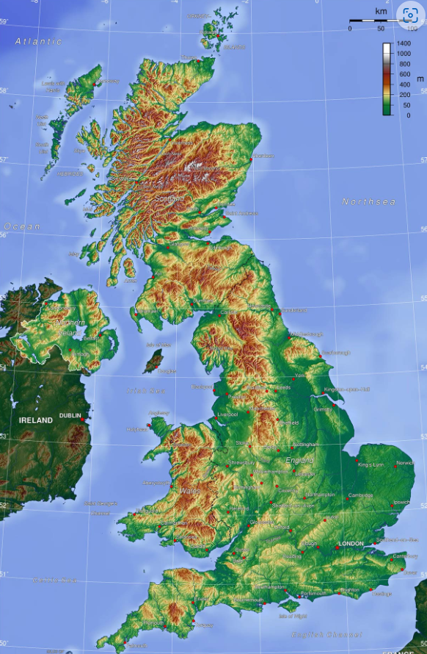
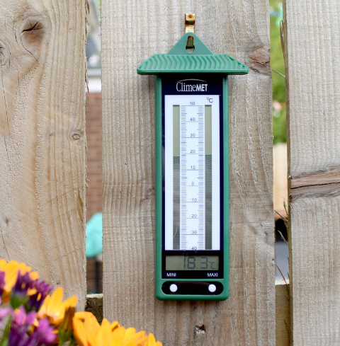
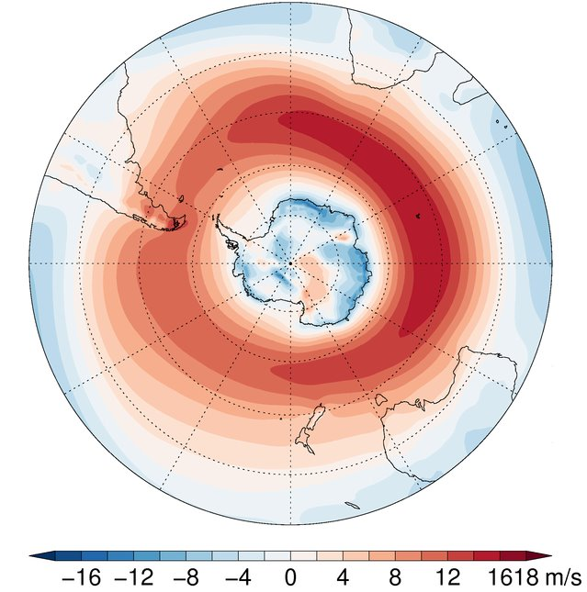
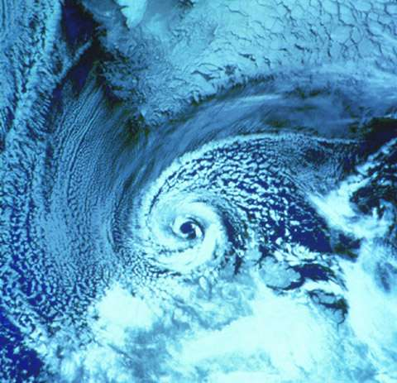
Introduction
Weather!
Larger Scale atmospheric dynamics and climate change (BAS)
Polar storms
(PhD Reading)

Slide 3
Cove Bay, Aberdeen
Source: Tripadvisor
Introduction

Slide 4
Introduction
Weather!
Larger Scale atmospheric dynamics and climate change (BAS)
Polar storms
(PhD Reading)

Slide 5
Summary
Dynamics of the eddy driven jet and its behaviour under climate change including the roles of ocean/seaice coupling.
How will climate change affect ocean-ice-atmosphere coupling?
Antarctic extreme weather and climate events in the context of changes in sea ice and the westerlies/storm track.

Slide 6
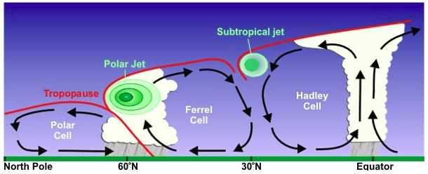
Pole
60 N/S
30 N/S
Graphic: NOAA
Tropopause height decreases towards the poles
The subtropical jet is higher (~100hPa) than the polar jet (~300hPa)

Slide 7
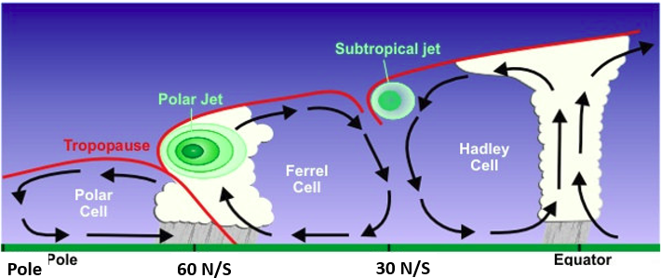
Polar Jet
Found at latitudes from 30 to 70°
Between 300 - 200 hPa (about 7.5–11 km above sea level).
Strongest during winter when it occasionally migrates to tropical latitudes and merges with the subtropical jet.
Forms in the region of strong temperature gradients between cold, polar air and warmer mid-latitude air masses.

Slide 8
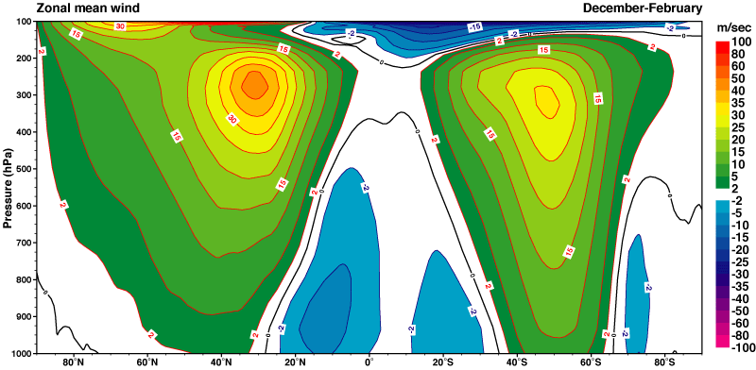
Climatological mean jet (DJF)
ERA-40 Atlas
Northern Hemisphere
(Winter)
Southern Hemisphere
(Summer)

Slide 9
Subtropical jet (STJ)
Found at latitudes from 20° to 35°
Usually strongest at 200 - 100 hPa (11 - 14km)
During winter, the STJ is nearly continuous in both hemispheres and has wind speeds of 75 to 100 ms-1
The STJ exists all year in the Southern Hemisphere.
The STJ is intermittent in the Northern Hemisphere during summer (not always present)
Forms between mid-latitude air masses and tropical air masses

Slide 10
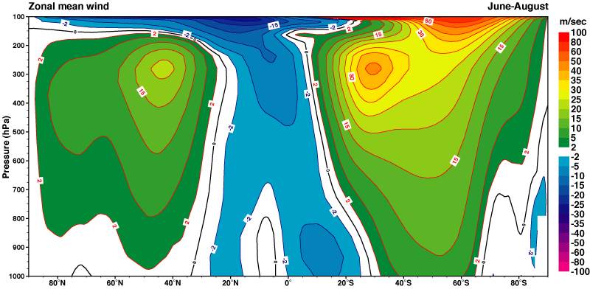
Climatological mean jet (JJA)
ERA-40 Atlas
Northern Hemisphere
(Summer)
Southern Hemisphere
(Winter)

Slide 11
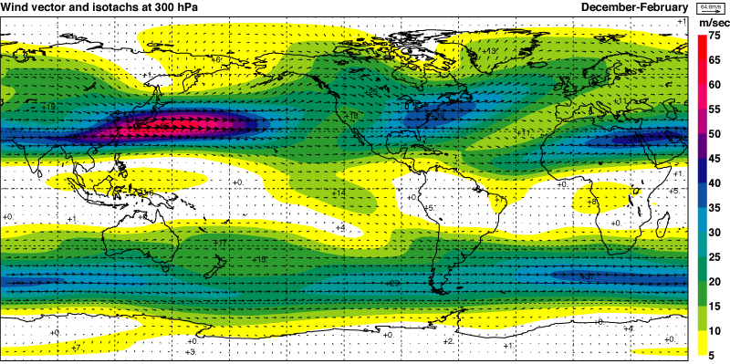
Climatological mean jet (DJF)
ERA-40 Atlas
Jets are strongest in the Northern (winter) hemisphere North Atlantic jet is tilted
Northern hemisphere sub-tropical jet clear over north Africa
Southern hemisphere jet is quite zonal

Slide 12
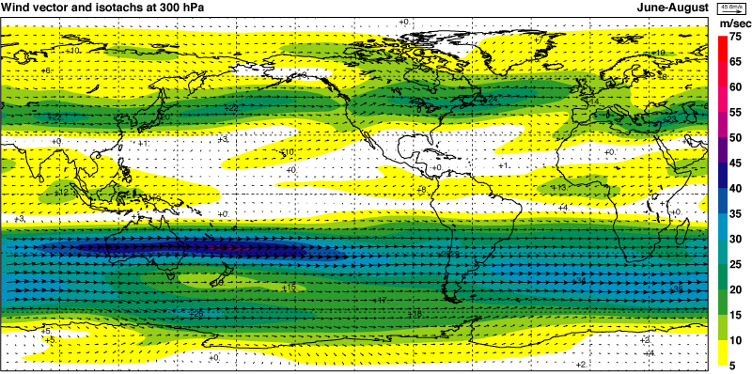
Climatological mean jet (JJA)
ERA-40 Atlas
Jets are strongest in the Southern (winter) Hemisphere “Spiral” type of jet in the Southern Hemisphere - from south America the jet spirals in towards Antarctica.
Split jet (e.g. polar jet and a subtropical jet) exist to the east of Australia

Slide 13

Time mean zonal momentum budget
Coriolis term
Momentum flux terms
Additional parameterised processes (gravity wave drag, diffusion)
Surface friction (wind stress)
Simpson et al. (2014)

Slide 14
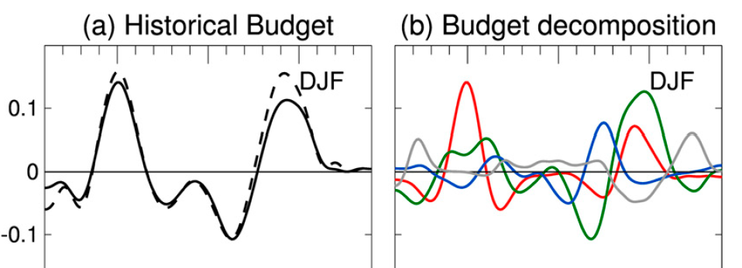
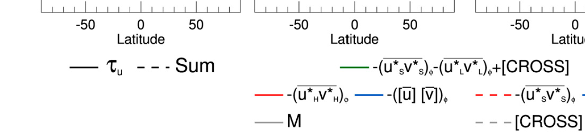
Transient and stationary eddy contributions to momentum budget
high-frequency meridional momentum flux,
zonal-mean advection,
Mountain torque,
combined stationary, low-frequency, and cross-frequency contribution.
Simpson et al. (2014)
The high-frequency meridional eddy momentum flux convergence maintains the westerly wind stress
The lower-frequency/stationary eddy momentum flux convergence acts to broaden the jet

Slide 15
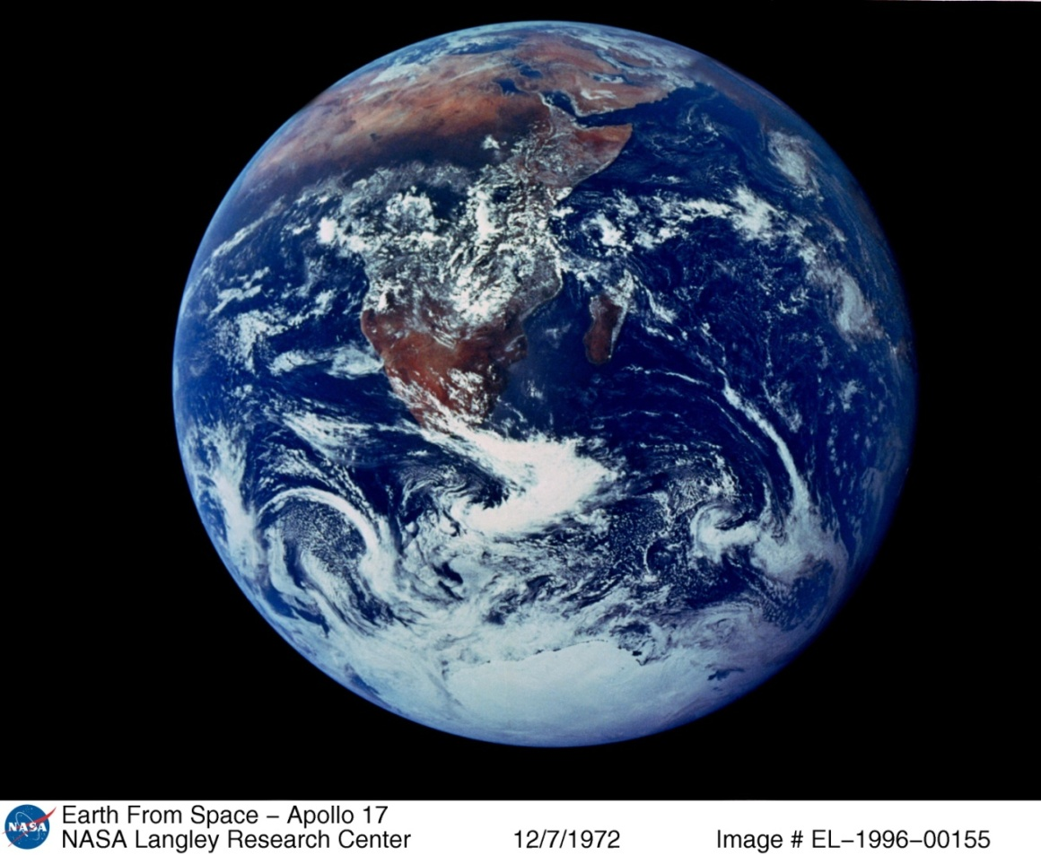
Transient and stationary eddy contributions to momentum budget
high-frequency meridional momentum flux,
zonal-mean advection,
Mountain torque,
combined stationary, low-frequency, and cross-frequency contribution.
Simpson et al. (2014)
The high-frequency meridional eddy momentum flux convergence maintains the westerly wind stress
The lower-frequency/stationary eddy momentum flux convergence acts to broaden the jet

Slide 16
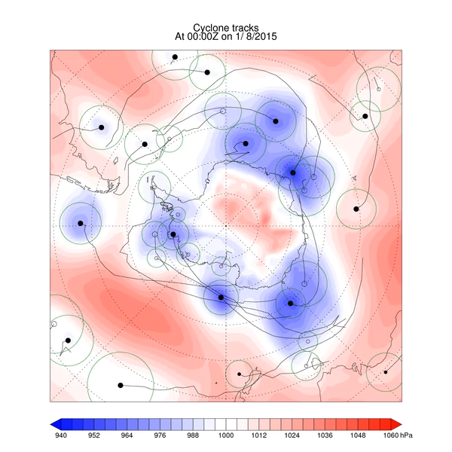
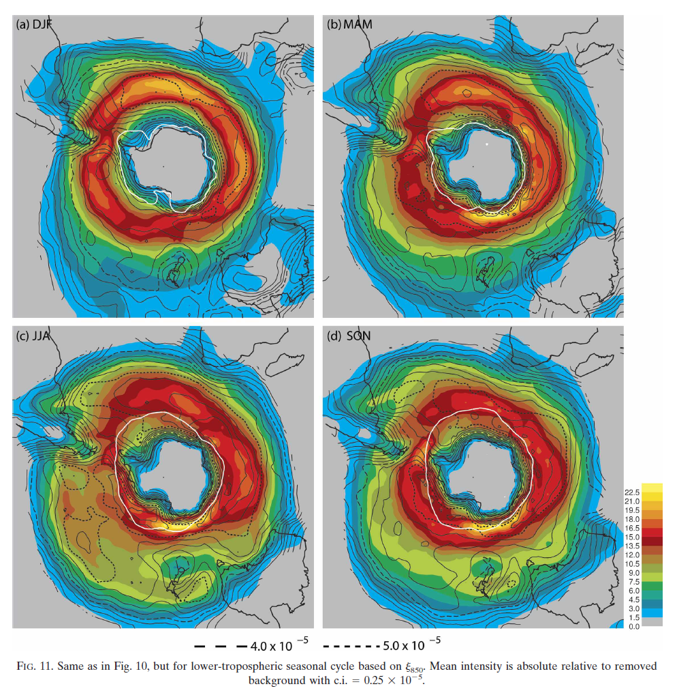
The storm track perspective
Hoskins and Hodges (2005)

Slide 17
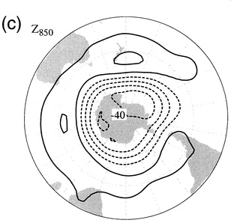
The Southern Annular Mode (SAM)
Circumpolar westerlies or ‘jet’
Thompson and Wallace (2000)
Annual mean westerly winds in the lower atmosphere (850 hPa). Climatology over the period 1979-2014.
High and low SAM index states maintained by transient eddy feedbacks (e.g. cyclones)

Slide 18
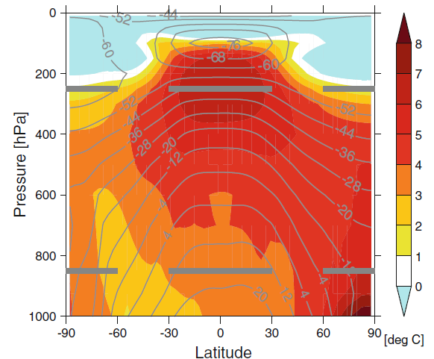
Climate projections
The SH is dominated by upper-level meridional temperature gradient changes
Weak ‘polar amplification’
This can help to explain the more consistent simulated SH poleward shift than for the NH
Harvey et al. (2014)

Slide 19
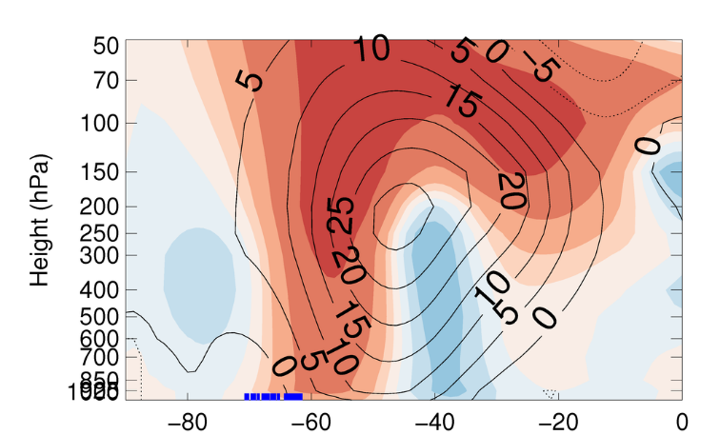
CMIP5 ensemble mean zonal mean westerly wind climatologies (lines) and RCP8.5 21st century responses (filled contours).
Simulated historical sea ice edges
Bracegirdle et al. (2018)

Slide 20
CMIP5 future projections
Key points
CMIP5 projections (high emissions RCP8.5) give:
Increases in upper-level equator-to-pole (meridional) temperature gradient
  In general this acts to strengthen the jet and shift it poleward
Decreases in lower-level meridional temperature gradient (e.g. polar amplification or sea ice retreat*)
  In general this acts to weaken the jet and shift it equatorward
*Across the CMIP5 models stronger Antarctic amplification is strongly correlated with more retreat of sea ice (r = -0.88)
The SH is dominated by upper-level meridional temperature gradient changes
Weak ‘polar amplification’
This can help to explain the more consistent simulated SH poleward shift than for the NH
Harvey et al. (2014)

Slide 21
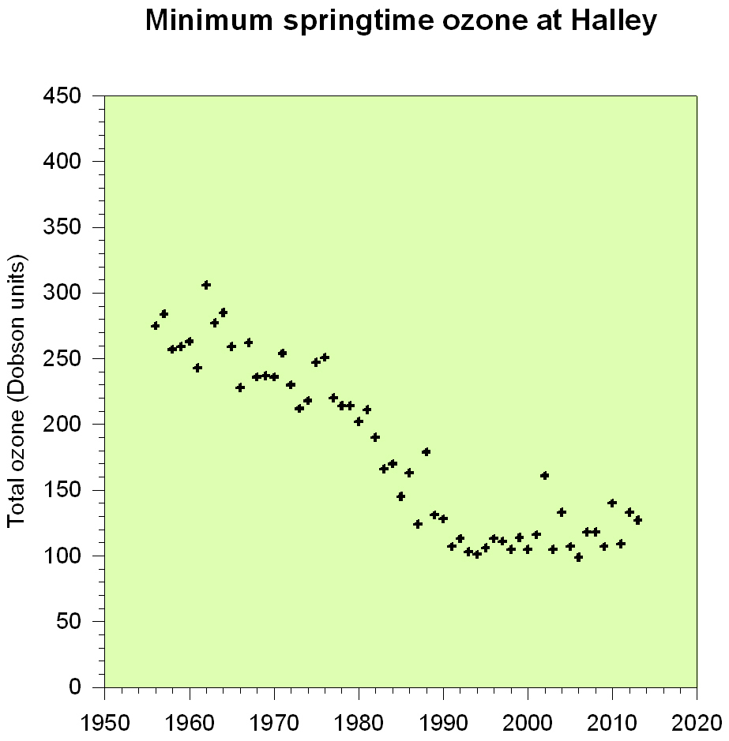
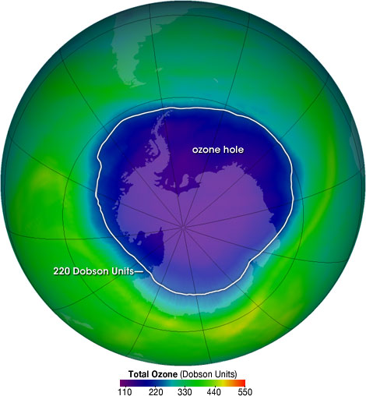
The ozone hole
Stratospheric ozone
Courtesy of Jonathan Shanklin, BAS
NASA/Goddard Space Flight Center
Scientific Visualization Studio

Slide 22
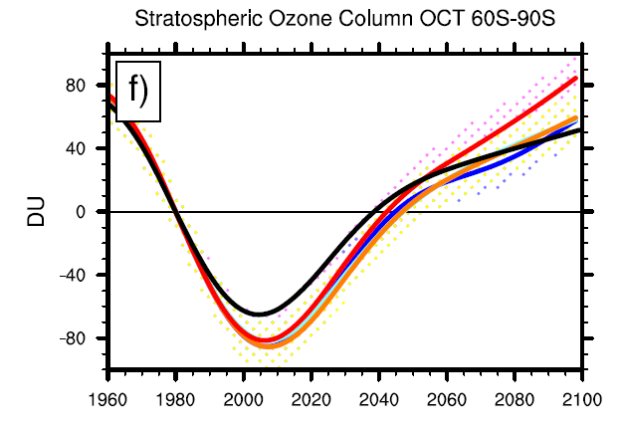
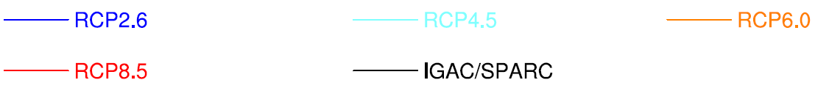
Stratospheric ozone
Eyring et al. (2013)

Slide 23
Ozone depletion and meridional temperature gradients
Ozone depletion is associated with a cooling above Antarctica in the lower stratosphere.
Increases the meridional temperature gradient
Acts to induce a strengthening and poleward shifting of the jet (more positive polarity of the SAM)
Wilcox et al. (2012)

Slide 24
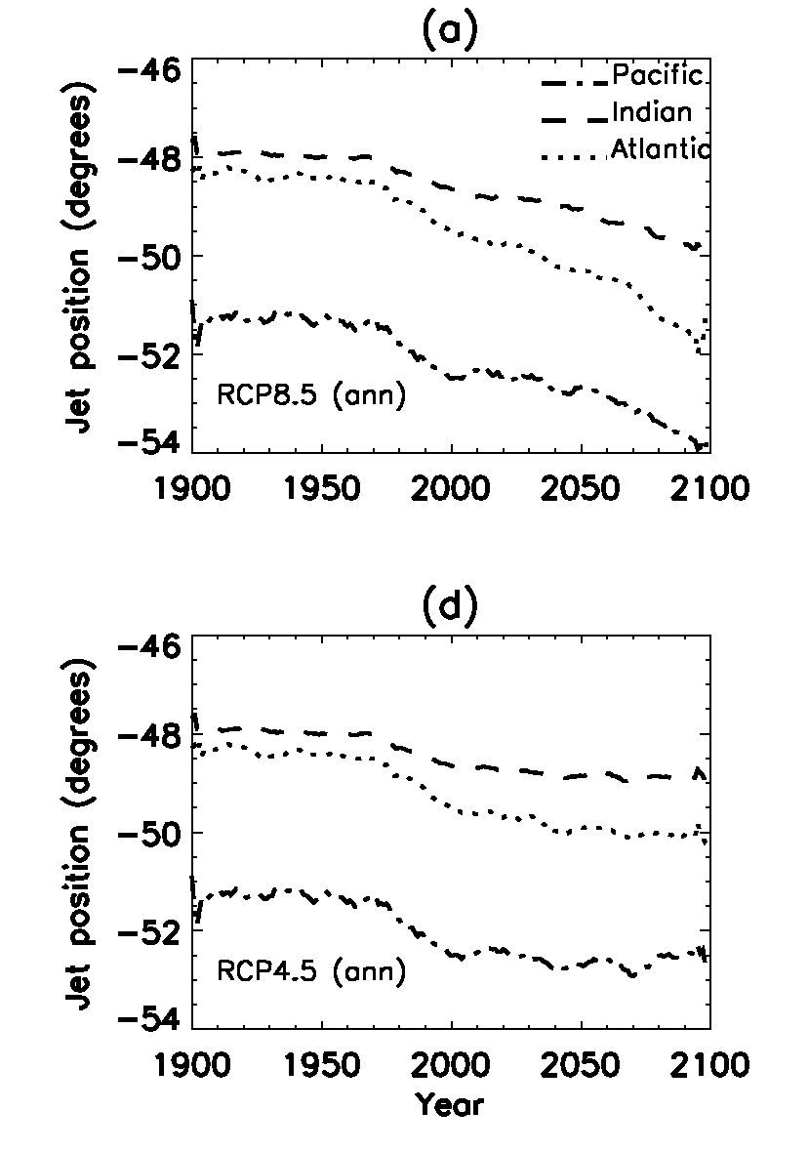
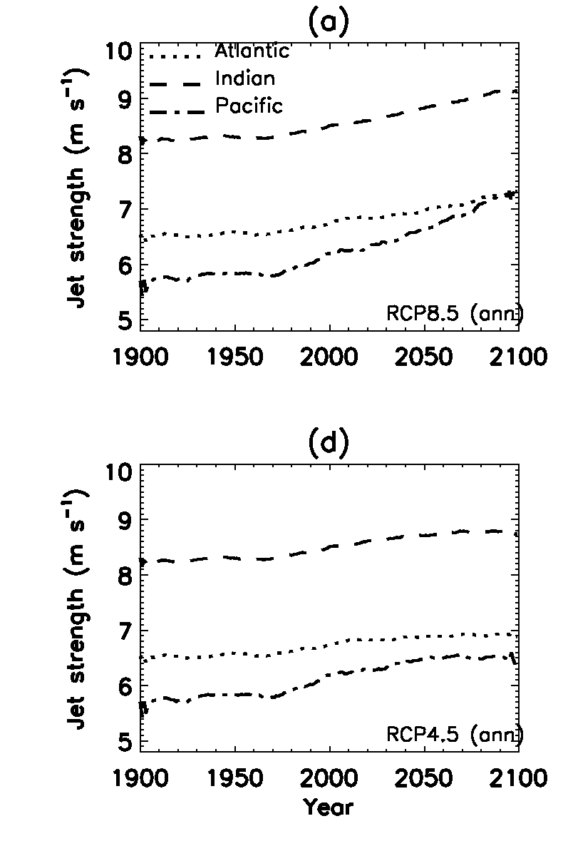
Climate model westerly jet projections
Position
Strength
High
emissions
Medium
Emissions
Bracegirdle et al. (2013)

Slide 25

… but models give a range of responses! Why?
Clouds and short-wave radiation
  SW cloud radiative changes strongly enhance the equator-to-pole temperature gradient (e.g. Ceppi et al., 2014)
Internal atmospheric dynamics
  Eddy feedbacks and momentum transport (Barnes et al., 2010; Simpson et al. 2012)
The coupled system
  The SST effect gives much more jet strengthening than CO2 alone (e.g. atmosphere-only 4xCO2 experiments of Grise and Polvani, 2014).
  Links to sea ice

Slide 26
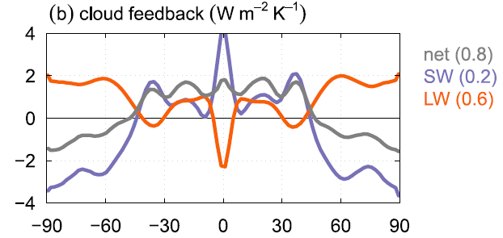
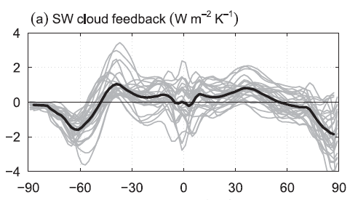
Clouds and circulation response
The SW cloud effect causes a weak temperature increase in the tropics and lower midlatitudes and strong cooling at high latitudes
(Fig. 2b) – Different components of cloud feedback
Ceppi and Hartmann (2015)
The effect of clouds on circulation results mainly from the SW cloud radiative changes
strongly enhance the equator-to-pole temperature gradient, favouring stronger and poleward-shifted midlatitude eddies.
AMIP4XCO2 feedbacks (Fig. 7a)

Slide 27
… but models give a range of responses! Why?
Clouds and short-wave radiation
  SW cloud radiative changes strongly enhance the equator-to-pole temperature gradient (e.g. Ceppi et al., 2014)
Internal atmospheric dynamics
  Eddy feedbacks and momentum transport (Barnes et al., 2010; Simpson et al. 2012)
The coupled system
  The SST effect gives much more jet strengthening than CO2 alone (e.g. atmosphere-only 4xCO2 experiments of Grise and Polvani, 2014).
  Links to sea ice

Slide 28
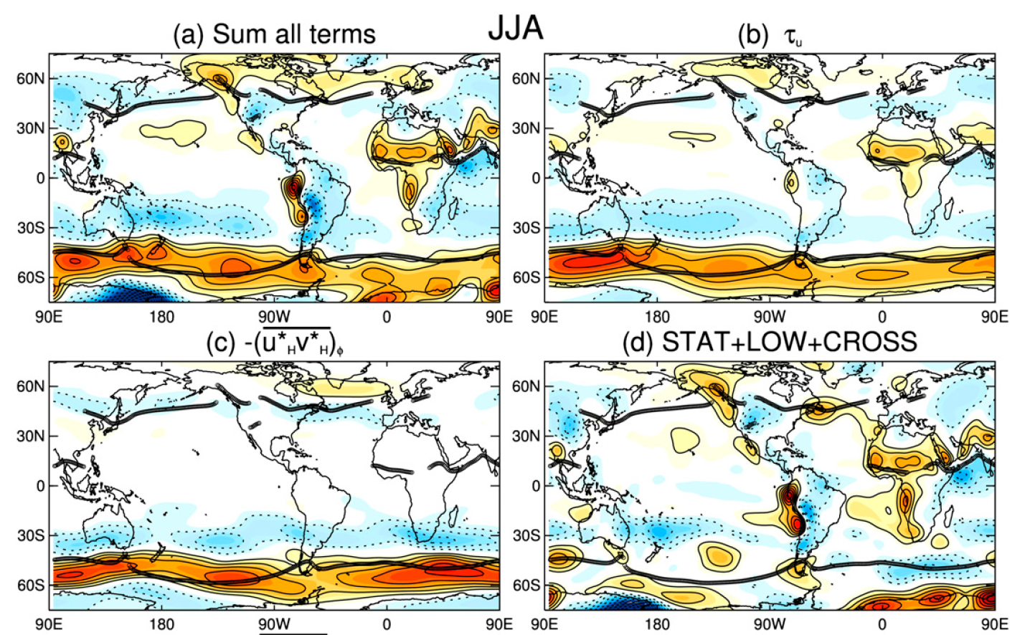
The dominance of transient eddies in balancing the wind projections
In the SH, the zonally symmetric poleward shifting of the surface wind stress is maintained by high frequency eddy momentum flux -(u_{H}*v_{H}*).
In the SH, the -(u_{H}*v_{H}*) response is relatively zonally symmetric, despite the asymmetry of the climatological SH jet and (u_{H} *v_{H}*).

Slide 29
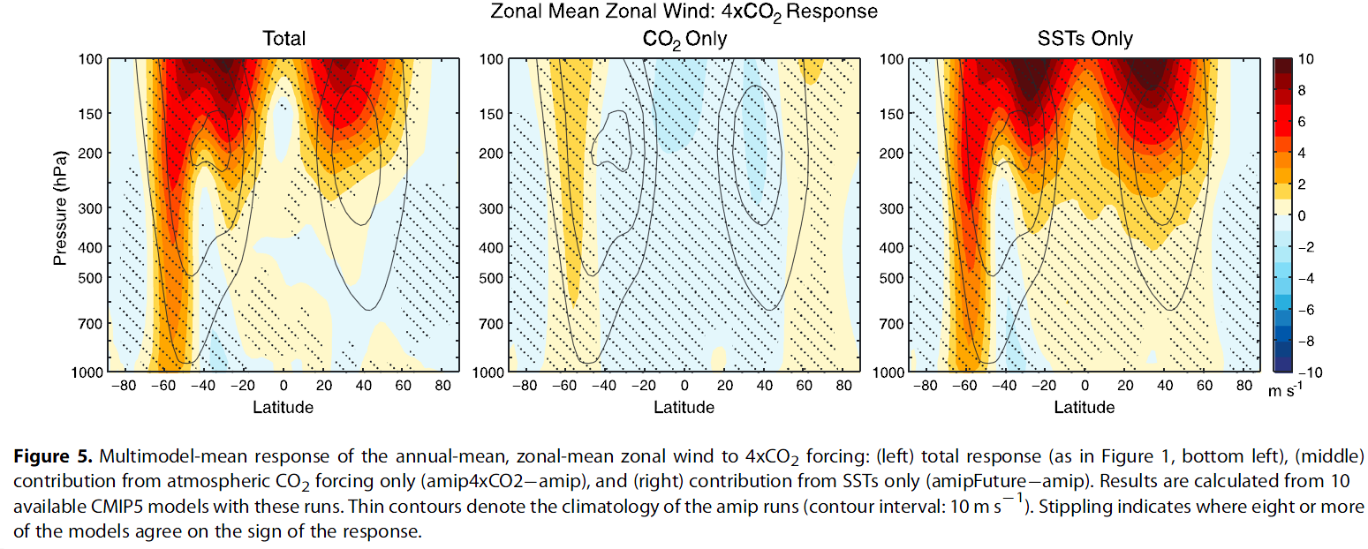
… but models give a range of responses! Why?
Clouds and short-wave radiation
  SW cloud radiative changes strongly enhance the equator-to-pole temperature gradient (e.g. Ceppi et al., 2014)
Internal atmospheric dynamics
  Eddy feedbacks and momentum transport (Barnes et al., 2010; Simpson et al. 2012)
The coupled system
  The SST effect gives much more jet strengthening than CO2 alone (e.g. atmosphere-only 4xCO2 experiments of Grise and Polvani, 2014).
  Links to sea ice

Slide 30
Major impacts of sea-surface temperature changes
  The SST effect gives much more jet strengthening than CO2 alone (e.g. atmosphere-only 4xCO2 experiments of Grise and Polvani, 2014).

Slide 31
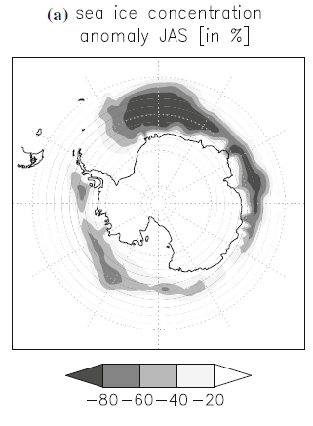
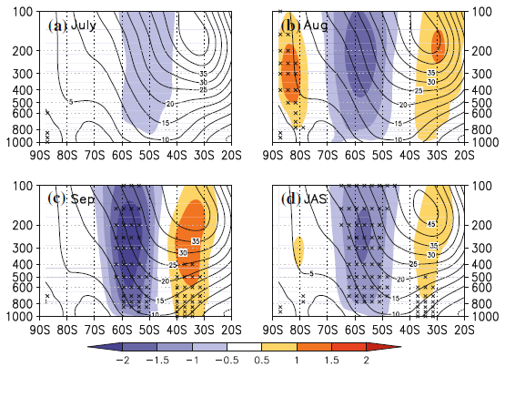
Impact of sea ice on the SH mid latitude jet
Westerly wind responses
Bader et al. (2013)

Slide 32
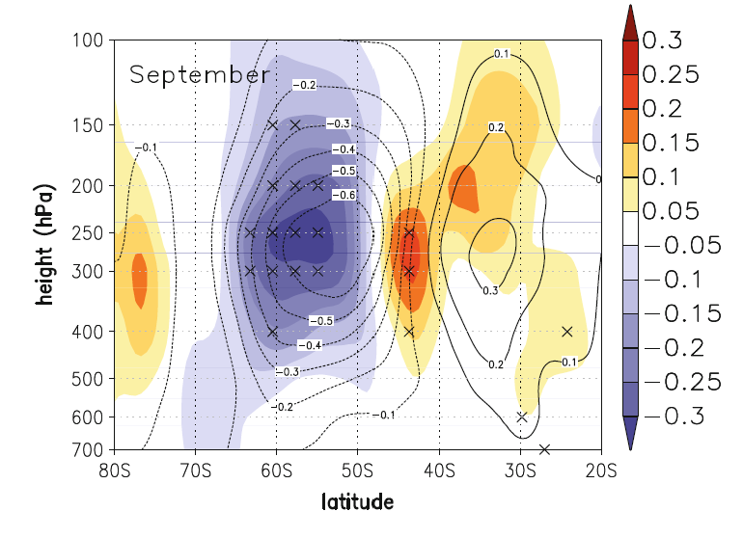
Impact of sea ice on the SH mid latitude jet
Momentum flux forcing from transient eddies
Westerly wind responses
Bader et al. (2013)

Slide 33
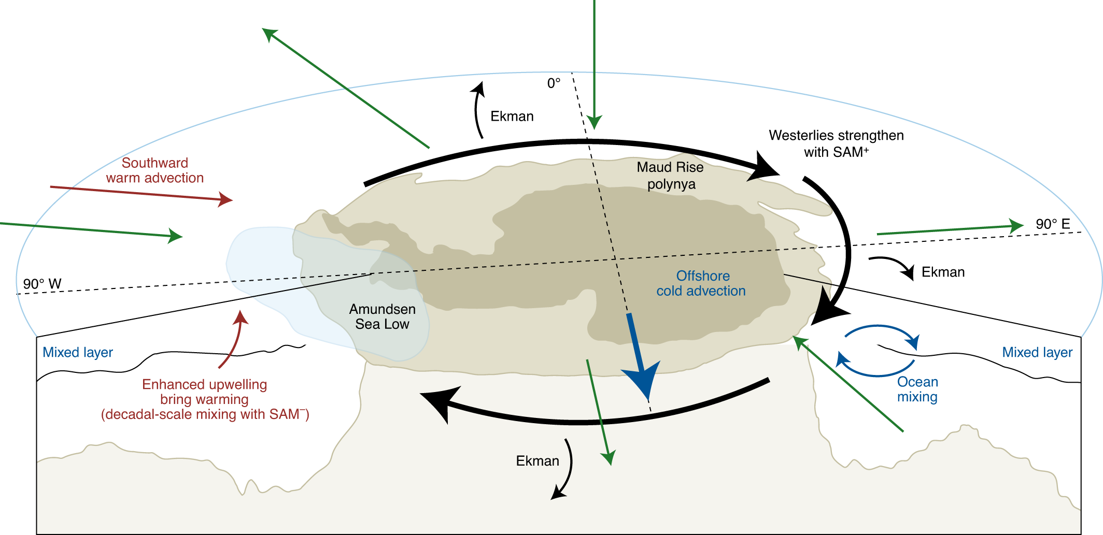
Impact of the SH mid latitude jet on sea ice
SAM⁺ is associated with stronger, poleward shifted, the westerlies.
On seasonal and interannual timescales, this can lead to increased sea-ice cover.
On decadal timescales, strengthened westerlies upwell warm, deep waters to the surface (small red arrow), leading to decreased sea-ice cover.
Eayrs (2021)
Notes:
Causes and consequences of Arctic amplification,
the recent rapid changes in Antarctica,
jet-stream/ice/ocean interactions,
hydroclimate change,
and changing extremes in polar climate.
Consistency and discrepancy between observations and models, and lessons learned from idealized model sensitivity experiments.

Slide 34
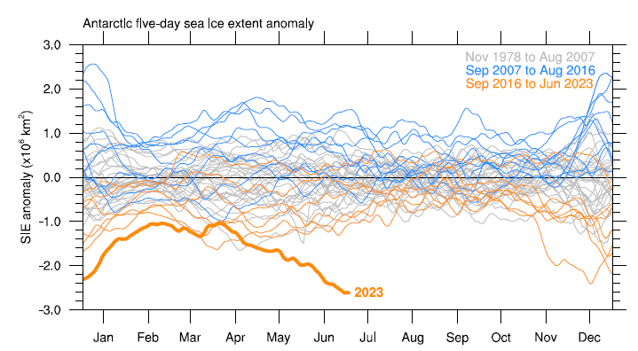
Are atmosphere-sea ice linkages changing and how might they change in the future?
Purich and Doddridge (2023)
Suggested breakdown in Southern Annular Mode-sea ice relationship.
Possibility that Antarctic sea ice has entered a new regime in which previously important relationships no longer dominate sea ice variability.

Slide 35
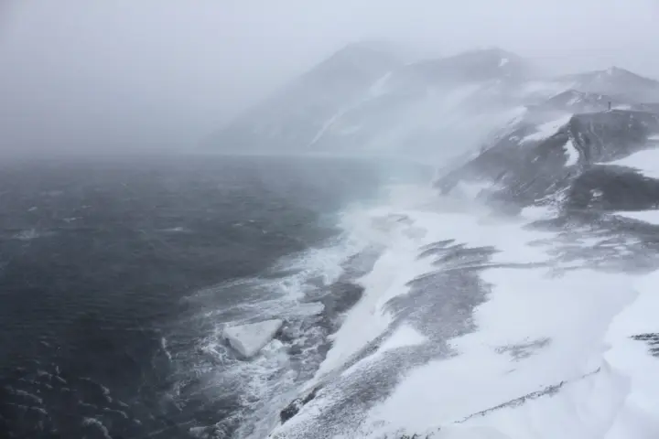

Extreme weather and climate events in a changing climate – Antarctic perspective
Source: The Independent

Slide 36
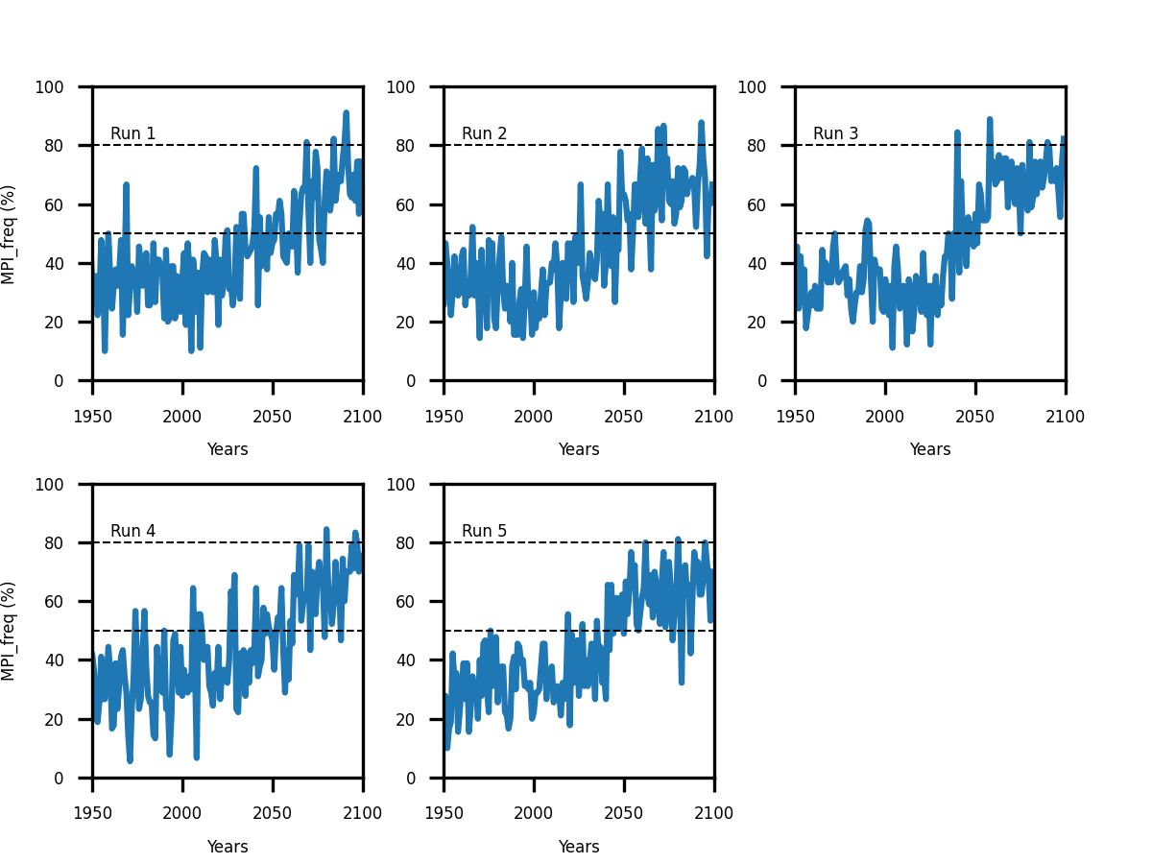
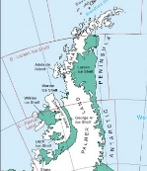
Using large ensembles to study extreme events in a changing climate
Summer ‘melt potential’ over the Wilkins Ice Shelf
One simulation:
Steady background change through 21st century with values reaching 80% in some years before 2100.
Time series of summer (DJF) surface “melt potential index” (Orr et al., 2023) that describes the frequency (MPI-freq, %) of daily maximum summer temperatures exceeding a melt threshold of 273.15 K over the location of the Wilkins Ice Shelf (71°S, 72°W)) from low-resolution CMIP6 global simulations of the UK Met Office HadGEM3 climate model. Ensemble members are shown all following identical emissions scenarios, ‘historical’ up to present day and SSP2-4.5 through to year 2100.

Slide 37
Using large ensembles to study extreme events in a changing climate
Summer ‘melt potential’ over the Wilkins Ice Shelf
Two simulations:
Quite similar evolutions.
Time series of summer (DJF) surface “melt potential index” (Orr et al., 2023) that describes the frequency (MPI-freq, %) of daily maximum summer temperatures exceeding a melt threshold of 273.15 K over the location of the Wilkins Ice Shelf (71°S, 72°W)) from low-resolution CMIP6 global simulations of the UK Met Office HadGEM3 climate model. Ensemble members are shown all following identical emissions scenarios, ‘historical’ up to present day and SSP2-4.5 through to year 2100.

Slide 38
Using large ensembles to study extreme events in a changing climate
Summer ‘melt potential’ over the Wilkins Ice Shelf
Five simulations:
Large differences in year-to-year variability between runs 3 and 4.
Very rapid shift in 2030s and 2040s in run 3.
Time series of summer (DJF) surface “melt potential index” (Orr et al., 2023) that describes the frequency (MPI-freq, %) of daily maximum summer temperatures exceeding a melt threshold of 273.15 K over the location of the Wilkins Ice Shelf (71°S, 72°W)) from low-resolution CMIP6 global simulations of the UK Met Office HadGEM3 climate model. Ensemble members are shown all following identical emissions scenarios, ‘historical’ up to present day and SSP2-4.5 through to year 2100.

Slide 39
Using large ensembles to study extreme events in a changing climate
Summer ‘melt potential’ over the Wilkins Ice Shelf
Five simulations:
Large differences in year-to-year variability between runs 3 and 4.
Very rapid shift in 2030s and 2040s in run 3.
Time series of summer (DJF) surface “melt potential index” (Orr et al., 2023) that describes the frequency (MPI-freq, %) of daily maximum summer temperatures exceeding a melt threshold of 273.15 K over the location of the Wilkins Ice Shelf (71°S, 72°W)) from low-resolution CMIP6 global simulations of the UK Met Office HadGEM3 climate model. Ensemble members are shown all following identical emissions scenarios, ‘historical’ up to present day and SSP2-4.5 through to year 2100.

Slide 40
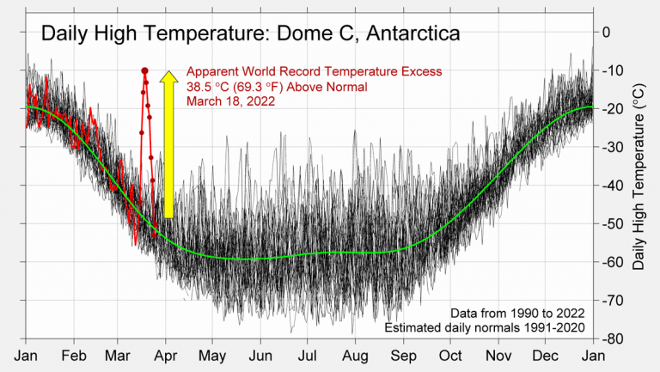
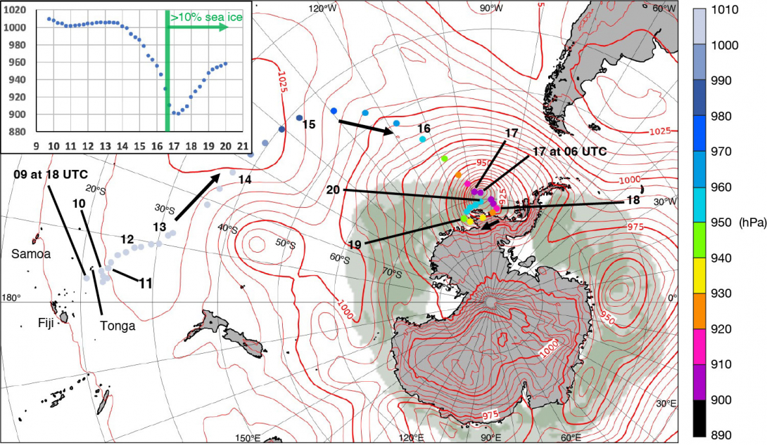
Recent examples of extreme weather events
October 2022: The deepest extratropical cyclone of modern times?
March 2022: East Antarctic ‘heat’ wave
Source: Berkely Earth https://berkeleyearth.org/antarctic-heatwave-rapid-attribution-review-dome-c-record/
Source: https://www.ecmwf.int/en/newsletter/174/news/deepest-extratropical-cyclone-modern-times
Notes:
https://www.newscientist.com/article/2378819-uk-and-ireland-suffer-one-of-the-most-severe-marine-heatwaves-on-earth/

Slide 41
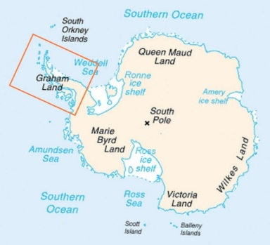
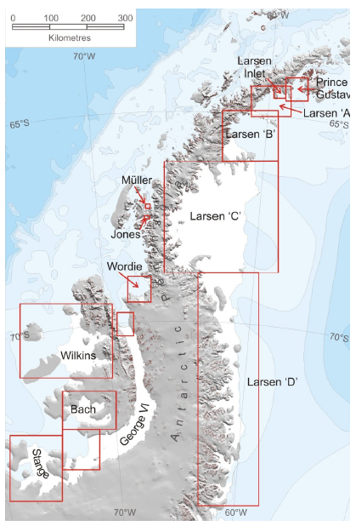
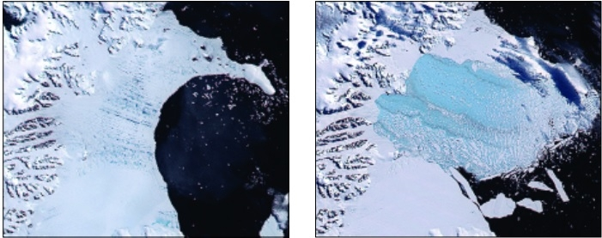
Motivation for studying extreme seasons
Larsen B Ice shelf, March 2002
Thinning, retreat and breakup of ice shelves affects sea level by allowing ice streams to flow into the ocean faster and increasing mass loss.
Anomalous summer season surface melt
Credit: NASA MODIS
Cook and Vaughan (2009)
Notes:
https://www.newscientist.com/article/2378819-uk-and-ireland-suffer-one-of-the-most-severe-marine-heatwaves-on-earth/

Slide 42
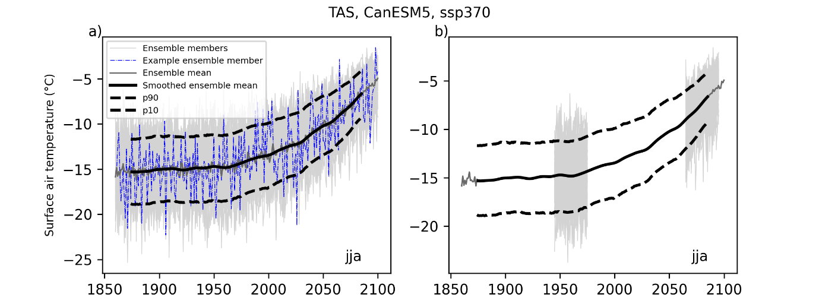
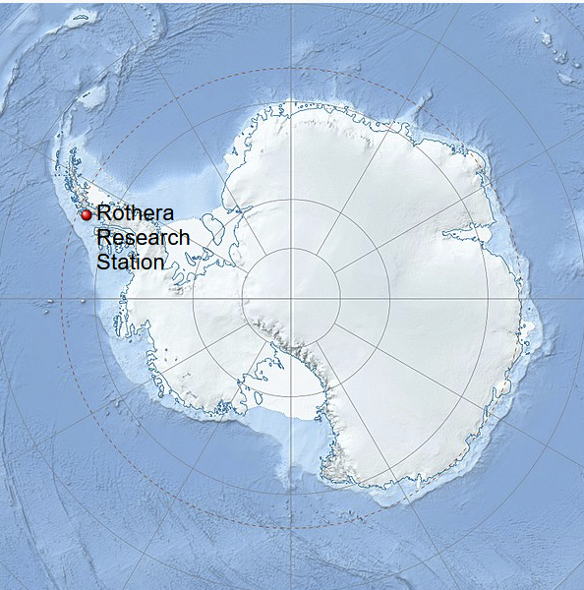
Methods
90th percentile
(p90)
2080
1960
10th percentile (p10)
Model name | Atmos grid | historical | SSP
 |  |  | 2-4.5 | 3-7.0
ACCESS-ESM1-5 | ~1.9°×1.3° | 40 | 40 | 40
CanESM5 | ~2.8°x2.8° | 65 | 50 | 50
MIROC6 | ~1.4°x1.4° | 50 | 50 | 50
MPI-ESM1-2-LR | ~1.9°x1.3° | 30 | 30 | 30
UKESM1-0-LL | ~1.9°x1.2° | 19 | 17 | 16

Slide 43
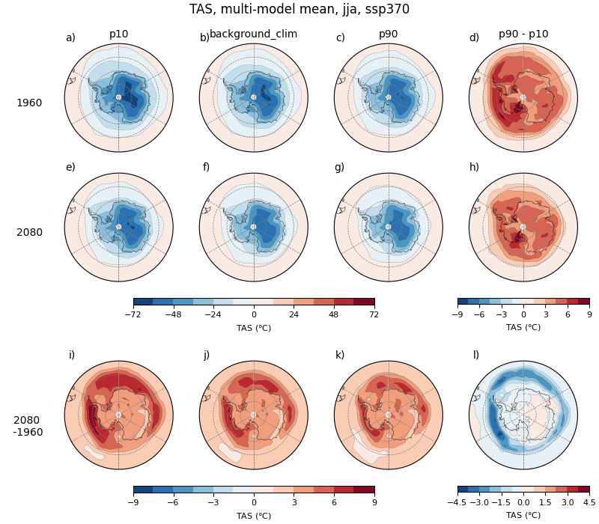
p10
background
P90
P90 – p10
Winter (JJA) surface air temperature (TAS) following SSP3-7.0.
Cold extremes warm more quickly than warm extremes, particularly in the vicinity of sea ice covered regions.
This results in a narrowing in the range between p10 and p90.
In summer (DJF) there is very little difference between responses in low and high extremes (not shown).
1960
2080
2080- 1960
Bracegirdle et al., in preparation

Slide 44
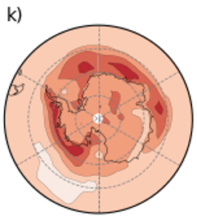
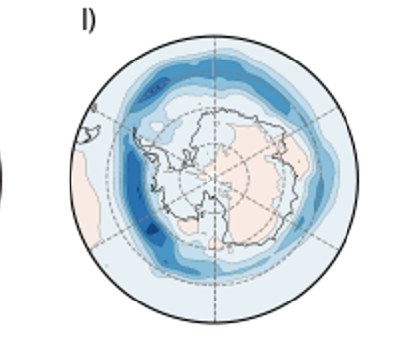
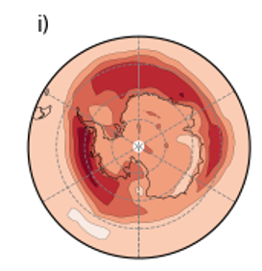
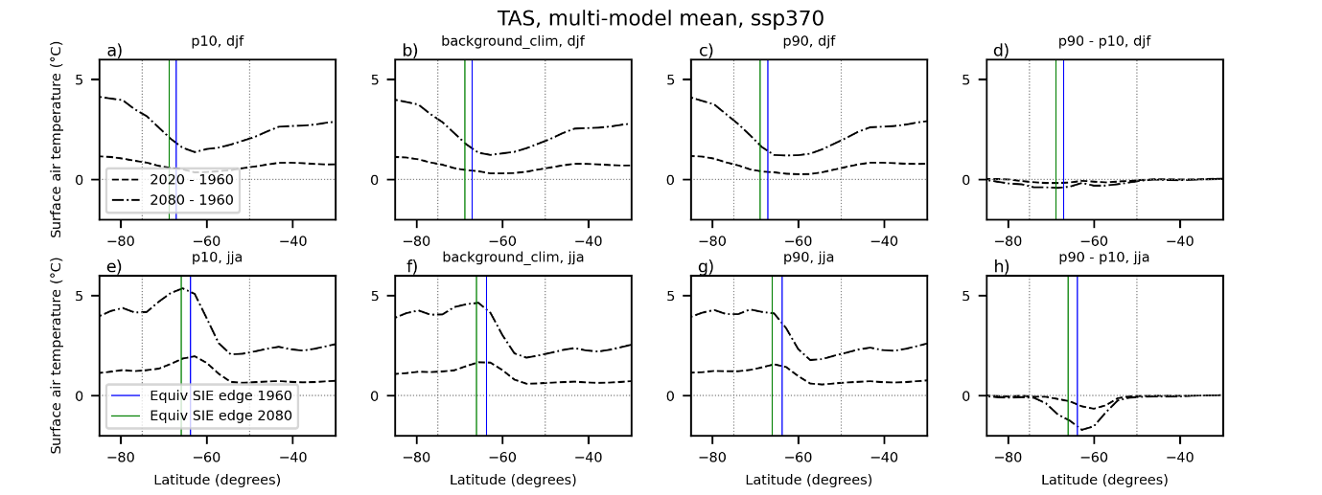

Cold extremes warm more quickly than warm extremes, particularly in the vicinity of sea ice covered regions.
Bracegirdle et al., in preparation
This results in a narrowing in the range between p10 and p90.

Slide 45
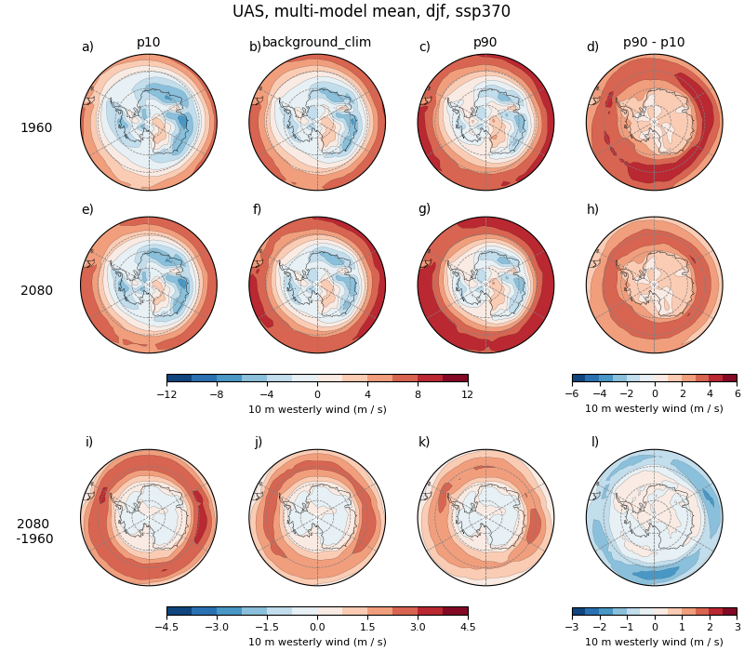
p10
background
P90
P90 – p10
Summer (DJF) near-surface zonal wind (UAS) following SSP3-7.0.
At mid latitudes weak-westerly summers increase more quickly than strong-westerly summers.
At high latitudes slightly slower increase of strong westerly extremes.
In winter (JJA) there is very little difference between responses in low and high extremes (not shown).
1960
2080
2080- 1960
Bracegirdle et al., in preparation

Slide 46



P90 – p10
Poleward shift in variability
1960
P90 – p10
2080
Change (m/s)
Time slice (m/s)
2080- 1960
Time mean jet latitude
Bracegirdle et al., in preparation

Slide 47

Summer
Winter
Surface air temperature
(NW peninsula)
Westerly wind
(NW peninsula)
Westerly wind
(S. Ocean)
Total precip
(NW Peninsula)

Slide 48
Summary
The storm track is strongly related to the southern hemisphere ‘eddy driven’ westerly jet stream
Surface conditions (SSTs and sea ice), clouds and atmospheric dynamical processes are all important in shaping projected responses in the westerlies/storm track.
Changes in background climate may already be altering key aspects of ocean-ice-atmosphere coupling and may continue to into the future.
Projected changes in sea ice area and the mid-latitude westerlies modulate simulated forcing responses of weather and climate extremes over Antarctica.

Slide 49
Changing polar atmosphere-ocean-sea-ice interactions with the general circulation
Lecture 2
Tom Bracegirdle
British Antarctic Survey
Summer school on Polar Climates
ICTP, Trieste, Italy - July 22-28, 2024
NASA MODIS Image 11 July 2005

