Slide 1


POLAR RESEARCH INFRASTRUCTURE NETWORK
Verónica Willmott Puig
POLARIN Project Manager
Alfred Wegener Institute
www.eu-polarin.eu

Slide 2
POLAR RESEARCH INFRASTRUCTURE NETWORK
Michele Rebesco
WP7 (Training) and Task 1.2 (Evlauation) leader
National Institute of Oceanography and Applied Geophysics – OGS
&
Verónica Willmott Puig
POLARIN Project Manager
Alfred Wegener Institute
www.eu-polarin.eu

Slide 3

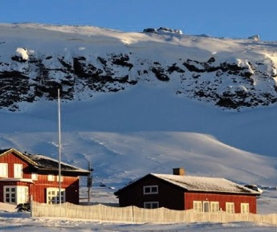
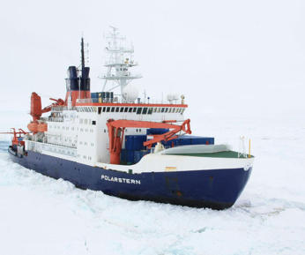
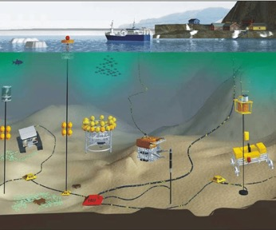
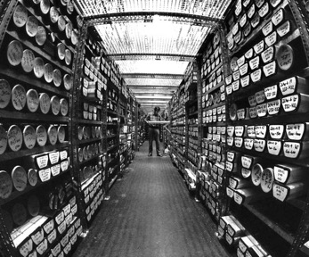
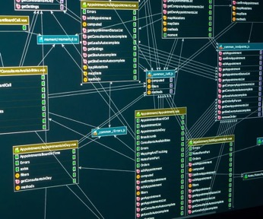
POLARIN: POLAr Research Infrastructure Network
Funded under:
HORIZON-INFRA-2023-SERV-01-01: Research infrastructure services to enable R&I addressing main challenges and EU priorities
Topic: For RI services for sustainable Arctic/polar regions
Coordinator:
52 partners
Budget: M14,6€
March 2024 – February 2029
38
Research stations
12
Polar vessels
18
Observatories
4 Ice and sediment core repositories
7 Data infrastructures
Notes:
RI (Research Infrastructures)

Slide 4





Background
2024-2029
2024-2029
2009-2023
2011-2024
2018-2022
2024-2028
2024-2029
38
Research stations
12
Polar vessels
18
Observatories
4 Ice and sediment core repositories
7 Data infrastructures
Notes:
RI (Research Infrastructures)

Slide 5
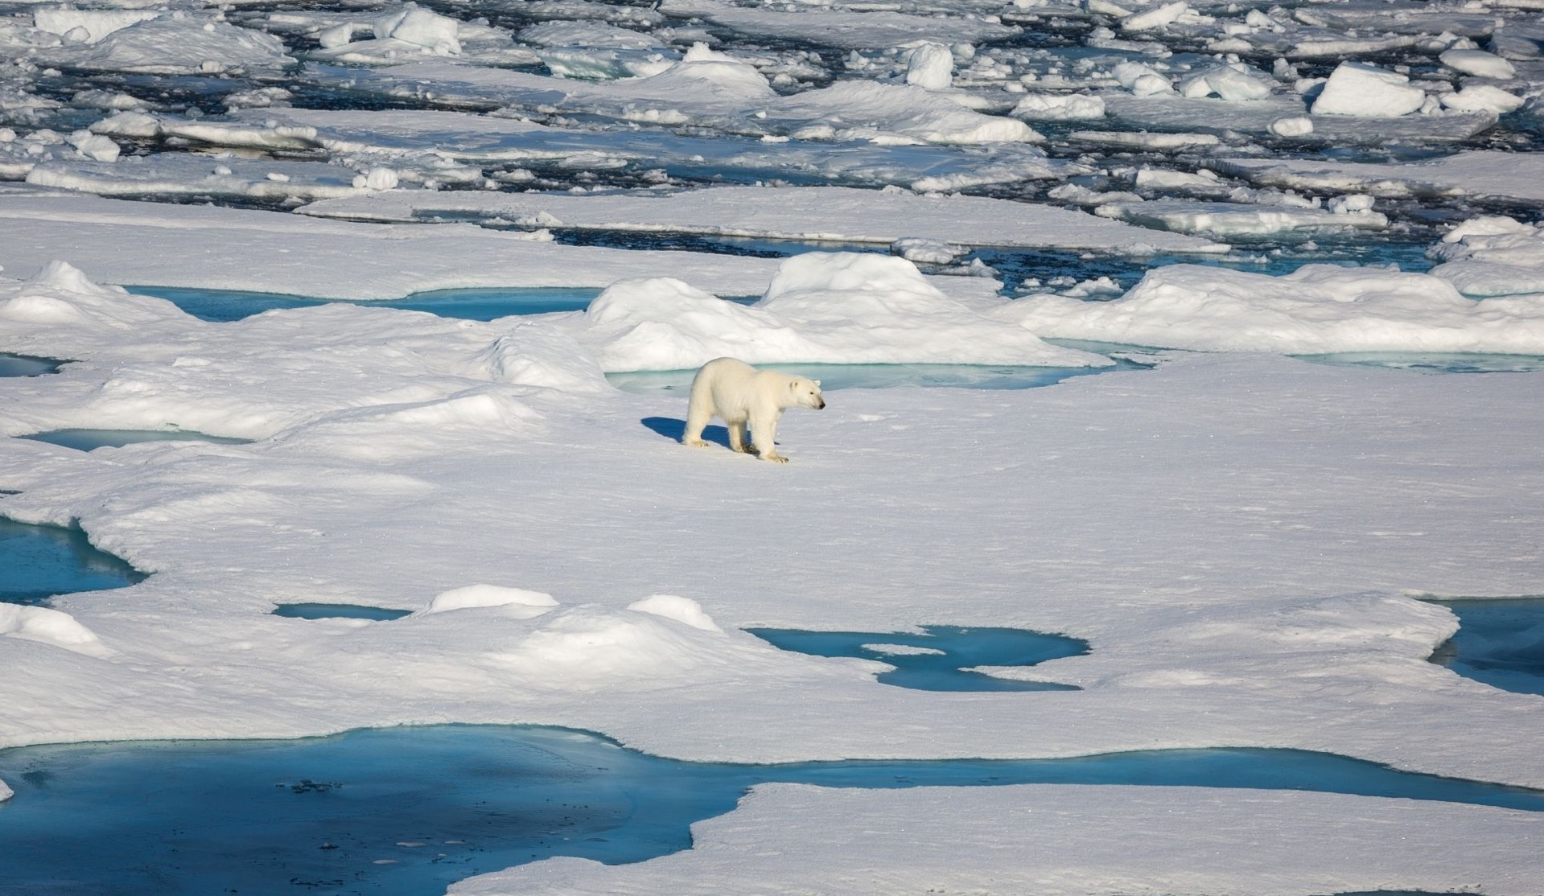
Overall aim
To provide efficient and customised RI services to address the scientific challenges of the polar regions, including access to a wide portfolio of complementary and interdisciplinary top level RIs.

Slide 6
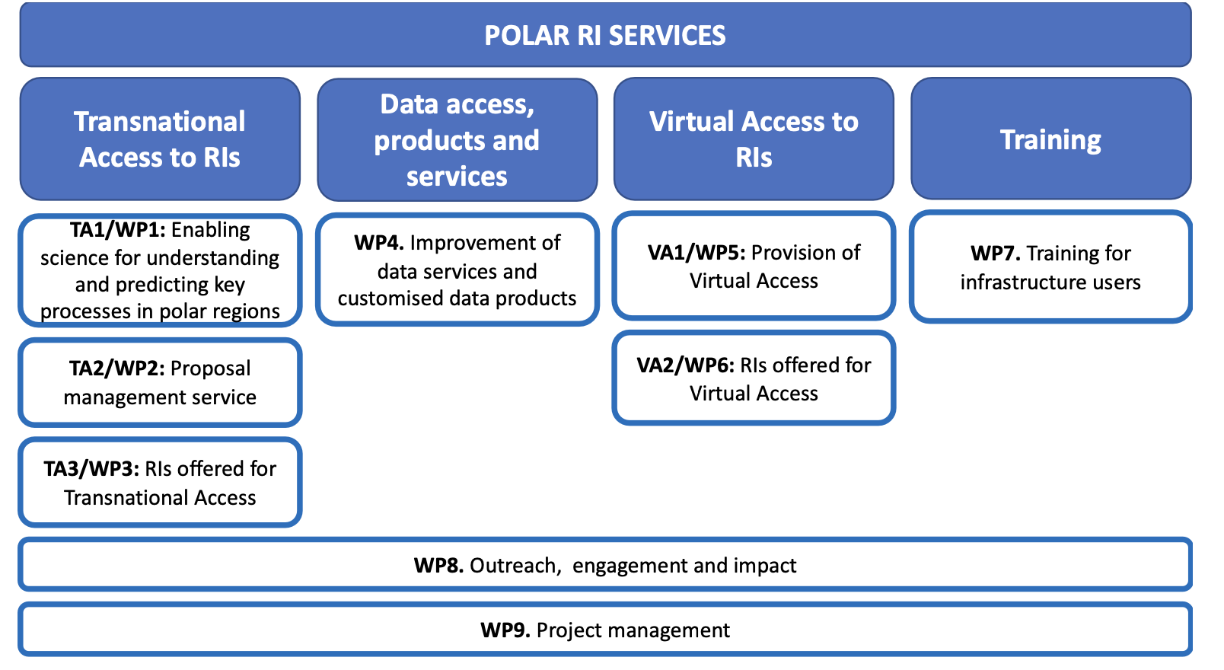
Overall structure of the work plan

Slide 7
Overall aim
Sea ice and Polar Oceans
To provide efficient and customised RI services to address the scientific challenges of the polar regions, including access to a wide portfolio of complementary and interdisciplinary top level RIs.
(paleo) climate processes
Sea level, glacier stability and melt
Key research challenges
Carbon balance and permafrost
Atmosphere dynamics
Polar ecosystems and biodiversity

Slide 8
Improve online services, data access and interoperability
Ensure that the new generations are trained to exploit the leading edge RIs
Integrate and combine the access to Arctic and Antarctic RI
Polarin will:
Notes:
RI: Research infrastructures

Slide 9




















































POLARIN Consortium
Notes:
52 partners
From 20 EU nations
And 5 non EU

Slide 10
POLARIN RESEARCH INFRASTRUCTURE
Access integration to 64 research infrastructures in both poles
38
Research stations
12
Polar vessels
18
Observatories
4 Ice and sediment core repositories
7 Data infrastructures
Notes:
RI (Research Infrastructures)

Slide 11
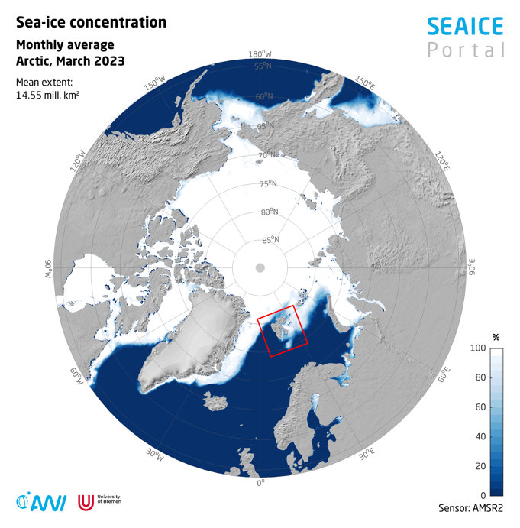

POLARIN INFRASTRUCTURE
38
Research stations
27 Arctic stations
11 Antarctic stations
www.meereisportal.de
12
Polar vessels
18
Observatories
4 Ice and sediment core repositories
7 Data infrastructures
Notes:
RI (Research Infrastructures)

Slide 12

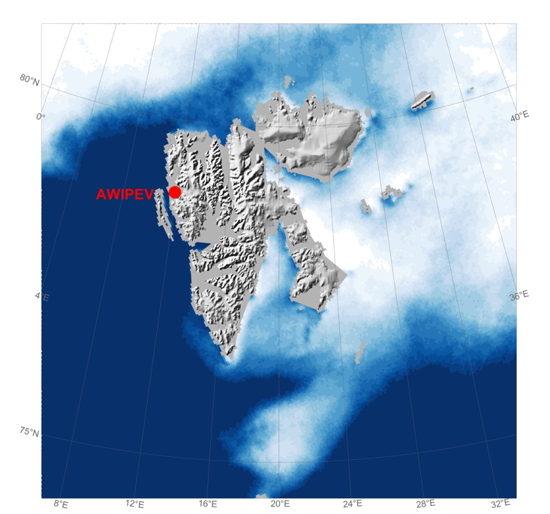
POLARIN Stations in the Arctic
Sverdrup
NERC Arctic Research Station
Base CNR Dirigibile Italia
Nicolaus Copernicus University Polar Station
Adam Mickiewicz University
Polar Station
Czech Arctic Research Station
Polish Polar Station, Hornsund
www.meereisportal.de

Slide 13








Arctic Stations
Abisko Scientific Research Station, SE
Adam Mickiewicz University Polar Station, PL
Arctic DTU Research Station, DK
Arctic Station, DK
Barrow Arctic Research Center, US
AWIPEV Base, DE + FR
Whapmagoostui-Kuujjuarapik Research Complex, CA
Greenland Institute of Natural Resources, GO
Arctic Station Dirigibile Italia, IT

Slide 14









Arctic Stations
Polish Polar Station Hornsund, PL
Kevo Subarctic Research Institute, FI
Kilpisjärvi Biological Station, FI
Koltur Research Station, FO
Oulanka research station, FI
Nicolaus Copernicus University Polar Station, PL
Pallas-Sodankylä Atmosphere-Ecosystem Supersite, FI
Rif Field Station, IS
The DMI Geophysical Observatory Qaanaaq, DK

Slide 15







Arctic Stations
Sermilik Station, DK
Sudurnes Science and Learning Center, IS
Ny-Ålesund Research Station – Sverdrup, NO
Toolik Field Station, US
UK Arctic Research Station, UK
Tarfala Research Station, SE
Villum Research Station, DK
Zackenberg Research Station, DK
Western Arctic Research Centre, CA

Slide 16
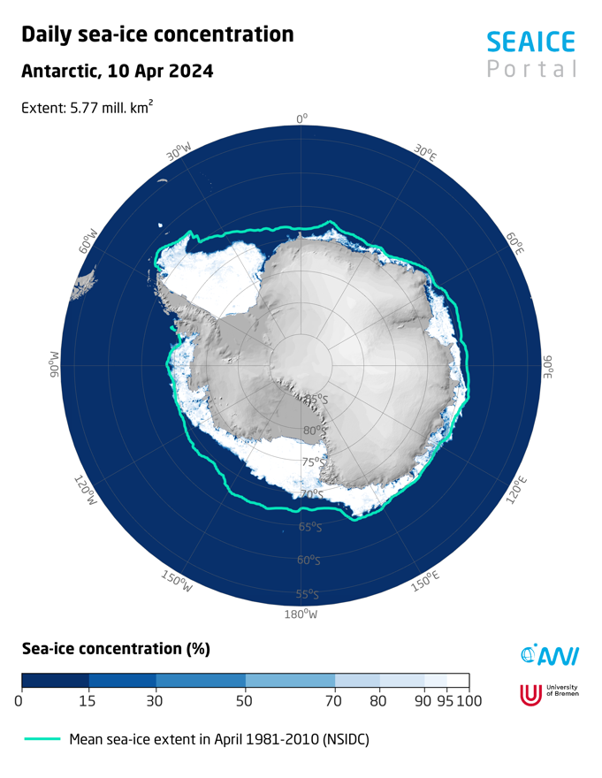
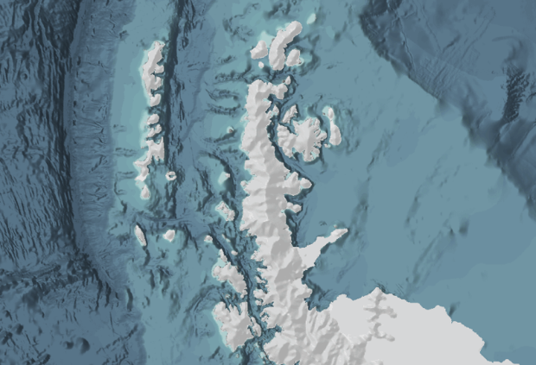
POLARIN Stations in Antarctica
Prat
Escudero
Neumayer III
Ohridski
Juan Carlos I
Gabriel de Castilla
Wasa
Troll
Concordia
Akademik Vernadsky
Mario Zuchelli

Slide 17


Antarctic Stations
Concordia Station, FR + IT
Mario Zucchelli Station, IT
Neumayer Station III, DE
Troll Research Station, NO
Wasa Station, SE

Slide 18



Antarctic Peninsula Stations
Akademik Vernadsky Station, UA
Bulgarian Antarctic Base St. Kliment Ohridski, BG
Professor Julio Escudero Station, CL
Captain Arturo Prat Navy Station Laboratories, CL
Juan Carlos I Antarctic Station, ES
Spanish Antarctic Station “Gabriel de Castilla”, ES

Slide 19


POLARIN INFRASTRUCTURE
12
Polar vessels
18
Observatories
4 Ice and sediment core repositories
7 Data infrastructures
Notes:
RI (Research Infrastructures)

Slide 20





Polar vessels operating in the Arctic Ocean
CCGS Amundsen, CA
Arni Fridriksson, IS
RV Celtic Explorer, IR
MV Le Commandant Charcot, FR
RV Dana, DK
RV Kronprins Haakon, NO
BIO Hespérides, ES
Noosfera, UA
PRV Polarstern, DE
TARA polar station, FR

Slide 21

Polar vessels operating in the Antarctic region
MV Le Commandant Charcot, FR
RV Kronprins Haakon, NO
RVIB Laura Bassi, IT
BIO Hespérides, ES
Noosfera, UA
PRV Polarstern, DE
RS Karpui, CL

Slide 22

POLARIN INFRASTRUCTURE
1 deep-sea observatory (FRAM)
2 observational networks (GIOS and Greenland Ecosystem Monitoring)
15 key observatories associated to research stations
18
Observatories
4 Ice and sediment core repositories
7 Data infrastructures
Notes:
RI (Research Infrastructures)

Slide 23

POLARIN INFRASTRUCTURE
AWI: Ice core repository
AWI: Sediment core repository
BAS: Polar Sediment Core Facility
UiT: Core repository and geological laboratories
4 Ice and sediment core repositories
7 Data infrastructures
Notes:
RI (Research Infrastructures)

Slide 24

POLARIN INFRASTRUCTURE
Arctic Biodiversity Data Service (CAFF)
ARICE Data infrastructure
Italian Arctic Data Center (CNR)
INTERACT data portal
Italian National Antarctic Data Center (CNR)
POSEDA (GFZ)
SIOS Data Management System
7 Data infrastructures
Notes:
RI (Research Infrastructures)

Slide 25
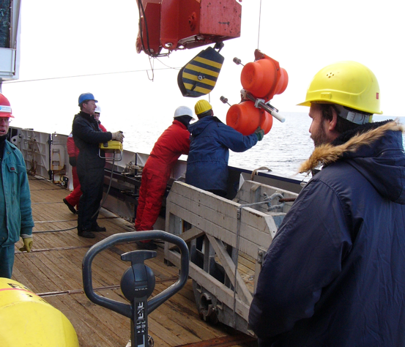
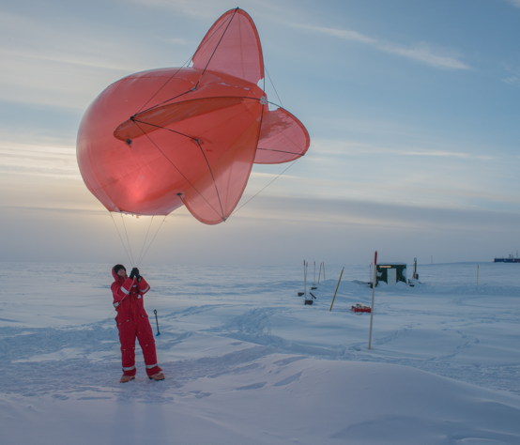

TYPES OF ACCESS TO RI
Transnational Access
In person
Remote
Virtual access
Notes:
virtual access (VA) through a single-entry portal to 7 data infrastructures, 2 observational networks and 10 research stations and their associated observatories in both polar regions

Slide 26


Transnational Access
In person
Remote
Proposal based, Challenge driven
Access to RIs from other countries
International cooperation
Externally evaluated
If granted, access to RI and travel expenses are covered by the project
Notes:
virtual access (VA) through a single-entry portal to 7 data infrastructures, 2 observational networks and 10 research stations and their associated observatories in both polar regions

Slide 27
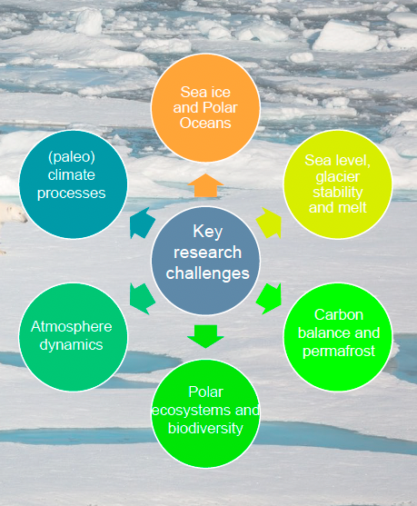
SCIENTIFIC CHALLENGES
Notes:
virtual access (VA) through a single-entry portal to 7 data infrastructures, 2 observational networks and 10 research stations and their associated observatories in both polar regions

Slide 28
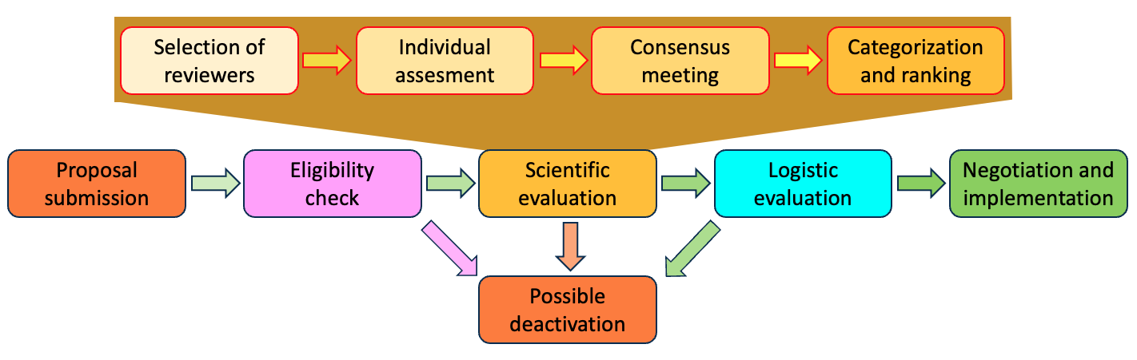
PROPOSAL BASED
Notes:
virtual access (VA) through a single-entry portal to 7 data infrastructures, 2 observational networks and 10 research stations and their associated observatories in both polar regions

Slide 29
Access to RI and travel expenses covered by the project
Example (Italian infrastructures):
Mario Zucchelli Station (120 users/days)
FR-IT Concordia Station (50 users/days)
Dirigibile Italia (80 users/days)
Laura Bassi (6 days)
Italian National Antarctic Data Center (NADC)
Italian Arctic Data Centre (IADC)
ARICE Data infrastructure (ADI)
Notes:
virtual access (VA) through a single-entry portal to 7 data infrastructures, 2 observational networks and 10 research stations and their associated observatories in both polar regions

Slide 30

Virtual Access
Virtual access
Open access to (new) data, databases and data services
Notes:
virtual access (VA) through a single-entry portal to 7 data infrastructures, 2 observational networks and 10 research stations and their associated observatories in both polar regions

Slide 31
Objectives
Enable science for understanding and predicting key processes in polar regions
Provide efficient challenge-driven transnational access (TA) to top level RIs in the polar regions
Improve data services and provide customised data products
Provide virtual access (VA) to data and data services
Provide training for infrastructure users
Advertise RI services and engage RI users

Slide 32
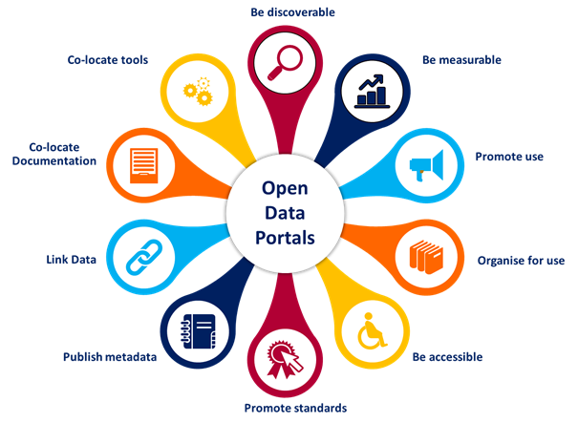
Data services and data products
POLARIN will concentrate its efforts on improving the data landscape and the utilization of data
A single-entry portal
VA to metadata, data and data services
Coordinate, harmonise, and optimise the implementation and integration of data services and products.
Create data products from environmental databases that can be directly used by researchers and decision makers.

Slide 33
Training for infrastructure users
Training for early career scientists and professionals
Training on data stewardship
Safety
training
Notes:
Training for early career scientists and professionals to ensure that the new generations are able to fully exploit the services of the diverse RIs. It will include a series of online seminars dedicated to scientific equipment and tools, expedition planning and legal, safety and sustainability requirements to work in the polar regions. Target groups will be PhD students and postdoctoral researchers, technicians, and engineers.
Training on data stewardship to ensure that data sets are adequately preserved and documented, and that they remain accessible and usable to end users. The usefulness of data sets depends also on the ability of data providers and stewards to assess, demonstrate, and describe the quality of the information, and their ability to adopt community best practices and standards. POLARIN will organise a dedicated training on data stewardship as a series of online seminars and workshops to ensure that data sets are not only collected, but also curated and able to deliver accurate, reliable environmental data sets.
Safety training to ensure that infrastructure users are prepared to deal with emergency conditions on land and at sea. POLARIN will organise a safety training under Arctic conditions in compliance with the Polar Code for a group of users. The safety training will prepare for marine and land expeditions. It will be accompanied by online and written training material.

Slide 34
POLARIN ADVISORY BOARD
Jennifer Mercer
NSF
Former Chair of the Forum of Arctic Research Operators (FARO)
Juan José Danobeitia
CSIC
Former General Director of EMSO
Diego Fernández
ESA
Head of the Research and Development Section at the European Space Agency.
Nicolás Villacorta
Helmholtz
Juliet Hermes
SAPRI
Manager of the South African Antarctic Programme (SAPRI)
Policy Officer for European Research Infrastructures at the Helmholtz Association
Notes:
POLARIN has implemented an Advisory Board with relevant stakeholders to enhance the connection with international partners and organisations as well as with other European initiatives and projects.

Slide 35






Connection with other projects, forums, organisations
Notes:
POLARIN will connect and collaborate intensely with other projects, forums and organisations, such as our sister project AQUARIUS, funded in the same call, the Eu Polar Cluster, operator organisations, and the Earth Observation community that wants to support in situ data collection.
POLARIN, with such a vast infrastructure network, has the opportunity to contribute to initiatives planned in the next years.

Slide 36
How will POLARIN be a 'game changer' for those doing polar research?
CONCLUSIONS
It is an unique opportunity to access infrastructures out of the national capacities
The access is fully funded
Easier and enhanced access to data
Notes:
POLARIN will connect and collaborate intensely with other projects, forums and organisations, such as our sister project AQUARIUS, funded in the same call, the Eu Polar Cluster, operator organisations, and the Earth Observation community that wants to support in situ data collection.
POLARIN, with such a vast infrastructure network, has the opportunity to contribute to initiatives planned in the next years.

Slide 37
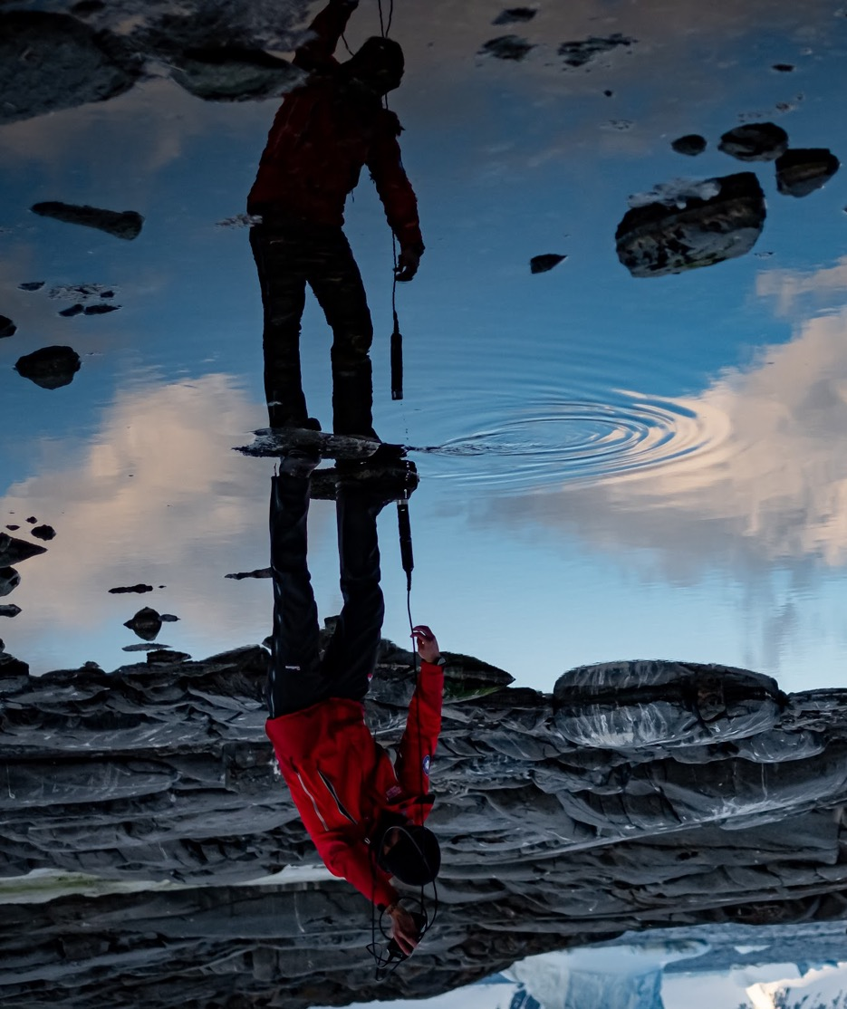

Contact Us
Project Coordinator
Nicole Biebow: Nicole.Biebow@awi.de
Project Manager
Verónica Willmott: Veronica.Willmott@awi.de
www.eu-polarin.eu
Michele Rebesco: mrebesco@ogs.it

