Slide 1
Planned and co-organized by
Northern Ocean Region Panel (NORP) & Southern Ocean Region Panel (SORP)
of CLIVAR, CliC and IASC/SCAR
Notes:
- Welcome
- hope everyone arrived savely considering the massive distractions last Friday/Saturday

Slide 2
Planned and co-organized by
Northern Ocean Region Panel (NORP) & Southern Ocean Region Panel (SORP)
of CLIVAR, CliC and IASC/SCAR
Co-sponsors
Notes:
- Briefly introduce NORP and SORP
- and the connections to the co-sponsors
CLIVAR and CliC are 2 of 6 core projects of WCRP
IASC: non-governmental, international scientific organization: started with 8 Arctic neighboring countries, now 23 in total
SCOR and SCAR both originate from International Council of Scientific Unions (ICSU), now International Science Council (ISC), after the IGY, the International Geophysical Year in 1957-58
- thank the co-sponsors
→ Panels and their work and network introduced in coming days

Slide 3
Planned and co-organized by
Northern Ocean Region Panel (NORP) & Southern Ocean Region Panel (SORP)
of CLIVAR, CliC and IASC/SCAR
Scientific organizing committee
Carolina Dufour, McGill, Canada & IFREMER, France
Alexander Haumann, AWI & LMU, Germany
Dorothea Iovino, CMCC, Italy
Torge Martin, GEOMAR, Germany
Alvaro Scardilli, SHN, Argentina
Amy Solomon, NOAA, USA
Riccardo Farneti, ICTP, Italy
Notes:
- Organizers stand up introduce themselves
- highlight Carolina, who is not there and thank her for her hard work in leading the organizer team, recently moved from McGill to IFREMER
- highlight Riccardo and thank ICTP for hosting and supporting the workshop – not had happened without!

Slide 4
The polar regions are key components of the global climate system and have been undergoing rapid, dramatic changes. We will emphasize interactions between the cryosphere, ocean and atmosphere and their regional to global impacts. Arctic and Antarctic similarities and differences will be discussed.
Polar hydrography
Atmospheric processes and interactions with ocean and cryosphere
Ocean and ice sheet interactions
Role of sea ice and change under global warming
Biogeochemical processes and physical drivers
Observational techniques & numerical modelling
Notes:
ITEML LIST FROM SCHOOL ADVERTISEMENT POSTER
a few genral remarks about the polar regions, how they differ in general and under global warming
* Ocean vs. continent
multi-year vs seasonal sea ice (Arctic now also vastly seasonsal)
Greenland vs Antarctic ice sheet: surface melt vs. ice shelf melt and calving
Arctic amplification vs no clear sign of Southern Ocean warming / sea ice decline (until recently)
Next few days hear about all these connections and discuss and work on global climate change impacts in high latitudes

Slide 5
Arctic Processes in CMIP6 Bootcamp, 11-21 October, 2022, Søminestationen, Denmark

Slide 6
Arctic Processes in CMIP6 Bootcamp, 11-21 October, 2022, Søminestationen, Denmark
22 Participants: ECR students, NORP members, invited guest lecturers and mentors
The main goals of the workshop were:
Learn how to work with climate model (CMIP6) data, from the modelers who produced them.
Use these data in conjunction with other datasets to answer crucial scientific questions about the past, present or future Arctic climate system, under the guidance of experts in the field.
Contribute to publications resulting from the Bootcamp.

Slide 7
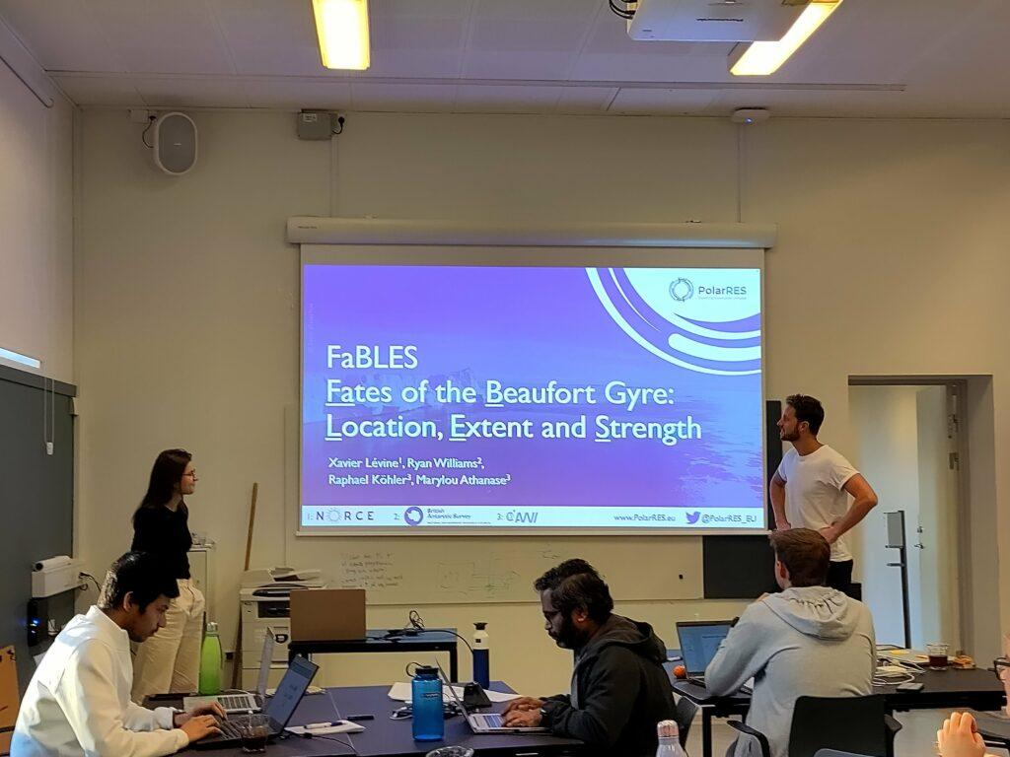
Arctic Processes in CMIP6 Bootcamp, 11-21 October, 2022, Søminestationen, Denmark
From the CMIP6 Bootcamp there are several projects were initiated: 1. WAFFLES: Western Arctic Freshwater Fluxes
2. Fables: Fates of the Beaufort Gyre: Location, Extent and Strength 3. Mosaic data in CMIP6-focused on sea ice thickness and snow on sea ice 4. Exchanges: Arctic - North Atlantic Exchanges
5. Greenland precipitation signals 6. PAMIP 7. BALSI: Boundary Atmospheric Layer over Sea Ice
Scientific capacity building and career support:
The Arctic Processes in CMIP6 Bootcamp was an
activity designed for young scientists and PhD students,
and was very successful.
Ideas for follow-on activities?

Slide 9
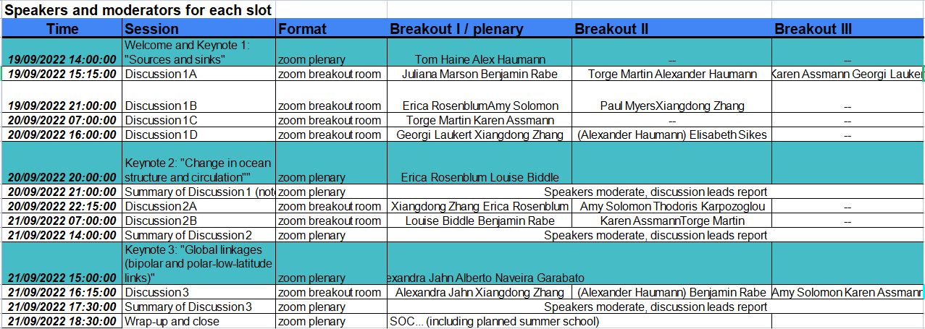
NORP-SORP workshop on polar fresh water: Sources, Pathways and ImpaCts of frEsh water in northern and soUthern Polar oceans and seas (SPICE UP)

Slide 10
The polar regions are key components of the global climate system and have been undergoing rapid, dramatic changes. We will emphasize interactions between the cryosphere, ocean and atmosphere and their regional to global impacts. Arctic and Antarctic similarities and differences will be discussed.
Polar hydrography and circulation
Observational techniques & numerical modelling
Atmosphere-ice-ocean interaction
Arctic & Antarctic sea ice
Ocean-ice sheet interactions
Biogeochemical processes
Notes:
ITEM LIST FROM ACTUAL SCHEDULE

Slide 11
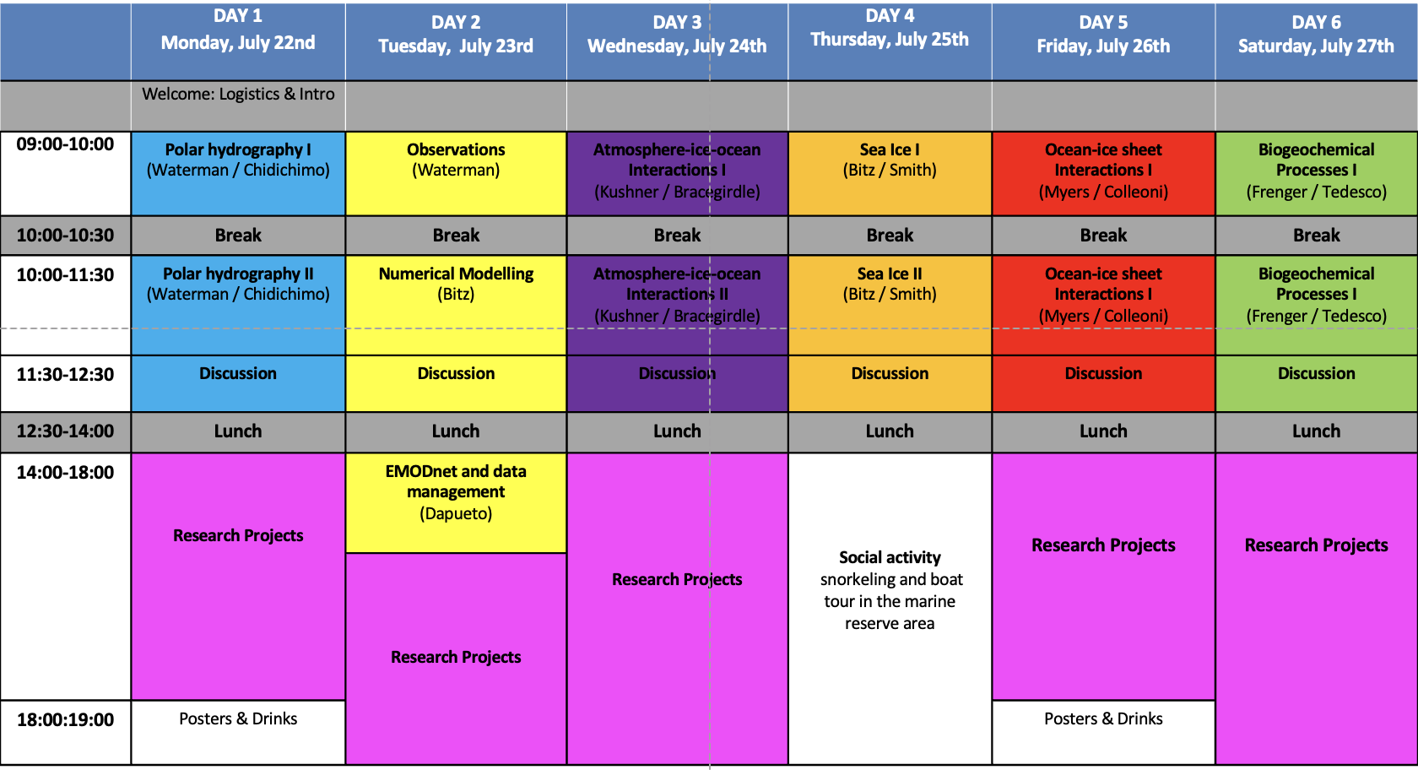
Planned and co-organized by
NORP & SORP
of CLIVAR, CliC and IASC/SCAR
Notes:
- quick over view of schedule
- let lecturers introduce themselves
Then enjoy!

Slide 12
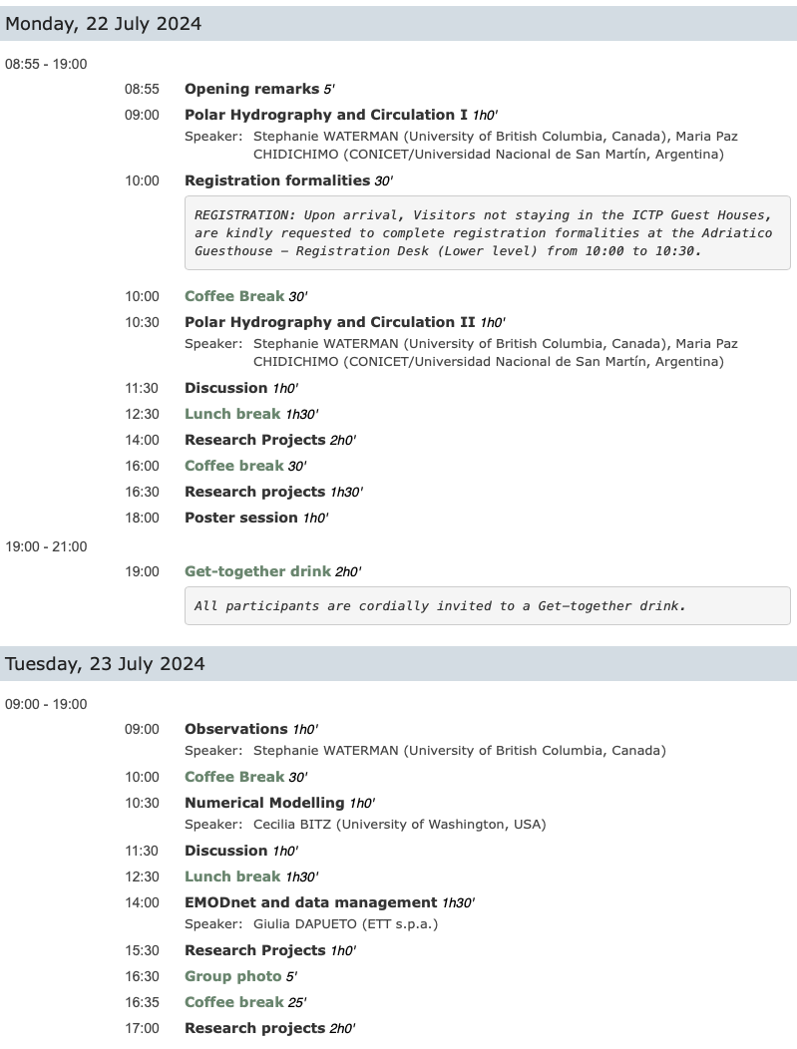
Planned and co-organized by
NORP & SORP
of CLIVAR, CliC and IASC/SCAR

Slide 13
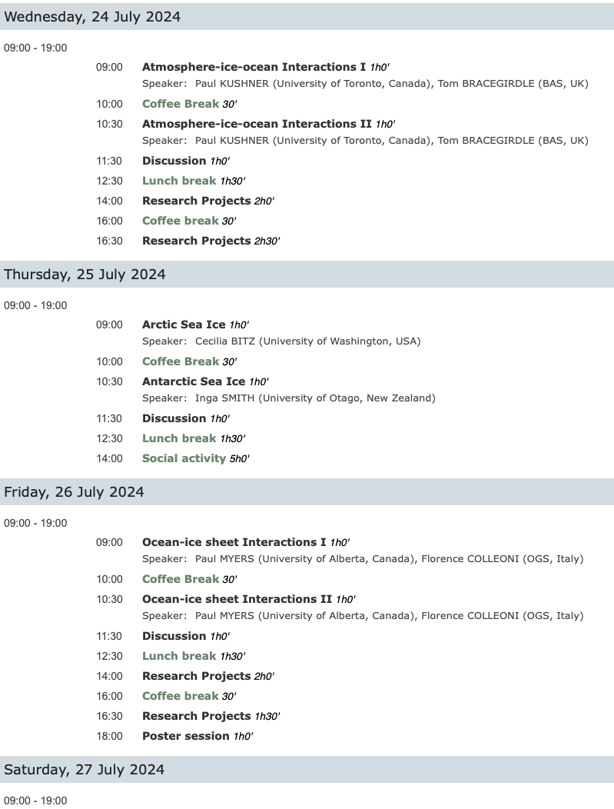
Planned and co-organized by
NORP & SORP
of CLIVAR, CliC and IASC/SCAR

Slide 14
Workshop Day 1
From Mosaic to Antarctica InSync: perspective & prospective
Drivers of the recent sea ice decline
Workshop Day 2
MIZ and coastal processes
Sea ice prediction and projections
Planned and co-organized by
NORP & SORP
of CLIVAR, CliC and IASC/SCAR
Workshop Day 3

