Slide 1
ICTP:
World-class Research and a Successful Model of International Collaboration
Public Information Unit

Slide 2
What
is ICTP?
Founded in 1964 by Nobel Laureate Abdus Salam to enhance international cooperation through science.
Combines world class research with a unique global mission of building science capacity in the developing world.
Governed by tripartite agreement between Italy UNESCO and IAEA.

Slide 3
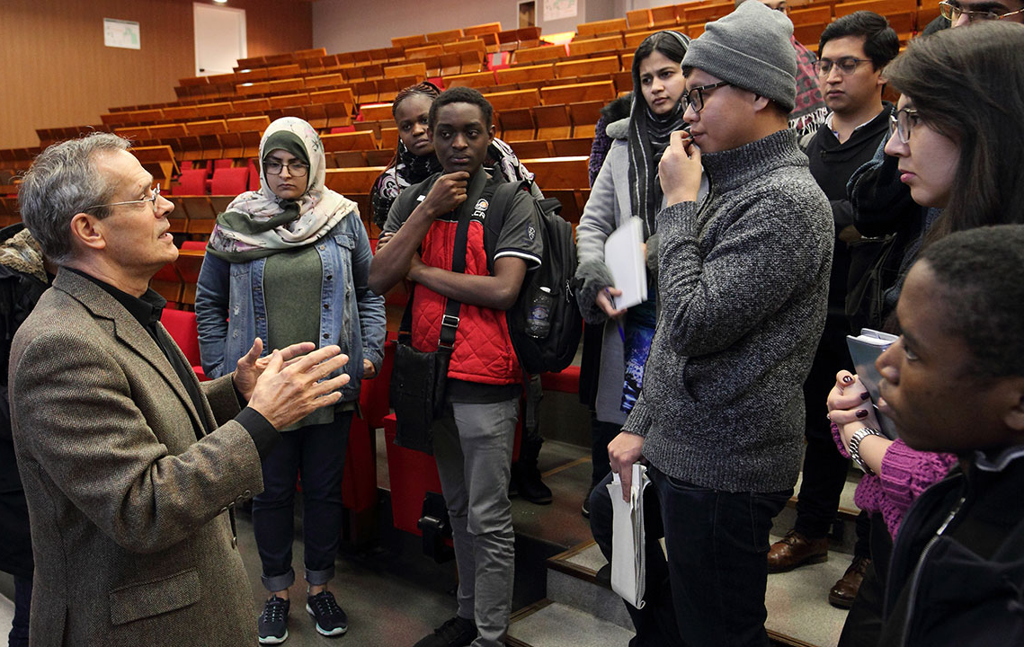
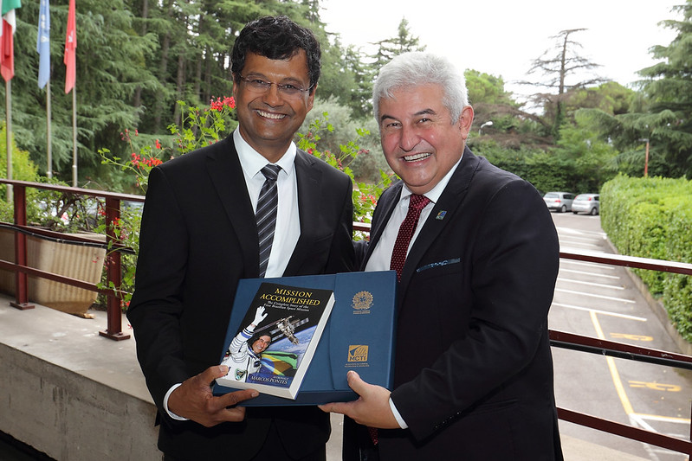
What is ICTP?
Research Education Cooperation

Slide 4
RESEARCH AT ICTP
Research Sections
High Energy Cosmology & Astroparticle Physics
Condensed Matter and Statistical Physics
Mathematics
Science, Technology and Innovation
Earth System
Physics
Quantitative Life
Sciences
Also: Sustainable Energy and High Performance Computing

Slide 5
RESEARCH AT ICTP
Nobel-worthy Contributions
Research at ICTP and its Partner Institutes has contributed to 5 Nobels:
Physics Nobel 1979: ICTP founder Abdus Salam
Nobel Peace Prize 2007: ICTP’s Earth System Physics scientist Filippo Giorgi’s work with IPCC
Physics Nobel 2013: ICTP’s High Energy Physics section contributed to ATLAS discovery of Higgs Boson
Physics Nobel 2015: Prize confirmed theory of solar neutrino oscillations co-developed by ICTP scientist Alexei Smirnov
Physics Nobel 2017: Gravitational wave detection by LIGO (ICTP-SAIFR collaborated)

Slide 6
RESEARCH AT ICTP
Papers produced within ICTP
Papers listed by final publication year

Slide 7
RESEARCH AT ICTP
Citations of ICTP papers

Slide 8
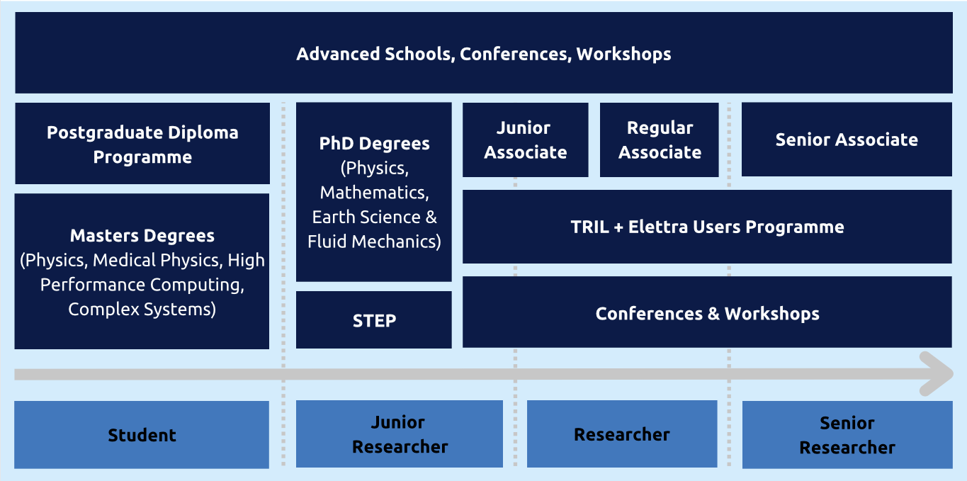
TRAINING AT ICTP
ICTP Programmes:
Supporting Scientists in all Stages of their Careers

Slide 9
EDUCATION AT ICTP
ICTP Degree Programmes as of 2023

Slide 10
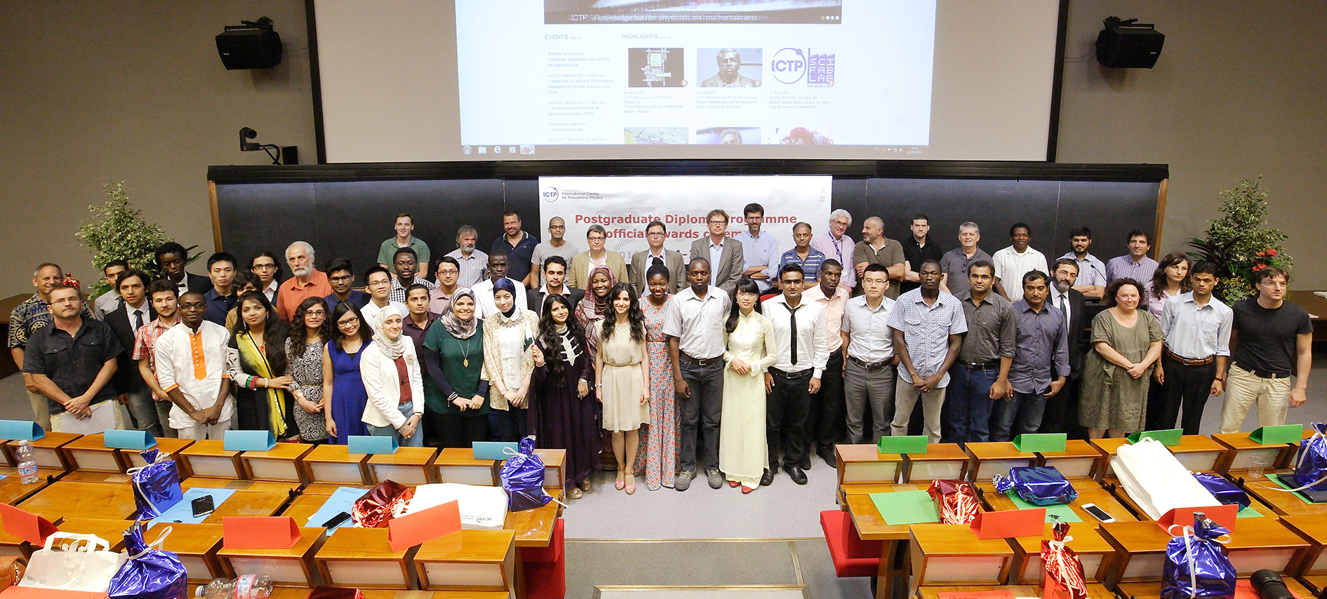
EDUCATION AT ICTP
ICTP’s Postgraduate Diploma Programme:
Preparing Young Scholars for PhD Studies
Since 1991:
1000+ Diploma graduates
More than 75% earned or working toward PhDs

Slide 11
EDUCATION AT ICTP
Master of Advanced Studies in Medical Physics:
Training Professionals for the Developing World
2023/2024:
46 students
from 33 countries
33% female students
25% of students funded by IAEA

Slide 12
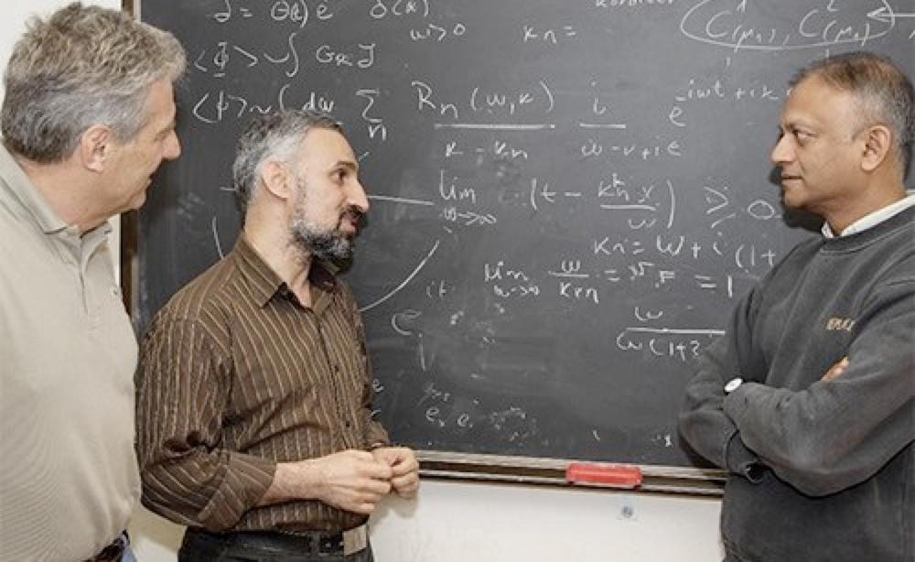
TRAINING AT ICTP
Associates Programme:
Working Together at ICTP
3,000+ Associates since 1964
6 year term, visits to IAEA to collaborate with ICTP Scientists
Simons Associates may also bring a student

Slide 13
TRAINING AT ICTP
ICTP: An International Hub for Scientific Networking
Organises more than 60 conferences & workshops each year.
Welcomes up to more than 6,000 scientists from 150+ nations each year.
Attracts an additional 1,000-2,000 scientists per year through hosted activities.

Slide 14
TRAINING AT ICTP
ICTP Visiting Scientists:
Where do they come from?
SINCE 1970:
IN 2023:
More than
180,000
visits
from scientists from 188 countries around the world
32%
of visitors were women
59%
of visitors were from developing and least-developed countries

Slide 15
ICTP SCIENTIFIC OUTREACH
ICTP: Long tradition of Scientific Capacity Building in Developing Countries
External Activities Unit
Partner Institutes (Brazil, China, Mexico, Rwanda)
Physics Without Frontiers
SciFabLab, Multidisciplinary Laboratory (MLab) & Marconi Laboratory

Slide 16
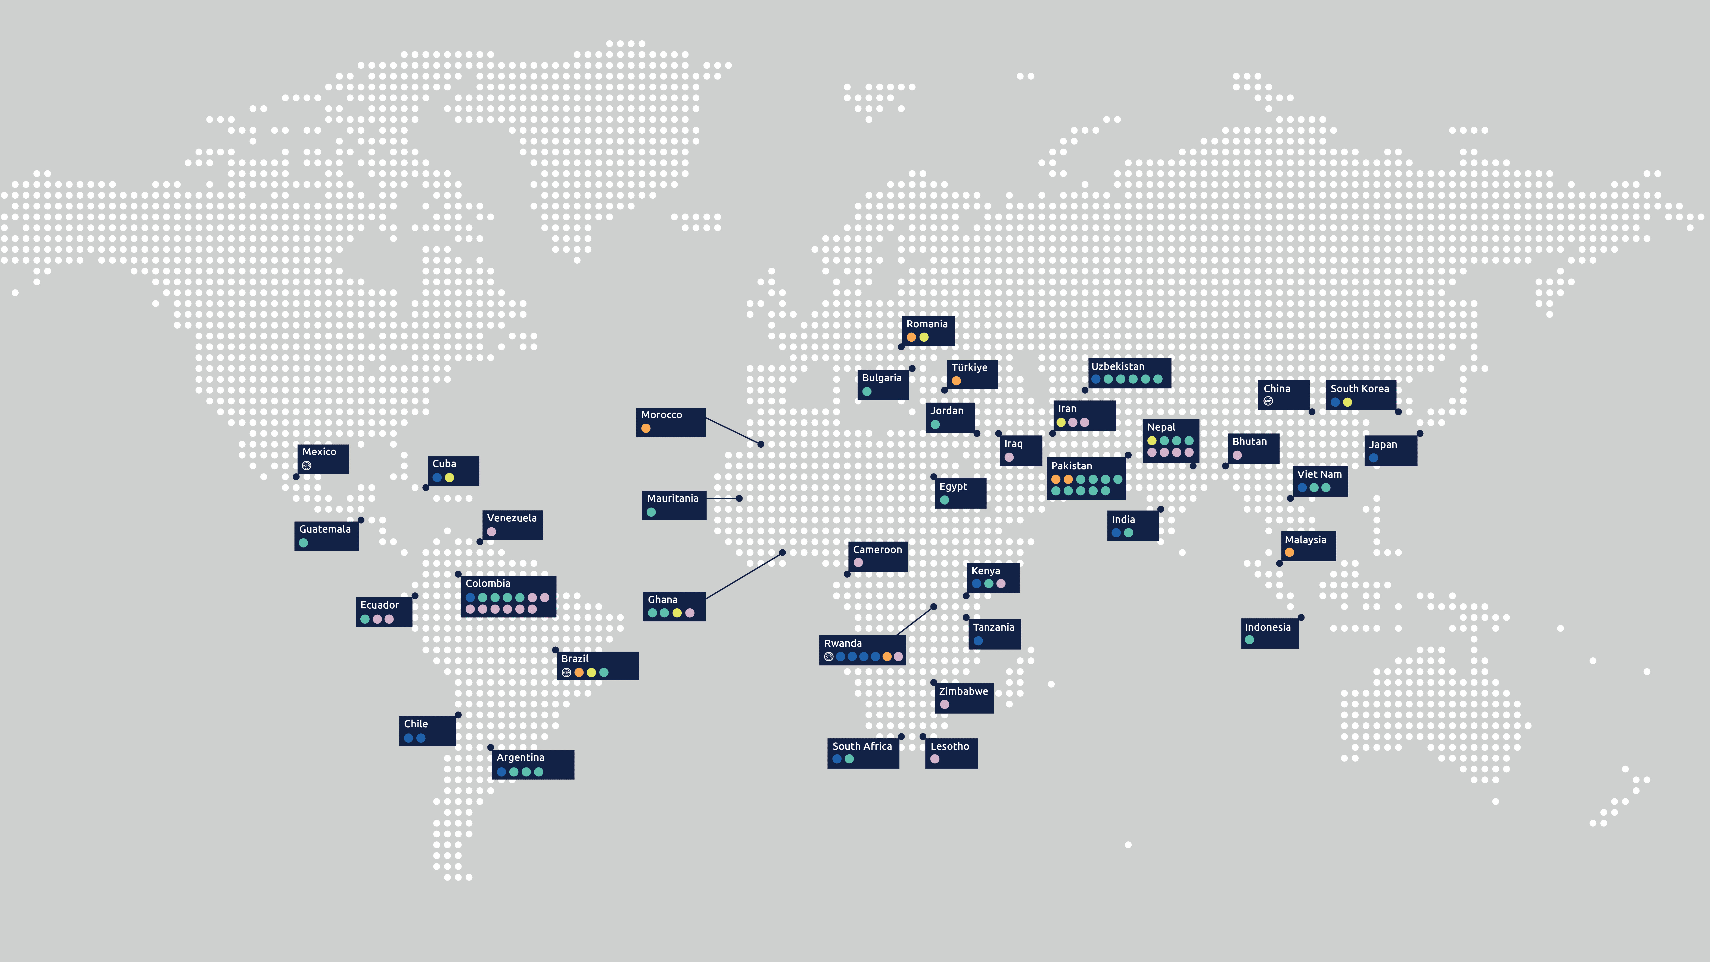
ICTP SCIENTIFIC OUTREACH
ICTP Impact 2023

Slide 17
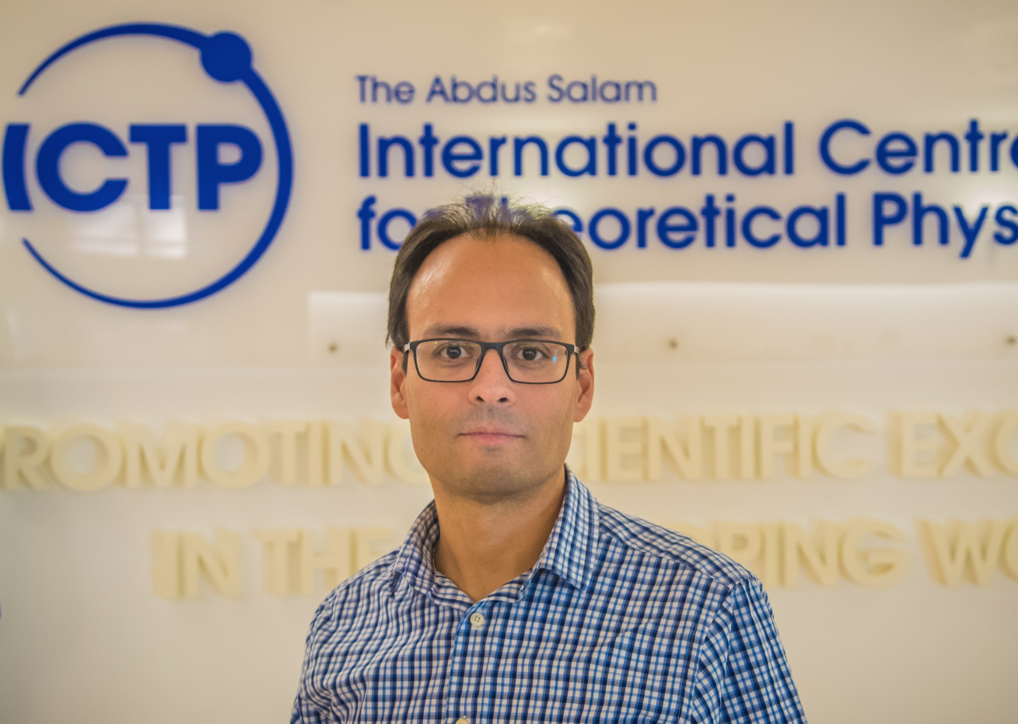
ICTP Success Stories
Freddy Cachazo,Venezuela Diploma Alumni (1996-97)
Recipient, 2014 New Horizons Prize
Gribov Medallist 2009
Dyson Chair, Perimeter Institute
Zohra Ben Lakhdar, Tunisia
ICTP Associate
Recipient, 2005 L'Oreal-UNESCO Award for Women in Science
Founding member, Tunisian Physics Society and Tunisian Astronomy Society
Professor of Physics, Tunis El Manar University
Narayan Adhikari, Nepal
Diploma Alumni (1997-98)
ICTP Regular Associate 2008-15
ICTP Senior Associate 2018-23
Research group leader, Tribhuvan University, Nepal

Slide 18
ICTP TESTIMONIAL
“Over the years, ICTP has left a deep legacy in performing and promoting outstanding fundamental scientific research. In particular, it has had a major impact supporting science in developing countries.”
STEPHEN HAWKING
UNIVERSITY OF CAMBRIDGE

Slide 19
ICTP TESTIMONIAL
“Much good emanates from ICTP. Salam's vision of a facility that couples the doing of first-rate research with advanced scientific training has been overwhelmingly vindicated and validated.”
DAVID GROSS
NOBEL LAUREATE IN PHYSICS 2004 AND DIRECTOR OF THE KAVLI INSTITUTE FOR THEORETICAL PHYSICS

Slide 20
Thank you!

