Slide 1
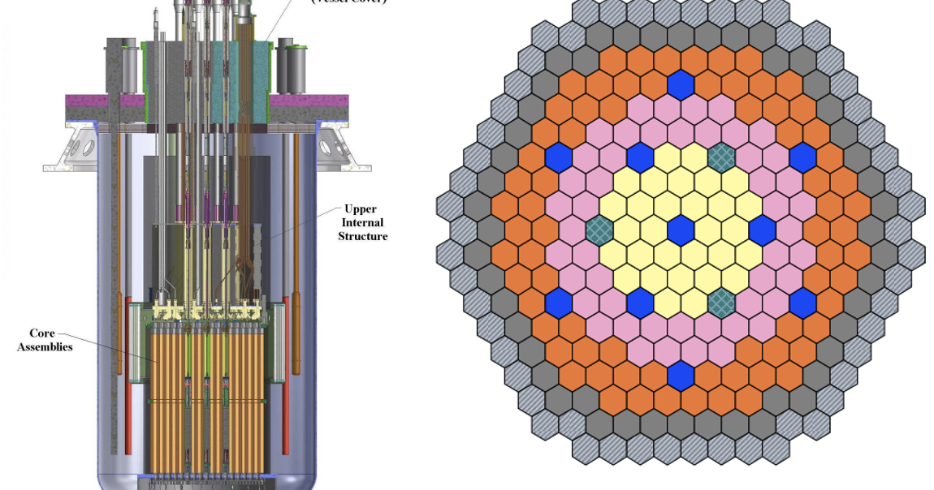
Fast reactor safety
Tanju Sofu
Program Manager
Nuclear Science & Engineering Division
Argonne National Laboratory

Slide 2
outline
Key features that impact safety
  Reactor physics
  Thermal-fluids
  Fuel forms
Safety approach
  Defense-in-depth
  Plant states considered in design
  Approach for operational states and design basis accidents
  Approach for design extension conditions and severe accidents
  Source term assessments
Summary

Slide 3
KEY safety features
Thermal design considerations
P
In WCR, water acts both as the coolant and moderator:
  Optimal P/D ratio to assure
    adequate moderation
    sufficient cooling
In a fast reactor with higher power density, only cooling function is needed
  Lattice is more compact, stipulating a coolant with much better heat transfer capabilities (liquid metals)
  Fuel pins can be packed much closer in a hexagonal lattice (triangular pitch)
    Typically separated by a thin wire wrapped around each fuel pin to prevent pin-to-pin contact
Water
D
Sodium
P
D

Slide 4
KEY safety features
Liquid sodium coolant
~100 times higher thermal conductivity compared to water
Wide margin to boiling (>350°C)
Compatible with structural components and metallic fuels
High temperature operation (>500°C core outlet temperature)
  Allows greater thermal efficiency (~40%) for energy conversion
Low pressure primary and intermediate coolant system
  No LOCA concern, no need for high-pressure coolant injection, low containment design pressure
  Guard vessel (and guard pipes in loop type reactor) to “maintain” coolant inventory
Dedicated systems for decay heat removal to an ultimate heat sink
  Large core ΔT (150°C in an SFR vs. ~30°C in an LWR) facilitates reliance on passive systems driven by natural circulation for decay heat removal
Simpler operation and accident management (long grace period for corrective action)
Liquid sodium chemically reacts with air and water, and it is opaque

Slide 5
KEY safety features
Reactor physics
Need for a finer multi-group cross-section structure to resolve the fast spectrum
  Neutrons are either absorbed or they leak before they get “thermalized”
  Mid-energy resonances contribute to significant Doppler feedback
Impact of energy spectrum on transmutation:
  Fission/capture ratio is much higher in fast spectrum
  Neutrons/fission is also greater in fast spectrum
  Net result is more excess neutrons and less actinide generation
    Greater flexibility for material selection
Fast spectrum leads to ~10× longer neutron mean-free paths
  Negligible spatial self-shielding
  Greater sensitivity to neutron leakage from minor geometric changes
  Reactivity perturbations impact the whole core, instead of locally as in thermal reactors

Slide 6
KEY safety features
Reactor physics (cont.)
High core power density (~5X in comparison to an LWR)
Breeding or transmutation of transuranic waste products
  Fast reactors are typically intended for closed fuel cycle
    Uranium conversion leads to improved resource utilization and waste minimization
  Long core life with breed-and-burn concepts
  But higher enrichment is needed to achieve initial criticality (HALEU fuel)
Inherent safety owing to “net” negative reactivity feedback during accidents with elevated core/coolant temperatures
  For large cores, sodium void worth can be positive
Shielding challenges unique to fast neutron spectrum

Slide 7
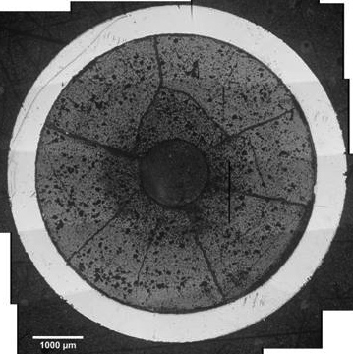
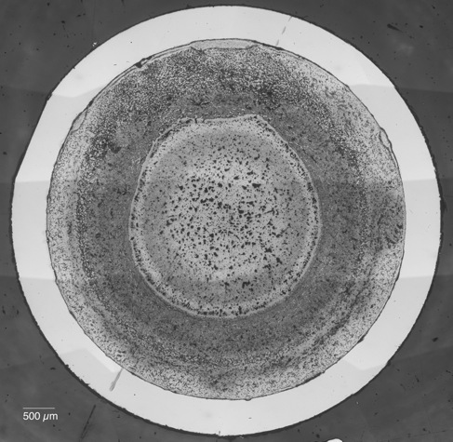
KEY safety features
Fuels
Design is expected to assure that
  Fuel is not damaged during operational states
  Fuel damage during postulated accidents does not propagate and core coolability is maintained
Fast reactor fuels can reach higher burnup than LWR fuels with higher initial fissile loading and opportunity for “breed & burn”
Fuel modeling capabilities should account for:
  Fast neutron irradiation induced swelling (greater in a fast neutron spectrum)
  Thermal and irradiation induced creep
  Mechanical stresses from internal fission gas pressure
  Thermal stresses from temperature gradients
  Fuel-cladding chemical and mechanical interactions
  Flow-induced vibration and fretting
High Burnup MOX Fuel
Metal Fuel with HT9 Clad

Slide 8
Fuel types
Oxide vs. metallic fuel comparisons

Slide 9
Safety approach
Defense in depth
Defense‐in‐depth is the key concept for fast reactor safety
Fast reactor reliability and safety goals:
  Excellence in operational safety and reliability
  Low likelihood and degree of core damage
  Smaller emergency planning zone
The traditional approach to demonstrating defense‐in‐depth compliance is deterministic, but a combination of deterministic and probabilistic approaches is increasingly recommended
  Risk‐informed safety approach considers both probability and consequences of postulated accidents
  Accidents with large consequences are reduced in risk significance by requiring that their likelihood are acceptably small
← simplified design
← inherent and passive safety
← reduced source term

Slide 10
Safety approach
Plant states and their alignment with defense-in-depth
Defense-in-Depth Levels
Level 1 | Level 2 | Level 3 | Level 4 | Level 5
Operational states |  | Accident conditions |  | EP&R
Normal Operation | Anticipated Operational Occurrences | Design Basis Accidents | Design Extension Conditions | Residual risk and practically eliminated accidents
Severe accidents
Plant states considered in design

Slide 11
Safety approach
Operational states and design basis accidents
Like WCRs, fast reactor safety is first based on use of multiple, redundant engineered protection systems to lower the probability of accident occurrence and limit the consequences:
  independent scram systems,
  multiple coolant pumps and heat transport loops,
  dedicated decay heat removal systems,
  multiple barriers to release of radioactive materials.
Unique LMR design features provide additional measures of protection:
  High thermal conductivity of liquid metal coolants (70 W/m-K for sodium vs. 0.6 W/m-K for water).
  Large margin to coolant boiling (~350°C in SFR and ~1150°C in LFR vs. ~20°C in PWR)
  Minimal pressure loading on the coolant boundary: Reduced concern for coolant pipe breaks, no need for high-pressure coolant injection system
  Large thermal inertia (especially with pool type reactors) with long grace period during accidents
Notes:
In an LFR, boiling can be completely ruled out.

Slide 12
Safety approach
Design Extension Conditions
Measures to prevent multiple-failure event sequences (including safety system failures) and mitigate their consequences are also considered in the design
  Design features that enhance inherent safety (net negative reactivity feedback) and passive decay heat removal
Independence and diversity of DEC design measures (from those relied on during design basis accidents)
  Due consideration of potential for common cause failures
A containment structure against external events and to prevent release of radioactivity to the environment as the last barrier
  Sodium fires that may challenge containment integrity are specifically addressed
DECs are analyzed using best estimate method, supported with a sensitivity analysis to identify and avoid cliff-edges

Slide 13
Inherent safety
Reactivity feedback mechanisms
Doppler feedback: Effect of changes in neutron fission and absorption cross sections due to Doppler broadening
Core radial expansion: Due to thermal expansion, irradiation-induced swelling, and irradiation-enhanced creep
Fuel axial expansion: Effect of thermal expansion and transient swelling of especially the metallic fuels (and cladding)
Coolant density and void worth: Can be positive (due to reduced Na moderation/absorption) or negative (due to enhanced neutron leakage) at elevated temperatures
Control rod drive line expansion (relative to reactor vessel expansion): Due to difference in thermal expansion of control-ride driveline and reactor vessel

Slide 14
PASSIVE decay heat removal
Room for independent and diverse means for decay heat removal

Slide 15
Safety approach
Severe accidents: Accidents leading to core damage
Depending on design choices and characteristics, severe accidents can be pushed under the residual risk category (level 5)
  Inherent/passive safety characteristics and choice of fuel
  Complex reactivity feedback mechanisms for LMRs
  Supplementary passive reactivity control devices, if needed
If core damage cannot be prevented, assurance for in-vessel retention and core debris coolability is required to reduce impact on the containment function
Severe accidents that could lead to a sudden or significant radioactivity release (beyond the regulatory limits) need to be practically eliminated:
  Simultaneous failure of both the reactor and guard vessels
  Complete loss of decay heat removal capability
  Collapse of core support structure
Notes:
Why is the emphasis on severe accidents? Because, unlike thermal reactors, the fast reactor cores are not in their most reactive configuration, and minor changes in geometry (a core compaction) can increase the reactivity and power.
This is why we require the net reactivity feedback to be negative at core temperatures above normal to support inherent safety.
When inherent safety isn’t enough, passive reactivity control devices can be used (GEM, Curie point detachment of control rods, hydraulically suspended rods).

Slide 16
Source term assessments
Risk-informed approach requires consequence analysis for all plant states considered in design through mechanistic source term assessments
In fast reactors, only a small number of bounding accident conditions (with very low likelihood) are expected to contribute to significant source term:
  Severe loss of decay heat removal capability
  Severe loss-off-flow cases (multiple pump seizures)
  Severe failures in spent fuel storage systems
Source term development process:
  Identification of radionuclide inventory and sources
  Modeling of radionuclide transport pathways and phenomena
  Evaluation of a class of bounding accidents

Slide 17
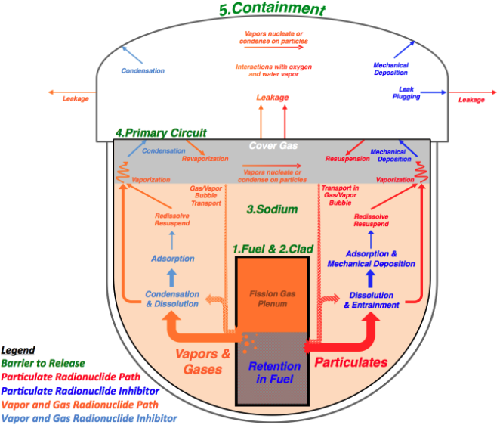
Source term assessments

Slide 18
summary
Rich legacy for fast reactor design, analysis and testing
Defense-in-depth as the key reactor safety concept
Plant states considered in design includes multiple failure events
  Similar safety approaches for AOO and DBAs to LWRs
    Unique safety features leading to significant design simplifications
  Reliance on inherent safety and passive decay heat removal for DEC
  Severe accidents (significant and sudden radioactivity release) are practically eliminated
  Mechanistic source term assessments for residual risk events
Unique reactor physics characteristics in fast spectrum
  Complex reactivity feedback mechanisms
Passive decay heat removal
  Based on natural circulation or heat-pipe concepts
Significant metallic and oxide fuel irradiation and transient testing base

Slide 19
BACK-UP material
Notes:
The accident is assumed to be initiated by a total loss of offsite power, causing the electrical power to be lost to all primary pumps, intermediate loop pumps, and feedwater pumps. There is also a total failure to scram the reactor so that the reactor power changes only in response to the reactivity feedbacks.
The primary and intermediate pumps coast down according to their internal characteristics only. The loss of the feedwater pumps causes the loss of heat rejection to water side at the steam generators. The decay heat removal system continues to operate at their rated total capacity.

Slide 20
EBR-II Inherent Safety Demonstration
EBR-II’s potential to survive severe accident initiators without core damage was demonstrated during the landmark inherent safety demonstration: Station blackout without scram (April 3, 1986)
  From full power and full flow conditions
  Simultaneous trip of all sodium pumps (primary and intermediate loop pumps)
    Only auxiliary sodium coolant pump on battery power kept running
  Reactor control system was manipulated to avoid scram
  Decay heat removal system continued to operate at its rated capacity as a passive device
Notes:
The accident is assumed to be initiated by a total loss of offsite power, causing the electrical power to be lost to all primary pumps, intermediate loop pumps, and feedwater pumps. There is also a total failure to scram the reactor so that the reactor power changes only in response to the reactivity feedbacks.
The primary and intermediate pumps coast down according to their internal characteristics only. The loss of the feedwater pumps causes the loss of heat rejection to water side at the steam generators. The decay heat removal system continues to operate at their rated total capacity.

Slide 21
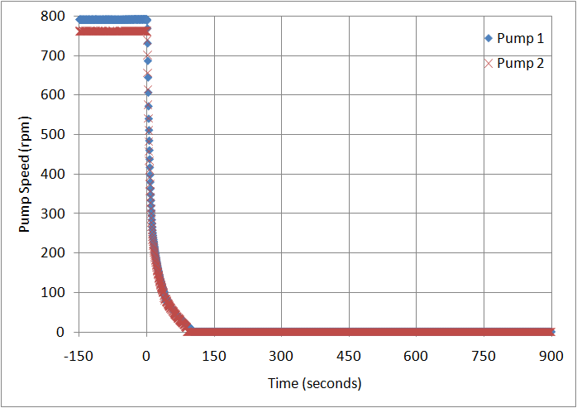
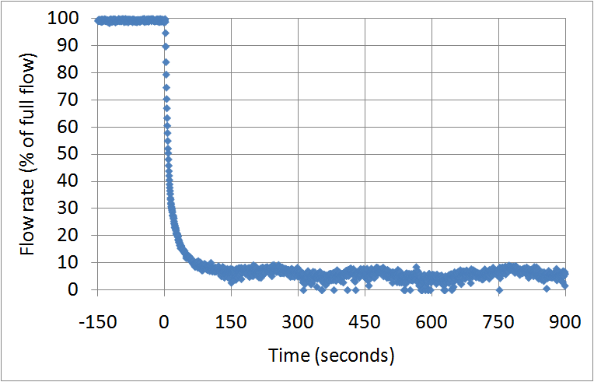
EBR-II Inherent Safety Demonstration
  Pump coast-down without scram caused the reactor core temperatures to rise, introducing net negative reactivity and reducing reactor power to decay heat level.
Notes:
The ULOF accident is assumed to be initiated by a total loss of offsite power, causing the electrical power to be lost to all primary pumps, intermediate loop pumps, and feedwater pumps. There is also a total failure to scram the reactor so that the reactor power changes only in response to the reactivity feedbacks.
The primary and intermediate pumps coast down according to their internal characteristics only. The loss of the feedwater pumps causes the loss of heat rejection to water side at the steam generators. The decay heat removal system continues to operate at their rated total capacity.

Slide 22
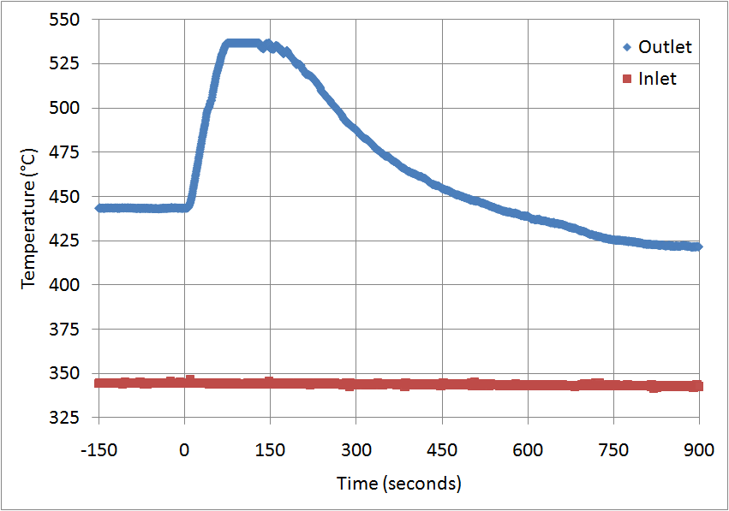
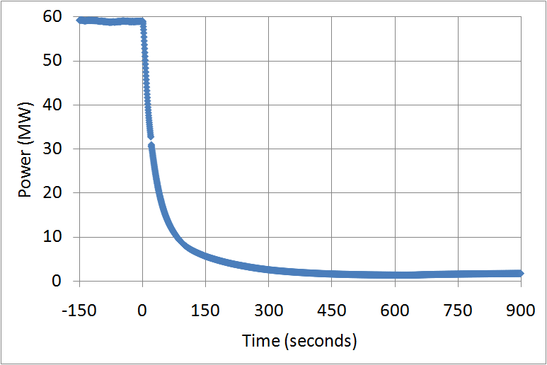
EBR-II Inherent Safety Demonstration
  Pump coast-down without scram caused reactor core temperatures to rise, introducing net negative reactivity and reducing reactor power to decay heat level.
Notes:
The change in core flow is accompanied by a change in power, with the flow dropping faster than the power. The power-to-flow ratio reaches 2.0 at 12 seconds after the start of the transient, and peaks at 2.3 at about 30 seconds.
Consequently, the peak coolant temperature reaches a maximum at about 70 seconds. The coolant temperature rises to 533°C at this point while the coolant saturation temperature is > 900°C. The minimum margin to coolant boiling of > 366°C.
Based on the analysis of this test, after the start of the transient, the negative reactivity contributions from core expansion, Doppler, and to the lesser degree, core axial expansion and control rod driveline expansion makes the core subcritical and net reactivity remains negative for the remainder of the transient.
All reactivity feedbacks tend to return to zero as power-to-flow ratio returns to 1.0 with slightly negative net reactivity. The temperatures stabilize at about nominal core-outlet coolant temperatures in the long term.
Measured and predicted peak XX09 instrumented assembly temperatures suggest that the eutectic limit was exceeded for ~ 90 seconds in the hottest driver assembly before natural convection fully compensated for the lack of pumping power (DAS records suggest no fuel failures)

Slide 23
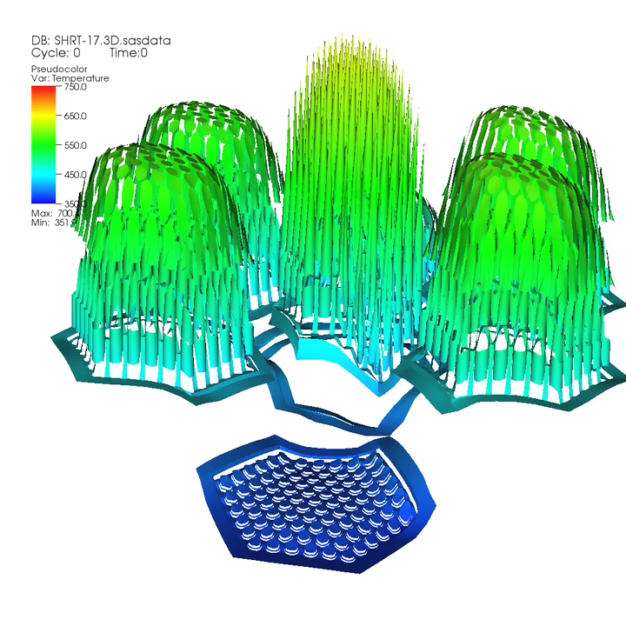
EBR-II Inherent Safety Demonstration
Mesh represents sodium temp. distribution at top of the XX09 and surrounding assemblies (elevation and color represents temperature)

