Slide 1
Group Activity 1
Assessing Uranium Demand under Varying
Nuclear Power Scenarios
4th Joint ICTP-IAEA Workshop on Physics and Technology of Innovative Nuclear Energy Systems, Trieste, Italia, 11-16 November 2024

Slide 2
When will innovative reactors with nuclear fuel (multi-)recycling be in demand?
Simplified reply: PWR technologies can work as long as there is enough uranium!
Task: to assess when the available uranium resources will run out with an increase in nuclear energy by only PWR technology deployment without nuclear fuel recycling.
Initial data: (1) Nuclear power growth projections and political requests,
(2) Identified recoverable uranium resources
Tool: NES Simulator (developed by IAEA INPRO)

Slide 3
It is suggested to assess three scenarios:
1) IAEA low (pessimistic) projection on growth of Nuclear Power Capacity
2) IAEA high (optimistic) projection on growth of Nuclear Power Capacity
3) Call to triple nuclear power capacity by 2050 (COP 28).
IAEA Projections (2024, RDS-1) | 2023 | 2030 |  | 2040 |  | 2050
Nuclear Electric Capacit,GW(e) |  | low | high | low | high | low | high
 | 372 | 414 | 461 | 491 | 694 | 514 | 950

Slide 4
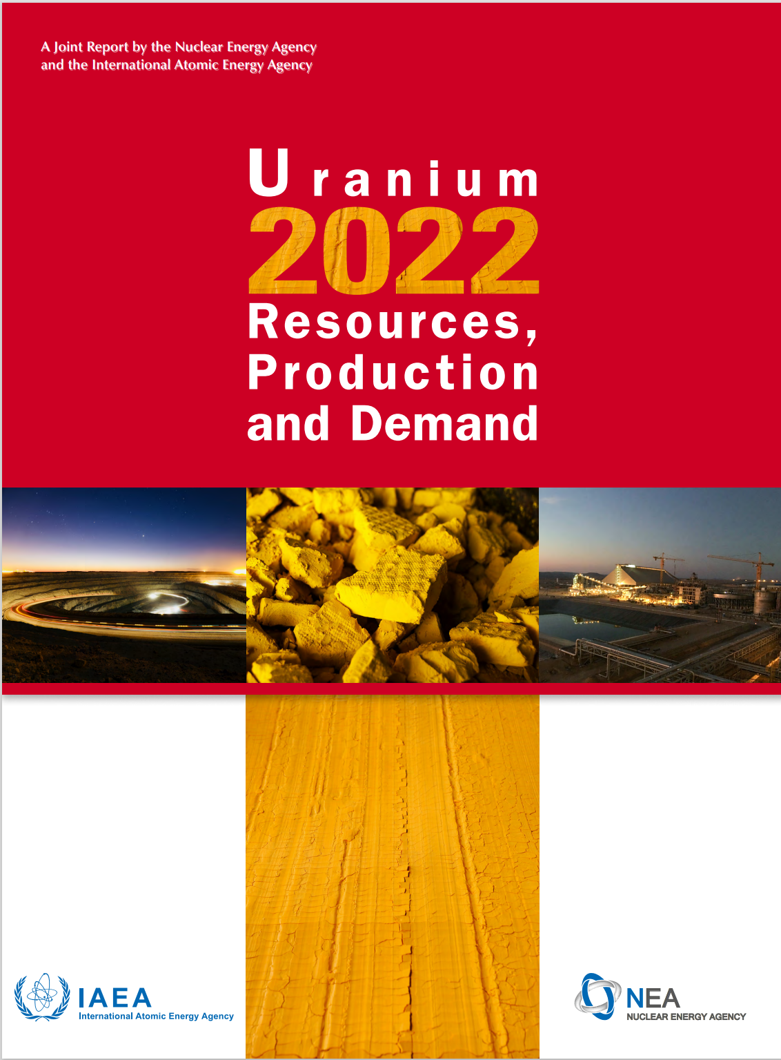
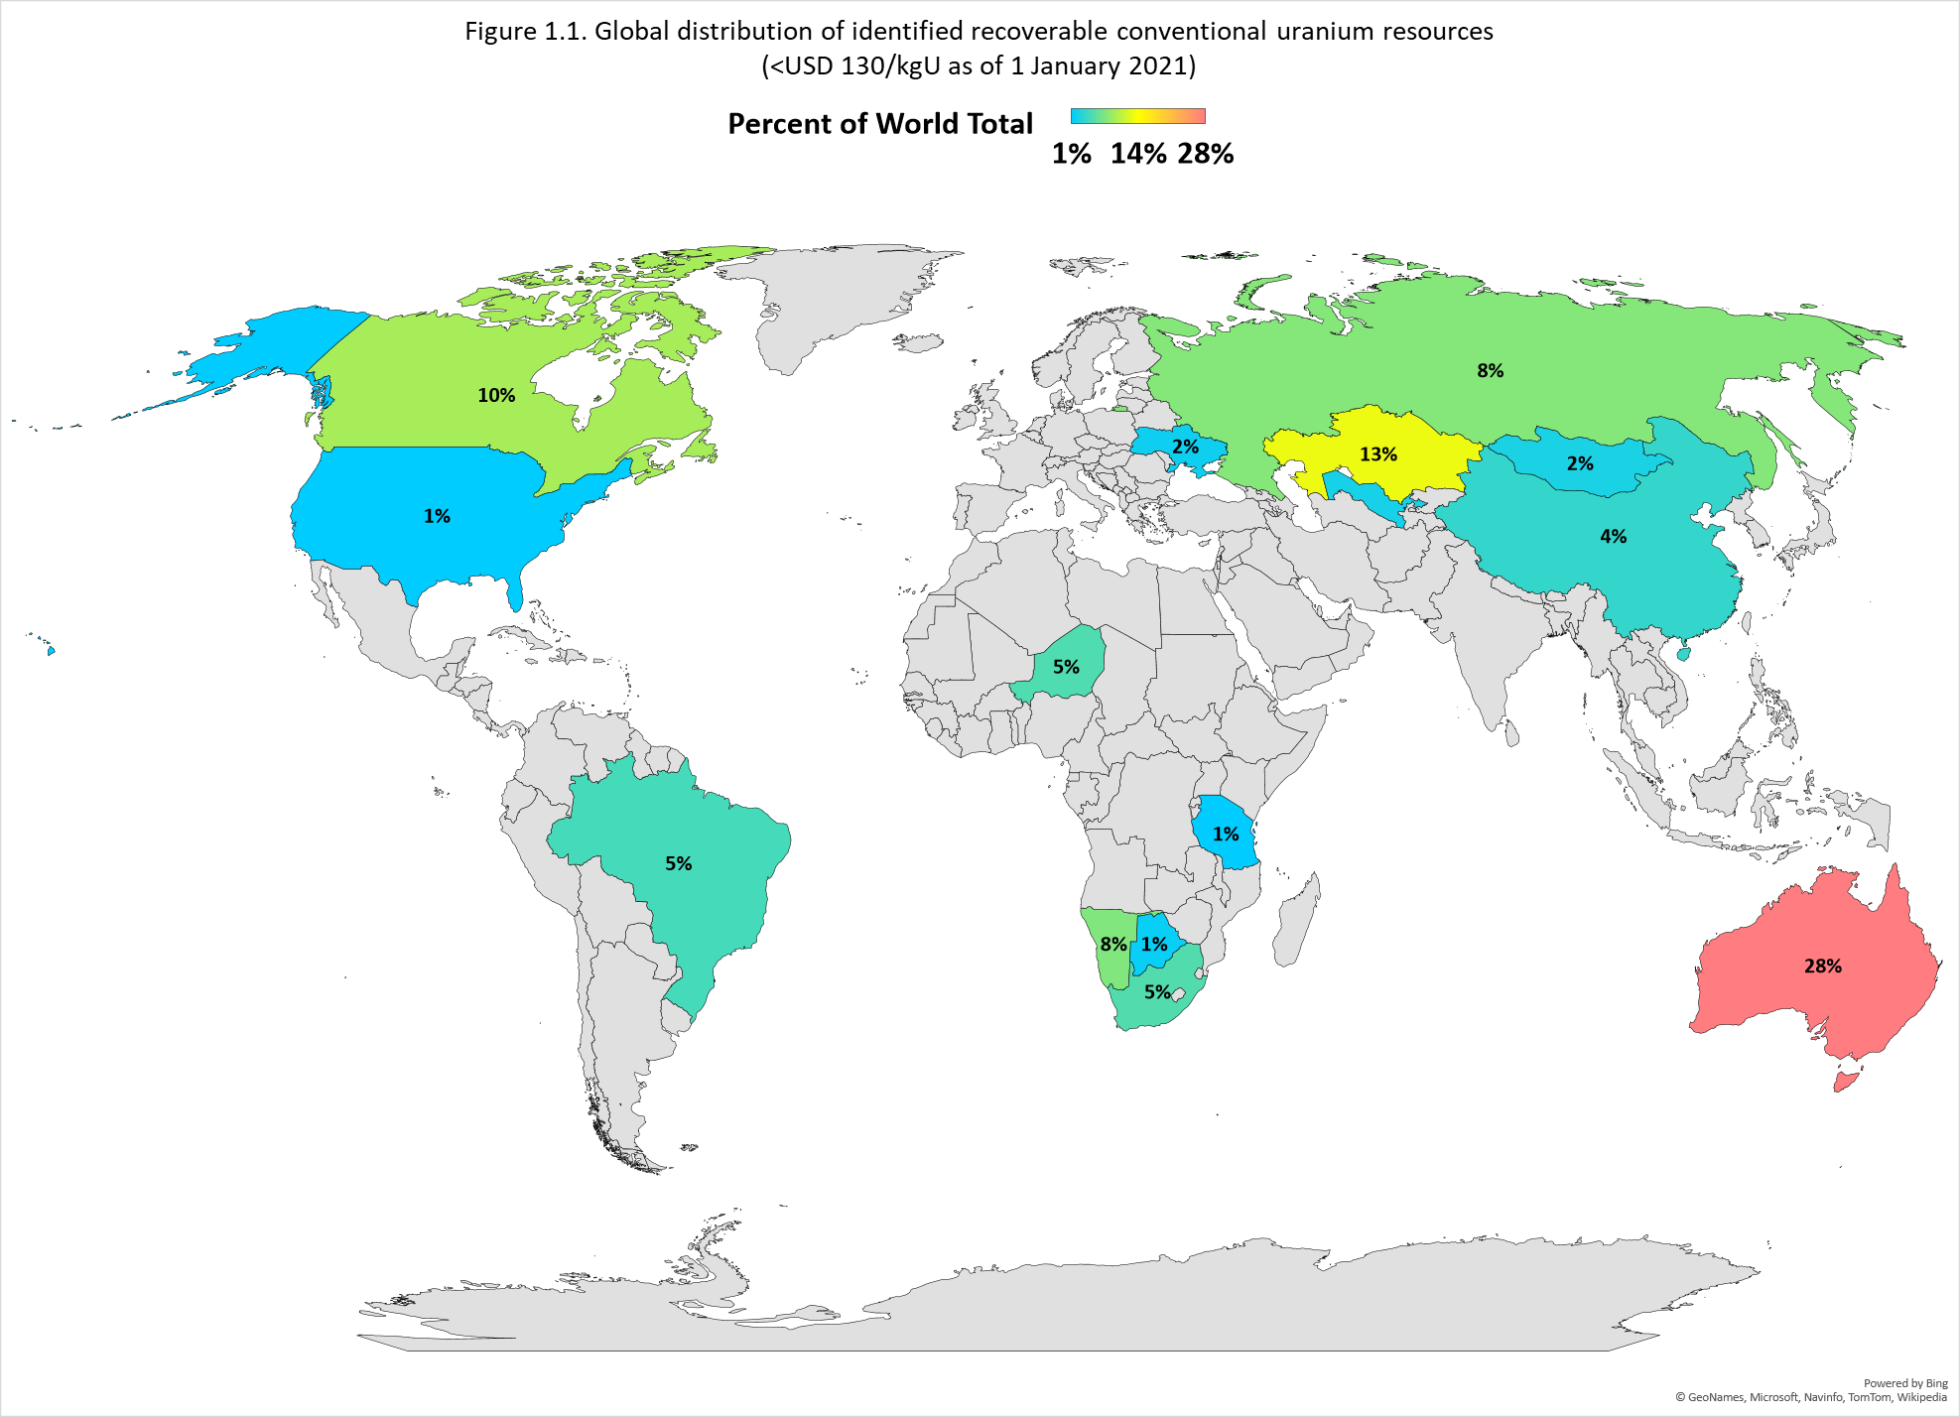
Global distribution of identified recoverable conventional uranium resources
(<USD 130/kgU as of 1 January 2021)
6 078 500 tons of uranium –
identified recoverable conventional
resources <USD 130/kgU
7 917 500 tons of uranium – resources with <USD 260/kgU
Notes:
Global identified recoverable resources of uranium, expressed in tonnes of uranium metal (tU), in the

Slide 5
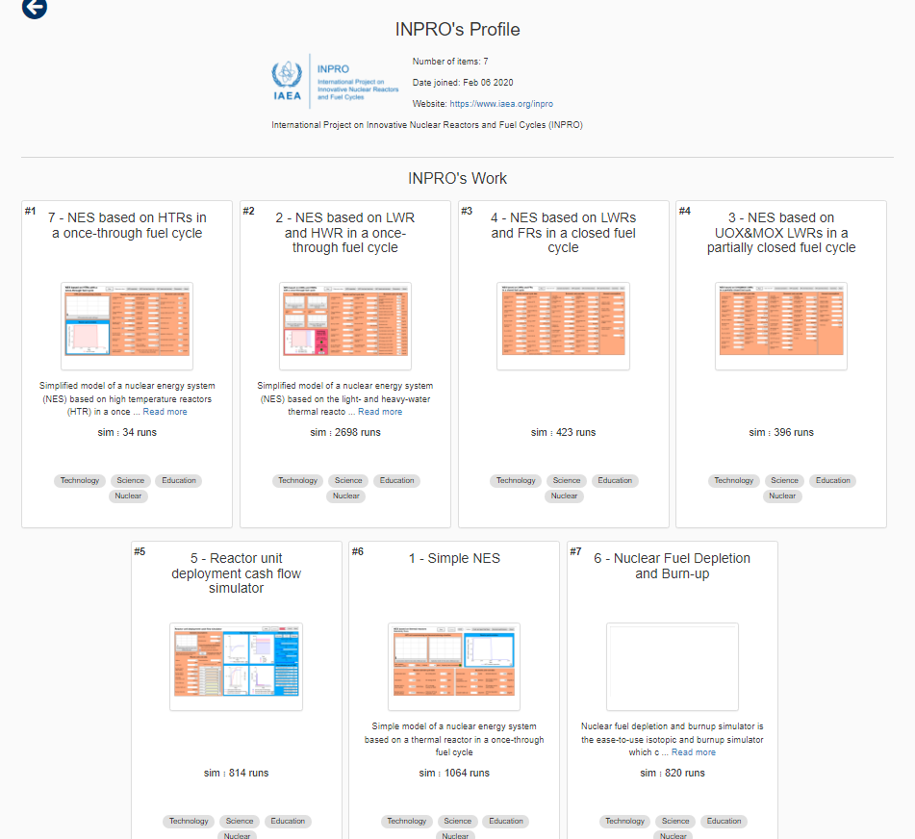
Tool:
INPRO NES Simulators
https://exchange.iseesystems.com/profile/12288

Slide 6
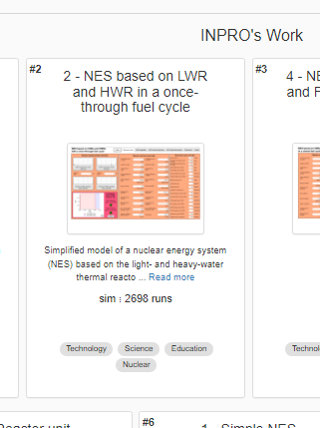
NES Simulator #2
Nuclear Energy System based on LWR and HWR in a once-through fuel cycle

Slide 7
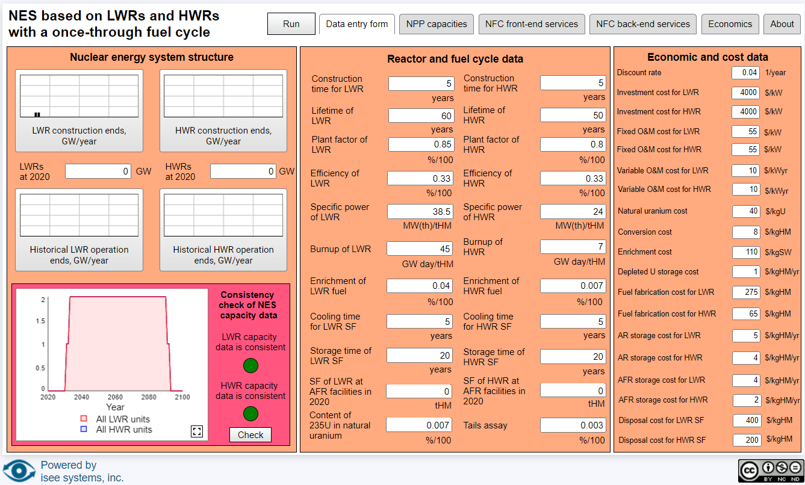
NES Simulator 1 - Inputs

Slide 8
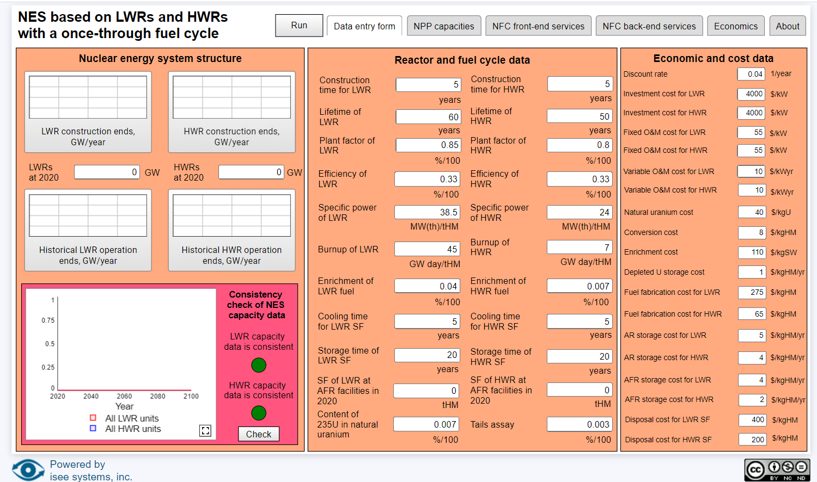

Slide 10
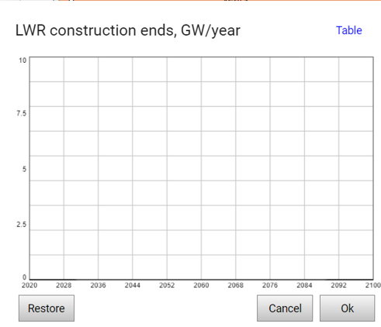
Click
Click

Slide 11
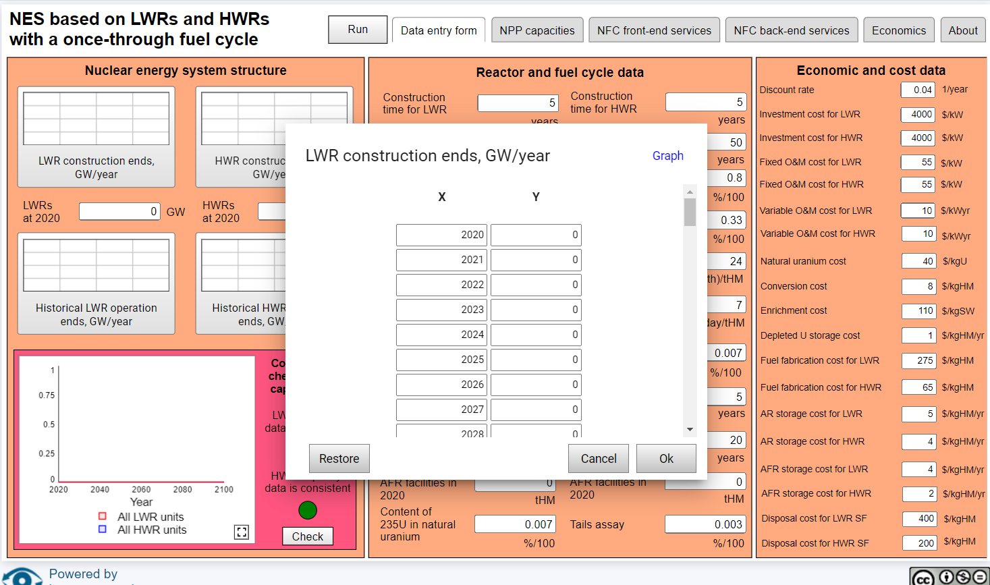

Slide 12
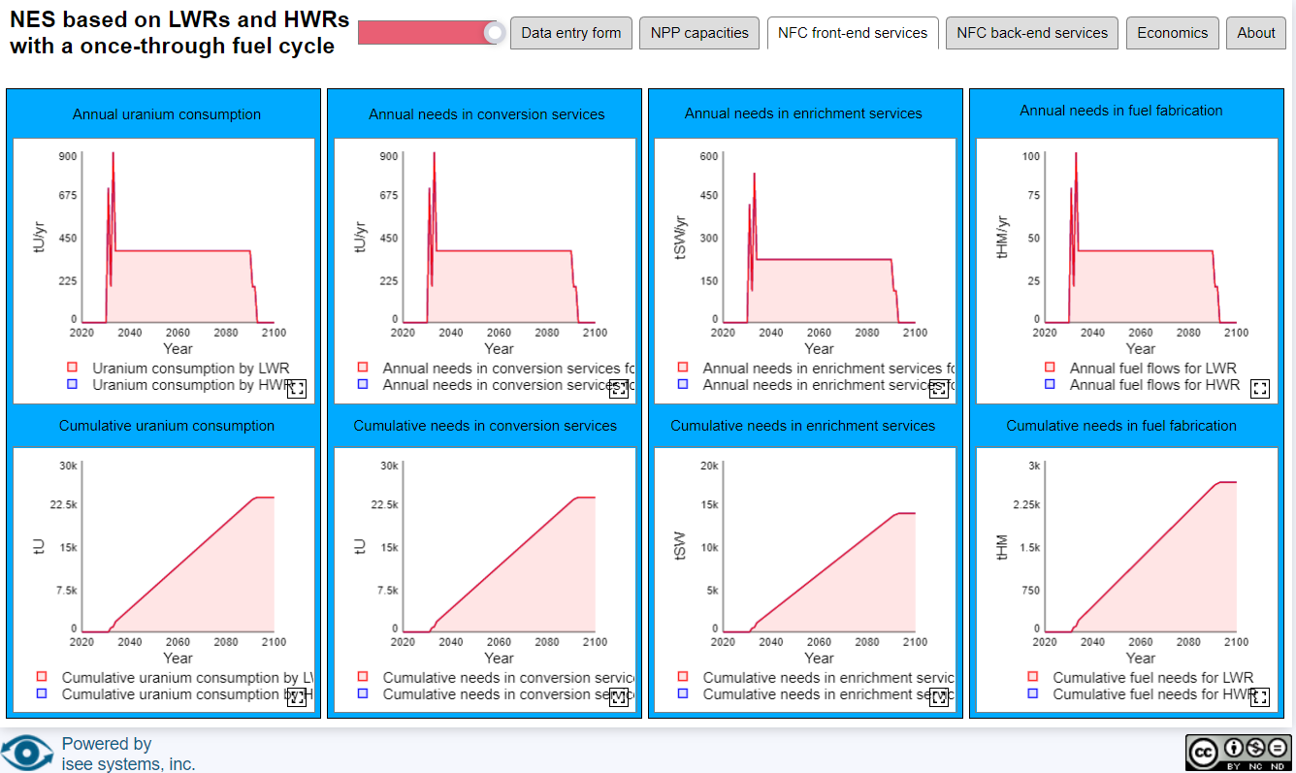
NES Simulator 1 – Results
Front end Material Flows

Slide 13
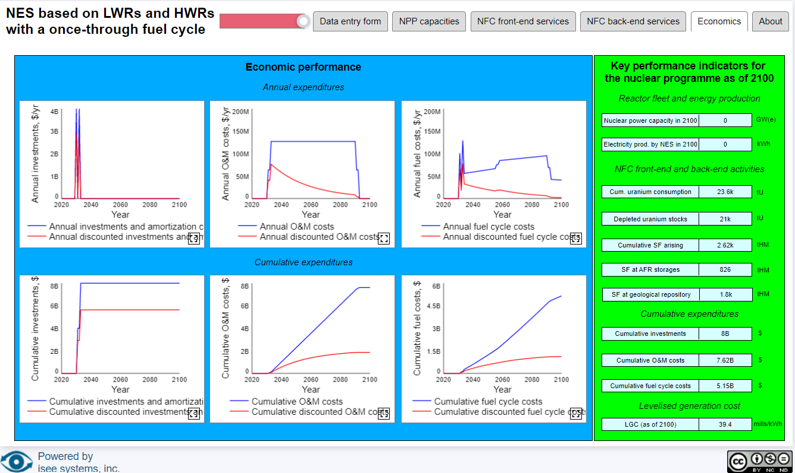
NES Simulator 1 – Results
Economic Performance

Slide 14
When will innovative reactors with nuclear fuel (multi-)recycling be in demand?
Notes:
Thank you!

