Slide 1
Fuel and cladding temperature in LFR – ALFRED test case
Trieste, Italy, November 11st -15st, 2024
M. Tarantino, P. Cioli Puviani, A. Bellomo

Slide 2
Scope of the exercise
Compute the temperature profile in the ALFRED reactor of:
- lead (bulk)
- cladding outer surface temperature
- maximum fuel temperature

Slide 3















Schematic of the problem
$$T_{bulk}$$
$$T_{f,i}$$
$$T_{f,o}$$
$$T_{c,i}$$
$$T_{c,o}$$
$$T_{bulk}$$
$$T_{c,o}$$
$$Q_{fuel}$$
$$T_{c,i}$$
$$T_{f,o}$$
$$Q_{gap}$$
$$T_{f,i}$$
$$Q_{clad}$$
$$Q_{lead}$$
In steady state condition
$Q_{fuel}=Q_{gap}=Q_{clad}=Q_{lead}=Q$

Slide 4
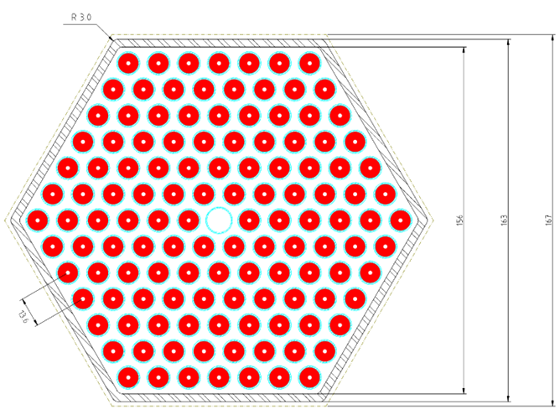
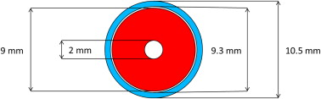
ALFRED Fuel and FA
Dummy element: d = 12 mm

Slide 5
ALFRED data and hypothesis
Data
Power | 300 MWth
Power released in the Fuel Assemblies | 95 %
Total mass flow rate | 17174 kg/s
Mass flow rate in the assemblies | 98.5 %
N° Fuel assemblies | 134
Fuel rods per assemblies | 126 + 1
Inlet temperature at the core | 400 °C
Active length | 810 mm
Data
Cladding outside diameter | 10.5 mm
Cladding thickness | 0.6 mm
Gap cladding fuel | 0.15 mm *
Pitch to diameter ratio | 1.29
Fuel internal diameter | 2 mm
Hot channel factor | 1.3
Fuel Assembly hexagonal key | 156 mm
* Reactor cold and at the
Beginning Of Life (BOL)

Slide 6
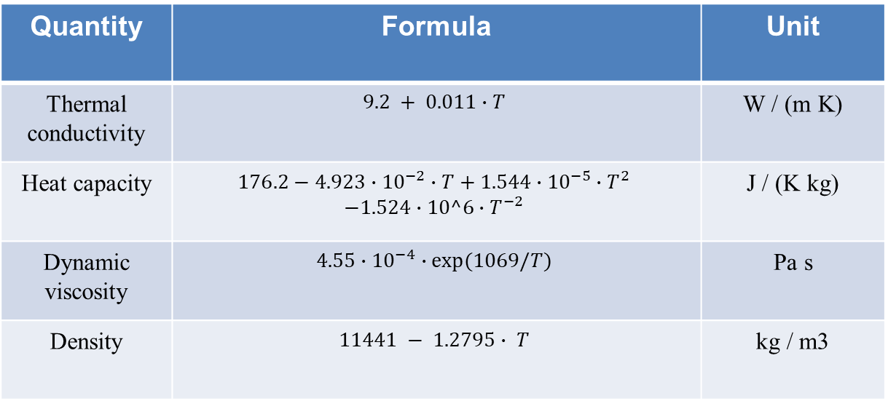
Lead Properties
Quantity | Formula | Unit
Thermal conductivity | $$9.2 + 0.011∙T$$ | W / (m K)
Heat capacity | $$176.2−4.923∙{10}^{−2}∙T+1.544∙{10}^{−5}∙T^{2} \\ −1.524∙10^6∙T^{−2}$$ | J / (K kg)
Dynamic viscosity | $$4.55∙{10}^{−4}∙exp⁡(1069/T)$$ | Pa s
Density | $$11441 − 1.2795∙ T$$ | kg / m3
Temperature in Kelvin

Slide 7
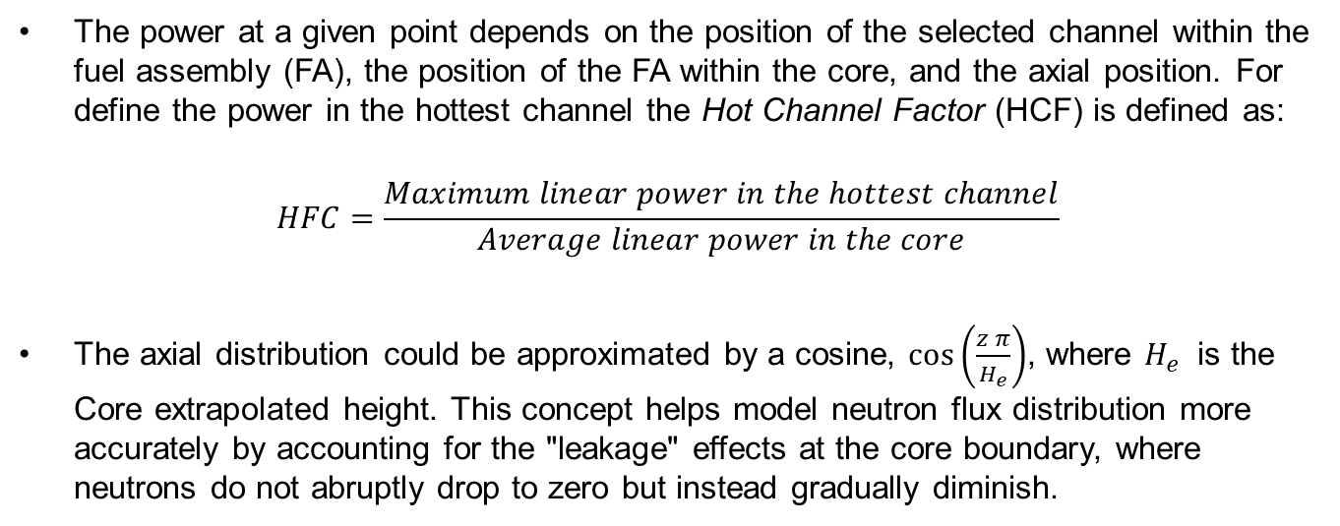
Axial power distribution in the hot channel
The power at a given point depends on the position of the selected channel within the fuel assembly (FA), the position of the FA within the core, and the axial position. For define the power in the hottest channel the Hot Channel Factor (HCF) is defined as:
$$HFC=\frac{Maximum linear power in the hottest channel}{Average linear power in the core}$$
The axial distribution could be approximated by a cosine, $\cos\left(\frac{z π}{H_{e}}\right)$, where $H_{e}$ is the Core extrapolated height. This concept helps model neutron flux distribution more accurately by accounting for the "leakage" effects at the core boundary, where neutrons do not abruptly drop to zero but instead gradually diminish.

Slide 8
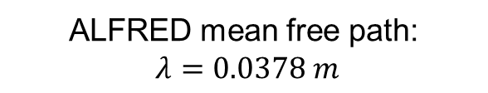
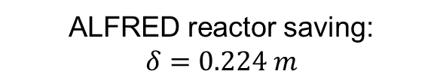
Axial power distribution in the hot channel
Core extrapolated height: $H_{e}=H_{active}+1.42 λ+2δ$
ALFRED mean free path:
$$λ=0.0378 m$$
ALFRED reactor saving:
$$δ=0.224 m$$
It is the average distance travelled by a particle before it collides with another particle.
It measures how efficiently neutrons are used to sustain the chain reaction. Depends on the neutronic properties of the core and the reflector.

Slide 9
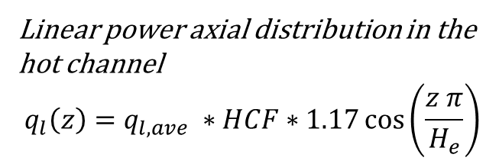
Power distribution
Linear power axial distribution in the hot channel
$$q_{l}\left(z\right)=q_{l,ave} ∗HCF∗1.17\cos\left(\frac{z π}{H_{e}}\right)$$
Hot channel factor
Normalization
factor

Slide 10

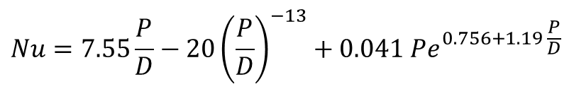


$$Q_{lead}$$
$$Q=h A (T_{c,o}−T_{bulk})$$
$$T_{bulk}$$
Mikityuk correlation
$$T_{c,o}$$
$$Nu=0.047\left(1−e^{−3.8\left(\frac{P}{D}−1\right)} \right)(Pe^{0.77}+250)$$
valid for 1.1≤ p/d ≤ 1.95 and 30 ≤ Pe ≤ 5000
Ushakov correlation
$$Nu=7.55\frac{P}{D}−20{\left(\frac{P}{D}\right)}^{−13}+0.041 Pe^{0.756+1.19 \frac{P}{D}}$$
valid for 1.2≤ p/d ≤ 2 and 1 ≤ Pe ≤ 4000

Slide 11
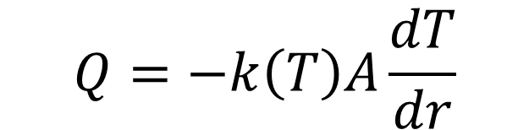



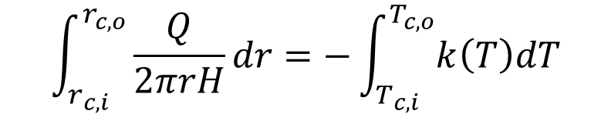
$$Q_{clad}$$
$$Q=−k\left(T\right)A\frac{dT}{dr}$$
Not considered
Axial conduction
$$k_{316L}=9.248+0.01572 T$$
$$T_{c,o}$$
$$\int_{r_{c,i}}^{r_{c,o}}{\frac{Q}{2πrH}dr}=−\int_{T_{c,i}}^{T_{c,o}}{k\left(T\right)dT}$$
$$T_{c,i}$$
The result is a polynomial of the second order!
1 equation → 1 unknown

Slide 12

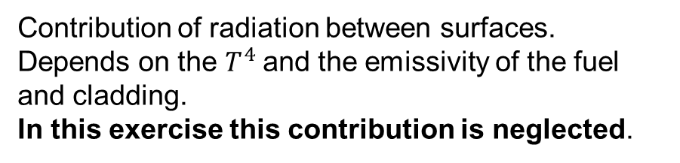
$$Q_{gap}$$
$$Q_{gap}=h_{g}^{T} A_{f,o}(T_{f,o}−T_{c,i})$$
Contribution of radiation between surfaces. Depends on the $T^{4}$and the emissivity of the fuel and cladding.
In this exercise this contribution is neglected.

Slide 13
$$Q_{gap}$$
$$Q_{gap}=h_{g}^{T} A_{f,o}(T_{f,o}−T_{c,i})$$
Contribution presents only if contact occurs.
Neglected in this exercise.

Slide 14
$$Q_{gap}$$
$$Q_{gap}=h_{g}^{T} A_{f,o}(T_{f,o}−T_{c,i})$$
The contribution due to the 3 thermal resistances in series is considered in this exercise
Computed with the Ross and Stoute correlation: next slide!
Hp: the gap is in cold condition (no expansion of the fuel/cladding considered) and filled by only helium (BOL) at fixed pressure → overall conservative assumption that reduce $h_{gap}$

Slide 15
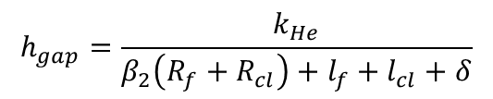
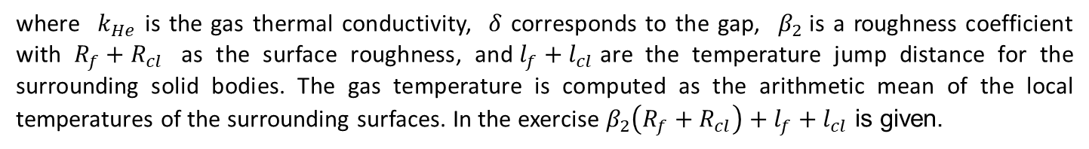
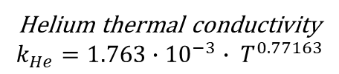
$$Q_{gap}$$
Computed with the Ross and Stoute correlation:
Helium thermal conductivity
$$k_{He}={1.763∙10}^{−3}{∙ T}^{0.77163}$$
$$h_{gap}=\frac{k_{He}}{β_{2}\left(R_{f}+R_{cl}\right)+l_{f}+l_{cl}+δ}$$
Hp: $β_{2}\left(R_{f}+R_{cl}\right)+l_{f}+l_{cl}=2.5 ∙{10}^{−5} m$
where $k_{He}$​ is the gas thermal conductivity, $δ$ corresponds to the gap, $β_{2}$is a roughness coefficient with $R_{f}+R_{cl}$​ as the surface roughness, and$l_{f}+l_{cl}$are the temperature jump distance for the surrounding solid bodies. The gas temperature is computed as the arithmetic mean of the local temperatures of the surrounding surfaces. In the exercise $β_{2}\left(R_{f}+R_{cl}\right)+l_{f}+l_{cl}$ is given.
Hp: the gap is in cold condition (no expansion of the fuel/cladding considered) and filled by only helium (BOL) at fixed pressure → overall conservative assumption that reduce $h_{gap}$

Slide 16


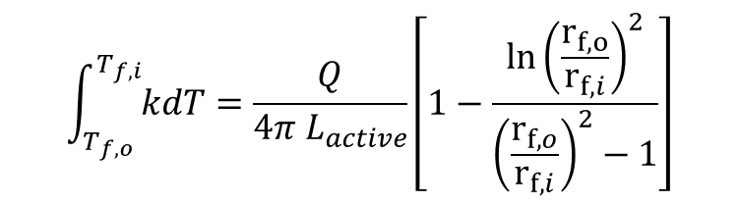

$$Q_{fuel}$$
From energy conservation of the fuel with uniform volumetric heat generation
$$T_{f,o}$$
Not considered
Density variation in time
Conductivity dependency from temperature and time
$$\int_{T_{f,o}}^{T_{f,i}}{kdT}=\frac{Q}{4π L_{active}}\left[1−\frac{\ln{{\left(\frac{r_{f,o}}{r_{f,i}}\right)}^{2}}}{{\left(\frac{r_{f,o}}{r_{f,i}}\right)}^{2}−1}\right]$$
$$T_{f,i}$$
Hp: $k_{fuel}≈2\frac{W}{m K}$

Slide 17
Mariano Tarantino
mariano.tarantino@enea.it

