Slide 1
4th Joint ICTP-IAEA Workshop on
Physics and Technology of
Innovative Nuclear Energy Systems
11 – 15 November 2024, Trieste, Italy
Group Exercise 3
Nuclear Electricity Production in 2050

Slide 2
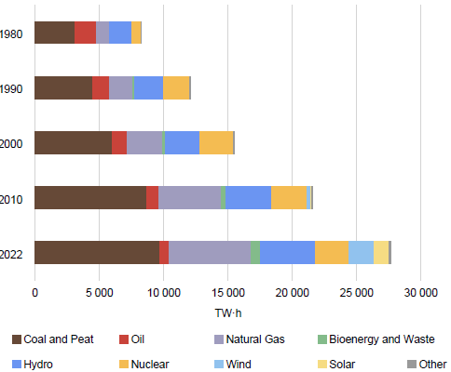
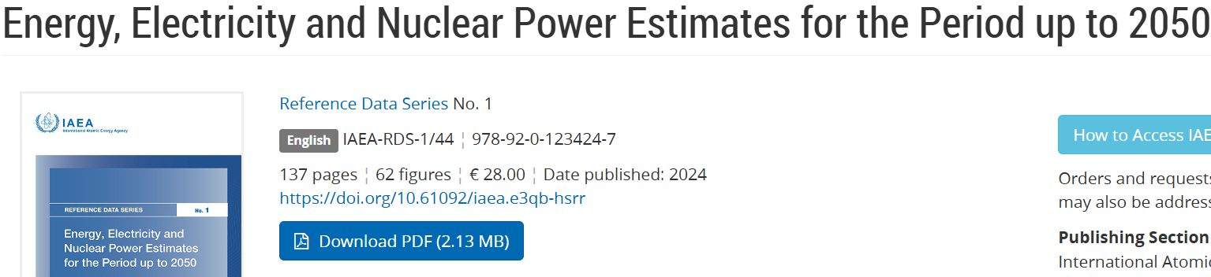
World Electricity Production by Energy Source
Drag and drop
your image here
IAEA RDS 1, 2023
Energy, Electricity and Nuclear Power Estimates for the Period up to 2050
Final energy consumption from electricity: 20% (2022), 30% (2050)​
16, 12 and 9% of electricity was produced by hydro, solar/wind, and nuclear, respectively, in 2022​
Nuclear Power reactors​
    415 in operation​
    374 GWe total installed capacity​
    61 under construction
Notes:
Since 1980 fossil fuels have continued to dominate final energy consumption, although there has been a gradual reduction in their combined share from 74% in 1980 to 66% in 2022.
The share of coal declined slightly from 1980 to 2000 and increased from 2000 to 2010 and has since declined again. Natural gas has maintained a consistent share of about 15%. The share of oil has declined slightly since 1980, stabilizing at about 40% since 2010.
20% of final energy consumption was electricity in 2022. The share of electricity has undergone the most significant change since 1980, increasing by 10 percentage points, with consumption growing at an average annual rate of about 3%.
Looking to the future, electricity consumption is expected to increase faster than final energy consumption, thus it is anticipated that the share of electricity in final energy consumption (20% in 2022) will continue to grow (22% in 2030, 30% in 2050).
Electricity Production
With a share of more than 60%, fossil fuels — particularly coal — have remained dominant sources of electricity production since 1980, despite increases in the combined share of nuclear and renewables over the years.
The share of natural gas has increased more than 10 percentage points since 1980. The share of coal remained around 40% until 2010 but has since gradually decreased by a few percentage points. Of all fossil fuels, the share of oil has experienced the most significant change, decreasing from about 20% in 1980 to about 2% in 2022
9.2% of electricity was produced by nuclear, it is expected the share will be between 8% (low case) and 14% (high case) in 2050.
Hydro remains the largest contributor of low carbon electricity, accounting for 16%, although its share has decreased by about 4 percentage points since 1980. In recent years, the share of solar and wind has undergone a rapid increase, rising from less than 1% in 1980 to about 12% in 2022.
The share of nuclear grew rapidly from 1980 to 1990, almost doubling, but has declined since 2000.

Slide 3
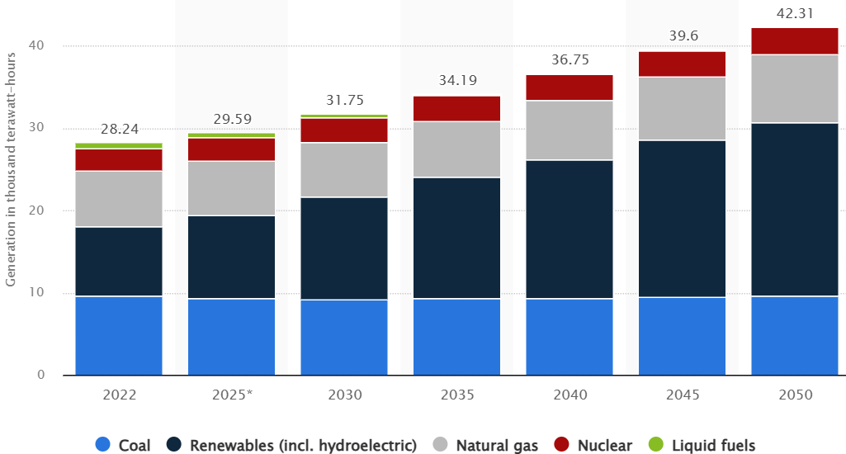
World Electricity Production in 2050
WORLD FINAL CONSUMPTION OF ENERGY AND ELECTRICITY, EJ
Final Consumption | 2023 | 2030 | 2040 | 2050
Energy | 440.9 | 439.4 | 432.2 | 432.3
Electricity | 89.0 | 103.0 | 136.2 | 189.4
Electricity as % of Energy | 20.2% | 23.4% | 31.5% | 43.8%
www.iaea.org (EJ)
www.statista.com (TWH/1000)
Notes:
Since 1980 fossil fuels have continued to dominate final energy consumption, although there has been a gradual reduction in their combined share from 74% in 1980 to 66% in 2022.
The share of coal declined slightly from 1980 to 2000 and increased from 2000 to 2010 and has since declined again. Natural gas has maintained a consistent share of about 15%. The share of oil has declined slightly since 1980, stabilizing at about 40% since 2010.
20% of final energy consumption was electricity in 2022. The share of electricity has undergone the most significant change since 1980, increasing by 10 percentage points, with consumption growing at an average annual rate of about 3%.
Looking to the future, electricity consumption is expected to increase faster than final energy consumption, thus it is anticipated that the share of electricity in final energy consumption (20% in 2022) will continue to grow (22% in 2030, 30% in 2050).
Electricity Production
With a share of more than 60%, fossil fuels — particularly coal — have remained dominant sources of electricity production since 1980, despite increases in the combined share of nuclear and renewables over the years.
The share of natural gas has increased more than 10 percentage points since 1980. The share of coal remained around 40% until 2010 but has since gradually decreased by a few percentage points. Of all fossil fuels, the share of oil has experienced the most significant change, decreasing from about 20% in 1980 to about 2% in 2022
9.2% of electricity was produced by nuclear, it is expected the share will be between 8% (low case) and 14% (high case) in 2050.
Hydro remains the largest contributor of low carbon electricity, accounting for 16%, although its share has decreased by about 4 percentage points since 1980. In recent years, the share of solar and wind has undergone a rapid increase, rising from less than 1% in 1980 to about 12% in 2022.
The share of nuclear grew rapidly from 1980 to 1990, almost doubling, but has declined since 2000.

Slide 4
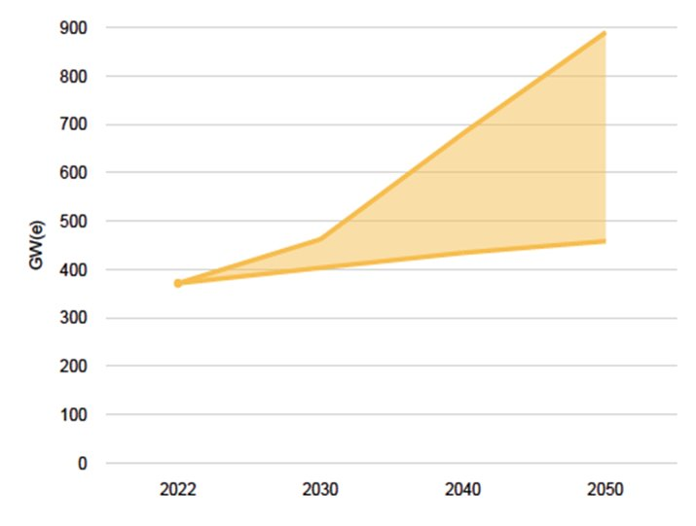
Expanded role of Nuclear
Technical Innovation:​
Key to expanded role in clean energy transition and for energy security​
Advanced Reactors, Small Modular Reactors​
Non-electric Applications​
Integrated Energy Systems
    Energy, Electricity and Nuclear Power Estimates for the Period up to 2050​
    IAEA RDS-1 2023
Notes:
2023 RDS-1
Status of nuclear power, 2022
20.1% of final energy consumed was electricity
Nuclear power accounted for 9.2% of total electricity production
Hydro and Solar/Wind produced 16% and 12%, respectively
Currently, 31 countries are operating 416 nuclear power plants with total net installed capacity of 375 GWe
Main drivers for maintaining and expanding the use of nuclear power are Climate Change Mitigation and Energy Security
Innovations can help nuclear energy meet many of the challenges which are holding back its growth.
Innovations should be developed, demonstrated and deployed in a timely manner to secure opportunities of contribution to net zero emissions and energy security.
Institutional challenges should be addressed as well, in addition to technical challenges.

Slide 5
World Nuclear Electricity Production in 2050
Q1: How much (%) of nuclear electricity will be produced in 2050?
Q2: How much of electricity (%) will be produced by SMRs in 2050?
Notes:
Since 1980 fossil fuels have continued to dominate final energy consumption, although there has been a gradual reduction in their combined share from 74% in 1980 to 66% in 2022.
The share of coal declined slightly from 1980 to 2000 and increased from 2000 to 2010 and has since declined again. Natural gas has maintained a consistent share of about 15%. The share of oil has declined slightly since 1980, stabilizing at about 40% since 2010.
20% of final energy consumption was electricity in 2022. The share of electricity has undergone the most significant change since 1980, increasing by 10 percentage points, with consumption growing at an average annual rate of about 3%.
Looking to the future, electricity consumption is expected to increase faster than final energy consumption, thus it is anticipated that the share of electricity in final energy consumption (20% in 2022) will continue to grow (22% in 2030, 30% in 2050).
Electricity Production
With a share of more than 60%, fossil fuels — particularly coal — have remained dominant sources of electricity production since 1980, despite increases in the combined share of nuclear and renewables over the years.
The share of natural gas has increased more than 10 percentage points since 1980. The share of coal remained around 40% until 2010 but has since gradually decreased by a few percentage points. Of all fossil fuels, the share of oil has experienced the most significant change, decreasing from about 20% in 1980 to about 2% in 2022
9.2% of electricity was produced by nuclear, it is expected the share will be between 8% (low case) and 14% (high case) in 2050.
Hydro remains the largest contributor of low carbon electricity, accounting for 16%, although its share has decreased by about 4 percentage points since 1980. In recent years, the share of solar and wind has undergone a rapid increase, rising from less than 1% in 1980 to about 12% in 2022.
The share of nuclear grew rapidly from 1980 to 1990, almost doubling, but has declined since 2000.

Slide 6
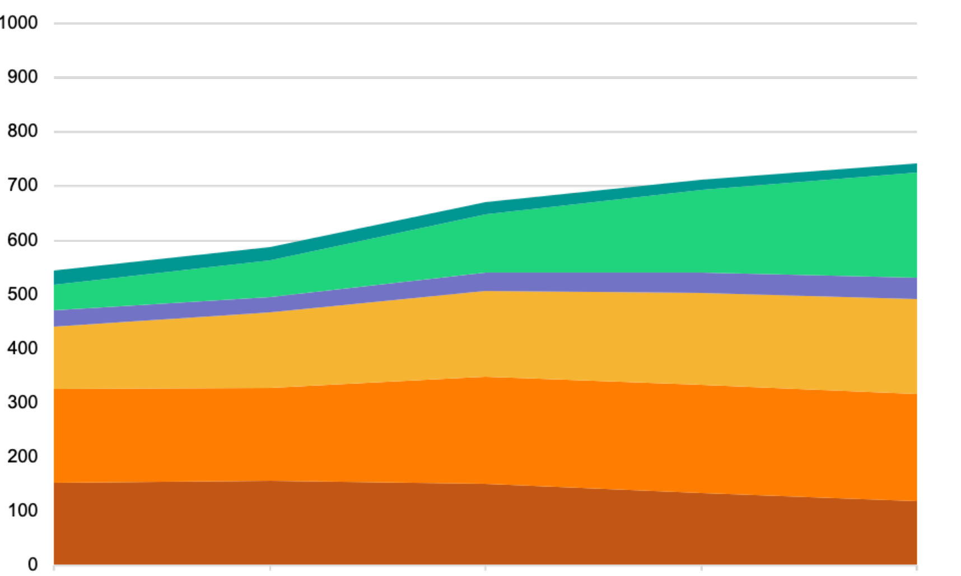

How much clean energy do we need?
Now, this question is different from the previous one
Q3: How many SMRs are needed to replace fossil fuels?
Biomass
Are SMRs ready to deliver this amount of energy?
Renewables
World Energy (EJ)
Nuclear
Gas
Oil
Fossil Fuels
If yes, then how?
Coal
2010
2020
2030
2040
2050
IEA’s Stated Policies Scenario: World Energy by Source (IEA, 2021)
Notes:
The world has been in an abusive relationship with fossil fuels since before we were born. And now we have until 2050 to break it off.
The good news is, people are waking up to the climate challenge. Over the past decade we have seen large-scale deployment of renewable energy. I just got back from COP27 the global climate and governments and corporations worldwide are making commitments to cut carbon emissions. The bad news is, even when we add up all the world’s stated commitments as does this graph – we are still on path of humanity destroying levels of climate change in this century.
Try as we might, the world has not been successful in breaking it off with fossil fuels– and here is why.

