Slide 1
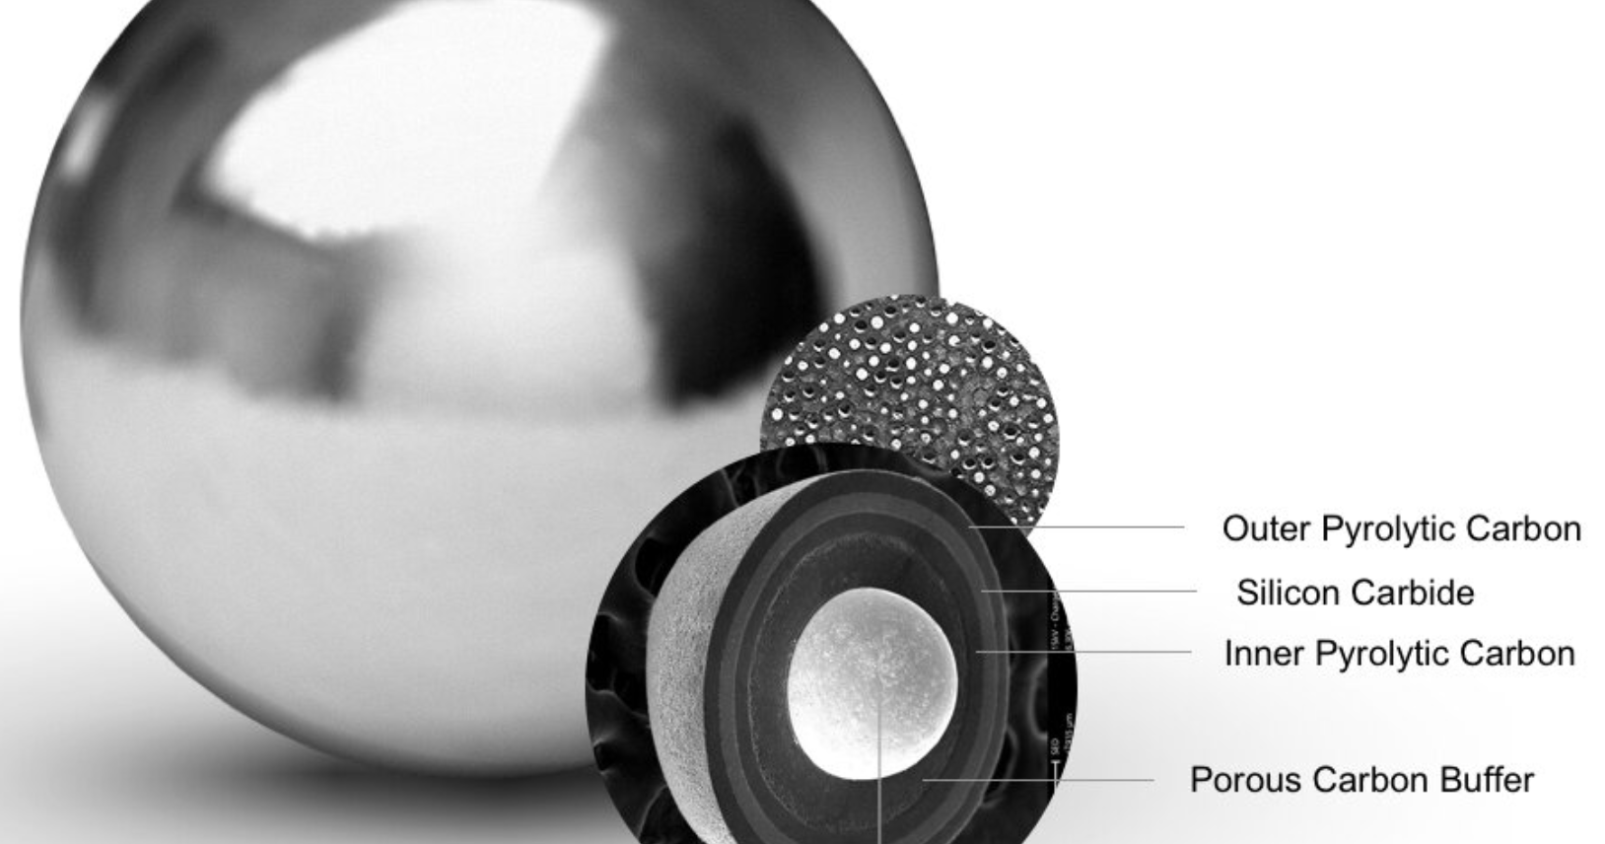
High Temperature Reactor Technology and Safety
Tanju Sofu
Program Manager
Nuclear Science & Engineering Division
Argonne National Laboratory

Slide 2
outline
Introduction: What are HTRs?
  Basic characteristics, design variants, past and ongoing experience
Key safety features
  Reactivity control
  Air and water ingress
  Core heat removal
  Confinement of radioactive materials
Defense-in-depth strategy
Summary

Slide 3
What are High-Temperature Reactors?
Thermal reactors with coated particle fuel forms
They use graphite as the moderator
Most use pressurized helium gas as chemically inert coolant (no boiling concern), one design variant with molten-salt coolant (not pressurized)
Known for ability to achieve much higher operating temperatures than traditional water-cooled reactors
  Greater thermal efficiency for electricity conversion
Inherent safety for reactivity control
Passive safety for decay heat removal
No risk of core melt

Slide 4
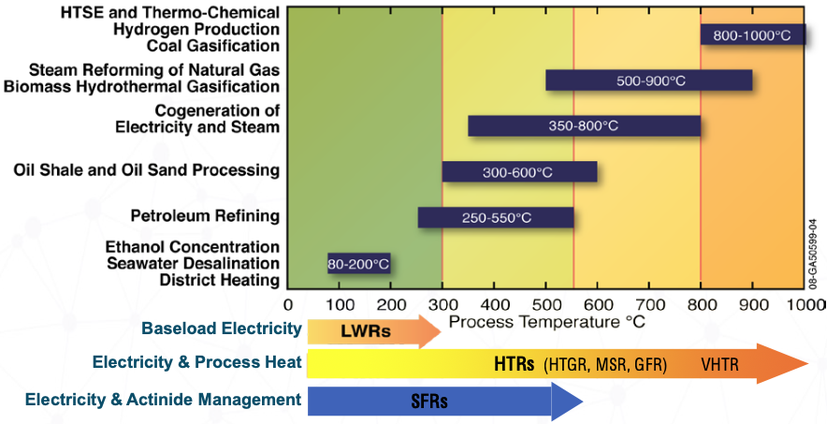
Potential for non-electric applications
Suitable for process heat and hydrogen production

Slide 5
Design variants
Types of HTRs
Prismatic block pressurized gas-cooled reactors: Reactor core consists of hexagonal graphite blocks containing fuel and coolant channels
Pebble-bed pressurized gas-cooled reactors: Reactor core is filled with spherical fuel elements (pebbles) made of graphite and uranium particles
Molten-salt-cooled fluidized-bed reactor:
  Fuel form and graphite moderation are like pebble-bed gas-cooled reactors, but with smaller pebbles (half in diameter)
  Higher power density than gas systems (20 W/cc vs. 5 W/cc)
  Coolant is not pressurized

Slide 6
Past and ongoing experience
Dragon (U.K.): 20 MW-th (1964-1975)
Peach Bottom (U.S.A.): 115 MW-th (1967-1974)
AVR (Germany): 46 MW-th (1967-1988)
Fort St. Vrain (U.S.A.): 842 MW-th (1976-1989)
THTR (Germany): 750 MW-th (1986-1989)
HTTR (Japan): 30 MW-th (1999-present)
HTR-10 (China): 10 MW-th (2000-present)

Slide 7
Key safety Features
Low power density (large volume)
High core heat capacity
Strongly negative temperature coefficient of reactivity
Large height-to-diameter ratio of the core for effective vessel cooling (via natural circulation of air)
Coated fuel particles as the primary barrier to radionuclide release

Slide 8
safety design approach
Design using chemically stable materials that can retain their integrity at high temperatures
  Coolant choices
    Pressurized helium (~7 Mpa) as inert single-phase coolant with negligible neutron absorption
    Unpressurized molten-salt as corrosive but practically single-phase coolant with moderate neutron absorption
  Ceramic coated particle fuel
    High temperature capability, high radionuclide retention characteristics
  Graphite as structural material and moderator
    High temperature stability, large heat capacity, long thermal response times

Slide 9
safety design approach (cont.)
Designs with inherent and passive safety features
  Large negative temperature coefficient for inherent reactivity control
  Shape and size of the reactor allows for passive decay heat removal from the reactor core through the reactor vessel
    Decay heat is removed passively even with a pressure boundary breach through conduction and radiation in the core
  No reliance on power or actuation signal to perform necessary safety functions
Low power density and slow thermal response during accidents (high heat capacity)
  Little or no reliance on operator action, insensitive to incorrect actions
Retain radionuclides at the source (mostly within coated fuel particles)

Slide 10
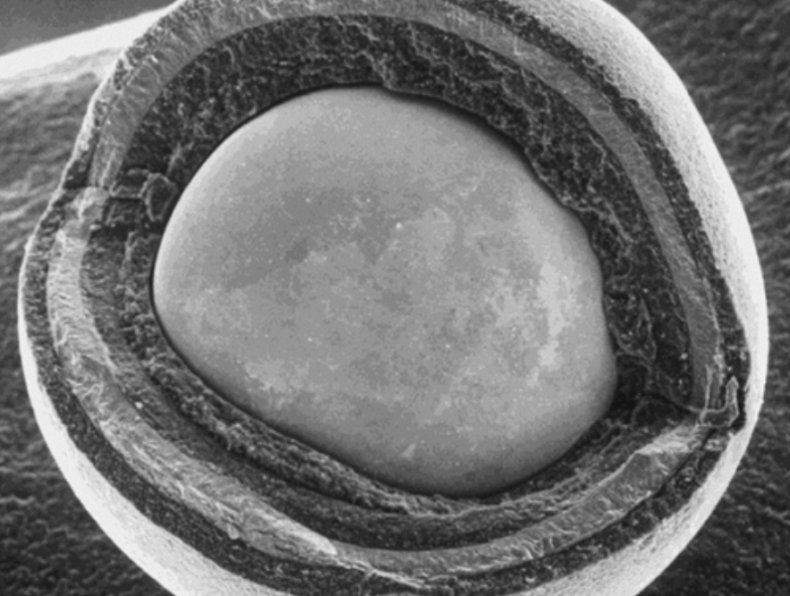
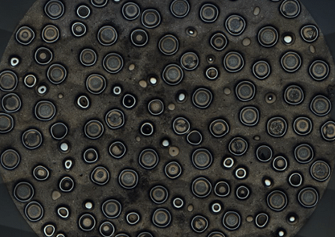
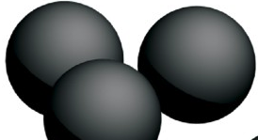
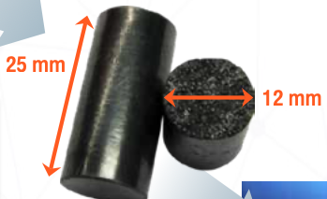
Coated particle fuel
UO₂ or UCO fuel kernels (fraction of a mm in diameter, size of a poppy seed)
Several layers of protective ceramic coating around the kernels
  These layers serve as initial barriers against release of fission products
Coated particles pressed into graphite matrix and shaped into pebbles or pellets
Large margin to particle failure (>1800ºC)

Slide 11
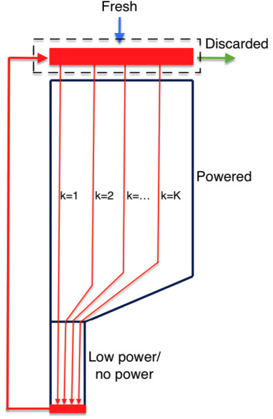
Pebble-bed design considerations
Pebbles are loaded from top and collected at the bottom
  Downward coolant flow, resulting flow reversal during loss of forced cooling event
In gas-cooled reactors, pebbles move slowly at different speed along streamlines
Partially burnt pebbles are sent back to the top after an online burnup measurement
  Reactor core eventually reaches an equilibrium burnup profile (can take up to a year or more)
This online fueling allows for a very low excess reactivity

Slide 12
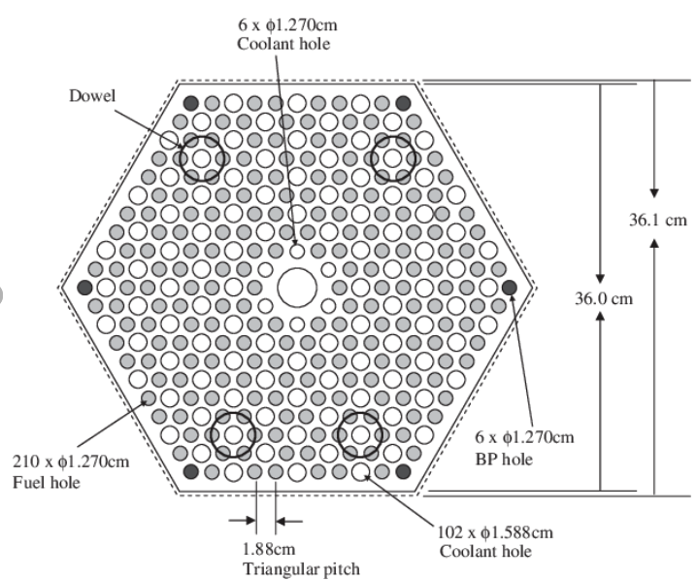
Prismatic fuel design considerations
Pellets in graphite blocks with embedded coolant channels
Pellets are batch-loaded and reshuffled during core reloading
Burnable poison is used to flatten the power and keep the reactor critical without excess reactivity
Shutdown rods are inserted into the blocks
Dimensional changes in graphite lead to alternate coolant pathways (bypass flow)
  Alters the temperature profile in the core and reflector
When the blowers stop, forced convection stalls quickly and natural convection (driven by buoyancy) picks up
  If there are significant bypass gaps, radiation across the gaps becomes a dominant heat transfer mechanism

Slide 13
Reactivity control
Mechanisms for reactivity control include:
  Absorber pebbles (in pebble bed concepts)
  Burnable poison (in prismatic fuel concepts)
Subcriticality is achieved via
  Inherent safety (strong Doppler feedback)
  Control rods
These mechanisms ensure that the reactor can be safely shut down and maintained in a subcritical state

Slide 14
Passive decay heat removal
Vessel cooling system
Radiation
Conduction
Convection
Removal of heat from the core to reactor vessel via conduction and radiation alone is sufficient
  Convective core cooling is not needed to keep the core temperatures below the design limits (during unpressurized events)
Core heat is then dumped to atmosphere (ultimate heat sink) via radiation and natural convection in the coolant panels surrounding the reactor pressure vessel
Vessel cooling system
Core barrel
Reactor pressure vessel
Reflector
Core
Concrete structures and earth
CL

Slide 15
Passive decay heat removal (cont.)
Vessel cooling system
A simple, always on system (during both operational states and off-normal events)
  Does not need power or an actuation signal
Its main function is to maintain reactor pressure vessel and concrete cavity wall temperatures below design limits
  Does not impact core temperatures significantly if not functional (not needed to protect the fuel)
Heat removal rates are similar during normal operations and accident conditions
Various air-cooled or water-cooled configurations are possible

Slide 16
Air Ingress
Helium is inert, but air and water ingress into the HTGR system can pose significant safety risks
Design measures to prevent or mitigate these events include:
  Preventing pressure boundary breach (rapid depressurization)
  Limiting water ingress in case of steam generator tube rupture
Nuclear grade steel pressure vessel makes large breaks highly unlikely
  Air ingress is limited by core flow area and friction losses
  High-purity, nuclear-grade graphite does not “burn” but it can oxidize at a slow rate at temperatures above critical point
    Oxidation rate is limited by availability of oxygen near the break point
Fuel compact matrix and ceramic coatings protect fuel particles

Slide 17
Water/steam ingress
Limited sources of water in steam cycle plants
Ingress is monitored and limited by
  Moisture monitors
  Steam generator isolation (does not require power)
  Steam generator dump system
Water-graphite reaction:
  Endothermic
  Requires temperatures above normal operation
  Slow reaction rate
Fuel compact matrix and ceramic coatings protect fuel particles

Slide 18
Defense in Depth Strategy
Fundamental safety approach for HTRs as well
  Involves multiple levels of protection to prevent and mitigate accidents
  Each level has independent safety features/measures to ensure overall safety
  Implemented throughout design, construction, operation, and decommissioning
Defense-in-Depth Levels
Level 1 | Level 2 | Level 3 | Level 4 | Level 5
Operational states |  | Accident conditions |  | EP&R
Normal Operation | Anticipated Operational Occurrences | Design Basis Accidents | Design Extension Conditions | Residual risk and practically eliminated accidents
Plant states considered in design

Slide 19
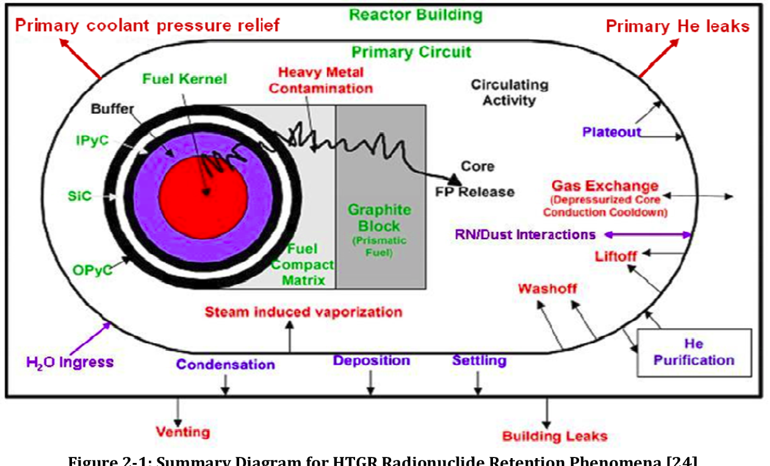
Confinement of radioactive materials
Functional containment
Multiple barriers to confine radioactive materials:
  Coated fuel particles
  Graphite matrix
  Coolant
    Helium purification system
    Molten salt with high retention rate
  Coolant boundary
  Reactor building

Slide 20
Confinement of radioactive materials
Functional containment (cont.)
Emphasis is on radionuclide retention at source:
  Coated fuel particles act as the primary barriers, effectively retaining fission products
  Normal operating peak fuel temperature is <1250°C and tests show high retention for hundreds of hours at >1600°C without fuel particle failure
Potential release mechanisms:
  Primary coolant leaks
  Liftoff (mechanical re-entrainment)
  Steam-induced vaporization
  Wash-off (removal by liquid H2O)
  Primary coolant pressure relief
This sequence of multiple barriers eliminates the need for traditional pressure-retaining containment structure
Barrier performance:
  Condensable radionuclides plate out during normal operation
  Graphite absorption
  Circulating activity is limited by helium purification system

Slide 21
Confinement of radioactive materials
Delayed release mechanisms during accidents
Early (but limited) release of circulating activity in coolant and liftoff mechanisms
  From defective coated fuel particles
  Helium purification system to reduce circulating activity from the coolant
Delayed releases during off-normal events leading to elevated core temperatures
  Releases from fuel depend on fraction of core above normal operating temperatures and duration of the event
  Timing of release is from tens of hours to several days
  Release rate is governed by amount of forced cooling or size of leak/break
    Small leaks can potentially lead to a greater radionuclide release
    Releases cease when internal temperatures decrease due to core cooldown

Slide 22
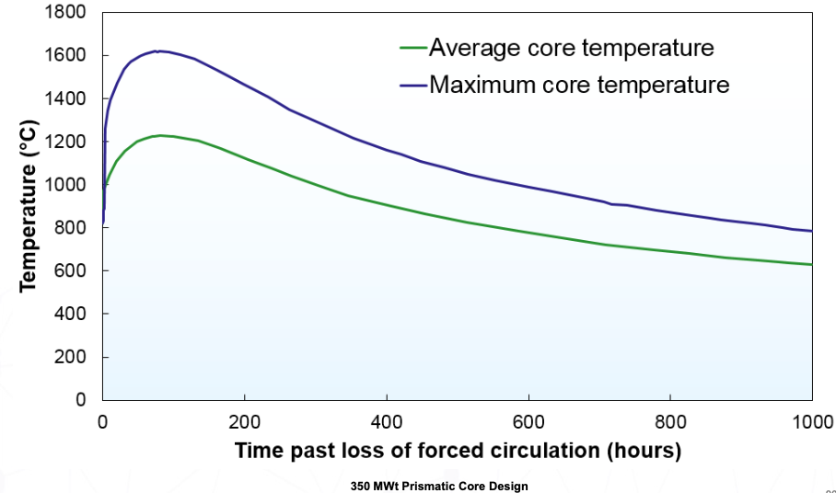
Typical core temperatures
Depressurized loss of forced cooling

Slide 23
Role of vented reactor building
Structurally protects pressure vessels and vessel cooling system from external hazards
Limits air ingress following helium pressure boundary breaks
Provides additional radionuclide retention opportunity, but may not be relied on for radionuclide retention to meet off-site dose regulatory requirements
  Not a conventional pressure-retaining containment structure
Reactor building is vented early in a helium pressure boundary break scenario (when the helium circulating activity is low)
  The reactor building vent is closed later in the transient (when the particle fuel experiences higher temperatures and becomes leakier)
  Prevents reactor building overpressure from release of non-condensing helium coolant

Slide 24
summary
High Temperature Gas-cooled Reactors are a type of Generation-IV reactor system
  Thermal reactors with coated particle fuels
  They offer high thermal efficiency and can be used for electricity generation and process heat applications
Design variants:
  Pebble bed reactors
  Prismatic fuel reactors
  Molten-salt cooled fluidized bed concept
Characteristics that contribute to inherent/passive safety and accident prevention:
  Low power density
  High heat capacity of the core
  Strongly negative temperature coefficient of reactivity
  Large height-to-diameter ratio of the core
  Coated fuel particles as the primary barrier to radionuclide release

