Slide 1

Planned and co-organized by
Northern Ocean Region Panel (NORP) & Southern Ocean Region Panel (SORP)
of CLIVAR, CliC and IASC/SCAR

Slide 2

Co-sponsors:
Scientific organizing committee
Carolina Dufour, McGill, Canada & IFREMER, France
Alexander Haumann, AWI & LMU, Germany
Dorotea Iovino, CMCC, Italy
Torge Martin, GEOMAR, Germany
Alvaro Scardilli, SHN, Argentina
Amy Solomon, NOAA, USA
Riccardo Farneti, ICTP, Italy

Slide 3
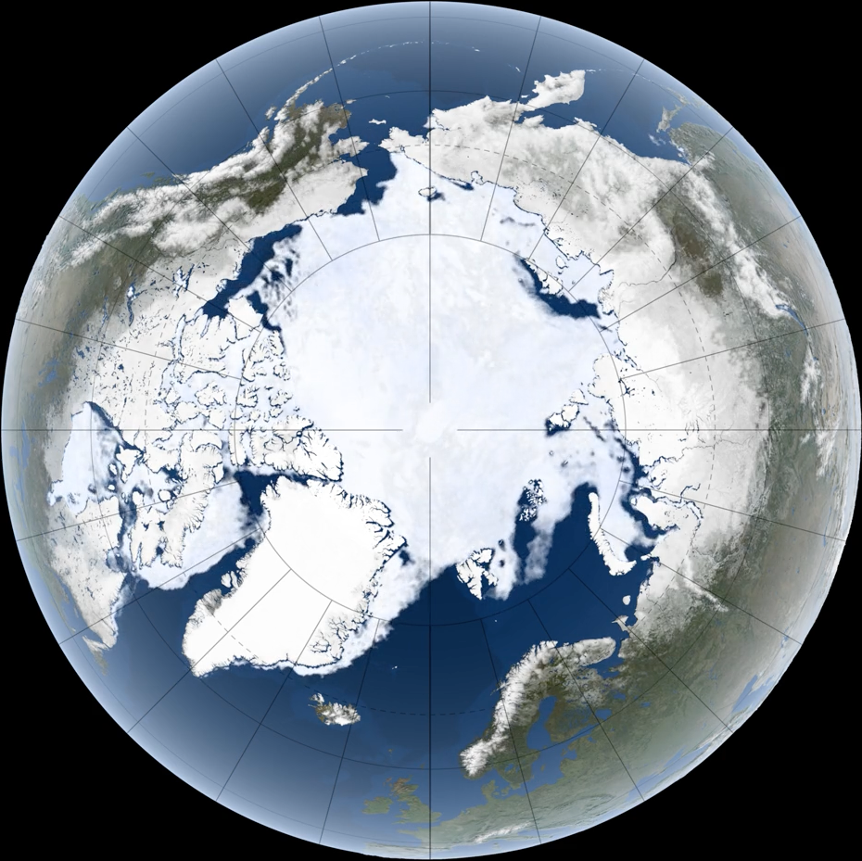
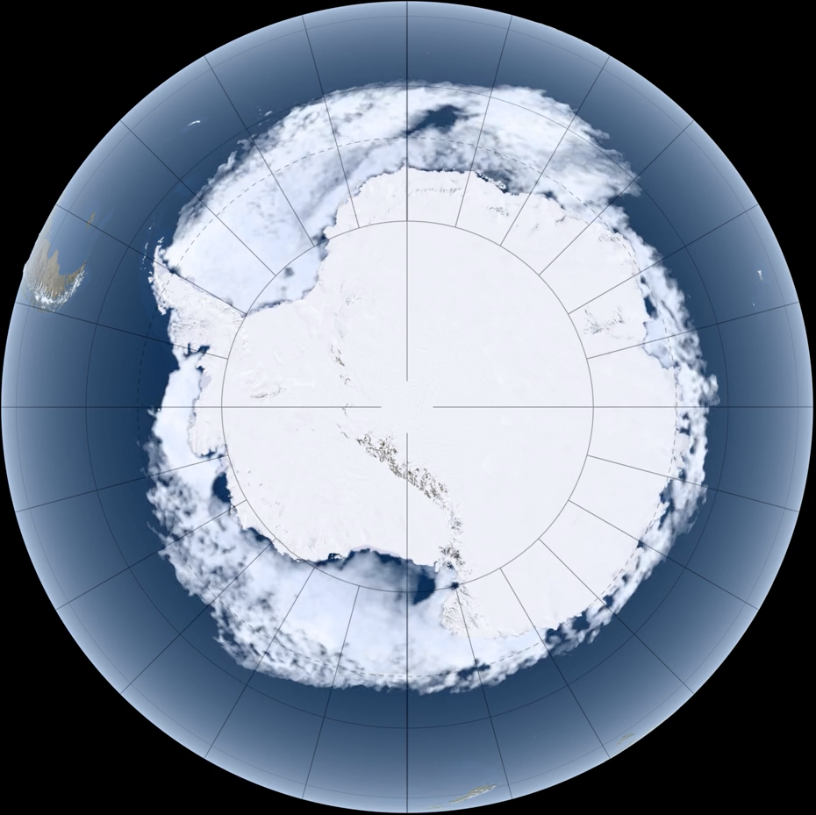
Objectives of the workshop
Review the recent advances on understanding the variability of the sea ice in both hemispheres and its linkage with the climate system.
Discuss the important research avenues and identify the challenges and opportunities to refine this understanding.
Reflect on the MOSAiC expedition and brainstorm on Antarctica InSync.
Bridge the gap between the two polar communities and foster scientific collaborations and technical cooperations around models and observations.
Think about possible workshop outcomes, e.g. press release, white paper, review or perspective papers.
4 topics introduced by keynotes
1 - From MOSAiC to Antarctica InSync: perspective and prospective
2 - Drivers of the recent sea ice decline
3 - Marginal Ice Zone and coastal processes
4 - Sea ice prediction and projections

Slide 4
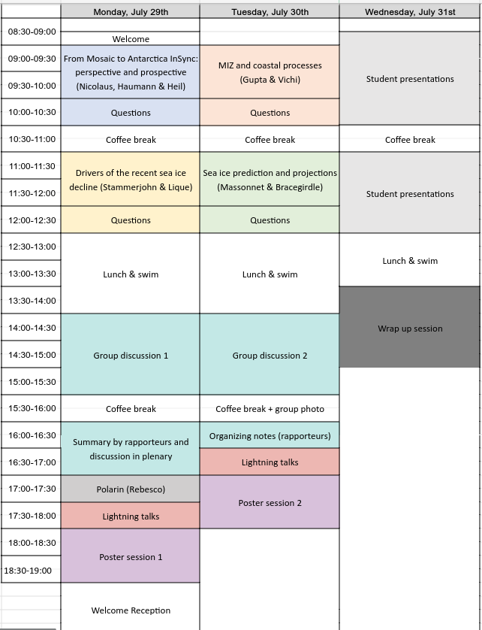
Agenda
Days 1:
> Keynotes and questions
> Lightning talks & poster sessions (last names A to N)
> Group discussions
Days 2:
> Keynotes and questions
> Lightning talks & poster sessions (last names O to Z)
> Group discussions
Days 3:
> Presentations of research projects from the school
> Wrap up session

Slide 5
Day 1 (groups & plenary)
Discuss to make important questions and outcome emerge
Day 2 (groups)
Discuss specific questions/outcome in-depth
Day 3 (plenary)
Report on the conclusions and discuss outcome
Group
Group
Expert group
Expert group
All
2 rapporteurs per group
(1 junior & 1 senior)
Group
Group
2 rapporteurs per group
(1 junior & 1 senior)
Expert group
Expert group
Group
Group
Expert group
Group
Group
Summary of the group discussions & selection of questions/outcome to address on day 2 in plenary
Organization of notes in prep. for
the wrap up session
Rapporteurs within each group
By rapporteurs of each group

Slide 6
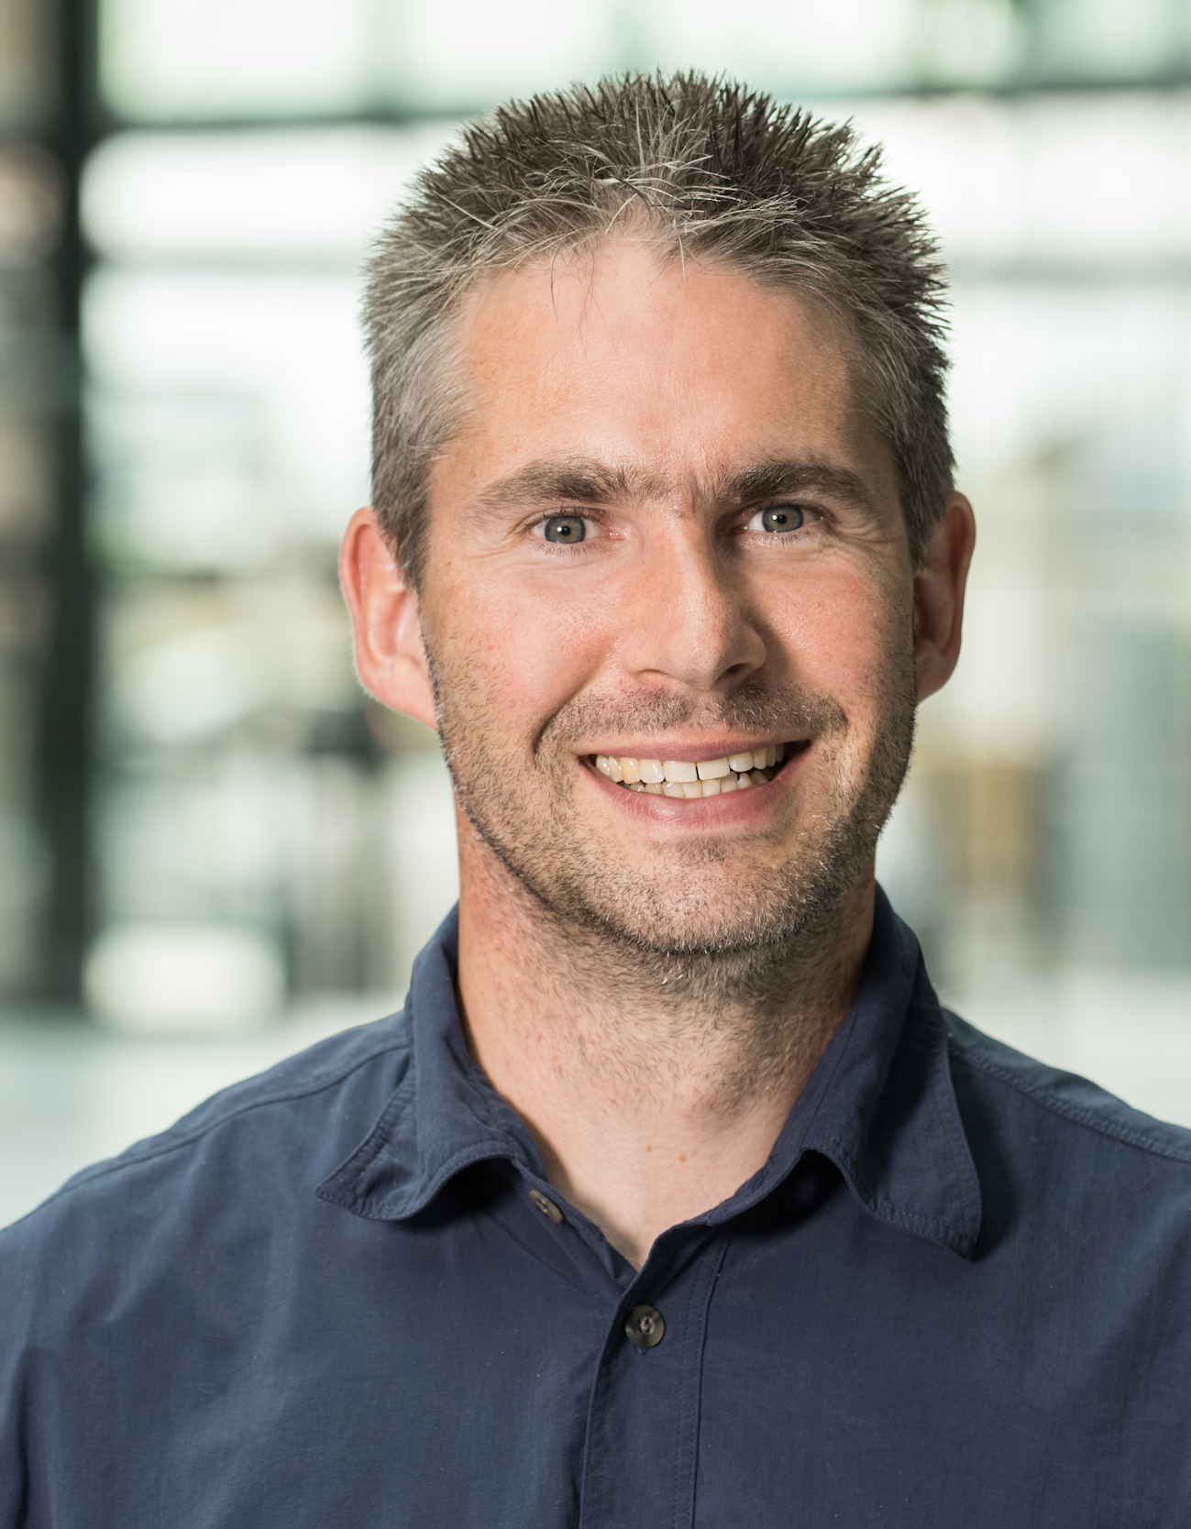
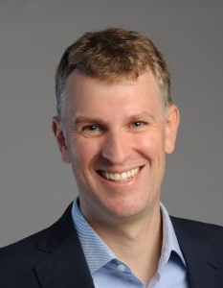
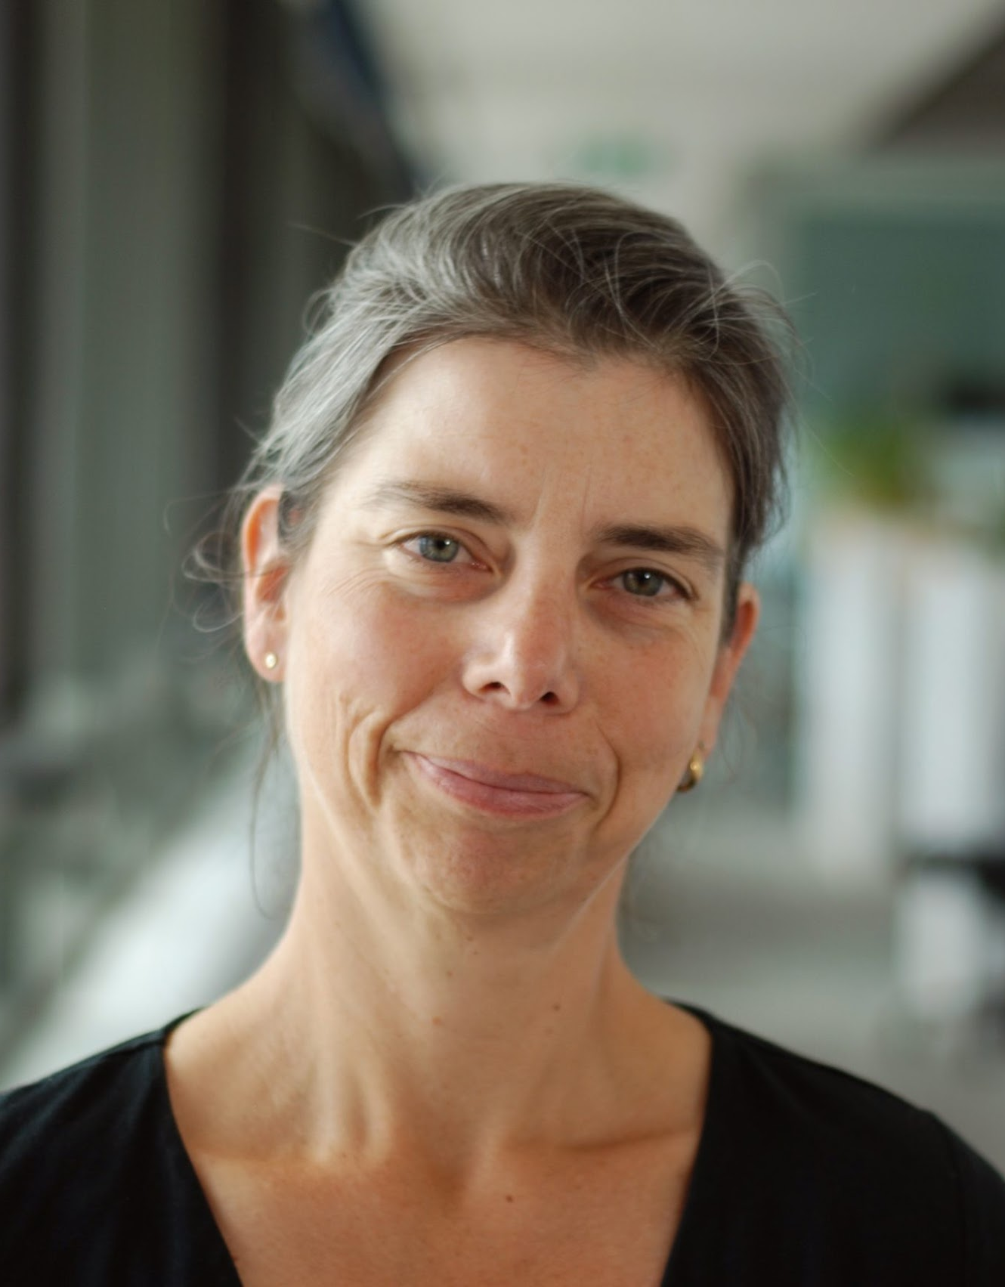
KEYNOTE #1
From MOSAiC to Antarctica InSync: perspective and prospective
Marcel Nicolaus
Deputy head of sea ice physics group at AWI
Experienced sea-going senior scientist
also with outreach and media
Sea ice & snow, Arctic & Antarctic
Moderator: Torge Martin
Alexander Haumann
Professor at AWI/LMU
Helmholtz young investigator
group SOS-iClimate
ERC project VERTEXSO
ocean dynamics, freshwater & ice
Petra Heil
Senior research scientist at ACE CRC
Sea ice physicist with experience in
remote sensing and modelling
Sea ice dynamics and ice-ocean-atmosphere

Slide 7
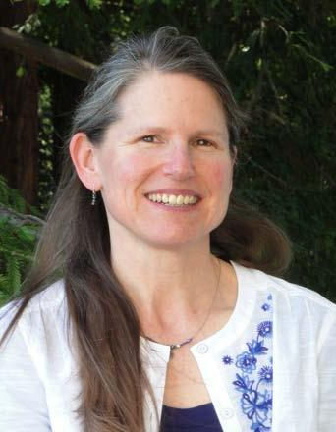
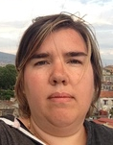
KEYNOTE #2
Drivers of the recent sea ice decline
Sharon Stammerjohn
Senior Research Associate at University of Colorado Boulder
Atmosphere-ice-ocean interactions & sea ice/climate/ecosystem linkages
Editor of the BAMS State of the Climate report on Antarctic & SO for 8 years
Camille Lique
Research scientist at the Laboratory for Ocean Physics and Satellite remote Sensing, France
Arctic Ocean dynamics & connections to the global ocean and climate
Member of the CliC scientific steering group
Moderator: Carolina Dufour

Slide 8

GROUP DISCUSSION #1 (14:00-15:30) - SUMMARY (16:00-17:00)
State of the sea ice; Processes and drivers; Impacts; Observations, tools and models
Day 1 (groups & plenary)
Discuss to make important questions and outcome emerge
Link for notes:
List of groups and places to meet are posted in the main lecture room
Group
Group
2 rapporteurs per group
(1 junior & 1 senior)
Group
Group
Group
Group
Group
Group
Summary of the group discussions & selection of questions/outcome to address on day 2 in plenary
By rapporteurs of each group
https://tinyurl.com/ictp-norp-sorp-discussion0724

Slide 9
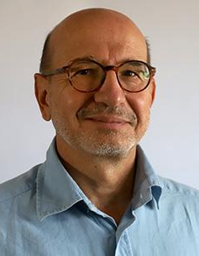
KEYNOTE #3
Polar Research Infrastructure Network (POLARIN)
Moderator: Alex Haumann
Michele Rebesco
Lead Researcher at the National Institute of Oceanography and Applied Geophysics (OGS)
Steering Board Member and Work Package leader of the EU Project POLARIN
Geological/geophysical exploration of polar continental margins, depositional processes and paleoclimatic reconstructions

Slide 10
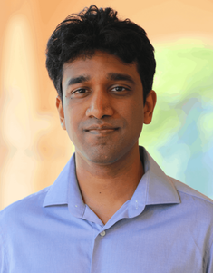
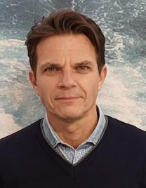
KEYNOTE #4
MIZ and coastal processes
Mukund Gupta
Bla bla
Bla bla
Moderator: Dorotea Iovino
Marcello Vichi
Bla bla
Bla bla

Slide 11
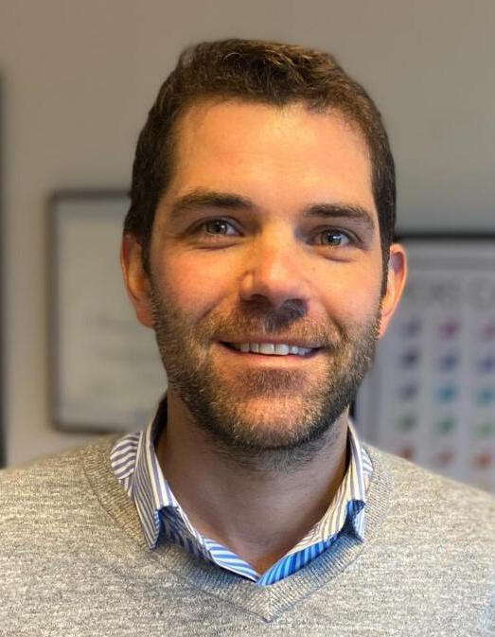
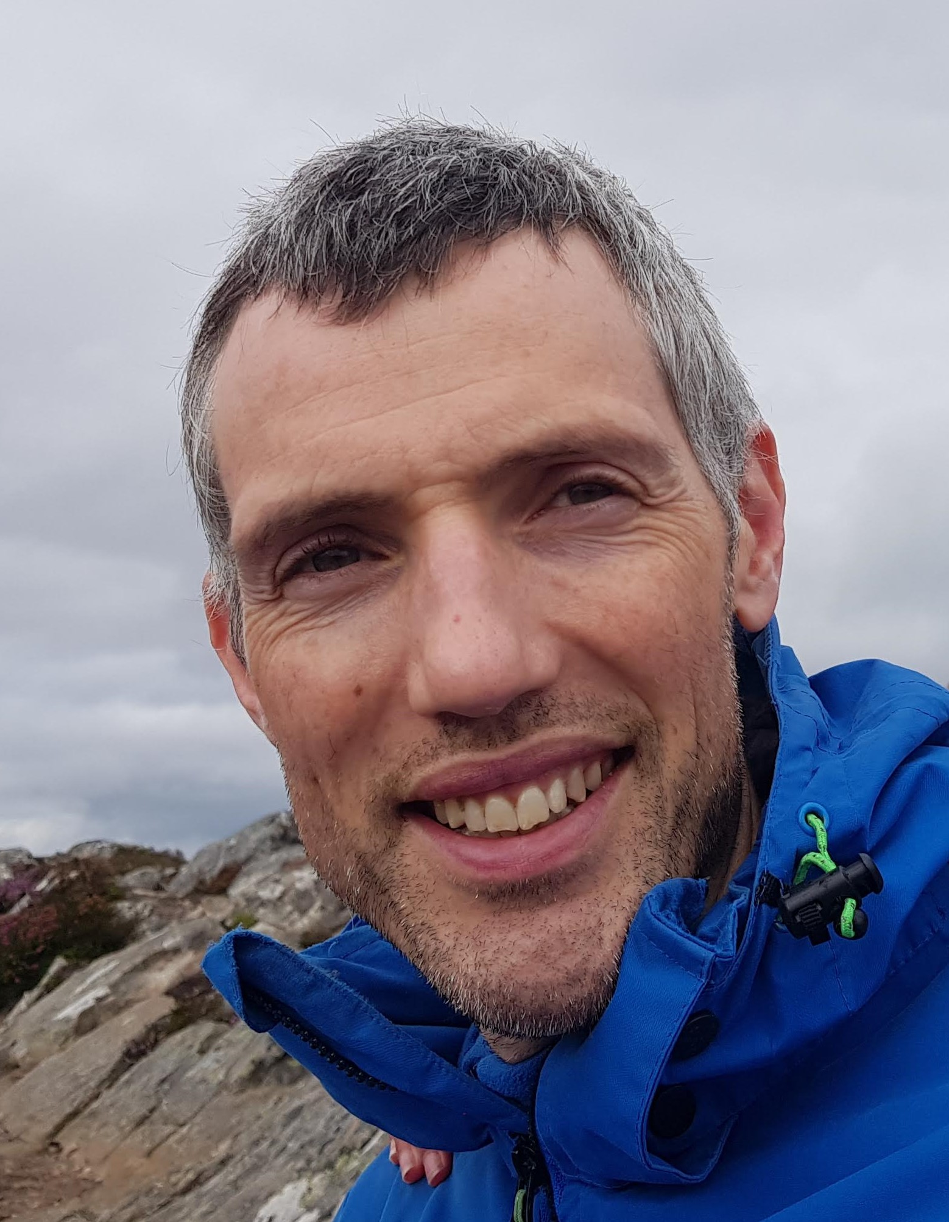
KEYNOTE #5
Sea ice prediction and projections
François Massonnet
F.R.S-FNRS Research Associate and lecturer at Université catholique de Louvain
ERC project on rapid Arctic sea ice loss events; Coordinator of SIPN South
Climate prediction and variability, polar regions, sea ice, data assimilation, climate model evaluation and forecast verification
Tom Bracegirdle
Science Leader at the British Antarctic Survey
Co-Chief Officer of the SCAR AntClimNow program
Polar meteorology and climate, troposphere-stratosphere interactions, climate model projections, evaluation & uncertainty assessment
Moderator: Alvaro Scardilli

Slide 12
GROUP DISCUSSION #2 (14:00-15:30)
Expert Groups
Day 2 (group)
Discuss specific questions/outcome in-depth
Link for notes:
Expert group
Expert group
2 rapporteurs per group
(1 junior & 1 senior)
Expert group
Expert group
Expert group
Rapporteurs within each group
Organization of notes in prep. for
the wrap up session
https://tinyurl.com/ictp-norp-sorp-discussion0724

