Slide 1




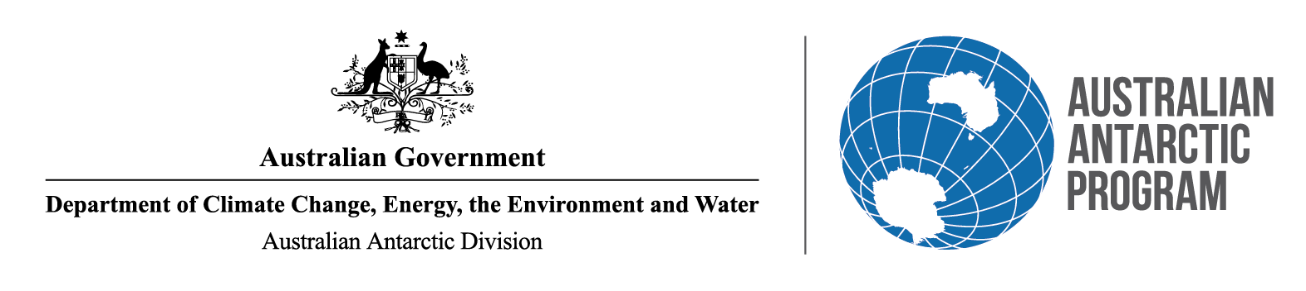
Antarctica InSync
Sea Ice:
Petra Heil
Australian Antarctic Division
Australian Department of Climate Change, Energy, The Environment & Water
&
Australian Antarctic Program Partnership
University of Tasmania, Australia
&
Snow and Avalance Institute,
WSL Institute for Forest and Snow Research, Switzerland
Notes:
'I acknowledge the Palawa people, the traditional owners of the Land from which I am speaking to you today, and pay my respect to Aboriginal Elders; past and present.

Slide 2


Time
EUMETSAT & ESA [2023]
Notes:
However, due to anthropogenic forcing the Earth systems are out of balance, including the global temperature or carbon budgets.

Slide 3
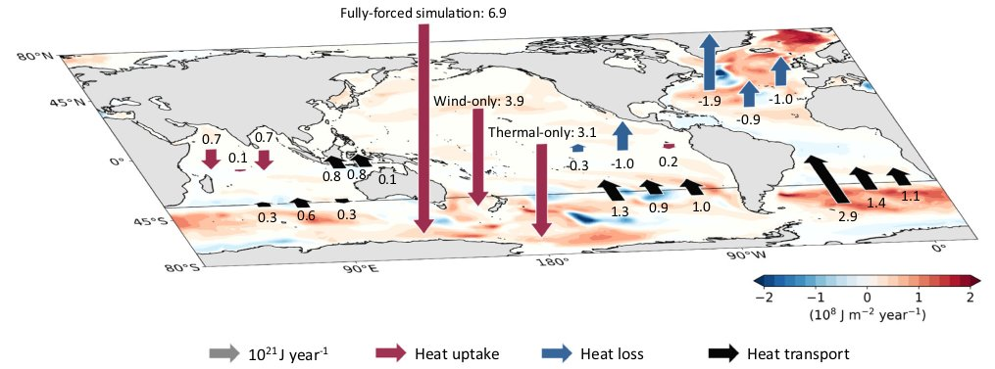
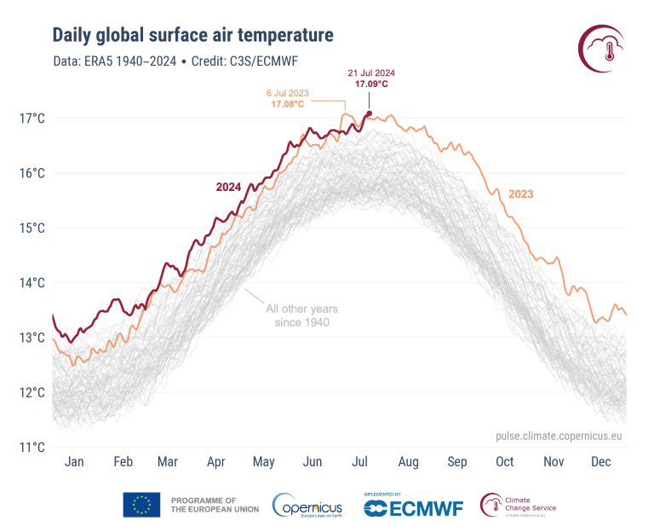
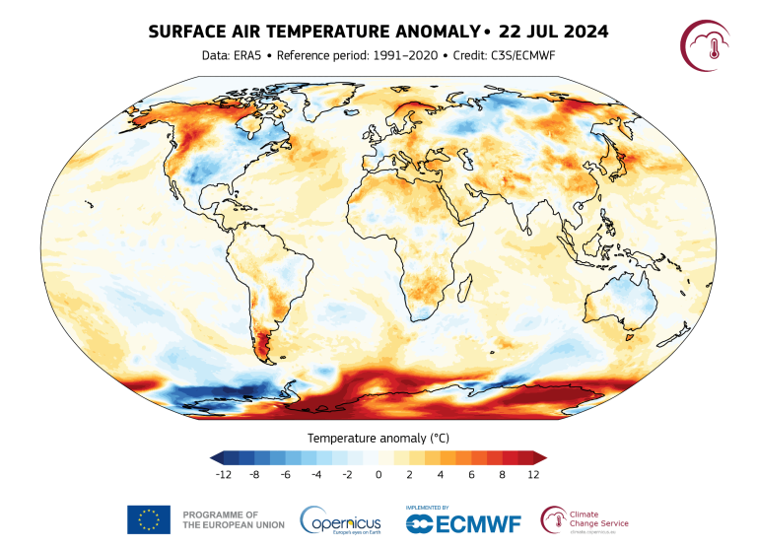
Earth – Antarctica
Why?
Huguenin et al. [2022]
nilas.org
Data @NSIDC

Slide 4
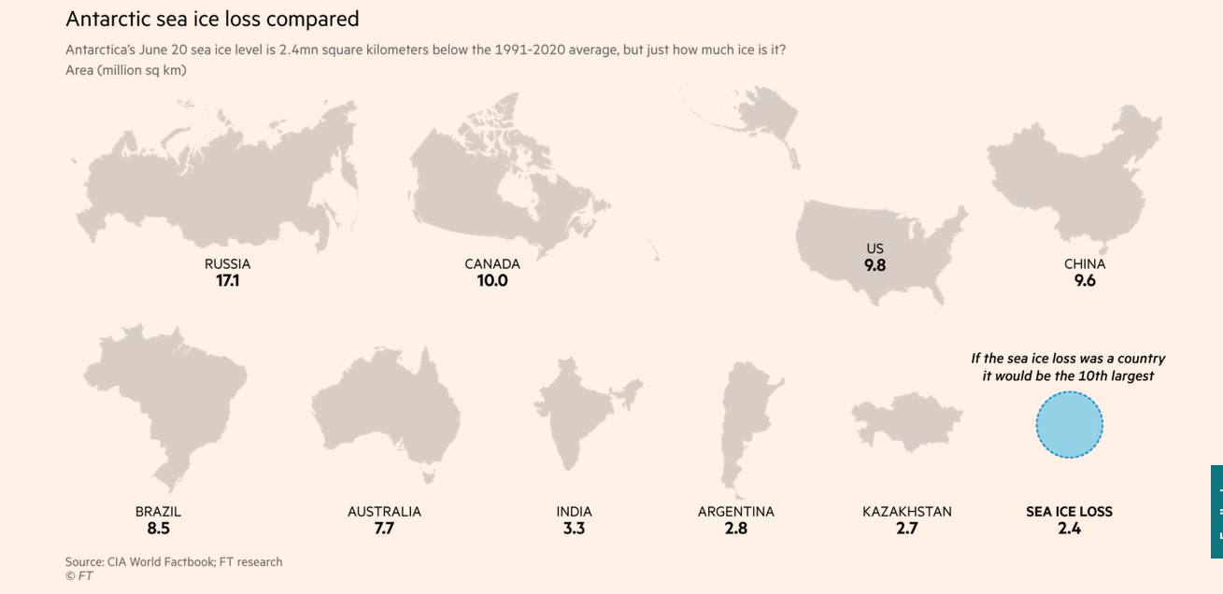
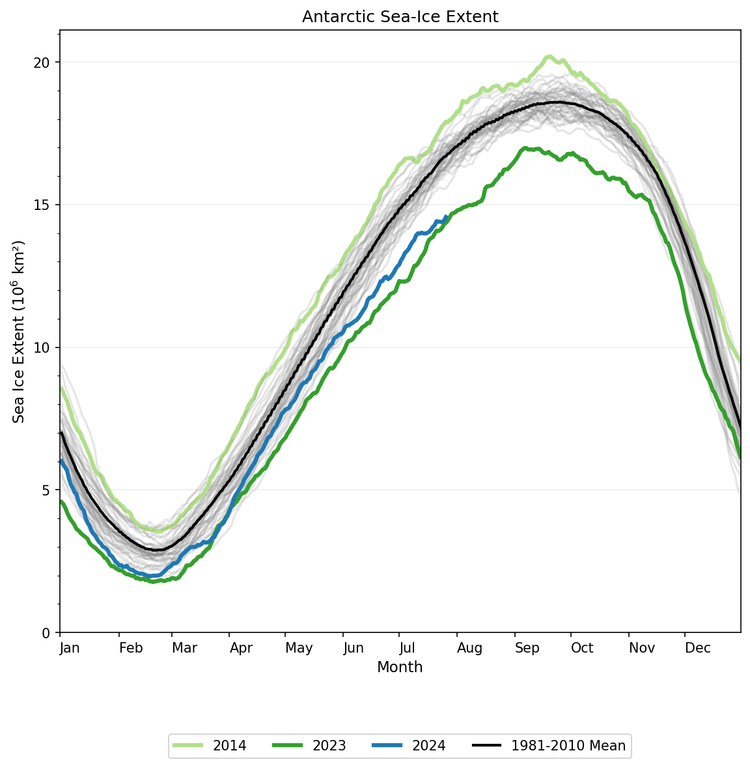
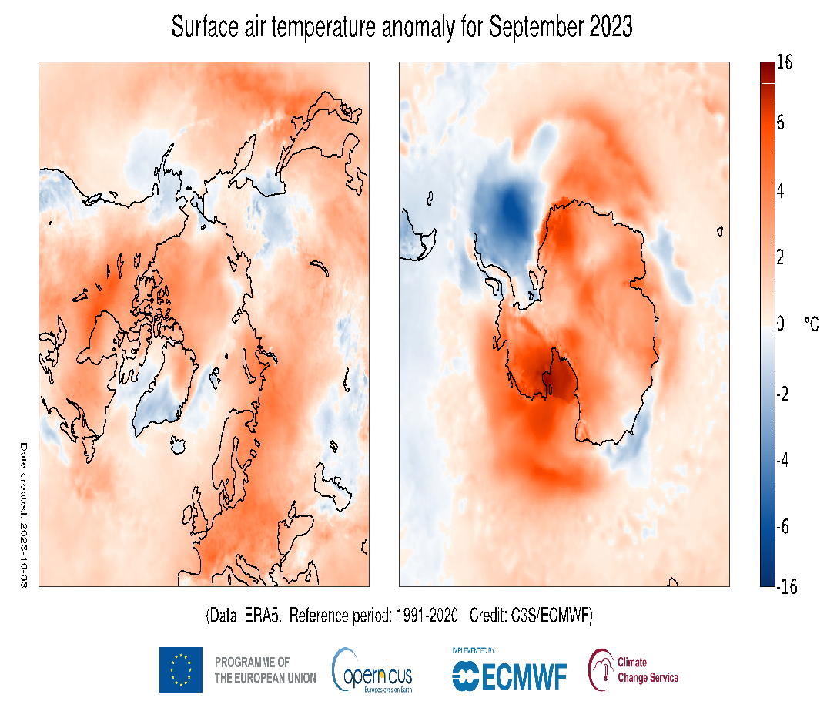
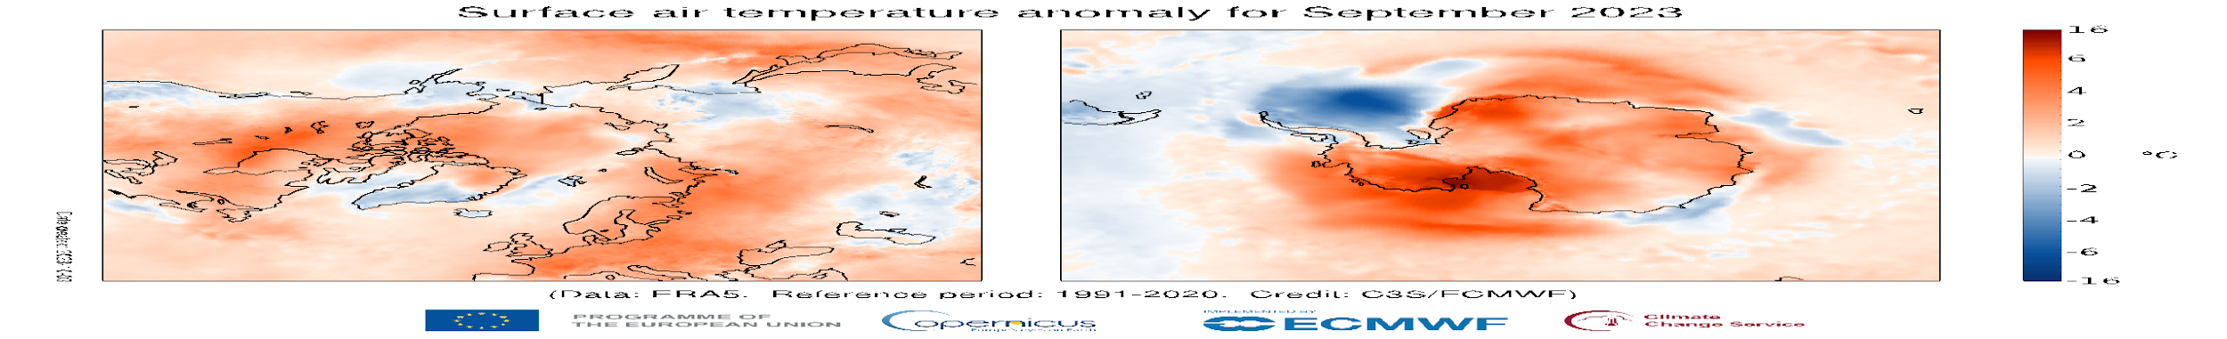
Antarctica InSync
Why?
Surface air temperature anomaly for Sep 2023
nilas.org
Data @NSIDC

Slide 5

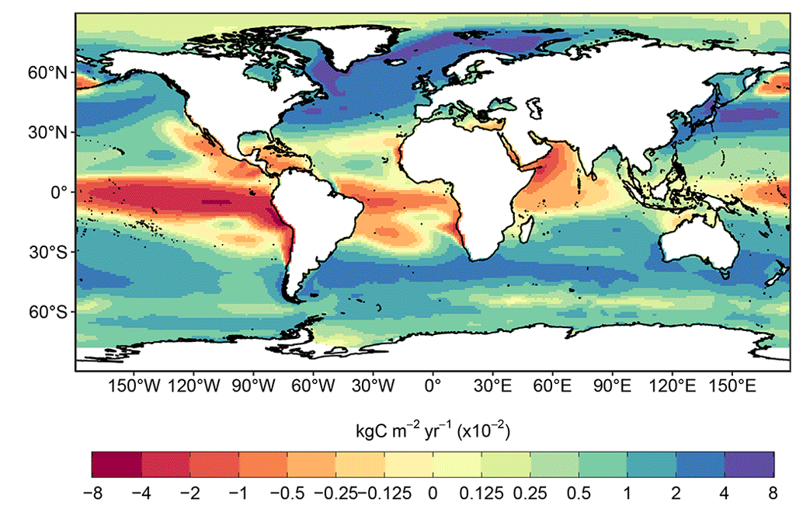
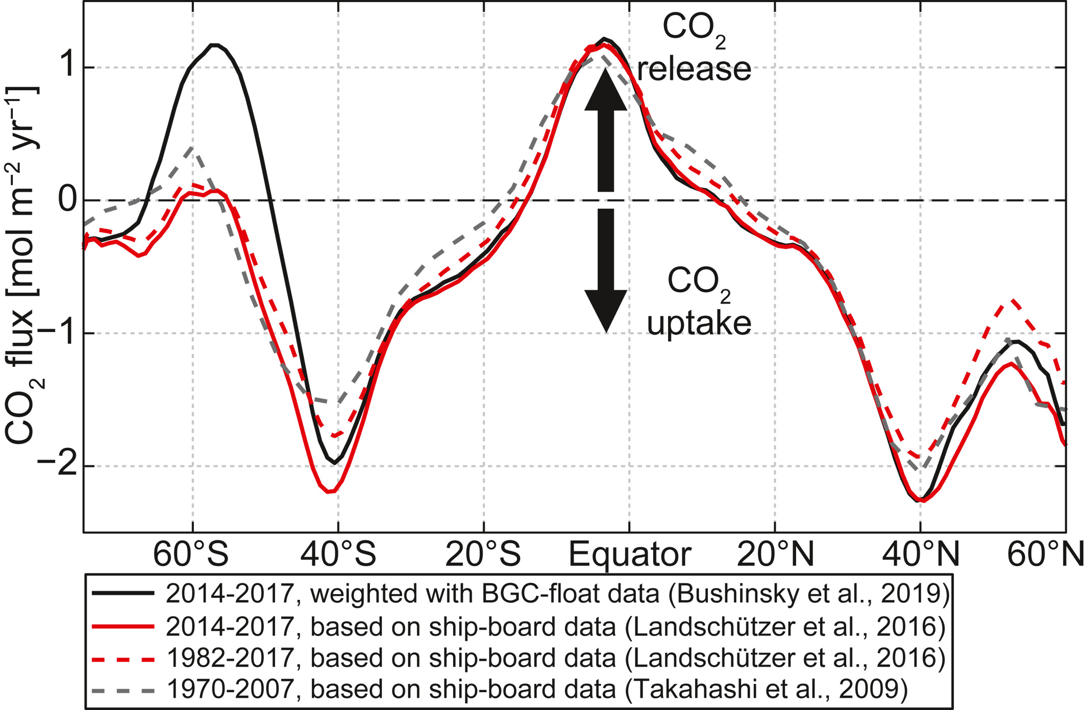
The global ocean carbon sink
MUSE CO₂ flux mooring!
Source: Chen et al., 2023;
Friedlingstein et al., 2023

Slide 6











Antarctic/SO – status quo
Status Quo
Starting point for Antarctica InSync:
National programs incl AWI, BAS, KOPRI, NSF, CPI, JARE, AAS, NZ etc.
International organisations
  SCAR Expert Groups, incl ASPeCt, BEPSII, AntClim
  CCAMLR
WMO, WCRP etc. endorsed working groups, incl:
  IPAB
  AFIN
International support, incl:
  CliC
  SOOS
…

Slide 7
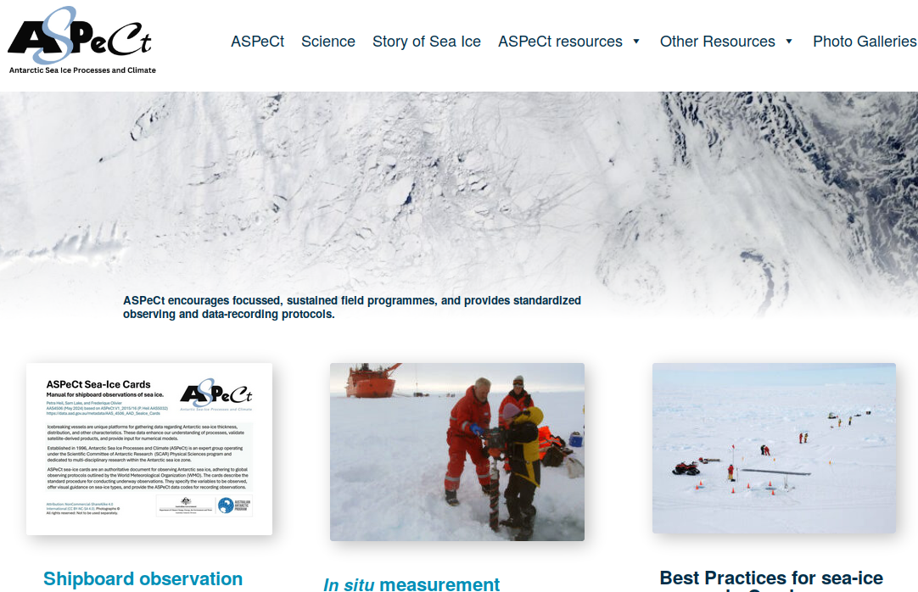
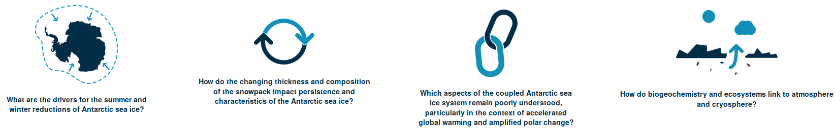
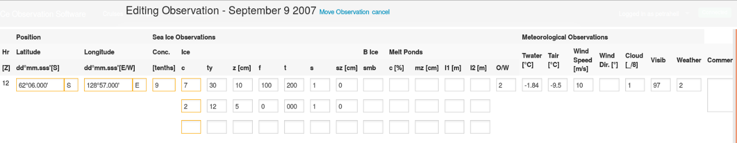
ASPeCt - A SCAR Expert Group
Status Quo

Slide 8
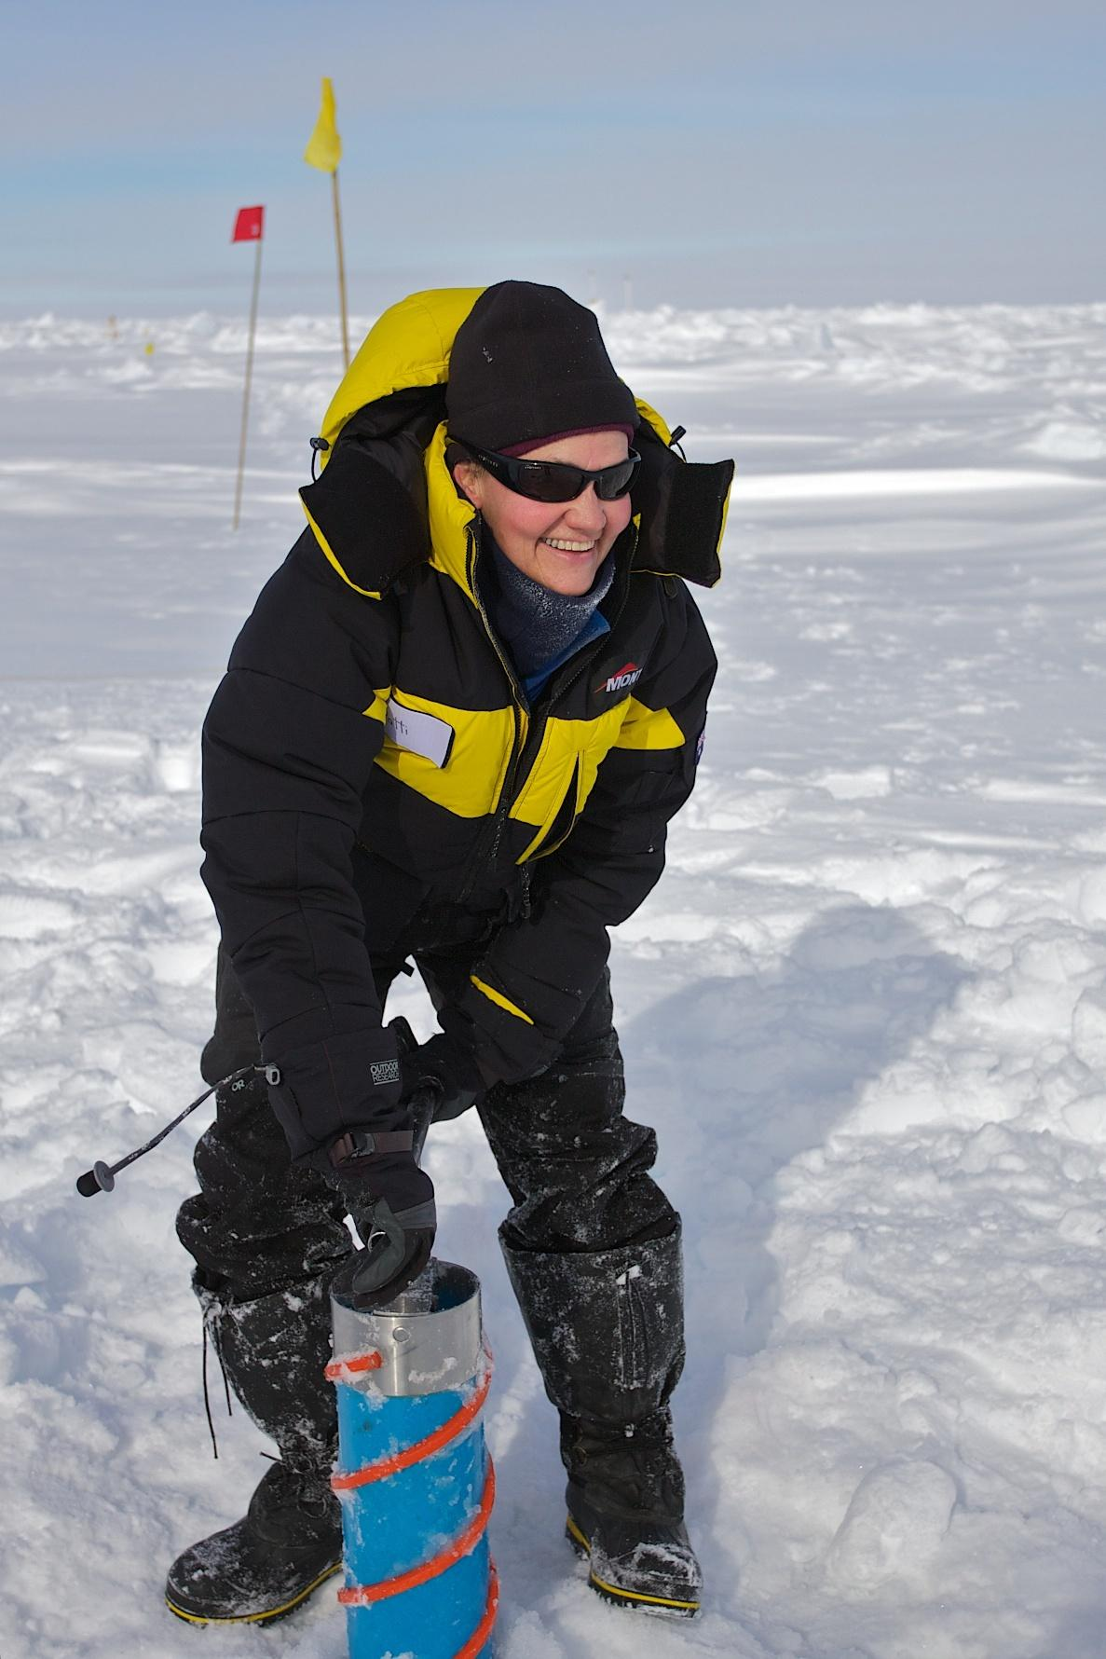
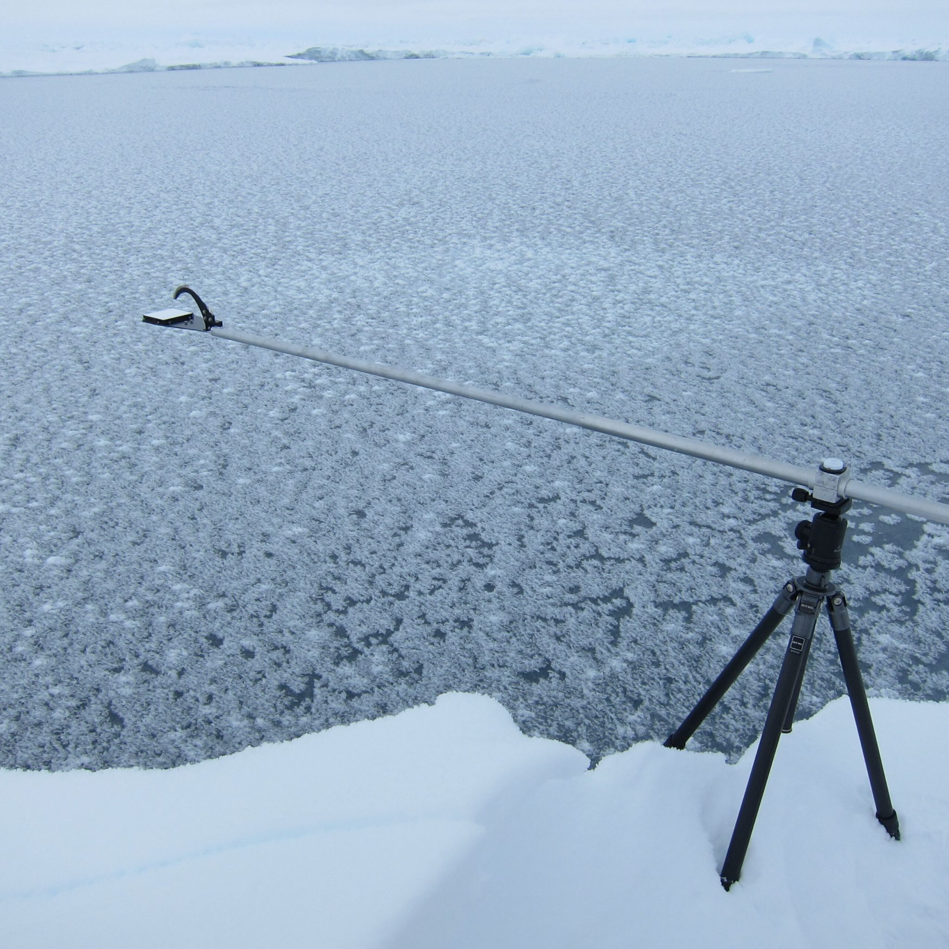
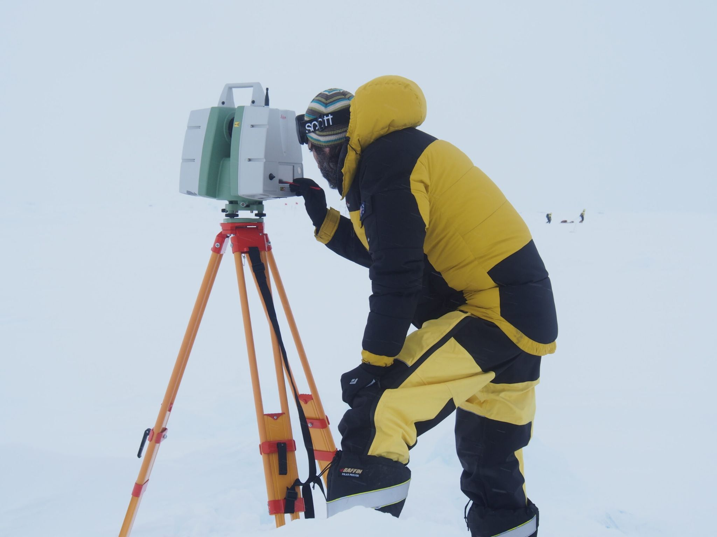
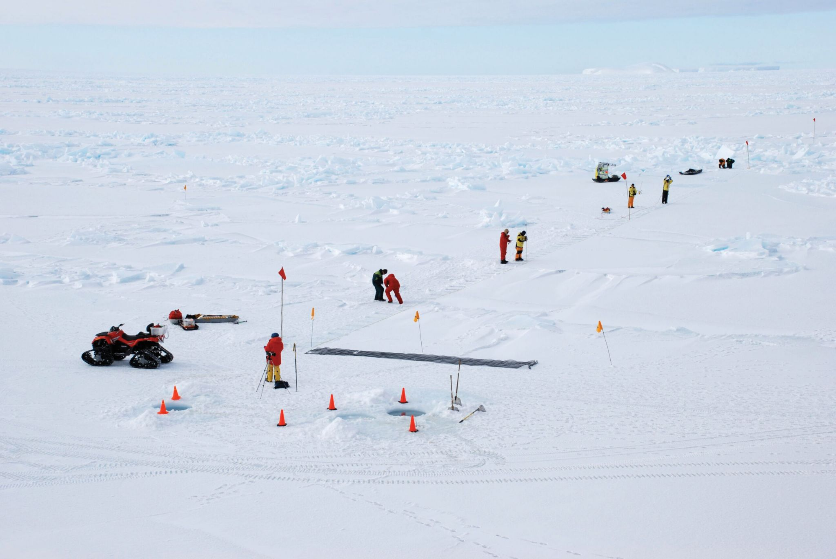
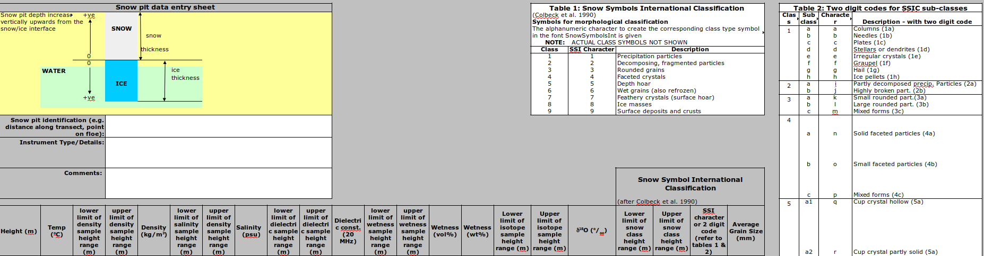
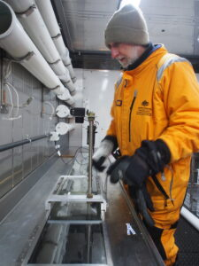
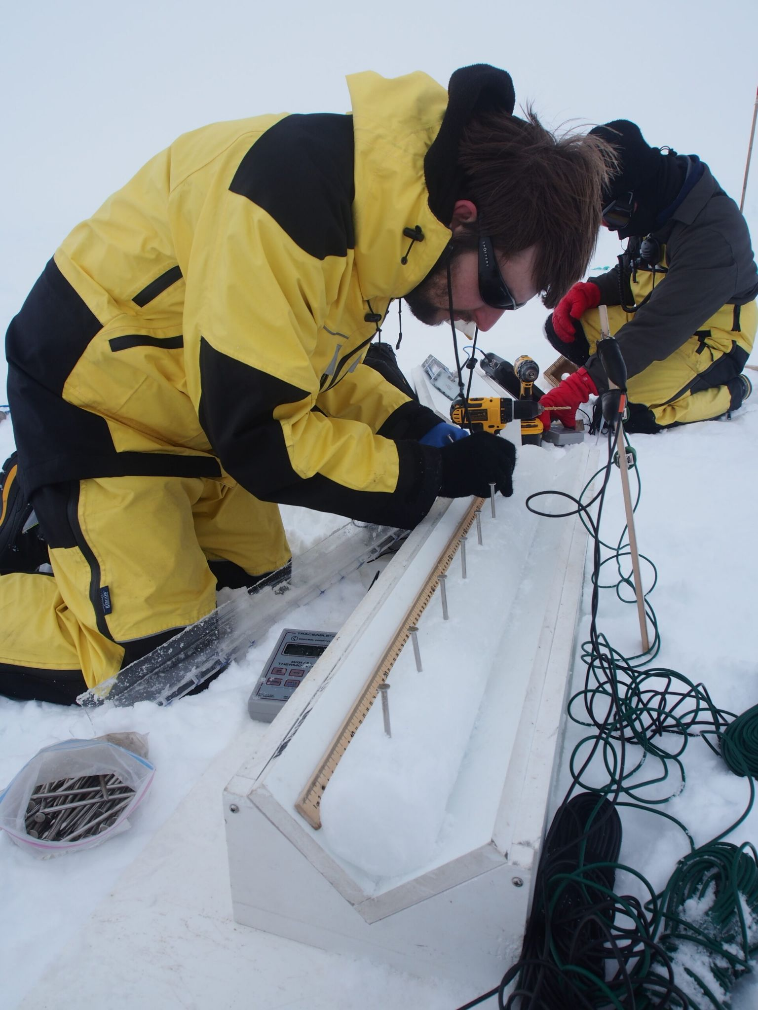

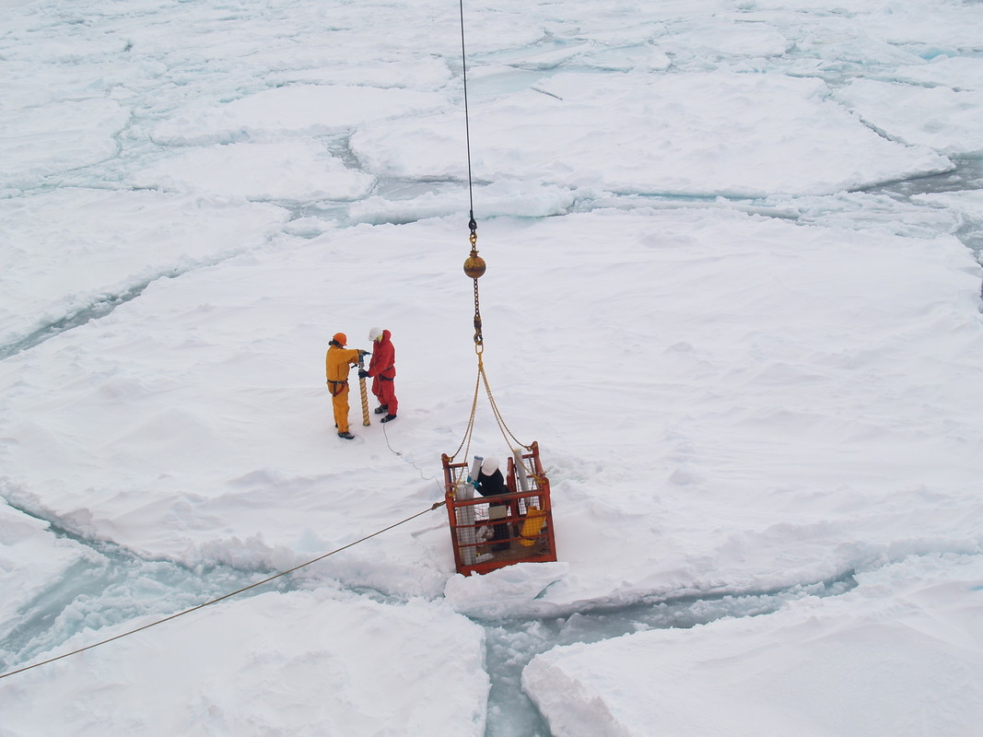
ASPeCt - Examples from ice-station work
Status Quo
Photos courtesy S.Warren, W.Pyper, T.Worby, P.Heil, KGolden, S.Zicus

Slide 9
Antarctica InSync
Next?
What is needed?
Community effort:
  Build project international teams - network.
  Identify science hotspots#.
  Identify key variables. (→ ECVs).
  Devise Ant InSync observational strategies#. → Resource requirements.
  Agreed observations & measurement protocols.
  Bridging observations and models.
  .Write white paper.
Identify funding agencies.
Coordinating national/internat proposals.
Open data access.

Slide 10
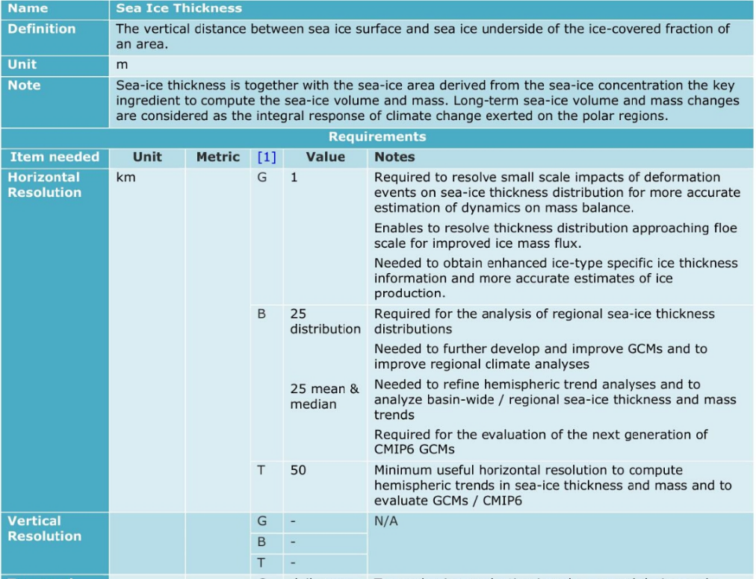
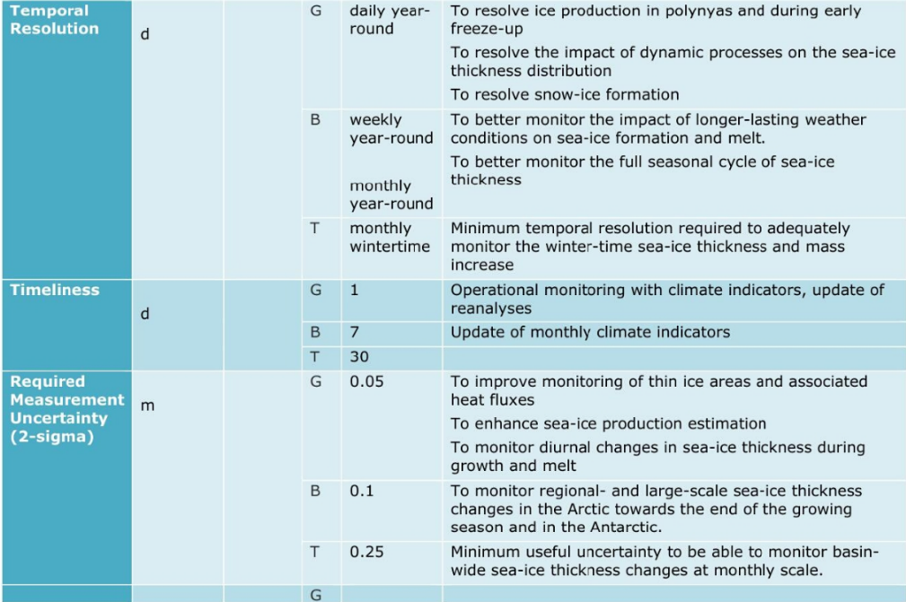
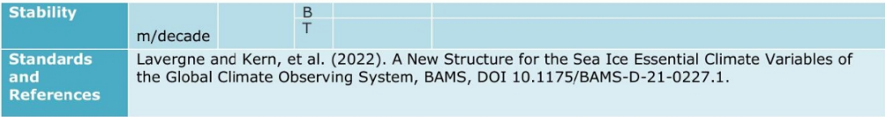
Antarctica InSync
GCOS ECV for Sea Ice
Next?
GCOS 245 [2022]

Slide 11
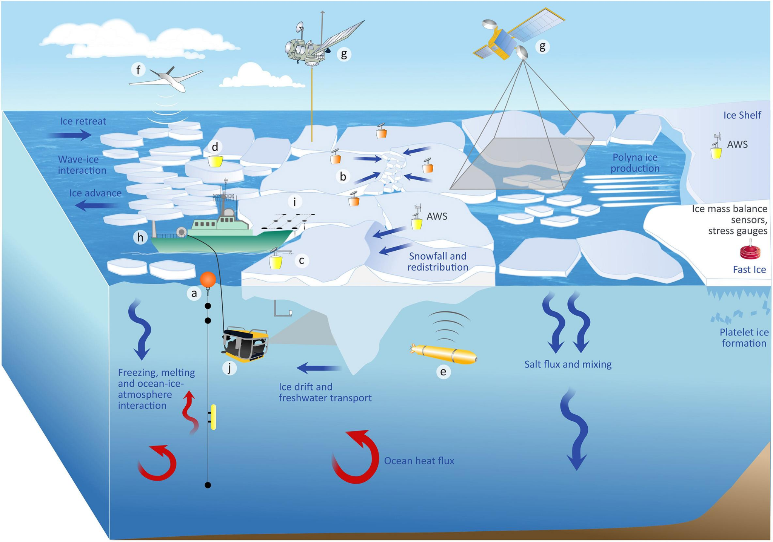
Antarctica InSync - Strategy
Next?
Newman et al. [2019]

Slide 12
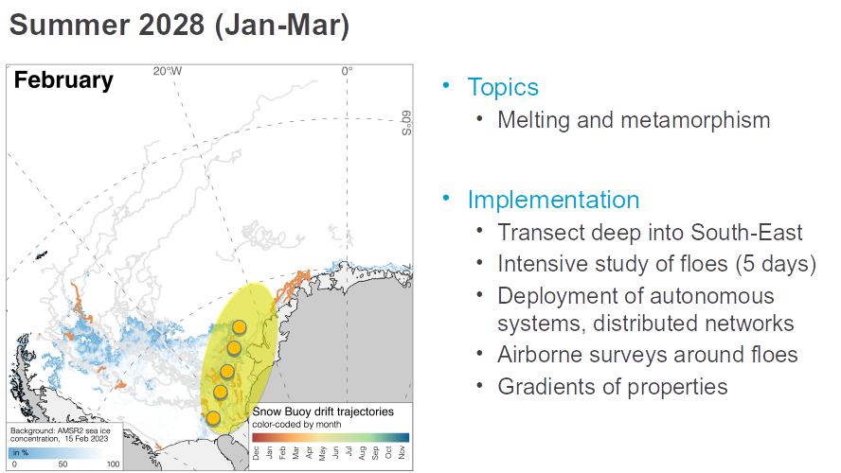
Antarctica InSync - Strategy
Next?
Arndt, Nicolaus and others [dated 2024]

Slide 13
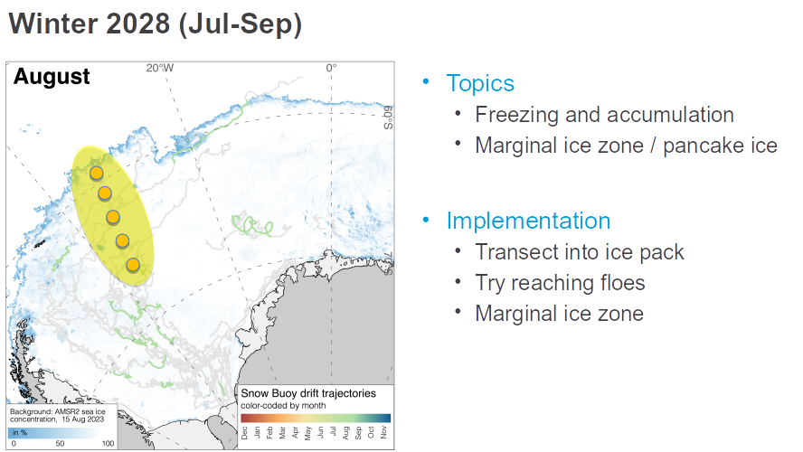
Antarctica InSync - Strategy
Next?
Arndt, Nicolaus and others [dated 2024]

Slide 14
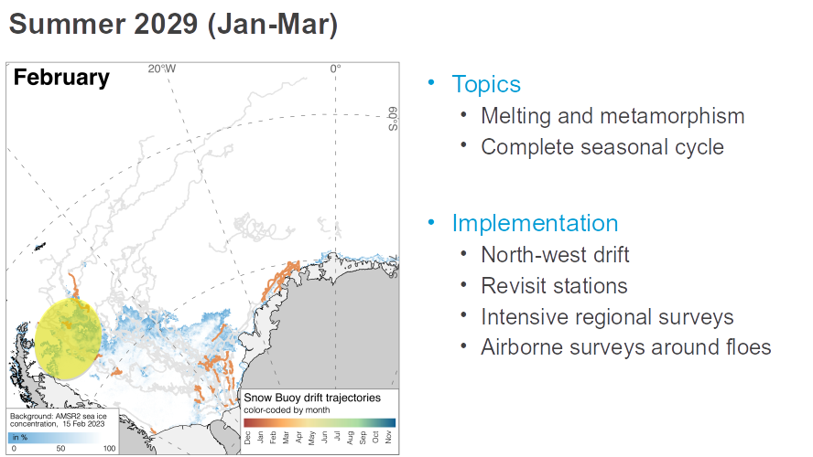
Antarctica InSync - Strategy
Next?
Arndt, Nicolaus and others [dated 2024]

Slide 15
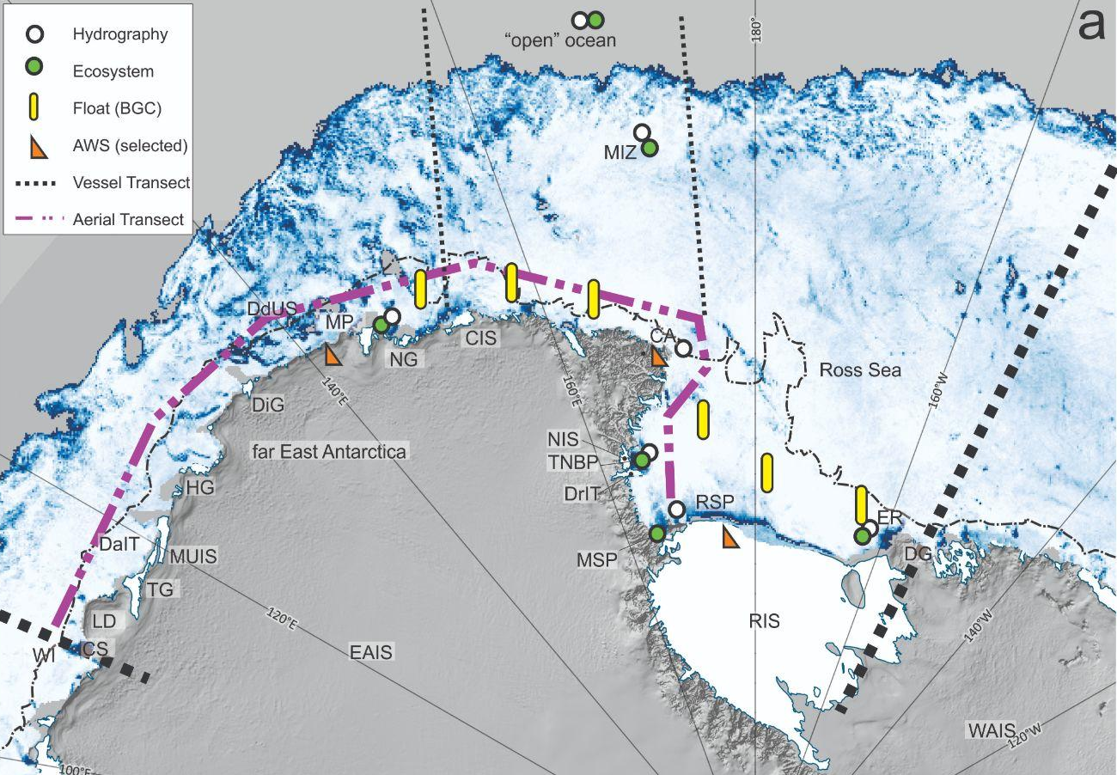
Antarctica InSync - Strategy
Next?
RSfEAR:
An integrated observing system
Heil et al. [2023]

Slide 16
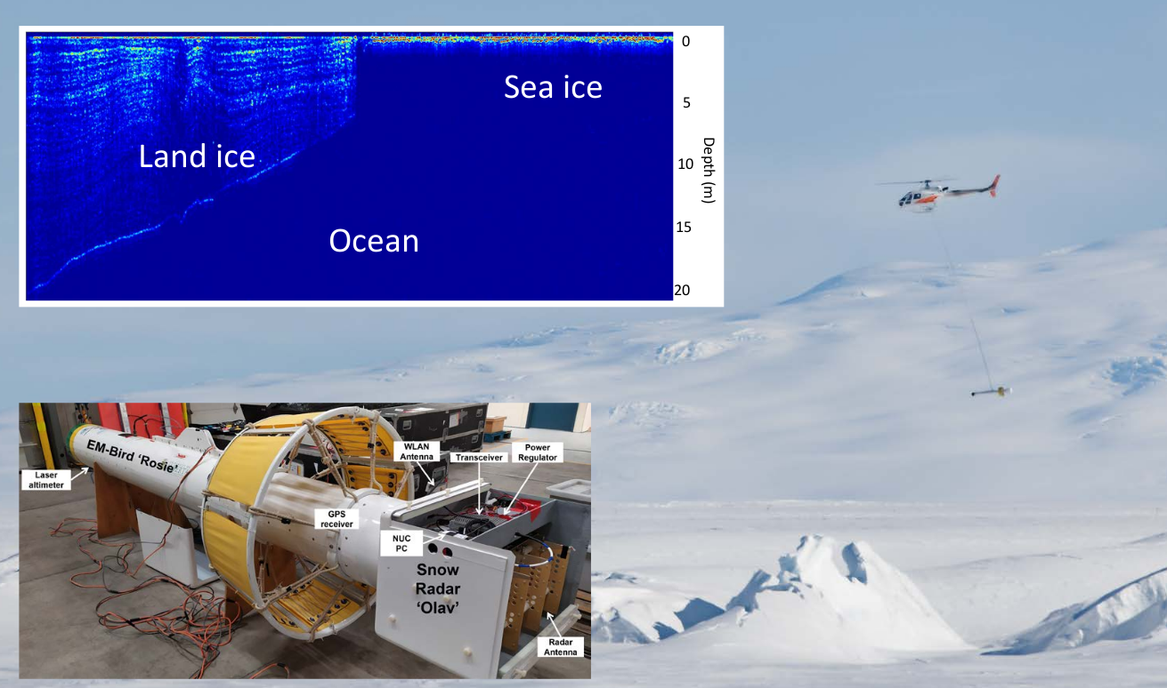
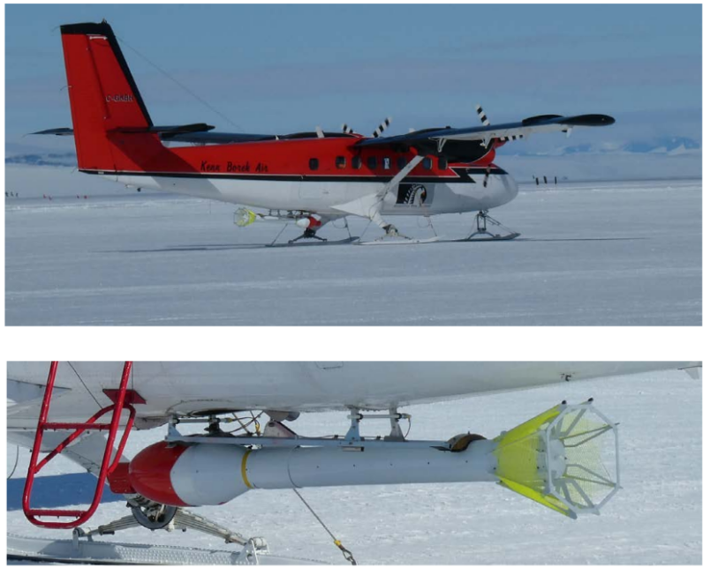
Antarctica InSync - Strategy
Next?
R&D and RSfEAR
Rack et al [in prep]

Slide 17
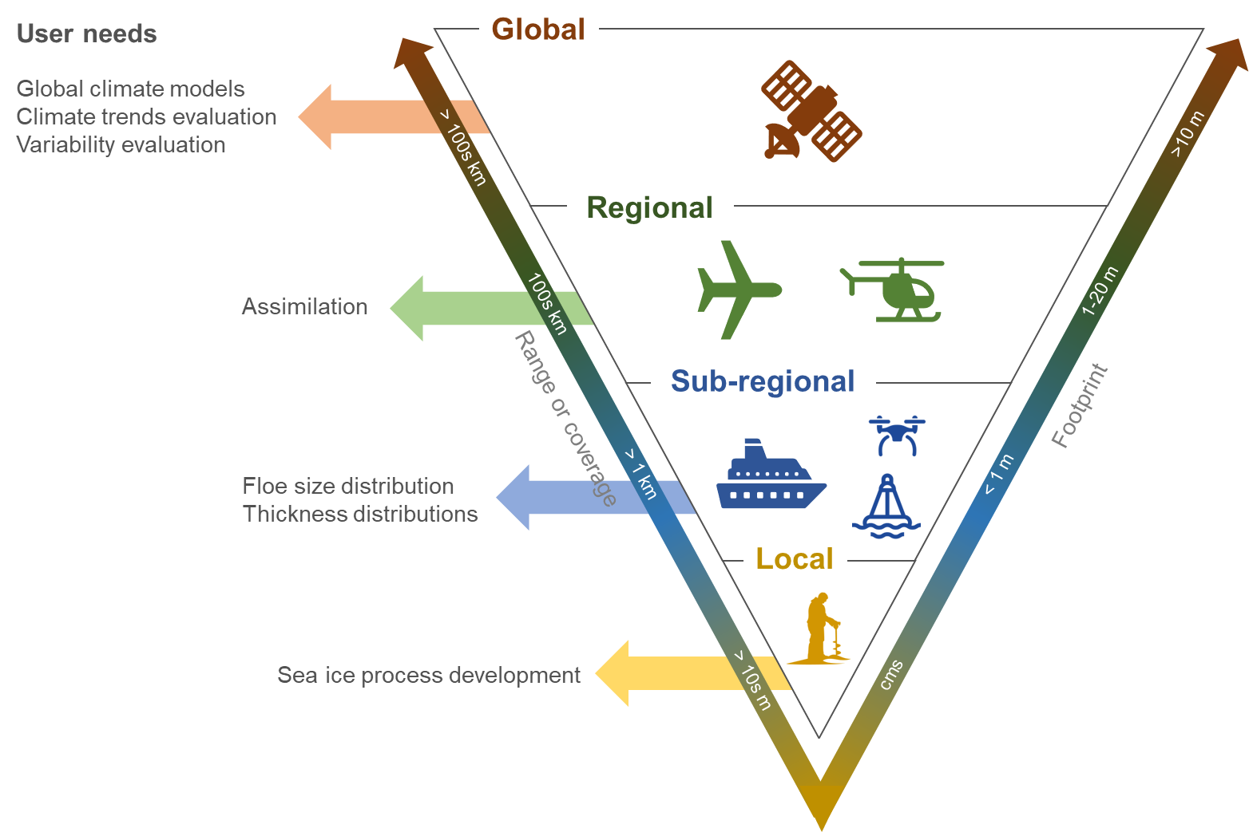
Antarctica InSync - Strategy
Next?
ISSI Antarctic Team:
Multi-scale approach
Mallett, Heil, Tilling and ISSI team [in prep]

Slide 18
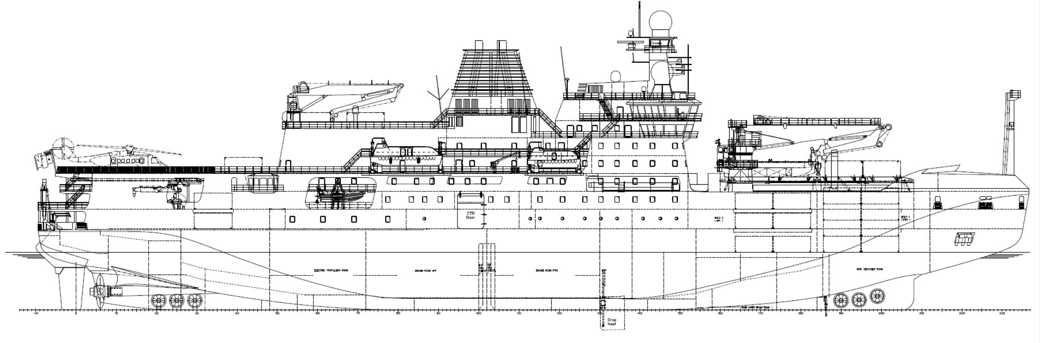
OSIA Observatory for RSV Nuyina [AAS #4506]
Atmosphere sensors
Sea-ice sensors
Ocean sensors
Heil et al. [in prep]
In addition: Science-enabling functions and sensors from Nuyina’s general Science Data Management System.
Notes:
I will focus on three main groupings of sensors,
Sea ice
Atmosphere
Ocean

Slide 19
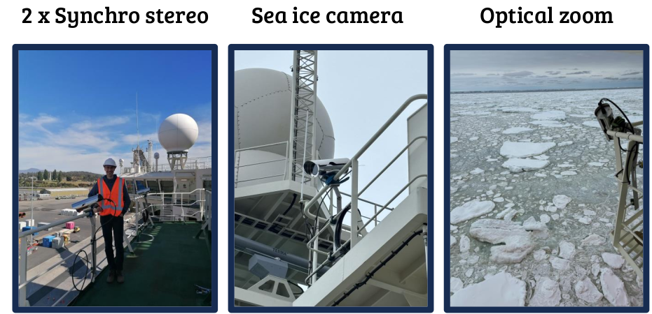
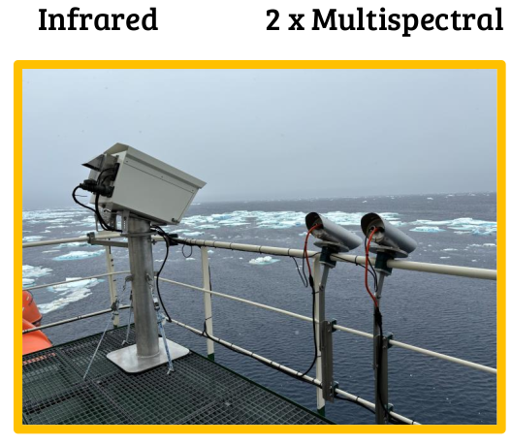
RSV Nuyina: OSIA wave-ice cameras
Derived variables incl surface elevation, wave evolution and attenuation, sea-ice thickness, sea-ice type etc.

Slide 20
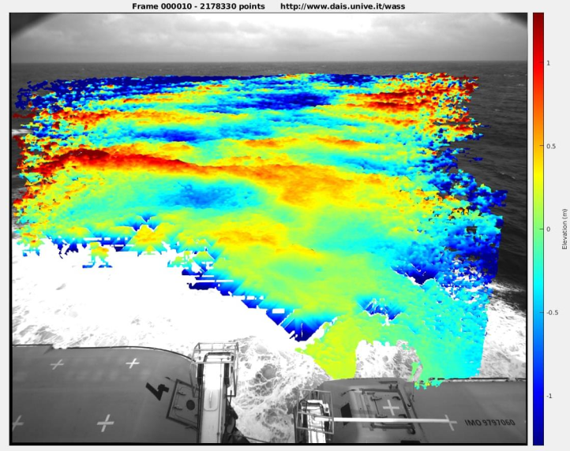

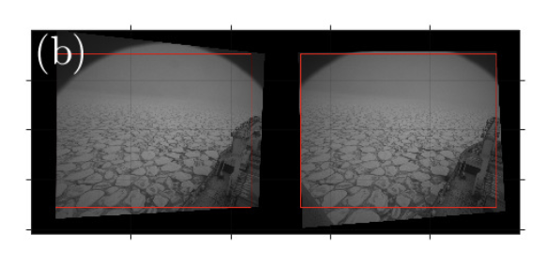
OSIA: Wave height in sea ice from
stereo images
Tersigni, Toffoli and Heil, V3 2023/24
Notes:
From a pair of images from the stereo-cameras, can calculate sea surface elevation, and then derive wavelength from multiple image sets. This gives a unique view on how waves interact in the marginal ice zone and will be supplemented with other biological and thermal information captured.

Slide 21
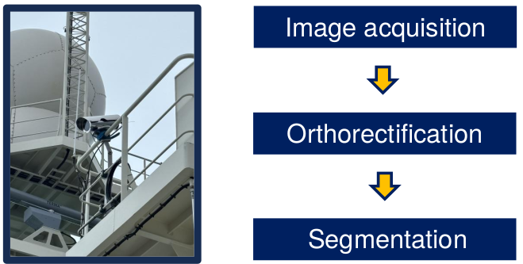
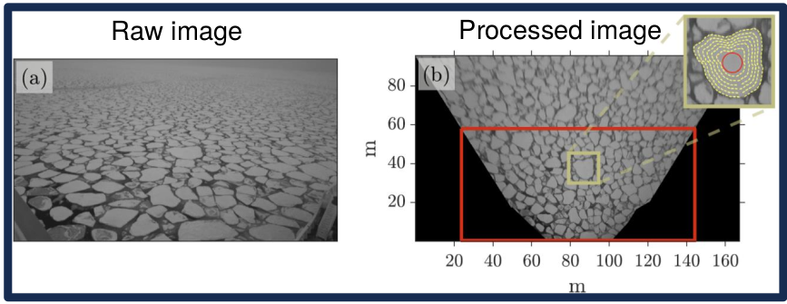
OSIA: Sea-ice floe size & classification
Towards a Synthetic ASPeCt data set

Slide 22
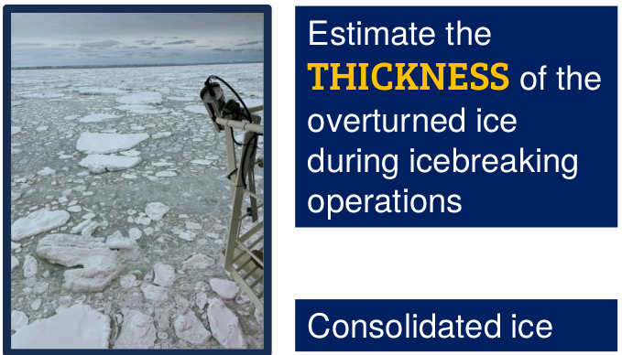
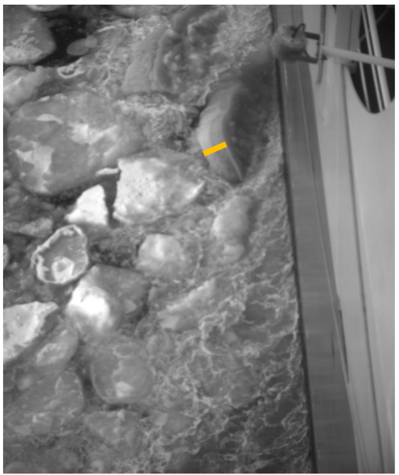
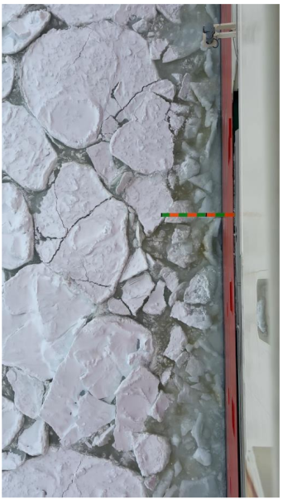
OSIA: Sea-ice thickness
Towards a Synthetic ASPeCt data set

Slide 23
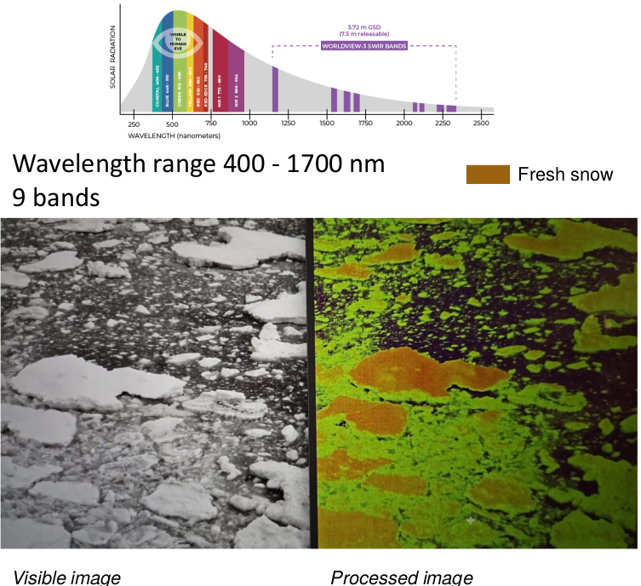
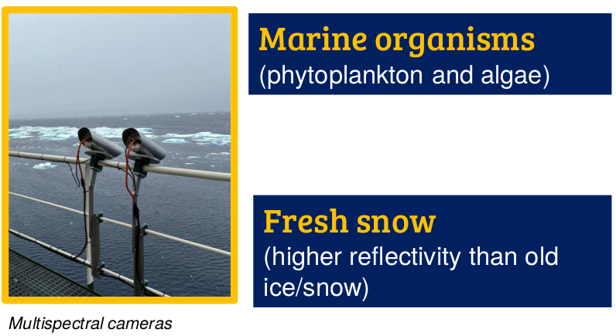
OSIA: Multispectral
Towards a Synthetic ASPeCt data set

Slide 24
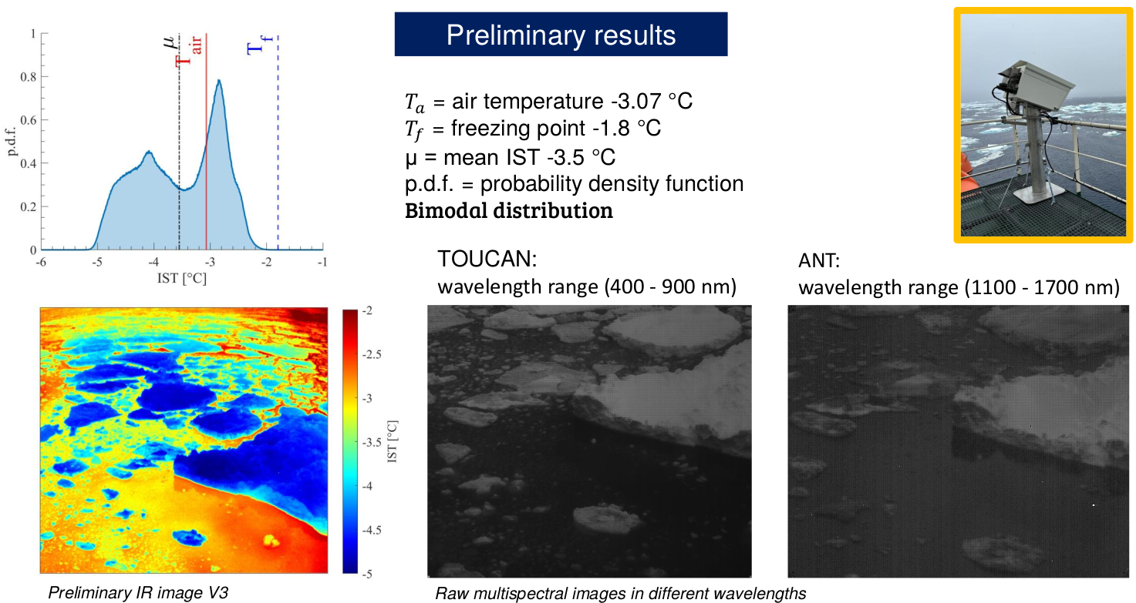
OSIA: Thermal camera
Towards a Synthetic ASPeCt data set

Slide 25
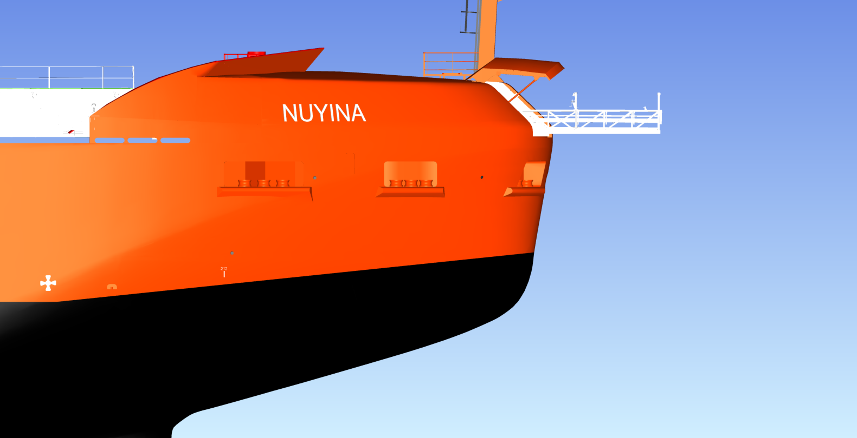
Sea-Ice Thickness Suite
Ultrasonic
Radar
EM and Sonar
Snow
Sea Ice
Water
Heil et al. [in prep]
Image @ A Steketee
Notes:
A deployable walkway has been installed which can be deployed past the bow of the ship. This will hold the instrument suite at appropriate heights above the water to allow separate measurements of snow thickness and sea ice thickness.
Can we measure freeboard?

Slide 26
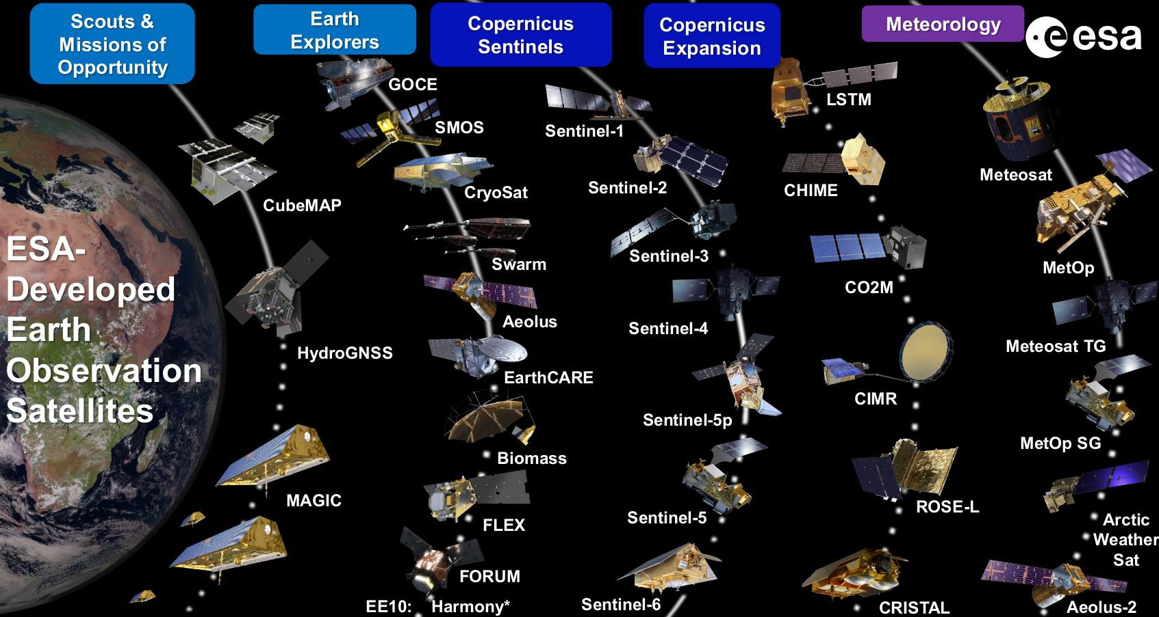
Antarctica In Sync
→ Leading role for satellite cal-val for sea ice and other elements of the Antarctic and Southern Ocean.
Drinkwater [2023]
Notes:
The future of space-borne EO is ramping up. Data Science is leaping ahead, and similar next generation numerical modelling is advancing rapidly.
This overview of ESA’s EO missions will provide us with magnificent opportunities and I am excited to work with you on exploring their capability and deriving crucial climate data products to inform science, decision makers and the wider public.

Slide 27
Impact: Antarctica & the Southern Ocean feel the heat
Polar amplification: Extreme heatwaves becoming more frequent and severe.
Melting Ice: Rising temperatures 📈 → Decline in sea ice 📉 & melt of glaciers and ice sheets 📉 → Increasing sea-level rise 📈 threatening coastal communities worldwide.
Ocean Impacts: Ice melt 📈 → ocean salinity 📉 → Potential to disrupt ocean circulation globally.
Atmospheric Change: Polar vortex 📉 → … → Australian rainfall
Tipping Points: Antarctica may reach tipping points, where changes self-perpetuate towards a new stable level. → Ice-sheet melt could become irreversible.
Cascading Effects: Antarctica/SO changes may hold the trigger for a domino effect. → Climate change 📈 → Ecosystem change 📈 → Climate, biodiversity collapse → Human health 📉 & cost 📈 → … → Deep societal impacts.
Notes:
Domino effects. Overall, the situation in Antarctica is serious. While Antarctica is a long way from (our) civilisation, the changes there have the potential to impact everyone on Earth.

Slide 28
Impact: Antarctica & the Southern Ocean feel the heat
Polar amplification: Extreme heatwaves becoming more frequent and severe.
Melting Ice: Rising temperatures 📈 → Decline in sea ice 📉 & melt of glaciers and ice sheets 📉 → Increasing sea-level rise 📈 threatening coastal communities worldwide.
Ocean Impacts: Ice melt 📈 → ocean salinity 📉 → Potential to disrupt ocean circulation globally.
Atmospheric Change: Polar vortex 📉 → … → Australian rainfall
Tipping Points: Antarctica may reach tipping points, where changes self-perpetuate towards a new stable level. → Ice-sheet melt could become irreversible.
Cascading Effects: Antarctica/SO changes may hold the trigger for a domino effect. → Climate change 📈 → Ecosystem change 📈 → Climate, biodiversity collapse → Human health 📉 & cost 📈 → … → Deep societal impacts.
Inter-sectoral impacts
Society
Science
Decision
Notes:
Domino effects. Overall, the situation in Antarctica is serious. While Antarctica is a long way from (our) civilisation, the changes there have the potential to impact everyone on Earth.

Slide 29
Antarctica InSync
Next?
What is needed?
Community effort:
  Build project international teams - network.
  Identify science hotspots#.
  Identify key variables. (→ ECVs).
  Devise Ant InSync observational strategies#. → Resource requirements.
  Agreed observations & measurement protocols.
  Bridging observations and models.
  Write white paper.
Identify funding agencies.
Coordinating national/internat proposals.
Open data access.

