Slide 1
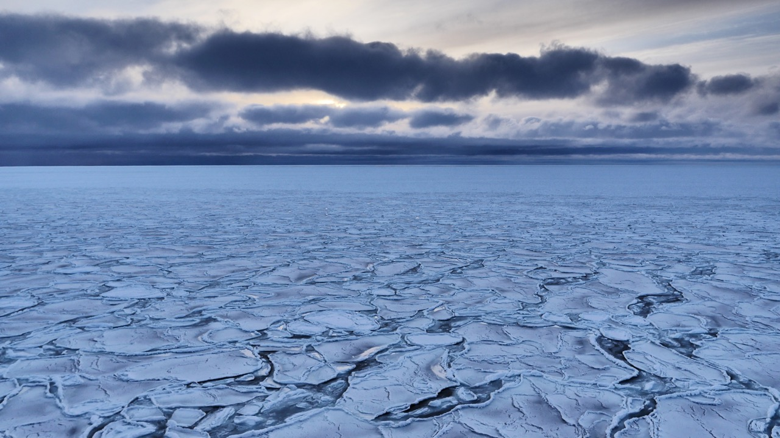
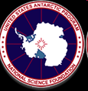
Drivers of the Recent [Antarctic] Sea-Ice Decline
Sharon Stammerjohn (INSTAAR, U. Colorado Boulder, USA)
ARTEMIS
Photo: Guy Williams
Notes:
Slide 1: Early winter thin ‘pancake’ sea-ice formed under strong winds and waves, a typical feature of Antarctica sea ice near the advancing edge. This is because the Southern Ocean is home to some of the strongest winds and waves on the planet.

Slide 2
Question 1
What distinguishes recent [Antarctic] sea-ice declines from past variability in terms of atmosphere-ice interactions (better known) versus ocean-ice interactions (not well known)?

Slide 3
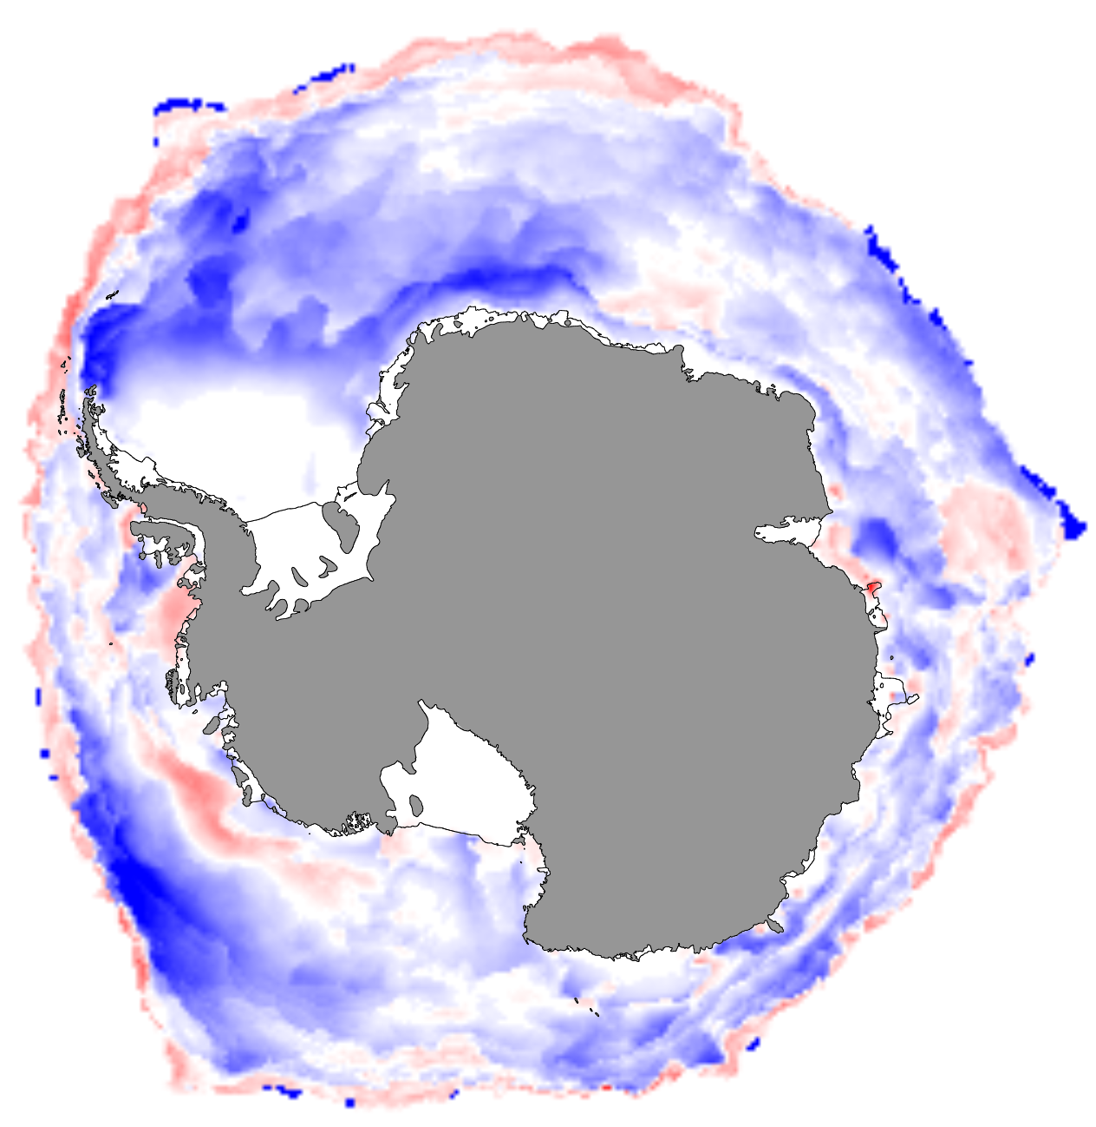
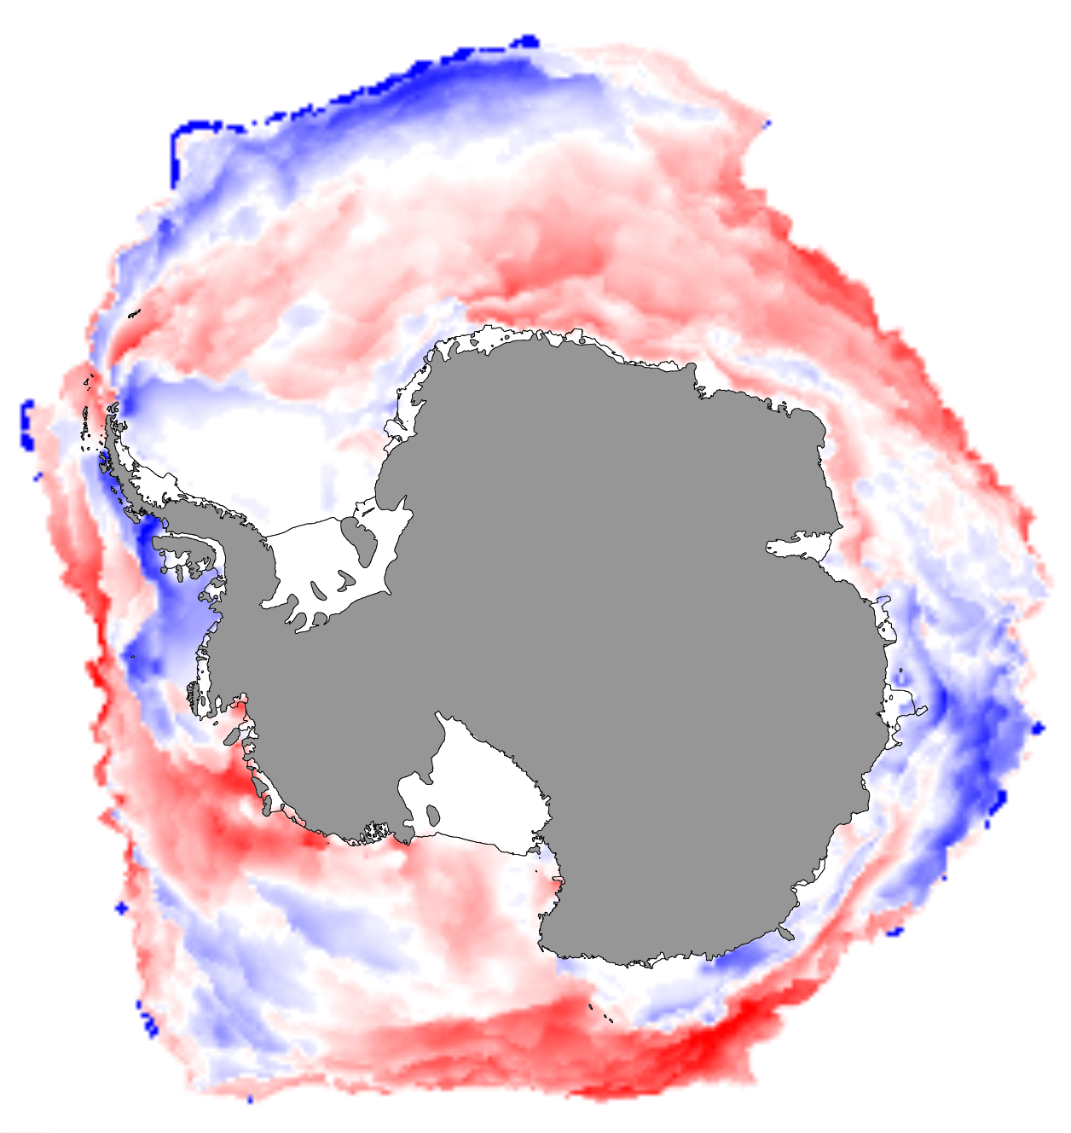
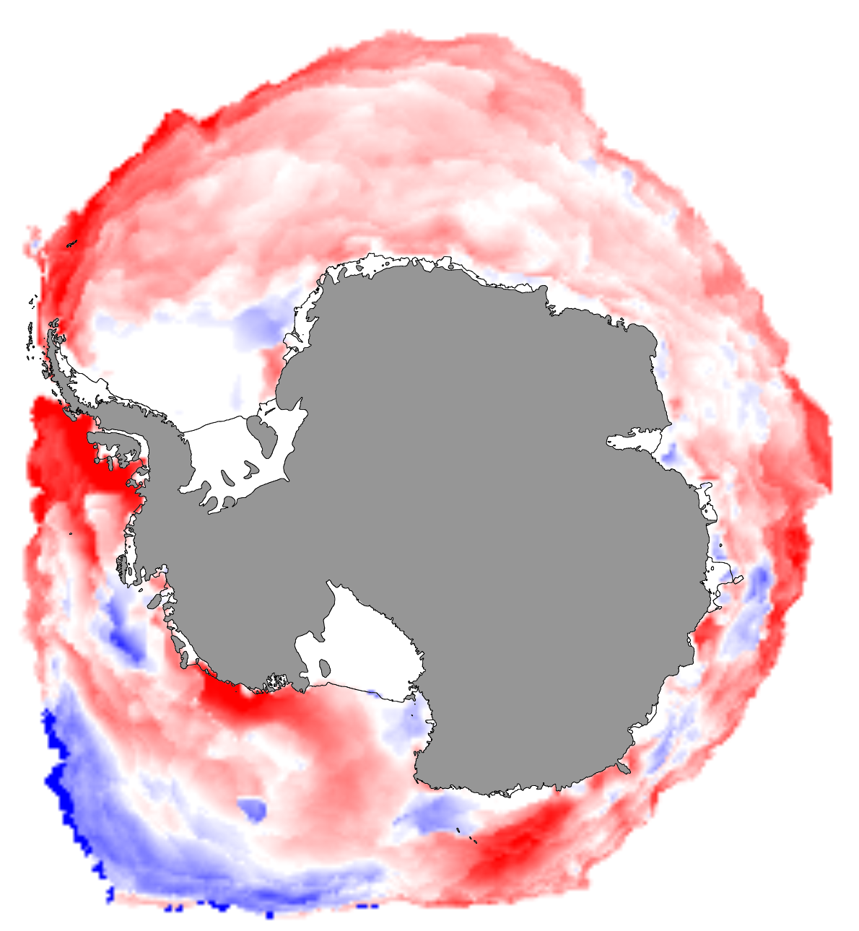
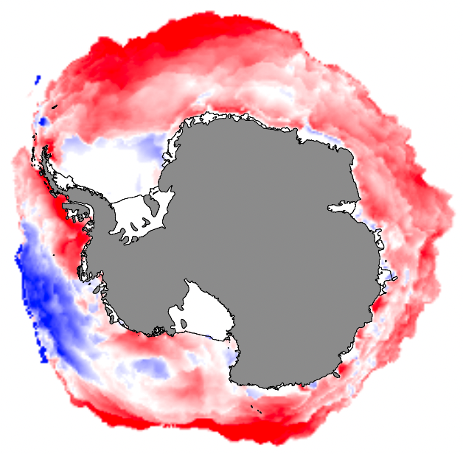
BLUES: longer ice season
(by up to 3 months)
REDS: shorter ice season
(by up to 3 months)
The relatively short but perplexing satellite record
2014-15
2016-17
Sea-Ice Extent Anomalies
https://zacklabe.com/
Ice Season Duration Analysis:
Stammerjohn et al, 2012
Stammerjohn & Makym, 2017
2022-23
2023-24
Notes:
Slide 4: Satellite-observed Antarctic sea-ice extent changes over the last 40+ years, showing a gradual increase in Antarctic sea-ice extent (positive anomalies) that culminated as record highs in 2015 (and longer ice seasons). Shortly thereafter and quite suddenly, Antarctic sea-ice extent dropped to record lows (and shorter ice season) in 2016, followed by 4 years of persistently low sea ice that started to show some recovery by 2021, only to suddenly drop again to new record lows (and widespread shorter ice seasons) in 2022 and 2023. Much of the year-to-year variability in Antarctic sea-ice is due to variability in atmospheric circulation patterns, but the underlying sustained sea-ice increases up to 2015, followed by the persistence sea-ice decreases point to multi-decadal changes in ice-ocean interactions. However, the magnitude of the recent sea-ice decreases indicate an amplification of that natural cycle by a now much warmer Southern Ocean.

Slide 4
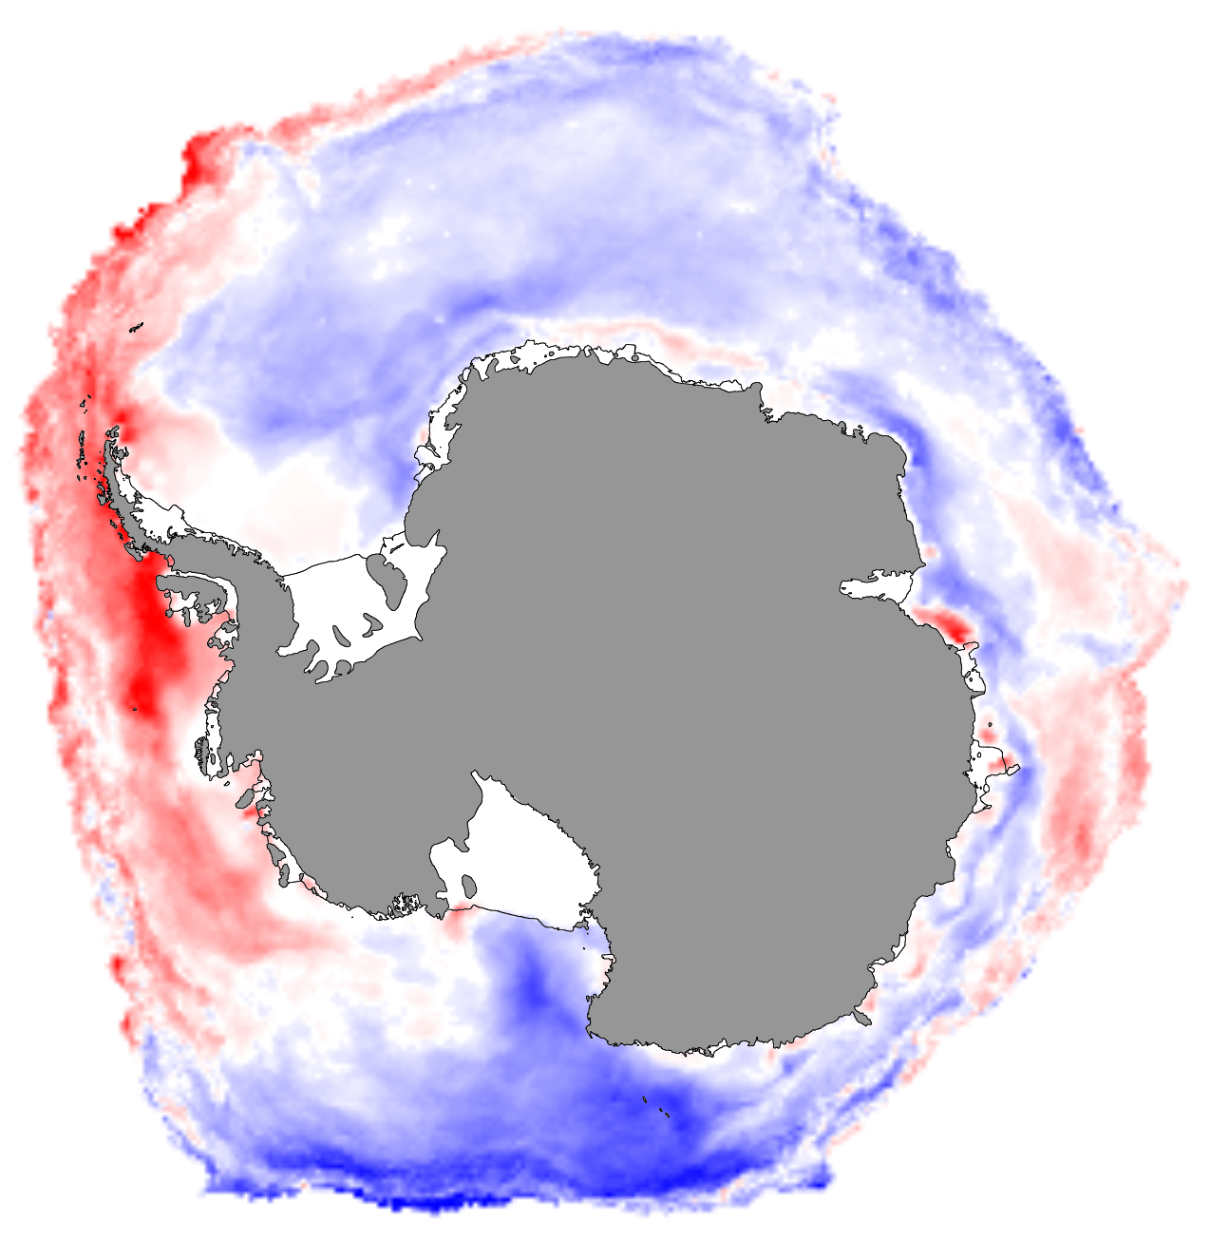
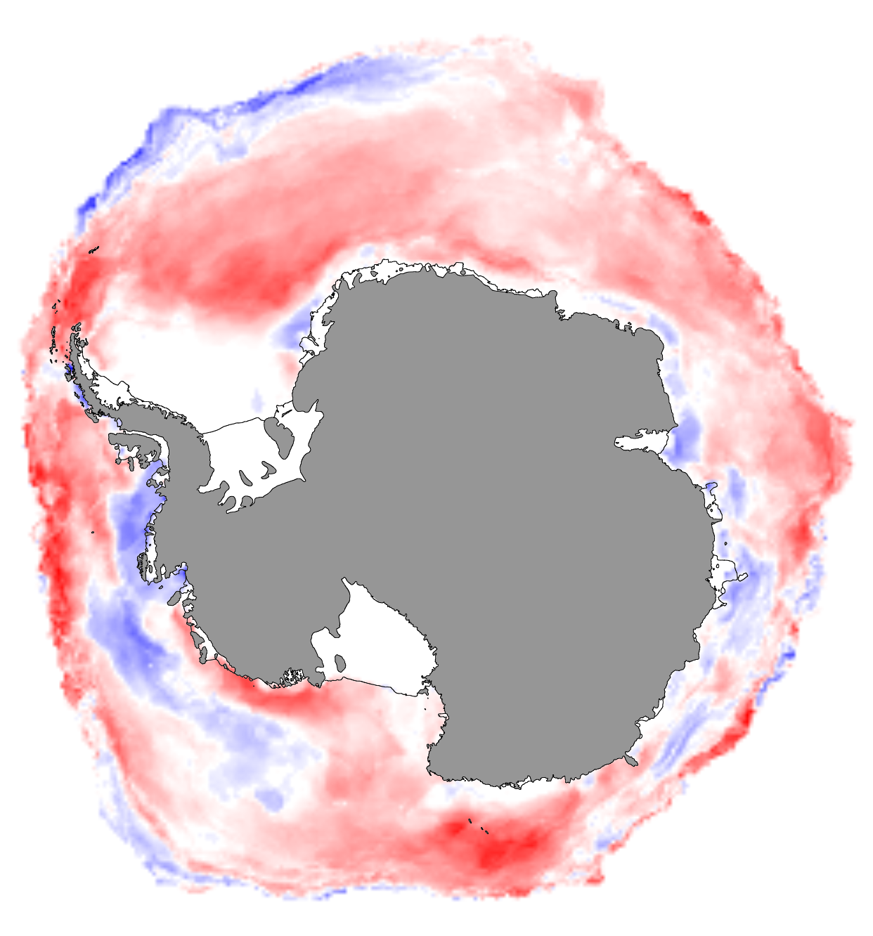
Changing Patterns Ice Season Duration Trends
BLUES: longer ice seasons by up to 3 months
REDS: shorter ice seasons by up to 3 months
Trend first 30 Years
(1979-2008)
Trend last 14 Years
(2009-2022)
Stammerjohn & Makym, 2017, updated

Slide 5
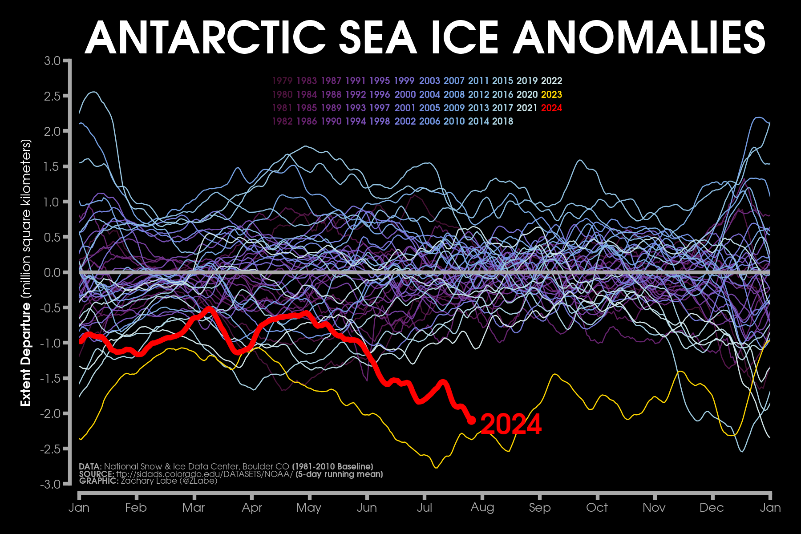
And then the Winters of 2023 & 2024 happened…
2023
2023
2023
https://zacklabe.com/
Notes:
Slide 4: Satellite-observed Antarctic sea-ice extent changes over the last 40+ years, showing a gradual increase in Antarctic sea-ice extent (positive anomalies) that culminated as record highs in 2015 (and longer ice seasons). Shortly thereafter and quite suddenly, Antarctic sea-ice extent dropped to record lows (and shorter ice season) in 2016, followed by 4 years of persistently low sea ice that started to show some recovery by 2021, only to suddenly drop again to new record lows (and widespread shorter ice seasons) in 2022 and 2023. Much of the year-to-year variability in Antarctic sea-ice is due to variability in atmospheric circulation patterns, but the underlying sustained sea-ice increases up to 2015, followed by the persistence sea-ice decreases point to multi-decadal changes in ice-ocean interactions. However, the magnitude of the recent sea-ice decreases indicate an amplification of that natural cycle by a now much warmer Southern Ocean.

Slide 6
Observational Evidence for a Regime Shift in Summer Antarctic Sea Ice
Hobbs et al 2024
Analysis of the variance over 1979-2023 shows a change point in 2007
The STD of summer sea ice between [1979-2006] and [2007-2022] doubled from 0.31 to 0.76 million km²
Anomaly persistence also dramatically increased (with a sharp increase in autocorrelation) [also Purich and Doddridge 2023]
Anomaly spatial coherence also increased (greater circumpolar-wide anomaly distributions) [e.g., Reid et al 2017; 2023; 2024, BAMS SOTC]
Indeed, these 3 characteristics indicate an ‘abrupt critical transition’ based on dynamical systems theory

Slide 7
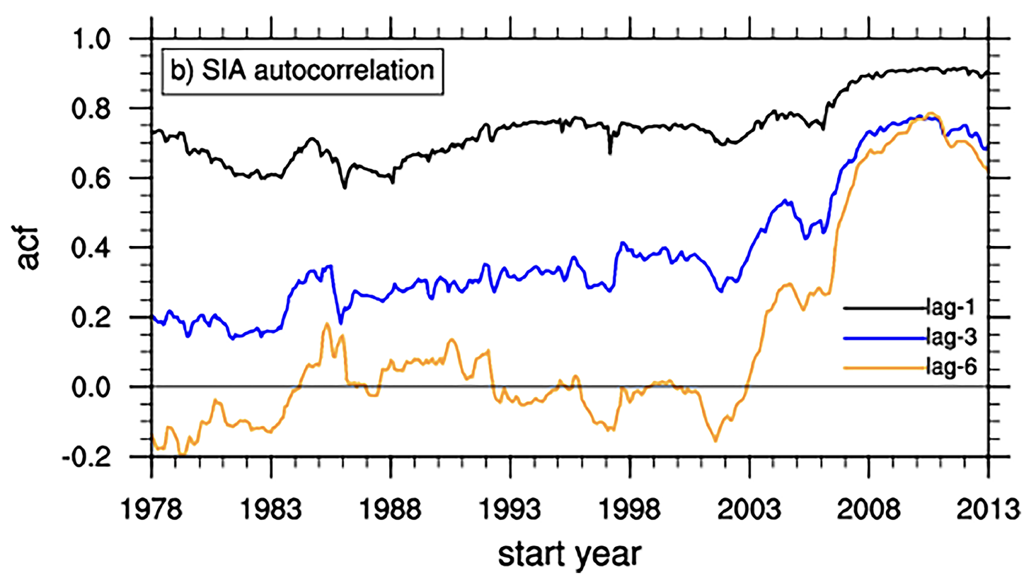
A Sharp Increase in Autocorrelation at Longer Lags
Hobbs et al 2024
Heralding a shift to increased winter sea ice preconditioning

Slide 8
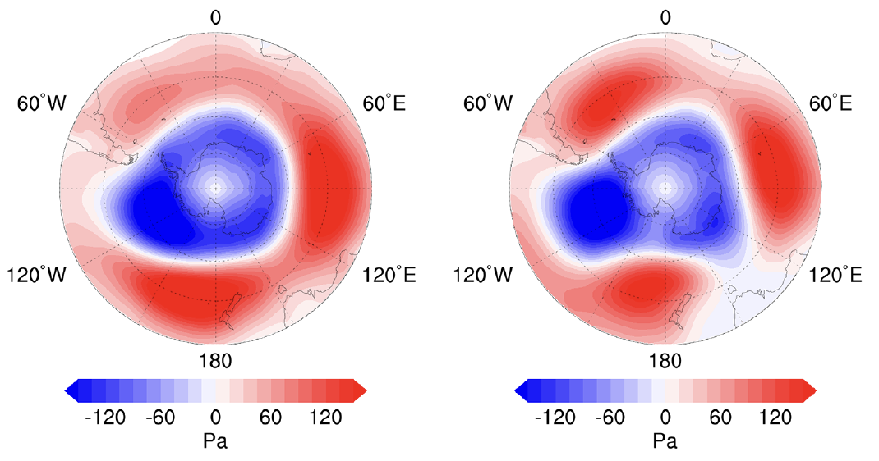
Has there been a Regime Shift in atmosphere-ice interactions?
Atmospheric modes (e.g., SAM, ENSO, ZW3) alone are not enough to explain the recent increased variance (Hobbs et al 2024) or shift in mean states (Purich and Doddridge 2023)
Sea-ice anomalies in winter and spring have become a more reliable predictor of the summer sea ice state (Hobbs et al 2024)
Atmospheric variability is now more heterogeneous (e.g., SAM now more ZW3-like) (Schroeter et al 2023)
SAM: 1979-1993
SAM: 2007-2021
While sea-ice variability is now more homogeneous

Slide 9
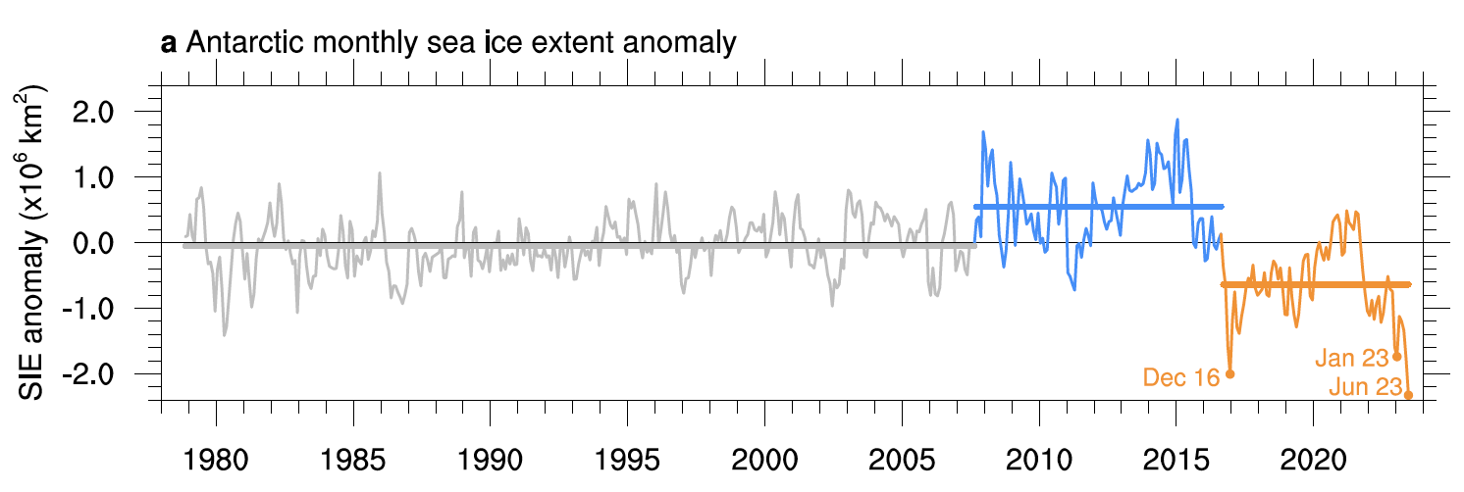
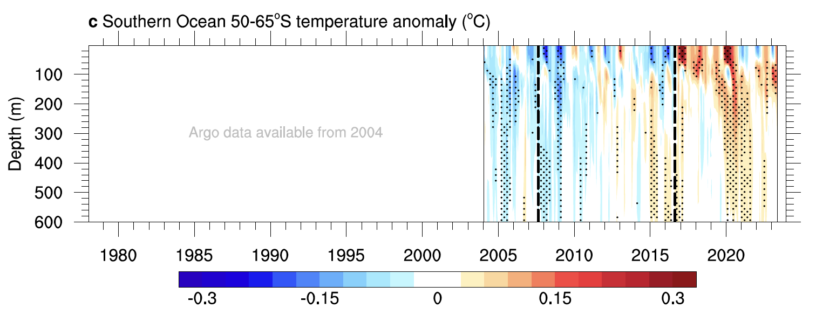
Has there been a Regime Shift in Ice-Ocean interactions?
Increased spatial coherence in Antarctic sea-ice anomalies, together with longer season-to-season sea-ice memory, suggests a greater role of ocean forcing and/or a shift in seasonal sea-ice / ocean mixed layer interactions (Hobbs et al 2024)
Sea-ice changes align with ocean changes (Purich and Doddridge, 2023)

Slide 10
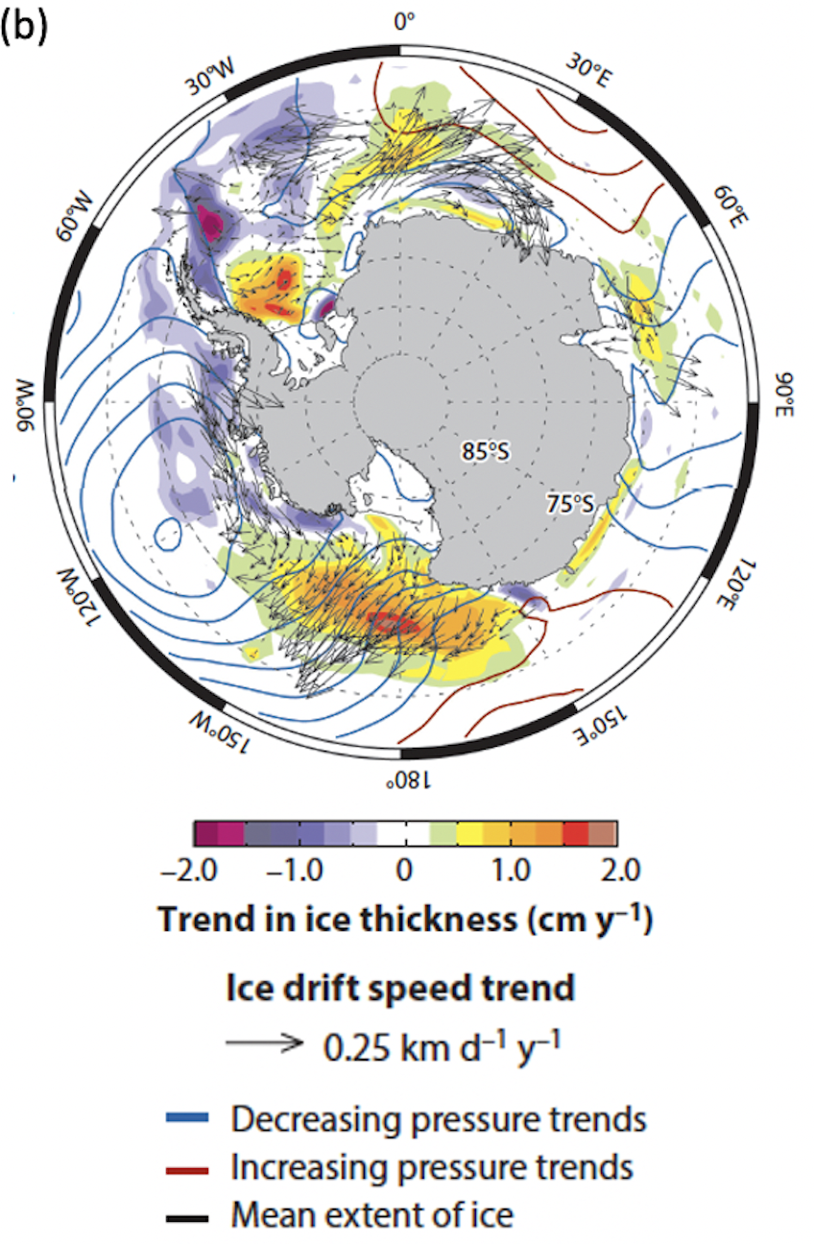
What about Snow &Sea-Ice Thickness?
Trends in Winds, Sea-Ice Drift & Thickness
Maksym, 2019
Recent sea-ice thickness changes?
Prior to ~2009
Spatial trend patterns align between winds, sea-ice drift/thickness, and sea-ice season duration
But what about post-2009?
1990–2009
Trends
BLUES: longer by up to 3 months
REDS: shorter by up to 3 months
1979-2008 Trends
2009-2022 Trends
Has sea-ice become thinner most everywhere now?
Thermodynamically, maybe yes?
Dynamically, maybe no?
Massonnet et al 2013: modeled May–June sea-ice thickness trends (shading)
Kwok et al 2016: ice motion trends (arrows)
Maksym 2019: trends in sea-level pressure (contours)

Slide 11
Question 2
Which are the important processes at play for the sea-ice decline?
What are the knowledge gaps ?

Slide 12
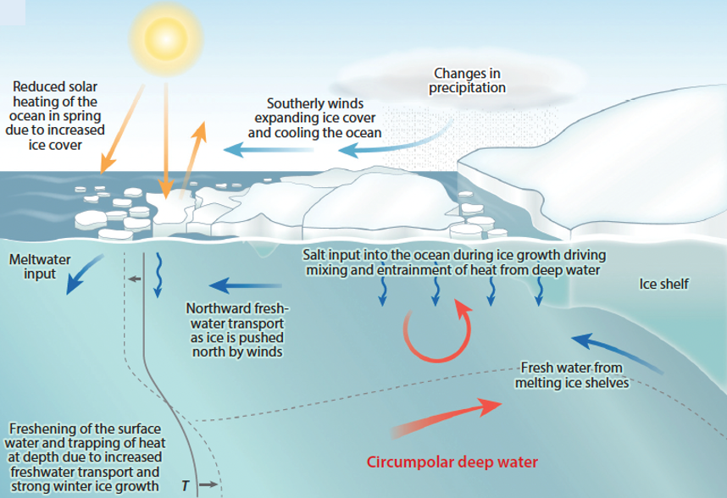
How well do we know these processes?
Upward ocean heat entrainment due to brine-induced convection and/or turbulent mixing constraining sea-ice growth and thickness
Maksym 2019
Ocean stratification due to surface freshening in areas of net sea-ice melt, glacial meltwater inputs, and/or ocean heat accumulation at depth

Slide 13
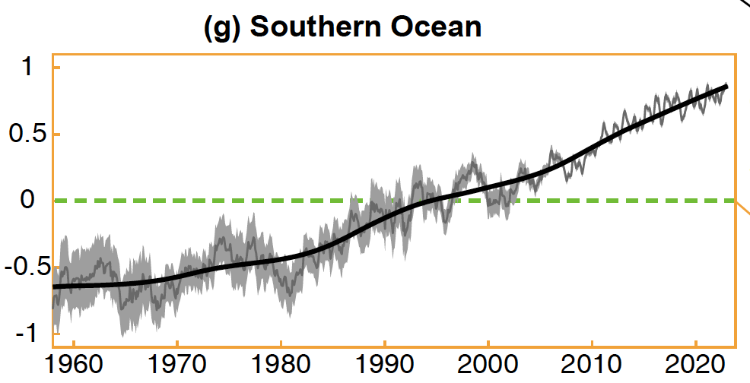
Southern Ocean Warming versus Strong Multi-Decadal Variability
Difficult to disentangle natural from anthropogenic variability, especially with high multi-decadal variability in upper ocean (warm/salty vs cool/fresh upper ocean) (e.g., Haumann et al 2020; Zhang et al 2019; 2023)
Perhaps the ‘warm/salty’ periods are becoming warmer (then saltier), in step with global & Southern Ocean warming (Haumann et al, 2023 SOOS)
Cheng et al 2024
Southern Ocean alone absorbs 60-70% of that anthropogenic heat
Southern Ocean (30ºS to 60ºS)
Heat Content Anomaly
(10⁹J m⁻²; 0-2000m)
(Baseline 1981-2010)

Slide 14
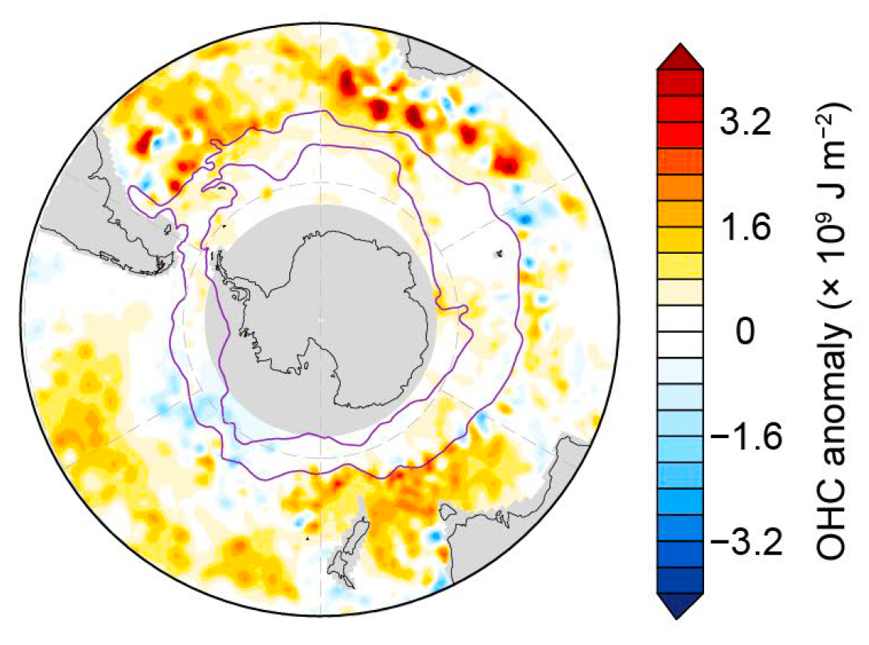
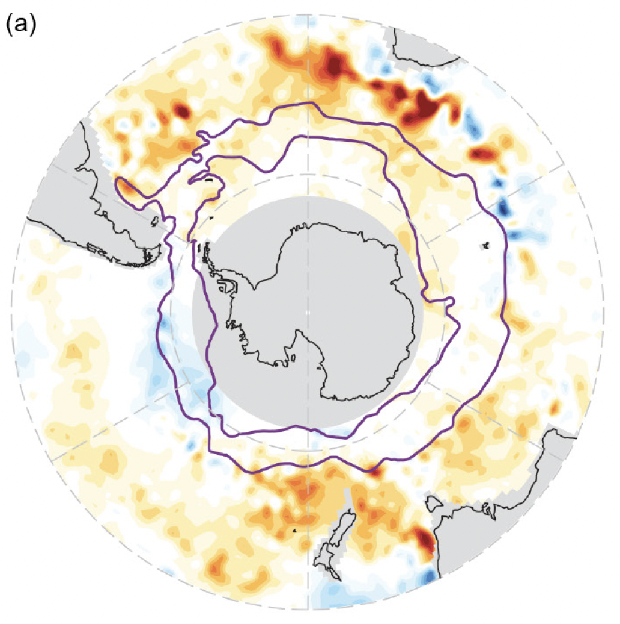
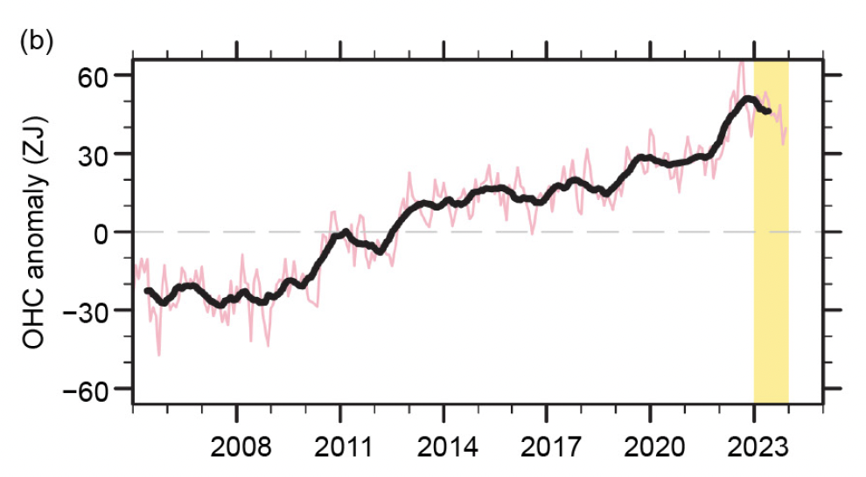
But how is Southern Ocean warming affecting the seasonal sea-ice zone?
BAMS State of the Climate 2023 – Antarctic Chapter (Clem & Raphael 2024, eds)
Section on Southern Ocean (Thomalla et al)
2022 Anomaly
2023 Anomaly
OHC upper 2000m
Argo Data 30S - 65S
Baseline 2005-2020
Notes:
Slide 5: A spatial view: increasing ocean heat content is ‘knocking at the door’ of the seasonally sea-ice covered regions and is finding ways to intrude southward where these warm ocean anomalies are associated with large areas of decreased sea ice. (The warm ocean anomalies appear to intrude southward in well-defined areas associated with bathymetric ridges where ocean upwelling and mixing are known to occur.)

Slide 15
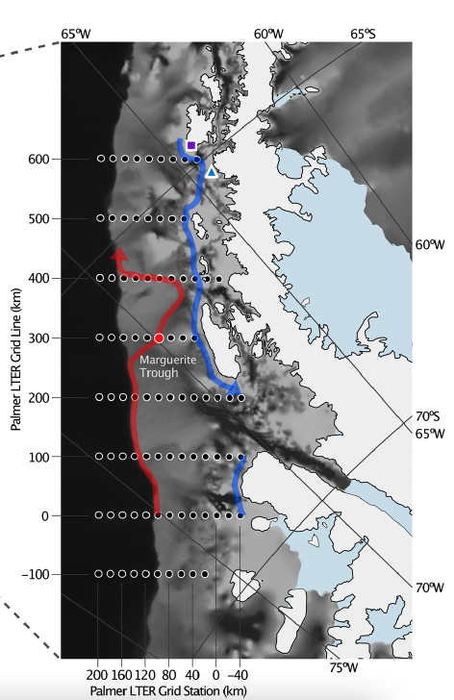
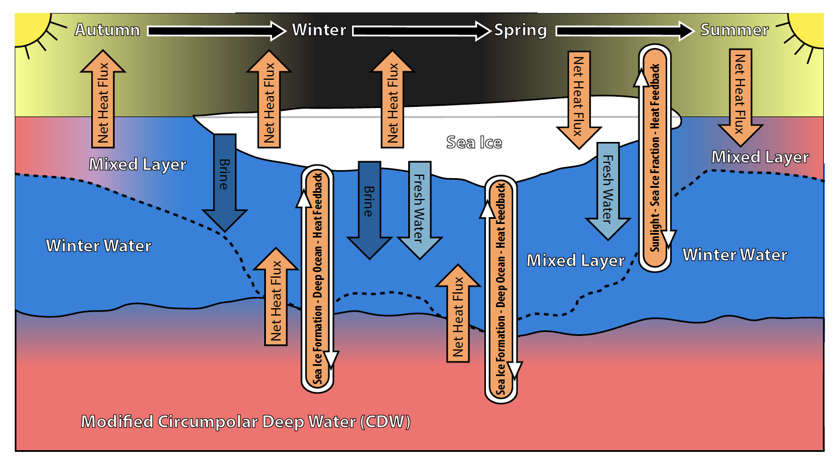
How can the Subsurface Ocean Heat affect Sea Ice?
Influence of seasonally varying sea-ice concentration and subsurface ocean heat on sea-ice thickness and sea-ice seasonality (Saenz et al 2023)
Saenz et al 2023

Slide 16
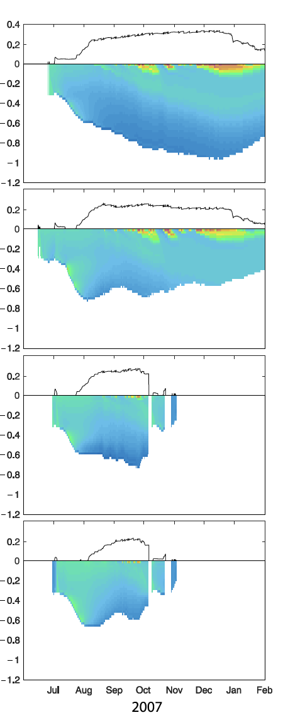
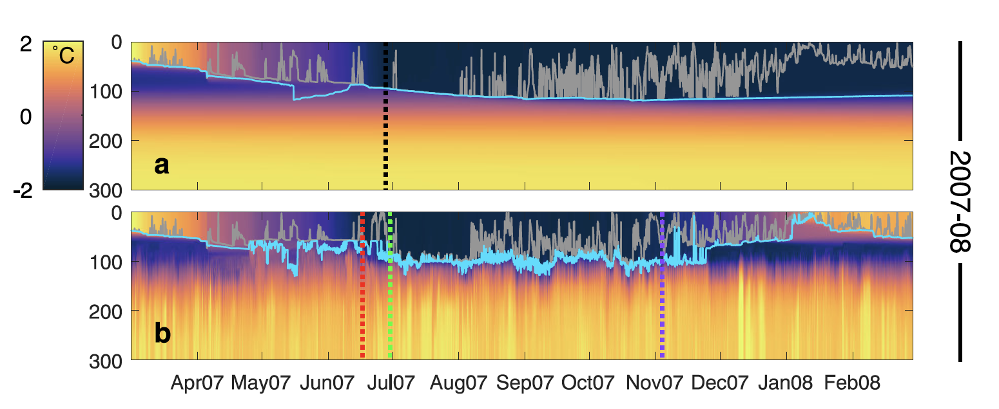
Saenz et al 2023
snow cover
Surface forcing only
winter ice thickness evolution
Simulated ocean temperatures (0-300)
(gray line: KPP mixing depths)
Ocean assimilated
Assimilated ocean temperatures
Sea-ice assimilated
Key take-homes:
Assimilated sea-ice (& implied motion) always produced greater surface heat fluxes & thinner sea ice
Assimilated ocean temperatures modified the start date of ice season & produced thinner (thicker) sea ice when the pycnocline was shallow (deeper), facilitating higher (lower) upward ocean heat flux
Both ocean & sea-ice assimilated
Resolving sea-ice concentration & subsurface heat fluxes matters significantly in understanding & simulating sea-ice thickness

Slide 17
Question 3
What capabilities must be maintained or developed in the coming decade in terms of observations (in situ, satellite), modeling tools, and data/model synthesis

Slide 18
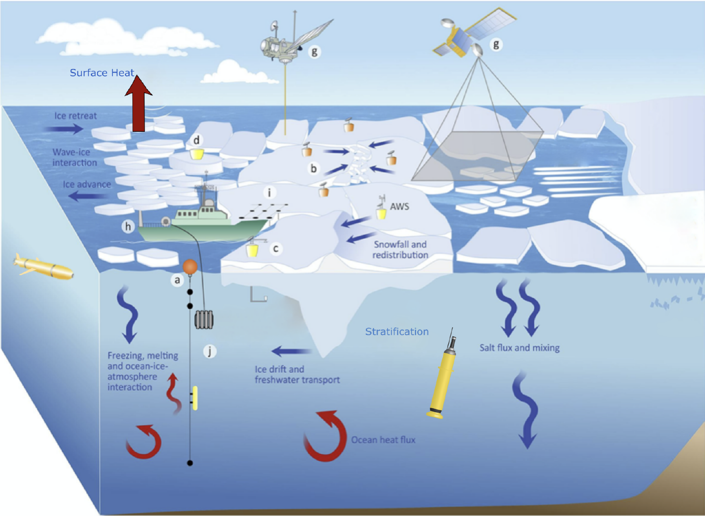
Multi-Platform Multi-Disciplinary Process Studies to Address Fundamental Questions
Under what conditions does the ocean have greater or lesser thermodynamic control on seasonal sea-ice production (i.e., bottom-up versus top-down forcing and the net balance of surface versus subsurface heat fluxes)?
Under what conditions do the dynamics (e.g., wind, waves, ocean eddies) override the thermodynamics in controlling seasonal sea-ice production?
Adapted from Newman et al 2019, SOOS
Over what time/space scales is the ocean a dominant driver of Antarctic sea-ice variability, from synoptic to seasonal, and from the relatively shallow shelf region, to the shelf break, to over the deep ocean?
These coupled processes are especially strong during extreme storm events (e.g., Vichi et al 2019)
Need to resolve in real-time & on short episodic timescales

Slide 19
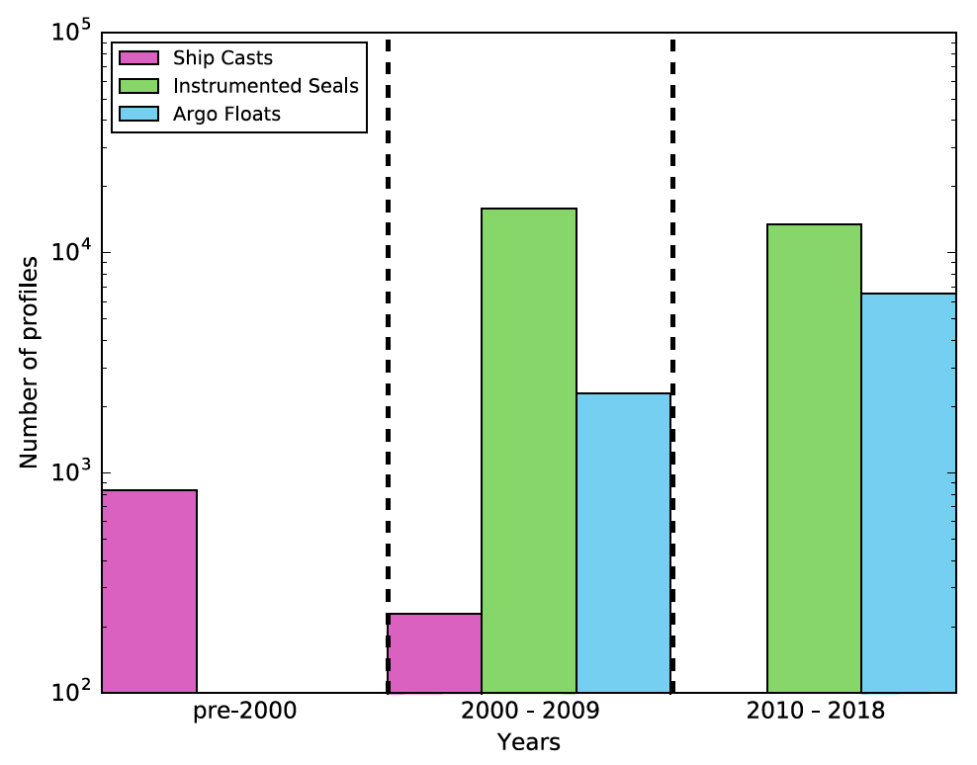
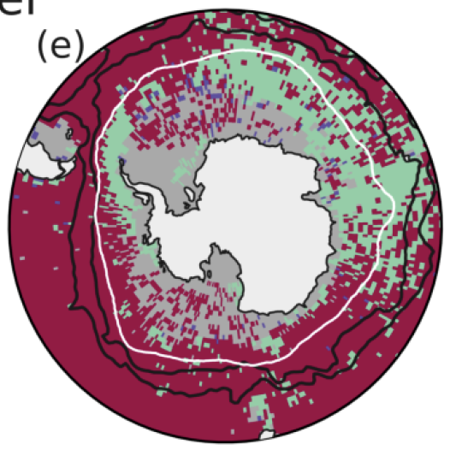
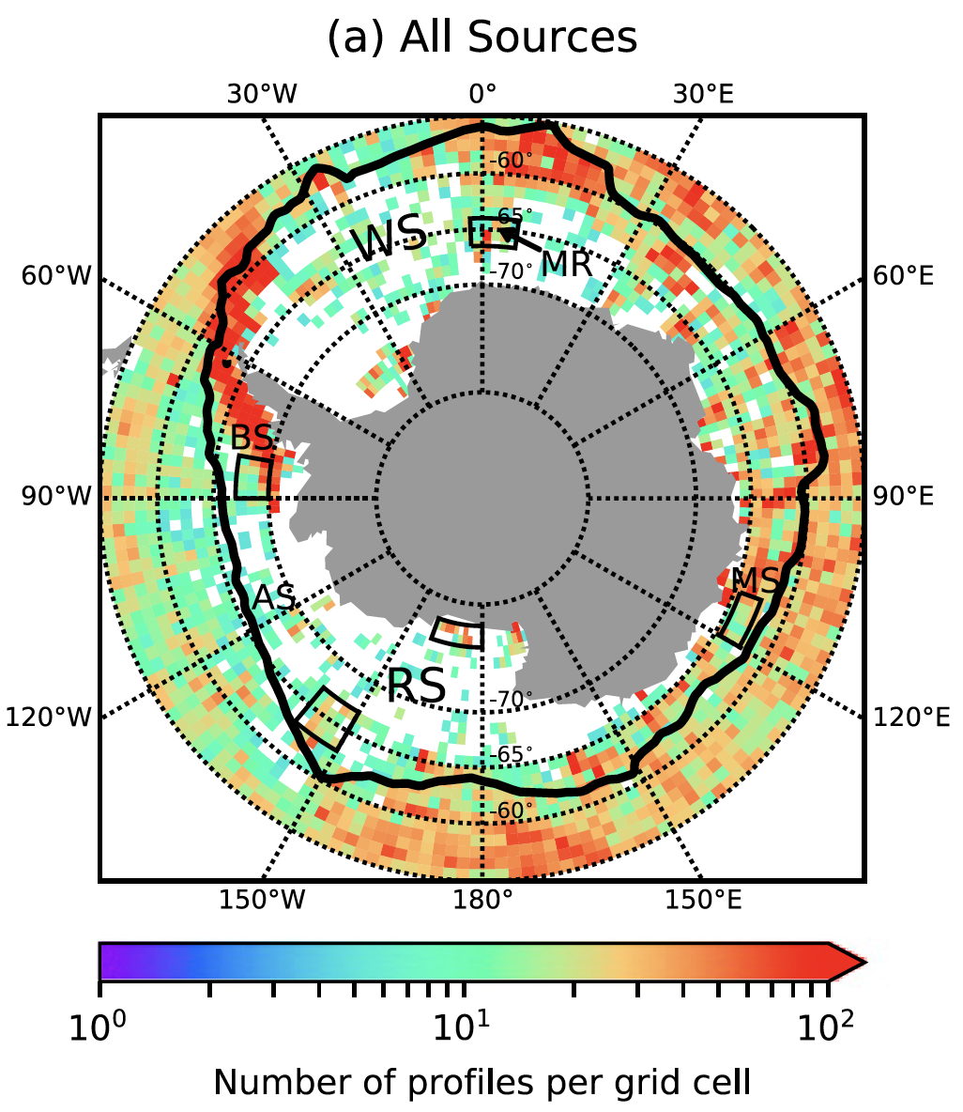
Studying Winter Water and Ice-Ocean Interactions using all available Ocean Observations in Winter
Wilson et al (2019)
Spira et al (2024)

Slide 20
Continue to Expand Observations and Conduct Data/Model Synthesis
Improve snow & sea-ice thickness observations (satellite-derived, snow/ice mass-balance buoys), as well as sustained (year-round) ocean observations under the seasonal sea ice cover (ship-based, ocean moorings, floats, gliders, marine mammal & seabird tags)
Deepen understanding of sea ice-ocean physics to improve numerical modeling capability, especially to help address the complexity of modeling mixed layer processes
Conduct data/model synthesis to assess air-ice-ocean interactions under varying atmospheric and oceanic forcing conditions, both on short (seasonal) and long (multiyear) time scales and for key geographic regions (on-shelf, at the shelf break, off the shelf)

Slide 21
In short…
How Well Do We Know the Space/Time Evolution of these Various Sea-Ice Drivers?
Atmospheric versus oceanic drivers
Influence of wind and waves
Warming versus freshening
Modulation of thermodynamics by snow loading
Deciphering anthropogenic changes amidst high natural variability
Role of sea ice in mediating climate feedbacks, including Antarctic ice sheet changes

Slide 22
Discussion Questions
Are the drivers of the [recent] sea-ice decline the same/different at the two poles?
Are the knowledge gaps the same/different for understanding sea-ice changes at the two poles?
How can we better share and/or translate observational technologies (in situ, satellite, autonomous), modeling tools, and data/model synthesis approaches between the two polar communities?

Slide 23
Extra Slides

Slide 24
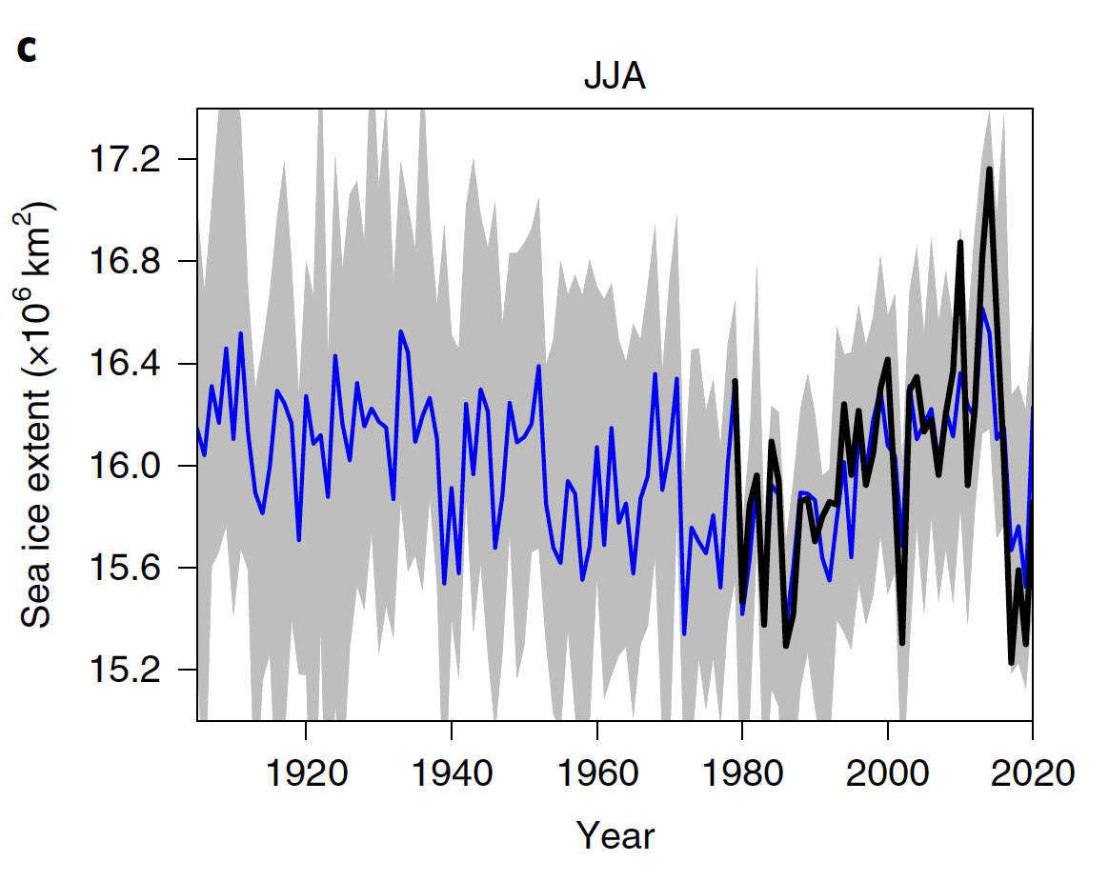
What can we learn from a Longer View?
(Fogt et al 2022)
Observational-Based Reconstruction (Winter/JJA)
As the climate warms, are we seeing a 3-Phase Response (e.g., Ferreira et al 2015) due to a tug-of-war between intensifying winds and warmer oceans?
?

Slide 25
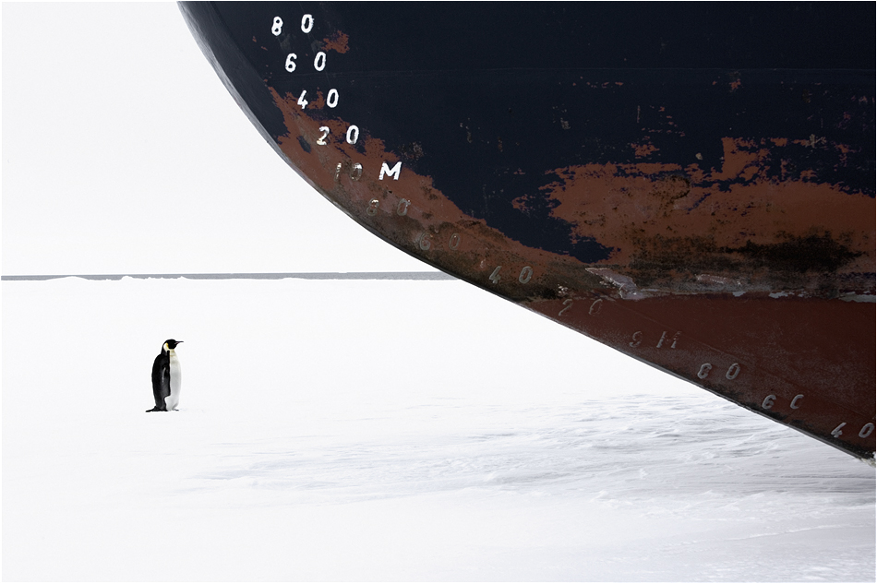
And now to make it real…
Antarctic Marine Protected Areas: Biodiversity and Diplomacy in the Global Ocean Commons
Photo: John B. Weller

Slide 26
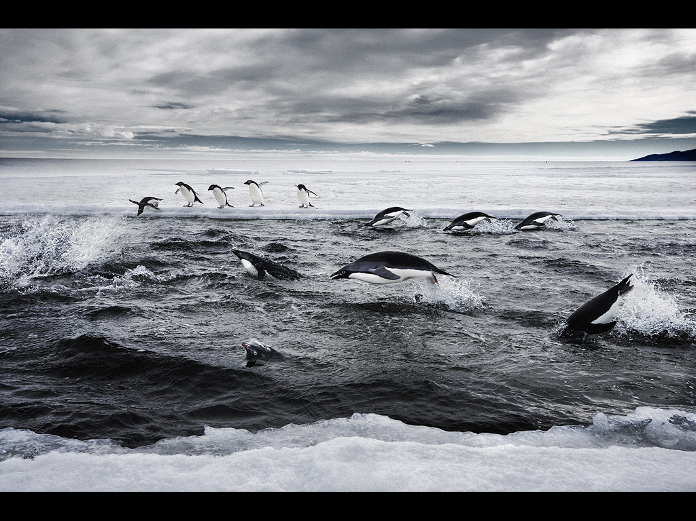
Cassandra Brooks & S. Stammerjohn, NSF Planning Meeting (Oct 2022):
Formulating and Sustaining a System-Level Understanding of a Large Marine Ecosystem in the Ross Sea Region Marine Protected Area to Better Conserve and Guide Policy
C. Brooks & S. Stammerjohn, NSF Research Coordination Network (Aug 2024, submitting):
An International Network of Science and Management to Improve Efficacy of Remote Large-Scale Marine Protected Areas
Plus: George Watters, Cara Nissen, Eileen Hofmann, Michelle LaRue, Grant Ballard, Jack Pan, Alex Orona, John Weller, Claire Christian (Steering Committee)
Photo: John B. Weller
Notes:
And despite its harsh conditions, the Antarctic waters teem with life. Indeed, the Antarctic contains some of our last intact marine ecosystems. Part of the reason we have healthy marine ecosystems is that Antarctica has been protected by ice and remoteness, but also political will…

Slide 27
Create a Policy-Engaged Science Network
(inclusive of all community partners)

Slide 28
Key Questions in Relation to Recent Antarctic Sea-Ice Changes
Despite the statistical evidence that Antarctic sea ice has gone through a systemic change (regime shift), we still do not have a physical mechanism to explain the change (Hobbs et al 2024)
How will 2024 continue to evolve, and can it definitively substantiate a fundamental change in seasonal sea-ice / ocean mixed layer interactions?
https://zacklabe.com/

Slide 29
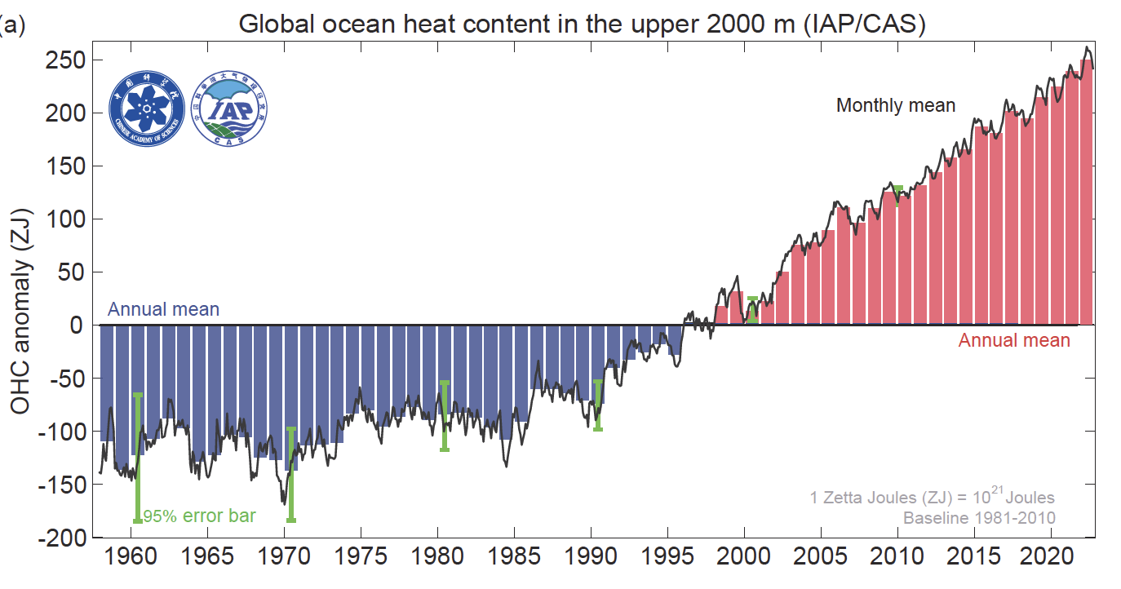
Global Ocean Heat Content Anomaly
(10²¹J; 0-2000m)
Cheng et al, 2023
The Global Ocean accounts for ~90% of anthropogenic heat uptake
(Baseline 1981-2010)
Southern Ocean (south of 30ºS)
Heat Content Anomaly
(10⁹J m⁻²; 0-2000m)
Southern Ocean alone absorbs 60-70% of that anthropogenic heat
(Baseline 1981-2010)
Notes:
Slide 6: The well-documented global increase in ocean heat content is due to an increase in the absorption of atmospheric heat. If it weren’t for the oceans absorbing up to 90% of the atmospheric heat resulting from increased carbon emissions, our planet would be far warmer and far less sustainable than it is currently. All this time, the oceans have been doing us a huge favor by helping to moderate our climate, but it has come at a cost. The Southern Ocean alone absorbs up to 60-70% of the atmospheric heat (of that total 90%), thus plays an outsized role in regulating our global climate. As the Southern Ocean and its sea-ice environment changes, so does its regulatory capacity to moderate our global climate.

Slide 30
Did anthropogenic warming contribute to the Regime Shift?
Formal detection and attribution studies require adequate observations and adequate coupled models
Currently, the satellite sea-ice time series are too short, and the ocean observations too sparse (within the seasonal sea-ice zone)
Currently, there is low confidence that current coupled models adequately represent Southern Ocean processes (e.g., Meredith et al 2019; Roach et al 2020)
However, robust sea ice reconstructions can provide a longer-term climate perspectives (e.g., Fogt et al 2022), keeping in mind the reconstructive caveats

Slide 31
Research priorities that emerge as key future directions
Targeted process studies to improve understanding of how atmosphere-ice-ocean interactions respond to episodic forcing, e.g.,
Fine-scale ocean turbulence measurements under actively growing sea-ice (ahead to within the advancing sea-ice cover) to improve understanding and quantify the influence of ocean heat on Antarctic sea-ice thickness
Wave-ice process studies to improve understanding of effects on sea-ice production, thickness, and floe size distributions
Coastal process studies to improve understanding of how atmosphere-ice-ocean interactions moderate glacial ice mass changes.

