Slide 1






Sea ice predictions and projections
The role of sea ice and its variability
in the climate system
ICTP, Trieste, Italy - July 29-31, 2024
Part 1: François Massonnet

Slide 2

Svalbard UNIS summerschool, 2011
Notes:
This is a picture of Alex and I taken 13 years ago in Svalbard at a summer school and I really like the picture because for me it sort of closes the loop.
At that time, we were the students (well we are still students and learning somehow), we were presenting posters, we were preparing projects, we were drinking beers at night.
I really hope that many of you will be able to pull out such a picture in 15 years at a sea ice summer school because in research, certainly papers are important, projects are important, but what is the most important is encounters, collaborations, and human moments like these.

Slide 3
Sea ice predictions and projections
The role of sea ice and its variability
in the climate system
ICTP, Trieste, Italy - July 29-31, 2024
Part 1: François Massonnet
Notes:
Hook – difference polar vs mediterranean research

Slide 4
Questions for today
What is predictability?
How is predictability assessed?
What are the sources of sea ice predictability?
Does predictability evolve in a changing climate?
What is the skill of current sea ice prediction systems?
What are the next steps?

Slide 5
Questions for today
What is predictability?
How is predictability assessed?
What are the sources of sea ice predictability?
Does predictability evolve in a changing climate?
What is the skill of current sea ice prediction systems?
What are the next steps?
Notes:
Predictability is like energy, we all have an intution of what it is, but it’s in fact extremely hard to define

Slide 6
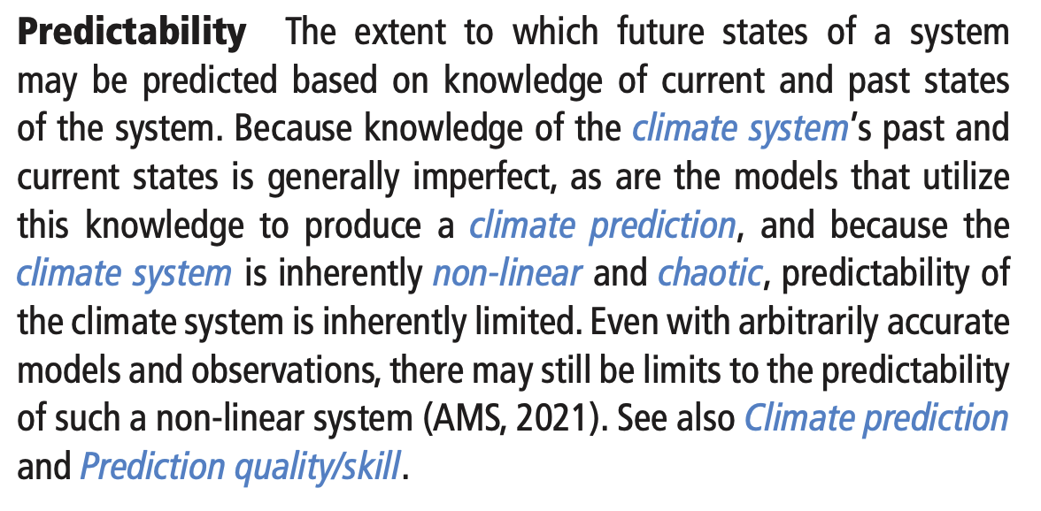
The IPCC definition: somewhat modest
IPCC, 2021: Annex VII: Glossary [Matthews, J.B.R., et al (eds.)]. Cambridge University Press, Cambridge, United Kingdom and New York, NY, USA, pp. 2215–2256, doi:10.1017/9781009157896.022.

Slide 7
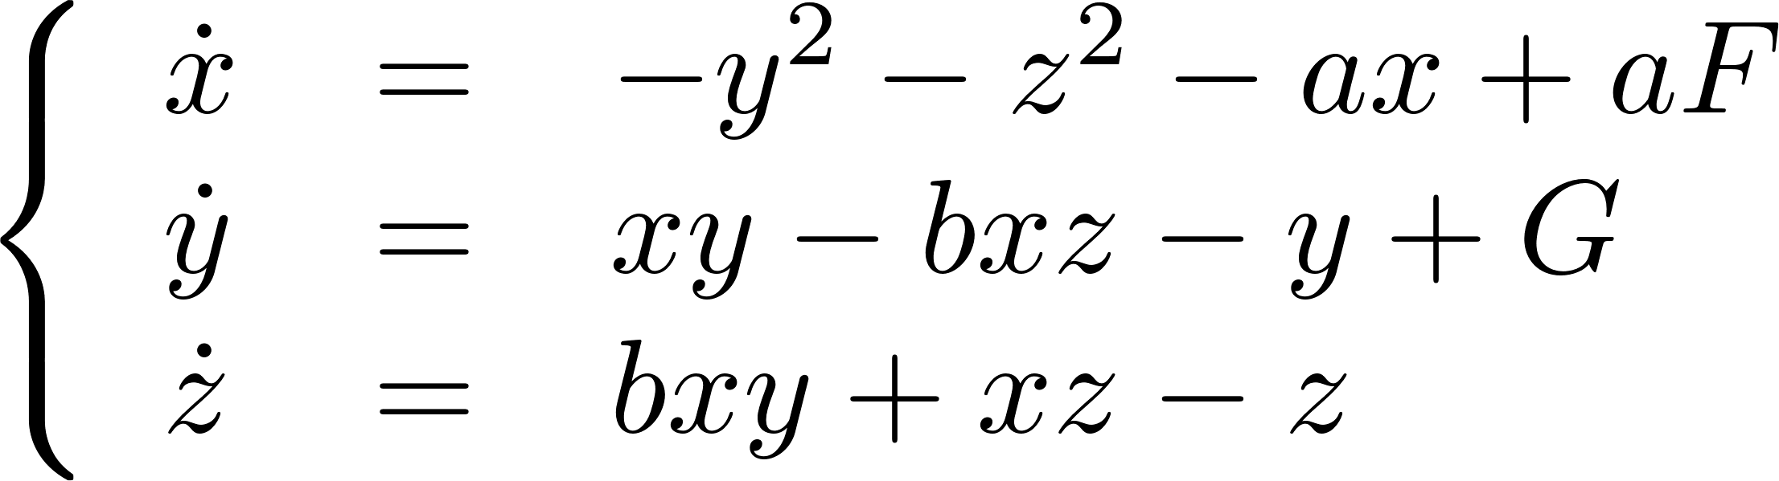
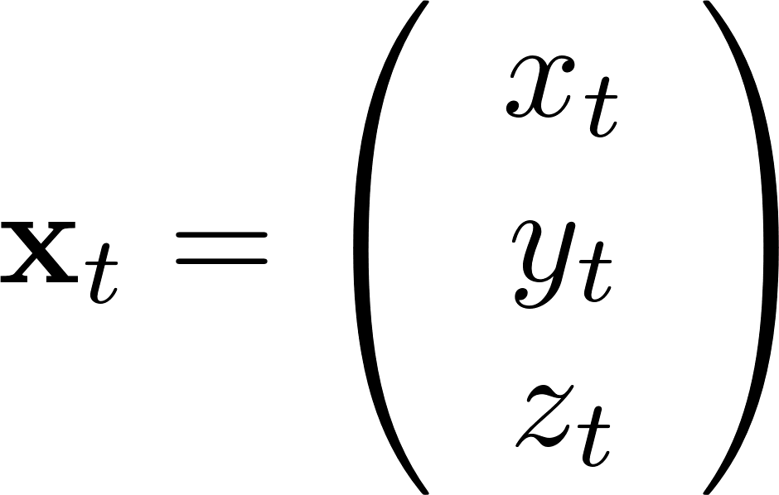
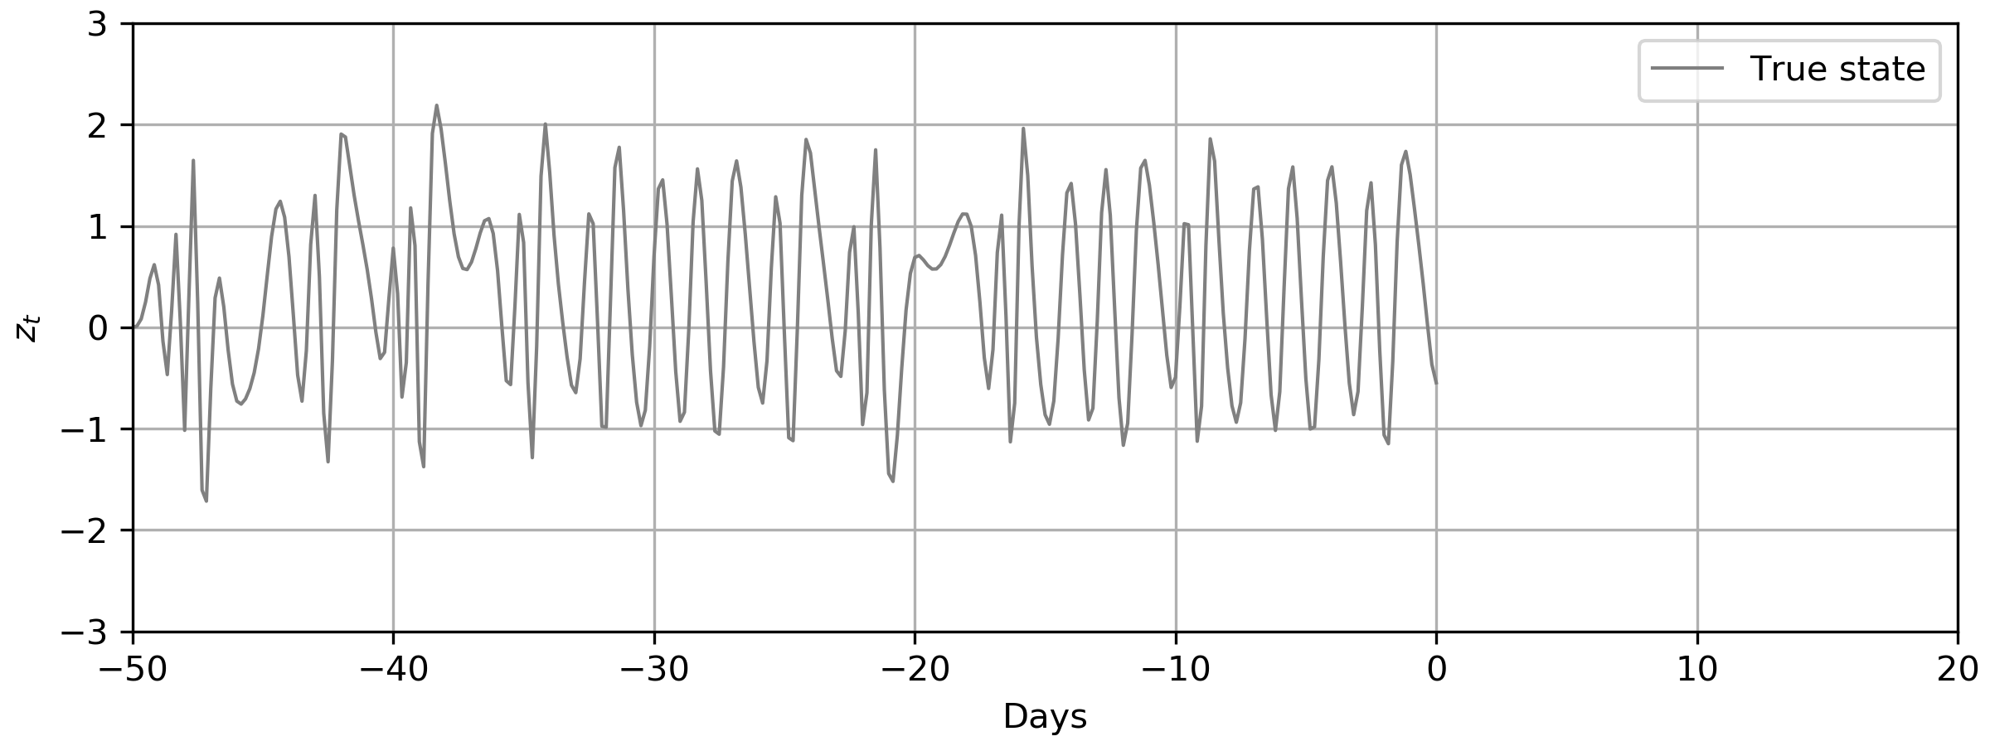
Initial-value predictability
Notes:
IV predictability : this part

Slide 8
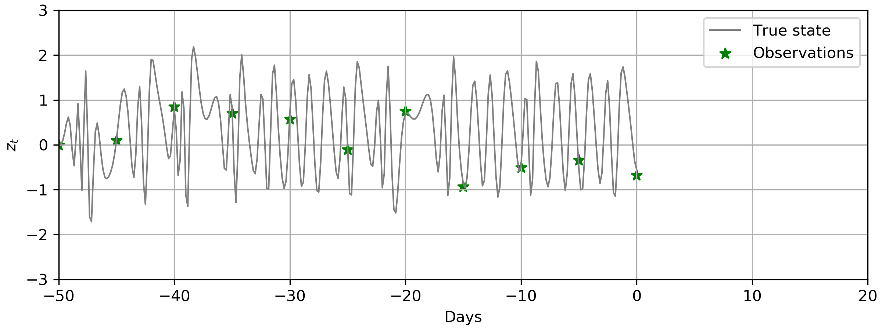
Initial-value predictability

Slide 9
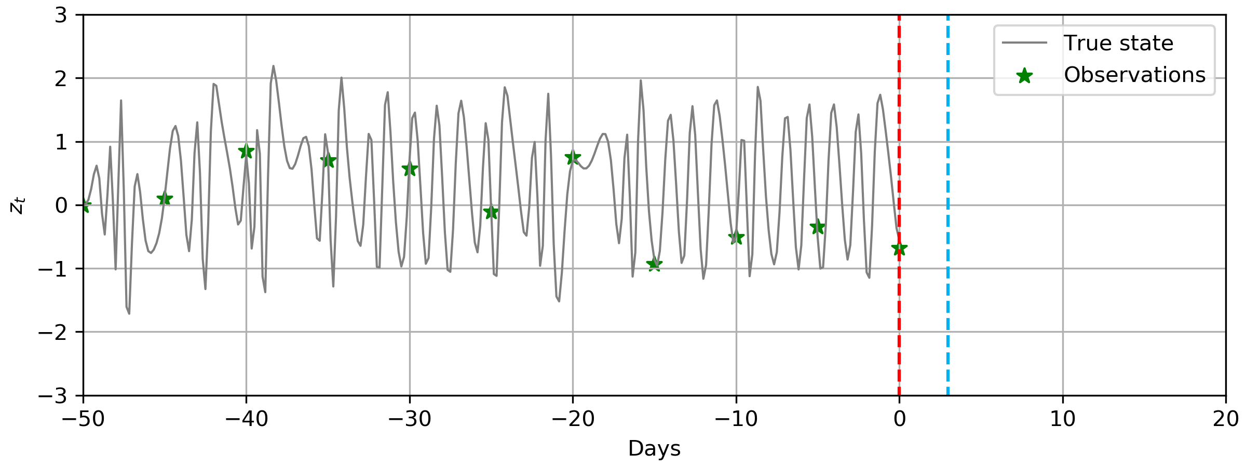
Initial-value predictability
τ
Lead time
t
Initial
condition time
t+τ
Verification time

Slide 10
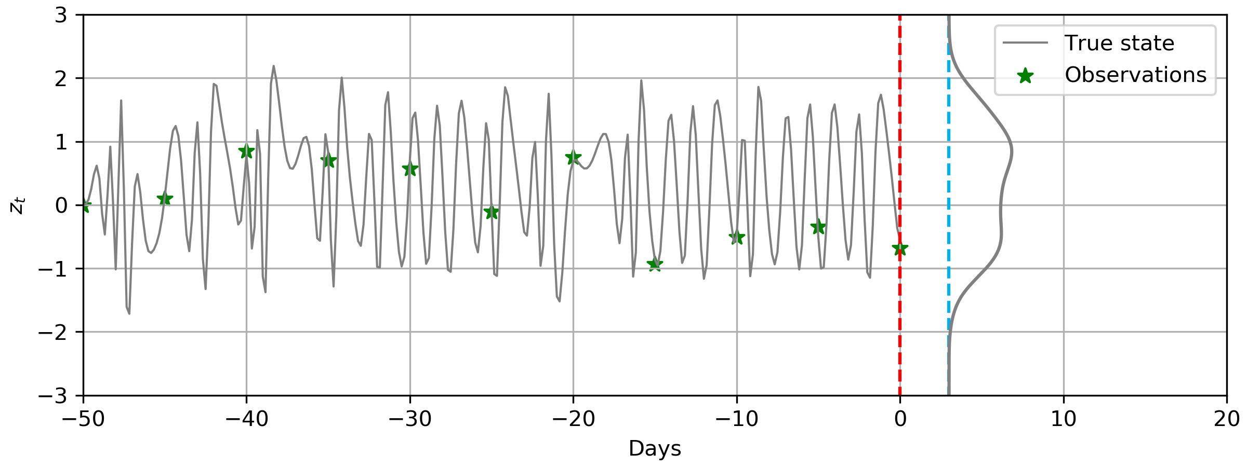

Initial-value predictability
Climatological distribution: unconditional forecast
τ
Lead time
t
Initial
condition time
t+τ
Verification time

Slide 11
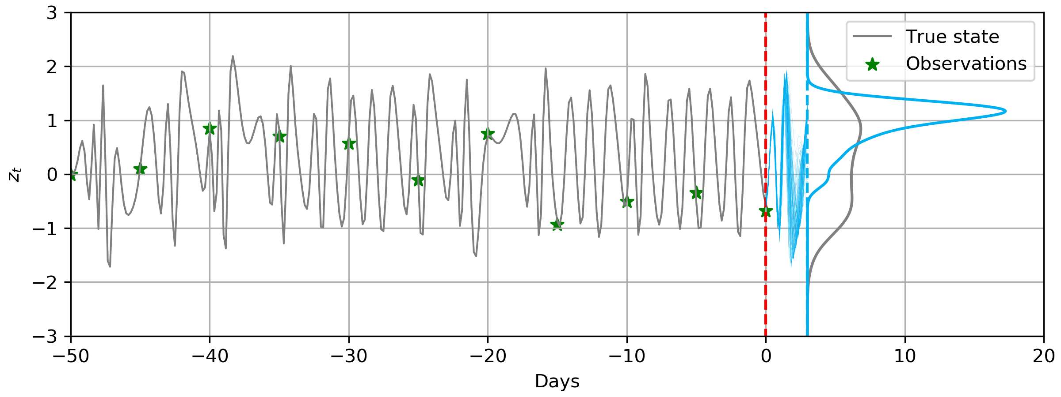

Initial-value predictability
Forecast distribution: forecast PDF conditioned on observed state at t=0
Climatological distribution = unconditional forecast
τ
Lead time
t
Initial
condition time
t+τ
Verification time
Notes:
PDF

Slide 12
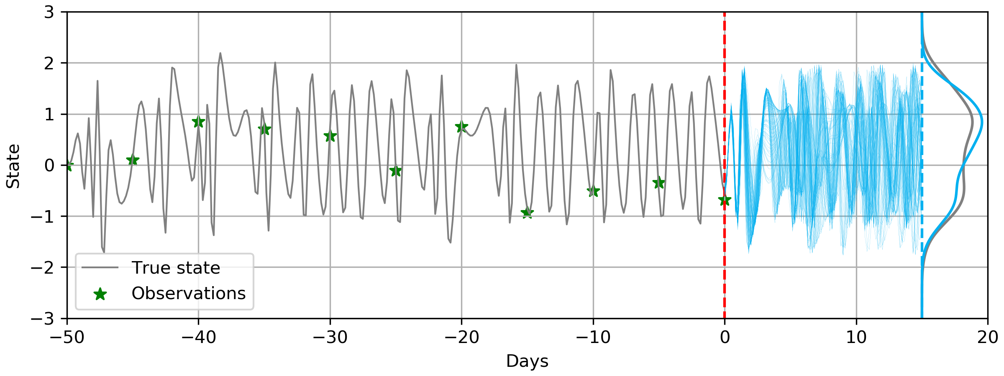


Initial-value predictability
Initial-value predictability is lost: the two distributions are (almost) identical
Forecast distribution
Climatological distribution
τ
Lead time
t
Initial
condition time
t+τ
Verification time
Notes:
Obs = knowledge that the clim forecast does not have

Slide 13
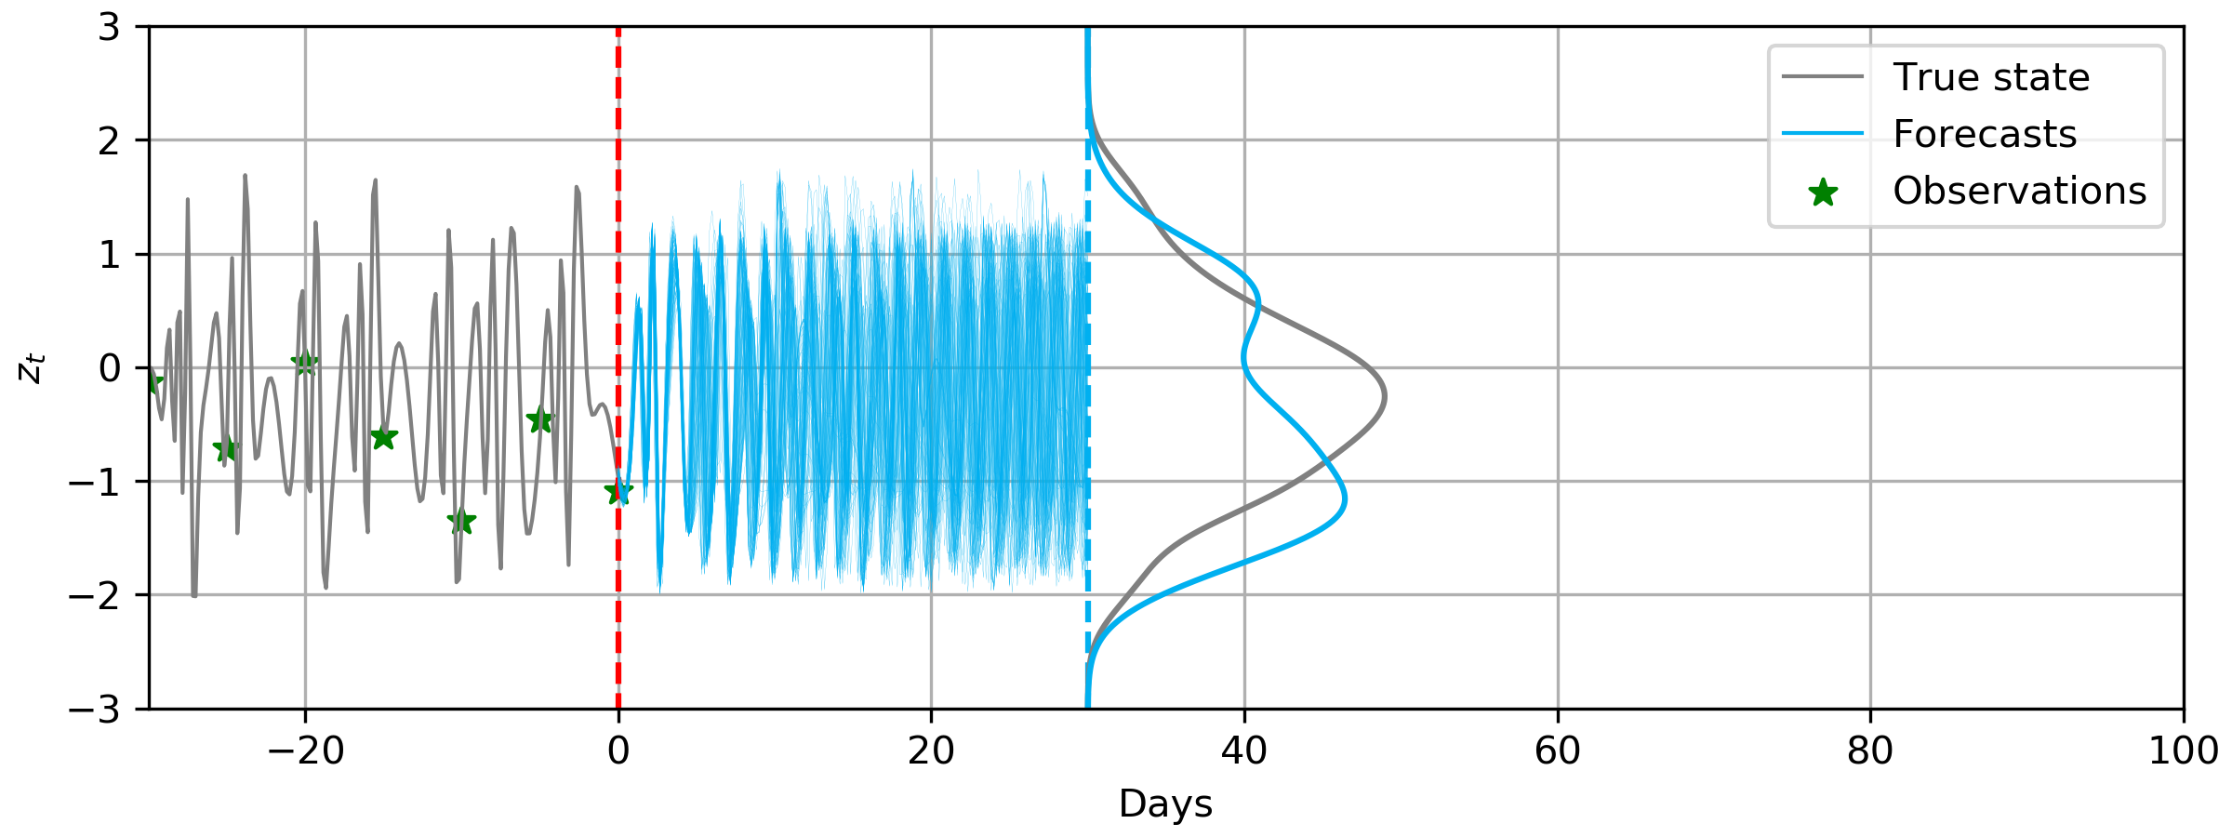
Boundary-condition predictability
Initial-value predictability is progressively eroded, and eventually lost
Forecast distribution
lorenz1984.py|3d35e68
Climatological distribution

Slide 14
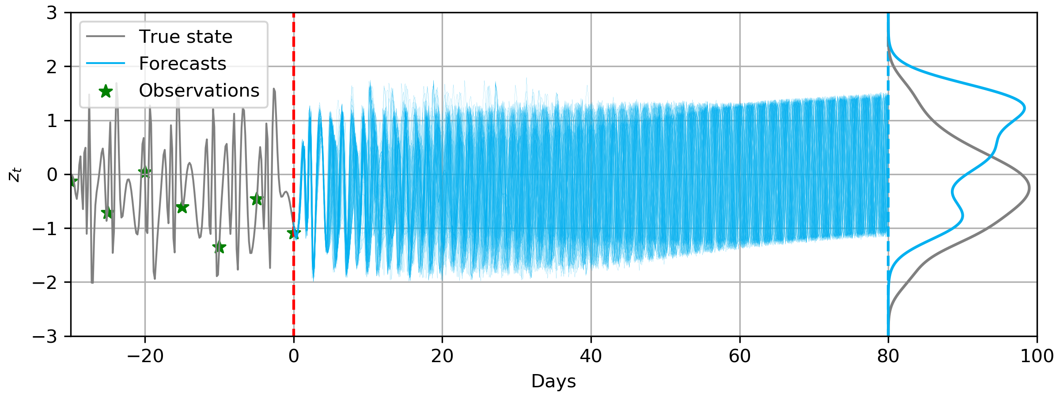

Boundary-condition predictability (Tom’s part)
Initial-value predictability is progressively eroded, and eventually lost
Predictability emerges from the changes in forcing
Forcing
Forecast distribution
lorenz1984.py|3d35e68
Climatological distribution

Slide 15
Climatological PDF = Probability density function of the unconditional forecast
« Forecast PDF » = Probability density function of the forecast conditioned on some knowledge (initial condition and/or forcing)
predictability
Variable (e.g. temperature)
Climate predictability is the extent to which the forecast distribution for some variable of interest, conditioned on either the knowledge of observations or on future forcings on the system (or both), differs from the climatological distribution for that variable:
⇔
“A variable is said to be unpredictable from a set of observations if it is statistically independent from those observations” (DelSole, T., & Tippett, M. K. (2018). Predictability in a changing climate. Climate Dynamics, 51(1), 531–545. https://doi.org/10.1007/s00382-017-3939-8)
Notes:
The gap reveals predictability. If the forecast, based on some knowledge that the climatological forecast does not benefit from, would produce a PDF that is undistinguishable from the climatological PDF, then there would be no predictability.

Slide 16
Very important remarks
Climate (and hence sea ice) predictability is not an absolute concept:
It is model-dependent. Indeed, a forecast model is required to estimate predictability.
It relies on the adequate estimation of a ‘climatological PDF’ → challenging concept these days.
Stating when two PDFs differ from one another involves subjective choices (which metric, which threshold, …)
Initial-value predictability depends on the quality of observations at initial time. A forecast with initial errors as large as the interannual variability will indicate no predictability
Predictability depends on the region, the season, the mean state, the averaging scales (temporal and spatial).
Notes:
There is no such a thing as « the predictability » of sea ice. If you ask, how predictable is sea ice, well, it’s an ill-posed question
. Predictability estimates change with our models! (Extreme case: a linear model has infinite predictability

Slide 17
Questions for today
What is predictability?
How is predictability assessed?
What are the sources of sea ice predictability?
Does predictability evolve in a changing climate?
What is the skill of current sea ice prediction systems?
What are the next steps?

Slide 18
Questions for today
What is predictability?
How is predictability assessed?
What are the sources of sea ice predictability?
Does predictability evolve in a changing climate?
What is the skill of current sea ice prediction systems?
What are the next steps?

Slide 19
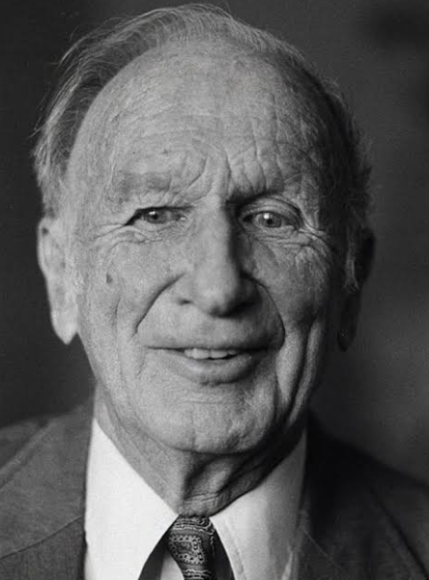
Measuring predictability: the early days
Analog 1 trajectory
t=0
Edward Lorenz (1917-2008)
Analog 2 trajectory
doubling time = t such that err(t) = 2 ⨉ err(0)
Lorenz, Edward N. “Atmospheric Predictability as Revealed by Naturally Occurring Analogues.” Journal of the Atmospheric Sciences 26, no. 4 (July 1, 1969): 636–46. https://doi.org/10.1175/1520-0469(1969)26<636:APARBN>2.0.CO;2.
Notes:
In the early days of meteorology, when computers would not allow to estimate a forecast distribution easily, the empirical method of analogs was popular for estimating predictability of the real atmosphere. From a catalogue of past weather conditions, two resembling conditions (“analogs”) are extracted and the rate of increase of errors is studied
This method is diagnostic

Slide 20
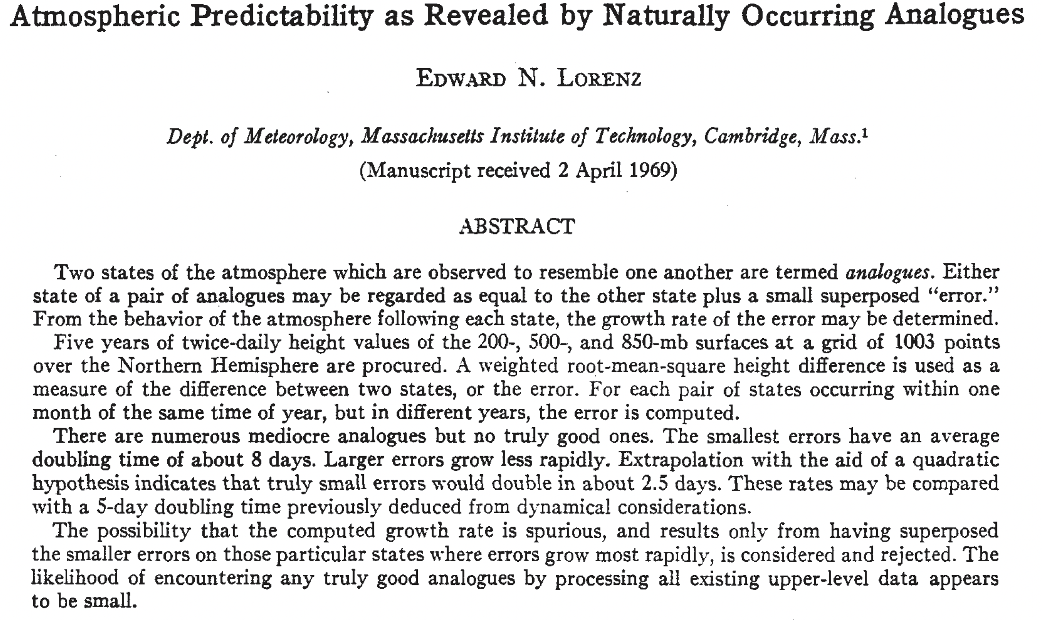

Slide 21
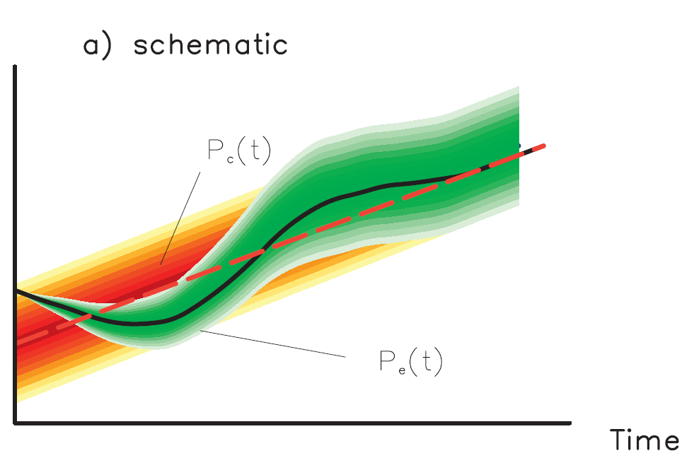
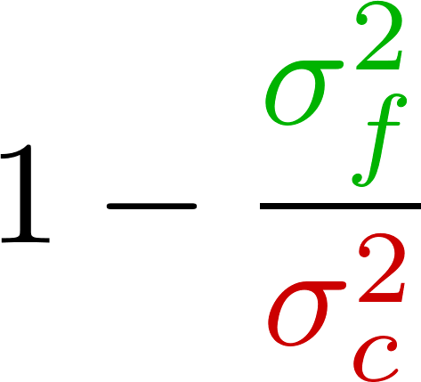
Measuring predictability: current practices
Initialized forecast
Climatological ensemble
A modern, and popular approach to quantify initial-value predictability is to:
  Integrate a coupled climate model and derive the (possibly time-dependent) climatological distribution
  Restart the model at some point and add small perturbations
  Assess when the ensemble variance has reached the climatological variance
“Prognostic Potential Predictability”: reaches zero when all initial-value information is lost
Branstator, Grant, and Haiyan Teng. “Two Limits of Initial-Value Decadal Predictability in a CGCM.” Journal of Climate 23, no. 23 (August 27, 2010): 6292–6311. https://doi.org/10.1175/2010JCLI3678.1.
Notes:
Note the limitations of this metric, as the mean state could be different
Where to restart? → mean state dependence
How to perturb? --> ensemble generation
Other metrics: ACC

Slide 22
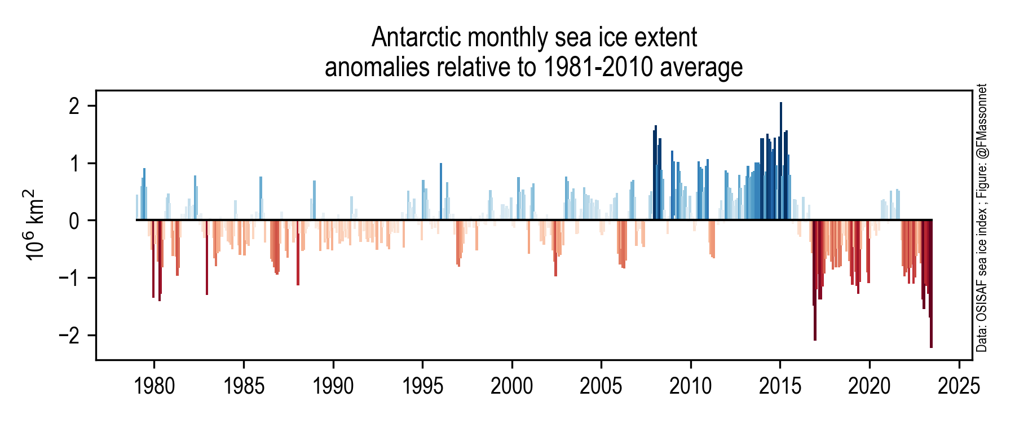
Measuring predictability: current practices
Predictability can also be diagnosed from the autocorrelation function of the anomalies.
Issues:
How to remove the forced component? The seasonal cycle? The trend (if any)?
How to make the difference between forcing and multi-decadal variability?
How about possible non-monotonic decay of the autocorrelation function?
autocorrelation
1
1/e
persistence
lag
Massonnet, F., et al. (2023). SIPN South: Six years of coordinated seasonal Antarctic sea ice predictions. Frontiers in Marine Science, 10. https://doi.org/10.3389/fmars.2023.1148899
Notes:
EO

Slide 23
Questions for today
What is predictability?
How is predictability assessed?
What are the sources of sea ice predictability?
Does predictability evolve in a changing climate?
What is the skill of current sea ice prediction systems?
What are the next steps?

Slide 24
Questions for today
What is predictability?
How is predictability assessed?
What are the sources of sea ice predictability?
Does predictability evolve in a changing climate?
What is the skill of current sea ice prediction systems?
What are the next steps?

Slide 25
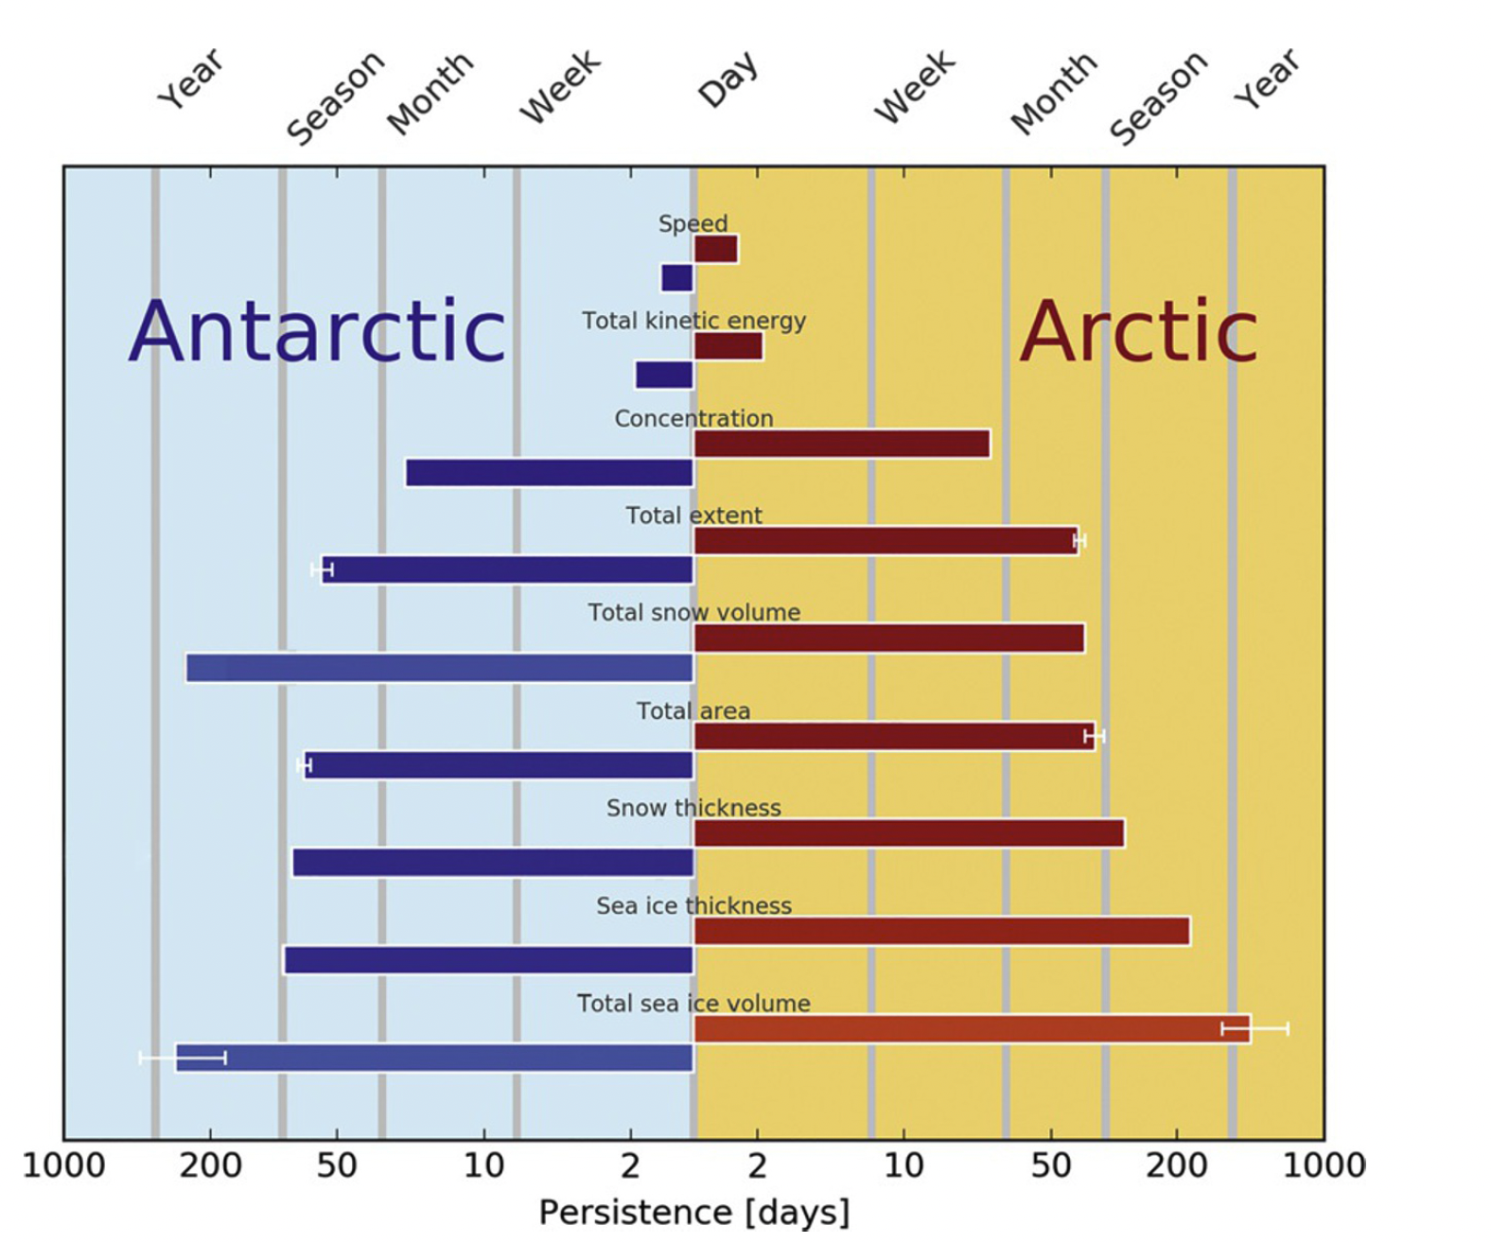
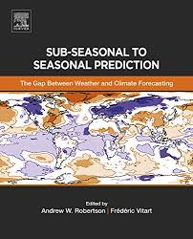
Plain
Persistence is the principal source of sea ice predictability at the sub-seasonal to annual timescale
Antarctic sea ice exhibits in general less predictability than Arctic sea ice
Predictability is larger for variables influenced by thermodynamic processes
Predictability is larger for spatially integrated quantities (i.e. the least user-relevant ones)
Chevallier, M., Massonnet, F., Goessling, H., Guémas, V., & Jung, T. (2019). The Role of Sea Ice in Sub-seasonal Predictability. In Sub-Seasonal to Seasonal Prediction (pp. 201–221). Elsevier. https://doi.org/10.1016/B978-0-12-811714-9.00010-3

Slide 26
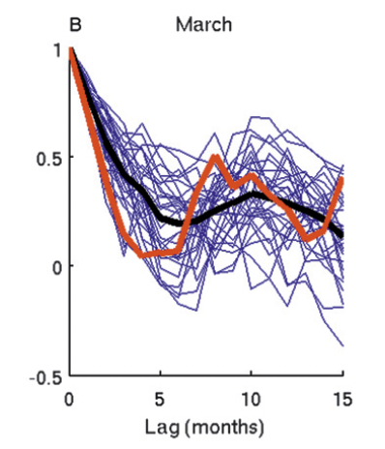
Beyond persistence: winter-to-summer reemergence
Lagged correlations (from March) of Arctic sea ice area
Observations
Any idea for the physical mechanism behind the « bump » here?
Ensemble runs + mean
Blanchard-Wrigglesworth, E., Armour, K. C., Bitz, C. M., & DeWeaver, E. (2011). Persistence and Inherent Predictability of Arctic Sea Ice in a GCM Ensemble and Observations. Journal of Climate, 24(1), 231–250. https://doi.org/10.1175/2010JCLI3775.1
Notes:
EO

Slide 27
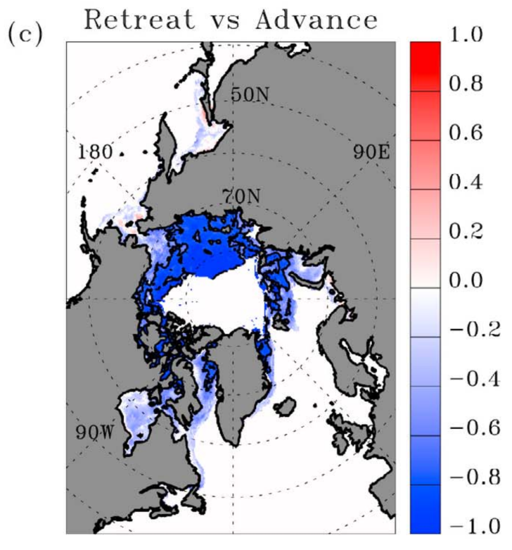
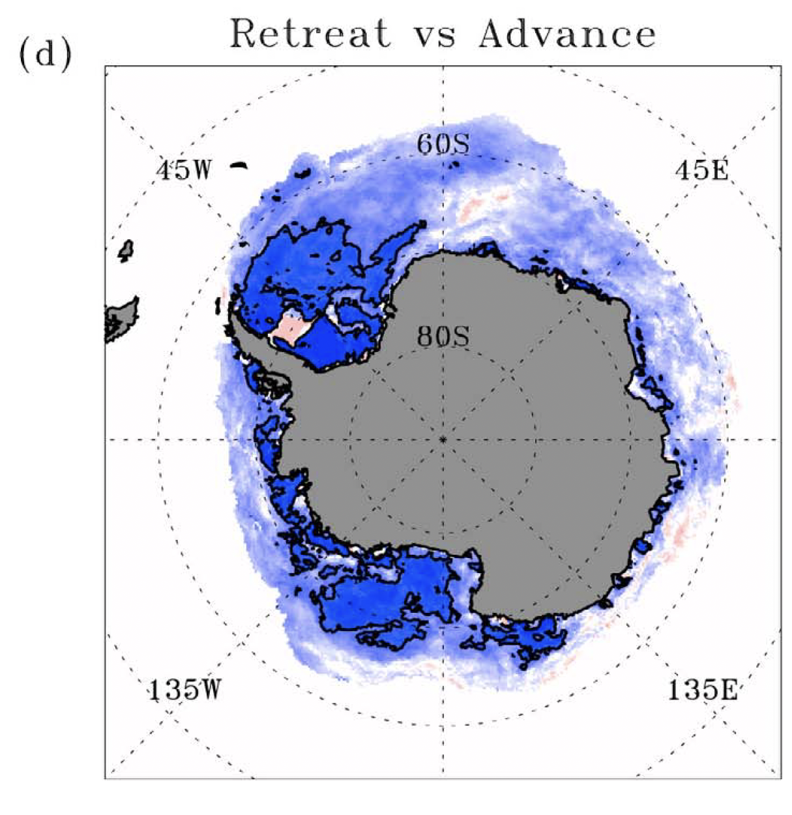
Correlation between the date of ice retreat and the date of ice advance (1979-2010)
A 1 day earlier retreat causes a 1.6 day later advance date (Lebrun et al., 2019)
Stammerjohn, S., Massom, R., Rind, D., & Martinson, D. (2012). Regions of rapid sea ice change: An inter-hemispheric seasonal comparison. Geophysical Research Letters, 39(6), https://doi.org/10.1029/2012GL050874
Lebrun, M., Vancoppenolle, M., Madec, G., & Massonnet, F. (2019). Arctic sea-ice-free season projected to extend into autumn. The Cryosphere, 13(1), 79–96. https://doi.org/10.5194/tc-13-79-2019
Notes:
Insist that memory is lost in the intermediate season! And that is beyond the trend

Slide 28
Beyond the season: multi-year predictability mechanisms in both hemispheres (but distinct mechanisms)!
Arctic
Negative sea ice area anomaly
Delayed freeze-up
Thinner ice cover (+ altered thickness distribution)
Negative sea ice area anomaly
Sep.
Oct.
Nov.
Dec.
Jan.
Feb.
Mar.
Apr.
May
Jun.
Jul.
Aug.
Sep.
Oct.
Nov.
Dec.
Jan.
Antarctic
Negative sea ice area anomaly
Zonal advection + storage of heat content anomalies below the mixed layer
Upper ocean heat uptake
Re-surfacing and negative sea ice anomalies
Holland, M. M., Blanchard-Wrigglesworth, E., Kay, J., & Vavrus, S. (2013). Initial-value predictability of Antarctic sea ice in the Community Climate System Model 3. Geophysical Research Letters, 40(10), 2121–2124. https://doi.org/10.1002/grl.50410; Marchi, S., Fichefet, T., Goosse, H., Zunz, V., Tietsche, S., Day, J. J., & Hawkins, E. (2019). Reemergence of Antarctic sea ice predictability and its link to deep ocean mixing in global climate models. Climate Dynamics, 52(5–6), 2775–2797. https://doi.org/10.1007/s00382-018-4292-2; Chevallier, M., & Salas-Mélia, D. (2012). The Role of Sea Ice Thickness Distribution in the Arctic Sea Ice Potential Predictability: A Diagnostic Approach with a Coupled GCM. Journal of Climate, 25(8), 3025–3038. https://doi.org/10.1175/JCLI-D-11-00209.1

Slide 29
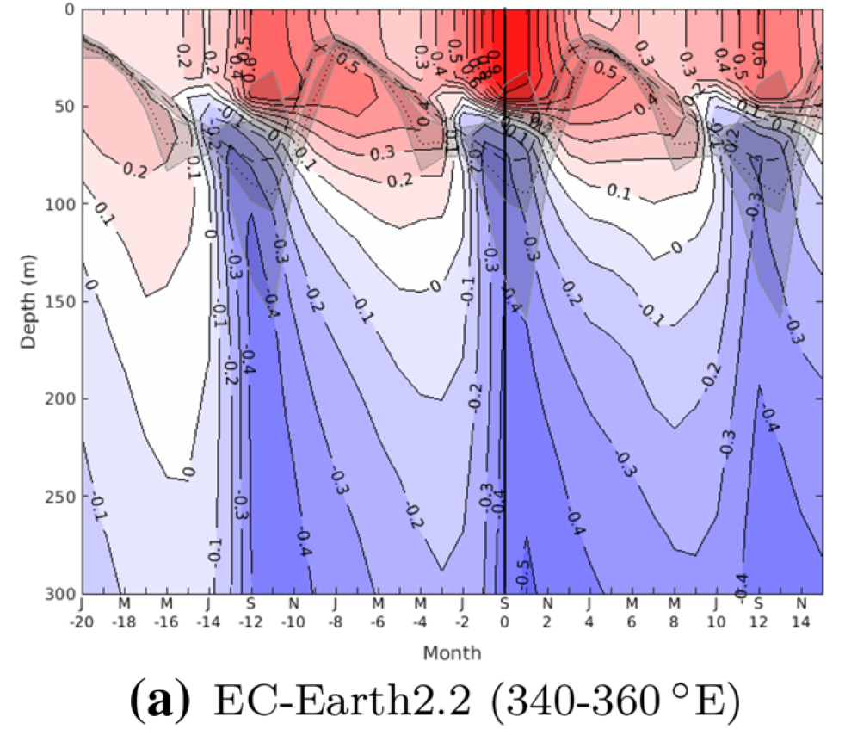
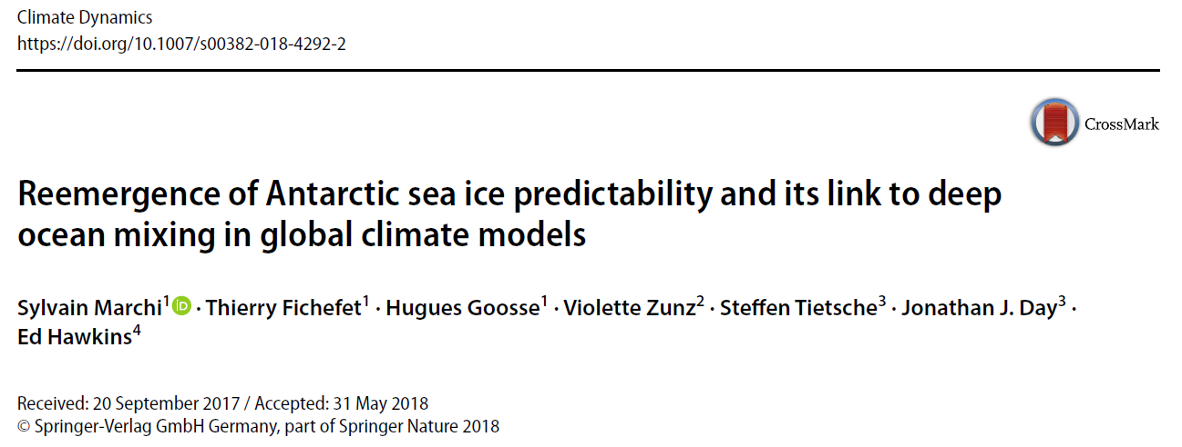
A mechanism of reemergence for Antarctic sea ice predictability
Correlation of September SST and potential temperature at different lags and depths
Marchi, S., Fichefet, T., Goosse, H., Zunz, V., Tietsche, S., Day, J. J., & Hawkins, E. (2019). Reemergence of Antarctic sea ice predictability and its link to deep ocean mixing in global climate models. Climate Dynamics, 52(5–6), 2775–2797. https://doi.org/10.1007/s00382-018-4292-2

Slide 30
Remarks
These mechanisms have been identified in climate models
They are (unfortunately for us) not the only ones operating in the coupled atmosphere-ocean-sea ice system → difficult to exploit them at 100% for prediction
Predictability is NOT synonym of potential skill, but should rather be seen as a theoretical upper bound of it.

Slide 31
Questions for today
What is predictability?
How is predictability assessed?
What are the sources of sea ice predictability?
Does predictability evolve in a changing climate?
What is the skill of current sea ice prediction systems?
What are the next steps?

Slide 32
Questions for today
What is predictability?
How is predictability assessed?
What are the sources of sea ice predictability?
Does predictability evolve in a changing climate?
What is the skill of current sea ice prediction systems?
What are the next steps?

Slide 33
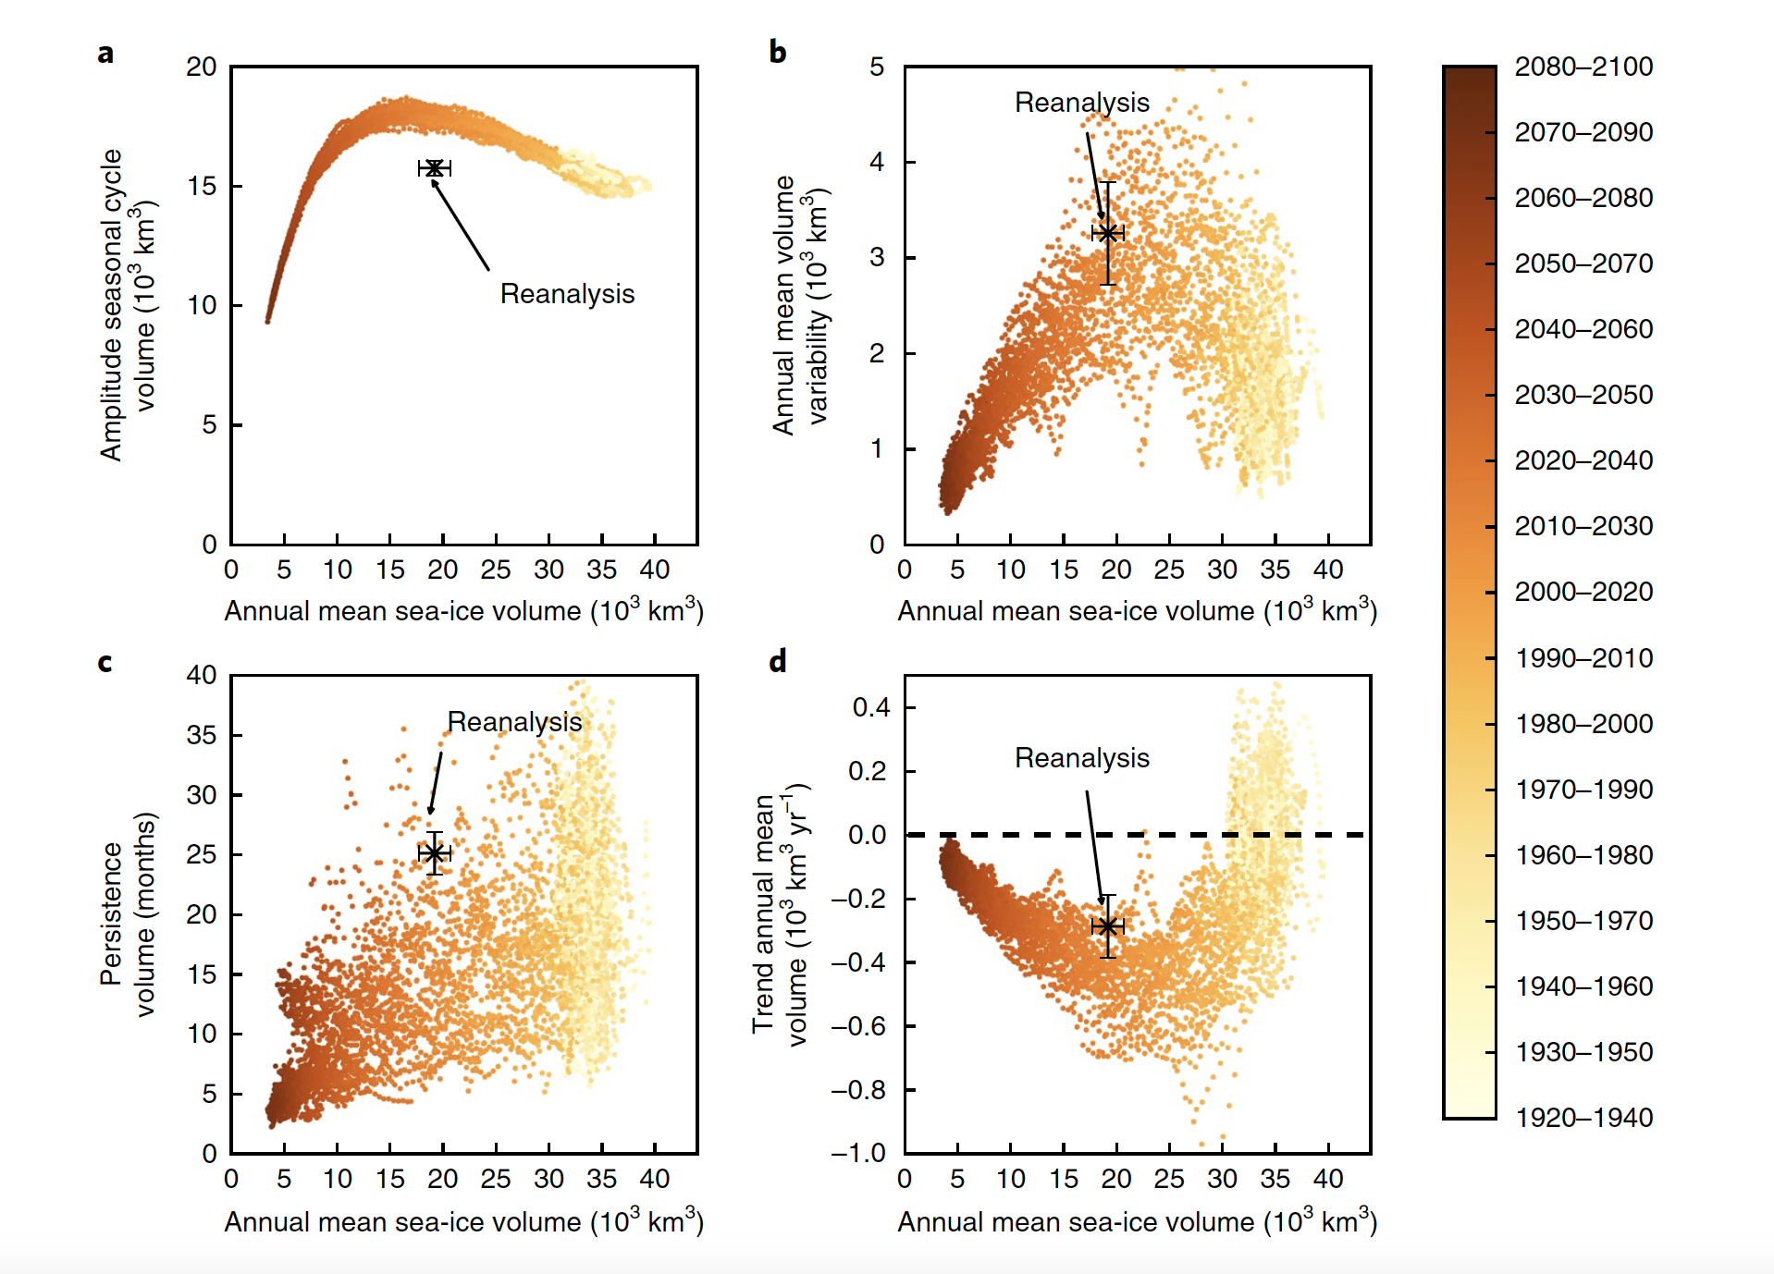
Does predictability evolve in a changing climate?
Almost surely, YES, because sea ice variability is mean-state dependent
Massonnet, F., Vancoppenolle, M., Goosse, H., Docquier, D., Fichefet, T., & Blanchard-Wrigglesworth, E. (2018). Arctic sea-ice change tied to its mean state through thermodynamic processes. Nature Climate Change, 8(7), 599–603. https://doi.org/10.1038/s41558-018-0204-z

Slide 34
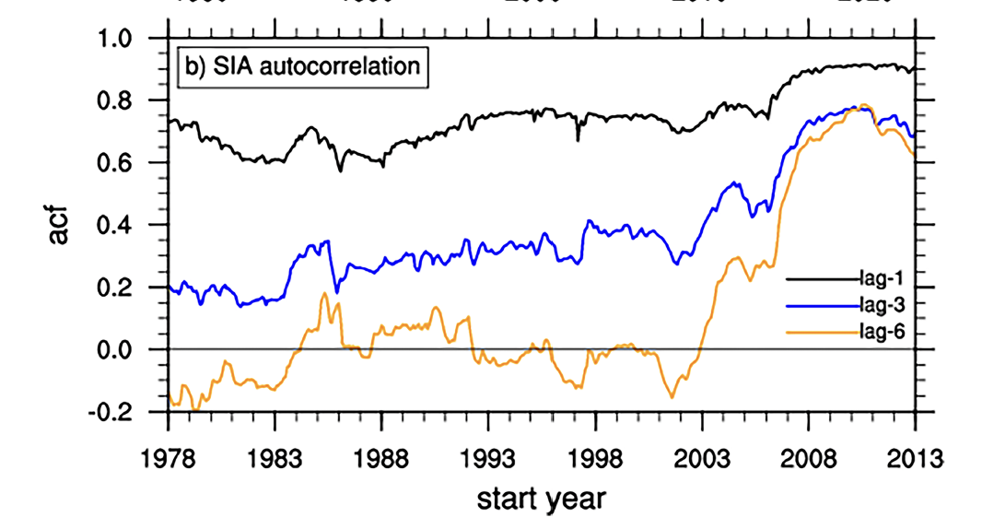
The persistence of Antarctic sea ice has dramatically increased since 10-15 years.
The recent changes in variability and persistence cannot be explained by atmospheric processes alone (Hobbs et al., 2024) → critical role of a warmer ocean for sea ice predictability from the 2020s?
Hobbs, W., Spence, P., Meyer, A., Schroeter, S., Fraser, A. D., Reid, P., Tian, T. R., Wang, Z., Liniger, G., Doddridge, E. W., & Boyd, P. W. (2024). Observational evidence for a regime shift in summer Antarctic sea ice. Journal of Climate, 1(aop). https://doi.org/10.1175/JCLI-D-23-0479.1

Slide 35
Questions for today
What is predictability?
How is predictability assessed?
What are the sources of sea ice predictability?
Does predictability evolve in a changing climate?
What is the skill of current sea ice prediction systems?
What are the next steps?

Slide 36
Questions for today
What is predictability?
How is predictability assessed?
What are the sources of sea ice predictability?
Does predictability evolve in a changing climate?
What is the skill of current sea ice prediction systems?
What are the next steps?

Slide 37
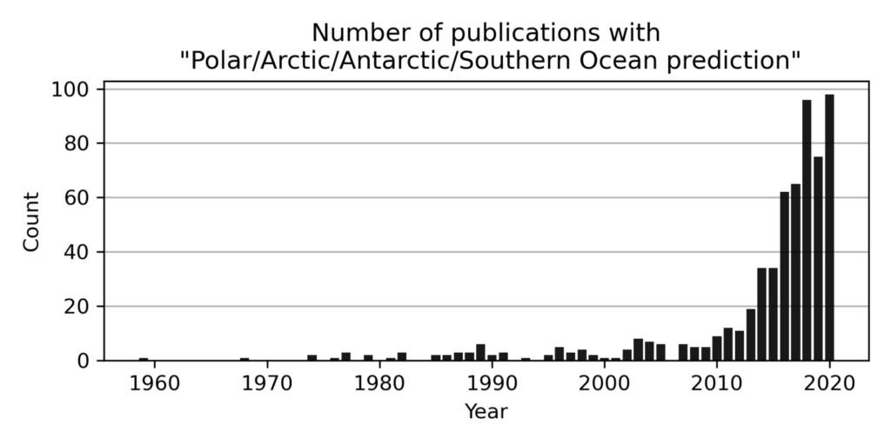
What is the skill of current sea ice prediction systems?
Polar prediction (specifically sea ice prediction) has seen massive progress in 15 years!
https://blogs.egu.eu/divisions/cl/2021/04/14/generation-polarprediction/
Notes:
Update?

Slide 38
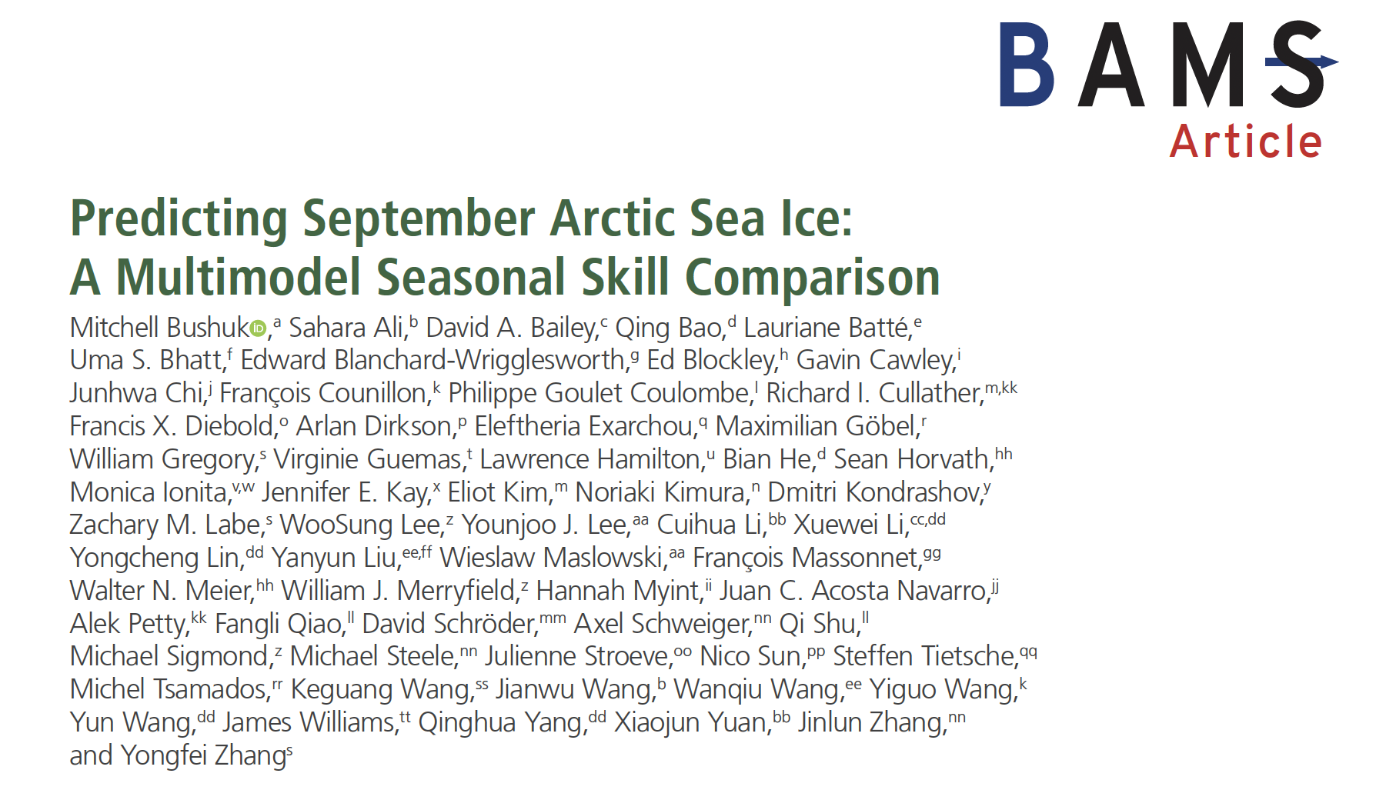
Arctic sea ice prediction: established
More than 30 groups are in the capacity of providing seasonal sea ice forecasts annually.
Predictive skill (≠ predictability!) found for September sea ice extent at 3-month lead time
Added value over trivial forecasts (persistence, climatology)
Dynamical models outperform statistical models regionally
Notes:
No group in 2005!

Slide 39
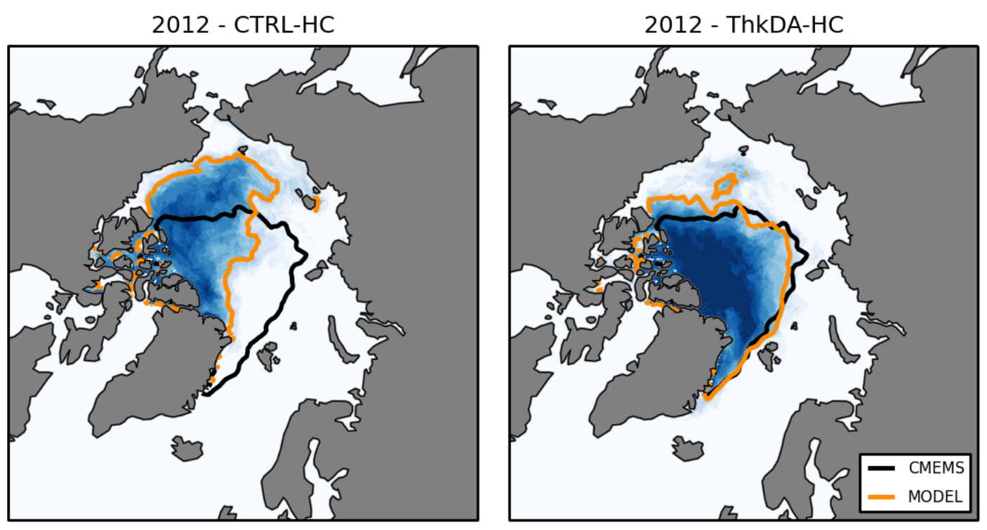
September 2012 sea ice concentration from the MetOffice GloSea forecast system, as forecasted from May 1st, 2012
Sea ice thickness initialized from observations (CryoSat-2)
Sea ice thickness not initialized
FORECAST
FORECAST
OBS
OBS
Blockley and Peterson., Cryosphere, 2018 (doi:10.5194/tc-12-3419-2018)

Slide 40

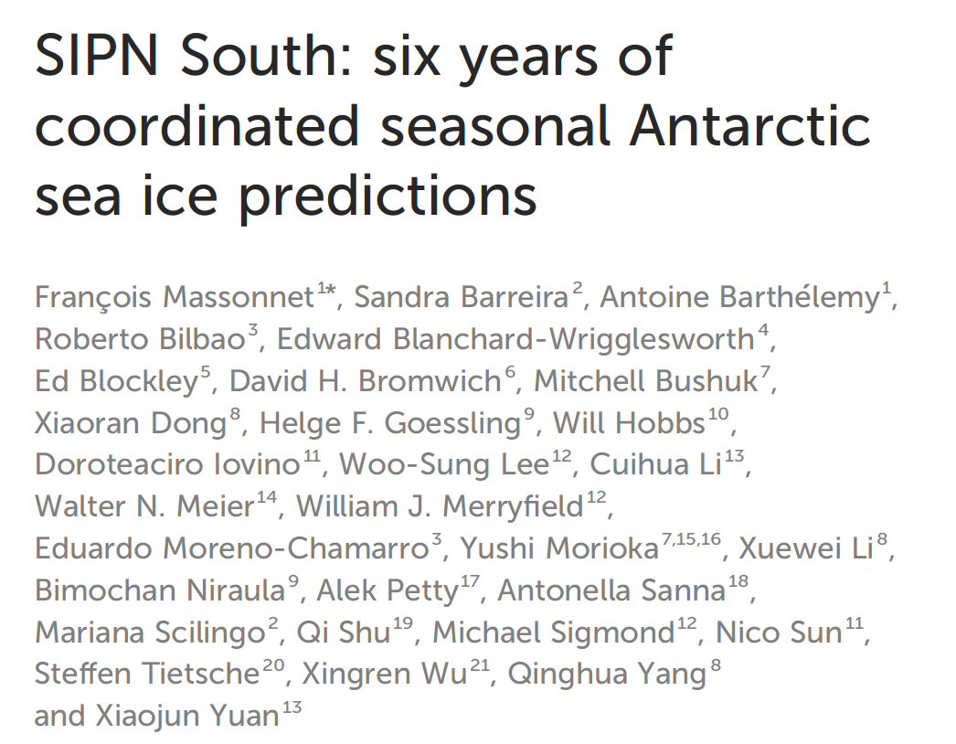
Antarctic sea ice prediction:
15 groups contribute forecasts annually
Forecasts more skillful than climatology
Group forecast better than the majority of the forecasts → room for improvement in individual predictions
Regional challenges (Ross Sea); statistical models better regionally.
https://fmassonn.github.io/sipn-south.github.io/

Slide 41
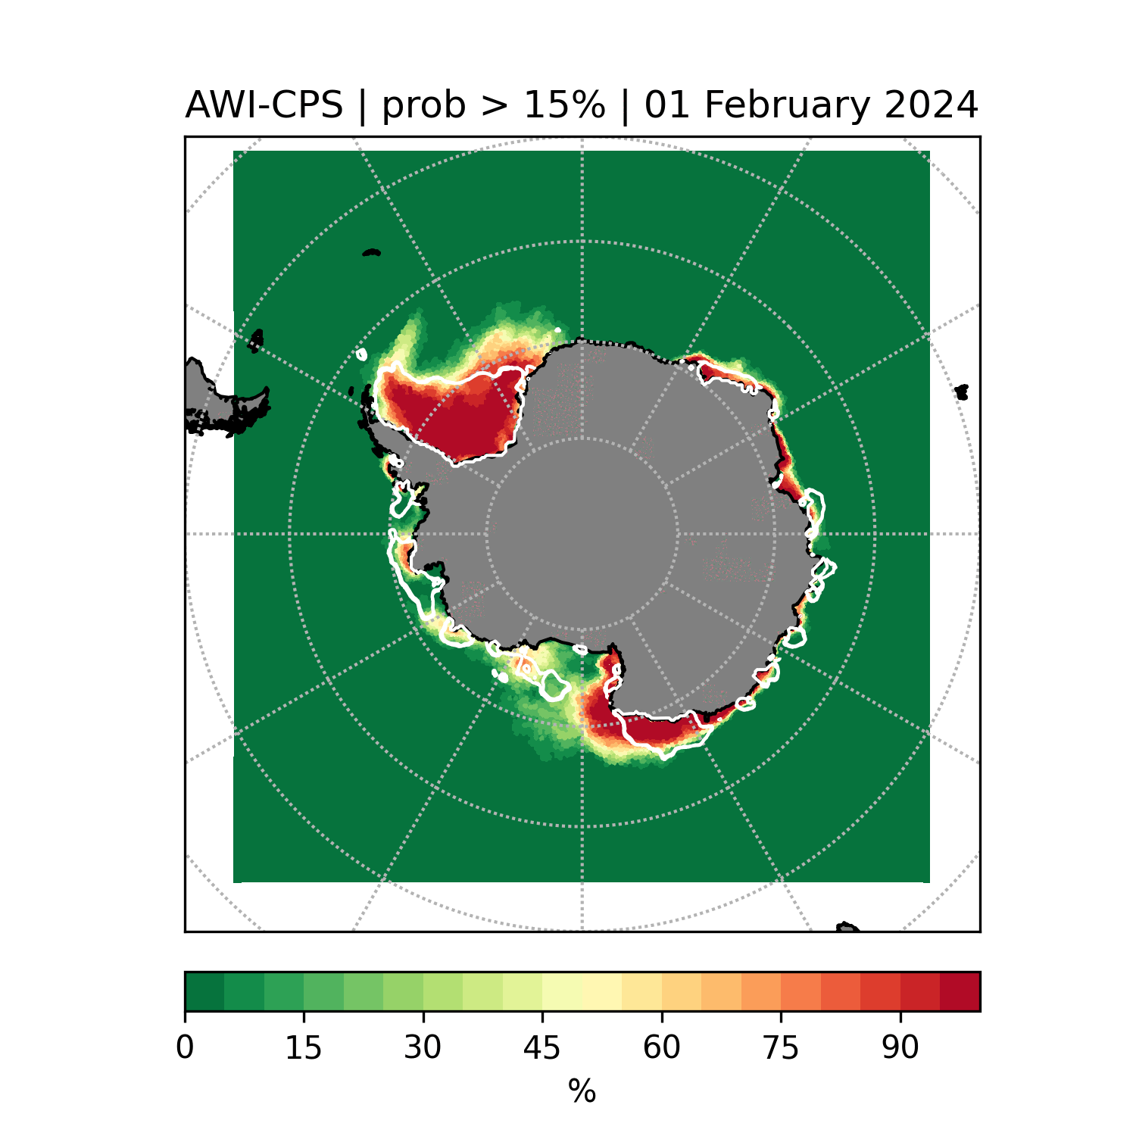

Slide 42
Questions for today
What is predictability?
How is predictability assessed?
What are the sources of sea ice predictability?
Does predictability evolve in a changing climate?
What is the skill of current sea ice prediction systems?
What are the next steps?

Slide 43
Questions for today
What is predictability?
How is predictability assessed?
What are the sources of sea ice predictability?
Does predictability evolve in a changing climate?
What is the skill of current sea ice prediction systems?
What are the next steps?

Slide 44
What’s next?
Move to user-relevant variables. Landfast ice breakup prediction, iceberg drift forecasts, date of melt onset, …
Support field campaigns (Antarctica InSync, IPY) & guide the observations. The new Arctic and new Antarctic will display predictive mechanisms that partly rely on observations not yet sampled. Climate models can help optimizing the future polar observing system.
Leverage bias-correction for the delivery of reliable forecasts
Explore the grey zone. Predictions in the ‘grey zone’ (1yr < x < 10yr): https://arcticwatch-erc.github.io/. See Alison’s, Annelies’s and Lauren’s posters
Massonnet, F. (2019). Climate Models as Guidance for the Design of Observing Systems: The Case of Polar Climate and Sea Ice Prediction. Current Climate Change Reports, 5, 334–344. https://doi.org/10.1007/s40641-019-00151-w
Notes:
→ Thomas

Slide 45
Dynamical process-based model predictions
Observations
Data assimilation
Initial condition
Statistical steps
Dynamical Model (incl. tuning)
Ensemble generation
Forcing
Forecast
verification
Post-processing
Prediction
Users

Slide 46
Statistical data-driven model predictions
Training dataset
Physical model/expertise
Predictors selection
Statistical Model (incl. tuning)
Forecast
verification
Prediction
Users
Notes:
SS

