Slide 1

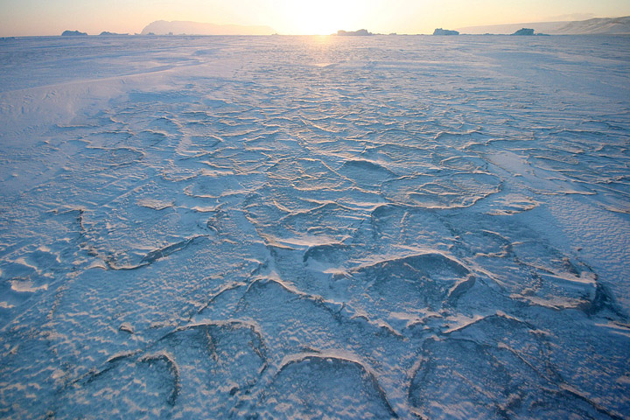
Sea ice prediction and projections
Part 2
Tom Bracegirdle
Caroline Holmes
Francois Massonnet
Photograph courtesy Andy Mahoney, NSIDC.
Notes:
Are there emergent constraints for sea ice, and do we have the observations to apply these constraints? → Tom
What are the broad implications of the changing sea ice conditions (on the atmospheric circulation, storm tracks, ocean)? → Tom

Slide 2
Overview
Are there emergent constraints for sea ice, and do we have the observations to apply these constraints?
What are the broad implications of the changing sea ice conditions (on the atmospheric circulation, storm tracks, ocean)?

Slide 3
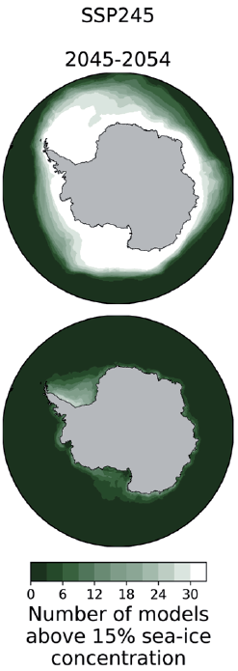
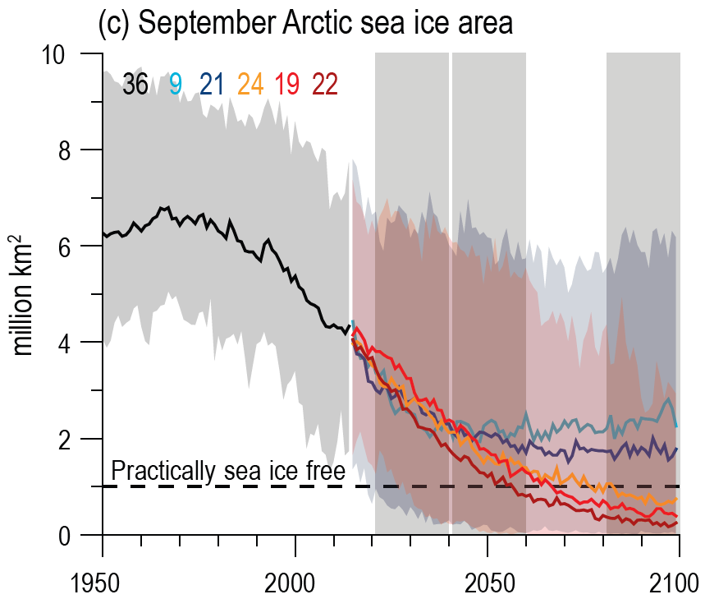
Sea ice projection in IPCC AR6
IPCC AR6 Figure 4.2
IPCC AR6 Figure 9.15
Notes:
Keen et al. (2021) – Arctic inter-model spread.

Slide 4
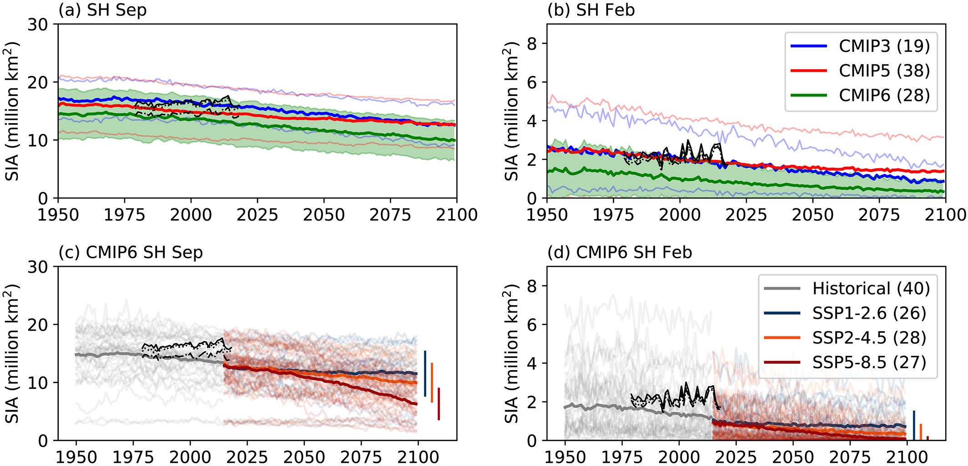
SH sea ice projections
Roach et al. (2020)

Slide 5
Introducing emergent constraints
How should one interpret a wide range of projections produced by different models such as the many CMIP6 models?
Simple average?
Improve the models?
Model sub-setting based
on skill metrics?
Model recalibration?
Exploit ‘emergent constraints’?
Pick the “best” model?

Slide 6
Introducing emergent constraints
How should one interpret a wide range of projections produced by different models such as the many CMIP6 models?
Simple average?
Improve the models?
Model sub-setting based
on skill metrics?
Model recalibration?
Exploit ‘emergent constraints’?
Pick the “best” model?
Forms of model weighting

Slide 7
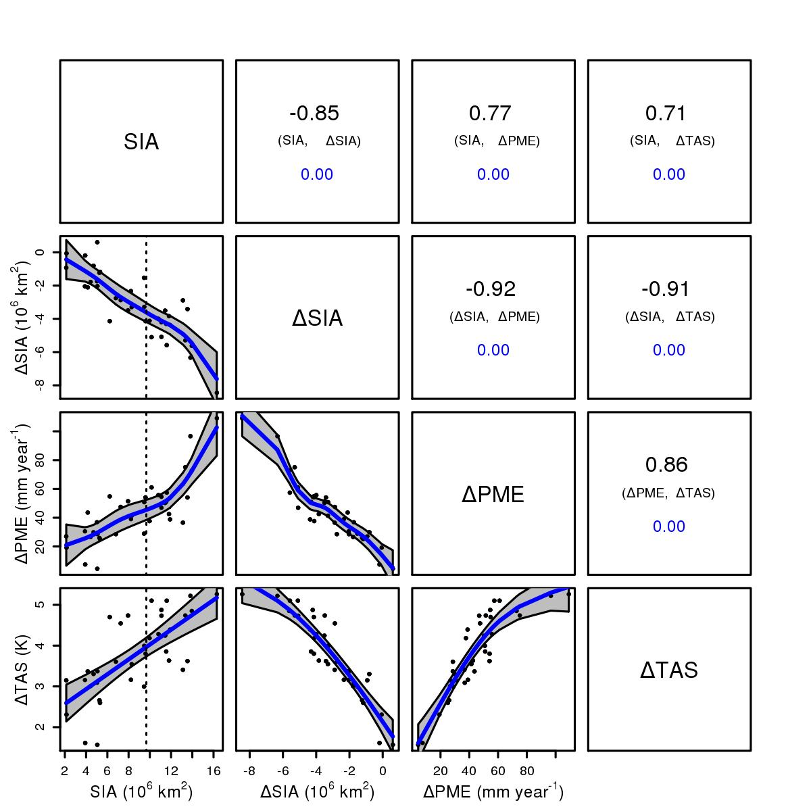
Introducing emergent constraints
A case study on Annual mean Antarctic sea ice area (SIA):
CMIP5 Models with large present-day Antarctic sea ice area (SIA) exhibit large future retreats (∆SIA)
21st century change
CMIP6 models
Historical
Bracegirdle et al., (2015) GRL
Notes:
Add cmip6 model

Slide 8
Introducing emergent constraints
CMIP5 Models with large present-day Southern Hemisphere sea ice area (SIA) exhibit large future retreats (∆SIA)
r = -0.85
“Emergent relationship”
Bracegirdle et al., (2015) GRL

Slide 9
Introducing emergent constraints
Observed SIA
CMIP5 Models with large present-day Southern Hemisphere sea ice area (SIA) exhibit large future retreats (∆SIA)
Physical understanding
“Emergent constraint”
Bracegirdle et al., (2015) GRL

Slide 10


Precision - spread around statistical prediction.
Accuracy - prediction compared to observed outcome. Depends on many factors such as emissions scenarios. Don’t know this until the future happens.
What can emergent constraints tell us?
High precision;
Low accuracy
High accuracy;
Low precision

Slide 11
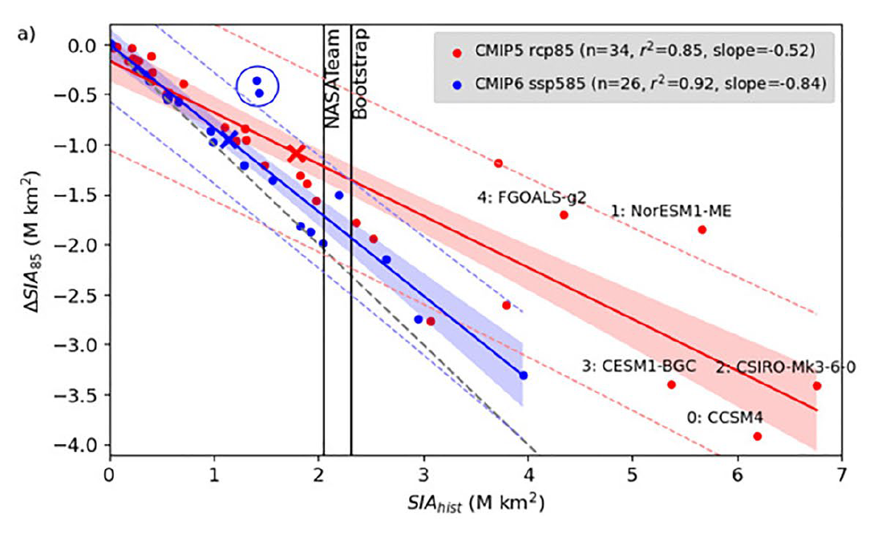
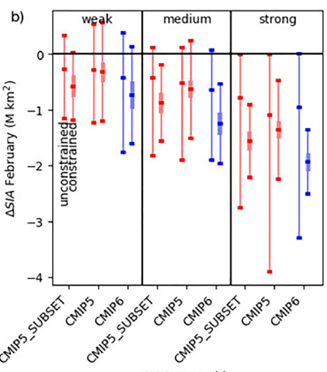
Emergent relationships in Antarctic sea ice
February Antarctic sea ice
Constrained
Equal weight
Holmes et al. (2022)

Slide 12
Emergent constraint?
Constrained
A "capacity for change" argument provides a physical basis for using this emergent relationship to observationally constrain model projections of ΔSIA.
The greater SIA loss in CMIP6 found in this paper is consistent with the higher ECS and warming in CMIP6.
Further research is required on potential emergent constraints in Antarctic sea ice and improve the required observations.
Develop improved statistical approaches for capturing emergent relationships – see poster by Caroline Holmes
Equal weight
Notes:
Add reference to Caroline’s poster

Slide 13
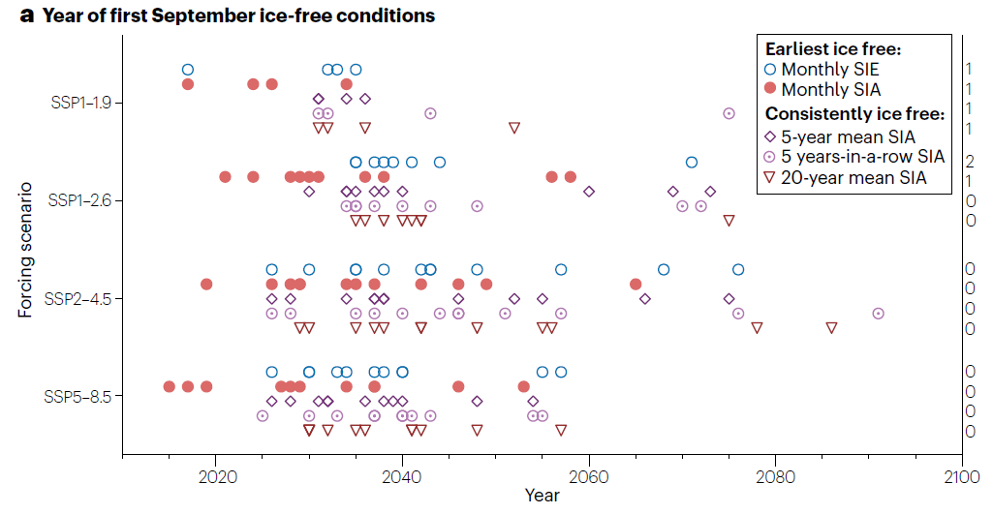
The Arctic
Predicting the timing of occurrence of ice-free summers is a key challenge
A number of different approaches have been suggested to improve estimates from models. Jahn et al. provide a list:
  Model selection
  model weighting
  emergent constraints
  and model recalibration or constrained estimation
Jahn et al. (2024)
Notes:
As for the Antarctic, climate models produce a wide range of projections.

Slide 14
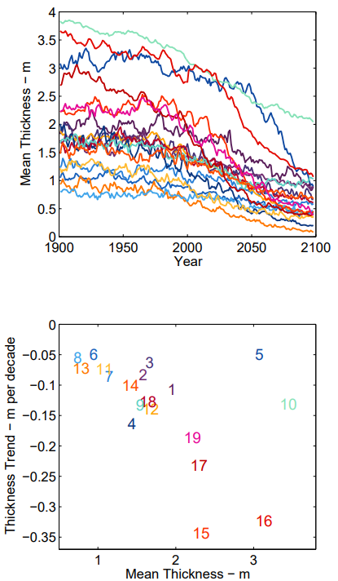
The Arctic
No clear correlation between baseline SIA and projected change in the Arctic.
  This may be because the “capacity for change" mechanism is less relevant with more sea ice remaining in the high Arctic in many models.
However, emergent relationships on thickness have been identified.
Due to uncertainties in observing sea ice thickness, it is currently not an effective constraint.
Bitz (2008)

Slide 15
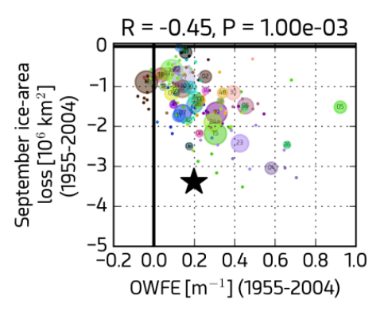
The Arctic – process based approaches
A number of process-based approaches have been proposed in the Arctic.
Thermodynamic processes
  Open-water-formation efficiency (OWFE¹)
  Ice-formation efficiency (IFE)
Sensitivity experiments were conducted with a simple model. This provided process-based understanding of the primary factor affecting mean state thickness in models and the real world.
¹OWFE - a diagnostic quantifying the area of open water formed in a control region for a unit reduction in sea-ice volume.
Massonnet et al. (2018)

Slide 16
Current status and where next?
Emergent constraints are a way to extract more precise projections from a specific generation/ensemble of climate models.
  In general they do not account for processes lacking in a given ensemble – for example freshwater input from the Antarctic ice sheet.
Emergent relationships are important for identifying reasons for inter-model spread.
Some emergent relationships not well understood. Correlation/causation question.
Observations key to producing more precise predictions using emergent constraints.
Develop improved statistical approaches for capturing emergent relationships – poster by Caroline Holmes.
Impacts: better understand implications of sea ice biases on the wider system.

Slide 17
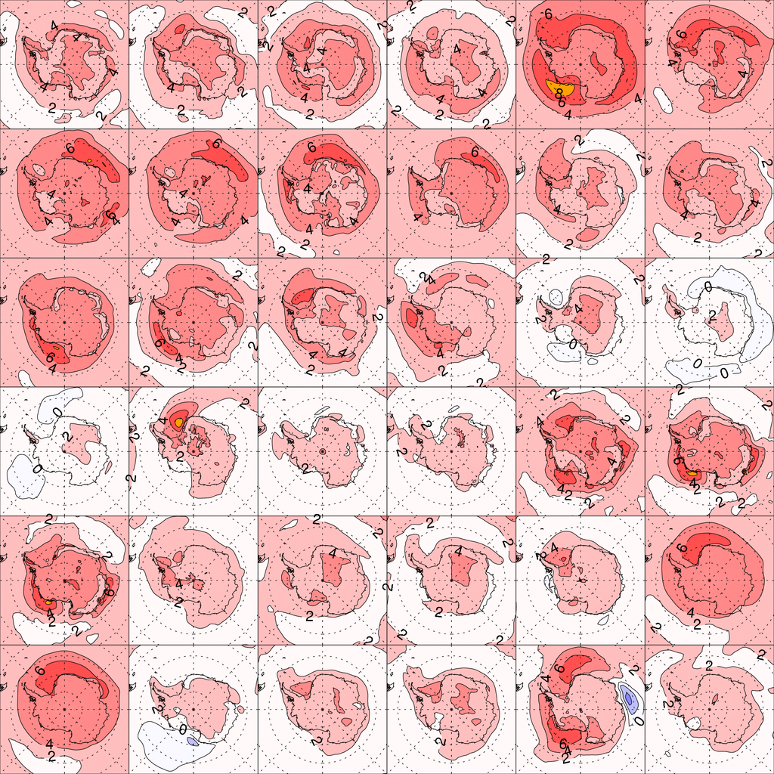
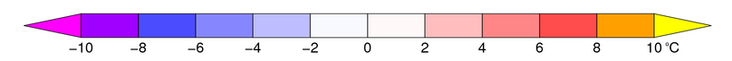
Implications of differing sea ice projections
Local proximal implications
Regional-hemispheric circulation implications
Annual mean 21st century temperature change (2069-2098 RCP8.5 minus 1970-1999 historical).
Notes:
Annual mean 21st century temperature change (2069-2098 RCP8.5 minus 1970-1999 historical).

Slide 18
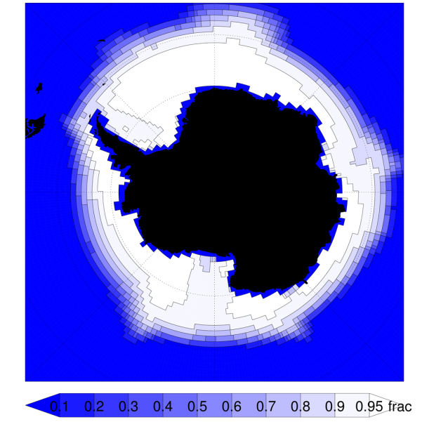
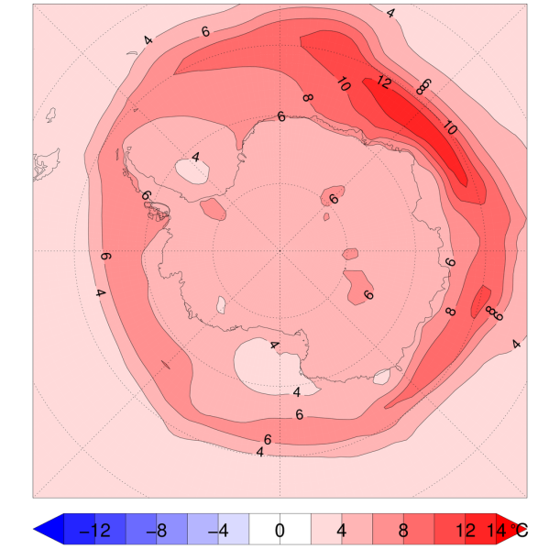
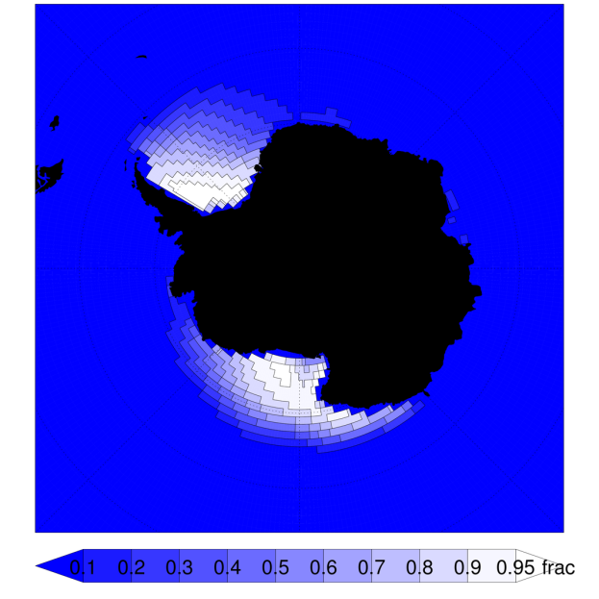
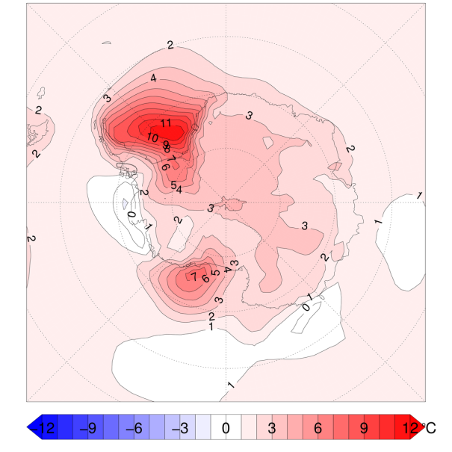
Proximal surface air
temperature
Simulated sea ice concentration
climatology (1970-1999)
Projected temperature change
(2070-2099 minus 1970-1999)
A CMIP5 model with
excessive sea ice
in winter (ccsm4)
A CMIP5 model with
too little sea ice
in winter (ipsl-cm5b-lr)
Notes:
Too much: ccsm4
Too little: ipsl-cm5b-lr

Slide 19
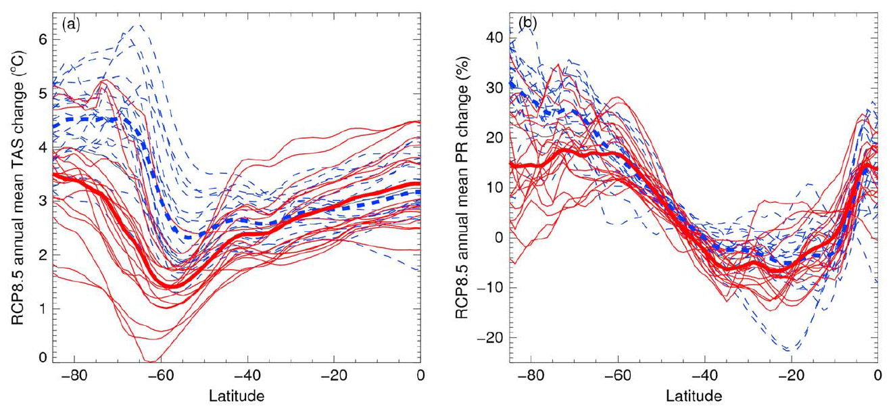
The importance of sea ice area biases in 21st century multimodel projections of Antarctic temperature and precipitation
Models with high historical SIA climatology
Models with low historical SIA climatology
Bracegirdle et al. (2015)
Notes:
Too much: ccsm4
Too little: ipsl-cm5b-lr

Slide 20
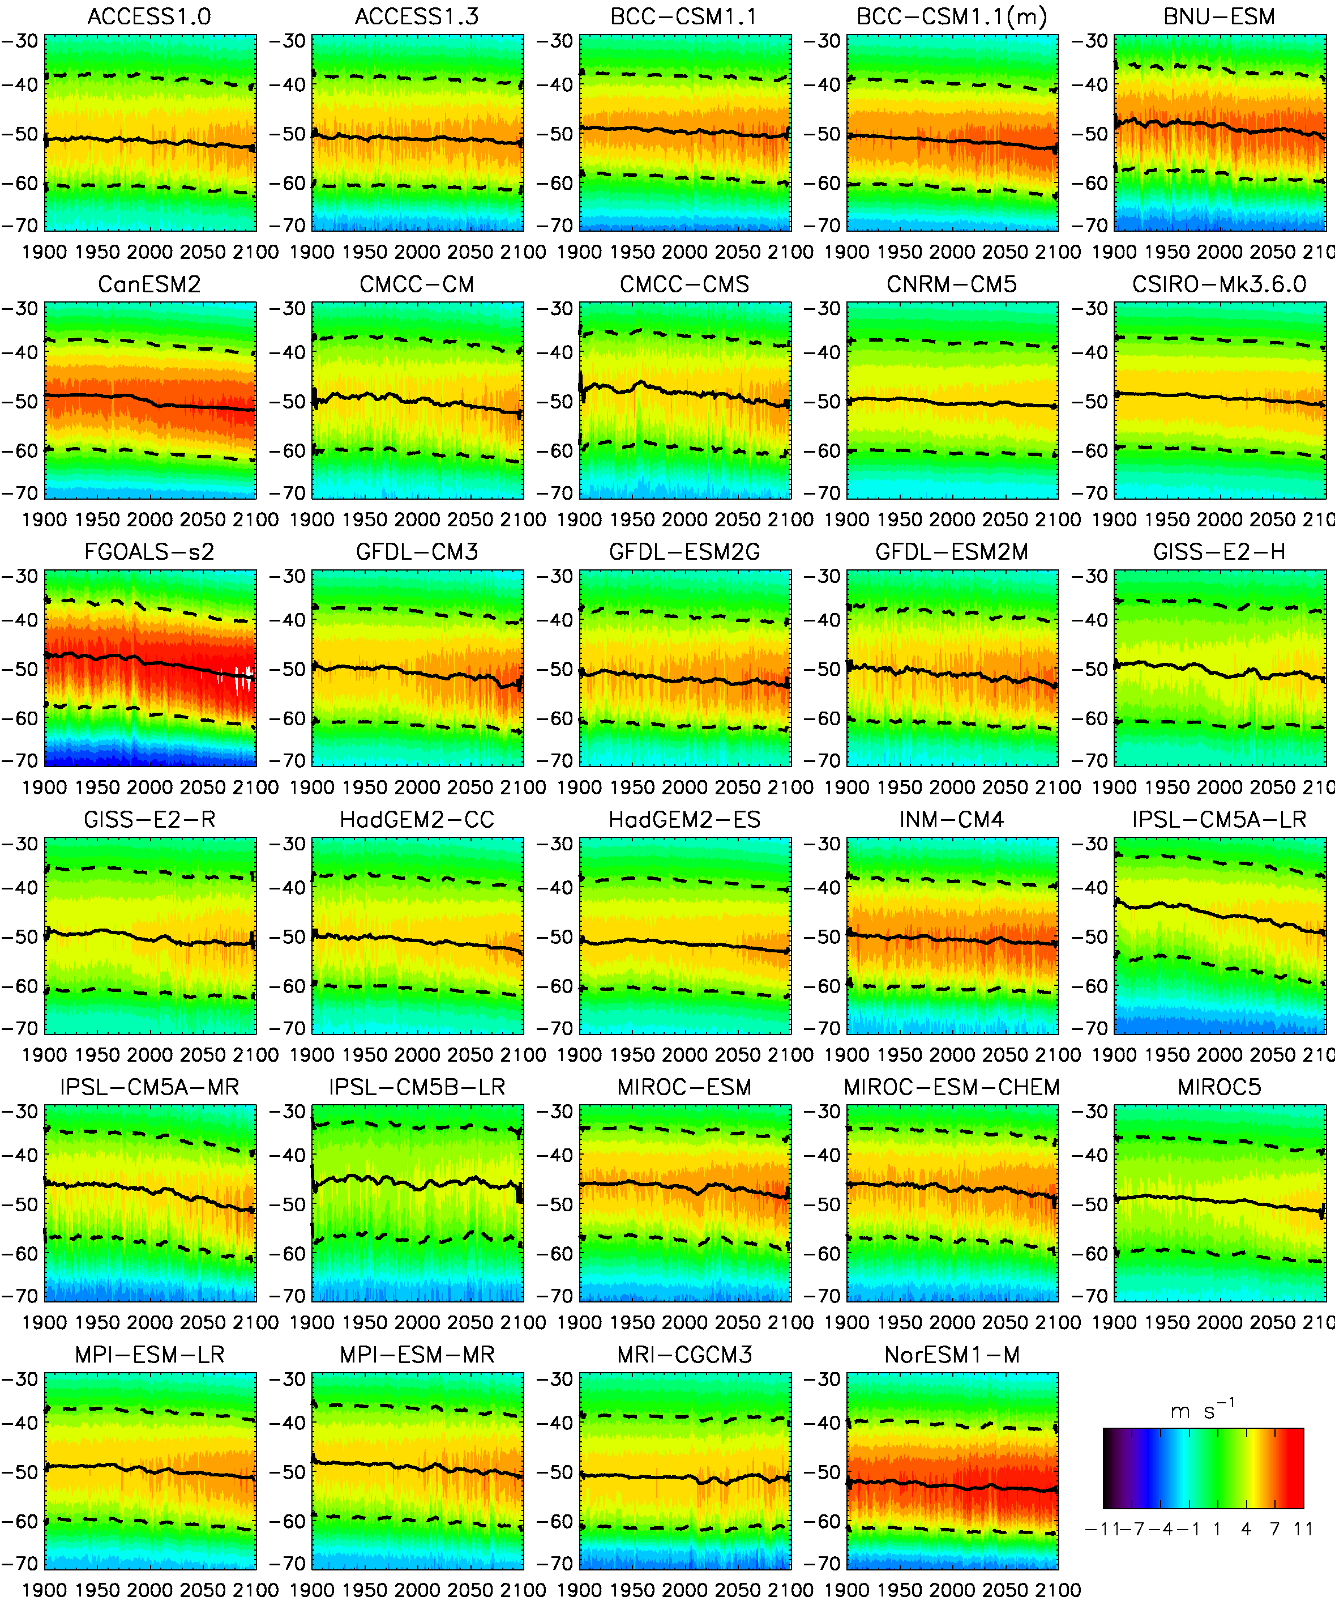
Implications of differing sea ice projections
Local proximal implications
Regional-hemispheric circulation implications

Slide 21
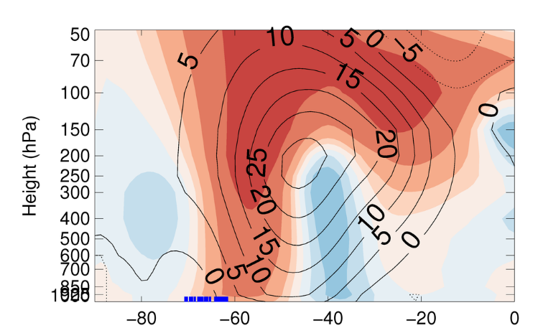
SH westerlies
CMIP5 ensemble mean zonal mean westerly wind climatologies (lines) and RCP8.5 21st century responses (filled contours).
Simulated historical sea ice edges

Slide 22
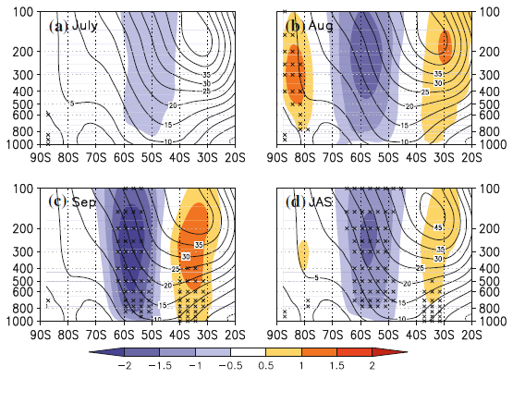
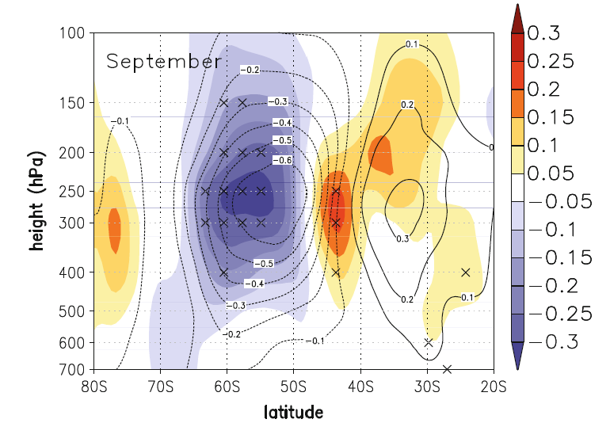
Impact of sea ice on the SH mid latitude jet
Momentum flux forcing from transient eddies
Westerly wind responses
Bader et al. (2013)

Slide 23
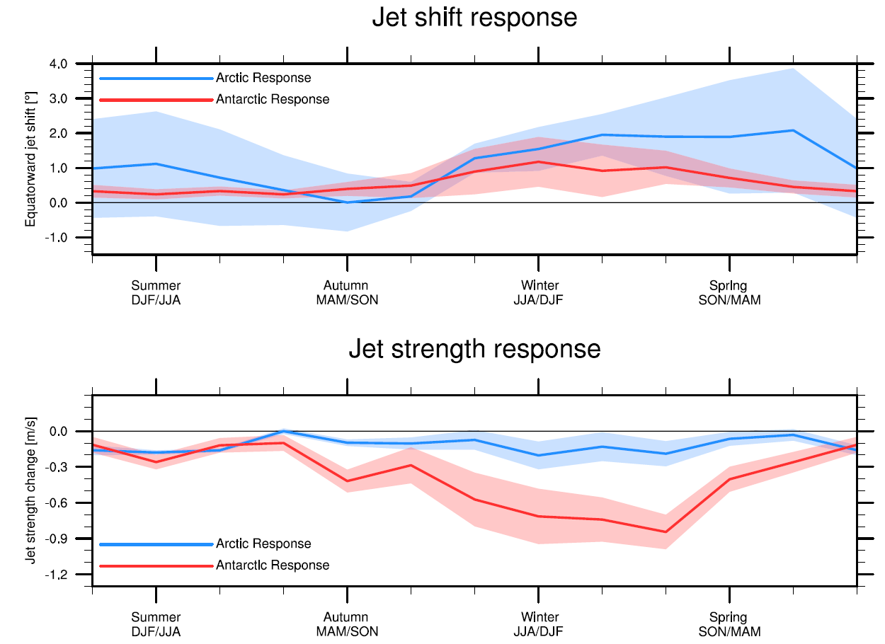
England et al. (2018)

Slide 24
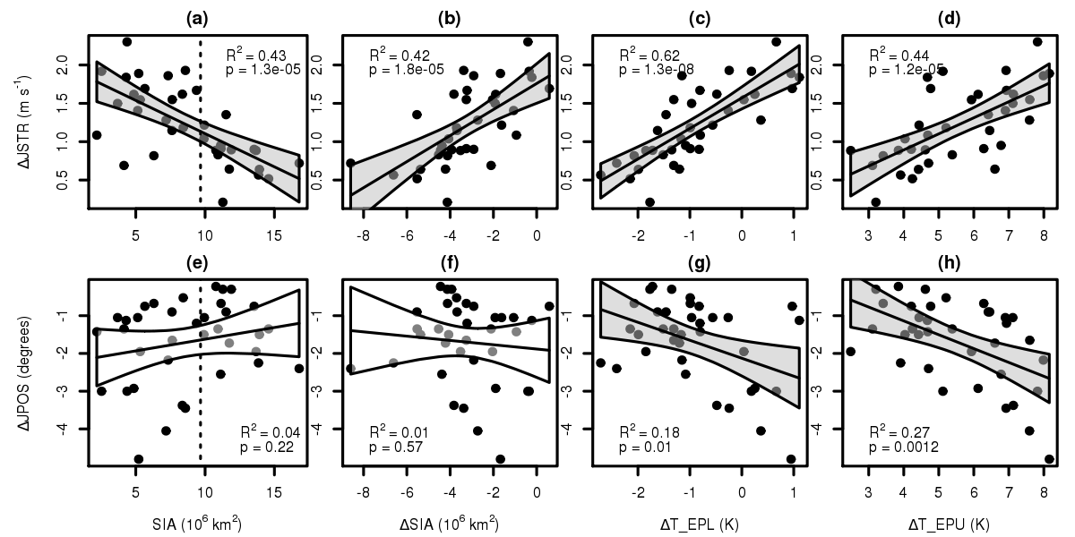
CMIP5 sea ice and westerly jet projections
CMIP5 Models with large present-day sea ice area (SIA) exhibit large future retreats (∆SIA)
CMIP5 Models with large present-day sea ice area (SIA) exhibit less future jet strengthening
nearly half of the variance explained!
Jet strength response (m/s)
Bracegirdle et al., (2015) GRL
Bracegirdle et al., (2018) J. Clim.

Slide 25
CMIP5 sea ice and westerly jet projections
CMIP5 Models with large present-day sea ice area (SIA) exhibit large future retreats (∆SIA)
CMIP5 Models with large present-day sea ice area (SIA) exhibit less future poleward shifting
Jet latitude response (m/s)
Bracegirdle et al., (2015) GRL
Bracegirdle et al., (2018) J. Clim.

Slide 26
Summary – take home messages
Emergent constraints provide a tool for interpreting the diverse range in projections in multi-model ensembles such as CMIP6.
Some emergent relationships are well understood and may be used as emergent constraints, but others require improvements in understanding and/or observations.
Biases in model-simulated baseline sea ice statistically provide for emergent constraints on the wider system. For example half of the range in future CMIP6-simulated future jet strengthening can be statistically related to baseline biases in sea ice.

Slide 27
Sea ice prediction and projections
Part 2
Tom Bracegirdle
Photograph courtesy Andy Mahoney, NSIDC.
Notes:
Are there emergent constraints for sea ice, and do we have the observations to apply these constraints? → Tom
What are the broad implications of the changing sea ice conditions (on the atmospheric circulation, storm tracks, ocean)? → Tom

Slide 29
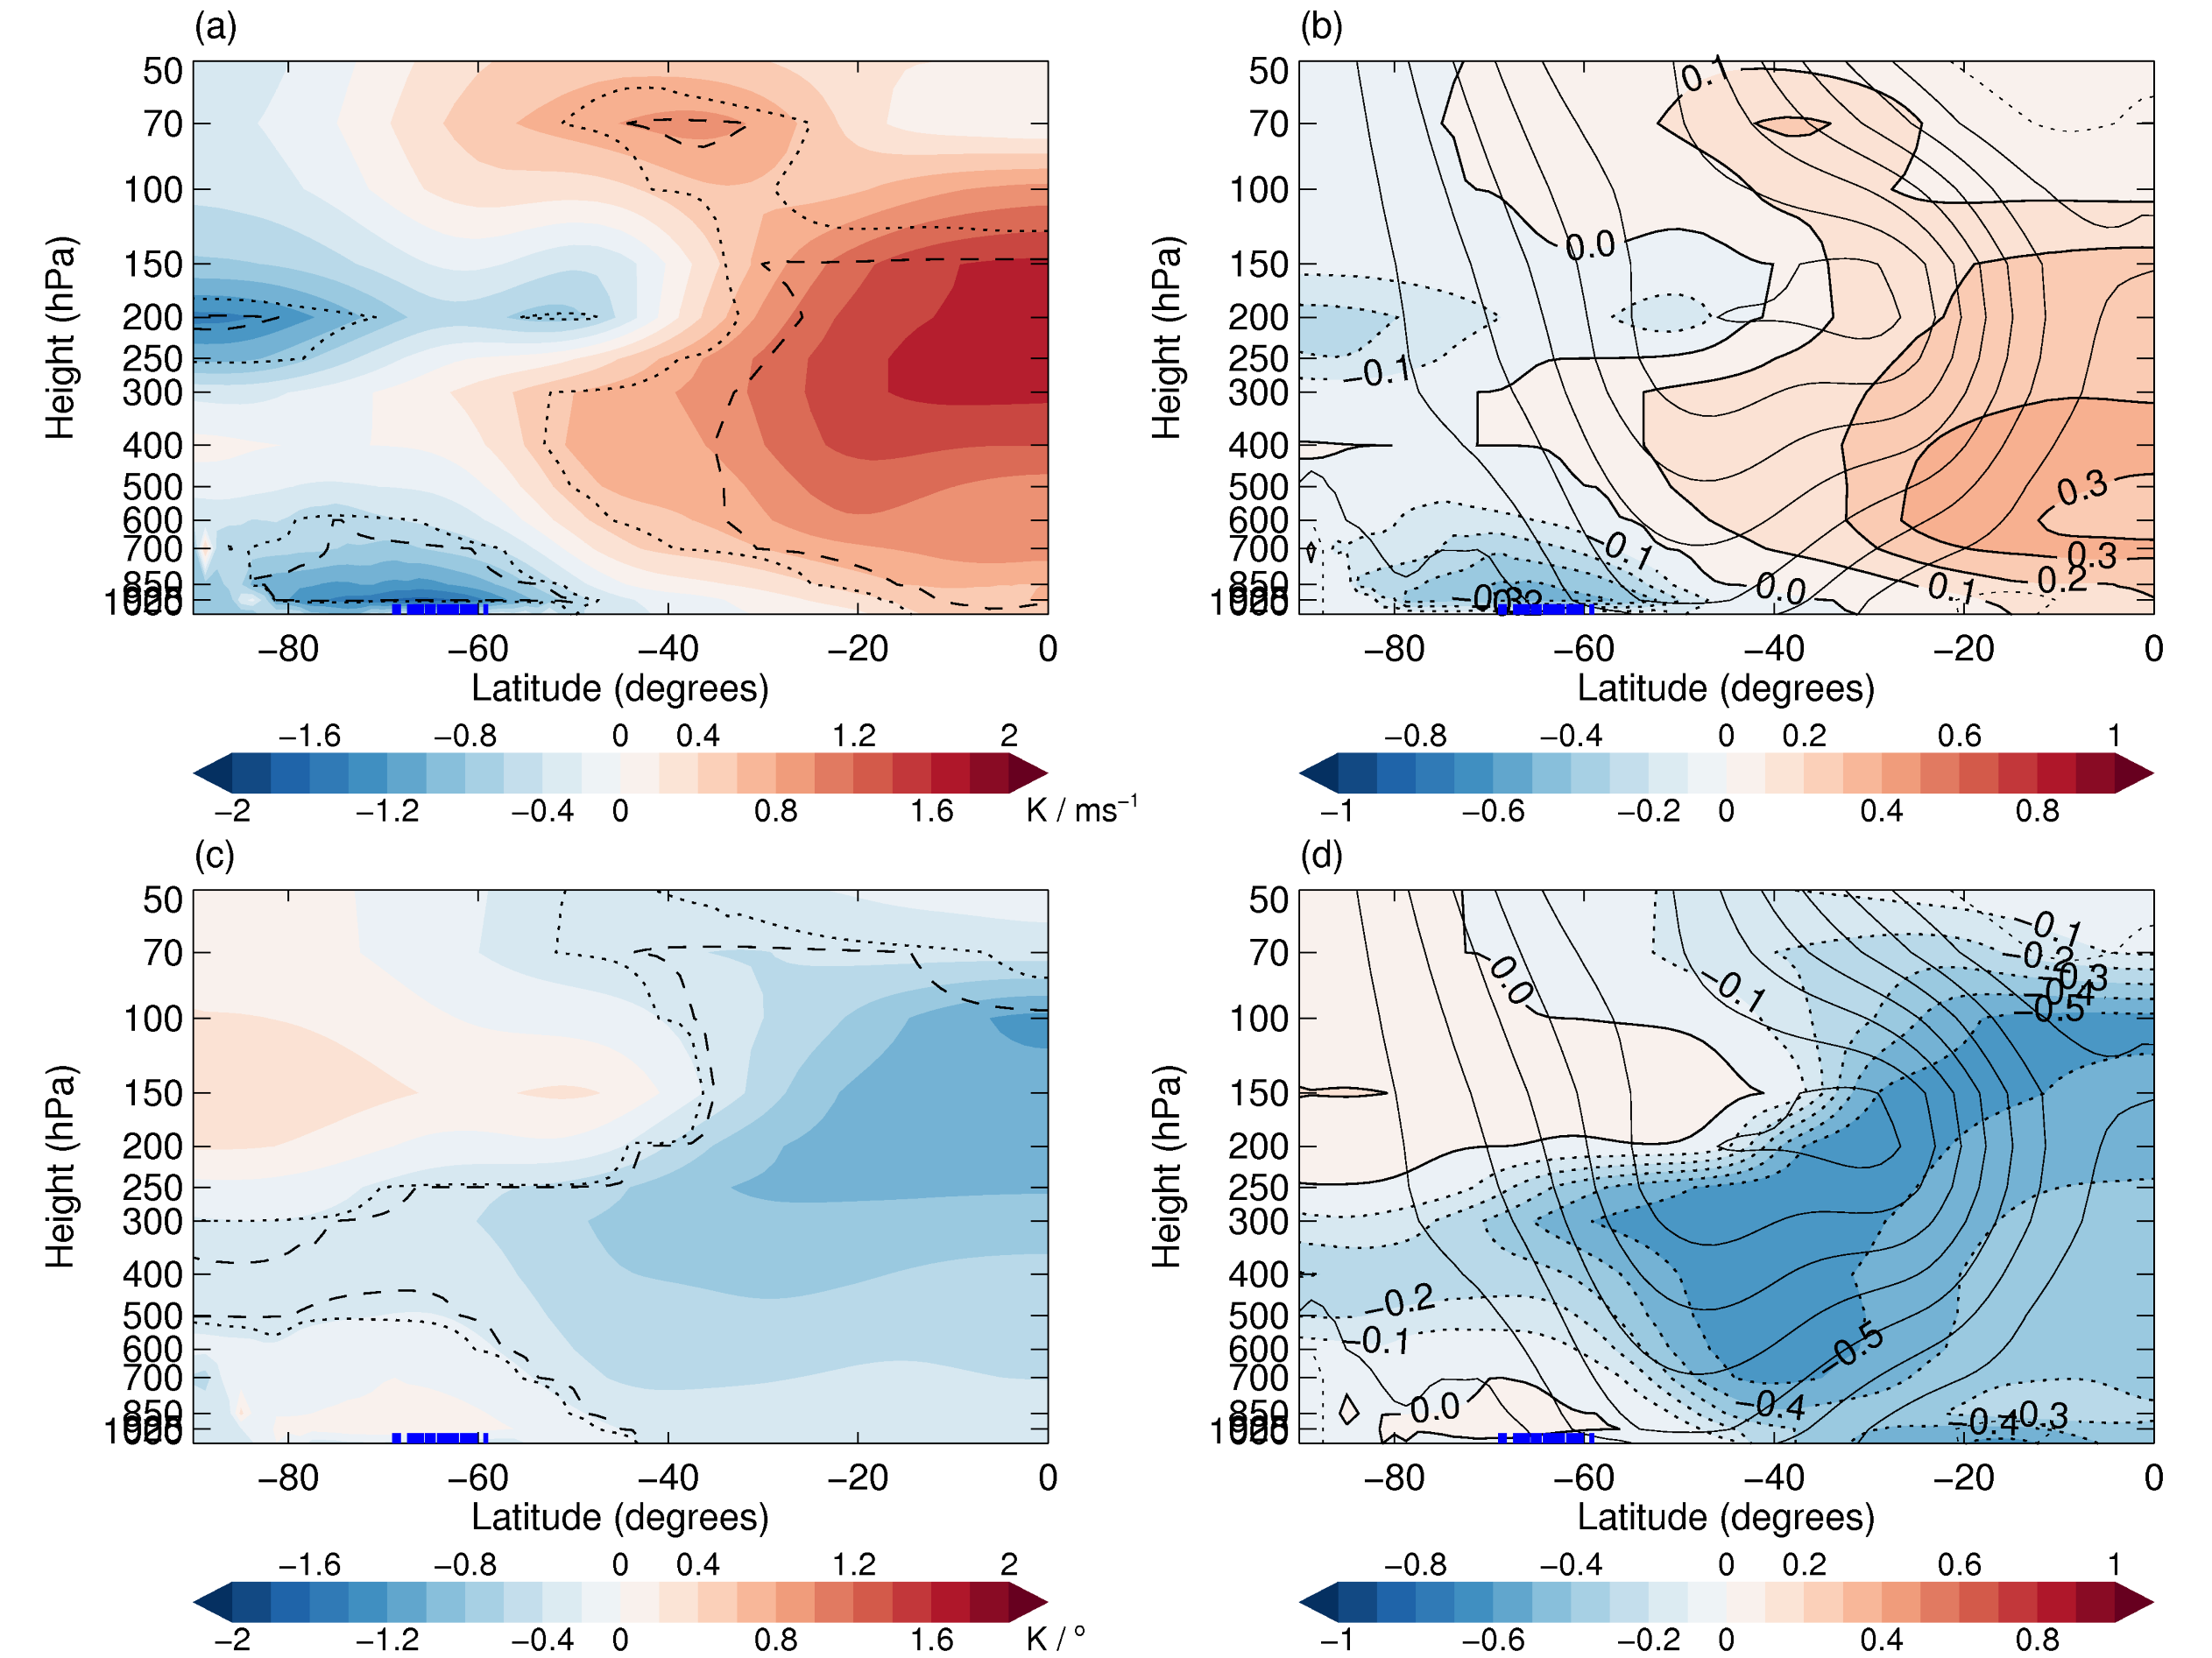
Contrasting drivers of diversity in strengthening and shifting
Cross-model correlations between zonal mean temperature response (∆T) and jet diagnostics.
  Note that |r|* r is shown (i.e. sign and variance explained)
Corr(∆T, strength change)
Corr(∆T, shift)
unfilled contours
-> present day zonal mean westerlies
Models with more polar warming (and sea ice retreat) exhibit less strengthening
Notes:
Consistency with McGraw and Barnes (2016).
Trop heat more closely linked to jet strength in winter (r² = 0.37) compared to summer (r² = 0.21).
Polar amp more closely related to jet strength than jet position (r² = 0.55 vs 0.37 (JJA); 0.58 vs 0.21 (DJF). Bring in Riviere result here.
Internal dynamics appear important for position (timescales etc), but not for strength (less evidence of state dependency and link between short-term fluctuations and longer-term response (F-D).
FIG. 8. Zonal mean annual mean temperature change (ΔT) regressed onto annual mean jet strength change (ΔJSTR) (a, b) and jet position change (ΔJPOS) (c, d). Linear regression slopes are shown in the left column and explained variance (R2) is shown in the right column.

Slide 30
Contrasting drivers of diversity in strengthening and shifting
Cross-model correlations between zonal mean temperature response (∆T) and jet diagnostics.
  Note that |r|* r is shown (i.e. sign and variance explained)
Corr(∆T, strength change)
Corr(∆T, shift)
unfilled contours
-> present day zonal mean westerlies
Models with more mid-latitude warming exhibit more poleward shift (poleward is negative here)
Notes:
Consistency with McGraw and Barnes (2016).
Trop heat more closely linked to jet strength in winter (r² = 0.37) compared to summer (r² = 0.21).
Polar amp more closely related to jet strength than jet position (r² = 0.55 vs 0.37 (JJA); 0.58 vs 0.21 (DJF). Bring in Riviere result here.
Internal dynamics appear important for position (timescales etc), but not for strength (less evidence of state dependency and link between short-term fluctuations and longer-term response (F-D).
FIG. 8. Zonal mean annual mean temperature change (ΔT) regressed onto annual mean jet strength change (ΔJSTR) (a, b) and jet position change (ΔJPOS) (c, d). Linear regression slopes are shown in the left column and explained variance (R2) is shown in the right column.

