Slide 1
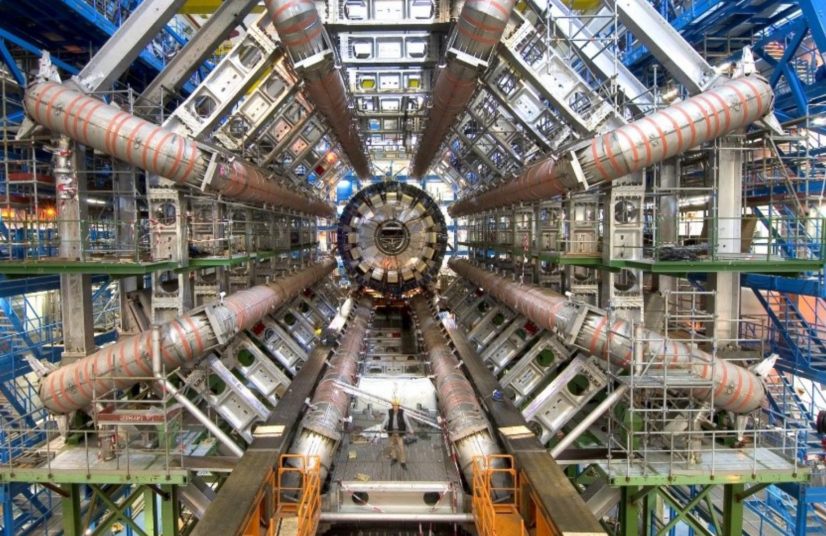
Data Analysis at the ATLAS experiment at the Large Hadron Collider
Kate Shaw
ICTP & University of Sussex
PWF Bhutan
25-29 th March 2024

Slide 3
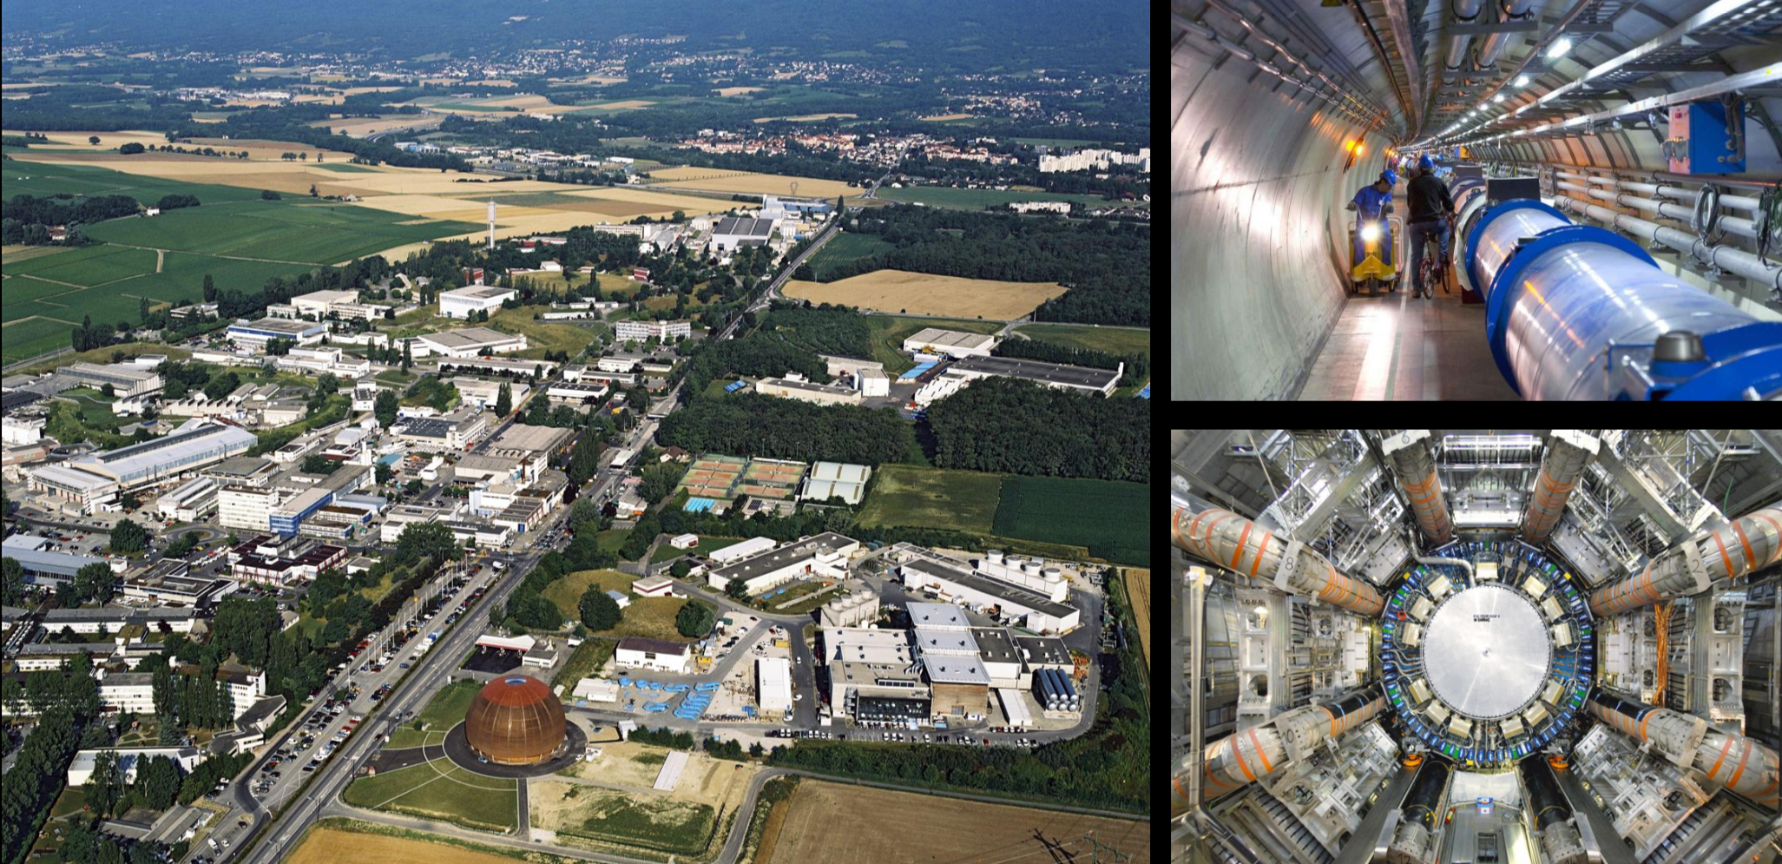
The Large Hadron Collider at CERN

Slide 4
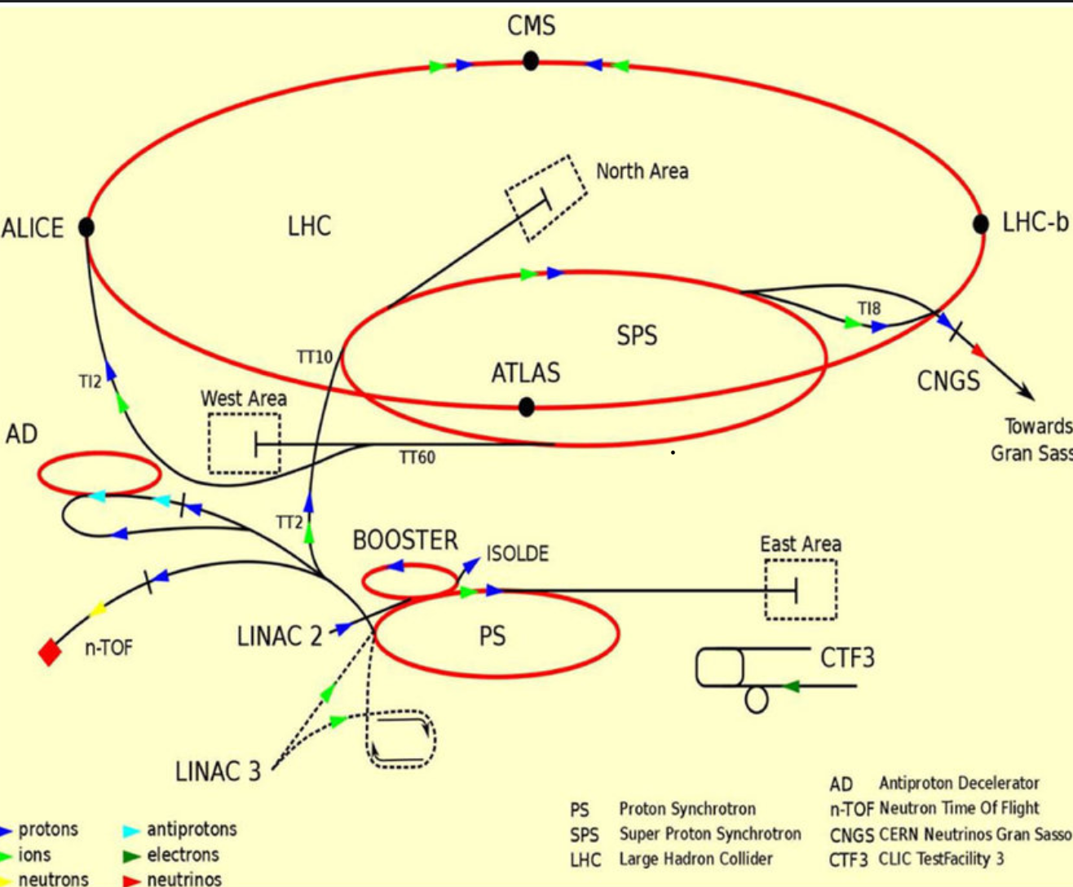
The Large Hadron Collider at CERN
LHC accelerate protons to almost the speed of light before smashing them millions of times a second inside 4 big detectors!
Our detector is called ATLAS!

Slide 5
The Large Hadron Collider at CERN

Slide 6
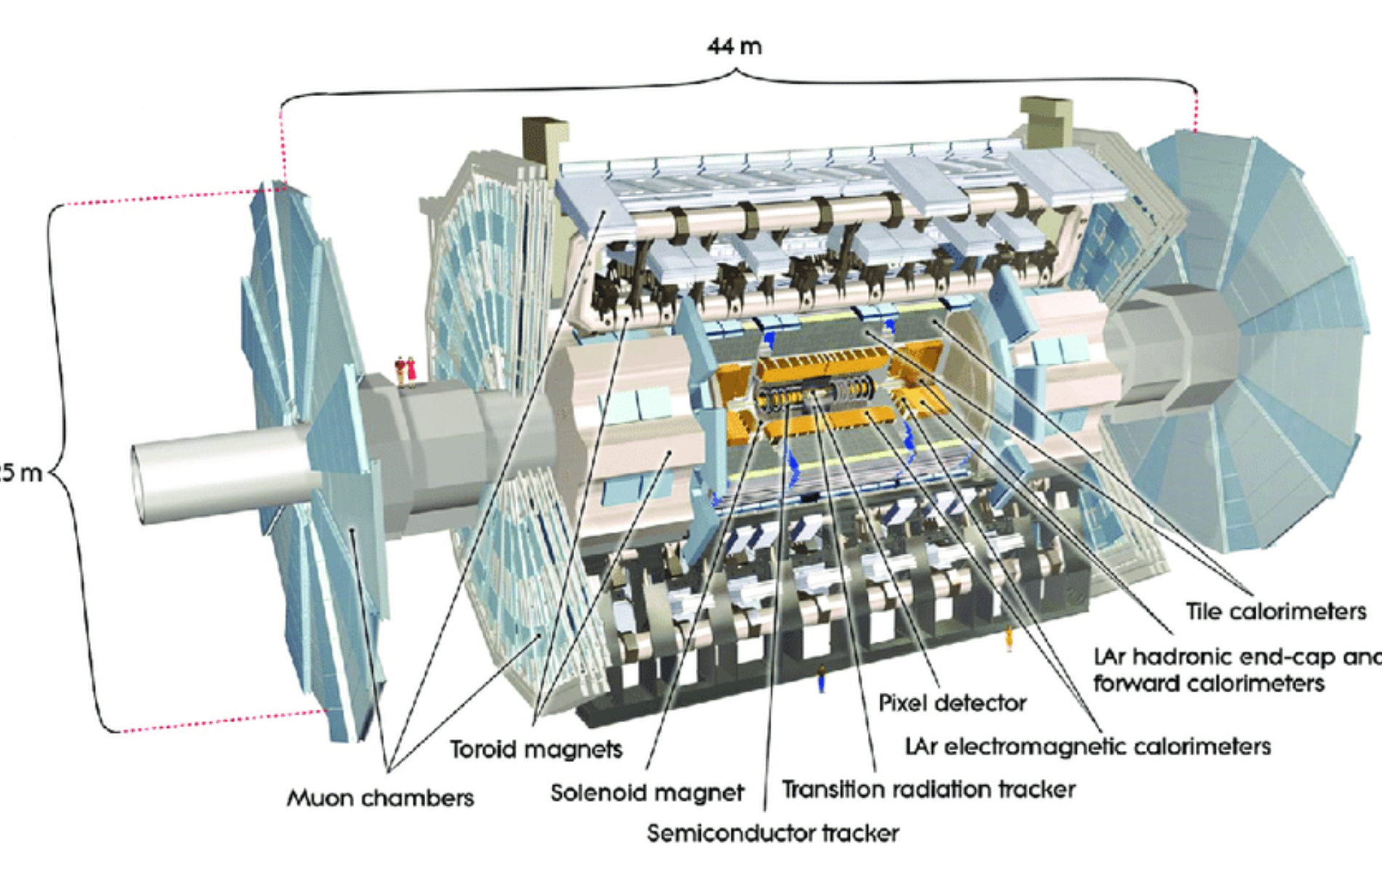
The ATLAS experiment

Slide 7
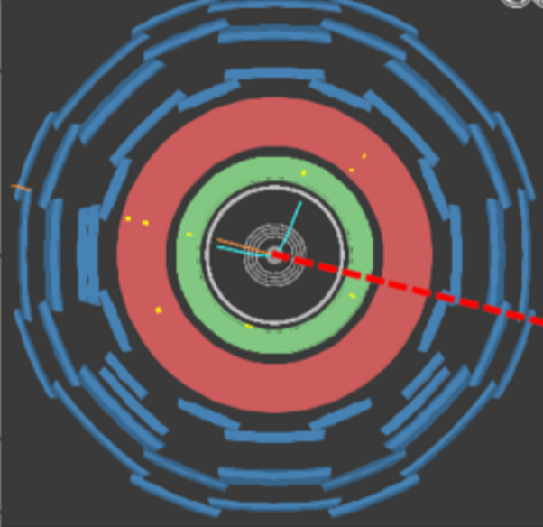
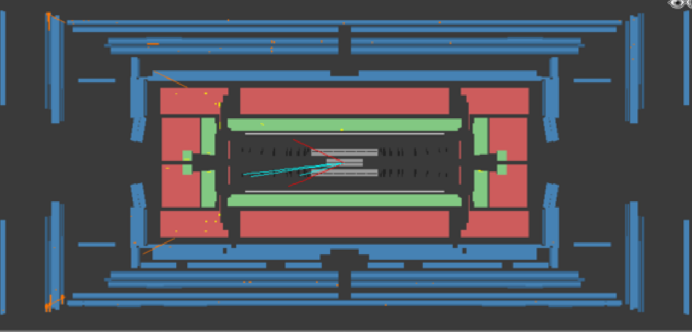
The ATLAS experiment
Longitudinal plane
Inner Tracker : tracks the paths of charged particles, bent in solenoid magnetic field
Electromagnetic calorimeter: measured energy of Electrons, Photons
Hadronic calorimeter: measures energy of hadronic jets
Muon spectrometer: Tracks the paths of muons, bent in toroidal magnetic field
Transverse plane

Slide 8
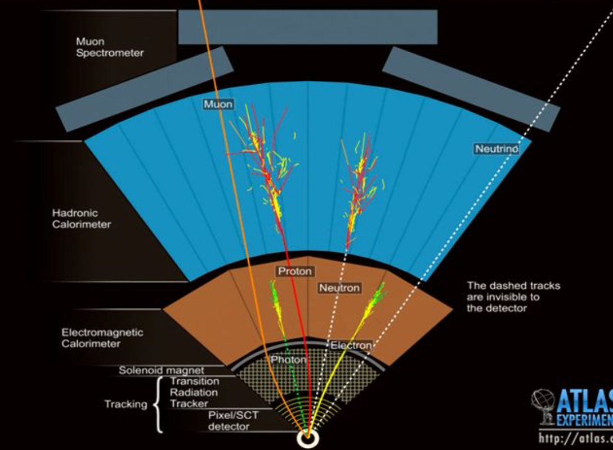
The ATLAS experiment

Slide 9
The ATLAS experiment
What Objects do we reconstruct?
Electrons
Muons
Photons
Jets
Bjets
Missing Energy
What variables?
Number of particles
Transverse momentum (PT)
Energy
Phi and eta
Charge
What do we also calculate with the variables?
Invariant mass (of the two or more objects)
Angles between objects

Slide 10
The ATLAS experiment
Quarks – hadronise into jets (also gluons!)
Detected in the hadronic Calorimeter
Bjets can be tagged as they don’t hadronise immediately!
Top quark does not turn into jets, it decays immediately!
Electrons – stable
Track ID, energy absorbed in the EM calorimeter
Muons – travel all through ATLAS, decay later!
Track ID, Track Muon Spectrometer
Taus – decay very soon - Reconstruct these
Neutrinos – don’t interact - Leave missing Energy!
Photons – No track in ID, energy reconstructed in EM calorimeter
Top, W and Z and Higgs – all decay into other particles immediately, tau decays after a few meters.

Slide 11
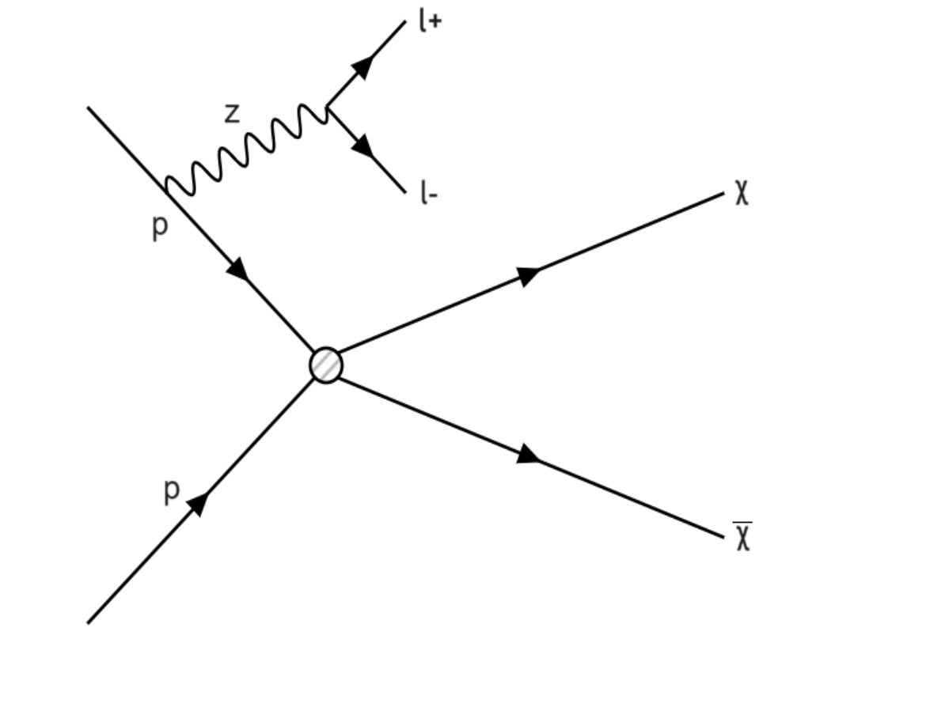
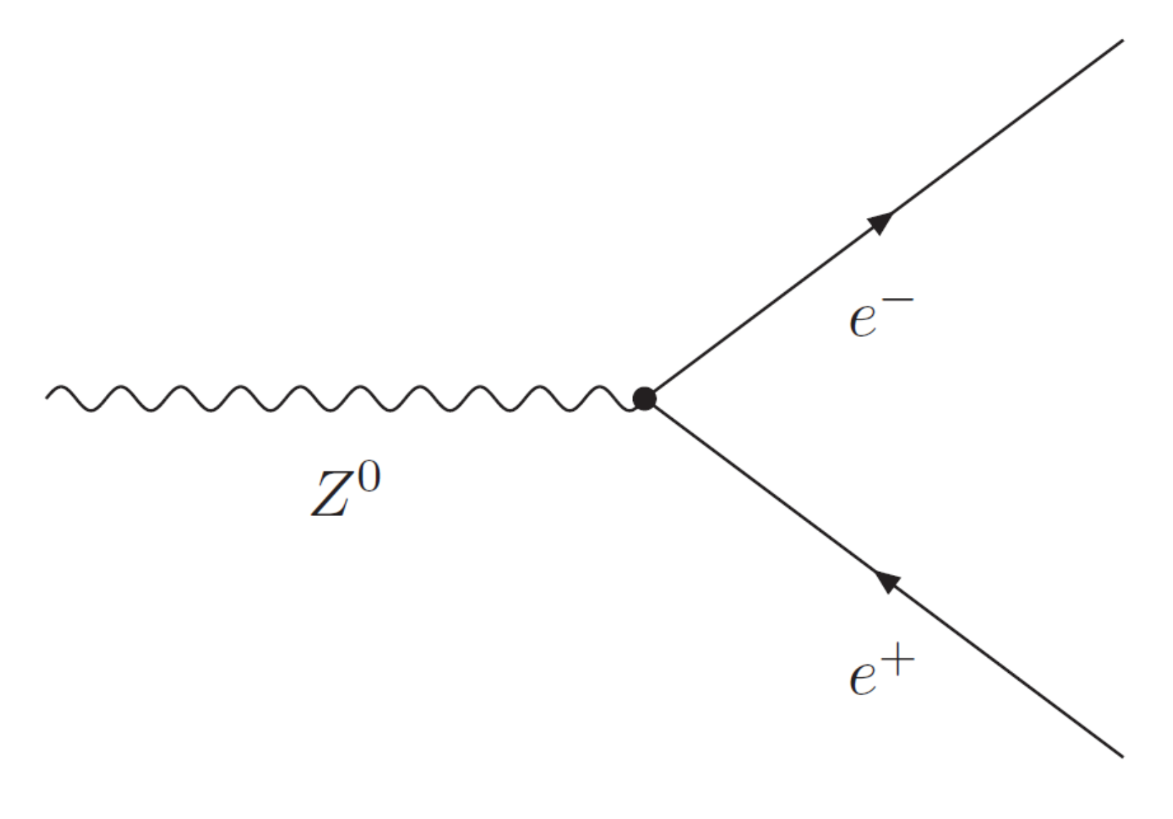
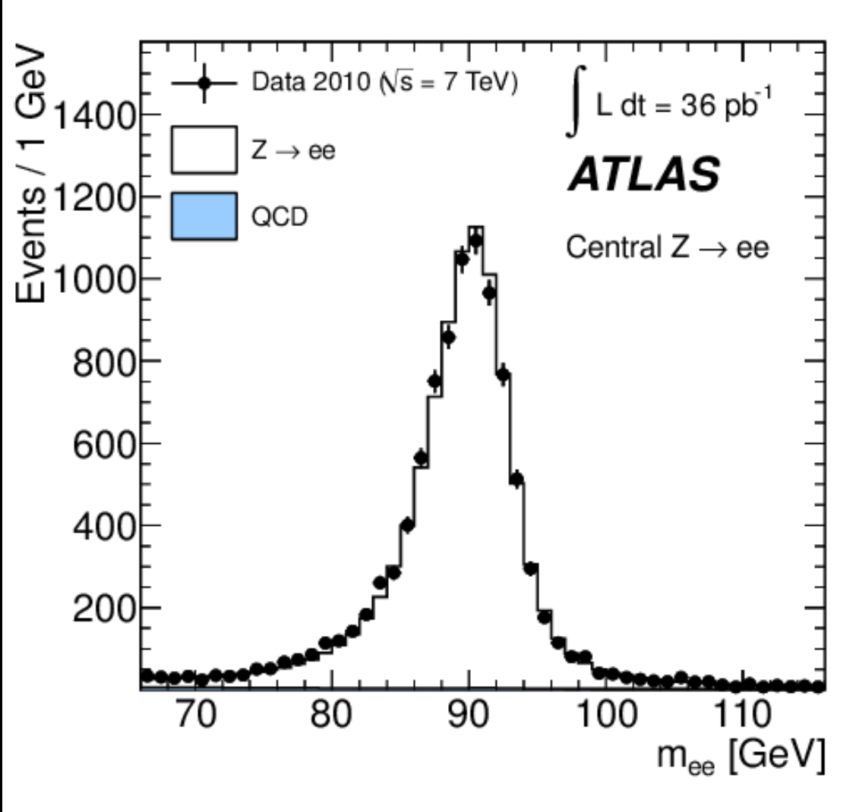
The ATLAS experiment
What do we also calculate with the variables?
Invariant mass (of the two leptons)
Angles between leptons
The angle between to leptons
Z-> ee = back to back, phi = ~180
DM+Z->ee = angle smaller~90

Slide 12
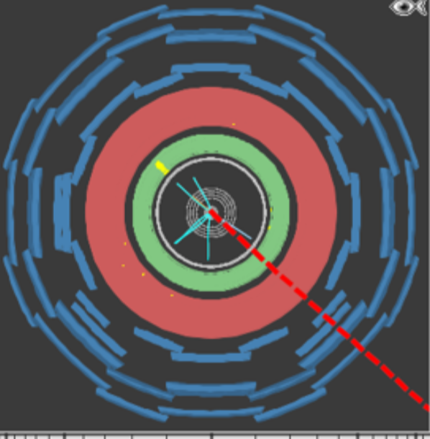
The ATLAS experiment
One track point to energy in EM calorimeter,
Track had charge = -1
This particle is an electron
The red dotted line = missing energy
If MissET > 25 GeV it could be a neutrino
Thus we think this is a W-> eν event!

Slide 13
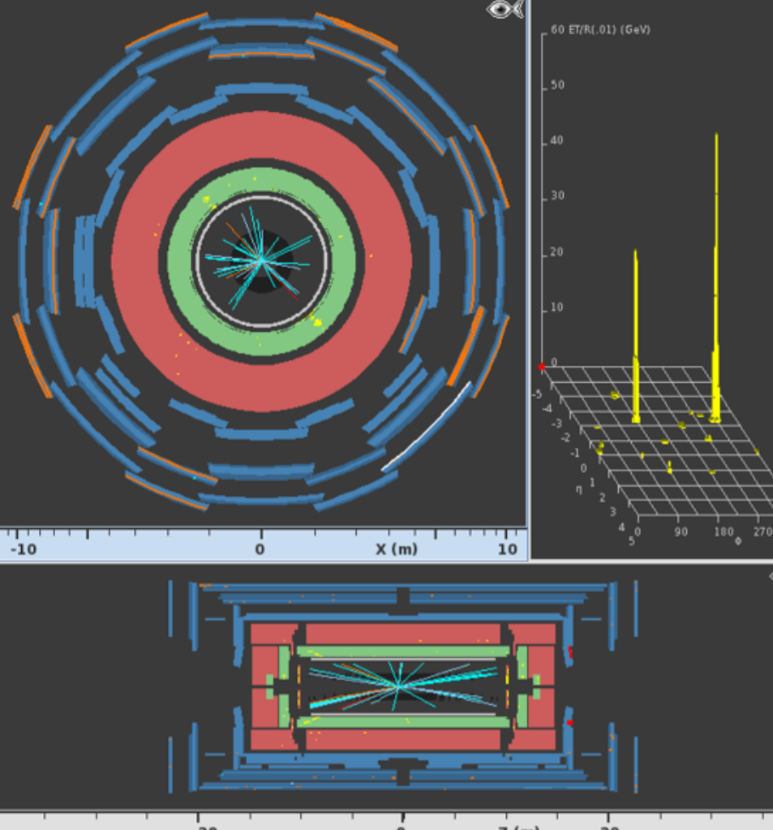
The ATLAS experiment
Two big energy deposits in EM calorimeter
-> Must be photons or electrons
Two tracks are pointing to the energy deposits
One track has charge -1 and one has +1
These are e+ and e-
We also could work out the invariant mass 9see later which ~ 88 GV
This event is Z-> ee

Slide 14
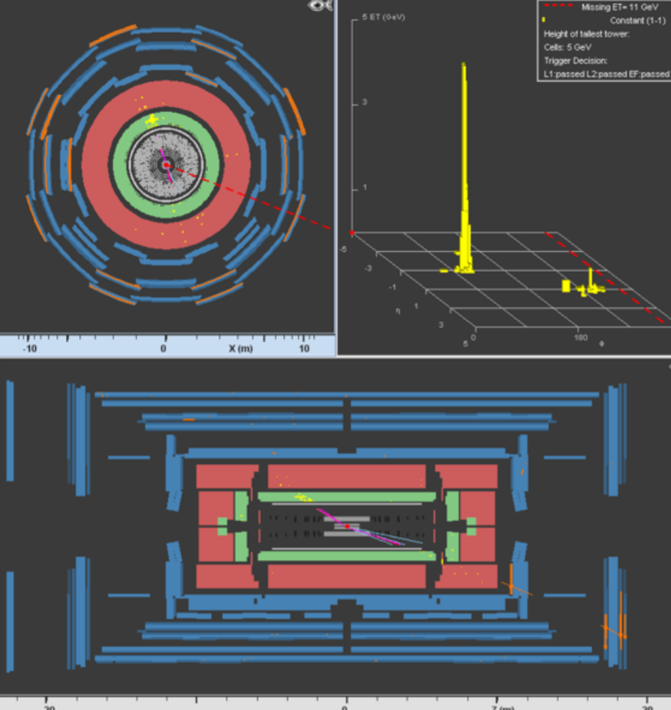
The ATLAS experiment
Missing ET is small < 25 GeV so we don’t think this is from neutrino
We see lots of track together in bundles
These probably 2 jets from two quarks or two gluons

Slide 15
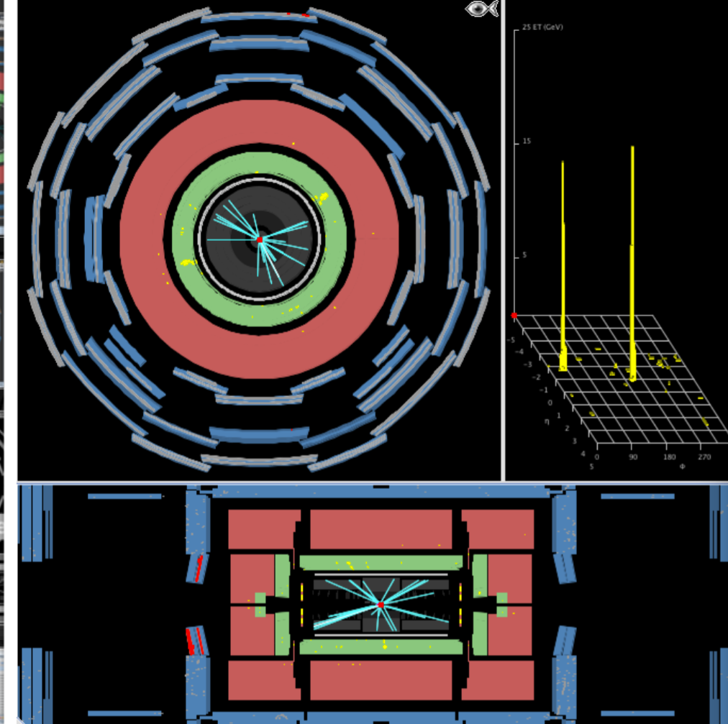
The ATLAS experiment
Two big deposits in the EM calorimeter
What particles are here?
The invariant mass = 110 GeV
Hint : mass of Higgs = 125 GeV

Slide 16
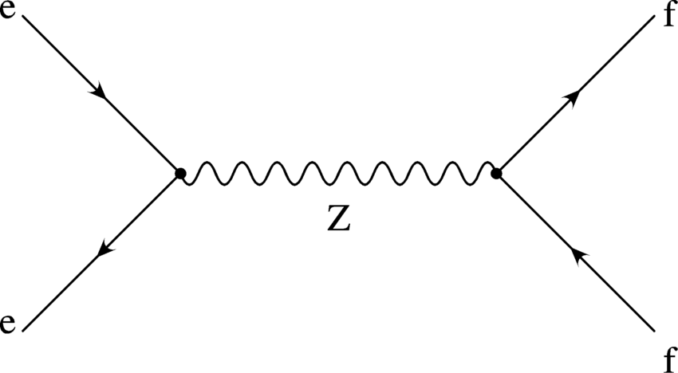
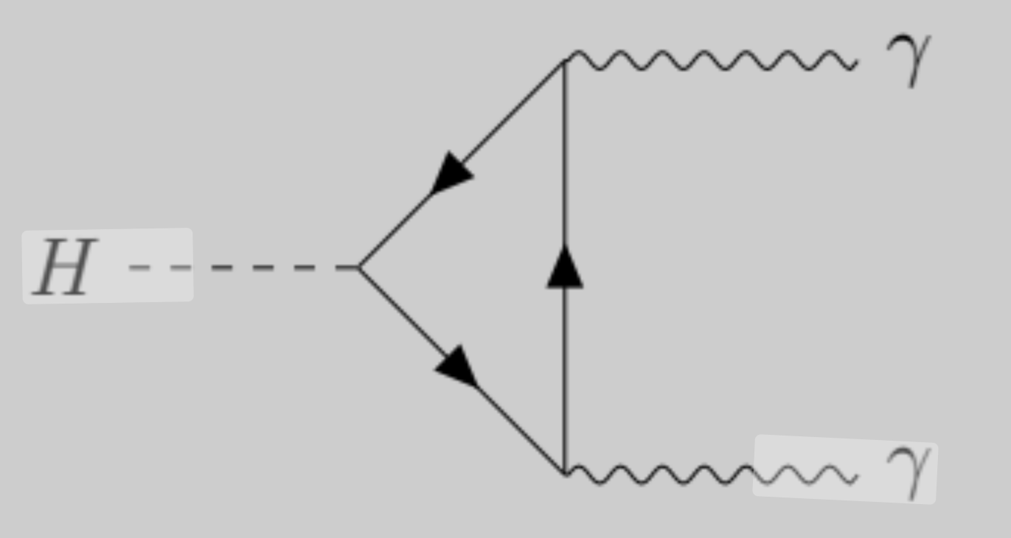
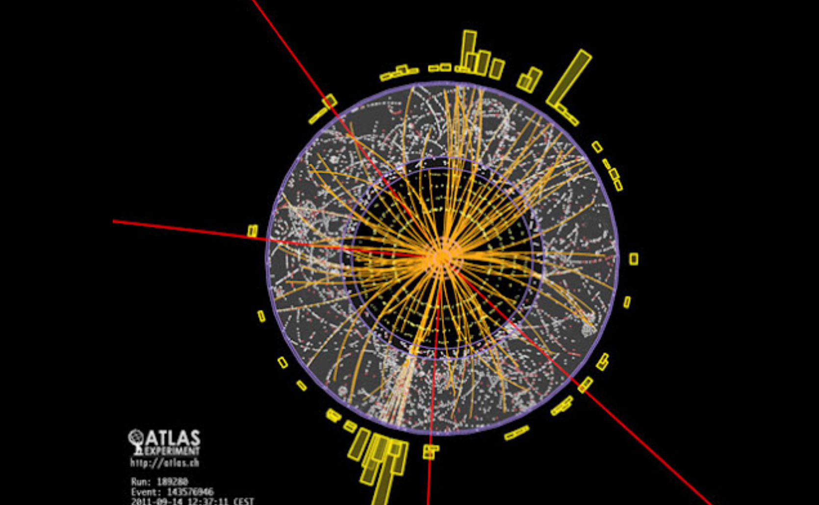
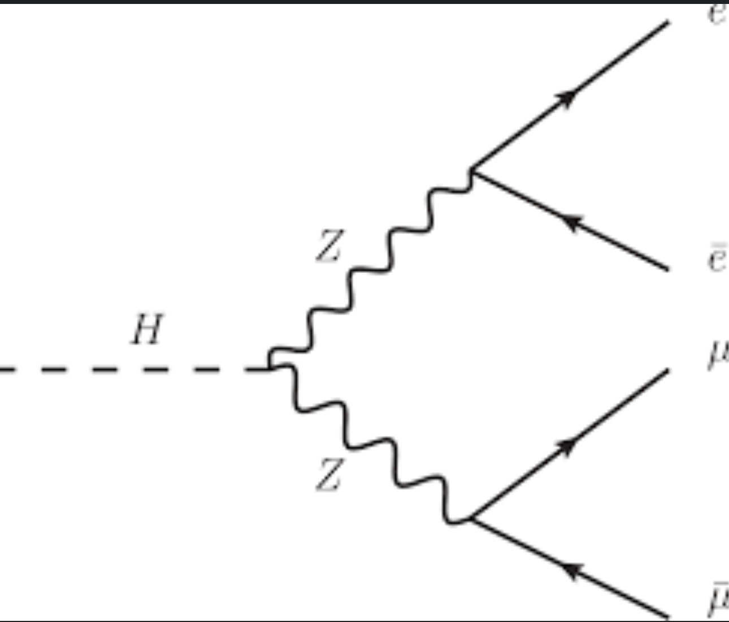
The ATLAS experiment
Some example Processes:
Z -> lepton (anti)lepton (Z-> ee, Z->μμ)
Z-> quark (anti)quark (Z->qq, Z->bb)
Higgs -> photon photon (H->γγ)
Higgs -> Z-> 4 leptons (H->Z->llll)

Slide 17
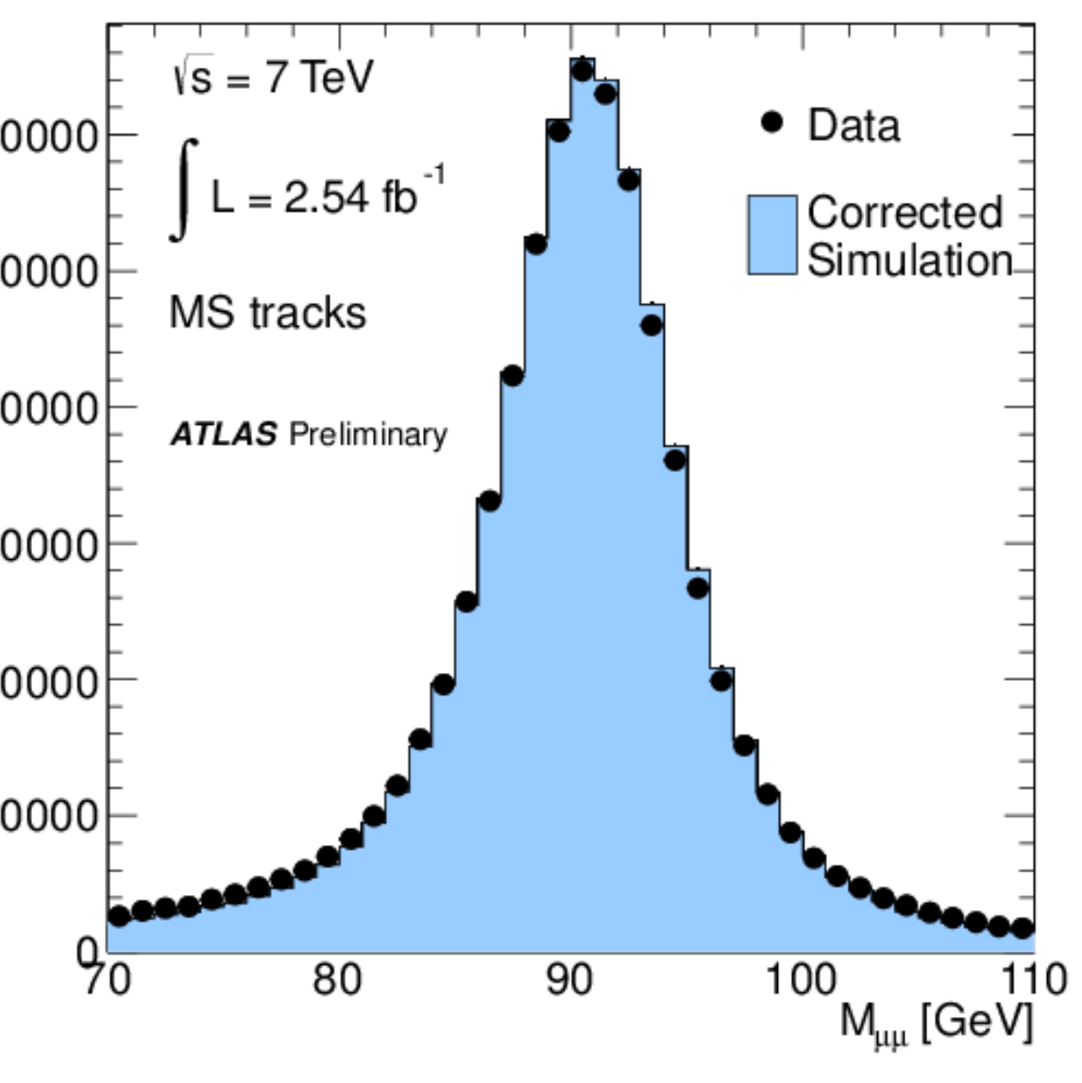
The ATLAS experiment
Event reconstruction:
Each proton-proton collision we record the objects detected by ATLAS
We then collect all the data together, and look to reconstruct certain processes.
For example, if we look for Z bosons, want do we look for in ATLAS
Events with 2 leptons of opposite electric charge
Events with two quarks of opposite electric charge
NO jets, NO Bjets, No missing Energy
Another good (cut!) idea is
Mυυ > 70, and Mμμ < 110

Slide 18
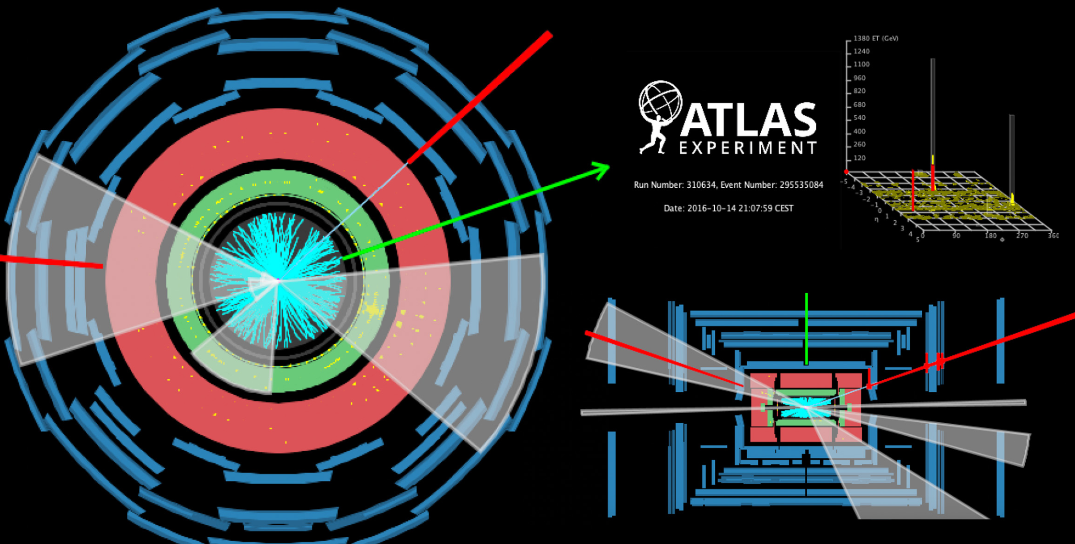
How we do analysis
We collect the data from ATALS, and store all the information for each event, the objects (e.g. electron), its measured variables (e.g. PT, phi, eta), calculate reconstructed quantities (Mll, Delta Phi)
We decide what physics we want to do!
Measurement of SM particles
Searches for New BSM particles
This week = we will search for dark matter particles!

Slide 20
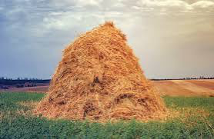
Needle in a haystack!
Searches are often hard because we are looking for a rare event, so only a very few proton-proton collisions make this particle
They are often rare – because we have found all the common things!
Searches are also often hard because the ‘signature’ of the event we are searching for often looks just like many other SM events

Slide 21
Final States & Signatures of processes
What is the final state?
The final particles from the process
E.g. for Z-> ee, the final state is two electrons
For W->μν, the final state is a muon and a neutrino
For H-> γγ, the final state is two photons
For H-> bb, the final state is two bjets
What is the signature?
This is what we reconstruct in ATLAS, the objects we can see
E.g. For Z-> ee, this is two electrons with opposite charge
For W->μν, this is a muon and missing energy
For H-> γγ, this is two photons
For H-> bb, this is two jets that are bragged = 2 bjets

Slide 22
Final States & Signatures of processes
Our signal is the process we are searching for
The signature of our signal is what this looks like
The background = any SM processes that have the same signature
= Processes that have the same signature
Often because of mis-reconstruction
For example, a b-jet not being reconstructed
Or a charge misidentification of a lepton

Slide 23
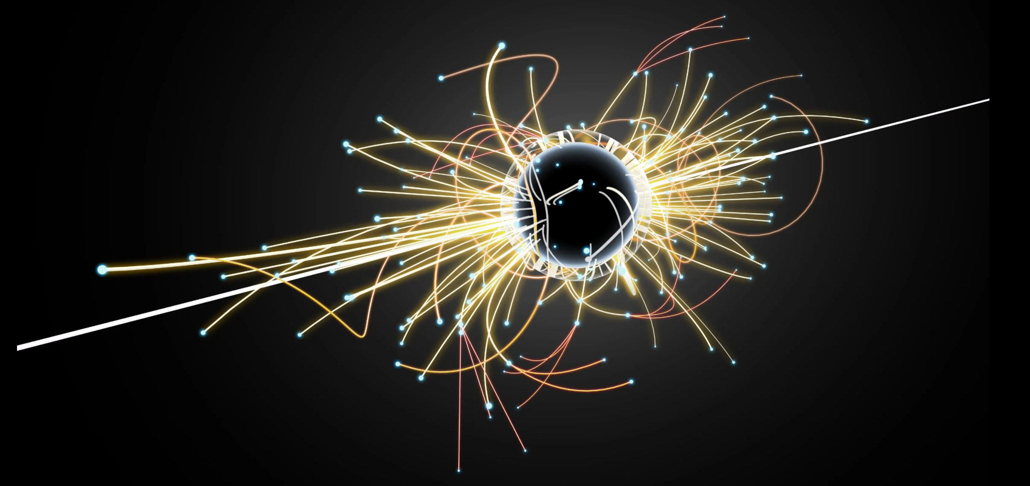
Search for Dark Matter!
This week we are going to design a search analysis using Monte Carlo simulated data for dark Matter.
The particle we will search for, which we are calling a dark matter candidate is a WIMP
Weakly Interacting massive particle
What does it look like in ATLAS?
This particles has no electric charge
Leave the detector without being detected = Missing ET
The dark matter particle is massive = very big for a fundamental particle = LARGE missing ET

Slide 24
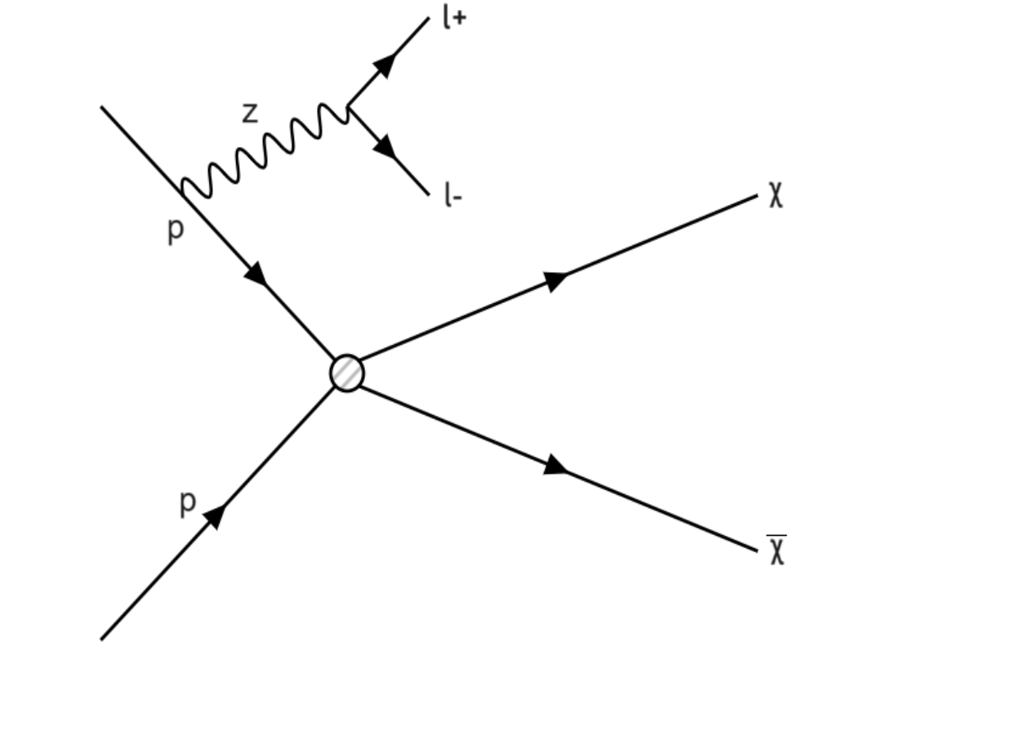
Search for Dark Matter!
We are going to search for a specific process, where the Dark Matter particles are created with a Z-boson
The Z boson decays into two leptons
This is our SIGNAL process:
pp-> X X+ Z->ll
Written as DM+Z->ll

Slide 25
Analysis: SIGNAL
Our signal is the process we are searching for
Signal = Dark Matter + Z boson -> lepton + lepton
Signal = DM +Z->ll
What will the signature be?

Slide 26
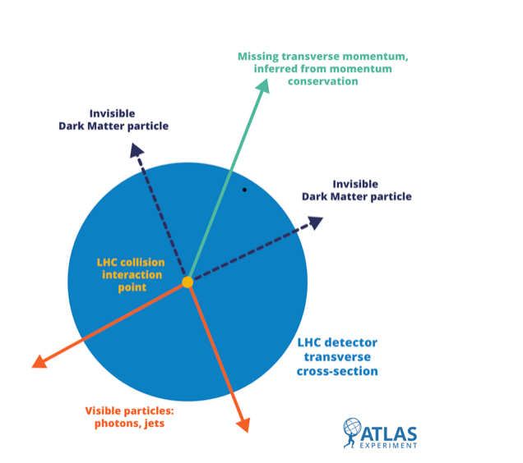
Analysis: Signature
The Signature of our signal
Missing ET + two opposite sign leptons (electrons or muons)
Etmiss + 2 OS leptons (e,μ)

Slide 27
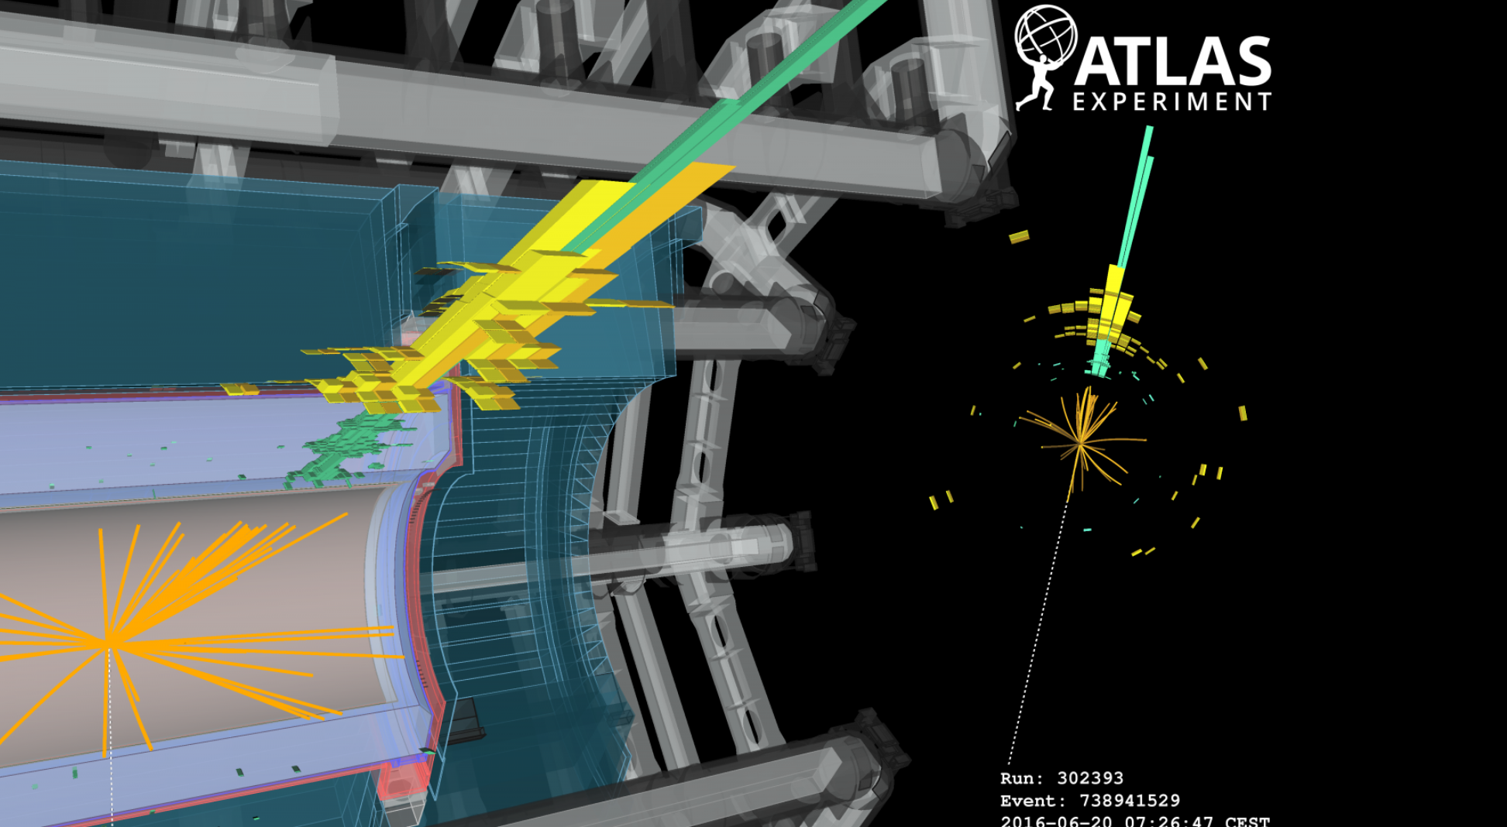
Analysis: Signature

Slide 28
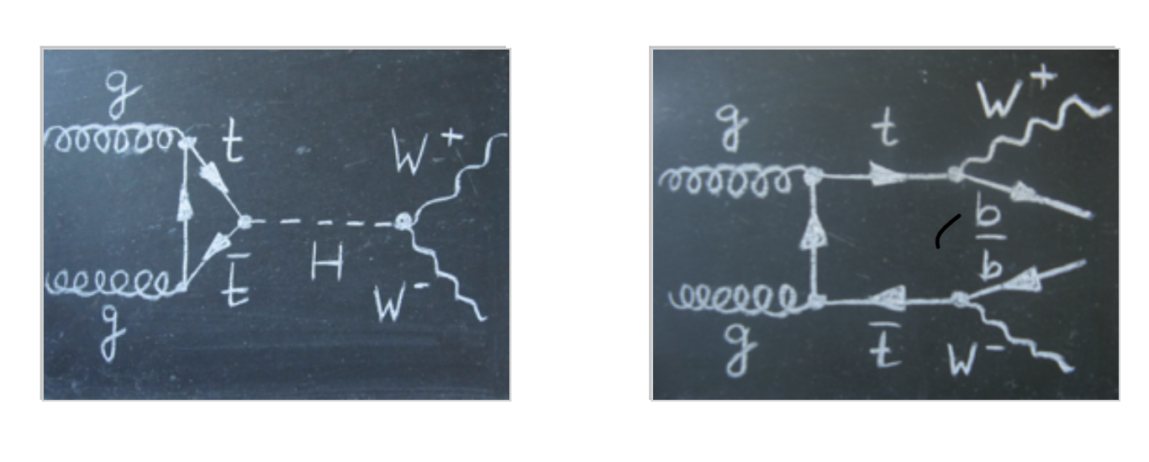
Analysis: background
The background = any SM process that looks like the Signal
= Processes that have the same signature
Often because of mis-reconstruction
For example, a b-jet not being reconstructed
Or a charge misidentification of a lepton

Slide 29
Signal and Background
Our signal is the process we are searching for
Signal = Dark Matter + Z boson -> lepton + lepton
Signal = DM +Z->ll
The signature of our signal
Missing ET + two opposite sign leptons (electrons or muons)
Etmiss + 2 OS leptons (e,μ)
The background = any SM processes that have the same signature
Signature of the backgrounds = Etmss + 2OSl

Slide 30
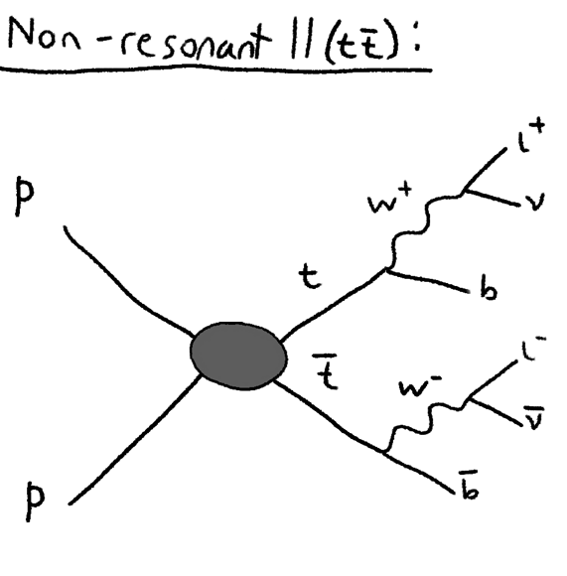
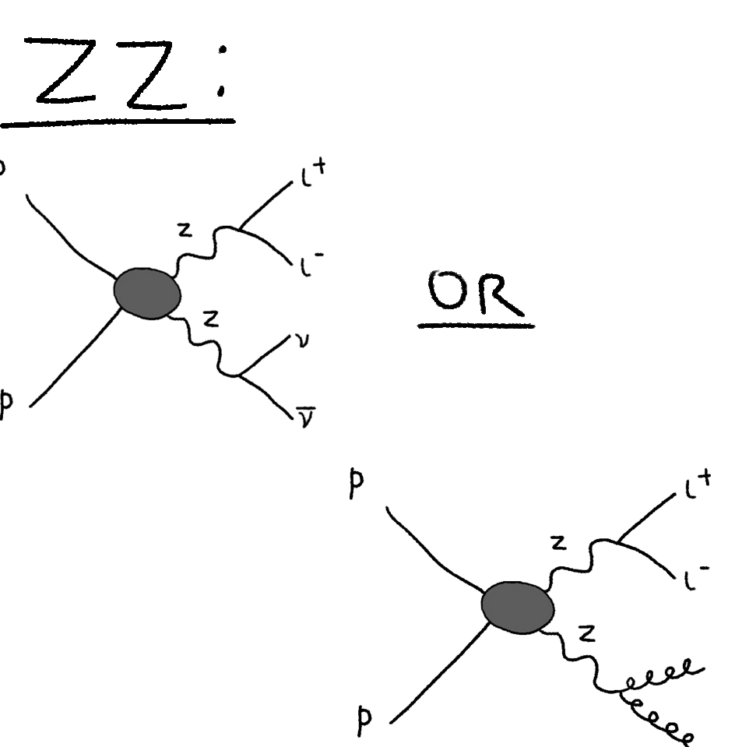
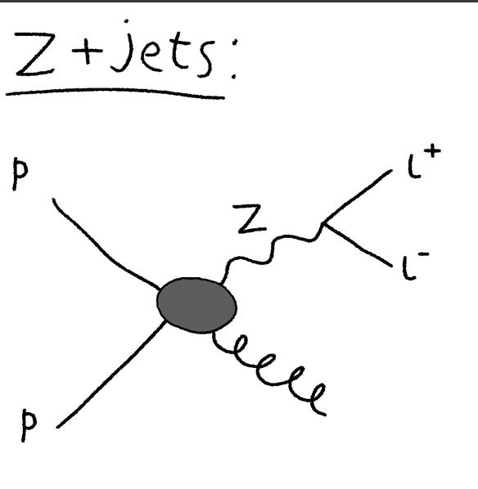
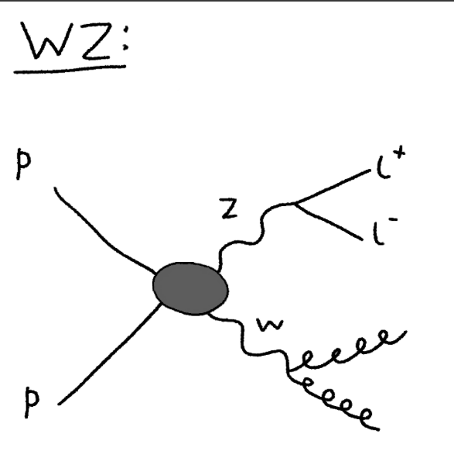
Analysis: Background

Slide 31
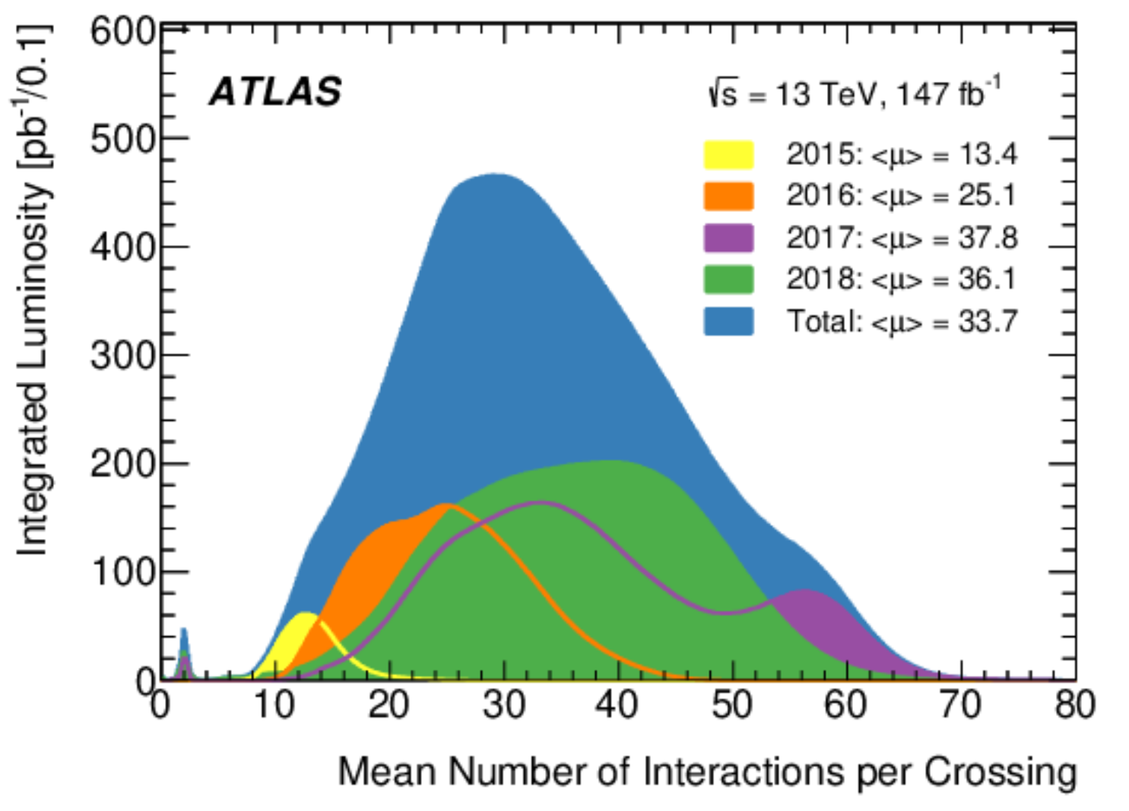
Search for Dark Matter
How do we find it – how do we do the experiment
We collide protons for an amount of time to get our dataset
Our data set has a number o events. In particle physics we measure the number of events in terms of luminosity
This data set will have everything
How many Higgs, W and Z etc.
We simulate Monte call simulations of our SIGNAL and backgrounds to develop and optimise our analysis

Slide 32
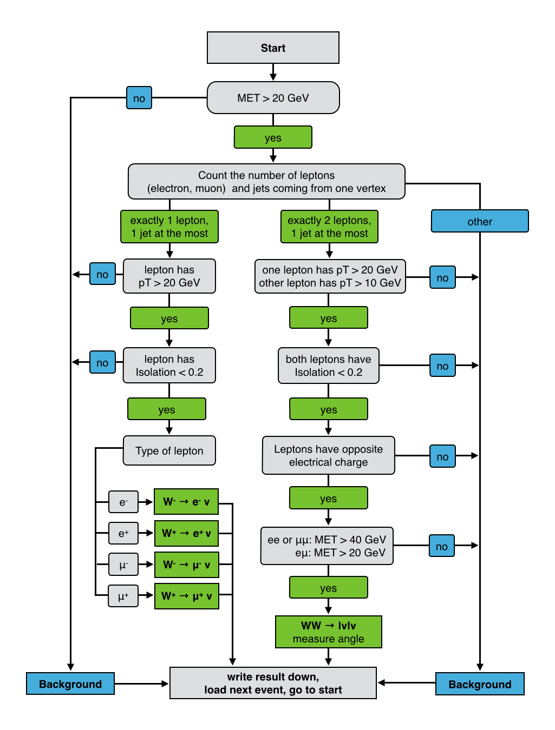
Search for Dark Matter
Example of a cut flow
We make cuts on the data to find events that look like our signal!
Some background events will also look like our signal (hey have a similar signature) so we need to be clever to think how to get rid of more background without getting rid of too much background
Our CUTS Would start:
Must have exactly TWO Opposite sign leptons
Must have large missing ET (lets say >25 GeV)

Slide 33
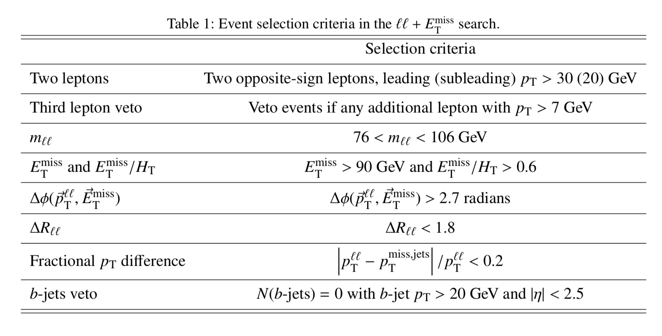
Search for Dark Matter
How do we find it – how do we lets look at the background again
What cuts can we do to get rid of more of these events?
This is doing a cut based optimisation analysis:

Slide 34
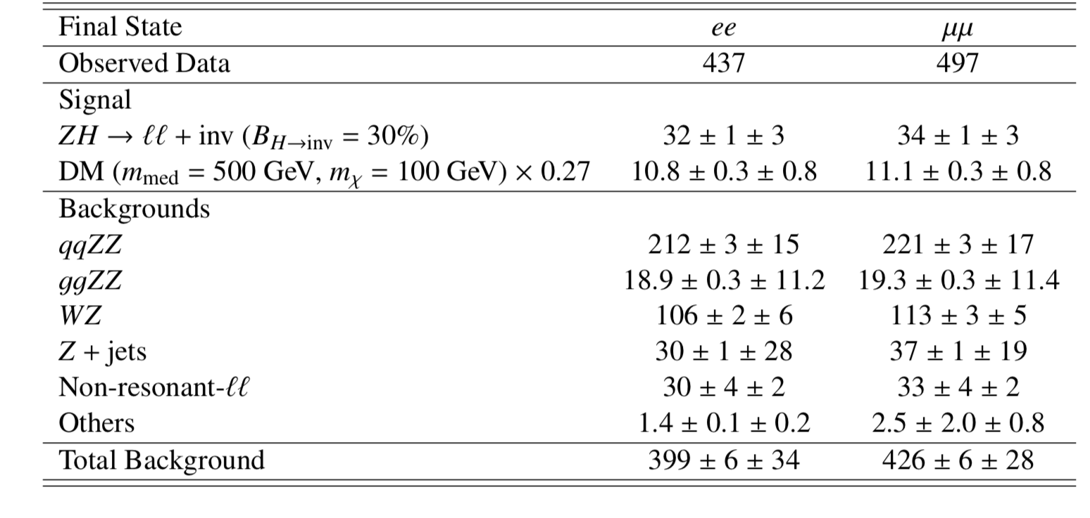
Search for Dark Matter
We optimise the cuts as best we can to get most amount of background and least amount of signal
We measure this as a number signal/sqrt (number background)

Slide 35
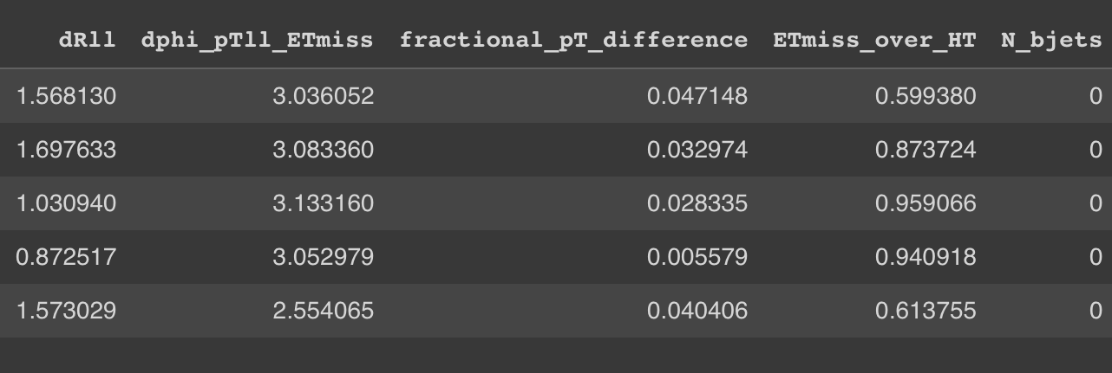
Search for Dark Matter
We usually use hundreds of variables in our analyses.
This week we have chosen a few important ones

Slide 36
Analysis: Background

Slide 37
Search for Dark Matter
Signal dataset: DM_300, Background datasets: NR_ll, Z_jets, WZ or ZZ.
Each row represents a single event or proton-proton collision, inside ATLAS.
Each column represents a different type of measurement / variable of the proton-proton collisions. 1. sum_lep_charge represents the total charge for the leptons that ATLAS detects after the collision. Generally, these will have opposite charge, and so they add to zero.
2. lead_lep_pt represents the transverse momentum of the fastest lepton that ATLAS detects.
3. sublead_lep_pt represents the transverse momentum of the second-fastest lepton that ATLAS detects
4. Mll represents the “dilepton invariant mass”
5. Etmiss represents the missing transverse momentum.
6. HT is the scalar sum of all the momentum after the collision; so ETmiss_over_HT is a measurement of how much of the momentum in a collision is missing.

Slide 38
Search for Dark Matter
You are going to choose and optimise these cuts!

Slide 39
Statistical Significance
Most particle physics analyses are based on hypothesis testing, meaning that the goal is to use data to ­ support or disprove a given hypothesis.
For example, if we are looking for a new particle not predicted by the Standard Model, then our hypothesis would be the presence of this new particle in our data.
The null hypothesis would exactly correspond to the Standard Model prediction, assuming no new particle.

Slide 40
Statistical Significance
The p-value corresponds to the likelihood that an observed test statistic can be explained by the null hypothesis, without the need for an alternative.
More specifically, it equates to the fraction of times you would get an observed test statistic showing worse agreement with the null hypothesis than that observed, assuming the null hypothesis is true.
The smaller the p-value, the more confidence we have that the null hypothesis can be excluded

Slide 41
Statistical Significance

Slide 42
Statistical Significance
Significance is a quantity that expresses how certain we are that the null hypothesis can be excluded.
Closely related to the p-value: the lower the p-value, the higher the significance, and vice-versa

Slide 43
Statistical Significance
Significance is often expressed as the number of “standard deviations” the observed test statistic is away from the null hypothesis.
If the test statistic is distributed like a Gaussian (a bell shape) and the null hypothesis is true, then a randomly sampled test statistic will be within 1 standard deviation (1σ) of the mean 68% of the time.
Therefore, for a 1σ significance, there is a 32% probability that the observed test statistic was obtained outside of this range by random chance, despite the null hypothesis being true.

Slide 44
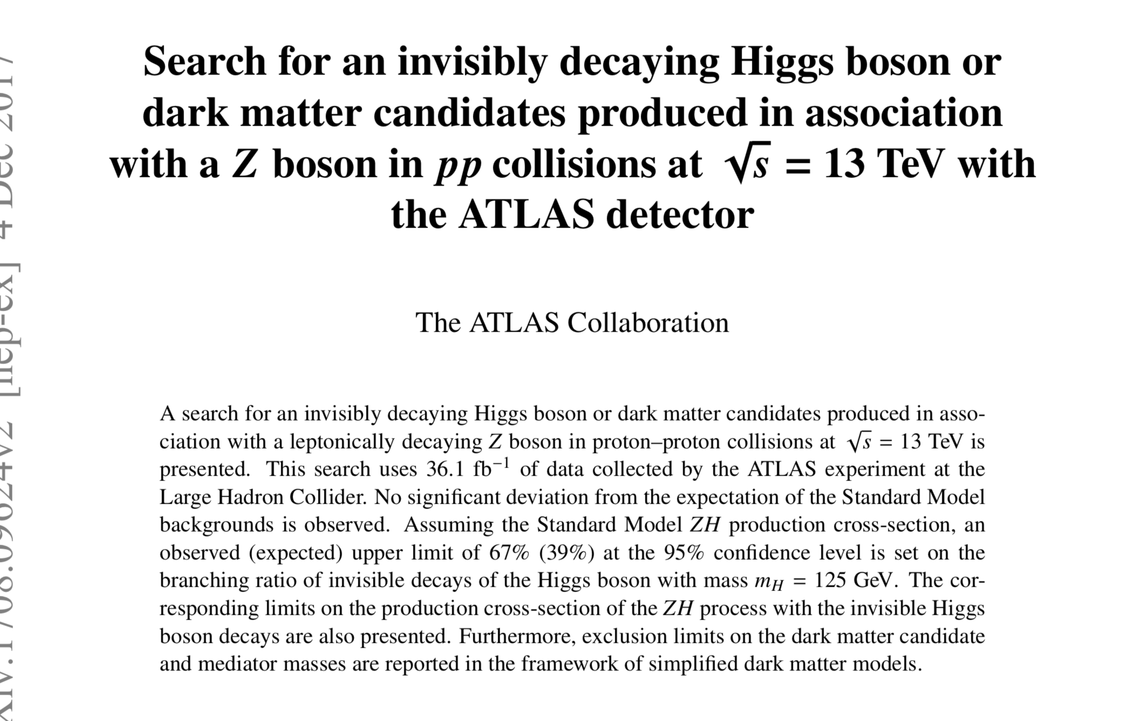

Slide 45
Search for Dark Matter
You are going to choose and optimise these cuts!

Slide 46
Next Steps
Go through the notebooks staring with Notebook 1 on the indico pages.
Notebook 1 is an introduction to some tools
Notebook to is the cut based optimisation analysis
GO SLOW and take time to understand, make notes
They do not explain everything = they give you some tools to do the analysis, and you can understand the approach and techniques
You can save a copy when you start and this is yours!
Notebook 3 you wont start until later in the week. It is on using machine Learning and is more complex, we do not expect you to understand the programming, only the approach

