Slide 1
Studying the Interference and Focusing of Gaussian Beam
Mohammad Mosa Mohammadi
mj.mohammadi@iasbs.ac.ir
Supervisor: Dr.Faegheh Hajizadeh
Department: Physics
Summer 1403

Slide 2
Outline
Optical Tweezers
Gaussian Beam
Interference of Gaussian Beam
Gaussian Focused Beam

Slide 3
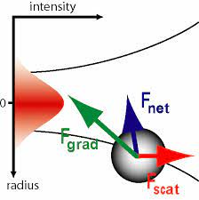
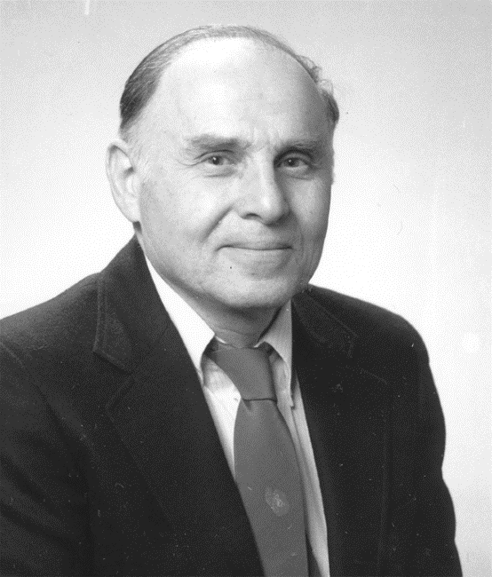
Optical Tweezers
https://www.ncbi.nlm.nih.gov/pmc/articles/PMC9486066/

Slide 4
Gaussian Beam
$U\left(r\right)= A_{0}\frac{W_{0}}{W(z)}e^{−\frac{ρ^{2}}{{(W(z))}^{2}}} e^{(−jkz+ \frac{ρ^{2}}{2 R\left(z\right)}+ ζ(z))}$
$I= I_{0} \frac{{W_{0}}^{2}}{W^{2}}e^{−\frac{2 ρ^{2}}{{(W(z))}^{2}}}$
$R\left(z\right)=z[1+{(\frac{z_{0}}{z})}^{2}]$
$W\left(z\right)= W_{0} \sqrt{1+ {(\frac{z}{z_{0}})}^{2}}$
$$ζ\left(z\right)= \tan^{−1}{\frac{z}{z_{0}}}$$
$$W_{0}= \sqrt{\frac{λz_{0}}{π}}$$
https://onlinelibrary.wiley.com/doi/book/10.1002/0471213748

Slide 5
Gaussian beam profile
https://www.researchgate.net/publication/29685849

Slide 6
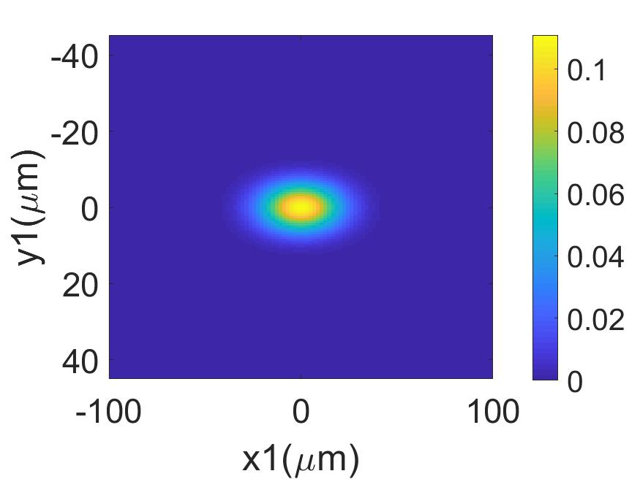
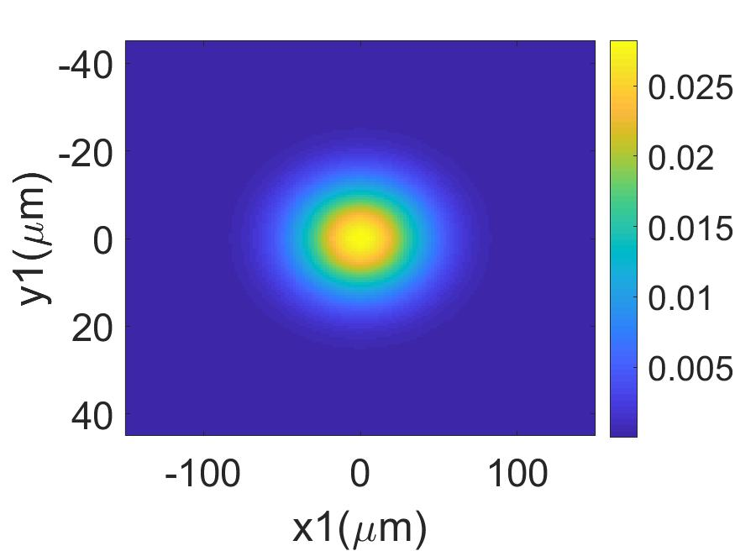
Gaussian Beam Intensity pattern in (x - y)
A
B
C
Z = 0
Z = Z0
Z = 2Z0

Slide 7
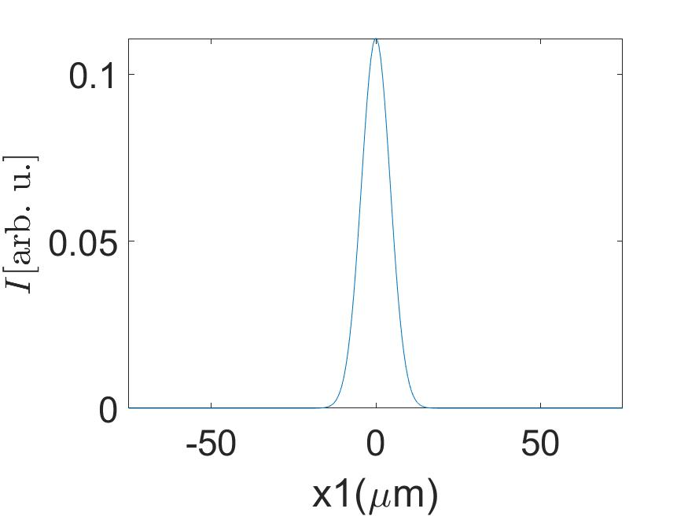
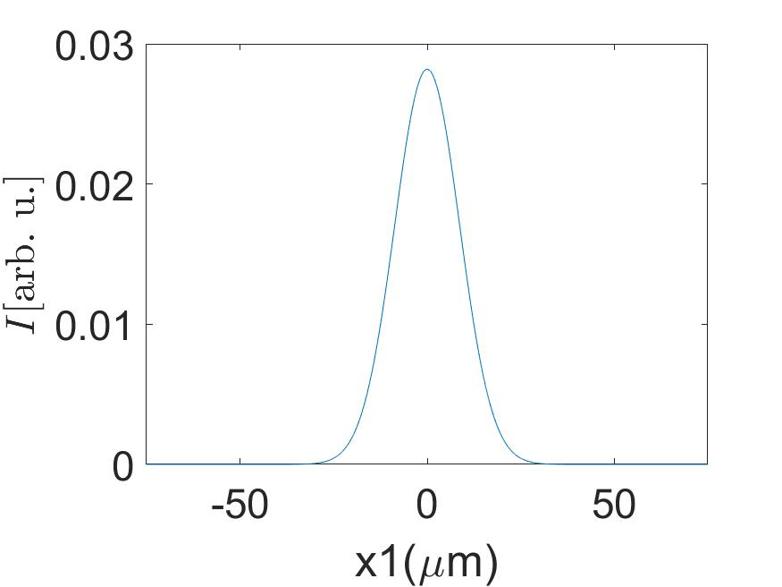
Gaussian Beam Intensity profile in (x - y)
A
B
C
Z = 0
Z = Z0
Z = 2Z0

Slide 8
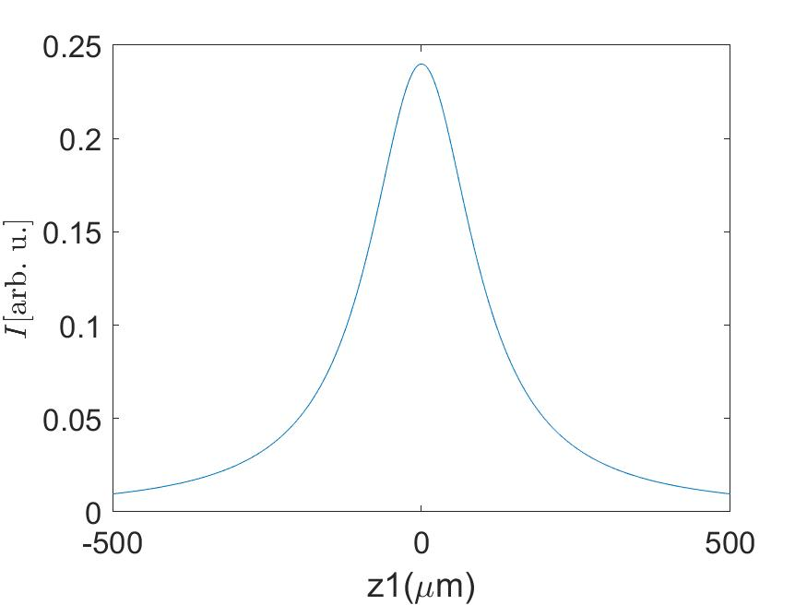
Gaussian Beam Intensity pattern in (x - z)
A
B

Slide 9
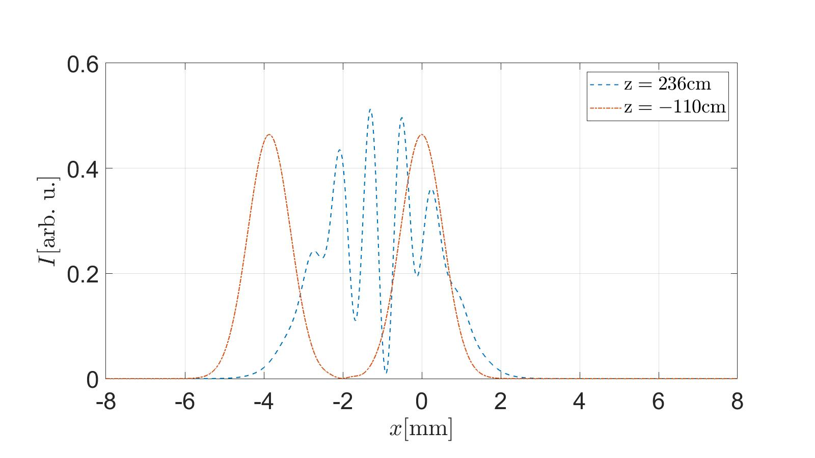
Gaussian Beams interference in (x - z)
A
B
$$θ=0,027 , xc=2mm$$
a
b
c

Slide 10
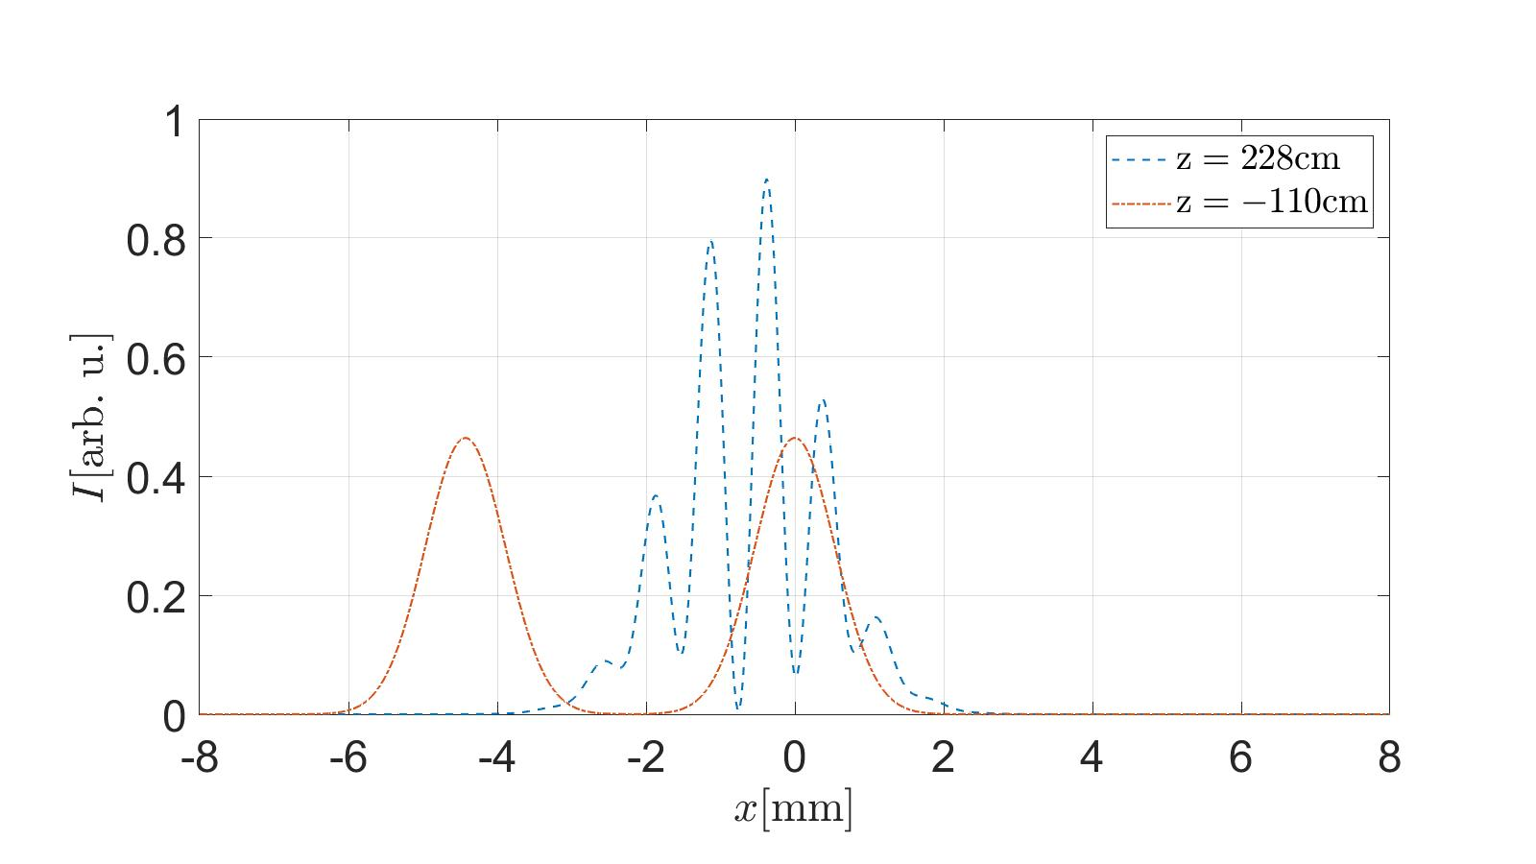
Gaussian Beams interference in (x - z)
A
B
$$θ=0.05 , xc=2mm$$
a
b
c

Slide 11
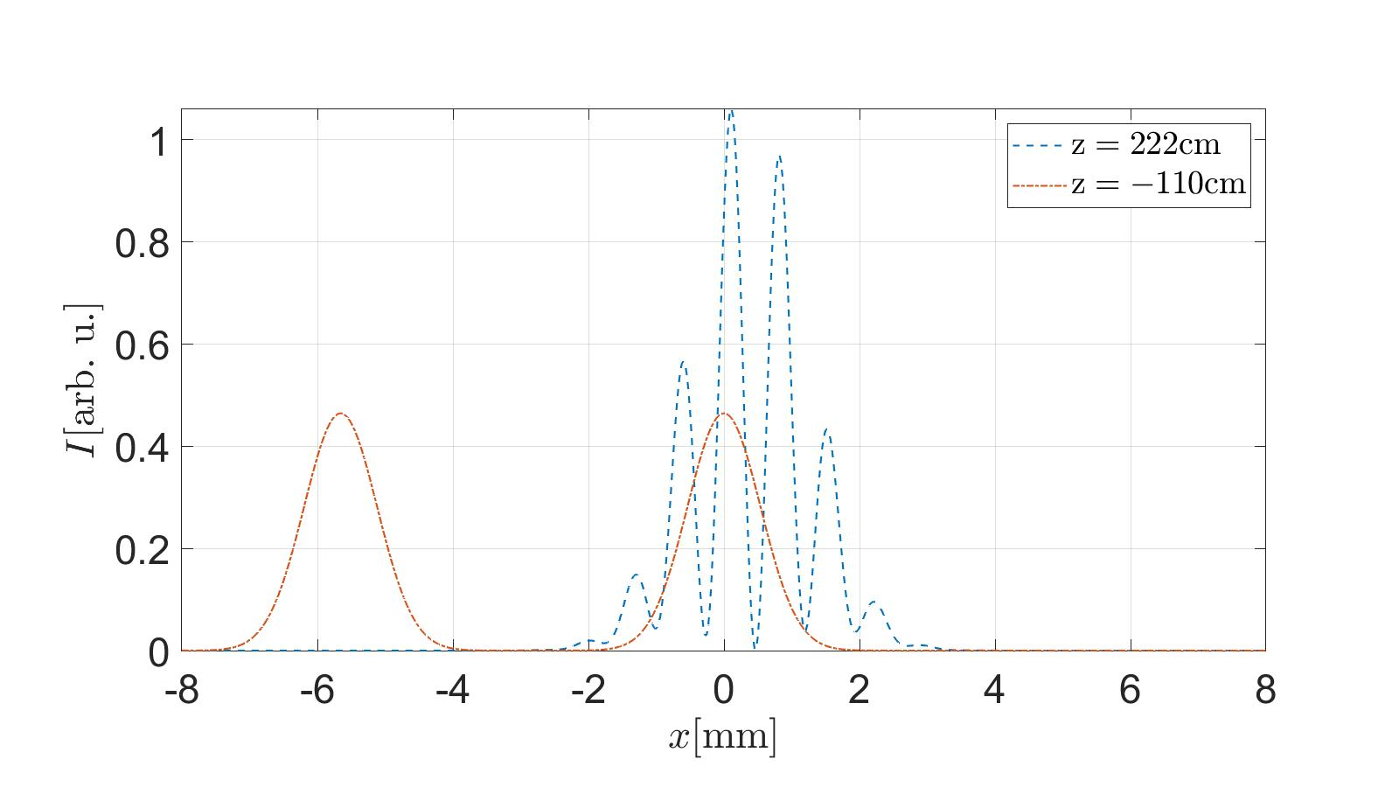
Gaussian Beams interference in (x - z)
A
B
$$θ=0,1 , xc=2mm$$
a
b
c

Slide 12
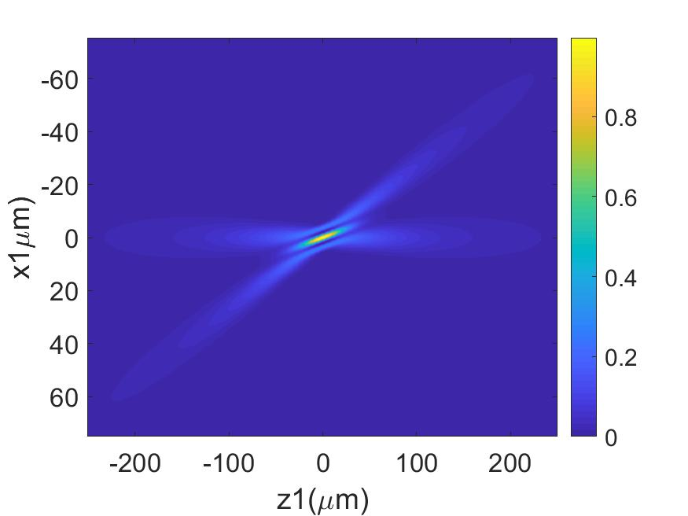
Gaussian beams Interference by Rotation Matrix
A
B

Slide 13
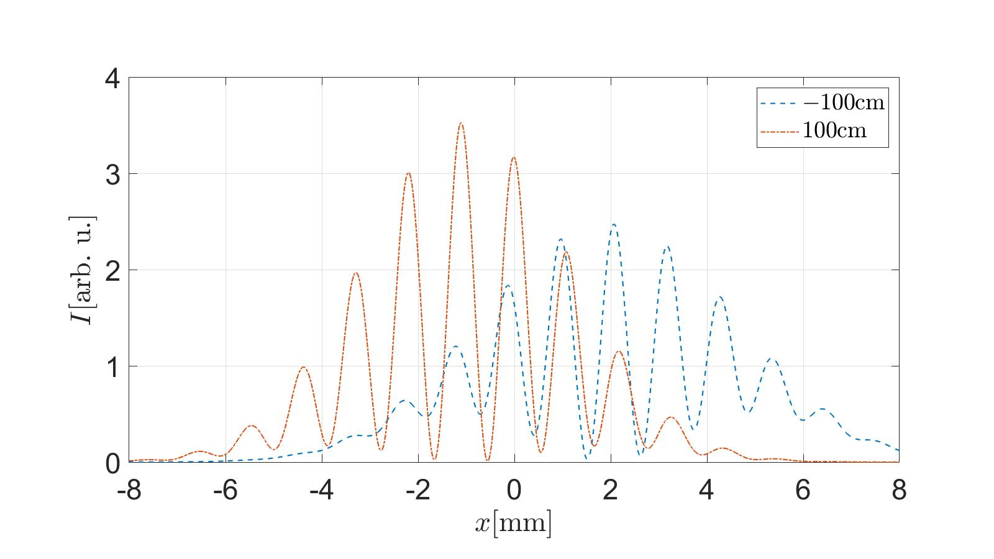
Gaussian Focused Beams interference in (x - z)
A
B
a
b
c

Slide 14
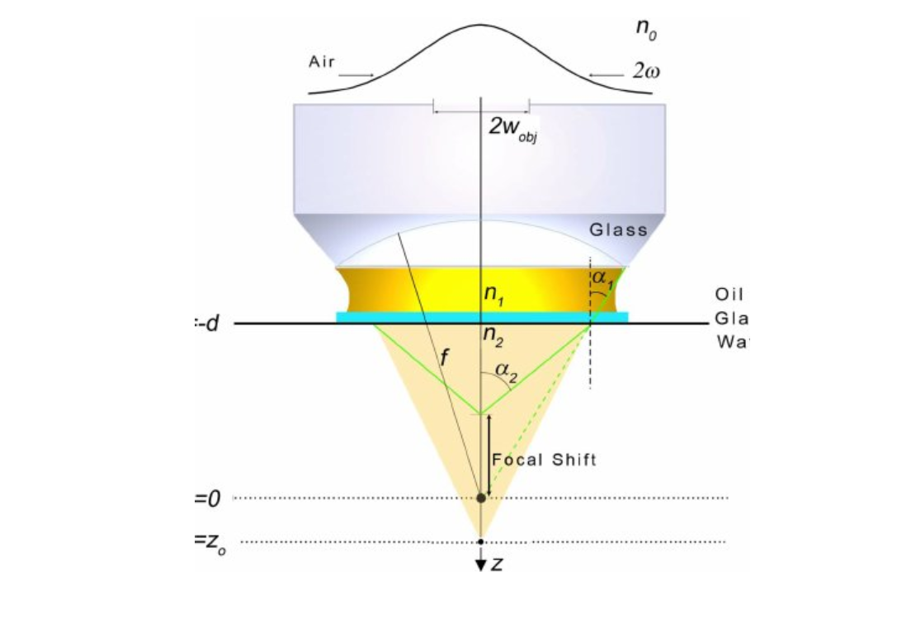
Gaussian highly focused beam
$$E= \int_{0}^{α}{\{(−κρ^{2}}){\left(\csc{θ}\right)}^{1/2}\left(\sin{θ_{1}}\right)\left(e^{\left[ik_{0}ψ\right]}\left(τ_{s}+ τ_{p}\cos{θ_{2}}\right)\right)\left(J_{0}k_{0}n_{1}r\sin{θ_{1}}\right)\left(e^{ik_{0}n_{2}z\cos{θ_{1}}}\right)\}dθ_{1}$$
$$ψ=−d(n_{1}\cos{θ_{1} − n_{2}\cos{θ_{2}}})$$
https://doi.org/10.1080/09500349808231752

Slide 15
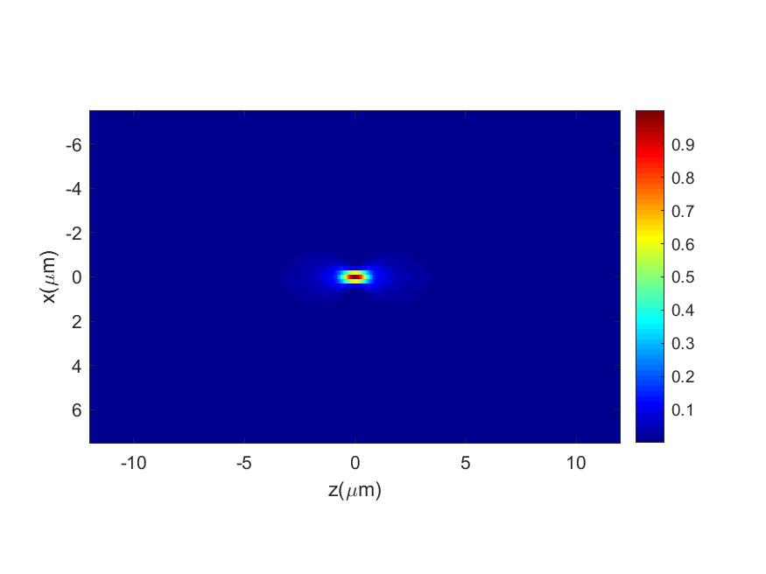
Gaussian highly Focused Beam ($ψ$ = 0 and $ψ$ = 0)
B
A

Slide 16
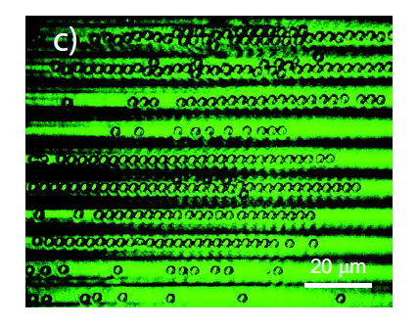
Interference in Optical Tweezers
A
B
https://www.mdpi.com/2072-666X/2/2/221#

