Slide 1
A brief introduction to atmospheric modelling
Franco Molteni
Agenzia Italia Meteo, Bologna, Italy

Slide 2
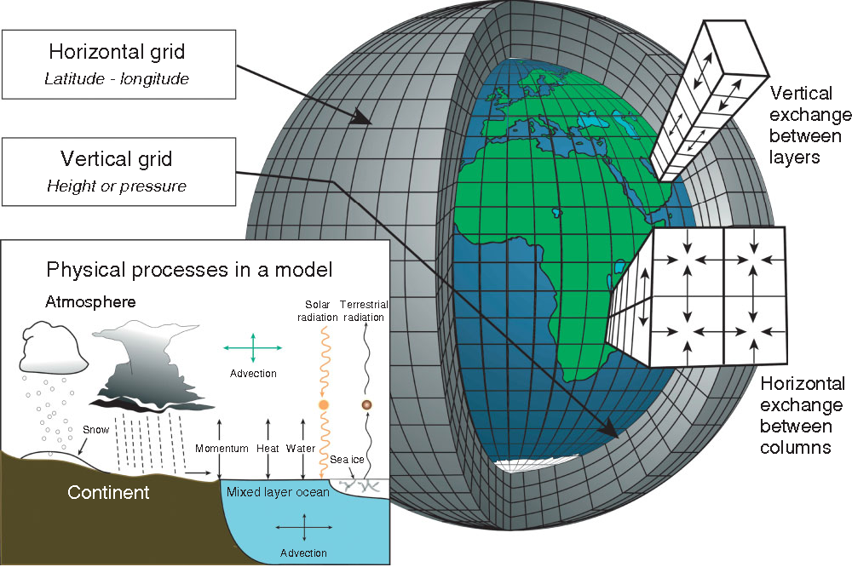
General circulation models: discretization and physical processes

Slide 3
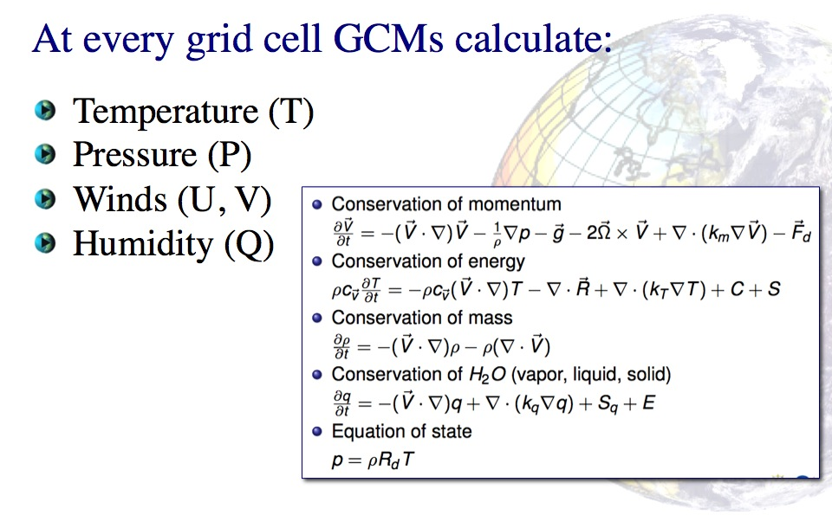
General circulation models: atmospheric dynamics

Slide 4
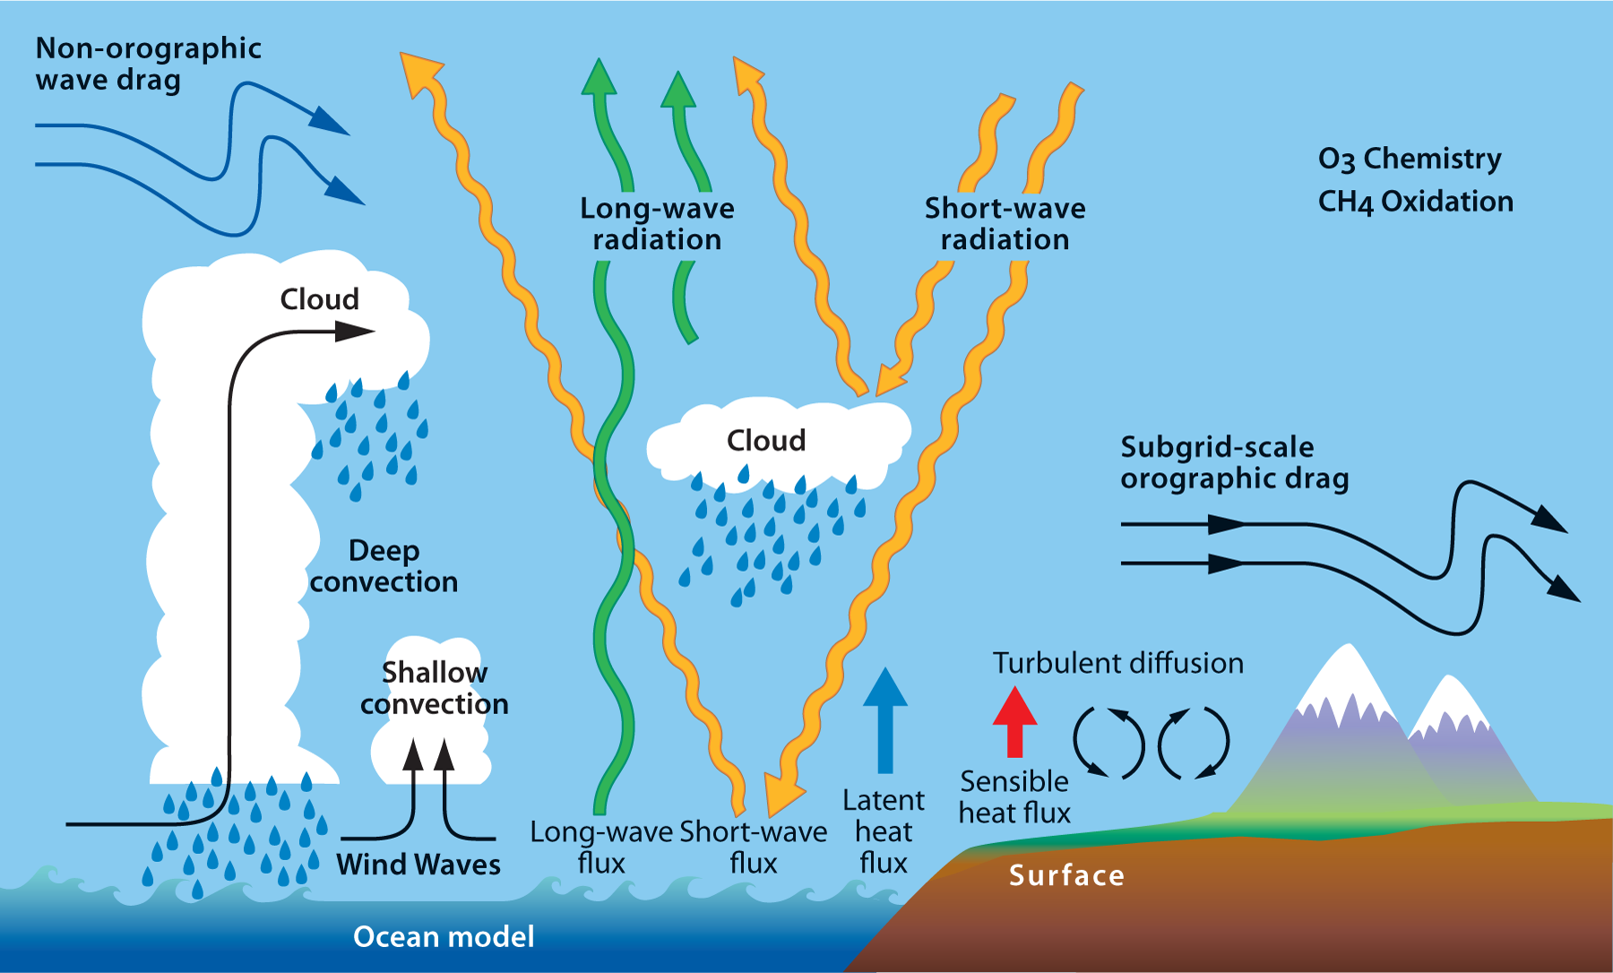
Parametrization of physical processes

Slide 5

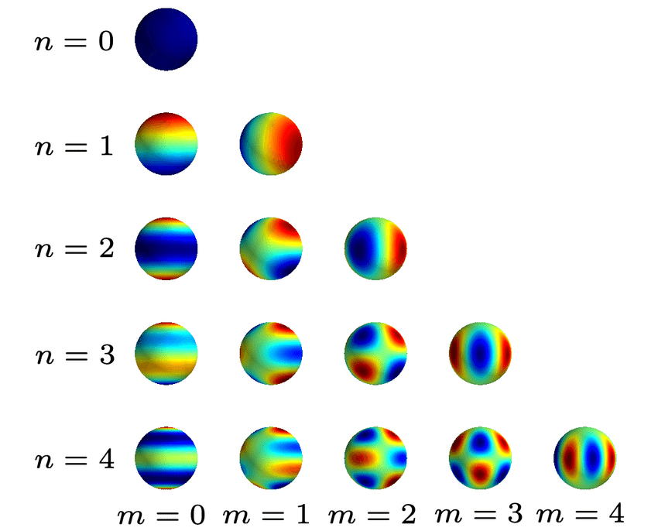
Expansion of horizontal fields into spherical harmonics
Spherical harmonics are the eigenfunctions of the Laplacian operator on the sphere:
  ² Y_{n}^{m} (λ, φ) = - [ n (n+1) / r²] Y_{n}^{m} (λ, φ)
  Y_{n}^{m} (λ, φ) = N P_{n}^{m}(sin φ) e ^{imλ}
  where λ is longitude and φ is latitude
  F (λ, φ) = ∑ _{n, m} C_{n}^{m} Y_{n}^{m} (λ, φ)
In spectral numerical models, linear terms are computed in
spectral space, while non-linear terms are computed on a suitable
grid after a spectral transform of the input fields.
Quadratic terms (e.g. advection) involving waves produce fields
with both higher and lower wavenumbers than the source terms.

Slide 6
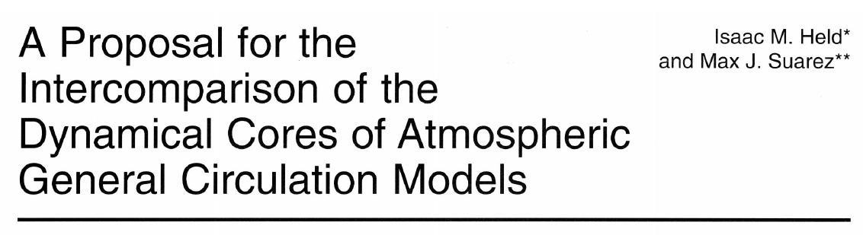
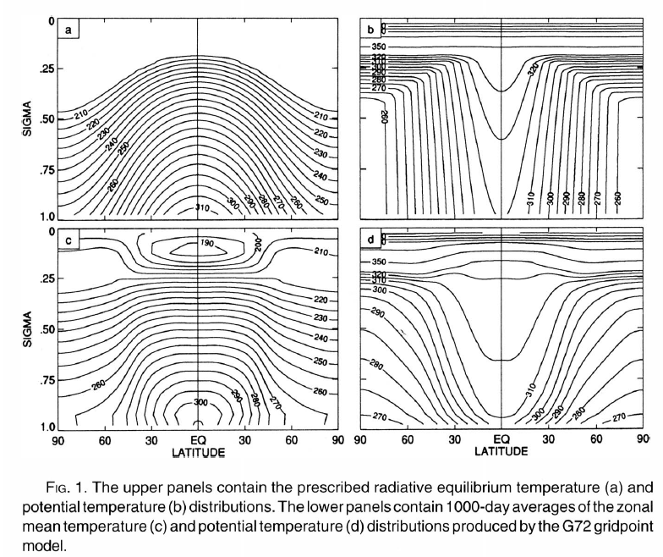
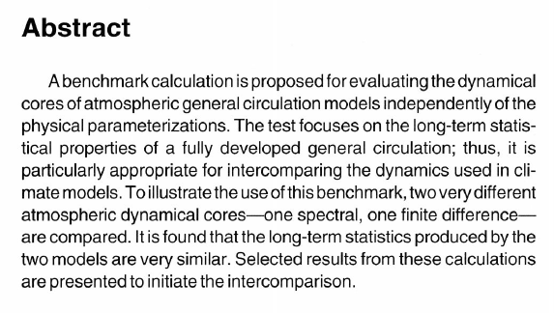
Held and Suarez
Bull. American Met. Soc. 1994

Slide 7
The ICTP intermediate-complexity general circulation model (SPEEDY)
SPEEDY : Simplified Parametrization, primitivE-Equation Dynamics
Prognostic variables:
  Vorticity
  Divergence
  Temperature
  Specific humidity
  Surface pressure
Each variable on one layer is represented by ~900 spherical harmonic coefficients (T30)
The latest version uses 8 atmospheric layers, 6 in the troposphere and 2 in the stratosphere, with the lowest layer representing the PBL.
Simplified parametrizations of:
  Surface fluxes of momentum, heat and water
  Solar and infrared radiation, including cloud reflection/absorption
  Shallow and deep convection

Slide 8
σ = 0. |  |  | σ’ = dσ/dt = 0
σ = 0.025 (30 hPa) | ----------------------- | ζ, D, T, Ф
 | Stratosphere |  | σ'
σ = 0.095 (100 hPa) | ----------------------- | ζ, D, T, Ф
 |  |  | σ'
σ = 0.200 (200 hPa) | ----------------------- | ζ, D, T, S_{h}, Ф
 |  |  | σ'
σ = 0.340 (300 hPa) | ----------------------- | ζ, D, T, S_{h}, Ф
 | “free” |  | σ'
σ = 0.510 (500 hPa) | ----------------------- | ζ, D, T, S_{h}, Ф
 | troposphere |  | σ'
σ = 0.685 (700 hPa) | ----------------------- | ζ, D, T, S_{h}, Ф
 |  |  | σ'
σ = 0.835 (850 hPa) | ----------------------- | ζ, D, T, S_{h}, Ф
 |  |  | σ'
σ = 0.950 (925 hPa) | -------- PBL -------- | ζ, D, T, S_{h}, Ф
σ = 1. |  | p₀ | σ’ = dσ/dt = 0
Atmospheric
layers in
SPEEDY (T30)
σ = p / p₀
_{Total no of DOF:}
_{~ 900 * 39 ≈ 35000}

Slide 9
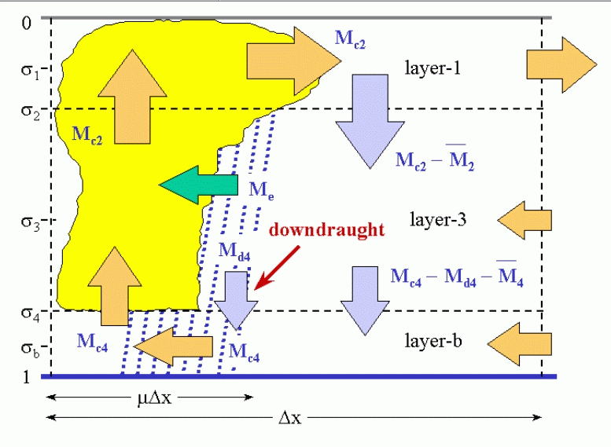
A mass-flux approach to convection

Slide 10
The ECMWF Integrated Forecasting System (IFS) atmospheric model
Prognostic variables:
  U and V wind components (computed from vorticity and divergence in spectral space)
  Temperature
  Surface pressure (log)
  6 moisture variables: specific humidity, cloud fraction, cloud liquid and ice water content, rain and snow water content
On one level, each “dry” variable is represented by ~1.6 10⁶ spherical harmonic coefficients (T1279)
On one level, each moisture variable is represented by ~6.5 10⁶ grid point values (~9 km resolution)
The operational version uses 137 atmospheric layers, with a total of ~ 6 10⁹ degrees of freedom
State-of-the art parametrizations of:
  Surface fluxes of momentum, heat and water
  Solar and infrared radiation, including cloud reflection/absorption
  Shallow and deep convection
  Cloud microphysics
  Orographic and non-orographic gravity wave drag

Slide 11
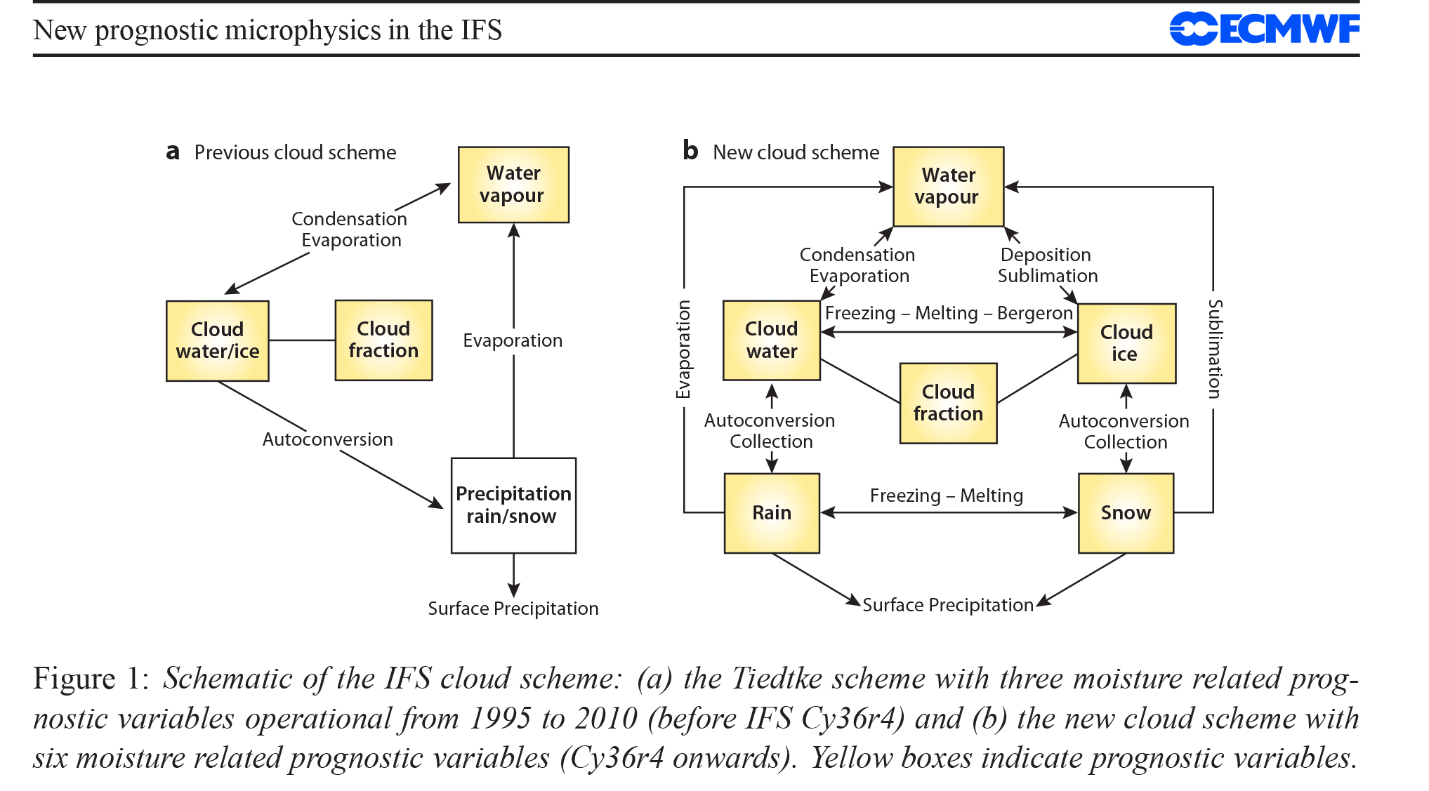
IFS microphysics (Forbes, Tompkins & Untch 2011, ECMWF Tech Memo 649)

Slide 12
ECMWF coupled ensemble forecasting system
Atmosphere model
ECMWF IFS
~32km / 91 levels
Coupler
(integrated
into IFS)
Ocean model
NEMO v3.4
0.25 deg./ 75 levels
Land surface model
H-TESSEL
Sea-ice model
LIM-2 (single categ.)
Atm. data assimilation
(4-D variational)
Generation
of I.C.
perturbations
Coupled
GCM
Ocean data assimil.
(3-D variational)
Initial Conditions
Ensemble Forecast

Slide 13
The result of an atmospheric model simulation depends on:
The model formulation (dynamical core, physical parametrizations)
The initial conditions for the model state vector
Prescribed boundary conditions (solar energy flux at TOA, ocean/sea-ice conditions and land surface properties in uncoupled simulations)
Prescribed (fixed or time evolving) atmospheric chemical composition
Errors in atmospheric I.C. are particularly important in weather forecasts (typically up to one week), while errors in ocean conditions dominate in seasonal and multi-year forecasts
Changes in atmospheric composition drive simulations of anthropogenic climate change (climate projections), but are also important in multi-decadal series of re-forecasts for the historical period

Slide 14

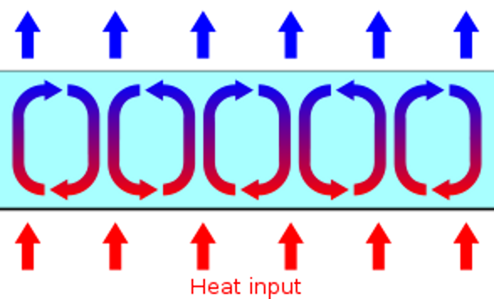
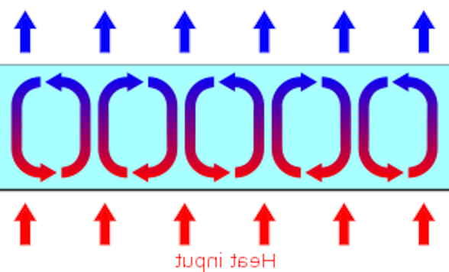
An atmospheric model is a dynamical system with its own attractor
A highly truncated model of Rayleigh-Benard convection in a layer of fluid heated from below (Lorenz 1963)
dX/dt = σ (Y – X)
dY/dt = - X Z + r X – Y
dZ/dt = X Y – b Z
X, Y > 0 X, Y < 0

Slide 15
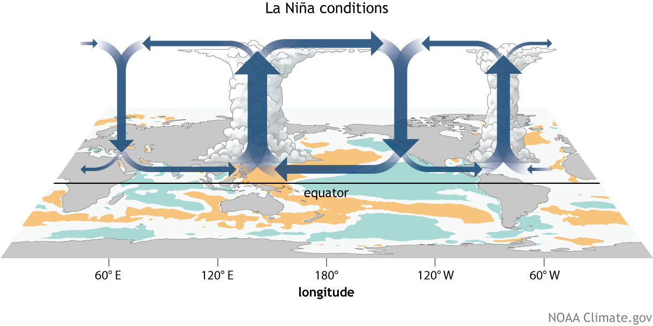
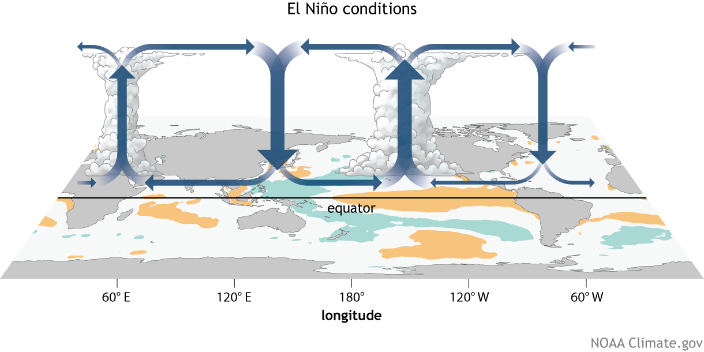
Changes in the tropical circulation associated with the El Nino – Southern Oscillation

Slide 16
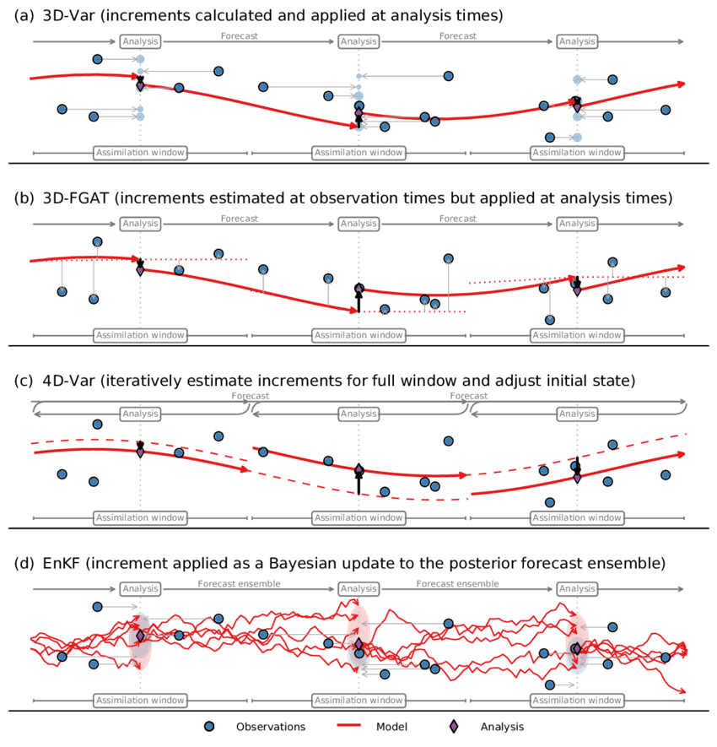
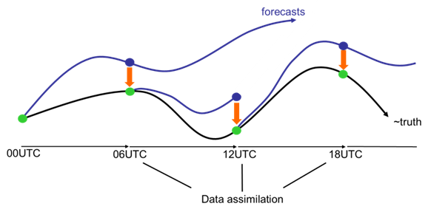
In weather forecasts and seasonal prediction, initial conditions are specified to fit observed values at the start of the integration using a variety of data assimilation schemes

Slide 17
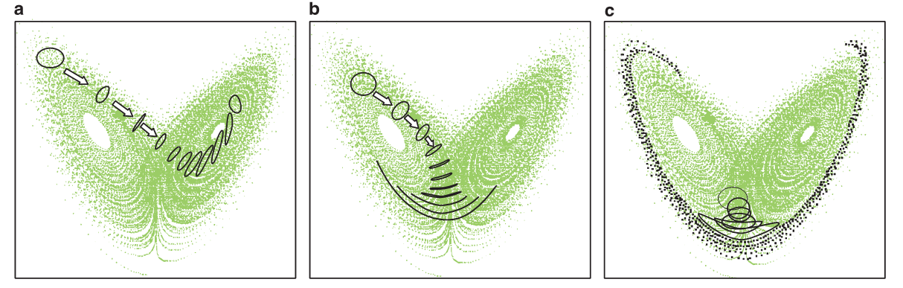
Sensitivity to initial conditions in non-linear, chaotic systems

Slide 18
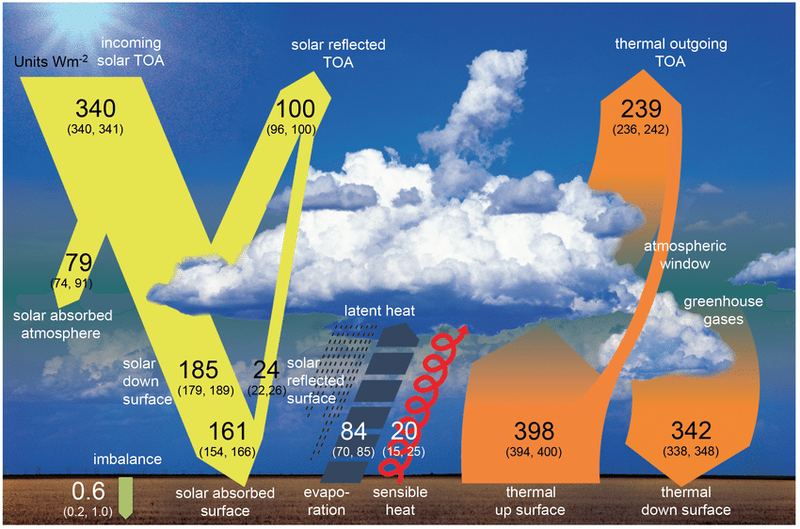
The global energy balance in the current climate
~ 93% of the global
energy flux imbalance ΔF is absorbed by the oceans
In the atmosphere, we only need an imbalance ΔF’ of ~ 0.04 W/m²
to explain a trend of
1 ºK/century

Slide 19
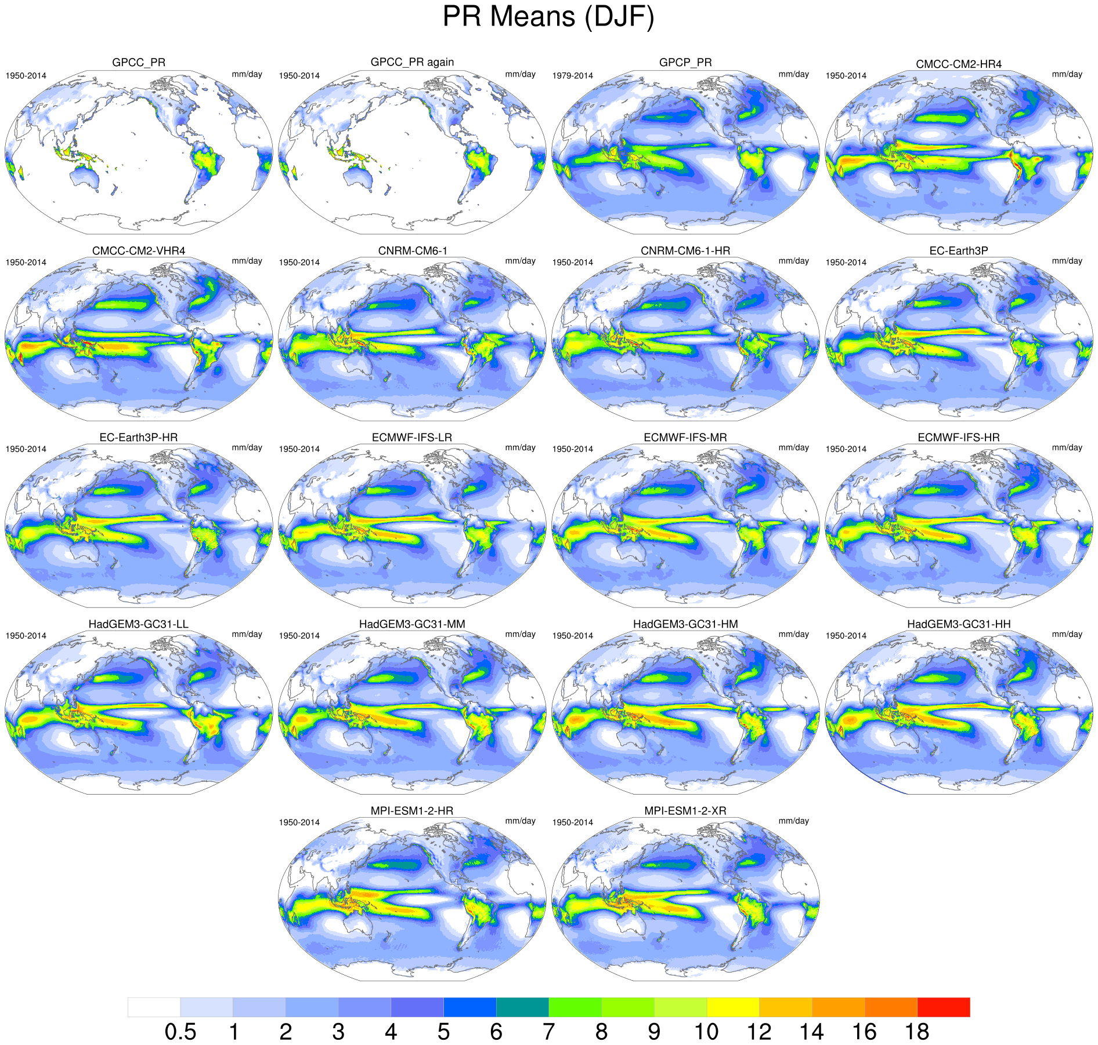
Simulation of boreal winter rainfall in CMIP6/HighResMIP historical simulations for the PRIMAVERA project (from CERFACS)

Slide 20
Zonal-mean temperature and wind biases in ECMWF seasonal forecasts
(Johnson et al. 2019)

Slide 21
Strategies to account for climate drift
Real-world initialization (seasonal & decadal predictions)
  The climate model is initialised from the observed state of the climate system at a specific time
  Re-forecasts are run from past dates (eg in the last 20-30 years) using re-analyses as I.C.
  Biases are computed from re-forecasts and re-analyses as a function of seasonal and fc. time
  The estimated biases are subtracted from model output to create forecast products
Anomaly initialization (alternative for decadal predictions)
  The model is run for a long period of time from an arbitrary I.C. until its climatology is quasi-stable (ie biases do not grow significantly with increasing integration time)
  The observed anomaly at a given time is superimposed to the model climate to initialise the model, and forecasts are expressed as anomalies from the model climate
Simulation of response to time-varying radiative forcings (multi-decadal “historical” and climate scenario runs)
  The model is run for a long period of time from an arbitrary I.C. until its climatology is quasi-stable (ie biases do not grow significantly with integration time), with radiative forcings appropriate for a reference time T₀
  At the end of the “spin-up” run, the model integration is restarted with both constant forcings and time-varying forcings appropriate for either the historical period or a future scenario
  The difference between the two runs provides an estimate of the climate response to varying forcing

Slide 22
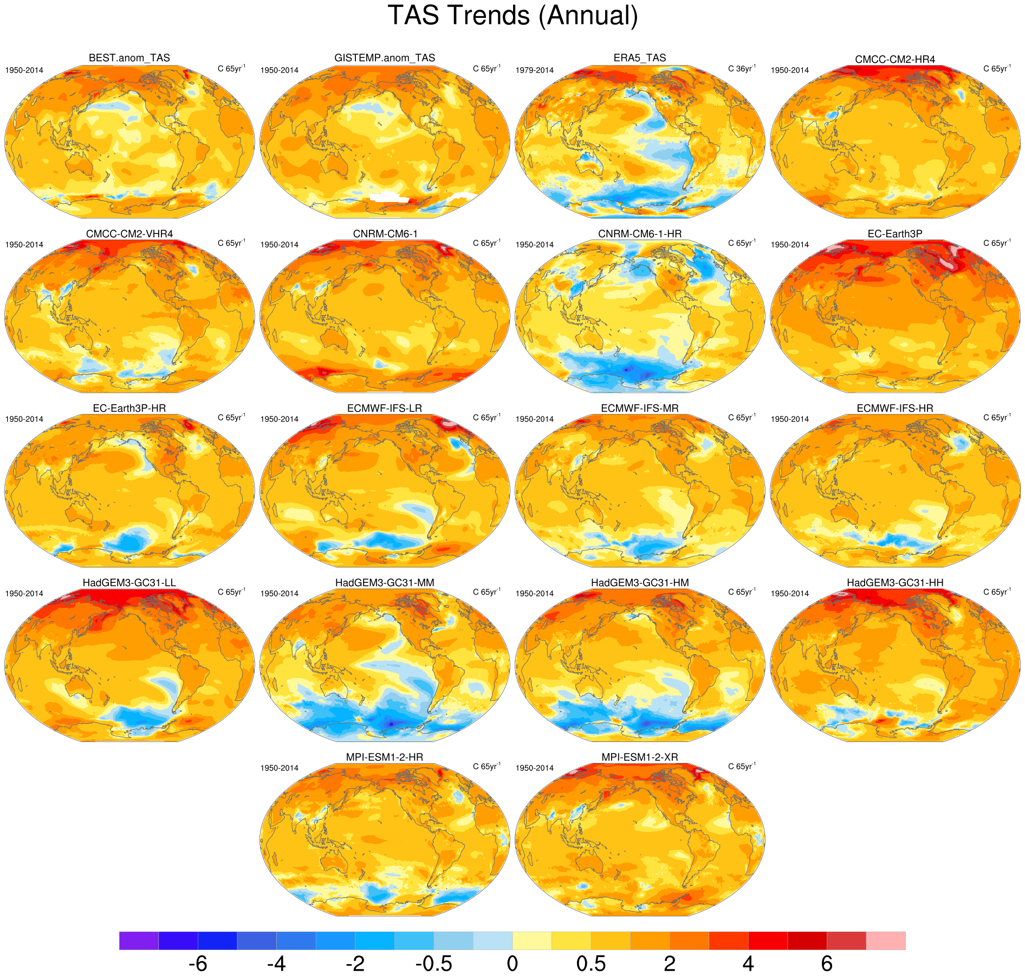
65-year trends of near-surface air temperature in CMIP6/HighResMIP historical simulations for the PRIMAVERA project
(from CERFACS)

Slide 23
Summary
Global atmospheric models use a variety of numerical methods to describe the evolution of atmospheric variables on a 3-dimensional grid.
The numerical equations representing the motions involving both horizontal and vertical transport are called the “dynamical core” of the model; physical parameterizations describe sub-grid scale phenomena which only involve transport within a vertical column.
Global models are dynamical systems with their own climatology; depending on the time scales, different strategies have been used to cope with the difference between the real-world and the model climatology.
Global atmospheric models exhibit chaotic dynamics, which implies sensitivity of error growth to initial conditions; errors arising from amplification of initial errors will also affect AI-based models.
Because of the compensation between sources and sinks of energy in the atmosphere, significant discrepancies in the net energy balance at the surface and the atmospheric top may arise from relatively small errors in the parametrization of individual processes. An AI approach focussing on net tendencies may be beneficial in this respect and lead to more realistic model climatologies.

