Slide 1
PSoC Architecture & Design Methodology
Cristian Sisterna
Senior Associate, ICTP-MLAB
Universidad Nacional San Juan- Argentina

Slide 2
Agenda
01
FPGA Architecture
02
PSoC Architecture
03
PSoC Design Flow
04
PSoC Design Methodoloy
05
TCL – Overview and Usage

Slide 3
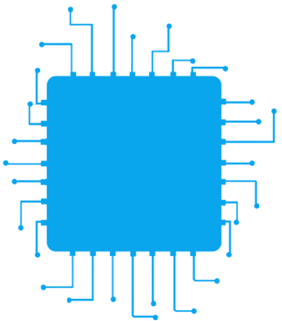
FPGA Architecture

Slide 4
FPGA – PSoC Applications
Source: Logic Fruit Technology

Slide 5
FPGA – SoPC Evolution

Slide 6
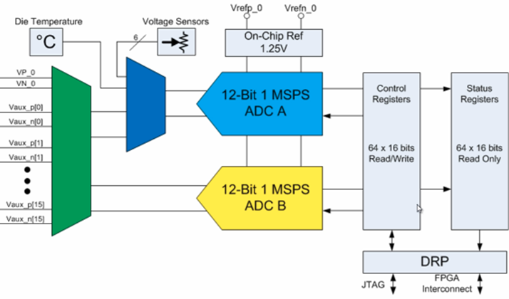
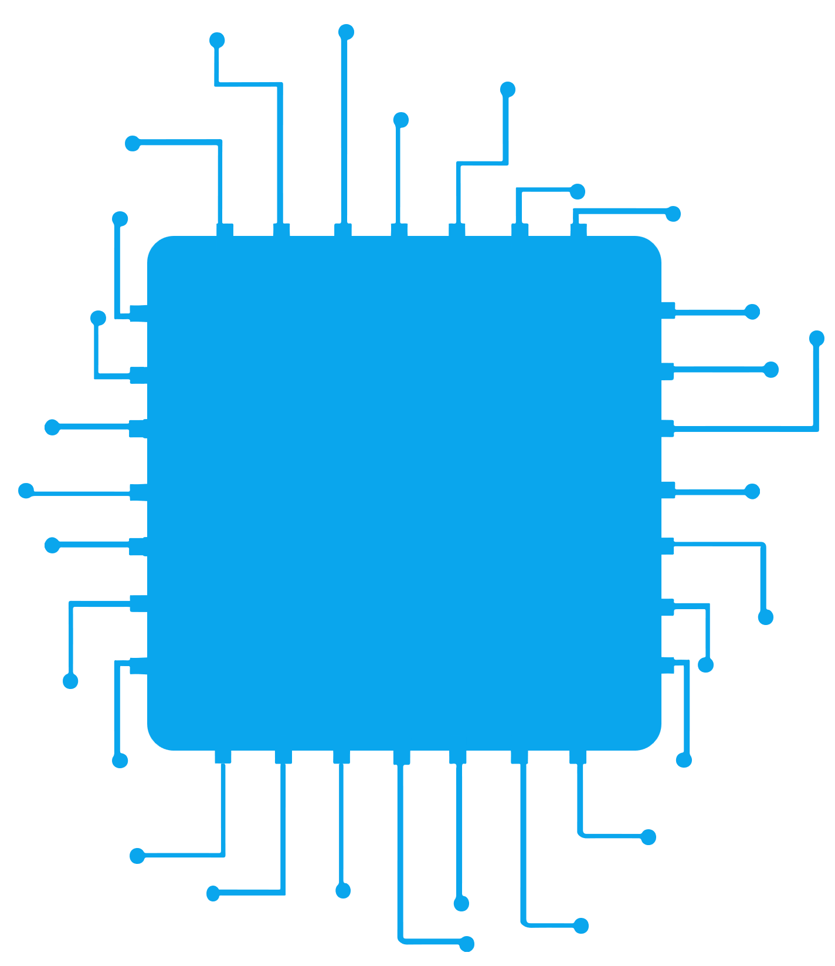
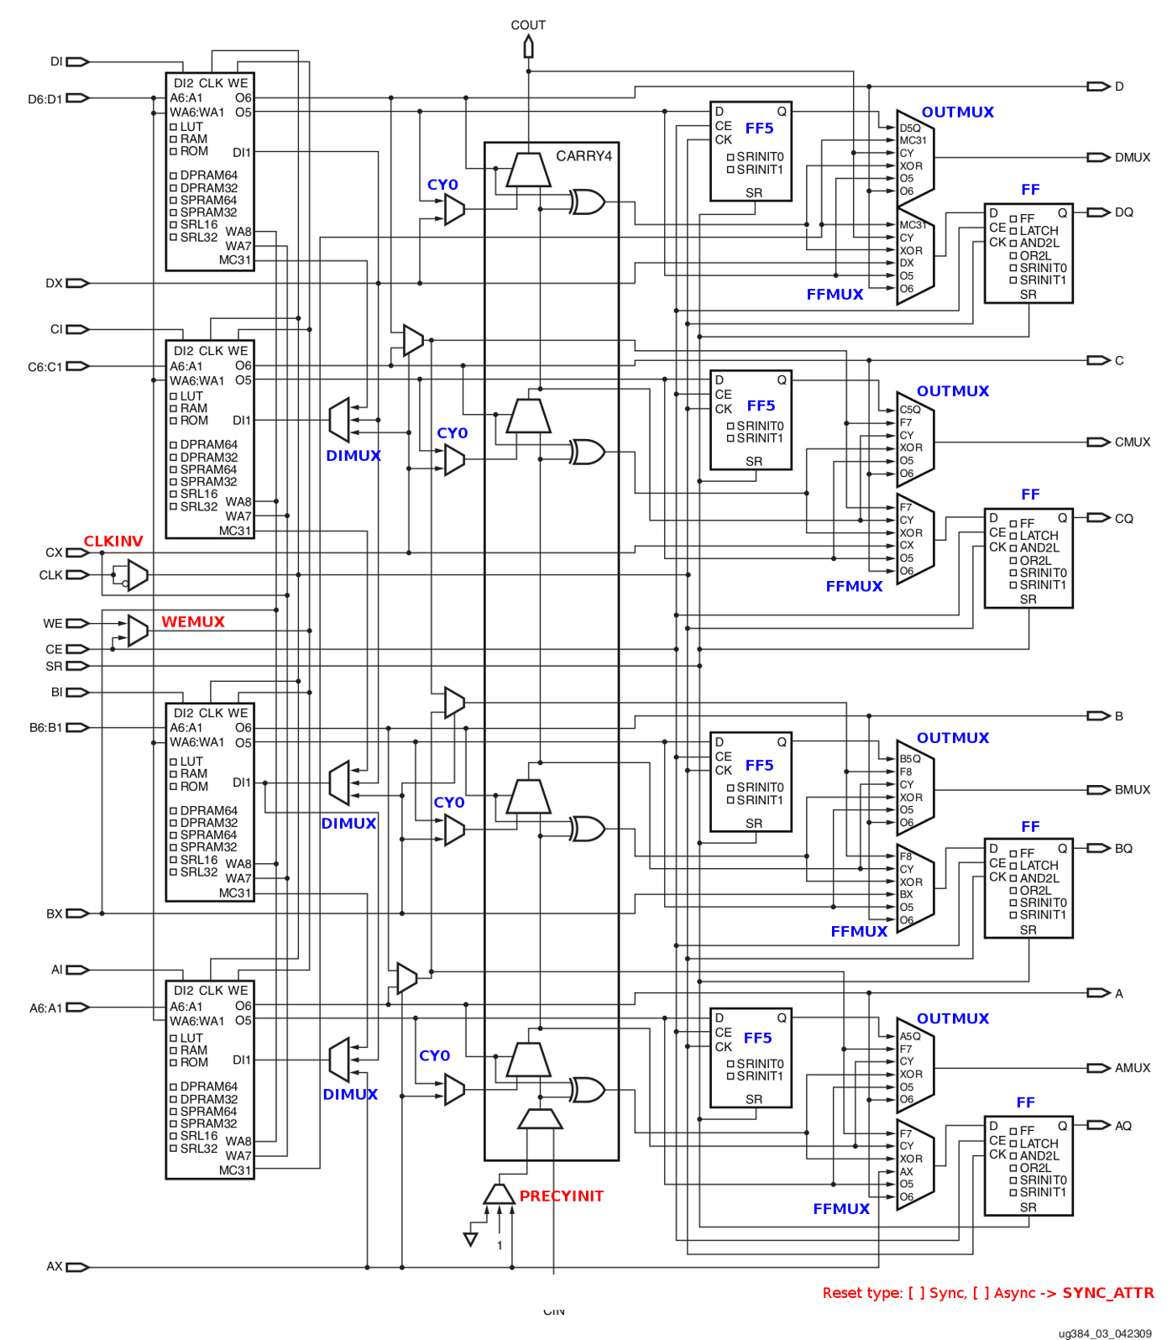
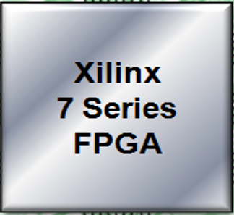
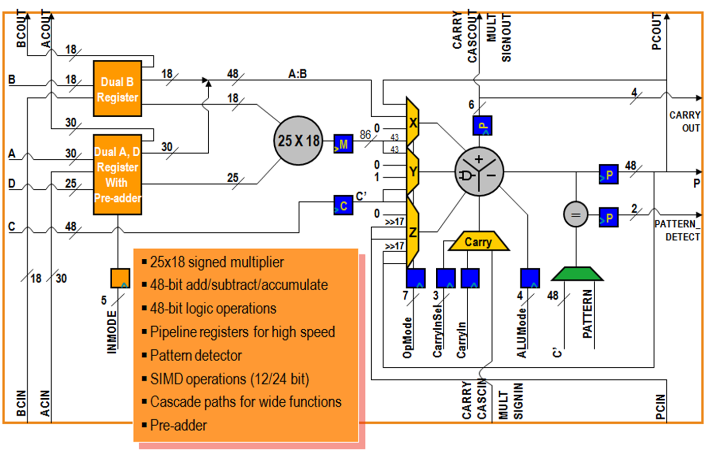
What is an FPGA ?

Slide 7
FPGA ~ Lego Bricks

Slide 8
AMD 7-Series Architecture – Common Elements
Common elements enable easy IP reuse for quick design portability across all 7-series families
Design scalability from low-cost to high-performance
Quickest time to market

Slide 9
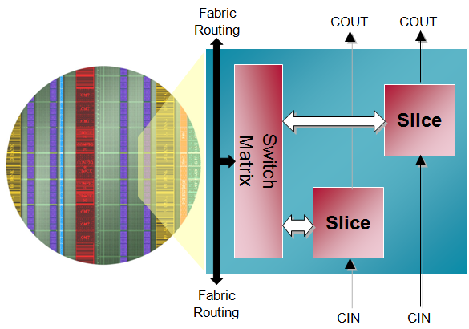
Logic Resources - CLB
Each CLB contains two slices:
Primary resource for design
Combinatorial functions
Flip-flops
Connected to switch matrix for routing to other FPGA resources
Carry chain runs vertically in a column from one slice to the one above

Slide 10
AMD-FPGA SLICE

Slide 11
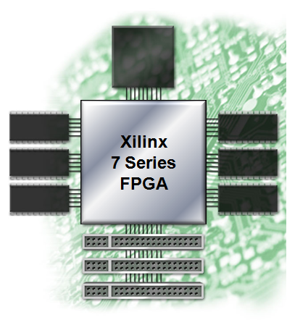
7-Series FPGA - Inputs/Outputs
Wide range of voltages
1.2V to 3.3V operation
Many different I/O standards
Single ended and differential
Referenced inputs
3-state support
Very high performance
Up to 1600 Mbps LVDS
Up to 1866 Mbps single-ended for DDR3
Easy interfacing to standard memories
Hardware support for QDRII+ and DDR3
Digitally controlled impedance
Low power

Slide 12
Most Common I/Os Standards Available
Standard | VCCO | Vref | Application
LVTTL | 3.3 | na | Single ended General Purpose
LVCMOS25, -18, -15 | 2.5, 1.8, 1.5 | na
LVDS33, 25, 18 | 3.3, 2.5, 1.8 | na | Low Voltage Differential
PCI 33/66 MHz, 3.3V | 3.3 | na | PCI Bus
GTL / GTL+ | na | 0.80 | Back-Plane
HSTL-I, HSTL-III | 1.5 | 0.75 | SRAM
SSTL3-I, -II, SSTL2-I | 3.3 | 0.90, 1.5 | SDRAM

Slide 13
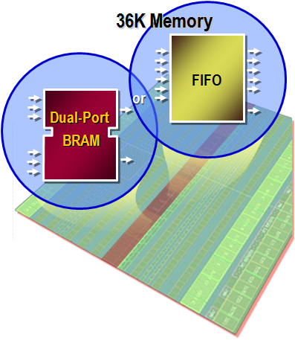
7-Series Block RAM and FIFO
All members of the 7-series families have the same Block RAM/FIFO
Fully synchronous operation
All operations are synchronous; all outputs are latched
Optional internal pipeline register for higher frequency operation
Two independent ports access common data
Individual address, clock, write enable, clock enable
Independent data widths for each port
Multiple configuration options
True dual-port, simple dual-port, single-port
Integrated control for fast and efficient FIFOs

Slide 14
7- Series DSP48E1 Slice

Slide 15
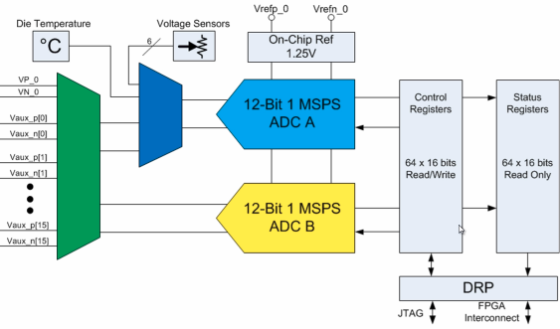
XADC and Analog Mixed Signals (AMS)
XADC is a high quality and flexible analog interface new to the 7-series
Dual 12-bit 1Msps ADCs, on-chip sensors, 17 flexible analog inputs, and track & holds with programmable signal conditioning
1V input range (unipolar, bipolar and differential)
12-bit resolution conversion
Built in digital gain and offset calibration
On-chip thermal and Voltage sensors
Sample rate of 1 MSPS
Analog Mixed Signal (AMS)
Using the FPGA programmable logic to customize the XADC and replace other external analog functions; for example, linearization, calibration, filtering, and DC balancing to improve data conversion resolution
https://henryomd.blogspot.com/2015/06/bare-metal-code-to-read-adc-on-zynq.html

Slide 16
7-Series FPGA Families

Slide 17
Zynq-PSoC Architecture

Slide 18
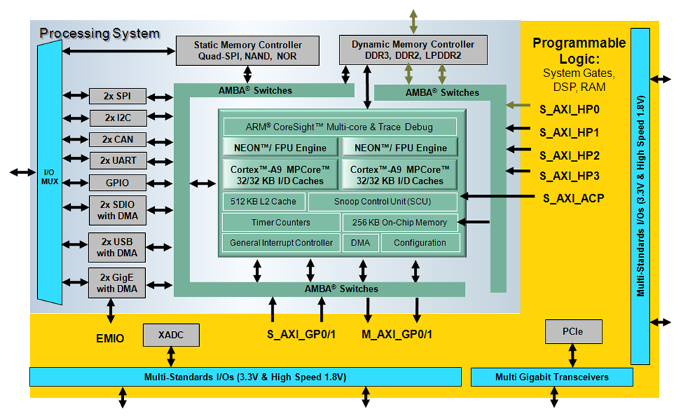
Zynq PSoC Block Diagram

Slide 19
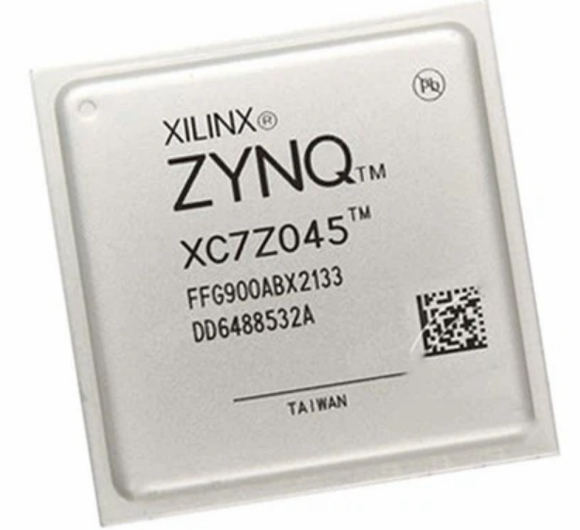
Zynq-7000 Main Features
Flexible array of I/O
Wide range of external multi-standard I/O
High-performance integrated serial transceivers
Analog-to-digital converter inputs
Complete ARM®-based processing system
Application Processor Unit (APU)
Dual ARM Cortex™-A9 processors
Caches and support blocks
Fully integrated memory controllers
I/O peripherals
Tightly integrated programmable logic
Used to extend the processing system
Scalable density and performance

Slide 20
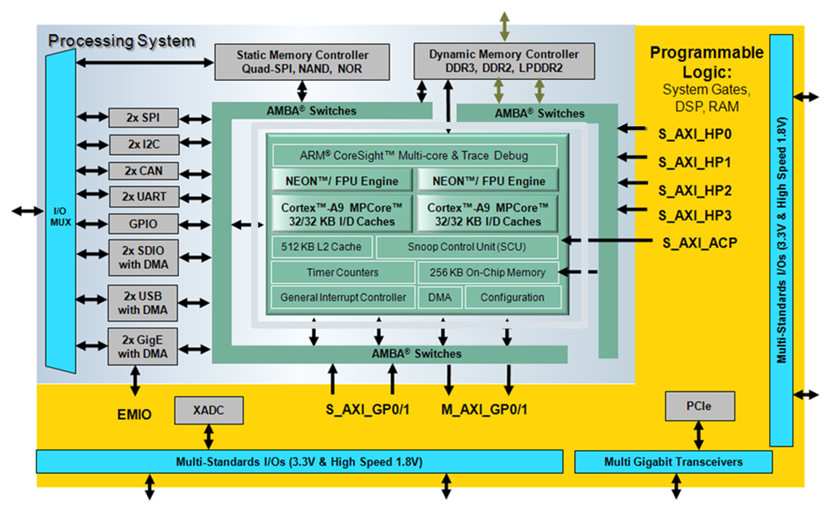
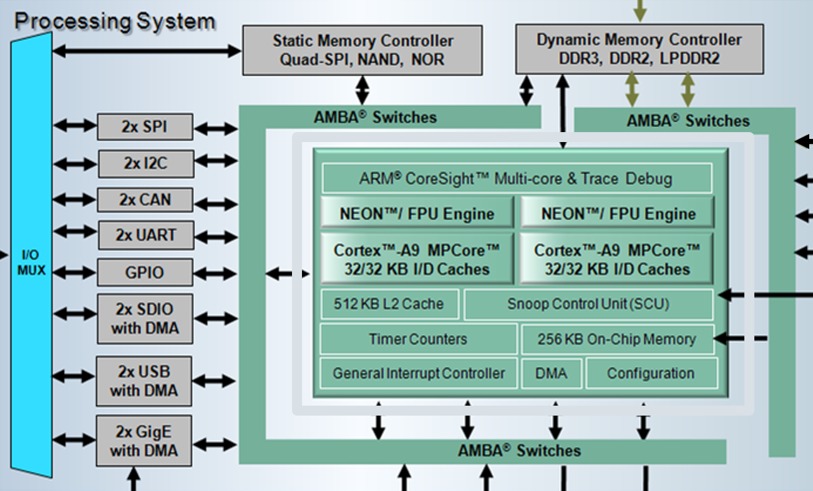
Zynq PS Main Components
Application processing unit (APU)
DMA
Timers
Public and private
General interrupt controller (GIC)
On-chip memory (OCM): RAM
Debug controller: CoreSight
I/O peripherals (IOP)
Multiplexed I/O (MIO), extended multiplexed I/O (EMIO)
Memory interfaces
PS interconnect

Slide 21
Zynq PL Main Components
Configurable logic blocks (CLB)
6-input look-up tables (LUTs)
Memory capability within the LUT
Register and shift register functionality
36 Kb BRAM
DSP48E1 Slice
Clock management
Configurable I/Os (HR/HP)
High Speed Serial Transceivers
Integrated interface for PCI Express
Zynq | FPGA Based Fabric
7z010, 7z015, 7z020 | Artix
7z030, 7z035, 7z045, 7z100 | Kintex
Notes:
The Zynq®-7000 AP SoC devices integrates a feature-rich dual-core ARM® Cortex™-A9 MPCore™ based processing system (PS) and Xilinx programmable logic (PL) in a single device. Each Zynq-7000
device contains the same PS while the PL and I/O resources vary between the devices. The PL of the three smallest devices, the 7z010, 7x015, and 7z020, is based on Artix®-7 FPGA logic. The three
biggest devices, the 7z030, 7z035, 7z045, and 7z100 are based on Kintex®-7 FPGA logic.
The PS and PL can be tightly or loosely coupled using multiple interfaces and other signals that have a combined total of over 3,000 connections. This enables the designer to effectively integrate
user-created hardware accelerators and other functions in the PL logic that are accessible to the processors and can also access memory resources in the PS. Zynq customers are able to differentiate
their product in hardware by customizing their applications using PL.
Features
The PL provides a rich architecture of user-configurable capabilities. The key features are:
• Configurable logic blocks (CLB)
° 6-input look-up tables (LUTs)
° Memory capability within the LUT
° Register and shift register functionality
Cascadable adders
• 36KB block RAM
° Dual port
° Up to 72 bit-wide
° Configurable as dual 18 KB
° Programmable FIFO logic
° Built-in error correction circuitry
• Digital signal processing – DSP48E1 Slice
° 25 × 18 two's complement multiplier/accumulator high-resolution 48-bit multiplier/accumulator
° Power saving 25-bit pre-adder to optimize symmetrical filter applications
° Advanced features: optional pipelining, optional ALU, and dedicated buses for cascading
• Clock management
° High-speed buffers and routing for low-skew clock distribution
° Frequency synthesis and phase shifting
° Low-jitter clock generation and jitter filtering
• Configurable I/Os
° High-performance SelectIO technology
° High-frequency decoupling capacitors within the package for enhanced signal integrity
° Digitally controlled impedance that can be 3-stated for lowest power, high-speed I/O operation
° High-range (HR) I/O supporting 1.2V to 3.3V
° High performance (HP) I/Os support 1.2V to 1.8V (7z030, 7z035, 7z045, and 7z100 devices)
• Low-power serial transceivers (7z015, 7z030, 7z035, 7z045 and 7z100 devices)
° High-performance transceivers capable of up to 12.5 Gb/s (GTX) in 7z030, 7z035, 7z045, and 7z100 devices.
° High-performance transceivers capable of up to 6.25 Gb/s (GTP) in 7z015 device.
° Low-power mode optimized for chip-to-chip interfaces
° Advanced transmit pre and post emphasis, and receiver linear (CTLE) and decision feedback
equalization (DFE), including adaptive equalization for additional margin
• Integrated interface block for PCI Express designs
° Compatible with the PCI Express Base Specification 2.1 with Endpoint and Root Port capability
° Supports Gen2 (5.0 Gb/s)
° Advanced configuration options, advanced error reporting (AER), and end-to-end CRC (ECRC) advanced error reporting and ECRC features

Slide 22
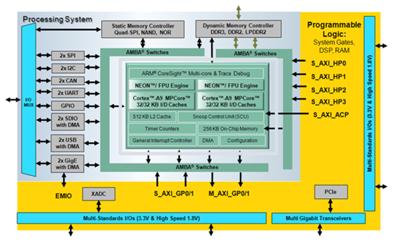
Zynq PS-PL Interface
AXI high-performance slave ports (HP0-HP3)
Configurable 32-bit or 64-bit data width
Access to OCM and DDR only
Conversion to processing system clock domain
AXI FIFO Interface (AFI) are FIFOs (1KB) to smooth large data transfers
AXI general-purpose ports (GP0-GP1)
Two masters from PS to PL
Two slaves from PL to PS
32-bit data width
Conversion and sync to processing system clock domain

Slide 23
Zynq PS-PL Interface
One 64-bit accelerator coherence port (ACP) AXI slave interface to CPU memory
DMA, interrupts, events signals
Processor event bus for signaling event information to the CPU
PL peripheral IP interrupts to the PS general interrupt controller (GIC)
Four DMA channel RDY/ACK signals
Extended multiplexed I/O (EMIO) allows PS peripheral ports access to PL logic and device I/O pins
Clock and resets
Four PS clock outputs to the PL with enable control
Four PS reset outputs to the PL
Configuration and miscellaneous

Slide 24
Zynq Architecture
AXI Masters
HP0
OCM and DDR Interconnect
OCM
PS
DDR3 DRAM Controller
AXI
HP1
HP2
L2
ARM9
HP3
L1
AXI Master
64 bits
Snoop Control Unit (SCU)
ACP
Interconect
MGP0
DMA Controller
L1
ARM9
AXI Slaves
AXI
MGP1
AXI Masters
SGP0
APU
SGP1
Peripherals Interconnect
PL
SPI, CAN, SD, Ethernet, USB, UART,…
EMIO
Notes:
Having thse definitions for axi interfaces in mind we will go ahead and have a relook at the architecture of the Xilinx Zynq device.
Let go back and see in detail the AXI interfaces that we have between the PL and the PS.
First let’s take a look at the HP interface ports. (aparecer cuadraro marcando la zona, y el cartel de 64 bits): HP0… HP# which are called High Performance interfaces. This HP interfaces are SLAVE for the logic we develop inside the PL, so practically they are axi slave ports for the PS. All of these ports as it was described before they are memory map ports, there is no streaming ports in here. Let’s focus in this ports, each ports is 64 bits. The logic that you dvelopo in the PL should contain AXI Master clock, or AXI master interface. Trhoguh this axi master interface you can get connected to this axi slave interfaces (HPx) and this axi slave ports redirect you to the address space in the PS. So, for instance the logic in the PL can initiate Rd/Wr transactions over the DDR3 memory or to the OCM . On the other hand the CPU has also access to the DRAM memory, therefore, the AXI master in the PL and the PS can share data through the DRAM memory.
Then , we have these two AXI master ports they are called MGP0 and MGP1 (aparecer cuadro de MGP y 32 bits, y desaparecer cuadro the HP). These ports are vey important bescause they are the only master ports of the PS, it means that I need to develop and AXI Slave interface for the module that I will implement in the PL, so that the logic I have in the PS can initiate transactions with the logic that I have in the PL. For instance, using these MGP ports the CPU core that we have in the PS, can initiate Rd/Wr transaction on the logic implemented in the PL. Tehrefore, the AXI Slave block in the PL should respond to the initiated transaction. Keep in mind that the ports are memory mapped locations. These two ports are the main means that the ARM can control the hardware developed in the PL part, it is also commonly used as Hardware Accelerator: CPU send data to the PL to process them then the PL return the processed data (usually processes that could require a lot of CPU time). Furthermore, these two ports are also the main engine that the DMA Controller (on the PS) can perform Rd/Wr directly on the logic developed in the PL part.
Next, Accelerator Coherence Port (aparecer cuadrado, desaparecer otro cuadrad0) is very similar to the HP port. It’s an AXI Slave port to carry out Rd/Wr transaction to the PS. The main diff with the HP ports, is that the ACP port is connected directly to the SCP; and the SCP is connected to the caches of the CPU (L1 cache and L2 cache). So, whenever the transaction is initiated by the master you have in the PL, then first the cache of the CPU will be checked for coherence of the data. If an instance of the data is available, then maybe if all the conditions are met, the transaction will be responded by the data in the caches, this allows faster data transfer from the PS to the PL. If for the address transaction initiated by the Master there is no data or copy of the data, then through the communication between L2 and DDR3 Controoler the transaction maybe redirected to the DRAM memory, and the data will be obtained from the DDR memory, Of course this introduces an additional latency, which may degrade the performance of your system. The use of the ACP port should be done with extreme caution. Also, the OCM can be reached by the logic in the PL through the SCU (ACP->SCU->OCM).
Finally the SGP# ports, there are two slave general purpose ports, therefore we need to develop AXI Master interface in the PL. This is the main mean to access to the PS Peripherals from the PL. These ports are also 32 bits wide.
The DMA controller is interconnected to: Peripherals interconnect, OCM interconnect, and DDR Controller.

Slide 25
PS-PL AXI Interfaces
Interface Name | Interface Description | Master | Slave
M_AXI_GP0 | General Purpose (AXI_GP) | PS | PL
M_AXI_GP1 |  | PS | PL
S_AXI_GPO | General Purpose (AXI_GP) | PL | PS
S_AXI_GP1 |  | PL | PS
S_AXI_ACP | Accelerator Coherence Port | PL | PS
S_AXI_HP0 | High Performance Ports (AXI_HP)with read/write FIFOs and two dedicated memory ports on DDR controller and a path to the OCM | PL | PS
S_AXI_HP1 |  | PL | PS
S_AXI_HP2 |  | PL | PS
S_AXI_HP3 |  | PL | PS
Notes:
The PS side of the AXI interfaces are based on the AXI 3 interface specification. Each interface consists of multiple AXI channels. The interfaces are summarized in Table 2-6. Over a thousand
signals are used to implement these nine PL AXI interfaces.
The accelerator coherency port (ACP) is a 64-bit AXI slave interface on the SCU that provides an asynchronous cache-coherent access point directly from the PL to the Cortex-A9 MP-Core processor
subsystem. A range of system PL masters can use this interface to access the caches and the memory subsystem exactly the way the APU processors do to simplify software, increase overall system
performance, or improve power consumption. This interface acts as a standard AXI slave and supports all standard read and write transactions without any additional coherency requirements
placed on the PL components. Therefore, the ACP provides cache-coherent access from the PL to ARM caches while any memory local to the PL are non-coherent with the ARM.

Slide 26
PS-PL Interface Performance
Method | Benefits | Drawbacks | Usage | Performance
PL AXI-HP DMA | Highest throughput Multiple interfaces Command/Data FIFO | OC/DDR access only Complex PL Master design | HP DMA for large datasets | 1.200 MB/s (per interface)
PL AXI-ACP DMA | - Highest throughput Lowest latency Optional cache coherency | Large burst might cause cache trashing Shares CPU interconnect bandwidth Complex PL Master design | HP DMA for smaller coherent datasets Medium granularity CPU offload | 1.200 MB/s
PL AXI-GP DMA | Medium throughput | More complex PL Master design | PL to PS control functions PS I/O Peripheral access | 600 MB/s
CPU Programmed I/O | Simple Sw Least PL resources Simple PL Slave | Lowest throughput | Control functions | < 25 MB/s
Notes:
Page 660 UG585
CPU: The least intrusive method from a software perspective is to use the Cortex-A9 to move data between the PS and PL (see Figure 22-1). Data flow is directly moved by a CPU, removing the need
to handle events from a separate DMA. Access to the PL is provided through the two M_AXI_GP master ports, which each have a memory address range to originate PL AXI transactions. The PL
design is also simplified since as little as a single AXI slave can be implemented to service the CPU requests.
Drawbacks of using a CPU to move data is that a sophisticated CPU is spending cycles performing simple data movement instead of complex control and computation tasks, and the limited
throughput available. Transfer rates less than 25 MB/s are reasonable with this method.
PS DMA Controller (DMAC) via General Purpose Masters
The PS DMA controller (DMAC) provides a flexible DMA engine that can provide moderate levels of throughput with little PL logic resource usage (see Figure 22-2). The DMAC resides in the PS and
must be programmed via DMA instructions residing in memory, typically prepared by a CPU. With support for up to eight channels, multiple DMA fabric cores can potentially be served in the single
DMAC. However, the flexible programmable model might increase software complexity relative to CPU transfer or specialized PL DMA.
The DMAC interface to the PL is through the general purpose AXI master interfaces, whose 32-bit width along with the centralized DMA nature (a read and write transaction for each movement) of the
DMAC to limit the DMAC from highest throughput. A peripheral request interface also allows PL slaves to provide status to the DMAC on buffer state, to prevent transactions involving a stalled PL
peripheral from unnecessarily also stalling interconnect and DMAC bandwidth.
See Chapter 9, DMA Controller for more information on the DMAC controller. More information on the M_AXI_GP interfaces can be found in Chapter 5, Interconnect
PL DMA via AXI High-Performance (HP) Interface
The high-performance (S_AXI_HP) PL interfaces provide high-bandwidth PL slave interfaces to OCM and DDR memories. The AXI_HP ports are unable to access any other slaves. With four, 64-bit wide
interfaces, the AXI_HP provide the greatest aggregate interface bandwidth. The multiple interfaces also save PL resources by reducing the need to a PL AXI interconnect. Each AXI_HP contains control
and data FIFOs to provide buffering of transactions for larger sets of bursts, making it ideal for workloads such as video frame buffering in DDR. This additional logic and arbitration does result in
higher minimum latency than other interfaces.
The user IP logic residing in the PL will generally consist of a low-speed control interface and higher performance burst interface, as shown in Figure 22-3. If control flow is orchestrated by the
Cortex-A9 CPU, the general purpose M_AXI_GP port can be used for tasks such as configuring the memory addresses the User IP should access and transaction status. Transaction status can also be
conveyed via PL to PS interrupts. Higher performance devices connected to AXI_HP should be able to issue multiple outstanding transactions to take advantage of the AXI_HP FIFOs.
The PL design complexity of multiple AXI interfaces along with the associated PL utilization are the primary drawbacks of implementing a DMA engine in the PL for both S_AXI_HP and S_AXI_ACP
interfaces.
See Chapter
PL DMA via AXI ACP
The AXI ACP interface (S_AXI_ACP) provides a similar user IP topology as the high performance S_AXI_HP interfaces. Also 64 bits wide, the ACP also provides highest throughput capability for a
single AXI interface. As shown in Figure 22-4, the User IP topology is likely often similar to the S_AXI_HP example in the previous section.
The ACP differs from the HP performance ports due to its connectivity inside of the PS. The ACP connects to the snoop control unit (SCU) which is also connected to the CPU L1 and the L2 cache.
This connectivity allows ACP transactions to interact with the cache subsystems, potentially decreasing total latency for data to be consumed by a CPU. These optionally cache-coherent
operations can prevent the need to invalidate and flush cache lines. The ACP also has the lowest memory latency to memory of the PL interfaces. The connectivity of the ACP is similar to that of the
CPUs.
The drawbacks from using the ACP besides those shared with the S_AXI_HP interfaces also stem from the locality to the cache and CPUs. Memory accesses through the ACP utilize the same interconnect
paths as the APU, potentially decreasing CPU performance. Large, coherent ACP transfers can cause thrashing of the cache. Thus ACP coherent transfers are best suited for less than the largest
data-sets. The ACP low-latency access allows opportunity for algorithm acceleration of medium granularity.
PL DMA via General Purpose AXI Slave (GP)
While the general purpose AXI Slave (S_AXI_GP) has reasonably low latency to OCM and DDR, its narrow 32-bit interface limits its utility as a DMA interface. The two S_AXI_GP interfaces are more
likely to be used for lower-performance control access to the PS memories, registers and peripherals.

Slide 27
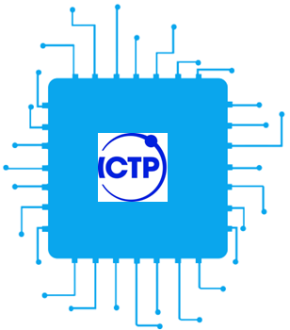
Zynq PS Peripherals and Connections

Slide 28
PS Available Peripherals
PS Peripheral | Description
SPI (x2) | Serial Peripheral Interface, either master or slave mode.
I2C (x2) | I²C bus. Supports master and slave modes.
CAN (x2) | Controller Area Network. CAN 2.0A and CAN 2.0B.
UART (x2) | Universal Asynchronous Receiver Transmitter. One UART is used for terminal connections to a host PC.
GPIO | General purpose Input/Output. There are four GPIO banks, each of 32 bits.
SD (x2) | SD card memory controller
USB (x2) | Universal Serial Bus. Host or OTG (in-the-go) modes.
GigE (x2) | Gigabit Ethernet MAC peripheral, supports 10Mbps, 100MBps and 1Gbps.

Slide 29
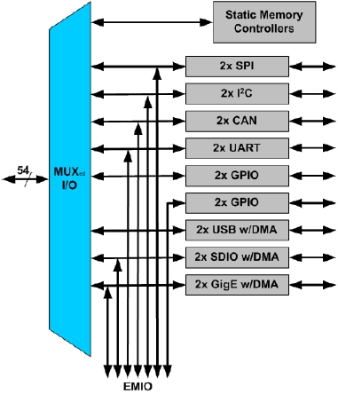
Multiplexed I/O – Internal / External
Multiplexed input/output (MIO)
Multiplexed output of peripheral and static memories
Two I/O banks; each selectable: 1.8V, 2.5V, or 3.3V
Configured using configuration
Dedicated pins are used
User constraints (LOC) should not be present
The BitGen process will throw errors if LOC constraints are present
Extended MIO
Enables use of the SelectIO™ interface with PS peripherals
User constraints must be present for the signals brought out to the SelectIO pins
The BitGen process will throw errors if LOC constraints are not present
PL
Notes:
The majority of the I/O signals for PS peripherals, other than USB, can be routed to either the PS pins through the MIO, or to the PL pins through the EMIO. Most peripherals also maintain the same
protocol between MIO and EMIO, except Gigabit Ethernet. To reduce pin count, a 4-bit RGMII interface runs through the MIO at a 250 MHz data rate (125 MHz clock with a double data rate). The
route through the EMIO includes an 8-bit GMII interface running at a 125 MHz data rate. The USB, Quad-SPI, and SMC interfaces are not available to the EMIO interface to the PL
Static Memory Controller (SMC) Interface: Only one SMC memory interface can be used in a design. The SMC controller consumes many of the MIO pins and neither of the SMC memory
interfaces can be routed to the EMIO.
For example, if an 8-bit NAND Flash is implemented, then Quad-SPI, is not available and the test port is limited to 8-bits. If a 16-bit NAND Flash is implemented, then additional pins are consumed.
Ethernet 0 is not available. The SRAM/NOR interface consumes up to 70% of the MIO pins, eliminating Ethernet and USB 0.
The SRAM/NOR upper address pins are optional, as appropriate for the attached device. Also note that the SMC interface straddles the two MIO voltage banks.

Slide 30
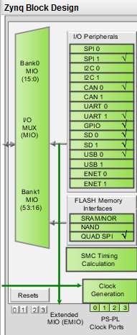
Extended Multiplexed I/O (EMIO)
Extended interface to PL I/O peripheral ports
EMIO: Peripheral port to PL
Alternative to using MIO
Mandatory for some peripheral ports
Facilitates
Connection to peripheral in programmable logic
Use of general I/O pins to supplement MIO pin usage
Allows additional signals for many of the peripherals
Alleviates competition for MIO pin usage
Notes:
Most IOP peripheral ports can also be routed to package pins using the select I/O features of the PL; however some limitation and rules apply.
The EMIO connection alternative eliminates the competition for the 54 available MIO pins. Most IOP competition for MIO pins is with the flash configuration memory devices (NOR, SPI, NAND) that must use MIO pins.
You can also connect the IOP ports to user IP in programmable logic, although the use scenarios may be far and few between. GPIO would be a good example of using a PS IOP peripheral directly in the PL, connected to user IP only, and never leaving the chip.
EMIO allows for additional communication signals for many of the peripherals e.g. UART using MIO has only TX-RX pair, but when routed through the EMIO it also has modem handshaking signals.

Slide 31
Multiplexed I/O (MIO)
Notes:
think you will agree it is a pretty impressive list standard interfaces and devices. You will of course end up in a situation at times where you need to trade off the many interfaces with the available pin count. Engineering is, after all, always an art of compromise.
Using the Vivado design flow, you assign functions within the MIO by double clicking on the processor within your block diagram, which brings up the re-customize IP window. There are two options for defining the MIO. The first option—Peripheral I/O Pins—is very graphical and allows you to see how assigning one interface standard affects others, as shown in the image below:
You can also use this window to define the bank-voltage settings for each of the two I/O banks (green = active).

Slide 32
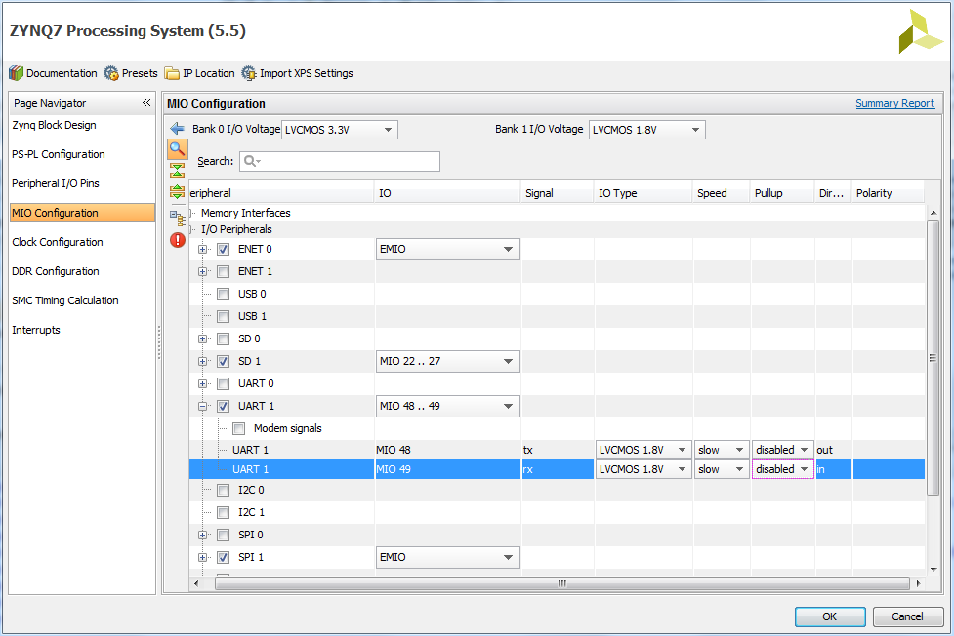
MIO Port Configuration
Notes:
The MIO is split into two voltage banks:
MIO0 pins 0 to 15
MIO1 pins 16 to 53
Bank 0 includes the configuration input pins, which are sampled following power up. These mode pins share the multiuse I/O pins on the PS side of the device. In all, there are seven mode pins mapped to MIO[8:2]. The first four mode pins define the boot mode; the fifth determines whether the PLL is used or not; and the sixth and seventh mode pins define the bank voltages on MIO bank 0 and bank 1 during power up. The voltage standard defined on MIO bank 0 and 1 can be changed from LVCMOS to HTSL following completion of the boot loader.
As mentioned above, at times there are not enough MIO pins to bring out all the interfaces you wish to have. In such cases, you can extend the MIO into the Programmable Logic (PL) side of the Zynq SoC. This is called Extended Multipurpose IO or EMIO. EMIO can provide up to 64 additional GPIO pins. Alternatively you can assign most of the MIO interfaces to the EMIO with the notable exception of the USB, SRAM/NOR memory interfaces, and the NAND Flash interface. The Zynq SoC technical reference manual provides very detailed information on the differences between MIO and EMIO capabilities. Assigning functions to the EMIO is very simple and is accomplished by clicking the EMIO button at the end of the Peripheral I/O Pins tab as shown below:
The second option is the “MIO Configuration” tab in the Zynq Processing System screen, shown below, which brings up a list of interfaces assigned to the MIO. We can also assign the EMIO pins in this view, which we will address in a little while.

Slide 33
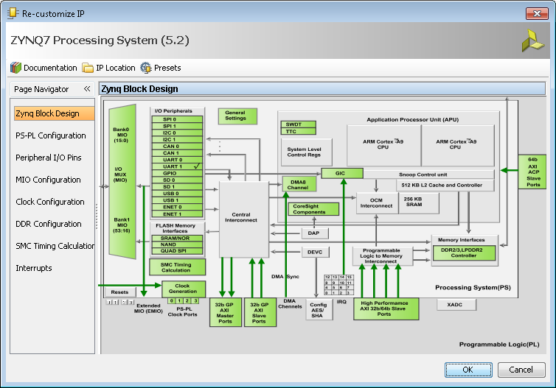
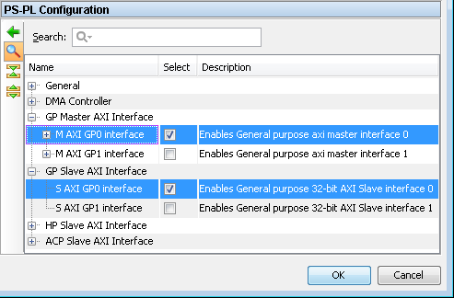
GP0/1 Ports Configuration for PS-PL Interface
Click on the menu or green GP Blocks to configure

Slide 34
GP 0/1 Ports
By default, GP Slave and Master ports are disabled
Enable GP Master and/or Slave ports depending on whether a slave or a master peripheral is going to be added in PL

Slide 35
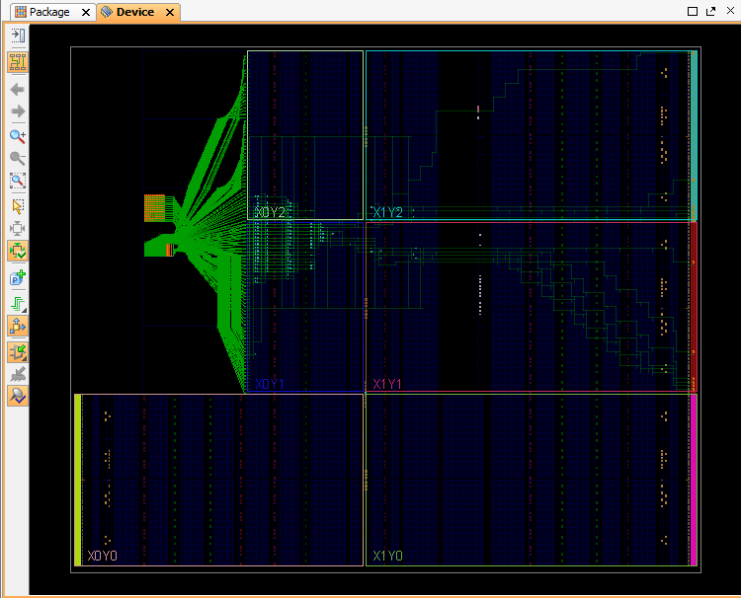
Zynq – Internal Device View

Slide 36
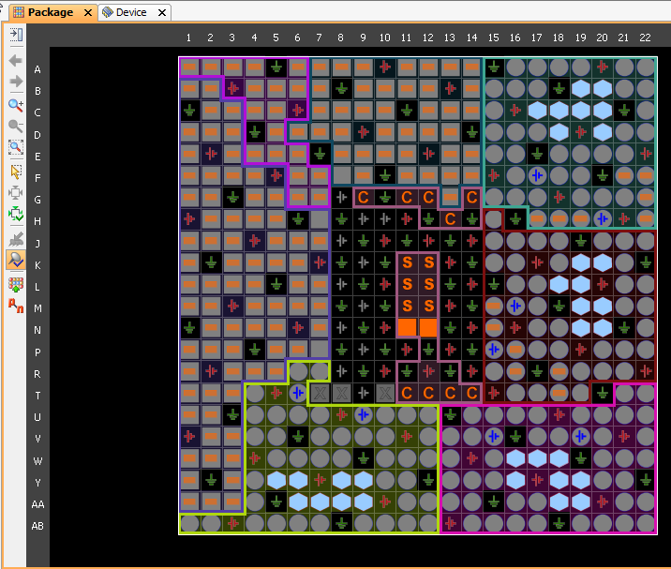
Zynq – Package View

Slide 37
PSoC Design Methodology

Slide 38
PSoC Design Flow
Requirements
Specifications
System Design
Software/Hardware Partitioning
HLS
Model Composer
Custom
IP Cores
Software Modules
Hardware Development & Simulation
Software Development & Simulation
Placement &Timing Constraints
Operating Systems
Vivado IP Integrator
Software Development Vitis
System Integration and
Debug
PSoC Architecture & Design Methodology
ICTP-MLAB

Slide 39
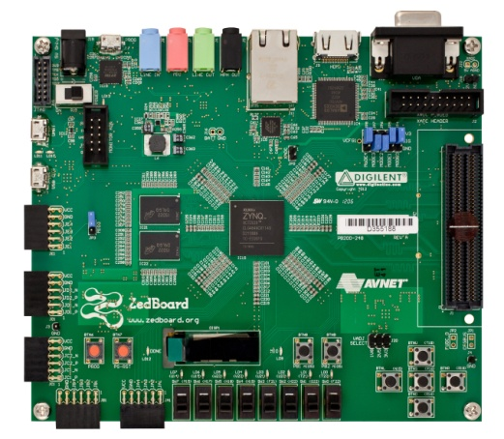
PSoC Design – PL Design Flow
Spec
IP Cores
Create Project
(Block Design)
HDL
Constraints
Synthesis
Constraints
Optional
Elaborate
Place & Route
Constraints
VIVADO
Behavioral Verification
Timing Verification
Optional
Optional
VIVADO
Bitstream Generation / Hardware Export .xsa

Slide 40
PSoC Design – Vivado-Vitis Design Flow

Slide 41
PL Design Specification
Written specifications for the design to be done
Spec can specify:
Functionality
Timing
Interfaces
Power
Spec

Slide 42
PL Design Partition
Divide and conquer strategy
Complex design is progressively partitioned into smaller and simpler functional units. This is known as
Top-Down Design or Hierarchical Design
IP Cores
HDL
Behavioral model for each functional unit are written
It has its own synthesis results
It has it own functional test bench
Some cases it has its own place and route and timing constraints

Slide 43
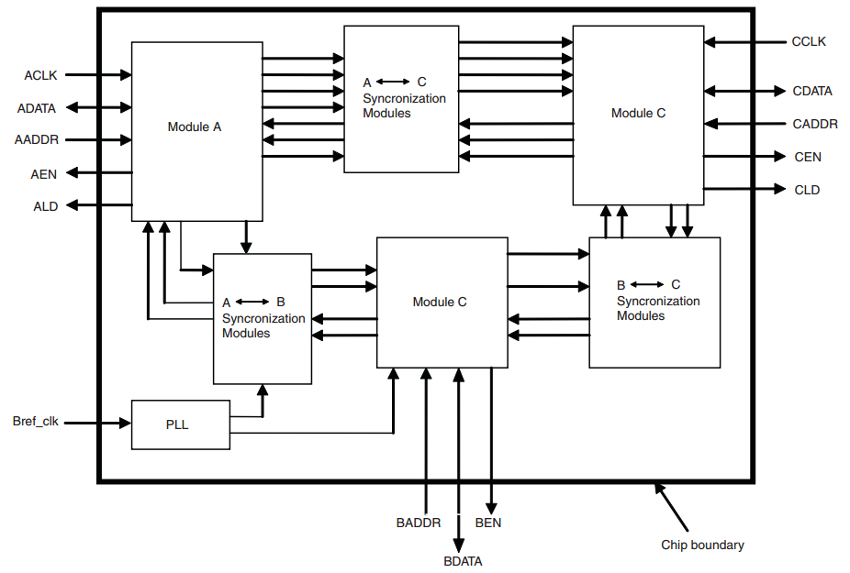
PL Design Partition

Slide 44
PL Design Partition
Partition the design at functional boundaries.
Minimize the I/O connections between different partitions.
Register all inputs and outputs of each block. This makes logic synchronous and avoids glitches and avoids any delay penalty on signals that cross between partitions. Registering I/Os typically eliminates the need to specify timing requirements for signals that connect between different blocks.
Do not use “glue logic” or connection logic between hierarchical blocks. When you preserve hierarchy boundaries, glue logic is not merged with hierarchical blocks. Your synthesis software may optimize glue logic separately, which can degrade synthesis results and is not efficient when used with the LogicLock design methodology.
Remember that logic is not synthesized or optimized across partition boundaries, which means any constant values (signals set to GND, for example) will not be propagated across partitions.
IP Cores
HDL

Slide 45
PL Design Partition
Do not use tri-state signals or bidirectional ports on hierarchical boundaries. If you use boundary tri-states in a lower-level block, synthesis pushes the tri-states through the hierarchy to the top-level to take advantage of the tri-state drivers on the output pins of Altera device. Because this requires optimizing through hierarchies, lower-level boundary tri-state signals are not supported with a bllock-level design methodology.
Limit clocks to one per block. Partitioning the design into clock domains makes synthesis and timing analysis easier.
Place state machines in separate blocks to speed optimization and provide greater encoding control.
Separate timing-critical functions from non-timing-critical functions.
Limit the critical timing path to one hierarchical block. You can group the logic from several design blocks to ensure the critical path resides in one block

Slide 46
PL HDL Components
Behavioral modeling describes the functionality of a component (design), that is, what the component will do
A behavioral prototype of a component can be quicly created
Its functionlatiy verified
Synthezised, optimized and mapped, to a specific technology
Structural Modeling connect components to create a specific functionality.
Architectural partitioning forms a structural model, but the functional components are modeled behaviorally
HDL

Slide 47
PL Functional Verification – Block Level
In general, a design should be partitioned along functional lines into smaller functional units, each having a common clock domain, and each of which is to be verified separately.
Behavioral Verification
The verification process is threefold:
Development of a test plan
Development of test-benches
Execution of the simulations

Slide 48
PL Functional Verification – Block Level
Development of a test plan: Specify what functional features are to be tested and how they are to be tested
For example, the test plan might specify that an exhaustive simulation of its behavior will verify the instruction set of an ALU.
Test plans for sequential machines must be more elaborate to ensure a high level of confidence in the design.
A test plan identifies the stimulus generators, response monitors, and the "gold" response against which the model will be tested.
Your grade, and your company's future, will depend on the care that you take in developing and executing your test plan.

Slide 49
PL Functional Verification – Block Level
Test bench development
A Test Bench is a VHDL module in which the Unit Under Test (UUT) has to be instantiated together with pattern generators that are to be applied to the inputs of the component during simulation.
Note: If a design is formed as an architecture of multiple modules, each must be verified separately, beginning with the lowest level of the design hierarchy, then the integrated design must be tested to verify that the modules interact correctly
Test bench execution
The test bench is exercised according to a test plan, and the response is verified against the original specification for the design

Slide 50
PL Design Integration – System Level Verification
After each of the functional sub components has been verified to have correct functionality, the architecture must be integrated and verified to have the correct overall functionality
A separate test plan for the system is developed at the beginning of this step.
This requires development of a separate testbench whose stimulus generators exercise the input/output functionality of the top-level module, monitor port and bus activity across module boundaries, and observe state activity in any embedded state machines.
This step in the design flow is crucial and must be executed thoroughly to ensure that the design that is being signed off for synthesis is correct.

Slide 51
PL Synthesis Constraints – Post-Synthesis Simulation
Synthesis
Constraints
A synthesis tool is used to translate from ‘software’ (VHDL) to ‘hardware’: logic gates, flip-flops, memory, etc.
A synthesis tool removes redundant logic and seeks to satisfy the requirements regarding the area of the logic needed to implement the functionality and the performance (speed) specifications
Post-Synthesis simulation is, in general, optional, but it is advisable in case of using specific synthesis attributes.

Slide 52
PL Place & Route
Place & Route
Constraints
The logic generated by the synthesis tool is a netlist, commonly known as EDIF netlist, that is take by the Place and Route tool to scatter the logic in the FPGA’s resources.
P&R tool has different effort levels, which can be used in case the final result does not meet the needed requirements.
In complex design:
P&R could take several hours to accomplish its task.
Some floorplanning may be needed (constraints).

Slide 53
PL Post Place & Route Simulation
Timing Verification
Optional
The simulation test (test bench) not only test the logical/behavioural functionality but also the timing of the whole system:
Routing and logic delay are taking into consideration when executing this simulation
Each delay is well known after the P&R
Hold-time and Set-up time violations can be found out in this simulation as well as any glitch

Slide 54
Export Hardware Platform (.xsa file)
Once the bitstream is generated, export the hardware platform as an XSA (Xilinx Shell Architecture) file.
This file encapsulates all the hardware information, including the bitstream, address map, and peripheral details, which will be used by Vitis.

Slide 55
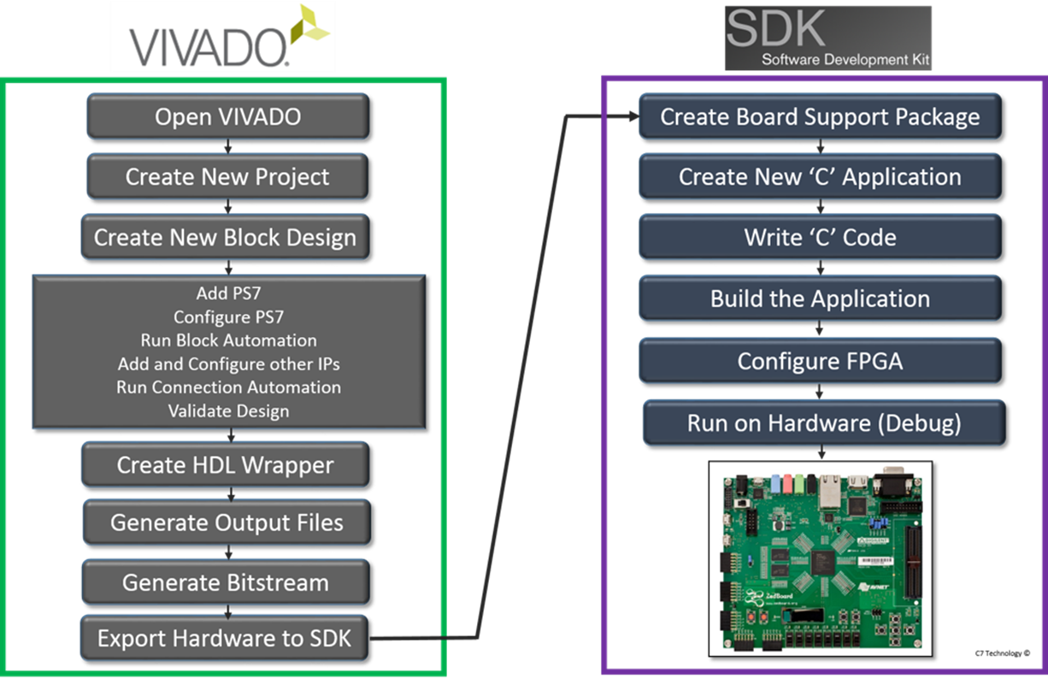
Vitis Flow Design
The AMD Vitis environment provides a comprehensive design flow for Zynq SoCs.
The Vitis flow emphasizes a software-centric approach, allowing developers to create and write an application in bare-metal ‘C’ code or run an Operating System, such as FreeRTOS, PetaLinux, etc.
From the Vitis application can easily access to the logic on the PL or any peripheral in the PS.

Slide 56
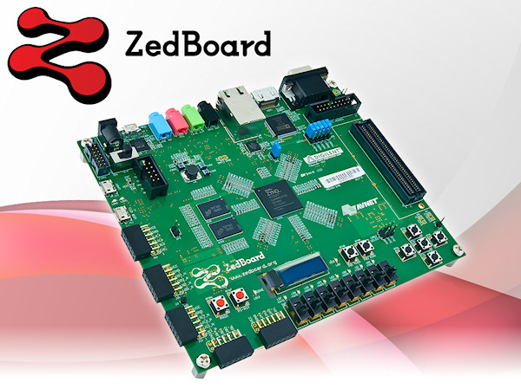
Vitis Design Flow
Create Board Support Package (BSP)
Customize App. ‘C’ code / OS
Configure FPGA
(.bit file)
1
3
5
2
4
6
Create new application: ‘Bare Metal’ or ‘OS Based’
Build the application
‘Run on hardware .elf file’ (debug)

Slide 57
Vitis Design Flow
The Vitis environment takes over from the XSA file to facilitate software development.
Create a Platform Project: Import the XSA file generated from Vivado to create a Vitis platform project. This platform serves as the base for your software applications, providing information about the hardware components and their addresses. You can choose to create platforms for:
Standalone (Bare-metal) applications: For simple, direct control of hardware.
FreeRTOS applications: For real-time operating system based designs.
Linux applications: If you plan to run a full Linux OS on the Zynq's PS (Petalinux). generation).
Create an Application Project: Based on the platform, create a new application project. This is where you write your C/C++ code.
You can select from various templates (e.g., "Hello World", memory tests) or start with an empty application.
For accelerated applications, you can define "kernels" (functions intended to run on the PL) which will be compiled and implemented in the FPGA fabric.

Slide 58
Vitis Design Flow
Write Software Application: Host Application (for PS): This is the C/C++ code that runs on the ARM processor(s) of the Zynq. It interacts with the PL via AXI interfaces.
Build the Project: Vitis compiles your software application and links it with the necessary libraries and the hardware platform. For accelerated designs, this also involves building the PL kernels and generating the final bitstream if it includes custom hardware.
Generate Boot Image: Once your application is stable, generate a boot image (e.g., BOOT.BIN) that includes the First Stage Boot Loader (FSBL), the bitstream, and your application. This image is used to boot the Zynq device
Program and Run on Hardware: Load the boot image onto your Zynq board (e.g., via SD card, QSPI flash, or JTAG) and run your application.

Slide 59
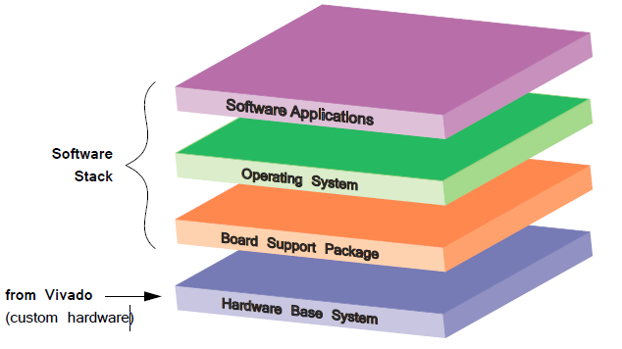
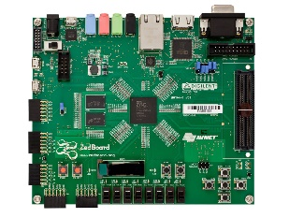
Vitis Design Flow - .elf .bit Download
Software Stack (Vitis)
.elf
.xsa file
Custom Hardware-FPGA (Vivado)
.bit

Slide 60
Vitis - Running the App. - .elf .bit Download
First of all, configure the PL part of the Zynq, using the .bit file
Download the .elf file to the PS (processor) part of the Zynq.
Execute the C/Linux application
Check the result into either:
Terminal
Console
3rd party terminal emulator

Slide 61
Basics of TCL in Vivado

Slide 62
Tool Command Language
TCL , is an interpreted programming language with variables, procedures , and control structures, to interface to a variety of design tools and to design data.
It has been an industry standard language since early 90s’
AMD-Xilinx adopted TCL for the Vivado Design Suite

Slide 63
Tool Command Language (cont)
TCL in Vivado enables the designer to:
Create a project
Target a SoPC device/board
Create a block design
Include IP Cores
Configure PS, IP Cores, etc.
Run synthesis
Run implementation
Modify P&R options
Customize reports
Program SoPC

Slide 64
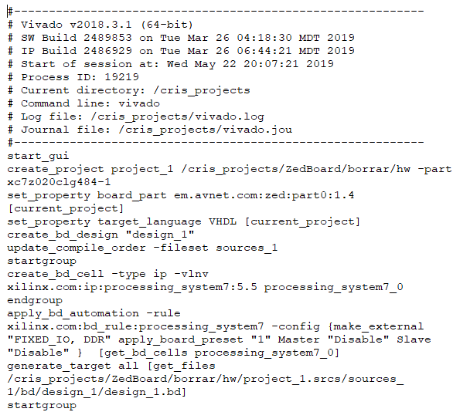
Tool Command Language (cont)

Slide 65
How to run a provided .tcl script
Methot 1: Through Vivado TCL console
Method 2: Through Command Line

Slide 66
Method 1: Run .tcl in Vivado TCL Console
Start Vivado Design Suite. You can see a tcl console on the left bottom of Vivado Design Suite
Click on the title 'type a tcl command here‘ (button left of the screen)
Go to the folder location where the tcl script resides (use ‘cd’, ‘pwd’)
Once the directory has been changed, you can use the ‘ls’ command to list the files in the current directory. Check that the .tcl is in there.
Run the .tcl script by using the following command:
source <filename>.tcl
The processes defined in the .tcl file will be executed. It could take sometimes to execute a .tcl file (depending on the defined processes)

Slide 67
Vivado TCL Console

Slide 68
Vivado TCL Option in the GUI

Slide 69
Method 2: Run .tcl through Command Line W10/11
In W10 you can start the Vivado TCL Shell by doing:
Start-> All apps->Vivado 20xx.x Tcl Shell
A small command line window should come up
Go to the folder location where the tcl script resides (use ‘cd’, ‘pwd’)
Once the directory has been changed, you can use the ‘dir’ command to list the files in the current directory. Check that the .tcl is in there.
Run the .tcl script by using the following command:
source <filename>.tcl
The processes defined in the .tcl file will be executed. It could take some times to execute a .tcl file (depending on the defined processes)

Slide 70
Run .tcl in Linux
Make sure TCL interpreter is installed:
$whereis tclsh
tclsh: /usr/bin/tclsh /usr/bin/tclsh8.4 /usr/share/man/man1/tclsh.1.gz
In case you don’t have the tcl interpreter installed, do the following:
$ sudo apt-get install tcl8.4
Note: if you have already installed Vivado, the Tcl interpreter should be installed
Execute TCL script:
$ tclsh helloworld.tcl
( or )
$ chmod u+x helloworld.tcl
$ ./helloworld.tcl

Slide 71
Is there any Need to Learn TCL ?
It is purely based on your objectives.
If you want to automate some basic processes in creating design , it is the best choice as we can export a tcl script to another computer and create an exact replica of the project with same configurations, ip integrations in just a single execution.

Slide 72
Xilinx TCL Docs
Vivado Design Suite TCL Command Reference Guide
Vivado Design Suite User Guide - Using TCL Scripting
TCL Tutorial (up to Chapter 14 for Vivado appl)

Slide 73
Apendix

Slide 74
PS I/O Peripherals

Slide 75
I2C
I²C bus specification version 2
Programmable to use normal (7-bit) or extended (10-bit) addressing
Programmable rates: fast mode (400 kbit/s) , standard (10 0kbits/s), and low (10 kbits/s)
Rates higher than 400 kbits/sec are not supported
Programmable as either a master or slave interface
Capable of clock synchronization and bus arbitration
Fully programmable slave response address
Reversible FIFO operation supported
16-byte buffer size
Slave monitor mode when set up as master
I²C bus hold for slow host service
Slave timeout detection with programmable period
Transfer status interrupts and flags
Notes:
I²C is a multi-master, serial computer bus invented by Philips that is used as a communication medium between low-speed peripherals. The name stands for Inter-Integrated Circuit and is pronounced I-squared-C. As of October 1, 2006, no licensing fees are required to implement the I²C protocol. Licensing fees for assigning addresses is still required and regulated by NXP.
Because of it low pin count and cost, the I²C protocol is a popular interface for on-board peripheral components.
This I²C module is a bus controller that can function as a master or slave in a multi-master design. In master mode, the I²C interface can transmit data to a slave and initiate a transfer to receive data from a slave.
I²C uses only two bidirectional open-drain lines: serial data (SDA) and serial clock (SCL). Both lines are pulled up with resistors. The next slide shows the implementation of an I²C peripheral. The I²C peripheral can use both normal (7-bit) addressing or extended (10-bit) addressing modes. This option is programmable in master mode and automatic in slave mode by detecting a specific code in bits [7:3] of the first address byte. It also supports an extremely wide clock frequency range from DC (almost) up to 400 Kb/s.
The I²C controller supports operation in several configurations:
I²C master: In I²C master mode, the Zynq device acts as the master device on the I²C bus. In this mode, the I²C clock (I2C_SCL) is driven by the Zynq device.
I²C slave: In I²C slave mode, the Zynq device acts as the slave device on the I²C bus with another device being the master. In this mode, the I²C clock (I2C_SCL) is driven by the I²C master device.
Multi-master operation: In I²C multi-master mode, the Zynq device acts as a master, sharing the bus with other masters. In this mode, the I²C clock (I2C_SCL) is driven by the device that acts as the master.

Slide 76
CAN
Up to 24-MHz CAN_REF clock as system clock
64 message-deep receiver and transmitter buffer
Full CAN 2.0B compliant; conforms to ISO 11898-1
Maximum baud rate of 1 Mb/s
Four message filters required for buffer mode
Listen-only mode for test and debug
External PHY I/O
“Wake-on-message”
Time-stamping for receive messages
TX and RX FIFO watermarking
Exception: no power-down mode
Notes:
The CAN is a computer network protocol and bus standard designed for low-cost, flexible, and small data packet networks. It is designed specifically for automotive applications but is now also used in other areas.
The CAN peripheral supports these standards:
CAN 2.0-A standard as defined by BOSCH
CAN 2.0-B standard as defined by BOSCH
ISO 118981-1 standard as defined by the ISO
As the standards specify, the CAN peripheral is divided into three different layers: object layer, transfer layer, and physical layer.
The object layer is further divided into a data link layer and physical layer.
The data link layer is subdivided into logic link control (LLC) and medium access control (MAC).
The CAN peripheral’s object layer handles the LLC functionality. The transfer layer handles the MAC functionality.
The physical layer in ISO 11898-1 is subdivided into physical signaling (PLS), physical medium attachment (PMA), and medium dependent interface (MDI). The transfer layer handles only the PLS functionality. An external PHY device should meet all the requirements specified by the PMA and MDI sublayers.
The CAN controller is supported by the Standalone library in SDK.

Slide 77
SD-SDIO
Support for version 2.0 of SD Specification
Full-speed (4 MB/s) and low-speed (2 MB/s) support
Low-speed clock (400 KHz) used until bandwidth negotiated
1-bit and 4-bit data interface support
Host mode support only
Built-in DMA controller
Full-speed clock (0-50 MHz) with maximum throughput at 25 MB/s
1 KB data FIFO interface
Support for MMC 3.31 card at 52 MHz
Support for memory, I/O, and combo cards
Support for power control modes and interrupts
Notes:
The SD/SDIO peripheral controls communication with SDIO devices, SD memory, and MMC cards connected to the processing system. It is designed to support SD, SDIO, and MMC applications in a wide range of portable, low-power applications (such as the 802.11devices, GPS, WiMAX, and UWB).
The SD/SDIO peripheral is fully compliant with the standard SD Host Controller Specification Version 2.0 Part A2 with SDMA (Single Operation DMA), ADMA1 (4 KB boundary limited DMA), and ADMA2 (ADMA2 allows data of any location and any size to be transferred in a 32-bit system memory - scatter-gather DMA) support. The core also supports up to seven functions in SD1, SD4, and SPI mode. It also supports SD high-speed (SDHS) and SD high-capacity (SDHC) card standards.
The SDIO device controller supports an internal FIFO to meet throughput requirements.

Slide 78
SPI
Master or slave SPI mode
Four wire bus: MOSI, MISO, SCK, nSS
Supports up to three slave select lines
Supports multi-master environment
Identifies an error condition if more than one master detected
Software can poll for status or function as interrupt-driven device
Programmable interrupt generation
50-MHz maximum external SPI clock rate
Selectable master clock reference
Integrated 128-byte deep read and write FIFOs
Full-duplex operation offers simultaneous receive and transmit
Notes:
The serial peripheral interface (SPI) bus is a synchronous serial data link standard named by Motorola that operates in full-duplex mode. Devices communicate in master/slave mode where the master device initiates the data frame. Multiple slave devices are allowed with individual slave select (chip select) lines. Sometimes SPI is called a “four-wire” serial bus, contrasting with three-, two-, and one-wire serial buses.
Due to its low-chip count and implementation cost, the SPI protocol is mainly used for peripheral, on-board, chip-to-chip communication.

Slide 79
UART
Two UARTs
Programmable baud rate generator
64-byte receive and transmit FIFOs
6, 7, or 8 data bits and 1, 1.5, or 2 stop bits
Odd, even, space, mark, or no parity with parity, framing, and overrun error detection
"Line break" generation and detection
Normal, automatic echo, local loopback, and remote loopback channel modes
Interrupts generation
Support 8 Mb/s maximum baud rate with additional reference clock or up to 1.5 Mb/s with a 100-MHz peripheral bus clock
Modem control signals: CTS, RTS, DSR, DTR, RI, and DCD (through EMIO)
Simple UART: only two pins (TX and RX through MIO)

Slide 80
USB
Two USB 2.0 hardened IP peripherals per Zynq device
Each independently controlled and configured
Supported interfaces
High-speed USB 2.0: 480 Mbit/s
Full-speed USB 1.1: 12 Mbit/s
Low-speed USB 1.0: 1.5 Mbit/s
Communication starts at USB 2.0 speed and drops until sync is achieved
Each block can be configured as host, device, or on-the-go (OTG)
8-bit ULPI interface
All four transfer types supported: isochronous, interrupt, bulk, and control
Supports up to 12 endpoints per USB block in the Zynq device
Running in host mode
Source-code drivers
Notes:
The PS USB 2.0 peripherals in the Zynq architecture completely support the USB 2.0 standard:
Per the defined protocol, each peripheral will initiate connection at high speed (480 Mbit/s), drop to full speed, and finally go to low speed until a connection is established.
Each block can be configured as either a USB host, USB device, or USB on-the-go.
Each block supports the standard ULPI (ultra-low pin interface) 8-bit interface for USB 2.0
All four transfer types are supported: isochronous (video devices), interrupt (printers, keyboards and mice), bulk (file transfers), and control (bus control commands)
Up to 12 USB endpoints can be supported per peripheral block when in USB host mode
Xilinx provides source code for all drivers

Slide 81
USB 2.0 OTG
Control and configuration registers for each USB block
Software-ready with standalone and OS linux source-code delivered drivers
EHCI compliant host registers
USB host controller registers and data structures compliant to Intel EHCI specifications
Internal DMA
Must use the MIO pins
Notes:
USB is a cable bus that supports data exchange between a host device and a wide range of simultaneously accessible peripherals. The attached peripherals share USB bandwidth through a host-scheduled, token-based protocol. The bus allows peripherals to be attached, configured, used, and detached while the host and other peripherals are in operation.
The USB 2.0 specification supersedes the earlier versions of the USB specification. USB 2.0 offers the user a larger bandwidth increasing data throughput by a factor of 40.
In addition to the 1.5 Mb/s and 12 Mb/s data rates of USB 1.1, the evolution to USB 2.0 adds an additional data rate of 480 Mb/s.
The processing system is equipped with two USB 2.0 on-the-go (OTG) peripherals. The OTG supplement to the USB specification extends USB to peer-to-peer applications. With USB OTG technology, consumer electronics, peripherals, and portable devices can connect to each other.
With USB OTG, fully USB-compliant peripheral devices can be developed that can also assume the role of a USB host.
Register Interfaces
52 synchronous registers for status and control hook each USB module to the CPU in the Zynq device through an AXI-based interface. The registers allow the user to control the configuration of each peripheral, status of the peripheral, and control peripheral operation. The registers are grouped into USB host-compatible registers per the IBM EHCI (Enhanced Host Controller Interface ) standard as well as registers for controlling a target device.
DMA Engine
Moves USB data between the outside world and internal buffers
Automatically parses USB data structures
Queues device responses for multiple endpoints
The DMA engine presents a master interface to system memory and moves all of the data to be transferred over USB between the peripheral and buffers in system memory. The DMA engine accesses both control information and packet data and can queue data for transfer, freeing up the CPU in the Zynq device for other operations. The data structure of the DMA engine is also IBM EHCI compliant.
Buffers
Configurable FIFOs
Decouples the DMA from protocol engine to maintain fast USB timing
Supports multiple endpoints
The USB data buffers are configurable FIFOs between the protocol engine and the DMA controller. The FIFOs help uncouple system memory from the extremely tight timing of the actual USB transfers between devices. In device mode, one data channel is maintained through dual-port memory. In host mode, a single data channel is maintained for each active endpoint in the target system.
High-Speed Protocol Engine
This USB peripheral block is responsible for parsing all USB transfers and generating response packets when requested. It also handles:
Error checking
Field generation
Formatting of data handshakes
Ping and data response packets on the bus
Automatically parses USB tokens and generates response packets
Transceiver Interface
Maintains external PHY and clock domain timing
ULPI-standard interface
Each block uses 12 MIO pins
The transceiver interface isolates the USB peripheral from the physical PHY and moves all transceiver signaling into the primary clock domain of the peripheral. This lets the USB peripheral run synchronously with the CPU in the Zynq devices and its resources. The transceiver interface supports the standard USB 2.0 ULPI 8-bit protocol definition.

Slide 82
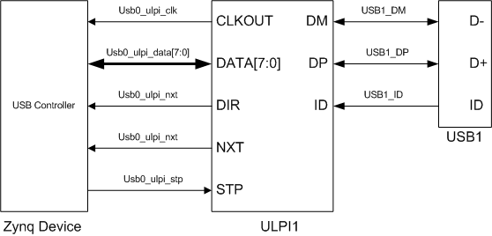
USB 2.0 Usage Example
Notes:
USB can only be pinned out through the MIO. The USB ports can be configured for host, peripheral or USB on-the-go (OTG) operation.
The USB core relies on an 8-bit ULPI interface to a PHY.
The USB controllers are integrated into the PS IOP to bridge between the PS interconnect and an
external ULPI PHY.
The two independent USB controllers have individual control and status registers. Each ULPI
interface is independently enabled through the MIO. There are separate port indicator and power
signals for each controller that are routed through the EMIO. The system functions are further
described in section 15.15 System Functions.
The USB controller can operate in the modes
Host mode. In host mode, the software includes driver-layer programming to discover and
enumerate the bus, manage PHY operations, and setup the periodic and asynchronous schedules of
transfer descriptors.
° EHCI software model except as described in section 15.11 EHCI Implementation.
Device mode. In device mode, the controller responds to host commands. Software can include
driver-layer programming to respond, as a single- or multi-function device, to the upstream
commands.
On-the-Go. The OTG software switches between Host and Device modes based on the Host
Negotiated Protocol (HNP) and the Session Request Protocol (SRP). Once the controller is in device
or host mode, it has all the functionality of the selected mode.

Slide 83
Gigabit Ethernet Controller
Tri-mode Ethernet MAC (10/100/1G) with native GMII interface
IEEE1588 rev 2.0
Time stamp support
1 us resolution
IEEE802.3
RGMII v2.0 (HSTL) interface to MIO pins
Need MIO set at 1.8V to support RGMII speed
Need to use large bank of MIO pins for two Ethernets
MII/GMII/SGMII/RGMII ver1.3 (LVCMOS) and ver2.0 (HSTL) interface available through EMIO (programmable logic I/O)
TX/RX checksum offload for TCP and UDP
Internal DMA and wake on LAN
Notes:
The Gigabit Ethernet MAC (GEM) implements a 10/100/1000 Mb/s Ethernet MAC compatible with the IEEE 802.3 standard. The Gigabit Ethernet can operate in either half or full duplex at all three speeds. The network configuration register is used to select the speed, duplex mode, and interface type (MII or GMII).
The processing system has two Gigabit Ethernet MACs and both have direct RGMII interface access to pins through the multiplexed I/O (MIO), or programmable logic pins using the GMII interface through the external multiplexed I/O (EMIO). Through EMIO, MAC signals can be either routed to PL pads or GTX components.
Via the GMII interface and the EMIO soft IP cores implemented in the PL, any required Ethernet standards can be supported.
Some examples are:
SGMII (devices with GTX)
RGMII v2.0 (PHY devices with HSTL Class 1 drivers and receivers)
The Gigabit Ethernet MAC comprises four main components:
MAC controlling transmit, receive, address checking, and loopback
Control and status registers, statistics registers, and synchronization logic
DMA transmit and receive control
Time stamp unit (TSU) for calculating the IEEE 1588 timer values
Note: Ethernet going through MIO as RGMII is at 1.8V only.
MAC Transmitter
The MAC transmitter block takes data via the DMA interface and adds a preamble, pad, and frame check sequence (FCS). Both half-duplex and full-duplex Ethernet modes of operation are supported. When operating in half-duplex mode, the MAC transmit block generates data according to the carrier sense multiple access with collision detect (CSMA/CD) protocol.
The start of transmission is deferred if carrier sense is active. If collision becomes active during transmission, a jam sequence is asserted and the transmission is retried after a random back off. The carrier sense and collision signals have no effect in full duplex mode. When operating in gigabit mode half duplex, both carrier extension and frame bursting are performed in accordance with the IEEE 802.3 standard.
MAC Receiver
The MAC receive block checks for valid preamble, FCS, alignment and length, and presents received frames to the MAC address checking block and external FIFO interface. It can optionally strip CRC from the received frame prior to transfer to the external FIFO interface.
The address checker recognizes four specific, 48-bit addresses and can recognize four different type ID values. It also contains a 64-bit hash register for matching multicast and unicast addresses as required and can recognize the broadcast address of all ones, copy all frames, and act on external address matching signals.
The MAC can also reject all frames that are not VLAN tagged and recognize “Wake on LAN” events.
The MAC receive block supports offloading of IP, TCP, and UDP checksum calculations (both IPv4 and IPv6 packet types supported) and can automatically discard bad checksum frames.
Register Interface
Control Registers
Control registers drive the management data input/output (MDIO) interface, set-up DMA activity, start frame transmission, and select the different modes of operation such as full-duplex, half-duplex and 10/100/1000 Mb/s operation.
Status and Statistics Registers
The statistics register block contains registers for counting various types of event associated with transmit and receive operation. These registers, along with the status words stored in the receive buffer list, enable software to generate network management statistics compatible with IEEE 802.3.
DMA Interface
The DMA is configured in a full packet buffering mode. The DMA block connects to memory through its bus interface. The DMA loads the transmit buffer and empties the receive buffer using bus master operations.
Receive data is not sent to memory until the address checking logic has determined that the frame should be copied.
Receive or transmit frames are stored in one or more DMA buffers. The receive buffer size 64 bytes and 2 KB. Transmit buffers range in length between 1 and 2 KB and up to 128 buffers are permitted per frame.
The DMA block manages the transmitter and receiver frame buffer queues.
Time Stamp Unit (TSU)
The 1588 time stamp unit (TSU) is a timer implemented as a 62-bit register. The 32 upper bits count seconds and the 30 lower bits count nanoseconds. The 30 lower bits roll over when they have counted to one second. The timer increments by a programmable number of nanoseconds with each PCLK period and can be adjusted (incremented or decremented) through APB register accesses.
Ethernet Clocks
The Ethernet clocks are generated by the Ethernet receiver and reference clocks described in Chapter 4, Clock Generation Section of the Zynq Technical Reference Manual (UG585).

Slide 84
Gigabit Ethernet Controller
Notes:
The Ethernet peripheral requires an external PHY to be able to communicate with other Ethernet devices. Only the RGMII interface is available through MIO pins; other interface options are available through the EMIO. The MIO RGMII interface option is shown in the figure.

Slide 85
Application Processor Unit (APU)

Slide 86
ARM Processor Architecture
ARM Cortex-A9 processor implements the ARMv7-A architecture
ARMv7 is the ARM Instruction Set Architecture (ISA)
Thumb instructions: 16 bits; Thumb-2 instructions: 32 bits
NEON: ARM’s Single Instruction Multiple Data (SIMD) instructions
ARMv7-A: Application set that includes support for a Memory Management Unit (MMU)
ARMv7-R: Real-time set that includes support for a Memory Protection Unit (MPU)
ARMv7-M: Microcontroller set that is the smallest set
ARM Advanced Microcontroller Bus Architecture (AMBA®) protocol
AXI3: Third-generation ARM interface
AXI4: Adding to the existing AXI definition (extended bursts, subsets)
Cortex is the new family of processors
ARM family is older generation; Cortex is current; MMUs in Cortex processors and MPUs in ARM

Slide 87
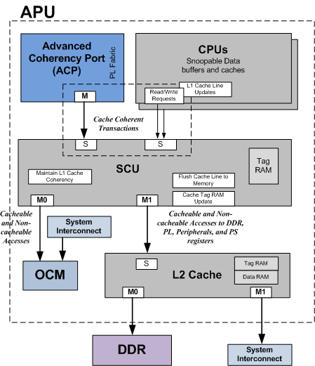
APU

Slide 88
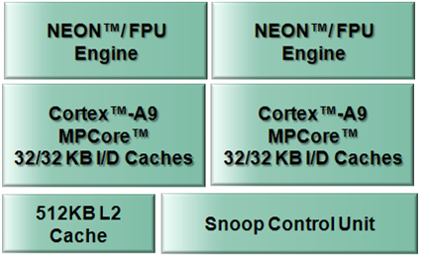
APU Components
Dual ARM® Cortex™-A9 MPCore with NEON extensions
Up to 800-MHz operation
2.5 DMIPS/MHz per core
Separate 32KB instruction and data caches
Snoop Control Unit (SCU)
L1 cache snoop control
Accelerator coherency port
Level 2 cache and controller
Shared 512 KB cache with parity
Notes:
The foundation of the Zynq AP SoC is the processing power of the dual Cortex-A9 MPCore processors. This is the “heart” of the AP SoC and you can build the rest of the device upon this.
The Cortex-A9 processor is one of the premier processors today. The are L1 and L2 caches both support parity and there is hardware coherency in the snoop control unit.
Both CPUs have a NEON processing engine that includes a double-precision FPU.
The L2 cache is 512KB and it is lockable for routines that might need low latency.
The dual Cortex-A9 processors can run up to 800 MHz in commercial grade and the supported operating modes are independent, symmetrical multiprocessing (SMP) and asymmetrical multiprocessing (AMP). They both have separate instruction and data first-level caches, but share the same 256K L2 cache.
The application processing unit (APU), located within the PS, contains two ARM® Cortex™-A9 processors with NEON co-processors that are connected in an MP configuration sharing a 512 KB L2
cache. Each processor is a high-performance and low-power core that implements two separate 32 KB L1 caches for instruction and data. The Cortex-A9 processor implements the ARM v7-A
architecture with full virtual memory support and can execute 32-bit ARM instructions, 16-bit and 32-bit Thumb instructions, and 8-bit Java™ byte codes in the Jazelle state. The NEON™ coprocessor
media and signal processing architecture adds instructions that target audio, video, image and speech processing, and 3D graphics. These advanced single instruction multiple data (SIMD)
instructions are available in both ARM and Thumb states. A block diagram of the APU is shown in Figure 3-1.
The two Cortex-A9 processors within the APU are organized in an MP configuration with a snoop control unit (SCU) responsible for maintaining L1 cache coherency between the two processors and
the ACP interface from the PL. To increase performance, there is a shared unified 512 KB level-two (L2) cache for instruction and data. In parallel to the L2 cache, there is a 256 KB on-chip memory
(OCM) module that provides a low-latency memory.
An accelerator coherency port (ACP) facilitates communication between the programmable logic (PL) and the APU. This 64-bit AXI interface allows the PL to implement an AXI master that can access the
L2 and OCM while maintaining memory coherency with the CPU L1 caches.
The unified 512 KB L2 cache is 8-way set-associative and allows you to lock the cache content on a line, way, or master basis. All accesses through the L2 cache controller can be routed to the DDR
controller or can be sent to other slaves in the PS or PL depending on their address. To reduce latency to the DDR memory, there is a dedicated port from the L2 controller to the DDR controller.

Slide 89
APU Sub-Components
General interrupt controller (GIC)
On-chip memory (OCM): RAM and boot ROM
Central DMA (eight channels)
Device configuration (DEVCFG)
Private watchdog timer and timer for each CPU
System watchdog and triple timer counters shared between CPUs
ARM CoreSight debug technology
Notes:
Besides the two CPUs, the above processing system components very tightly couple together to make up the APU block in the PS:
The GIC services the Zynq architecture with 16 dedicated interrupts from the PL.
The OCM RAM is scratch pad memory that can be used to communicate to/from the PL-PS or as a fast dedicated memory for the CPUs. It is also used during the boot process.
The DMA can service peripherals both in the PS and PL.
The device configuration unit uses an interface called PCAP (similar to ICAP) to configure the PL.
CoreSight is the ARM internal debug engine IP for use with development and debug tools.

Slide 90
APU Address Map
All registers for both CPUs are grouped into two contiguous 4KB pages
Accessed through a dedicated internal bus
Fixed at 0xF8F0_0000 with a register block size of 8 KB
Each CPU uses an offset into this base address
0x0000-0x00FC | SCU registers
0x0100-0x01FF | Interrupt controller interface
0x0200-0x02FF | Global timer
0x0600-0x06FF | Private timers and watchdog timers
0x1000-0x1FFF | Interrupt distributor
Notes:
There is a separate register set that encompasses the APU companion entities.
All registers accessible by all Cortex-A9 processors within the Cortex-A9 MPCore are grouped into two contiguous, 4KB pages accessed through a dedicated internal bus. The base address of these pages is defined by the pins PERIPHBASE[31:13]. The base address used in the processing system is 0xF8F0_0000, and the register block size is 8 KB. This address space includes registers for timers, watchdogs, interrupt controller, and SCU registers

Slide 91
NEON Main Features
NEON is the ARM codename for the vector processing unit
Provides multimedia and signal processing support
FPU is the floating-point unit extension to NEON
Both NEON and FPU share a single set of registers
NEON technology is a wide single instruction, multiple data (SIMD) parallel and co-processing architecture
32 registers, 64-bits wide (dual view as 16 registers, 128-bits wide)
Data types can be: signed/unsigned 8-bit, 16-bit, 32-bit, 64-bit, or 32-bit float
Notes:
The Cortex-A9 NEON MPE extends the Cortex-A9 functionality to provide support for the ARM v7 advanced SIMD and vector floating-point v3 (VFPv3) instruction sets. The Cortex-A9 NEON
MPE supports all addressing modes and data processing operations described in the ARM Architecture Reference Manual.
The Cortex-A9 NEON MPE features are:
• SIMD vector and scalar single-precision floating-point computation
° Unsigned and signed integers
° Single bit coefficient polynomials
° Single-precision floating-point values
• The operations supported by the NEON co-processor include:
° Addition and subtraction
° Multiplication with optional accumulation
° Maximum or minimum value driven lane selection operations
° Inverse square-root approximation
° Comprehensive data-structure load instructions, including register-bank-resident table lookup.
• Scalar double-precision floating-point computation
• SIMD and scalar half-precision floating-point conversion
• 8, 16, 32, and 64-bit signed and unsigned integer SIMD computation 8 or 16-bit polynomial computation for single-bit coefficients
• Structured data load capabilities
• Dual issue with Cortex-A9 processor ARM or Thumb instructions
• Independent pipelines for VFPv3 and advanced SIMD instructions
• Large, shared register file, addressable as:
° Thirty-two 32-bit S (single) registers
° Thirty-two 64-bit D (double) registers
° Sixteen 128-bit Q (quad) registers

Slide 92
L1 Cache Features
Separate instruction and data caches for each processor
Caches are four-way, set associative and are write-back
Non-lockable
Eight words cache length
On a cache miss, critical word first filling of the cache is performed followed by the next word in sequence

Slide 93
L2 Cache Features
512K bytes of RAM built into the SCU
Latency of 25 CPU cycles
Unified instruction and data cache
Fixed, 256-bit (32 words) cache line size
Support for per-master way lockdown between multiple CPUs
Eight-way, set associative
Two AXI interfaces
One to DDR controller
One to programmable logic master (to peripherals)
Notes:
The L2 cache controller is based on the ARM PL310 and includes an 8-way set-associative 512 KB cache for dual Cortex-A9 cores. The L2 cache is physically addressed and physically tagged and
supports a fixed 32-byte line size. These are the main features of the L2 cache:
• Supports snoop coherency control utilizing MESI algorithm.
• Offers parity check for L2 cache memory.
• Supports speculative read operations in the SMP mode.
• Provides L1/L2 exclusive mode (that is, data exists in either, but not both).
• Can be locked down by master, line, or way per master.
• Implements 16-entry deep preload engine for loading data into L2 cache memory.
• To improve latency, critical-word-first line-fill is supported.
• Implements pseudo-random victim selection policy with deterministic option.
° Write-through and write-back.
° Read allocate, write allocate, read and write allocate.
• The contents of the L2 data and tag RAMs are cleared upon an L2 reset to comply with security requirements.
• The L2 controller implements multiple 256-bit line buffers to improve cache efficiency.
° Line fill buffers (LFBs) for external memory access to create a complete cache line into L2 cache memory. Four LFBs are implemented for AXI read interleaving support.
° Two 256-bit line read buffers for each slave port. These buffers hold a line from the L2 cache in case of cache hit.
° Three 256-bit eviction buffers hold evicted lines from the L2 cache, to be written back to main memory.
° Three 256-bit store buffers hold bufferable writes before their draining to main memory, or L2 cache. They enable multiple writes to the same line to be merged.
• The controller implements selectable cache pre-fetching within 4k boundaries.
• The L2 cache controller forwards exclusive requests from L1 to DDR, OCM, or external memory.

Slide 94
On-Chip Memory (OCM)
The on-chip memory (OCM) module contains 256 KB of RAM and 128 KB of ROM (BootROM).
It supports two 64-bit AXI slave interface ports, one dedicated for CPU/ACP access via the APU snoop control unit (SCU), and the other shared by all other bus masters within the processing system (PS) and programmable logic (PL).
The BootROM memory is used exclusively by the boot process and is not visible to the user.
Notes:
OCM supports high AXI read and write throughput for RAM access by implementing the RAM as a double-wide memory (128 bits). To take advantage of the high RAM access throughput, the user
application must use even AXI burst sizes and 128-bit aligned addresses.
Key features of the OCM include:
• On-chip 256KB RAM
• On-chip 128 KB BootROM (not user visible)
• Two AXI 3.0, 64-bit slave interfaces
• Low latency path for CPU/ACP reads to OCM (CPU at 667 MHz – minimum 23 cycles)
• Round-robin pre-arbitration between read and write AXI channels on OCM-interconnect port (non-CPU port)
• Fixed priority arbitration between the CPU/ACP (via SCU) and OCM-interconnect AXI ports
• Supports full AXI 64-bit bandwidth of simultaneous read and write commands (with optimal alignment restrictions) on the OCM interconnect port
• Random access supported to RAM from AXI masters
Interrupts
The OCM module is able to assert an interrupt signal to the APU under the following circumstances:
• Single-bit Parity Error
• Multiple-bit Parity Error
• Unsupported LOCK Request

Slide 95
Snoop Control Unit (SCU)
Shares and arbitrates functions between the two processor cores
Data cache coherency between the processors
Initiates L2 AXI memory access
Arbitrates between the processors requesting L2 accesses
Manages ACP accesses
A second master port with programmable address filtering between OCM and L2 memory support
Notes:
The SCU block connects the two Cortex-A9 processors to the memory subsystem and contains the intelligence to manage the data cache coherency between the two processors and the L2 cache. This
block is responsible for managing the interconnect arbitration, communication, cache and system memory transfers, and cache coherence for the Cortex-A9 processors.
The SCU can also copy clean data from one processor cache to another and eliminate the need for main memory accesses to perform this task. Furthermore, it can move dirty data between the
processors, skipping the shared state and avoiding the latency associated with the write-back.
Note: The SCU does not maintain coherency between instruction and data L1 caches, so this coherency must be maintained by software.

Slide 96
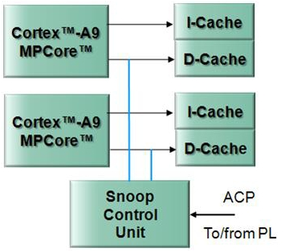
Cache Coherency Using SCU
High-performance, cache-to-cache transfers
Snoop each CPU and cache each interface independently
Coherency protocol is MESI
M: Cache line has been modified
E: Cache line is held exclusively
S: Cache line is shared with another CPU
I: Cache line is invalidated
Uses Accelerator Coherence Port (ACP) to allow coherency to be extended to PL

Slide 97
System Level Control Register (SLCR)
A set of special registers in the APU used to configure the PS
Power and clock management
Reset control
MIO/EMIO management
Accessible through software
Standalone BSP support
SLCR Categories
System clock and reset control/status registers | TrustZone control register
APU control registers | SoC debug control registers
DMA initialization registers | MIO/IOP control/status registers
DDR control registers | Miscellaneous control registers
PL reset registers | RAM and ROM control registers

Slide 98
Zynq Clocks

Slide 99
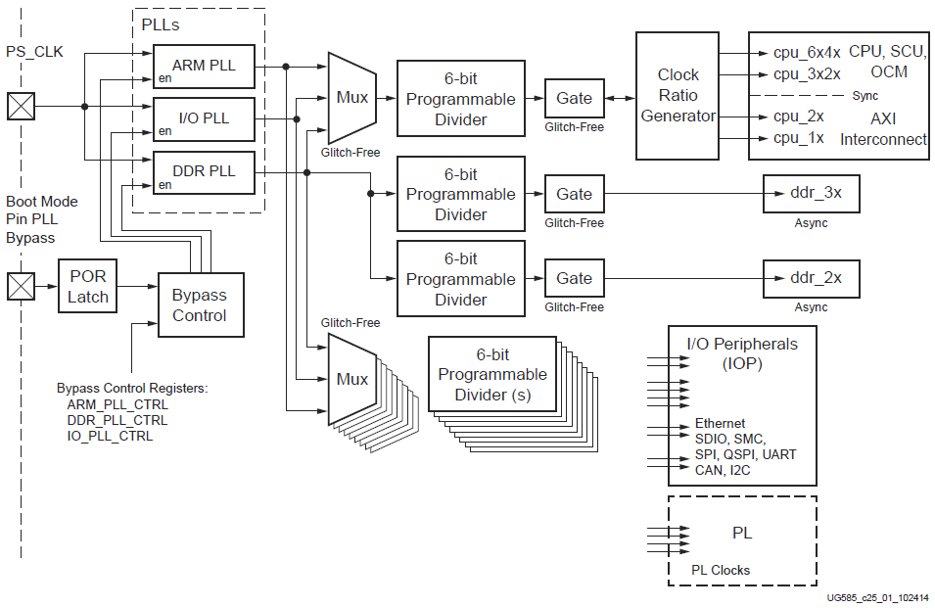
System Clocks
Notes:
All of the clocks generated by the PS clock subsystem are derived from one of three programmable PLLs: CPU, DDR and I/O. Each of these PLLs is loosely associated with the clocks in the CPU, DDR and
peripheral subsystems
Clock Generation
During normal operation, the PLLs are enabled, driven by the PS_CLK clock pin. In bypass mode, the clock signal on the PS_CLK pin provides the source for the various clock generators instead of the
PLLs. (Refer to the applicable Zynq-7000 AP SoC data sheet for PS_CLK characteristics.)
When the PS_POR reset signal deasserts, the PLL bypass boot mode pin is sampled and selects between PLL bypass and PLL enabled for all three PLLs. The bypass mode runs the system
significantly slower than normal mode, but is useful for low-power applications and debug. After the boot process and when the user code executes, the bypass mode and output frequency of each PLL
can be individually controlled by software.
The clock generation paths include glitch-free multiplexers and glitch-free clock gates to support dynamic clock control.
Three Programmable PLLs
• Single external reference clock input for all three PLLs
° ARM PLL: Recommended clock source for the CPUs and the interconnect
° DDR PLL: Recommended clock for the DDR DRAM controller and AXI_HP interfaces
° I/O PLL: Recommended clock for I/O peripherals
• Individual PLL bypass control and frequency programming
• Shared bandgap reference voltage circuit for VCOs
Clock Branches
• Six-bit programmable frequency dividers
• Dynamic switching on most clock circuits
• Four clock generators for the PL
A version of the CPU clock is used for most of the internal clocking. The asynchronous DMA peripheral request interfaces between the DMAC and the PL are not shown in Figure 25-2. In
addition, PL AXI channels (AXI_HP, AXI_ACP and AXI_GP) have asynchronous interfaces between the PS and PL. The synchronization, where the clock domain crossing occurs, is located inside the PS.
Therefore, the PL provides the interface clock to the PS. Each of the aforementioned interfaces could use unique clocks in the PL.
All the CPU clocks are synchronous to each other; while the DDR clocks are independent of each other and the CPU clocks. The I/O peripheral clocks, such as CAN reference clocks and SDIO
reference clocks, are all generated by a similar method, starting from the PS_CLK pin, through a PLL, then a divider, and finally to the peripheral destination. Each peripheral clock is completely
asynchronous to all other clocks.

Slide 100
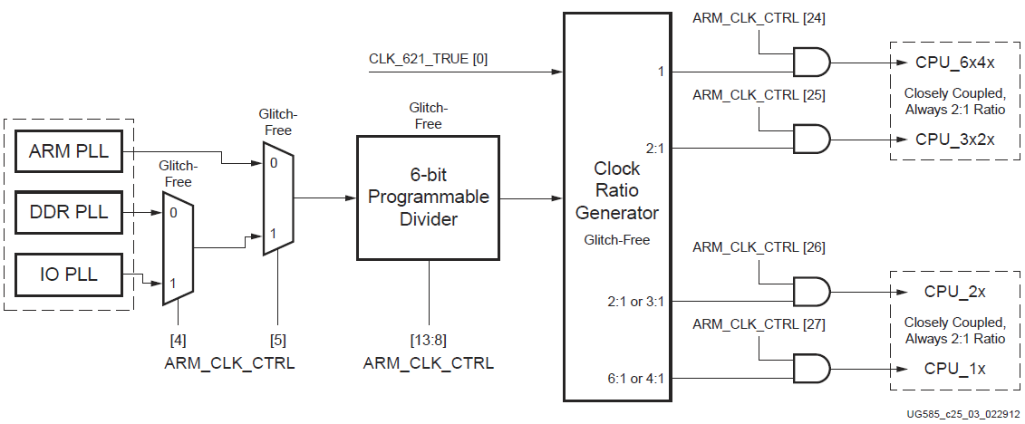
CPU Clock
CPU Clock | 6:2:1 | 4:2:1 | Clock Domain Modules
CPU_6x4x | 800 MHz (6 times faster than CPU_1x) | 600 MHz (4 times faster than CPU_1x) | CPU clock freq, SCU, OCM arbitrer, NEON and L2 Cache
CPU_3x2x | 400 MHz (3 times faster than CPU_1x) | 300 MHz (2 times faster than CPU_1x) | APU Timers
CPU_2x | 266MHz (2 times faster than CPU_1x) | 300 MHz (2 times faster than CPU_1x) | IOP, central interconnect, master interconeect, slave interconnect and OCM RAM
CPU_1x | 133 MHz | 150 MHz | IOP, AHB and APB interface busses
Notes:
Ratio Examples
The CPU clock domain operates in two modes 6:2:1 and 4:2:1. Table 25-1 shows example frequencies for these modes and modules operating in each clock domain.
Clock Usage
During normal usage, most system clocks will be derived by taking the input clock PS_CLK, sending it through the PLL, and finally dividing it down to be used within the PS. While the PS generates many
different clocks, as shown in Figure 25-1, there are three clock domains that have the largest interaction and importance in the system: These are the DDR_3x domain, the DDR_2x domain, and
the CPU clock domain. The DDR_3x clock domain includes the DDR memory controller. The DDR_2x domain is primarily used for the high performance AXI interfaces to the PL (AXI_HP{0:3}) and the
interconnect. The CPU clock domain controls the ARM processors along with many of the CPU peripherals.
The CPU clock domain is composed of four separate clocks: CPU_6x4x, CPU_3x2x, CPU_2x, and CPU_1x. These four clocks are named according to their frequencies, which are related by one of two
ratios: 6:3:2:1 or 4:2:2:1 (abbreviated 6:2:1 and 4:2:1). The operating clock ratio is determined by the CLK_621_TRUE [0] bit value. In the 6:2:1 mode, the frequency of the CPU_6x4x clock is 6 times as fast
as the CPU_1x clock. Table 25-1, page 683 shows examples of how these clocks are related. Refer to the applicable Zynq-7000 AP SoC data sheet for the maximum clock frequency of each clock domain.
All the CPU clocks are synchronous to each other; while the DDR clocks are independent of each other and the CPU clocks. The I/O peripheral clocks, such as CAN reference clocks and SDIO
reference clocks, are all generated by a similar method, starting from the PS_CLK pin, through a PLL, then a divider, and finally to the peripheral destination. Each peripheral clock is completely
asynchronous to all other clocks.
Interconnect Clock Domains
The individual clock domains are shown in Figure 25-2. The central interconnect has two main clock domains: the DDR_2x and the CPU_2x. For the five sub-switches, four clocks are in the CPU_2x clock
domain, while the memory interconnect clock is in the DDR_2x clock domain. The direct path between the CPU (via the L2 cache) and DDR controller is in the DDR_3x clock domain, ensuring
maximum throughput.The direct path between CPU and OCM is in the CPU_6x4x clock domain. The direct path between the SCU ACP and the PL is in the CPU_6x4x clock domain (clock domain crossing
between the PL clock domain and the CPU clock domain is done in an asynchronous AXI bridge on the PS side of the PL).
PS Peripheral AMBA Clocks
Every peripheral within the PS is supplied with its own independently gated version of the CPU clock for its AMBA bus connection to the control and status registers and sometimes to the controller logic
itself. This clock can be disabled when it is guaranteed that the peripheral is not addressed. This gating is applied with a glitch-free clock gate as shown in Table 25-2.
System Performance
The clock frequencies of the different clock domains of the PS help dictate total system performance. In many cases, the highest frequency CPU clock results in the highest performance. However, some
users will find that the CPU is not the critical performer in the system and that bandwidth across the interconnect is the bottleneck. In that case, it might be useful to switch the ratio from 6:2:1 to 4:2:1
mode. Depending on the device speed grade, the frequency of the CPU clocks might be limited by the cpu_6x while in 6:2:1 mode and might be limited by the cpu_2x clock while in 4:2:1 mode.
Therefore, it is suggested that for those applications that might exchange some CPU performance for interconnect performance, check the appropriate data sheet to determine the optimal
frequencies.

Slide 101
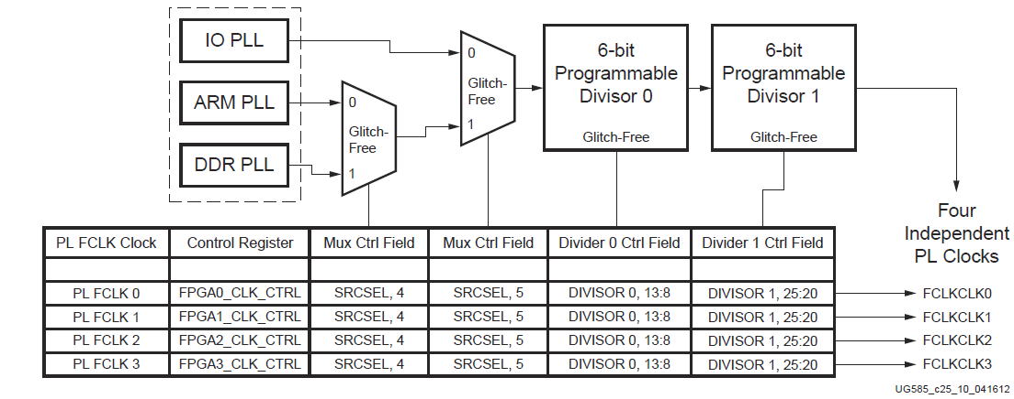
PL Clocks
Notes:
25.7 PL Clocks
The PL has its own clock management generation and distribution features and also receives four
clock signals from the clock generator in the PS (see Figure 25-10). For the details of the PL clocking
structures, see the 7 series FPGAs clocking documentation.
The four clocks that are generated by the PS are completely asynchronous to each other with no
relationship to other PL clocks.
The four clocks are derived from individually selected PLLs in the PS. Each of the PL clocks are
independent output signals that produce suitable clock waveforms for PL use.

