Slide 1
Deep Underground Neutrino Experiment (DUNE)
Fabian Castaño (PhD in Electronics Engineering and Computer Science)
Universidad de Antioquia (DUNE collaboration member since June 2022)
Fabian Castaño

Slide 2
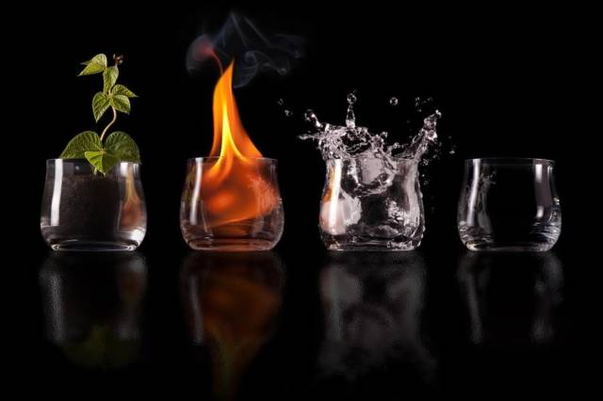
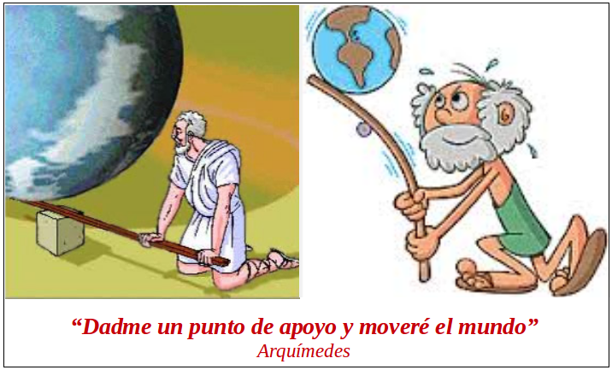
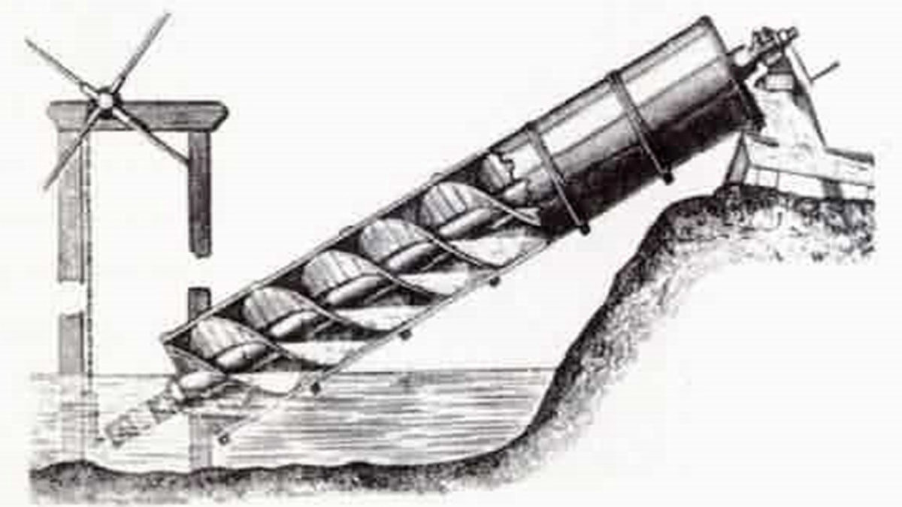
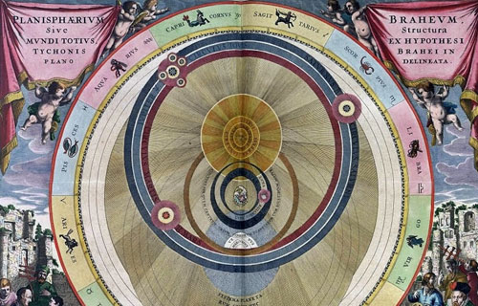
Matter that matters
Understanding the building blocks of the universe
Matter composition
Mechanics and movement
Astronomy
Fabian Castaño

Slide 3
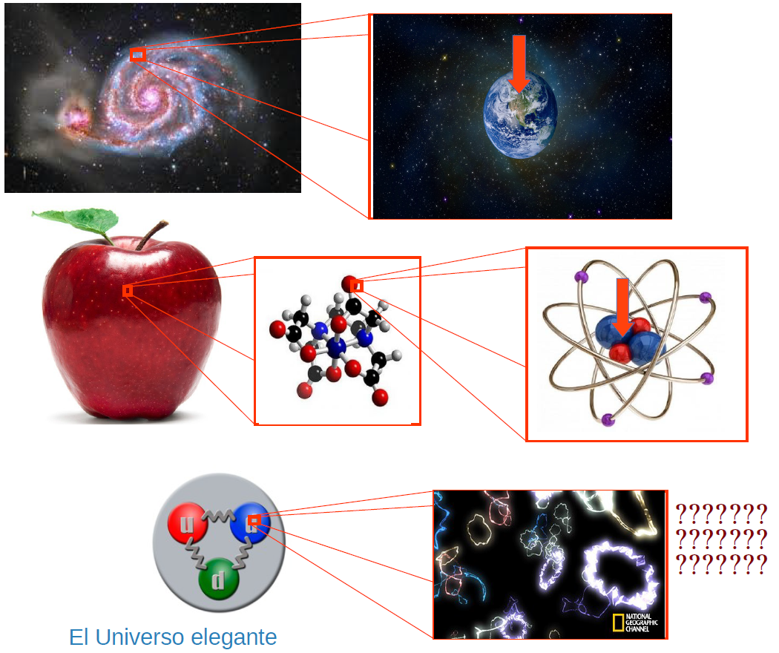
Matter composition
Fabian Castaño

Slide 4
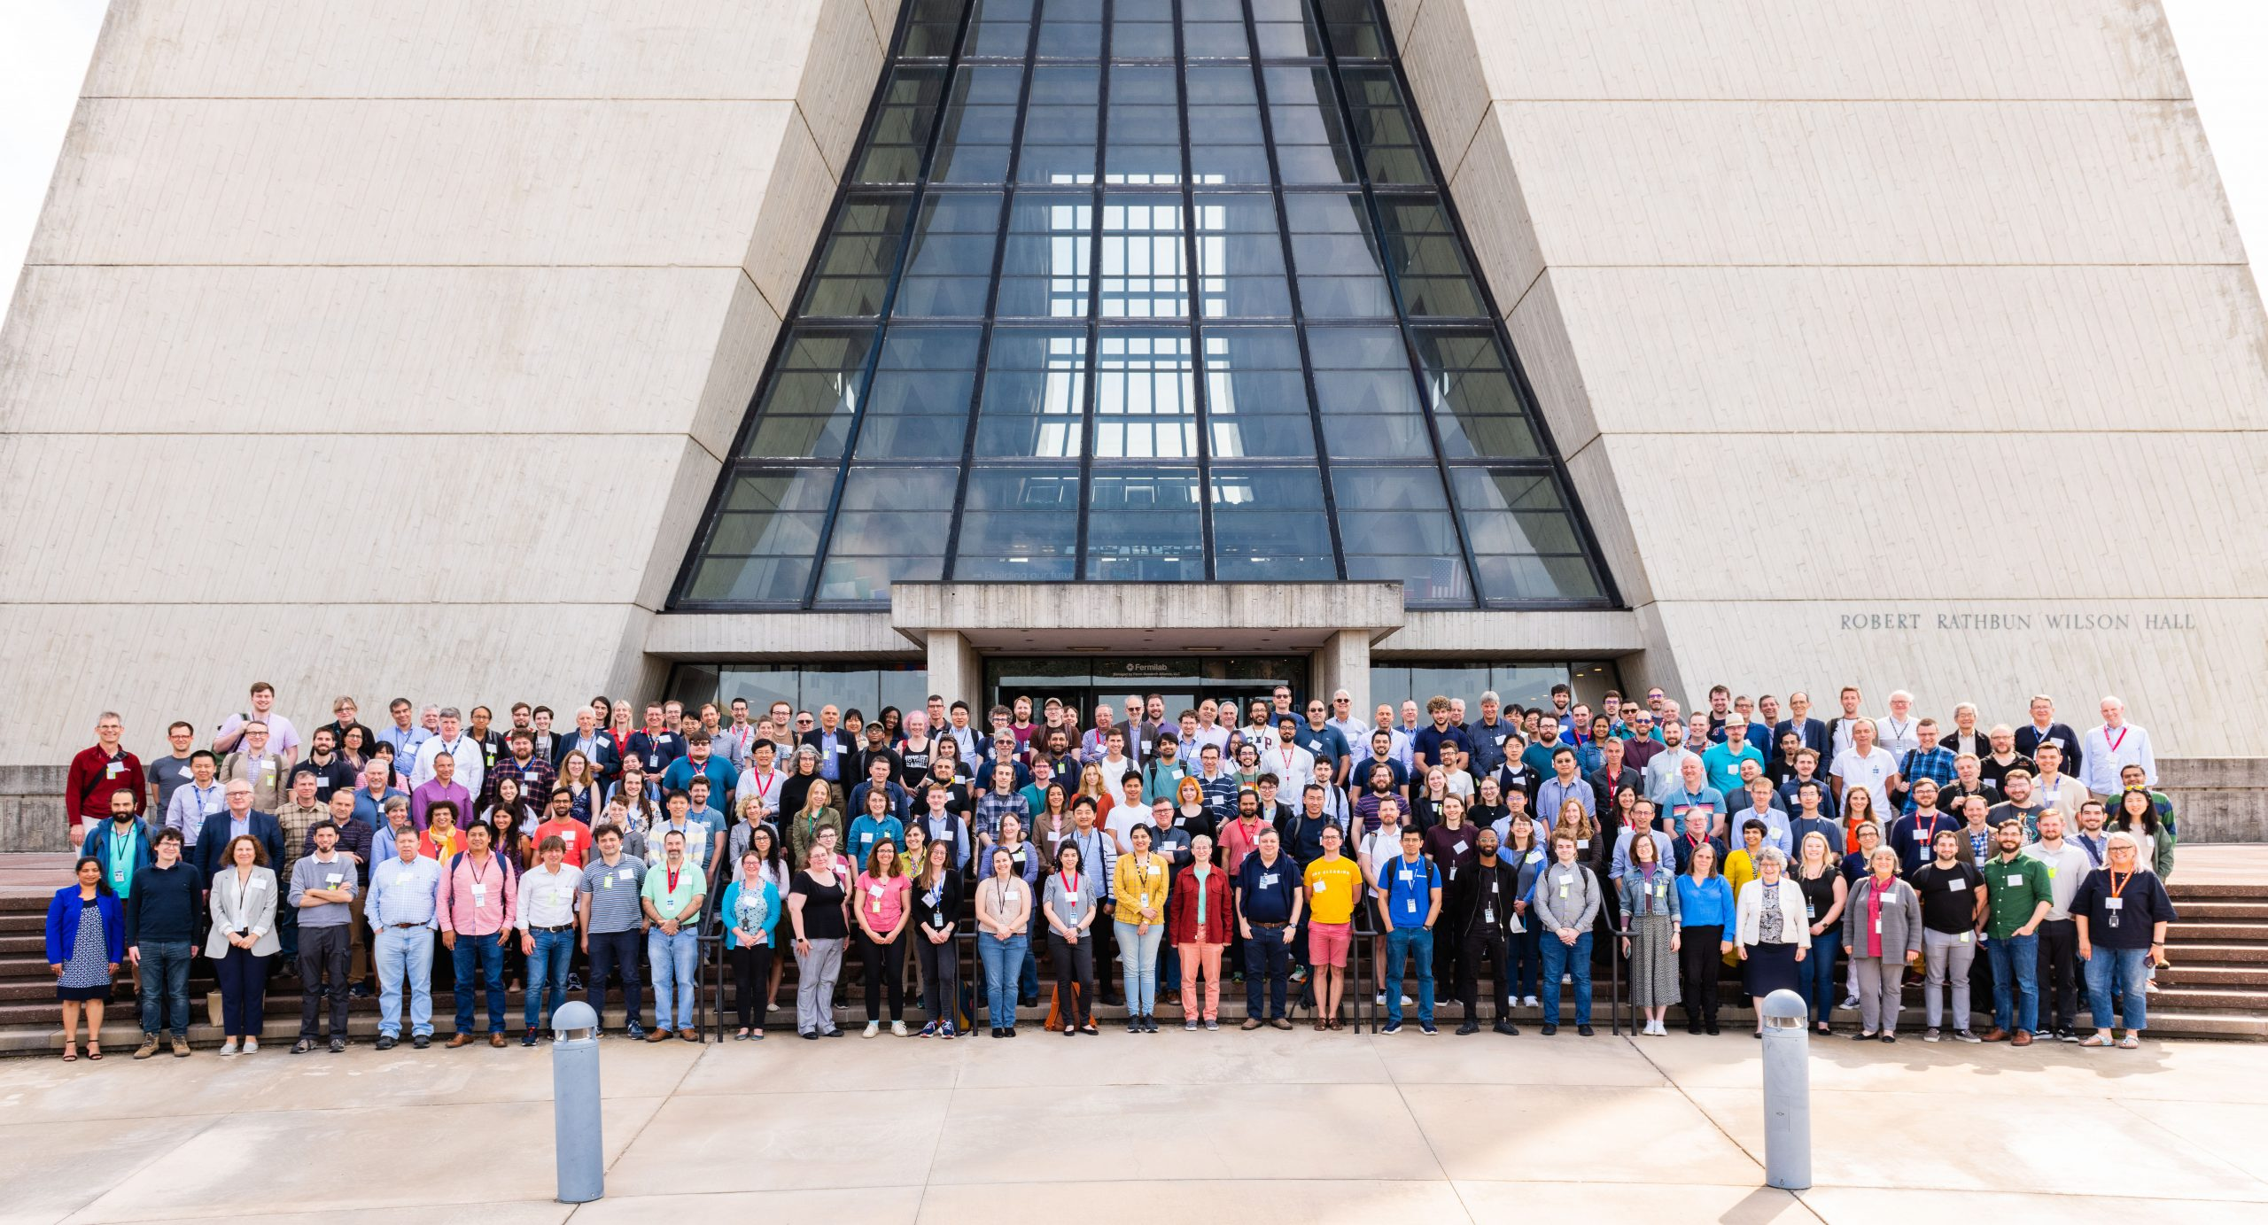
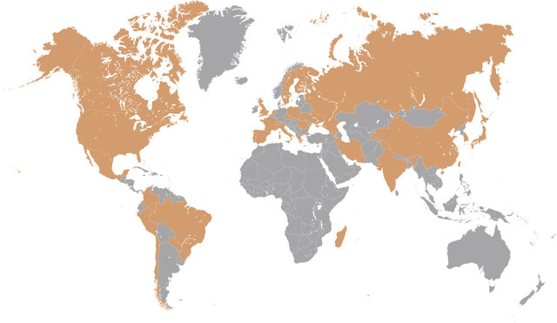
What is DUNE?
DUNE Scientific Staff
More than 30 countries contribute to the collaboration
Fabian Castaño

Slide 5
What is DUNE?
Investigate Neutrino oscillation to prove charge parity violation (CP)
Determine the order of the mass of the neutrinos
Study supernovae, the formation of neutron stars and black holes
Fabian Castaño

Slide 6
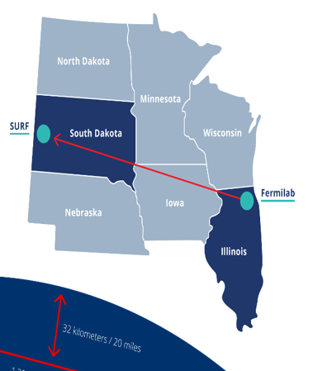
What is DUNE?
1300 km between near and far detector
Fabian Castaño

Slide 7
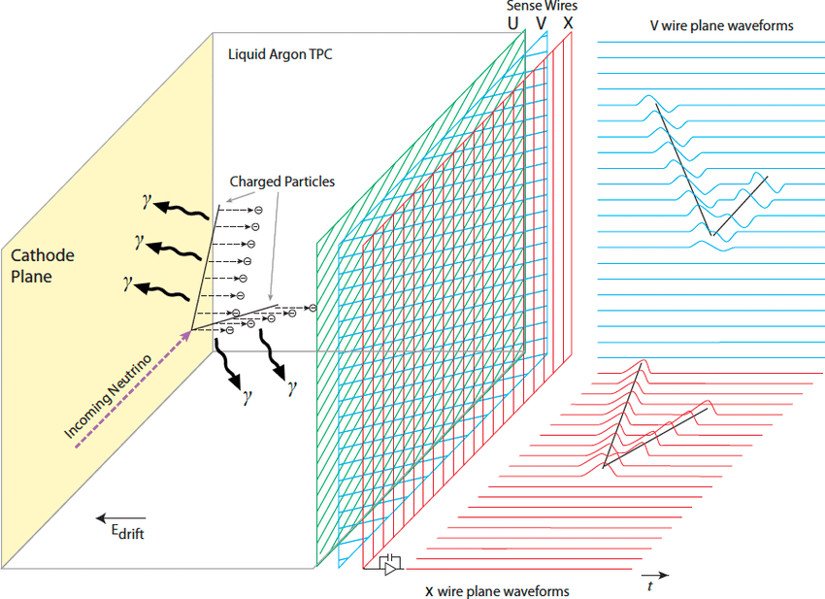
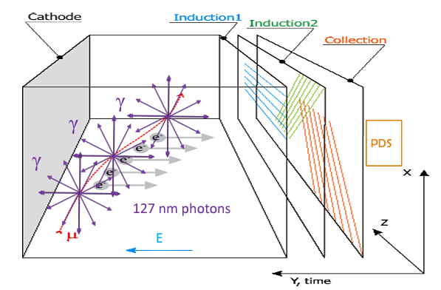
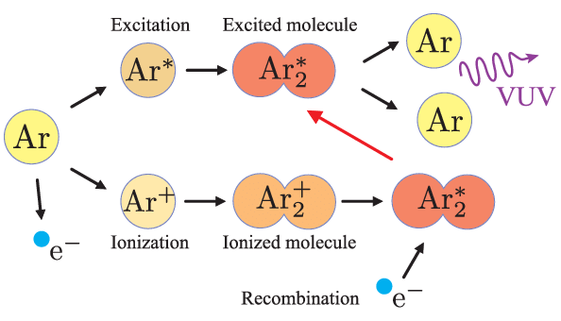
Deep Underground Neutrino Experiment
LArTPC Interaction
Cross-Section =
$$1×{10}^{−45} m^{2}$$
P(x) = 2E-14
1 in 5 Billion of neutrinos
1000 $ν_{e}$ in 7 years
10000 $ν_{μ}$ in 7 years
https://www.youtube.com/watch?v=R5G1_hW0ZUA
Fabian Castaño

Slide 8
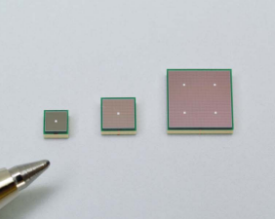
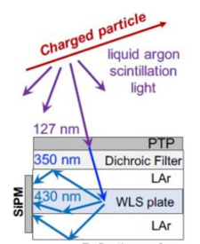
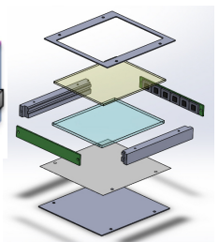
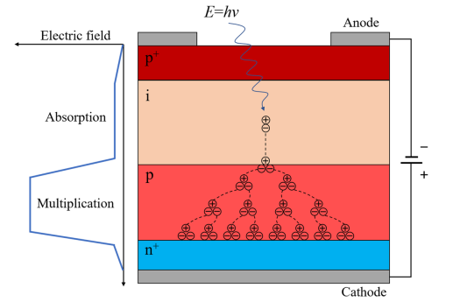
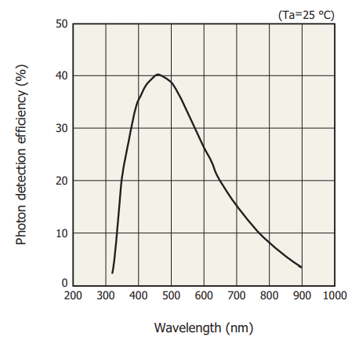
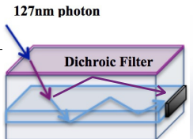
Deep Underground Neutrino Experiment
X-Arapuca
MPPC (Multi-Pixel Photon Counter)
SiPM Hamamatsu S13360-6050VE
Fabian Castaño

Slide 9
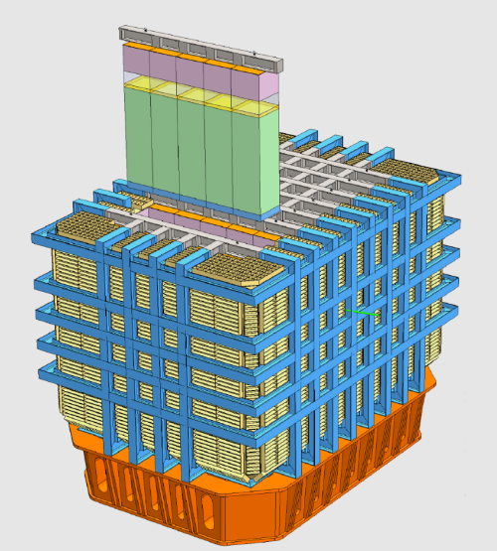
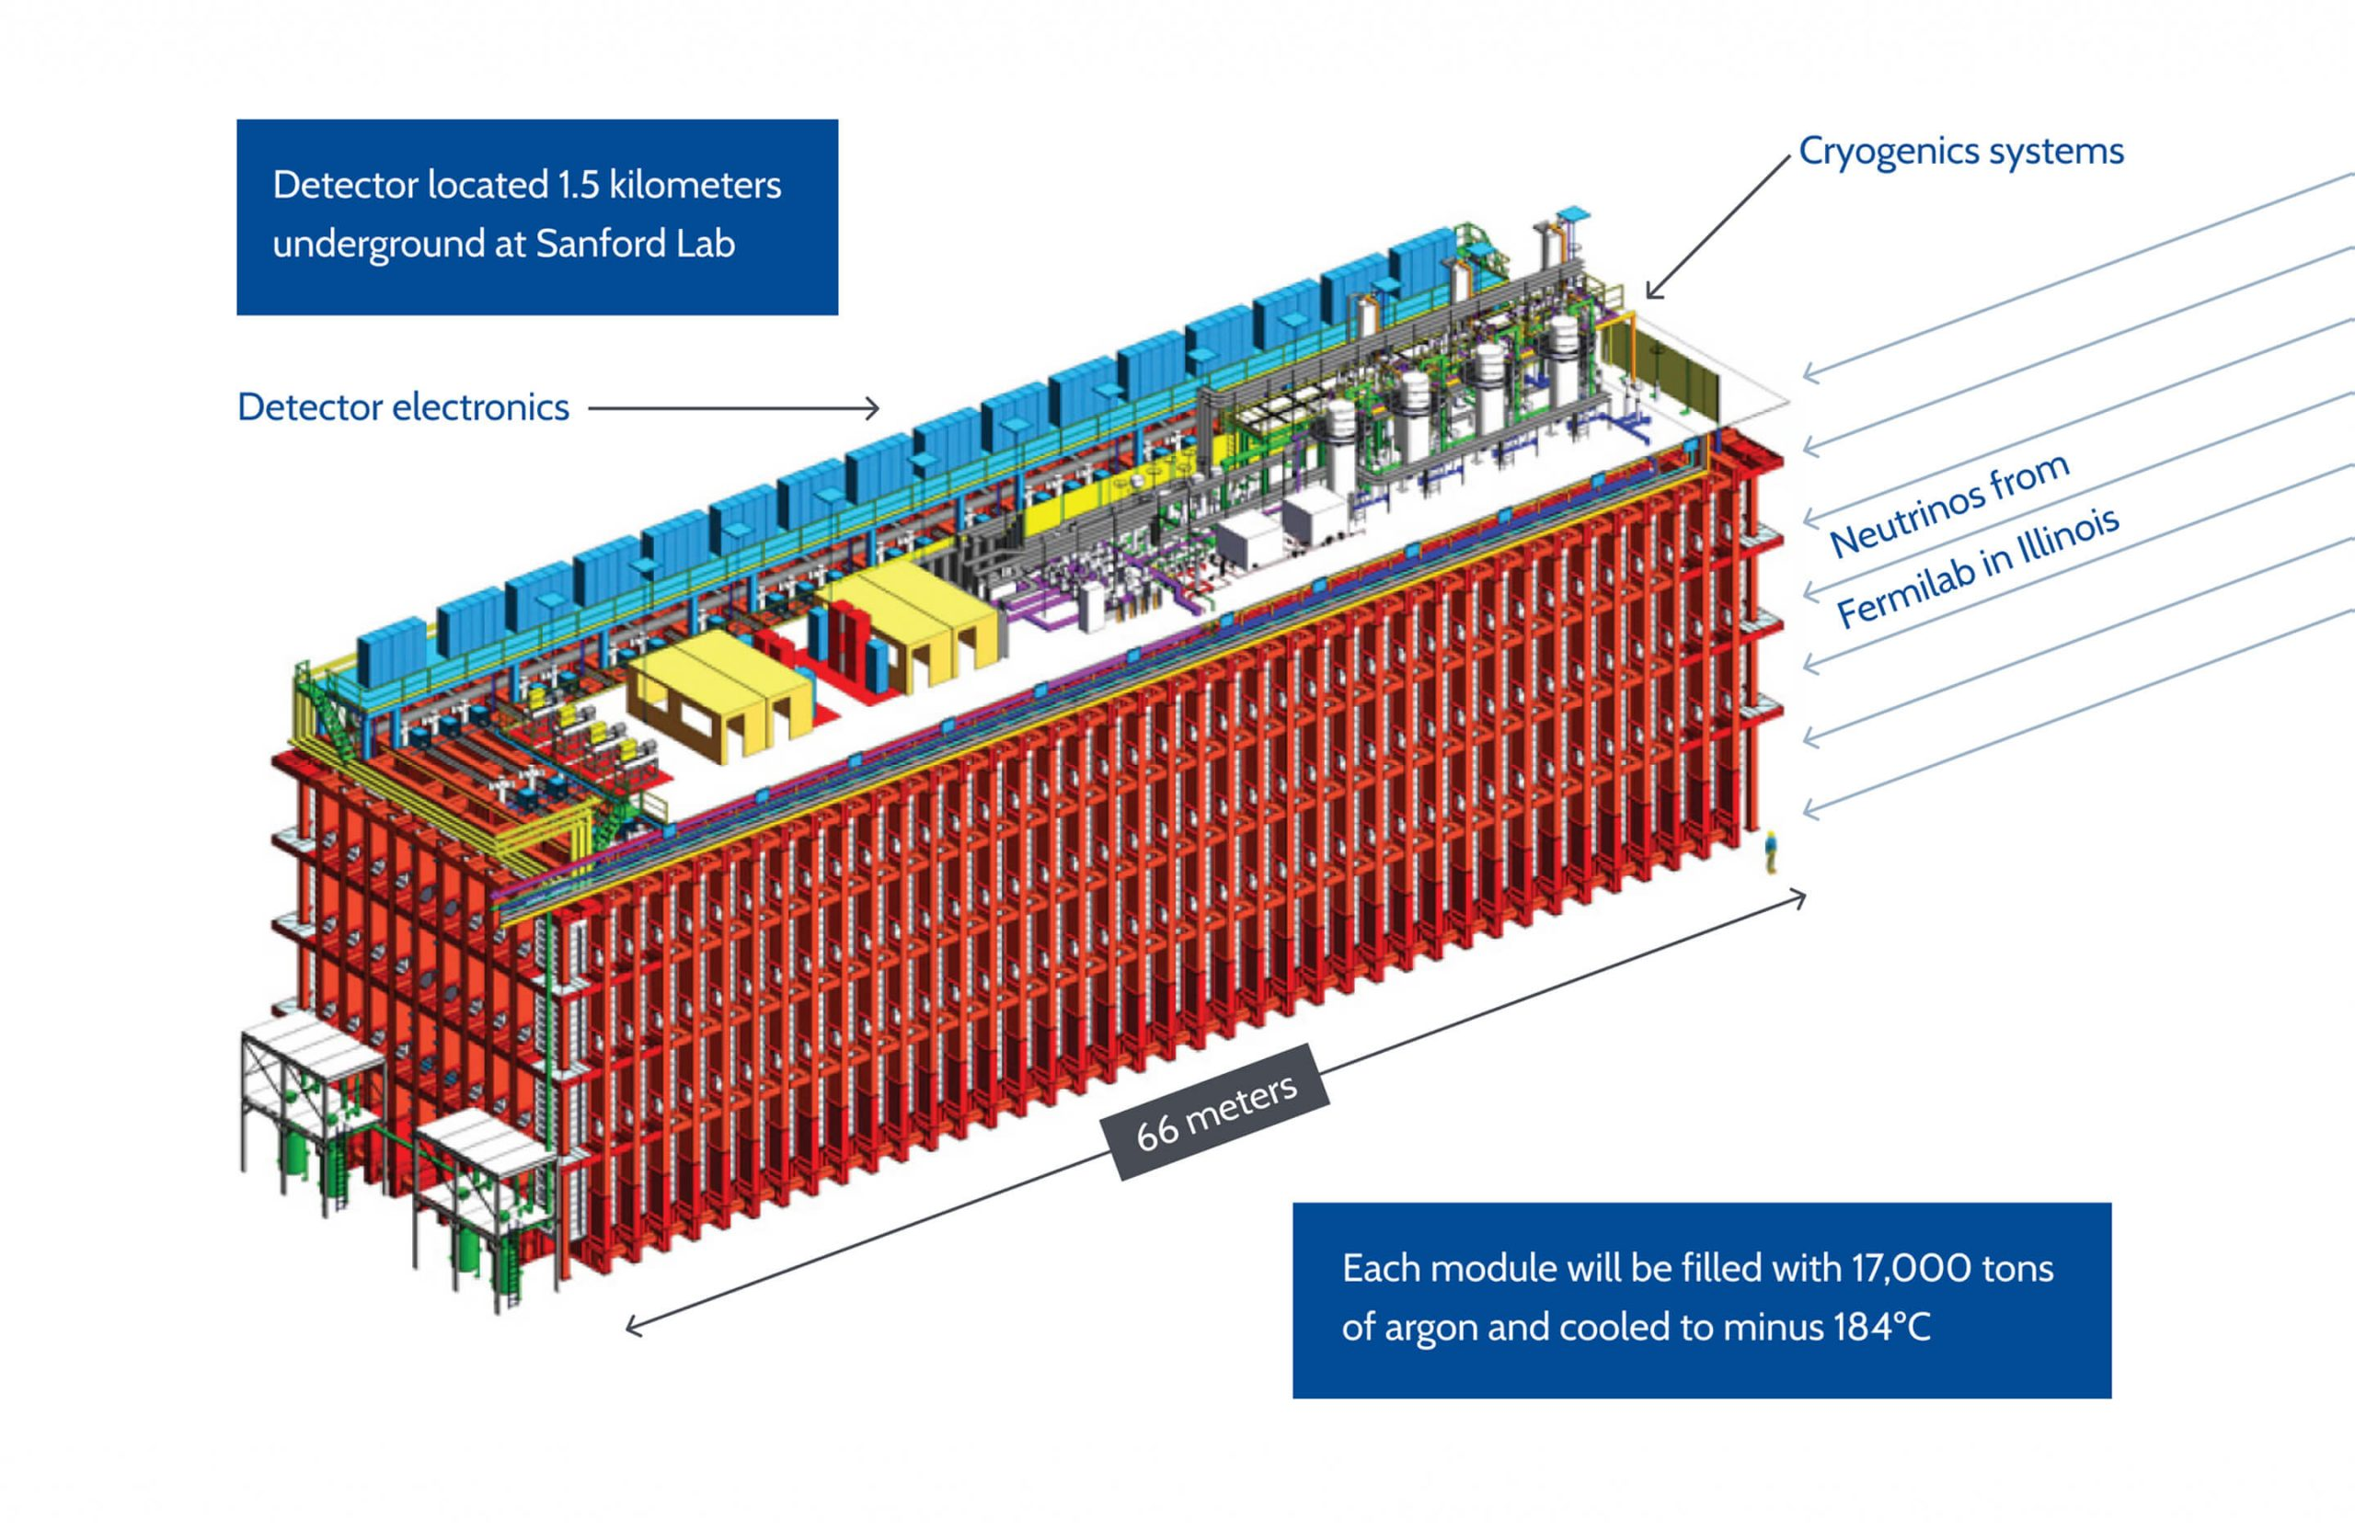
Deep Underground Neutrino Experiment
Near and Far Detector
Fabian Castaño

Slide 10
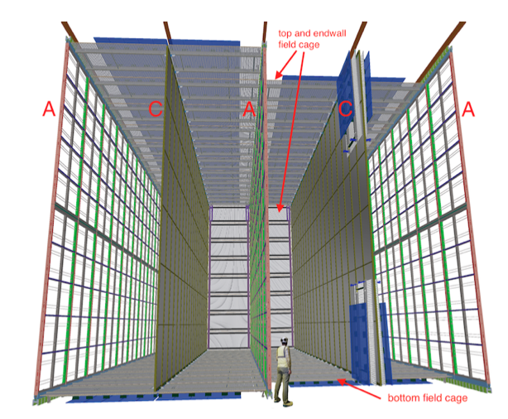
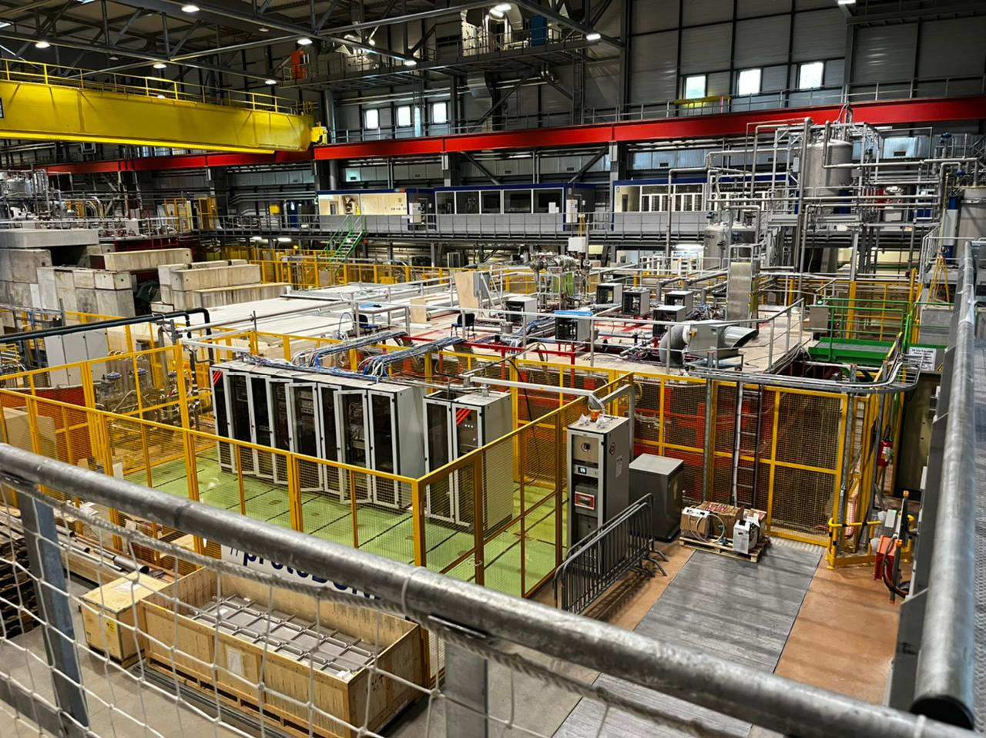
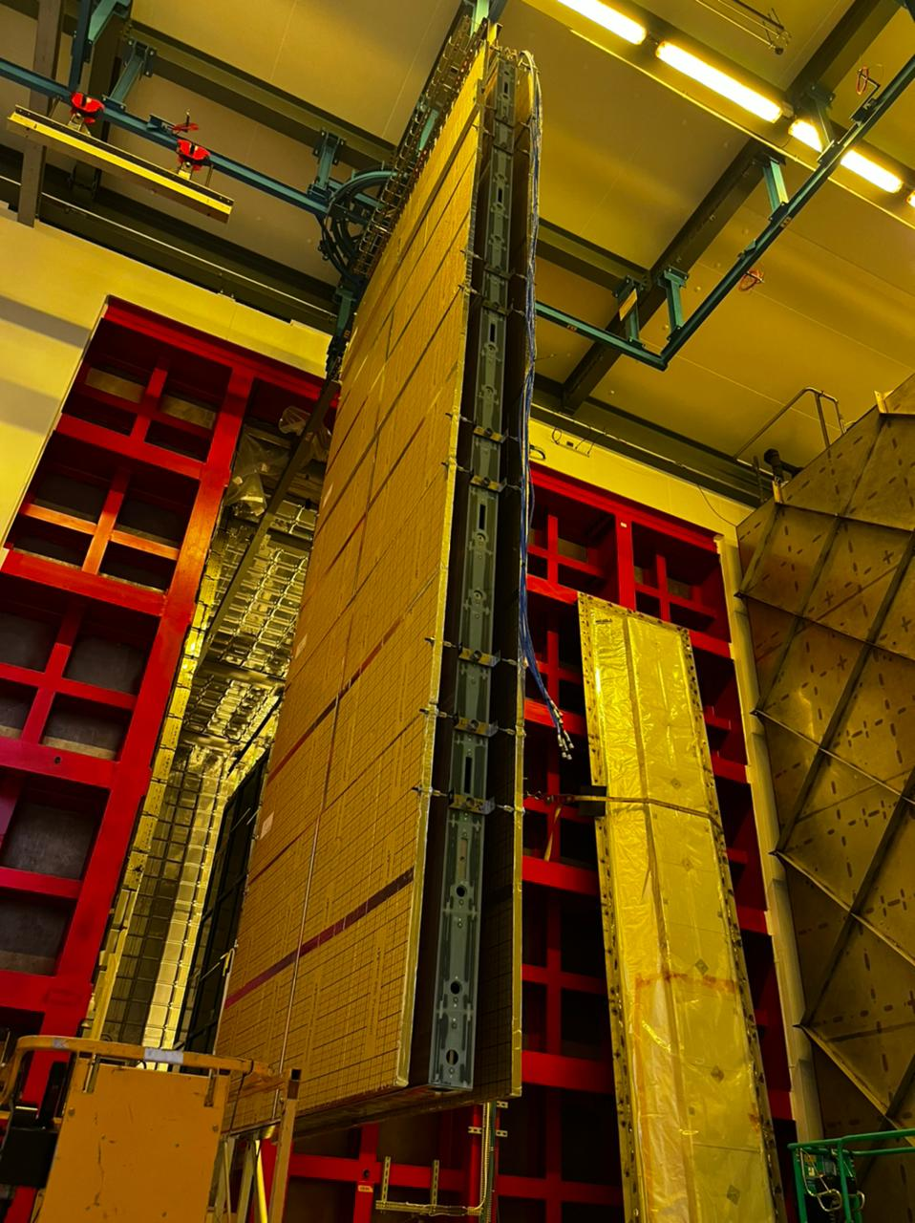
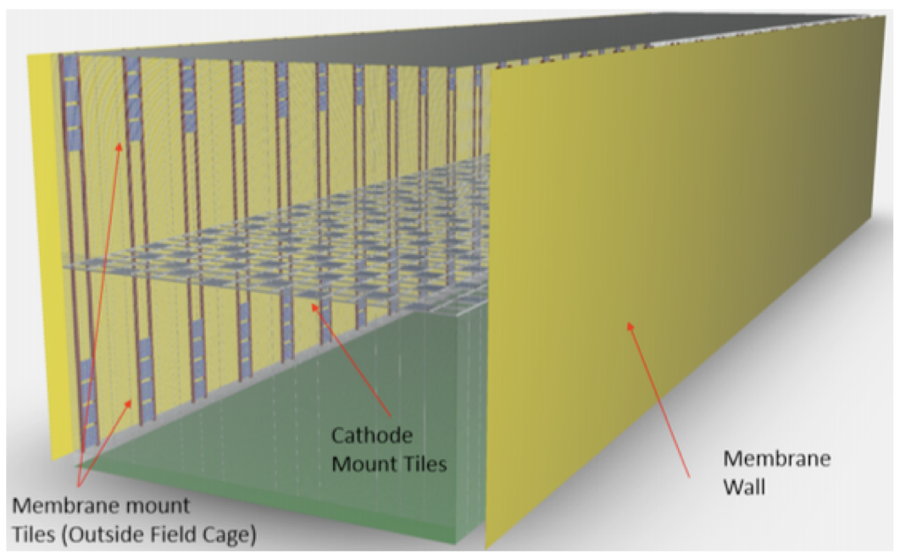
Horizontal and Vertical Drift
HD
Prototype Experiment built in CERN (Geneva, Switzerland)
VD
Fabian Castaño

Slide 11
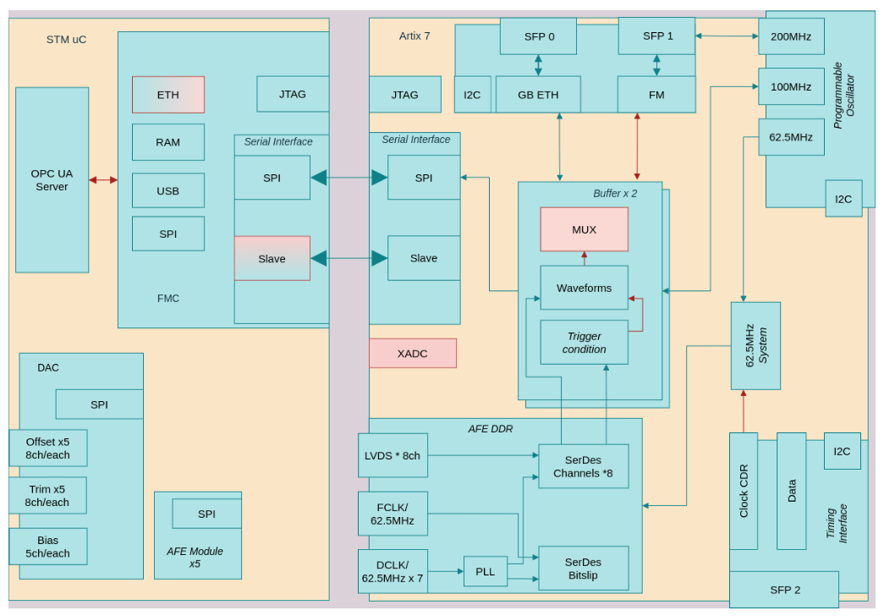
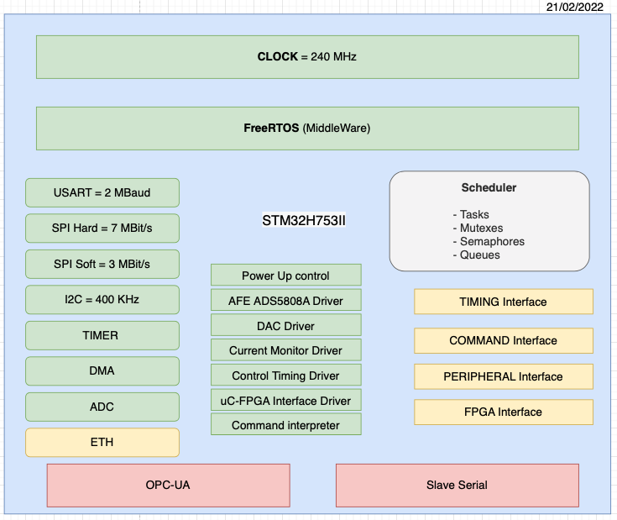
DAPHNE V1 and V2A
Firmware
Hardware
Software
Fabian Castaño

Slide 12
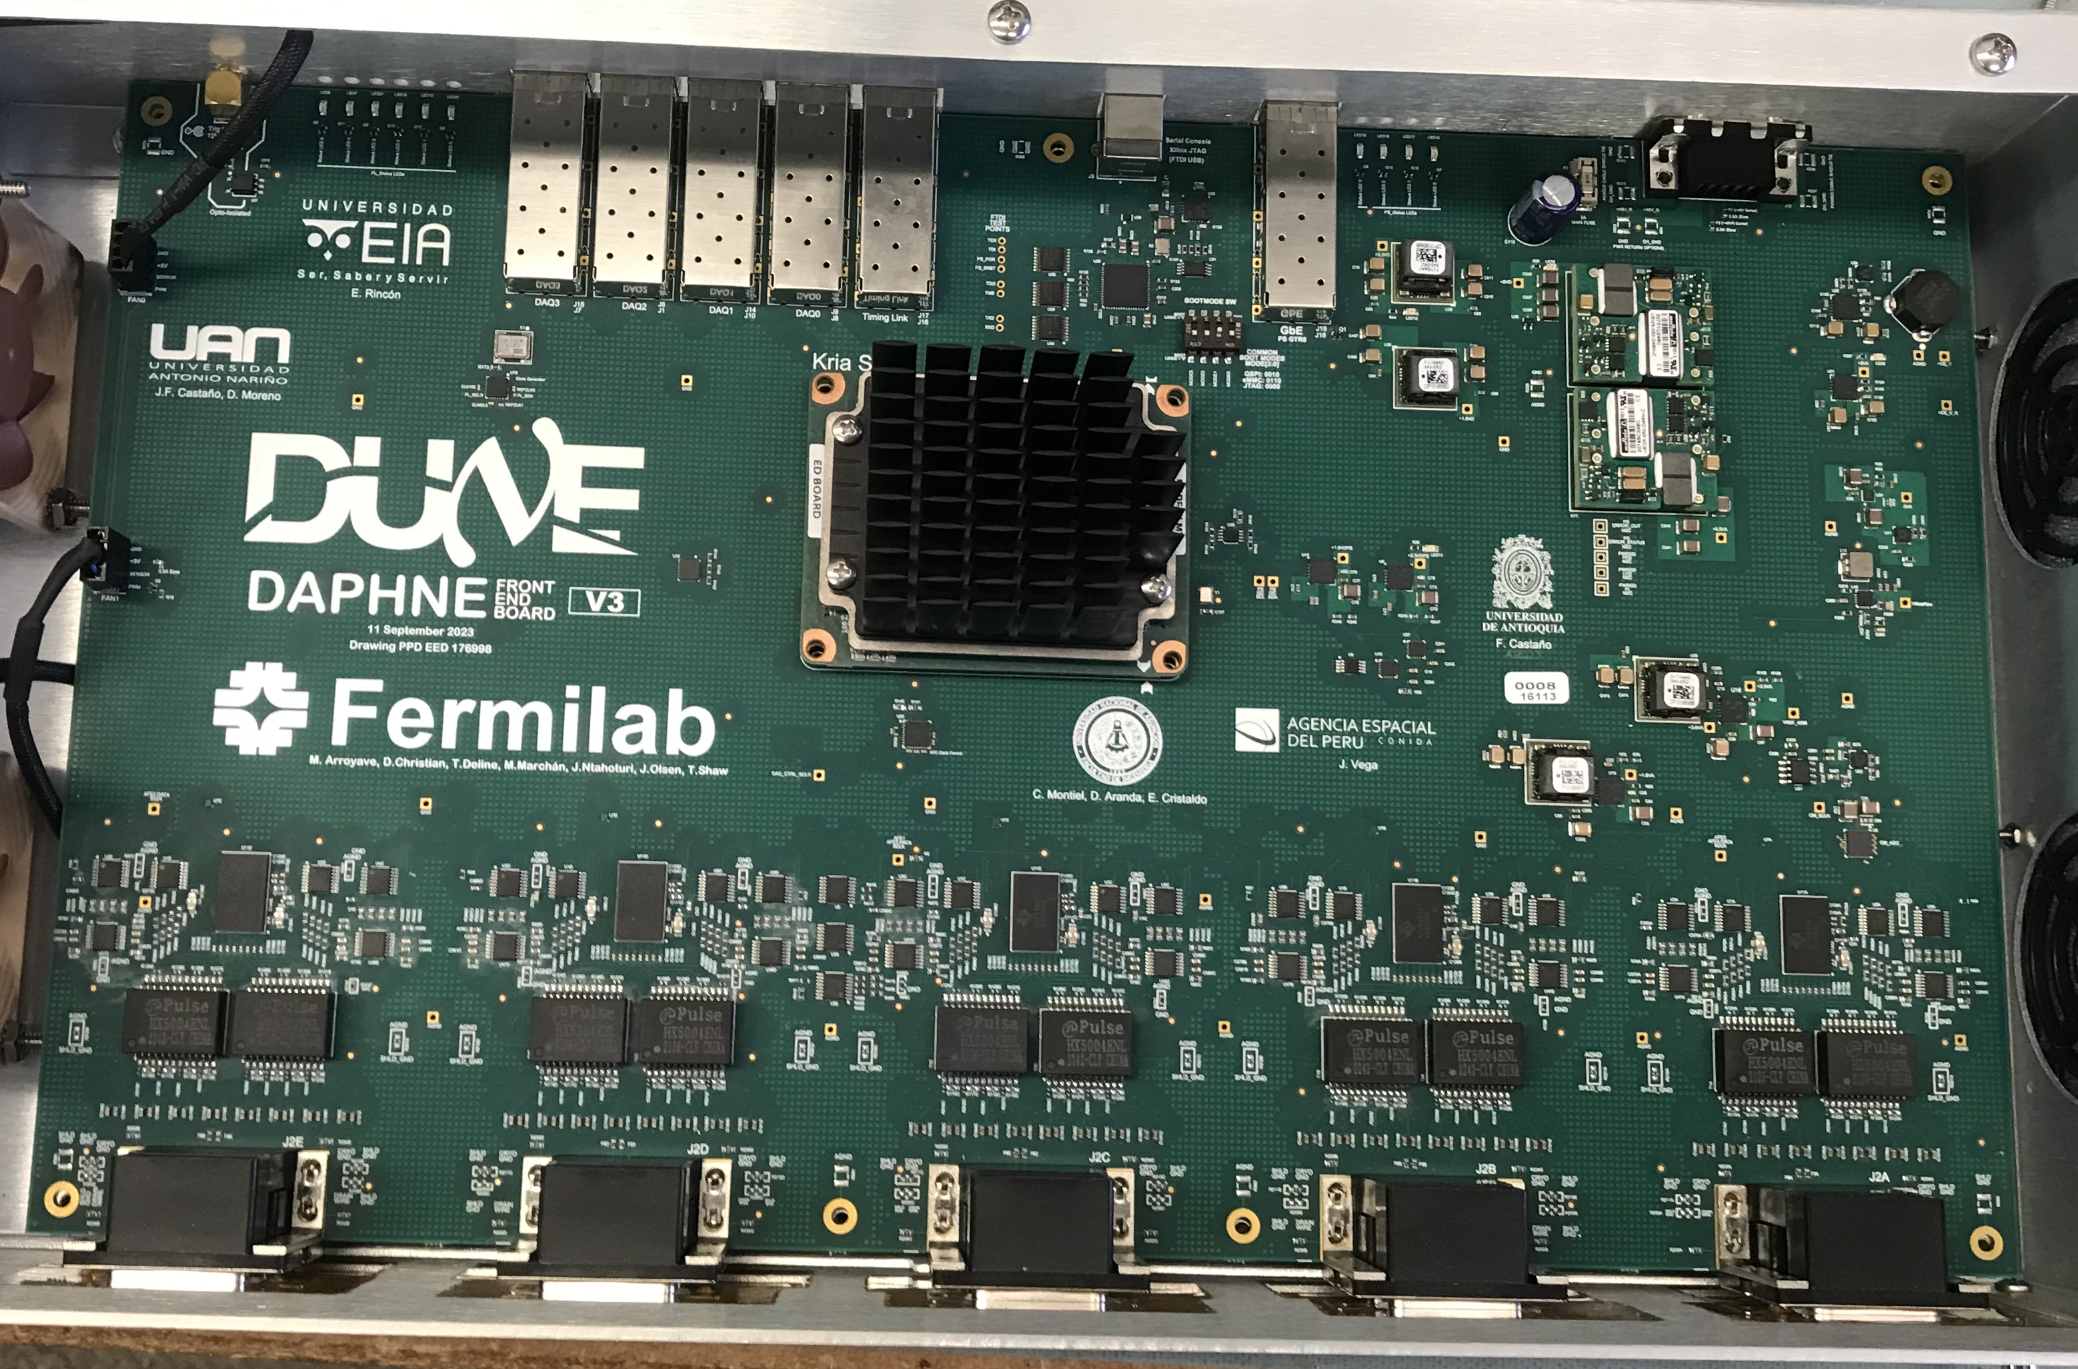
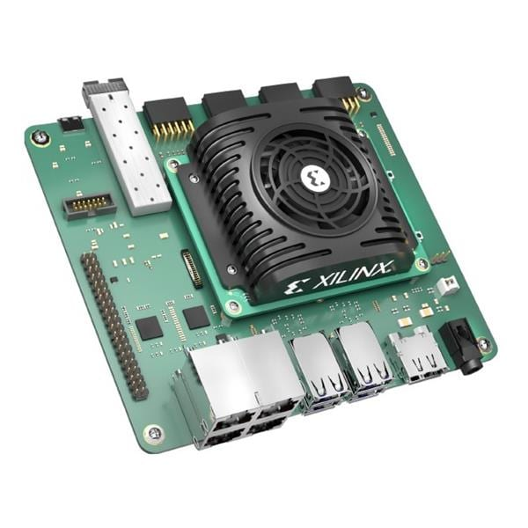
DAPHNE V3
Kria KR260 – DAPHNE V3
Design of new architecture for Data Acquisition System
Acquisition of development boards for the collaboration
https://github.com/fabioc9675/KRIA_Starter_Guide/blob/documentation/Tutorial/T01_Kria_and_Vivado.md
Fabian Castaño

Slide 13
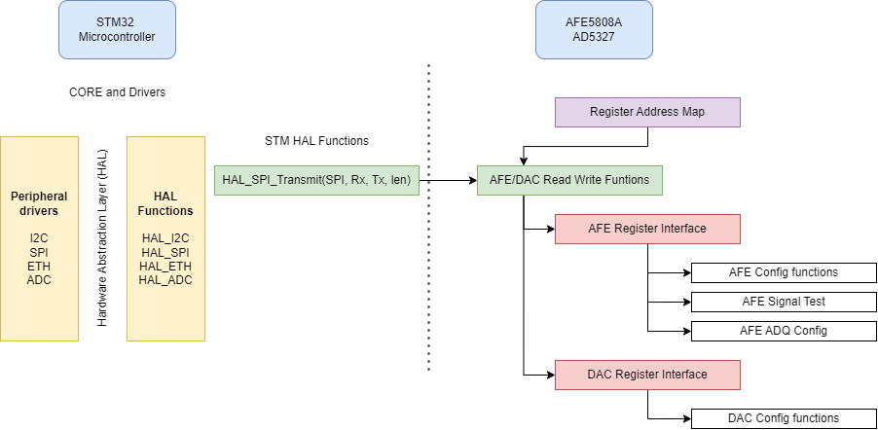
Distributed design
DAPHNE v1-v2a Slow Control Firmware architecture
Fabian Castaño

Slide 14
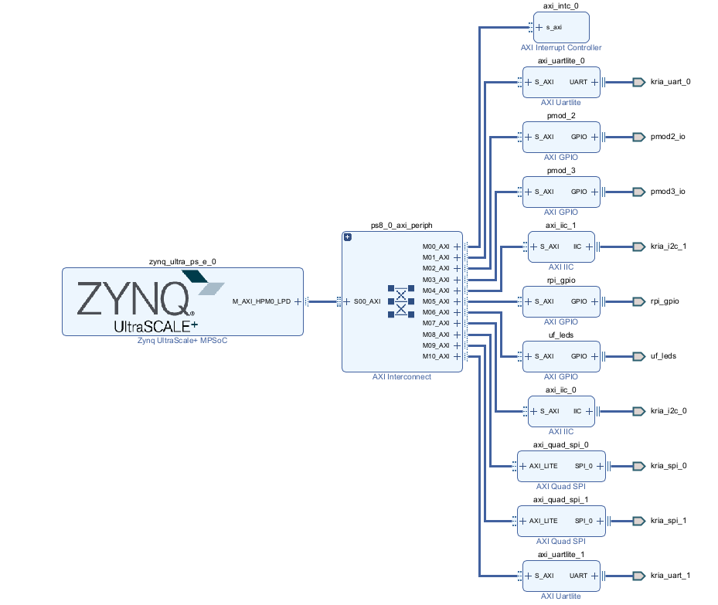
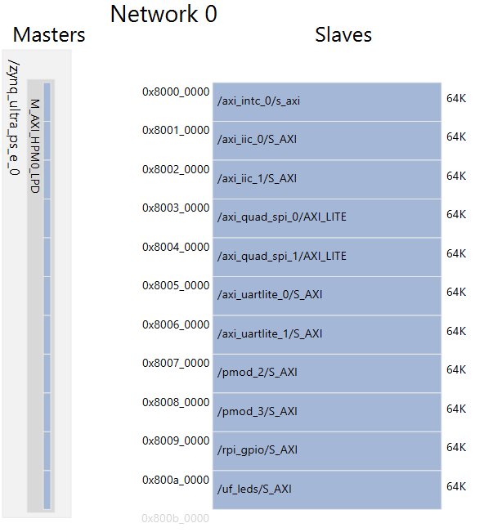
Co-Processor design
Vivado Block Design
Fabian Castaño

Slide 15
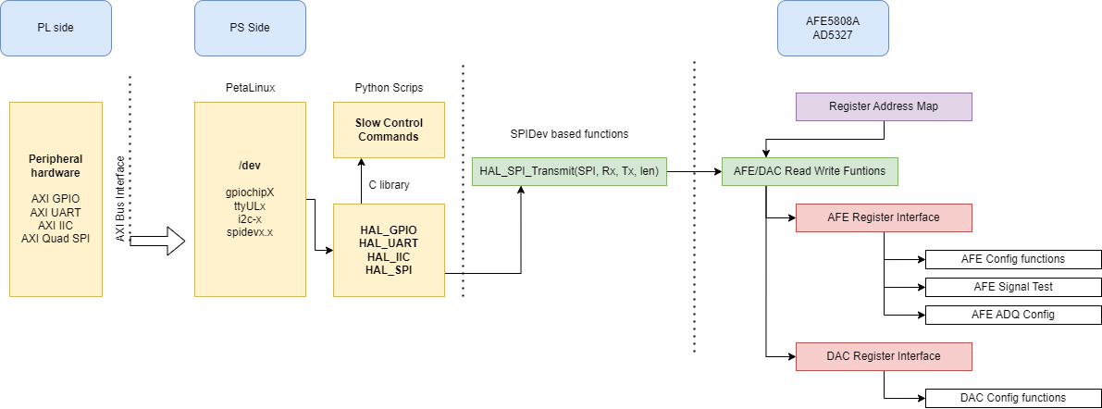
Co-Processor design
DAPHNE v3 Slow Control Firmware architecture
Fabian Castaño

Slide 16
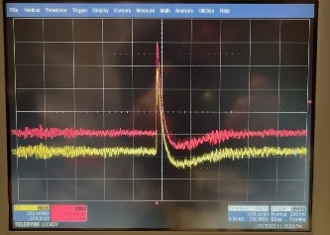
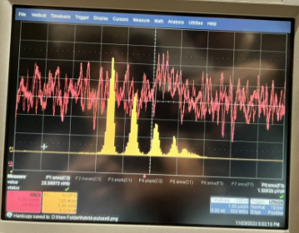
Photon Detection System (PDS)
Analog signal form SiPM
Single Photon Detection
Fabian Castaño

Slide 17
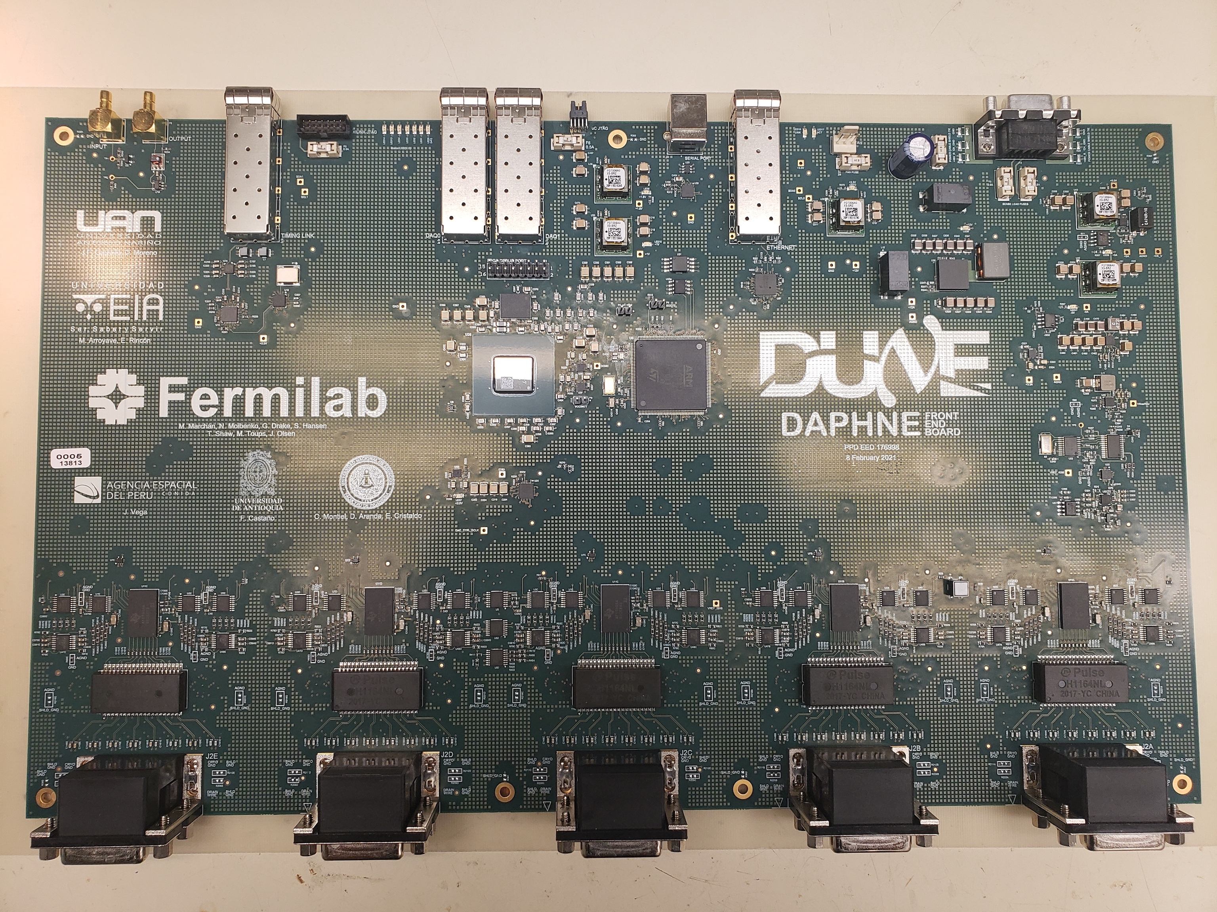
Data Acquisition for Photon-Neutrino Electronics (DAPHNE)
Fabian Castaño

Slide 18
DAPHNE
Fabian Castaño

Slide 19
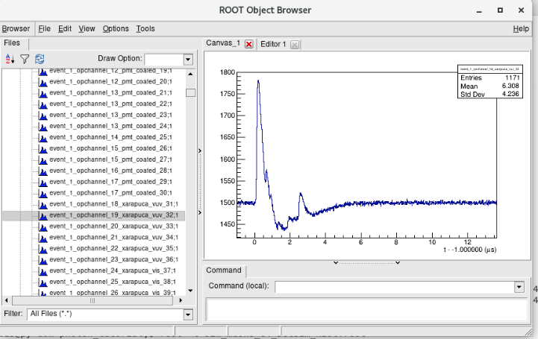
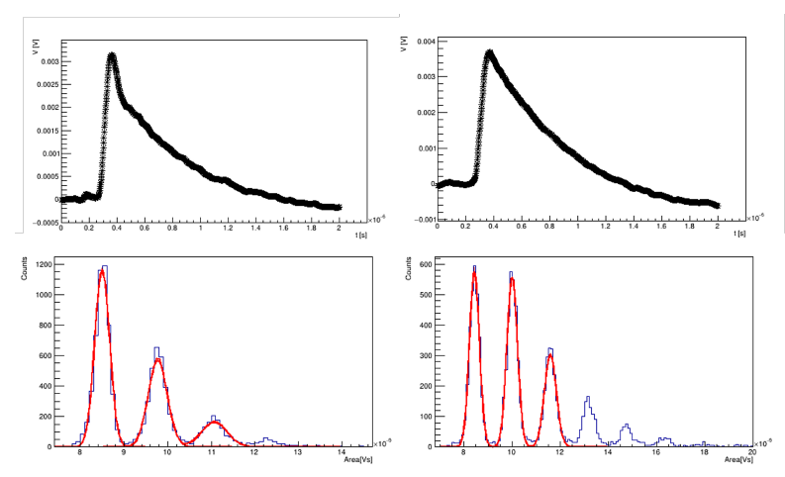
Test bench as event signal simulator
Generation of simulated events based on physics.
Measurement of the performance in readout system.
Diagnosis of electronics' system.
Fabian Castaño

Slide 20
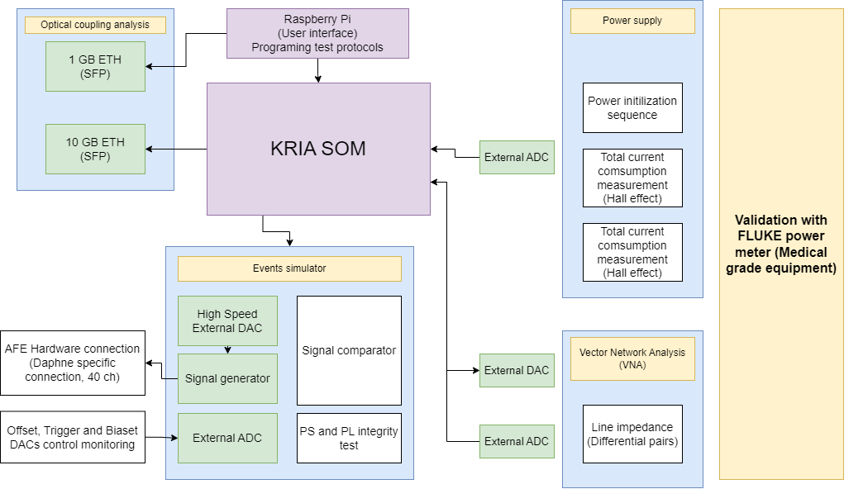
Test bench architecture
Cooperation with Gustavo and Vinicius
Fabian Castaño

Slide 21
Simulation model building
Biexponential model (Radiation events’ model)
Radiation Event sampled (Geiger Detector)
Baseline noise extraction
Event model fitting
Fabian Castaño

Slide 22
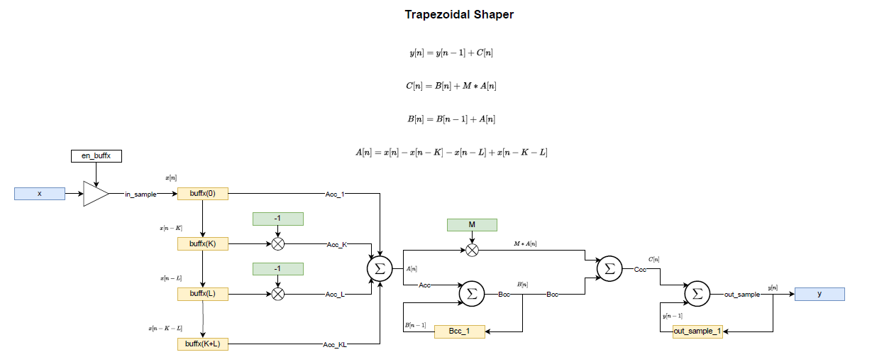
Simulation model building
Multiple event simulation
Design of Event counter
Trapezoidal Shaper Filter and DPP implementation
Fabian Castaño

Slide 23
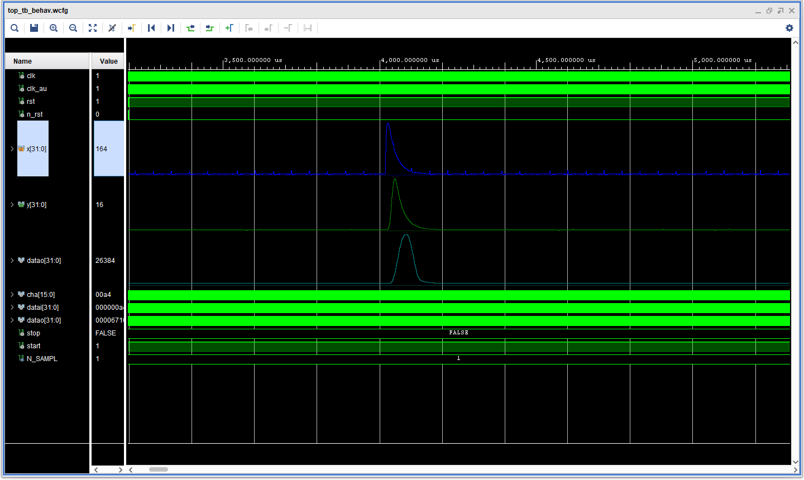
Simulation model building
Multiple event simulation
Fabian Castaño

Slide 24
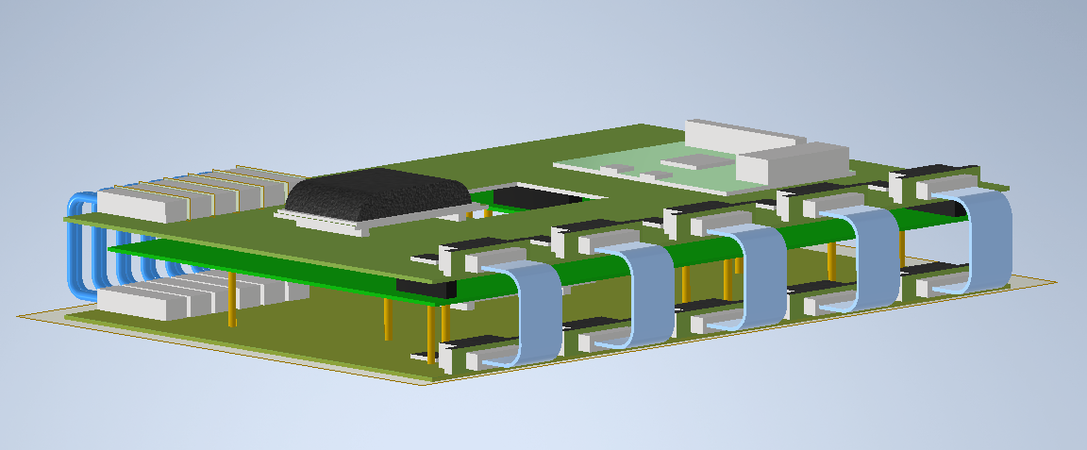
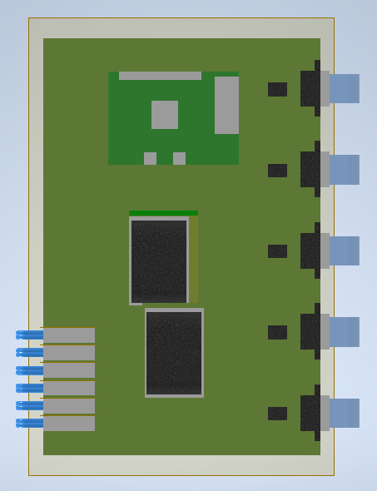
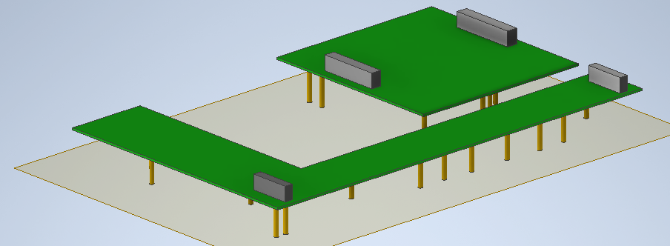
New Concept design
Fabian Castaño

Slide 25
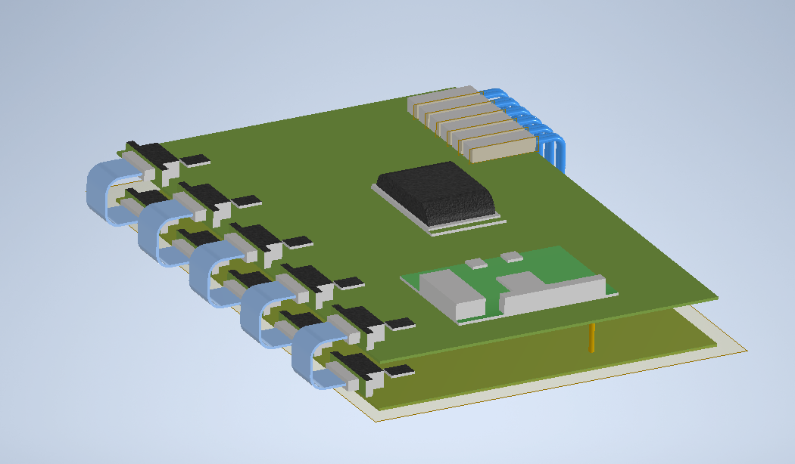
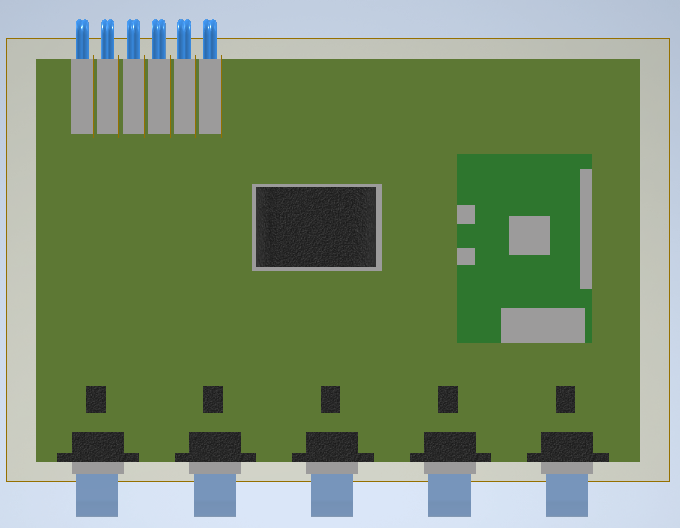
Concept design
Fabian Castaño

Slide 26
Thank you!
Fabian Castaño

