Slide 1
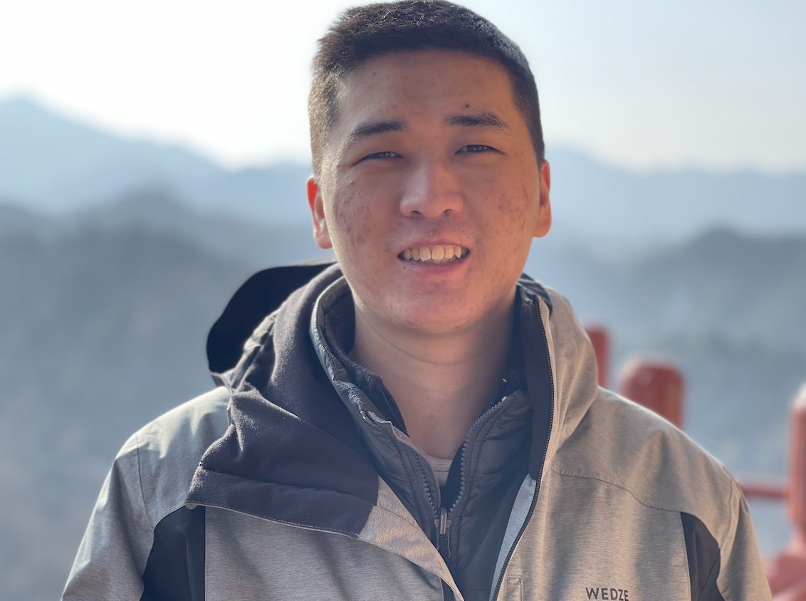


Quantum optimization and quantum Neural networks
Alex Kamenev
Hao Zhang
University of Minnesota
August 2025

Slide 2
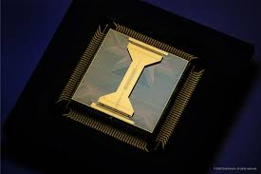
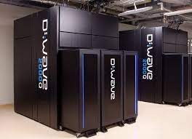

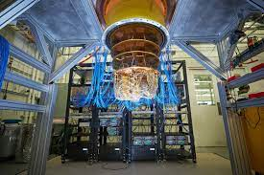
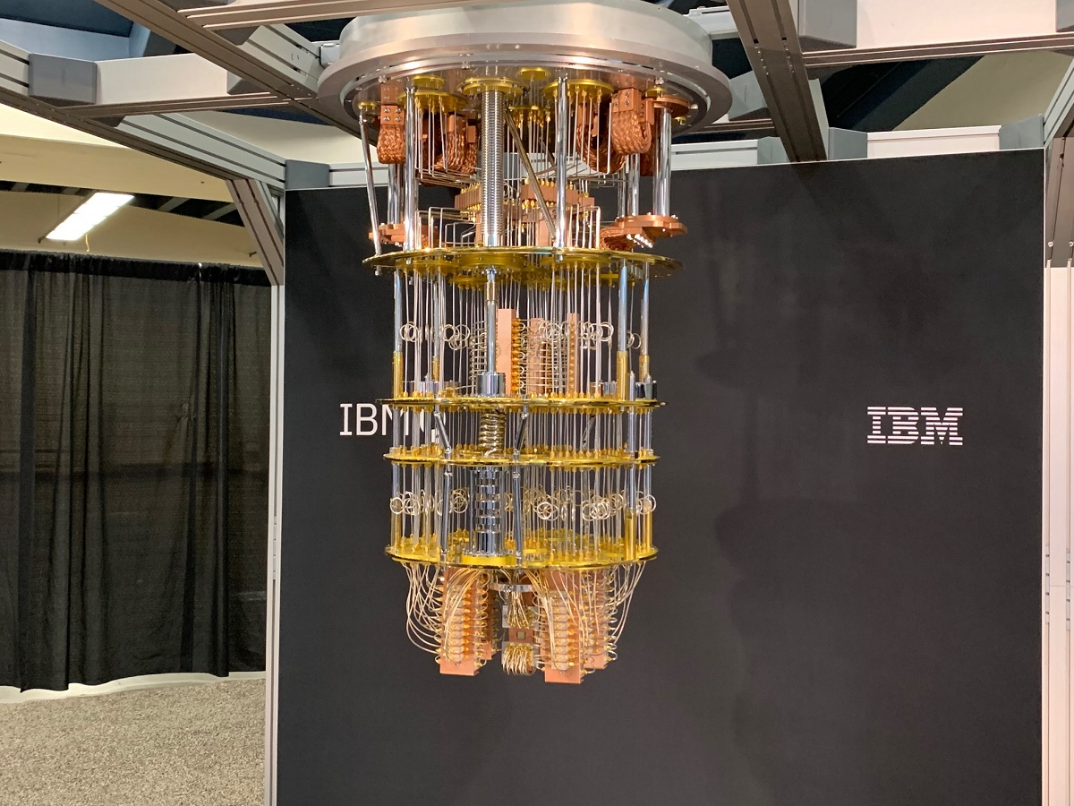
Motivation:

Slide 3
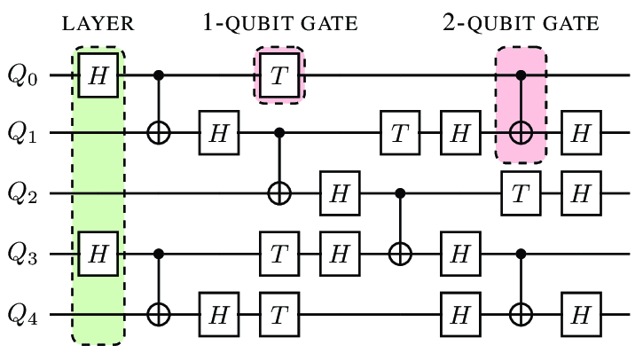
Gate computers vs. Annealers
digital vs. Analog

Slide 4
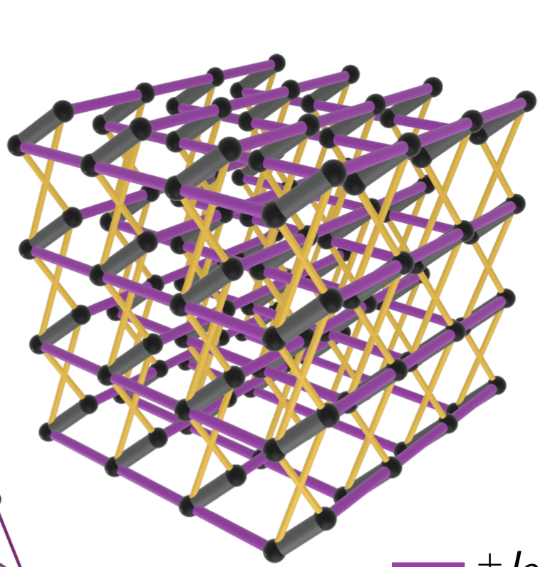
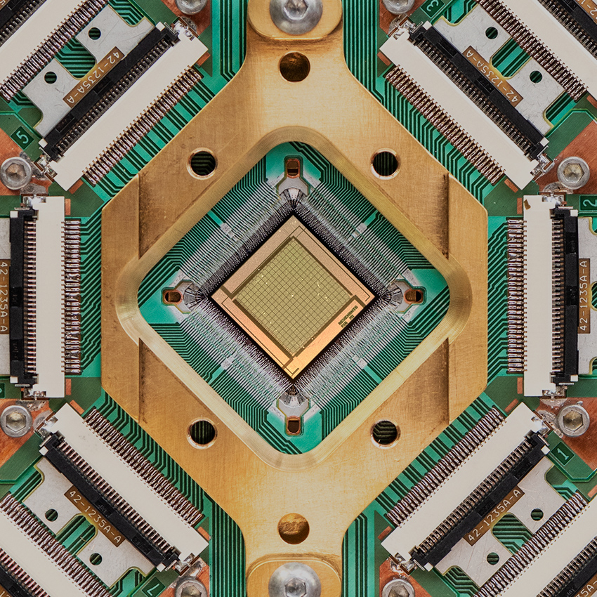
SIMULATIONS WITH THE D-Wave:
a 3D lattice of transmon qubits
5627 qubits, 40279 couplers
5627 qubits, 40279 Z-Z couplers, , plus local (dynamical) fields, B_{z}(t), and B_{x}(t).
4

Slide 5
Classical Optimization:
Find a bit-string {σ}= (1,1,-1,1,-1,….-1),
N
which minimizes a cost function: H[{σ}] (energy or Hamiltonian)
EXAMPLE: H[{σ}]
If is a realization of a random matrix – Sherrington-Kirkpatrick model.
If is random, restricted to d-dim lattice -- d-dim spin glass (SG); D-Wave d=3

Slide 6
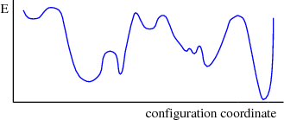
Classical Annealing:
Start from a bit-string {σ}= (1,1,-1,1,-1,….-1),
Accept if H[{σ}_{new}]<H[{σ}]
flip 1 spin to find {σ}_{new}
Reject otherwise
Leads to a local minimum, with other local minima at a Hamming distance of order N

Slide 7
FORWARD Quantum Annealing:
SG
2^{N} * 2^{N} matrix
At a very large B_{x}, the
ground state is:
SG
Adiabatically reducing B_{x}, the
system arrives at a true GS of SK
para
Requires exp-long time, due to
Zener tunneling.
gap
B_{x}
Altshuler, Krovi, & Roland, (2010).

Slide 8
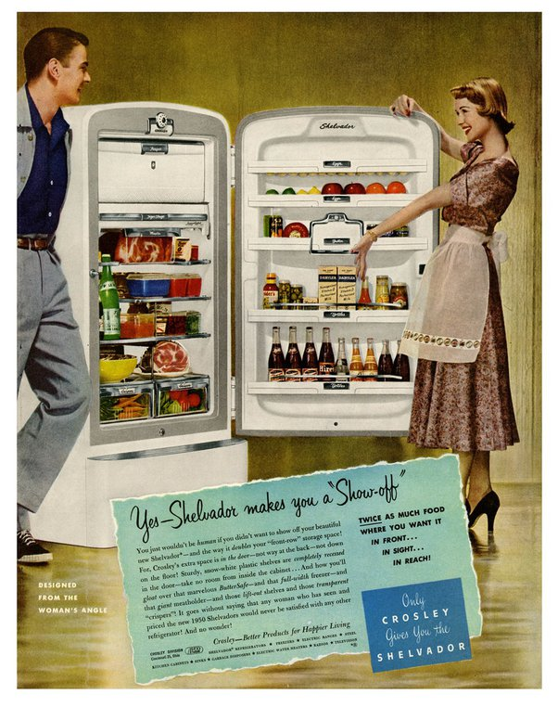



Quantum Refrigeration Cycle: cyclic annealing
H. Wang, H-C. Yeh, A.K., Nature Comm (2022).
SG
gaped paramagnet
step 1
step 3
SG
gapless
step 2
χ
gaped
4
step 3
B_{c}
step 1
B_{c}
Ohkuwa, Nishimori, & Lidar, (2018).

Slide 9
Complexity of finding the minimum of the glass

Slide 10
Complexity:
Best known (quantum) algorithm for Sherrington-Kirkpatrick model
A. Montanaro, (2020).
For 3D spin glass, the computational complexity is > Z. Zhang, (2020).

Slide 11
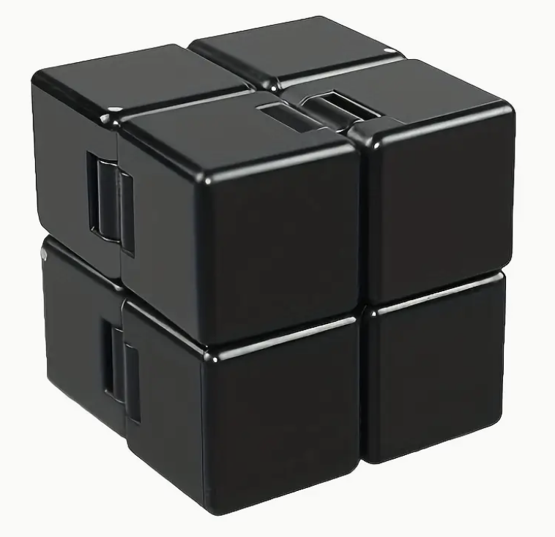
Spin glass complexity
Complexity of solving the cube 2^{f(L)}
Cut the cube into 8 cubes of size L/2
L
Fix 3L² spins on the 3 cutting planes
Each L/2 cube is solved independently
2^{f(L)} = 2 2³ 2^{f(L/2)}
3L²
f(L) = 4L² + 3 log₂ L

Slide 12
Forward vs. Cycle annealing:

Slide 13
Dendrogram

Slide 14
Basin’s distribution
δ₀ = 1.6
GS energy per spin
d – Hamming distance between
the basins;
= E – E₀ is the residual energy
of basin’s bottoms.

Slide 15
Digital cooling: Cluster flipping algorithm
Divide states into random groups, identify and flip individual loosely connected clusters within a group, until lowest energy state is reached.
Repeat
Eventually all groups collapse to a single state!

Slide 16
Lessons:
Cycle annealing protocol is capable of producing large ensembles of low energy states with T_{eff} < 10⁻³ .
2. Complexity of finding a ground state scales as 2 ^{Teff} ^{N} .
Annealers are more efficient than the asymptotic, 2^{N^2/3} , algorithm for N < (T_{eff})⁻³ = 10⁹ .

Slide 17
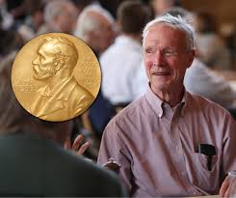
Image recognition: Hopfield Model

Slide 18
(Quantum) Hopfield Model
Ising model with p<<N pre-designed minima (images)
H[{σ}]
Capacity:
p < 0.138…*N
ξ³
ξ¹
ξ²
ξ⁴

Slide 19
Image recognition
Quantum Annealing

Slide 20
Neural Networks
An image – x, provides a bias for h-layer
28
28
where

Slide 21
Training Neural Networks
For each training image – x, belonging to class y=0,1,…9, one finds a ground-state of H[x]
and H_{N} [x,y], where H_{N} [x,y] is strongly biased (nudged) towards a known output class, y.
28
28
NN parameters dynamically evolve
according to the following evolution rule:

Slide 22
Training NN’s
Each point represents a low energy state
of H[x] – 10,000 per panel: 100 test images,
100 states per image.
Color code shows output class y=0,1,..9.

Slide 23
Training NN’s

Slide 24
Quantum advanaage:

Slide 25
Amplitude amplification (grover algorithm)

Slide 26
Lessons:
QUANTUM ANNEALERS CAN PROVIDE A PALTFORM TO TRAIN NEURAL NETWORKS, WHICH ARE THEN DEPLOYED ON A CONVENTIONAL HARDWARE.
2. EVEN LARGE NEURAL NETWORKS CAN BE TRAINED BY APPLYYING AN ANNEALER TO A FEW LAYERS AT A TIME.
FULLY COHERENT ANNEALERS CAN BE EVEN MORE EFFICIENT.

Slide 27
THANK YOU

