Slide 1
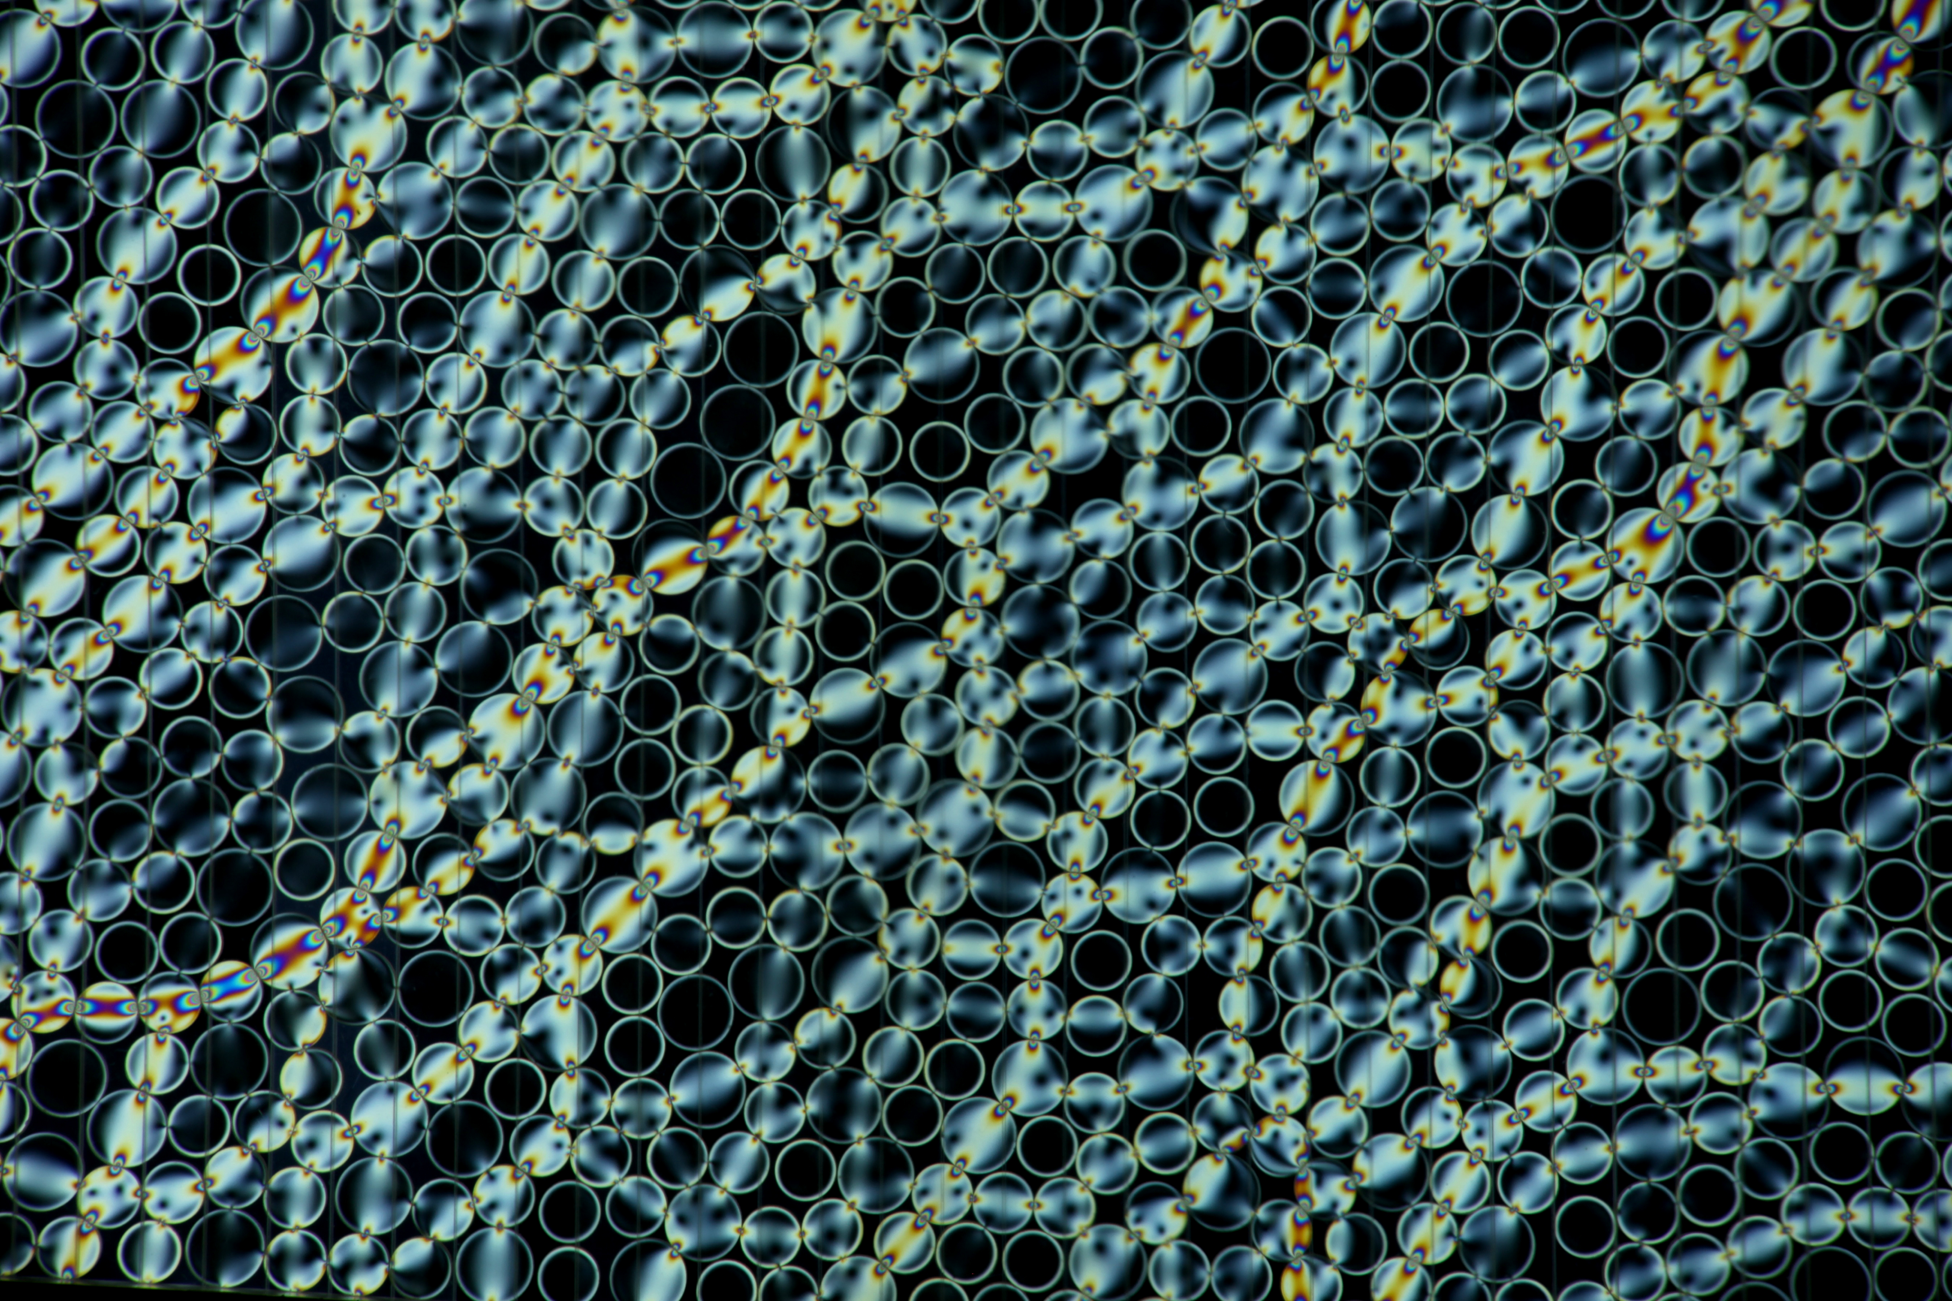
Regional Earth System Model
Graziano Giuliani^{1,2}, Marco Reale³ , Tapajyoti Chakraborty² , Erika Coppola² , Stefano Salon³
(1) University of Trieste, (2) The Abdus Salam International Centre for Theoretical Physics, Trieste, (3) OGS, Trieste
12th Workshop on the Theory and Use of Regional Climate Models
Trieste 25 August 2025

Slide 2
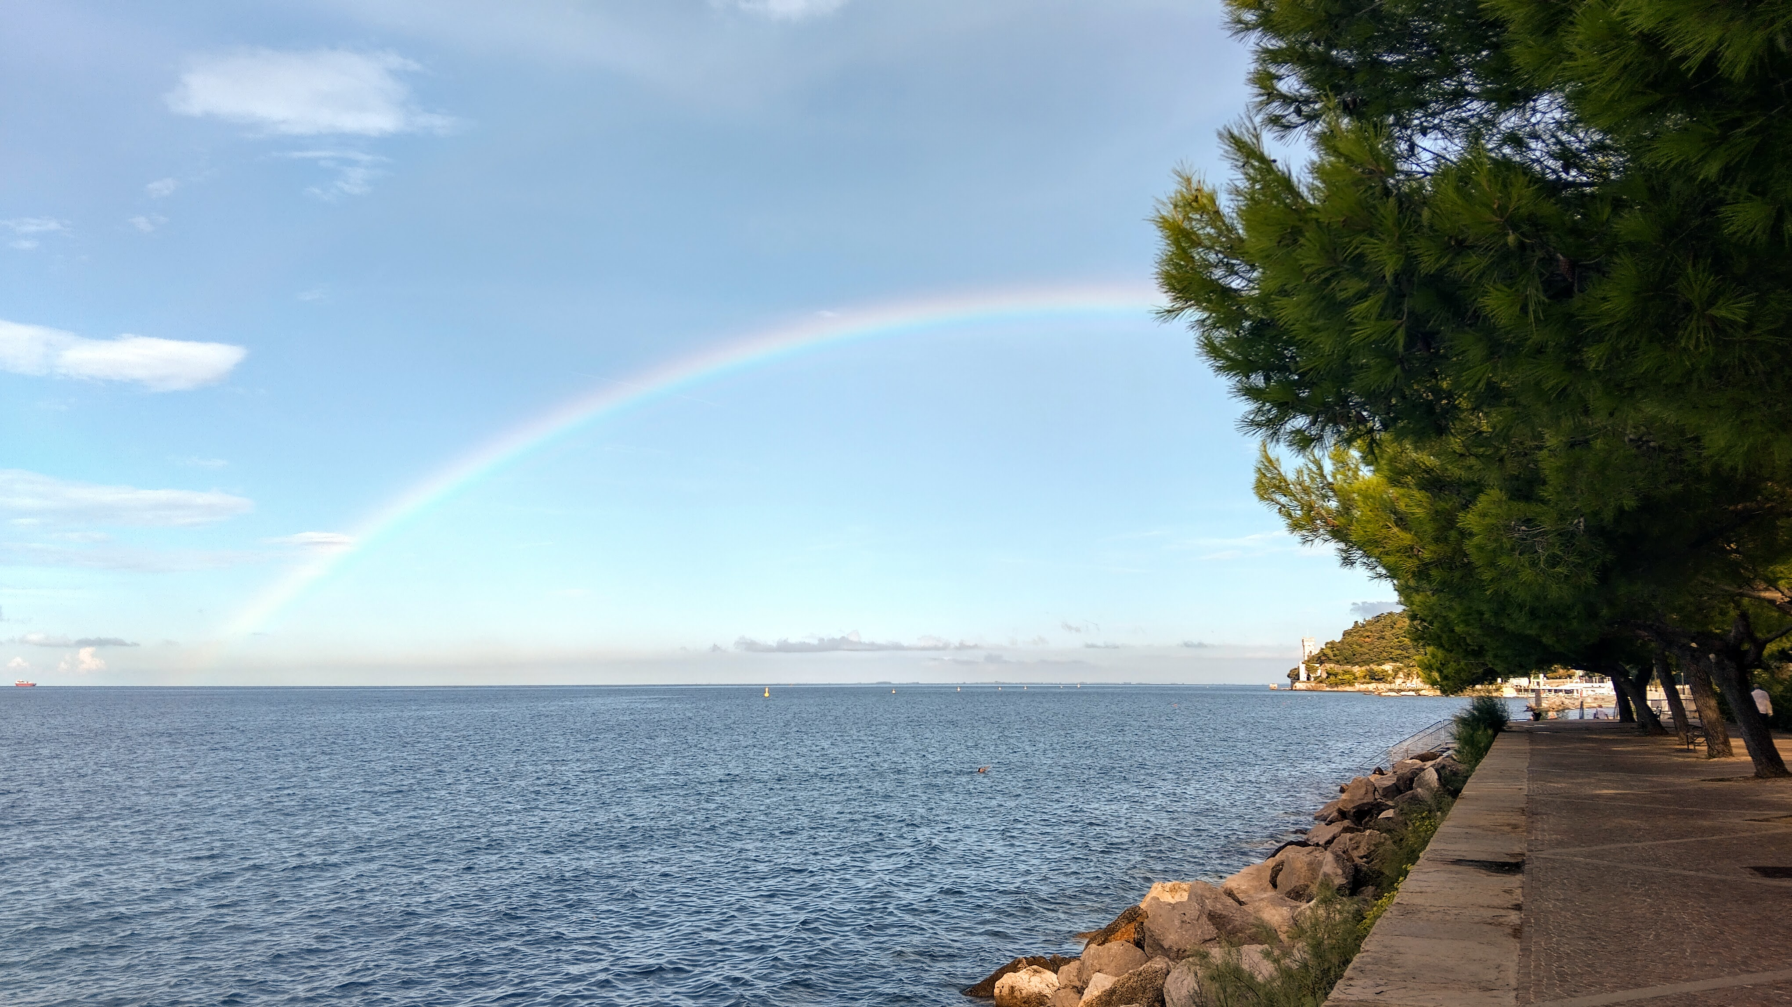
Regional Coupled Models
Coupling Models
Interface surfaces
Drastic change of physical properties
Drastic change of relevant timescales
Different equations and variables
Different scaling and resolution
Two way exchange of energy and mass
Author picture

Slide 3
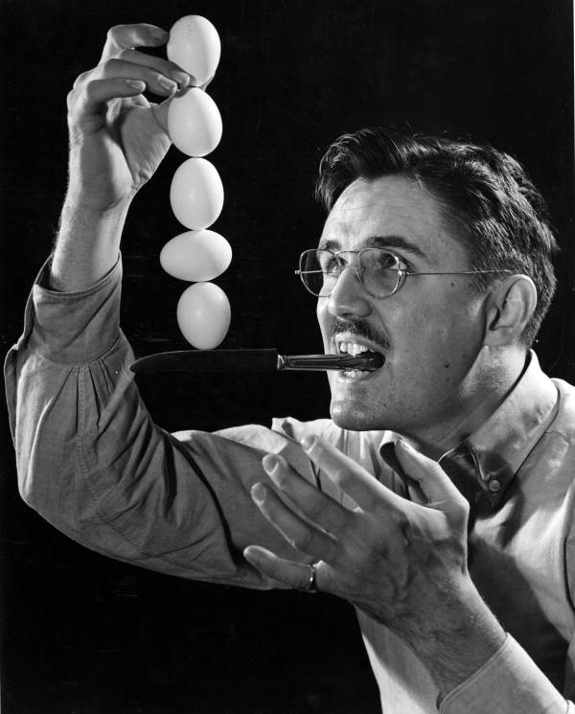
Regional Coupled Models
Equilibrium states
Global Descripion
Closed system
Long term equilibrium
Regional Description
Treansient responses
Forced system out of equilibrium
Steinmetz collection. N2011- 7, Photographic collection, 1930s-1970s; Box 9

Slide 4

Regional Coupled Models
What I want
Components feedbacks
Better processes description
Higher resolution understanding
Gemini AI generated image

Slide 5
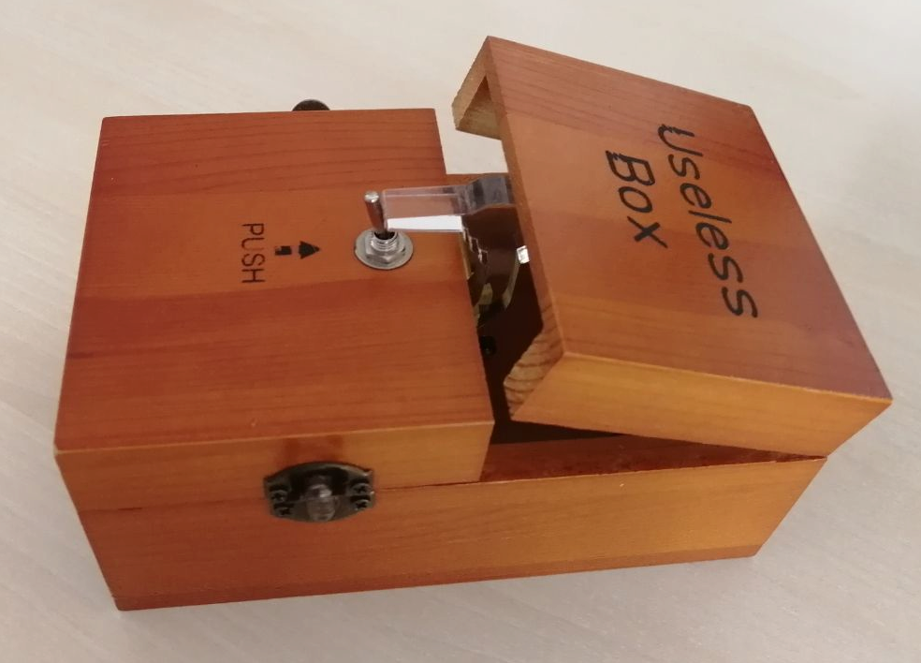
Regional Coupled Models
What I am buying
By Mr.donovan - Own work, CC BY-SA 4.0, https://commons.wikimedia.org/w/index.php?curid=94209395
A blacker box
Different expertise per model
Polymath are scarce
A (more) complex setup
A lot of description and bounding datasets
More knobs to turn than I have hands for
Increased instability

Slide 6

OCEAN COUPLING in RegCM
AI generated – water. body

Slide 7
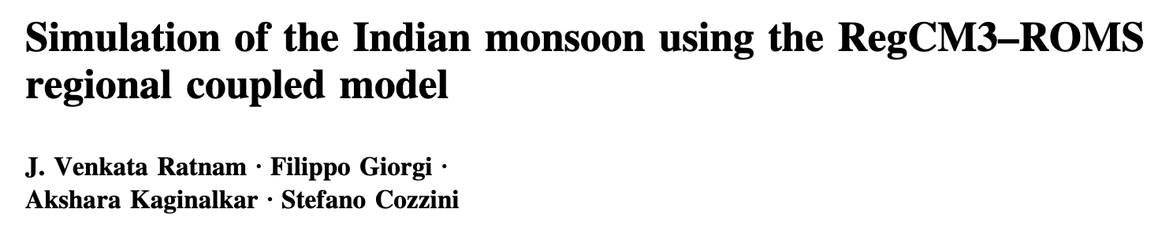
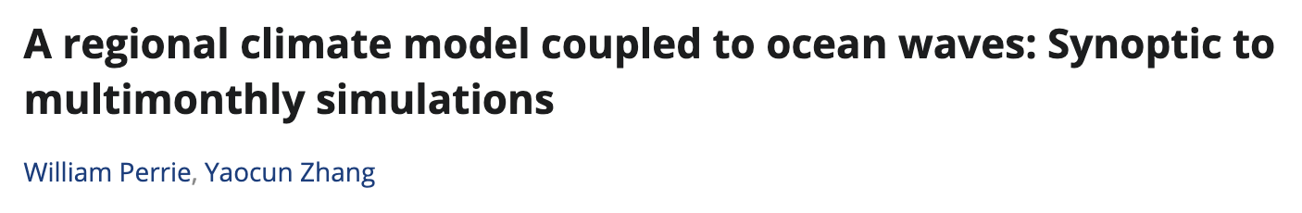
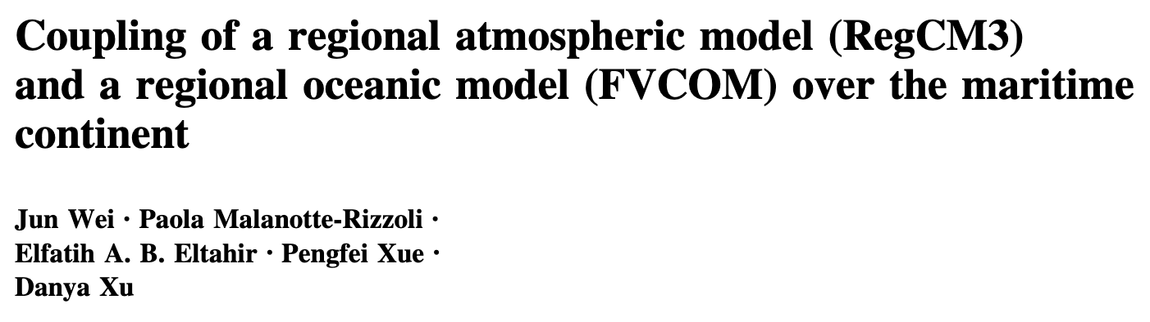
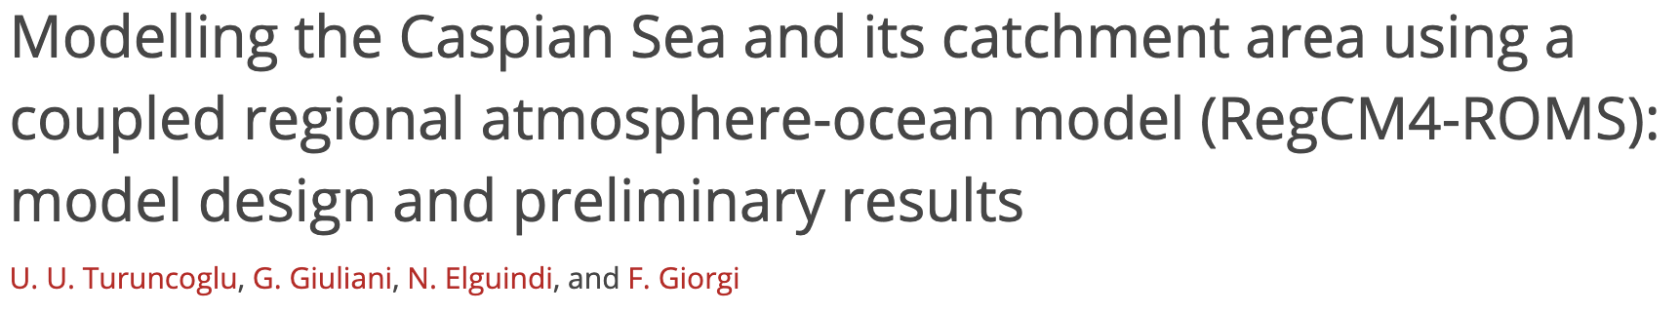
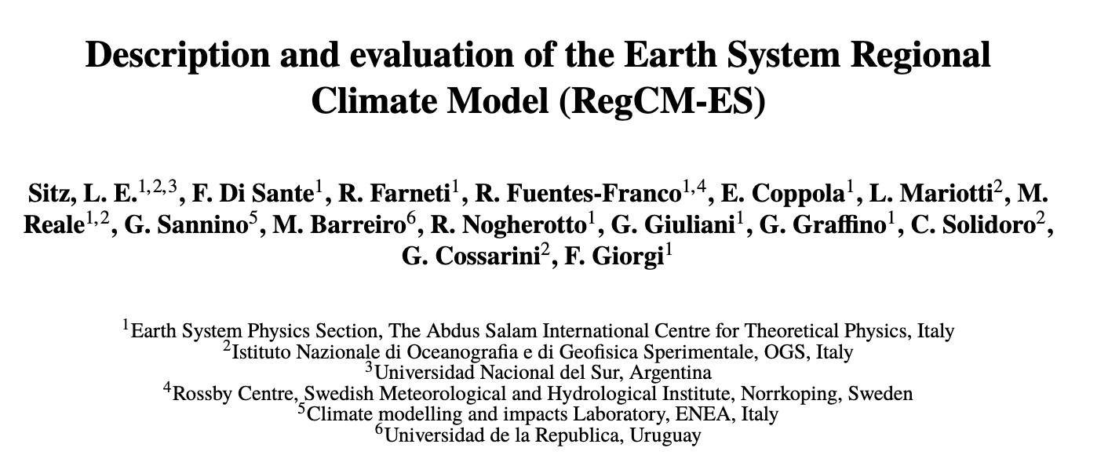
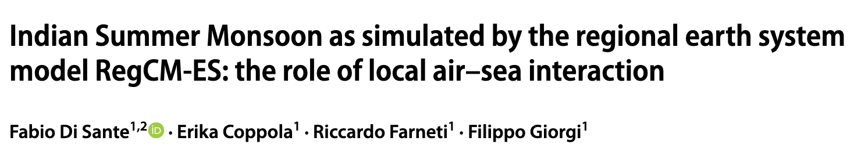
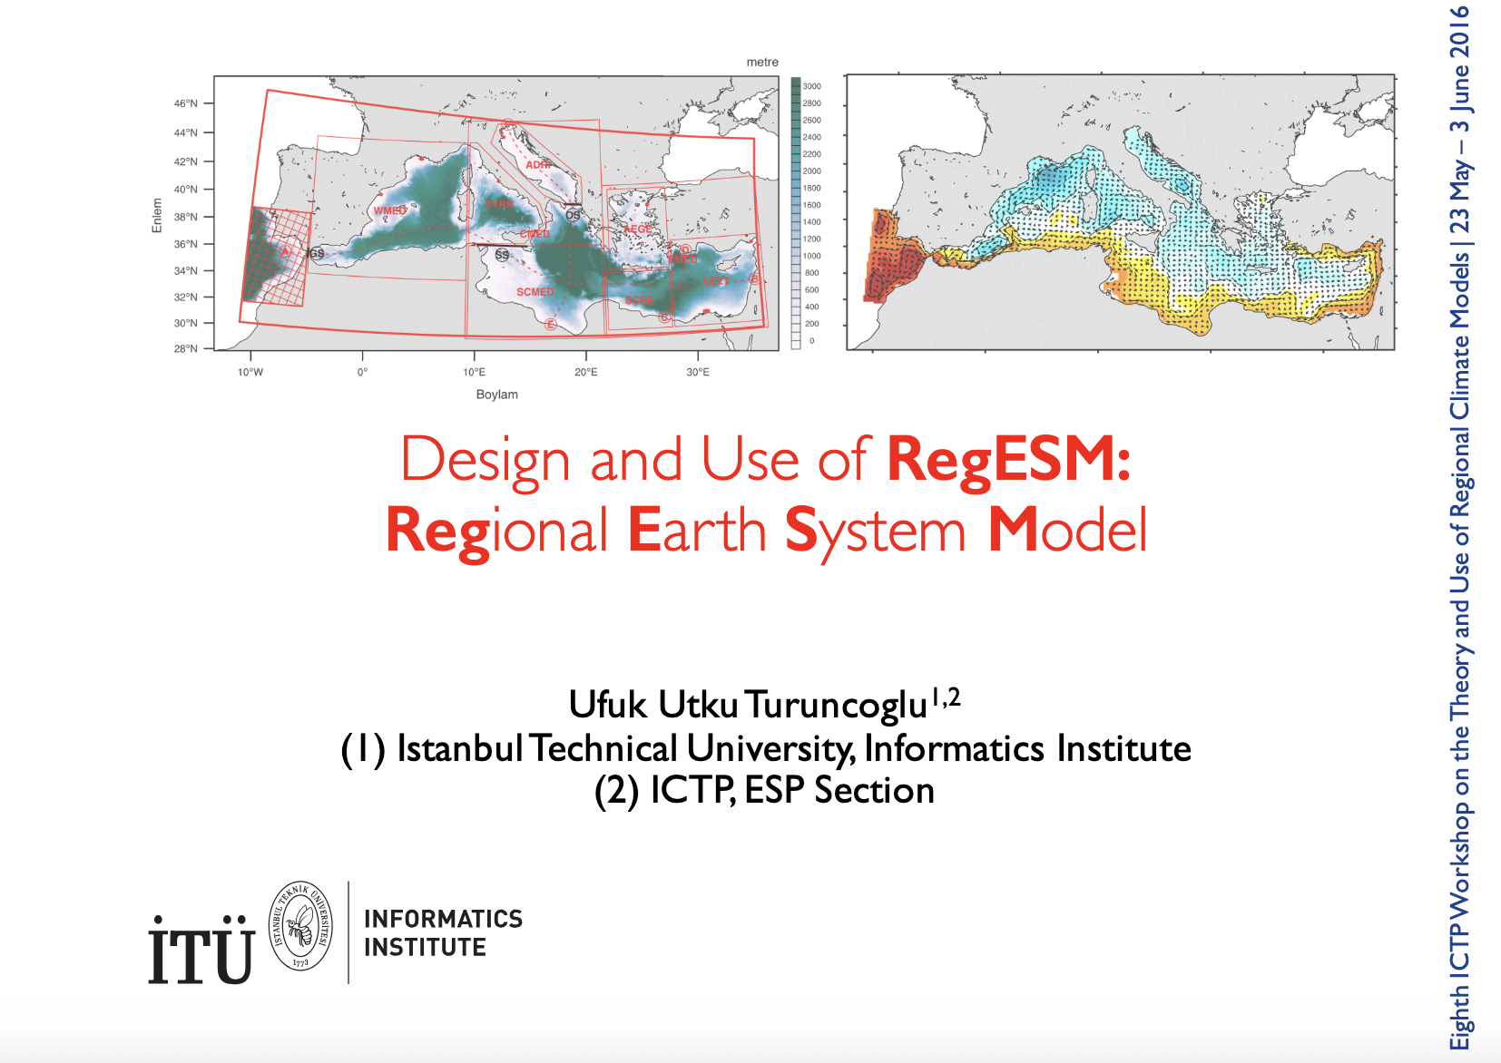
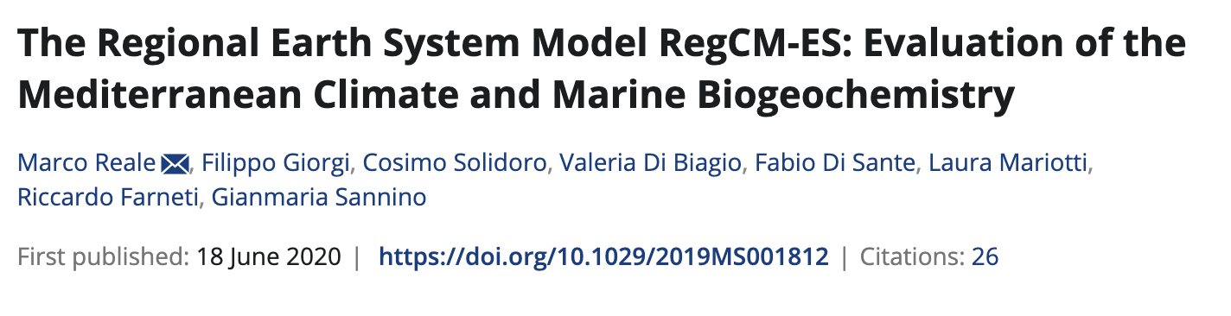
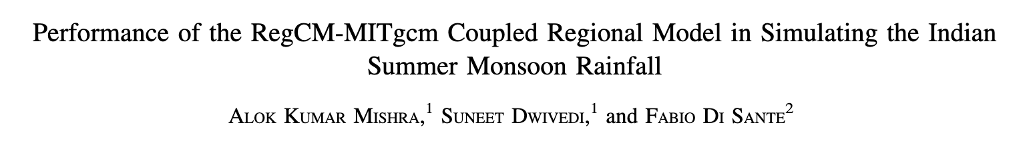
2009
2001
RegCM and Ocean coupling
2014
A brief recap
2013
2017
2019
2020
2016
2021

Slide 8
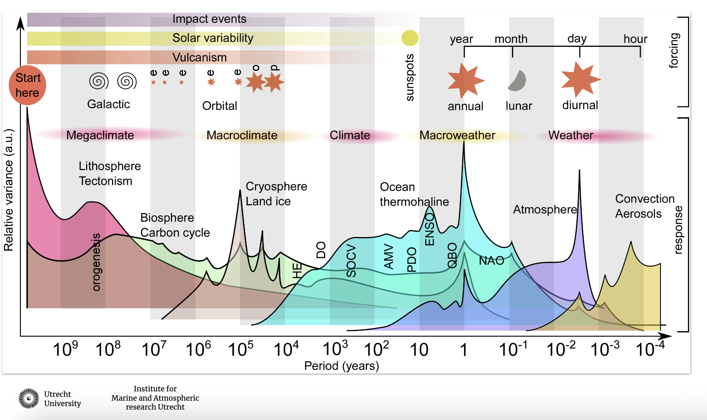
The Ocean
The Need for Coupling
Adapted from Erik van Sebille SMR 4067

Slide 9

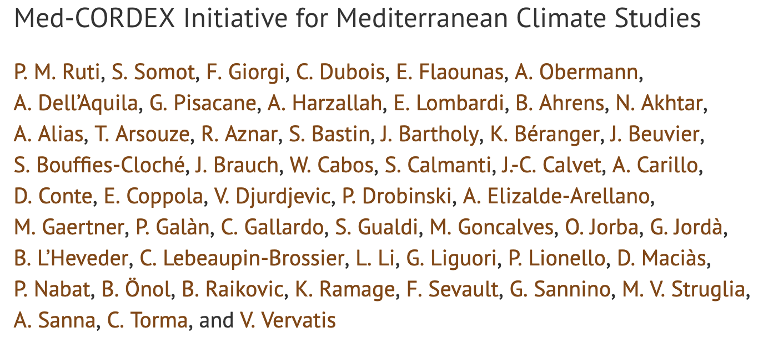
MED-CORDEX
The Need for Coupling
The Mediterranean Coordinated Regional Downscaling Experiment (Med-CORDEX) initiative aims at coordinating the Mediterranean climate modeling community toward the development of fully coupled regional climate simulations, improving all relevant components of the system from atmosphere and ocean dynamics to land surface, hydrology, and biogeochemical processes.
2016

Slide 10

Coupling 101
WHO HAS THE INTERFACE?
Chi Hong – Fighting Monkeys

Slide 11
The interface
Bulk fluxes
Thermal unbalance between the air and the water at ocean surface causes turbulent heat fluxes accounting for the exchange of energy (heat, momentum ) and mass (water) between the earth system fluid components.
The go to formulation is the Monin-Obukov similarity theory describing the fluxes in terms of mean quantities with a bulk transfer coefficient correlating the near-surface wind speed and an air-sea imbalance term: the temperature difference for the sensible heat and the humidity saturation deficit for the latent heat.
Computation of the fluxes is usually included in both Ocean and Atmospheric codes, and in most cases the implementation details are different. It is common to have 10-15 % differences in the values depending on the used method (Brodeau et al, 2017 [1]) .
Just to be simple, RegCM is using something like 20+ different possible formulations for the momentum, evaporation and sensible heat bulk formulas computation…
Bulk fluxes : Ocean or Atmosphere?
[1]https://journals.ametsoc.org/view/journals/phoc/47/1/jpo-d-16-0169.1.xml

Slide 12
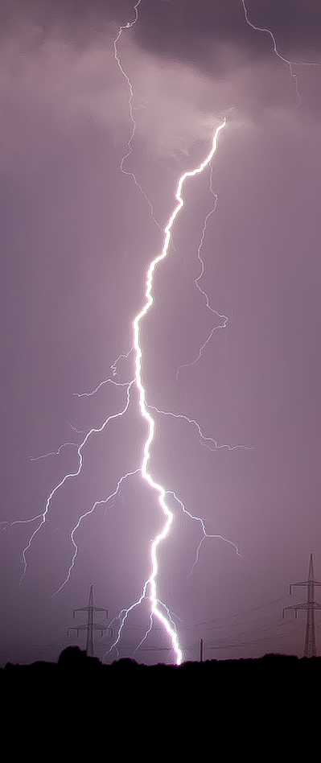
The air sea interaction
Function of scale? Of Latitude?
Large scales : ~ 200 km
The atmospheric dynamics drives the ocean variability (ENSO, Gill, 1982)^{[1]}
Small scales : ~ 10 km
The ocean forces the near-surface atmosphere, the air temperature, the frictional stress and the marine atmospheric boundary layer stability (Small et al., 2008)^{[2]}
Wikipedia Storm
SST contribution is most relevant in mid-latitude ocean frontal regions, whereas the wind influence is prominent in tropical and sub-tropical regions. Warm ocean eddies induce an increase in surface fluxes, surface winds and vertical motion enhancing cloud cover and precipitation.
At SMALL scales, SST gradients can modulate the surface wind response and can produce turbulent heat fluxes that are significantly larger than bulk parametrization predictions driving significant atmospheric responses.
How to couple Atmosphere and Ocean models at Regional Scale?
[1] Gill, A. E. (1982). Atmosphere-ocean dynamics Vol. 30 (Academic press)
[2] Small, R. J., Bryan, F. O., Bishop, S. P., and Tomas, R. A. (2019). Air–sea turbulent heat fluxes in climate models and observational analyses: What drives their variability? J. Climate 32, 2397–2421. doi: 10.1175/JCLI-D-18-0576.1

Slide 13
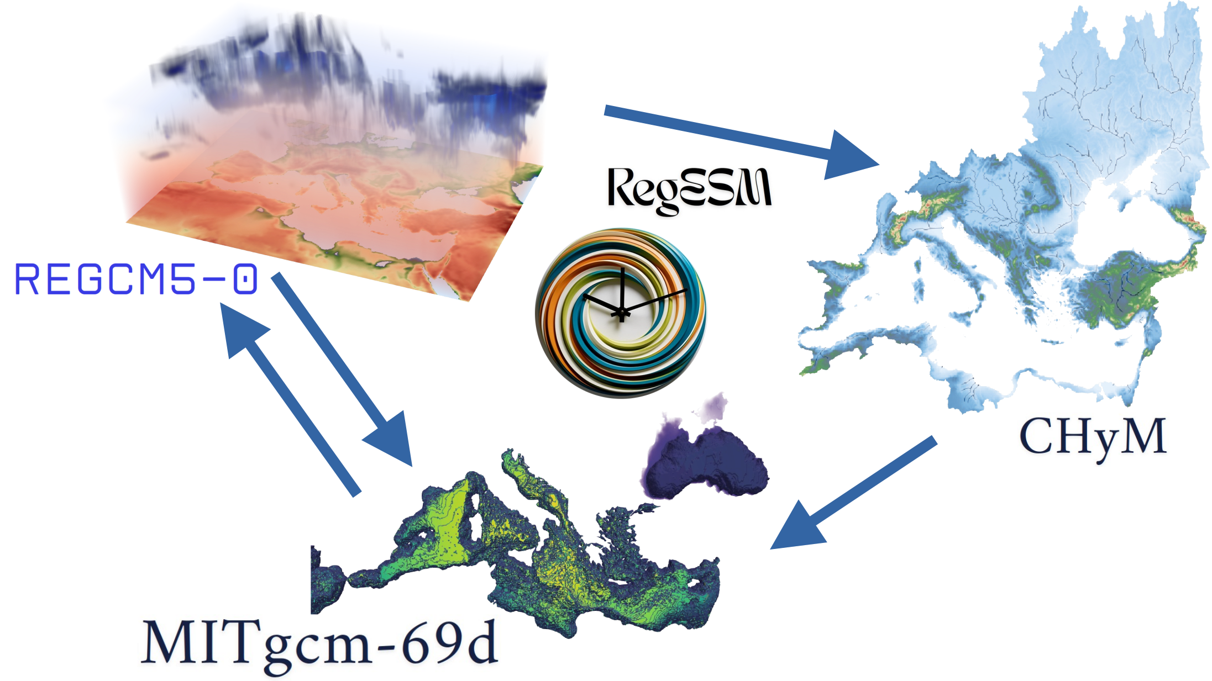
ICTP – OGS RegCM-ES1-1
Coupled Regional AORCM RegCM-ES1-1
Model components
Update!
Update!
NEW!
Update!
Reference in writing phase ☺

Slide 14
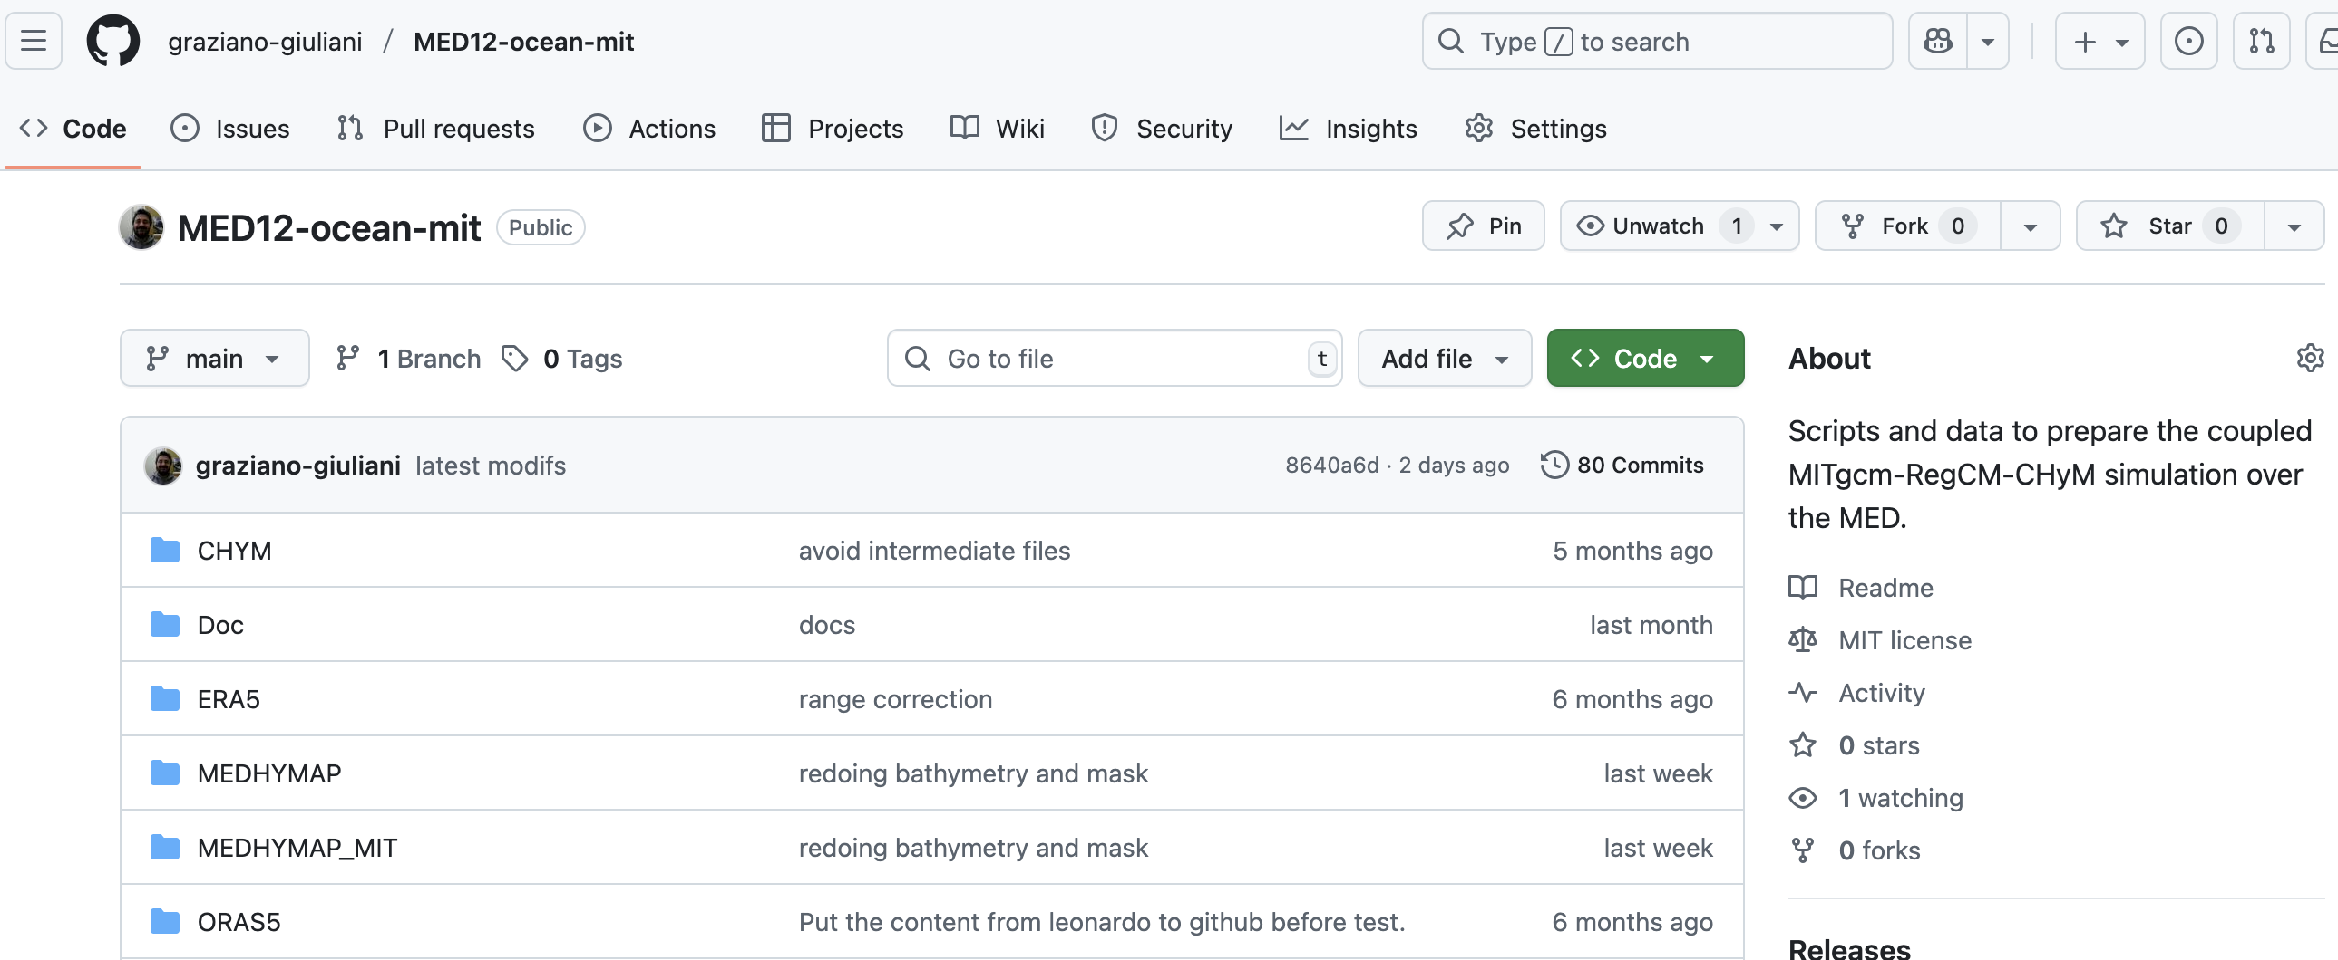
Project GitHub Page
The MED-CORDEX in ICTP

Slide 15
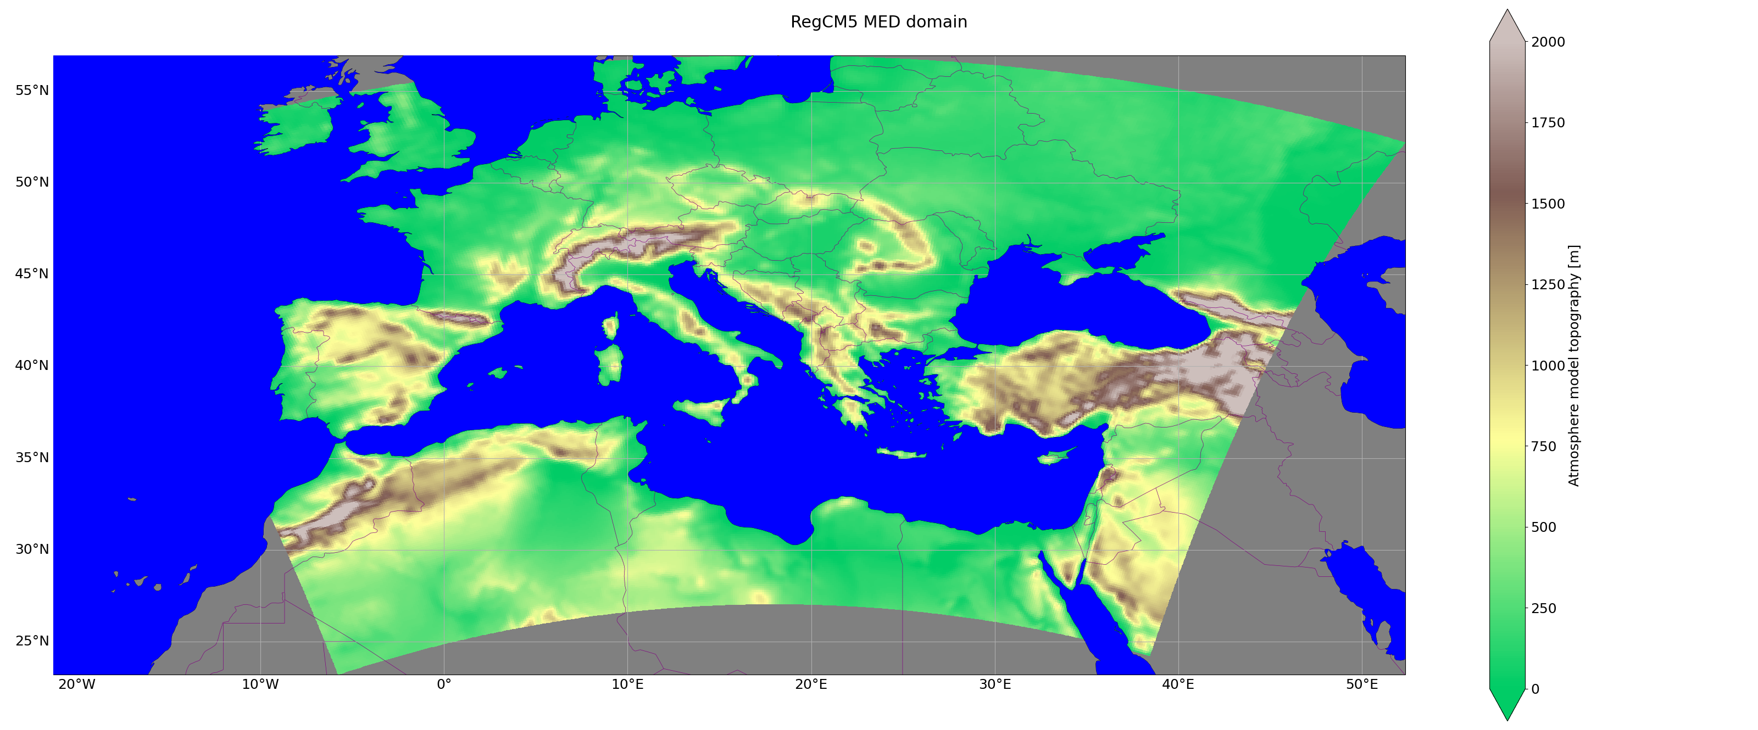
Atmosphere & Land
https://github.com/ICTP/RegCM/tree/CORDEX-5
RegCM5
ICTP Regional Climate Model v5
Non hydrostatic MOLOCH core
Tiedtke convection
Holtslag non-local PBL
Nogherotto-Tompkins microphysics scheme
CLM4.5 land model
Zeng Ocean bulk fluxes
30 vertical levels
Horizontal resolution 0.11 deg 402x272 points ROTLLR
Input4MIPS ready and MERRA2 aerosols
Giorgi et al, 2023; Coppola et al. (submitted 2025)

Slide 16
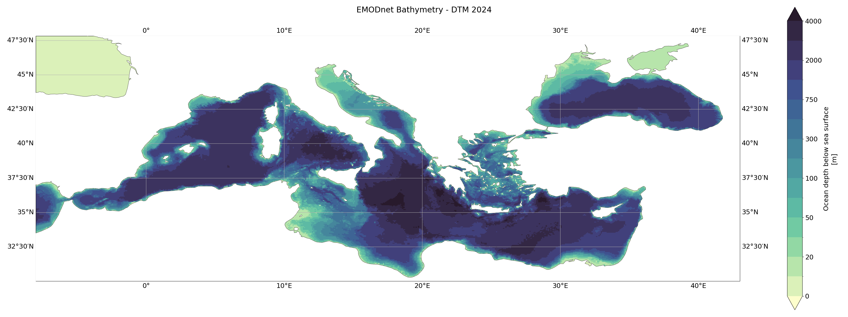
Ocean
MITgcm
Mitgcm 69
1/12 deg Mediterranean + Black Sea
75 vertical z levels
GGL90 TKE vertical mixing scheme
Open boundary conditions over Atlantic
Hourly exchange with ATM, daily with RTM
https://github.com/graziano-giuliani/MITgcm
Marshall. Et al, 1997; Adcroft et al. 2004

Slide 17
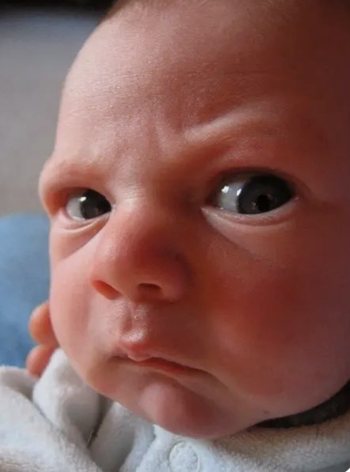
Ocean
Problems!
How are straits treated?
The Gibraltar strait is a boundary condition (Forcing)
The Marmara sea straits are “hand carved” in the bathymetry at the model resolution.
Meme picture, unkown origin

Slide 18
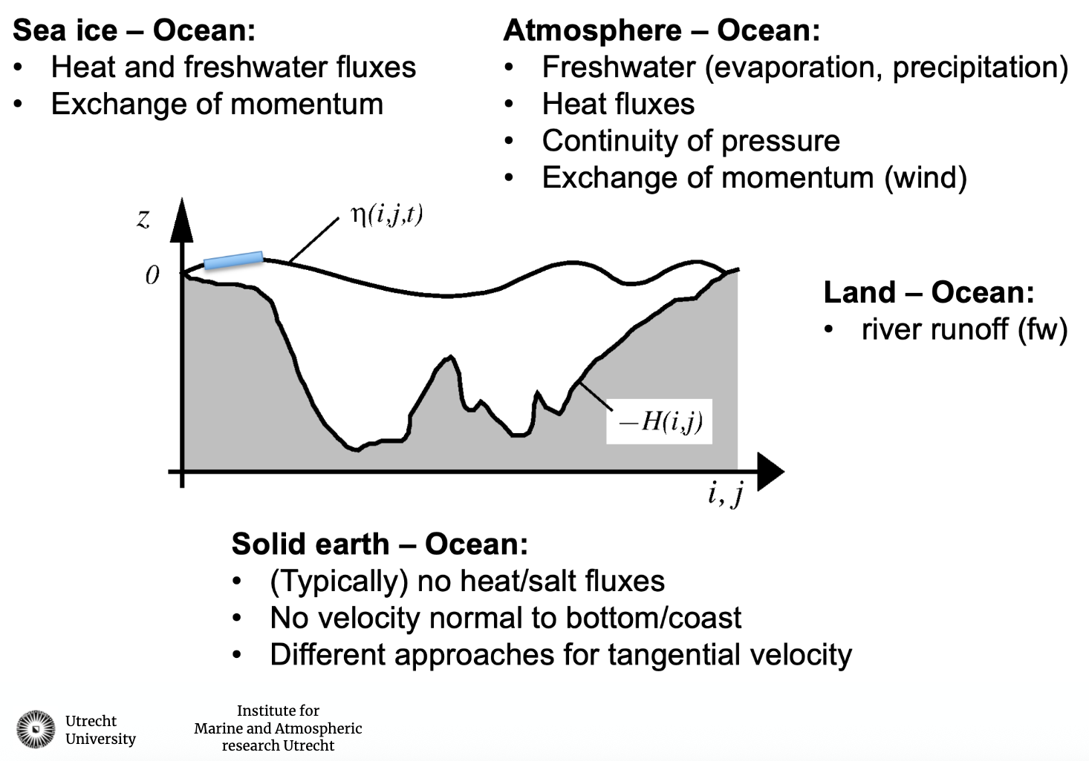
Ocean model
Boundary Conditions
Adapted from Erik van Sebille SMR 4067

Slide 19
First attempt
Interface layer computed in both models
Two computation at the interface layer: the turbulent fluxes are computed by both the RegCM and the MITgcm codes. MITgcm has every hour:
The surface winds at 10 m
The radiative long and short wave net fluxes *
The Precipitation
The air pressure, temperature and moisture at 2m
The RegCM sends the daily runoff to the CHyM
The MITgcm receives the daily river discharge as runoff over ocean from ChyM. **
* Albedo? Ocean color?
** Water temperature and salinity?

Slide 20
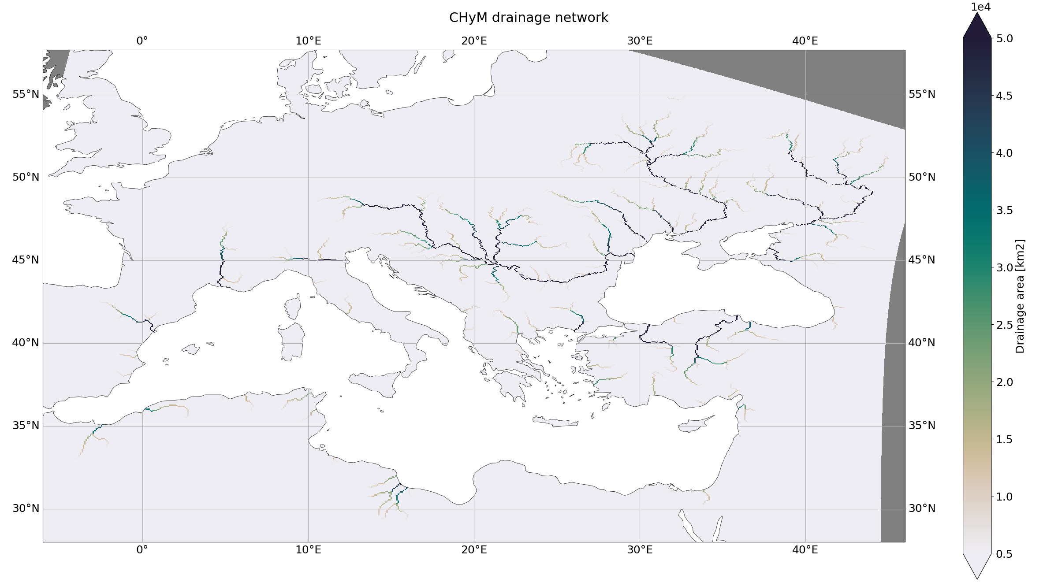
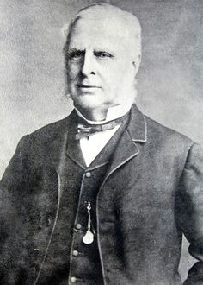
https://github.com/graziano-giuliani/CHyM_cpl
River [routing]
CHyM
CHyM runoff
Dniepr
Don
Danube
Robert Manning (1816 –1897)
Full Mediterranean and Black Sea basins (shown activation drainage area 5400 km²)
Manning’s equation with tuned coefficients for 68 rivers.
Coppola et al, 2007; Di Sante et al, 2021

Slide 21
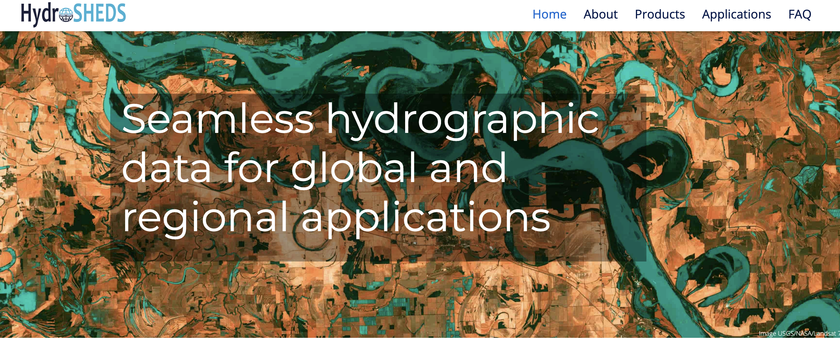
River [routing]
Problems!
Coarsening the HydroSheds data.

Slide 22
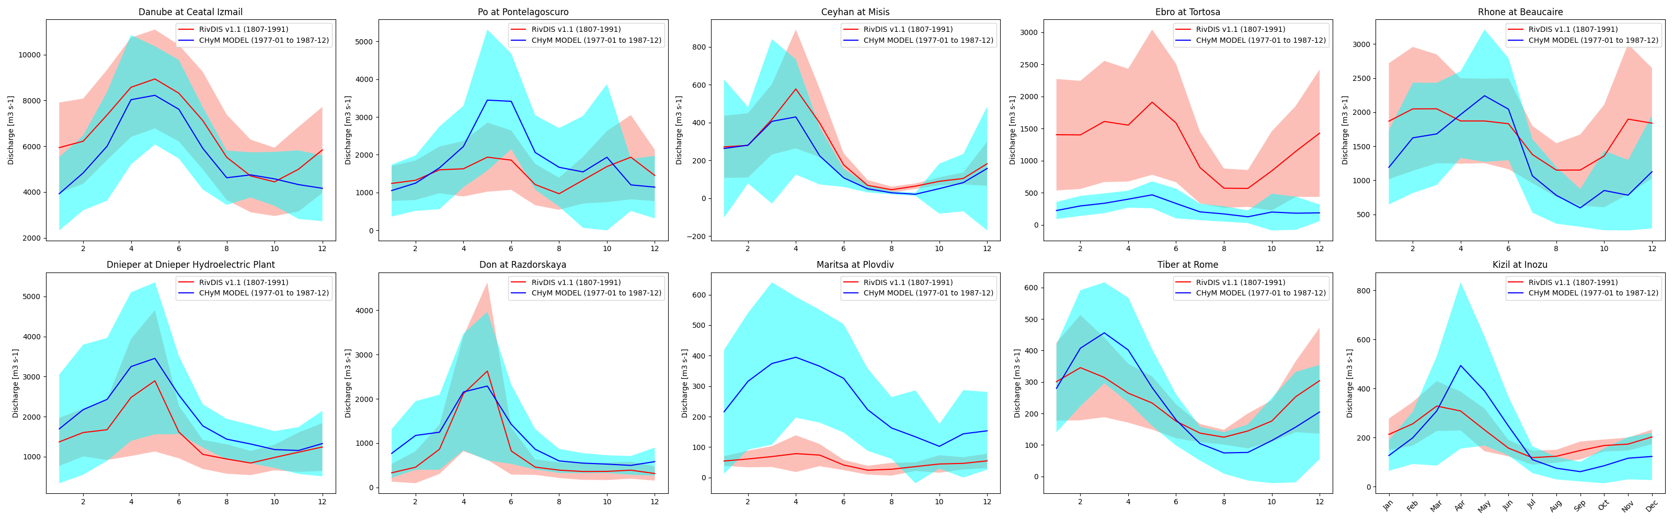
River Evaluation
Tuning of the CHyM using ERA5 runoff product
River
CHYM - ERA5 runoff field : 1977 - 1987
https://github.com/graziano-giuliani/CHyM-roff

Slide 23
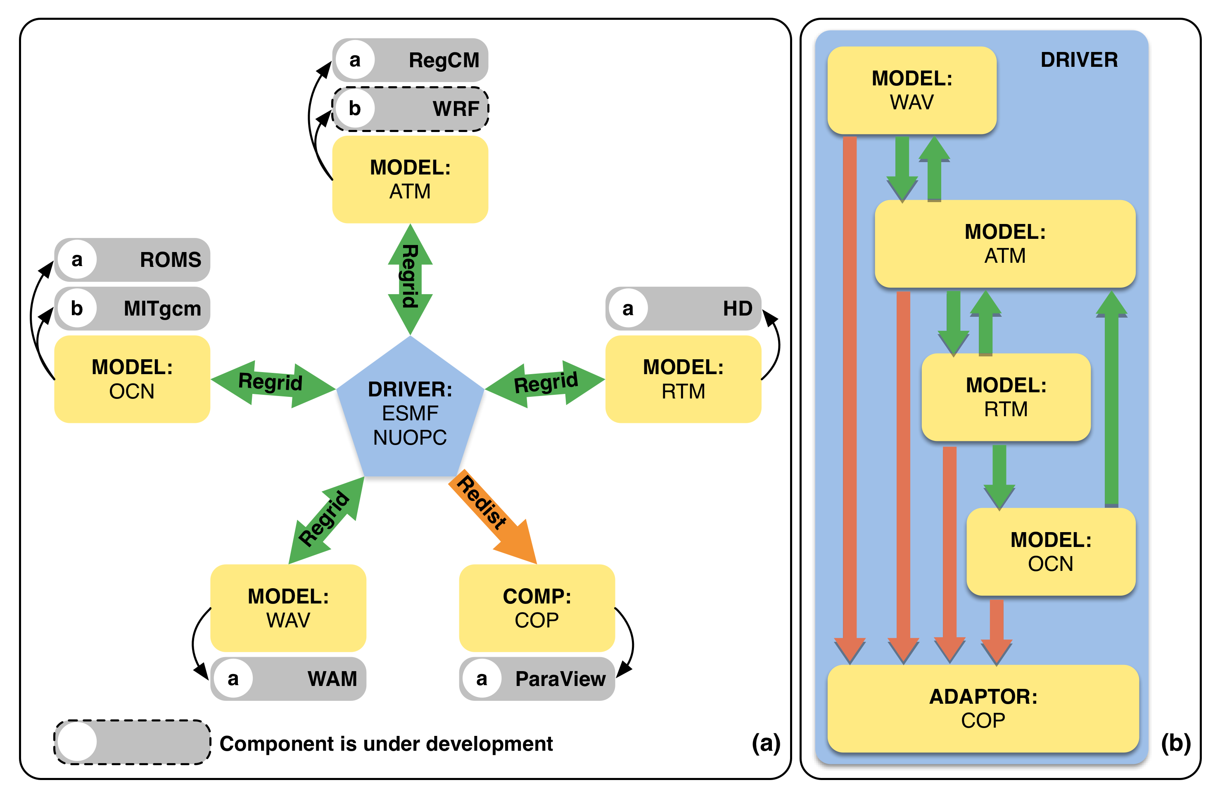
Coupler
https://github.com/graziano-giuliani/RegESM
RegESM
Update to use ESMF NUOPC v8.9.0!
Design of RegESM modeling system. a) components and b) currently supported coupling directions. The arrows indicate the interaction direction between the sub-components.
The CHyM RTM model is now an option along with the HD for river routing.
Turuncoglu, 2019
RegESM github page

Slide 24
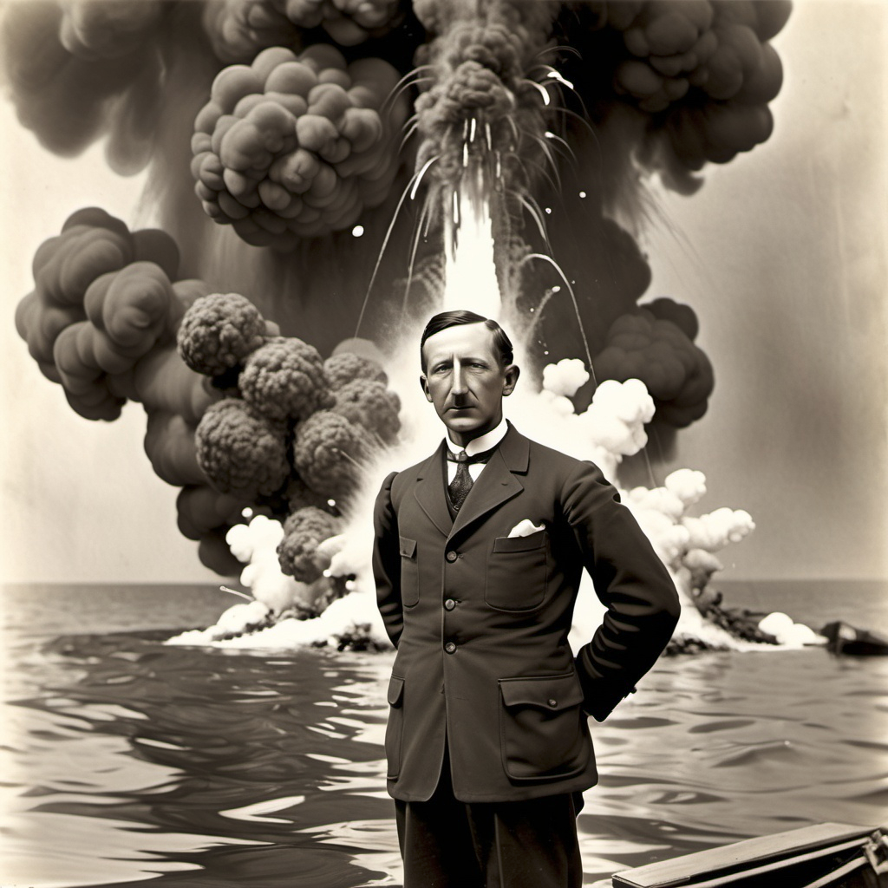
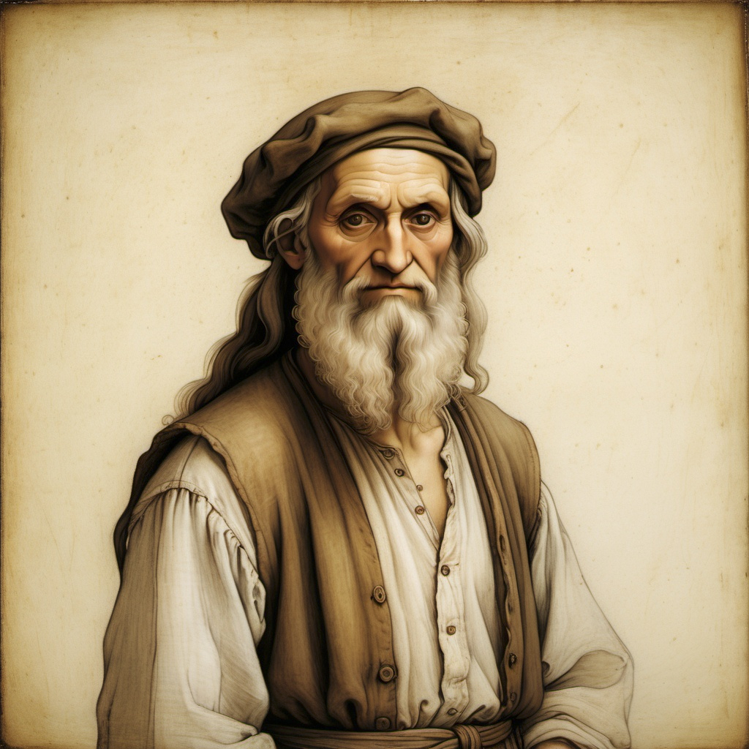
MedCORDEX status
We are late…
AI generated – Guglielmo Marconi blowup
AI generated – Leonardo in poor man clothes

Slide 25
Where are we now
Model spinup!
Following MedCORDEX protocol
Ocean: Initial Conditions: MEDHYMAP
Boundary Conditions: ORAS5
Land:
I.C.: August 1987 from standalone
River:
I.C. : August 1978 from standalone
Loop1 - 197908 – 198708
Pick random restart for Land in the last 3 years
Pick random restart for Ocean in the last 3 years
Pick random restart for River in the last 3 years
Loop2
Repeat as above
Loop3
Repeat as above – Pick latest august and start EVALUATION

Slide 26
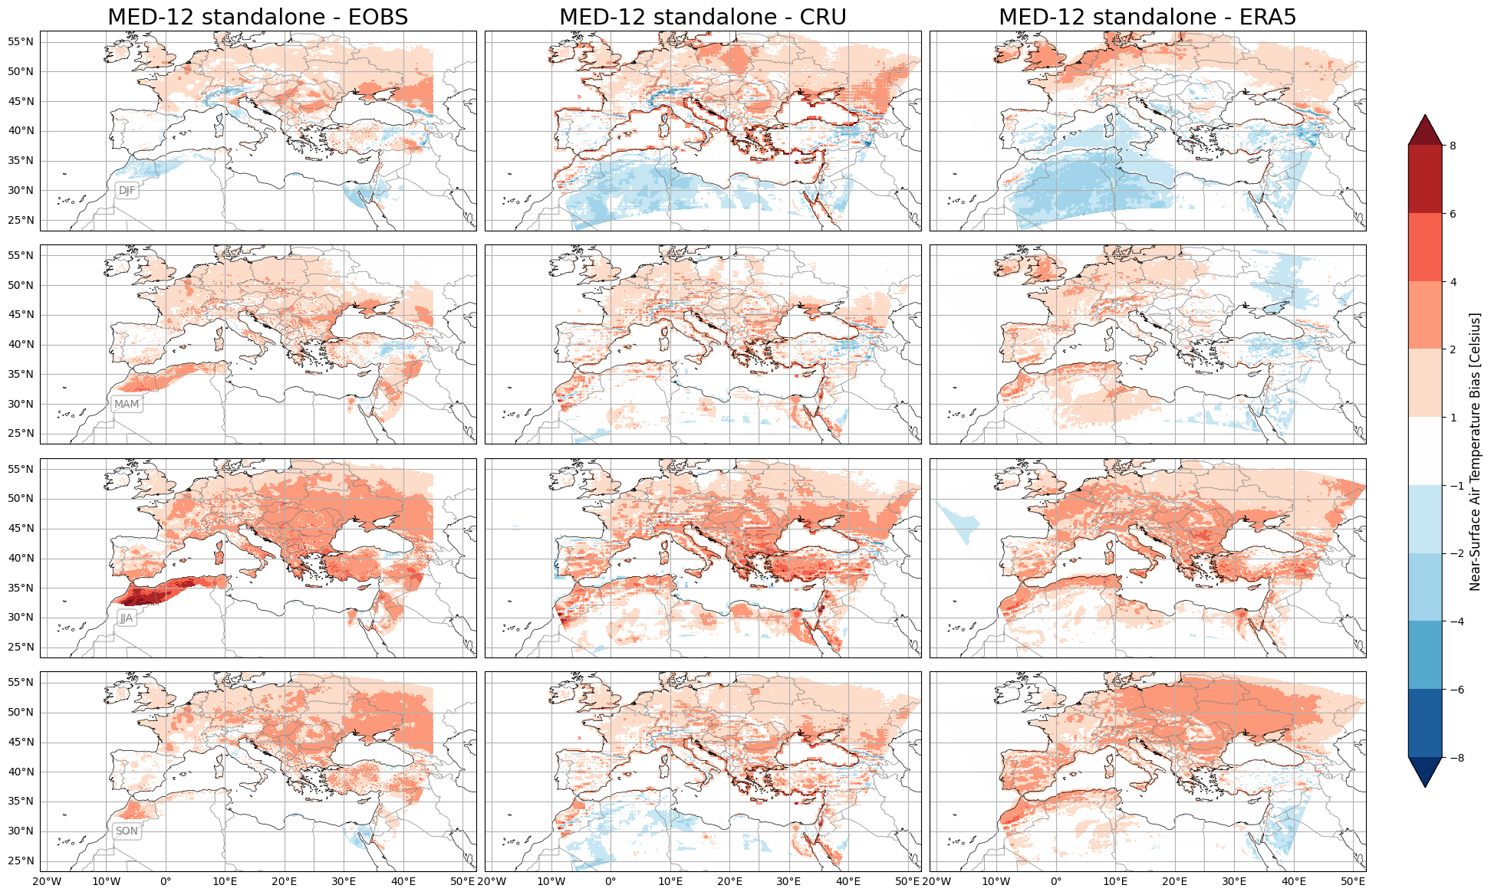
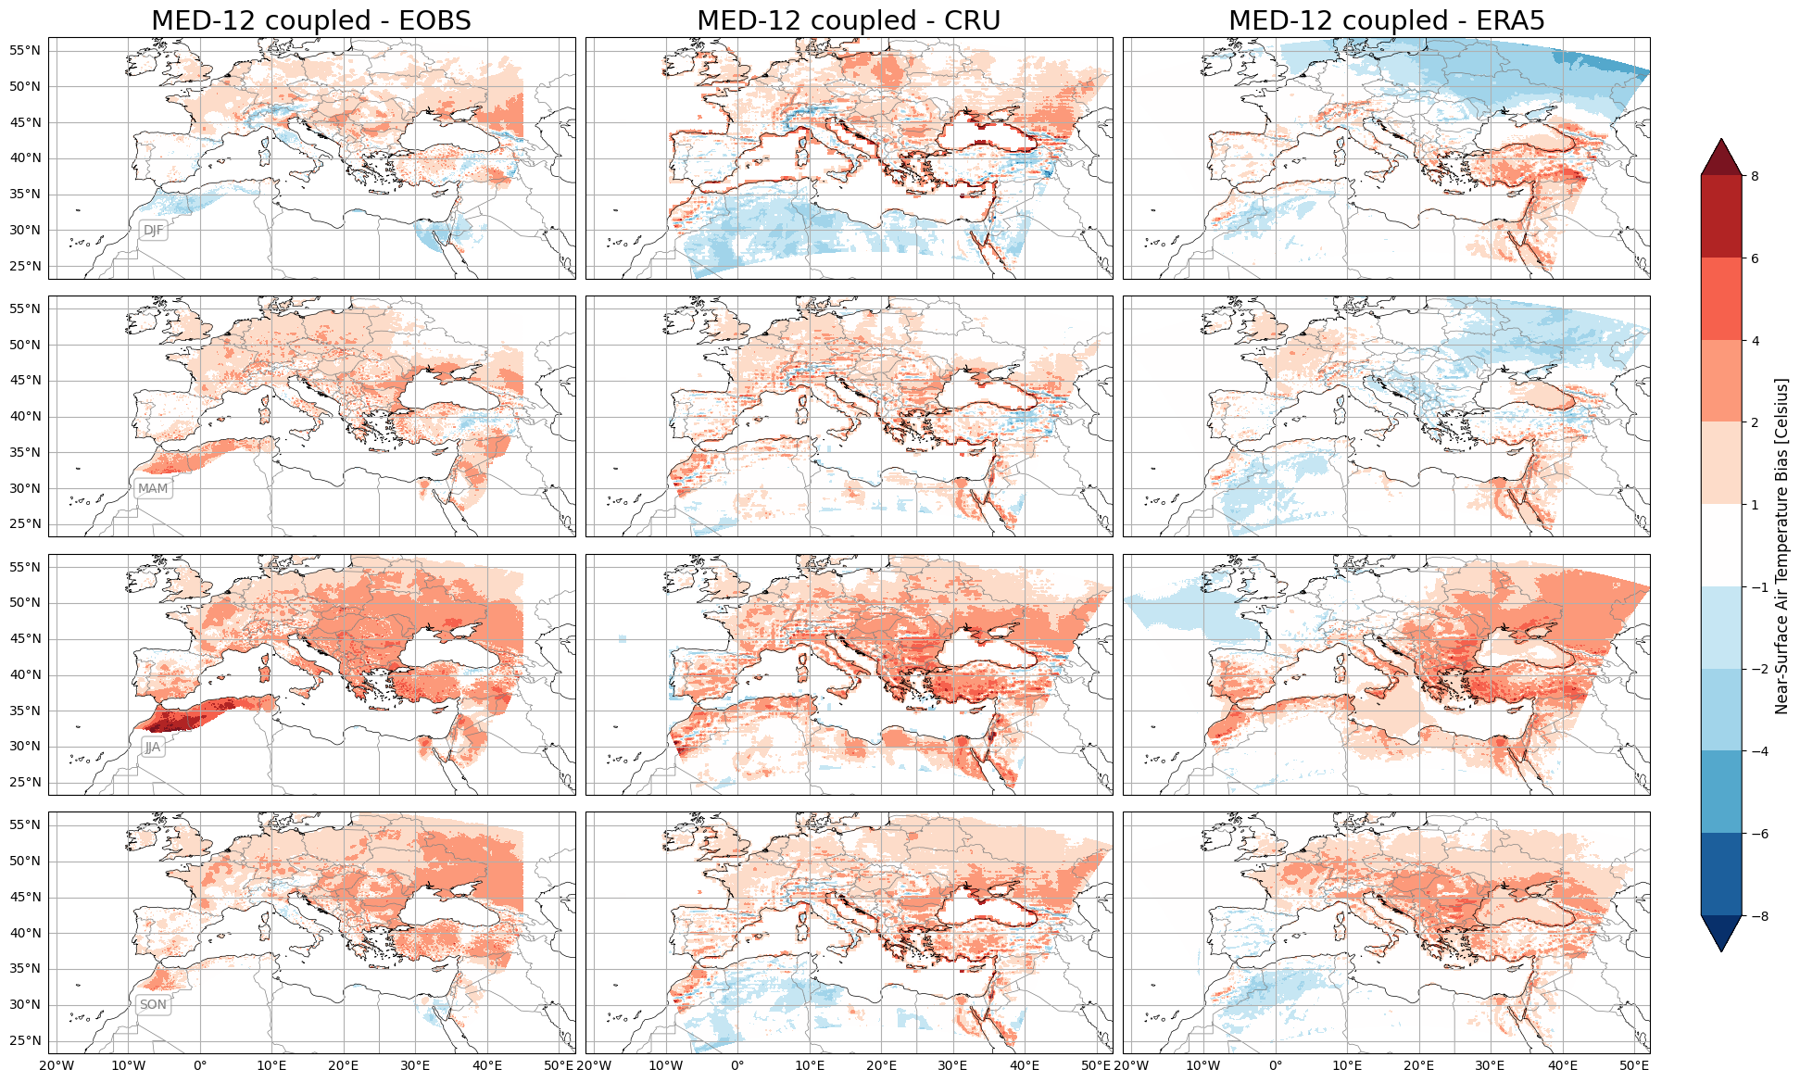
Coupled Model Evaluation
Atmos
https://github.com/graziano-giuliani/MED12-ocean-mit
DJF
Surface 2m temperature
MAM
Coupled Loop1
JJA
SON
Uncoupled

Slide 27
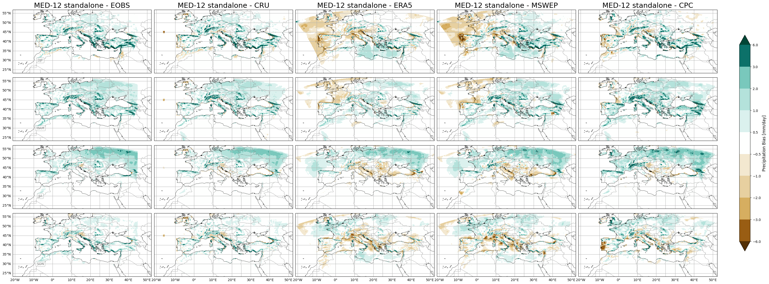
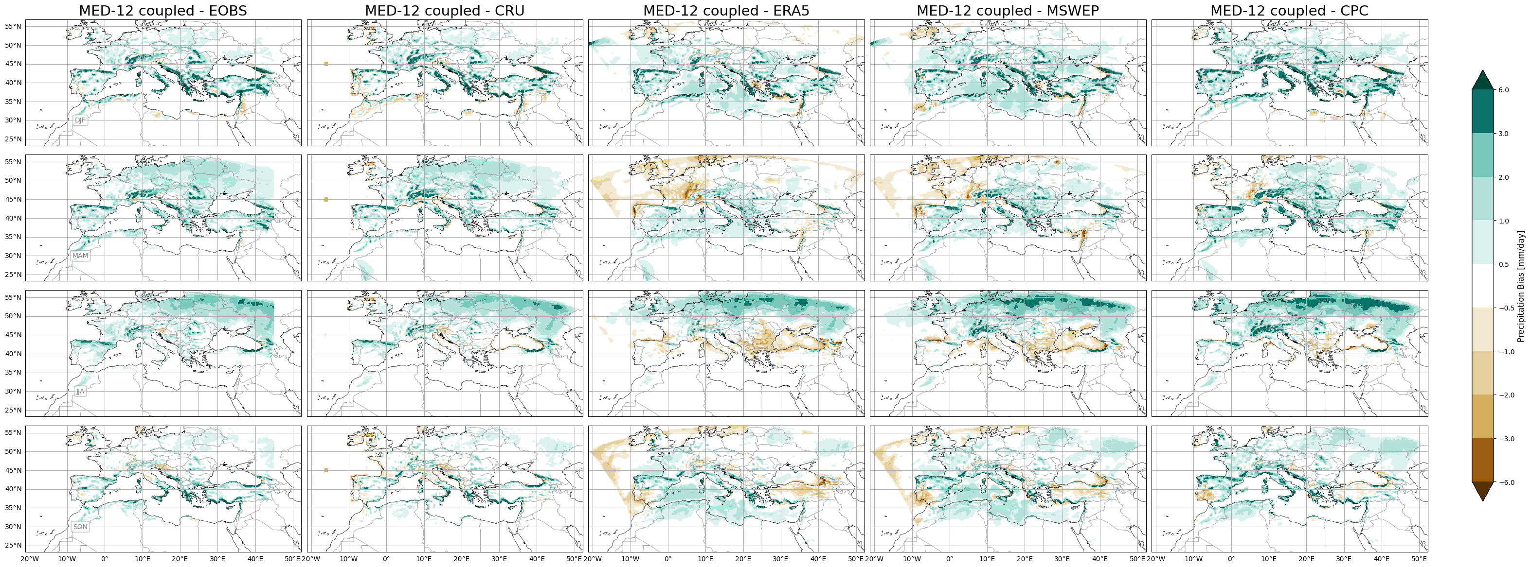
Coupled Model Evaluation
Surface precipitation
Atmos
Uncoupled
DJF
MAM
JJA
SON
Coupled Loop 1
DJF
MAM
JJA
SON

Slide 28
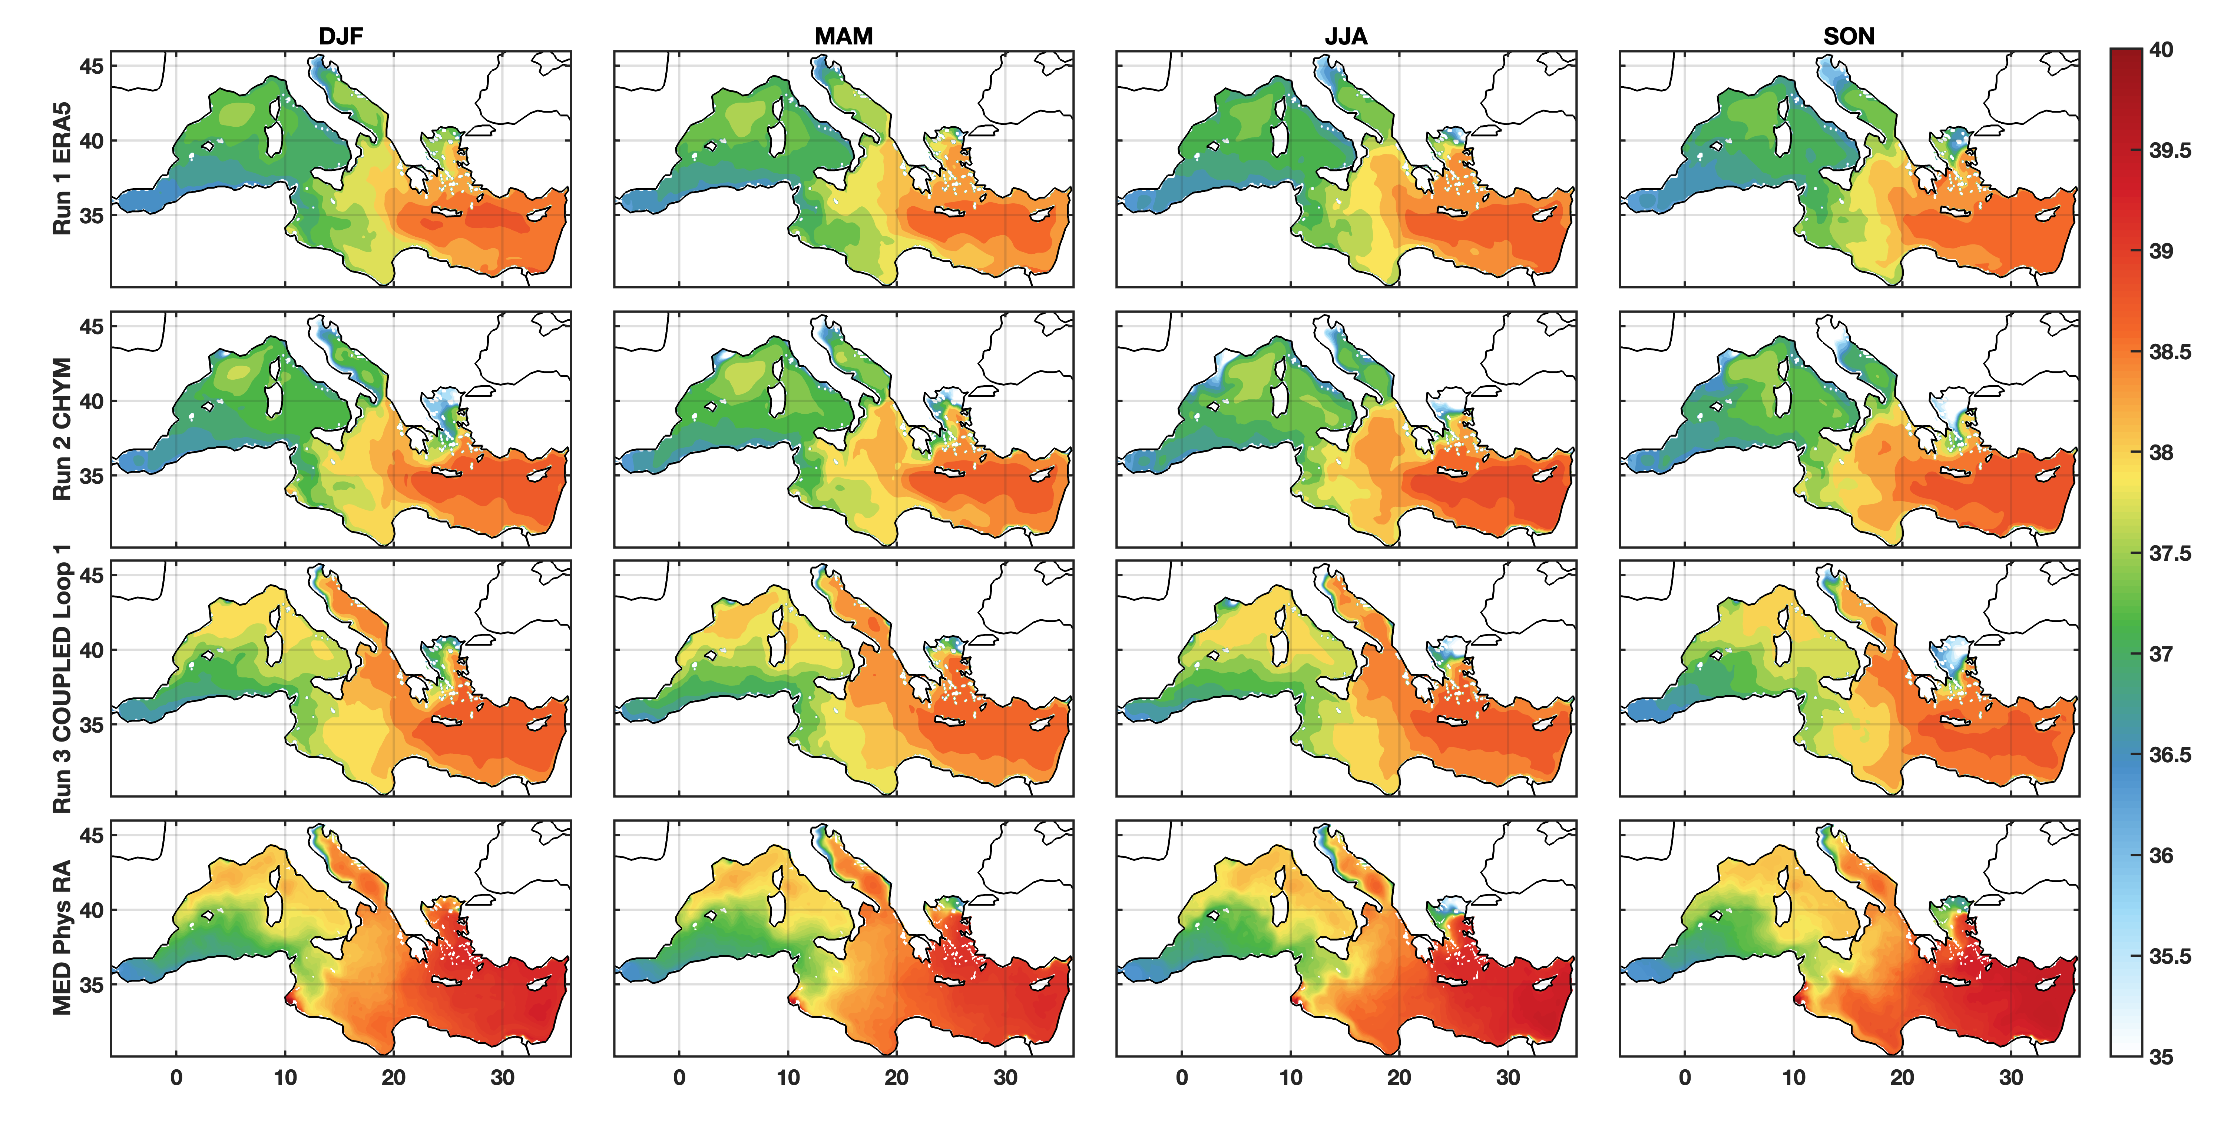
Coupled Model Evaluation
Era5 monthly data driven
Era5 + CHyM-ERA5
Cooupled Loop 1
CMEMS MedPhys Reanalysis
Ocean
Surface Salinity

Slide 29
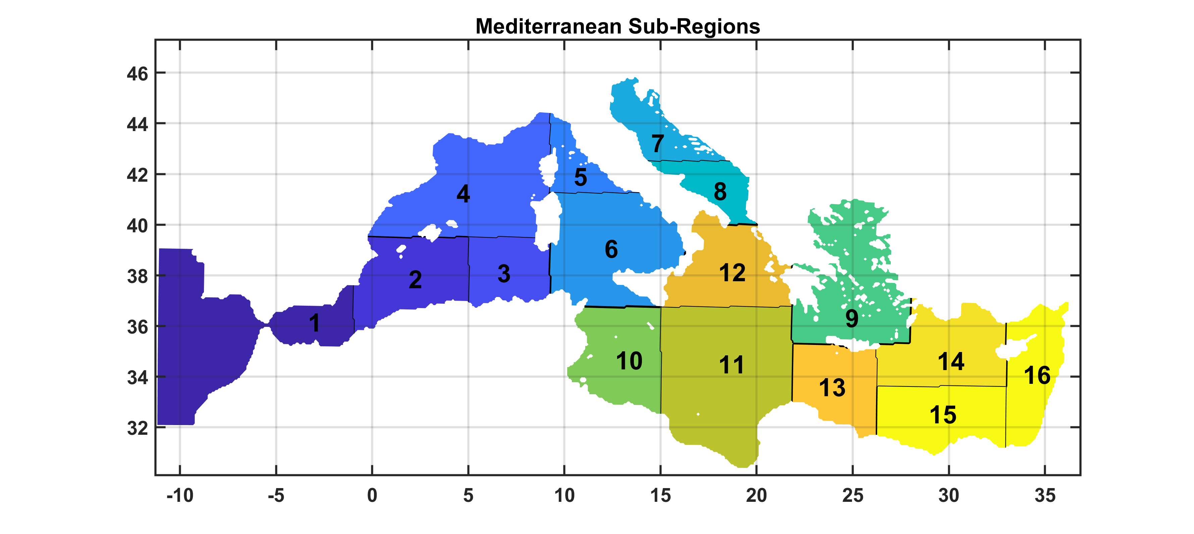
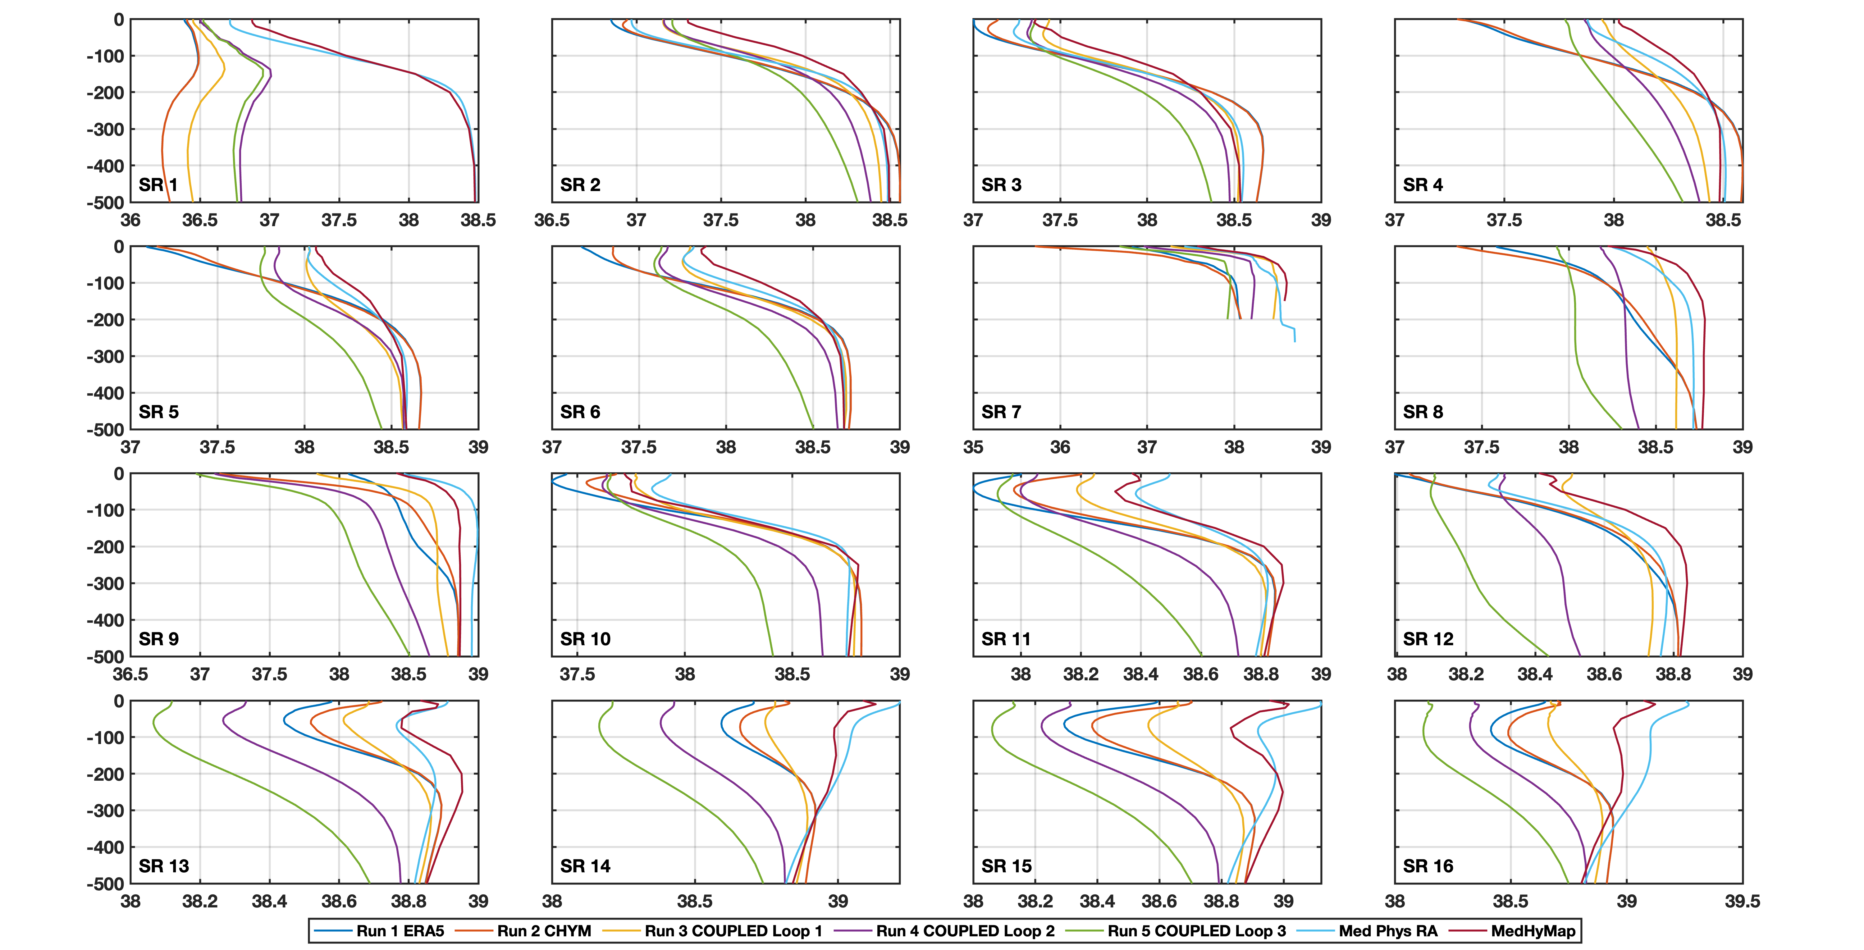
Coupled Model Evaluation
Ocean Loops… Ops!
Salinity ….. Too much freshwater?

Slide 30
Back square one….
It is not “pick it up and run it”
Moved interface layer into the atmosphere. The turbulent fluxes are computed in the RegCM code, the MITgcm receives hourly from RegCM:
The surface wind stresses
The turbulent fluxes
The radiative long and short wave net fluxes *
The Precipitation and evaporation
The RegCM sends the daily runoff to the CHyM
The MITgcm receives the daily river discharge as runoff over ocean from ChyM. **
* Albedo? Ocean color?
** Water temperature and salinity?

Slide 31
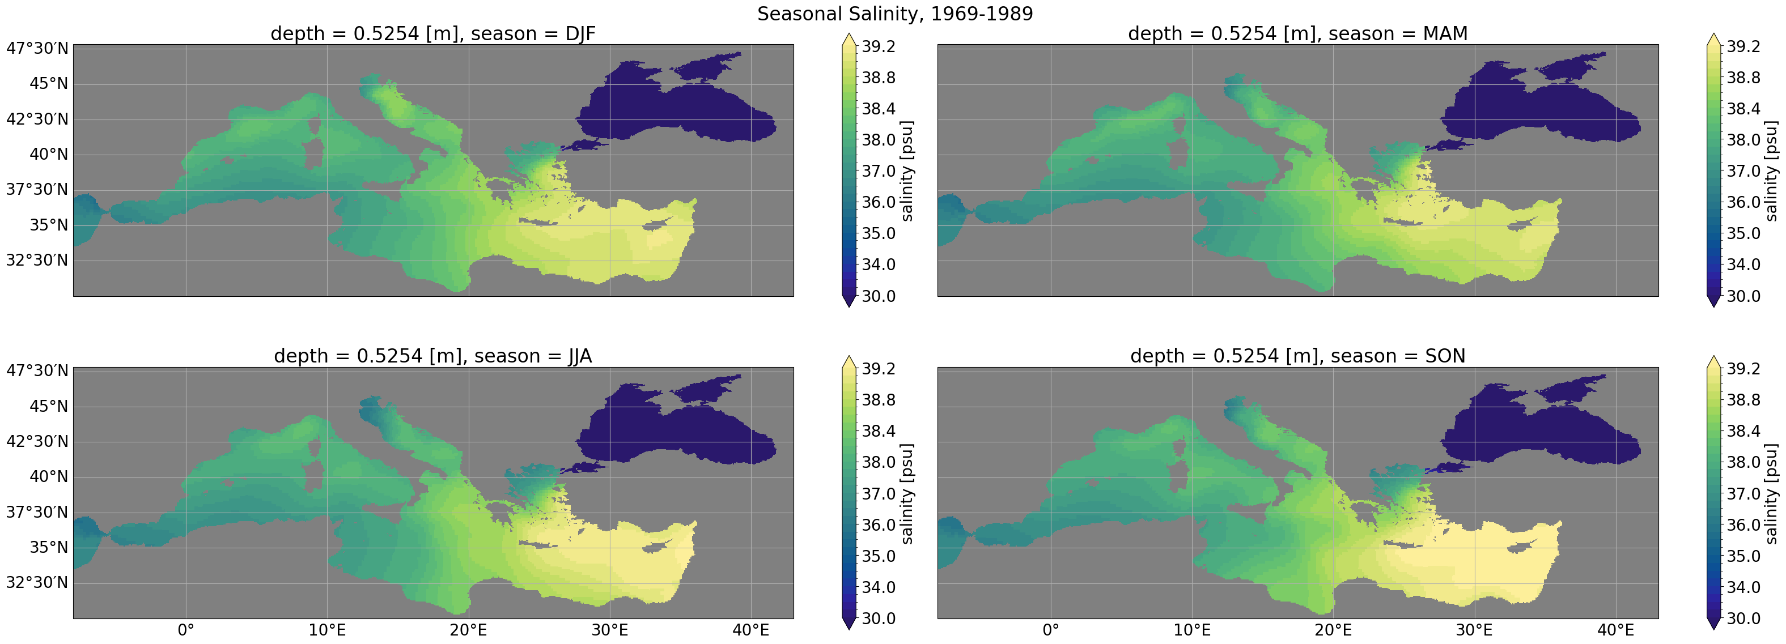
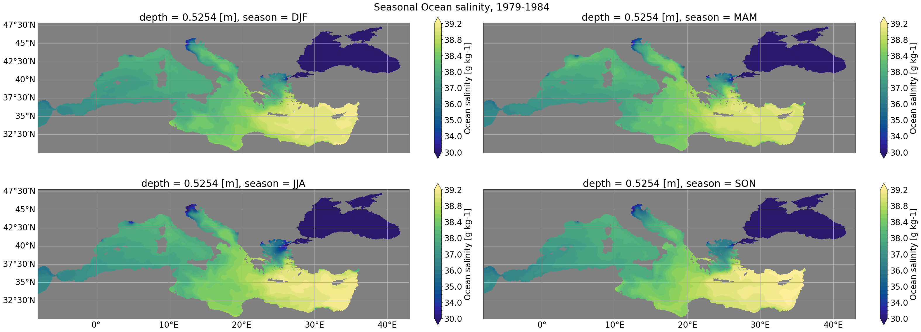
MedHymap
RegCM-ES1-1

Slide 32
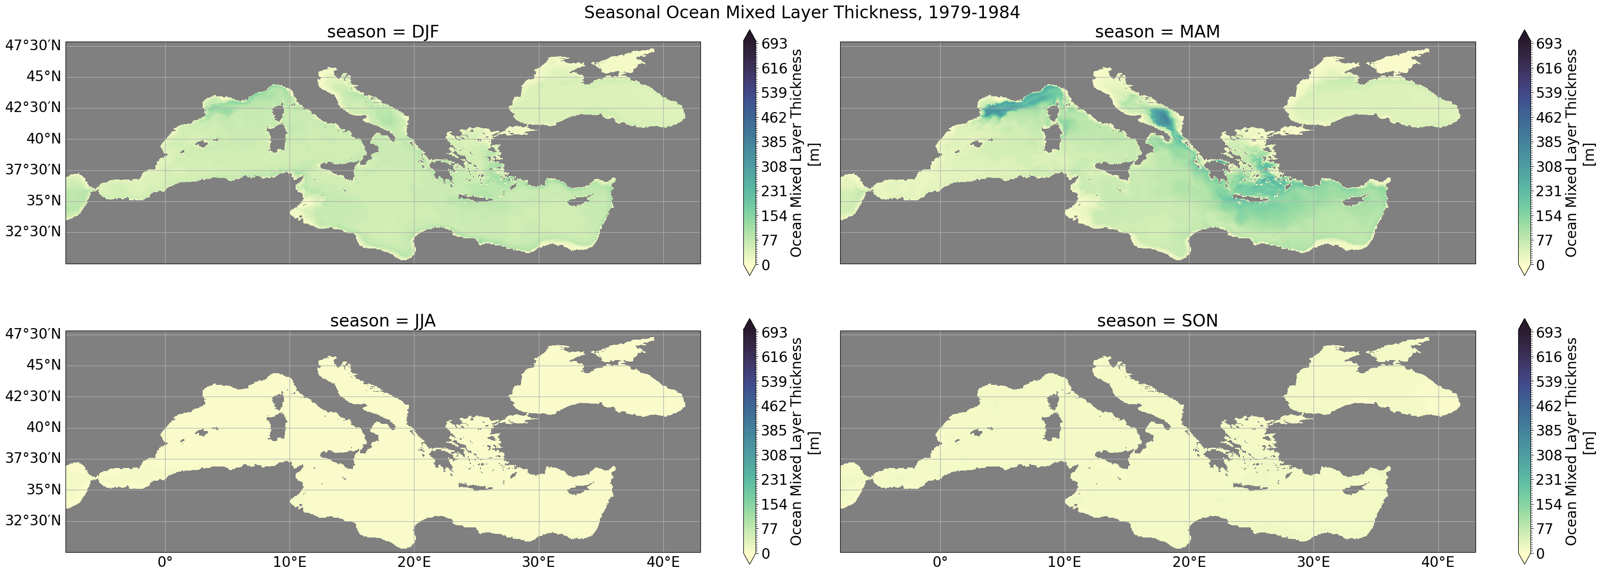
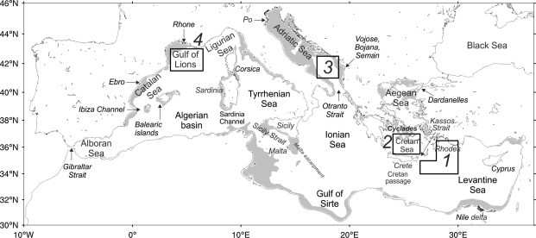
Deep water formation regions in the Mediterranean Sea (Pinardi et al, 2015)

Slide 33
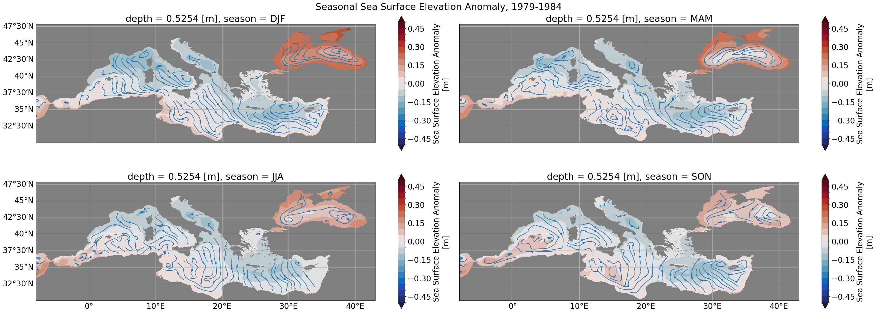
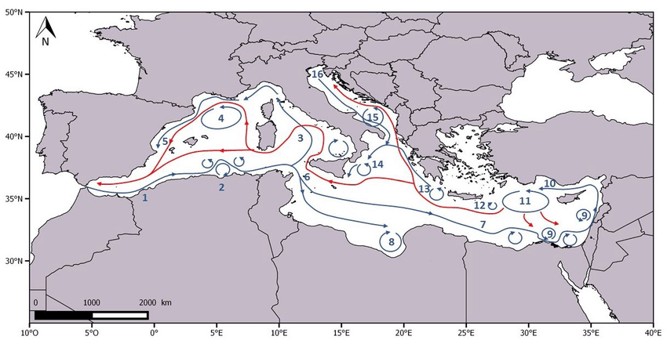
Main currents in the Mediterranean Sea. Blue arrows represent the surface currents and red arrows represent the deep water circulation. 1: Inflows of the Atlantic Ocean; 2: Algerian Current and eddies; 3: Tyrrhenian cyclonic circulation; 4: Lions Gyre; 5: Ligurian-provencal Current; 6: Atlantic Ionian Stream; 7: MidMediterranean Jet; 8: Anticyclone in the Gulf of Syrte; 9: Shikmona and Mers a-Matruh gyres; 10: Cicilian and Asia Minor Current; 11: Rhodes Gyre; 12: Iera-Petra Gyre; 13: Pelops Gyre; 14: Western Ionian Gyre; 15: Southern Adriatic Gyre; 16: Western Adriatic Coastal Current. Adapted from Pinardi and Masetti (2000).

Slide 34
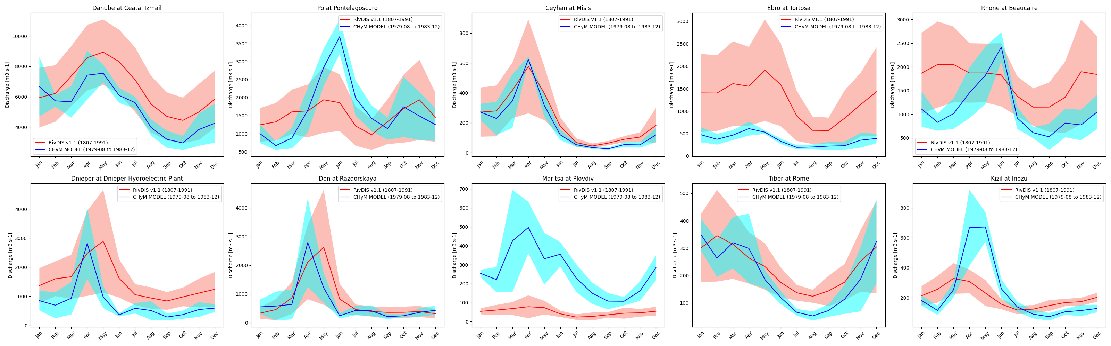

Slide 35
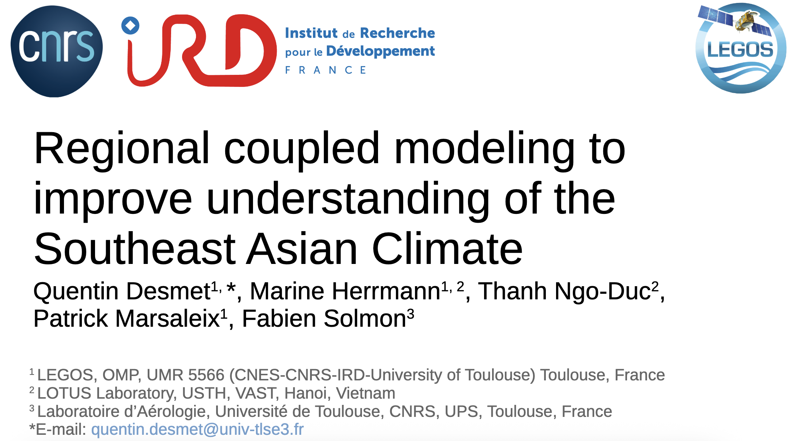
RegCM coupling
Is it all? No other coupling?
OASIS Interface – RegCM with Simphonie Ocean model

Slide 36
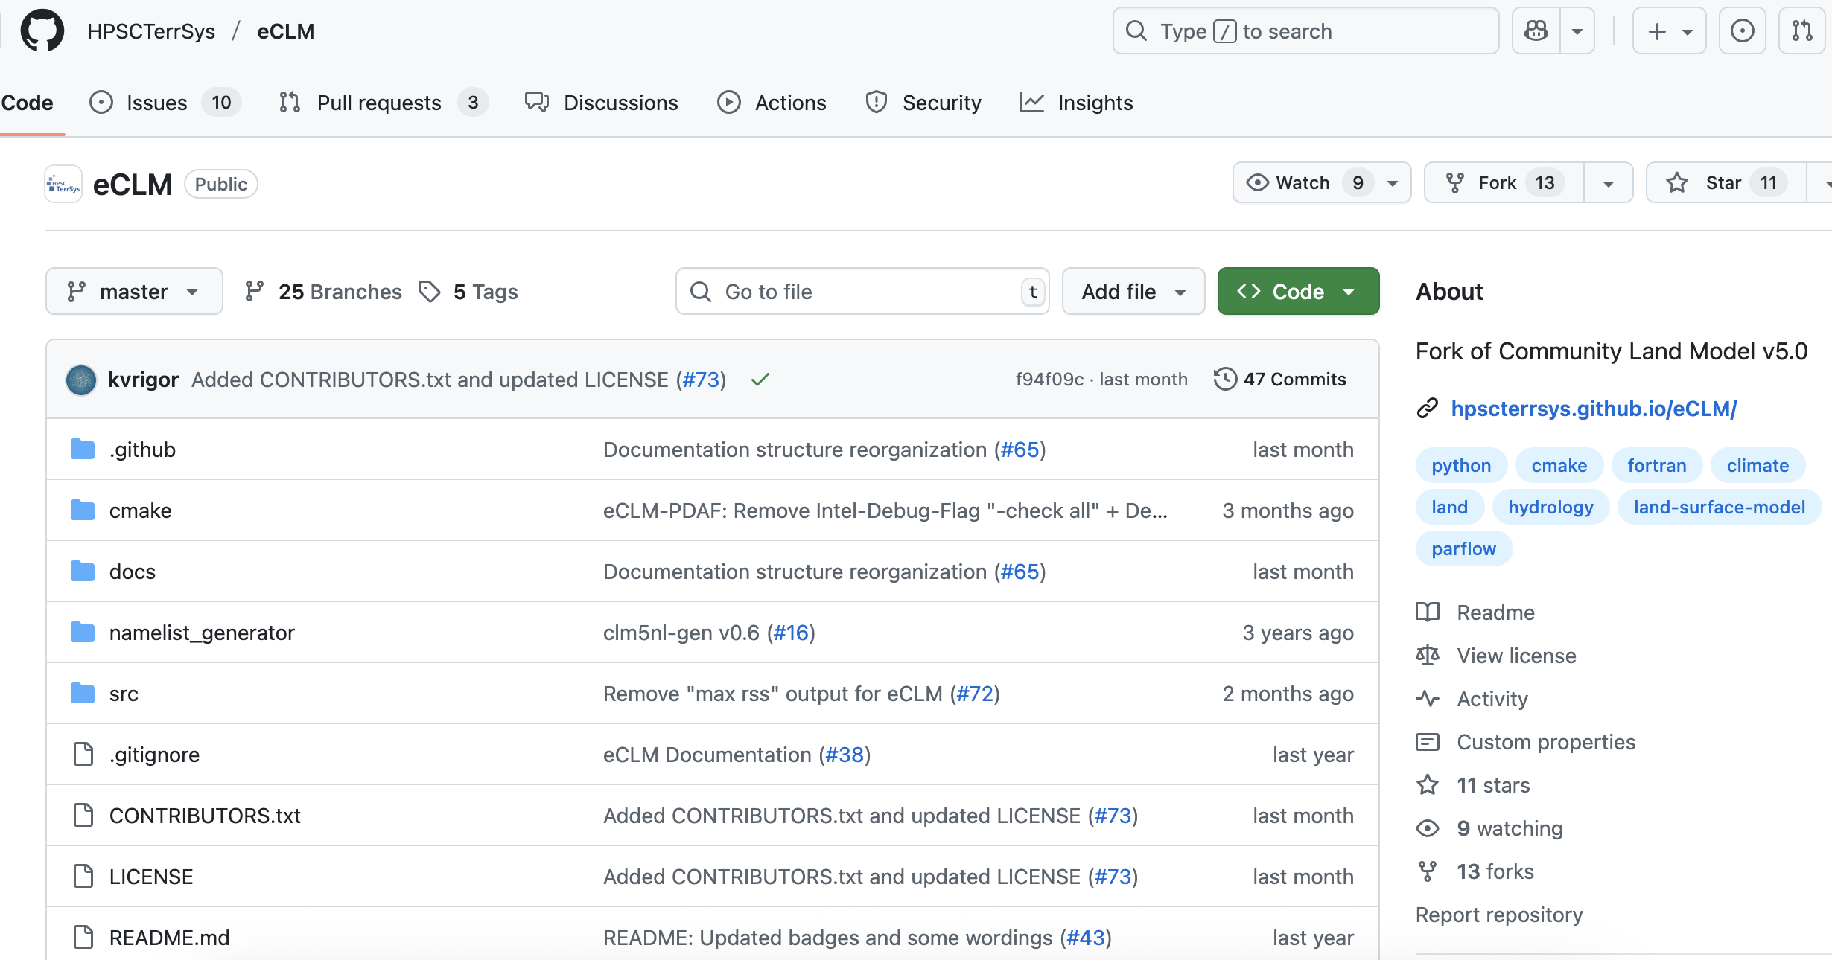
RegCM coupling
Is it all? No other coupling?
OASIS Interface – REGCM with eCLM (CLM5).
In development by Luiza Vargas Heinz (PhD UniTS)

Slide 37
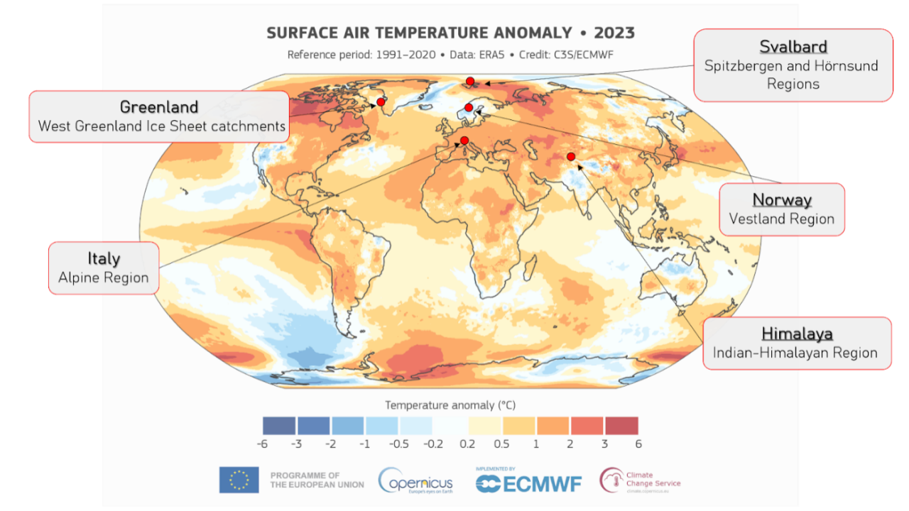
RegCM coupling
Is it all? No other coupling?
ESMF – RegCM with CISM, Communnity Ice Sheet Model
Planned in LIQUIDICE EU project
LIQUIDICE EUPROJECT

Slide 38
Questions?

Slide 39
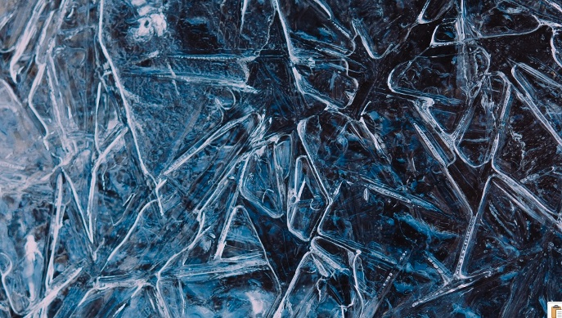
Thank you !

