Slide 1

ICTP RegCM5
Description and basic installation guide
Graziano Giuliani
University of Trieste and The Abdus Salam International Centre for Theoretical Physics, Trieste
12th Workshop on the Theory and Use of Regional Climate Models
Trieste 25 August 2025

Slide 2
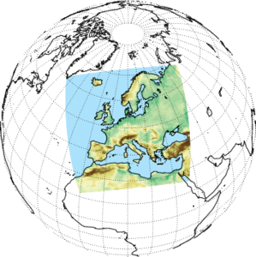
ICTP RegCM
RegCM1
  Dickinson et al. (1989), Giorgi and Bates (1989)
RegCM2
  Giorgi et al. (1993a,b)
RegCM2.5
  Giorgi and Mearns (1999)
RegCM3
  Pal et al. (2007)
RegCM4
  Giorgi et al. (2012)
RegCM5
  Giorgi et al. (2023)

Slide 3
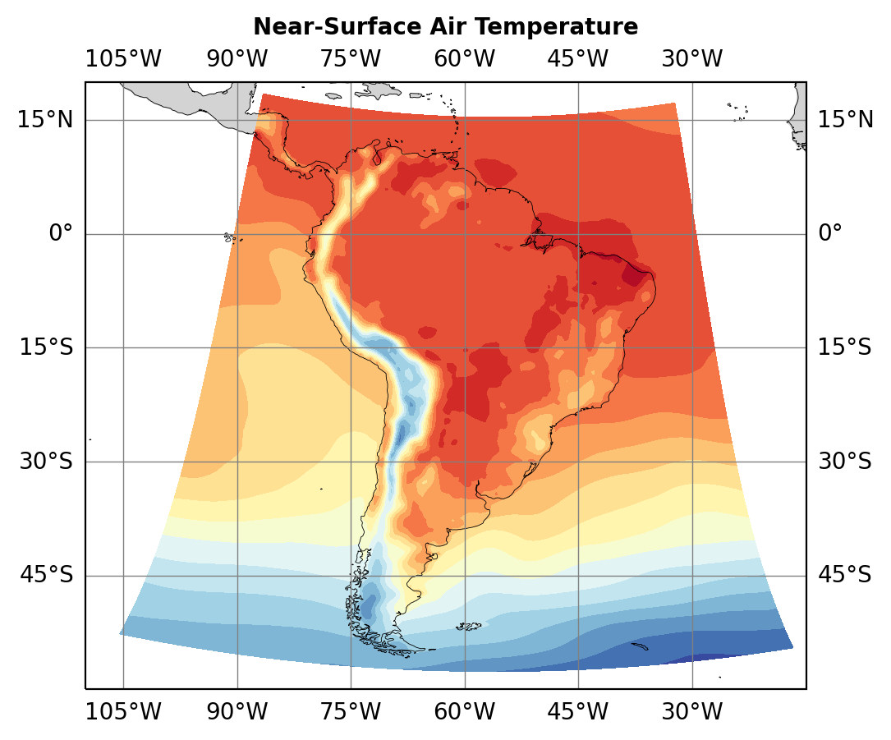
Projection
RegCM supports different Earth projections
  Mercator – cylindrical, good for equatorial zones
    https://en.wikipedia.org/wiki/Mercator_projection
  Stereographic – plane-point, good for polar zones
    https://en.wikipedia.org/wiki/Stereographic_projection
  Lambert conformal – conical, tangent or secant, good for mid-latitudes
    https://en.wikipedia.org/wiki/Lambert_conformal_conic_projection
  Rotated (oblique) mercator – cylindrical, a rotation followed by a mercator, all season
    https://en.wikipedia.org/wiki/Oblique_Mercator_projection
  Rotated latitude-longitude – official CORDEX projection

Slide 4
Dynamical Cores
Solve one form or another of the Navier-Stokes equations for the motion of fluids.
RegCM4
Hydrostatical core (Giorgi 1989)
Non-hydrostatical core (Coppola et al, 2022)
RegCM5
NH-MOLOCH core (Giorgi et al, 2023)
Hydrostatic core cannot be used for horizontal resolutions < 10km

Slide 5
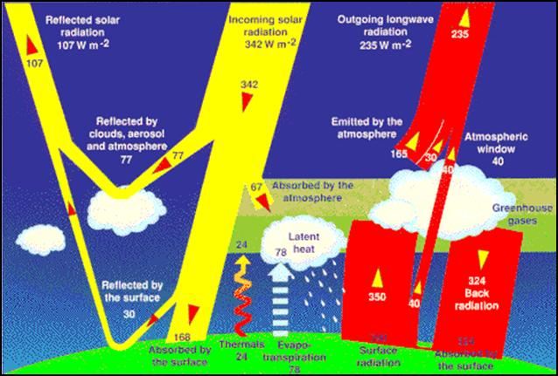
Radiation Scheme
Solves the equation for the radiation transmission in the atmosphere
CAM CCM3 (Kiehl 1996)
Simple scheme with SW and LW
RRTM-G
RRTM is a rapid radiative transfer model which utilizes the correlated-k approach to calculate fluxes and heating rates efficiently and accurately. State of the art with high accuracy relative to line-by-line results for single column calculations with high efficiency for GCM
http://rtweb.aer.com/rrtm_frame.html

Slide 6
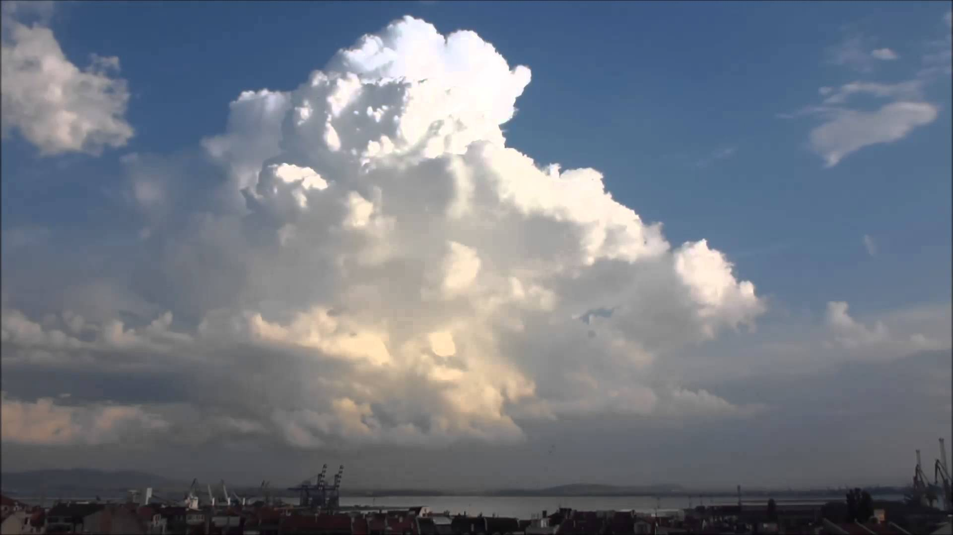
Cumulus
Solves cumulus scheme evolution for resolution > 3 km
Tiedtke
Used in ECMWF operational NWP model. Generically global good performances over land.
MIT (Emanuel)
Mass flux scheme developed by legend Kerry Emanuel, low overall bias but poor representation of extremes. Can create instabilities.
Kain – Fritsh
Developed for intermediate resolution (~25km) over Ocean. Fast response for NWP application, can sometimes over-react for climate applications.

Slide 7
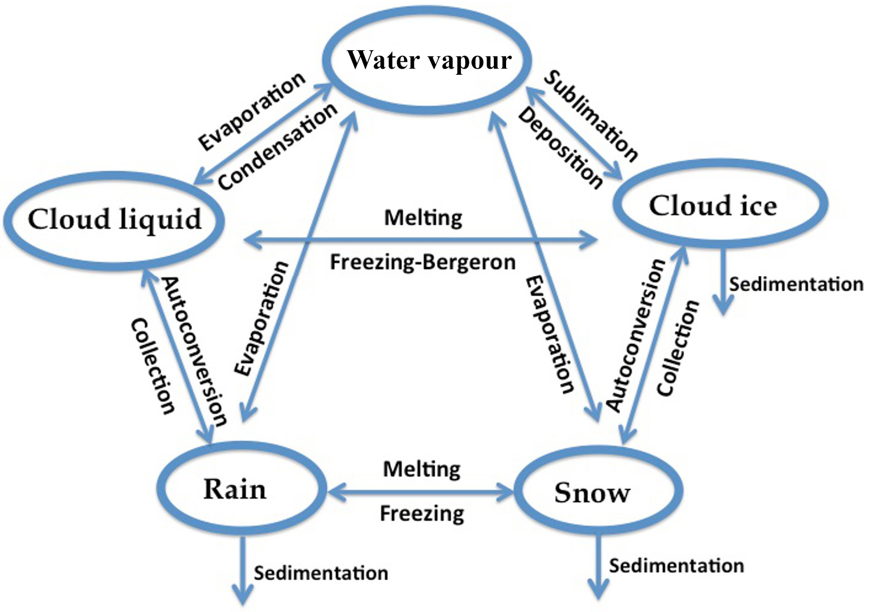
Microphysics
Parameterize in-cloud microphysics and phase status changes
Warm Rain – SUBEX scheme
  Should be used only for resolutions > 20 km. Missing ice phase.
Nogherotto-Tompkins scheme
  Developed by ICTP to work in RegCM from ideas now in the ECMWF model code
WRF Simple Microphysics 5 species WSM5
  Code borrowed and adapted from WRF NWP model. Used to verify the NoTo Scheme performances as a reference implementation with ice phase.

Slide 8
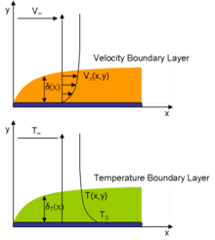
PBL scheme
Solve eddy diffusion and transport in the planetary boundary layer.
Non-local Holtslag scheme (Holtslag, 1990)
UW-PBL (O’Brien et al. 2011)

Slide 9
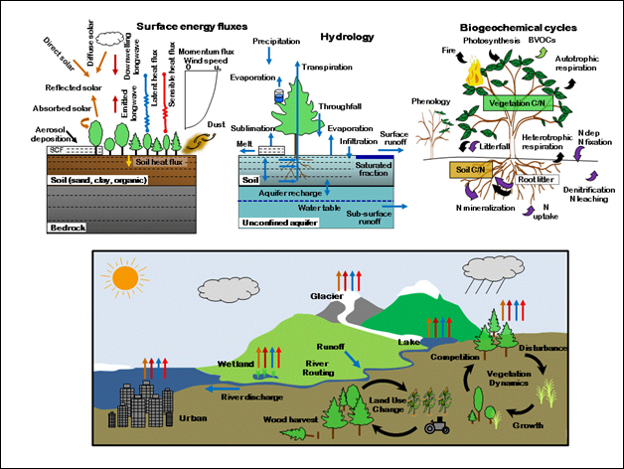
CLM4.5 surface model

Slide 10
RegCM installation requirement
Requisites:
Some reasonable computing resources. Minimal would be a multi-core system. Laptops are STRONGLY discouraged. Best HPC cluster with high speed interconnect.
A LOT of storage. Depending on the resolution/options multiple Terabyte data volumes are very likely. USB data transfer are so Slooooow.
Unix like OS (WSL in windows can be used, MacOS or Linux OK, the second one BETTER)
Standard development environment (make, automake, autoconf, libtool)
Fortran compiler – GNU gfortran = Intel OneApi = Nvidia SDK nvfortran all ok.
MPI library: used for parallel execution. From multi-core to multi-node.
NetCDF library with netCDF4 support (HDF5)
On any linux distro, all is ready packaged. Keys are netcdff-dev and libmpi-dev.
On ubuntu: apt install libnetcdff-dev openmpi-dev
Multiple options can be available for MPI.

Slide 11
Environment
ictptutor@ins45071:~$ cat /home/esp-shared-b/smr4096.sh >> .basrc

Slide 12
RegCM installation
ictptutor@ins45071:~$ cd /scratch/$USER
ictptutor@ins45071:ictptutor$ git clone https://github.com/ICTP/RegCM.git
ictptutor@ins45071:ictptutor$ cd RegCM
ictptutor@ins45071:RegCM$ git checkout CORDEX-5 # [or stay on master for untested]
ictptutor@ins45071:RegCM$ bash bootstrap.sh
ictptutor@ins45071:RegCM$ ./configure --enable-clm45
ictptutor@ins45071:RegCM$ make version
ictptutor@ins45071:RegCM$ make install

Slide 13
RegCM environment
Creating a run environment on ICTP desktop machine
ictptutor@ins45071:~$ cd /scratch/$USER
ictptutor@ins45071:ictptutor$ mkdir testrun
ictptutor@ins45071:ictptutor$ cd testrun
ictptutor@ins45071:testrun$ mkdir input output
ictptutor@ins45071:testrun$ ln -sf /home/esp-shared-b/RegCM_Data/tutorial RCMDATA
ictptutor@ins45071:testrun$ cp /scratch/$USER/RegCM/Testing/test_001.in test.in
ictptutor@ins45071:testrun$ ln -sf /scratch/$USER/RegCM/bin .

Slide 14
EDIT NAMELIST FILE
ictptutor@ins45071:~$ cd /scratch/$USER/testrun
ictptutor@ins45071:testrun$ gedit test.in

Slide 15
RegCM test run
VERY BASIC hindcast simulation
ictptutor@ins45071:~$ cd /scratch/$USER/testrun
ictptutor@ins45071:testrun$ ./bin/terrainCLM45 test.in # <= Create static
ictptutor@ins45071:testrun$ ./bin/mksurfdataCLM45 test.in # <= Static for CLM45
ictptutor@ins45071:testrun$ ./bin/sstCLM45 test.in # <= SST interpolation
ictptutor@ins45071:testrun$ ./bin/icbcCLM45 test.in # <= BC created
ictptutor@ins45071:testrun$ mpirun ./bin/regcmMPICLM45 test.in # <= Model

Slide 16
Let’s go!

