Slide 1
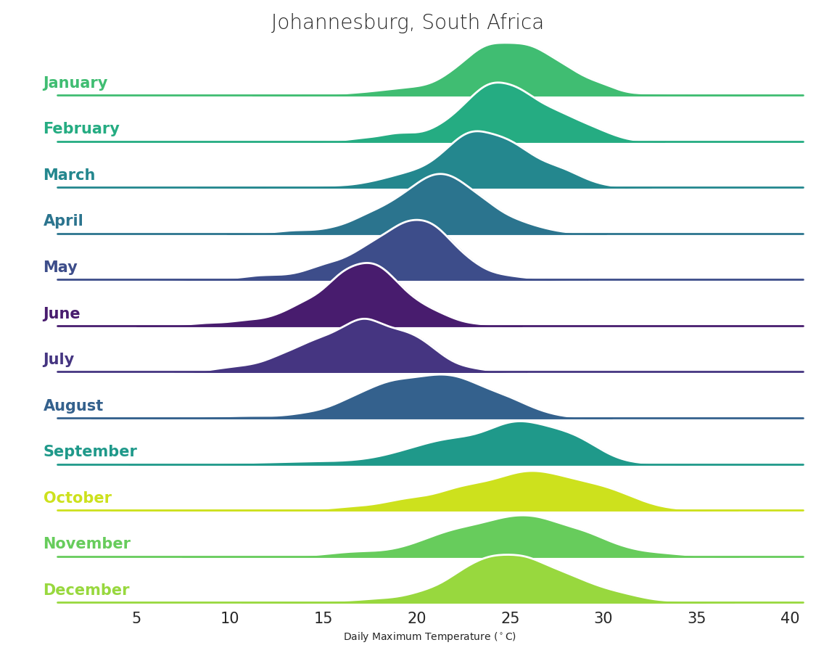
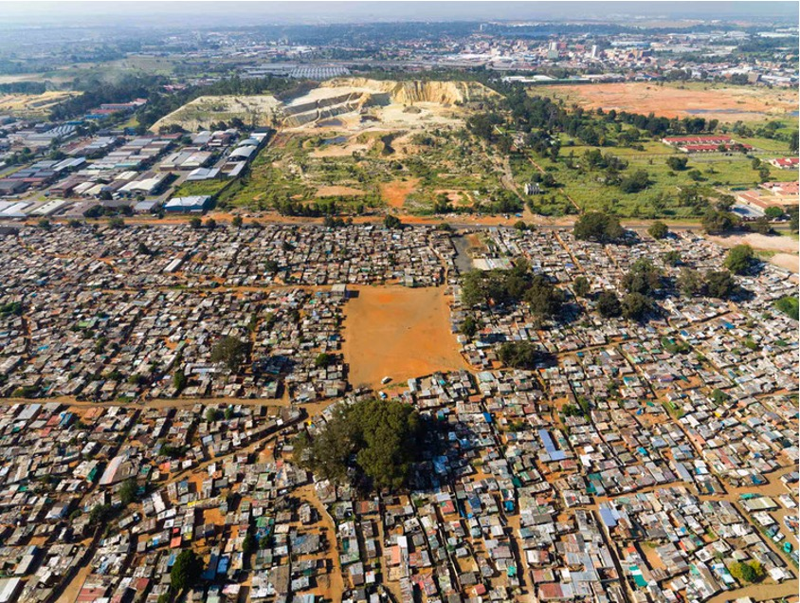
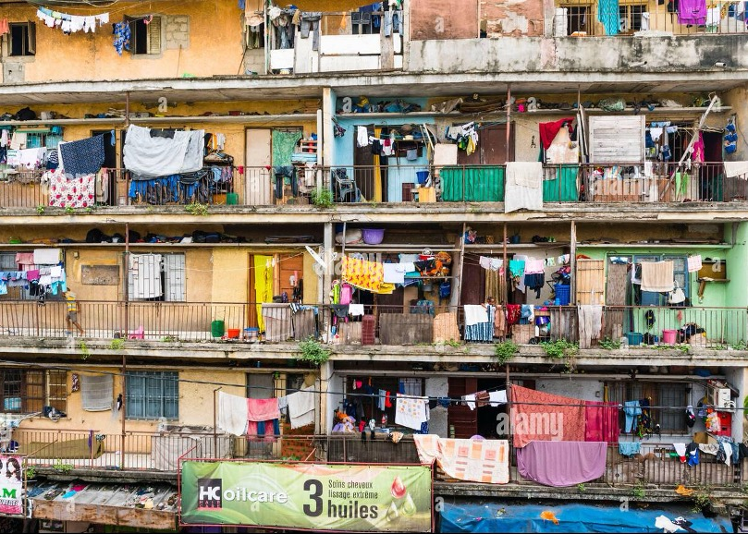



Exploring the Value of High Resolution Climate Model Simulations for Heat Information Within an African City
Sabina Abba Omar, Peter Marsh, Chris Jack, Lisa van Aardenne, Pierre-Louis Kloppers

Slide 2

This study forms part of the HE2AT project which aims to look at the health impact caused by heat in Africa
  Objective 1: Characterize the relationship between heat exposure and pregnancy outcomes (pre-term birth, birth weight and pre-eclampsia)
  Objective 2: Assess the burden of heat-related morbidity in vulnerable urban settings
Excessive exposure to heat is becoming more frequent and will have health implications
Africa is especially vulnerable to this
Often to get resources and help explicit indications of these health impacts needs to be shown
Thus information on heat within African cities is valuable for understanding these health implications

Slide 3
Currently we are focusing the study on Johannesburg, South Africa
Next goal is to look at Abidjan, Cote D’Ivore
Ultimate goal is to scale up to multiple African cities

Slide 4
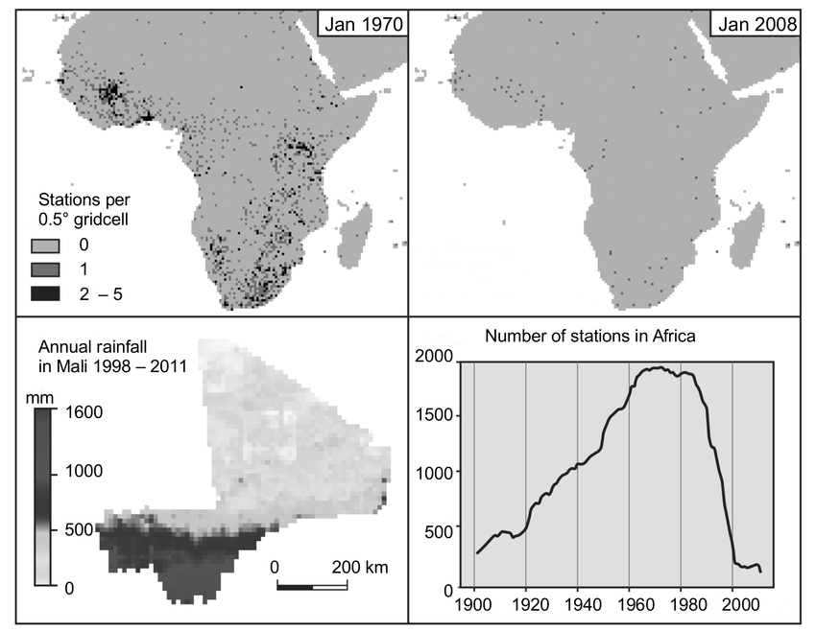
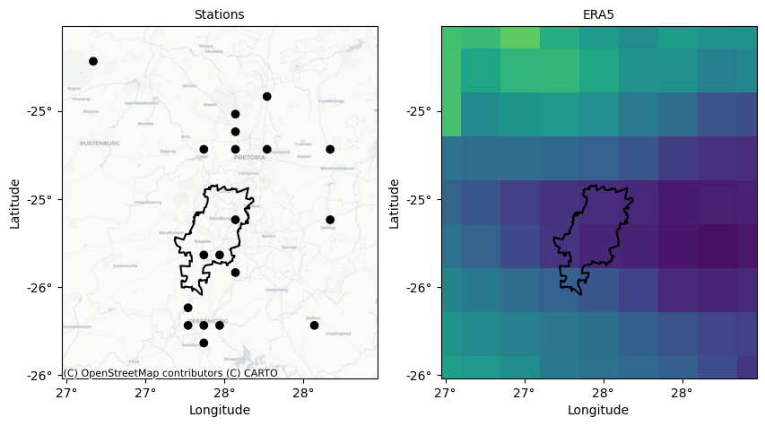
There is a challenge of station data within Africa
Access to station data is complicated and very expensive
Datasets that are available may not have the required spatial or temporal density
source Eklund, L., Romankiewicz, C., Brandt, M., Doevenspeck, M. and Samimi, C., 2016. Data and methods in the environment-migration nexus: a scale perspective. DIE ERDE–Journal of the Geographical Society of Berlin, 147(2), pp.139-152.
Massive decline of stations in Africa in CRU data

Slide 5
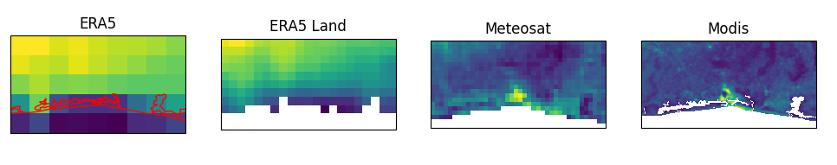
Currently the health research space either uses ERA5
Or land surface temperature from satellite data
Each of these providing their own challenges

Slide 6
The question is therefore, can regional climate simulations be used to bridge this data gap
  Can it provide useful heat information?
  Does it make sense resource wise?

Slide 7

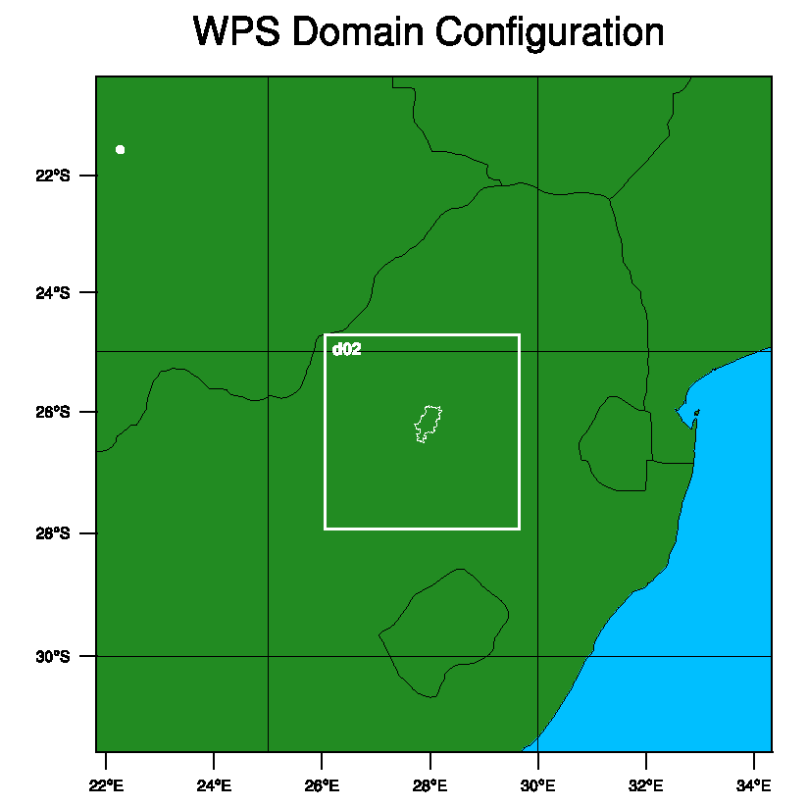
Used a Regional Climate Model - Weather Research and Forecasting Model (WRF) to simulate air temperature over Johannesburg and surrounds. With ERA5 being our forcing at the boundary.
Simulations produced for 6 months (Oct 2018 - April 2019) at 3km resolution with hourly output
Compared this to SAAQIS (South African Air Quality Information System) observation stations, ERA5 (31km), ERA5-land (9km) and modis
 | Outer Domain | Inner Domain
resolution | 9km | 3km

Slide 8
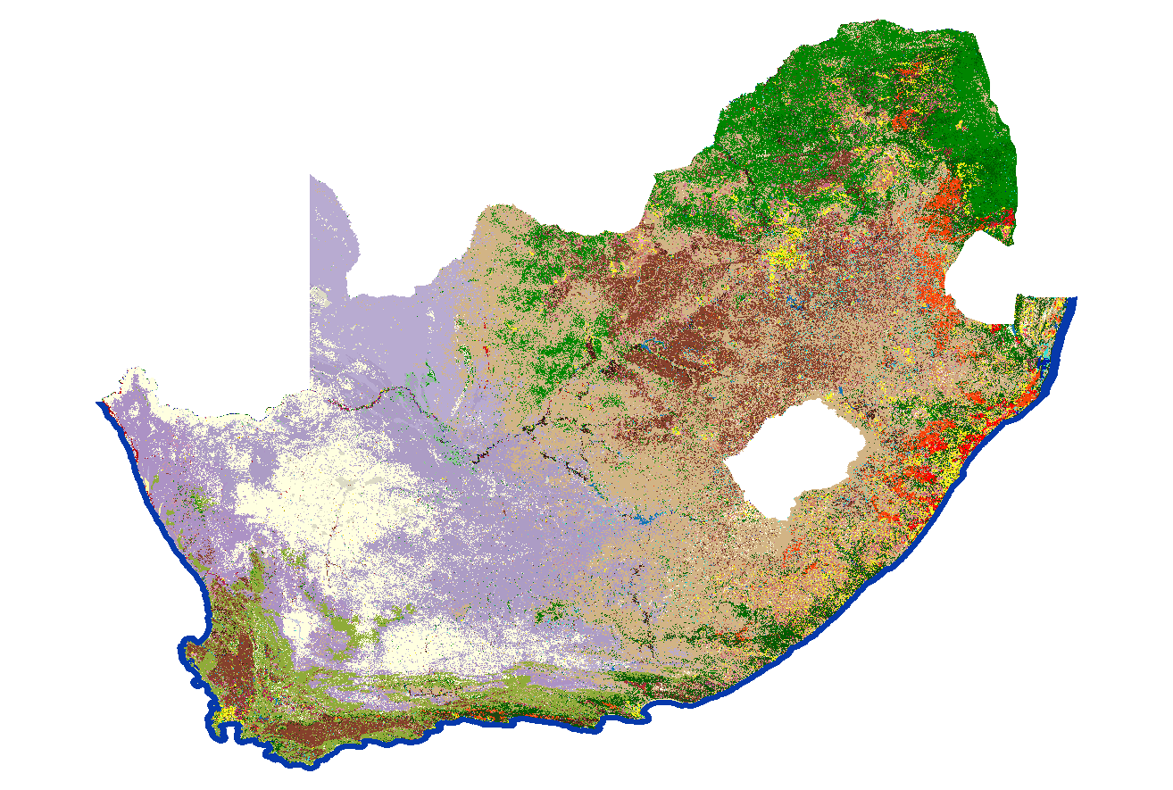
Updated Land surface cover with The 2020 South African National Land cover Dataset
The simulations were run with the Single layer urban canopy model parameterization scheme
Characterizes Low Intensity residential, High Intensity residential and Commercial/Industrial/Transportation
Updated some parameters for these three urban types - updated roof height and width - solely based on policies found restricting certain heights in certain area of the city
Small simulation tests were done and the albedo of the roofs was also tweaked to show more reasonable results

Slide 9
Experiment Name | PBL Scheme | Outer domain Cumulus Scheme | Microphysics Scheme
wrf1 | Mellor-Yamada-Janjic TKE scheme | Tiedtke scheme | WSM 6
wrf2 | MYNN 2.5 level TKE scheme | Tiedtke scheme | WSM 6
wrf3 | UW boundary layer scheme from CAM5 (CESM 1_0_1) | Tiedtke scheme | WSM 6
wrf4 | Mellor-Yamada-Janjic TKE scheme | Multi-scale Kain-Fritsch scheme | WSM 6
wrf5 | (BouLac) PBL | Tiedtke scheme | WSM 6
wrf6 | (BouLac) PBL | Multi-scale Kain-Fritsch scheme | WSM 6
wrf7 | UW boundary layer scheme from CAM5 (CESM 1_0_1) | Multi-scale Kain-Fritsch scheme | Wsm 6

Slide 10

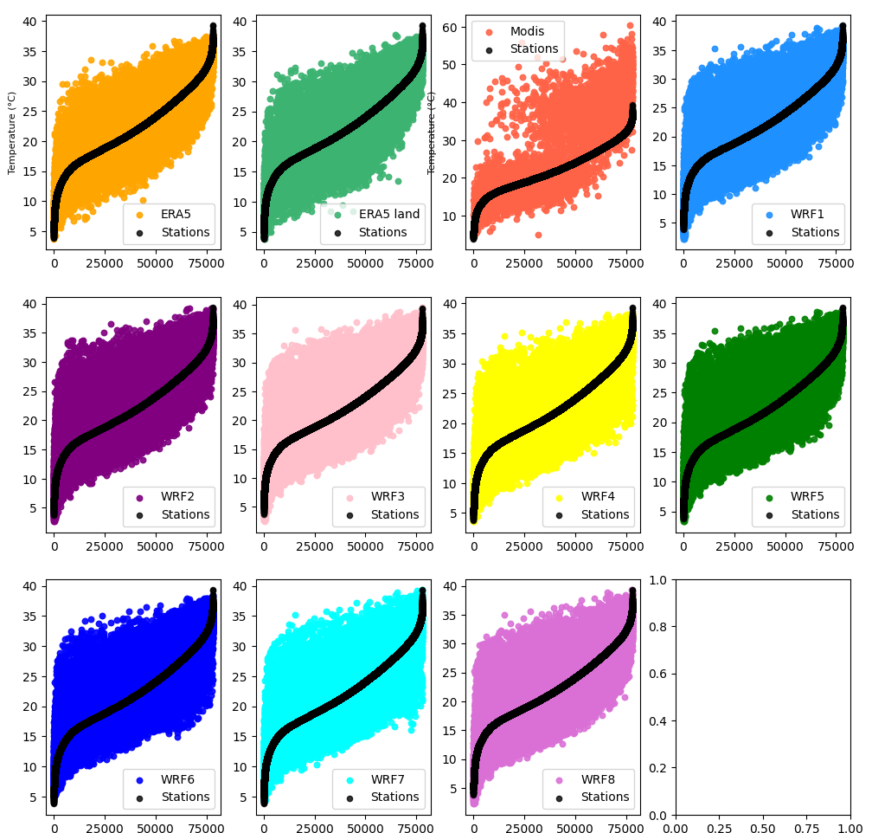
Sorting hourly observations from coolest to warmest:
Here the main thing is to see that all the WRF simulations are able to pick up on the higher temperatures
Whereas ERA5 and ERA5-land doesn’t

Slide 11
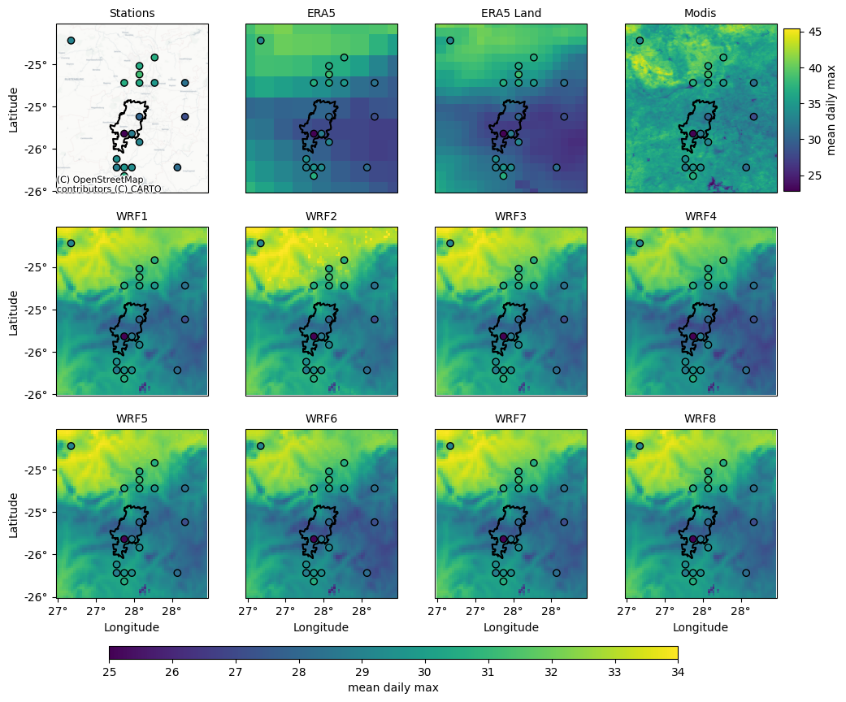
Mean daily maximum temperature
Dataset | MAE
wrf4 | 0.83
wrf6 | 0.87
wrf7 | 0.98
wrf1 | 1
ERA5 | 1.1
wrf5 | 1.12
wrf3 | 1.13
ERA5-Land | 1.18
wrf2 | 1.3
modis_lst | 8.5

Slide 12
Mean daily maximum temperature
Dataset | MAE
wrf4 | 0.83
wrf6 | 0.87
wrf7 | 0.98
wrf1 | 1
ERA5 | 1.1
wrf5 | 1.12
wrf3 | 1.13
ERA5-Land | 1.18
wrf2 | 1.3
modis_lst | 8.5
simulations performed with Kain Fritsch Scheme

Slide 13
Mean daily maximum temperature
Dataset | MAE
wrf4 | 0.83
wrf6 | 0.87
wrf7 | 0.98
wrf1 | 1
ERA5 | 1.1
wrf5 | 1.12
wrf3 | 1.13
ERA5-Land | 1.18
wrf2 | 1.3
modis_lst | 8.5
Simulations performed with Mellor Yamada PBL and Tiedke
simulations performed with Kain Fritsch Scheme

Slide 14
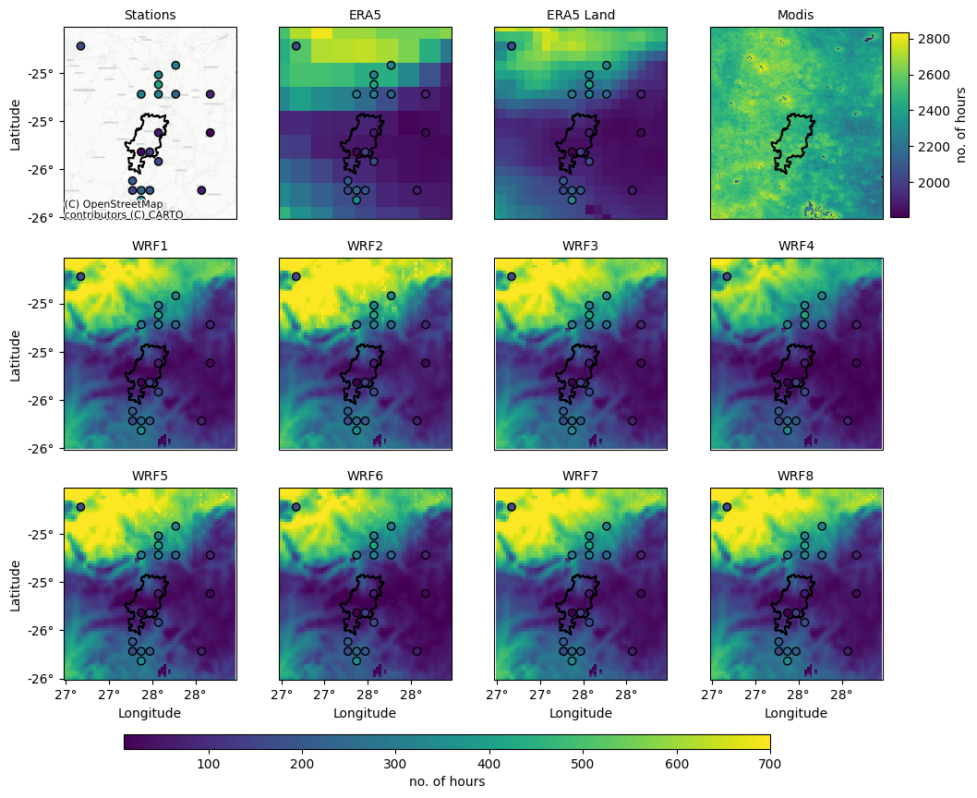
Number of hours where the temperature > 32℃
Dataset | MAE
wrf1 | 68.63
ERA5-Land | 74.26
wrf7 | 76.37
wrf6 | 76.47
wrf3 | 77.42
wrf4 | 80.0
ERA5 | 82.74
wrf2 | 83.78
wrf5 | 84.05
modis_lst | 86.16

Slide 15
Number of hours where the temperature > 32℃
Dataset | MAE
wrf1 | 68.63
ERA5-Land | 74.26
wrf7 | 76.37
wrf6 | 76.47
wrf3 | 77.42
wrf4 | 80.0
ERA5 | 82.74
wrf2 | 83.78
wrf5 | 84.05
modis_lst | 86.16
Similar to what we see in the previous slide

Slide 16
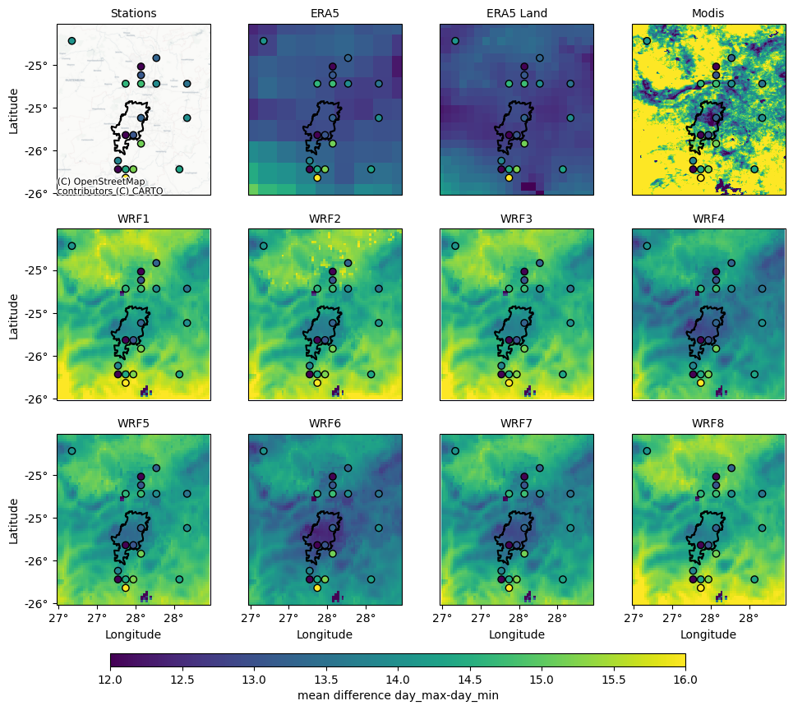
Dataset | MAE
wrf5 | 0.75
wrf8 | 0.76
wrf4 | 0.77
wrf3 | 0.8
wrf2 | 0.82
wrf1 | 0.85
wrf2 | 0.92
ERA5 Land | 1.3
ERA5 | 1.7
All the simulations are better at representing the maximum daily difference in temperatures than ERA5 and ERA5 Land

Slide 17
Computational cost and proposed solution further
Resolution | Simulation time required for 1 month data | Space required for 1 month data
3km | 5 hours 33 minutes | 117 Gb
More than 27 days of continuous simulation time for 10 years of data with 3km resolution run on 96 processors

Slide 18
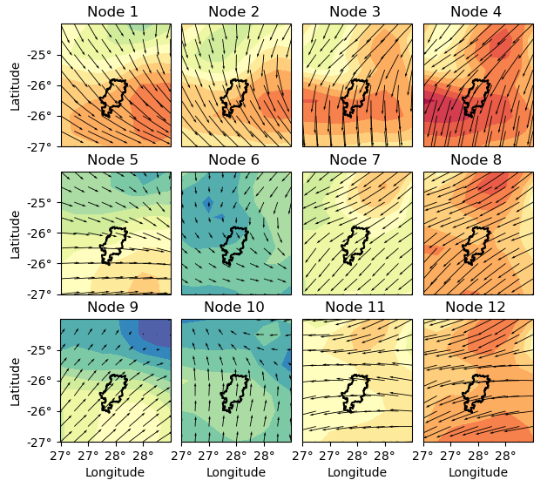
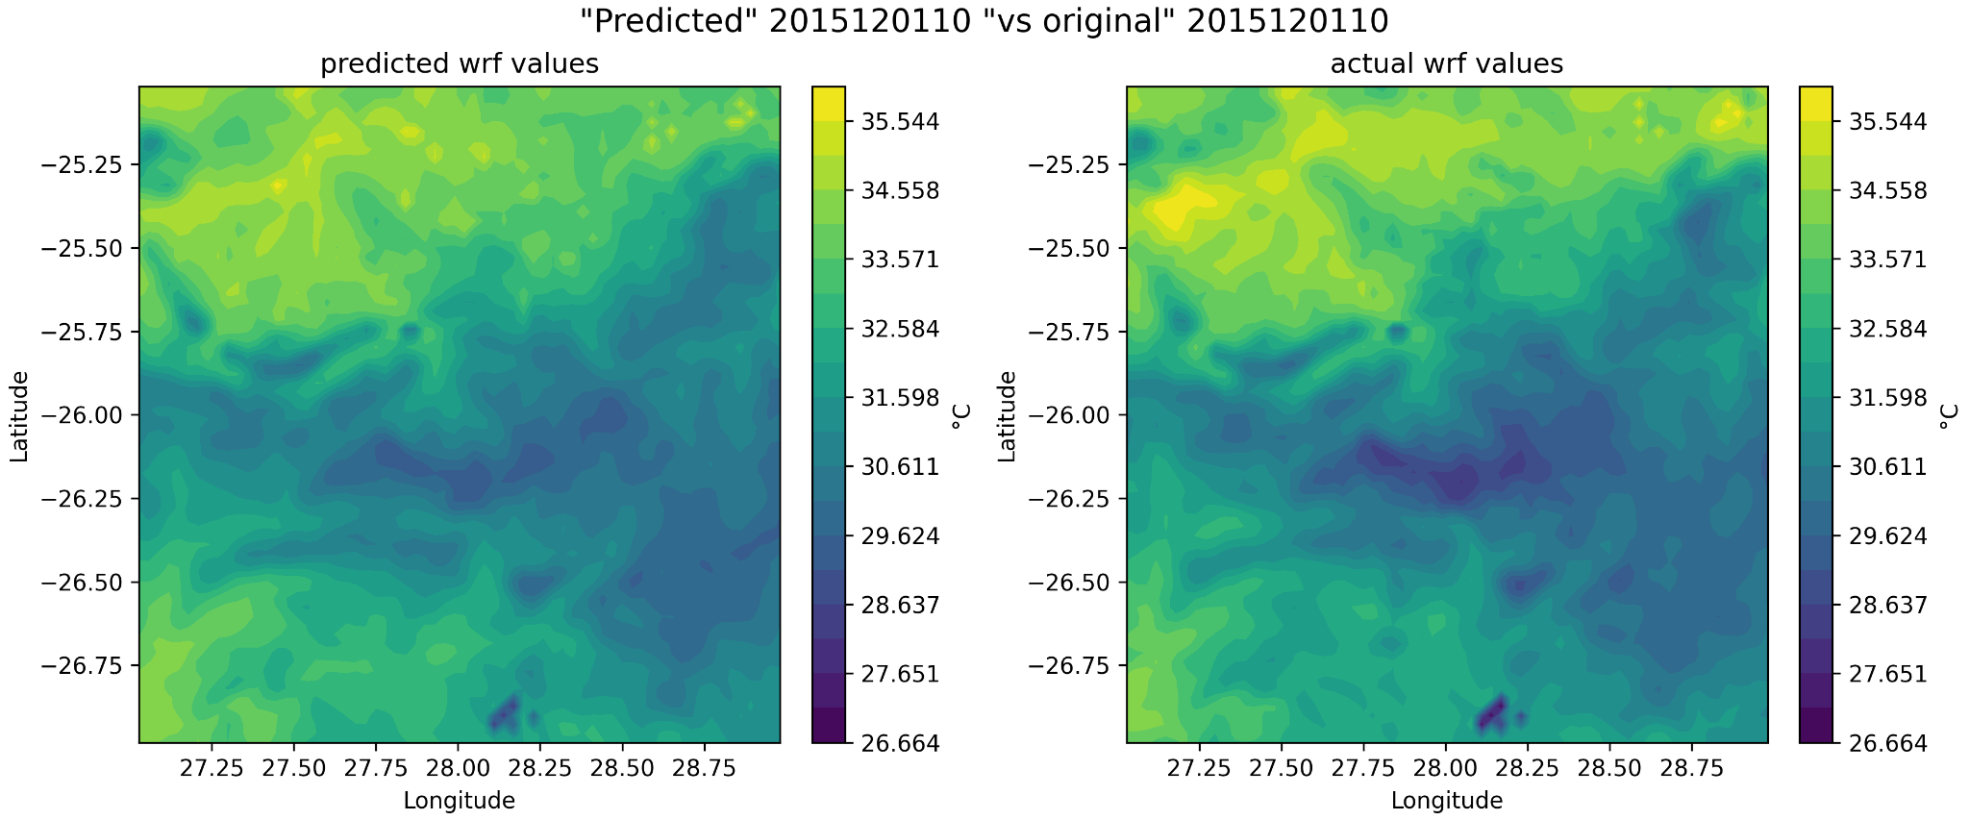
Proposed solution further
Synoptic typing combined with spatial anomaly data from WRF simulation to provide a simple downscaling of ERA5

Slide 19

There are cases where ERA5-land air temperature for health information could be useful, especially when needing direct event to event data
However, in terms of representing spatially higher temperatures, especially over vulnerable areas where often station data is non-existent the value of the WRF simulations is clear
The simulations that performed the best were: those with Kain Fritsch scheme on the outer domain and the Mellor Yamada PBL and Tiedke
Producing these longer simulations and scaling this up beyond two cities seems to not be feasible in terms of computational expense
Can we use these shorter simulations to produce a synoptic type downscaling? Does this make sense? Would this work for cities beyond Johannesburg? - All questions that need to be answered (Advice Welcome!!)

