Slide 1






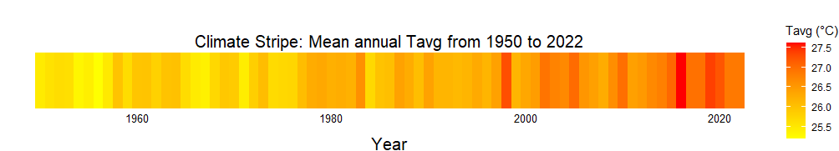
Projections of Compounded Extreme Rainfall Events under SSP5-8.5 from CMIP6 Models for Flood Risk Assessment in Kelantan and Terengganu, Malaysia
Z. Sa’adi*, Z. Yusop, M.K.I. Muhammad, M.M. Hamed, Z. Zainon Noor, and Ricky Anak Kemarau
29 August 2025 | Fri
Trieste, Italy

Slide 2
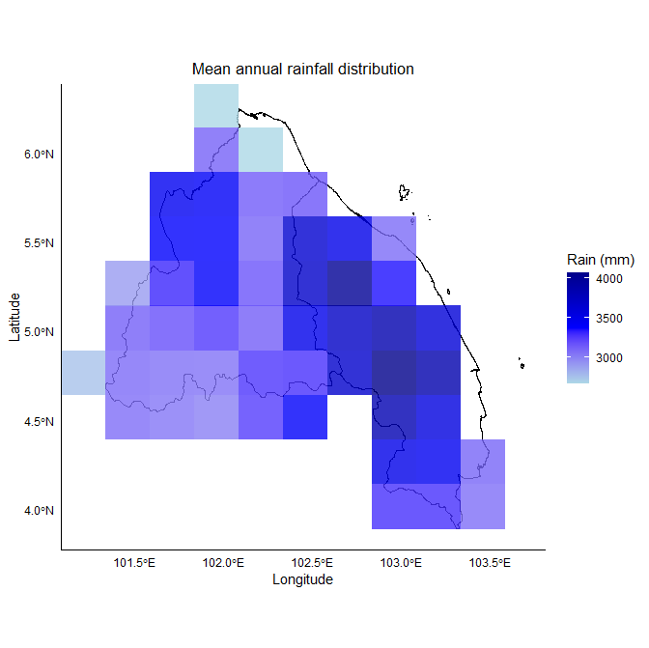
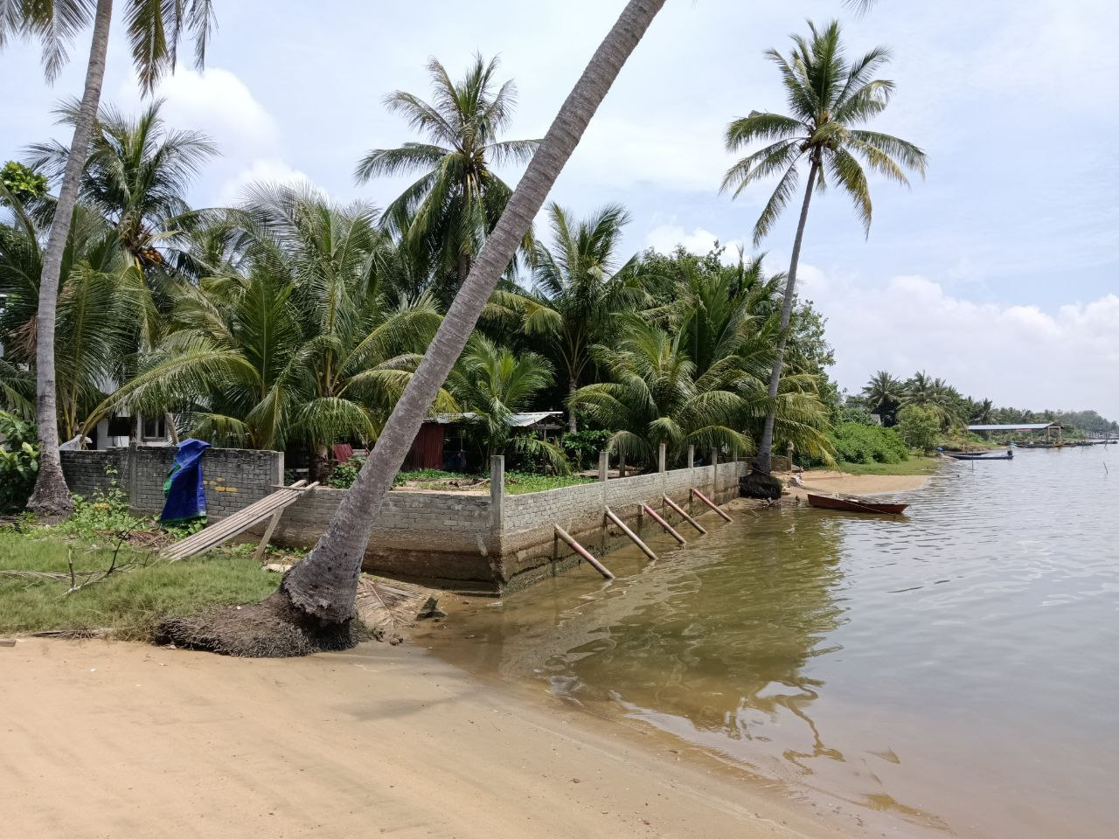

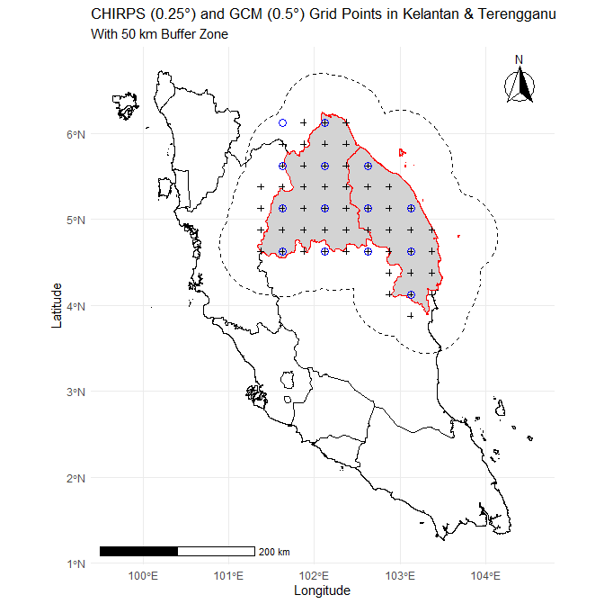
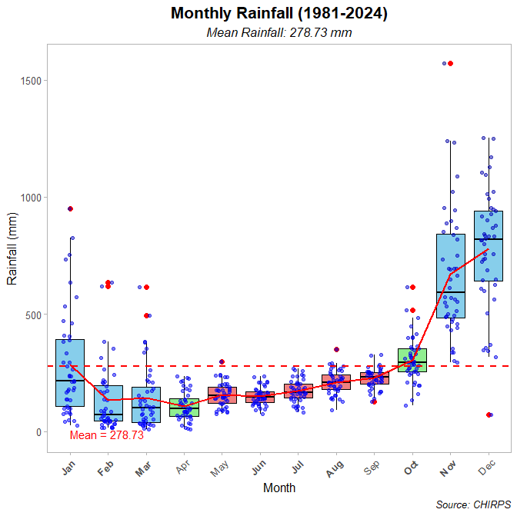




Extreme rainfall
Flood Grant 2024
The influence of climate change on extreme rainfall and flood risk projections in Kelantan and Terengganu
Climate change projection
Adaptation
Kpg. Jubakar Pantai, 25/6/2025
MyNAP
Government of Malaysia under the project UKM MONSUN (Grant Num. R.J130000.7713.4J776), administered by Universiti Kebangsaan Malaysia.
UTM Zamalah and Research Management Centre UTM (Grant No.Q.J130000.2522.14H84).

Slide 3
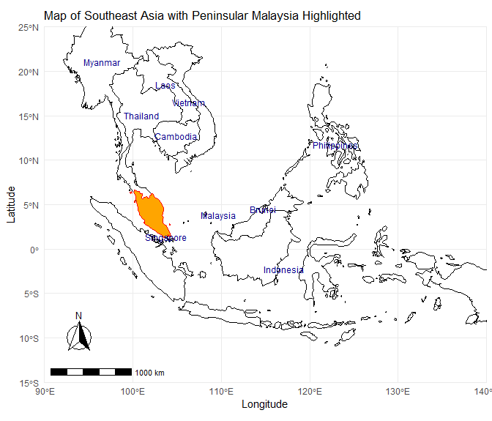
Study Area

Slide 4
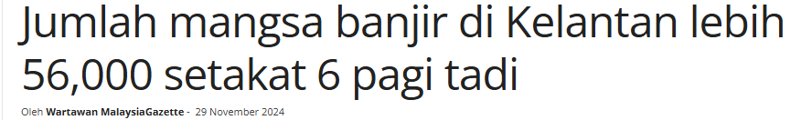
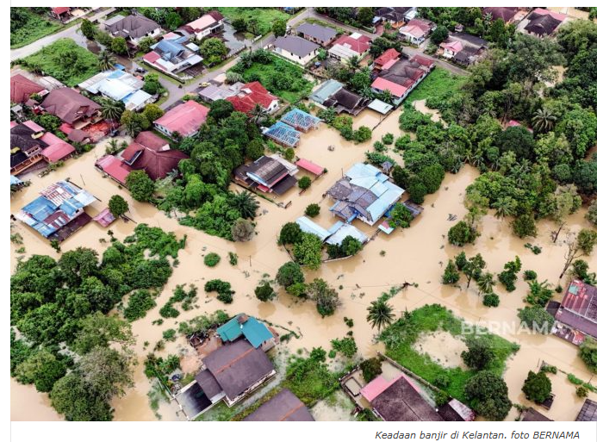
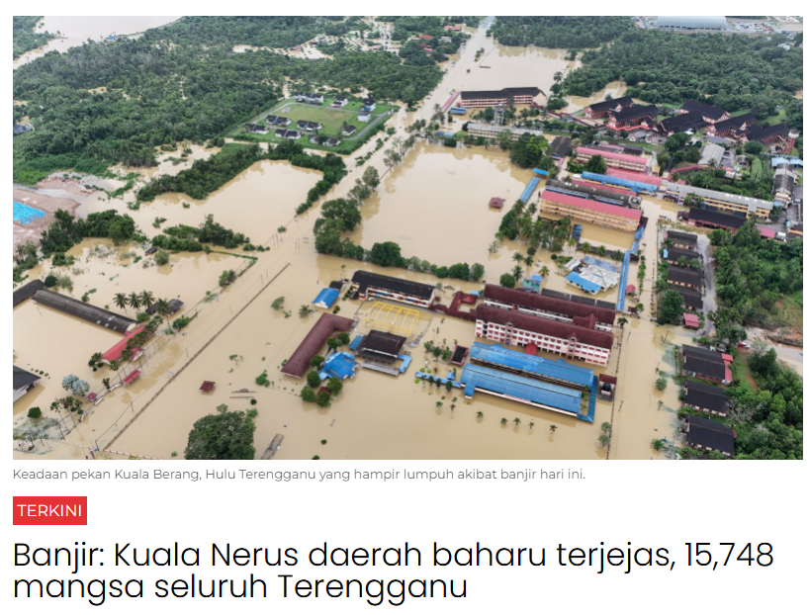
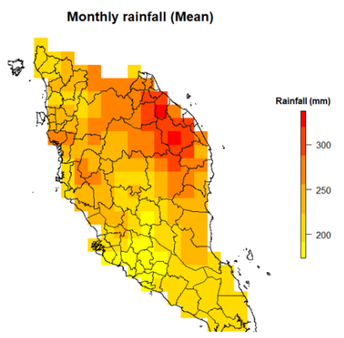
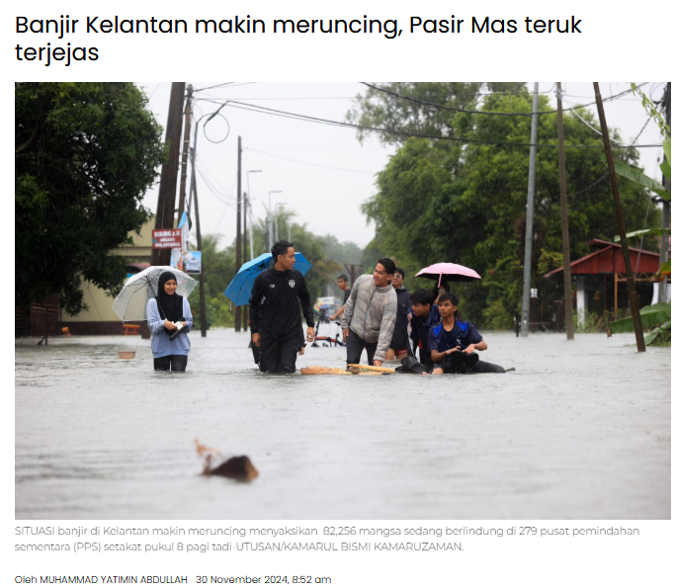
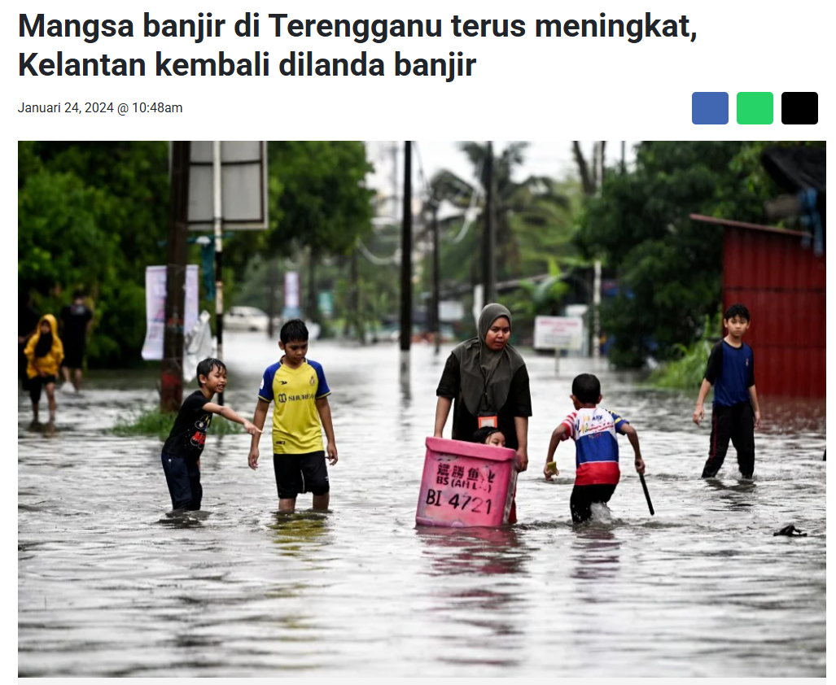
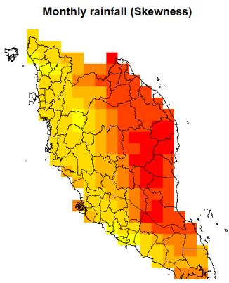
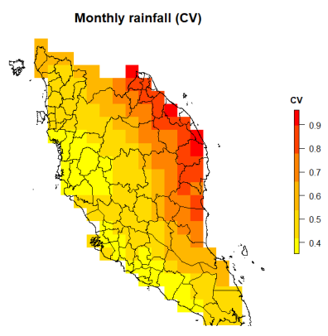
Flood
Extreme & High Variability
Sa’adi, Z. et al. (2024). IOP Conf. Ser.: Earth Environ. Sci.

Slide 5
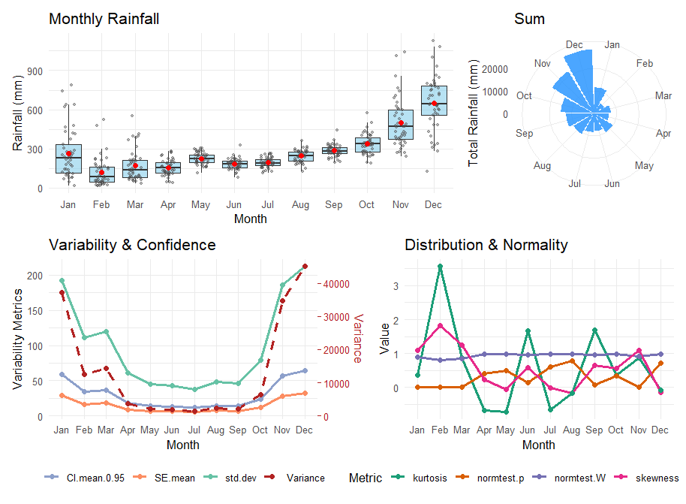
Study Area
52 grids CHIRPS
Daily
1981 to 2024
Du, H. et al. (2023). Theor. Appl. Climatol.
Sa’adi, Z. et al. (2023). Sci Total Environ.

Slide 6
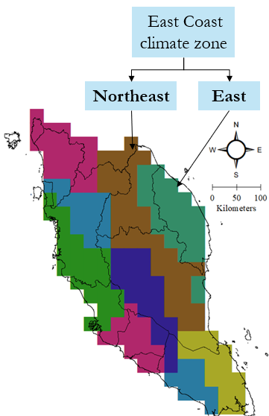
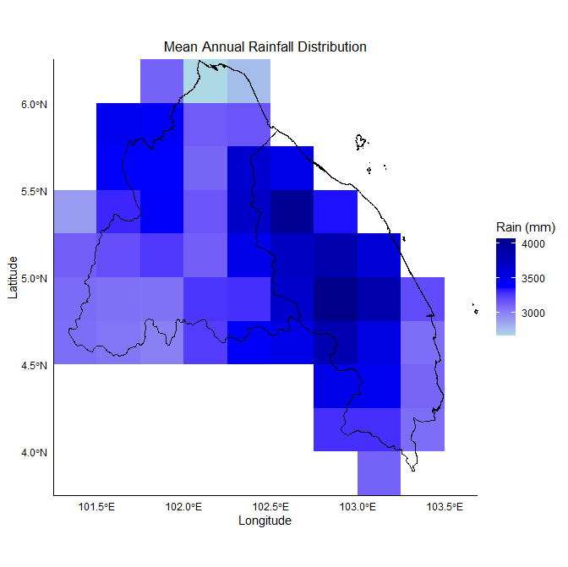
Study Area
Sa’adi, Z. et al. (2024). Atmos. Res.
Moran ‘s I: 0.577
p-value: 2.29×10⁻¹¹
52 grids CHIRPS
Daily
1981 to 2024
Strong and statistically significant positive spatial autocorrelation, indicating that similar rainfall values cluster together.

Slide 7
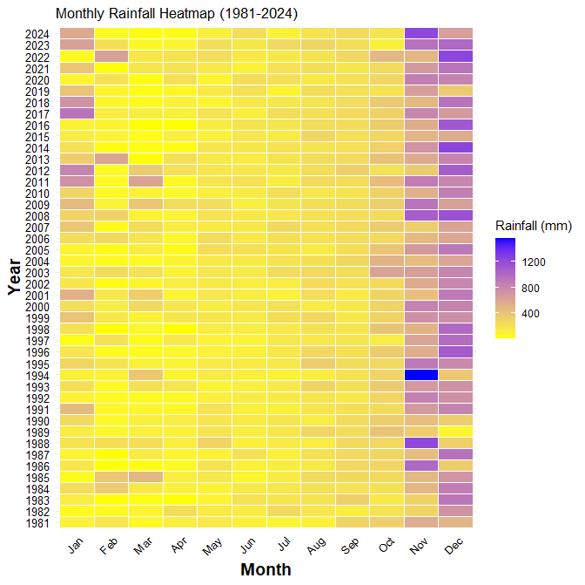
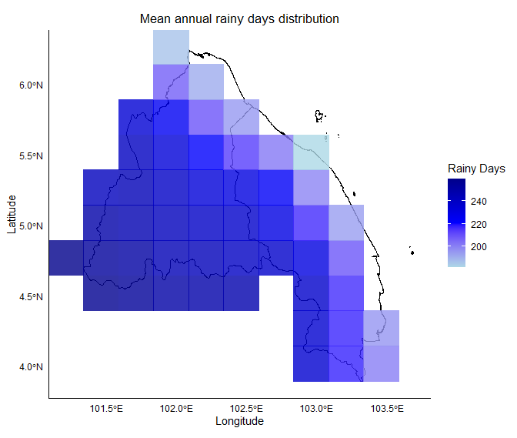
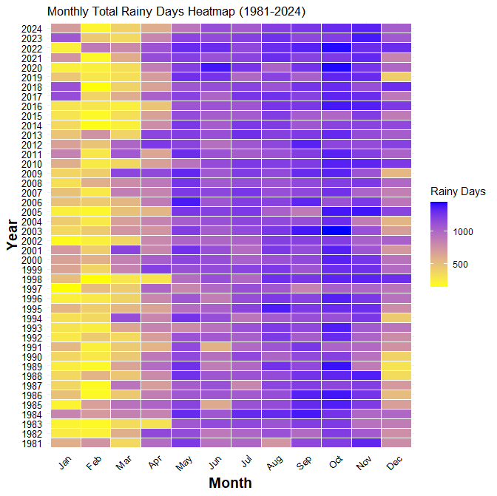
Study Area

Slide 8
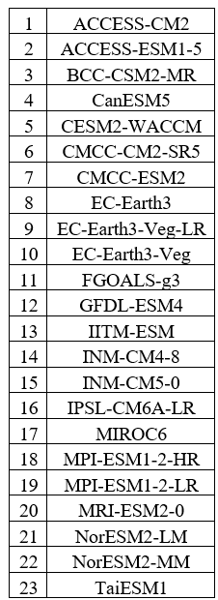
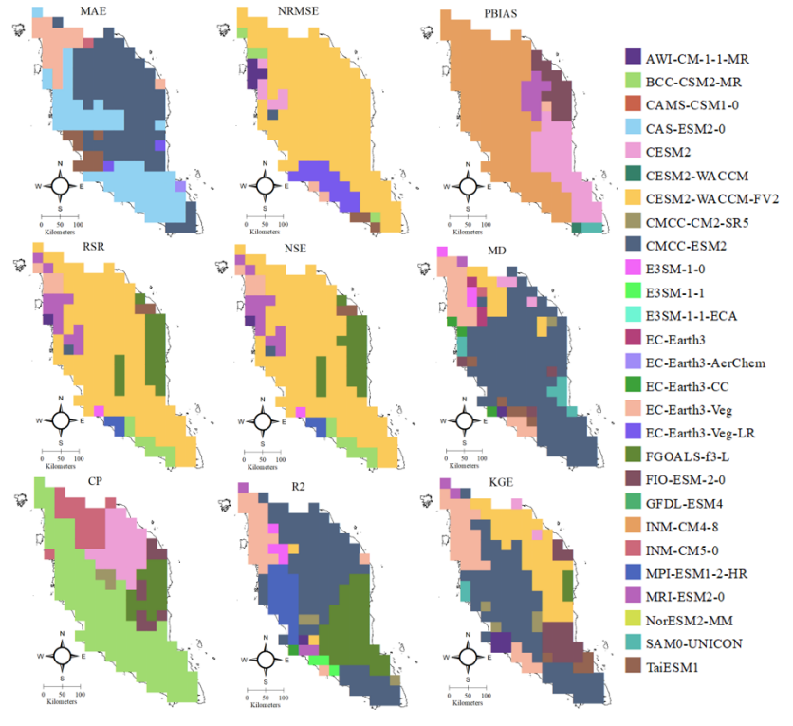
GCM Selection
GCMs performance in Peninsular Malaysia
Which GCMs to used?
Sa’adi, Z. et al. (2024). IOP Conf. Ser.: Earth Environ. Sci.

Slide 9
GCM Selection
High-percentile rainfall that can replicate extreme rainfall
90th, 95th, and 99th percentiles
KGE
MAE
MD
NSE
PBIAS
RMSE
CPI:
Aggregate the rank
Fisher Jenks:
GCMs subset
CHIRPS | GCMs
0.25° | 0.5°
52 grids | 14 grids
Upscale

Slide 10
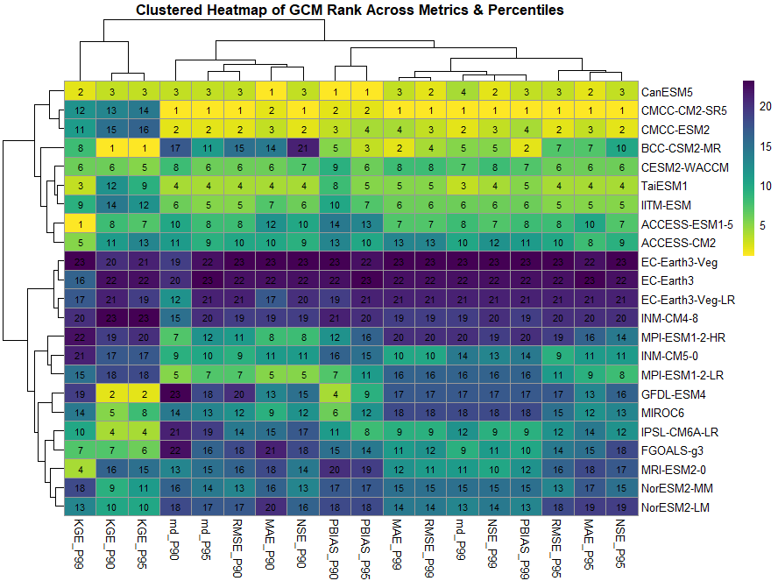
GCM Selection | Multi-statistical metric
Mean statistical value
CMCC-CM2-SR5

Slide 11
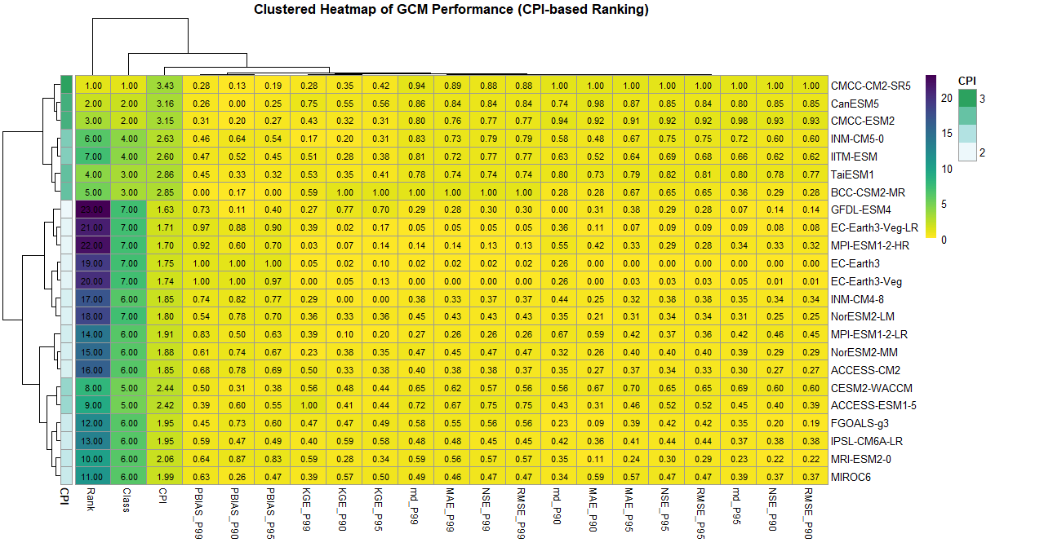
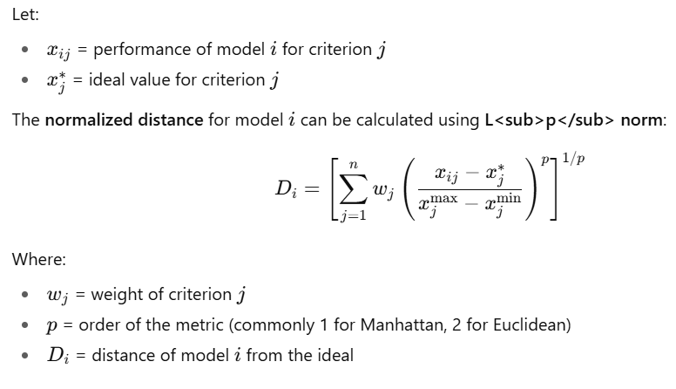

GCM Selection | CPI

Slide 12
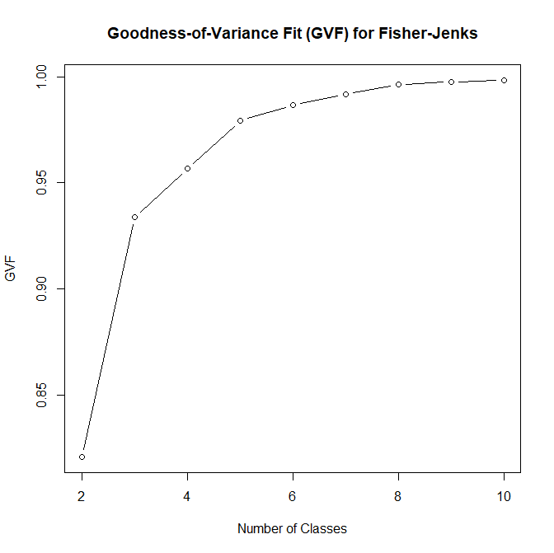
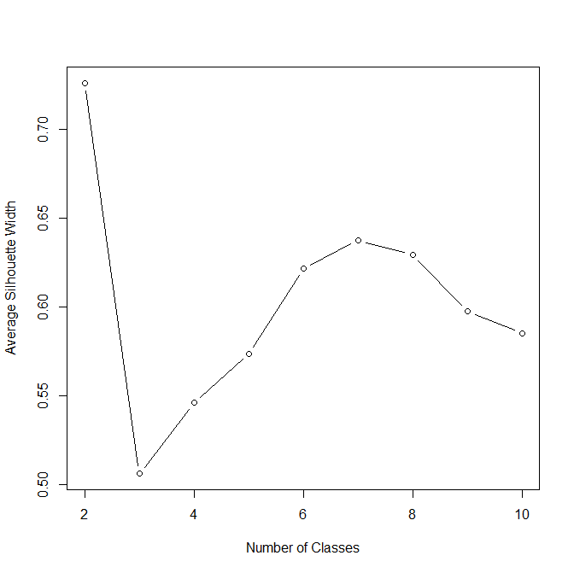
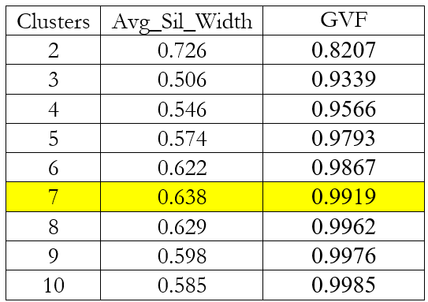
GCM Selection | Fisher Jenks

Slide 13
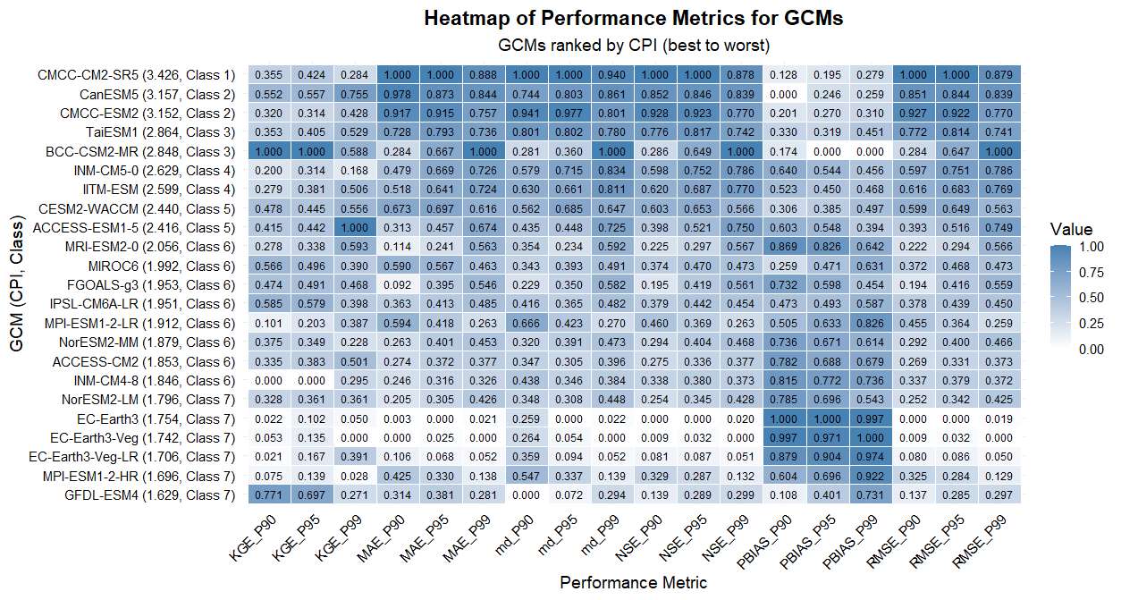
GCM Selection

Slide 14
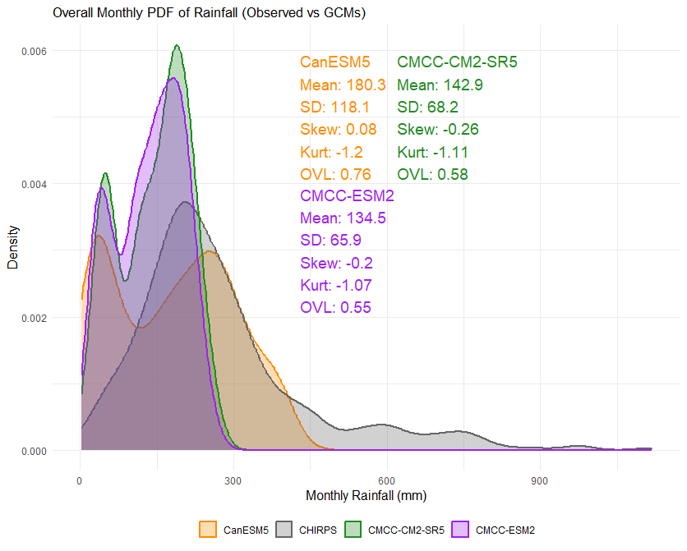
Top-performing GCMs
CanESM5 most closely matches CHIRPS monthly rainfall with higher mean and overlap
CMCC-CM2-SR5 and CMCC-ESM2 underestimate rainfall and show lower similarity.

Slide 15
Bias correction
HYBRID
Random Forest classifier to identify wet/dry days, dynamically adjusting thresholds and sample sizes to correct both historical and future GCM rainfall to match observed distributions
Quantile Mapping (QM)
Support Vector Machine (SVM)
Random Forest (RF)
Quantile Random Forest (QRF)
Hybrid Quantile Mapping (QM)
Hybrid Support Vector Machine (SVM)
Hybrid Random Forest (RF)
Hybrid Quantile Random Forest (QRF)
Threshold: 1 mm/day & minimum sample size of 20.
Fallback limits: 0.1 mm/day & 10 sample size to handle sparse rainfall data.
The algorithm adjusts the threshold and sample size iteratively to ensure a sufficient number of wet days are available for bias correction.

Slide 16
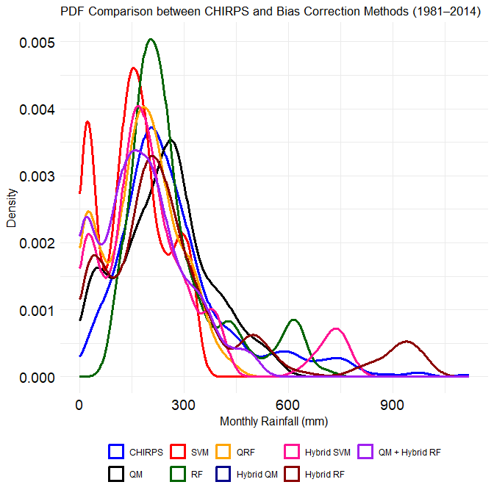
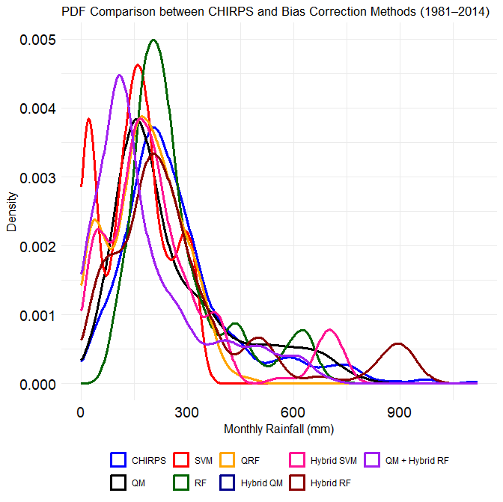
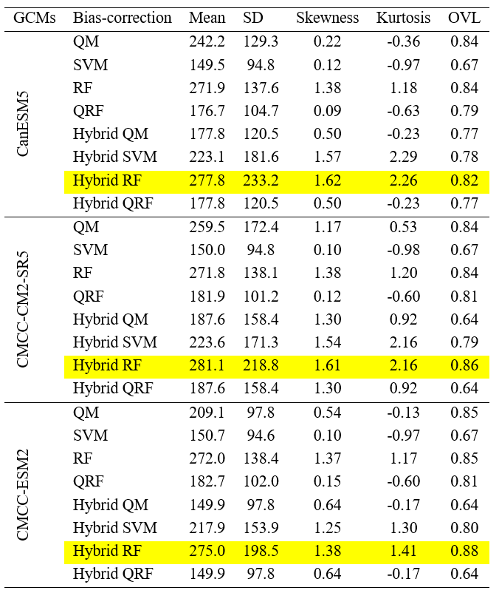
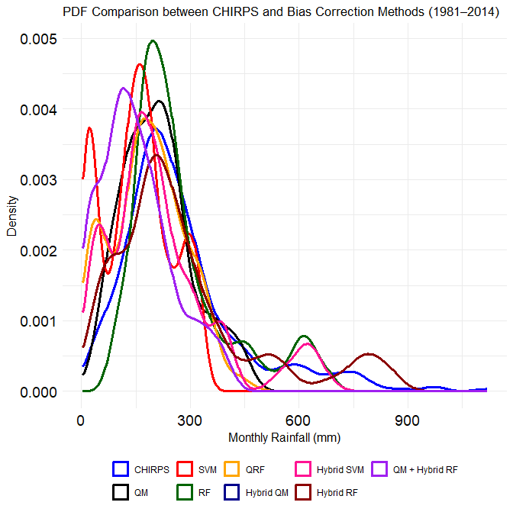
Bias correction
CanESM5
CMCC-CM2-SR5
CMCC-ESM2

Slide 17
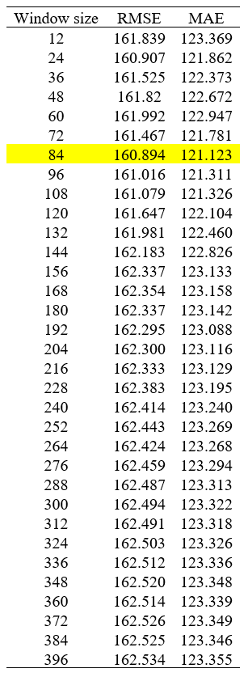
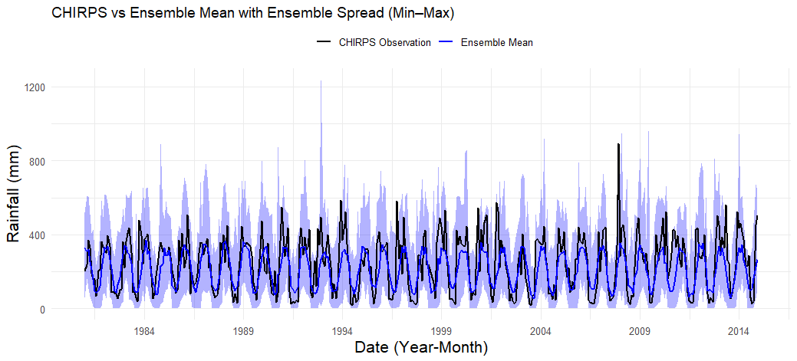
RF-ensemble
+
BCCA (Hybrid RF)
CanESM5
CMCC-CM2-SR5
CMCC-ESM2
Sa’adi, Z. et al. (2024). Natural Hazards.

Slide 18
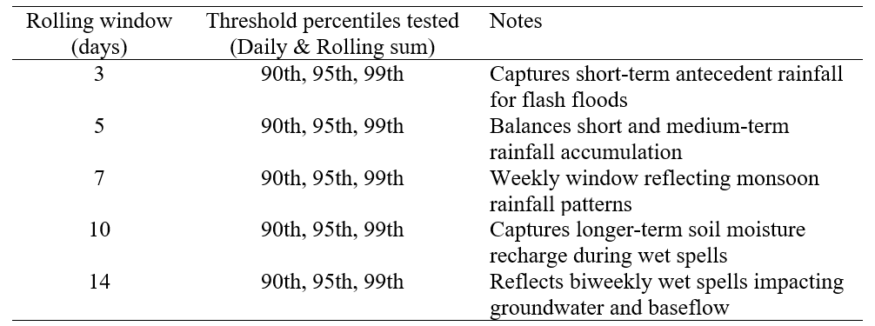
Compound event
Pre-condition compound events
When one extreme event creates a condition that makes a subsequent event more severe.
Pre-condition compound events
Spatial compound events
Temporal compound events
Multivariate compound events
Network or system compound events
Cascading compound events
Synchronous compound events
[Antecedent rainfall accumulation threshold] + [Percentile threshold]

Slide 19
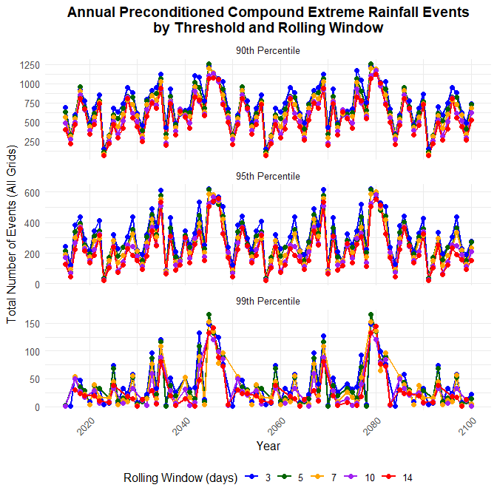
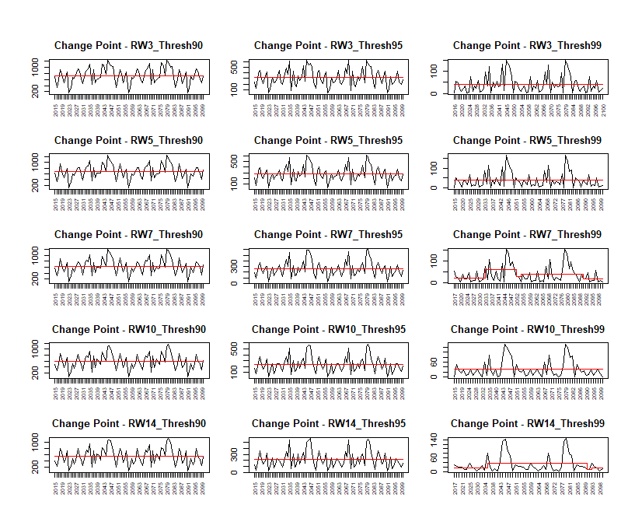
Compound event | SSP5-8.5

Slide 20
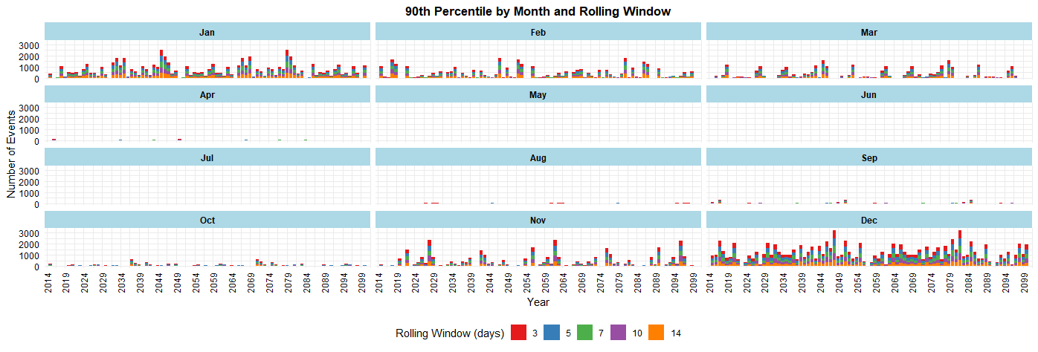
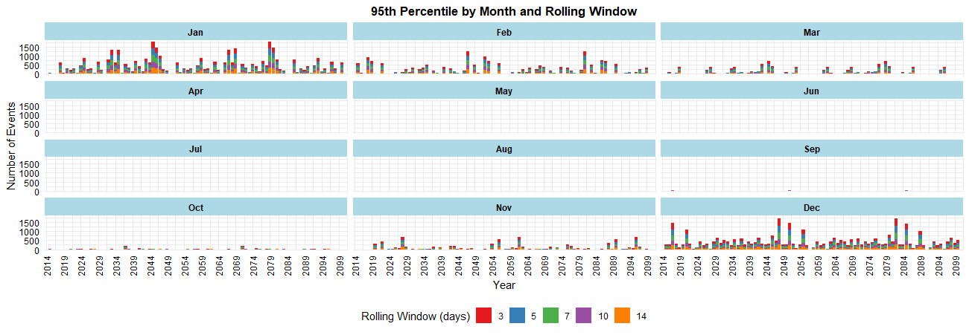
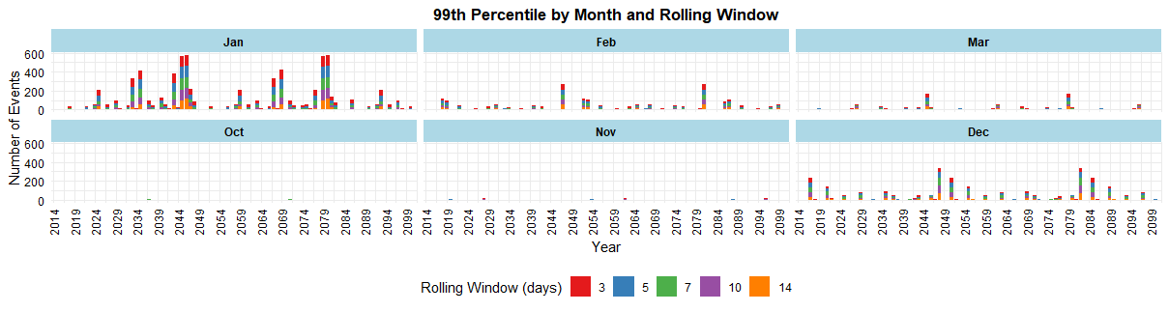
Compound event | SSP5-8.5
Pre-conditioned extreme rainfall increase in December and shifted to January

Slide 21
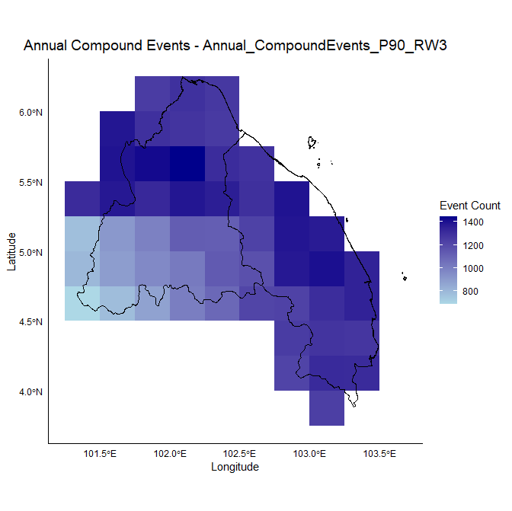
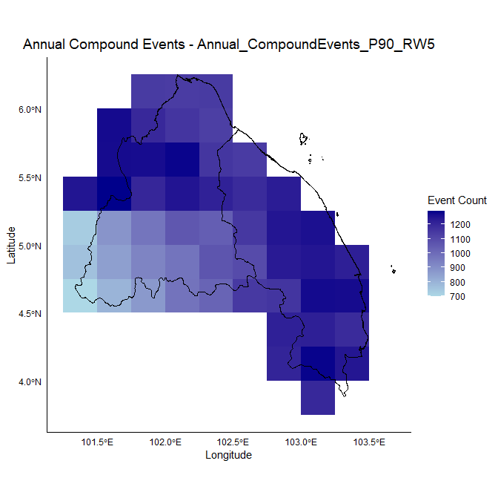
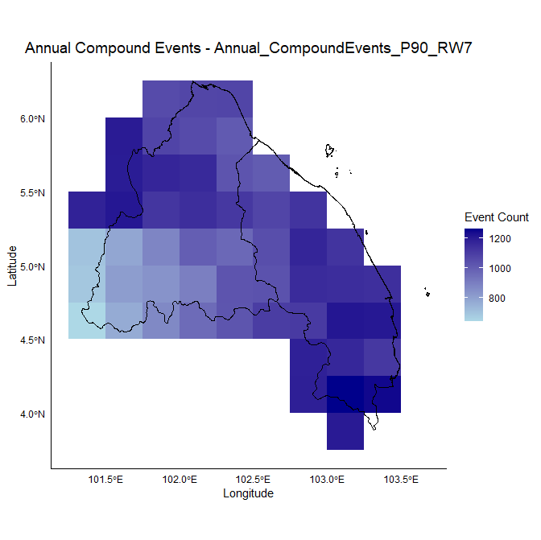
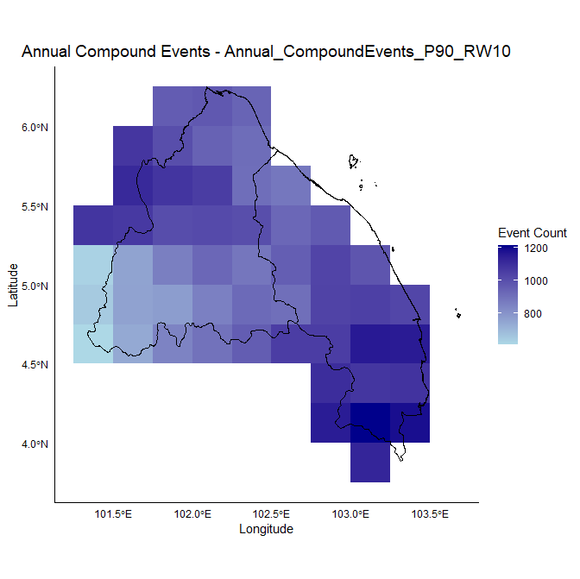
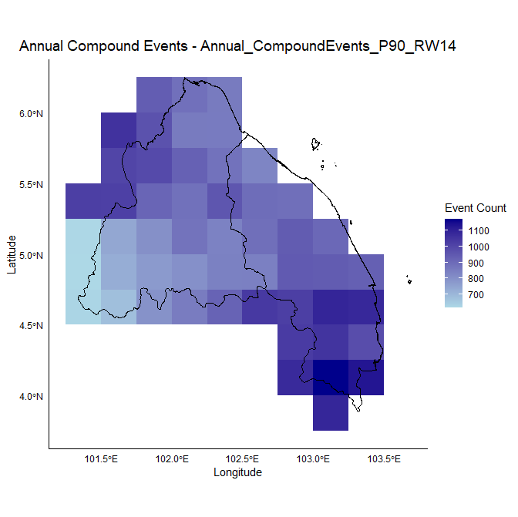
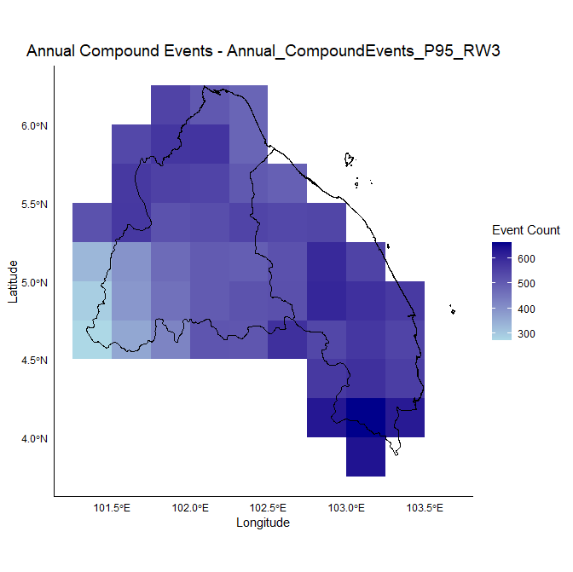
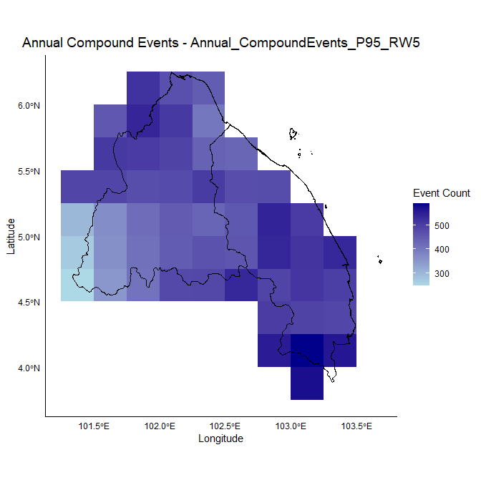
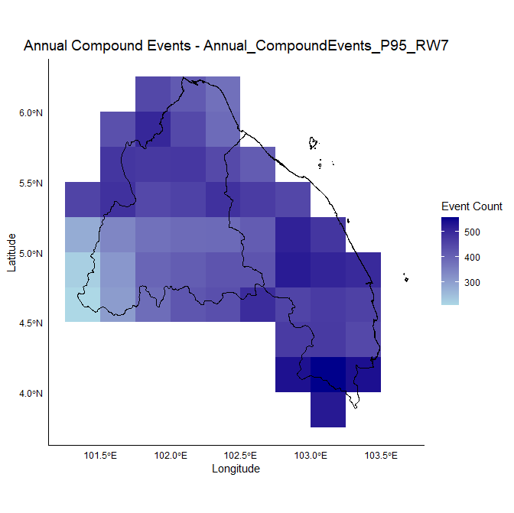







Compound event | SSP5-8.5
P90
P95
P95

Slide 22


La Niña?

Slide 23

SCS-type cold surge mostly appears in early winter
Abdillah, M.R et al. (2020). J. Clim..

Slide 24




Projecting the Future & Solution
Projected data
Human-level resolution data
Downscaling
Co-adaptation mapping

Slide 25

Projections of Compounded Extreme Rainfall Events under SSP5-8.5 from CMIP6 Models for Flood Risk Assessment in Kelantan and Terengganu, Malaysia
Terima Kasih
Government of Malaysia under the project UKM MONSUN (Grant Num. R.J130000.7713.4J776), administered by Universiti Kebangsaan Malaysia.
UTM Zamalah and Research Management Centre UTM (Grant No.Q.J130000.2522.14H84).

