Slide 1

Assessing RegCM’s Performance in Simulating Drought: A Case Study for Hungary
Tímea Kalmár
Eötvös Loránd University, Institute of Geography and Earth Sciences, Department of Meteorology, Budapest, Hungary (timea.kalmar@ttk.elte.hu)
Institute of Atmospheric Physics, Czech Academy of Sciences, Prague, Czechia
12th Workshop on the Theory and Use of Regional Climate Models
Trieste, Italy
29. 08. 2025

Slide 2
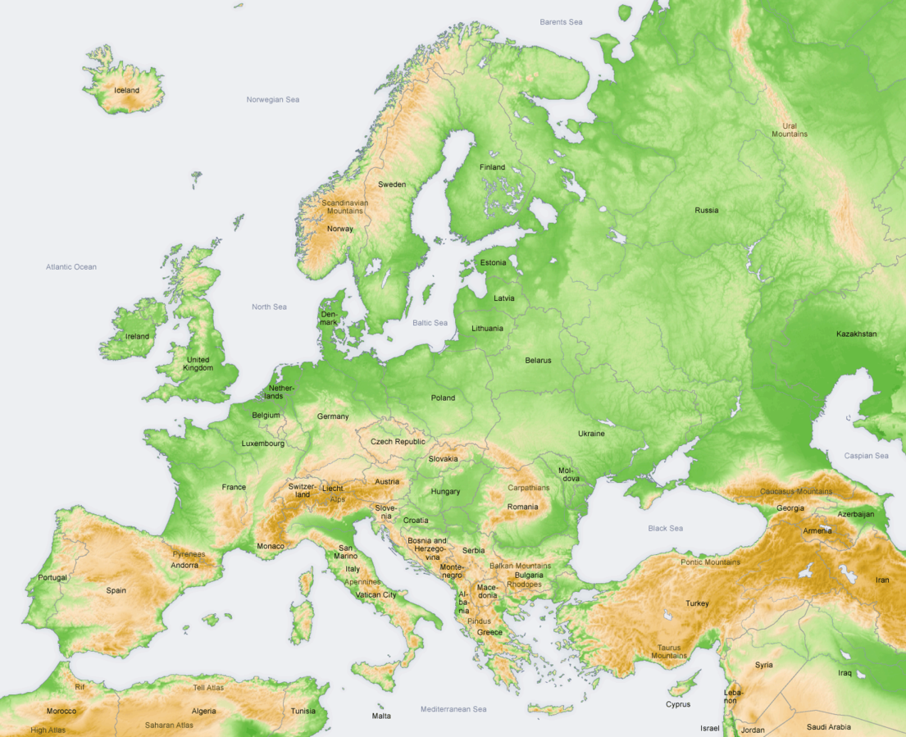
Motivations
Nearly 55% of Hungary’s area is agricultural
Droughts frequently
occur in Hungary and
cause major agricultural damage
Climate models help us understand possible future scenarios and predict drought risks
Testing climate models is essential

Slide 3
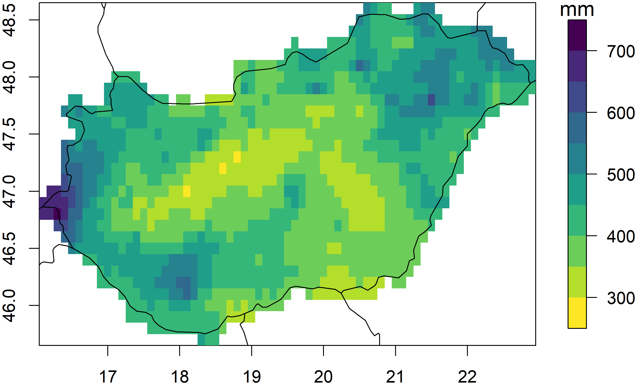
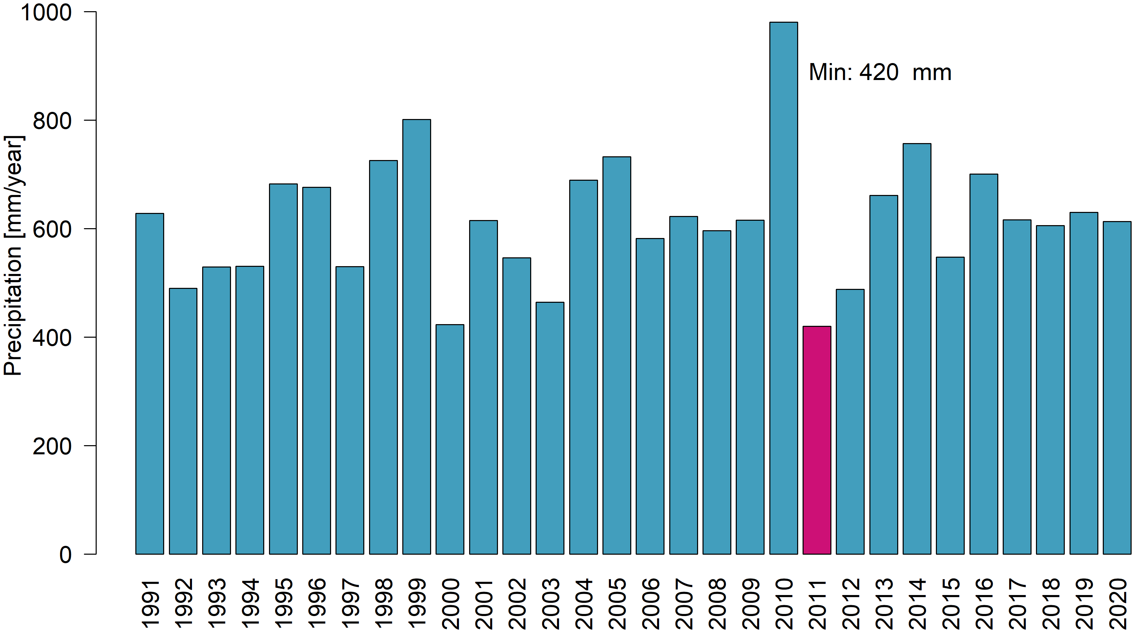
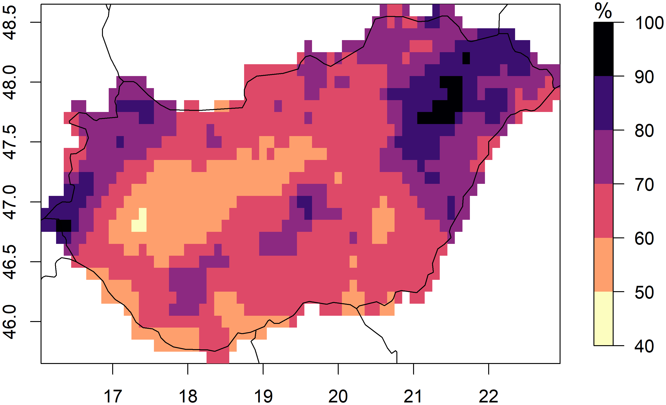
Motivations
Spatial distribution of the annual precipitation sum (2011)
2011 was the driest year in Hungary
since 1901
Relative to the 1991-2020 climate normal
Data source: HUCLIM (HMS – HungaroMet)

Slide 4

Methods and Data
Version:
RegCM4.7.1
Time period: 2011
(spin up: 2 years)
Boundaries:
ERA-Interim (0.75°)
Horisontal resolution:
10 km
24 simulations
(UW-WSM5 problem)
(2×2×3×2-6) → 18
Datasets for validation:
HUCLIM (0.1°)
CERRA-Land (5.5 km)
Physics schemes
Land surface scheme | BATS
 | CLM4.5
Moisture scheme | Modified SUBEX – SUB4.3
 | WSM5
Cumulus convection scheme | Grell (land)/Emanuel (ocean)
 | Kain-Fritsch
 | Tiedtke
PBL scheme | Holtslag
 | UW PBL
*
*
*
*

Slide 5
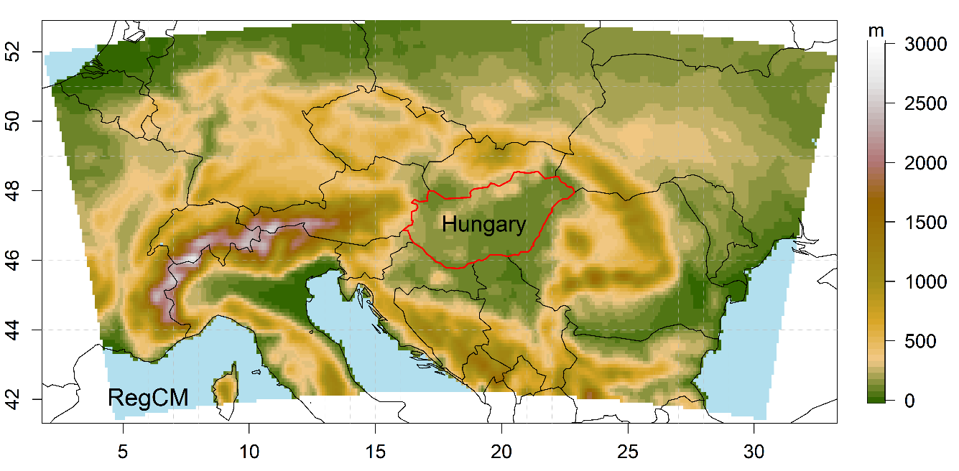
Domain for the simulations
# | Full name
1 | 01_BATS_SUB43_Grell_UW
2 | 02_BATS_SUB43_Grell_HO
3 | 03_BATS_WSM5_Grell_HO
4 | 04_BATS_SUB43_Tiedtke_UW
5 | 05_BATS_SUB43_Tiedtke_HO
6 | 06_BATS_WSM5_Tiedtke_HO
7 | 07_BATS_SUB43_KF_UW
8 | 08_BATS_SUB43_KF_HO
9 | 09_BATS_WSM5_KF_HO
10 | 10_CLM_SUB43_Grell_UW
11 | 11_CLM_SUB43_Grell_HO
12 | 12_CLM_WSM5_Grell_HO
13 | 13_CLM_SUB43_Tiedtke_UW
14 | 14_CLM_SUB43_Tiedtke_HO
15 | 15_CLM_WSM5_Tiedtke_HO
16 | 16_CLM_SUB43_KF_UW
17 | 17_CLM_SUB43_KF_HO
18 | 18_CLM_WSM5_KF_HO

Slide 6
Temperature bias
(2011)
BATS
RegCM is sensitive to the choice of scheme combinations
The choice of land surface scheme and the choice of boundary layer scheme have a significant impact on the evolution of temperature values
The effect of the other scheme types (microphysical scheme, convective scheme) is not clear, it
depends on the choice of the other schemes
CLM4.5

Slide 7
Temperature bias
(2011)
RegCM is sensitive to the choice of scheme combinations
The choice of land surface scheme and the choice of boundary layer scheme have a significant impact on the evolution of temperature values
The effect of the other scheme types (microphysical scheme, convective scheme) is not clear, it
depends on the choice of the other schemes
UW
Holtslag

Slide 8
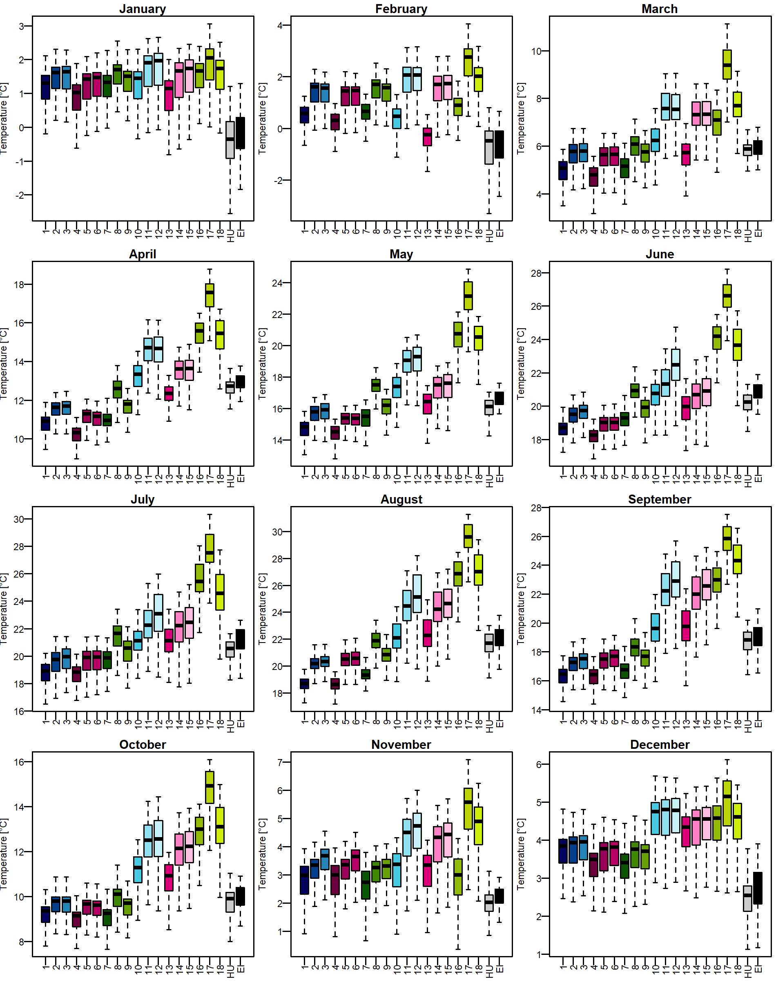
Temperature – monthly values (2011)
Box-Whiskers plots of monthly temperature values ​​
Similarity between ERA-Interim and HUCLIM
Boundary layer scheme effect is observed throughout the year
The effect of the land surface scheme is the largest in summer and autumn

Slide 9
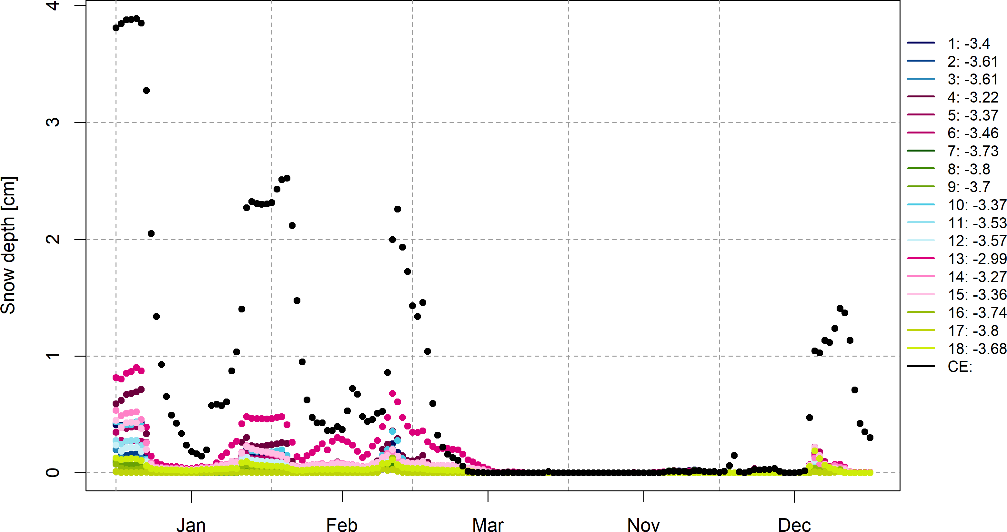
Daily snow depth (2011)
Reference:
CERRA-Land
RegCM simulations underestimate snow depth in Hungary

Slide 10
Precipitation bias (2011)
Grell
Tiedtke
The choice of the convective precipitation scheme has a significant impact on the precipitation
The choice of the land surface scheme is secondary
The effect of the other scheme types (microphysical scheme, boundary layer scheme) is not clear, it depends on the choice of the other schemes
KF
Grell
Tiedtke
KF
Notes:
Majd bejelölni a szimulációkat aszerint, hogy melyik séma szerint értékelem

Slide 11
Precipitation bias (2011)
BATS
The choice of the convective precipitation scheme has a significant impact on the precipitation
The choice of the land surface scheme is secondary
The effect of the other scheme types (microphysical scheme, boundary layer scheme) is not clear, it depends on the choice of the other schemes
CLM4.5
Notes:
Majd bejelölni a szimulációkat aszerint, hogy melyik séma szerint értékelem

Slide 12
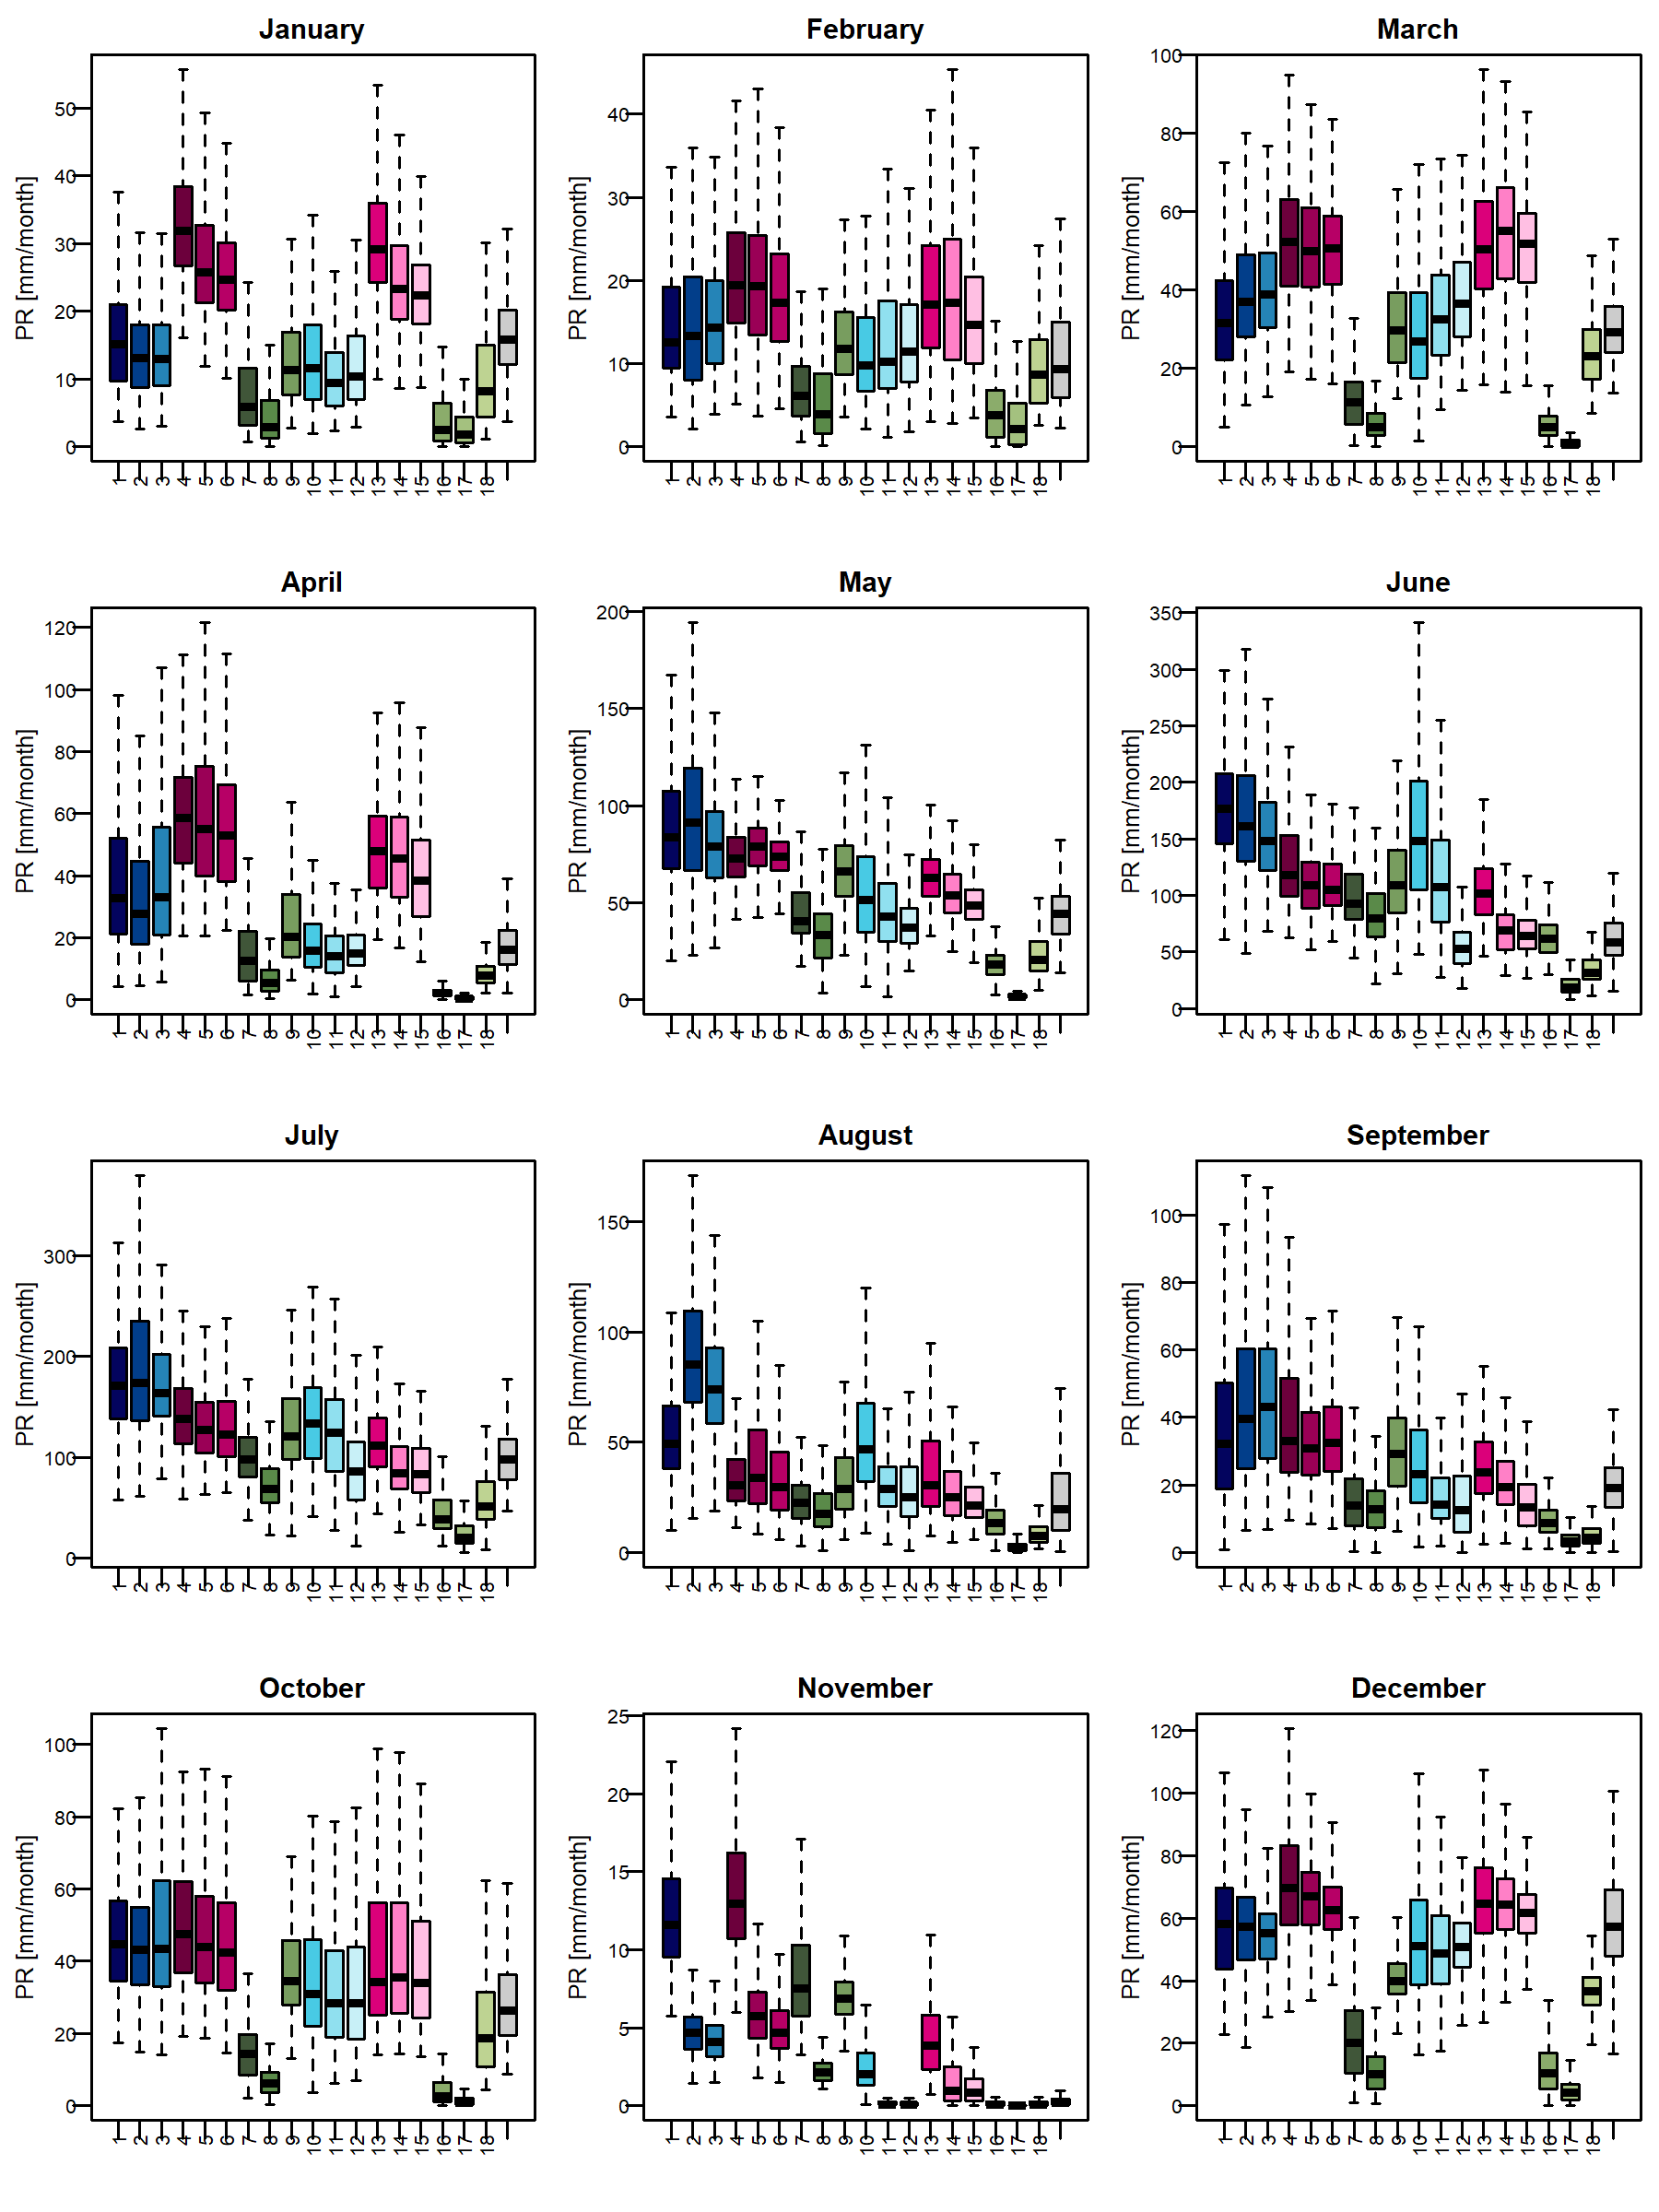
Monthly precipitation (2011)
The choice of the convective precipitation scheme has a significant impact on the precipitation values
The choice of the land surface scheme is secondary
The effect of the other scheme types (microphysical scheme, boundary layer scheme) is not clear, it depends on the choice of the other schemes
Notes:
Majd bejelölni a szimulációkat aszerint, hogy melyik séma szerint értékelem

Slide 13
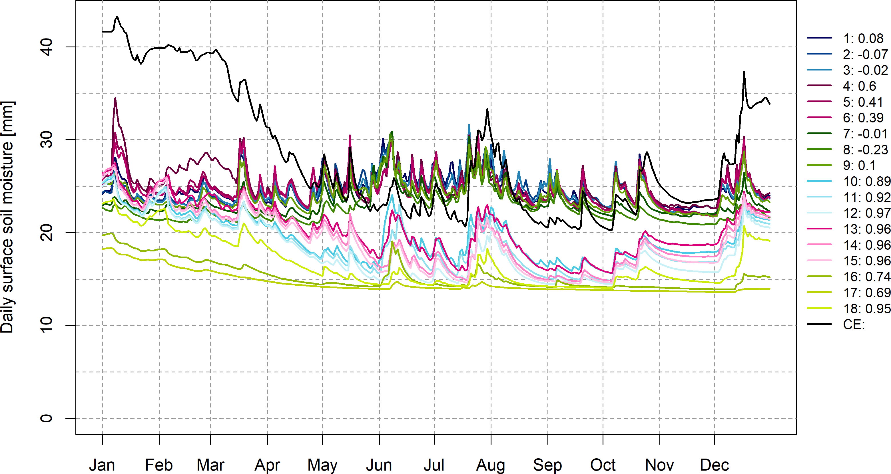
Daily surface soil moisture (10 cm)
Underestimation in winter
Simulation using BATS could capture the magnitude of
CERRA-Land
Simulations using
CLM4.5 underestimate values, but the correlation is high with CERRA-Land

Slide 14
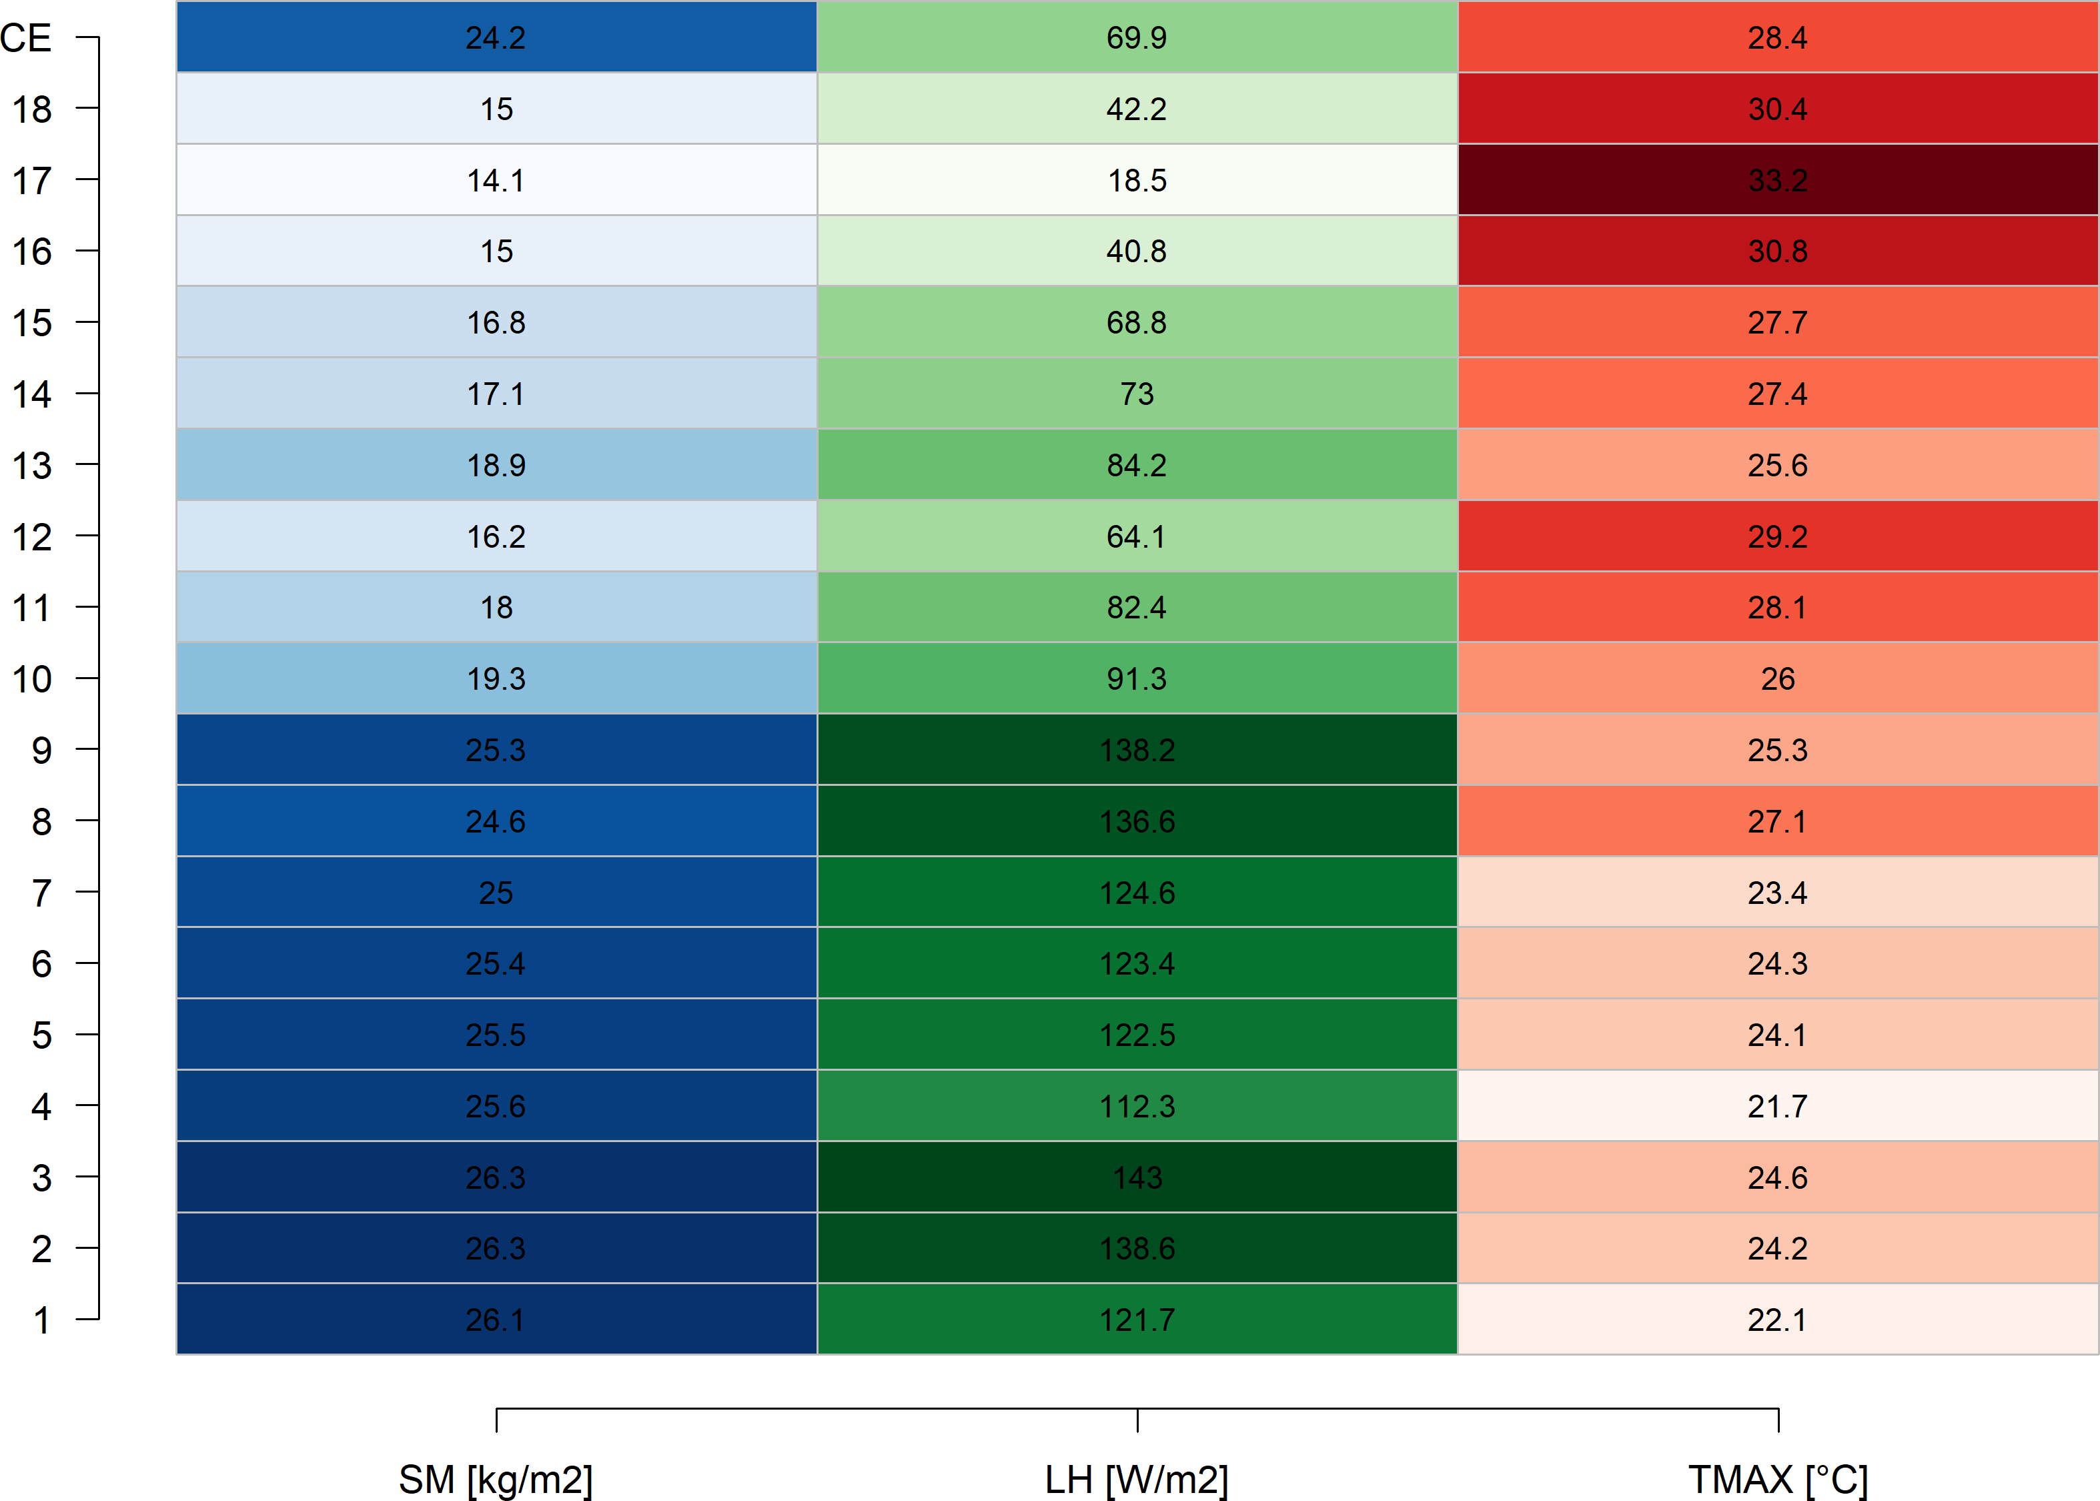
Summer values (JJA)
CLM4.5
Surface Soil moisture (SM)
Latent heat (LH)
Maximum temperature
(TMAX)
BATS

Slide 15
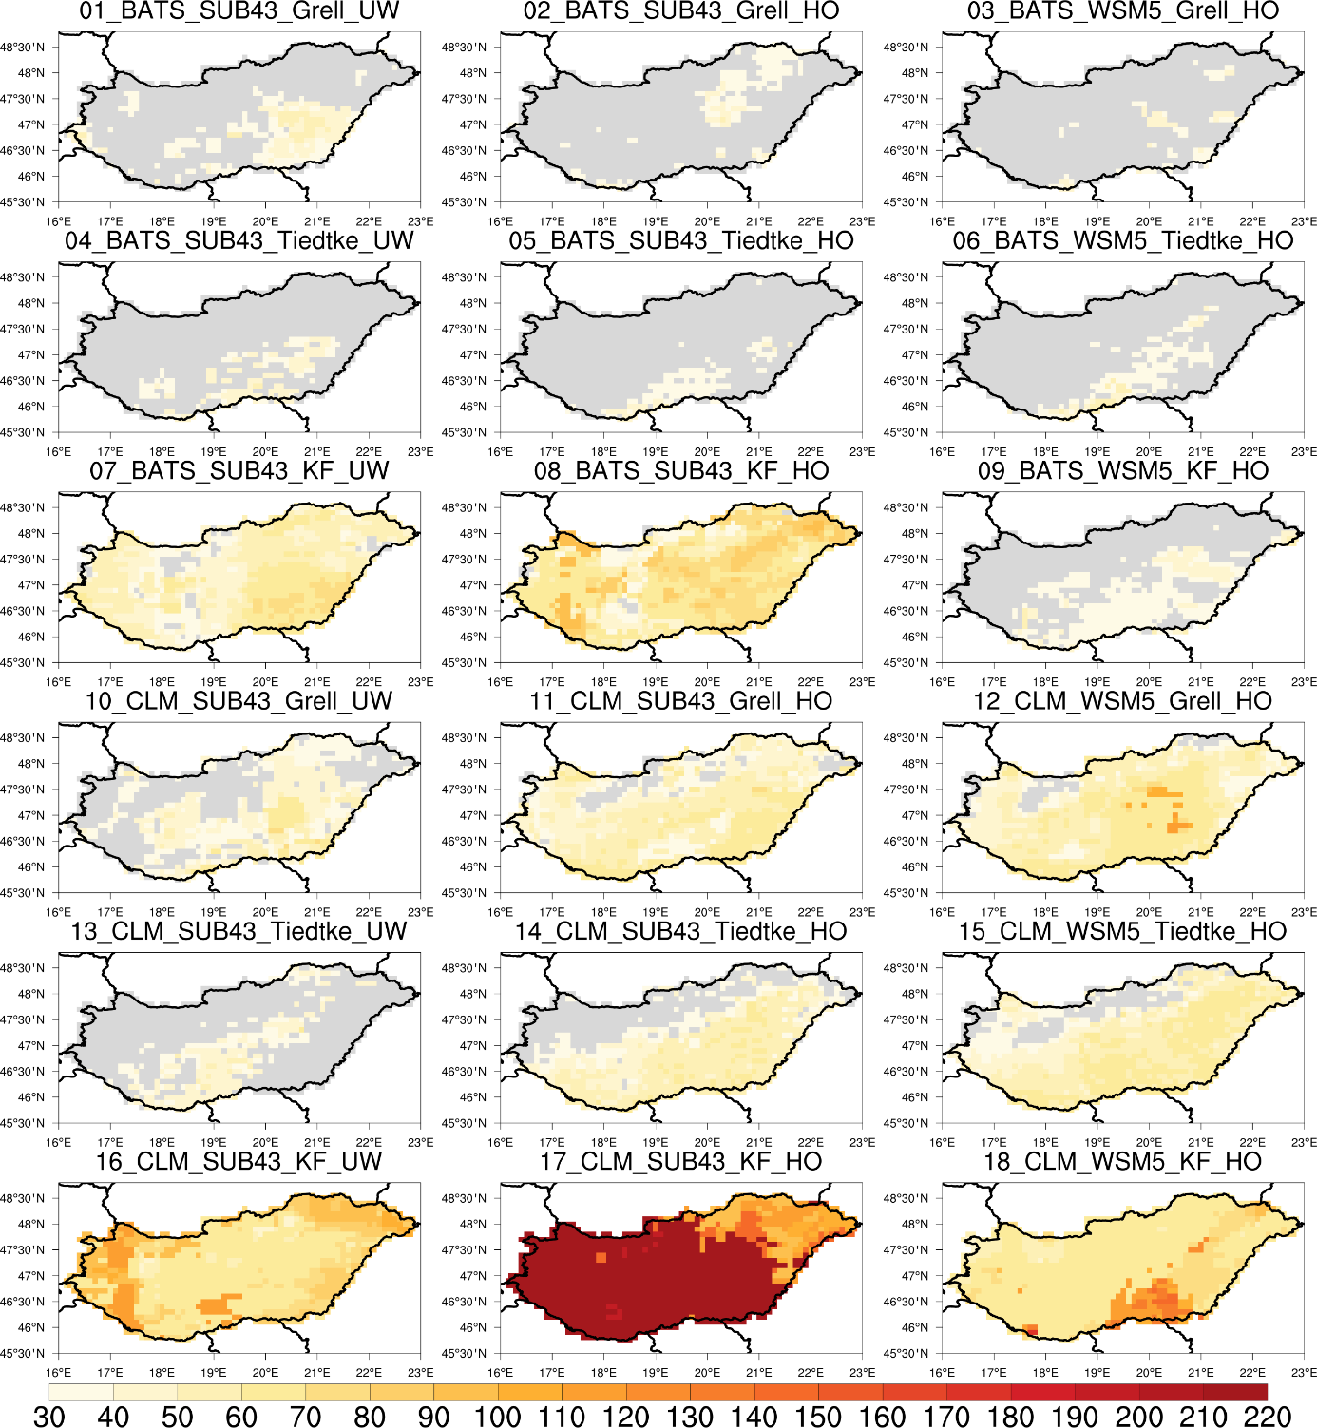
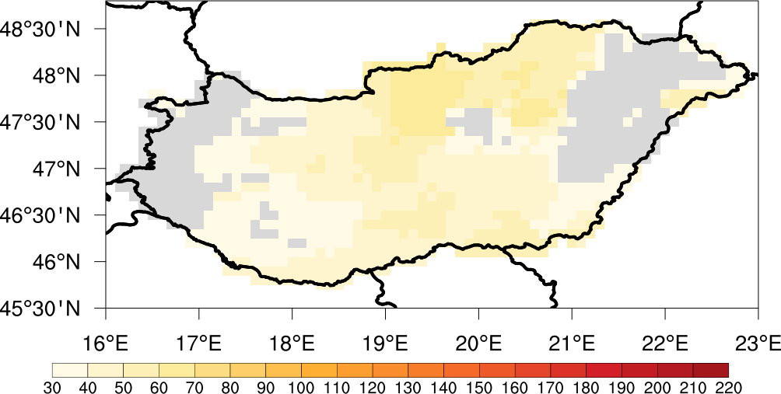
Drought (2011)
Legal definition of drought in Hungary:
an event during which, within the 30 consecutive days of the vegetation period of a particular plant, at the location of risk,
(a) the total amount of precipitation is below 10 mm, or
(b) the total amount of precipitation is below 25 mm, and the daily maximum temperature is higher than 31 °C for at least 15 days
Vegetation period: March-September
Maximum number of days when any of the conditions is met
HUCLIM
day

Slide 16
Summary
We tested different parameterisation schemes over Hungary in a dry condition
RegCM is very sensitive to the choice of parameterisation scheme combinations, so testing is essential
The precipitation values strongly depend on the choice of the convective scheme, while the choice of the surface land surface model is secondary
The temperature values strongly rely on the choice of the land surface model, and the influence of the boundary layer scheme is also observed
Although the BATS is simpler than CLM4.5, it provided better results in many cases
Results show there is no wrong scheme, just the wrong combination

Slide 17
Thank you for your attention!
The research was funded by the National Multidisciplinary Laboratory for Climate Change,
RRF-2.3.1-21-2022-00014 project.

