Slide 1
Climate Change Projections over High Latitudes Northern Asia Using a Regional Climate Model
Xuejie GAO¹, Xianbing Tang¹, Zhenyu Han²
1. Institute of Atmospheric Physics, Chinese Academy of Sciences, Beijing, China
2. National Climate Center, China Meteorological Administration, Beijing 100081, China
12th Workshop on the Theory and Use of Regional Climate Models
25 August - 5 September 2025, Trieste, Italy

Slide 2
  1. Motivation
    NAS spans a wide longitude range and various climate zones, with extensive snow and permafrost cover, is one of the most vulnerable and sensitive areas to global warming.
    Lies upstream of weather and climate systems for East Asia, in particular during the winter months.
    Relatively less studied.
    ……(others).
Notes:
In the QM method a transfer function (TF) depending on the quantile distribution is first established by matching daily values in present day simulations with observations during a reference period. This is then applied to other periods of the model simulations.

Slide 3
2. Method, experimental design, and data
  The Abdus Salam International Center for Theoretical Physics (ICTP) Regional Climate Model RegCM5, 25km×25km, L18
  Model Physics: CLM4.5; PBL UW; TDK convection scheme; WSM5 micro-physics + Xu-Randall cloud fraction; CCM3 radiation
  Driven by three CMIP6 models:
  EC-Earth3-Veg, MPI-ESM1-2-HR, NorESM2-MM
  Present day: 1995–2014, Future: 2080–2099 (+2 years spin-up)
  Mid-level emission pathway: SSP2-4.5
  Observation:
  CN05.1 + (APHRODITE + GPCP , precipitation) + CPC (temperature); ERA5
  ensG: ensemble mean of the GCMs; ensR: ensemble mean of RegCM5

Slide 4
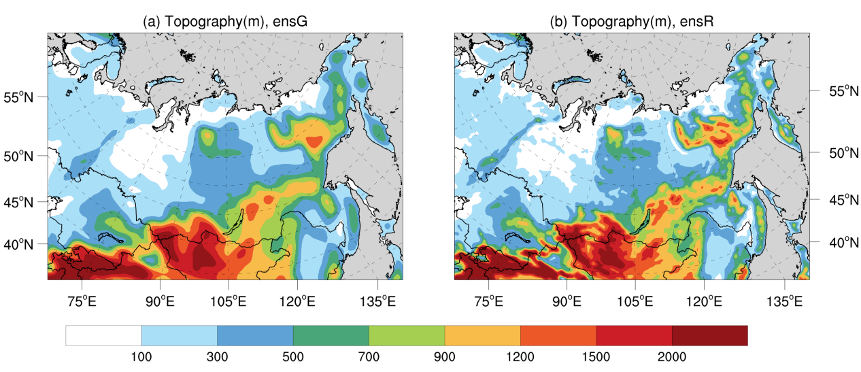
Model domain and topography (m) of the average of the GCMs and RegCM5

Slide 5
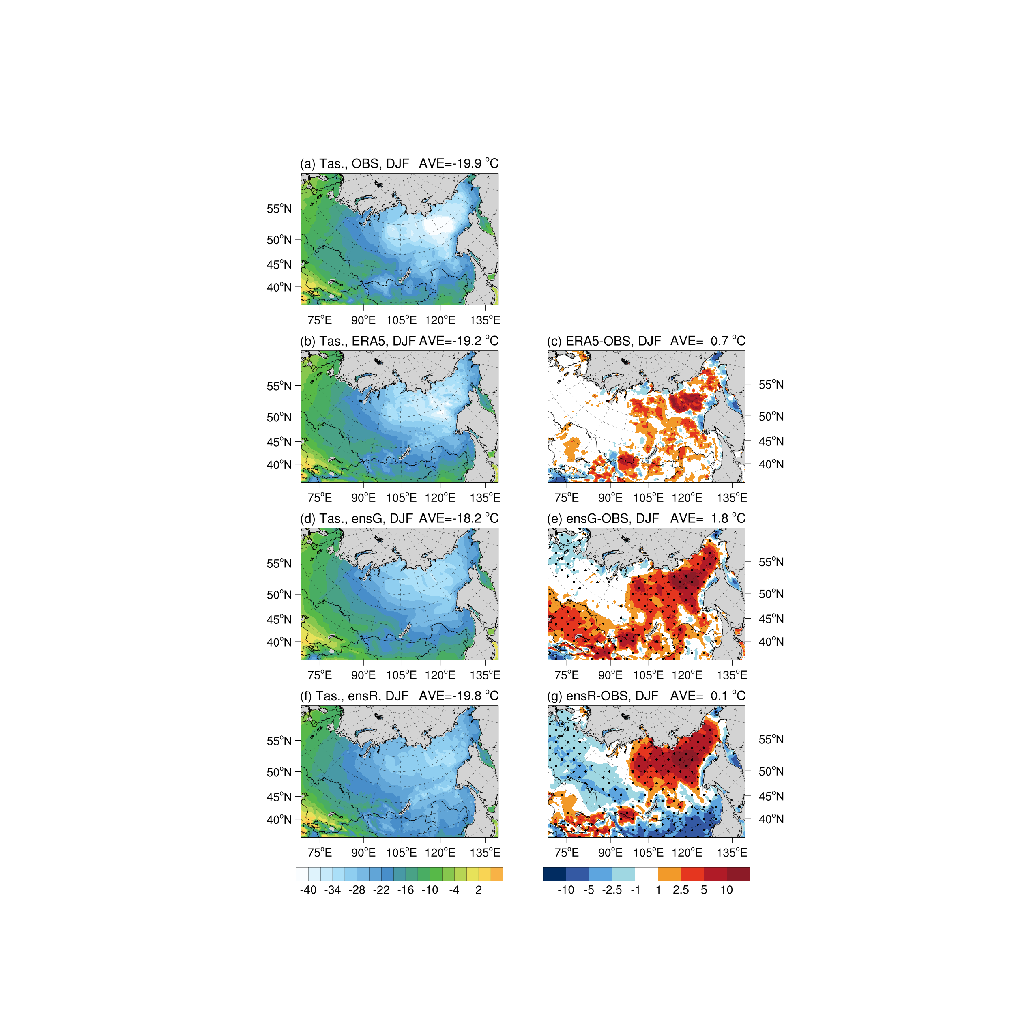
3. Results
DJF ensemble mean temperature and biases during the present day (ºC)

Slide 6
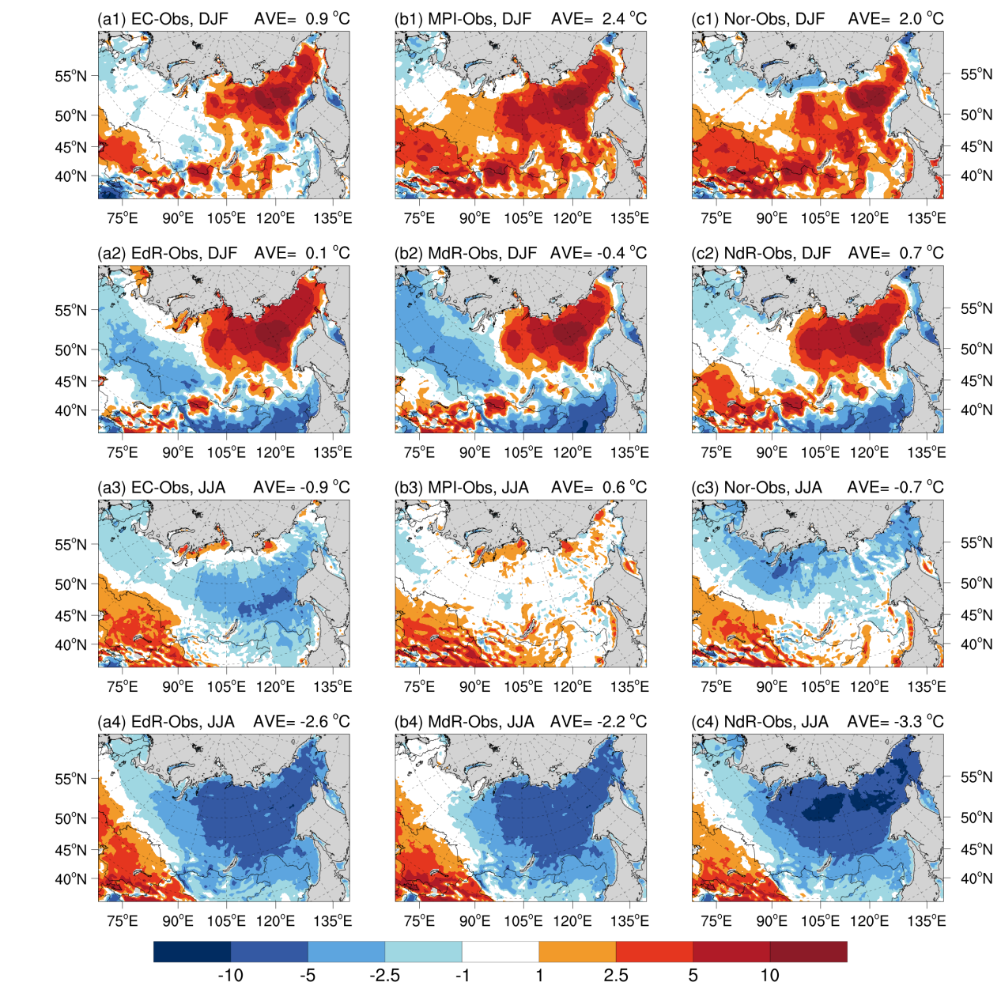
DJF temperature biases from individual models during the present day (ºC)
EC: EC-Earth3-Veg, MPI: MPI-ESM1-2-HR, Nor: NorESM2-MM
EdR: RegCM5 driven by EC, MdR: RegCM5 driven by MPI, NdR: RegCM5 driven by Nor

Slide 7
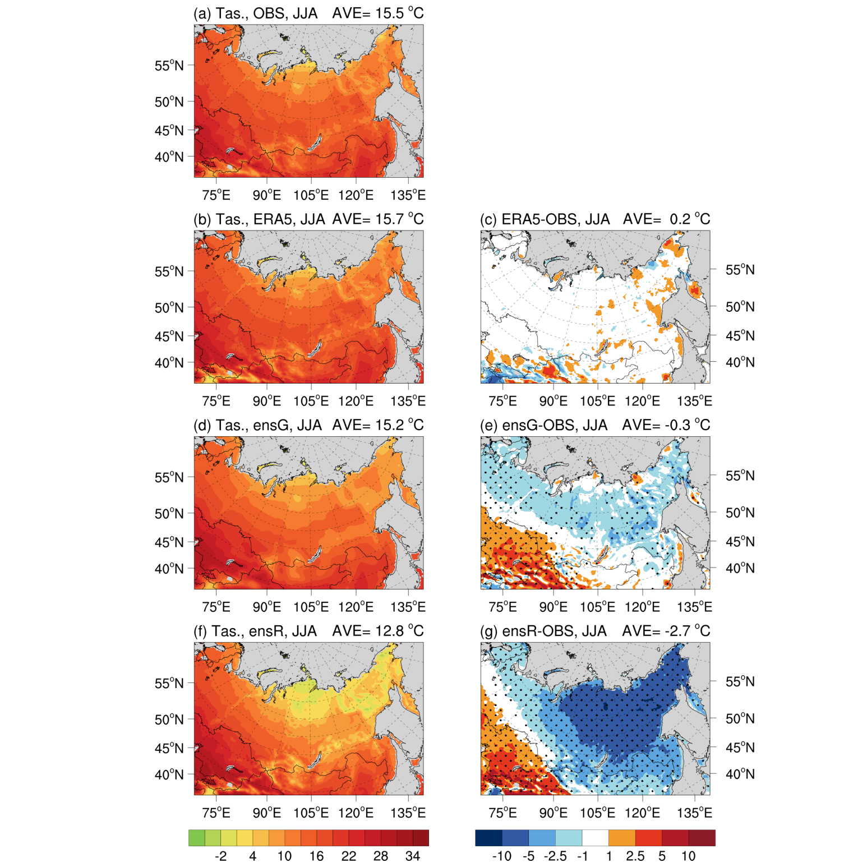
JJA ensemble mean temperature and biases during the present day (ºC)

Slide 8
JJA temperature biases from individual models during the present day (ºC)

Slide 9
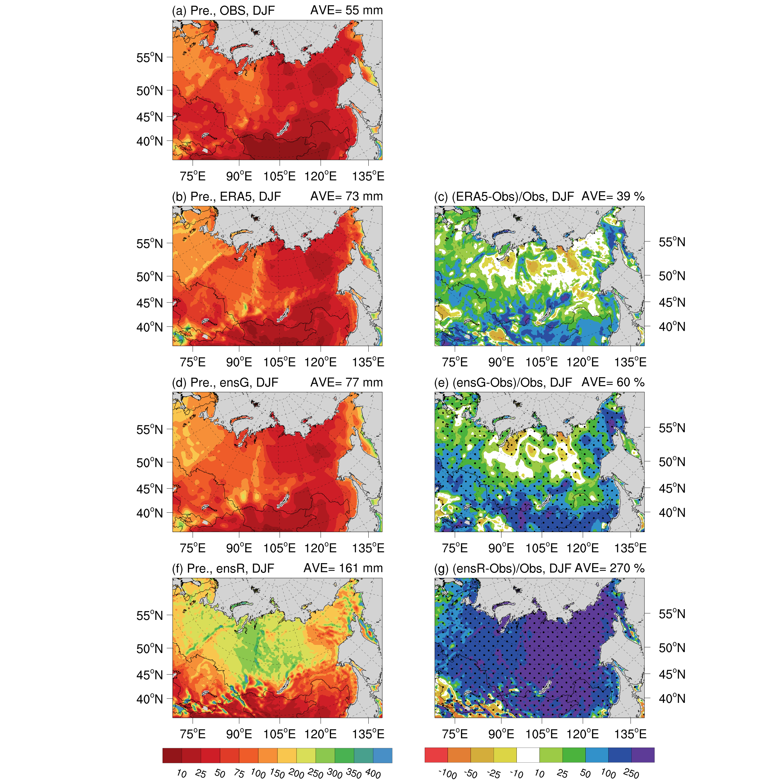
DJF mean precipitation and biases during the present day (mm/%)

Slide 10
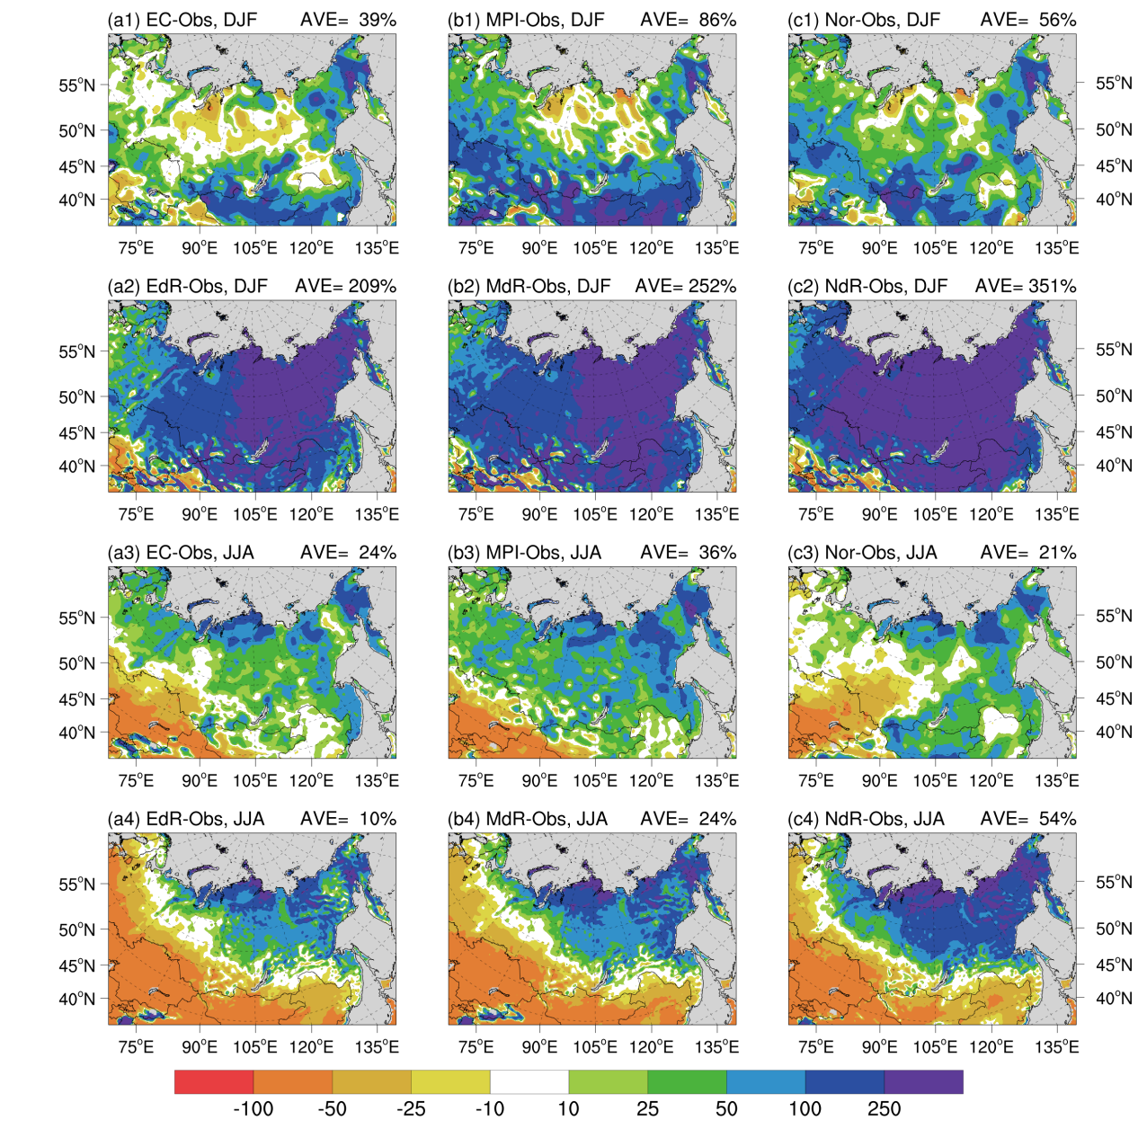
DJF precipitation biases from individual models during the present day (%)

Slide 11
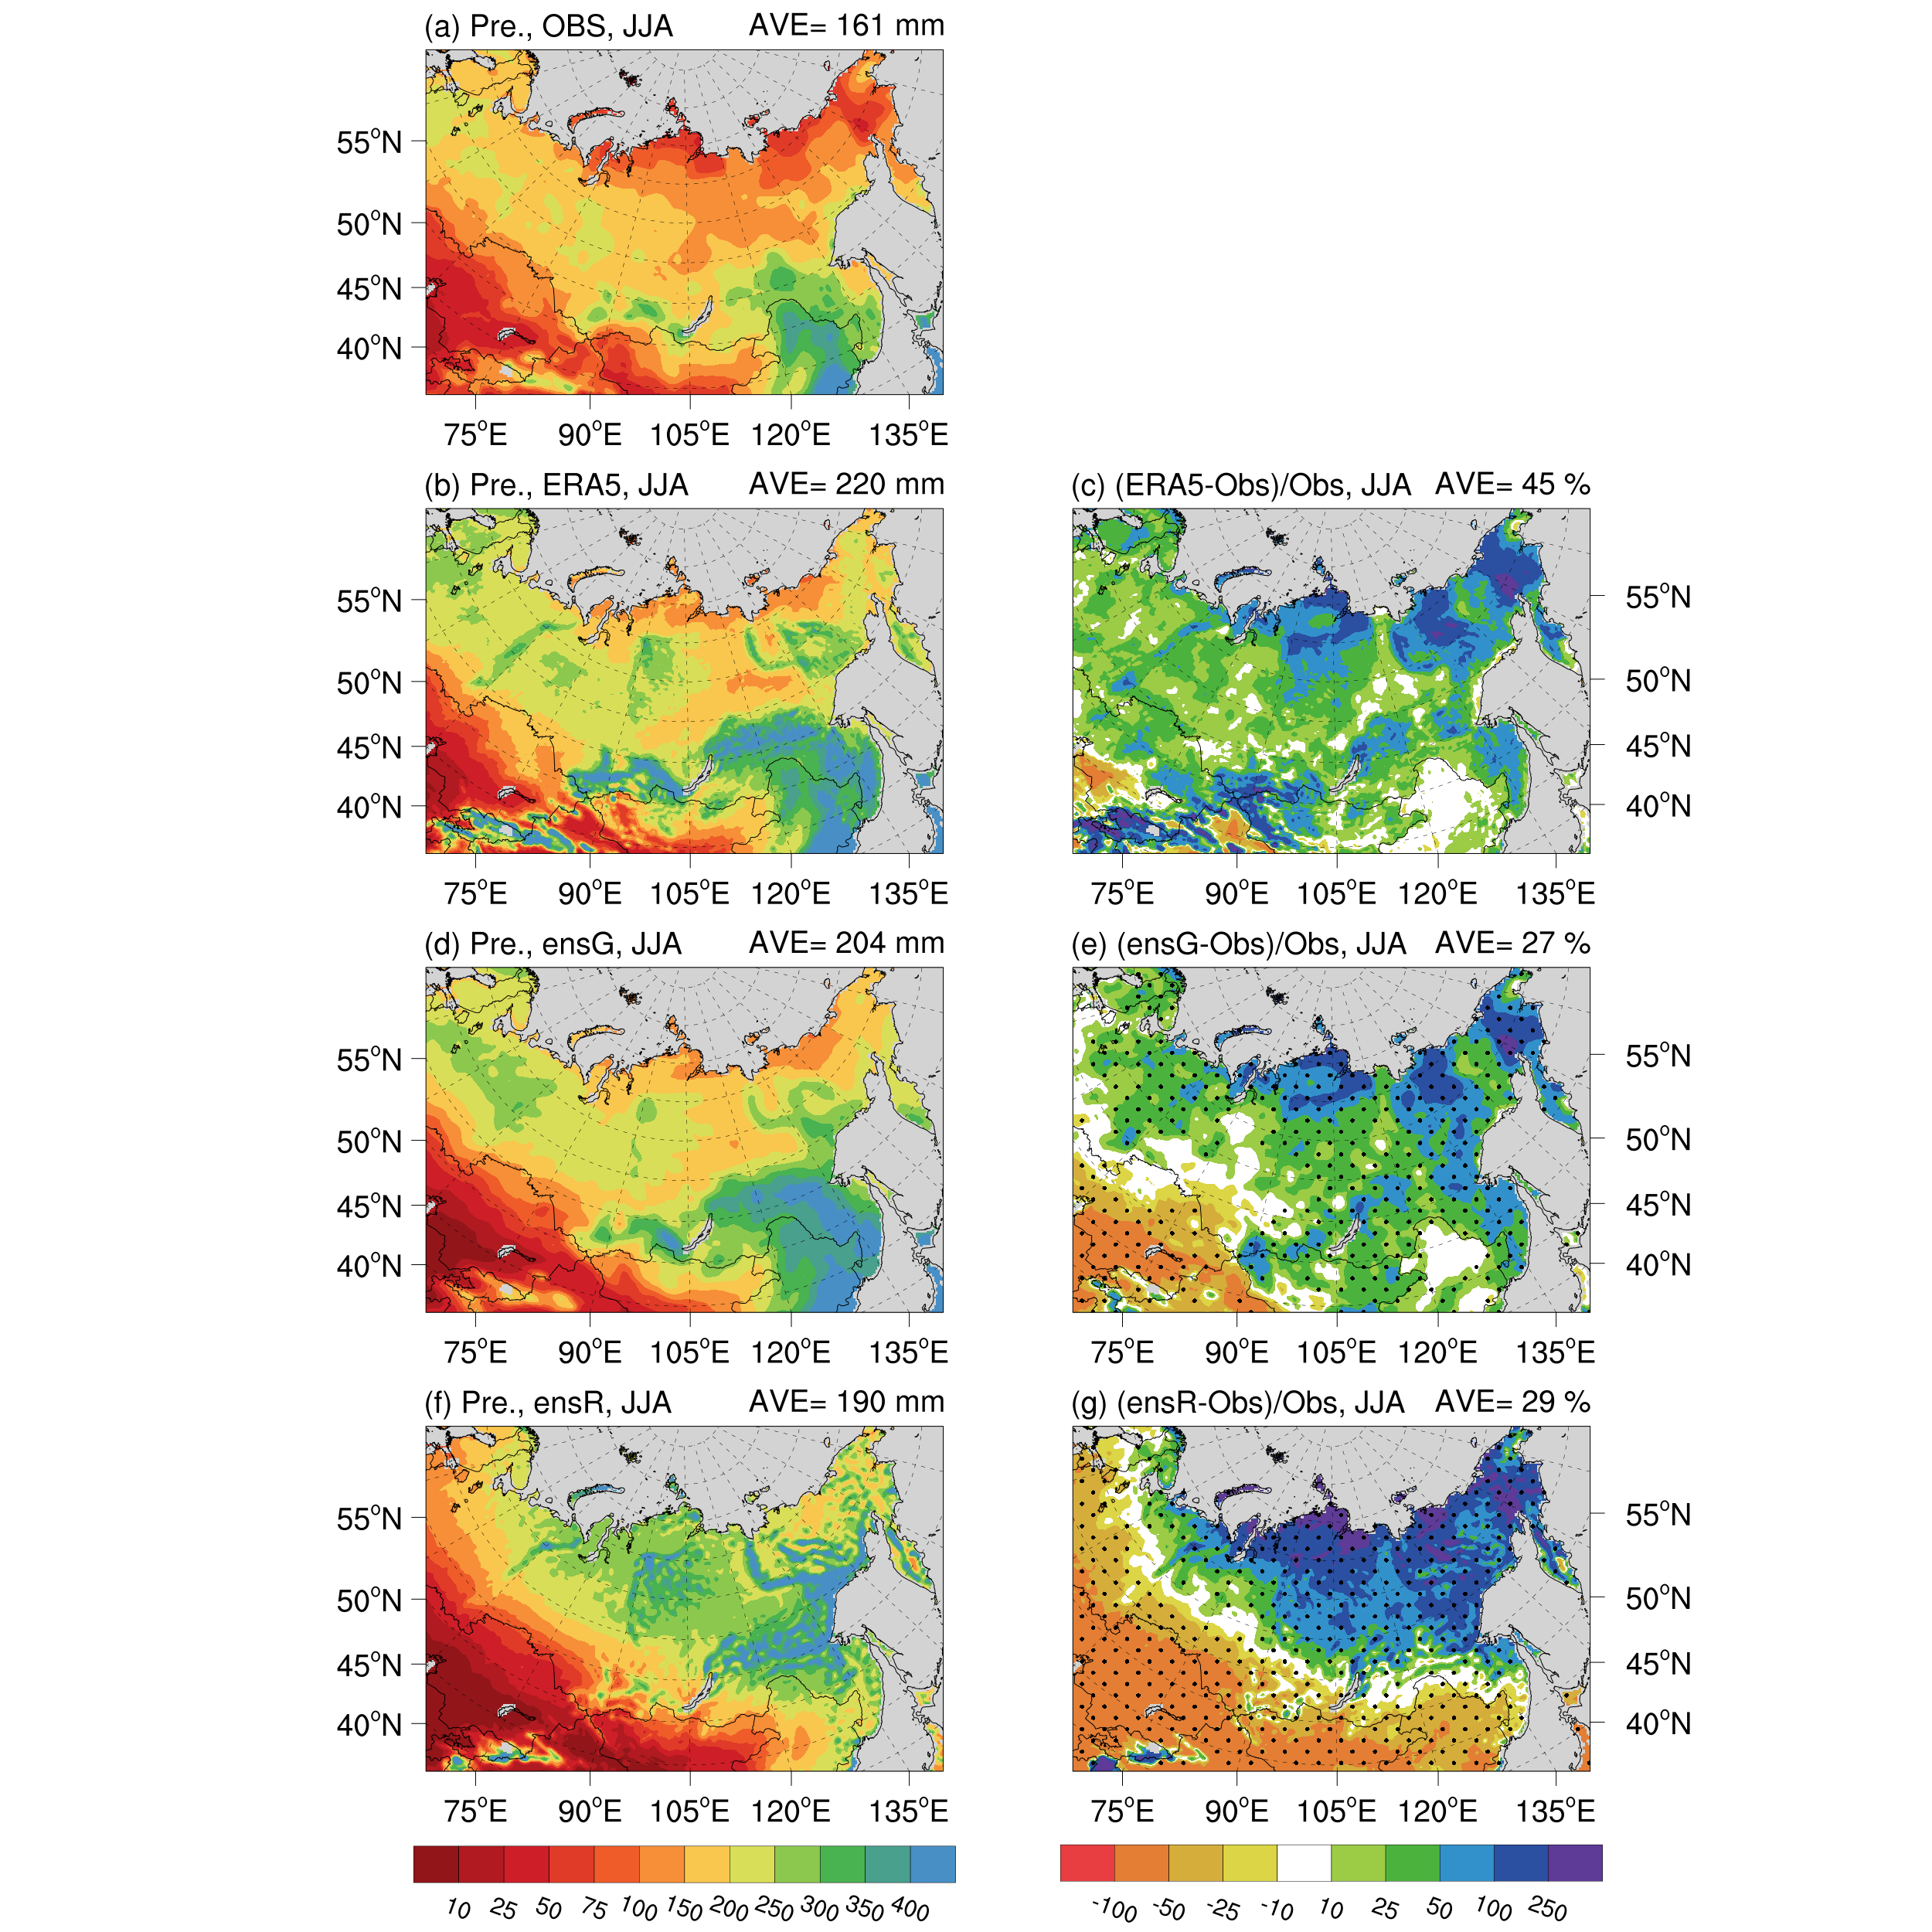
JJA mean precipitation and biases during the present day (mm/%)

Slide 12
JJA precipitation biases from individual models during the present day (%)

Slide 13
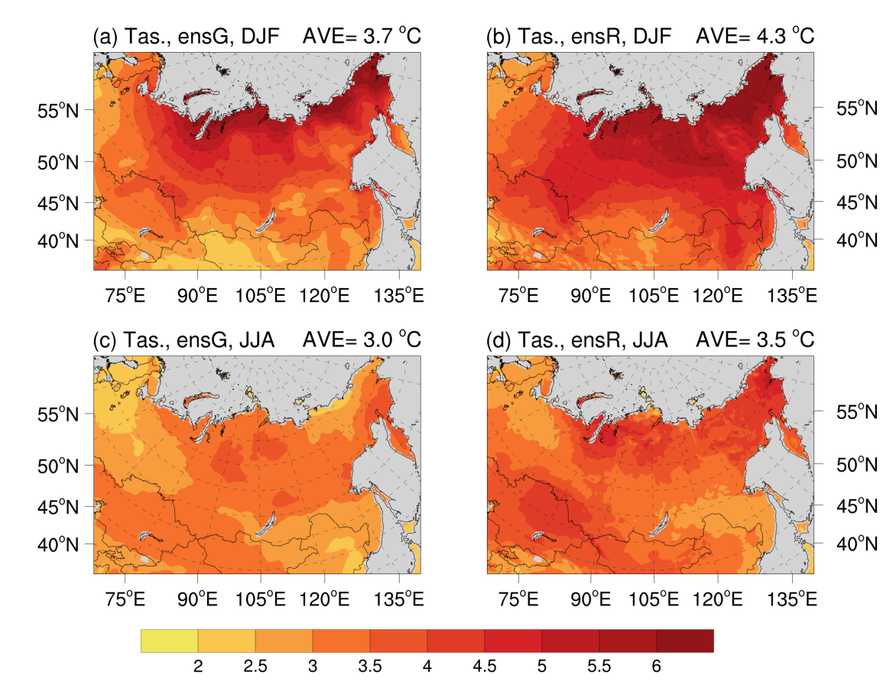
Ensemble mean changes of temperature in DJF and JJA (ºC)

Slide 14
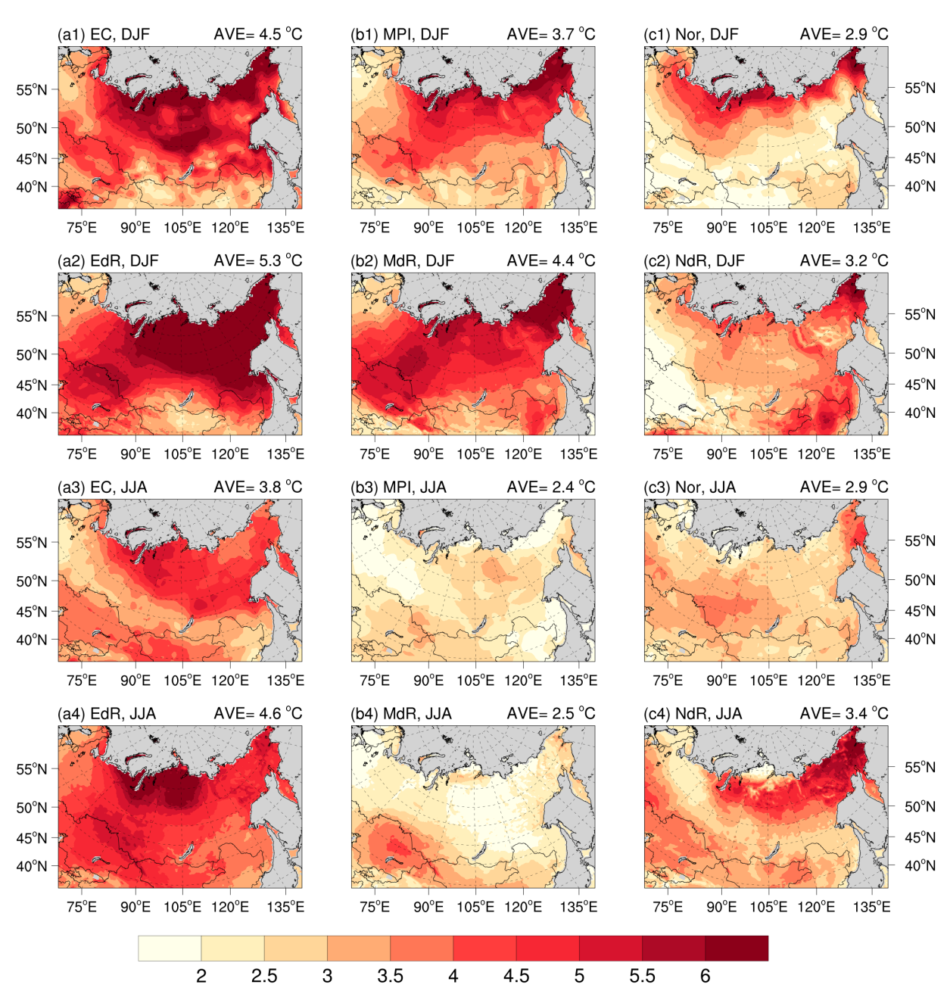
Changes of temperature in DJF and JJA for individual models (ºC)

Slide 15
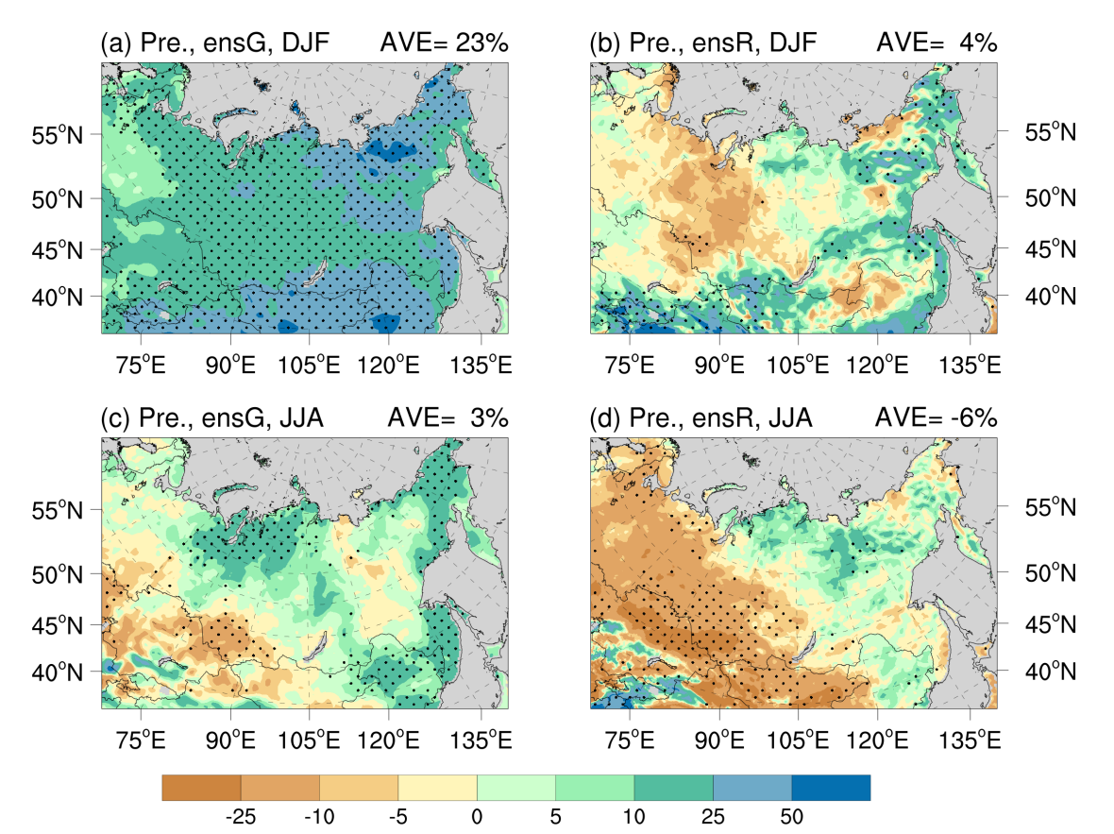
Future changes of precipitation in DJF and JJA (%)

Slide 16
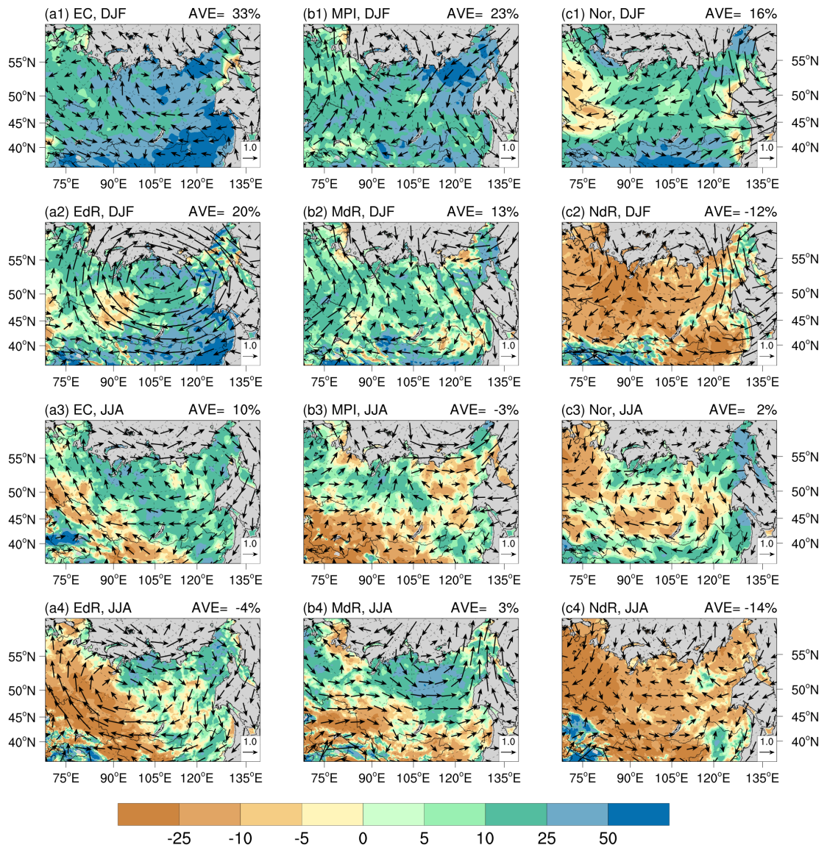
Changes of precipiation in DJF and JJA for individual models (%)

Slide 17
4. Conclusions and discussions
The models show large warm biases in the coldest regions in DJF.
Large cold biases is found in JJA in RegCM5 simulations.
The models are wet in northeastern part of the region, more pronounced in DJF and RegCM5.
Significant warming in the future, with greater magnitude in the northern part and in DJF. RegCM5 projected a greater warming compared to the driving GCMs.
Precipitation changes show large differences between the GCMs and RegCM5. Regional mean change in DJF for them are 23%/4%, and in JJA are 3%/-6%.
A region very difficult to reproduce the present climate well…
The data are available at ScienceDB (https://doi.org/10.57760/sciencedb.20250).

Slide 18

Thank you!

