Slide 1
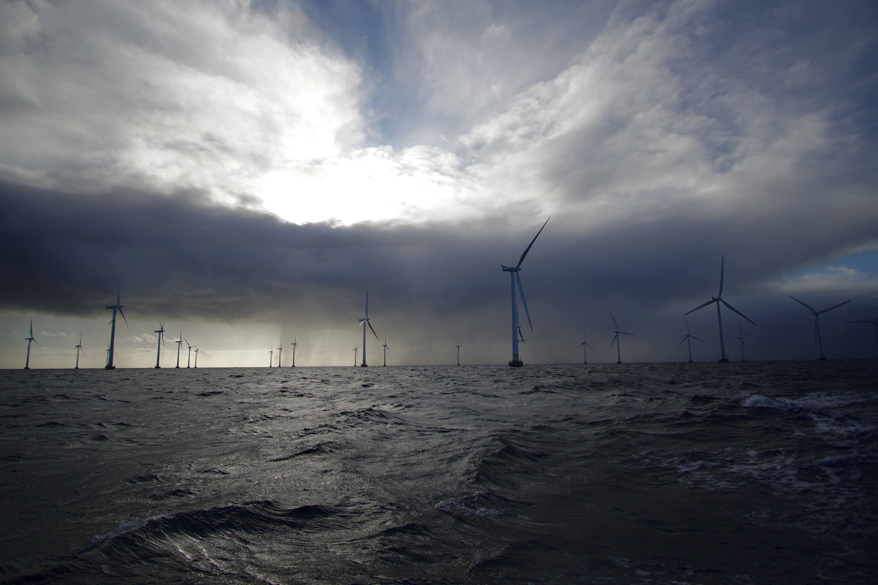
Advancing wind and solar energy assessments with Regional Climate Simulations
Graziela Luzia, Erika Coppola
International Centre for Theoretical Physics
12th Workshop on the Theory and Use of Regional Climate Models
September 2nd 2025
Lillgrund Wind Farm | Author’s own photo

Slide 2
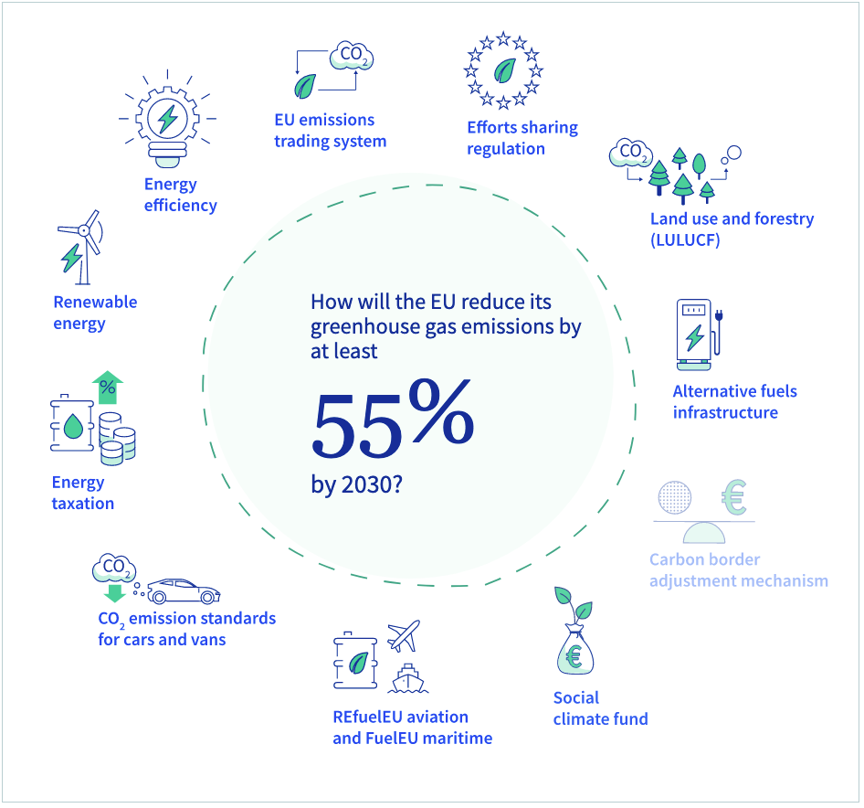
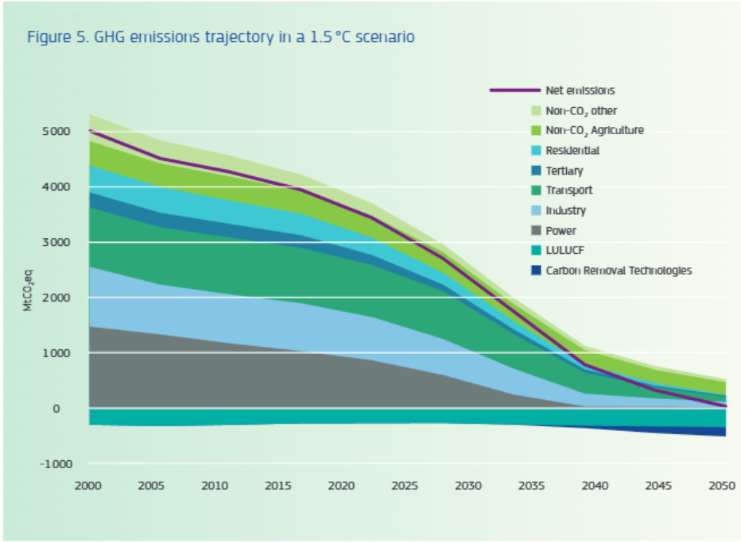
The need for decarbonization
Example of EU goals
“Achieving climate neutrality by 2050, meaning net-zero greenhouse gas (GHG) emissions.”
“Reducing GHG emissions by at least 55% by 2030, compared to 1990 levels.”
Source: op.europa.eu
POWER
Source: renewable-carbon.eu/
- FOSSIL FUELS
+ RENEWABLES
+ “ELECTRIFICATION”
+ “SECTOR COUPLING”

Slide 3
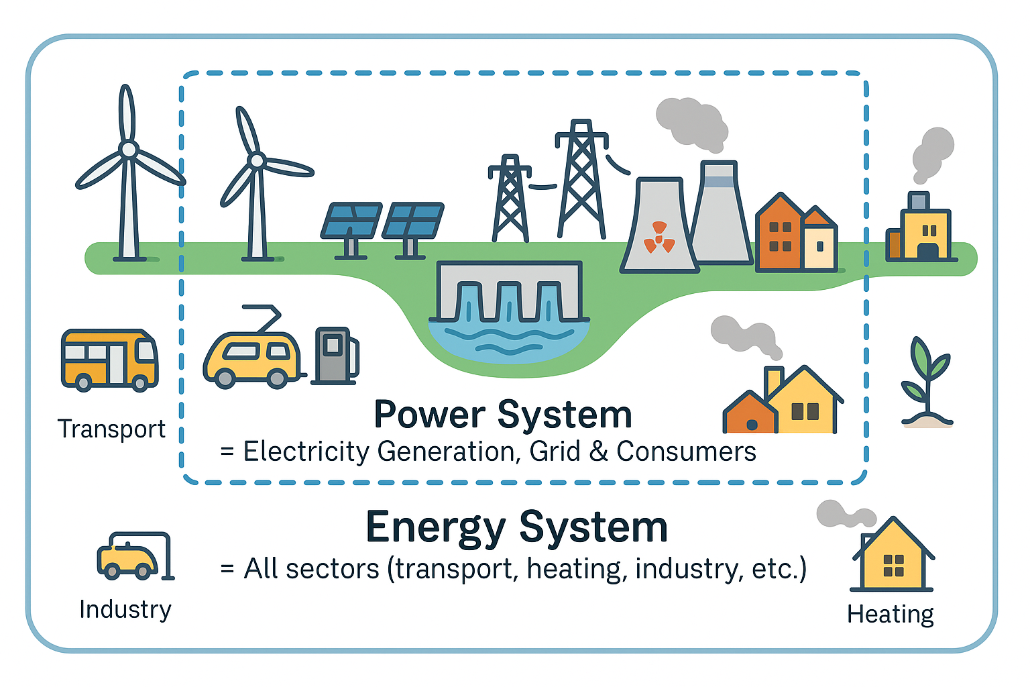
Power and Energy Systems
Power and energy systems are the networks and infrastructures that produce, deliver, and use energy in all its forms, including electricity, heat, fuels, and transport.
Electrification and sector coupling mean replacing fossil fuels with electricity and linking sectors like transport, heating, and industry so they work together in a more efficient, and low-carbon system
Source: ChatGPT creation
Notes:
Sector coupling meaning the coupling of our power systems, which includes the electricity generation and the end users, our houses and electric cars etc, with the entire energy system. This means that components of the energy system that are not usually powered by electricity (such as public transport and district heating) should replace their energy sources by electricity generate by cleaner sources. This requires a lot of renewables in the power grids.

Slide 4
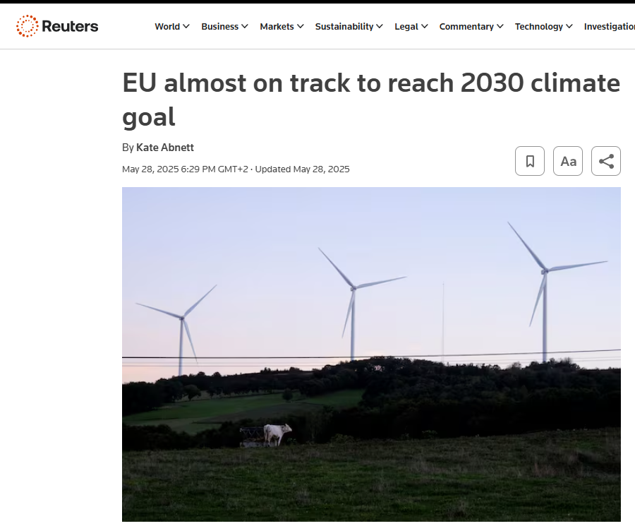
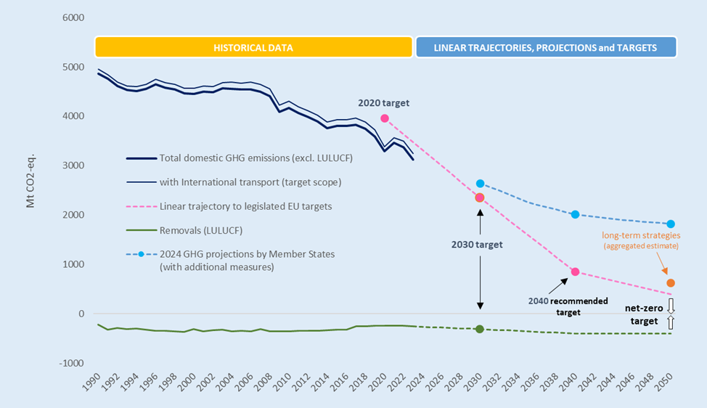
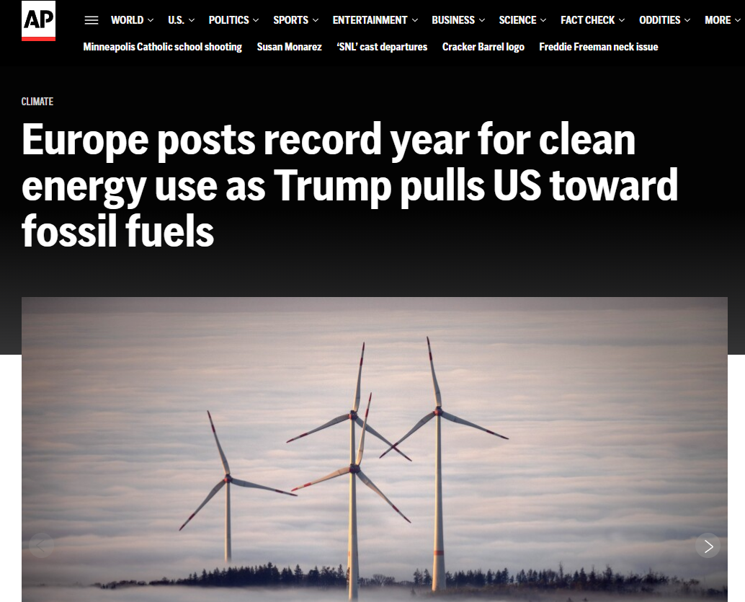
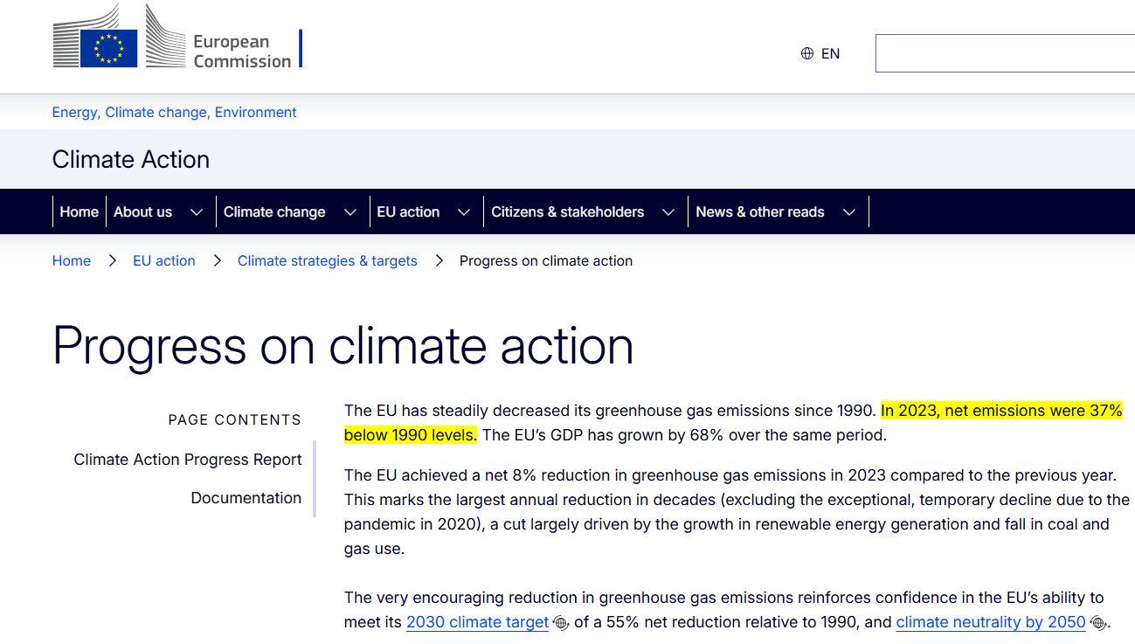
Source: reuters.com/
1 INTRODUCTION
Energy transition in course
“In 2023, EU GHG emissions were 37% below 1990 levels, reflecting the strongest annual reduction since the pandemic.”
Source: climate.ec.europa.eu
Source: apnews.com/
“EU is almost on track to meet its 2030 target, with current policies projected to reduce emissions by about 54%”.
Source: op.europa.eu
“In 2024, nearly 47% of electricity generation came from renewable sources.”
But there is still a long way to reach the net-zero goal by 2050.
Notes:
In case you asking yourself where is the European union in terms of the 2030 goal, as it is almost here already. It’s been reported as “very close”, with last report saying something like 54% already last year.
This changes were manly pushed by the increase in the share of renewables, as it was reported that Renewables accounted for approximately 47% of total electricity generation in 2024.—solar alone contributed 11%, and wind surpassed gas for the second consecutive year.
But theres still a long way to reach net zero goal in 2050

Slide 5
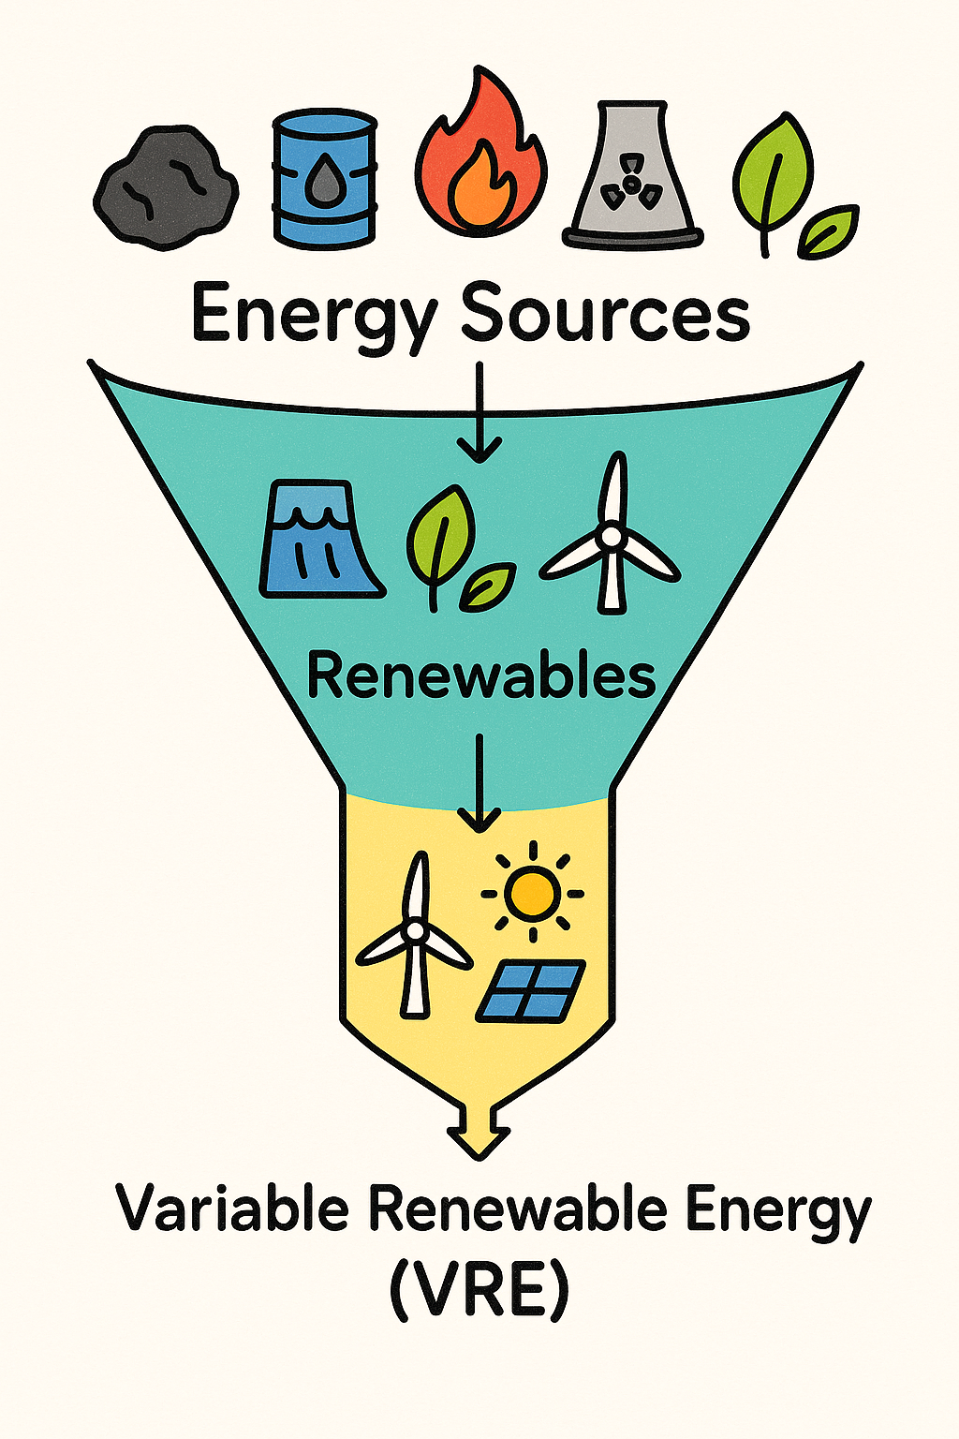

1 INTRODUCTION
Renewable Energy
Traditional and Renewables
A 100% renewable??? (Not yet.)
Source: pnnl.gov/
Source: ChatGPT creation
**No energy source is completely free of environmental impacts.**
Alternative classifications: Conventional x Renewables; Dispatchable x Non-dispatchable, Low/Zero emissions x Fossil Fuels Based

Slide 6
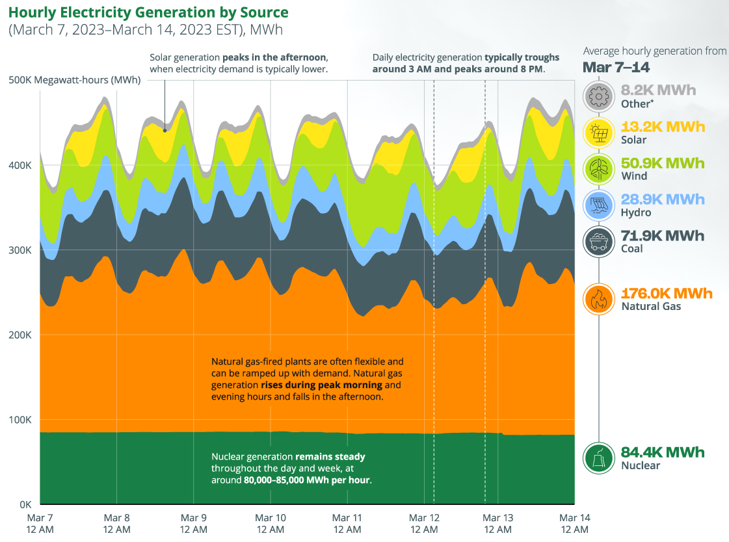
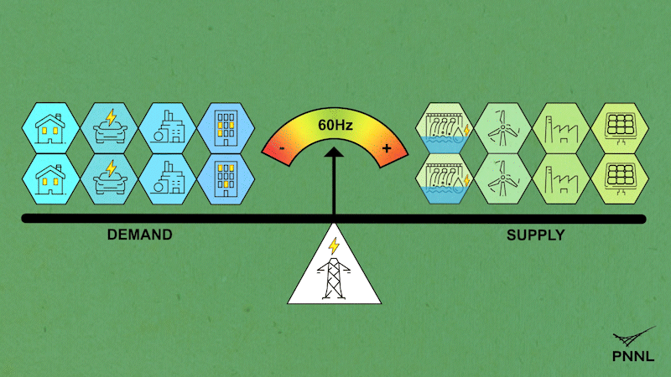
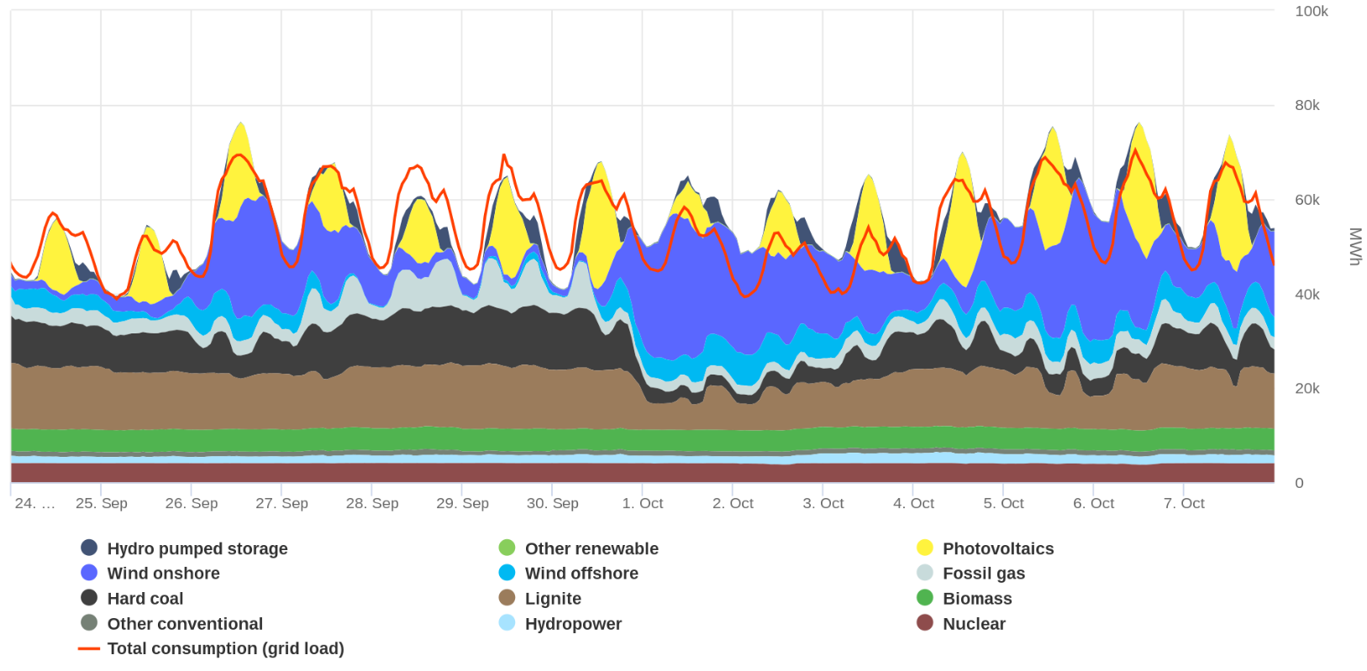
1 INTRODUCTION
Source: eia.gov/
V
VRE is challenging to integrate
www.smard.de/en/
Variable | Fluctuating | Intermittent | Unsteady | Non-dispatchable | Weather-dependent | Non-controllable | Stochastic |Unpredictable
Energy production in Germany over two weeks in 2022
Source: pnnl.gov/
Source: smard.de/
Notes:
Lets talk about VRE and what makes it so challenging to integrate into power systems. The complicate part of VRE is the V that stands for variable, but could also be read as fluctuating or intermittent, as it’s not only the seasonal and daily cycles that make it variable, but at shorter time scales such as hourly minutes or seconds. On the right side there are two real examples of hourly generation: 1 week in EUA and 2 weeks in Germany. They have different energy mixes, but we can see some similarities. I want to highlyght that conventional sources such as nuclear or dispatchable renewables are much more steady over the time, while VRE shows clearly the diurnal cicle (we can see solar peaking at noon, and the demand peaking in the late afternoon, a bit less in the morning). Dispatchable mean sources that can be controlable, we can turn on or turn off and adjust whenever the system needs. The non dispatchable are not controlable, and are more unpredictable, they have a stochastic component (when we look at shorter time scales).
This animation is showing a nice analogy to how the this balance between the energy needed (or the demand) and the energy generated (or the suply) works. In this example, there a mixed grid with conventional and renewables. When for some reason solar and wind drops (wich is called ramp down), other power units need to be adjusted to compensate. When the demand is larger then the supply, we can see a decrease in the frequency, which is normally 50, 60 Hz depending on the location. This can cause power outages, it can damage our electronics, or in most serius cases, it can trigger a blackout. One case we seen recently, was the blackout in spain and Portugal. Im not saying it was caused by renewables, as far as I know the reason was not completely explained, but it could be. The fact is that somthng triggered the unbalance between demad and supply in Spain, and because the system is al interconnected Portugal was also left in the dark for a several hours. This is very serious and need to e avoid completely.

Slide 7
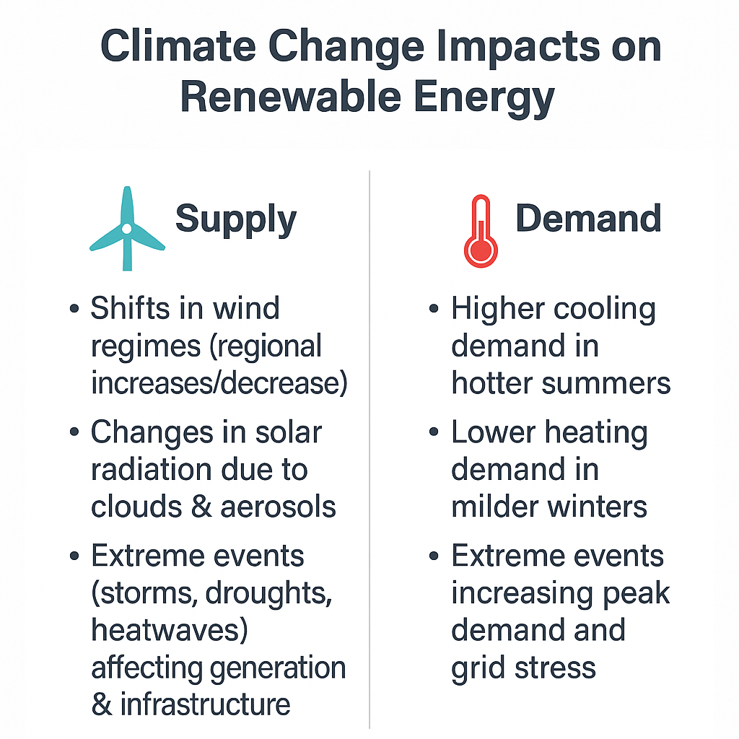
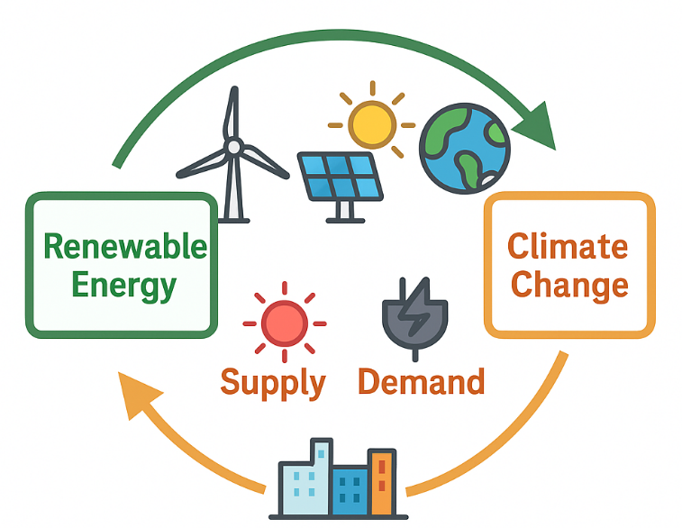
2 RCM FOR RENEWABLES
Weather, climate, and VRE
Weather forecasts in energy meteorology supports reliable operation of grids with high shares of VRE.
Longer simulations guide long-term energy planning
Source: ChatGPT creation
Notes:
Weather forecasts play a critical role in operating power systems with high shares of VRE. By anticipating changes in wind and solar generation, the system operators can schedule backup plants or storage to keep supply and demand balanced.
Beyond day-to-day operations, there is a two-way interaction between renewables and climate. On one hand, renewables help mitigate climate change by reducing emissions. On the other hand, climate change affects renewables themselves — influencing the supply side (wind regimes, solar radiation, extreme events) and the demand side (heating, cooling, peak demand).”
I will now breatlhy show some examples of impact studies in renewable energy using climate simulations, in special RCMs.

Slide 8
2 RCM FOR RENEWABLES
RCM’s add value to impact studies
Provide higher spatial resolution (10–50 km vs. ~100–250 km for GCMs): more appropriate to represent localized wind/solar patterns.
Capture shorter-term variability: coarser GCM grids smooth out extremes and ramps, but RCMs better preserve sub-daily fluctuations.
Include relevant physical processes: land-sea and orographic breezes
Enable multi-variable consistency: RCMs produce physically coherent time series of multiple variables (wind, radiation, temperature, precipitation), supporting multi-hazard and cross-sector studies.

Slide 9
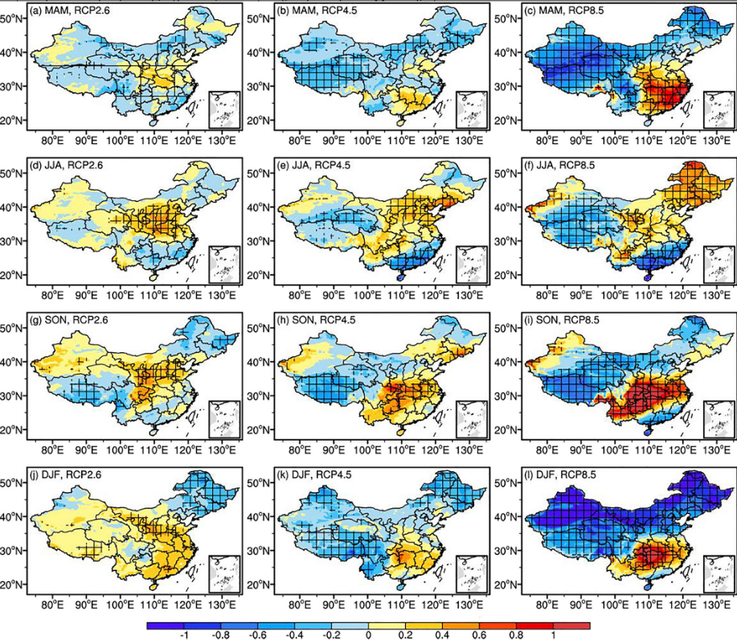
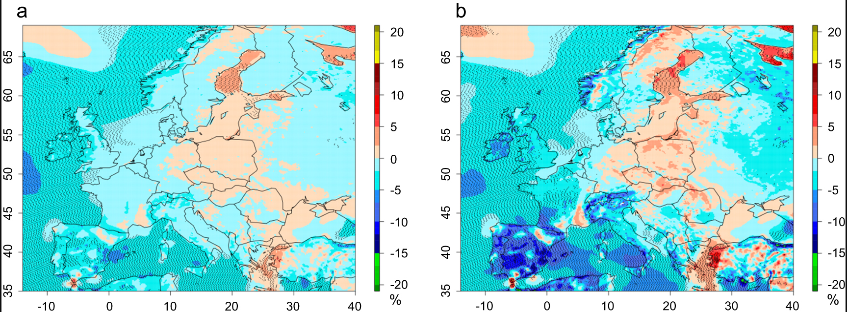
RCM FOR RENEWABLES
Resource assessments with RCMs
Widely used to create wind and solar resource maps from climatology.
Raw wind speed and solar radiation or processed variables relevant to renewable energy, e.g., wind power density, solar power potential, capacity factor, etc.
When large ensembles, usually 10 m wind speed is extrapolated using over simplified power law.
Climate change impacts on the power generation potential of a European mid-century wind farms scenario. Tobin et al (2016). DOI 10.1088/1748-9326/11/3/034013
Future Projection of Solar Energy Over China Based on Multi-Regional Climate Model Simulations. Wu et al. (2022) DOI: 10.1029/2021EA002207

Slide 10
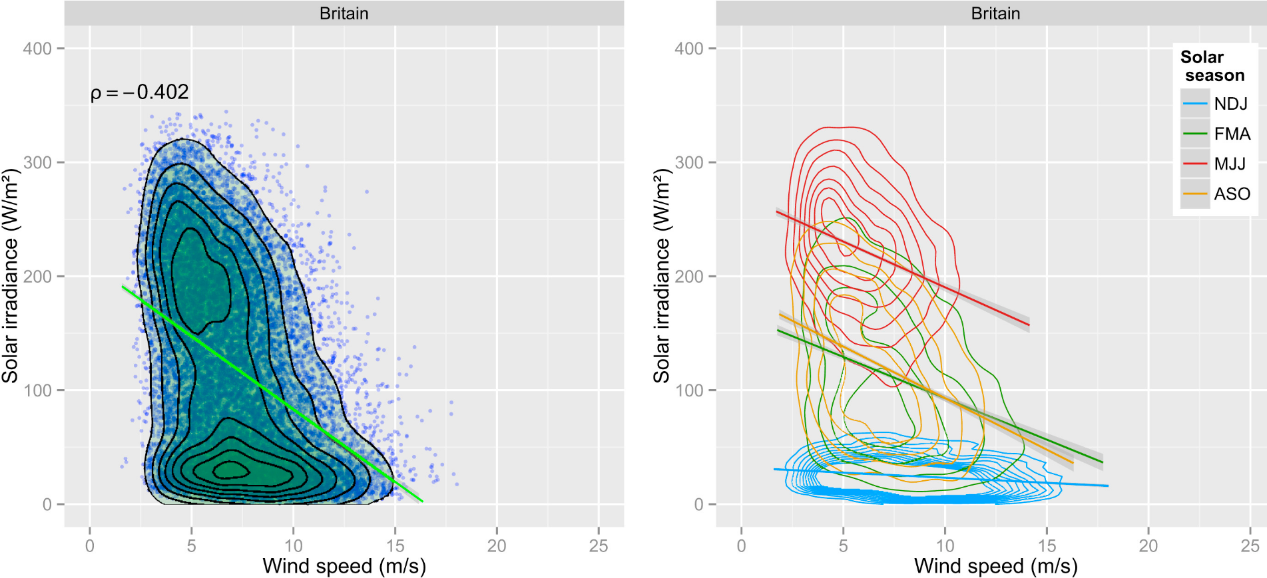
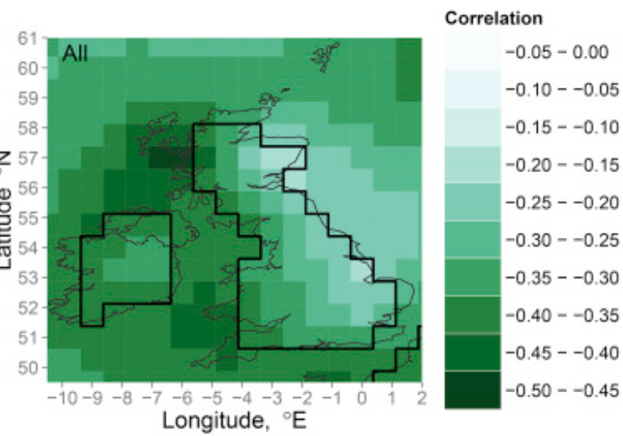
RCM FOR RENEWABLES
Combined wind & solar variability
Wind and solar often complement each other, smoothing fluctuations in renewable generation.
RCMs allow joint assessment of temporal co-variability at sub-daily to annual scales.
The climatological relationships between wind and solar energy supply in Britain. Bett and
Thornton (2016). DOI 10.1016/j.renene.2015.10.006
Joint distribution between daily mean 10m wind speed and downwelling shortwave radiation.
All year correlation between daily-mean wind speed and surface clearness in Great Britain
Notes:
Using reanalysis and RCM data, analyzed how wind and solar resources co-vary in Great Britain.
→ Found strong seasonal complementarity: solar peaks in summer, wind in winter. But on daily timescales, they are only weakly anticorrelated, meaning variability is not fully smoothed out.

Slide 11
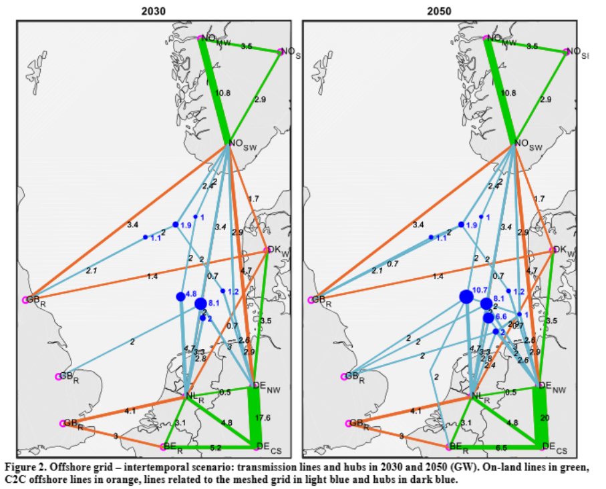
Cross-regional variability
Spatial complementarity: low correlation between countries/regions smooths output.
RCMs help quantify cross-regional correlations of single or multiple VRE-sources, guiding optimal transmission and system integration (through a hybrid RCM/Engineering approach)
Supports transmission planning and cross-border interconnection.
Optimal generation and transmission development of the North Sea region: Impact of grid architecture and planning horizon. Bermudez et al. (2019). DOI 10.1016/j.energy.2019.116512
Notes:
Optimizes generation and transmission investments for the North Sea region out to 2050.
→ Reinforcing transmission provides the flexibility needed for high-VRE operation; less thermal capacity is required (less cost) in the integrated grid.

Slide 12
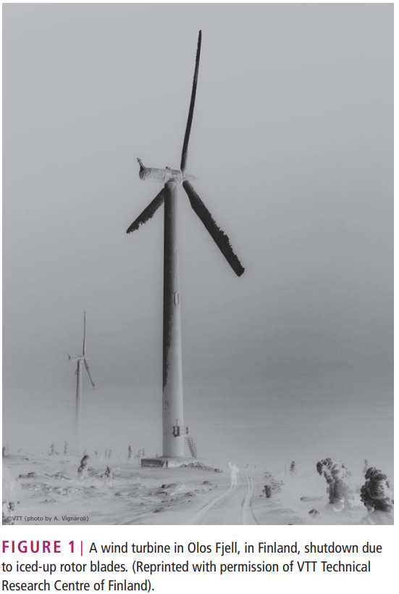

Impacts on Power and Energy Systems
Extreme weather (storms, heatwaves, wildfires) threatens power system resilience worldwide.
Transmission lines suffer capacity loss from heat.
RCM outputs can inform system-level risks and costs, guiding infrastructure and transmission planning
Overview of cold climate wind energy: challenges, solutions, and
future needs. Wallenius and Lehtomäki. (2016). DOI 10.1002/wene.170
Notes:
RCM-based studies are increasingly used to assess climate impacts on grids, planning, and infrastructure.
Icing of wind turbines reduces the amount of energy produced and thus reduces income to wind power plant owners
Increased Fatigue impact the lifetime of wind turbines

Slide 13
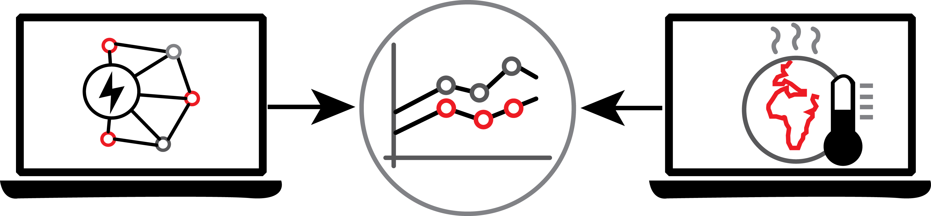
From climate data to energy models
RCMs are increasingly used for VRE assessment and impact studies.
But integration with power & energy system (P&ES) models is still limited.
P&ES models simulate how energy is produced, transmitted, and consumed, supporting planning, integration of VRE, and long-term policy decisions.
What if RCM simulations became actionable inputs for these models?
Source: author’s own figure
P&ES modelling
Climate modelling
Notes:
Right now, RCM outputs (wind, solar, temperature, etc.) are mostly used for climate research or broad resource assessments.
They already contribute to the energy sector, but in a scattered, punctual way.
power & energy system models (P&ES) — which planners and policymakers use to design grids, evaluate storage needs, or test future scenarios — often rely on synthetic, bias-corrected, or historical data instead of climate projections.
By by making RCM outputs directly usable make P&ES models could directly account for climate change impacts (variability, hazards, extremes).
We could test future energy scenarios with climate-informed data, not just “static” assumptions.
From the Energy Modeling side, this need is already communicated. However, while their models grow in complexity to simulate more complete scenarios, these models are not yet designed to assimilate information from ensemble climate models.

Slide 14
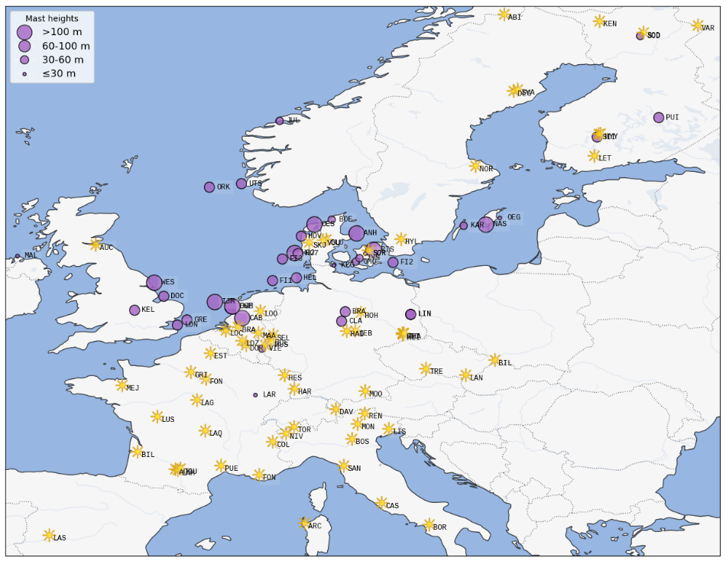
Observational data
31 sites for wind
62 sites for solar
Data sources:
The Tall Tower dataset [1]
Marine data exchange [2]
DTU Data [3]
ICOS data Portal [4]
Different time spans :
2000 – 2024 Wind
2015 – 2024 Solar
Criteria:
3-hourly aggregated from minute-scale instantaneous (wind)
3-hourly mean aggregated from hourly-scale instantaneous (wind)
Minimum 5 years-long and 80% completeness
[1] Ramon et al., 2020, doi: 10.5194/essd-12-429-2020
[2] marinedataexchange.co.uk/
[3] data.dtu.dk/
[4] ICOS Data Portal icos-cp.eu/
Notes:
Right now, RCM outputs (wind, solar, temperature, etc.) are mostly used for climate research or broad resource assessments.
They already contribute to the energy sector, but in a scattered, punctual way.
power & energy system models (P&ES) — which planners and policymakers use to design grids, evaluate storage needs, or test future scenarios — often rely on synthetic, bias-corrected, or historical data instead of climate projections.
By by making RCM outputs directly usable make P&ES models could directly account for climate change impacts (variability, hazards, extremes).
We could test future energy scenarios with climate-informed data, not just “static” assumptions.
From the Energy Modeling side, this need is already communicated. However, while their models grow in complexity to simulate more complete scenarios, these models are not yet designed to assimilate information from ensemble climate models.

Slide 15
RCM data
Short name | GCM | RCM | Variable | Wind speed levels (m)
NCC-R | NCC NorESM1-M | RegCM4-6 | RSDS/WS | 10, 100
CNR-R | CNRM-CERFACS CNRM-CM5 | RegCM4-6 | RSDS/WS | 10, 100
ICH-R | ICHEC EC-EARTH | RegCM4-6 | RSDS/WS | 10, 100
MPI-R | MPI-M ESM-LR | RegCM4-6 | RSDS/WS | 10, 100
HAD-R | MOHC HadGEM2-ES | RegCM4-6 | RSDS | –
CNR-A | CNRM-CERFACS CNRM-CM5 | ALADIN63 | RSDS/WS | 10, 50, 100, 150, 200, 250
NCC-A | NCC NorESM1-M | ALADIN63 | RSDS/WS | 10, 50, 100, 150, 200, 250
HAD-A | MOHC HadGEM2-ES | ALADIN63 | RSDS/WS | 10, 50, 100, 150, 200, 250
MPI-A | MPI-M ESM-LR | ALADIN63 | RSDS | –
CNR-4 | CNRM-CERFACS CNRM-CM5 | RCA4 | RSDS | –
ICH-4 | ICHEC EC-EARTH | RCA4 | RSDS | –
IPS-4 | IPSL CM5A-MR | RCA4 | RSDS | –
HAD-4 | MOHC HadGEM2-ES | RCA4 | RSDS | –
MPI-4 | MPI-M ESM-LR | RCA4 | RSDS | –
NCC-4 | NCC NorESM1-M | RCA4 | RSDS | –
CNR-H | CNRM-CERFACS CNRM-CM5 | HadREM3-GA7-05 | RSDS | –
HAD-H | MOHC HadGEM2-ES | HadREM3-GA7-05 | RSDS | –
ICH-H | ICHEC EC-EARTH | HadREM3-GA7-05 | RSDS | –
MPI-H | MPI-M ESM-LR | HadREM3-GA7-05 | RSDS | –
NCC-H | NCC NorESM1-M | HadREM3-GA7-05 | RSDS | –
3-hourly instantaneous (wind) and 3-hourly mean (solar)
HIST, RCP8.5
1990 – 2010
2050 – 2070
Notes:
Right now, RCM outputs (wind, solar, temperature, etc.) are mostly used for climate research or broad resource assessments.
They already contribute to the energy sector, but in a scattered, punctual way.
power & energy system models (P&ES) — which planners and policymakers use to design grids, evaluate storage needs, or test future scenarios — often rely on synthetic, bias-corrected, or historical data instead of climate projections.
By by making RCM outputs directly usable make P&ES models could directly account for climate change impacts (variability, hazards, extremes).
We could test future energy scenarios with climate-informed data, not just “static” assumptions.
From the Energy Modeling side, this need is already communicated. However, while their models grow in complexity to simulate more complete scenarios, these models are not yet designed to assimilate information from ensemble climate models.

Slide 16
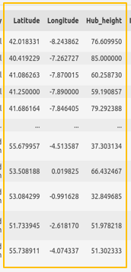
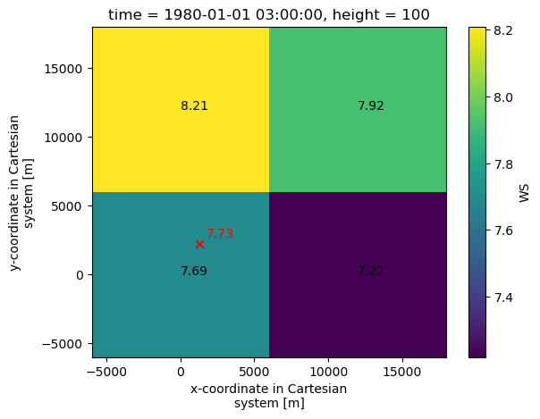
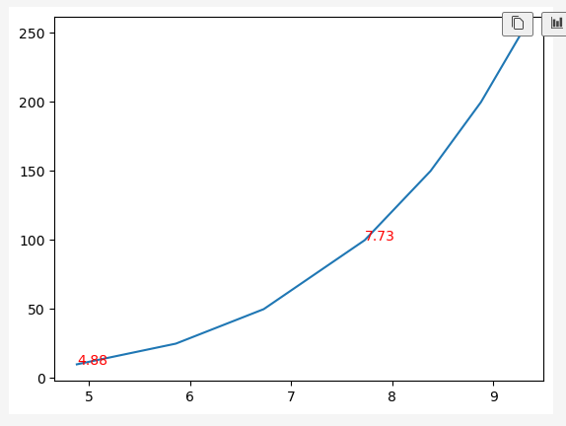
RCM data – time series extraction
Nearest 4-neighbours
Log-interpolation
Extrapolation from 10m WS using power law not recommended.
Log-interpolation at every time step reduce errors.
Codes to extract TS can be found at: github.com/gluzia/cordex_to_energy
doi: 10.5281/zenodo.17033716
Horizontal and vertical interpolation
Notes:
Right now, RCM outputs (wind, solar, temperature, etc.) are mostly used for climate research or broad resource assessments.
They already contribute to the energy sector, but in a scattered, punctual way.
power & energy system models (P&ES) — which planners and policymakers use to design grids, evaluate storage needs, or test future scenarios — often rely on synthetic, bias-corrected, or historical data instead of climate projections.
By by making RCM outputs directly usable make P&ES models could directly account for climate change impacts (variability, hazards, extremes).
We could test future energy scenarios with climate-informed data, not just “static” assumptions.
From the Energy Modeling side, this need is already communicated. However, while their models grow in complexity to simulate more complete scenarios, these models are not yet designed to assimilate information from ensemble climate models.
It assumes a constant shear exponent (α)
But α is not constant — it changes with stability, roughness, time of day, season, and terrain.

Slide 17
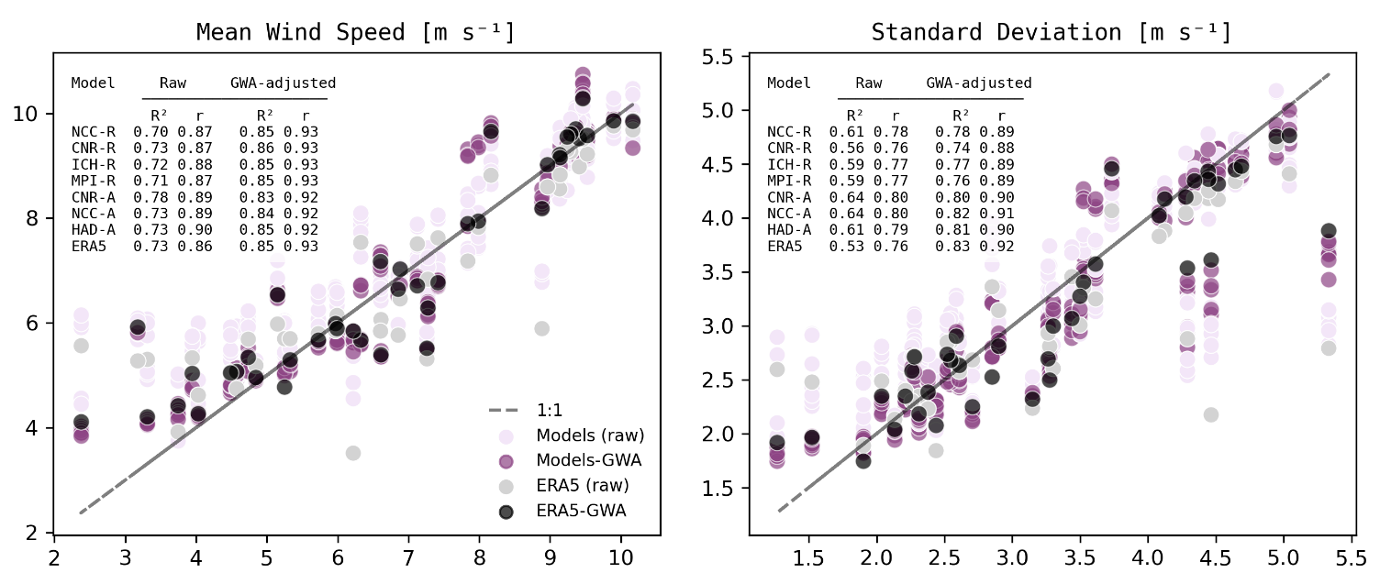
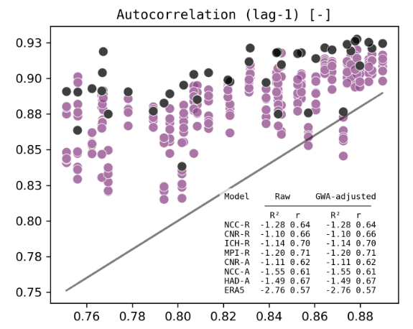
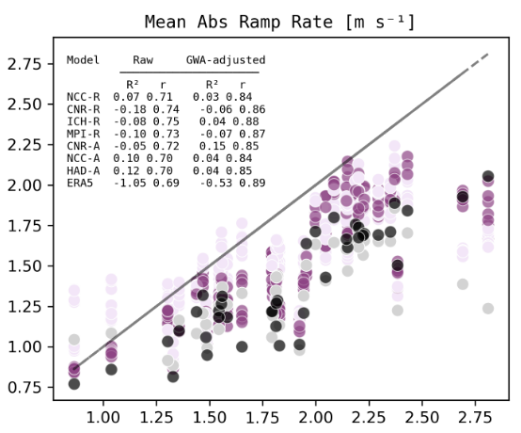
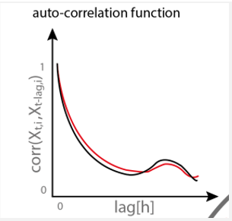
Validating wind speed

Slide 18
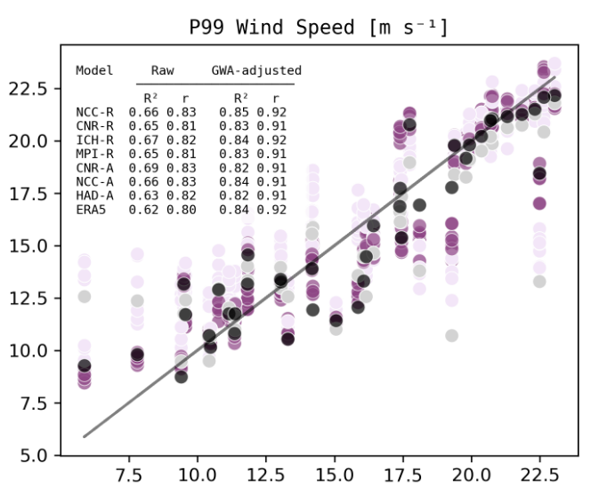
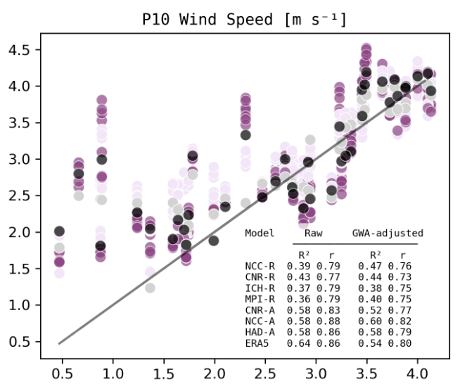
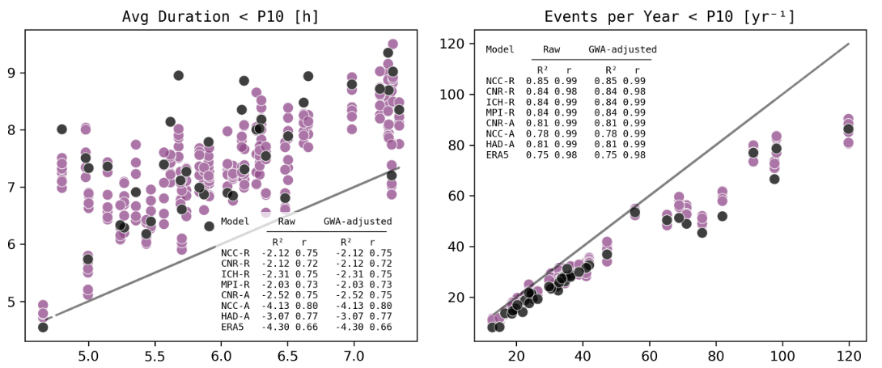
Validating wind speed

Slide 19
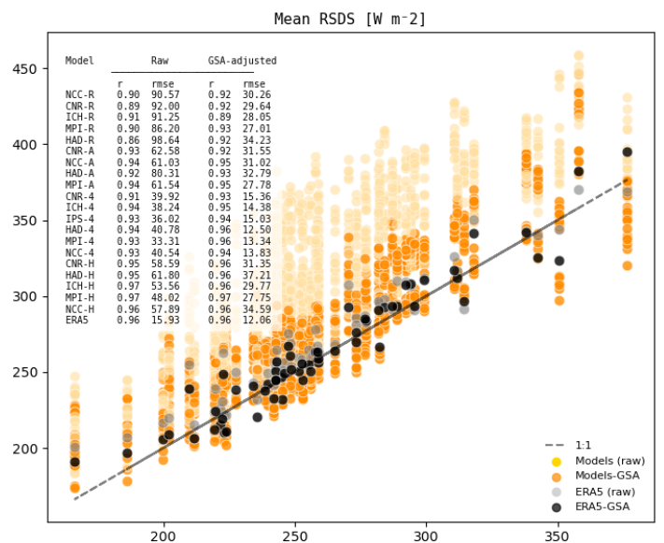
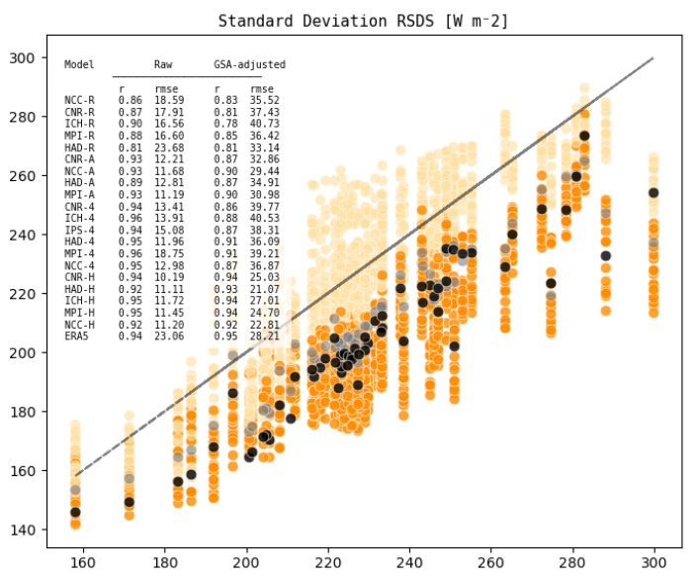
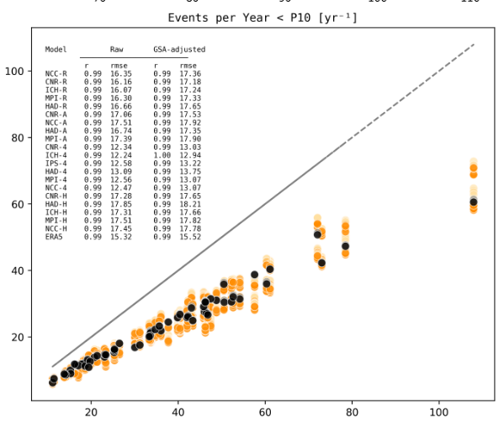
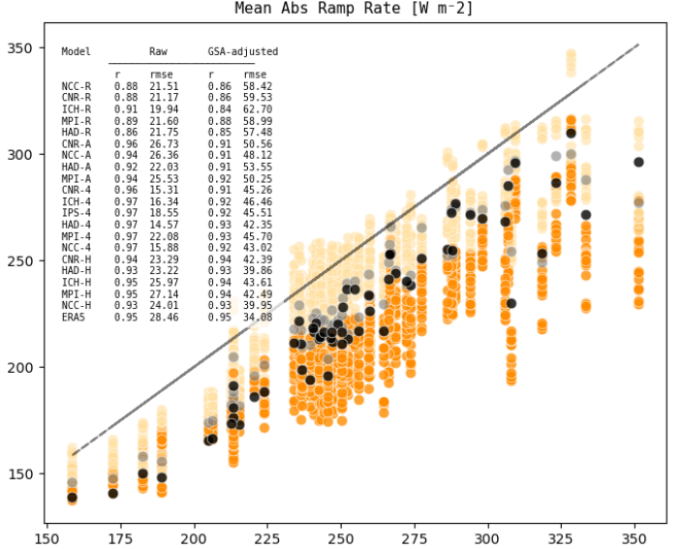
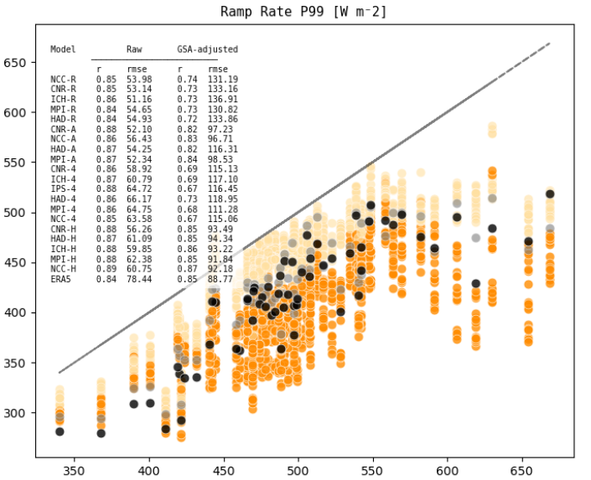
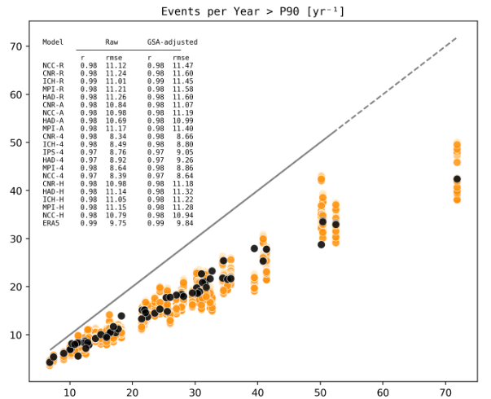
Validating solar radiation

Slide 20
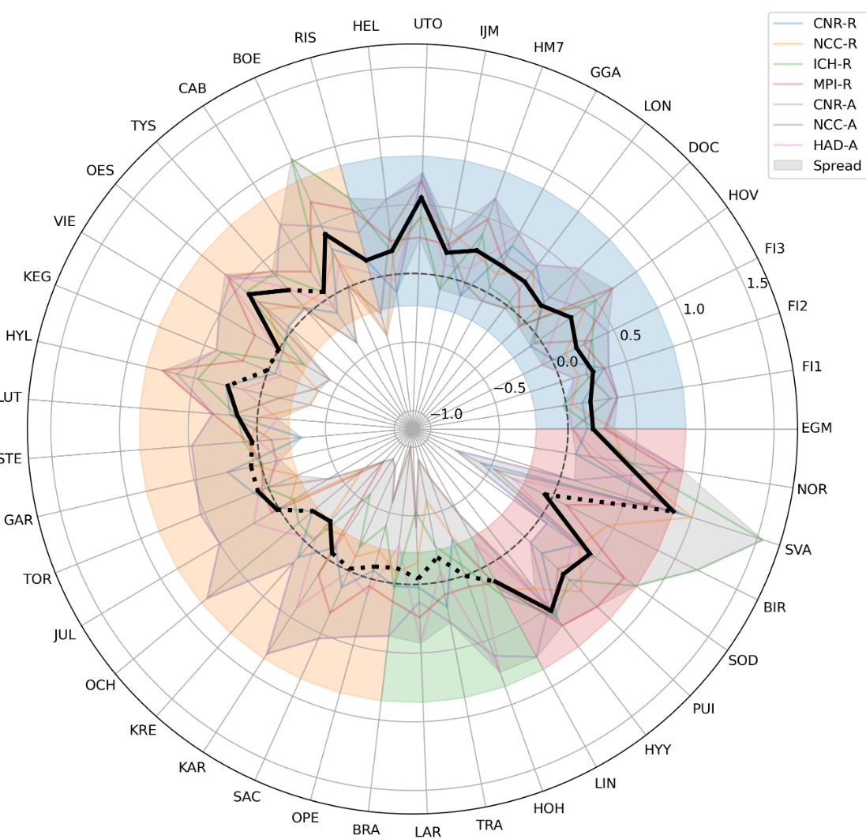
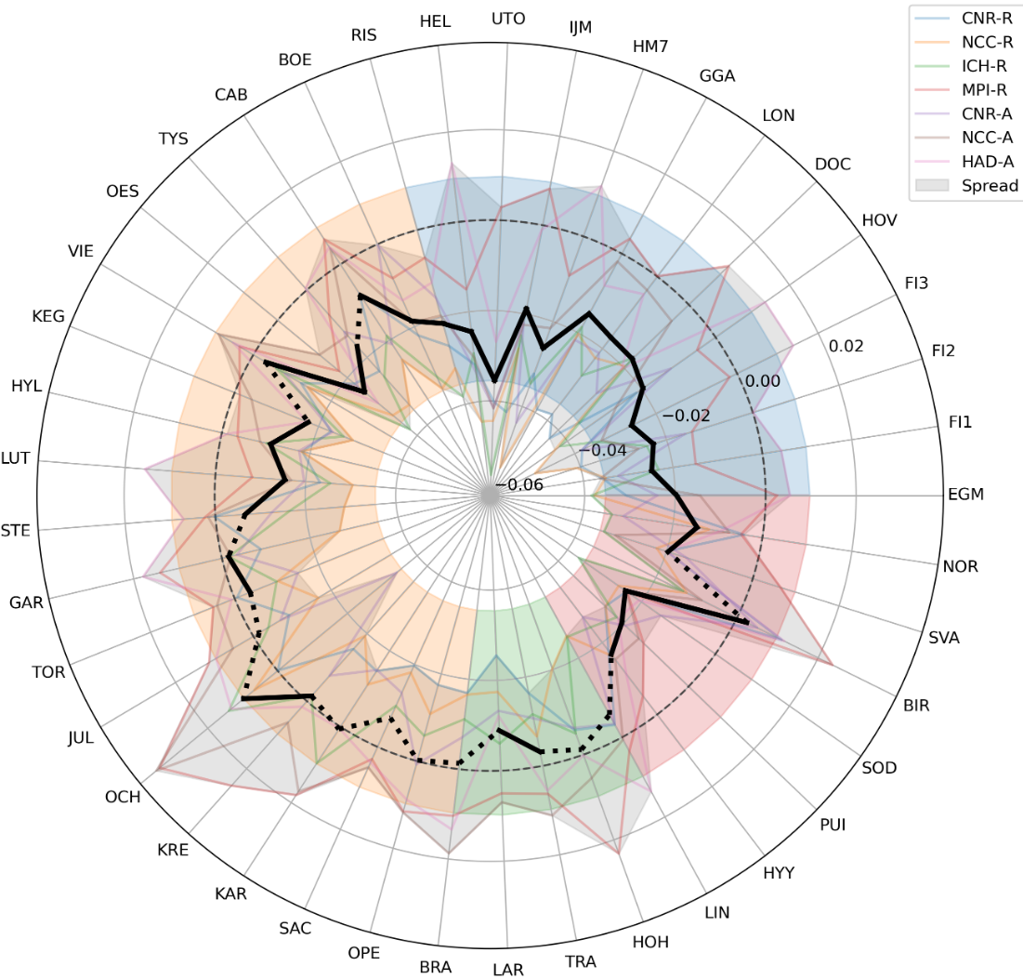
Preliminary results wind
ACF Changes [%] | 2050-2070 – 1990-2010
Mean abs ramp change [m/s] | 2050-2070 – 1990-2010

Slide 21
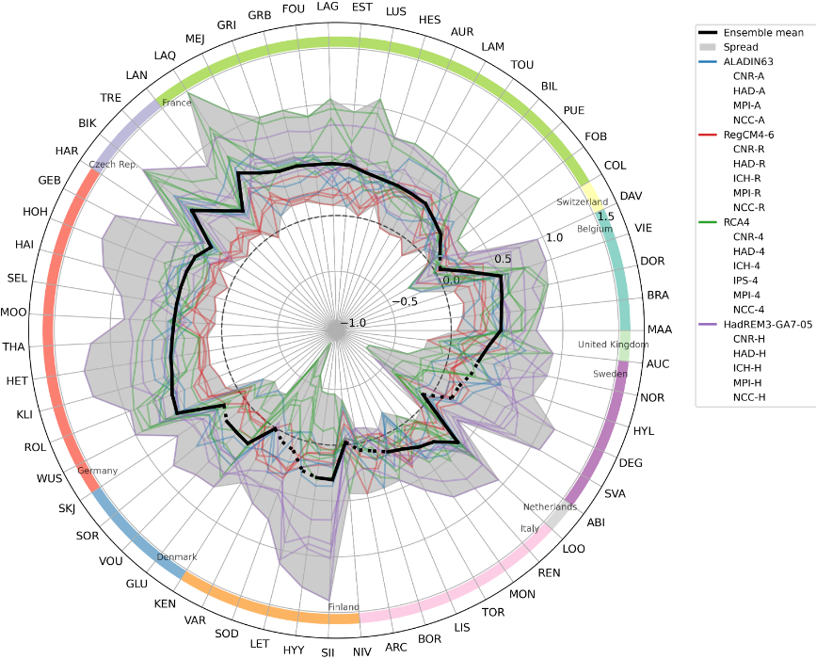
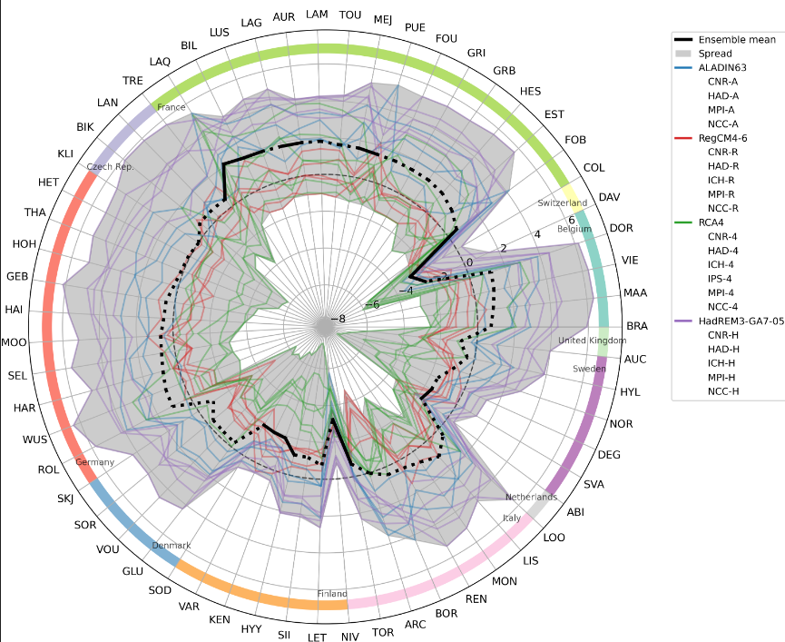
Preliminary results solar
ACF Changes [%] | 2050-2070 – 1990-2010
Mean abs ramp rate [m/s] | 2050-2070 – 1990-2010

Slide 22
Summary
Wind and solar are key to decarbonization, but their variability makes integration into power systems challenging.
RCMs have been used in resource mapping, combined wind–solar complementarity, and cross-regional variability studies, but their integration into power & energy system (P&ES) models is still limited.
The currently work develops methods to process and validate RCM wind and solar outputs, making them usable as inputs to energy system models. This approach enables future energy scenarios to explicitly account for climate change impacts on intra-daily variability, hazards, and system planning.
The results are preliminary, as the workflow is still being developed. It’s been tested only on EURO-CORDEX CMIP5. The next round of CORDEX simulations are expected to provide higher spatial and temporal resolution, as well as wind speed near surface in more than 1 level.
Suggestions are welcome, as well as suggestions to collaborate in expanding the study to other domains.

Slide 23

Thank you!
gluzia@ictp.it

Slide 24
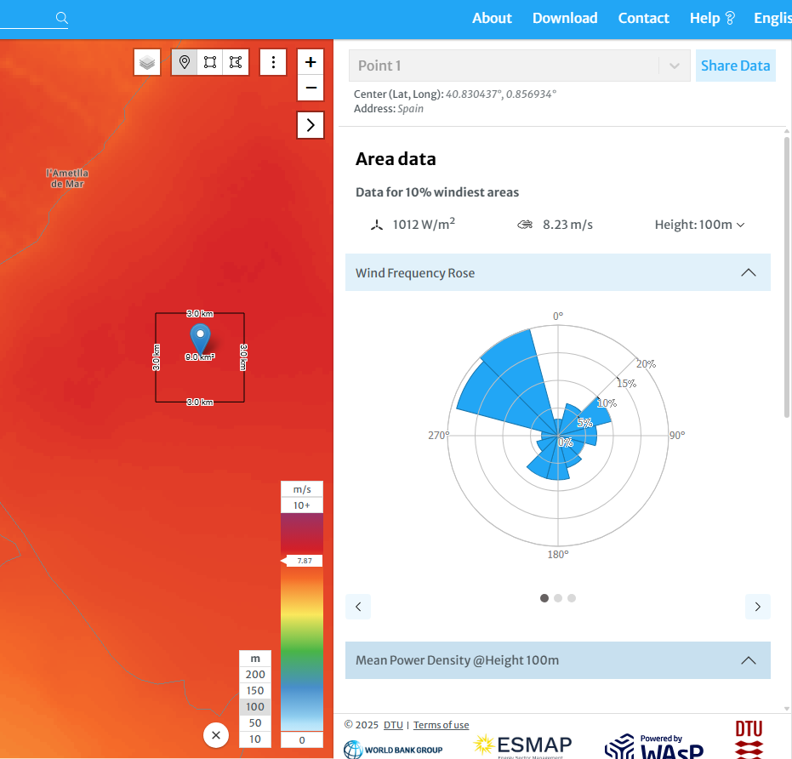
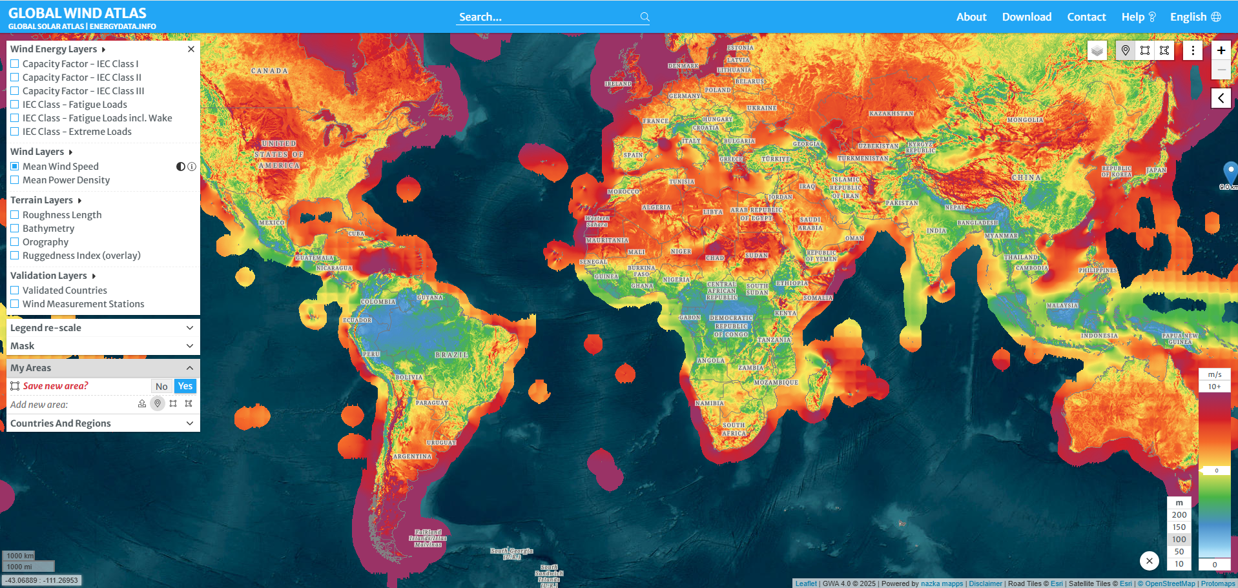
Support energy planning, site selection, and integration studies
2 RCM FOR RENEWABLES
Wind atlases
Regional climate simulations used to produce high-resolution wind atlases. Provide maps of long-term averages, seasonal patterns, and variability.
Regional wind atlases:
South African wind atlas [1]
Wind energy resource atlas of Southeast Asia [2]
New European Wind Atlas [3]
Global Wind Atlas (DTU/World Bank)
Corrected with mesoscale–microscale coupling using CFD
[1] https://sawea.org.za/
[2] http://documents.worldbank.org/curated/en/252541468770659342
[3] https://map.neweuropeanwindatlas.eu/
Source: globalwindatlas.info/
Notes:
RCMs have also been used to create renewable energy atlases. These combine long-term climate simulations with observational datasets to provide maps of wind speeds and solar radiation across regions. The Global Wind Atlas and Global Solar Atlas are widely used tools for site selection and planning

Slide 25
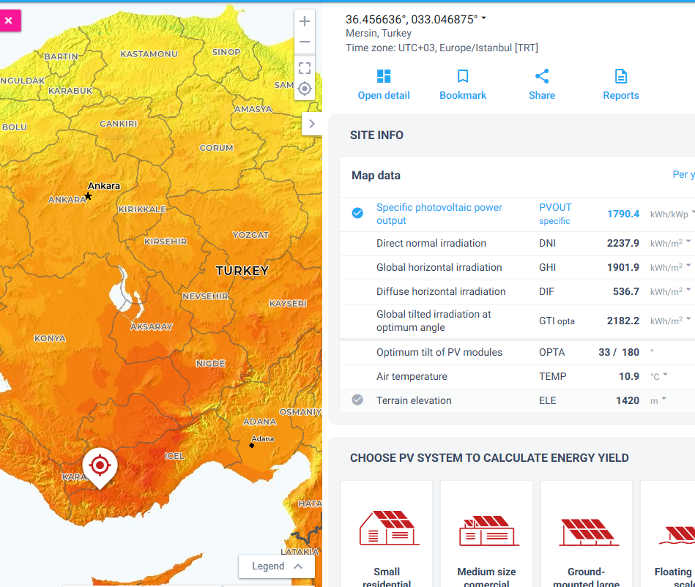
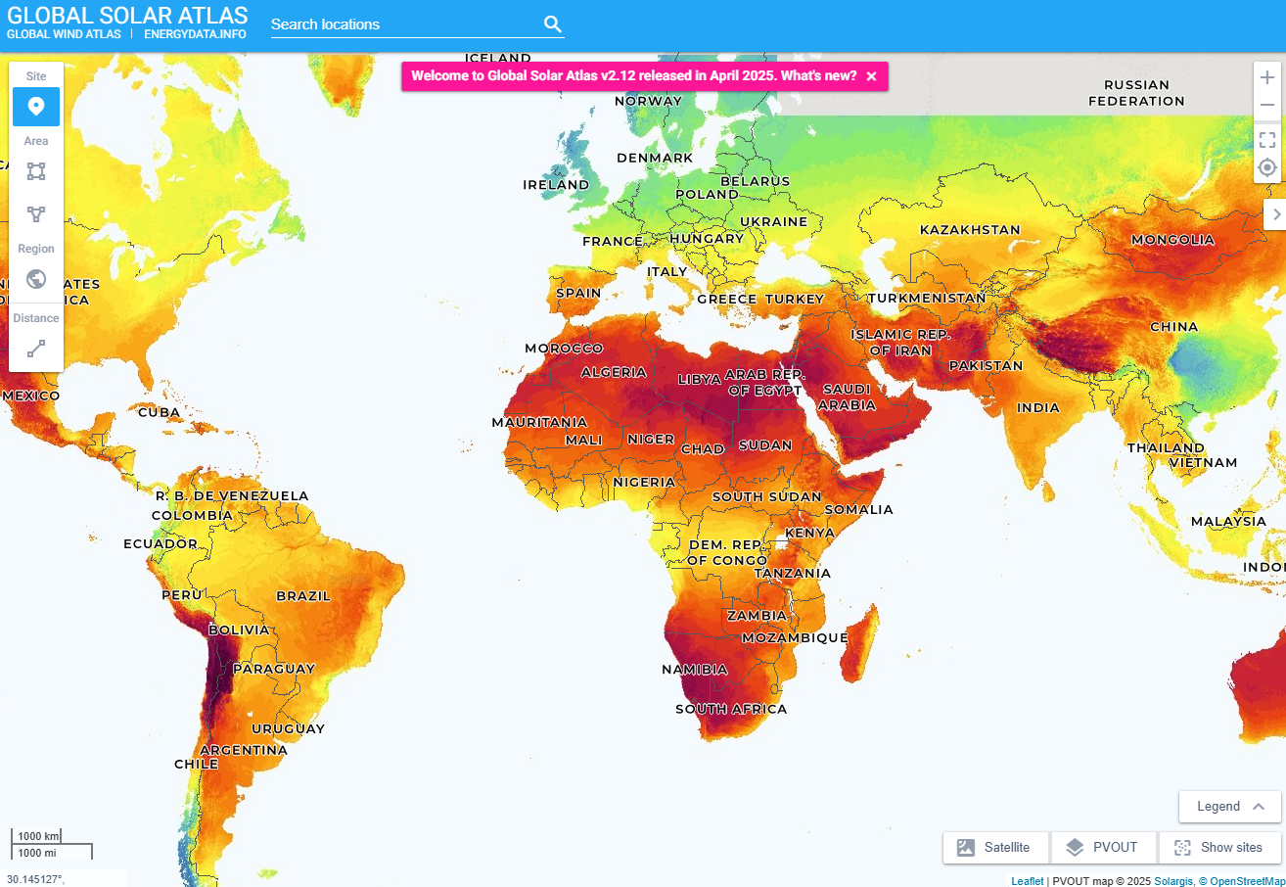
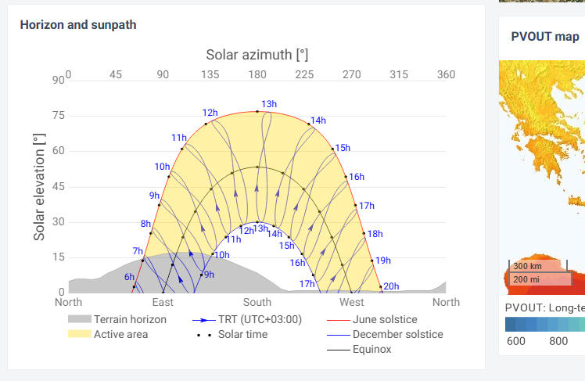
2 RCM FOR RENEWABLES
Solar atlases
Usually satellite + reanalysis based, or radiative transfer models, not RCM-forced. Corrected with ground station measurements.
Global Solar Atlas (World Bank/Solargis)
Regional solar (e.g.): Brazilian Solar Atlas https://labren.ccst.inpe.br/atlas_2017-en.html
Source: globalsolaratlas.info/
Notes:
RCMs have also been used to create renewable energy atlases. These combine long-term climate simulations with observational datasets to provide maps of wind speeds and solar radiation across regions. The Global Wind Atlas and Global Solar Atlas are widely used tools for site selection and planning

